Slide 1
Community Discovery and Ideation:
Creating Smart Libraries
Betha Gutsche
WebJunction Programs Manager, OCLC
Mary Lou Carolan
Director, Cornwall Public Library

Slide 2





Small Libraries Create Smart Spaces
GOAL: Co-create a space
with the community
for participatory,
active learning
and social engagement
Notes:
A little background on the “living laboratory” that is behind our evolving ideas on igniting learning in public libraries.
We all know that libraries are evolving. There is a shift in the library’s role in its community from passive to active engagement with community members. This shift is igniting the library heart of the community.
Active learning is at the core of this shift.
At OCLC’s WebJunction program, we know that active learning is not just for large libraries; it’s every bit as beneficial in small and rural communities. With funding from IMLS, OCLC’s WebJunction program launched Small Libraries Create Smart Spaces.

Slide 3
Active learning
in libraries
is…
participatory, informal,
interest-driven
and relevant to real life
Everyone can participate.
Learning happens by doing.
Challenge is constant.
Everything is interconnected.
Notes:
First we had to define what active learning means in a library setting…
But what is active learning in a library?
Libraries offer an informal setting outside of formal education environments where all members of the community can participate together in hands-on learning that is driven by their interests and meaningful to their lives.

Slide 4
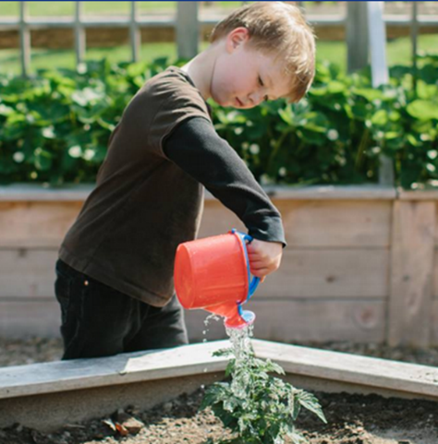
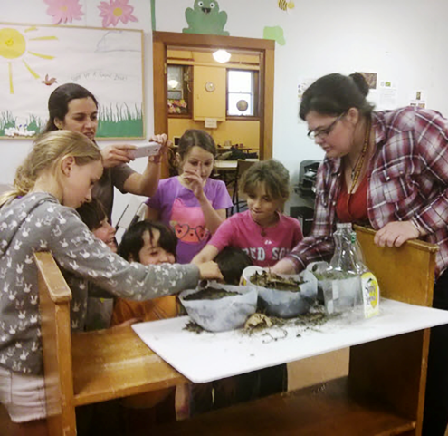
Hands-on activities
CSM Libraries, CA
Children’s Learning Garden,
Lewes (DE) Public Library
STEM program at Wilton (NH) Public Library
Learning happens by doing
Notes:
At its essence, active learning means learning that happens by doing.
Learners literally get their hands dirty for learning as they design and build and grow things. Learning by doing engages the power of the hand-brain connection. When learners are offered multiple opportunities to actively engage and interact with objects, participate in social activities, and reflect on their discoveries, greater learning occurs.
Photo, left: Children’s Learning Garden, Lewes (DE) Public Library; used with permission
Photo, right: STEM program at Wilton (NH) Public Library; courtesy of Stephanie Loiselle

Slide 5
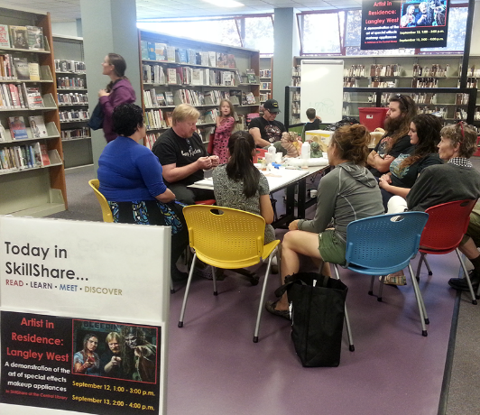
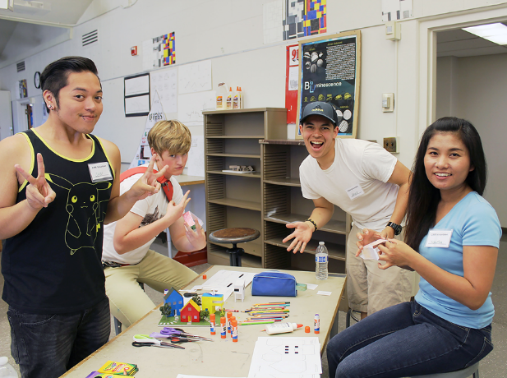
DIY becomes DIT (doing it together)
Artist-in-Residence program,
Bellingham (WA) Public Library
Build a City by CSM (CA) Libraries on Flickr
Learning is social. Everyone can participate
Notes:
Learning is social. Everyone can participate.
Active learning spaces create social connections where people learn together and from each other. It shifts DIY (do it yourself) to DIT –do it together. The space fosters a sense of community and participation in a community increases the motivation to learn.
Photo, left: Artist-in-Residence program at SkillShare, Bellingham (WA) Public Library; by Jennie Johnson
Photo, right: Build a City by CSM (CA) Libraries on Flickr: https://www.flickr.com/photos/collegeofsanmateolibrary/15577279965/in/photostream/

Slide 6
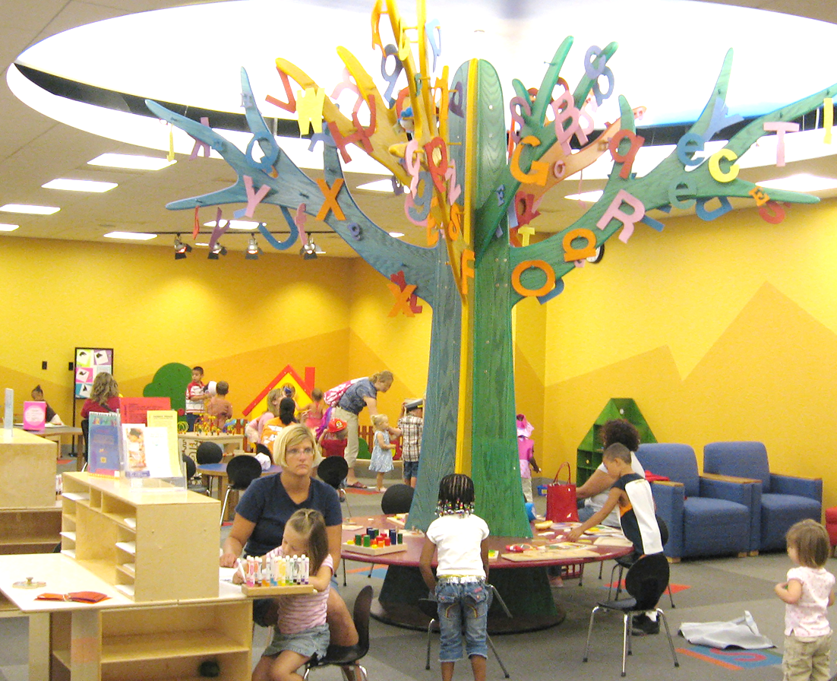
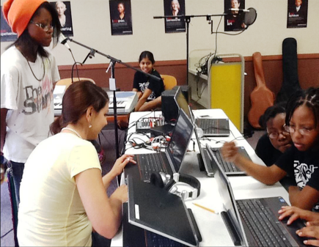
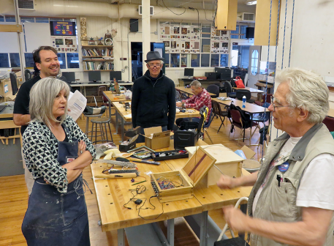
Active learning is for all ages
Early learning
and play
Digital
media lab
Alphabet Tree, Early Learning Space,
Allen County (IN) Public Library
Digital Media Lab, Laurel (DE) Public
Library; by Tameca Beckett
Makerspace
You can make it by Fabrice Florin on Flickr
Notes:
Active learning in the library starts early. For the very young, it’s a play space embedded with early literacy tools.
Kids learn through play, so turning literacy tools into playthings helps get them ready to read when they enter kindergarten. The bright colors and age-appropriate materials help kids want to learn. The space is conducive to families spending time together and engaging with their young learners in hands-on activities and games that support early learning skills.
Photos:
Alphabet Tree, Allen County Public Library, Indiana; by ACPL on Flickr: https://www.flickr.com/photos/acplinfo/1073609313/in/photostream/
Digital Media Lab, Laurel (DE) Public Library; by Tameca Beckett
You ca make it, TAM Makers at Tamalpais High School, Mill Valley, CA; by Fabrice Florin on Flickr: https://www.flickr.com/photos/fabola/28225768406/

Slide 7
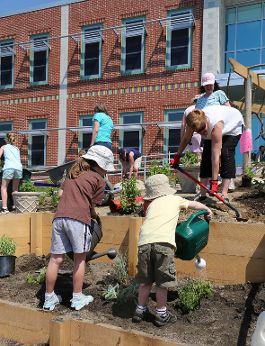
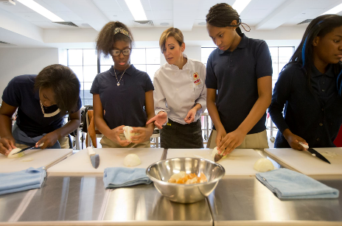
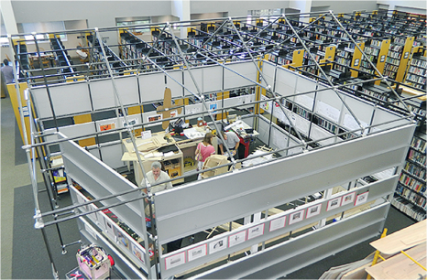
Challenge is constant
Culinary literacy center
Makerspace, Westport (CT) Public Library
Culinary Literacy Center,
Free Library of Philadelphia, PA
FES Learning garden, ME;
by Sheila Sullivan on Flickr
Learning garden
Makerspace
Working together to co-create solutions
Notes:
In an active learning space, challenge is constant and multi-faceted. Participants encounter ever-changing situations and work together to co-create solutions.
Active learning at the library does not have to be confined to the indoors. Many libraries are growing learners young and old through gardening. In addition to learning how to cultivate plants and food, garden experiences lead to education about nutrition, healthy eating and environmental health, as well as learning accountability.
Makerspaces are intentionally equipped to pose designing, crafting, building challenges. Not all makerspaces are about technology; the primary emphasis is on the collaborative and imaginative making and problem-solving.
Some libraries are even installing kitchens, or partnering with organizations that can provide kitchen space while the library provides the programming.
It’s not just about learning to cook, although that’s always a good thing to know. Often branded as “culinary literacy centers,” there are ripe opportunities to learn about health and nutrition, and the science and chemistry of cooking. In the heat of the kitchen, challenge is constant and multi-faceted. Learners must work together as teams and come up with solutions to unexpected situations.
Photos:
FES Learning garden, Maine; by Sheila Sullivan on Flickr: https://www.flickr.com/photos/sggc/9093738551/in/photostream/
Makerspace, Westport (CT) Public Library
Culinary Literacy Center, Free Library of Philadelphia, PA

Slide 8
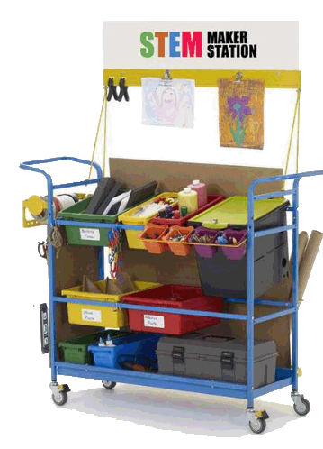
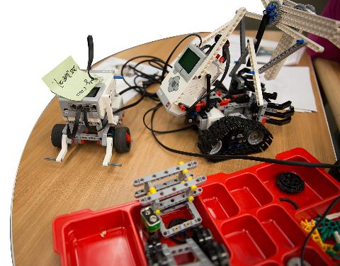
Active learning space is… open and inviting
Tools are visible & accessible
Projects-in-progress are left lying around
STEM Cart: Demco.com
EPL Makerspace by Mack Male on Flickr
Messy is okay
Notes:
Transforming physical space to make these active learning ideas happen involves creating some key conditions for success.
The space needs to be open and inviting:
users can see what kinds of activities happen in the space;
they can see the tools available, maybe see some projects in mid-stream;
messy is okay
Images:
EPL Makerspace by Mack Male on Flickr https://www.flickr.com/photos/mastermaq/19583797075/
STEM Cart: Demco.com

Slide 9
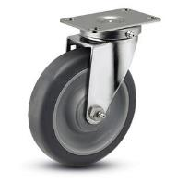
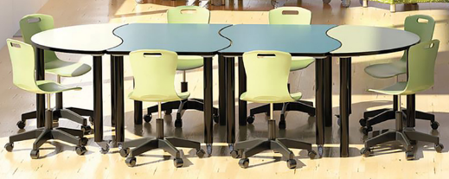
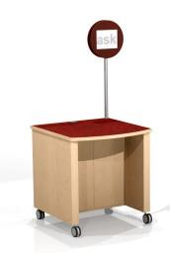
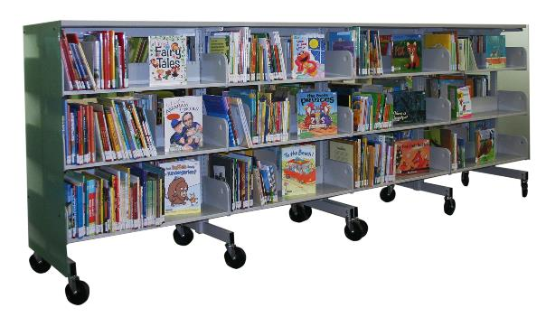
Active learning space is… flexible
Modular tables
The caster is your friend
Movable shelving
Mobile reference pod
Mobile Library Shelving
by Group3 Planners on Flickr
Tables, chairs, pod: Demco.com
Notes:
17. The space is Flexible, --this is especially important in small spaces:
Put everything on wheels, including shelving
Think modular; it’s easier to put small tables together when you need a large work surface than it is to accommodate a large, immovable table for most of the time when you don’t need it
Get comfortable with the idea of letting patrons move things around
Images:
Mobile Library Shelving by Group3 Planners on Flickr https://www.flickr.com/photos/group3planners/6035765761/
Tables, chairs and reference pod: Demco.com

Slide 10
Community Discovery
Authentic exploration of community
needs and aspirations
Notes:
Turning to your community to listen to what their learning aspirations are
Beginning of a process that will engage them in their own active learning at the library

Slide 11
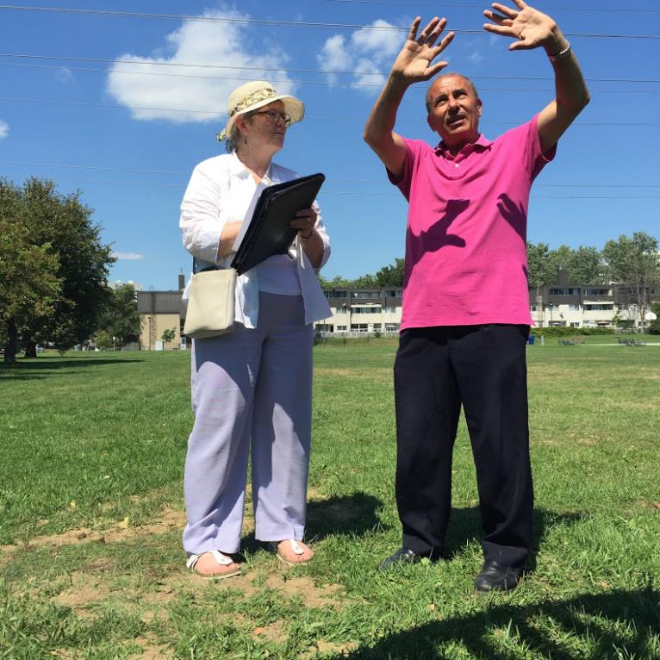
The community is the expert
Photo: Surveying Community Members by Car Martin on Flickr
Notes:
The Smart Spaces Process – how are we guiding the development of active learning spaces with our participating libraries?
We’re using a combination of Placemaking and the IDEO Design Thinking approach
It starts with discovering and understanding the community’s needs and interests
The “community is the expert” is the key principle
Photo: Surveying Community Members by Car Martin on Flickr: https://www.flickr.com/photos/torontocat/31947418754/

Slide 12
“We are a town where everyone knows everyone, you can charge on your local account just about anywhere you go, and deals are still made over coffee and a handshake.”
Discovery Tools:
Stakeholder Interviews
Topical Focus Groups
Intercept Surveys
Online Surveys
Observations
Visioning/ Idea Workshops
Open Brainstorming
Dot Boards/ Wish Trees
Notes:
There are a variety of tools and strategies to choose from, from traditional surveys to more open-ended approaches like wish trees and dot boards. In some small communities, it’s a matter of talking to your neighbors and the folks at the local coffee shop.

Slide 13
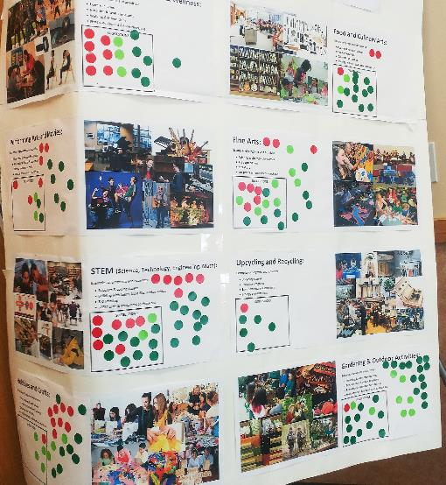
Survey >> Dot Board
(James Kennedy Public Library, IA)
Health & Wellness
Food and Culinary Arts
Performing Arts & Movies
Fine Arts
STEM
Upcycling & Recycling
Hobbies & Crafts
Gardening & Outdoor Activities
Notes:
Dot board question; What active learning space would you most likely use at the James Kennedy Public Library?

Slide 14
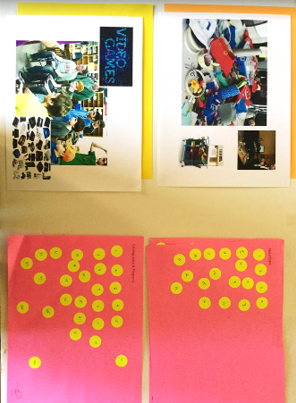
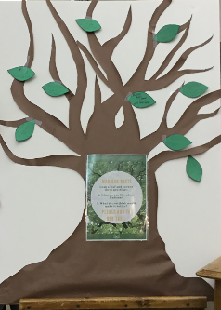
Wish Tree >> Dot Board
(Madison Public Library, SD)
What do you like about your community?
What do you think would make it better?
Four options: gaming space, teen space, maker space, and business incubator
Wish tree
Dot board
Notes:
Wish Tree
Wish tree activity from Cindy Fesemyer, Director, Columbus (WI) Public Library
The Wish Trees were placed in 7 locations around the community; they received over 150 responses
Dot Board
we took the data that we had and came up with four ideas to dot board: gaming space, teen space, maker space, and business incubator. Interesting, the last one was chosen not because of an overwhelming number of people asked, but because it was requested so specifically. However, while doing the discovery process, we learned that Madison does have a business incubator!
The dot board was up in the library for about 2 weeks and then I took it out to our Madison Discovery Days where over a hundred people voted for their 2 favorite spaces.
Highlights of what you learned about your community from the discovery process
Teen space and maker space were neck in neck, but teen space won. We would like to have some STEAM activities in our teen space and some passive maker space activities to try to incorporate both spaces.

Slide 15
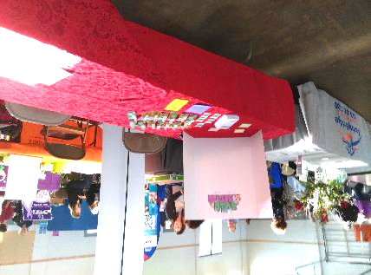
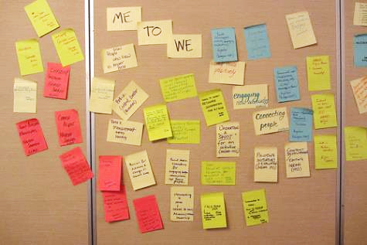
Asking Questions
(Bertha Voyer Memorial Library, TX)
If given the opportunity – what would you do to build a better library?
What could Your library do Better? What do we do really well?
Notes:
Fannin County Expo – Library Table
Mail Chimp questionnaire
Town Hall Meetings
Results – lots of ideas
Then took it to the “right people” –library Board
I asked the right people – the right questions!
At the end of The Hall-Voyer Foundation Board meeting in May –
I asked for 15 minutes for a brief exercise
It turned into an hour and a half of discussion and lots of post-it notes!

Slide 16
Community is the heart of the library
Mary Lou Carolan, Cornwall Public Library
Notes:
PLACEHOLDER

Slide 17
What do you really know about your community?
Who are the stakeholders?
Who are your partners in education?
Who would care if the library was no longer there?

Slide 18
If people don’t get who we are and what we do…. how much longer will they support us?

Slide 19
Connections
Relationships
Conversation

Slide 20
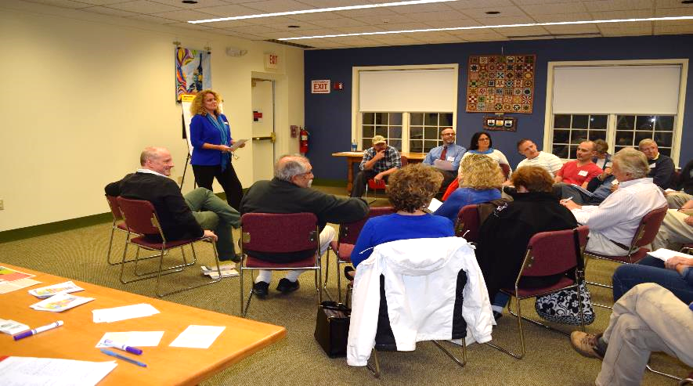
Community Conversations

Slide 22
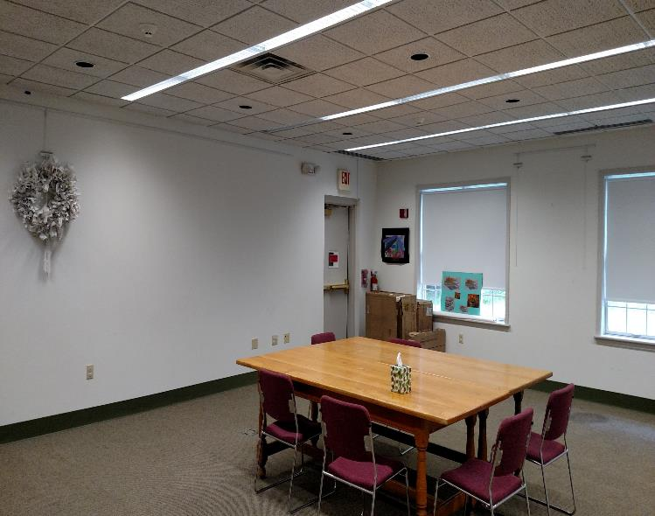
Community Room - BEFORE
You can’t really see the old, worn carpet but I am pretty convinced a murder took place here. Ack!

Slide 23
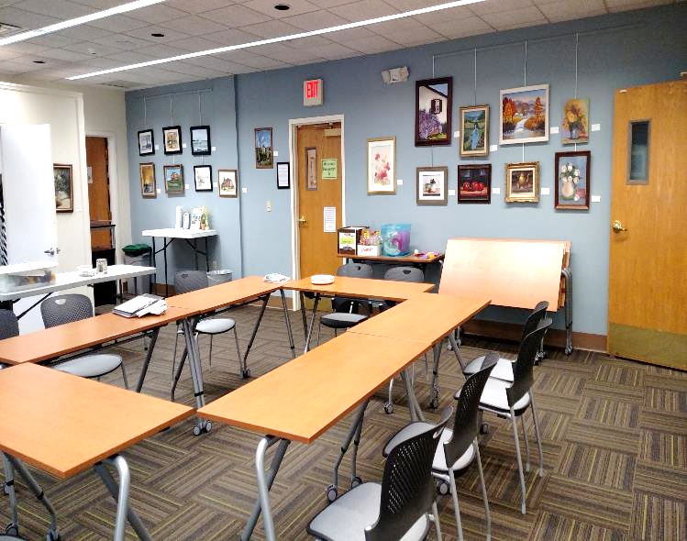
Community Room - AFTER
…this came directly from our community discovery process and initiated our Small Libraries Smart Spaces plan.
BEWARE: Once you get started, it is hard to stop!
Practice: “Lighter, Quicker, Cheaper”

Slide 24
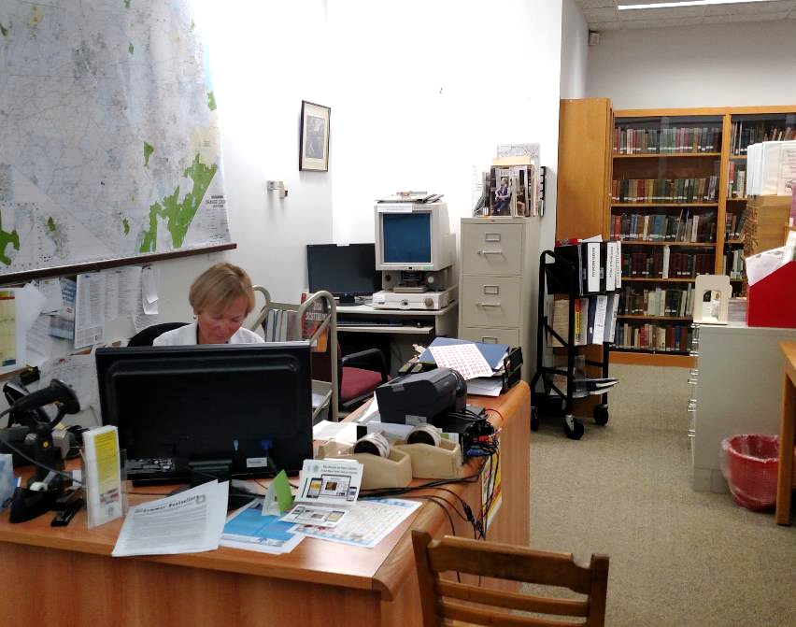
What’s Next?
This space will be transformed into a “Smart Space.” Designed to be transitioned throughout the day for different audiences and activities including: a teen tech space, tech training area, makerspace, and a homework/small group workspace.
This re-imagined space will provide for a more efficient, flexible and vibrant use of our current floor plan.

Slide 25
When the community discovers who we are and what we offer, they will love us & fight for us.
It’s that important!

Slide 26
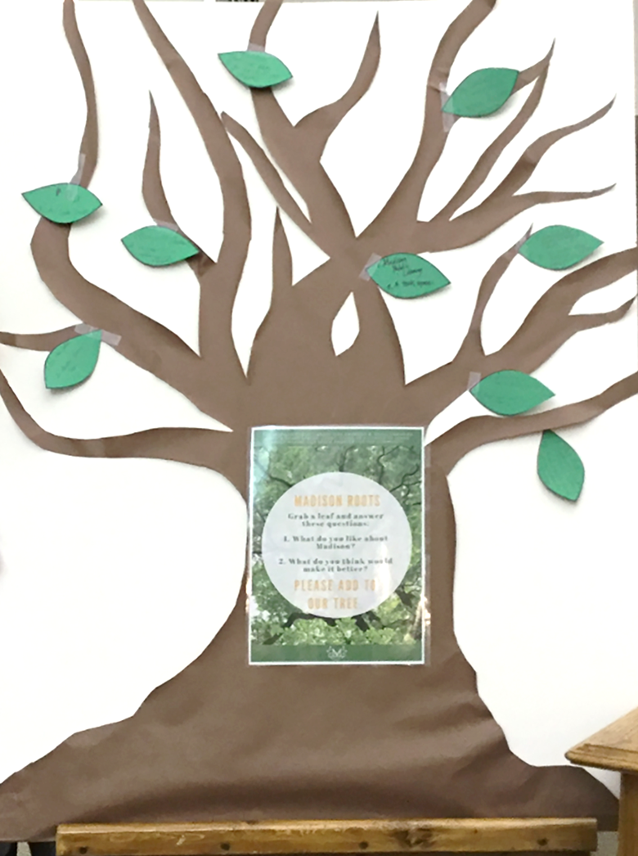
Wish Tree Activity
Think from the perspective of the persona you’ve been given and respond to these questions:
What do you like about your community?
What do you think would make it better?
Write a your answers on a post-it note
and place it on the Wish Tree.
Photo: Madison (SD) Public Library
Wish Tree, by Lisa Martin
Notes:
Community Discovery ACTIVITY
Wish tree activity from the WebJunction webinar Engaged Planning: Ask What You Can Do For Your Rural Community, with Cindy Fesemyer, Director, Columbus (WI) Public Library
Wish Tree poster, post-its, dot stickers
What do you like about your community?
What do you think would make it better?”
Ask participants to think in terms of the personas in response to the questions; write on post-its and place on wish tree poster

Slide 27
Ideation
The power of suspending judgment
and opening the floodgate of ideas
Notes:
Community input is not necessarily going to give you neat, complete answers –it takes some interpretation and imagination
For example, the Madison PL heard from their community that that wanted more shopping, especially a Walmart.
This is where ideation comes in.

Slide 28
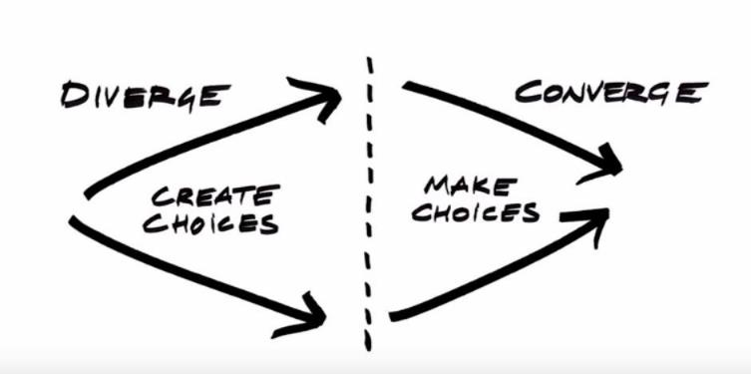
Ideation
Community input
Ready to prototype
Select 3-4 items from community input to explore further
Expand the possibilities of those items through brainstorming
Narrow choices (dot voting) to top 2-3 ideas
Evaluate these ideas and pick one to prototype
Notes:
Once the community input is gathered, the Design Thinking process takes the top 2-3 ideas and does an ideation brainstorm to expand those ideas into a wealth of possibilities.

Slide 29

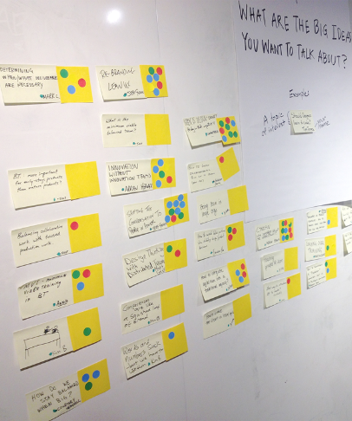
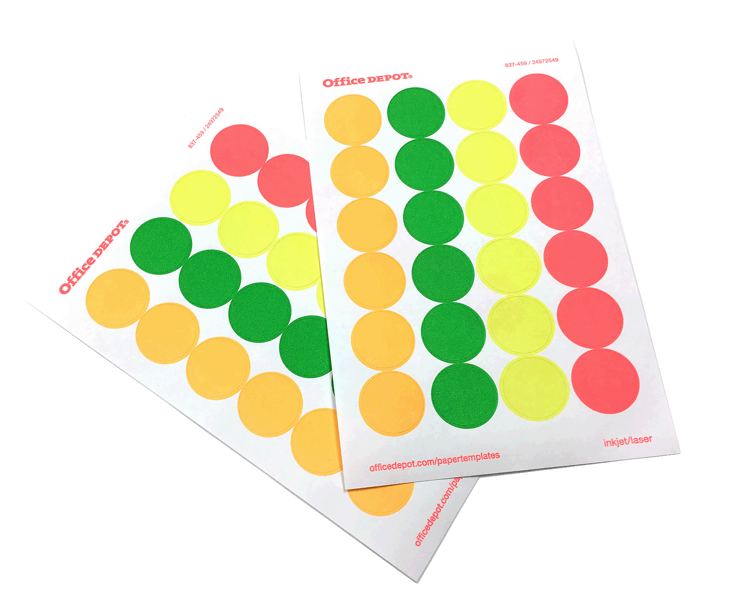
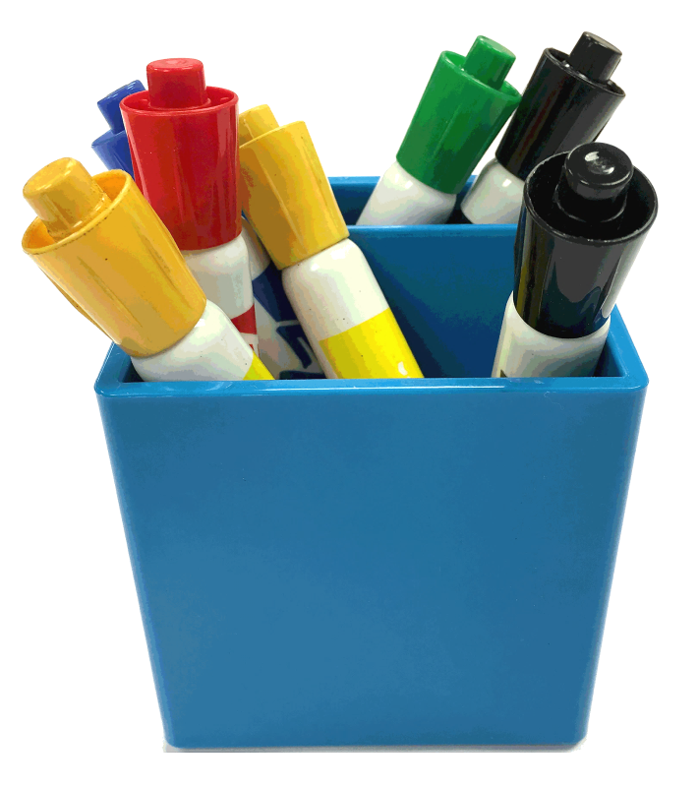
Post-its and a beginner’s mind
Photo: Balanced Team by IMG_3226 on Flickr
Notes:
In this creative brainstorm, the number one rule is to suspend judgement. No idea is too impractical, too unconventional, too costly, too wacky. Let all ideas flow onto post-it notes and be considered.
Gather simple materials and get ready to approach with a “beginner’s mind”

Slide 30
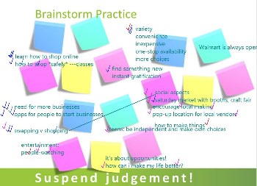
Ideation Activity
How might your library create
active learning opportunities
around ____________ idea?
Hint:
Think beyond the obvious
Dissect the idea
  What are people’s feelings about it?
  What is the essential experience behind it?
  What activities are related to it?
Notes:
Remember lessons learned from the Madison Library example:
Don’t discard any input from the community right off the bat because it’s “not what the library does”
Think beyond the obvious conclusion
Dissect the idea: how do people feel when they’re shopping? What do they think they are missing by not having Walmart? What other activities are related to shopping?

Slide 31
Brainstorm rules
!
Defer judgement
Encourage wild ideas
Build on the ideas of others
Stay focused on topic
One conversation at a time
Be visual
Go for quantity
Notes:
Brainstorm activity
Pose “how might the library…?” question for top idea from discovery process
Introduce brainstorm rules
Participants share ideas; B & P record ideas on flip charts; remind them to keep active learning in focus and suspend judgement
Debrief about experience

Slide 32
Rating the ideation ideas
IDEA: | Least |  |  |  | Most
Instinctively, how excited are you about this idea? | 1 | 2 | 3 | 4 | 5
How innovative and fresh does this idea feel? | 1 | 2 | 3 | 4 | 5
How practical, feasible and realistic is this idea? | 1 | 2 | 3 | 4 | 5
TOTAL =
Notes:
Ideation rating matrix
Interactivity:
Pick 3 ideas from the brainstorm
Rate them, using this matrix
Pick your ONE top idea and put a dot sticker on the ideation sheet/whiteboard

Slide 33
Prototyping and Beyond
Making ideas tangible
and ready to move into action

Slide 34
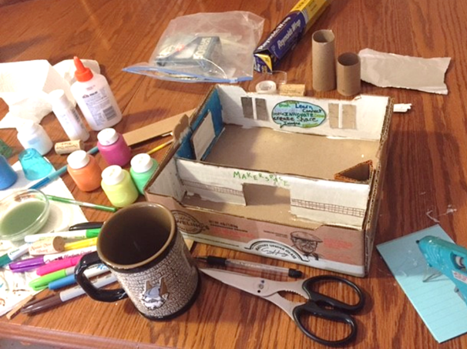
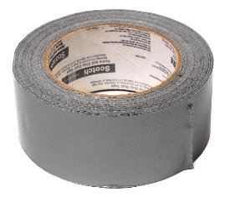
The humble prototype
Transfer key ideas
from post-it notes
to tangible objects
for users to test
Notes:
Before running out to buy furniture and equipment, it’s important to prototype. Your transformation team votes on which idea from the brainstorm is most exciting and innovative, yet practical and feasible. Then transfers that idea from post-it note to tangible objects for testing with your users. Nothing high tech or fancy here. Cardboard and duct tape are your best tools.

Slide 35
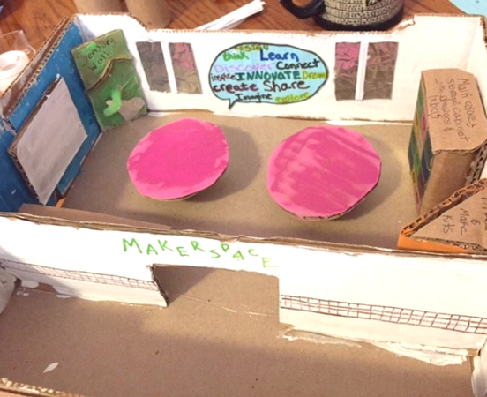
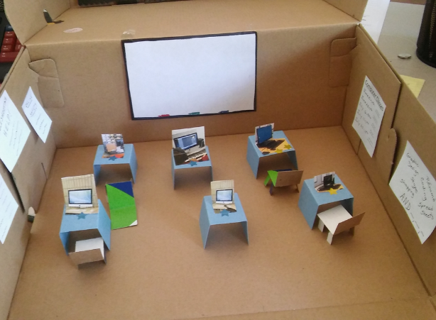
Prototypes from our participants
Makerspace mock-up
Mobile, flexible computer lab
Fun with cardboard and tape!
Notes:
I was a little hesitant about this exercise. I must admit I'm learning that I must be a person who likes to jump to results and adjust on the fly. However, I really really enjoyed this process. I completed my prototype in one sitting and had a blast doing it. I've showed it to several people who have been so happy to actually physically see the plan that's been floating around in my head. (Jennifer Trail, Glenns Ferry Public Library)

Slide 36
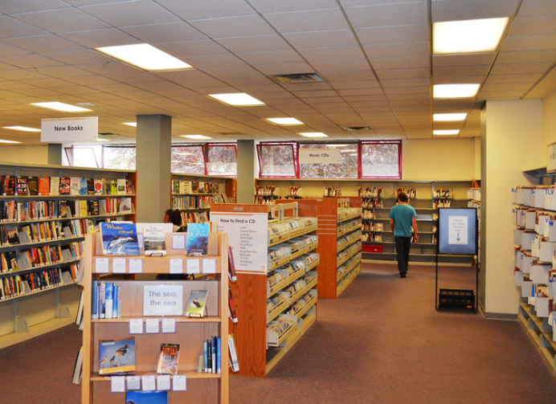
Before transformation…
Stacks, Bellingham (WA) Public Library
Racks of CDs, DVDs and audio books
Notes:
The ultimate goal of creating active learning space in libraries is transformation – of physical space, of library service, and of community engagement.
You don’t need to do any fancy remodeling or buy expensive furnishings and equipment. Take a cue from the Bellingham (WA) Public Library. In its “before” state, this space was previously filled with racks of CDs, DVDs and audio books. Patrons came in, got what they wanted, checked out and left.
Photo: Stacks, Bellingham (WA) Public Library; by Beth Farley

Slide 37
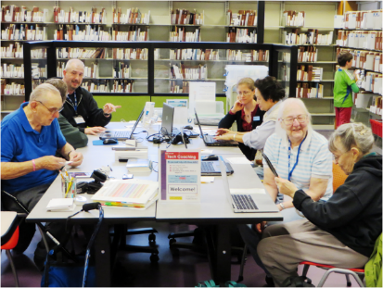
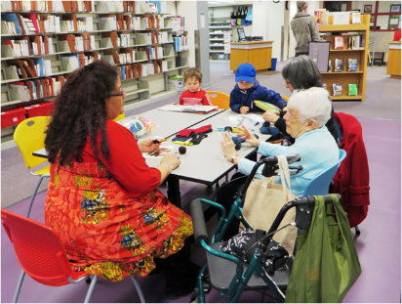
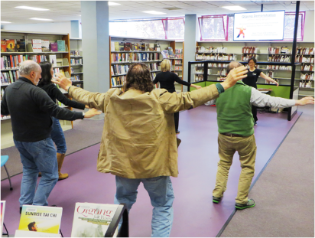
After: Activated for multi-use
Brainbuilders
Think it, build it
Tech coaching
Baby sign language
"SkillShare has provided a
great opportunity for us to connect people with other people and with other ways
of learning,“
―Jenni Johnson
SkillShare, Bellingham (WA) Public Library
Quigong & tai chi
Creative crafting
Papercraft party
Knit nights
Coloring for grownups
Something is always happening at SkillShare
Notes:
Now that same space is opened up and activated for multiple uses, and community members determine how the space is used. They come in, stay, learn and engage with each other. The SkillShare space is built around some simple tables and chairs that can be set aside for open floor space. There is something happening nearly every day of the month, with a combination of programs offered by community members and those offered by library staff, including tai chi and Qigong, financial literacy, creative crafting, tech coaching and the ever­-popular knit night. The activities attract community members of all ages.
To activate the learning in between facilitator-led events, the library developed several programs that do not require staffing, such as BrainBuilders, PaperCraft Party, Coloring for Grownups, and Think It, Build It with Lego Bricks. Materials are set out on the tables and patrons can drop by and use them anytime.
SkillShare is still lively four years after this space was transformed for active learning. This is what igniting space for active learning looks like.
Photos: SkillShare, Bellingham (WA) Public Library; by Beth Farley

Slide 38




Acknowledgements
Mary Lou Carolan
mlcarolan@rcls.org
The Small Libraries Create Smart Spaces project is made possible in part by a grant from the Institute of Museum & Library Services, LG-80-16-0039-16.
Association of Rural & Small Libraries (ARSL) is working collaboratively with WebJunction on all phases of the project.
Project for Public Spaces (PPS) provided subject expertise, consultation and instruction.
Betha Gutsche
gutscheb@oclc.org
Thank you!

