Slide 1
Next Library / Berlin, Germany / September 13, 2018
Return to the Real: Building social capital in an analog revival
Betha Gutsche
WebJunction Programs Manager, OCLC

Slide 2
Thesis
Public libraries have the position and power to rebuild social bonds and heal fractured communities
Notes:
This session is built around a thesis

Slide 3
Trajectory (agenda)
Possibilities
YOU!
Library as connection catalyst
Revival of interest in analog
Erosion of social connections
Value of social connections
Image: You can do anything girl by lavnatalia on Pixabay
Notes:
This is the trajectory of how we get from thesis to possibilities and solutions, otherwise known as the agenda for this session

Slide 4
Value of social connection
Notes:
First establish the value of social connection in a community

Slide 5
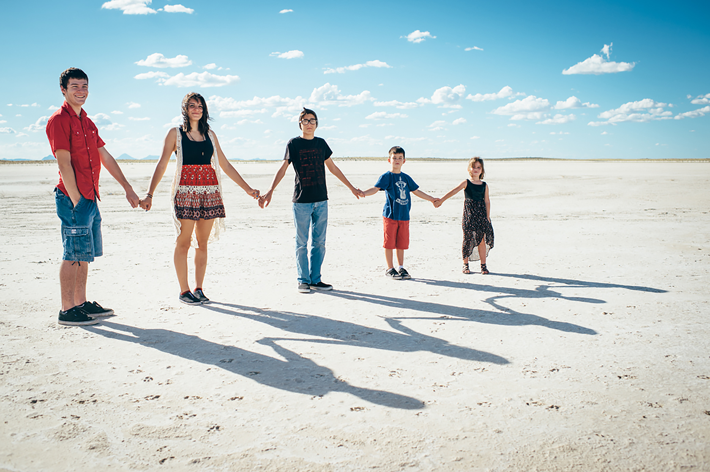
“Social connections are as important to our survival and flourishing as the need for food, safety, and shelter.”*
*Photo: 5 Tribe by amanda tipton on Flickr CC BY-NC-ND 2.0
*Source: Social Connection Makes a Better Brain; E. E. Smith; The Atlantic; Oct 29,2013
Notes:
The strongest predictor of a species’ brain size is the size of its social group. We have big brains in order to socialize.
Photo: 5 Tribe by amanda tipton on Flickr: https://www.flickr.com/photos/demandaj/15029571791/ CC BY-NC-ND 2.0
Quote: Social Connection Makes a Better Brain - The Atlantic
https://www.theatlantic.com/health/archive/2013/10/social-connection-makes-a-better-brain/280934/

Slide 6
“Social connectedness generates a positive feedback loop of social, emotional and physical well-being.”*
Lowered anxiety and depression
Stronger immune system
Faster recovery from illness
Increased chance of longevity
Higher self-esteem, greater empathy
*Source: Connectedness & Health: The Science of Social Connection; Dr. Emma Seppala; Stanford Medicine; May 8, 2014
Notes:
strong social connection:
– leads to a 50% increased chance of longevity; – may even lengthen your life! – strengthens your immune system(research by Steve Cole shows that genes impacted by loneliness also code for immune function and inflammation) – helps you recover from disease faster - lower levels of anxiety and depression
- higher self-esteem, greater empathy
Quote: Connectedness & Health: The Science of Social Connection ...
http://ccare.stanford.edu/uncategorized/connectedness-health-the-science-of-social-connection-infographic/

Slide 7
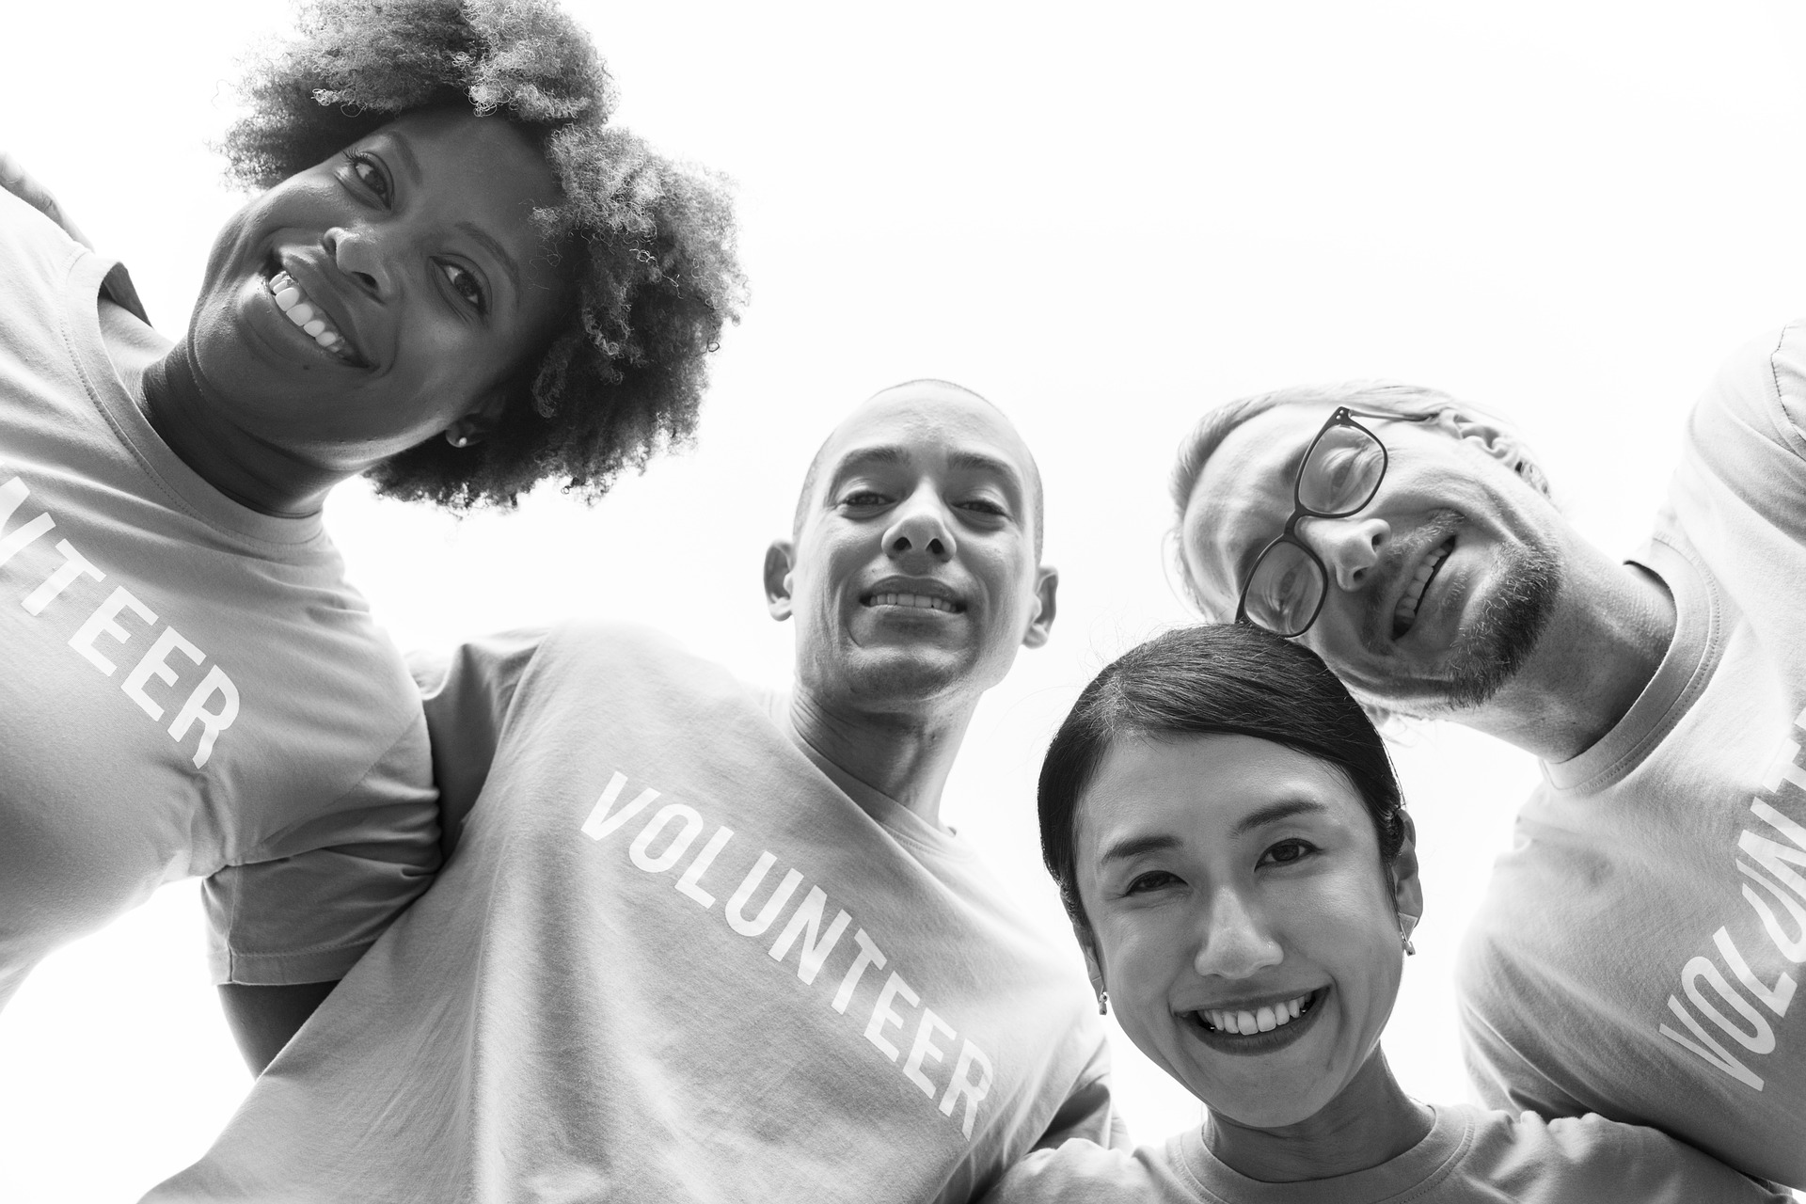
Social connection = more trusting and cooperative
Volunteers by rawpixel on Pixabay
Notes:
strong social connection:
more trusting and cooperative and, as a consequence, others are more open to trusting and cooperating with them
This is social capital!
Photo: Volunteers by rawpixel on Pixabay: https://pixabay.com/en/caucasian-charity-community-3390232/

Slide 8
erosion of social connection

Slide 9
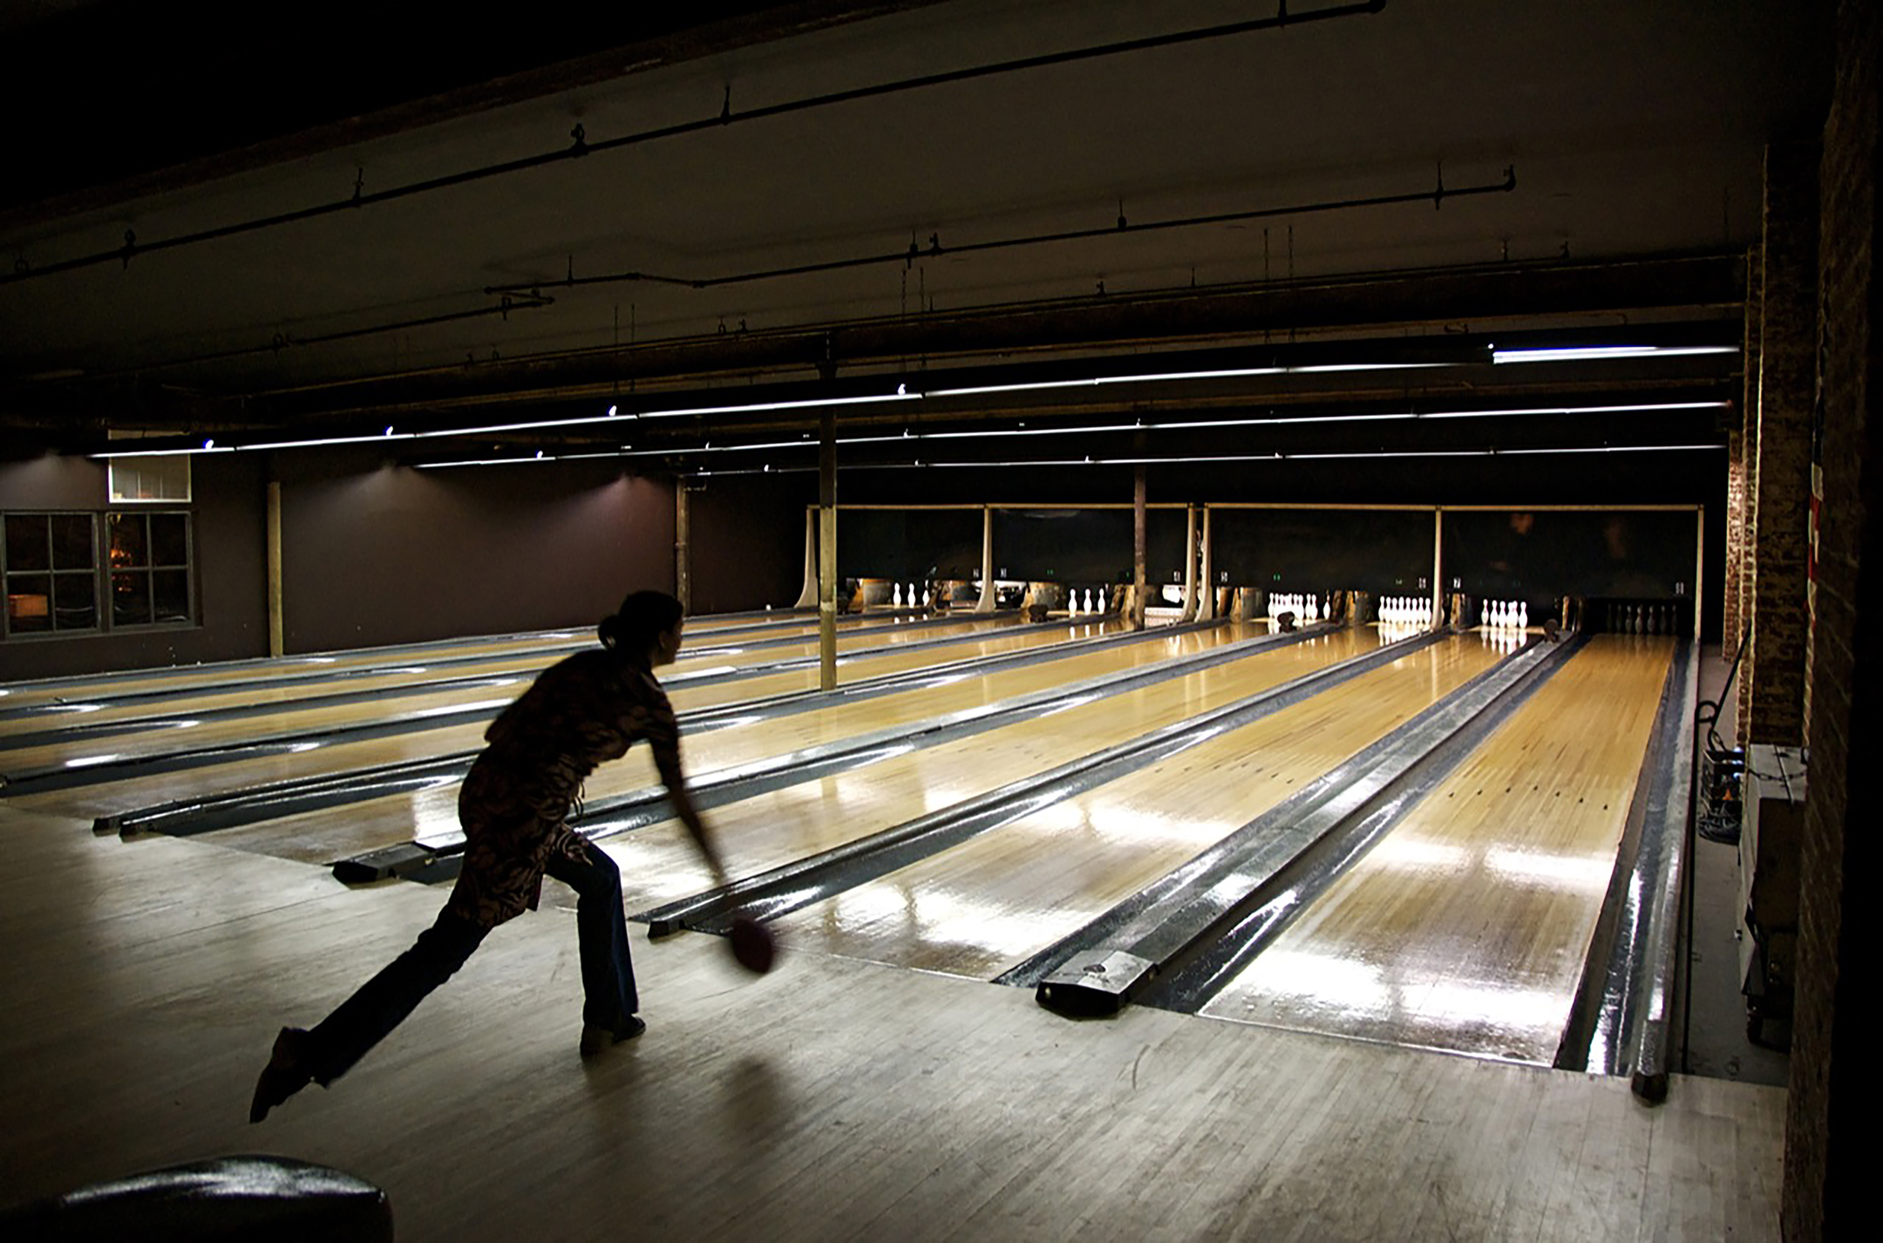
Bowling alone
“If people bowl alone, they do not participate in social interaction and civic discussions that might occur in a league environment.”
⎯Wikipedia
Photo: Bowling alone by Kilgub on Flickr CC BY-NC-ND 2.0
Notes:
Seminal book: Bowling Alone: America’s Declining Social Capital by Robert Putnam, 2000
Putnam notes the aggregate loss in membership and number of volunteers in many existing civic organizations, such as labor unions, fraternal organizations (Elks Clubs, Rotary, Kiwanis, etc.), parent-teacher associations, veterans’ organizations, volunteers with community-based orgs,
Putnam uses bowling as an example.
“If people bowl alone, they do not participate in social interaction and civic discussions that might occur in a league environment.” (Wikipedia)
This is about the loss of “social capital” or social cohesion in a community. Social capital refers to the bonds between people that lead to trust and reliance among community members, and increased resilience of the community in times of stress
Photo: Bowling alone by Kilgub on Flickr: https://www.flickr.com/photos/kilgub/2028592585/ CC BY-NC-ND 2.0

Slide 10
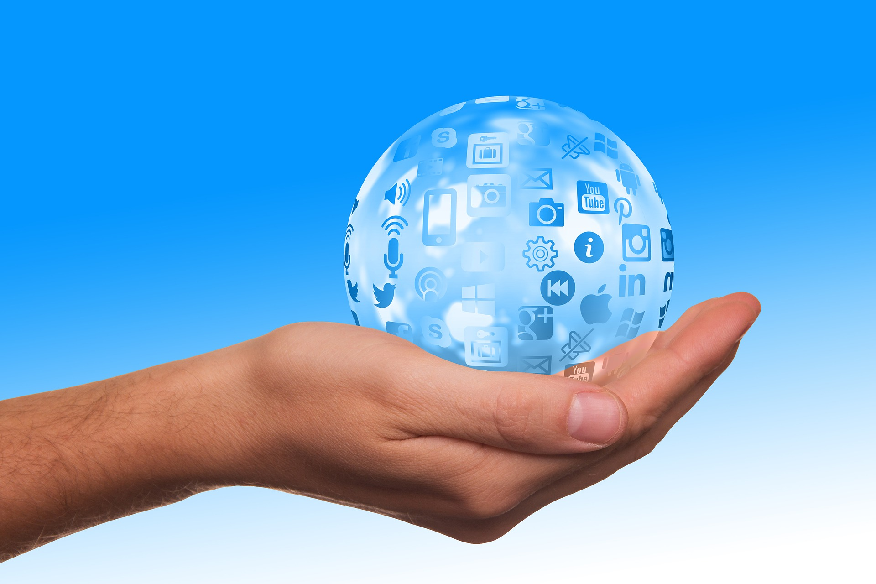
Technology “individualizes” leisure time
Photo: Social media bubble by geralt on Pixabay
Notes:
Putnam suggests the main cause is technology "individualizing" people's leisure time via television and the Internet (written when social media just beginning to infiltrate; AOL, Yahoo! And MSN Messenger platforms launched 1997-99; MySpace 2003; Facebook 2004, then Flickr, Reddit, YouTube, Twitter, etc.
Photo: Social media bubble by geralt on Pixabay: https://pixabay.com/en/social-media-icon-hand-keep-2489595/

Slide 11
New Yorker
Forbes
Atlantic
NPR
Notes:
Atlantic article: But over the last fifty years, while society has been growing more and more prosperous and individualistic, our social connections have been dissolving. We volunteer less. We entertain guests at our homes less. We are getting married less. We are having fewer children. And we have fewer and fewer close friends with whom we’d share the intimate details of our lives. We are increasingly denying our social nature, and paying a price for it. Over the same period of time that social isolation has increased, our levels of happiness have gone down, while rates of suicide and depression have multiplied.
Social media studies: the more people use social media, the lonelier and more depressed they felt.
"What we know at this point is that we have evidence that replacing your real-world relationships with social media use is detrimental to your well-being," says Holly Shakya, an assistant professor in the division of global public health at the University of California, San Diego (from NPR ‘Feeling Lonely’ report)
Rates of teen depression and suicide have skyrocketed since 2011. (Atlantic ‘Destroyed Generation’ report)
*findings are controversial
Headlines from top: New Yorker 2013, Forbes 2017, Atlantic 2017, NPR 2017

Slide 12
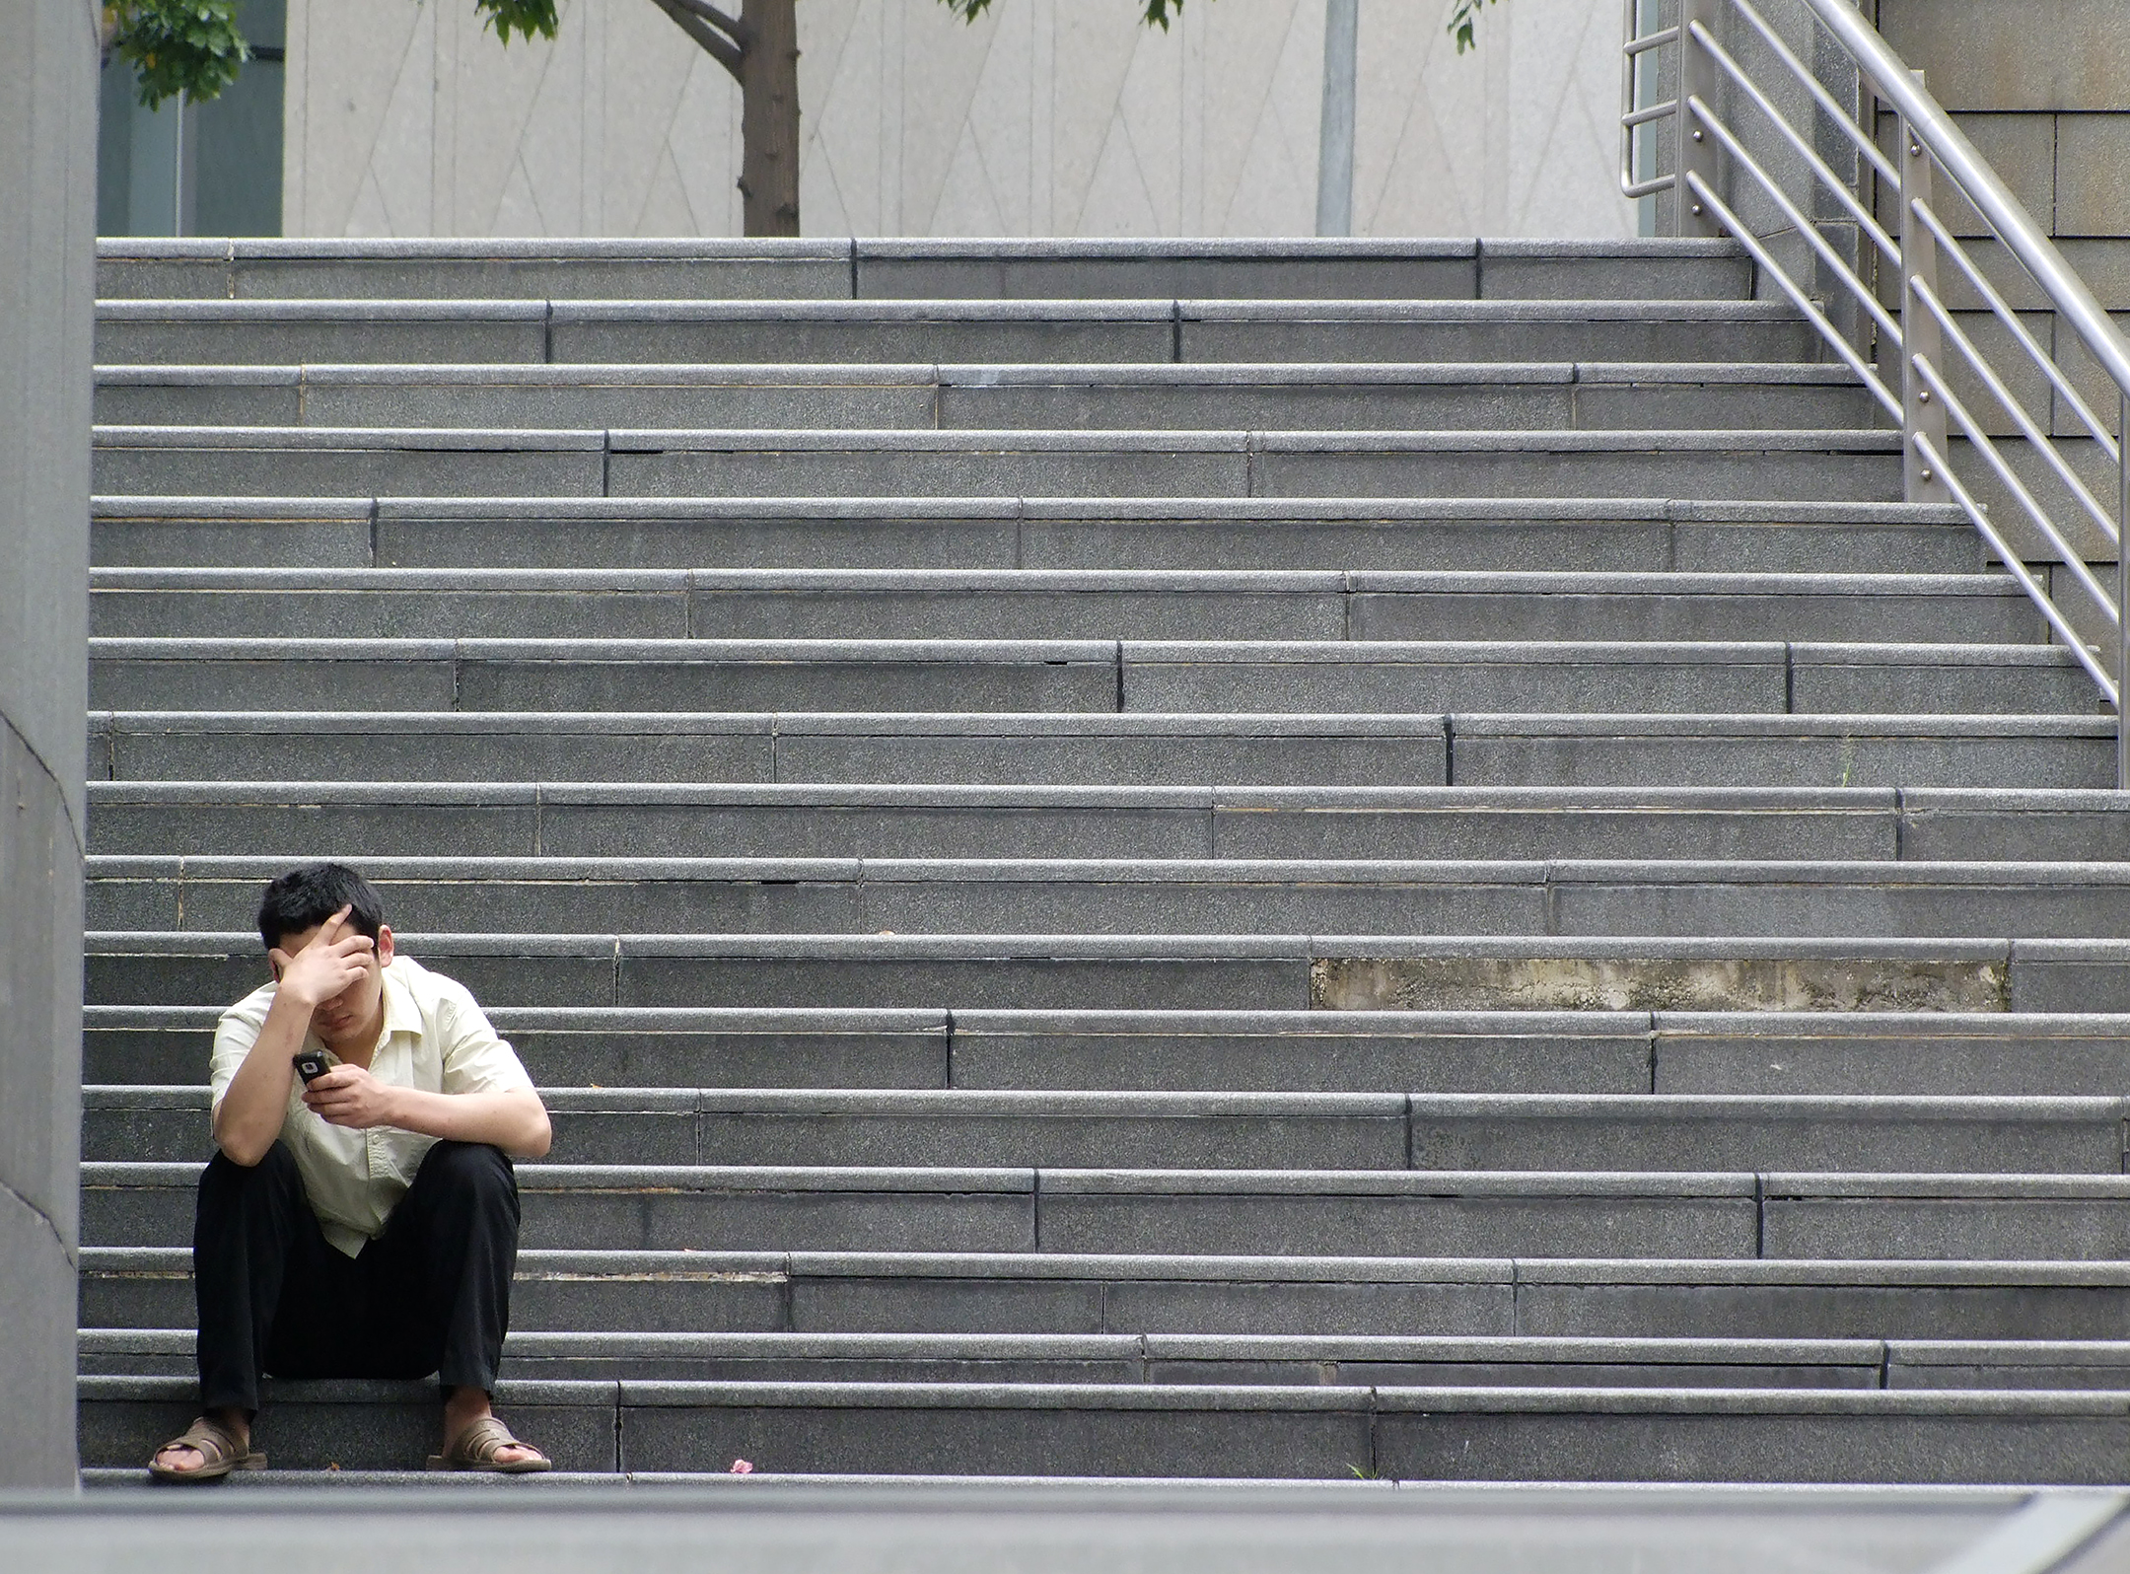
We’ve lost that “we feeling”
Photo: Stressed by aaayyymm eeelectriik on Flickr CC BY 2.0
Notes:
“Their silent withdrawal from social intercourse has affected urbanites propensity to pitch into the common tasks that bind people together with a ‘we feeling’. The net result is, today, people in large cities have collectively turned away from the responsibilities of community building, community development and community participation in civic activities and social and public affairs.”
Article, 2012: Bowling Alone: Urban Tribes in Concrete Jungles: http://journals.sagepub.com/doi/abs/10.1177/004908571204200201
Photo: Stressed by aaayyymm eeelectriik on Flickr: https://www.flickr.com/photos/aaayyymmm/3300146442/ CC BY 2.0

Slide 13
Revival of interest in analog
Notes:
Fortunately we are seeing a renewed interest in things and experiences that are not digital, that are physical and tangible, and involve real-time face-to-face interaction with others

Slide 14
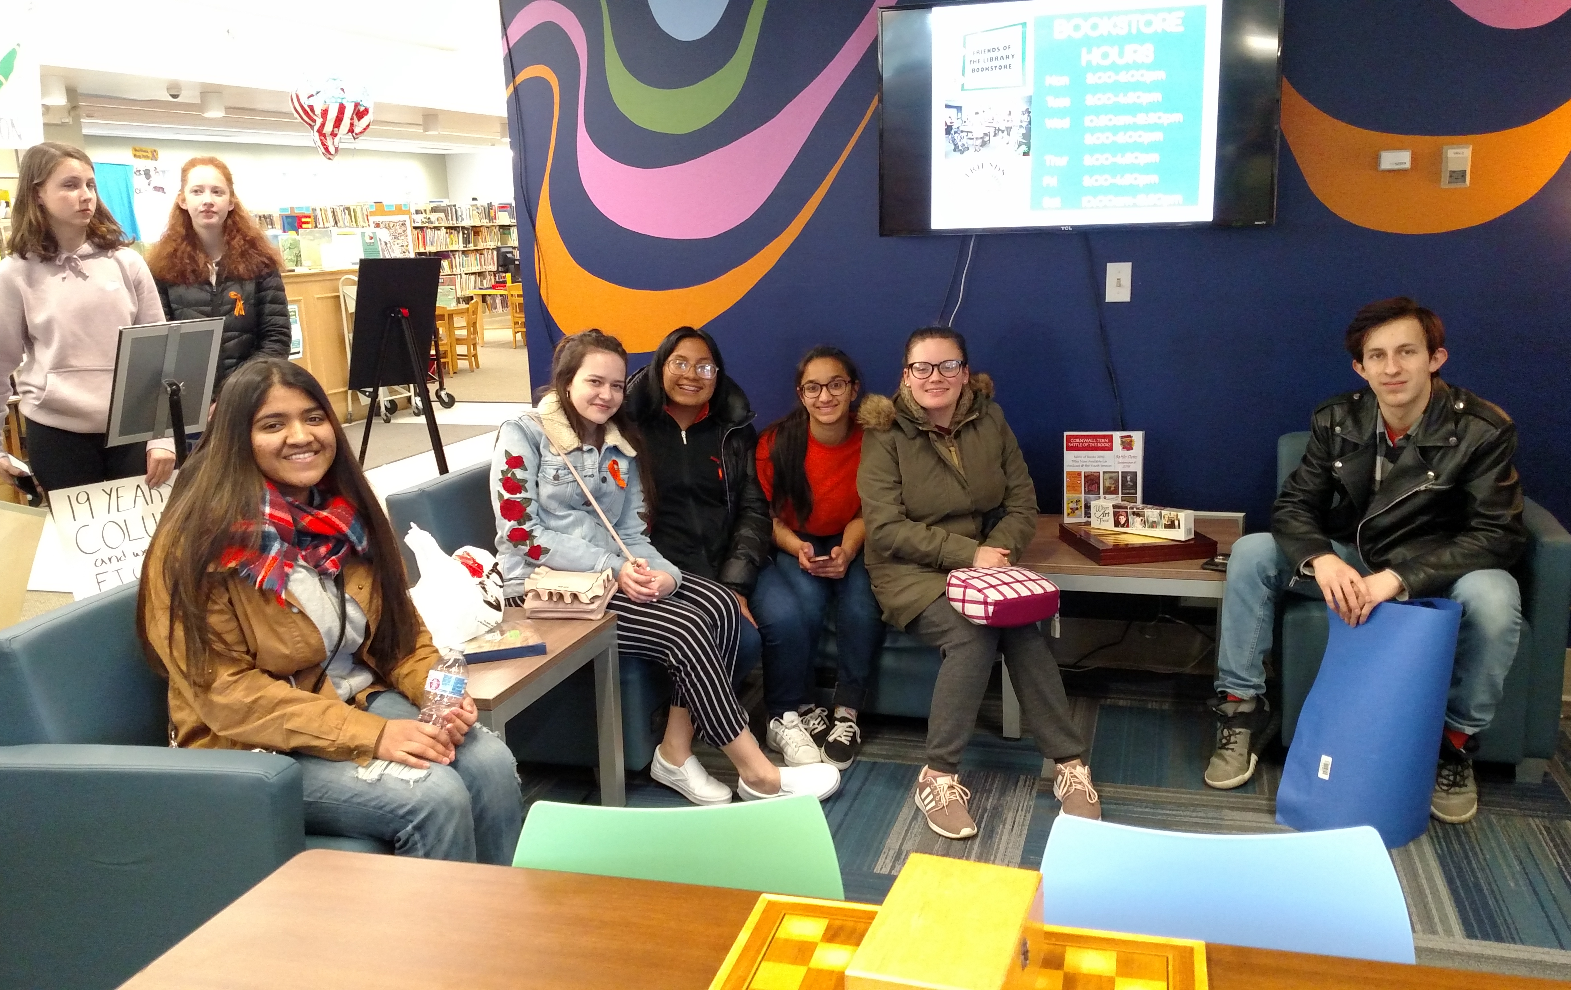
The Guardian
Aug 29, 2018
Photo: Cornwall Public Library Smart Space, used with permission
Notes:
Logged off: meet the teens who refuse to use social media
https://www.theguardian.com/society/2018/aug/29/teens-desert-social-media
The Guardian, Aug 29, 2018
More teens that you might think are turning their backs on social media
One 18-year-old student “turned against social media when her classmates became zombified. “Everyone switched off from conversation. It became: ‘Can I have your number to text you?’ Something got lost in terms of speaking face to face. And I thought: ‘I don’t really want to be swept up in that.’”
One 2017 survey of British schoolchildren found that 63% would be happy if social media had never been invented.
According to a study by US marketing firm Hill Holliday of Generation Z – people born after 1995 – half of those surveyed stated they had quit or were considering quitting at least one social media platform. “Significant cracks are beginning to show.”
41% of the Gen Z teens surveyed by Hill Holliday reported that social media made them feel anxious, sad or depressed.
“I was presenting this dishonest version of myself. It’s a competition for who can appear the happiest….It became depressing.” (and the most risqué, outrageous or conformist)
***but FOMO arises –when you are from a digitally native generation, quitting social media can feel like joining a monastery.
Photo: Cornwall Public Library Smart Space, used with permission

Slide 15
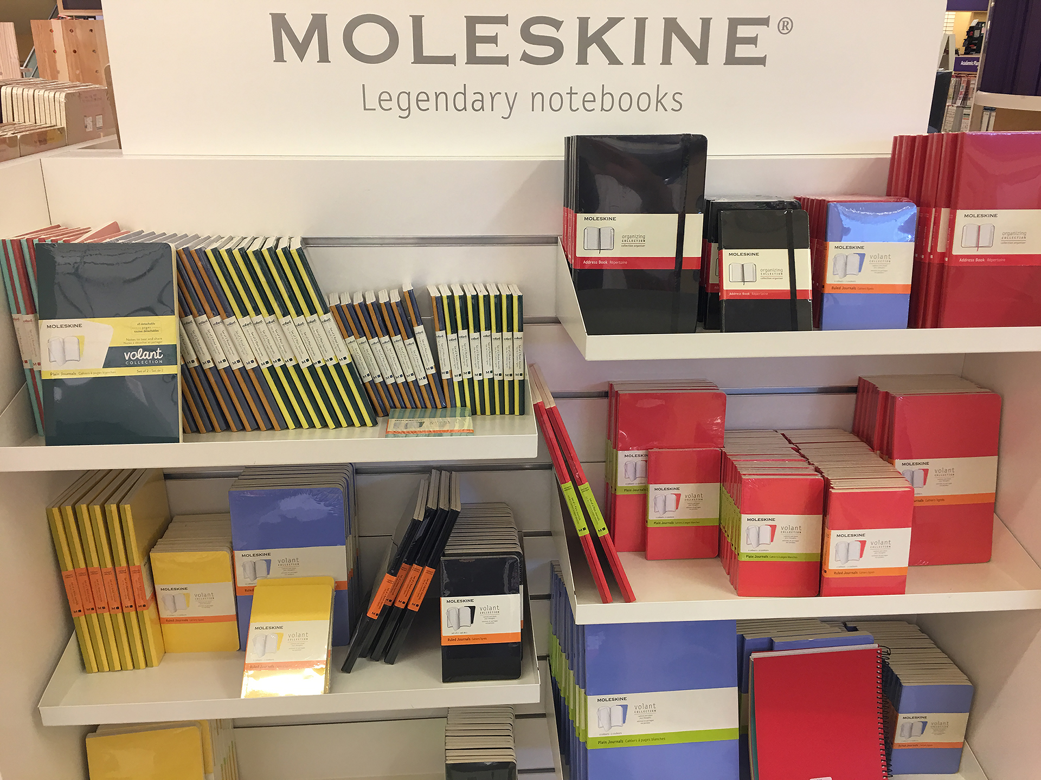
“Analog gives us the joy of creating and possessing real, tangible things”
⎯David Sax
Photo: Moleskin display by B. Gutsche; used with permission
Notes:
Why am I showing this display of Moleskin notebooks?
Book: Revenge of Analog: Real Things and Why They Matter; by David Sax
Renewed interest in board games, vinyl records, moleskin!
teenagers and 20-somethings discovering turntables and LPs, paperback novels and film cameras.
“The younger someone was, the more digitally exposed their generation was,” he writes near the end of this book, “the less I found them enamored by digital technology, and the more they were wary of its effects.” These kids were falling in love with analog.
Photo: Moleskin display by B. Gutsche; used with permission

Slide 16
“This desire for human interaction — and a sense of community and place — is one of the magnets that draw people to neighborhood bookstores…”
Notes:
This desire for human interaction — and a sense of community and place — is one of the magnets that draw people to neighborhood bookstores, where readers can get expert recommendations (from a person, not an algorithm), and attend readings and discussion groups. (David Sax)

Slide 17
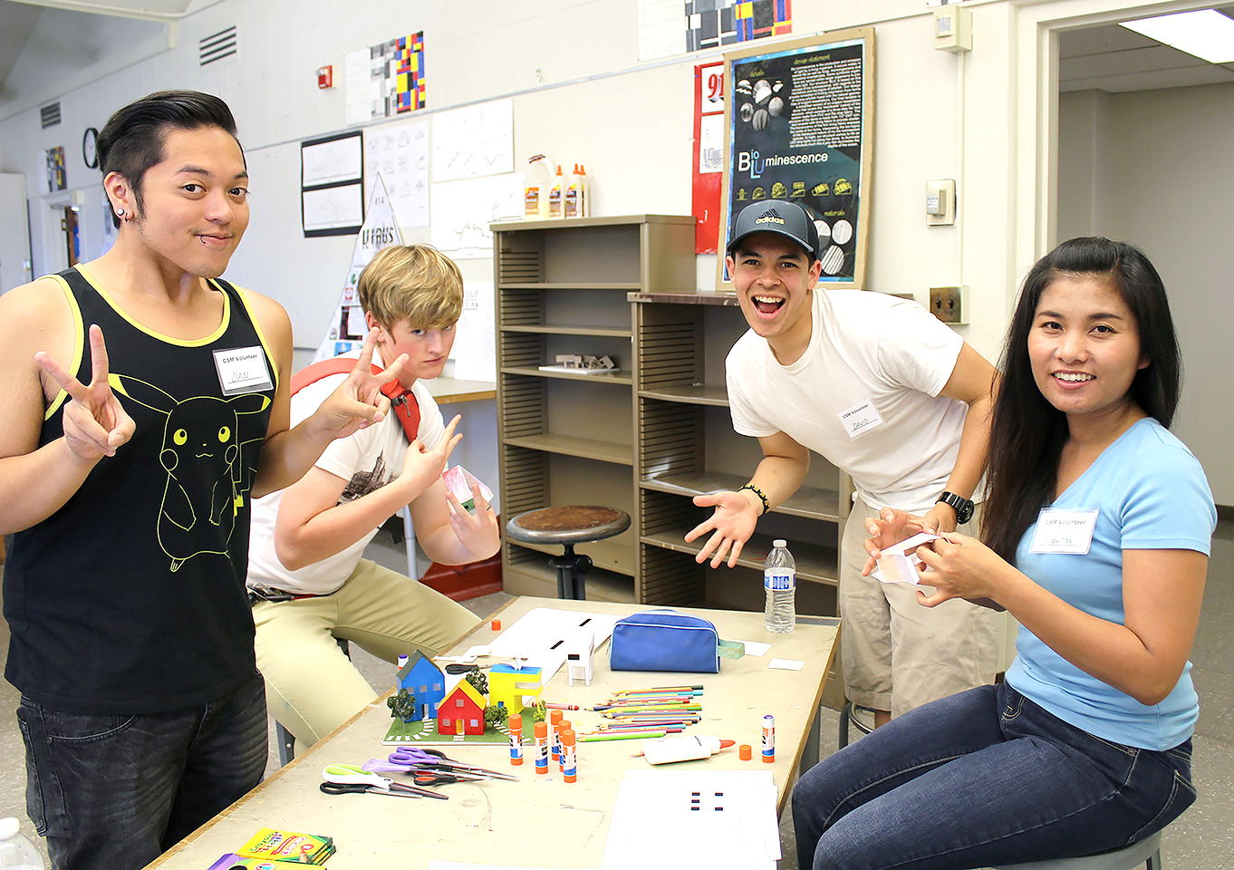
“This desire for human interaction — and a sense of community and place — is one of the magnets that draw people to neighborhood bookstores…”
libraries
Photo: Build a City by CSM (CA) Libraries on Flickr; CC BY 2.0
Notes:
The return to the “real” includes libraries!
According to 2017 PEW research, Majority of Americans believe public libraries help them:
65% say libraries help them grow as people.
49% think libraries help them focus on things that matter in their lives.
43% believe libraries help them cope with a busy world.
38% say libraries help them cope with a world where it’s hard to get ahead.
***and Millennials (those ages 18 to 35) stand out as the most ardent library fans
http://www.pewresearch.org/fact-tank/2017/08/30/most-americans-especially-millennials-say-libraries-can-help-them-find-reliable-trustworthy-information/
Photo: Build a City by CSM (CA) Libraries on Flickr: https://www.flickr.com/photos/collegeofsanmateolibrary/15577279965/in/photostream/ CC BY 2.0

Slide 18
Library as connection catalyst
Notes:
Which brings us to the role of the public library as a catalyst for connection in a community

Slide 19
Why libraries?
“‘Why build a library when we have an internet?’ Put another way, ‘Why go to a party when I have food and music at home?’
Internet surfing is largely a solo endeavor. A library is a shared experience.”*
*Quote: A Library for All Ages; Louie Castoria; Half Moon Bay Review, Aug 22, 2018
Notes:
Recurring question – are libraries still relevant in the digital age? YES!!!
Quote: A Library for All Ages; Louie Castoria; Half Moon Bay Review, Aug 22, 2018
https://www.hmbreview.com/community/a-library-for-all-ages/article_d765b23e-a646-11e8-ad6b-27d3fb335393.html

Slide 20
Participatory, active learning at the library
DIY becomes DIT (doing it together)
Photos, from left: Artist-in-Residence program, Bellingham (WA) Public Library; with permission from Jenni Johnson; STEM program; with permission from Wilton (NH) Public Library; Digital Media Lab, Laurel (DE) Public Library; with permission from Tameca Beckett
Notes:
The role of the library in its community has evolved from passive to active engagement with community members, from book repository, reference resource, and individual study to embrace hands-on, participatory active learning opportunities that bring people together.
Active learning spaces create social connections where people learn together and from each other. It shifts DIY (do it yourself) to DIT –do it together. The space fosters a sense of community, and participation in a community increases the motivation to learn.
***What active learning programs are you offering in your libraries? (record on flip chart)

Slide 21
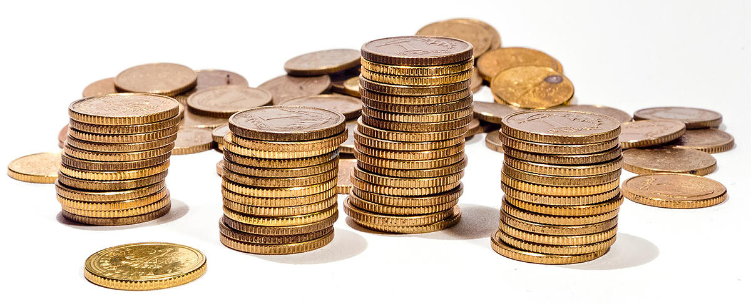
Build social capital
What can the library do to amplify social connections?
Photo: Gold coins by aleksandra85foto on Pixabay
Notes:
Your libraries are already creating many analog opportunities (makerspaces, digital media labs, learning circles, board game play, etc.). But often the emphasis is more on the technologies and the activities and less on the capitalization of social connection.
When you have people together in a space, how can you amplify the social capital? How can you foster the bonding that increases the reliance, trust and resilience of the community?
Photo: Gold coins by aleksandra85foto on Pixabay: https://pixabay.com/en/money-coins-gold-currency-coin-605077/

Slide 22
challenge
Design a public program that brings people together at the library to do or make things in a way that enhances social connections, especially between/among individuals who are unlikely to connect in their everyday lives
Notes:
This is our challenge for today
Power of learning together, social learning, strengthening community ties, addressing diversity through working together

Slide 23
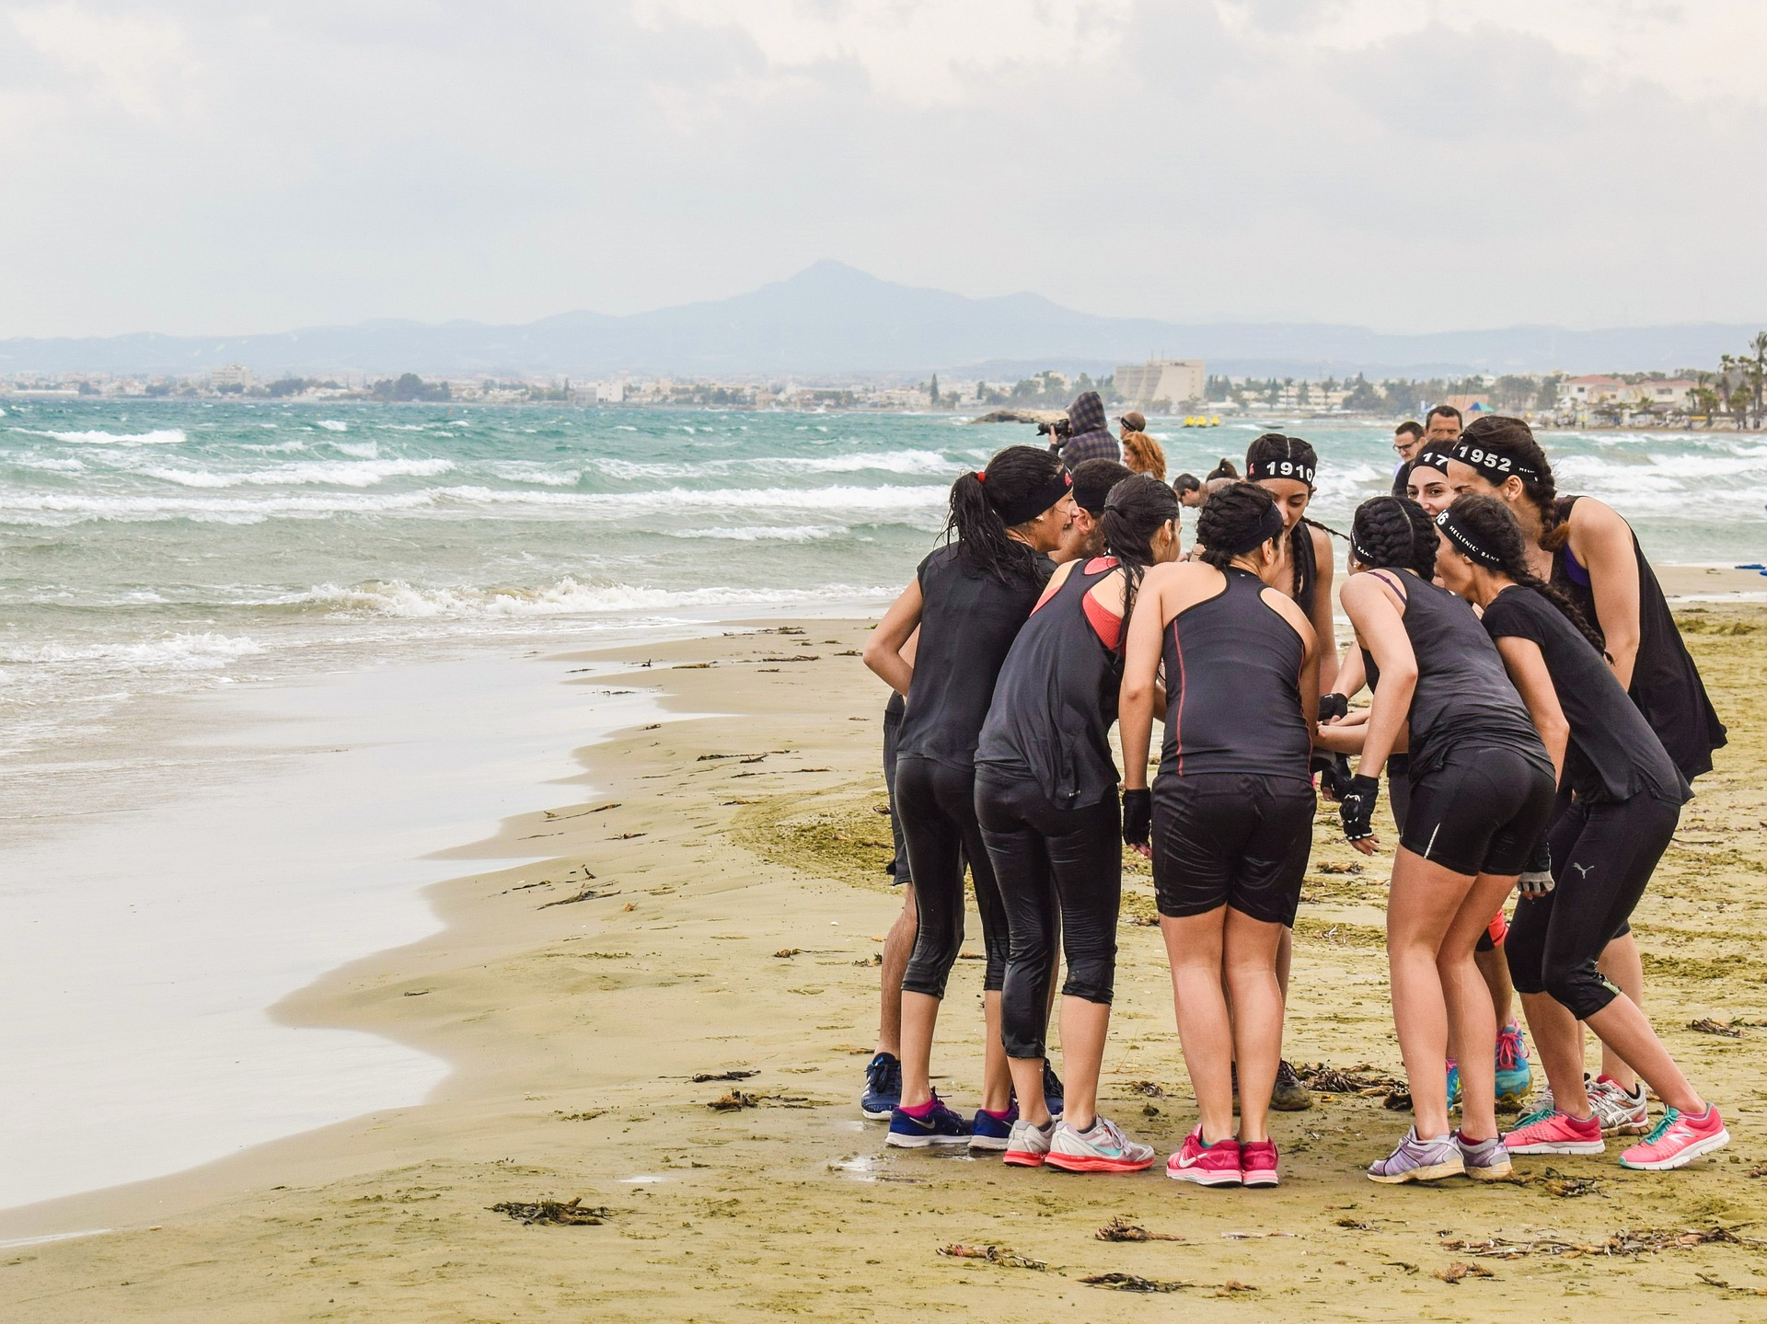
Possibilities
*YOU* are idea generators
Photo: Team spirit by dimitrisvetsikas1969 on Pixabay
Notes:
You are here at Next Library to “encourage the unexpected” and to explore the frontiers of public library power in community
We’re going to break into working groups to test out the thesis that ‘Public libraries have the position and power to rebuild social bonds and heal fractured communities’
Photo: Team spirit by dimitrisvetsikas1969 on Pixabay: https://pixabay.com/en/team-spirit-group-team-teamwork-2238843/

Slide 24
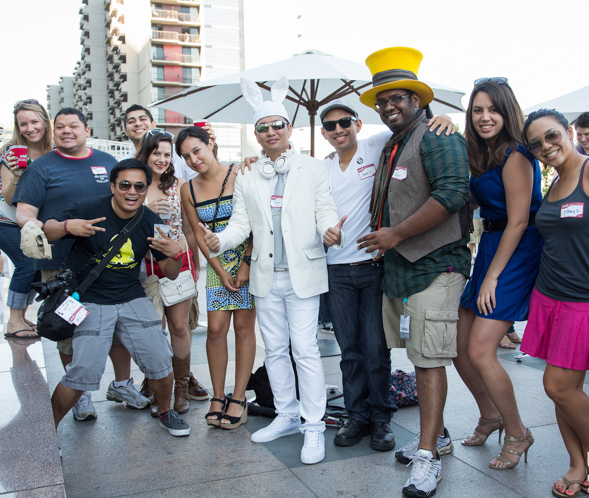
Be a party host
Best strategies to:
Get a variety of people to the party
Get people who don’t know each other to mingle
Get people to learn more about each other
Photo: Grand Summer Event by Yelp Inc on Flickr CC BY-NC-ND 2.0
Notes:
First, put on your cocktail party host hat
How can you invite a variety of guests and convince them to come?
What are ways to get people who don’t know each other to mingle? (fun ways)
How can you facilitate people getting to know more about each other (casually)
*what about people who are “wet blankets” – don’t want to engage at the party?
***write each idea on a post-it note at your table
***ask tables to share ideas –encourage others to “steal” ideas
Photo: Grand Summer Event by Yelp Inc on Flickr CC BY-NC-ND 2.0
https://www.flickr.com/photos/yelp/7510970048/

Slide 25
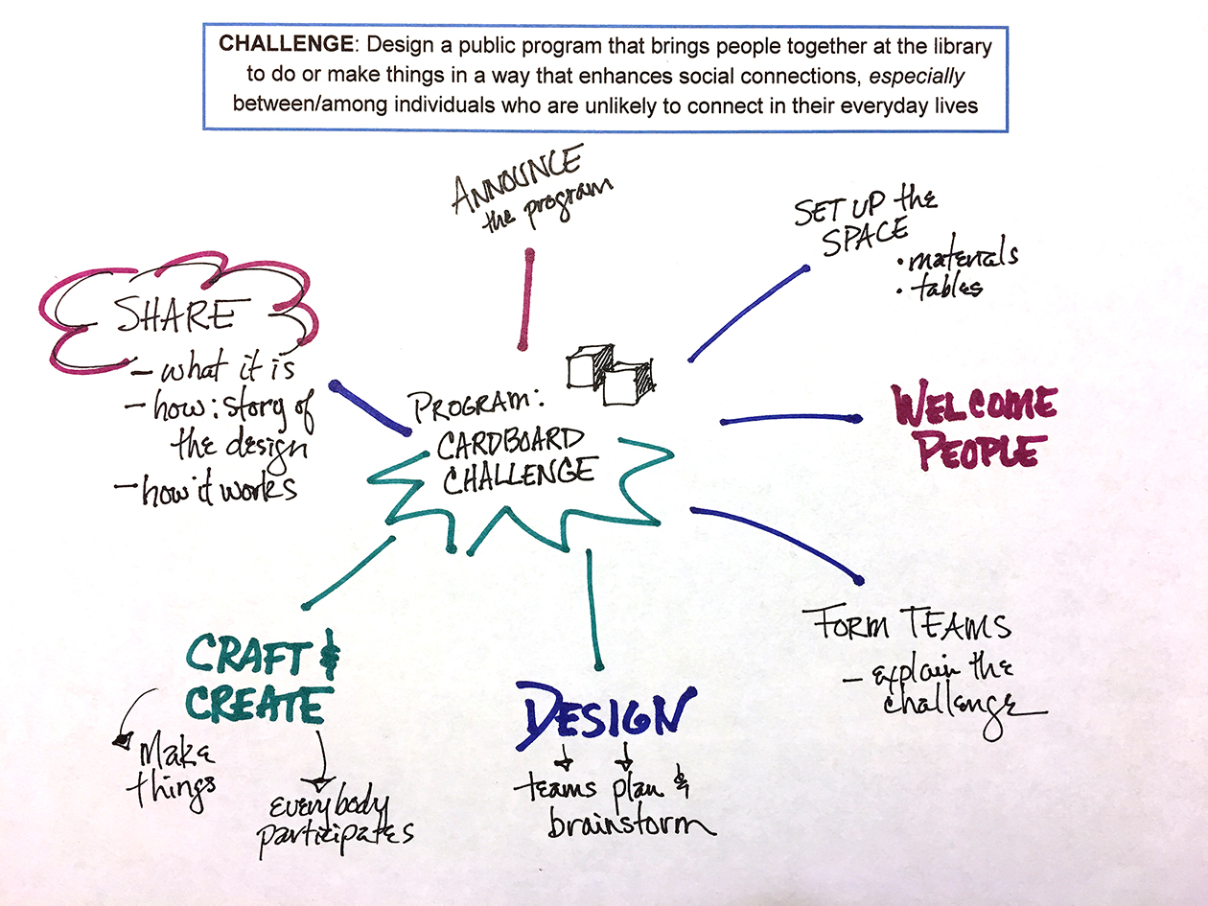
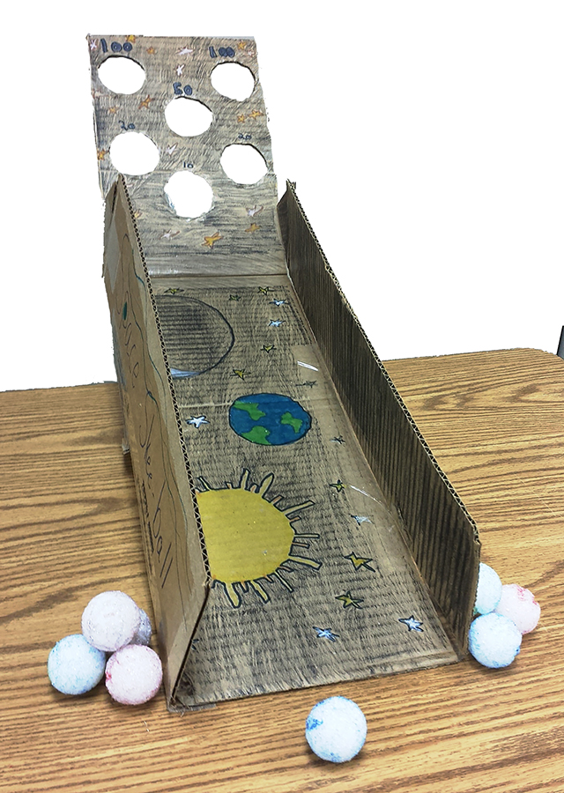
Program
map
Photo: Cardboard Challenge 2014 by Michael Buist on Flickr CC BY-NC-ND 2.0
Notes:
Each group decide on a program (or program series) that you think is ripe for fostering social connections.
Think broadly about programs that are hands-on and participatory, where people are working together making things or discovering things
On chart paper:
Write name of program at center of the ‘challenge’ sheet
Add details: what will happen in the program/event; flow of events/actions from time people arrive to end of program; potential follow-up
Write the details radiating out from the center
***Be prepared to report out later about the program your group chooses
Photo: Cardboard Challenge 2014 by Michael Buist on Flickr CC BY-NC-ND 2.0
https://www.flickr.com/photos/buistbunch/15359240915/

Slide 26
A few low-tech ideas…
Board game night
Community garden
Storytelling event
Sew a community quilt
Plan/do yarn bombing
Create a neighborhood newspaper
Plan, perform a talent show
Blackout poetry with discarded books
Notes:
If your library has a makerspace, the programs are inherently active and hands-on
Building robots, doing a LEGO challenge,
BUT you don’t have to have a high-tech program
Board game night
Start a community garden, solicit planting suggestions from different cultures
Have a storytelling event where participants share a 10-minute story about their life (think MOTH radio hour)
Sew a community quilt together or plan/execute a yarn-bombing
Plan and deliver a talent show
Create a neighborhood newspaper together
Blackout poetry with discarded books

Slide 27
Socialize
your
program
Notes:
Place the post-it notes with “party host” ideas at the points on your program chart where they apply.
You may need to modify the ‘party’ ideas to apply to the situation
You may need to duplicate post-it notes when an idea applies in multiple places.
Or feel free to write new ideas on post-its and add to the poster.
It’s fine if any one stage of the program has multiple ideas.
***report-out: tell us what your program is and why you think it’s ripe for social connection.

Slide 28
What will you take back to your library?

Slide 29
Return to the Real
Betha Gutsche
WebJunction Programs Manager, OCLC
gutscheb@oclc.org

Slide 30
References (in order of mention)
Social Connection Makes a Better Brain; E. E. Smith; The Atlantic; Oct 29,2013
Connectedness & Health: The Science of Social Connection; Dr. Emma Seppala; Stanford Medicine; May 8, 2014
Bowling Alone: America’s Declining Social Capital; R. Putnam, 2000
How Facebook Makes Us Unhappy; M. Konnikova; New Yorker; Sep 10, 2013
6 Ways Social Media Affects Mental Health; A. Walton; Forbes; Jun 30, 2017
Have Smartphones destroyed a generation?; J. Twenge; The Atlantic; Sep 2017
Feeling Lonely? Too much time on Smart Phones; K. Hobson; NPR; Mar 6, 2017
Social Media, Social Life: Teens Reveal Their Experiences; Common Sense Media; Sep 10, 2018
Logged off: meet the teens who refuse to use social media; The Guardian; Aug 29, 2018
Revenge of Analog: Real Things and Why They Matter; D. Sax; 2017
PEW Research Center Report on Library Use; Aug 2017

