Slide 1
Minitex Technical Services Symposium, St. Paul Minnesota. 6 December 2017
Breaking Out of the Walled Garden: Lessons Learned in Moving Library Linked Data from Research to Production
Jean Godby
Senior Research Scientist
OCLC Membership and Research

Slide 2
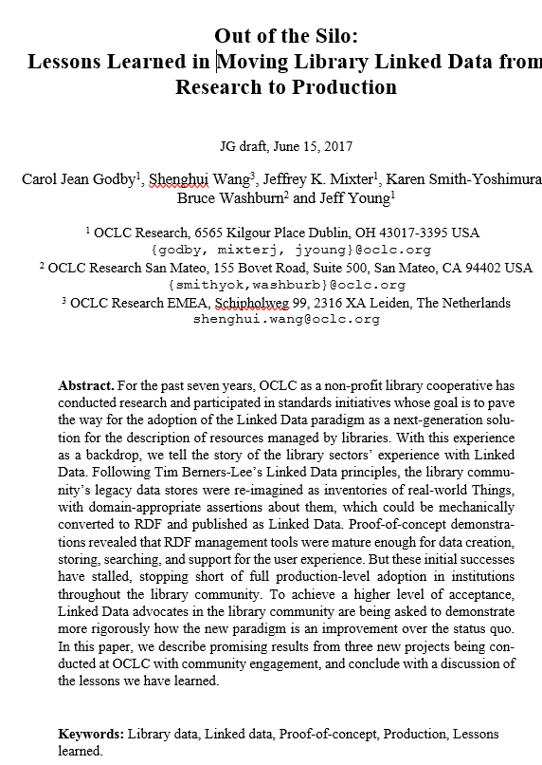
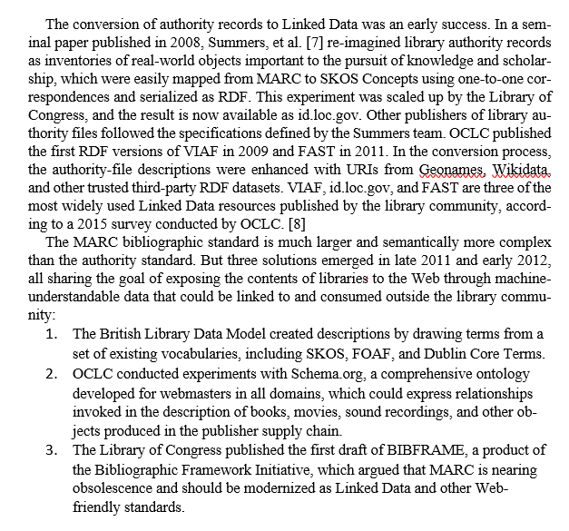
Spiked!
Notes:
The inspiration for this presentation came from a research article I was writing for last year’s International Semantic Web Conference. I wanted to describe the library community’s experiences with linked data. It was about getting our data out of the library community’s walled gardens and onto the web.
The arc of the story seemed clear enough: initial successes, then a feeling of being stuck, and then a new sense of optimism. But I ended up abandoning the project, because I needed to convince myself that we were back on a positive trajectory.

Slide 3
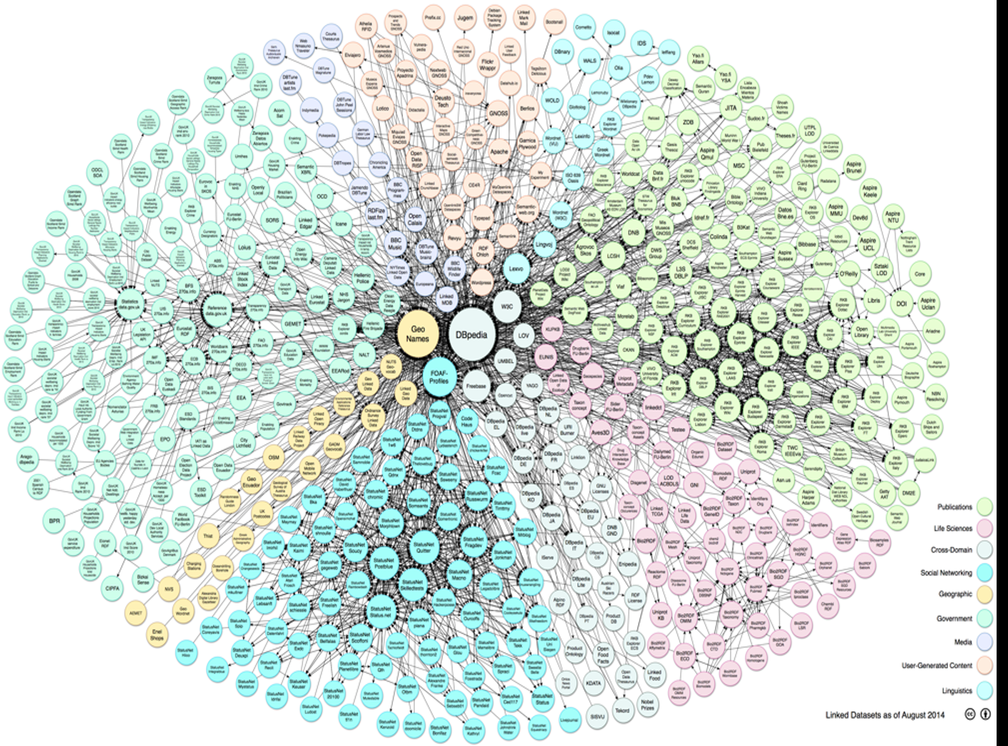
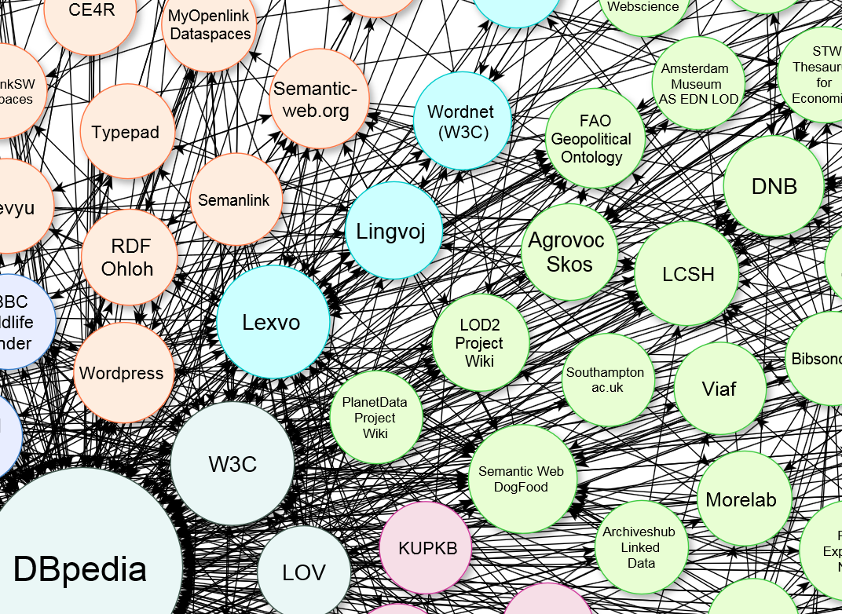
Government
Libraries, publishing
DBpedia
Life sciences
Social networking
Notes:
--To set the framework, consider some clichés. [A more positive spin: persistent brand images for our endeavor]
--The linked data cloud, as it looked during our initial burst of activity. [The cloud represents RDF datasets that have been registered with Data Hub.]
--Libraries and publishing represented a significant portion of the cloud, as shown in light green. Our community’s resources, such as VIAF, were near the center of the diagram, which implies a growing recognition that libraries were important to whole linked data ecosystem.

Slide 4
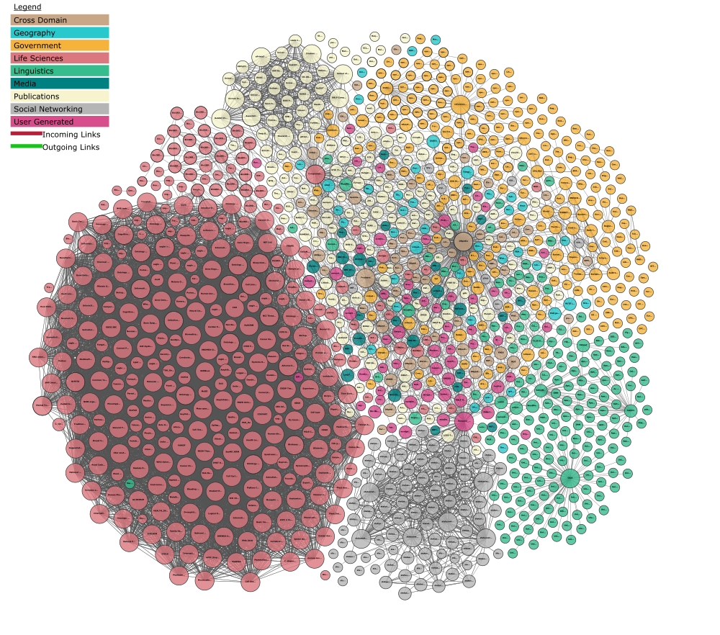
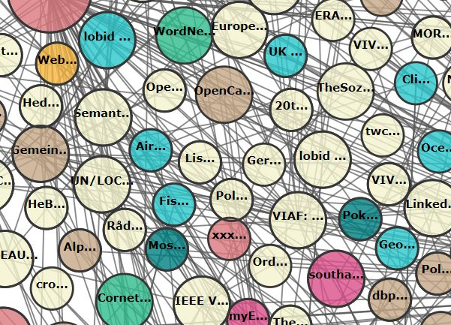
Libraries, publishing
Notes:
But last summer, the cloud was republished and things had changed.
--Libraries and publishing are now “buried” by other sectors. Note the explosion of new datasets representing life sciences. [pink]
--Is the library community falling behind? Are we getting anywhere now? Or is progress stalled? If so, why? If not, where is the locus of activity?
--These are the questions I want to explore today.

Slide 5
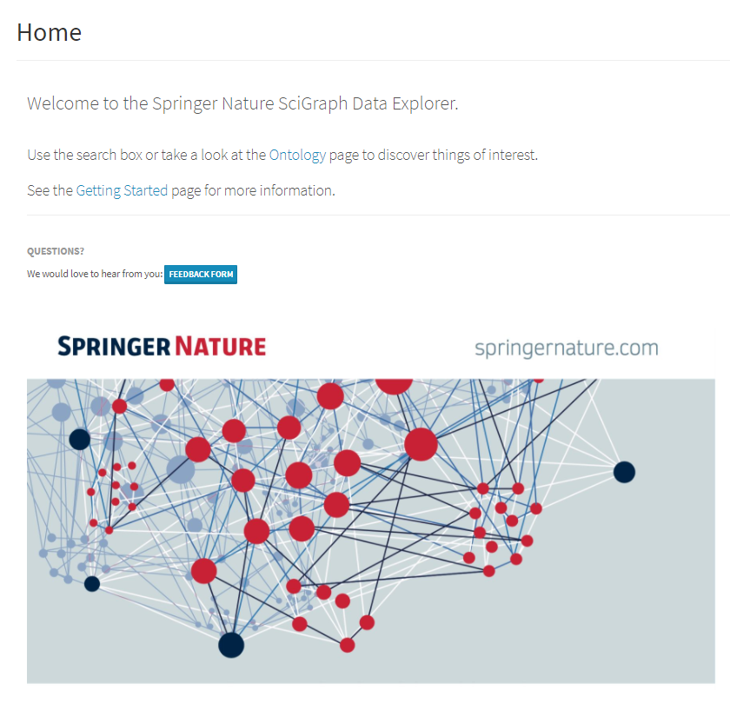
Notes:
Of course, these are overall impressions, and big things may be happening at a more granular level. One example: Springer Nature SciGraph [announced in March, 2017] https://scigraph.springernature.com/explorer
1.5-2 billion [RDF statements] or “triples”; Research information data, including authors, co-authors, cited works; plus supporting institutions and grant-funding agencies. Using linked data to support discovery.
Think: bibliometrics, supercharged.
Springer: “ By doing so, Springer Nature SciGraph overcomes former boundaries by relating comprehensive information about the research landscape. It represents a further step in data integration and it will continue to grow organically. Our aim is to increase the discoverability of high quality data as larger parts of our datasets are being made available under CC-BY licensing.”

Slide 6
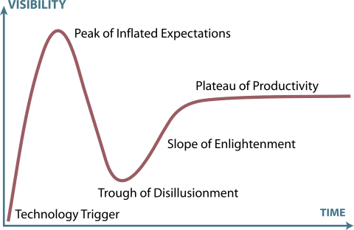
The Gartner Hype Cycle for Emerging Technologies
Image source: Wikipedia
Notes:
But the evidence suggests this is a good time for stock-taking. I’ve found it productive to think about how the library linked data project is advancing along a timeline that has ups and downs. Peaks and valleys, whose contours are perhaps conveniently framed by the Gartner Hype cycle. I’ll use this frame today to give an informal structure to my presentation.

Slide 7
Technology triggers

Slide 8
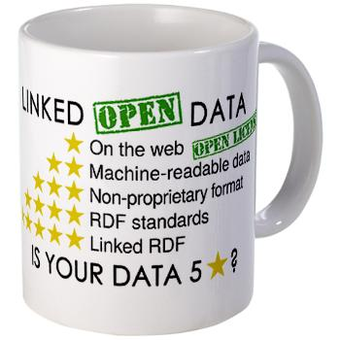
Notes:
Another cliché (hopefully, the last). We can go over this quickly because the principles are now familiar. They’ve been socialized in our community.
As we know, linked data implies a transformation from human-readable records to machine-understandable statements that can be linked to each other. They’re expressed in vocabularies that are understandable across the Web. Linked data operates best when resources are openly available.

Slide 9
The promise of linked data
Notes:
The peak of inflated expectation. The age of exuberance.
As always with technological change, there is a push and a pull.

Slide 10
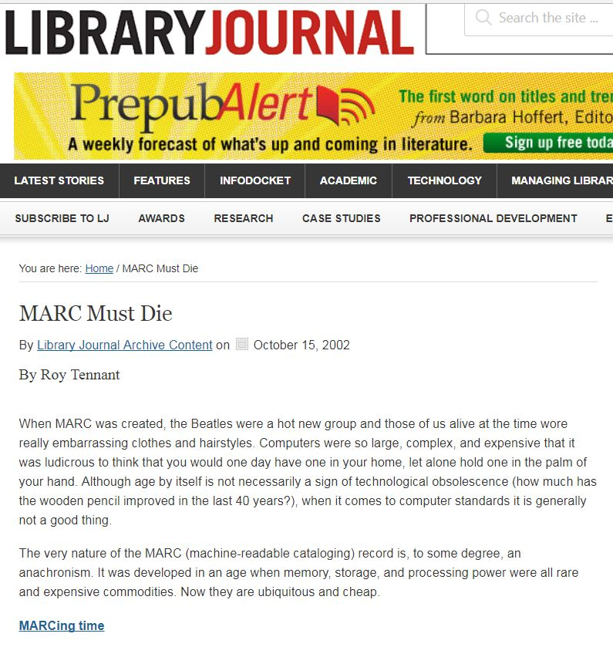
“When MARC was created, the Beatles were a hot new group and those of us alive at the time wore really embarrassing clothes and hairstyles.… “
“Although age by itself is not necessarily a sign of technological obsolescence…, when it comes to computer standards, it is generally not a good thing.”
Notes:
The push:
In 2002, my OCLC colleague Roy Tennant (who then worked for the California Digital Library) issued a clarion call to retire MARC. As he put it, “MARC must die!”
--A little later, the Library of Congress started assembling discussion groups on the future of bibliographic control, culminating with the publication of the 2006 report “On the Record”, which urged changes that would make library resource descriptions more compatible with web-friendly standards. By then, it was clear that users were beginning their search for information on the web, not in the library.
--The Bibliographic Framework Initiative followed, which made explicit recommendations to adopt linked data conventions. This was the program that launched BIBFRAME.

Slide 11
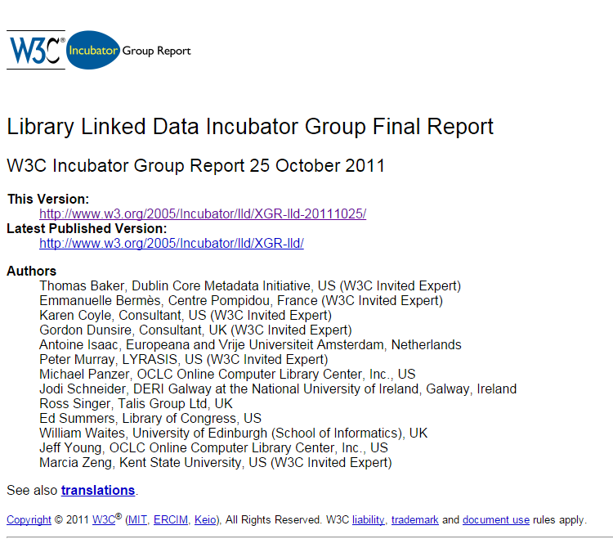
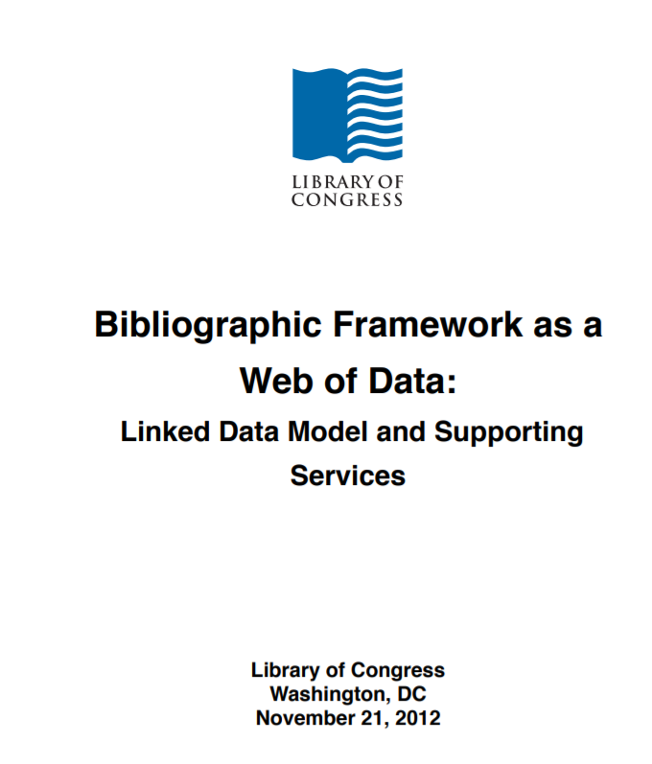
Notes:
Now, the pull:
In another social network that overlapped with the LC discussions, members of the global library standards community were experimenting with the early artifacts from linked data research. An influential W3C report was published in 2011. The first BIBFRAME report was published a year later.
Both groups argued that there was a good fit between linked data principles and the design of library data. There was a good fit with the professional values of librarianship, too.

Slide 12
Benefits for data publishers
Data is broadly understandable.
The cost of description can be shared.
Perceived value
Data is easier to integrate.
Data is easier to manage.
Conformance to linked data principles
Notes:
--The benefits of linked data can be organized along a ladder. At the lower levels, non linked-data solutions might deliver the same benefit. At the higher levels, linked data solutions appear to offer more promise for fulfillment than any technology that had been proposed to date.
--And given that librarians want to share and integrate their data across institutions, and embed libraries in the web, the fit with linked data seemed promising. In fact, we seemed to have a head start on other sectors.
The broad conclusions made sense. Linked data is about sharing. If you don’t have to share your data, you can do anything you want with it. Linked data principles compelled the library community to raise the bar and confront the tasks that need to be done to *really* share their data…not just with each other, but with the global web of data.

Slide 13
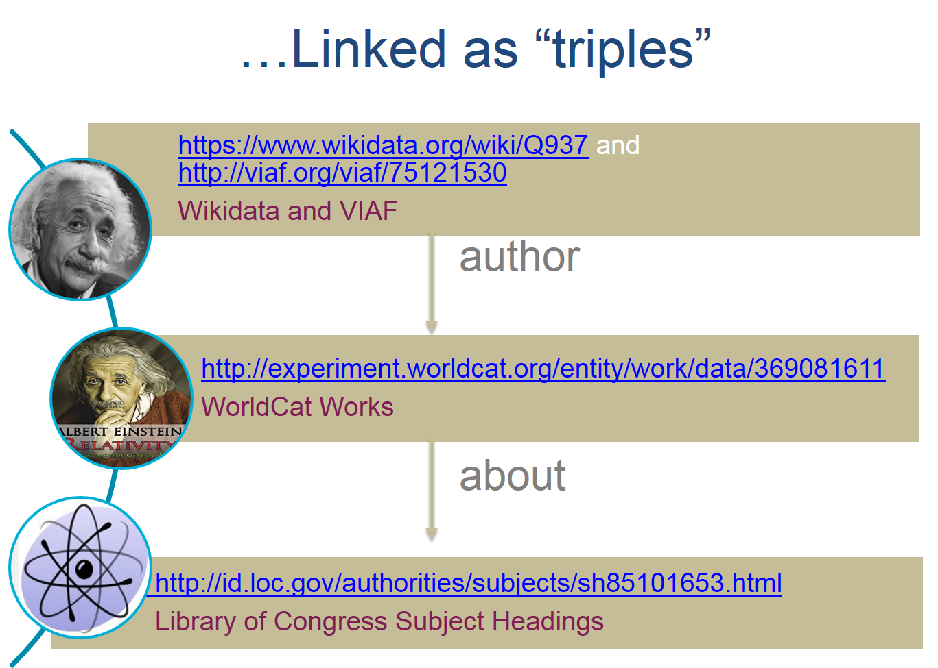
Entities and relationships
Albert Einstein
Person
Relativity: The Special and General Theory
Work
Physics
Concept
author
about
Notes:
--To accomplish these goals, we need to decompose our records (which are primarily read by humans) into statements that a software process can understand. The statements are about the things that people outside the library know about and are the subjects of their information quests … people, places, organizations, creative works.
--This enterprise fits closely with the design of linked data. Library authority files can be interpreted as inventories of persistent “things in the world.” Through a mechanical conversion process, descriptions of these “things” can be associated with globally unique URIs that software processes can understand, both inside and outside the library community.
--This slide showsstatements in our domain in two forms. [Albert Einstein is the author of The Special Theory of Relativity. The Special Theory of Relativity is about physics.] The first in a human-readable form, as you might find in a MARC or Dublin Core record. In the second, URIs replace much of the text.
--The W3C experts and the BIBFRAME sponsors both pointed out that the conversion of library authority files was an early success. But works were a harder problem.

Slide 14
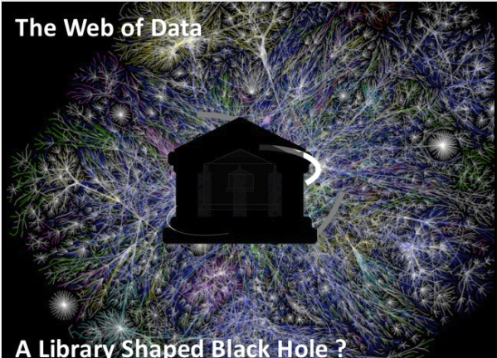
Source: Richard Wallis, “Web-Driven Revolution for Library Data.” Washington, DC. April 2015
Notes:
https://www.slideshare.net/rjw/web-driven-revolution-for-library-data?qid=5181ee74-69a6-4ecd-8cba-3e10bb8d5105&v=&b=&from_search=1
--In the Age of Exuberance, the transformation to linked data even took on a sense of urgency. As my colleague Richard Wallis, who once worked as a “technology evangelist” put it, linked data is the building block for a web of data, a hyperspace of semantically defined links. But he detected a “library-shaped hole” there.
--By that, he meant that libraries are an expected but missing piece in the web of data, because they have something valuable to contribute to the ecosystem.
--We are missing because our data is locked up in “walled gardens” that can be exchanged and understood among libraries, but not with the wider web. In other words, nobody outside our community understands our data.
--But we can unlock our data by following conventions just described—identify things, make machine-understandable statements about them in a vocabulary that can be understood outside our community, and associate them with a URI that be used or “consumed” in other contexts far beyond the walls of the library.

Slide 15
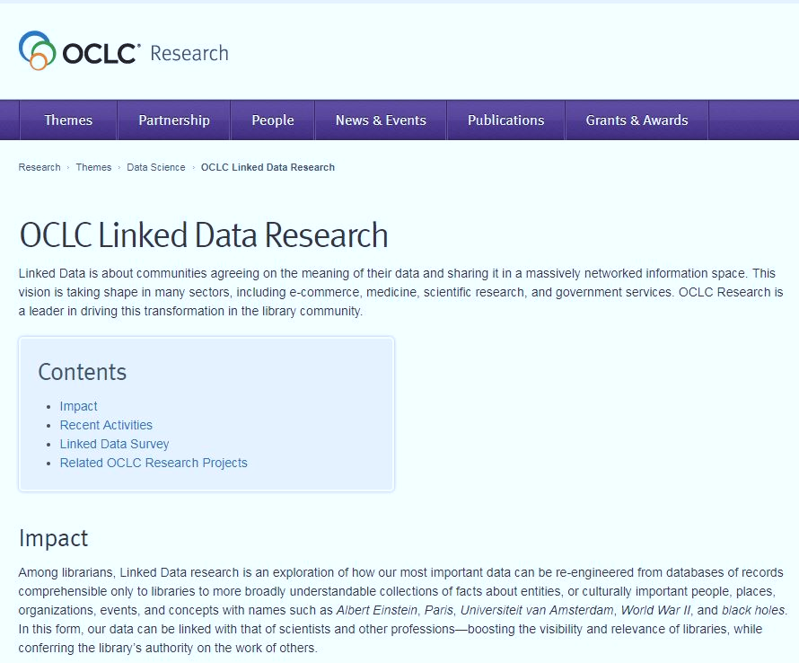
“Linked Data is about communities agreeing on the meaning of their data and sharing it in a massively networked information space….”
“In this form, our data can be linked with that of other professions…boosting the visibility of libraries while conferring the library’s authority on the work of others.”
Notes:
http://www.oclc.org/research/themes/data-science/linkeddata.html
--Even today, the OCLC public website for linked data research echoes these themes in slightly more down-to-earth language.
--This page also hints at the mutual benefit: the library is a source of authority and vetted information. This is a truism among librarians.

Slide 16
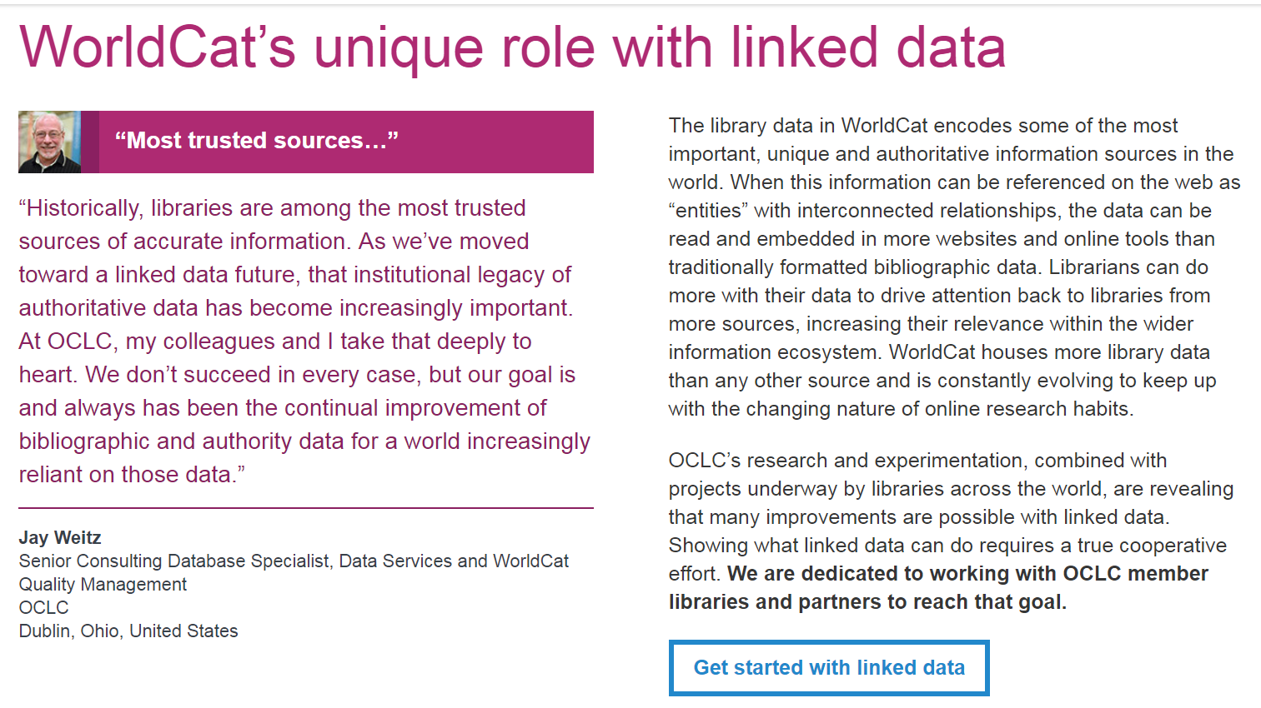
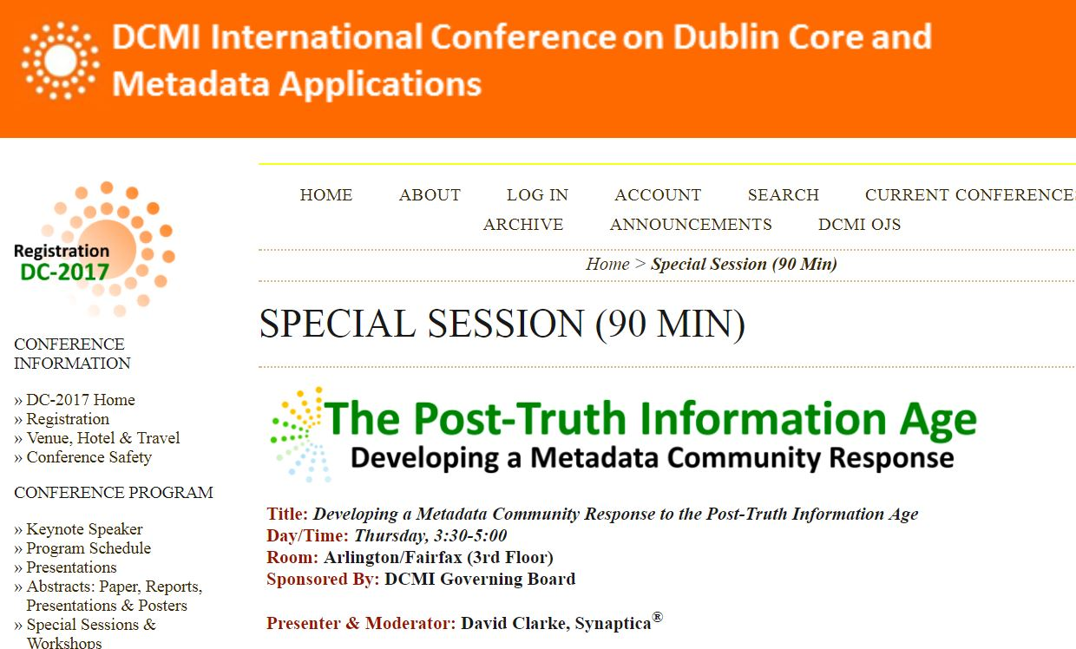
Notes:
The connection between trust and linked data on an OCLC corporate page.
But how might it be implemented?
--At the 2017 DCMI meeting, the importance of this connection was emphasized by David Clarke, co-founder and CEO of Synaptica, which is creating cutting-edge linked data applications. Clarke made the case that libraries can help distinguish between facts and alternative facts, information and disinformation, truth and propaganda. It is our imperative. And linked data is a good way of doing that.
--In fact, the Springer Nature SciGraph project shows how a network of trust can be built up from the work of scholars, co-authors, cited work, and their sponsoring institutions. Such a network is unlikely to contain bots and trolls, whose origins and motives are questionable.
--In other words, Nature SciGraph is yet another demonstration that bibliometrics is very hard to game. And linked data, as envisioned in the SciGraph dataset, makes bibliometrics even more powerful.

Slide 17


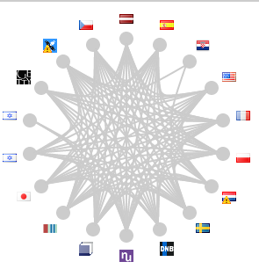

OCLC’s linked data resources
WorldCat Works
ISNI
http://www.oclc.org/research/themes/data-science/linkeddata.html
Experimental
VIAF
WorldCat Catalog
FAST
Notes:
In the age of exuberance, there was an obvious deliverable. We boasted about the number of RDF statements we had published from data sources with established brands. [Nature SciGraph just did that, too.]
--This is how we made the linked data cloud bigger and more interconnected. This is how we signaled that the library community was establishing a presence in the web of data.
--But there was a caveat: these services were experimental. They were research projects. Pushing them to full-scale production seemed like a footnote. We would soon learn that it wasn’t. And OCLC wasn’t alone in realizing this.
One of my old slides:
“In the past 7 or 8 years, OCLC has published about 20 billion triples from library data.”

Slide 18
A reality check
Notes:
In this section, I try to work out answer to a gnawing question. OCLC and other institutions in the library community succeeded in publishing our biggest, most important datasets as linked data, but the world wasn’t’ transformed. Why not? Instead, it felt as though the library linked data enterprise had fallen into the “trough of disillusionment”.

Slide 19
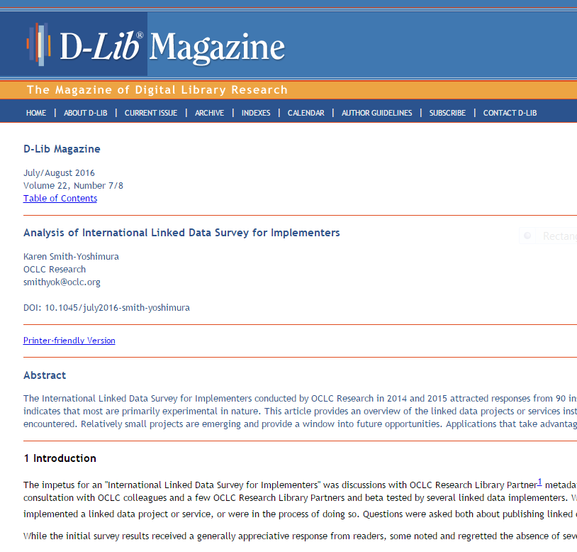
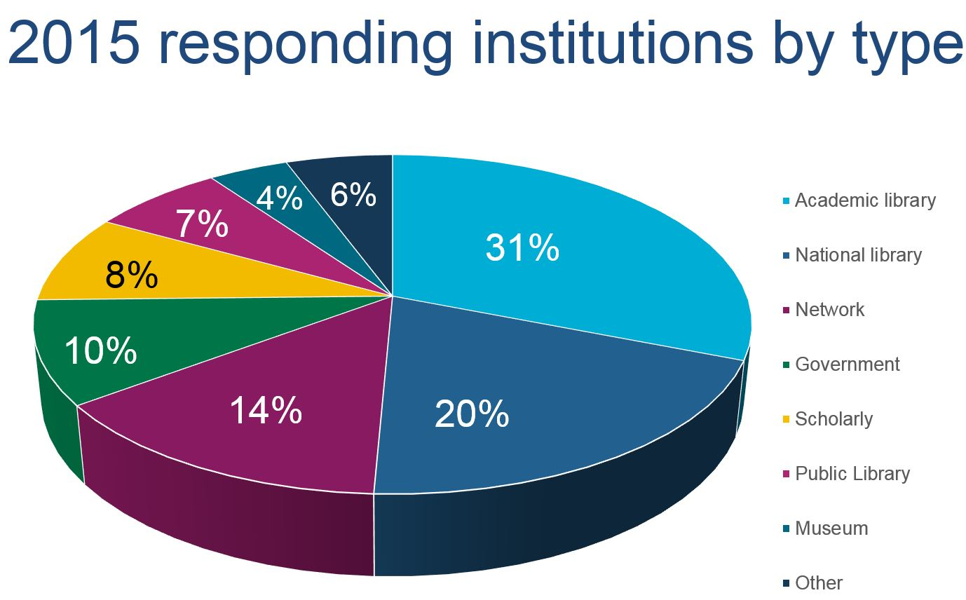
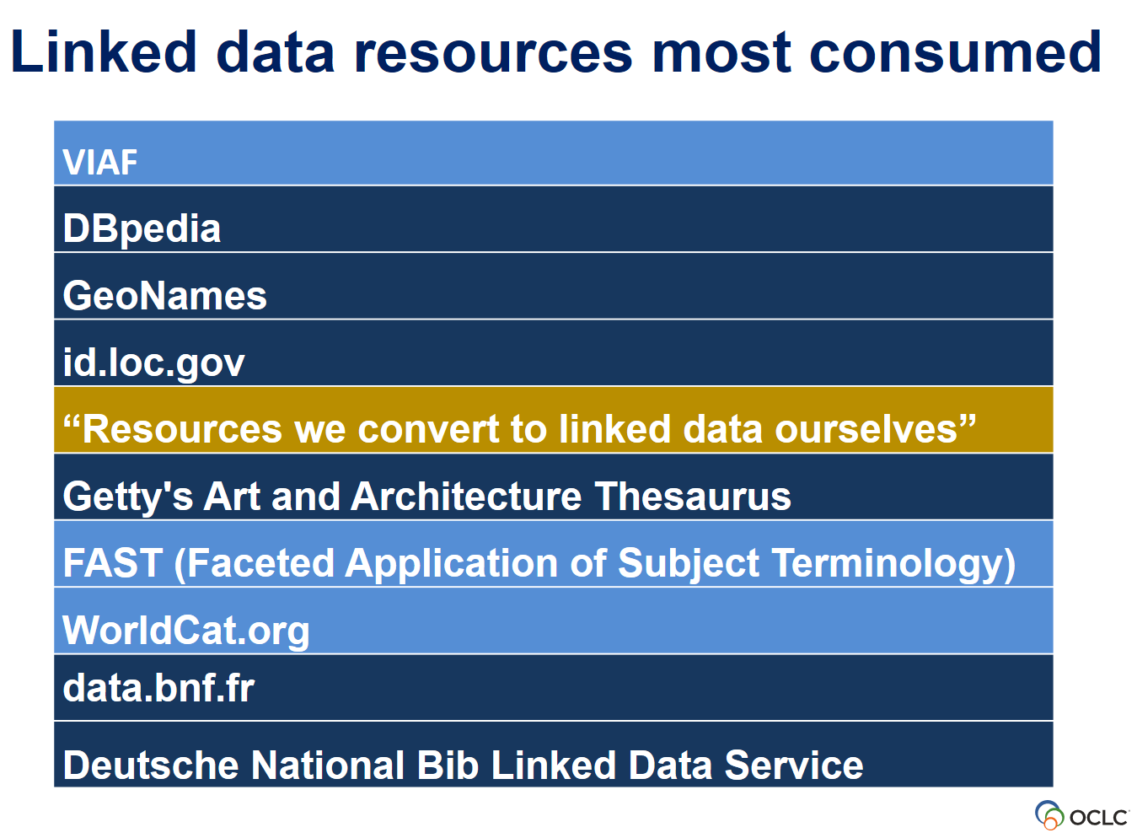
Notes:
http://www.dlib.org/dlib/july16/smith-yoshimura/07smith-yoshimura.html
Karen Smith-Yoshimura’s international survey with a wide cross-section of institution types in the library community first conducted in 2014, and repeated in 2015. This survey foreshadowed problems that we’re still trying to address. In particular, the survey results revealed challenges in the publication and consumption of linked data in the library community and associated sectors.
---[Slide 3] Bottom-line results
Light blue: Resources published by OCLC
Dark blue – other datasets in the library community and well-known third parties
Note that in Position 4 are “resources we convert…ourselves.” Evidence that the participants’ involvement was mostly experimental.

Slide 20
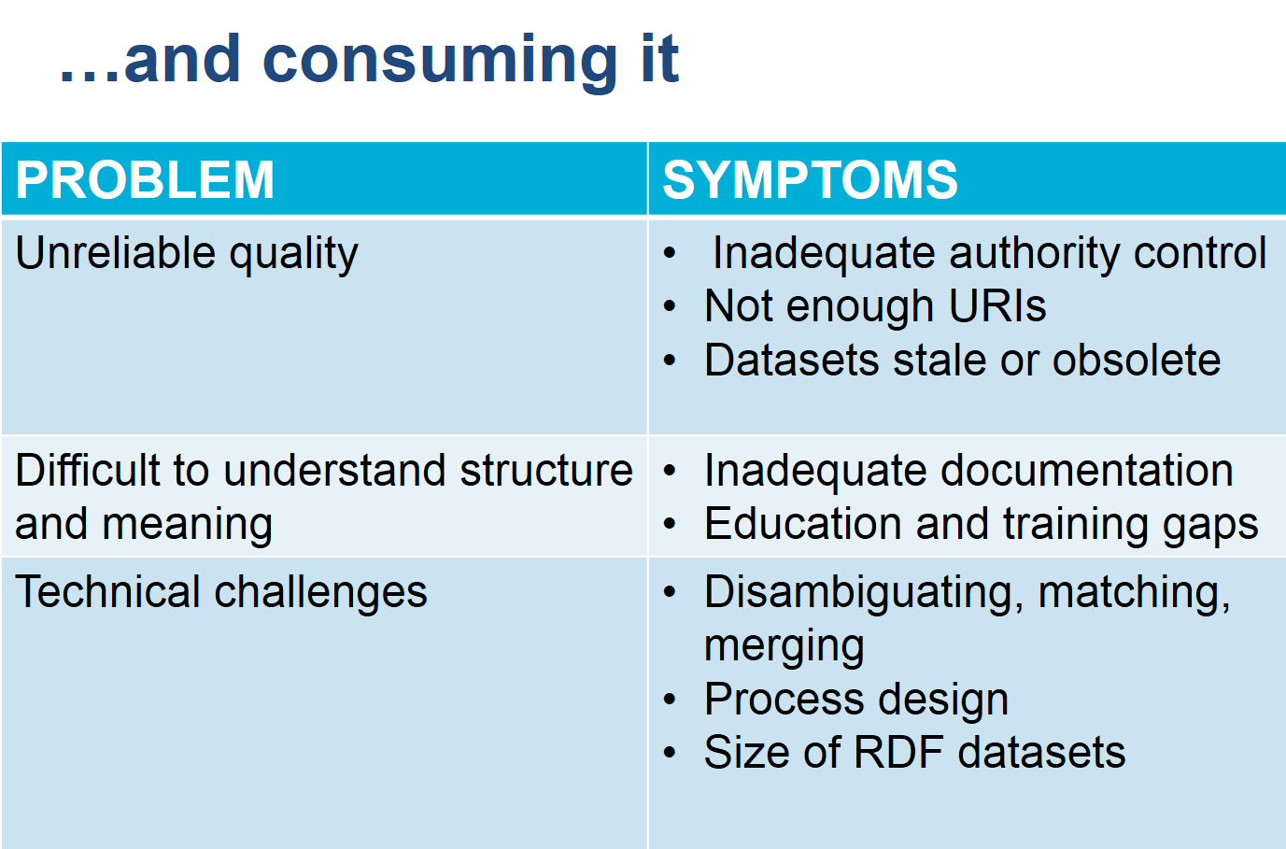
Barriers to publishing linked data
Steep learning curve
Inconsistent legacy data
Challenges with:
  selecting appropriate ontologies to model data
  establishing links
Little documentation or advice on how to build systems
Source: Karen Smith-Yoshimura
Notes:
Publishing and consuming linked data: issues with maturity and learning curves for new technology stacks and workflows.

Slide 21
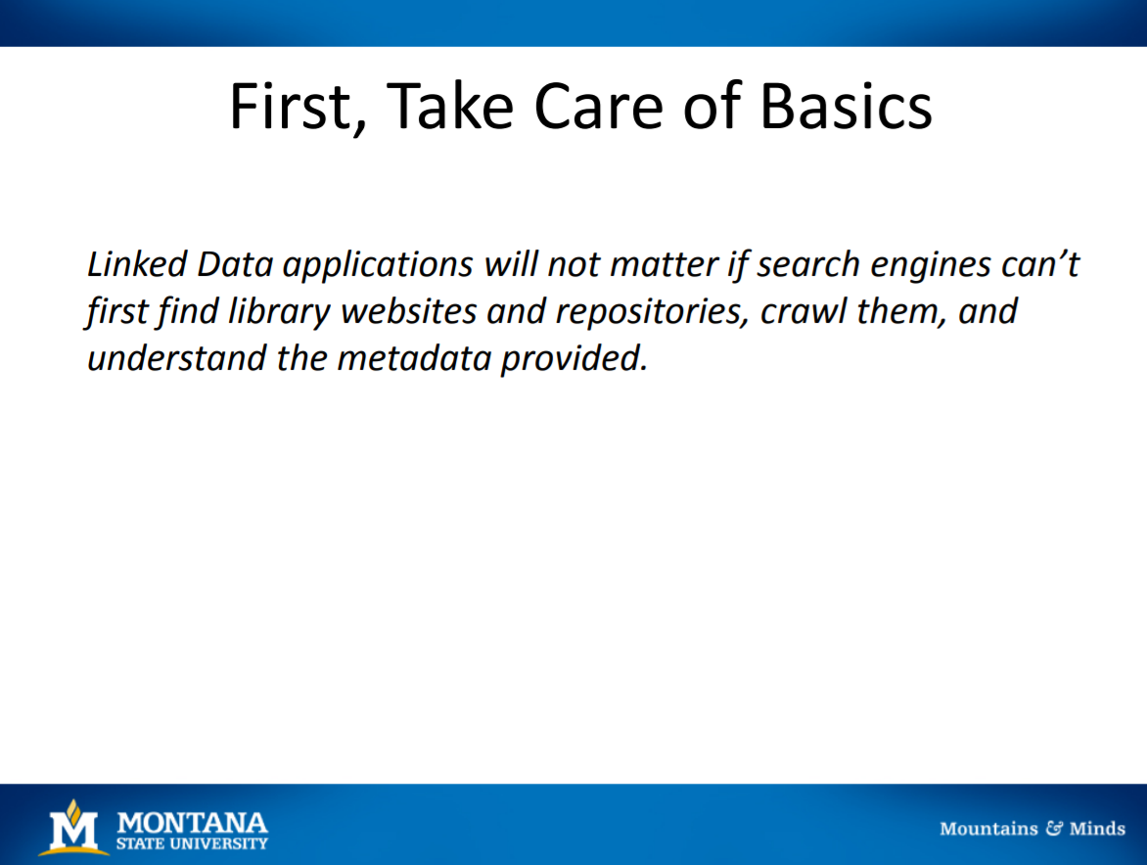
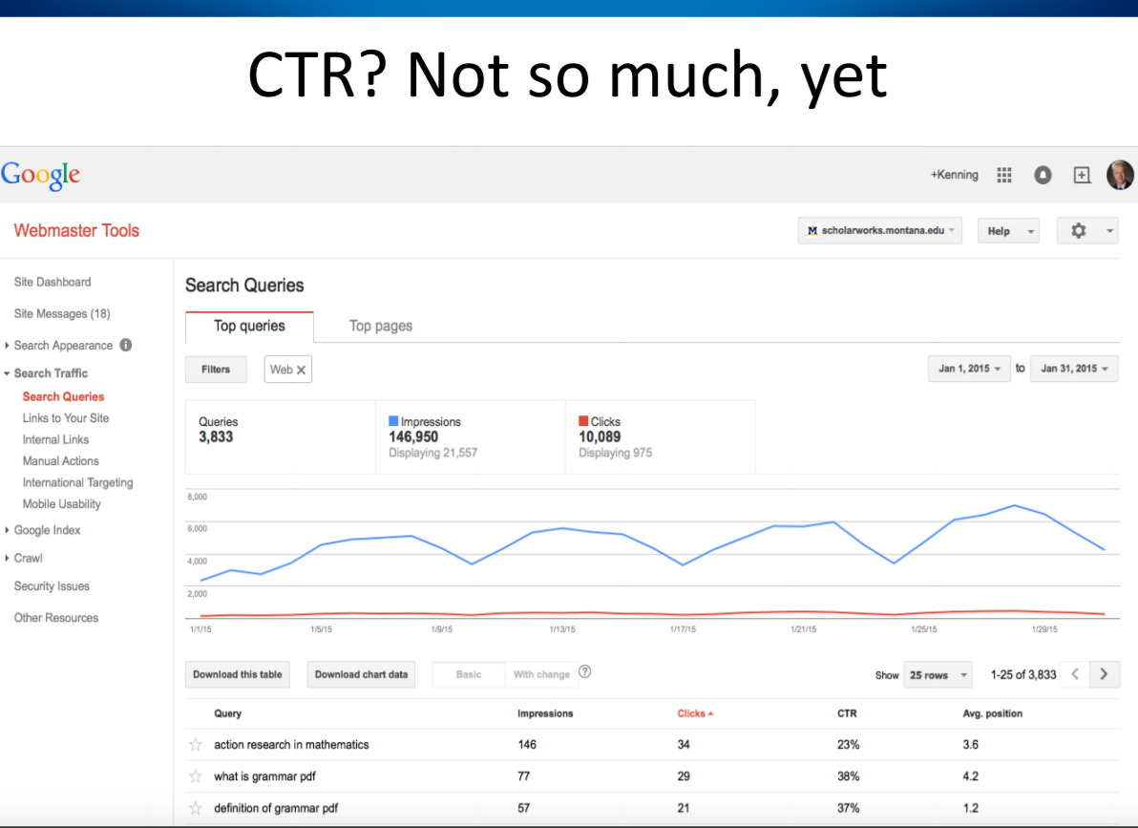
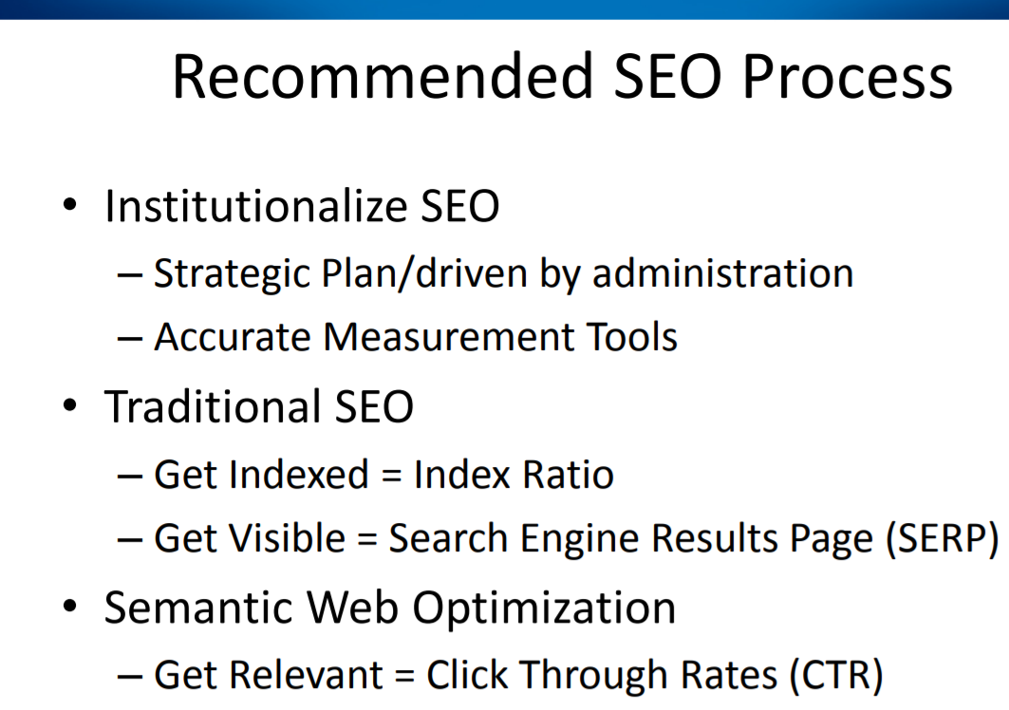
“Walk Before You Run: Prerequisites to Linked Data” – Kenning Arlitsch, 2015
Notes:
Another sober realization. Increased visibility of libraries on the web is one of the most important reasons for adopting linked data. But there are no quick wins.
--This is a lesson from the research program being conducted by Kenning Arlitsch, Dean of Libraries at Montana State University. A recent presentation:
https://www.oclc.org/content/dam/oclc/events/2015/CI_SFPL_PPTS/Arlitsch-OCLC-NCTPG_2015-02-10.pdf
--Arlitsch’s research shows that SEO improvements using linked data must be embedded in a traditional SEO program, which first tries to configure pages for crawling, use vocabularies that search engines understand. Once done, pages can be optimized to identify and describe entities, which are more likely to attract increased click-through rates.
--But preliminary tests showed that the improvements were not dramatic.

Slide 22
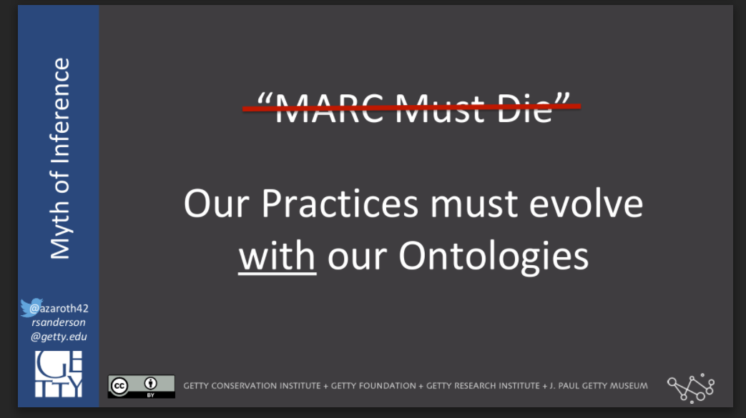
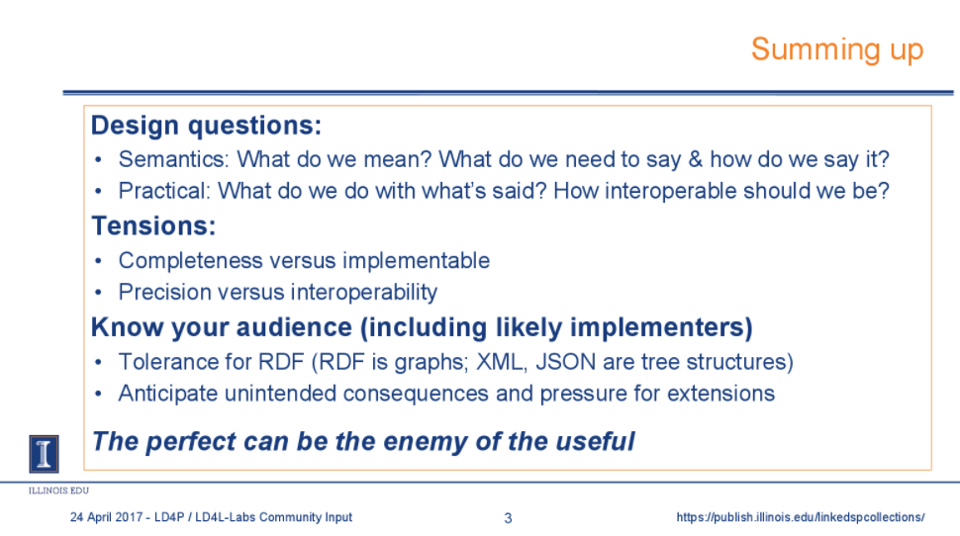
Source: Rob Sanderson 2017: “Myth of Inference”
Source: Tim Cole.
“What I learned (the hard way) from the Web Annotation Working Group”
Notes:
Slides from a Linked Data for Production meeting in April 2017 [Mellon-funded initiative to Harvard, Cornell, Columbia, Princeton, Library of Congress] .
Executive summary: https://wiki.duraspace.org/pages/viewpage.action?pageId=83232681
Slides available here: https://wiki.duraspace.org/display/LD4P/Community+Input+Meeting+Agenda%2C+Presentations%2C+and+Meeting+Notes
--Long-term goal: define resource-creation workflows involving linked data expressed in BIBFRAME. Shorter-term goal: ontology development.
It turns out that ontology development is more difficult and frustrating than originally envisioned.
--Rob Sanderson (a prominent ontologist in the library community, now working for the Getty): Where we’re going must be informed by where we came from. We can’t start from scratch.
--Tim Cole (Professor of LIS working at UIUC’s Grainger Math Library): We need more rigorously structured data, but analysis paralysis is a clear and present danger.

Slide 23
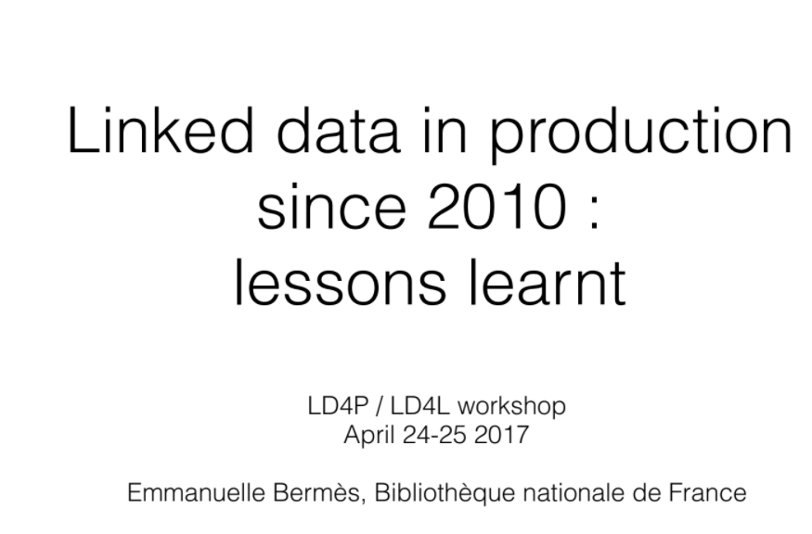
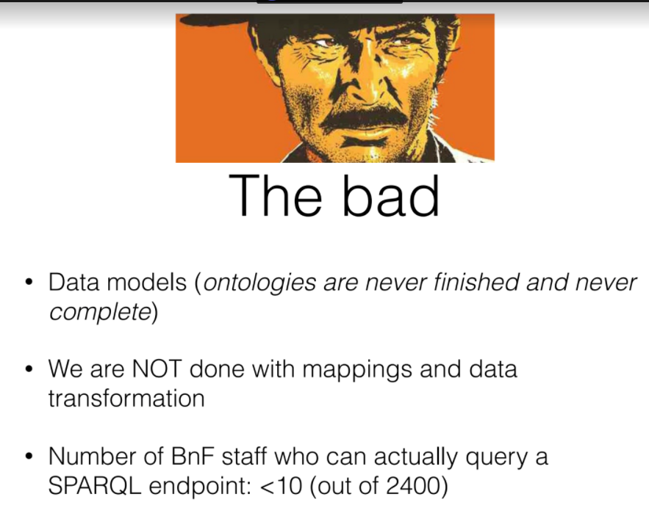
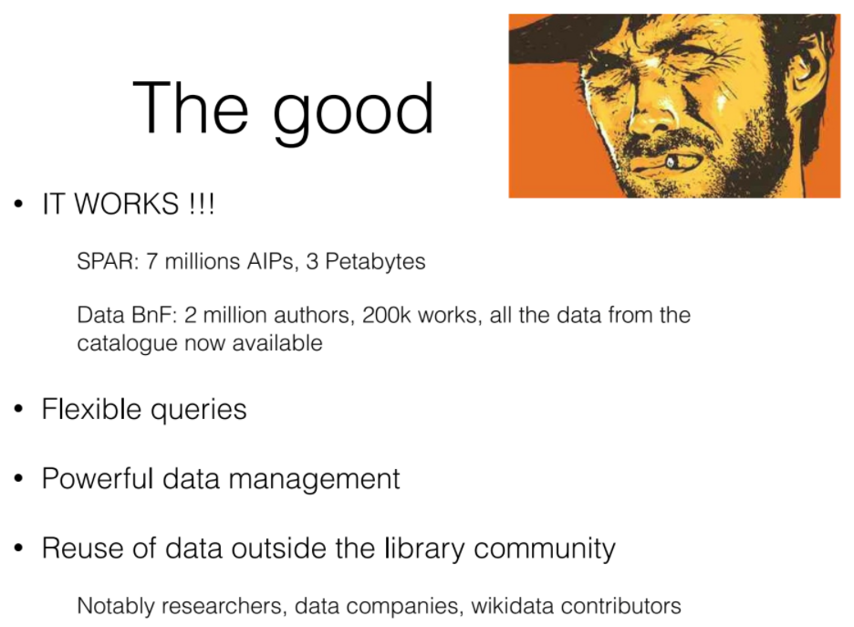
Source: Emmanuelle Bermès
Notes:
It gets worse. [slides]
…The Bermès presentation doesn’t omit “the ugly”. As she said, only 2 companies in France have the technical skills to assist in development; only 1 library can consume the data. Data replication and updates are “still a nightmare”.
--As a result, the BNF is not planning to publish RDF directly, either in cataloging or digitization workflows. They will add URIs to a version of MARC instead.
The BNF report represents a significant retrenchment.
…technically, the work is a success, but the climate simply isn’t right for wider adoption.
…data.bnf.fr is one of the 10 most widely used linked datasets according to Karen Smith Yoshimura’s 2015 survey.
…when it was introduced, it was a celebrated advance, which enabled interoperability among library silos and drove traffic to the BNF OPACs from web search engines.

Slide 24
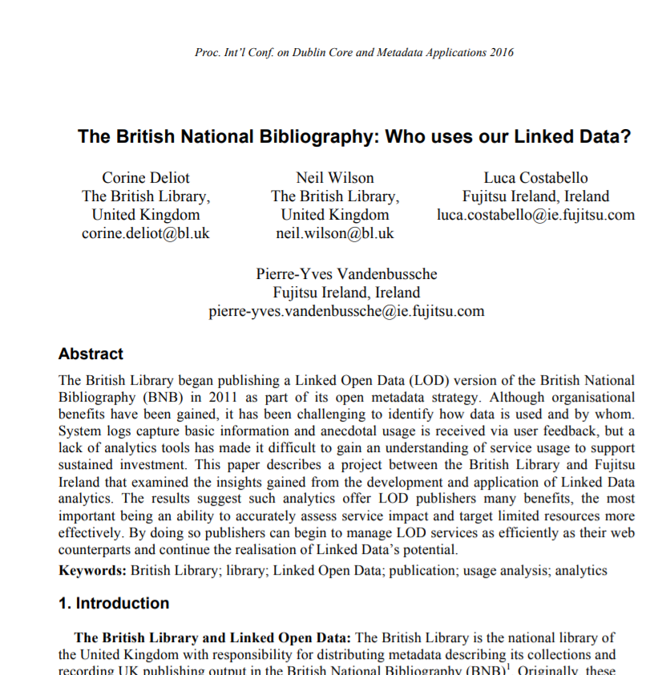
Bottom line
Nearly two thirds of the usage is by human readers--not machine access through the SPARQL endpoint.
…and most are first-time visitors.
Notes:
A similar conclusion was reported in 2016 by the British Library.
--The BL RDF dataset describes over 3 million resources included in the British National Bibliography.
--When it was introduced in 2011, this work was hailed as a major technical and conceptual advance in library linked data.
--It was nominated to be a component in the British national data infrastructure, according to news reports at the time.
--It had a big impact on our work at OCLC.
--[It showed significant progress on the “creative work” problem.]
--But according to the BL 2016 report, usage analytics imply only casual interest, not [yet] a sustained commitment.

Slide 25
[BIBFRAME] Discussion: Feb. 2017
“There are no there are no technical obstacles for
the success of BIBFRAME, only economic and political ones.”
“In my view, those obstacles are insurmountable, and
that's precisely why I posited that ‘BIBFRAME will fail’”.
“…too
conceptual”
“No killer app”
“BIBFRAME is a very complex thing to develop.…Cataloging librarians are very meticulous…and hard to please. BiBFRAME has to become perfect through use and continuous effort. It will never work in a vacuum like now. Someone has to start using it. There is no way turning back at this point.”
Notes:
From a discussion on the LC BIBFRAME list in February 2017. A collective airing of concerns about the transition from MARC to linked data. Given the venue, much of the commentary was about BIBFRAME, but the general theme was an effort to “get real” about the library community’s embrace of linked data as a replacement for MARC.
Add to this outburst a litany of complaints that are not so easy to document because they are aired in private. They reveal a discomfort with the openness and freeness of linked data, and the fundamental technical transformation it presumes. For example:
“*We’re* the experts. Links to Wikipedia would just pollute our data.”
“Curating a high-quality dataset is expensive. We can’t give it away for free.”
“Our systems can’t be dependent on somebody else’s data. What guarantee do I have that it will be maintained?”
“What does linked data do better/cheaper/faster than our current data?”

Slide 26
What’s next?
Notes:
Overall, the issues revealed in the “trough of disillusionment” fall into several categories. All contribute to the impression that we are stuck, that momentum has stalled, that we have encountered headwinds and turbulence.
--Depth of adoption. Researchers and other early adopters see the promise of linked data and have demonstrated technical proof of concept, but have not won widespread participation or endorsement.
--Unanticipated difficulties introduced by the new paradigm. (“Ontology development is hard!”)
--Unproven ROI. (“No killer app!”)
So, what’s next? The rest of the Gartner curve has two inflection points, and if we are emerging from “the trough”, we are closer to the first than the second. The slope of enlightenment, not the plateau of productivity. I think we are entering a new burst of activity, which has been informed and shaped by the reality check.

Slide 27
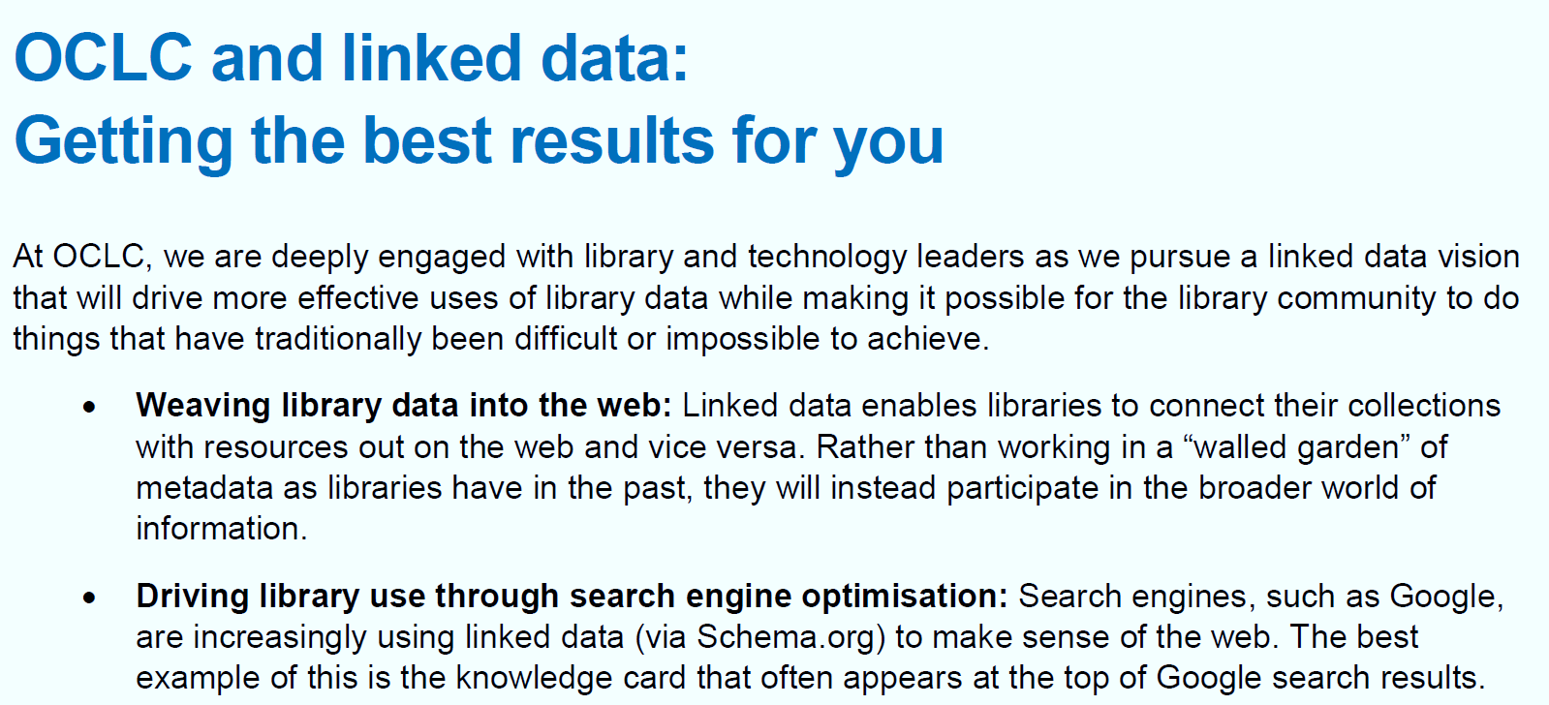
…“Understanding the challenges”
  Producing linked data requires more than simply converting records.
  Putting library linked data on the web is important, but it is not a panacea.
  One standard does not fit all.
“While we believe that linked data representations will eventually become the de facto standard, we also believe that MARC will continue to be used by the library community for many years to come. “
https://wiki.dnb.de/display/EBW/Documents+and+Results
Notes:
https://wiki.dnb.de/display/EBW/Documents+and+Results
This view is consistent with OCLC ‘s public position on linked data. In September 2017, OCLC published the strongest public statement in support of linked data to date. Because of our experience to date, we understand some of the challenges and have learned some important lessons. But because of the technical successes we have already witnessed, plus the sense that the library community’s current standards are bumping up against intractable problems, we at OCLC are formally committed to the view that linked data will become the de-facto standard. And we are working to make it so.
We now have a better understanding of the more nuanced environment required to move research to production. It’s much more complex than a set of legacy datasets that can be converted to a new format. That complexity includes the realization that MARC will be part of our data landscape for the foreseeable future.

Slide 28
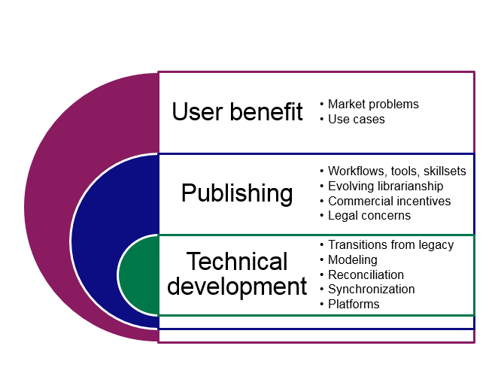
A more ambitious scope?
Semantic Web tools assessment
Technical proof of concept
Data publishing at scale
That was then:
This
is
now:
Notes:
“Then.” The work in the early days was focused on technical proof of concept. The tasks represented an orderly march through software-engineering milestones. It was tightly scoped. But these were big jobs, and success wasn’t guaranteed.
--How well do linked data principles fit with the design and use of the library community’s public data?
--To what extent could library data be transformed to RDF?
--How mature is the semantic web technology stack? RDF, triplestores, real-time search and retrieval, etc.
--The technology passed inspection. Sure, it was hard to use, but a few clever ontologists and engineers managed to create process flows that produced linked data at scale and an environment for accessing it.
“Now.” We learned that it wasn’t enough to publish RDF datasets converted from legacy. The path to adoption is embedded in a more complex environment that includes human and institutional factors both inside and outside the library community
--This is a much bigger space, and we are only sampling it. But the conversation could not have advanced to this point if earlier technical successes hadn’t given us something to discuss.
--I will briefly illustrate some of the problems now being addressed in the categories shown here.

Slide 29
Technical development
in a richer context

Slide 30

On the Critical Path: Entity Reconciliation
Albert Einstein
?
Name Authority File 1
Эйнштейн,
Альберт.
“Same As”
Name Authority File 2
A. Einstein
Web resource 1
Albert Einstein
Einstein
…(14 March 1879 – 18 April 1955) was a German-born theoretical physicist. Einstein developed the theory of relativity, one of the two pillars of modern physics (alongside quantum mechanics).
…
Web resource 2
Source: Wikipedia
Notes:
A consensus emerging from discussion in many contexts is that entity reconciliation is *the* key technical problem. Linked Data for Production, OCLC, other service providers, many individual projects being conducted at libraries, even Google agree. Reconciliation is a new problem that emerges only when lots of linked datasets are being published.
Left: Albert Einstein: a globally important entity. Right: sources of information containing his name in various forms. Middle: a process that determines that the name strings and associated descriptions on the right all refer to the person on the left. This is “reconciliation”. Two extensions: define new entities [that are locally by not yet globally important]. Expand the network of facts of relationships [as the Nature SciGraph dataset does].
Why it’s important:
To make unlock the richness of legacy data to machine processes.
To design workflows for describing new things.
To integrate library data with the broader web.
This is how we get from databases of records understandable only to libraries to sets of broadly understandable facts about identities or things of interest. And it’s a multidimensional problem that involves data conversion, modeling, workflow design, and support by institutions outside our own walls.

Slide 31
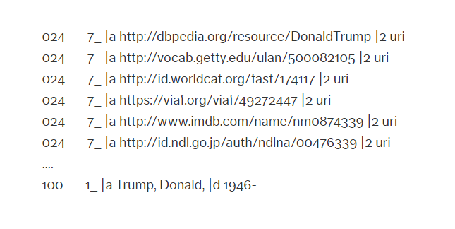
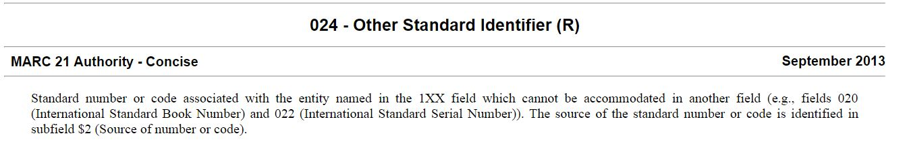
http://id.loc.gov/authorities/names/n85387872
… What does this URI refer to?
The person?
The heading?
“Trump, Donald, 1946-”
The concept?
“...entity named in the 1xx field”
Notes:
LC NAF file. https://lccn.loc.gov/n85387872
But what’s so new about reconciliation? Isn’t it an established practice in library authority control? The LCNAF record for Donald Trump shows that the library community has already been doing reconciliation. The 024 fields contain additional identifiers, including URIs, for the “entity” named in the 1xx field.
But which entity? This decision matters, because it has a big effect on the machine-understandable statements that can be made. Is the *concept* with the preferred heading “Donald Trump, 1946—” the president of the United States? Or is it the *person* named Donald Trump? By raising these questions, we are making demands of the data that MARC was not designed for. Because the human reader could figure it out. Or at least tolerate some vagueness.
The messiness in this example is also a reminder that:
...The data simply can’t be converted mechanically. It’s too ambiguous. It doesn’t encode a “settled” ontology that can simply be exposed as linked data. We have to do the hard work of defining a more useful ontology.
...It doesn’t make sense to maintain the status quo of our legacy standards. We have to start there, but now we can do better. Linked data forces us to be more rigorous about the assertions we are making.

Slide 32
Cultural factors in
data publishing
Notes:
With the issue of entity reconciliation, at least, it’s easy to glide into the next category in our expanded landscape…publishing data so it can be consumed. This category has more human factors. What is the workflow? Who will do the work? What skills must they have? On a deeper level, we must ask: what principles of librarianship govern what should be done and why?

Slide 33
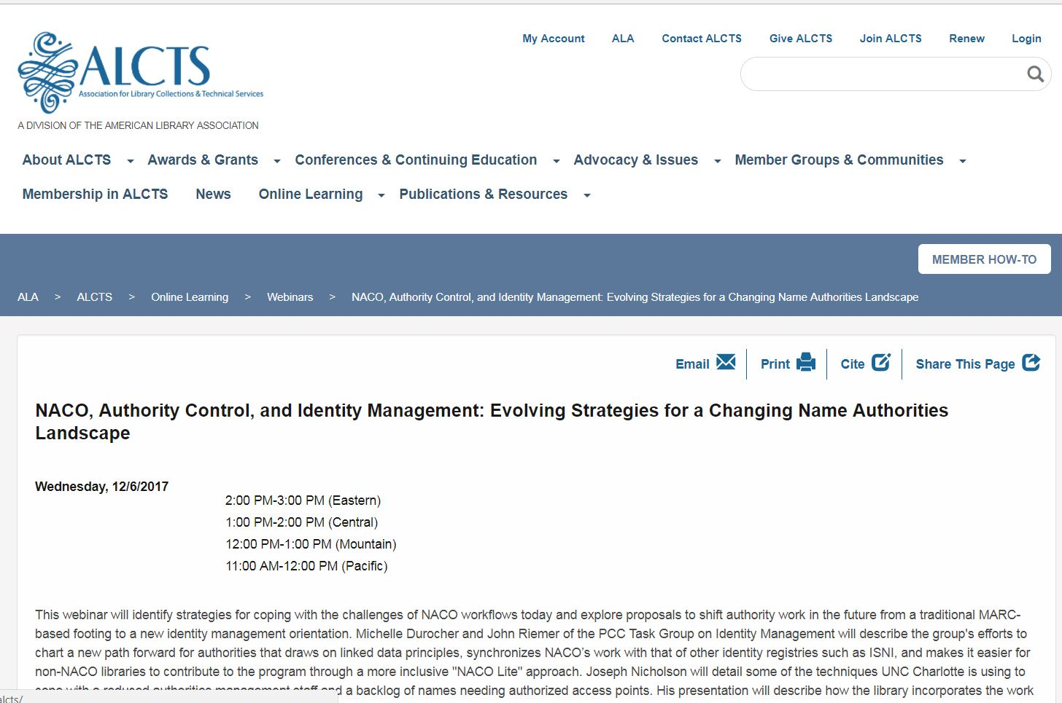
“This webinar will identify strategies for coping
with the challenges of NACO workflows today
and explore proposals to shift authority work in
the future from a traditional MARC-based footing
to a new identity management orientation….”
Notes:
It turns out that reconciliation is evidence of a major shift of focus in library descriptive practice. That’s why this task is so challenging. The practice of authority control is evolving from the management of headings to the management of identities. The implications of this shift will be the subject of a webinar presented by members of the PCC-Identities task group later today.

Slide 34
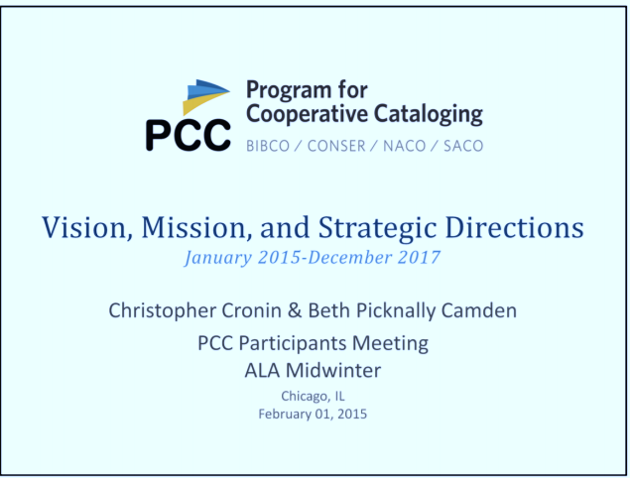
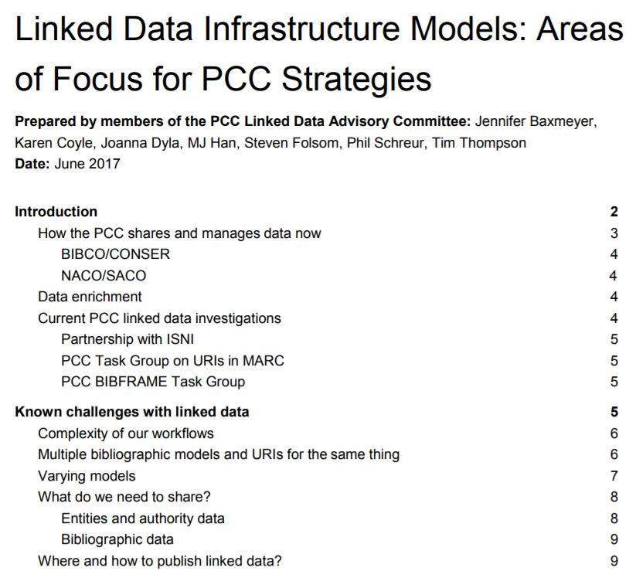
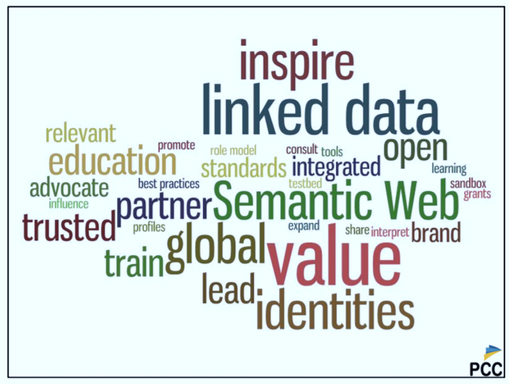
Notes:
https://www.loc.gov/aba/pcc/documents/LinkedDataInfrastructureModels.pdf
--The issues I have just discussed represent one strand of work sponsored by the Program for Cooperative Cataloging [PCC], which has invested heavily in library linked data and is assuming an expanded role in coordinating it.
--The current 3-year planning cycle has just ended. The results are a position paper on Works, and approved proposals for the inclusion of linked-data URIs in MARC bibliographic records.
--A position paper for the next 3-year cycle has already been prepared and discussed. It covers many of the themes I have highlighted today.

Slide 35
Changing Resource Description Workflows
Today
Tomorrow
Original cataloging
Copy cataloging
Library authority control
Entity description
Link management
Vocabularies from many sources
Notes:
This effort is focused on preparing for changes that are already on the horizon.

Slide 36
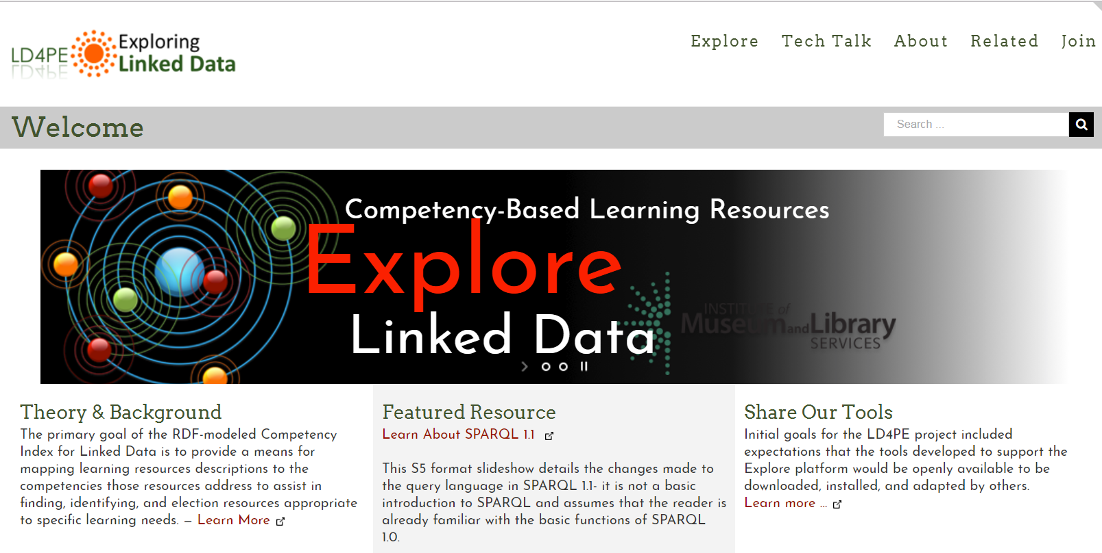
LD4PE:
Linked Data for Professional Educators
Notes:
http://explore.dublincore.net/
Those on the front lines of know about the implications of linked data for resource description workflows and are helping shape what comes next. For new practitioners, the PCC [in conjunction with DCMI] has developed an ontology of linked data competencies, from which a teaching & learning curriculum can be devised. That addresses one of the concerns raised in the Karen Smith-Yoshimura’s survey results mentioned earlier: that the barriers to entry are too high, and too few can participate.

Slide 37
Benefits for users
Notes:
In closing, a few comments about consuming linked data to deliver tangible benefits to users.
--I’ve described a larger context, in which the exploration of linked data is more than a format conversion. More than a fancier data-management solution.
--As a community, we still have long way to go to achieve critical mass, but linked data has always carried with it the potential to deliver something richer than what our data can do now.
--So far, we have not capitalized enough on that opportunity. We need to target our efforts strategically, and address difficult or even intractable problems that elude current solutions.
--But we can only do so by realizing the true promise of linked data and breaking out of the library’s walled gardens and truly integrating our data with resources on the broader web.

Slide 38
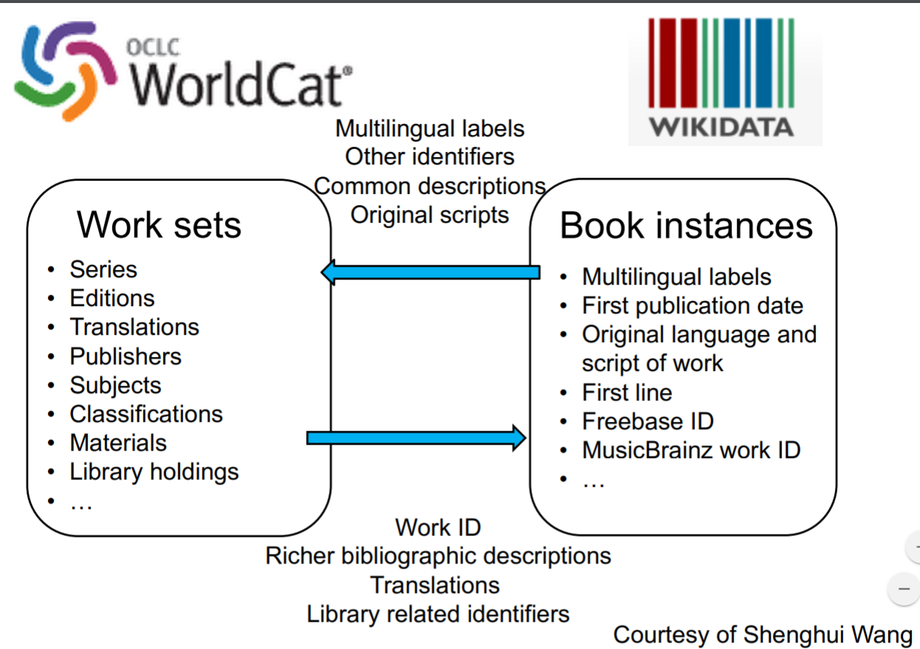
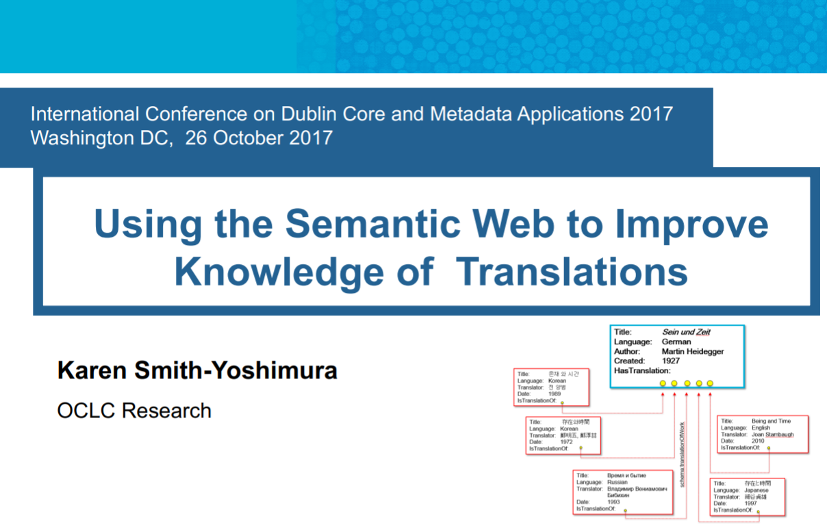
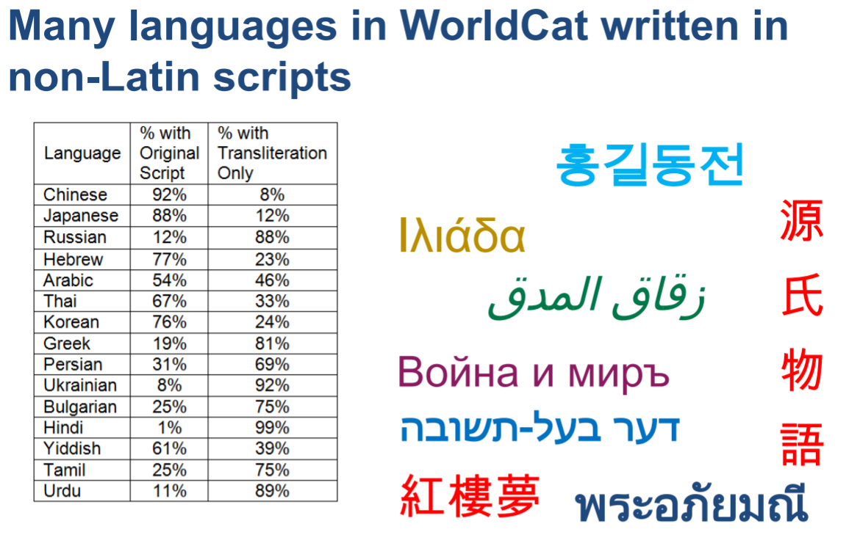
Notes:
cevents.dublincore.org/IntConf/dc-2017/paper/viewFile/496/609
--A growing body of work by Karen Smith-Yoshimura and her colleagues about works that have been translated.
--The intractable problem: translated works can be described in MARC, but because of differing cataloging traditions and a heavy reliance on strings, the data is tough to sort out. It’s barely usable.
--But the inadequacies of our data can be fixed by importing from Wikidata. If we do that, we don’t have to fix all of the records we already have. We don’t have to undertake a massive and expensive retrospective conversion project to remediate what has already been done.
--Much can be learned from Wikidata’s descriptions of works and their translations, but one of the most significant fixes would upgrade MARC’s transliterations to the original scripts collected in Wikidata. With this improvement, readers of languages other than English could search library resource descriptions for authors, titles, and translators in their preferred language and script. Transliterations don’t work as well because most information-seekers are unfamiliar with them.
--The innovations introduced by Wikidata can be imported into descriptions created in the library community because Wikidata contains OCNs, VIAF, and other library-community identifiers.

Slide 39
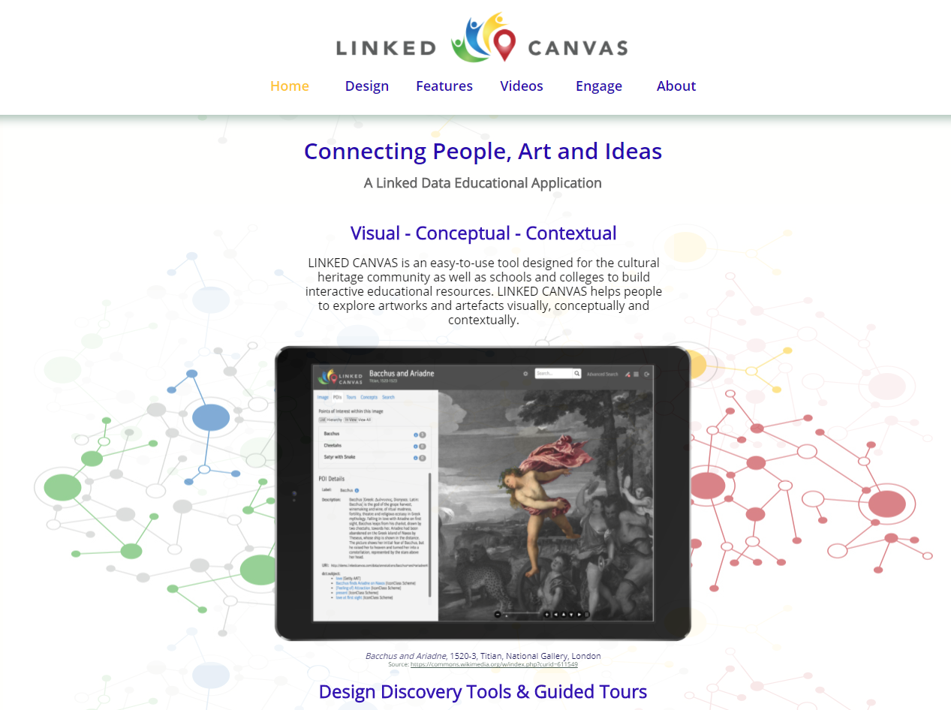
Notes:
http://linkedcanvas.org/
Linked Canvas is product offered by Synaptica, whose founder and CEO rang alarm bells about the post-truth world, which I mentioned earlier. It demonstrates the kind of integration, and a deeper awareness of context I have been discussing. The project occupies a linked-data sweet spot:
--Libraries and lots of other communities of practice have interesting things to say about art objects.
--Digitized objects are not described very well in existing library standards.
--Visual navigation for cultural heritage objects is not as engaging to users as it should be.
--These materials contain a wealth of identities that are not described at all in traditional library authority files.
--and the result is visually beautiful!
Fortunately, new standards are being developed to support digitized objects, and they’re based on linked data. [One example: the International Image Interoperability Format – IIF. http://iiif.io/]
Synaptica is taking advantage of these new standards, but so are other projects in the digital humanities and related disciplines. I’ll be bold and make a prediction: this is where the first killer apps for library linked data will come from. Watch this space.

Slide 40
Thank you!
Jean Godby
Senior Research Scientist
godby@oclc,org

