Slide 1
Can Quantitative Social Scientists Get Data Reuse Satisfaction?
Research Data Access & Preservation Summit 2013, April 4-5, 2013
Baltimore, MD
Ixchel M. Faniel, Ph.D.
Elizabeth Yakel, Ph.D.
Adam Kriesberg
Morgan Daniels
Postdoctoral Researcher OCLC Research
fanieli@oclc.org
Professor University of Michigan
yakel@umich.edu
Ph.D. Students University of Michigan
akriesbe@umich.edu
mgdaniel@umich.edu

Slide 2
Agenda
Introduction to the DIPIR Project
Survey of ICPSR Data Reusers
Theoretical Frame
Our Model
Findings
Discussion
Next Steps

Slide 3
Institute for Museum and Library Services (IMLS) funded project led by Drs. Ixchel Faniel (PI) & Elizabeth Yakel (co-PI)
Studying the intersection between data reuse and digital preservation in three academic disciplines to identify how contextual information about the data that supports reuse can best be created and preserved.
Focuses on research data produced and used by quantitative social scientists, archaeologists, and zoologists.
The intended audiences of this project are researchers who use secondary data and the digital curators, digital repository managers, data center staff, and others who collect, manage, and store digital information.
For more information, please visit http://www.dipir.org

Slide 4
The Research Team
DIPIR Project
Nancy McGovern
ICPSR/MIT
Ixchel Faniel
OCLC Research
(PI)
Eric Kansa Open Context
William Fink UM Museum of Zoology
Elizabeth Yakel University of Michigan (Co-PI)

Slide 6
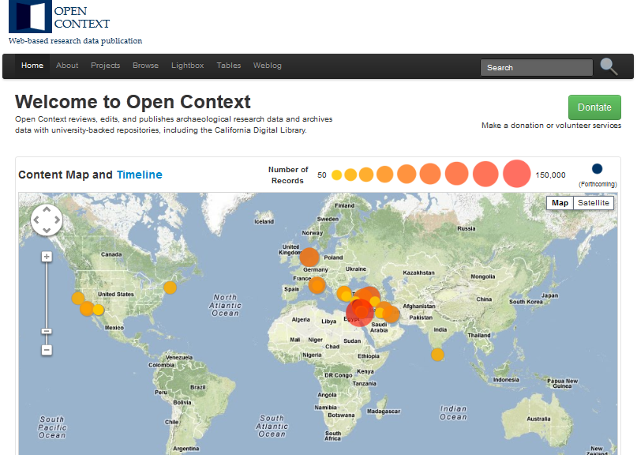

Slide 8
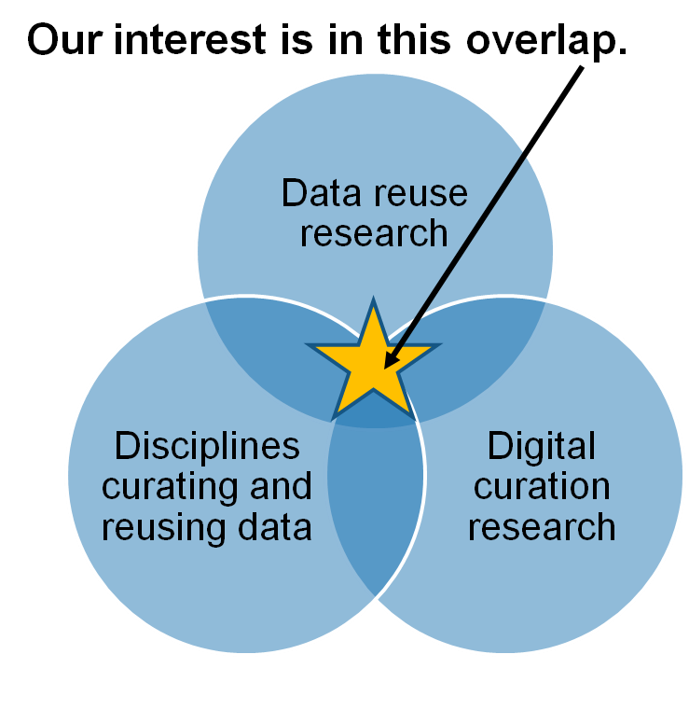
Research Motivations & Questions
What are the significant properties of quantitative social science, archaeological, and zoological data that facilitate reuse?
2. How can these significant properties be expressed as representation information to ensure the preservation of meaning and enable data reuse?
Faniel & Yakel 2011

Slide 9
Methods Overview
 | ICPSR | Open Context | UMMZ
Phase 1: Project Start up
Interviews Staff | 10 Winter 2011 | 4 Winter 2011 | 10 Spring 2011
Phase 2: Collecting and analyzing user data
Interviews data consumers | 44 Winter 2012 | 22 Winter 2012 | 27 Fall 2012
Survey data consumers | Over 1,600 Summer 2012
Web analytics data consumers |  | Server logs Ongoing
Observations data consumers |  |  | 10 Ongoing
Phase 3: Mapping significant properties as representation information

Slide 10
A Survey of ICPSR Data Reusers
Measuring Data Repository Success

Slide 11
Theoretical Framework
DeLone and McLean Information Systems (IS) Success Model
Information Quality
Intention Use to use
System Quality
Net
Benefits
User
Satisfaction
Service Quality
(DeLone & McLean, 2003)

Slide 12
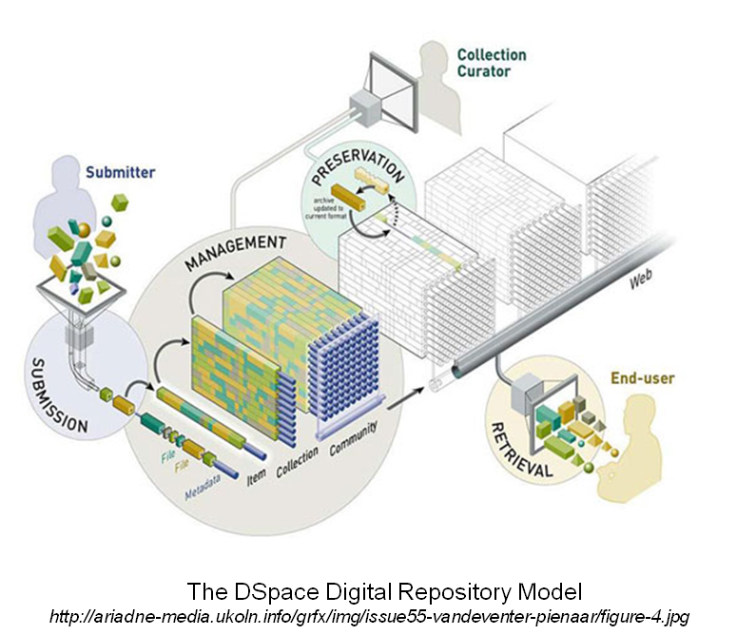
Measuring Repository Success
Survey of ICPSR Data Reusers - Part 1
What data quality
indicators contribute
to quantitative social
scientists’ data reuse
satisfaction?

Slide 13
Data Quality Indicators
ICPSR Survey of Data Reusers – Part 1
Completeness – sufficiency, breadth, depth, and scope of the data for the task
Relevancy – applicability and helpfulness of data for the task
Accessibility – ease and speed data were retrieved
Ease of Operation – ease data were managed and manipulated
Credibility – correctness, reliability, impartiality of data
(Wang and Strong, 1996; Lee et al., 2002)

Slide 14
Additional Quality Indicators
ICPSR Survey of Data Reusers – Part 1
Data Producer Reputation – regard for a data producer’s work
Documentation Quality – sufficiency and ability to facilitate use of the data

Slide 15
ICPSR Survey of Data Reusers – Part 1 (The Conceptual Model)
Data Producer Reputation
Data Ease of Operation
+
Data Credibility
+
+
+
Data Accessibility
Data Reuse Satisfaction
+
Data Completeness
+
+
Data Relevancy
Documentation Quality

Slide 16
Survey Methodology
Data Collection
1,632 first authors of published journal articles 2008-2012 surveyed
The Survey
Part 1: inquire about data reuse experience
Part 2: inquire about experience using ICPSR repository and intention to continue use

Slide 17
Findings: Descriptive Statistics
Variable Name | Mean | Std. Deviation | Cronbach’s Alpha
Data Completeness | 5.68 | 1.07 | 0.76
Data Relevancy | 6.50 | 0.58 | 0.75
Data Accessibility | 5.95 | 1.15 | 0.87
Data Ease of Operation | 5.93 | 1.14 | 0.86
Data Credibility | 6.23 | 0.66 | 0.79
Data producer reputation | 6.27 | 0.91 | 0.84
Documentation quality | 6.04 | 0.77 | 0.84
Data reuse satisfaction | 6.30 | 0.89 | 0.80
n = 254

Slide 18
Findings: Multiple Regression Analysis
Data Producer Reputation
Data Ease of Operation
.110*
.098
Data Credibility
.034
.303***
Data Accessibility
Data Reuse Satisfaction
Data Completeness
.278***
.113
.118*
Data Relevancy
Documentation Quality
*p < .05, ***p < .001

Slide 19
Discussion
ICPSR Survey of Data Reusers - Part 1
Tested measures of repository success
Extended ideas about data quality beyond credibility and relevance of data
Data reuse satisfaction requires data that are complete, accessible, and easy to operate
Data producer reputation was not significant
Documentation quality played a role if data reuse satisfaction

Slide 20
Next Steps – Continued Analysis
ICPSR Survey of Data Reusers – Part 1
How do other variables impact our model?
Journal impact factor
Prior data reuse experience
Nature of reuse
Prior ICPSR contributions
Data scarcity
Reuse dependence

Slide 21
Acknowledgements
Institute of Museum and Library Services
Partners: Nancy McGovern, Ph.D. (MIT), Eric Kansa, Ph.D. (Open Context), William Fink, Ph.D. (University of Michigan Museum of Zoology)
Students: Adam Kriesberg, Morgan Daniels, Rebecca Frank, Julianna Barrera-Gomez, Jessica Schaengold, Gavin Strassel, Michele DeLia, Kathleen Fear, Mallory Hood, Molly Haig, Annelise Doll, Monique Lowe

Slide 22
Questions?
Ixchel Faniel
fanieli@oclc.org
Notes:
22
22
22

