Slide 1
ALA Webinar May 18, 2017
Practices Do Not Make Perfect
Ixchel M. Faniel, PhD
Elizabeth Yakel, PhD
Research Scientist fanieli@oclc.org @imfaniel
Professor yakel@umich.edu @yakel
Notes:
This presentation is based on the following publication: Faniel, I.M., & Yakel, E. (2017). Practices do not make perfect: Disciplinary data sharing and reuse practices and their implications for repository data curation. In Curating Research Data, Volume One: Practical Strategies for Your Digital Repository, 103–126. Chicago, Illinois: Association of College and Research Libraries.

Slide 2
Dissemination Information Packages for Information Reuse (DIPIR)
Institute of Museum and Library Services
PI: Ixchel M. Faniel (OCLC), Co-PI: Elizabeth Yakel (University of Michigan)
Partners: Nancy McGovern, Ph.D. (MIT), Eric Kansa, Ph.D. (Alexandria Archive, Open Context), William Fink, Ph.D. (University of Michigan Museum of Zoology), Sarah Whitcher Kansa (Alexandria Archive, Open Context)
OCLC Fellow: Julianna Barrera-Gomez
Doctoral Students: Rebecca Frank, Adam Kriesberg, Morgan Daniels, Ayoung Yoon
Master’s Students: Alexa Hagen, Jessica Schaengold, Gavin Strassel, Michele DeLia, Kathleen Fear, Mallory Hood, Annelise Doll, Monique Lowe
Undergraduates: Molly Haig
The DIPIR Project was made possible by a National Leadership Grant from the Institute of Museum
and Library Services, LG-06-10-0140-10, “Dissemination Information Packages for Information Reuse”
and support from OCLC Online Computer Library Center, Inc., and the University of Michigan.

Slide 3
Methods

Slide 4
Data Collection
 | Archaeology | Zoology | Social Science
Phase 1: Project Start-Up (2011)
Staff Interviews | 4 | 10 | 10
Phase 2: Collecting and Analyzing Reuser Data (2011-2013)
Interviews | 22 | 27 | 43
Observations |  | 13
Survey |  |  | 237
Server log entries | 572,134

Slide 5
findings

Slide 6
DISCIPLINARY TRADITIONS
Social Scientists
50+ years of data reuse, professionalized staff, and repositories
Archaeologists
Face internal and external legal and ethical pressures
Zoologists
Nature of zoological research has transformed and data types increased
Established reuse culture and best practices for curation
Variety of data types, lack of shared practices, dispersion of data and artifacts
Museum curators and staff help prepare and manage specimen data

Slide 7
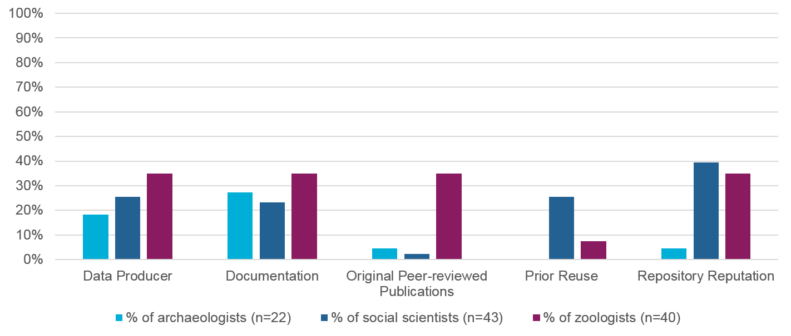
DATA REUSE AND TRUST

Slide 8
Trust Marker: Data Producer
“Whose data do you trust? And it’s primarily…who do you know who does good work. So I go to people from programs that are well known in the field.”
– Archaeologist 13

Slide 9
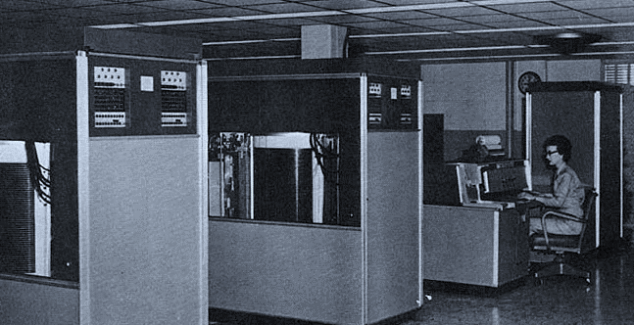
Trust Marker: Prior Reuse
“It has been around since 1968. It’s heavily used. The dataset has been examined for problems like people dropping out of the study…It’s an extremely trustworthy dataset.”
– Social Scientist 27
Notes:
Photo credit: By User:RTC from U.S. Army Red River Arsenal [Public domain], via Wikimedia Commons

Slide 10
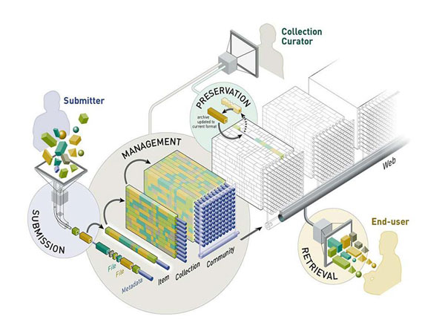
Trust Marker: Repository Reputation
“I’m a lot more trustworthy of academic repositories and academically associated sources of data…they are subject to a lot of scrutiny in the academic community…”
- Social Scientist 14
Notes:
Photo credit: http://www.ariadne.ac.uk/issue55/vandeventer-pienaar

Slide 11
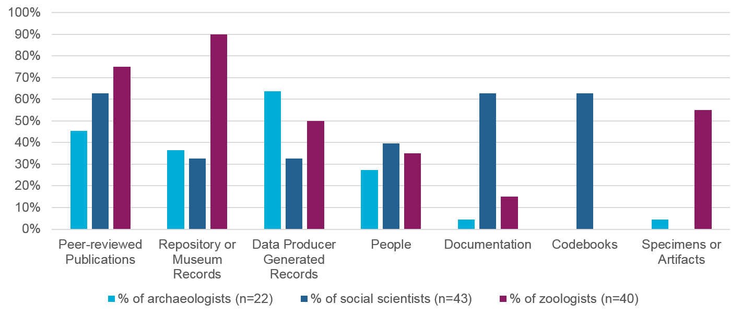
SOURCES OF CONTEXTUAL INFORMATION

Slide 12
Codebooks
“The codebook for me is like; first to get the label of the variable. Second, to get the meaning of the different categories that they have inside the dataset.”
– Social Scientist 29

Slide 13
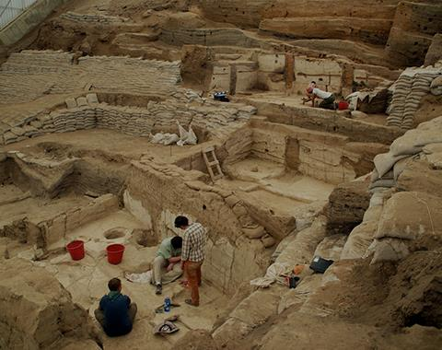
People
I began to realize that I needed two things…. So I arranged to go to Tulsa and spend several days there getting the information I needed.… I sat down with the original excavator with maps and with everything else.… ”
- Archaeologist 09
Notes:
Photo credit: Jason Quinlan (2013). Çatalhöyük. https://www.flickr.com/photos/catalhoyuk/9184503529

Slide 14
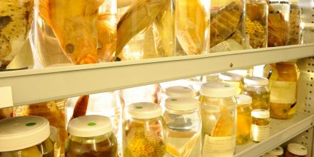
Specimens or Artifacts
“If somebody misidentifies…whatever it is you’re looking at and uploads it to GenBank with an incorrect taxon identifier, that causes downstream problems…. So when I do reuse specimens, I try to…verify that the original person that deposited the DNA sequence had correctly identified the species from which it was taken.”
- Zoologist 19
Notes:
Photo credit (top right): Sonia Fernandez (2015) from Estrada, Andrea. “The Challenge of Measuring a Bird Brain.” Accessed May 27, 2016. http://phys.org/news/2015-06-bird-brain.html at http://phys.org/news/2015-06-bird-brain.html#jCp.
Photo credit (bottom left): Specimens in the Australian National Fish Collection. Image: CSIRO at http://cba.anu.edu.au/research/projects/genetic-characterisation-formalin-preserved-fish-tissue

Slide 15
Implications

Slide 16
Implications for Repository Staff
Researchers’ trust in data is informed by more than their encounters with data.
Data repositories need to provide links to contextual information about data.
People remain an important source of information about data.
Repository staff are key to data reusability, especially when they can intervene early in the data life cycle.

Slide 17
Ixchel M. Faniel, PhD
Research Scientist fanieli@oclc.org @imfaniel
Elizabeth Yakel, PhD
Professor yakel@umich.edu @yakel
©2017 OCLC and Elizabeth Yakel. This work is licensed under a Creative Commons Attribution 4.0 International License. Suggested attribution: This work uses content from Curating Research Data, Volume One: Practical Strategies for Your Digital Repository © OCLC and Elizabeth Yakel, used under a Creative Commons Attribution 4.0 International License: http://creativecommons.org/licenses/by/4.0/.

