Slide 1
79th Annual Meeting of the Society of American Archivists
Research Libraries Roundtable Panel
August 19, 2015
Managing and Curating Data with Reuse in Mind
Ixchel M. Faniel, Ph.D.
Research Scientist
OCLC, Online Computer and Library Center, Inc.
fanieli@oclc.org
Twitter: @DIPIR_Project

Slide 2
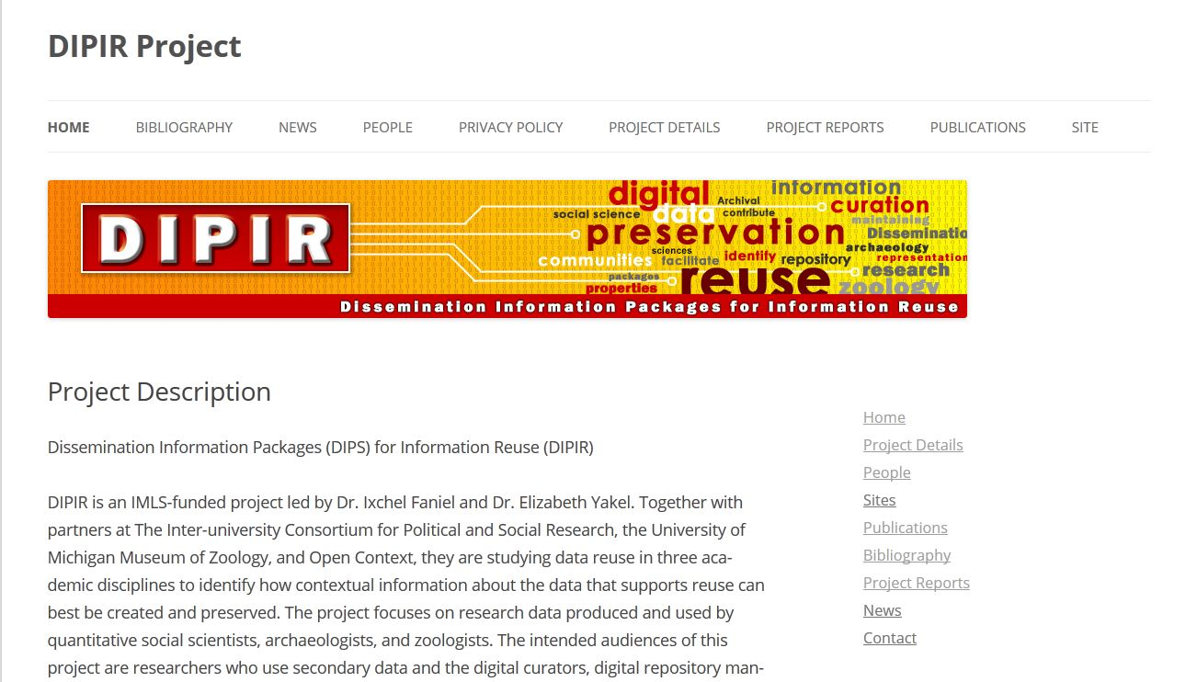
Notes:
Image: http://www.dipir.org

Slide 3
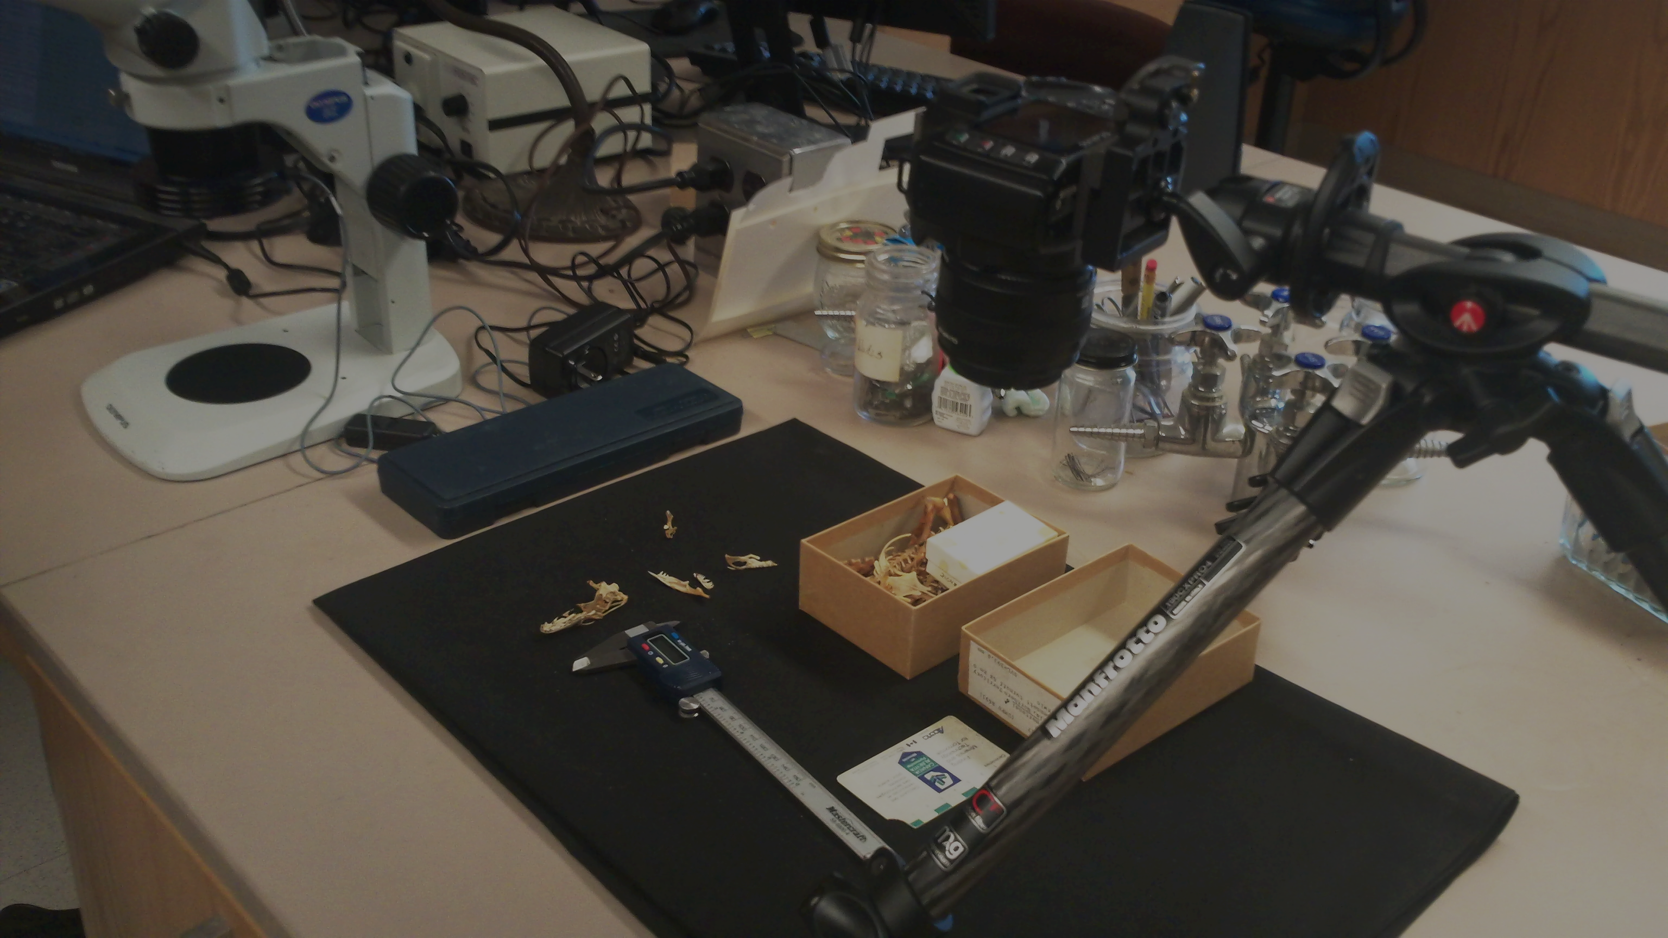
Research Questions: Zoology
“I recently published a paper that provided information on the identification and distribution of all fishes in a particular…taxonomic group, they have four families in a particular region of the world. So I wanted to…say, ‘This is the distribution map for 70 different species. In order to do that, I combined data from…eight different museums…”.
- Zoologist 19
Notes:
Image: DIPIR project team at the University of Michigan Museum of Zoology
Zoologist 19: interview participant for the DIPIR project – http://dipir.org

Slide 4
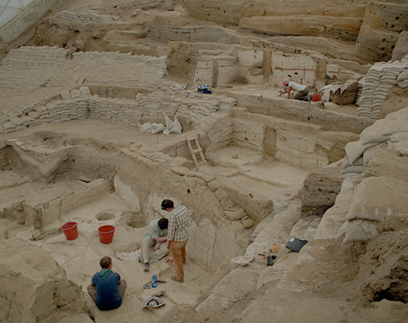
Research Questions: Archaeology
“I’m sort of transitioning from …hunting and herding […] to look at how animals are incorporated into increasingly complex societies […] so the role they play in the emergence of wealth and elites, particularly domestic animals, commodity production and the use of wool as a major foundation for urban economies in the Bronze Age…”.
- Archaeologist 13
Notes:
Image: https://www.flickr.com/photos/catalhoyuk/9184503529
Çatalhöyük Zooarchaeology
Faunal data from Neolithic Çatalhöyük and Chalcolithic Çatalhöyük West, Konya, Turkey.
http://opencontext.org/projects/1B426F7C-99EC-4322-4069-E8DBD927CCF1
Archaeologist 13: interview participant for the DIPIR project – http://dipir.org

Slide 5
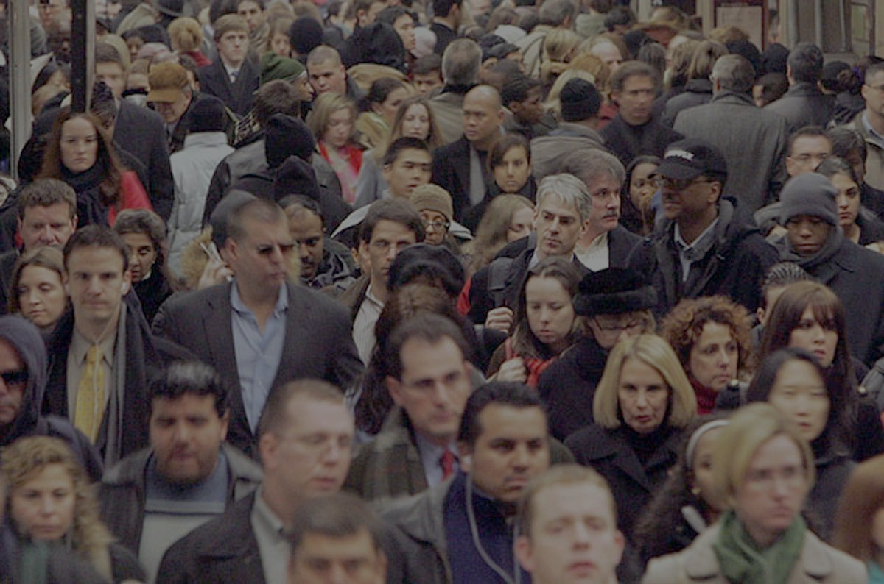
Research Questions:
Social Science
“I primarily look at capital punishment and geographical disparity in death sentencing…so I use like the SHR [Supplementary Homicide Report] and the LEOKA [it’s a report on law enforcement officers killed in the line of duty] to identify capital eligible homicides over time…and then I used the Uniform Crime Report for the violent crime rate. And then I also used a few other datasets through ICPSR…and then I got a lot of data from different agencies like…the Texas Department of Criminal Justice”.
Social Scientist 05
Notes:
Image: Clarity Research http://www.clarity-research.net/
Social Scientist 05: interview participant for the DIPIR project – http://dipir.org

Slide 6
Data consumers’ influence on data management & curation in 21st century archives
Questions asked
Preserving data's meaning
Partnerships formed
Activities pursued

Slide 7
Preserving data’s meaning
“our wolf data are not making a lot of sense…so going back to the field notes sometimes can help you sort out, what were the circumstances under which this animal was collected?” (Zoologist 07).
“seeing the instructions to survey takers and the form that was collected is pretty helpful for understanding why you might get differences between surveys when you’d expect them to be fairly similar” (Social scientist 32).
“Every object has to have a context otherwise it’s meaningless…You need to know where it comes from, how it was acquired, how it was excavated” (Archaeologist 11).
Notes:
Zoologist 07: interview participant for the DIPIR project – http://dipir.org
Social Scientist 32: interview participant for the DIPIR project – http://dipir.org
Archaeologist 11: interview participant for the DIPIR project – http://dipir.org

Slide 8
Influencing questions asked:
IT’S NOT JUST ABOUT CONTEXT
“…you’re combining data, you want to do it in a way where you have some sense of what the terms mean…, which is does the database X definition of time match database Y…”
(Zoologist 07).
“So with the war, the international war stuff, that’s just like straight off operationalizations. My definition, my theory fit the definition of what they were using to code” (Social scientist 02).
“If it’s somebody whose training I don’t know about, I’m going to be less likely to use their dataset because I’m
not sure how reliable it is” (Archaeologist 06).
Notes:
Zoologist 7: interview participant for the DIPIR project – http://dipir.org
Social Scientist 02: interview participant for the DIPIR project – http://dipir.org
Archaeologist 06: interview participant for the DIPIR project – http://dipir.org

Slide 9
Influencing partnerships formed:
IT’S BIGGER THAN THE ARCHIVE
Data Collection
Data Producer
Data Sharing
Data Producer
Data Curation
Repository Staff
Data Reuse
Data Reuser
Notes:
Faniel, I. M., & Yakel, E. (2014, July). Three perspectives on data reuse: Producers, curators, and reusers. Research Data and Curation panel presented at Digital Preservation 2014, Washington, DC. http://www.slideshare.net/oclcr/three-perspectives-on-data-reuse-producers-curators-and-reusers

Slide 10
Influencing partnerships formed:
IT’S BIGGER THAN THE ARCHIVE
Notes:
Faniel, I. M. (2014, October). Delivering research data services: Early experiences in academic libraries. Presented at the E-Research Peer Network and Mentoring Group (ERPNMG) Meeting, 2014 Digital Library Federation (DLF) Forum, Atlanta, GA. http://www.slideshare.net/oclcr/delivering-research-data-services-early-experiences-in-academic-libraries

Slide 11
Influencing activities pursued:
IT’S ALWAYS ABOUT DESIGNATED COMMUNTIES
“now, we follow the same practice of preserving everything directly in ethanol and not using formalin at all. And hopefully, that’s going to be relevant for future use” (UMMZ Staff 11).
“No one has really tackled [providing video data]. And it’s ripe, right now; we’re going to start moving in that direction” (ICPSR Staff 03).
“They want to have something where you can put your data in and it’s citable” (Open Context Staff 02).
Notes:
Daniels, M., Faniel, I., Fear, K., & Yakel, E. (2012). Managing fixity and fluidity in data repositories. In Mai, J. (Ed.), Proceedings of the 2012 iConference (pp. 279-286). New York: ACM. (Awarded 1 of 5 best conference papers)

Slide 12
Data consumers’ influence on data management & curation in 21st century archives
Questions asked
Preserving data's meaning
Partnerships formed
Activities pursued
It’s always about the designated communities
It’s not just
about the
context
It’s bigger than the archive

Slide 13
Acknowledgements
DIPIR Project
Institute of Museum and Library Services
Elizabeth Yakel (Co-PI), William Fink, Eric Kansa, Nancy McGovern, Sarah Whitcher Kansa, Julianna Barrera-Gomez, Rebecca Frank, Adam Kriesberg, Morgan Daniels, Anthea Josias, Ayoung Yoon, Jessica Schaengold, Gavin Strassel, Michele DeLia, Kathleen Fear, Mallory Hood, Annelise Doll, Monique Lowe, Molly Haig
EDOLE Project
Julianna Barrera-Gomez, Lynn Connaway, Alyssa Darden, Erin Hood, Kendra Parson
Notes:
DIPIR: http://www.dipir.org or http://www.oclc.org/research/themes/user-studies/dipir.html
EDOLE: http://www.oclc.org/research/themes/user-studies/e-research.html

Slide 14
Select References
Faniel, I. M., Kriesberg, A., & Yakel, E. (2012). Data reuse and sensemaking among novice social scientists. Proceedings of the Association for Information Science and Technology (ASIS&T), 49.
Daniels, M., Faniel, I., Fear, K., & Yakel, E. (2012). Managing fixity and fluidity in data repositories. In Mai, J. (Ed.), Proceedings of the 2012 iConference (pp. 279-286). New York: ACM. (Awarded 1 of 5 best conference papers)
Faniel, I., Kansa, E., Whitcher Kansa, S., Barrera-Gomez, J., & Yakel, E. (2013). The challenges of digging data: A study of context in archaeological data reuse. Proceedings of the Joint Conference on Digital Libraries (JCDL), 295-304.
Faniel, I. M., & Yakel, E. (2014, July). Three perspectives on data reuse: Producers, curators, and reusers. Research Data and Curation panel presented at Digital Preservation 2014, Washington, DC. http://www.slideshare.net/oclcr/three-perspectives-on-data-reuse-producers-curators-and-reusers
Faniel, I. M. (2014, October). Delivering research data services: Early experiences in academic libraries. Presented at the E-Research Peer Network and Mentoring Group (ERPNMG) Meeting, 2014 Digital Library Federation (DLF) Forum, Atlanta, GA. http://www.slideshare.net/oclcr/delivering-research-data-services-early-experiences-in-academic-libraries
Faniel, I. M. (2014, November). Putting research into context: A scholarly approach to curating data for reuse. Panel presented at the 77th Annual Meeting of the Association for Information Science and Technology (ASIS&T), Seattle, WA. http://www.slideshare.net/oclcr/putting-research-data-into-context-a-scholarly-approach-to-curating-data-for-reuse

Slide 15
Thank you
Ixchel M. Faniel, Ph.D.
Research Scientist
fanieli@oclc.org
Twitter: @DIPIR_Project

