Slide 1
The University of Michigan, School of Information, August 5, 2015
Data Management, Sharing and Reuse: A User’s Perspective
Ixchel M. Faniel, Ph.D.
Research Scientist
OCLC Online Computer Library Center, Inc.

Slide 2
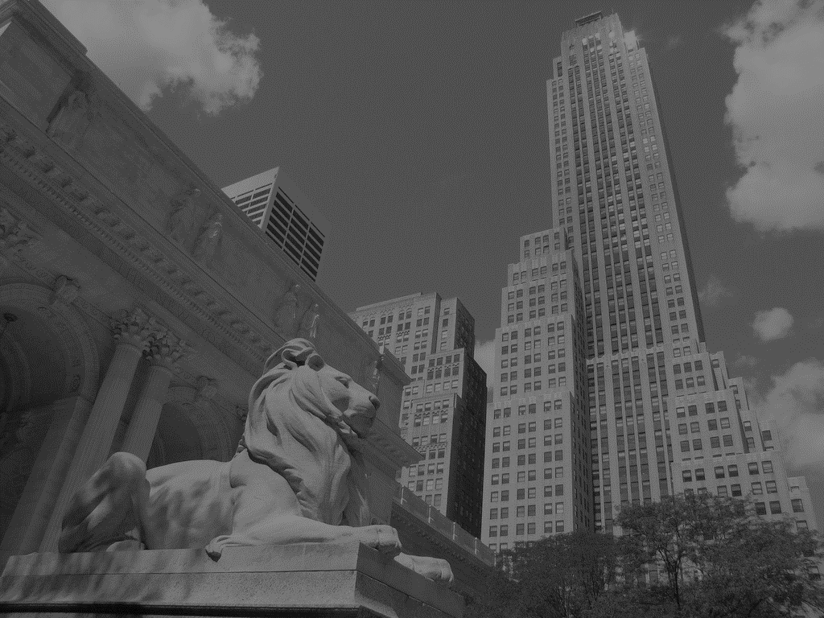
Data Reuse – Marine Biologists
“In 2005, a team of marine biologists…used inflation-adjusted pricing data from the New York Public Library’s (NYPL) collection of 45,000 restaurant menus, among other sources, to confirm the commercial overharvesting of abalone stocks along the California coast beginning in the 1920s…”
(Enis, 2015)
Notes:
Image: http://www.flickr.com/photos/25869855@N04/6357282813
Enis, M. (2015, July 13). Wisdom of the crowd. Library Journal. Retrieved from http://lj.libraryjournal.com/2015/07/technology/wisdom-of-the-crowd-digital-collections/#_

Slide 3
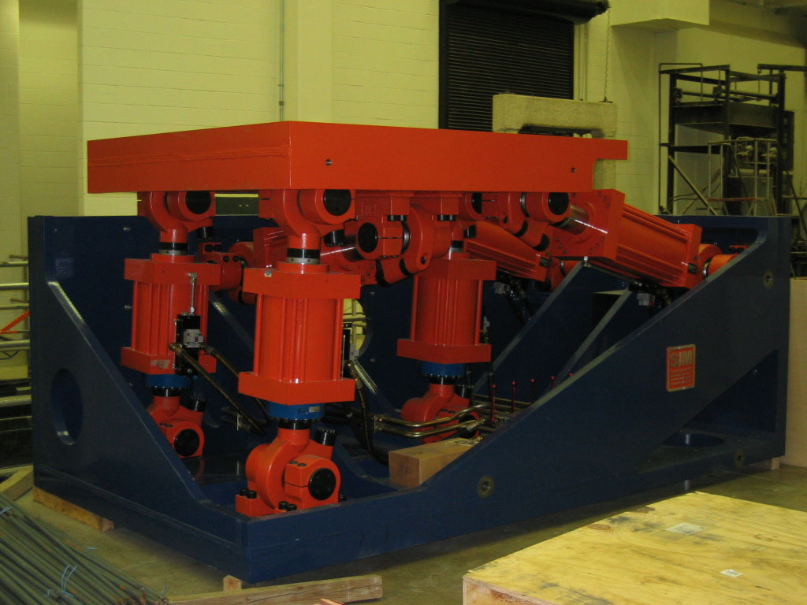
Data Reuse – Earthquake Engineering Researchers
“[It] is a lot harder than a lot of people think because it’s not just about getting the data and getting some kind of file that tells you what it is, you really have to understand all the detail of an actual experiment that took place in order to make proper use of it usually. And so it’s usually pretty involved…”
- NEES User 10
Notes:
Image: large-scale laboratory experimentation lab: http://nees.org/sites-mainpage/laboratories
Faniel, I. M., & Jacobsen, T. E. (2010). Reusing scientific data: How earthquake engineering researchers assess the reusability of colleagues' data. Computer Supported Cooperative Work, 19(3-4), 355-375.

Slide 4
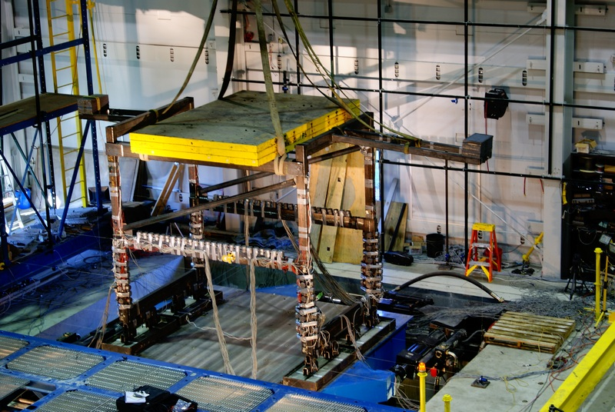
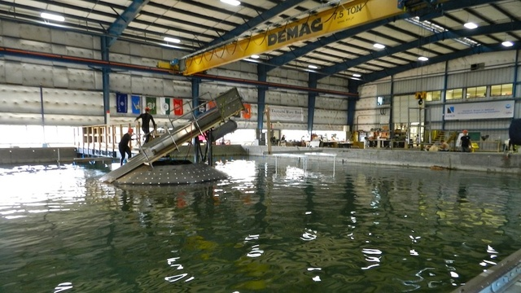
A Cyberinfrastructure Evaluation of the George E. Brown, Jr. Network for Earthquake Engineering Simulation (NEES)
Funded by the National Science Foundation (NSF)
Status: closed
Notes:
Images: shake table lab and tsunami wave basin lab: https://nees.org/sites-mainpage/laboratories#shake
Faniel, I. M. (2009). Unrealized potential: The socio-technical challenges of a large scale cyberinfrastructure initiative. Sponsored by the National Science Foundation. http://hdl.handle.net/2027.42/61845
Faniel, I. M., & Jacobsen, T. E. (2010). Reusing scientific data: How earthquake engineering researchers assess the reusability of colleagues' data. Computer Supported Cooperative Work, 19 (3-4), 355-375.

Slide 5
Data Reusability Assessment | Strategies | Example Context Information | Resources
Are the data relevant? | Generate narrow set of criteria to match against experiment parameters | Test specimens, material properties, events | Journals & personal networks are substitutable
Can the data be understood? | Review experimental procedures in exhaustive detail | Data acquisition parameters, how specimen attached to base | Conversations with colleagues complement documentation
Are the data trustworthy? | 1. Build confidence can produce same data consistently 2. Identify data anomalies, experimental errors & how they were resolved | 1. Sensor descriptions & other measures 2. Data spikes, temperature effects, human errors | Conversations with colleagues complement documentation
Notes:
Table 1. How EE researchers assess the reusability of experimental data for model validation from Faniel, I. M., & Jacobsen, T. E. (2010). Reusing scientific data: How earthquake engineering researchers assess the reusability of colleagues' data. Computer Supported Cooperative Work, 19(3-4), 355-375.

Slide 6
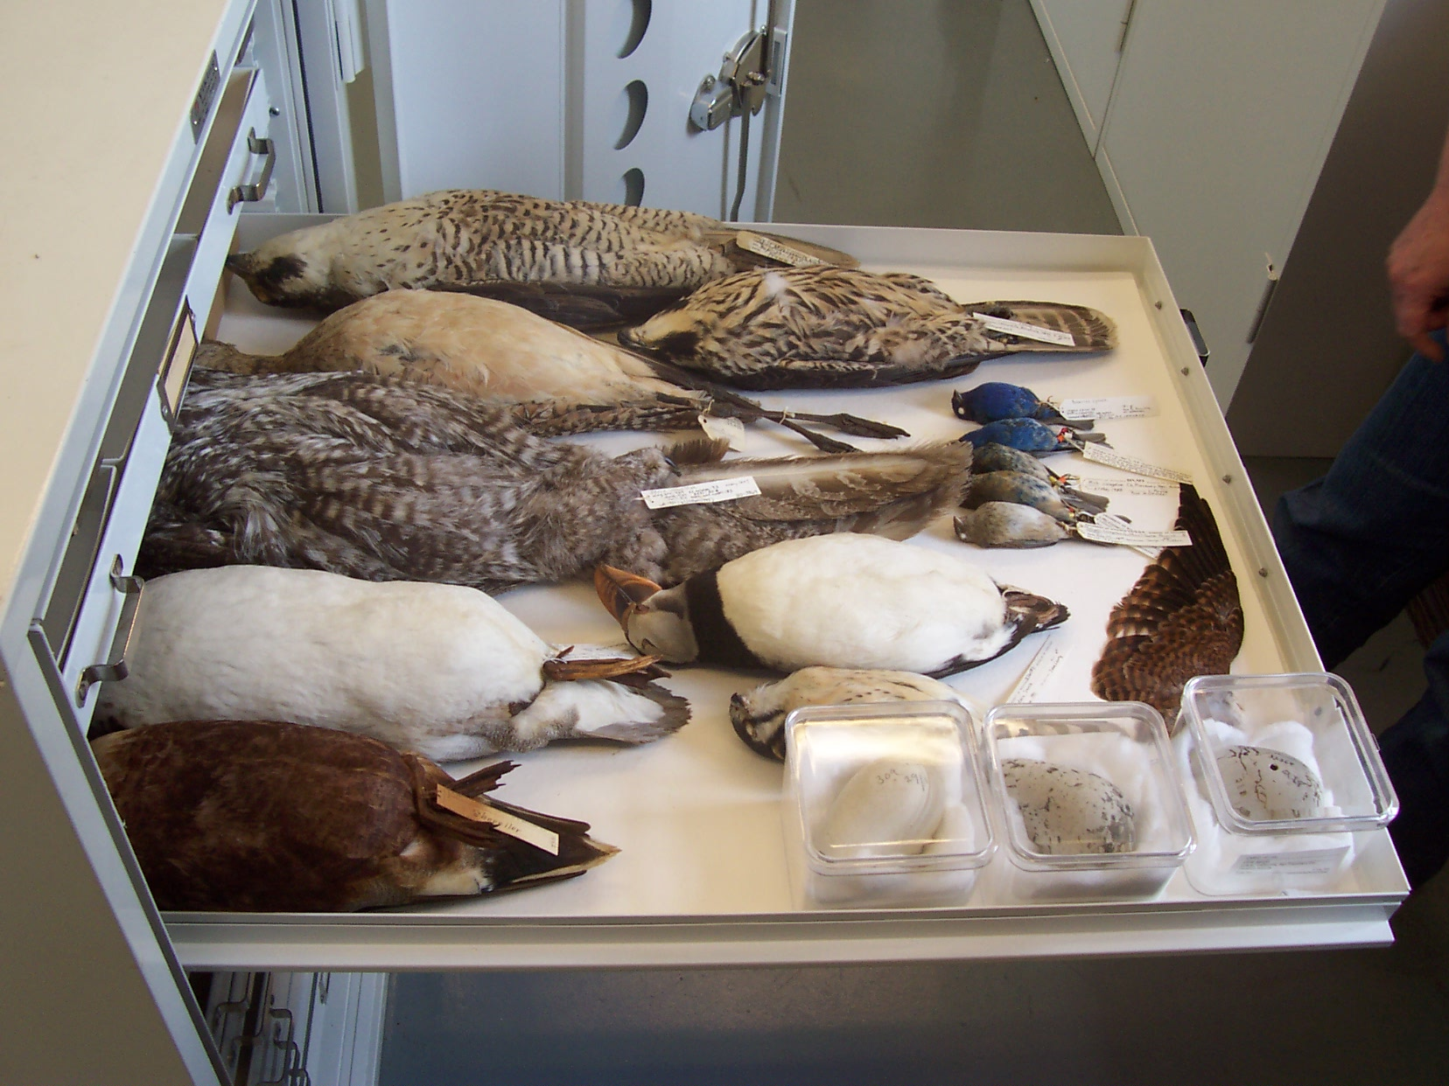
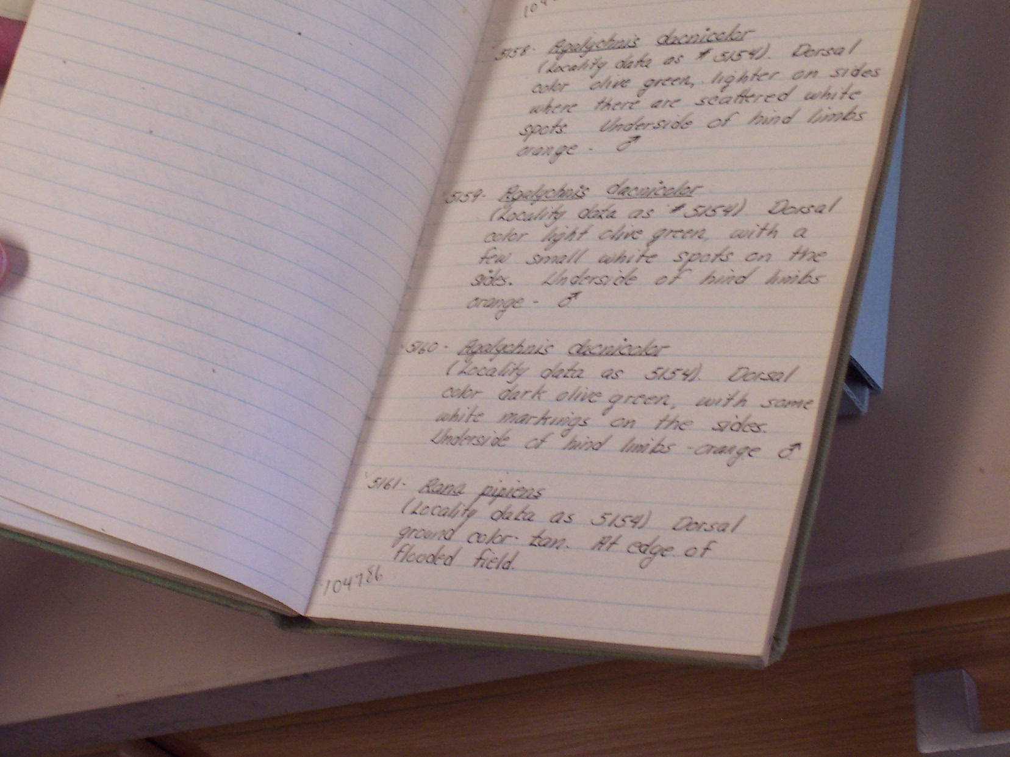
Dissemination Information Packages for Information Reuse (DIPIR)
Funded by:
Institute for Museums & Library Services (IMLS) grant
University of Michigan & OCLC in-kind contributions
Status: ongoing
Notes:
Images: DIPIR team at the University of Michigan Zoology

Slide 7
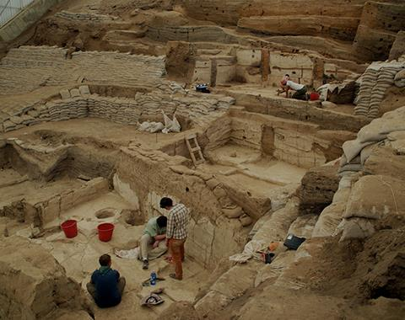
Data Reuse – Archaeologists
“I’m sort of transitioning from …hunting and herding […] to look at how animals are incorporated into increasingly complex societies […] so the role they play in the emergence of wealth and elites, particularly domestic animals, commodity production and the use of wool as a major foundation for urban economies in the Bronze Age…”.
- Archaeologist 13
Notes:
Image: https://www.flickr.com/photos/catalhoyuk/9184503529
Çatalhöyük Zooarchaeology
Faunal data from Neolithic Çatalhöyük and Chalcolithic Çatalhöyük West, Konya, Turkey.
http://opencontext.org/projects/1B426F7C-99EC-4322-4069-E8DBD927CCF1
Archaeologist 13: interview participant for the DIPIR project, http://www.dipir.org.

Slide 8
What are the significant properties of social science, archaeological, and zoological data that facilitate reuse?
2. Can data reuse and curation practices be generalized across disciplines?
Our Interest
Data reuse research
Digital curation research
Disciplines curating & reusing data
Notes:
Faniel, I. M., & Yakel, E. (2011). Significant properties as contextual metadata. Journal of Library Metadata, 11(3-4), 155-165.

Slide 9
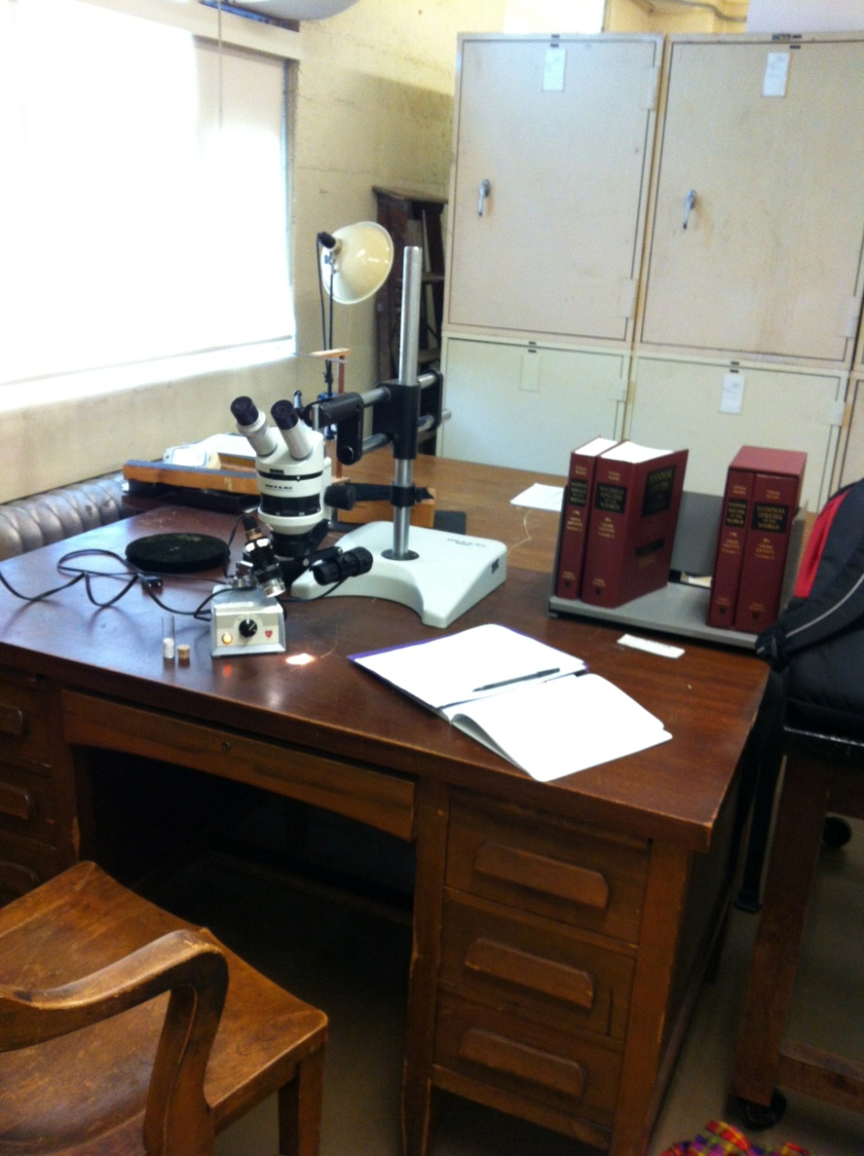
Findings
Detailed context reuser needed
Place reuser went to get context
Reason reuser needed context
Notes:
Image: DIPIR Team at the University of Michigan Museum of Zoology
Faniel, I. M. (2014, November). Putting research into context: A scholarly approach to curating data for reuse. Panel presentation at the 77th Annual Meeting of the Association for Information Science and Technology (ASIS&T), Seattle, WA. http://www.slideshare.net/oclcr/putting-research-data-into-context-a-scholarly-approach-to-curating-data-for-reuse

Slide 10
Percentage of mentions by discipline
Detailed context reuser needed | Social Scientists | Zoologists | Archaeologists
3rd Party Source | 42%⁴ | 34%⁵ | 18%⁴
Data Analysis Information | 63%² | 26% | 14%⁵
Data Collection Information | 100%¹ | 76%² | 77%¹
Data Producer Information | 63%² | 55%³ | 14%⁵
Digitization or Curation Information | 9% | 37%⁴ | 9%
General Context Information | 19% | 11% | 23%³
Missing Data | 37%⁵ | 5% | 0%
Prior Reuse | 58%³ | 24% | 0%
Specimen or Artifact Information | 2% | 100%¹ | 50%²
¹⁻⁵Top 5 rank ordered
(n=43)
(n=38)
(n=22)
Notes:
Faniel, I. M. (2014, November). Putting research into context: A scholarly approach to curating data for reuse. Panel presentation at the 77th Annual Meeting of the Association for Information Science and Technology (ASIS&T), Seattle, WA. http://www.slideshare.net/oclcr/putting-research-data-into-context-a-scholarly-approach-to-curating-data-for-reuse

Slide 11
Percentage of mentions by discipline
Place reuser went to get detailed context | Social Scientists | Zoologists | Archaeologists
Additional 3rd Party Records | 44%³ | 95%¹ | 45%²
Bibliography of Data Related Literature | 63%¹ | 74%² | 41%³
Codebook | 63%¹ | 0% | 0%
Data Producer Generated Records | 30%⁵ | 47%⁴ | 59%¹
Documentation | 58%² | 16% | 5%⁵
Miscellaneous | 7% | 3% | 5%⁵
People | 40%⁴ | 34%⁵ | 27%⁴
Specimen or Artifact | 0% | 55%³ | 5%⁵
¹⁻⁵Top 5 rank ordered
(n=43)
(n=38)
(n=22)
Notes:
Faniel, I. M. (2014, November). Putting research into context: A scholarly approach to curating data for reuse. Panel presentation at the 77th Annual Meeting of the Association for Information Science and Technology (ASIS&T), Seattle, WA. http://www.slideshare.net/oclcr/putting-research-data-into-context-a-scholarly-approach-to-curating-data-for-reuse

Slide 12
Percentage of mentions by discipline
Reason reuser needed context | Social Scientists | Zoologists | Archaeologists
Assess Data Completeness | 26% | 42%⁵ | 9%
Assess Data Credibility | 40% | 53%³ | 41%²
Assess Data Ease of Operation | 53%⁴ | 47%⁴ | 18%⁵
Assess Data Interpretability | 60%³ | 42%⁵ | 50%¹
Miscellaneous | 42%⁵ | 55%² | 27%³
Assess Data Quality | 21% | 42%⁵ | 23%⁴
Assess Data Relevance | 81%¹ | 68%¹ | 18%⁵
Assess Trust in the Data | 63%² | 68%¹ | 41%²
¹⁻⁵Top 5 rank ordered
(n=43)
(n=38)
(n=22)
Notes:
Faniel, I. M. (2014, November). Putting research into context: A scholarly approach to curating data for reuse. Panel presentation at the 77th Annual Meeting of the Association for Information Science and Technology (ASIS&T), Seattle, WA. http://www.slideshare.net/oclcr/putting-research-data-into-context-a-scholarly-approach-to-curating-data-for-reuse

Slide 13
There are different ways to measure repository success
Data quality attributes
Data Usage Index
Ingwersen & Chavan (2011)
Data producer reputation
Satisfaction with data reuse
Documentation quality
The DIPIR Project (www.dipir.org)
Photo Credit: http://www.datacite.org/
Trustworthiness of organization
Intention to continue using repository
Social influence
Trust in repository
Structural assurances
The DIPIR Project (www.dipir.org)
Photo credit: http://datasealofapproval.org/en/
Notes:
Faniel, I. M., Kriesberg, A., & Yakel, E. (2015). Social scientists' satisfaction with data reuse. Journal of the Association for Information Science and Technology. doi: 10.1002/asi.23480
Ingwersen, P., & Chavan, V. (2011). Indicators for the Data Usage Index (DUI): An Incentive for Publishing Primary Biodiversity Data Through Global Information Infrastructure. BMC Bioinformatics, 12(Suppl 15), S3. http://doi.org/10.1186/1471-2105-12-S15-S3
Yakel, E., Faniel, I., Kriesberg, A., & Yoon, A. (2013). Trust in digital repositories. International Journal of Digital Curation, 8(1), 143-156. http://www.ijdc.net/index.php/ijdc/article/view/8.1.143/303

Slide 14
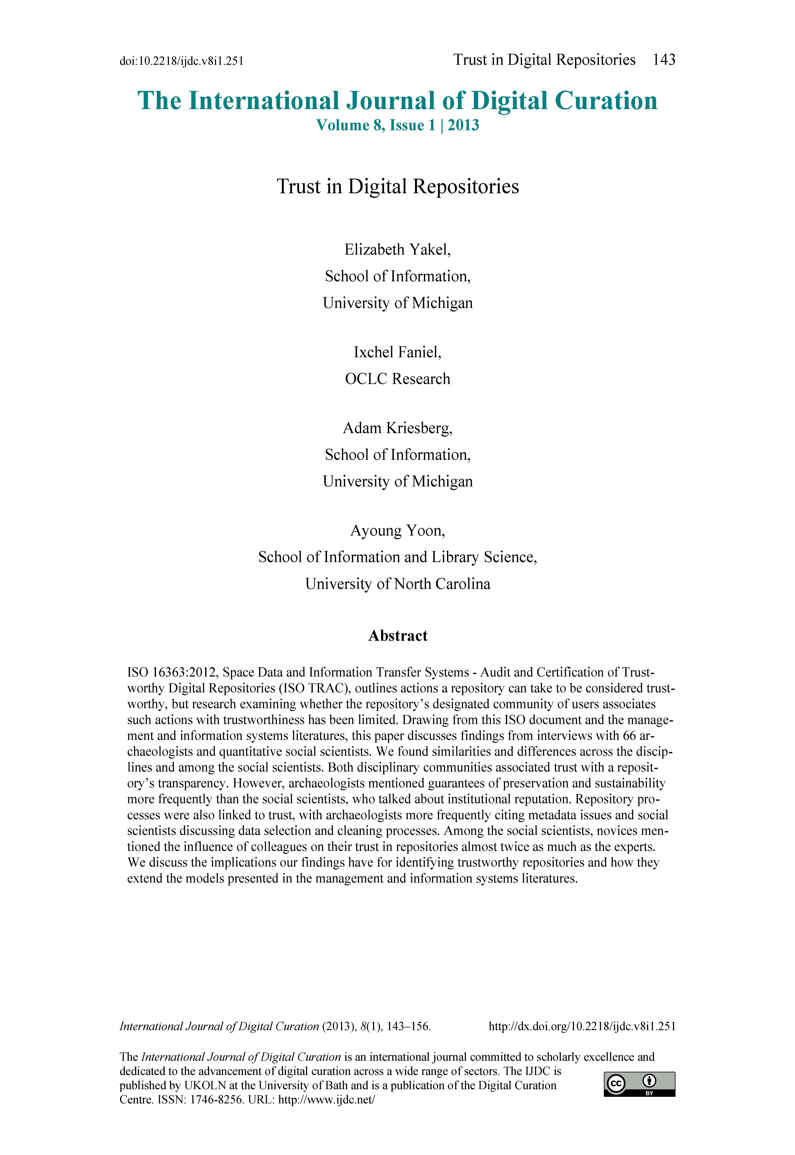
Trust in Digital Repositories
Do data consumers associate repository actions with trustworthiness?
How do data consumers conceive of trust in repositories?
Notes:
Yakel, E., Faniel, I., Kriesberg, A., & Yoon, A. (2013). Trust in digital repositories. International Journal of Digital Curation, 8(1), 143-156. http://www.ijdc.net/index.php/ijdc/article/view/8.1.143/303

Slide 15
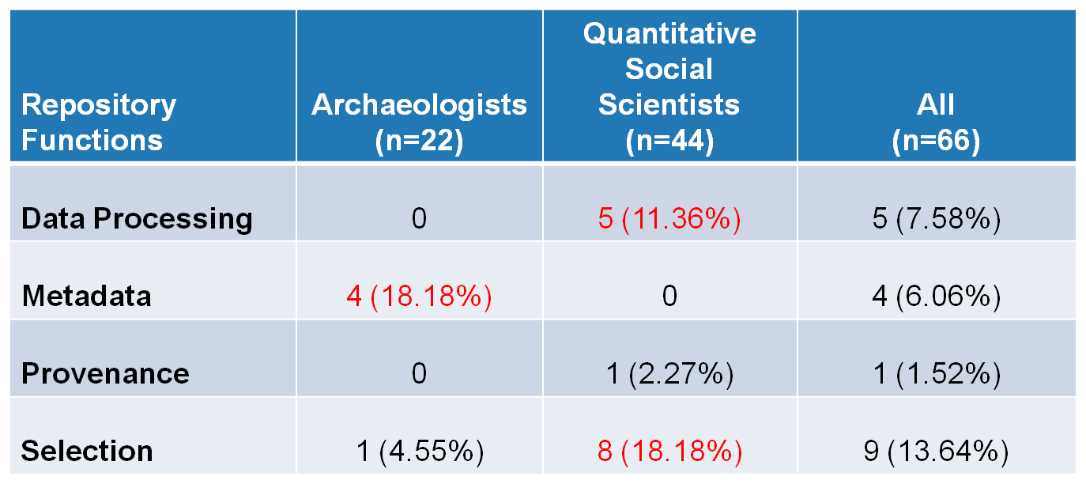
Frequency interviewees linked repository functions and trust
Yakel, Faniel, Kriesberg, & Yoon, IDCC 8, 2013
Notes:
Yakel, E., Faniel, I., Kriesberg, A., & Yoon, A. (2013, January). Trust in digital repositories. Paper presented at the 8th International Digital Curation Conference (IDCC), Amsterdam, Netherlands. http://www.slideshare.net/oclcr/trust-in-digital-repositories (Awarded best conference paper)

Slide 16
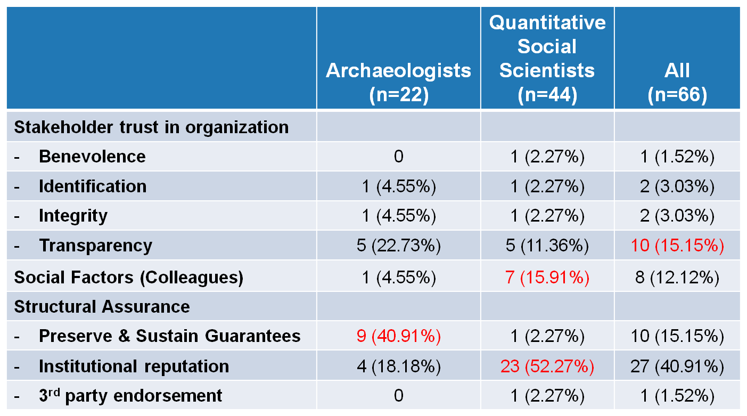
Frequency interviewees mentioned trust factors
Yakel, Faniel, Kriesberg, & Yoon, IDCC 8, 2013
Notes:
Yakel, E., Faniel, I., Kriesberg, A., & Yoon, A. (2013, January). Trust in digital repositories. Paper presented at the 8th International Digital Curation Conference (IDCC), Amsterdam, Netherlands. http://www.slideshare.net/oclcr/trust-in-digital-repositories (Awarded best conference paper).

Slide 17
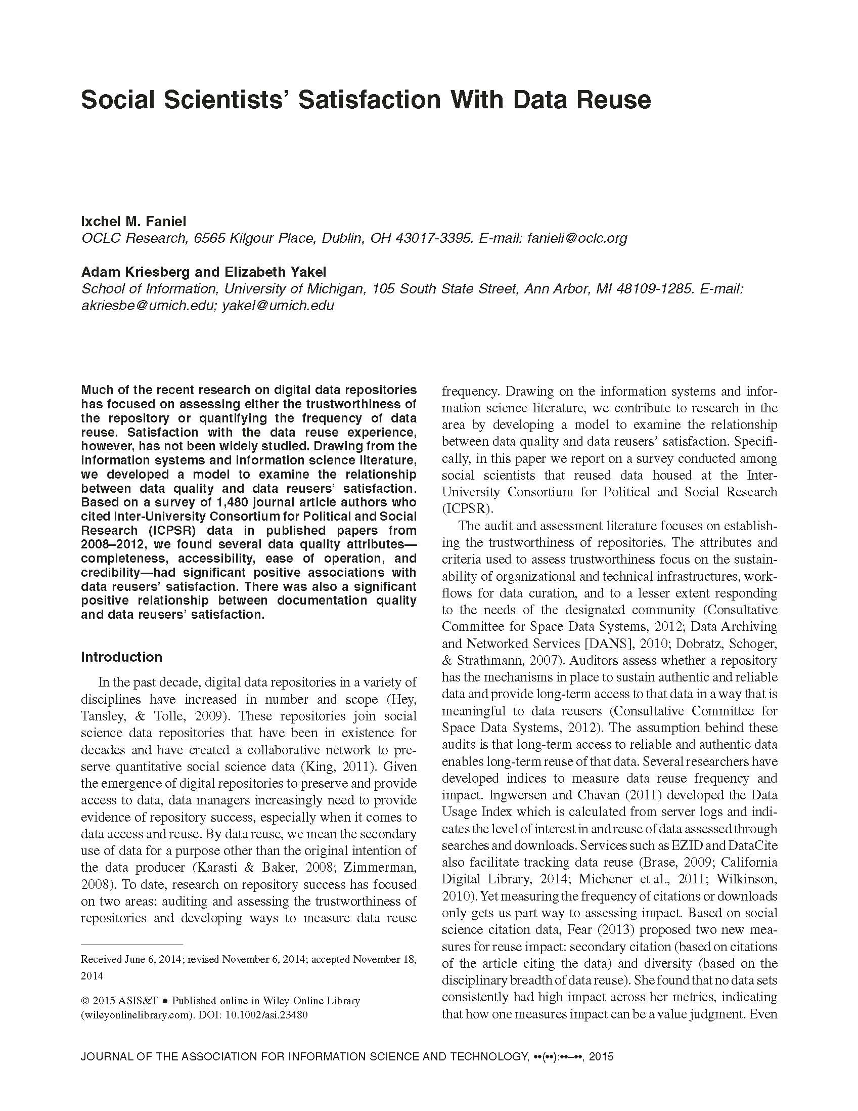
Social Scientists’ Satisfaction with Data Reuse
What data quality attributes influence
data reusers’
satisfaction after controlling for journal rank?
Notes:
Faniel, I. M., Kriesberg, A., & Yakel, E. (2015). Social scientists' satisfaction with data reuse. Journal of the Association for Information Science and Technology. doi: 10.1002/asi.23480

Slide 18
 | Β
Constant | -.030
Data Relevancy | .066
Data Completeness | .245***
Data Accessibility | .320***
Data Ease of Operation | .134*
Data Credibility | .148*
Documentation Quality | .204**
Data producer reputation | .008
Journal rank | .030
Model Statistics
N | 237
R² | 55.5%
Adjusted R² | 54.0%
Model F | 35.59***
Data quality attributes that influence reusers’ satisfaction after controlling for
journal rank?
Notes:
Faniel, I. M., Kriesberg, A., & Yakel, E. (2015). Social scientists' satisfaction with data reuse. Journal of the Association for Information Science and Technology. doi: 10.1002/asi.23480

Slide 19
Data Management, Sharing and Reuse: A Users Perspective
Data Sharing (supply)
Data producers
What motivates sharing?
Resources
Recognition
Know how
Need
Data Reuse (demand)
Data consumers
How people reuse data?
What they need?
Why they need it?
Where they get it?
Data Management, Curation, and Preservation
Academic libraries, disciplinary repositories
How can we help?

Slide 20
Three Perspectives on Data Reuse
Data Collection
Data Producer
Data Sharing
Data Producer
Data Curation
Repository Staff
Data Reuse
Data Consumer
Notes:
Faniel, I.M. and Yakel, E. “Three Perspectives on Data Reuse: Producers, Curators, and Reusers,” Research Data and Curation Panel. Digital Preservation 2014. Washington, D.C. http://www.slideshare.net/oclcr/three-perspectives-on-data-reuse-producers-curators-and-reusers

Slide 21
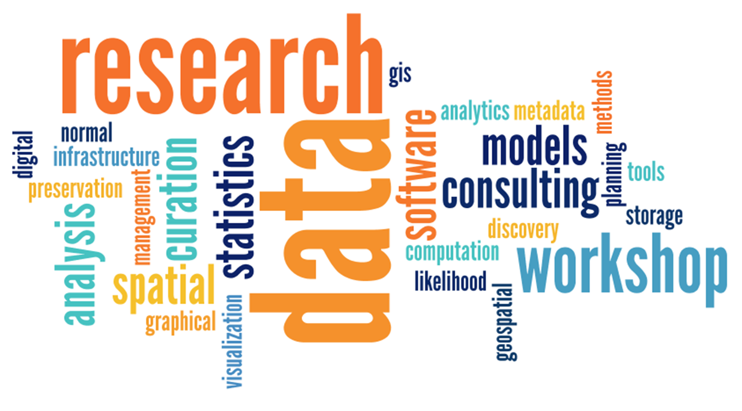
E-Research and Data: Opportunities for Library Engagement
Internal Project
Status: Ongoing
http://www.oclc.org/research/themes/user-studies/e-research.html
Notes:
Image: http://data.library.virginia.edu/

Slide 22
Notes:
Image of road: Phil Roeder https://flic.kr/p/7PynRu
Poster content: Faniel, I. M., & Connaway, L. S. (2014, October). The road to implementing successful research data services: Moving from challenges to benefits. Poster presented at the 2014 Digital Library Federation (DLF) Forum, Atlanta, GA.

Slide 23
Research Experience for Master’s Students (REMS) Program
Thank you
Ixchel Faniel, Ph.D.
Research Scientist
fanieli@oclc.org

