Slide 1
Research Data Access & Preservation (RDAP) Summit, Seattle, WA, April 19-21, 2017
Data reusability: A comparison across disciplines
Ixchel M. Faniel, PhD
Research Scientist, OCLC Research
fanieli@oclc.org, @imfaniel

Slide 2
Dissemination Information Packages for Information Reuse (DIPIR)
Institute of Museum and Library Services
Co-PI: Elizabeth Yakel (University of Michigan)
Partners: Nancy McGovern, Ph.D. (MIT), Eric Kansa, Ph.D. (Alexandria Archive, Open Context), William Fink, Ph.D. (University of Michigan Museum of Zoology), Sarah Whitcher Kansa (Alexandria Archive, Open Context)
OCLC Fellow: Julianna Barrera-Gomez
Doctoral Students: Rebecca Frank, Adam Kriesberg, Morgan Daniels, Ayoung Yoon
Master’s Students: Alexa Hagen, Jessica Schaengold, Gavin Strassel, Michele DeLia, Kathleen Fear, Mallory Hood, Annelise Doll, Monique Lowe
Undergraduates: Molly Haig
The DIPIR Project was made possible by a National Leadership Grant from the Institute of Museum and Library Services, LG-06-10-0140-10, “Dissemination Information Packages for Information Reuse” and support from OCLC Online Computer Library Center, Inc., and the University of Michigan.

Slide 3
DIPIR Methodology
 | Archaeology | Zoology | Social Science
Phase 1: Project Start-Up
Staff Interviews | 4 | 10 | 10
Phase 2: Collecting Reuser Data
Interviews | 22 | 27 | 43
Observations |  | 13
Data quality survey |  |  | 237
Server log entries | 572,134

Slide 4
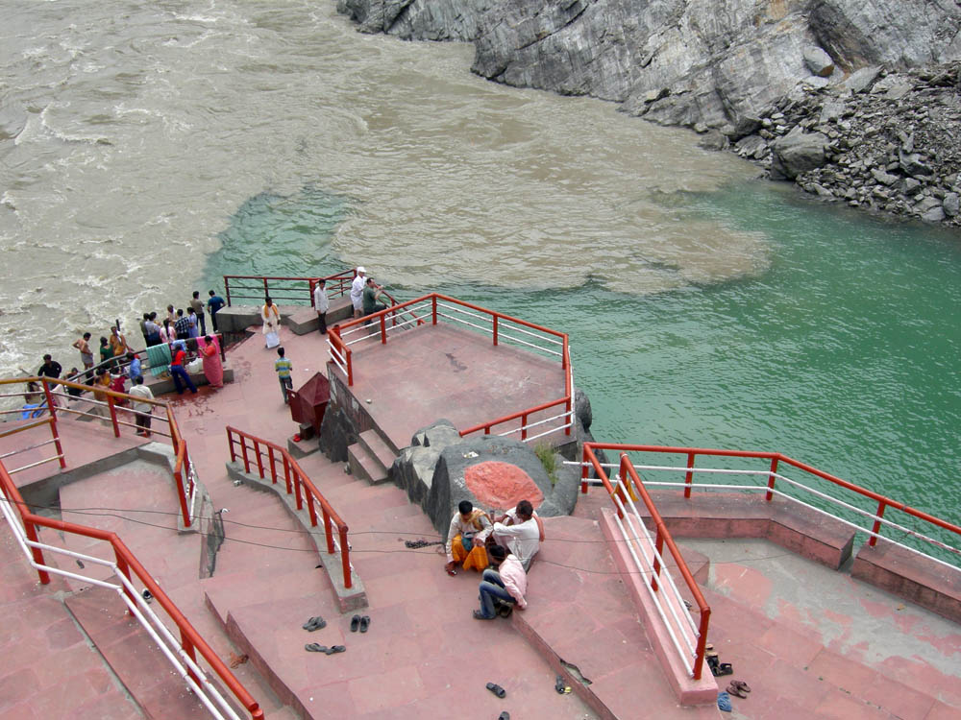
Confluence & Disparities of Researchers’ Reuse Needs
Types of context information needed
Sources relied on to get it
Data quality assessments made from it
Notes:
Image credit: By Photograph taken by Mark A. Wilson (Department of Geology, The College of Wooster). [1] (Original photograph) [Public domain], via Wikimedia Commons. Page URL: https://commons.wikimedia.org/wiki/File%3AConfluence.JPG

Slide 5
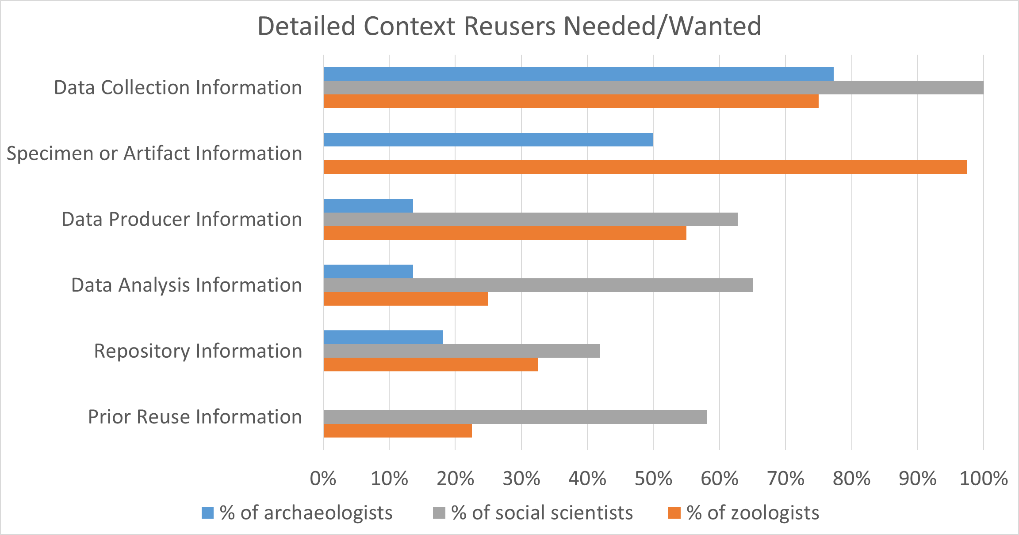
Notes:
Partial set of the different types of context information researchers mentioned needing or wanting when deciding whether to reuse others’ data.

Slide 6
Frequency Linked Repository Functions and Trust
Repository Functions | Archaeologists | Social Scientists
Data processing | 0 | 11.36%
Metadata | 18.18% | 0
Provenance | 0 | 2.27%
Selection | 4.55% | 18.18%
Yakel, Faniel, Kriesberg, & Yoon (2013)
Notes:
Yakel, Elizabeth, Ixchel Faniel, Adam Kriesberg, and Ayoung Yoon. 2013. “Trust in Digital Repositories.” International Journal of Digital Curation 8 (1): 143–56. doi:10.2218/ijdc.v8i1.251.

Slide 7
Frequency Trust Factors Mentioned
 | Archaeologists | Social Scientists
Stakeholder Trust in the organization:
Benevolence | 0 | 2.27%
Identification | 4.55% | 2.27%
Integrity | 4.55% | 2.27%
Transparency | 22.73% | 11.36%
Social Factors: Colleagues | 4.55% | 15.91%
Structural Assurances:
Guarantees (preserve & sustain) | 40.91% | 2.27%
Institutional reputation | 18.18% | 52.27%
Third party endorsements | 0 | 2.27%
Yakel, Faniel, Kriesberg, & Yoon (2013)
Notes:
Yakel, Elizabeth, Ixchel Faniel, Adam Kriesberg, and Ayoung Yoon. 2013. “Trust in Digital Repositories.” International Journal of Digital Curation 8 (1): 143–56. doi:10.2218/ijdc.v8i1.251.

Slide 8
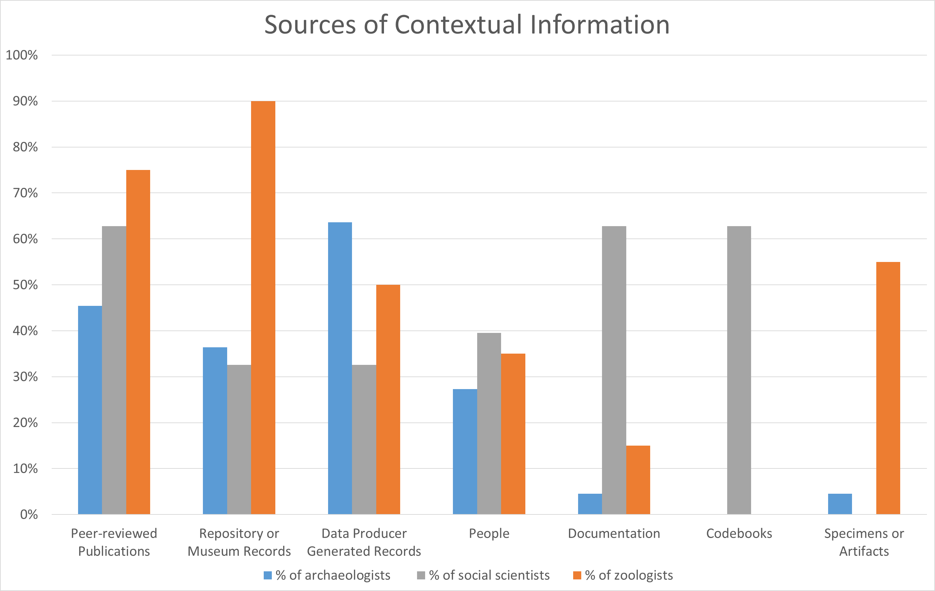
Faniel & Yakel (2017)
Notes:
Faniel, Ixchel M., and Elizabeth Yakel. 2017. “Practices Do Not Make Perfect: Disciplinary Data Sharing and Reuse Practices and Their Implications for Repository Data Curation.” In Curating Research Data Volume 1: Practical Strategies for Your Digital Repository, 103-126. Chicago, IL: Association of College and Research Libraries Press.

Slide 9
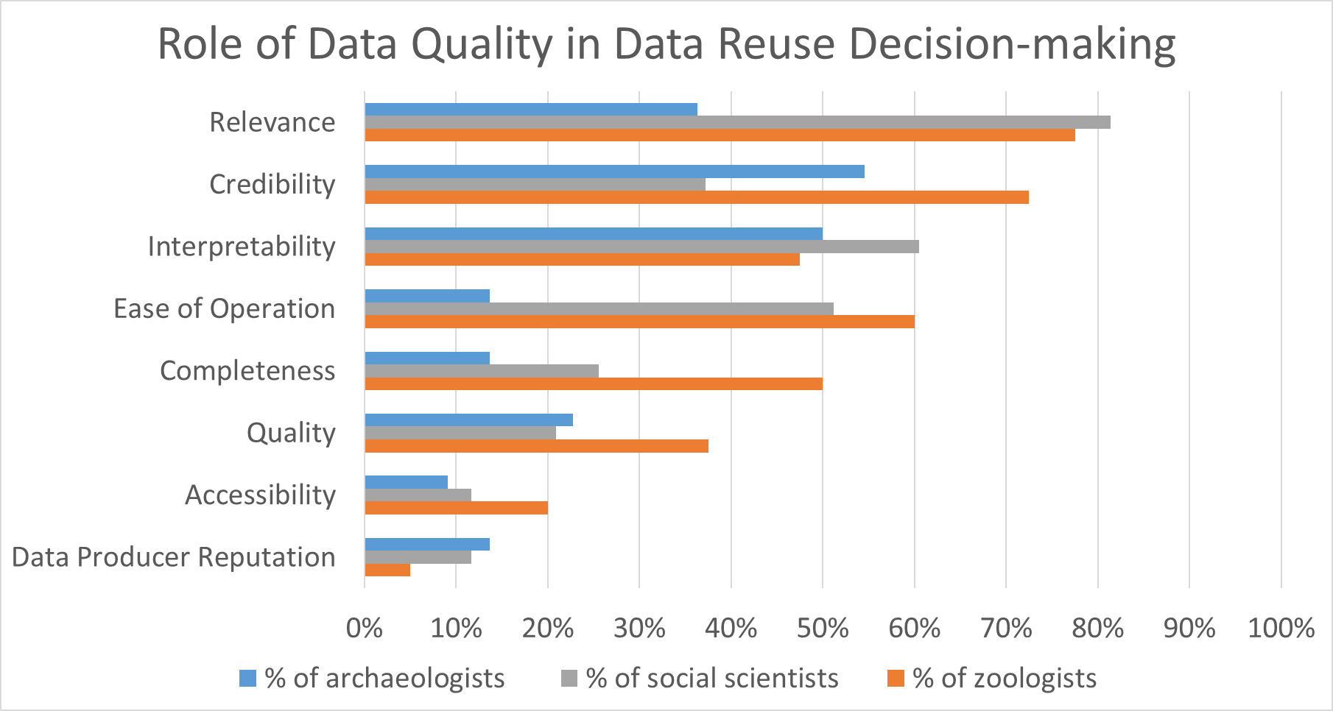
Notes:
Role of data quality in data reuse decision making.

Slide 10
Faniel, Kriesberg, & Yakel (2016)
 | Β
Constant | -.030
Data relevancy | .066
Data completeness | .245***
Data accessibility | .320***
Data ease of operation | .134*
Data credibility | .148*
Documentation quality | .204**
Data producer reputation | .008
Journal rank | .030
Model Statistics
N | 237
R² | 55.5%
Adjusted R² | 54.0%
Model F | 35.59***
What data quality attributes influence data reusers’ satisfaction after controlling for journal rank?
*p < .05, **p < .01, ***p , .001
Notes:
Faniel, I. M., Kriesberg, A., & Yakel, E. (2016). Social scientists' satisfaction with data reuse. Journal of the Association for Information Science and Technology, 67(6), 1404-1416. doi: 10.1002/asi.23480

Slide 11
Select References
Faniel, Ixchel M., and Elizabeth Yakel. 2017. “Practices Do Not Make Perfect: Disciplinary Data Sharing and Reuse Practices and Their Implications for Repository Data Curation.” In Curating Research Data Volume 1: Practical Strategies for Your Digital Repository, 103-126. Chicago, IL: Association of College and Research Libraries Press.
Faniel, I. M., Kriesberg, A., & Yakel, E. (2016). Social scientists' satisfaction with data reuse. Journal of the Association for Information Science and Technology, 67(6), 1404-1416. doi: 10.1002/asi.23480
Frank, R., Yakel, E., & Faniel, I. M. (2015). Destruction/reconstruction: Preservation of archaeological and zoological research data. Archival Science, 15(2), 141-167. doi: 10.1007/s10502-014-9238-9
Frank, R. D., Kriesberg, A., Yakel, E., & Faniel, I. M. (2015). Looting hoards of gold and poaching spotted owls: Data confidentiality among archaeologists & zoologists. Proceedings of the Association for Information Science and Technology (ASIS&T), 52.
Faniel, I., Kansa, E., Whitcher Kansa, S., Barrera-Gomez, J., & Yakel, E. (2013). The challenges of digging data: A study of context in archaeological data reuse. Proceedings of the Joint Conference on Digital Libraries (JCDL), 295-304.
Yakel, Elizabeth, Ixchel Faniel, Adam Kriesberg, and Ayoung Yoon. 2013. “Trust in Digital Repositories.” International Journal of Digital Curation 8 (1): 143–56. doi:10.2218/ijdc.v8i1.251.
Daniels, M., Faniel, I., Fear, K., & Yakel, E. (2012). Managing fixity and fluidity in data repositories. In Mai, J. (Ed.), Proceedings of the 2012 iConference (pp. 279-286). New York: ACM.
Additional references for the DIPIR project: http://www.oclc.org/research/themes/user-studies/dipir/publications.html

Slide 12
Research Data Access & Preservation Summit (RDAP 2017)
Thank you
Ixchel M. Faniel, PhD
Research Scientist, OCLC Research fanieli@oclc.org, @imfaniel

