Slide 1
Preservation of Research Data for Reuse Panel, iPRES 2015, Chapel Hill, NC, November 4, 2015
“You need the entire context, whatever that means.” A Study of Three Disciplines
Ixchel M. Faniel, Ph.D.
Research Scientist OCLC, Online Computer and Library Center, Inc. fanieli@oclc.org @DIPIR_Project www.dipir.org

Slide 2
Top 10 Types of Context Information Mentioned

Slide 3
Top 10 Types of Context Information Mentioned

Slide 4
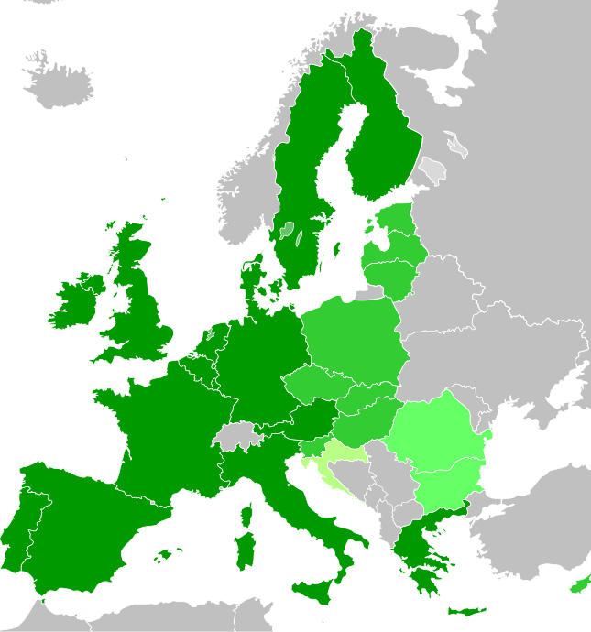
Data Collection Information
“…if it had something that I could use to represent my key independent variable…And so in this case, I was looking at opinions towards European enlargement. So if they ask them a question, ‘What is your preference for future enlargement or what's your opinion on the continuing enlargement?’ [I] then sort of immediately knew that it would be useful.” - Social Scientist 02
Notes:
"EU2004-2013" by Glentamara - Own work. Licensed under Public Domain via Wikipedia - https://en.wikipedia.org/wiki/File:EU2004-2013.svg#/media/File:EU2004-2013.svg

Slide 5
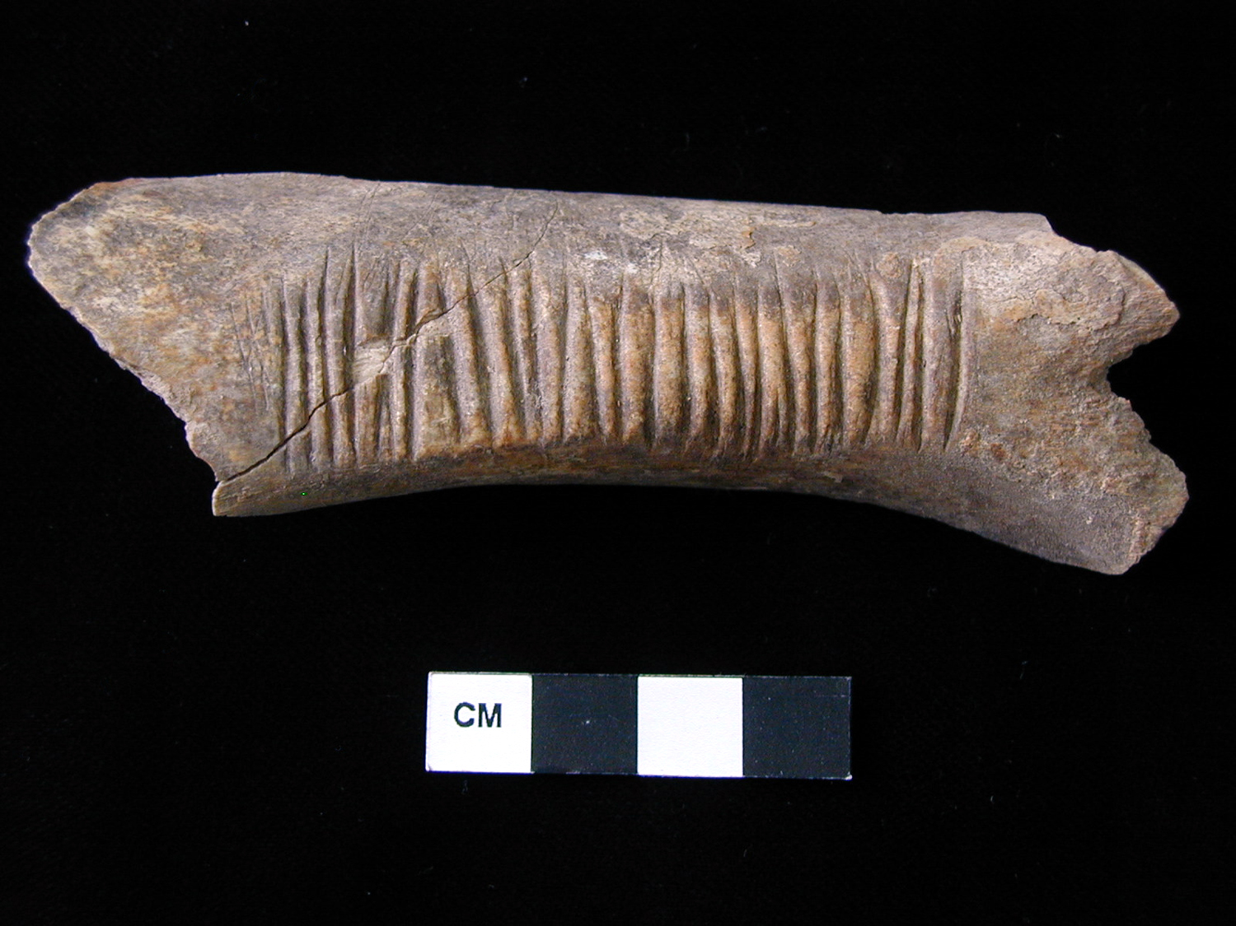
Data Collection & Artifact Information
“So I was contacting him for other specific information. Where was this found, what period did it date to, and what artifacts were found with it because that's often not cataloged along [with] this primary zooarchaeological data nor do you have access to field notes or anything like that.” – Archeologist 02
Notes:
“Photo of worked bone” by Bradley Parker, Peter Cobb. "F_5_5003_5010_1.JPG from Turkey/Kenan Tepe/Area F/Trench 5/Locus 5003/Finds Bag 5010". (2012) In Kenan Tepe. Bradley Parker, Peter Cobb (Eds.) . Released: 2012-03-28. Open Context. <http://opencontext.org/media/F6BC22FE-AD79-4BB9-8AAA-E05AC705EF61> ARK (Archive): http://n2t.net/ark:/28722/k2862h17z, used under CC BY.

Slide 6
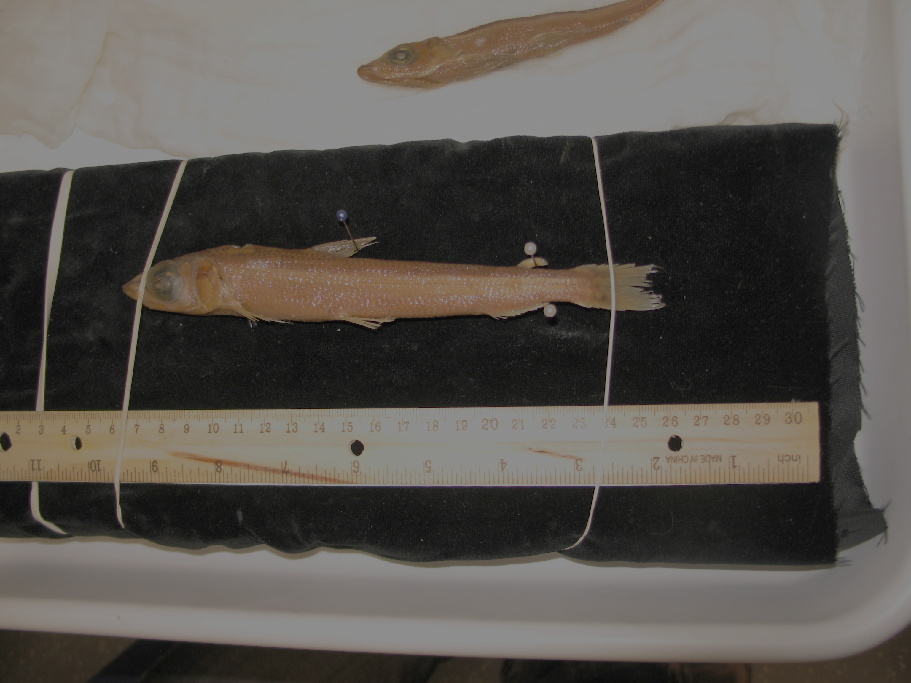
Data Collection & Specimen Information
The relevance would be determined by verifying that they were from the right geographic area and then in determining that they were correctly identified.” - Zoologist 19
“…knowing that a specimen is 30 millimeters or 30 centimeters makes a big issue of being able to say whether I want to borrow it. Is it a baby? Is it a full adult? Is it male? Is it female?…Is this a specimen that's been dragged…and then stepped on? Or is it in pristine condition?” - Zoologist 19
Notes:
Image: Photo by DIPIR Team

Slide 7
Data Producer Information
“…I have a hierarchy where I try to get information from governments if I can, state and federal governments…”. – Social Scientist 12
“…I can look at the authors, and I know that, say, so and so has published on this group before, has some experience with the fish systematics, and I can trust the taxonomic data…”. – Zoologist 15
…that Germans in Munich tradition is one of the respected traditions for zooarchaeology in the Old World. So, those senior scholars and then their students are the ones that you trust”. – Archaeologist 13

Slide 8
Data Analysis & Prior Reuse Information
“But even within the codebook they may tell you how it’s coded…and I still don’t know…For instance, they just say if this variable belongs to this category, we coded it as six. But it really doesn’t tell me how they coded it…the process ..is not really clear”. – Social Scientist 16
“Because corruption, I don’t think you can generate it unless you are a big organization with the resources…And then there are a few measures that the literature keeps repeating. It’s Transparency [International] and the World bank has one. But probably the Transparency [International measure] is most often used, so that’s why we picked that one”. – Social Scientist 13

Slide 9
Digitization/Curation Information
“So there’s some sort of cross-validation among other sequences…It’s partly quality control that I think GenBank does when they accession a
sequence. They will actually BLAST it, so compare it to other sequences that are available for that gene, and if something is wildly wrong, they will spot it”. – Zoologist 12
“one of the big issues we have to deal with was: How was that material originally preserved? Historically, museum specimens when into formalin and then into alcohol. Well, the exposure of the tissue to formalin does a real number on DNA, degrades it very rapidly”.
– Zoologist 13

Slide 10
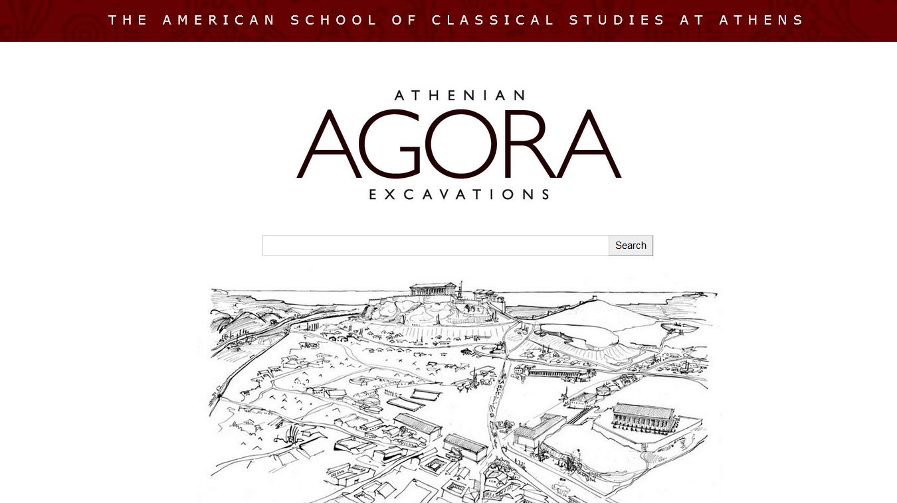
3rd Party Source Information
“Am I reading it in an article in JSTOR and going to the Agora website, which is the original sources of this [vessel]? Or am I reading it in some webpage of a project that’s mostly geared towards attracting students… Then I might be…Just want to check a little more to confirm…”. – Archaeologist 18
Notes:
Image from http://www.agathe.gr/

Slide 11
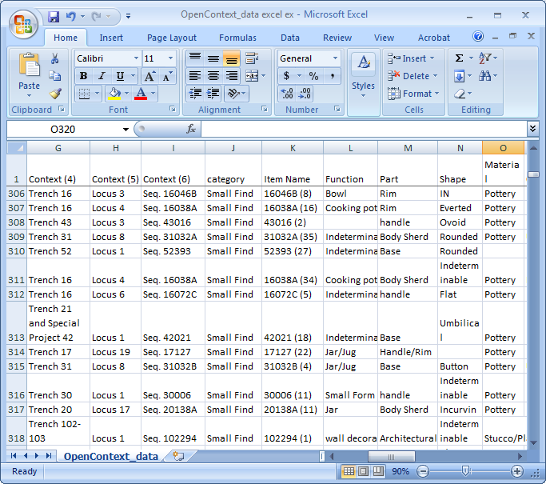
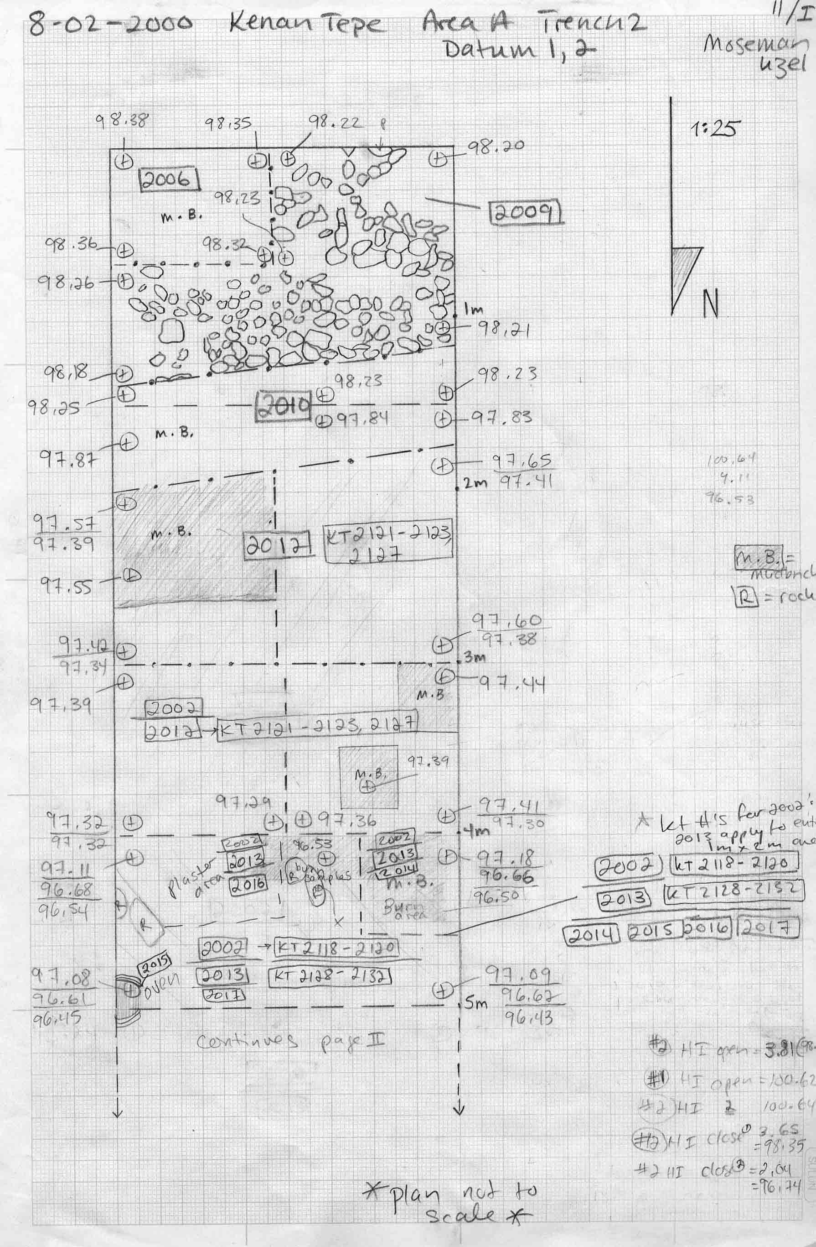
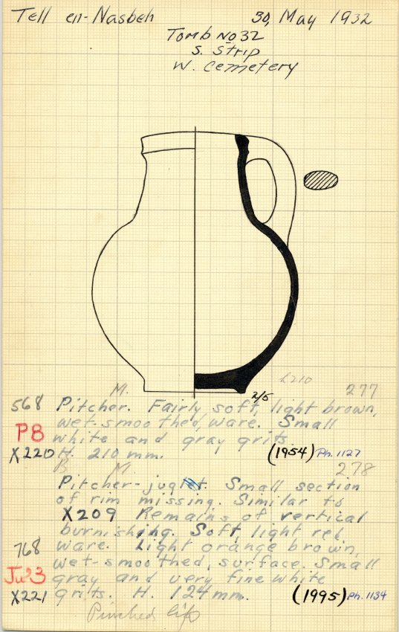
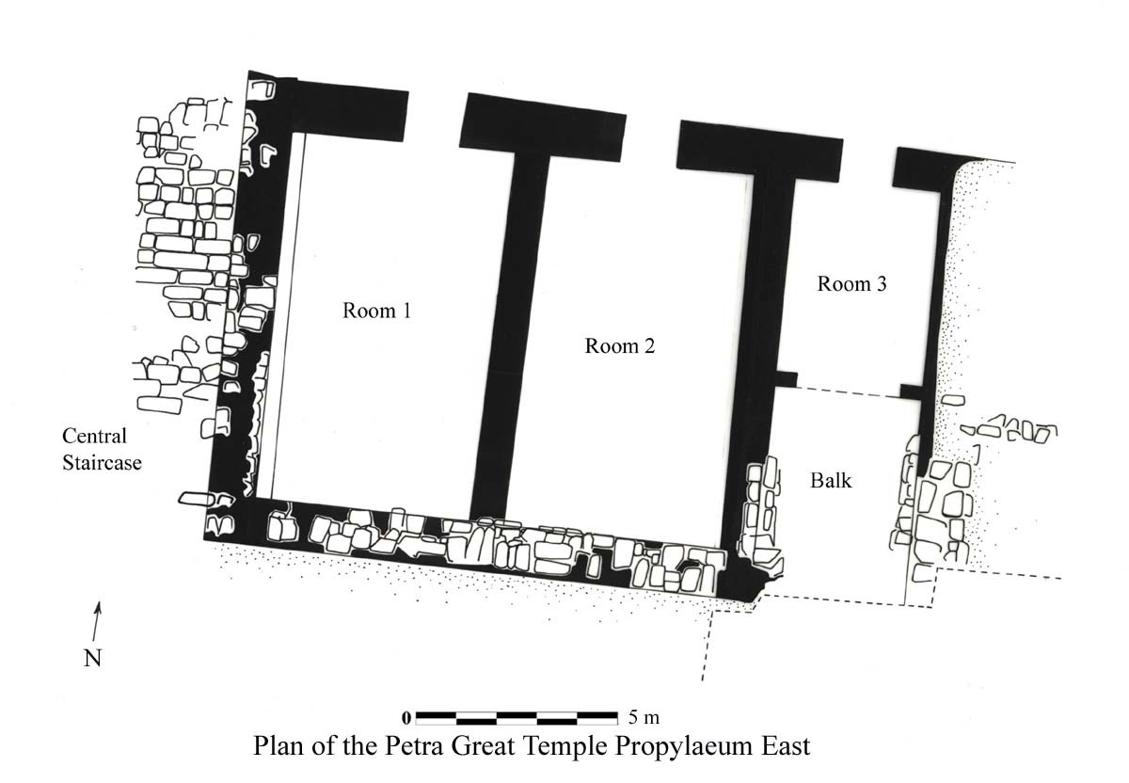
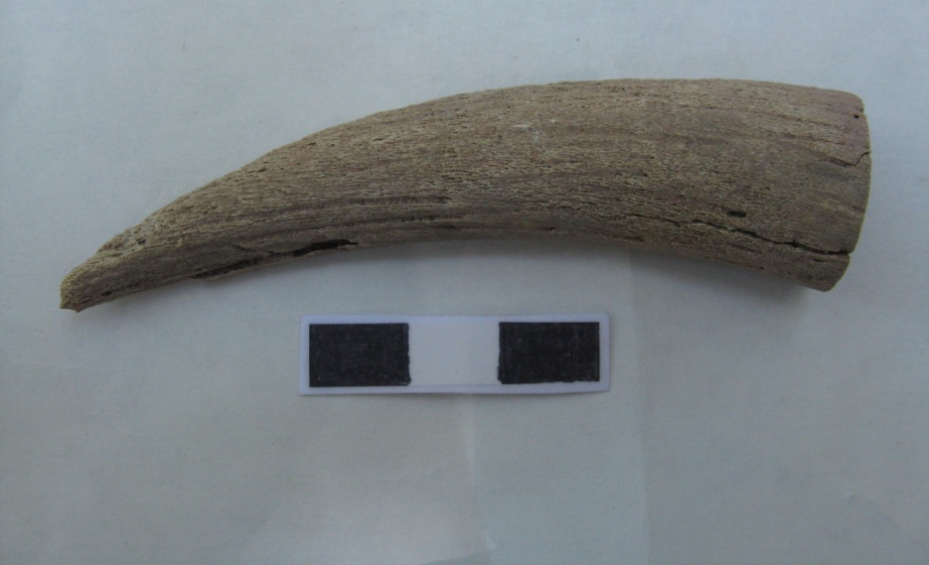
Sources for Context Information
Social Scientists
Archaeologists
Web of Discovery for Context
Archaeologists relied on a web of many sources to provide context for the data.

Slide 12
Implications
Boundaries between different types of context information are permeable
Context information is detailed and comes from several non-substitutable sources
Must work to satisfy present and potential future needs

Slide 13
Acknowledgements
DIPIR Project
Institute of Museum and Library Services
Elizabeth Yakel (Co-PI), William Fink, Eric Kansa, Nancy McGovern, Sarah Whitcher Kansa, Julianna Barrera-Gomez, Rebecca Frank, Adam Kriesberg, Morgan Daniels, Anthea Josias, Ayoung Yoon, Jessica Schaengold, Gavin Strassel, Michele DeLia, Kathleen Fear, Mallory Hood, Annelise Doll, Monique Lowe, Molly Haig

Slide 14
iPRES 2015
Preservation of Research Data for Reuse Panel, November 4, 2015
Ixchel M. Faniel, Ph.D.
Research Scientist
fanieli@oclc.org @DIPIR_Project
©2015 OCLC. This work is licensed under a Creative Commons Attribution 4.0 International License. Suggested attribution: “This work uses content from “You need the entire context, whatever that means.” A Study of Three Disciplines © OCLC, used under a Creative Commons Attribution 4.0 International License: http://creativecommons.org/licenses/by/4.0/.”

