Slide 1
Harvard University, Boston, MA, February 3, 2017
Do your data management and curation practices support data reuse?
Ixchel M. Faniel, PhD
Research Scientist, OCLC Research
fanieli@oclc.org, @imfaniel

Slide 2
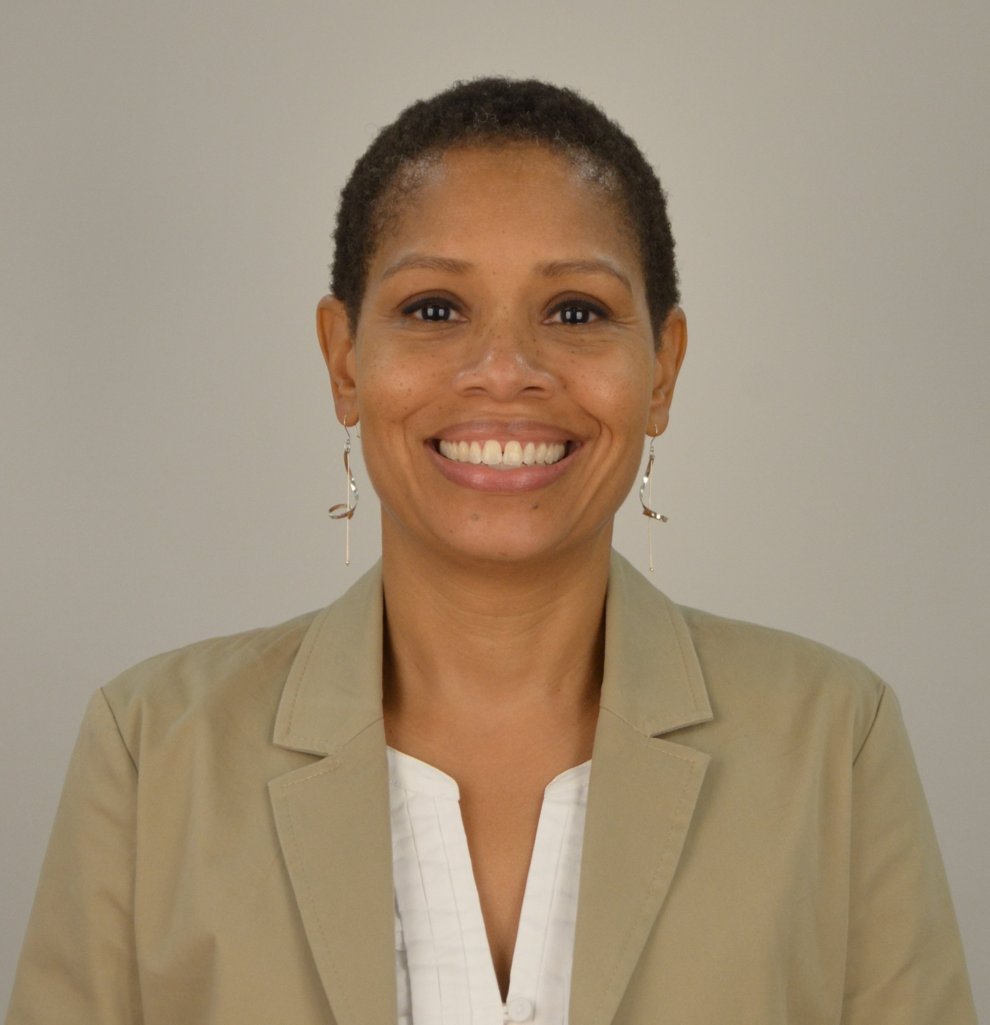
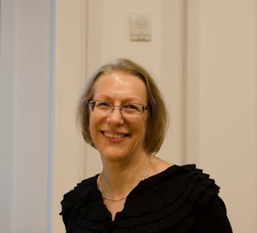
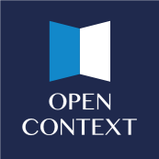
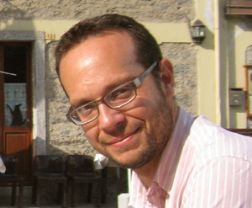
Dissemination Information Packages for Information Reuse (DIPIR)
The DIPIR Project was made possible by a National Leadership Grant from the Institute of Museum and Library Services, LG-06-10-0140-10, “Dissemination Information Packages for Information Reuse” and support from OCLC Online Computer Library Center, Inc., and the University of Michigan.
Notes:
This presentation is based on work I’ve done with Beth Yakel on the DIPIR project - a 3 year project funded by the Institute of Museum and Library Services. The funding ended, but our work continues
The project focuses on data reuse practices within the quantitative social science, zoology and archaeology communities and was done in partnership with scholars representing the Inter-university Consortium of Political and Social Research (ICPSR), the University of Michigan Museum of Zoology, and Open Context.
I will focus on the archaeologists today, particularly findings from qualitative studies of repository staff and archaeologists who produced and reused data.

Slide 3
How does contextual information serve to meaningfully communicate data to reusers?
Notes:
This panel was asked to think about a couple of topics. One was to explore the challenges in meaningfully communicating data to a wider audience. There are many from the perspective of the data producer, lack of incentives and limited time/money are typically mentioned the most.
Given my background, the challenge I saw that was not being addressed was knowing what researchers needed to reuse data – what besides the data was important for reuse. I was particularly interested in how contextual information served to meaningfully communicate data to reusers, but also why they needed it and where they got it.
When I began doing this research, it had not been something that was discussed much even though it’s critical. It also was a challenge for data producers, they hadn’t done it and weren’t sure how to go about it. As far as I could tell data curators and respository staff weren’t looking at the needs of data reusers either.
So I will start by taking about this work – what are the needs of data reusers.

Slide 4
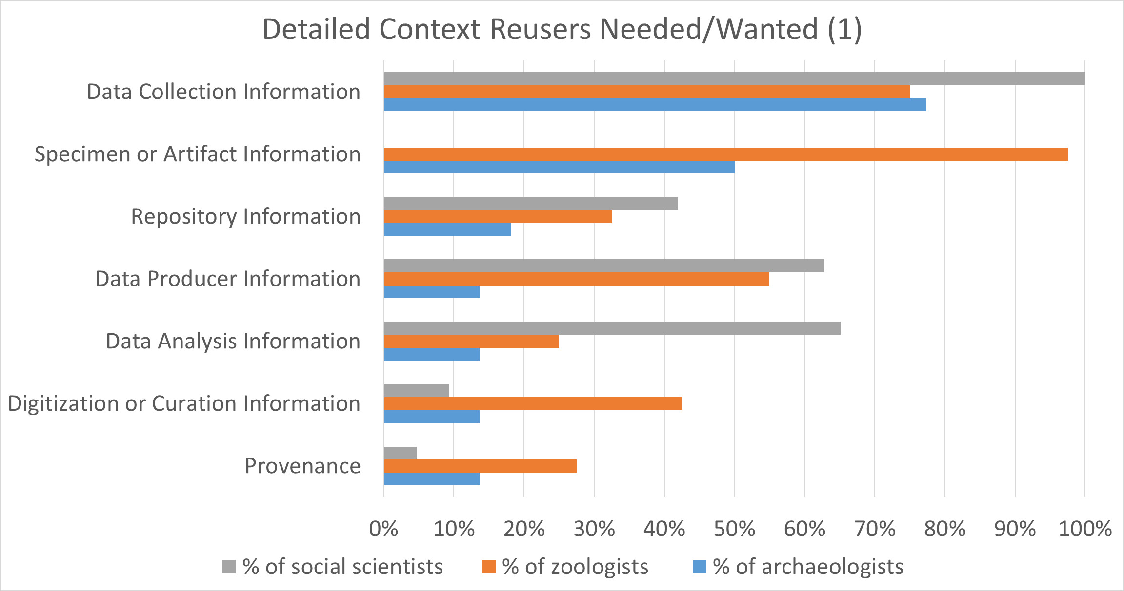
Notes:
Here you see results were based on 105 interviews with 22 archaeologists, 40 zoologists, and 43 social scientists. What you see here are results across the 3 disciplines regarding the percentage of reusers who mentioned needing/wanting different types of context information.
The charts are organized in order of most to least mentions for archaeologists. As you see data collection and artifact information are the most important at 75% and 50% followed by repository information which is close to 20% and data producer, data analysis, digitization/curation, and provenance information all tied at almost 15%.

Slide 5
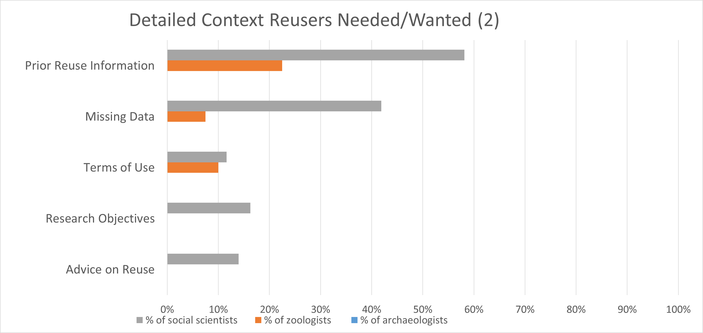
Notes:
The context information that archaeologists didn’t mention that the others did was information about prior reuse, missing data, terms of use, research objectives, and advice on reuse.

Slide 6
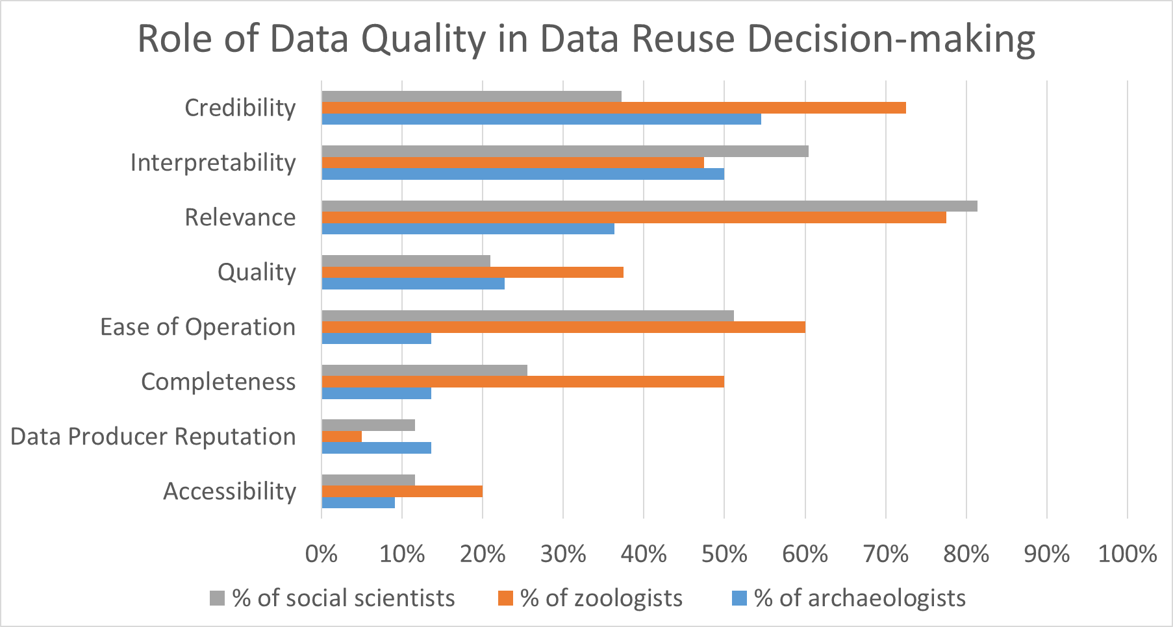
Notes:
Here we see the percentage of reusers within each discipline who mentioned assessing/evaluating data based on these data quality attributes when asked about their decisions to reuse data.
Credibility, interpretability, and relevance were mentioned the most among archaeologists.
Relevance, interpretability, and ease of operation were mentioned most among social scientists.
Relevance, ease of operation, and credibility were mentioned the most among zoologists.

Slide 7
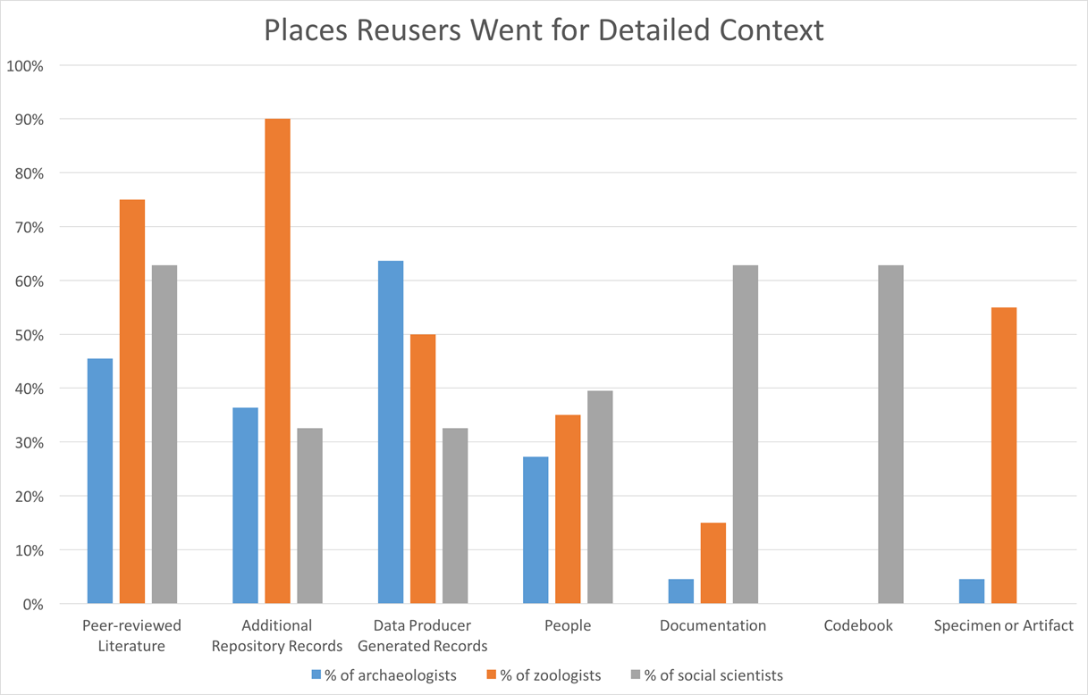
Notes:
Here are the sources reusers relied on to get context information. As you see some of the sources were employed across all three disciplines, but to different degrees. In other cases, the sources were discipline specific.
Archaeologists relied on data producer records and oftentimes had to search, review and assemble records on their own (e.g. photos, sketches of artifacts/stratigraphy, maps, day plans, field reports, etc.) to recreate the data producer’s interpretation.
The data producer’s peer review pubs were used for discovery and access to data and context info.
People (museum staff and data producers) were called on and use in the same was as the publications.
In the interest of time, I’m just going to highlight the top three types of context information archaeologists mentioned and provide some examples via quotes.

Slide 8
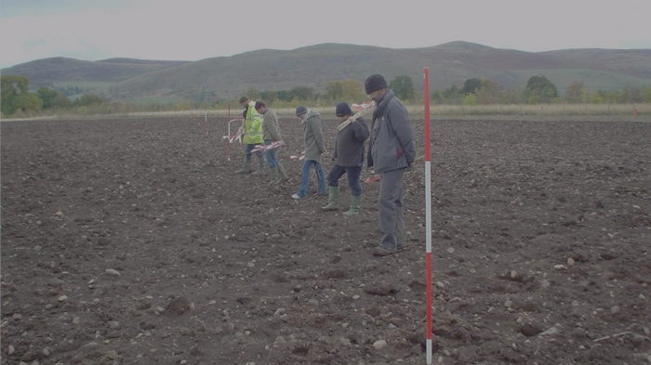
Data collection information
“Sometimes they'll simply declare we were only interested in broad-based information. We were only collecting broad-based artifacts...So, they're walking huge tracts of land, but they're only hitting big things…I've heard of things like shoulder surveys, where they literally walk side by side and pick those little things, but then, again, you've only, you're doing a very narrow tract. So there are procedures”.
- Archaeologist 01
Notes:
Photo credit: Archaeologists fieldwalking at Lanton Quarry http://www.archaeologicalresearchservices.com/lantonwebsite/how/fieldwalking.html
I will start with data collection information. We defined it to include anything related to how a study was designed and the data were gathered. From an earlier study in JCDL (Faniel et al., 2013) we know data collection information was important for archaeologists, because it accounted for the:
context destroyed in the field
interpretations archaeologists made in the field
different approaches to excavations/surveys archaeologists took in the field
One example of different approaches is shown in the photo - a team walking the field site. One of our archaeologist’s explained that details about field walks were important because, it impacted what data producers (i.e. creators) were interested in finding and whether that was of interest to him (data relevance).

Slide 9
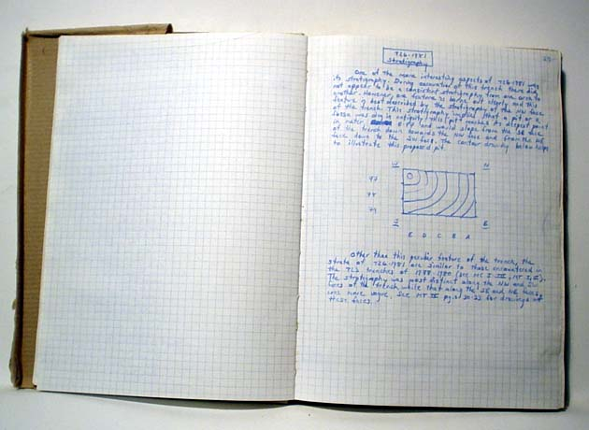
Artifact Information
“I actually mean what strata it's from. I was talking about the importance of having a clear stratigraphy. And so, if they had labeled stratigraphy, let's say, A, B, C, D, E, and if they're comparing the fauna from E to A, that tells me that when they excavated, they were really careful about preserving that information.” - Archaeologist 06
Notes:
Photo credit: Anthony Tuck. "Trench Book MT IV:28-29 from Italy/Poggio Civitate/Tesoro/Tesoro 23/Tr-ID 419". (2012) In Murlo. Anthony Tuck (Ed.) . Released: 2012-07-06. Open Context. <http://opencontext.org/media/3E96B9D7-7507-45D1-D704-BCA4D8CF6FFB>
Related to data collection information was artifact information. The archaeologists reusing data wanted in-depth information about the artifact. And it was typically found in data producers’ records. They were looking to understand and verify the data producers’ interpretations and they wanted to be able to draw their own conclusions. (data interpretability, data credibility).
Asked to describe what s/he meant by “where in the cave something is from”, Archaeologist 06 explained the importance of a clear stratigraphy. Archaeologists wanted to know 1) where below ground an artifact was found (e.g. what strata) so they could figure out the chronology (e.g. its time period) and 2) what else was found with it and where in time the other finds fit given the artifact – did they come before or after or at the same time. And they wanted to see all of that documented – the stratigraphy diagrams, the labeling of the layers, photos/sketches, the written text, etc. And if not documented they wanted to talk to museum staff and original excavators.

Slide 10
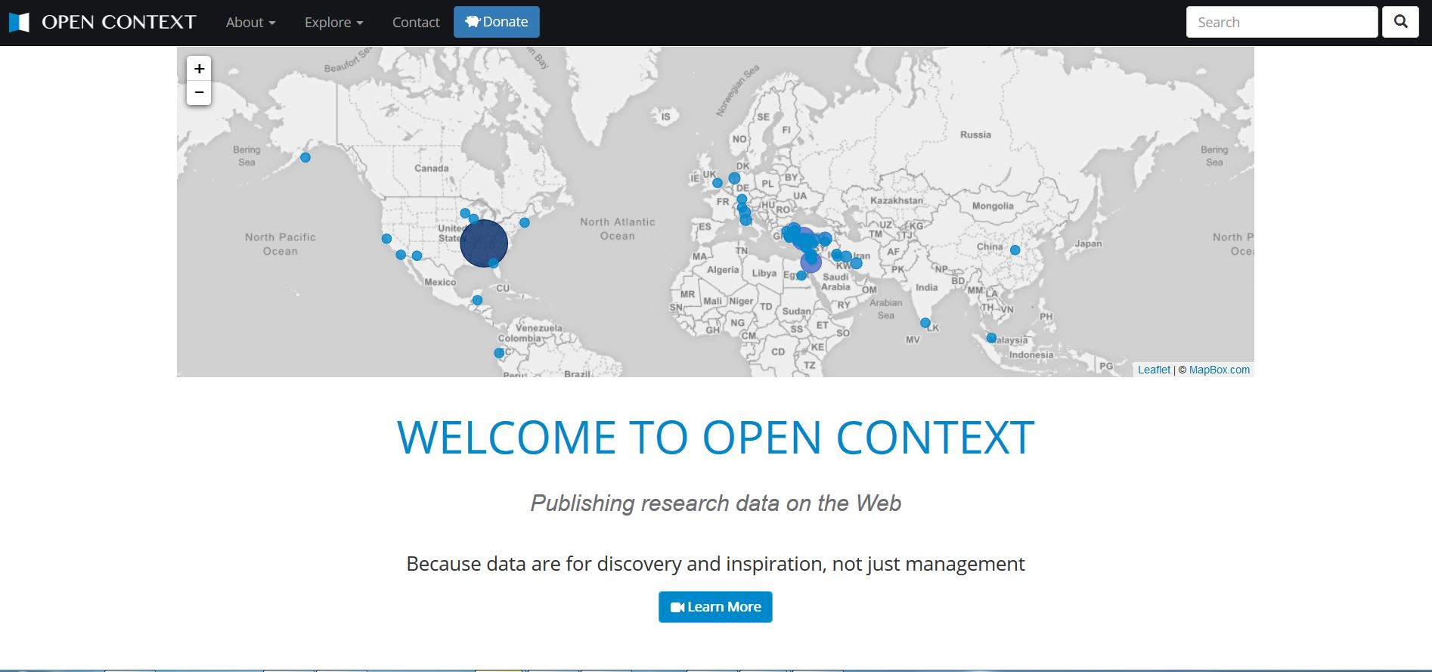
Repository Information
“I don't give [the archaeological repository] a sort of blanket trust that all the data in there is correct…they provide enough metadata for me to check that on my own…I sort of trust going there because I know that I can find the information I need to validate it.”
- Archaeologist 02
Notes:
Image credit: https://opencontext.org/
Repository info: mentions about a repository or museum that provides access to the data. For more information on trust in digital repositories see Yakel et al., (2013).
The quote by Archaeologist 02, exemplifies the thoughts of other reusers – the reputation of the repository/museum impacted perceptions about the credibility of the data.
The repository information reusers often spoke about was not captured anywhere. It was not something data producers provided upon deposit. Rather it was information that was known and passed around within the disciplinary community and included information about a repository’s functions. For archaeologists, the application of metadata was important. Other factors that built archeologists trust in the repository were: preservation and sustainability guarantees, transparency, and institutional reputation.

Slide 11
How do actions in one part of the data lifecycle create challenges or facilitate work at another point in the lifecycle
Notes:
But looking at reuse and reusers is only part of the story. There are other stakeholders, which brings me to the second discussion topic our panel was given was: Where do we see misalignments between data creation and downstream reuse? I’m going to refer to another qualitative study, where we asked: How do the actions in one part of the data lifecycle create challenges or facilitate work at another point in the lifecycle?
Study results are based on additional data collected over the course of the DIPIR project where we:
interviewed data producers and data reusers both before and after the reuse experience
analyzed email threads between the data producers and reusers with repository staff,
conducted one focus group with data reusers,
observed presentations resulting from the data reuse, and read the final paper.
This study took advantage of a group of data producers and reusers who came together to integrate and collaboratively reuse several datasets the data producers had already collected.

Slide 12
Repositories benefit reusers & producers
STANDARDIZATION
“Everything is turned into intentionally difficult codes... hundreds of lines …you have to translate,… It was really important to streamline that translation process.” - Data Producer 3
INTEGRATION
“I don't know what kind of format the datasets had before they got integrated…, but I believe there was a lot of work.” - Data Reuser 9
Notes:
The good news here is that repository staff can facilitate data sharing and data reuse, through their work to:
Standardize data (e.g. decoding or aligning diverse codes for animal bones and teeth in this instance)
“Everything is turned into intentionally difficult codes... hundreds of lines …you have to translate, such as what is a 1 or 1.5, what's that mean? It was really important to streamline that translation process.” - Data Producer 3
Integrate of data from different sources.
“[Repository staff] did a great job integrating it…I don't know what kind of format the datasets had before they got integrated…Integrated to the extent that it’s comprehensible, but I believe there was a lot of work because I know that different zooarchaeologists did things in a number of different ways and coming from different traditions.” - Data Reuser 9
Saving data producers and reusers time and effort by readying the data for deposit and reuse
“It was great that [repository staff] did a lot of the cleaning…you can't do that on your own…you can do it,…you will have to change a lot to integrate it into yours [database] and that will take a lot of time.” - Data Producer 4

Slide 13
Repositories can’t reverse producer practices
DATA DOCUMENTATION
“Just so you have an idea of the issue with tooth wear…the following [seven] sites all record a single field ‘Payne Wear’…[four datasets] all code each tooth in a separate field with a Payne number. But they don’t come up with a letter code for the entire specimen…The remaining datasets don’t provide Payne Stages.” - Repository Staff 2
Notes:
But there are limits to what a repository can do to reverse data collection and documentation practices, which influence data reuse.
For instance, Payne’s tooth wear system, which is widely used in archaeology has well described stages, but no guidelines for documentation. So tooth wear data were recorded in different ways. So a juvenile molar with medium wear could be described with information that spanned 1 to 4 fields depending on the database. And in some cases datasets didn’t provide Payne Stages; in one case, repository staff recalled that one study “had incomprehensible codes…they were an old system.” This underspecified standard not only impacted data producers’ documentation, but also repository staff and data reusers understanding and integration of tooth data. It also saved time and effort.
Data producer 03 was sharing multiple small data sets collected from different sites and some of the data were sampled and some were not. But, he did not have a good way of documenting his practices, he just knew it. In preparing the data to share he kept on getting confused about which data sets were sampled vs. not and therefore could be included in a NISP calculation (number of identified or number of individual specimens). All was important information because sampling limits reusers’ analyses and conclusions.

Slide 14
Data sharing influence on repositories & reuse
DATA CONDITION
“It took 10 times longer to deal with those [coded] datasets….”
- Repository Staff 2
DATA PRODUCERS’ SELECTION
“I did think quite carefully about [including]…those …big subjective descriptions we write about the units...,but I decided to...I couldn’t really be sure if people …would necessarily want them out but they are an important part of the data set.” - Data Producer 10
Notes:
Just as repository staff influence sharing and reuse, how data were shared impacted the work of repository staff and downstream data reusers.
Here you see staff talking about the condition of data impacting time and effort preparing data for deposit. one coded dataset of 20,000 bones took ten times longer than a dataset of over 100,000 bones that had been decoded.
The selection of what data to share is key for reuse. We found data producers withheld different fields in order to submit a more coherent data set. For instance, notes fields were identified as candidates for deletion before sharing. The above quotation illustrates one data producer’s concerns over sharing the note fields. Another data producer eliminated her notes entirely stating, “I just changed my codes and then sent them to you. And I deleted all my comments like, you can't quantify them. So if there's nothing essential then, I deleted them.”

Slide 15
Data reuse influence on repositories & sharing
REPOSITORY PROCEDURES
“There are some inherent issues with CSV…the simplicity is why it is preferred for interoperability and longevity…we need to give users a few tips on working with CSV. I'm also looking into other open spreadsheet formats….” - Repository Staff 1
DATA PRODUCERS’ DOCUMENTATION
“I had a completely different recording system for [teeth, now I’m]…just using…Payne….” - Data Reuser 6
“ [I’m] just dropping numeric codes, not doing…numeric codes anymore.” - Data Reuser 10
Notes:
Many of our participants had shared data before with one another or with other archaeologists, but this collaborative data sharing and reuse experience opened their eyes to the interconnectedness of the lifecycle and made all involved reconsider their practices to better support the end goal - reuse.
Repository staff found that their dissemination format caused problems for some data reusers.
Archaeologists Interaction with colleagues who were reusing their data reflected on their own documentation practices as data producers.
One decided switch to the more common standard for tooth measurement
Another promised to write “down with my data what exactly all those criteria are” when discussing sampling, bone fusion, and tooth wear and to stop using numeric codes.

Slide 16
Next Steps
SLO-data
https://alexandriaarchive.org/secret-life-of-data/
Notes:
I’m not sure if you noticed, but my research has sort of marched around the data lifecycle from back to front.
First by looking at archaeologists reusing data on the DIPIR project
Second by extending that project and looking at the relationships/influences among data producers/reusers and repository staff on data that have already been produced/collected
Now, the idea with the (SLO-data) - Secret Life of Data - project is to examine data at the point of creation, documentation, and management by studying data producers on site at excavations along with potential reusers of their data.
This is another project I’m working on with Sarah and Eric Kansa as well as Anne Austin and Ran Boytner.

Slide 17
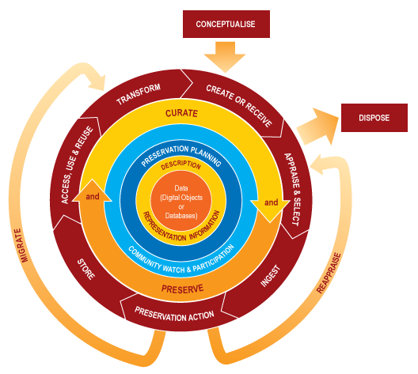
Some Conclusions
Stakeholders’ reusers’ needs must be considered throughout the data lifecycle
How do we do it?
Research data management takes time and effort
Who should bear the burden? How can we lessen the burden?
Notes:
So what do I make of all of this? Some broad conclusions are:
I used to say reusers needs must be considered, but I think to some degree that is known. I tend to be broader in my discussions now because of the interplay between stakeholders. They really have to work together, whether data producers, repository staff, data reusers, librarians at universities supporting their researchers via the disciplinary repositories, etc. There are needs all around that both support and conflict. We need to know what they are, so we can allow the supportive ones to happen and fix the ones that are unsupportive.
The question is how do we do it. In study two it was “radical” collaborative reuse, where archaeologists ate their own dog food so to speak and were faced with the consequences and questions for colleagues. That brought everything into sharp relief. How can we do it in absence of collaborative reuse?
The second conclusion is this takes time and effort to tend to data throughout the data lifecycle. The question is whose? Or better yet how can we lessen the time and effort?

Slide 18
Acknowledgements
Institute of Museum and Library Services
Co-PI: Elizabeth Yakel (University of Michigan)
Partners: Nancy McGovern, Ph.D. (MIT), Eric Kansa, Ph.D. (Alexandria Archive, Open Context), William Fink, Ph.D. (University of Michigan Museum of Zoology), Sarah Whitcher Kansa (Alexandria Archive, Open Context)
OCLC Fellow: Julianna Barrera-Gomez
Doctoral Students: Rebecca Frank, Adam Kriesberg, Morgan Daniels, Ayoung Yoon
Master’s Students: Alexa Hagen, Jessica Schaengold, Gavin Strassel, Michele DeLia, Kathleen Fear, Mallory Hood, Annelise Doll, Monique Lowe
Undergraduates: Molly Haig

Slide 19
Select References
Faniel, Ixchel M., and Elizabeth Yakel. 2017. “Practices Do Not Make Perfect: Disciplinary Data Sharing and Reuse Practices and Their Implications for Repository Data Curation.” In Curating Research Data Volume 1: Practical Strategies for Your Digital Repository, 103-126. Chicago, IL: Association of College and Research Libraries Press.
Frank, R., Yakel, E., & Faniel, I. M. (2015). Destruction/reconstruction: Preservation of archaeological and zoological research data. Archival Science, 15(2), 141-167. doi: 10.1007/s10502-014-9238-9
Frank, R. D., Kriesberg, A., Yakel, E., & Faniel, I. M. (2015). Looting hoards of gold and poaching spotted owls: Data confidentiality among archaeologists & zoologists. Proceedings of the Association for Information Science and Technology (ASIS&T), 52.
Kriesberg, A., Frank, R., Faniel, I., & Yakel, E. (2013). The role of data reuse in the apprenticeship process. Proceedings of the Association for Information Science and Technology (ASIS&T), 50.
Faniel, I., Kansa, E., Whitcher Kansa, S., Barrera-Gomez, J., & Yakel, E. (2013). The challenges of digging data: A study of context in archaeological data reuse. Proceedings of the Joint Conference on Digital Libraries (JCDL), 295-304.
Yakel, Elizabeth, Ixchel Faniel, Adam Kriesberg, and Ayoung Yoon. 2013. “Trust in Digital Repositories.” International Journal of Digital Curation 8 (1): 143–56. doi:10.2218/ijdc.v8i1.251.
Daniels, M., Faniel, I., Fear, K., & Yakel, E. (2012). Managing fixity and fluidity in data repositories. In Mai, J. (Ed.), Proceedings of the 2012 iConference (pp. 279-286). New York: ACM.
Additional references for the DIPIR project: http://www.oclc.org/research/themes/user-studies/dipir/publications.html

Slide 20
Critical Perspectives on the Practice of Digital Archaeology
Thank you
Ixchel M. Faniel, PhD
Research Scientist
fanieli@oclc.org, @imfaniel

