Slide 1
Data Reuse and Sensemaking among Novice Social Scientists
Baltimore, MD, 29 October 2012
ASIS&T 75th Annual Meeting, October 26-30, 2012
Ixchel M. Faniel, Ph.D.
Adam Kriesberg
Elizabeth Yakel, Ph.D.
Postdoctoral Researcher OCLC Research
fanieli@oclc.org
Ph.D. Student University of Michigan
akriesbe@umich.edu
Professor University of Michigan
yakel@umich.edu

Slide 2
An IMLS-funded project led by Dr. Ixchel Faniel and Dr. Elizabeth Yakel.
Studying data reuse in three academic disciplines to identify how contextual information about the data that supports reuse can best be created and preserved.
Focuses on research data produced and used by quantitative social scientists, archaeologists, and zoologists.
The intended audiences of this project are researchers who use secondary data and the digital curators, digital repository managers, data center staff, and others who collect, manage, and store digital information.
For more information, please visit http://www.dipir.org

Slide 3
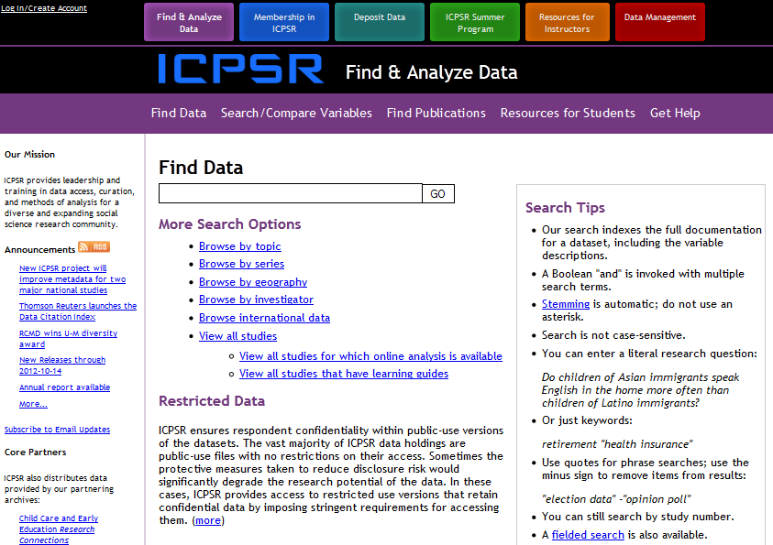

Slide 4
The Study
Research Question
How do novice social science researchers make sense of social science data?
Data Collection
22 Interviews
Data Analysis
Code set developed and expanded from interview protocol
http://www.english.sxu.edu

Slide 5
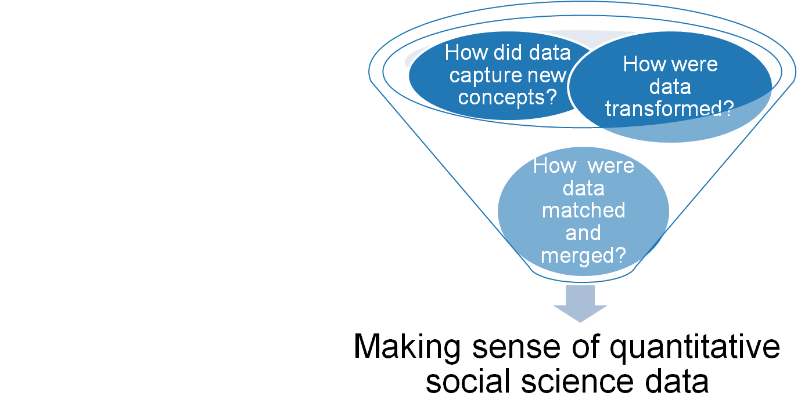
Findings
“…it's numerical value on things that don't have numerical value. So it's not like a sort of thing is worth a certain amount, that numerical value is something that everybody can understand” (CBU14).
Faniel, Kriesberg & Yakel 2012

Slide 6
Making sense of transformations from qualitative to quantitative data
Direct maps (e.g. White=0, Black=1, Asian=2, etc.) not enough
“…I want to find out when they ask the question to the parent or to the student, how was that question asked and was there follow-up questions in terms of did they ask what is your race as opposed to allowing the parent or the student to tell them what their race was” (CBU10).
Interested in how direct maps developed
“So they use New York Times continuously for like the 30 years. New York Times, it has changed. So I want to know like what years New York Times was used to gather data. I'm sure they used more than one newspaper. Also, I want to know which ones those were, for example” (CBU03).

Slide 7
Making sense of concepts not well-established in the literature
Do beliefs match data producer actions
“And that’s not to exclude it just by the nature of it being a right wing organization, but I would want to evaluate their methods to see if that’s the methods that I would’ve chosen…” (CBU09).
How will reusing data impact research
“some parties,… had only like one or two experts rating them, in the Dutch case, which makes it not super reliable, so that’s what’s kind of like [it made me think,…] ‘Oh I should really pay attention that that’s not going to hurt me…” (CBU17).

Slide 8
Making sense of matching and merging capabilities across multiple datasets
Combining longitudinal data
“If they're not asking the same question over years,… [it’s] particularly difficult because if they’ve changed the question wording, are then people answering differently and so there were several discussions that I had with my dissertation advisor…” (CBU18).
Merging data from different sources
“…authors will create a variable, they’ll average across a four or five year period, and I’m trying to match that with a variable that was coded for a single year period. So making an argument…that these two things should be put together …, is something I always have to be wary of …So when dealing with that,…I’ll see if it’s been done by others” (CBU04).

Slide 9
Discussion
Novices engaged in careful articulation of the data producer’s research process.

Slide 10
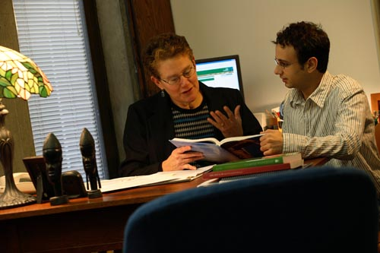
Discussion
Novices relied on human scaffolding
in the form of faculty
advisors and instructors.
http://www.lemoyne.edu

Slide 11
Discussion
Human scaffolding also came from the community as represented in the literature.
http://www.texasenterprise.utexas.edu

Slide 12
Next Steps
Interviews
Social scientists
Archaeologists
Zoologists
Survey
ICPSR Data Reusers
Observations
UMMZ Data Reusers
Web analytics
OpenContext.org transaction log analysis
Map significant properties of data as representation information
Faniel & Yakel 2011

Slide 13
Acknowledgements
Institute of Museum and Library Services
Co-PI: Elizabeth Yakel, Ph.D.
Partners: Nancy McGovern, Ph.D. (MIT), Eric Kansa, Ph.D. (Open Context), William Fink, Ph.D. (University of Michigan Museum of Zoology)
Students: Morgan Daniels, Rebecca Frank, Julianna Barrera-Gomez, Adam Kriesberg, Jessica Schaengold, Gavin Strassel, Michele DeLia, Kathleen Fear, Mallory Hood, Molly Haig, Annelise Doll, Monique Lowe

Slide 14
Questions?
Ixchel M. Faniel fanieli@oclc.org
Notes:
14
14
14

