Slide 1
The Evolving Scholarly Record Workshop Series
Past, Present, and Future
Ricky Erway
Senior Program Officer, OCLC Research
2 June 2015
San Francisco ESR Workshop
#OCLCESR
Notes:
I’m going to give an overview of the Evolving Scholarly Record Framework and a sense of what happened at the three previous workshops to get us all on the same page.

Slide 2
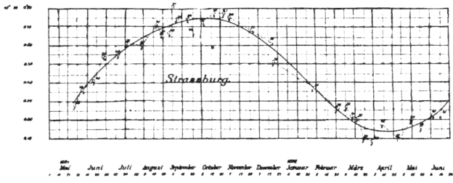
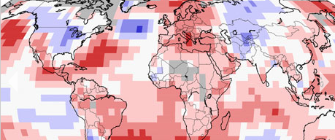
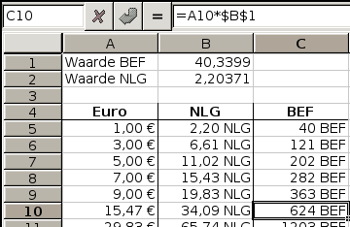
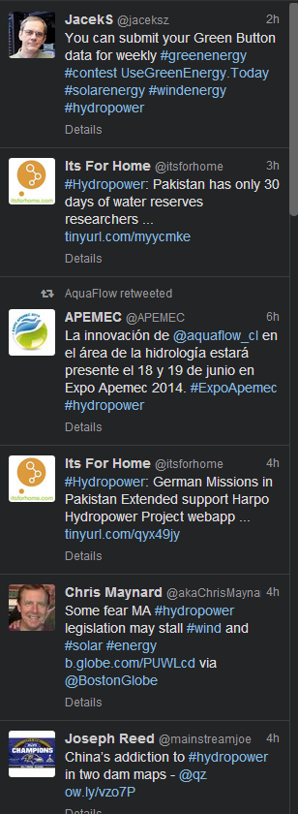
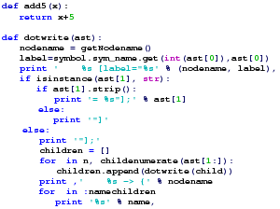
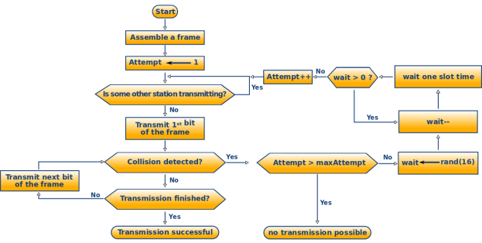
Notes:
[animated] First, what does the scholarly record look like? The majority to date has looked like this, but increasingly we’re seeing *data and *presentations and *social media and *blogs and *human observations and *sensor data and *code and *algorithms and *visualizations.

Slide 3
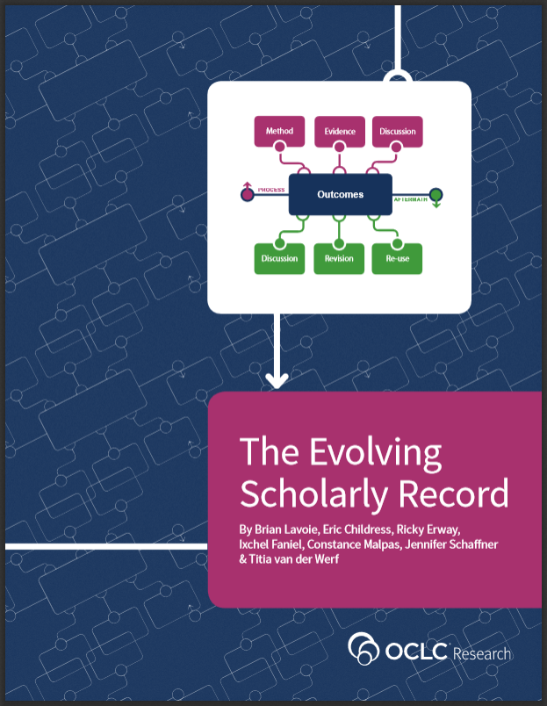
Explore changes in scholarly inquiry and communication
Consider changing perceptions of the long-term value of scholarly materials
Study the related changes to the stewardship of the scholarly record
Notes:
<!>
With the Evolving Scholarly Record essay, we wanted to consider the ways that fundamental changes in scholarly inquiry is affecting scholarly communication and ultimately, the scholarly record (the curated account of past scholarly endeavor).
The scholarly record is evolving into a corpus of material vastly different from its previous print-based version, driven by changes in research practices, as well as changing perceptions of the long-term value of certain forms of scholarly materials. We particularly wanted to explore the related changes in the ways libraries and other stakeholders will steward the scholarly record.

Slide 4
Objective of the essay
Further understanding the nature, scope, and evolutionary trends of the scholarly record
Audience: libraries, publishers, funders, and scholars
Issues: preservation, citation, replicability, provenance, and data curation.
Challenge: discussing issues across the range of stakeholders
Outcome: a conceptual framework providing a high-level view of
categories of materials
key stakeholder roles
Notes:
Understanding the nature, scope, and evolutionary trends of the scholarly record is important for libraries, for publishers, for funders, and of course for scholars themselves. Many issues are related to the scholarly record, such as preservation, citation, replicability, provenance, and data curation. Often these issues must be discussed and resolved across a range of stakeholder groups. With this in mind, OCLC Research has developed a framework of shared concepts and terminology that will help organize and drive discussions about the evolving scholarly record, by providing a high-level view of the categories of materials in the scholarly record, as well as the key stakeholder roles.

Slide 5
Evolutionary trends
Print-centric ➔ digital and networked
Primarily text-based materials ➔ includes research data sets, computer models…
Changes in character
Largely static ➔ mutable and dynamic
Formal publication channels ➔ a blend of channels
Focus on final outcomes ➔ the entire process
Notes:
A range of evolutionary trends are shaping the scholarly record.
First, we are witnessing a shift from what was traditionally a print-centric scholarly record to one that is increasingly digital and residing on the network.
Second, the boundaries of the scholarly record are shifting and blurring. It used to consist primarily of text-based materials like journals and monographs. Today it includes research data sets, computer models, interactive programs, complex visualizations, lab notebooks, and so forth.
Third, some of the fundamental characteristics of the scholarly record are changing. It had been largely static in fixed formats; it was made available primarily through formal publication in books or journals; and its focus was on the final outcomes. Now the scholarly record is more mutable and dynamic than in the past; it is made available through a blend of both formal and informal publication channels; and its boundaries are expanding to include materials from the entire process of scholarly inquiry.

Slide 6
Other influences
New expectations
replicability of scholarly outcomes
leveraging prior work in new work
Reconfiguration of stakeholder roles
creation, management, and consumption are changing
traditional stakeholders taking on new roles
new stakeholders taking on traditional roles
Notes:
There is an increased emphasis on replicability of scholarly outcomes, as well as higher expectations around “leverageability” or the the ability to take previously published work and integrate it into new work.
Finally, there is a reconfiguration of the stakeholder roles associated with the scholarly record. The ways materials are created, managed, and consumed are changing in a variety of ways, with traditional stakeholders taking on new roles, and new stakeholders taking on traditional roles.

Slide 7
The framework
Notes:
At the heart of the framework is what has traditionally been the payload, research outcomes.
The framework then distinguishes between materials that are byproducts of research activities (the process phase) and those that are byproducts of the publication of the scholarly outcome (the aftermath phase).
[Walk around the framework]
Upper/Process
Method – lab notebooks, computer models, protocols
Evidence – datasets, primary source documents, survey results
Discussion – proposal reviews, preprints, conference presentations
Outcomes still include articles and monographs, but also simulations, performances, videos, and a growing variety of other “end products”
Lower/Aftermath
We see Discussion again – this time after the fact: reviews, commentary, online exchanges
Revision – can include additional findings, corrections, and clarifications
Reuse – might involve summaries, or repackaging for popular media versions
Nothing is fixed here. For example, in some fields, a conference presentation may be the outcome, in others it is used to inform the outcome, and in others it may amplify the outcome to reach new audiences.
Including greater emphasis on context makes it a deeper and more complete record of scholarly inquiry.

Slide 8
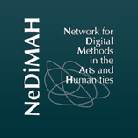
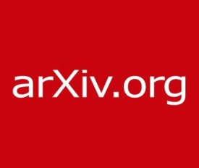
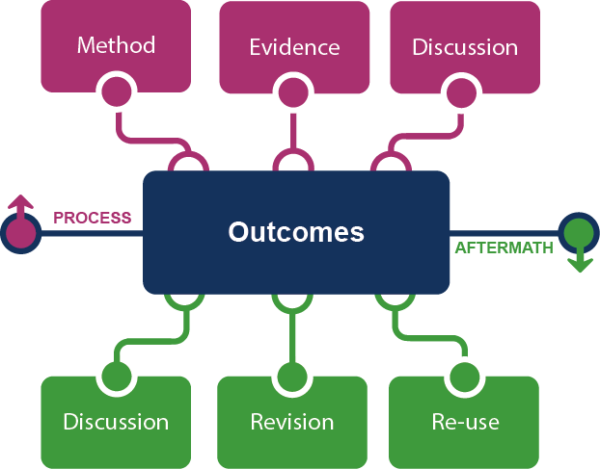
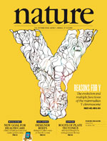
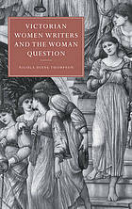
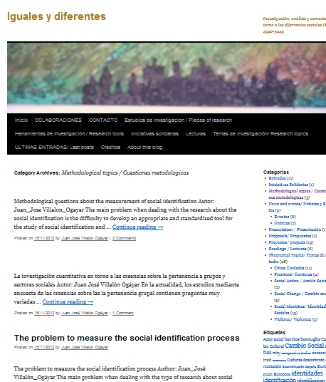
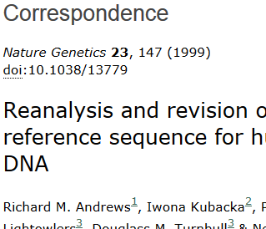
Notes:
There will be different examples for different people -- and the same examples can occur in different parts of the framework, depending on who is using it and for what purpose.
Many of these examples represent places rather than the stuff. Some places are part of the research workflow and others may be about access – and they are certainly not all offering preservation. How do we sort out the serious stewards? What kinds of relationships do we need with those who are serious? And perhaps more importantly, how should we interact with those who make no claim to preservation?

Slide 9
Framing the stakeholder eco-system …
Fix
Collect
Create
Use
Notes:
Let’s take a look at the stakeholder roles in this evolving ecosystem.
The traditional print configuration had well-defined roles and flow:
Researchers or authors create. Publishers fix the outcomes intellectually, physically, and legally. Libraries and archives select, organize, preserve and provide access to the outcomes. Researchers, faculty, and students use the outcomes.

Slide 10
Notes:
Stakeholder roles are being combined in new ways.
Now we see collecting being dis-intermediated. This has been happening for some time with the licensing of electronic journals and eBooks where most of the roles are fulfilled external to the library.
With social media, researchers are creating and using, while the social platform could be said to be fixing and collecting.
When a library publishes open access articles in its institutional repository it is taking on the fixity role as well as collection.
In some cases we have scientists creating a platform in which they use, create, share, preserve, and provide access to their data – taking on all four roles.
It is clear that stakeholders are evolving along with the evolving scholarly record.

Slide 11
The prior workshops
Brought in experts
Natasa Miliç-Frayling, Principal Researcher at Microsoft Research Cambridge, UK
Herbert Van de Sompel, Scientist, Los Alamos National Laboratory
Geneva Henry, Vice Provost for Libraries, George Washington University
Daniel Hook, Director Research Metrics, Digital Science
Clifford Lynch, Director, Coalition for Networked Information
Sarah Pritchard, Dean of Libraries, Northwestern University
Notes:
Now I’ll give you a sense of what happened at the first three workshops that took place over the past year:
Amsterdam in June, DC in December, and Chicago in March.
For those workshops we had guest speakers and then we had two-hour breakout discussions. First I’ll give you a sense of what our experts had to say and then you’ll hear what your colleagues had to say.

Slide 12
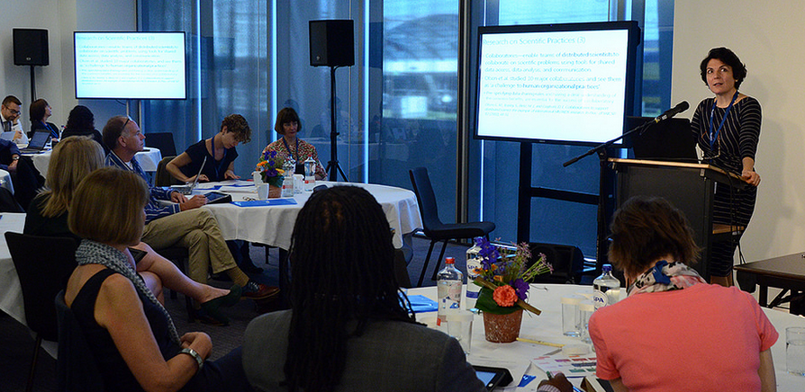
Research Records and Artifact Ecologies Natasa Miliç-Frayling, Microsoft Research
“The diversity and complexity of digital research information is like a rainbow. How do we preserve a rainbow?”
Take a sociological point of view
Notions of ownership and sharing are challenged
Shift thinking from the record to the ecology
Scientists want new services
Preservation requires a connection with the ecosystem
Notes:
Natasa illustrated the diversity and complexity of digital research information comparing it to a rainbow and asking how do we preserve a rainbow? She wanted us to think about how we can support the reuse of scientific data, tools, and resources to facilitate new discoveries. We need to take a sociological point of view because scientific discovery is a social enterprise within communities of practice – and the information takes a complex journey from the lab to the paper, evolving enroute. With teams consist of collaborating, distributed scientists, notions of ownership and sharing are challenged.
Natasa encouraged a shift in thinking from the record to the ecology. She shared her study of the artifacts ecology of a particular nanotechnology endeavor. Their ecosystem has electronic lab books, includes tools, ingests sensor data, and incorporates analysis and interpretation.
Scientists want help linking these artifacts. They want content extraction and format transformation services. They want to create project maps and overviews to support their work in order to convey meaning to guide third party reuse of the artifacts.
Preservation is not just persistence; it requires a connection with the contemporary ecosystem, which may involve virtualizing the old environments on future platforms. She acknowledged the challenges in supporting research, but implored libraries to persevere.

Slide 13
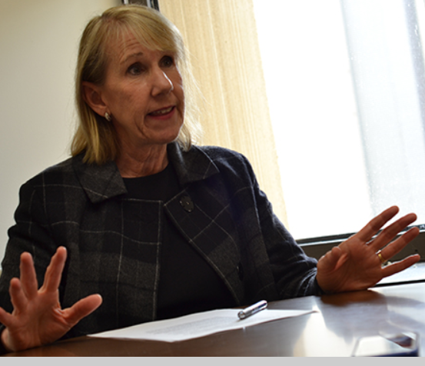
The View from the Campus Geneva Henry, GWU and Sarah Pritchard, NWU
Campus stakeholders
Administrators
Office of Research
Media relations
Academic departments
Promotion and tenure committees
Faculty members
General counsel
Campus IT
Trustees
Policy and compliance issues
Copyright
Privacy of records
IT security controls
State retention laws
Open access
Research information systems
Institutional repository
Course management
Research networking
Research management
Personnel
Campus servers, intranets…
“The library looks out for the institution, which can be
at odds with the faculty sense of professional identity”
Notes:
Our two university librarians gave us a university perspective. They identified the concerns of the various campus stakeholders, for instance:
Administrators care about the identity of the institution
Office of Research is responsible for funder’s requirements
Media relations staff want to identify experts in response to media inquiries
Academic departments want to showcase their faculty output to attract students and faculty
Promotion and tenure committees want a full understanding of faculty activity
Faculty members’ attitudes and perceptions may be excited, worried, protective, or open
General counsel has legal concerns
Public relations officers are image conscious
Campus IT has to manage security and feeds from enterprise systems
Trustees are concerned with governance & policy
They also talked about policy and compliance issues, including
Copyright (at the institutional and individual levels)
Privacy of records (student work, clinical data, business records)
IT security controls and web content policies
State electronic records retention laws
Open access (institutionally or funder mandated)
We also need to consider rights of external system owners
They mentioned the myriad systems involved in research information management
Institutional repository
Course management systems
Faculty research networking systems
Grant and sponsored research management systems
Student and faculty personnel system
Campus servers and intranets, and – because the campus boundaries are pervious — disciplinary repositories, cloud and social platforms.

Slide 14
The View from the Platform Daniel Hook, Digital Science
Importance of transparency and reproducibility
A need for pay-off for investors
Balance collaboration and competition
Who “owns” research and its record?
Demonstrate impact of research
The future will be in assertions of value and impact across institutions
Notes:
Daniel is from Digital Science, which is the parent company of several services, such as FigShare, AltMetrics, Symplectic Elements, and Overleaf. He shared his “view from the platform” and stressed the importance in transparency and reproducibility of research – there is a need for a demonstrable pay-off for investors in research and there is a delicate balance to be reached in collaboration versus competition in research. He said that we are in an era of increased collaboration and the “fourth age of research” is marked by international collaboration. Who “owns” research, and the scholarly record? Individual researchers? Their institutions? Evaluation of research increasingly calls for demonstrating impact of research. The future will be in dynamically making assertions of value and impact across institutions, and in building confidence in those assertions.

Slide 15
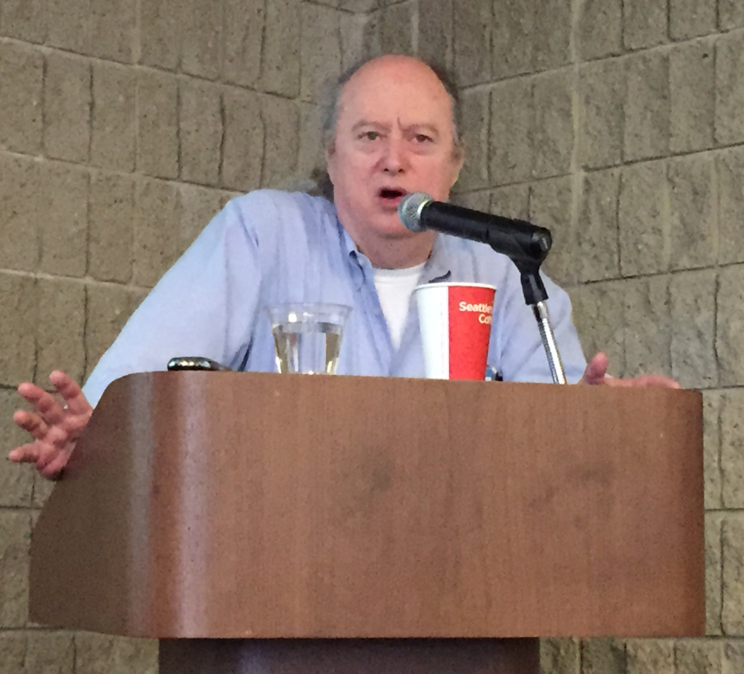
Evolving Scholarly Record: Scope and Context Clifford Lynch, Director, CNI
The scholarly record is huge
Should we keep everything?
Memory institutions are a system.
We can’t capture it all, but we can sample.
It is our role to safeguard the evidentiary record
the data and the science acted upon it.
both refereed and un-refereed
videos, blogs, websites, social media…
New access for the traditional
“There is a lot of stuff that doesn’t make it into IRs because all eyes are
on capturing things that are already archived somewhere. The eyes
are on the wrong ball…”
Notes:
Cliff highlighted stress points. Potentially, the scholarly record is huge, with an expanded range of media and channels. Selection issues are challenging. Is it sensible to consider keeping everything? There is an information density problem and prioritization must be done. Some formats seem to be overlooked — video, for example. Cliff called for the hard questions to be asked.
He talked about memory institutions as more than individual collections, but as a system — to capture both the scholarly record and the endlessly ramifying cultural record. It’s impossible to capture them completely, but hopefully we are sampling the best.
It is our role to safeguard the evidentiary record upon which future scholarship depends. But the scholarly record is taking on new definitions. It includes the relationship between the data and the science acted upon it. Its contents are both refereed and un-refereed. It includes videos, blogs, websites, social media… And even the traditional should be made accessible in new ways.

Slide 16
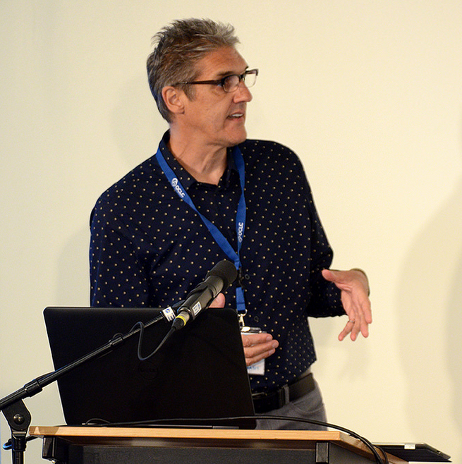
A Perspective on Archiving the Evolving Scholarly Record Herbert Van de Sompel, LANL
Functions of scholarly communication
Registration
Certification
Awareness
Archiving
Web of Objects.
Changes to scholarly communication and research objects
Content hosted on web platforms
Web resources seldom archived.
From atomic objects to compound objects
An important distinction between recording and archiving and the need for transfer from one to the other
“Our goal is to achieve the ability to persistently, precisely, and seamlessly
revisit the Scholarly Web of the Past and of the Now at some point in the Future.”
Notes:
Herbert took a web-focused view, saying that not only is nearly everything digital, it is nearly all on the web, which must be taken into account when we talk about archiving.
He used Roosendaal and Geurtz’s functions of scholarly communication to structure his talk: Registration (the claim, with its related objects), Certification (peer review and other validation), Awareness (alerts and discovery of new claims), and Archiving (preserving over time). The four functions had been integrated in print journal publishing, but now are distributed among many entities.
Herbert then characterized the future environment as the Web of Objects. Scholarly communication is becoming more visible, continuous, informal, instant, and content-driven. As a result, research objects are more varied, compound, diverse, networked, and open. This presents several challenges to libraries. Archiving must take into account that objects are often hosted on common web platforms (e.g., GitHub, SlideShare, WordPress), which are not necessarily dedicated to scholarship. We spend most of our efforts archiving only 50% of journal articles and they tend to be the easy, low-risk titles, which as Cliff noted, are usually archived elsewhere. But “Web at Large” resources are seldom archived. Today’s approach to archiving focuses on atomic objects and loses context. We need to move toward archiving compound objects in various states of flux, as resources on the web rather than as files in file systems.

Slide 17
Recording to Archiving
Notes:
Herbert’s distinction between recording and archiving is critical. Recording platforms make no commitment to long-term access or preservation. They may be a significant part of the scholarly process, but they are not a dependable part of the scholarly record.
We need to start creating workflows that support researcher-motivated movement of objects from private infrastructure to recording infrastructure and support curator-motivated movement of objects and context from recording infrastructure to archiving infrastructure.

Slide 18
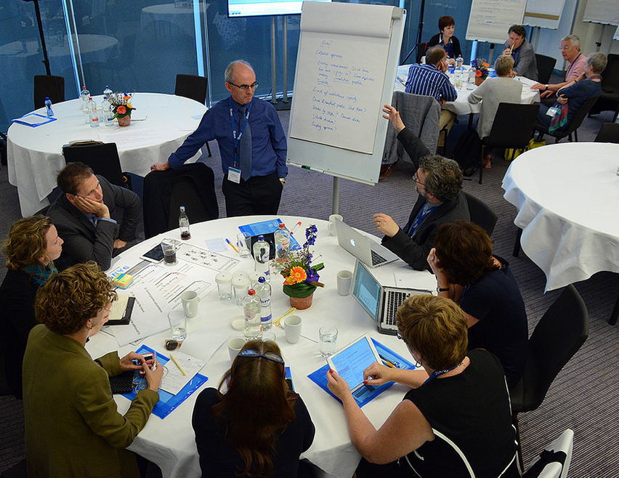
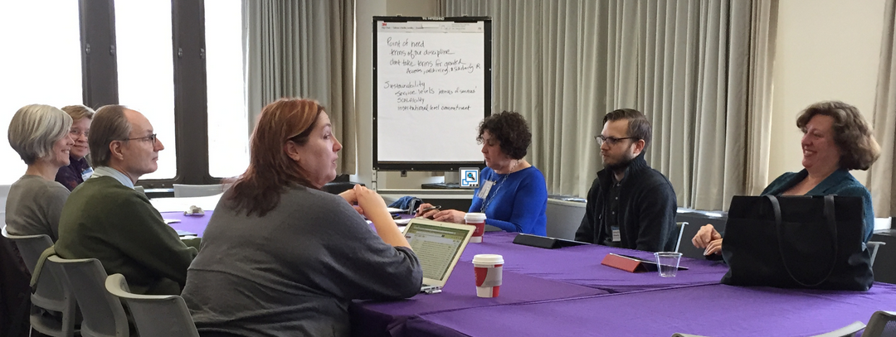
Breakout group discussions
Notes:
Now I’ll provide highlights of the breakout discussions from the three workshops.

Slide 19
Selection
First, your own institutional output
Capture from active research projects
Assess user demand
Ensure you keep evidence for verification
Determine what need not be saved
Have a deselection policy
Involve researchers in identifying resources but be prepared to do it yourself
Be aware of how your decisions fit into the broader system
Develop criteria for blogs and websites to be archived
Declare collections of record
Communicate web archiving commitments
Focus on the at-risk materials.
Accept adequate content sampling.
Notes:
First collect, preserve, and provide access to materials created by those at our own institution.
Figure out what should proactively be captured from active research projects.
To take into account user-driven demand, mine user studies/reviews to pull out research needs/methods/trends/gaps.
Ensure that we have evidence for verification and retain results of failed experiments.
Try to identify what need not be saved (locally or at all).
Have a deselection policy
While we can involve researchers in identifying resources for preservation, in some cases we’ll have to hunt them down and harvest them ourselves.
Be aware of how what we select fits into the broader scholarly record.
Establish criteria for selecting blogs and web sites to archive (e.g., number of hits, if it’s indexed for example by MLA, or cited in scholarly articles).
Declare collections of record so that others can depend on them.
Communicate when we have taken on a commitment to web archiving particular resources
And finally recommendations to:
Focus on at-risk materials.
And to accept adequate content sampling.

Slide 20
Support for researchers
Deposit somewhere
Help choose external repositories / offer an option for disciplines lacking them
Info as research input
Start with the dissertation, and work with grad students and untenured faculty
Hub for scholars who don’t know what they need
Link materials related to the same project
Determine what the “object” is
Portability throughout a researcher’s career
Be part of the grant process from the beginning
Ask researchers questions
Appropriate services for each discipline
Faculty profiling, bibliography, resumes
Service level and end-of-life agreements
Notes:
Assist researchers in depositing their content somewhere and to ensure that deposits are discoverable.
Offer expertise and familiarity with reliable external repositories to help researchers make good choices in use of disciplinary data repositories and provide a local option for disciplines lacking good choices.
Help researchers find and access information they need as inputs to their work, as well as helping them to ensure that their outputs are discovered and accessible by others.
Use the dissertation as the first opportunity to establish a relationship, mint an ORCID and DOIs for a researcher.
Work with grad students and untenured and newly-tenured faculty as that may be the time they are most receptive.
Create a hub for scholars who don’t know what they need, to refer them to the appropriate services in the library and elsewhere.
Explore ways to link the various research materials related to the same project.
Determine for each project what is considered the object and how to link it to related bits.
Find ways to ensure portability of research outputs throughout a researcher’s career.
Build library expertise and funding into the grant proposal process, becoming an integral part of the process to ensure that materials flow to the right places instead of needing to be rescued after the fact.
Ask researchers what’s important in their field, then ask who is looking after it.
Offer the appropriate services to each discipline. (Social Sciences want help with SPSS or R. Others want GIS. And for STEM and Humanities there are completely different needs.)
Help faculty avoid having to profile themselves in multiple venues. Offer bibliography and resume services.
When committing to archiving, include an MOU covering service levels and end-of-life provisions.

Slide 21
Collaboration within the university
Reputation through service provision
Focus
Use policy and financial drivers to motivate
Optimize expertise, minimize duplication
Metrics for impact and reputation
Statements of organizational responsibility
Get a partner on board early
Environmental scan
When to cede control
Partnerships with research centers and computing services
Licensing negotiation
Integrate non-traditional objects
Integrate library services with campus infrastructure
Cooperate with other universities
Notes:
Earn reputation through service provision and through access as opposed to reputation through ownership and use service offerings to re-position the library in the campus community.
Decide where the library will focus; it can’t be expert in all things.
Use policy and financial drivers (mandates, ROI expectations, reputation and assessment) to motivate a variety of institutional stakeholders.
Coordinate to optimize expertise, minimize duplication, rebalance resources, and contain costs.
Help find efficient metrics for assessing researcher impact and enhancing institutional reputation.
Decide what kinds of statements of organizational responsibility are needed: a declaration of intent covering what we will collect, a service agreement covering what services we will provide to whom, terms of use, and explicit assertions about which parts of the university are doing what.
Get at least one other partner on campus on board early — maybe someone in the office of research or in IT.
Have conversations with faculty departments to get an environmental scan. Identify what is needed (like GIS, text-mining, data analysis), and distill it into areas the library can support or send along to campus partners.
Know when to cede control to another area on the campus.
Develop partnerships with research centers and computing services, deciding what and where in the lifecycle things are to be archived and by whom.
When other parts of the university decide to license data from vendors like Elsevier, offer to help with the negotiation.
Coordinate with other campus pockets of activity involved with non-traditional objects to integrate them into the infrastructure so they can circulate with the rest of the record.
Make alliances on campus so you can integrate library services into the campus infrastructure. There are limits to institutional capacity, so cooperating with other universities is also necessary.

Slide 22
Collaboration with external entities
Fit into the ecosystem
Persistent object IDs and researcher IDs
IP rights, privacy, and terms of use
Open access vs. publisher agreements
Repositories’ commitment to preservation
Rely on dependable external services
Relationships with research centers and disciplinary repositories
Interoperate with external systems
Publishers and the process and aftermath
Not campus-centric but system-centric
Scholarly societies
Local vs. elsewhere
Centers of excellence
Work with companies on impact
Pockets of interoperability
Follow the money
Notes:
Restructure the role of the library so it functions along with other institutions and commercial and governmental entities.
Employ persistent object identifiers and multiple researcher name identifiers to interoperate with other systems.
Help researchers negotiate on IP rights, terms of use, privacy, and other issues when engaging with environments like GitHub, SlideShare, and publishers’ systems.
Help harmonize open access policies and publisher agreements.
Determine which external repositories are committed to preservation.
Rely on external services like JSTOR, arXiv, SSRN, and ICPSR, which are dependable delivery and access systems with sustainable business models.
Figure out what kinds of relationships are needed with research centers and disciplinary repositories.
Learn how to interoperate with external systems (such as SHARE).
Pursue with publishers whether they will collect the related materials from processes and aftermaths.
Provide a gateway to infrastructure that is not campus-centric but system-centric.
Work with scholarly societies to learn what we need to collect in a particular discipline — and how to work with those researchers to get those things.
Identify the things can be done elsewhere and those that need to be done locally.
Consider centers of excellence. You could offer your expertise, for instance, with a shared video repository and rely on another institution for data deposit.
Work with companies like Symplectic to help with the impact of researcher output.
Identify pockets of interoperability rather than waiting for total interoperability to happen.
Follow the money in the ESR ecosystem to see where there are disconnects between shareholder interests and scholar value.

Slide 23
Take-aways
Single institutions can’t manage all of the scholarly record.
Stewardship will be much more deliberate.
Decision-making around the scholarly record will be more consciously coordinated.
Notes:
We’ve talked about trends, the framework, and the stakeholder ecosystem. You’ve heard what your colleagues at previous workshops have had to say.
Some conclusions one might draw are that:
No single institution can hope to gather and manage all of—or even a significant share of—the scholarly record.
Perpetuation of the scholarly record is likely to become a much more collective and deliberate enterprise, with more tightly integrated and explicit roles and responsibilities.
Decision-making around the scholarly record will have to become more consciously coordinated.

Slide 24
Notes:
So now that we’re all on the same page, I look forward to the next two presentations, but even more so to our plenary discussions where we will take all of this a few steps closer to concrete action.

