Slide 1
University-wide Research Data Management Policy
CNI, 9 December 2013
Starting the Conversation
Ricky Erway
Senior Program Officer
OCLC Research
@rickyerway
Notes:
Much has been written about research funders requiring data management plans, and universities moving quickly to meet those requirements. Now is a good time to reflect on broader issues than those imposed by external requirements.

Slide 2
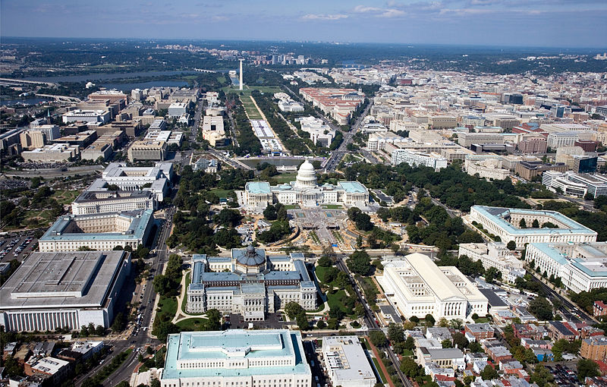
Overview
Genesis and approach
Benefits and advocacy
Stakeholders
The conversation
Notes:
Starting the Conversation: University-wide Research Data Management Policy is a call for action that addresses the benefits of adopting a university-wide policy regarding research data management. It identifies the various university stakeholders and suggests a conversation among them in order to get buy-in for a proactive, rather than reactive, high-level policy for responsible data planning and management that is supported and sustainable.
Any one of the stakeholders can be the instigator. It’s an opportunity for an entrepreneurial person to get things going and to make sure they are part of the conversation.
http://commons.wikimedia.org/wiki/File:Washington,_D.C._-_2007_aerial_view.jpg Aerial view (looking west) of Capitol Hill and the National Mall in Washington, D.C., United States. This work has been released into the public domain by its author, Carol M. Highsmith. This applies worldwide. This image is available from the United States Library of Congress's Prints and Photographs division under the digital ID highsm.01901.

Slide 3
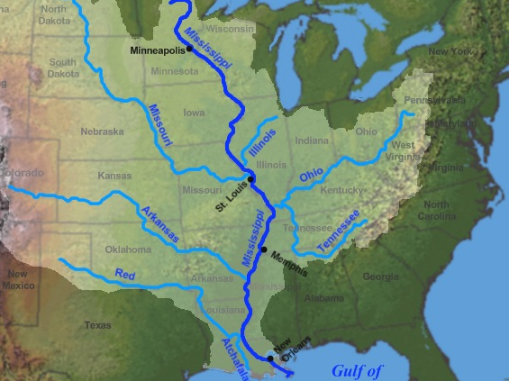
Source
Source
OCLC
OCLC Research
OCLC Research Library Partnership
Advancing the Research Mission
Library’s Role in Data Curation
Data Curation Working Group
OCLC
OCLC Research
OCLC Research Library Partnership
Activity: Advancing the Research Mission
Library’s Role in Data Curation
Data Curation Working Group
Jon Platek, Map of the course, watershed, and major tributaries of the Mississippi River.
Notes:
So here’s the derivation of this work…
I work for OCLC, in OCLC Research, and I work with the OCLC Research Library Partnership. One area of our work is focused on the library role in Advancing the Research Mission of their University. One of the activities focuses on data curation. We formed a working group to address the topic.
http://commons.wikimedia.org/wiki/File:Mississippi_watershed_map_1.jpg Map of the course, watershed, and major tributaries of the Mississippi River. Jon Platek This file is licensed under the Creative Commons Attribution-Share Alike 3.0 Unported license. Base map used was taken from the National Atlas, watershed map was from this site from the United States Geological Survey. The picture of the steamboat Robert E. Lee was from this file, which is public domain due to its age.

Slide 4
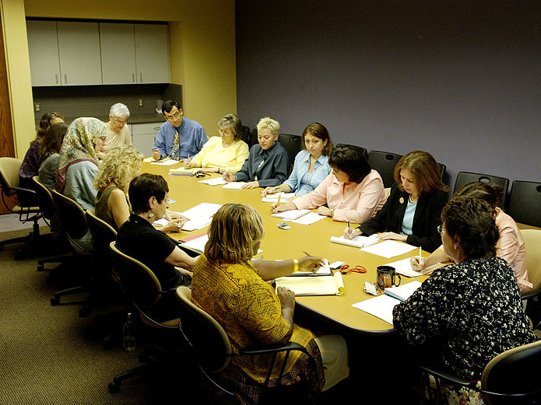
Data Curation Working Group
Daniel Tsang, University of California, Irvine (Chair)
Anna Clements, University of St. Andrews
Joy Davidson, Digital Curation Centre
Mike Furlough, Pennsylvania State University
Amy Nurnberger, Columbia University
Sally Rumsey, University of Oxford
Anna Shadbolt, University of Melbourne
Claire Stewart, Northwestern University
Beth Forrest Warner, Ohio State University
Perry Willett, California Digital Library
Notes:
And these are the people who actively contributed to the work, chaired by Daniel Tsang (who recently received an ICPSR distinguished service award)
The group has representatives from several fine research institutions
http://commons.wikimedia.org/wiki/File:Staff_meeting_%282%29.jpg Staff Meeting Description Staff from the Cancer Information Service (CIS) hold a meeting in their conference room. This work has been released into the public domain by its author, Bill Branson (Photographer).

Slide 5
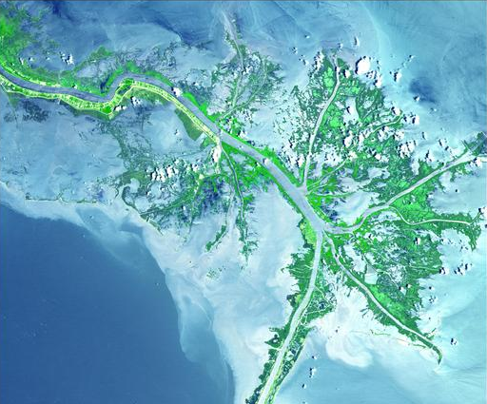
Distribution
Data Curation Working Group
OCLC Research Library Partnership Listservs
OCLC Publication
EDUCAUSE Review Online
CNI Fall Briefing
????
Notes:
And this is how we’re getting the word out
The working group is the first point of dissemination
We use the listservs of the Research Library Partnership to report on progress
The OCLC publication came out this week
A derivation of this work is in the Nov/Dec Educause Review Online – a special issue focused on Data Curation
We’re here at CNI
And we’re looking for other opportunities…
We have a proposal for the RDAP meeting in San Diego in March (Research Data Access and Preservation)
And hopefully through a variety of means it gets to the intended audience
The Working group started by looking at the benefits of a university-wide data policy….
http://commons.wikimedia.org/wiki/File:EAA2_Mississippi_River_Delta.pdf Earth-As-Art (EAA) satellite scenes Mississippi River Delta Mississipi River Delta, before the oil spill. This image is in the public domain because it contains materials that originally came from the United States Geological Survey, an agency of the United States Department of the Interior.

Slide 6
Benefits of data management
Validation of results
Reuse in new areas of research
Curation throughout data lifecycle
Efficiencies of scale
Clear expectations for data managers
Uniform requirements for researchers
Consistent standards foster harmony
Ease compliance and improve access
Benefit all research
Notes:
Now that universities have experience preparing data management plans required by grant funding agencies, benefits are becoming apparent:
Making data sets available can support validation of results.
Data can be repurposed in new ways.
Planning for data management early on eases curation throughout the data lifecycle.
Efficiencies can be achieved when data curation activities are not treated as one-off occurrences.
___
With a university-wide data policy, many desirable outcomes are possible:
Clear expectations will ease the way for data managers.
Uniform requirements will facilitate sharing among researchers.
Consistent data management standards, training , and tracking can foster harmony within the university.
A standardized approach to data management will ease compliance -- and improve access to the university's intellectual assets.
Positive impacts and efficiencies can benefit all research conducted at the university, not just that funded by agencies requiring a data management plan.
http://commons.wikimedia.org/wiki/File:Hyacint2.jpg Hyacint, Brno, CZ I, the copyright holder of this work, release this work into the public domain.

Slide 7
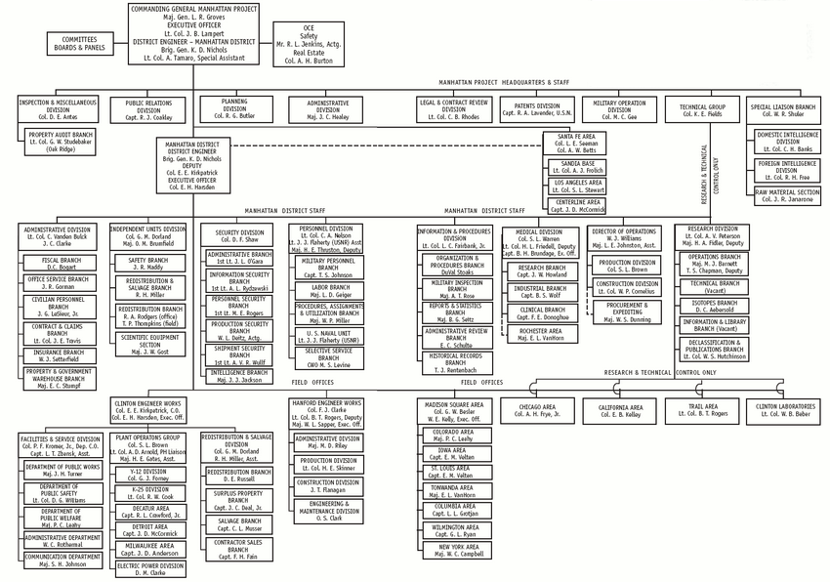
Stakeholders
The University
Office of Research
Research Compliance
IT Department
Researchers
Academic Units
Library
Notes:
Assuming that these benefits look appealing, stakeholders should enter into discussions to make sure their university realizes them.
These are the obvious stakeholders on most campuses. (There may be local variants)
We’ll consider their viewpoints one at a time.
http://commons.wikimedia.org/wiki/File:Manhttan_Project_Organization_Chart.gif Manhattan Project Organization Chart. This image is a work of a U.S. Army soldier or employee, taken or made as part of that person's official duties. As a work of the U.S. federal government, the image is in the public domain.

Slide 8
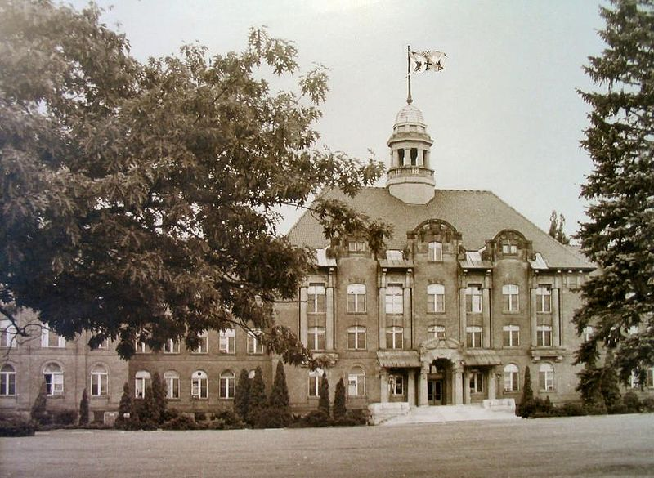
The University
Assets from research mission
Safeguard investment
Balance commercialization with sharing
Responsible steward
Economical and sustainable
Contribution to the public good
Ensure future research funding
Commitment to open access
Contribute to academic integrity and responsible stewardship
Notes:
Research data can be viewed as university assets, stemming from the university's mission to support quality research.
Applying best practices to safeguard such assets protects the university's intellectual, financial, human, and material investment in research.
The aspiration to commercialize research and patents must be balanced with the desire (in addition to the requirement) to share data.
The university will want to ensure that it is a responsible steward for the research outputs of the institution — and will want to find economical and sustainable ways to do so.
Responsible data management, and the resulting access to research data, can contribute to an improved public understanding of the university's contributions to the public good.
Public support can help ensure future research funding.
The university also may wish to make a public commitment to open access.
A university-wide policy should address how best practices in managing research data and making it publicly accessible contribute to high-quality research, academic integrity, and responsible stewardship.
http://commons.wikimedia.org/wiki/File:Mac-old.jpg Main building, Macdonald College in the 1940's. From McGill University Archives. This media file is in the public domain in the United States. This applies to U.S. works where the copyright has expired, often because its first publication occurred prior to January 1, 1923.

Slide 9
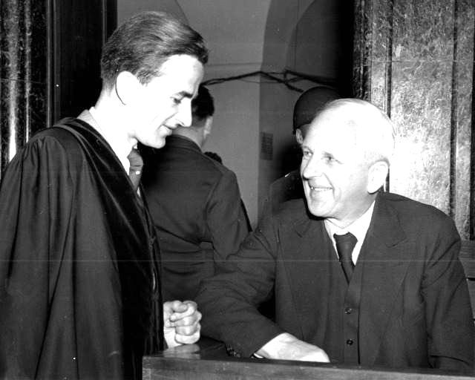
Office of Research
Administers sponsored research
Key contact with funding agencies
Responsibility for technology transfer, patent, IP
Tracks awards, progress reports, and completion
Point of coordination
Interest in funding, policy, and governance
Assists researchers with data mgmt costs
Embed data management into workflows
Notes:
The office of research has responsibility for administration of sponsored research and related policies and services.
It is a key contact with funding agencies and is involved in university and consortial advocacy around research funding and the conduct of research.
The office of research may have responsibility for technology transfer, patent and other IP administration, research integrity, and the institutional review board.
This usually is where proposals, awards, progress reports, and project completion are tracked.
During the proposal stage, the office of research can ensure that those who will implement the data management plan are involved as early as possible.
They are concerned with the funding and policy and governance of data management programs – and in maintaining good relationships with funders.
They can assist researchers with identifying data management costs for their grant proposals.
The research office is in the best position to embed research data management into grant management workflows.
http://commons.wikimedia.org/wiki/File:Ernst-von-Weizs%C3%A4cker.jpg Ernst-von-Weizsäcker.jpg ‎(640 × 512 pixels, file size: 64 KB, MIME type: image/jpeg) This work is in the public domain in the United States because it is a work prepared by an officer or employee of the United States Government as part of that person’s official duties

Slide 10
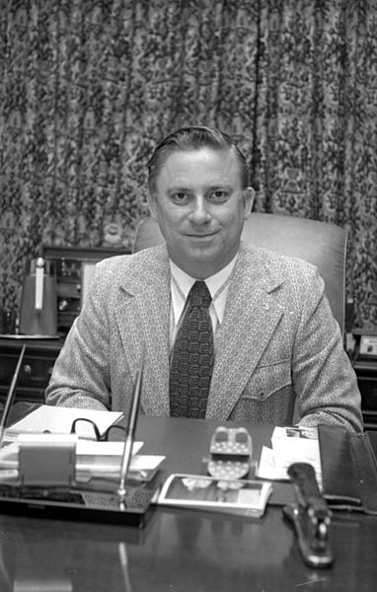
Research Compliance
Compliance with policies and regulations
Reviews policies, weighs benefits and risks
Training, communication, and enforcement
Uniformity of data management expectations, requirements, and standards
Measures of validation
Responsibilities to data housed elsewhere
Impacts of changing data retention requirements
Notes:
It is important to recognize the particular point of view that the research compliance office represents:
It ensures that institutional policies are in compliance with sponsor policies and regulations--
--and carefully reviews proposed institutional policies with a view towards the practical and procedural issues of compliance, weighing both benefits and risks.
The office's responsibility for ensuring compliance with institutional policy through training, communication, and enforcement requires their involvement in policy discussions.
Some points of consideration may include uniformity of data management expectations, requirements, and standards…
… and the measures of validation that proposed data management systems will require.
They may monitor the responsibilities of the institution to data housed elsewhere
And will attend to the impacts of changing data retention requirements.
http://commons.wikimedia.org/wiki/File:Louie_L._Wainwright.jpg Louie L. Wainwright.jpg This work was created by a government unit of the U.S. state of Florida and is in the public domain under Florida law.

Slide 11
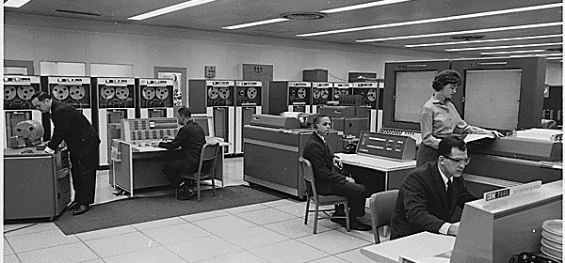
IT Department
Data acquisition, storage, management, security, integration, mining, and visualization
Systems for documenting, depositing, managing, archiving, and preserving data
Search and retrieval and access
Economies of scale, integration
Coordinating technology and expertise
Integration with CRIS, VRE to make data management part of the researchers' workflow
Notes:
Today's cyberinfrastructure must support advanced data acquisition, storage, management, security, integration, mining, and visualization, as well as other information-processing services.
All infrastructure must now include systems for documenting, depositing, managing, archiving, and preserving data, as well as
facilitating efficient search and retrieval; and providing access.
A coordinated cyberinfrastructure environment can offer advantages such as economies of scale, integration,
--and a focused approach to coordinating technology, expertise, computing power, and storage space.
Technology leaders may need to integrate the data management system with current research information systems or virtual research environments to make data management part of the researchers' workflow.
http://commons.wikimedia.org/wiki/File:NASAComputerRoom7090.NARA.jpg NASA mission control computer room with dual IBM 7090's, apparently taken around the time of the Mercury Atlas 6 (MA-6) mission in 1962. From US National Archives and Record Administration ARC system. This file is in the public domain because it was solely created by NASA.

Slide 12
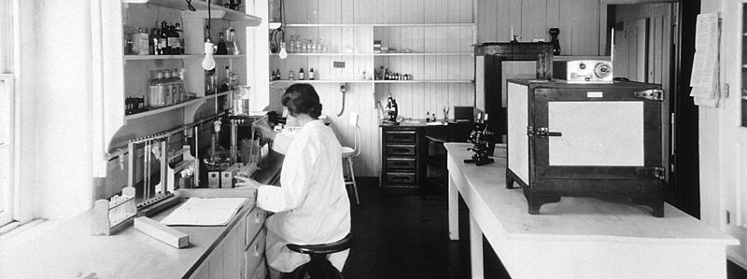
Researchers
Career advancement depends on research outputs.
Confront a mix of requirements
Negotiate publishing agreements
May deposit data in external repositories
Resist new administrative burdens
Trust is critical
Must be informed of decisions and procedures
Notes:
As the producers of the research data that must be managed and preserved, researchers are central stakeholders:
They may be especially invested when their career advancement depends on their research outputs.
Faculty members and other researchers confront a mix of requirements for data management and open access that are mandated by funding agencies, national and state law, and their own universities.
They may negotiate publishing agreements that determine ownership of data — and that in some cases mandate, or preclude, open access.
Some researchers already may have experience depositing data in institutional or discipline-based data repositories.
Researchers are likely to resist new administrative burdens
The relationship between researchers and their data is an intimate one. Trust is critical to productively engage them.
All researchers should be clearly informed of resulting decisions and procedures.
http://commons.wikimedia.org/wiki/File:Immunology_laboratory_at_the_central_cancer_research_labs.jpg Immunology Laboratory at the Central Cancer Research Labs (1931). This image was released by the National Cancer Institute, an agency part of the National Institutes of Health, with the ID 1866 (image) (next). This tag does not indicate the copyright status of the attached work. A normal copyright tag is still required. See Commons:Licensing for more information. Reuse Restrictions None - This image is in the public domain and can be freely reused. Please credit the source and/or author listed above.

Slide 13
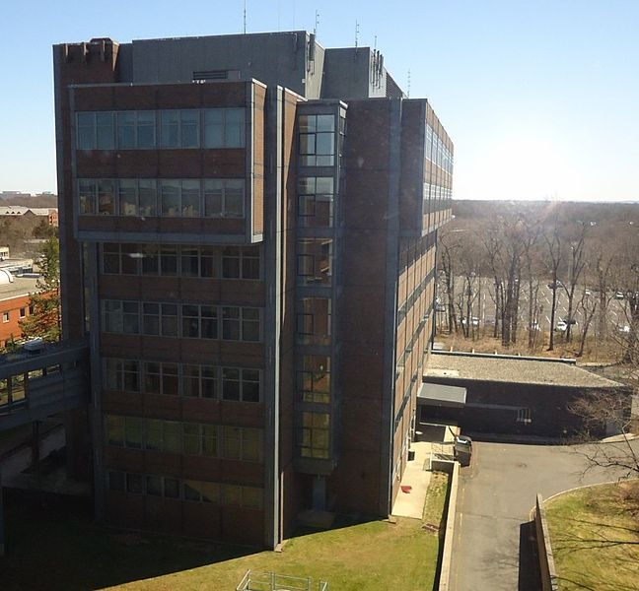
Academic Units
Manage research projects
Support proposal writing, budgets
Administration and tracking
Some have their own technology infrastructure
Close relationships with the researchers
Good conduits for communication
Might welcome guidance and infrastructure
Notes:
While the office of research is the locus for policies, oversight, and other activities regarding research grants, the researchers themselves are generally in academic units overseen by the university provost.
At the operational level, research projects are managed by the principal investigator's home department.
Some academic units have support staff to help with proposal writing, administration, budgets, tracking, and compliance.
Some also may have their own technology infrastructure.
They have close relationships with the researchers in their departments and can serve as good conduits for communication.
They may feel uncertain about the new data management requirements and might welcome guidance, including the provision of a more robust and sustainable infrastructure than they can manage independently.
http://commons.wikimedia.org/wiki/File:Rutgers_University_CoRE_Building.jpg Rutgers University Computing Research & Education Building on the Busch campus. Tomwsulcer This file is made available under the Creative Commons CC0 1.0 Universal Public Domain Dedication.

Slide 14
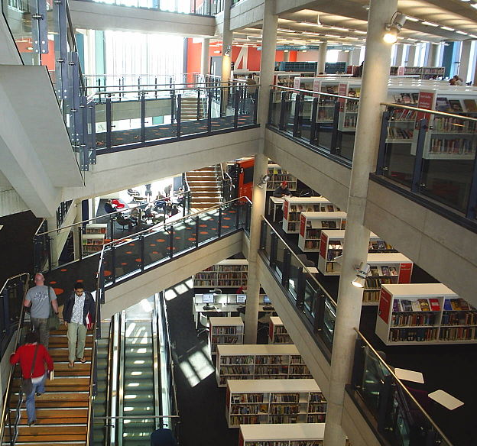
The Library
Experience with selection, repositories, preservation, and access
Subject area and functional liaisons
Help with appraisal, deposit, retention, metadata
Researcher name disambiguation
Copyright and privacy issues
Guidance for deposit in external repositories Creation of data-management plans
Notes:
The library has extensive experience with selection, metadata, collections, institutional repositories, preservation, curation, and access.
Many libraries have subject area liaisons who offer researchers assistance with their research projects.
They often provide functional liaisons for research support; data management is often one of those functions.
Those with archival training can help address appraisal, deposit, retention, and reappraisal.
Technical processing staff can offer advice about metadata.
The library's experience with name authorities can help to make the research easier to discover and ensure that acknowledgment goes to the right researcher.
Copyright issues related to ownership of both source materials and research outcomes are familiar to library staff, as are privacy issues.
When it makes sense to put the data in an external repository, the library can provide guidance to help researchers meet deposit requirements.
In many universities, the library has already led the way in the creation of data-management plans.
http://commons.wikimedia.org/wiki/File:Cardiff_Library_interior.JPG An interior view of Cardif Central Library I, the copyright holder of this work, release this work into the public domain.

Slide 15
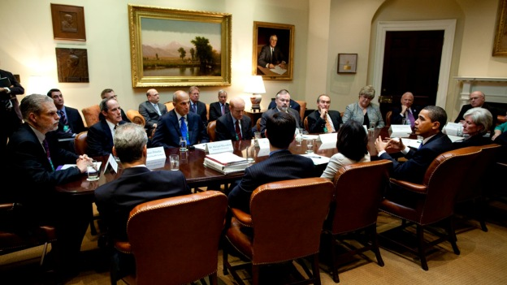
Elements of the Conversation 1/4
Who Owns the Data?
University? Funding agency? Researcher?
What Requirements are Imposed By Others?
Funders? Publishers? Other institutions?
Which Data Should Be Retained?
Only data worth keeping. Data from failed experiments? Data derived from secondary analysis?
Making data sets available can support validation of results.
Data can be repurposed in new areas of research.
Curation activities can be much easier throughout the data lifecycle. Efficiencies can be achieved when not treated as one-off occurrences.
Clear expectations will ease the way for data managers.
Uniform requirements will facilitate data understandability and sharing among researchers.
Consistent data management standards and training and tracking programs can foster harmony within the university.
A standardized approach to data management will ease compliance and improve management of and access to the university's intellectual assets.
Positive impacts and efficiencies can benefit all research conducted at the university, not just that funded by agencies requiring a data management plan.
Notes:
Identifying the stakeholders is a start. To achieve maximum benefit (and minimal burden), the conversation among stakeholders — and the resulting policy and procedures — should address the following points:
Who owns the data? Many universities assert ownership of research data generated on their campuses, as do some funding agencies. There is, however, widespread misunderstanding among researchers on this issue. Policies on data ownership must be clearly communicated and understood.
What requirements are imposed by others? Funding agencies may mandate public distribution of the resulting data set and require that data management plans be incorporated into the grant proposal. Publishers may require that the data supporting an article be deposited in a particular repository. Collaborative agreements with other institutions may impose stipulations. These requirements should be clarified early in the process.
Which data should be retained? No university can, or should, retain all research data generated by its researchers. Curating research data requires significant investment of staff time and financial resources, so universities should aim to ensure that they are investing only in data that is worth keeping. For example, data from a failed experiment may not merit curation, nor may that derived from secondary analysis of large data sets publicly available and archived elsewhere.
http://commons.wikimedia.org/wiki/File:Barack_Obama_meets_with_healthcare_stakeholders_5-11-09_1.jpg President Barack Obama meeting with healthcare stakeholders in the Roosevelt Room at the White House. As a work of the U.S. federal government, the image is in the public domain.

Slide 16
Elements of the Conversation 2/4
Who decides which data to keep?
Researcher? Someone else? Domain experts? Peers? Reuse? Validation? Expensive to recreate?
How Long Should Data Be Maintained?
Long-term value? Subject to review? How tracked? Reappraisal? Extension? Metrics? Who reassesses? How managed? Destroy? Document?
How Should Digital Data Be Preserved?
Unique needs? Cloud storage? DMPs preserved? File formats? Descriptors? Standards?
Making data sets available can support validation of results.
Data can be repurposed in new areas of research.
Curation activities can be much easier throughout the data lifecycle. Efficiencies can be achieved when not treated as one-off occurrences.
Clear expectations will ease the way for data managers.
Uniform requirements will facilitate data understandability and sharing among researchers.
Consistent data management standards and training and tracking programs can foster harmony within the university.
A standardized approach to data management will ease compliance and improve management of and access to the university's intellectual assets.
Positive impacts and efficiencies can benefit all research conducted at the university, not just that funded by agencies requiring a data management plan.
Notes:
Who decides which data to keep? Is it the researcher or someone else? Should other domain experts or peers be consulted? Which data sets are likely to be reused in future research? Which data must be retained to enable the validation of the findings? What data would be prohibitively expensive to recreate? What data do not merit preservation: perhaps the data could be easily recreated, or an algorithm is more significant than the data.
How long should data be maintained? Data may have long-term scientific or institutional value, but all preserved data should be subject to review. How will retention periods be tracked? How will it be decided whether the period should be extended? What metrics could assist with reappraisal? Who should be involved? How will reappraisal be managed in the repository? Should deaccessioned data be offered to others or destroyed? What records should be kept to document the disposition?
How should digital data be preserved? Are there any unique digital preservation needs? Are they different from the approaches identified by the Open Archival Information System reference model and the Trustworthy Repositories Audit and Certification process? What are the ramifications of cloud storage? Should the data management plan be kept with the data to provide provenance and additional context? Are the file formats supported by the repository? What descriptors should be applied? What standards (for identifiers, citation, metadata) will be required?
http://commons.wikimedia.org/wiki/File:Barack_Obama_meets_with_healthcare_stakeholders_5-11-09_1.jpg President Barack Obama meeting with healthcare stakeholders in the Roosevelt Room at the White House. As a work of the U.S. federal government, the image is in the public domain.

Slide 17
Elements of the Conversation 3/4
Are there Ethical Considerations?
IRB or grant conditions? IP, privacy, or access restrictions? Consent forms? Risk management?
How are Data Accessed?
Metadata discoverable? Deeper support? Which indices? Service-level assurances? Monitor and quantify access? Impact? Measure?
How Open Should the Data Be?
Constraints? Share case-by-case? Embargoes? Justification provided?
Making data sets available can support validation of results.
Data can be repurposed in new areas of research.
Curation activities can be much easier throughout the data lifecycle. Efficiencies can be achieved when not treated as one-off occurrences.
Clear expectations will ease the way for data managers.
Uniform requirements will facilitate data understandability and sharing among researchers.
Consistent data management standards and training and tracking programs can foster harmony within the university.
A standardized approach to data management will ease compliance and improve management of and access to the university's intellectual assets.
Positive impacts and efficiencies can benefit all research conducted at the university, not just that funded by agencies requiring a data management plan.
Notes:
Are there ethical considerations? Data should be kept in a way that is compliant with institutional review board requirements, grant conditions, or legal protocols. How will the institution handle IP rights and privacy issues? How will sensitive data be identified and contained? Are there access restrictions that must be enforced? How can ethical issues be identified during the proposal stage so that consent forms can be developed? What sort of risk management is needed for research data?
How are data accessed? Is it necessary only to make the metadata discoverable, with links to the data files, or is deeper support for manipulating the data needed? Which indices and catalogs should reference the data's availability? What service-level assurances should be made? How will the repository monitor access to ensure that restrictions are enforced? What are the possibilities for quantifying access -- and how might this information play into impact, promotion, and tenure? Indeed, what is the measure of "access”?
How open should the data be? An institution may decide to provide open access to its research data unless constrained by law or grant conditions, or it may decide to share only on a case-by-case basis. Data may also be embargoed with the goal to share in the future. In situations where data cannot be shared, what explanation should be provided for not sharing data?
http://commons.wikimedia.org/wiki/File:Barack_Obama_meets_with_healthcare_stakeholders_5-11-09_1.jpg President Barack Obama meeting with healthcare stakeholders in the Roosevelt Room at the White House. As a work of the U.S. federal government, the image is in the public domain.

Slide 18
Elements of the Conversation 4/4
How Will Costs Be Managed?
Include in proposals? Indirect or direct costs? Time-limited? Share costs? Co-investment? Which services covered? How to assess costs? ROI?
What are the Alternatives to Local Data Management?
National, international, or discipline-based data center? Other institutions? Local metadata for external data? Multiple homes?
Making data sets available can support validation of results.
Data can be repurposed in new areas of research.
Curation activities can be much easier throughout the data lifecycle. Efficiencies can be achieved when not treated as one-off occurrences.
Clear expectations will ease the way for data managers.
Uniform requirements will facilitate data understandability and sharing among researchers.
Consistent data management standards and training and tracking programs can foster harmony within the university.
A standardized approach to data management will ease compliance and improve management of and access to the university's intellectual assets.
Positive impacts and efficiencies can benefit all research conducted at the university, not just that funded by agencies requiring a data management plan.
Notes:
How should the costs be borne? Where will the necessary funds come from? Data curation costs could be included in the indirect costs in grant budgets – or it may be permissible to include data management as a direct cost, though these possibilities have not been discussed much. If funding is project-based and therefore time-limited, how will the costs of long-term preservation be supported? Another possibility is co-investment by multiple partners. 3TU in the Netherlands is an excellent example of three technical universities joining up to develop and deliver data management infrastructure and support. It is important that the university be clear about which services it will cover, and which are "over and above.” How will curation costs be assessed and projected into the future? Can a case be made about the potential return on their investment?
What alternatives to local data management exist? In some cases a more appropriate data center exists -- a national, international, or discipline-based data center. Many funders require data to be deposited in large national or international repositories that hold like data (e.g., the National Climatic Data Center or the Protein Data Bank). In some cases, researchers in a particular field use a specific data repository and develop a disciplinary culture around data sharing (e.g., Inter-university Consortium for Political and Social Research for social science data or Open Context for archaeology data). For multi-institutional collaborative research it should be made explicit which institution will take responsibility for the data. Regardless of where it is housed, most universities will want to include metadata with links in its local repository. In some cases, one home may be appropriate for preservation and another for access.
That’s a starter list for the conversation…
http://commons.wikimedia.org/wiki/File:Barack_Obama_meets_with_healthcare_stakeholders_5-11-09_1.jpg President Barack Obama meeting with healthcare stakeholders in the Roosevelt Room at the White House. As a work of the U.S. federal government, the image is in the public domain.

Slide 19
Changes ahead
Office of Science and Technology Policy mandate
ARL, AAU, and APLU’s proposal, "SHared Access Research Ecosystem (SHARE)
30 organizations that archive scientific data released a call for action urging the creation of sustainable funding streams
Notes:
With the recent Office of Science and Technology Policy mandate, other players may emerge in the data management milieu. The Association of Research Libraries, the Association of American Universities, and the Association of Public and Land-grant Universities have issued a proposal called, "SHared Access Research Ecosystem (SHARE)," that imagines a workflow architecture implemented across a network of university-operated repositories fulfilling the mandate's requirements.
Representatives of 30 organizations that archive scientific data released a call for action urging the creation of sustainable funding streams for domain repositories that are closely tied to scholarly communities.
Regardless of how this settles out, universities still will want to have a record of their own research output — and it could be that these data repositories will be important nodes in the evolving U.S. research data network.
http://www.arl.org/storage/documents/publications/share-tenets-and-overview.pdf
http://www.icpsr.umich.edu/icpsrweb/ICPSR/support/announcements/2013/09/sustaining-domain-repositories-for

Slide 20
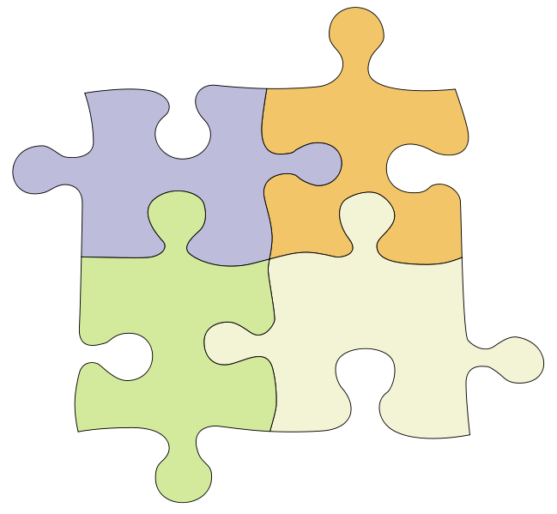
Ricky Erway
erwayr@oclc.org
Oc.lc/datamp
Notes:
20
20
20
It is important to recognize the current uncertainty as to how data management support and services will be distributed among university, disciplinary, funder, and national and international stakeholders. In this complex environment, an institution must actively determine how it will manage and distribute data services internally. The various stakeholders are important in determining the appropriate approach to providing data management.
Effective data management is just one aspect of achieving the ultimate goal of ensuring on-going access to the outputs of academic research. This goal can be achieved if the right questions have been asked and answered along the way.
http://commons.wikimedia.org/wiki/File:Puzzle-4.svg a drawing of a 4 piece jigsaw puzzle I, the copyright holder of this work, release this work into the public domain.
http://commons.wikimedia.org/wiki/File:Question_dropshade.png Question mark icon with drop shade. I, the copyright holder of this work, release this work into the public domain.

