Slide 1
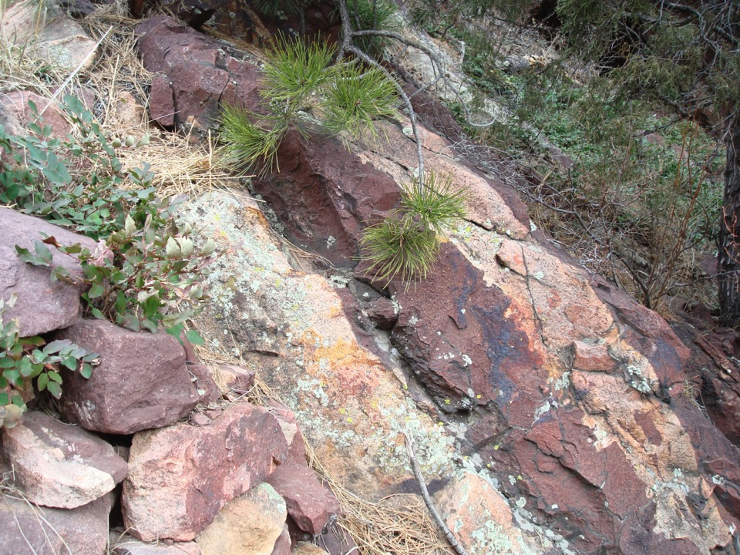
Archival Archaeology
Unearthing finds about archives and special collections users
Ellen Eckert, OCLC Research
Notes:
What I’ll cover today:
What is ArchiveGrid?
A survey about archives and special collections users
What we learned
What it means for ArchiveGrid

Slide 2
Our group
Bruce Washburn
Software Engineer
San Mateo, CA
Jennifer Schaffner
Program Officer
San Mateo, CA
Ellen Eckert
Research Assistant
Portland, OR
Jackie Dooley
Program Officer
San Mateo, CA
Merrilee Proffitt
Program Officer
San Mateo, CA
Marc Bron
Intern
San Mateo, CA
Notes:
Bruce, Ellen and Merrilee are the core of the ArchiveGrid team
[click]
We confer and consult regularly with other members of OCLC Research to guide our work, in particular Jen Schaffner and Jackie Dooley

Slide 3
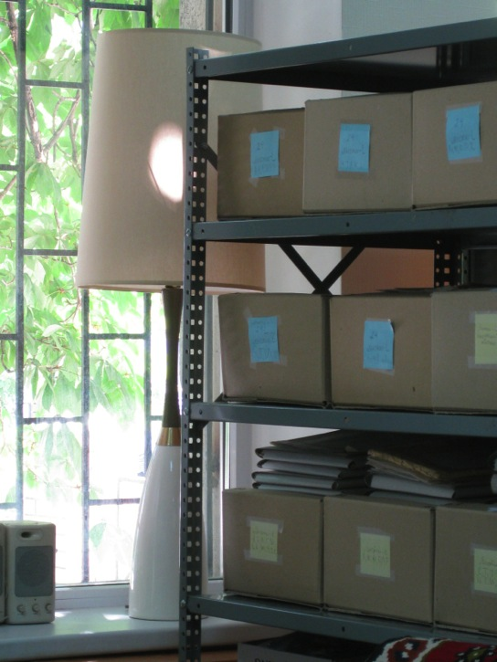
Connects people to primary sources
More than
1.7 million
collection descriptions

Slide 4
ArchiveGrid’s history
1999
2004
RLG launches
Archival Resources
RLG studies archives and special collections users
2006
2011
RLG and OCLC combine
ArchiveGrid tested
and launched
Subscription-free version of ArchiveGrid launched

Slide 5
http://beta.worldcat.org/archivegrid
Notes:
What does beta mean? Placeholder for a research system etc…

Slide 6
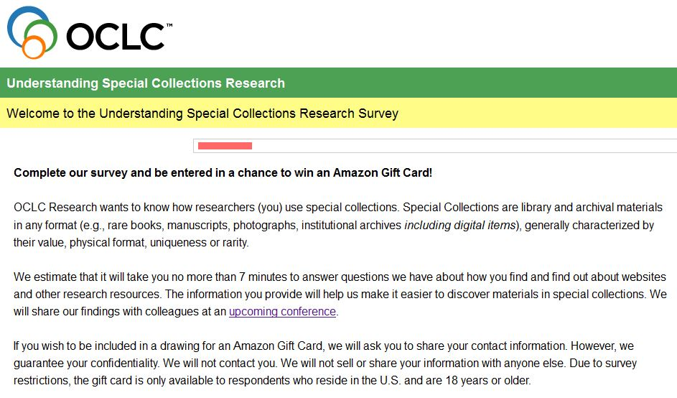
Our 2011 survey

Slide 7
14 questions
April 27-May 25
Targeted researchers
$50 Amazon gift card!
Each question allowed commenting
Notes:
Target subjects were archives and special collections audiences we defined in 2005 and tested early versions of ArchiveGrid on.

Slide 8
Scope

Slide 9
1.
Who are the researchers and what are they like?
2.
What resources do researchers use
and how do they find them?
3.
How do researchers search online?
4.
What do researchers want to know from their search?

Slide 10
“Archives and special collections” are defined as library and archival materials in any format, generally characterized by their value, physical format, uniqueness or rarity.
For example: rare books, manuscripts, photographs, institutional archives including digital items.

Slide 11
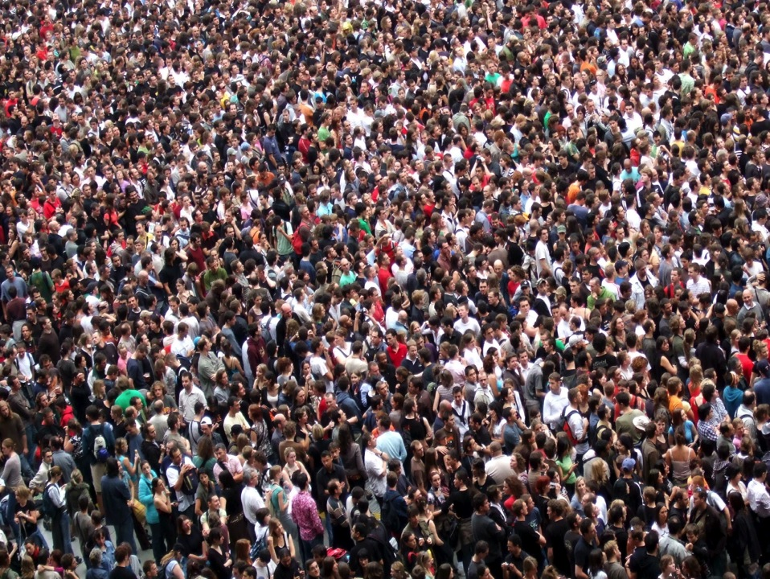
695 surveys done (81%)
Notes:
Photo attribution: “Crowd,” by James Cridland. james.cridland.net/. Retrieved 4/11/13 from Flickr: http://www.flickr.com/photos/jamescridland/613445810/.

Slide 12
Respondents
208
177
172
154
(36%)
(30%)
(29%)
(26%)
faculty
graduates/post grad’s
genealogists
unaffiliated scholars
Notes:
How did we account for librarians and archivists? The numbers add up to 711 because some people identified themselves in double roles.

Slide 13
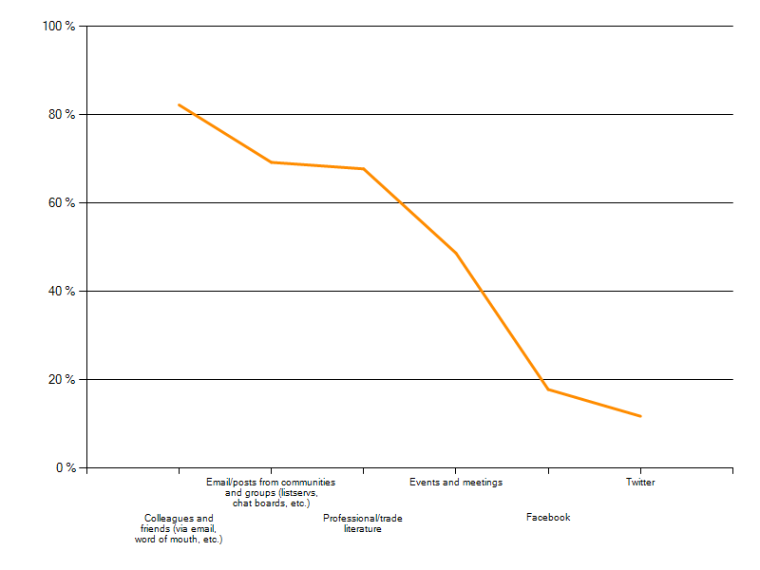
Discovering new websites and other research resources
Notes:
Word-of-mouth (colleagues and friends) = 82%
Email/posts from communities/groups = 69%
Print literature = 68%
Events/meetings = 49%
Facebook = 18%
Twitter = 12%

Slide 14
“I also find it useful to speak with my colleagues and advisor about resources that may be relevant or provide a good jumping off point.”
graduate student

Slide 15
Notes:
A melange of where researchers say they begin their research. Mostly online, with promise of digital and range from library catalogs and databases to regional, national, and commercial services.

Slide 16
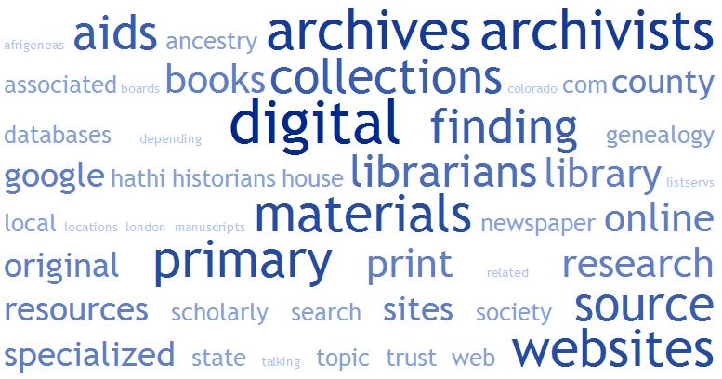
Notes:
Then as people continue and finish up their research, note the emphasis on the transition from online search systems to library and archival materials and offline information-gathering methods.

Slide 17
“I'm on Facebook, and use it, but do not generally find new research related sources there. Twitter though is a constant stream of new information.”
– museum curator

Slide 18
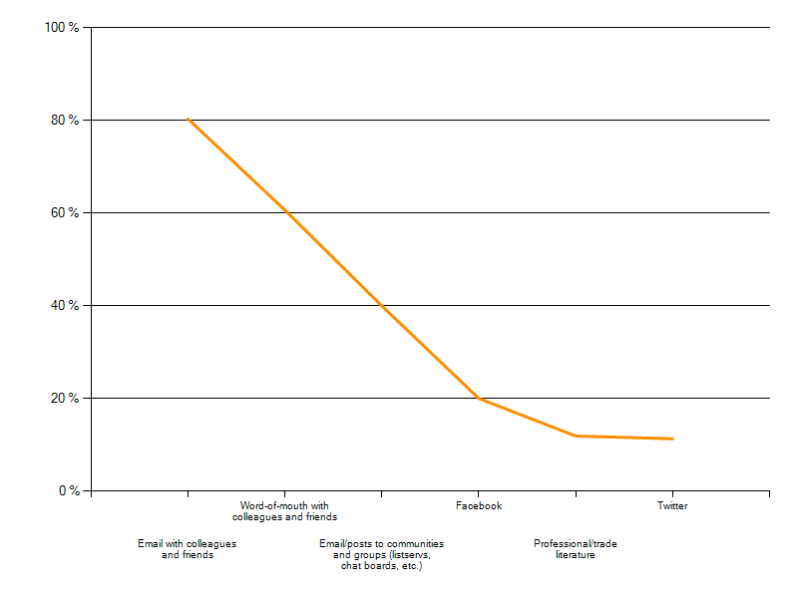
Sharing new websites and other research resources
Notes:
How do you share new websites and other research resources?
Email with colleagues and friends = 80%
Word-of-mouth = 61%
Email/posts to communities and groups = 40%
Facebook = 20%
Print literature = 12%

Slide 19
“When I want to share a research resource with friends, I email them a link.”
- unaffiliated scholar

Slide 20
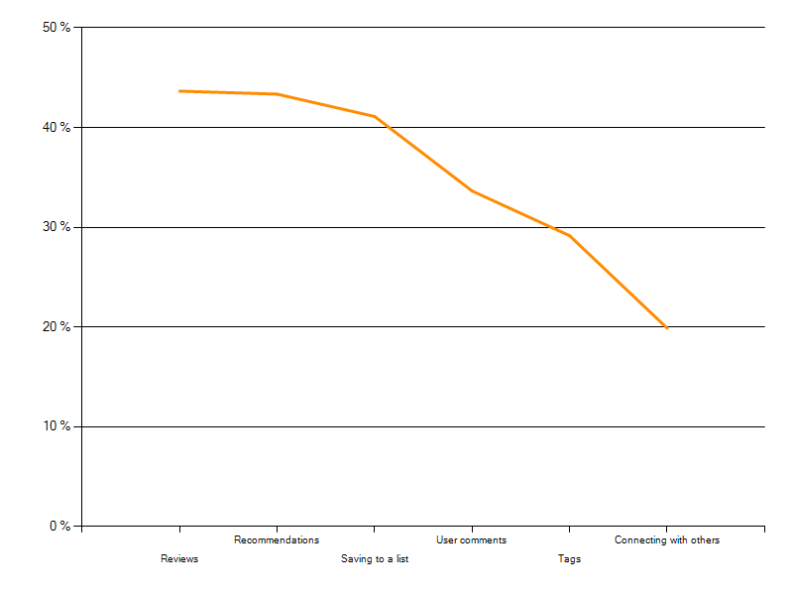
Valuable web features
Notes:
user comments = genealogists found most helpful, faculty found least helpful
Tags = grad students found most helpful, genealogists found least helpful
Reviews = genealogists found most useful, grad students found least useful
Recommendations = genealogists found most useful, faculty found least useful
Saving to a list = grad students found most useful, genealogists found least useful
Connecting with others = genealogists found most helpful, grad students found least useful
None are relevant for me = faculty the most, genealogists the least. But when we checked which features faculty liked the most, the top three are reviews, recommendations, and lists.
However, the group that uses FB and T the most to discover and share new research resources were faculty. They are also the ones who So, the gap between social media and doing research for publication isn’t as wide as we expected.

Slide 21
Over 80% of survey respondents identified librarians and archivists, when answering the question “Is there a particular type of user whose comments, recommendations, etc. you find most valuable?”
Notes:
“A scholar whose reputation I know” followed closely. Then colleagues and friends, then faculty. Faculty is the only group that identified other scholars before librarians and archivists.
47% who go to librarians and archivists said reviews are the most important website features. So, there is opportunity for librarians and archivists to show their expertise and knowledge through writing, which would be useful for faculty who is the largest group to find reviews the most valuable website feature.

Slide 22
Unaffiliated
scholars

Slide 23
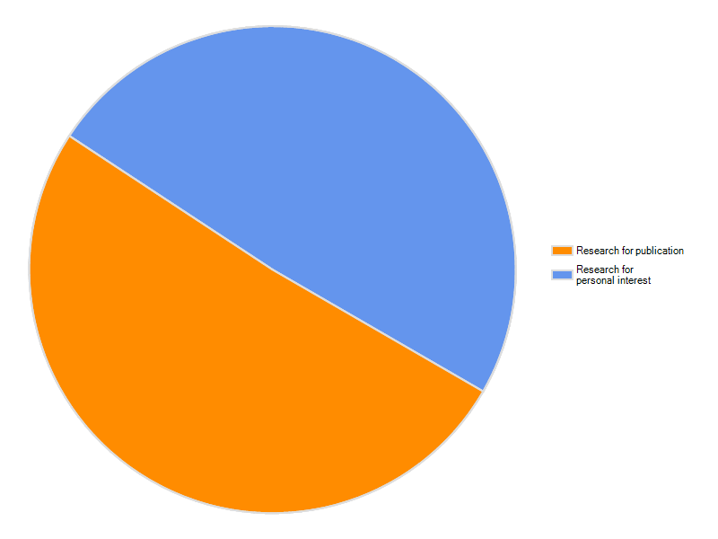
Unaffiliated scholars: what is the intended purpose of your research?
Research purpose
Personal
Publication

Slide 24
Exhibit designer
Model
ship
builder
Artist
Journalist
Consultant
Church
member
Archives, library, museum, historical society employee
Tutor
Writer
Forensic engineer
Teacher
Living
history
performer
Metal detecting explorer
Volunteer
Blogger
Event planner
Presenter
Curious person
Working professional
Filmmaker
Retiree
Documentary maker
Historic homes
tour guide
Family member
Notes:
Photo attribution: “Crowd,” by James Cridland. james.cridland.net/. Retrieved 4/11/13 from Flickr: http://www.flickr.com/photos/jamescridland/613445810/.

Slide 25
Now what?

Slide 26
Write
Embed
Digitize
Email
Talk
Socialize
Notes:
Write reviews and other user-initiated social content.
Embed online and dwell where the growing number of offsite researchers live
Digitize primary sources and make them easily findable online.
Email is still a tried and true method for sharing information, so keep it at the forefront of your operations
Word of mouth is still a tried and true method of sharing information, so establish relationships with people
Social media, along with library catalogs and databases, plays a role in how faculty and graduate students find and share information.

Slide 27
Sharing data
TopicWeb
Notes:
Working to share ArchiveGrid data with larger research systems for genealogists such as FamilySearch and Ancestry
TopicWeb funtions as an interactive opportunity for faculty, archivists, librarians, and experts to interact

