Slide 1
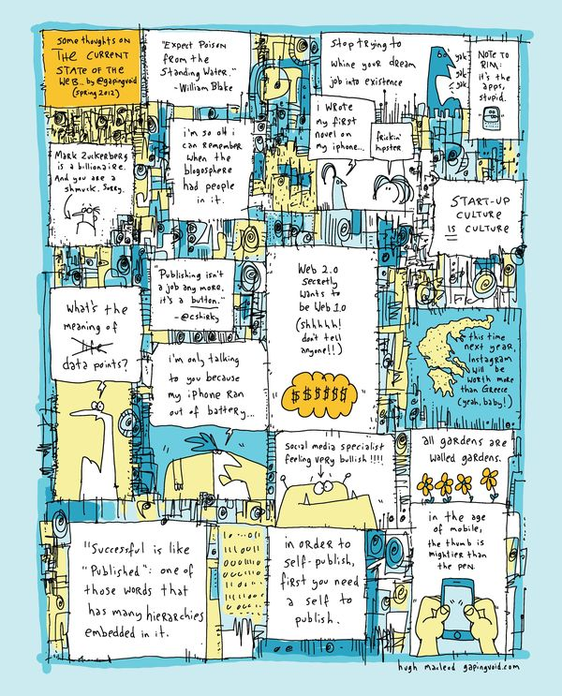
An informational future
Information
professionals 2050
conference
Lorcan Dempsey
UNC - 6/5/12

Slide 2
First …
Structural
change …

Slide 3
4 themes
An informational future: a processing perspective
From transaction costs to the network level: an organizational perspective
The power of pull: a social perspective
The need to focus: a strategy perspective

Slide 4
1. An informational future
Computational
Document centric
Promote structure; ‘distant reading’
Reservoir to river
Social
Rank, relate, recommend
Analytics
‘From strings to things’
Extract intelligence
Freebase, Dbpedia, Wolfram ..

Slide 5
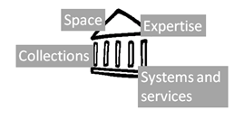
2. Transaction costs …
… and the network level

Slide 6
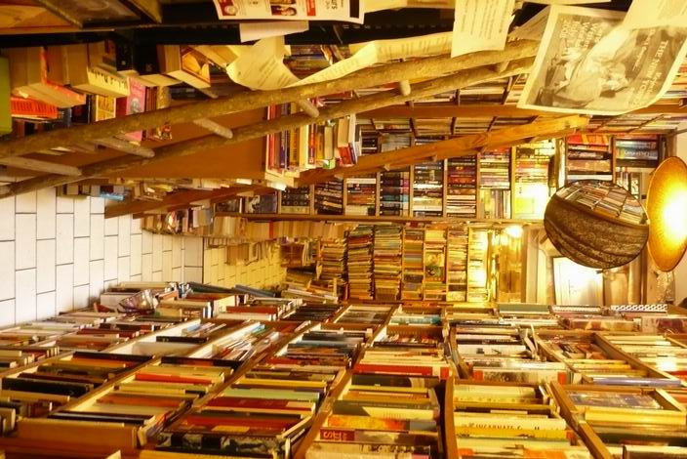
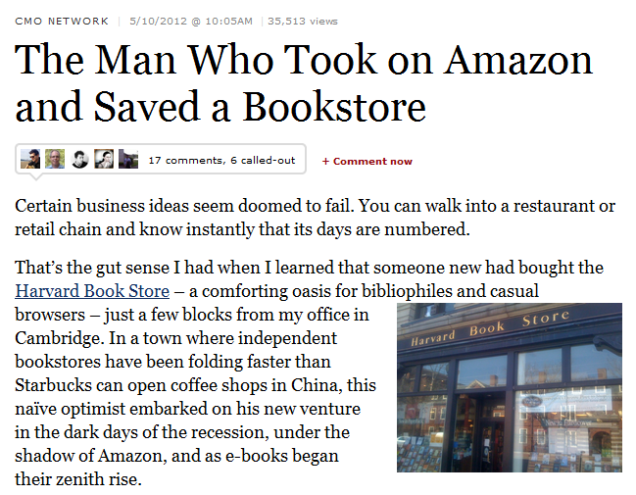
http://www.bookstoreguide.org/2009/07/ independent-bookstores-in-danger-of.html

Slide 7
Advice
Not just licensing
Connected
Disclose institutional resources
Switch to institutionally acquired resources
Data driven engagement
Aggregate and make useful usage data
Reputation management
What is the personal/institutional profile
Collaborative ……..

Slide 8
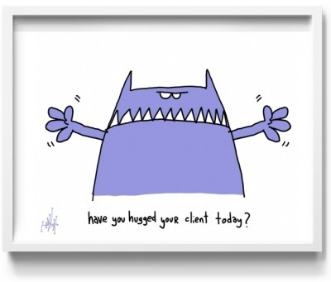
3. The power of pull
Hagel, Seely Brown and Davidson
For librarians to be seen as expert, their expertise has to be seen.

Slide 9
Not just a site but an ecosystem
Beyond the mobile web. Stephanie Rieger. http://www.slideshare.net/yiibu/beyond-themobilewebbyyiibu

Slide 10
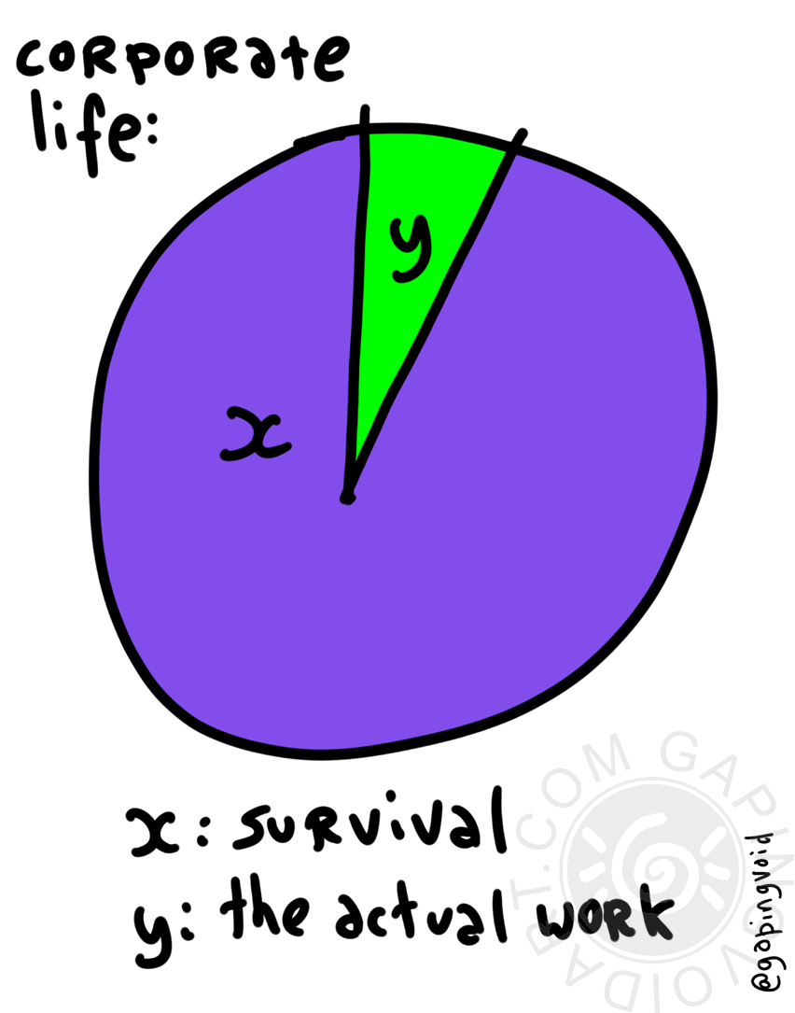
4. The need for focus
Engagement
Service turn
Importance of people
Infrastructure
Collections
Systems
Innovation
Hagel and Singer

Slide 11
Bookspace: Hennepin County Library
A community space for reading. Social engagement.
M Publishing, U Michigan
The University of Michigan Press, the Scholarly Publishing Office, Deep Blue (the University’s institutional repository service), the Copyright Office, and the Text Creation Partnership,
Salman Rushdie Archive, Emory U
Personal digital papers of Salman Rushdie. Have become his reference collection.
Stories from the web, Birmingham Public Library
… provides the opportunity for children and young people to have their own stories, book reviews and more displayed online in the Stories from the Web Gallery. .

Slide 12
The library should not provide an argument for a particular case, but demonstrate that there is always another case to be made. The notion that the library is a place that has no agenda other than allowing people to invent their own agendas is what makes it an indispensable resource for a democracy. It is where we can learn not just to be readers, but to be the authors of our own destiny. Fintan O’Toole

Slide 13
Cartoons from GapingVoid:
http://gapingvoid.com/

