Slide 1
Rebiun conference. Barcelona. 3 Nov 2011. Reconfiguring library boundaries and focus in a network environment. Lorcan Dempsey. OCLC. @lorcanD

Slide 2
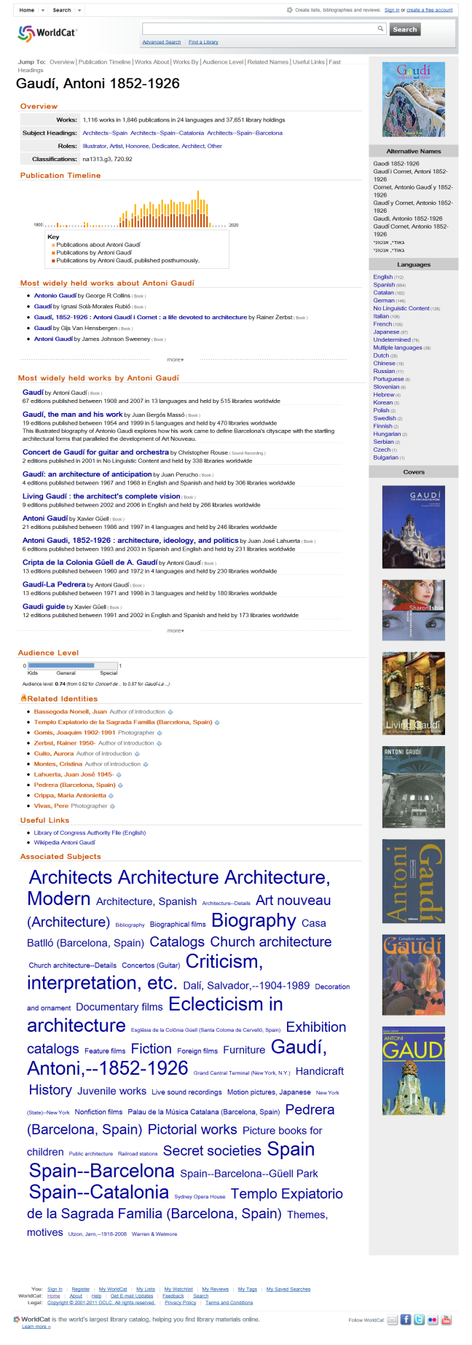
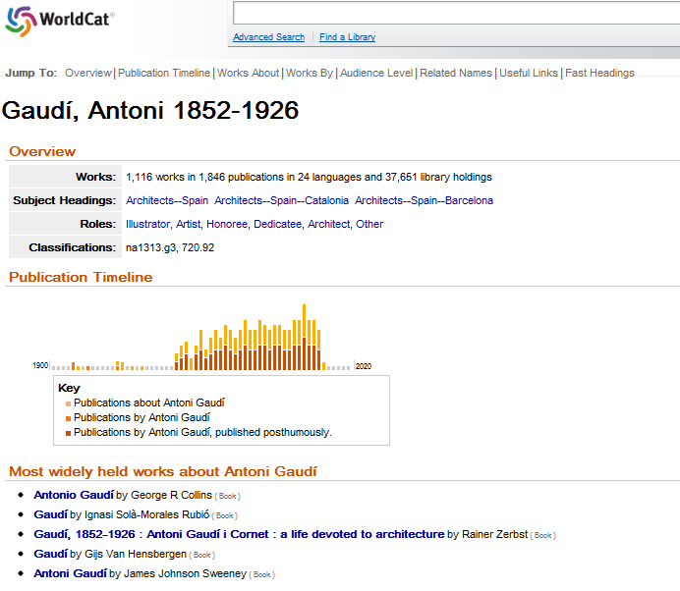
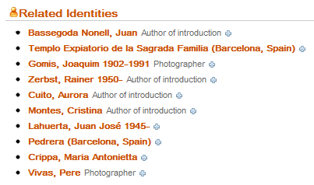
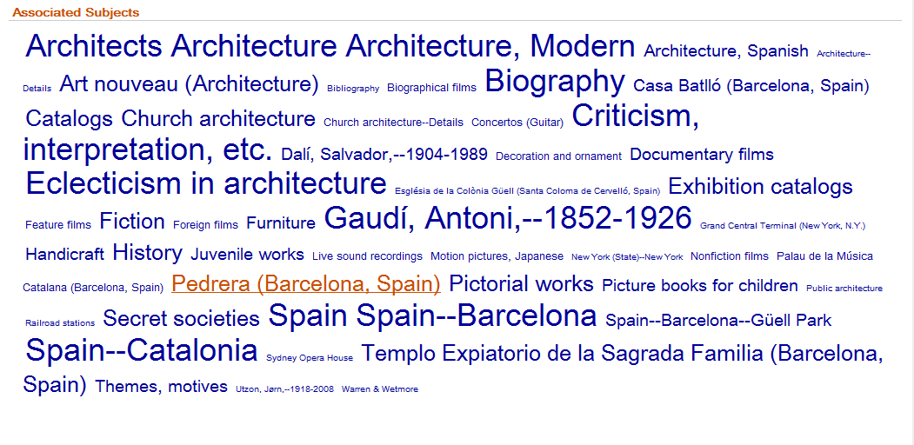

Slide 3
overview
@lorcanD

Slide 4
Direction? Widespread sharing of infrastructure within groups?
Added value: intelligence from circ, acq, …

Slide 5
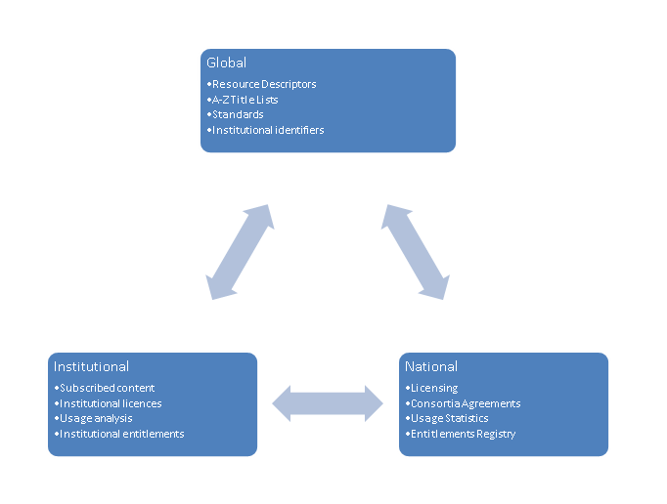
Direction? Widespread sharing of infrastructure within groups?
Added value: intelligence from resolution, …

Slide 6
Direction? Digital discovery at network level?
Shared preservation frameworks?

Slide 7
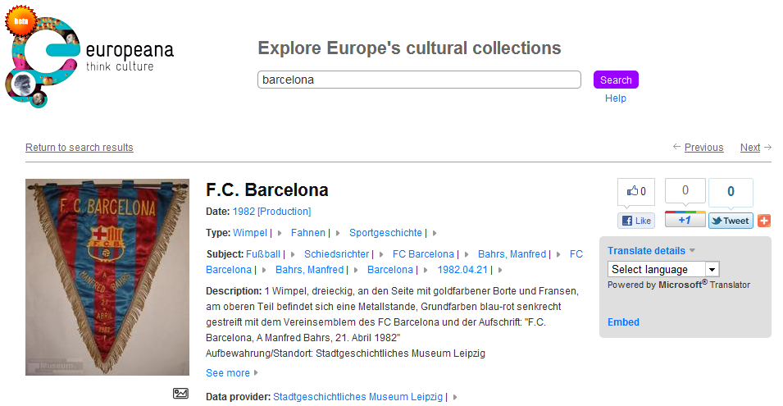

Slide 8
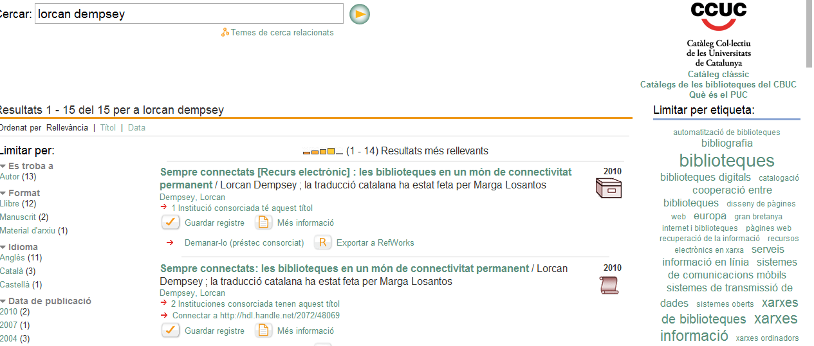
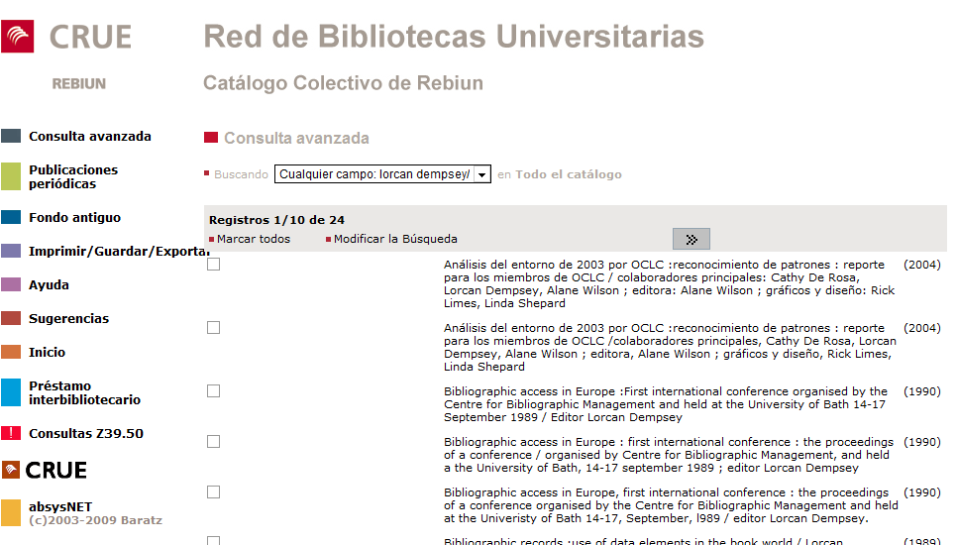
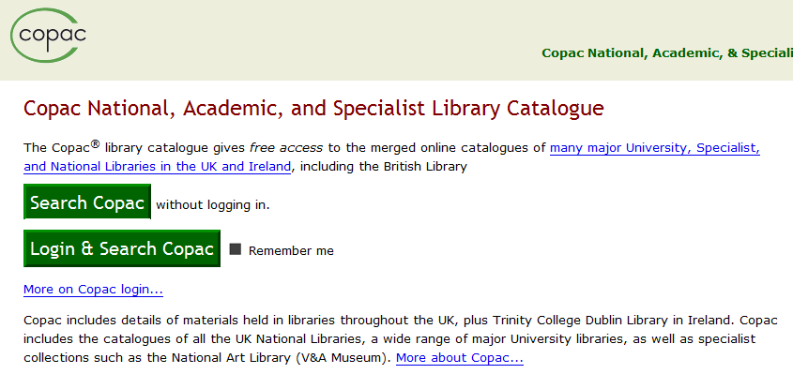
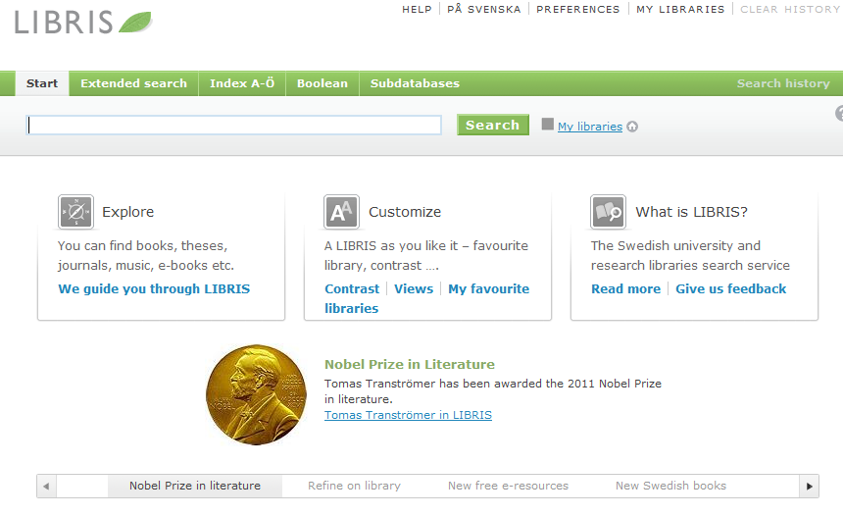
Direction? Basis for broader range of shared services?
Logistics infrastructure?

Slide 9
Direction? How many data wells?
The collection?
Registration model? Library does A&A?
Other players (Elsevier, Thomson Reuters?)

Slide 10
Direction? Discovery moves to the network level?
And local/institutional curation environments?

Slide 11
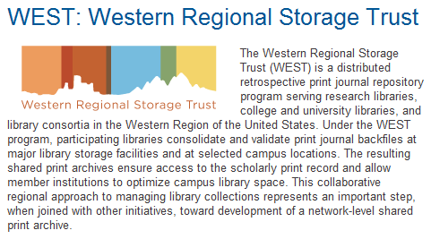
Direction? Print collections consolidated in national/regional initiatives?

Slide 12
The network reconfigures the library
Boundaries of the library are changing …
…. as the network reduces transaction costs …..
…. and as economics and functionality encourage new approaches.

Slide 13
Institution scale
Goodness: A large
collection in central locations
Organization: Structured around collection
Makes it possible to see library as …

Slide 15
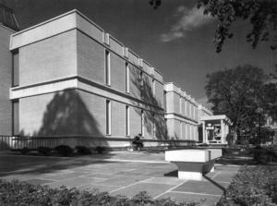
From modernist to modern Inside Higher Ed, March 21, 2011
"Skillman Library served us well for the first 30 years of its life," Neil J. McElroy, dean of libraries & information technology services at Lafayette, said of its 1960s-era centerpiece. But by the mid-1990s, it was "no longer suitable," due to the librarian's changing role "from steward of collections to educator" and the advent of the World Wide Web and digitization, he said.

Slide 16
The network is reconfiguring whole industries … research & learning
Travel News Book retail
E-research
Network level services
Learning

Slide 17
Consolidation at scale
Network encourages efficiencies of scale
Context and community: rich analytics drive richer experiences
The scalability of access: stronger gravitational attraction at network level

Slide 18
Consolidation at scale
Network encourages efficiencies of scale
Context and community: rich analytics drive richer experiences
The scalability of access: stronger Gravitational attraction at network level

Slide 19
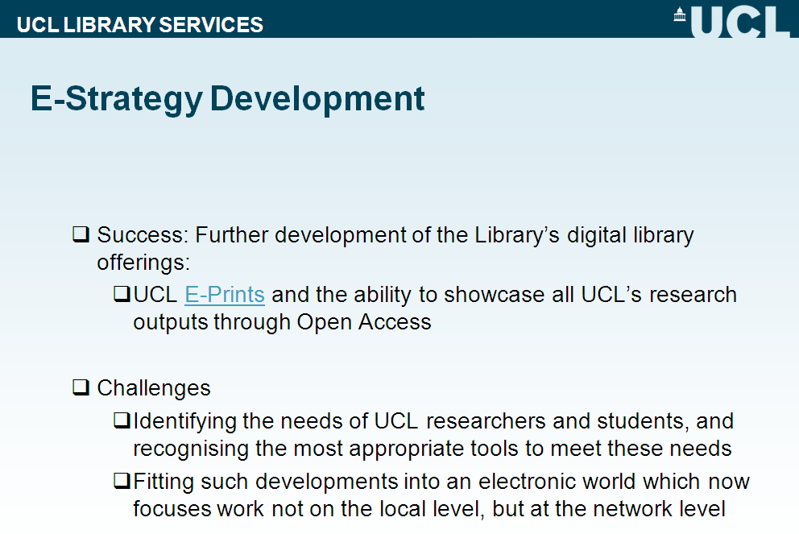

Slide 20
a Coasian view of the academic library
Universities find it useful and economical to internalize a bundle of information-related activities
As the pattern of transaction costs change, so too will the boundaries of the library.

Slide 21
Boundaries
Cataloging
Google
Resource sharing
A&I/E-journals
University:
Library
Teaching
Research
Administration
Laboratories
Sports facilities
JSTOR/Portico
Virtual ref
Instititutional support for research and learning
Shared storage

Slide 22
Information management?
IT
New forms of scholarly communication
Computer centre
Press? Departments …
E-learning
Research information management
E-learning
Research office
Repository, …
Data curation and eresearch
e.g. ODAI, Yale
Departments

Slide 23
Strategy:
Making choices
New opportunities e-research student experience
Strategic choices
Innovate Partner Disinvest Shared services
E-research, digital humanities, student experience, ….
Sustained advantage

Slide 24
Specialization: what business are you really in?
Specialise where can make an impact
Externalise what is routine and can be done well collaboratively or by others
Library: what is distinctive

Slide 26
Harvard Business Review (1999)

Slide 27
Core components of a firm
Attracting and building relationships with customers
“Service-oriented”, customization
Economies of scope important
Develop new products and
services and bring them to
market
Speed/flexibility important
Customer
Relationship
Management
Product Innovation
Infrastructure
Back office capacities that
support day-to-day operations
“Routinized” workflows
Economies of scale important

Slide 28
Attracting and building relationships with researchers and learners
“Service-oriented”, customization
Economies of scope important
Develop new
services and have them accepted
Speed/flexibility important
Engagement
Innovation
Infrastructure
Back office capacities that
support day-to-day operations
“Routinized” workflows
Economies of scale important

Slide 29
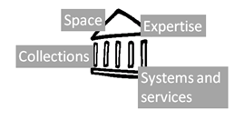
Shifting library boundaries
Libraries externalising infrastructure – economies of scale and network effects
Collections
Systems
Discovery?
Relationship management is central – engagement creates distinctive local value
Buildings
The service turn
People
Patterns of externalization vary
Collaborative: sharing innovation and resources
Commercial: contracting for services
The emergence of the cloud

Slide 30
Collections
We are moving to a situation where network-level management of the collective collection becomes the norm, but it will take some years for service, policy and infrastructure frameworks to be worked out and evolution will be uneven. The network may be at the level of a consortium, a state or region, or a country. At the moment, this trend is manifesting itself in a variety of local or group mass storage initiatives, as well as in several regional and national initiatives. [Emerging network level management of the collective print collection]
Lorcan Dempsey
Managing down print collections

Slide 31
Space
Reconfigure around the user experience rather than around collections
Social
Ad hoc rendezvous
Meeting place
Showcase and sharing
Exhibitions
Specialist equipment
Specialist staff
GIS, Writing centre, digital humanities, …

Slide 32
Find members of a group in the library ….

Slide 33
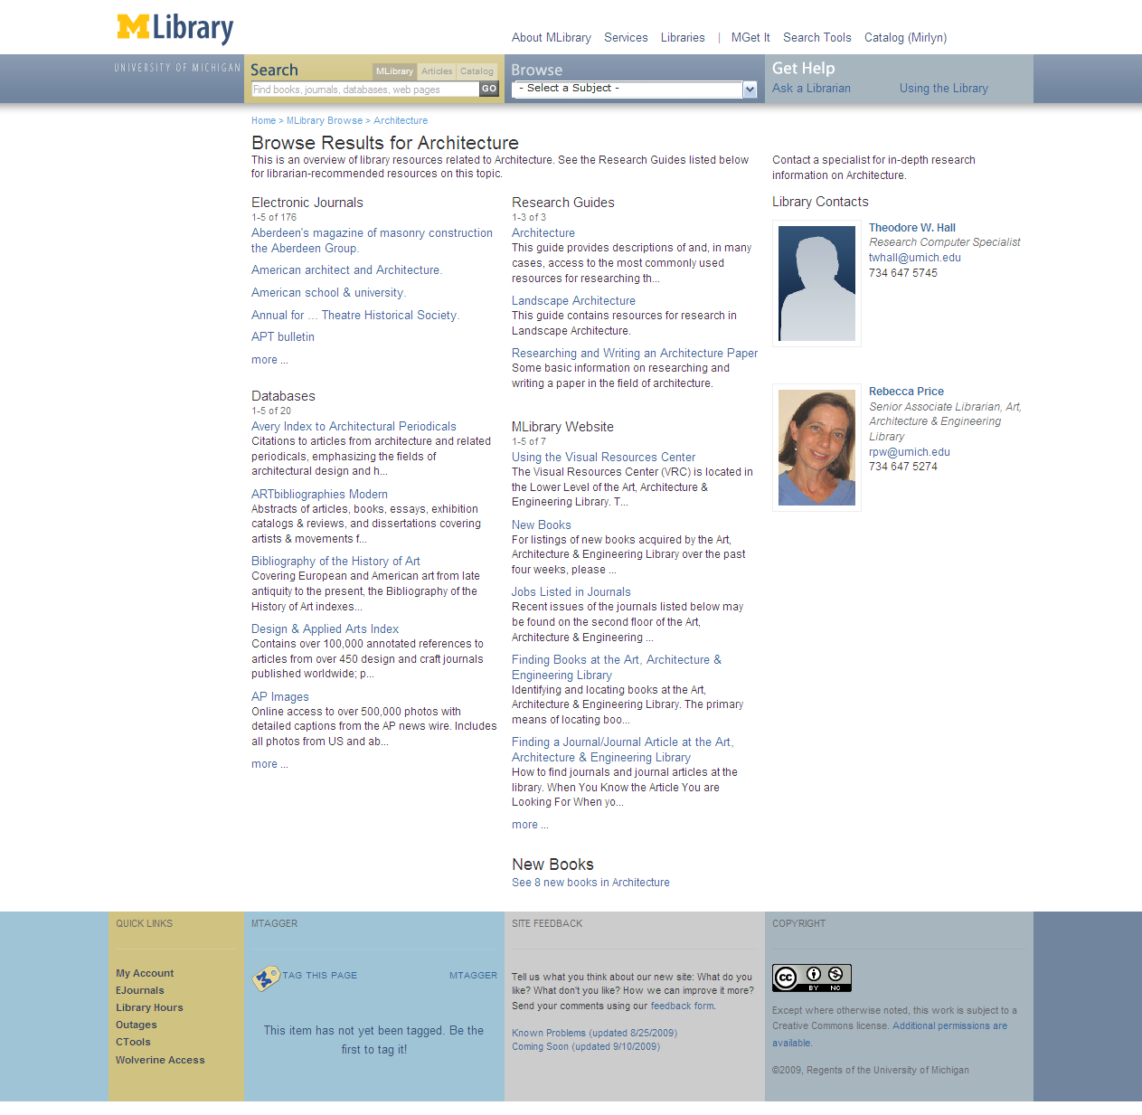
Expertise
People are entry points
Engagement with research and learning
Marketing/assessment/ partnership

Slide 34
Services
The service turn
U Minnesota, ARL Institutional profile
In alignment with the University's strategic positioning, the University Libraries have re-conceived goals, shifting from a collection-centric focus to one that is engagement-based.

Slide 35
Service
The service turn
Defining distinctive services with the clarity with which we have defined distinctive collections allows us to acknowledge that the 21st century will be marked by different, but equally valid, definitions of excellence in academic libraries, and that the manner in which individual libraries demonstrate excellence will be distinctive to the service needs, and to the opportunities to address those needs, found on each campus.
Scott Walter. “Distinctive Signifiers of
Excellence”: Library Services
and the Future of the Academic
Library. Coll. & res. libr. January 2011 72:6-8

Slide 36
First year initiatives: Bowling Green State Univ Libs
The Library First-Year Initiatives (F.Y.I.) Program strives to make meaningful connections with incoming students early in their academic career.
M Publishing, U Michigan
The University of Michigan Press, the Scholarly Publishing Office, Deep Blue (the University’s institutional repository service), the Copyright Office, and the Text Creation Partnership,
Salman Rushdie Archive, Emory U
Personal digital papers of Salman Rushdie. Have become his reference collection.
Scholarly Commons, U Illinois Urbana Champaign
... to serve the emerging needs of faculty, researchers and graduate students pursuing in-depth research and scholarly inquiry. Access to expertise, hardware and software.

Slide 37
Systems
Engagement, cloud and collaboration
Focus on engagement
Resource guides, integration with learning management, widgets, etc
Recommendation
Move to cloud for infrastructure
ILS, ERM, Discovery: move to cloud-based solutions
Deep collaboration
Shared systems infrastructure: Orbis Cascade Alliance, 2CUL

Slide 38
Disclosure vs discovery

Slide 39
Externalization

Slide 40
Scaling
Institution
Group
Web
Tripod:
(Tri-college
library catalog)
Collaborative
Dspace
VuFind
RePEc
Bibliographic
Standards
(LC Classification,
MESH, LCSH)
Rero, REBUIN, Bibsys, Libris
Sourcing
Public
PubMed
VTLS Virtua
(hosted ILS)
JISC Collections
worldcat.org
Third-Party

Slide 41
Rick Luce, LIBER 2011, Barcelona

Slide 42
Google Books/Scholar
Mendeley
Web-scale
Externalization
Web
4
Cooperative cataloging
Resource sharing
Collaborative
Externalization
Scaling
Group
2
Licensed e-content
Hosted systems
Self-
Sufficiency
Straight
Externalization
Institution
1
3
Internalized
Collaborative
Public
Third-Party
Sourcing

Slide 43
Google Books
Web-scale
Externalization
Web
4
Hathi Trust
Europeana
Collaborative
Externalization
Scaling
Group
2
JSTOR
Proquest
Self-
Sufficiency
Straight
Externalization
Institution
1
3
Internalized
Collaborative
Public
Third-Party
Life cycles?
Sourcing

Slide 44
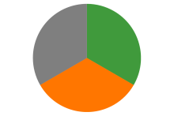
Some directions
Strengthening engagement
Systems for engagement
Relationship with campus partners
Marketing and assessment
The service turn
Externalising infrastructure
Give things up?
Deep collaboration
Cloud
Just in case to just in time
External relationships are even more critical: Strategic choices
Sharing Innovation and expertise
New skills
Organizational innovation

Slide 45
Thank you @lorcanD
Park Guell, Barcelona: “Park [Guell]” name in ceramic tile mosaic on enclosing wall, 1900-1914 (AG036) http://quod.lib.umich.edu/a/aict/x-ag036/AG000_IMG0036?chaperone=S-AICT-X-AG036+AG000_IMG0036;chaperone=S-AICT-X-AG036+AG000_IMG0036;evl=full-image;quality=2;resnum=;start=;subview=detail;view=entry Retrieved via http://oaister.worldcat.org

