Slide 1
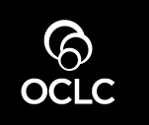
Managing our online profersonal lives
Random notes
Lorcan Dempsey / @LorcanD
University of Pittsburgh Library System,
7 Sept 2012

Slide 2
Overview/Conclusions .. 5 parts
There are different ways of participating in a network world. This changes all the time. Visitors vs residents.
What does the network know about you? The first page of Google results for you is your real home page.
It is difficult to speak knowledgably about them or provide sensible support for them if you don’t have some experience of network services. Picturing a rhino: experience is the only guide.
It is useful to track the changing network behaviors of researchers and learners. Research (and learning) (are social).
How do you get in the flow of communications and interaction? Is your expertise visible? Can you help researchers get into the flow and be visible? The power of pull.

Slide 3
Cartoons by Hugh MacLeod. From the Gapingvoid website.
http://gapingvoid.com/
Emphasis in quotes mine …

Slide 4
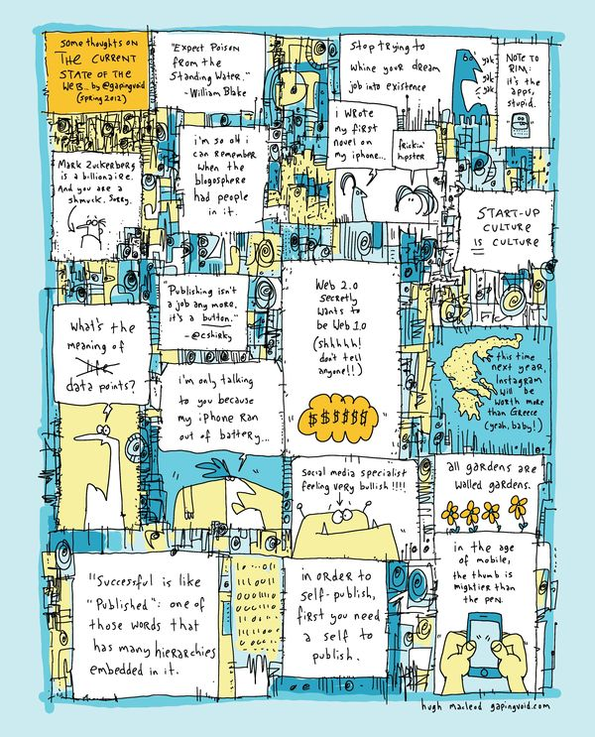
“It’s a Post-Facebook-IPO and Post-Web 2.0 world – But What Is It?”
http://gapingvoid.com/2012/05/30/saymedia/

Slide 5
Visitors and residents (4 headlines)
David White, Analysing digital literacies – four headlines
1

Slide 6
“
This is the overarching perspective with Visitor (web perceived as a collection of tools) and Resident (web perceived as a series of co-present spaces) as the principal genres placed at either end of a continuum of engagement ….
With regard to digital literacies it’s possible to equate the ‘skills’ based (learning the essential functionality of technology) approaches with Visitor and the more experiential/personal-professional identity approaches with Resident.
1. Genre

Slide 7
“
Views on the authority and role of Wikipedia and other non-traditional sources.
Views on the legitimacy and validity of academic blogs and blogging.
Views on the role of social media as a valid space for learning.
Views on the relative authority of various media e.g. the ‘a printed book always has more authority than a blog post’ stand-point.
Taking the
temperature ..
Self reflection
How do others see
you?
2. Attitudes

Slide 8
“
Geographically relocating – engaging with social media to keep in contact with remote friends and family or students from a previous institution.
Course requirements – assessment being attached to a Resident mode of engagement such as blogging.
Social tipping point – participants discover that the majority of their peer group are organising social events via social media and so they have to create a profile to ‘stay in the loop’
Professional identity – participants decide that it is of value to be ‘active’ online and to develop a visible online profile around their professional role.
Efficiency – participants discover that a Resident approach is ultimately a reasonably efficient/effective way to gather trusted sources and to further their thinking.
3. Transition
point

Slide 9
4. Management
Visitor
Resident
“
There is a desire to keep their time and their roles compartmentalised so that work and personal activities remain distinct making it easier to predict the time and effort that will be required when they log on.
“
The principle management issues for the Resident mode are likely to be around addiction, distraction and the artful maintenance of the blurred boundaries between differing roles and personas e.g. the perennial ‘do I friend my students?’ conundrum.

Slide 10
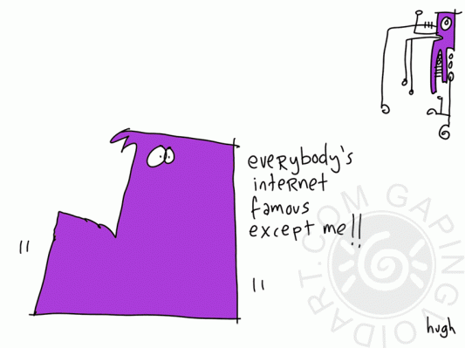
Visitor <> resident?

Slide 11
The first page of Google results is your real homepage
2
Tony Hirst, Psychemedia

Slide 12
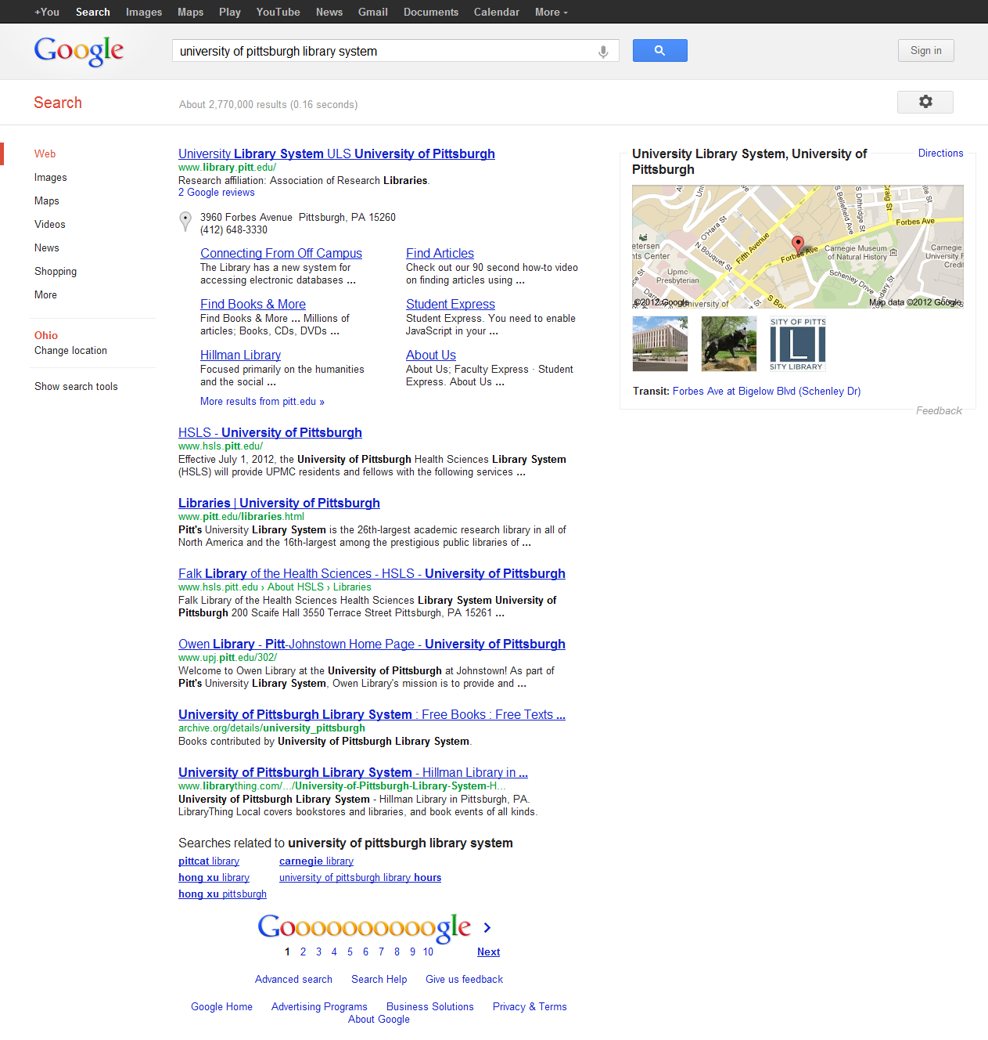

Slide 15
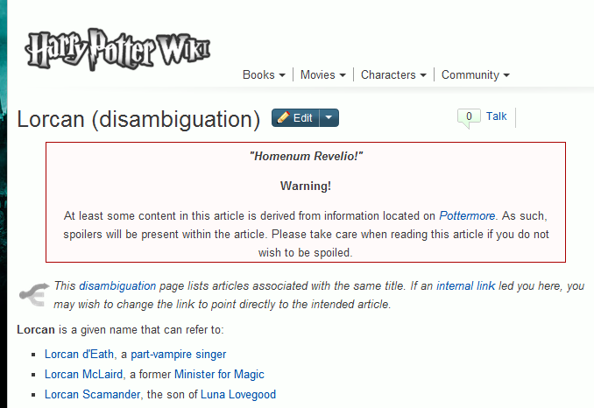

Slide 16
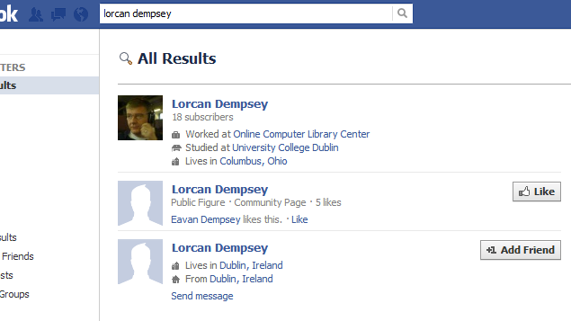

Slide 17
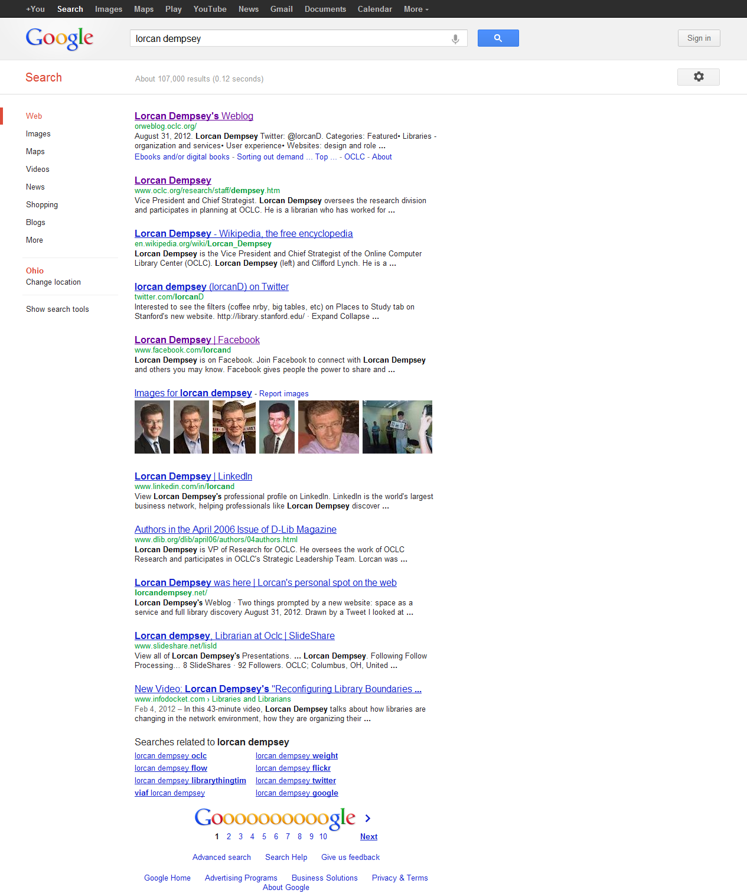

Slide 18
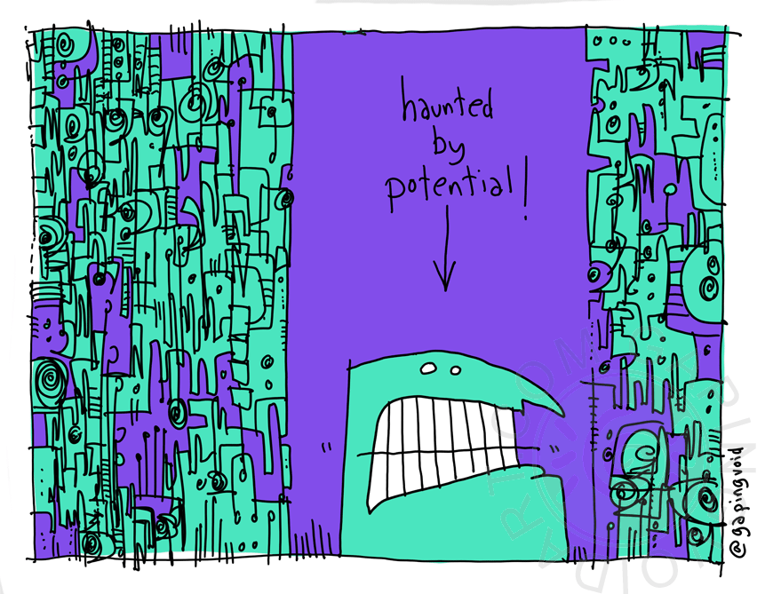
Lorcan Dempsey. Centering the decentralized identity.
December 2008.
Confession
My online identity is pretty
fragmented ☺

Slide 19
“
Most of the panelists (including me) have uncommon, perhaps unique, names. For me, this means it's really important to take control of what people see about me when they do a web search. I want the first few pages of hits to be about what I’m doing now, not when I first got on the Internet at age thirteen. And I want them to represent my professional skill set, not my personal life. (I'm inspired in this by Danah Boyd's excellent post.)
If you have a more common name, you have a different set of problems. How can you ensure that people find the right you? My husband has the same name as an artist, a football player, and a real estate agent. This makes it hard to find him in searches, but at least the other individuals don’t embarrass him.
Andromeda Yelton. Personal branding for new librarians.
ALA.org » NMRT » News » February 2011, Volume 40 No. 3

Slide 20
“
But above all else, seriously, create a public Internet identity, maintain it, link to it, build it, love it, hug it, and call it George. I can’t tell you how important this is. …
… Carefully crafting and cautiously managing one’s public image is a critical aspect of living in a mediated public world. Every advice column I’ve read warns people of the dangers of living online. I think that this is idiotic. People need to embrace the world we live in and learn to work within its framework. Don’t panic about being public – embrace it and handle it with elegance.
danah boyd. controlling your public appearance.
apophenia September 7th, 2007

Slide 21
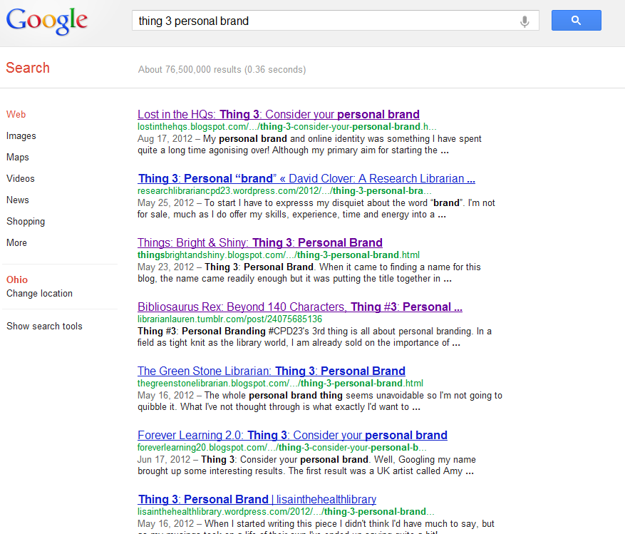

Slide 22
Life would be simpler
if Universities only
employed people with
unique names ☺

Slide 23
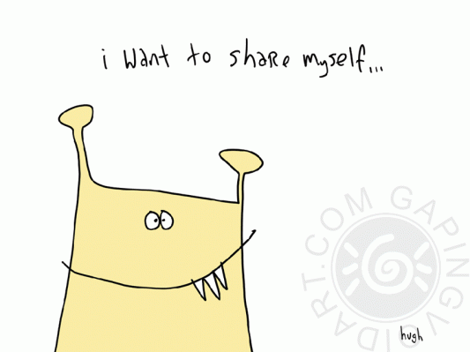
Have you a consistent online identity?
Where is it important to have a presence?

Slide 24
Picturing a rhino: experience is the only guide
3

Slide 25
“
I worry about the experiential gap between people who have immersed themselves in games, and people who have only heard secondhand reports, because the gap makes it difficult to discuss the meaning of games in a coherent way.
It reminds me of the way the social critic Jane Jacobs felt about the thriving urban neighborhoods she documented in the sixties: "People who know well such animated city streets will know how it is. People who do not will always have it a little wrong in their heads - like the old prints of rhinoceroses made from travelers' descriptions of the rhinoceroses."
Johnson, Steven. Everything Bad Is Good for You: How Today's Popular Culture Is Actually Making Us Smarter. New York: Riverhead Books, 2005.

Slide 26
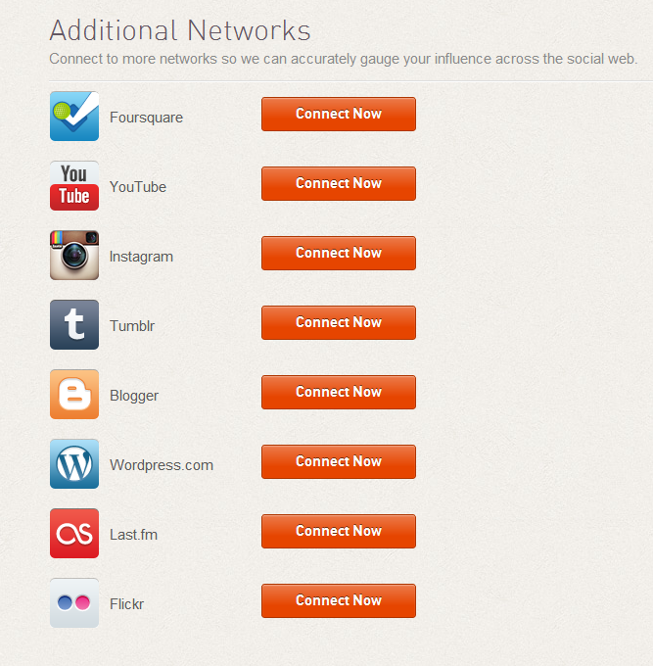
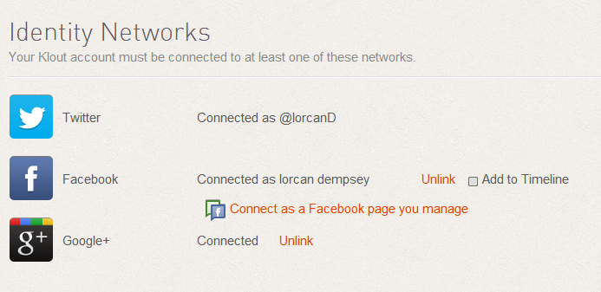

Slide 27
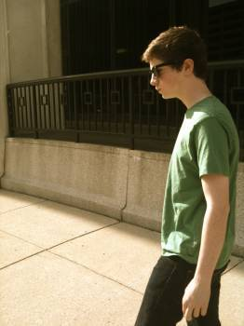

Slide 28
“
The most important word on the internet is not “Search”. The most important word on the internet is “Share”. Sharing is the driver. Sharing is the DNA. We use Social Objects to share ourselves with other people. We’re primates. we like to groom each other. It’s in our nature.
More thoughts on social objects. Hugh MacLeod.

Slide 30
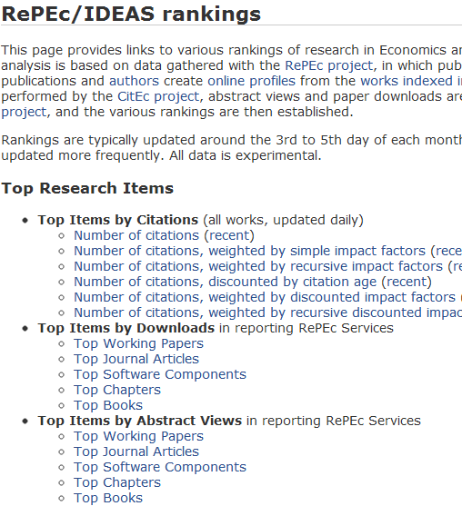
Characteristics?
Profiles
Sharing around social objects ..
Papers, collections, careers, …
Network level
Analytics
Assessment
Recommendation

Slide 31
Do you know which services your researchers/faculty/students use?

Slide 32
Research (and learning) (are social)
3

Slide 33
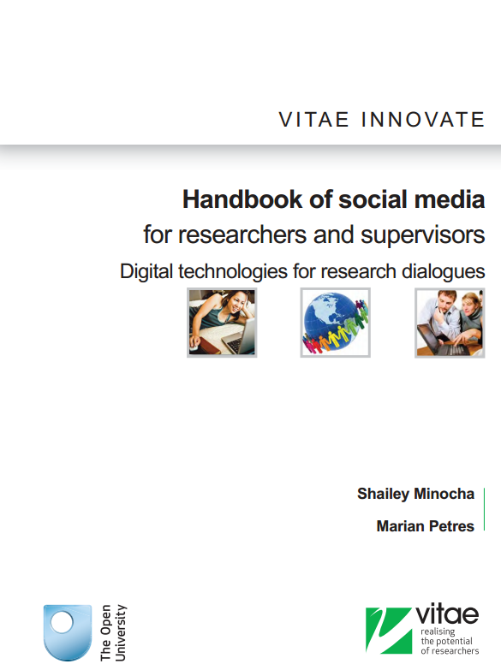
Research into behaviors/attitudes
Tips
Overview of tools
Good research practice
http://www.vitae.ac.uk/CMS/files/upload/Vitae_Innovate_Open_University_Social_Media_Handbook_2012.pdf

Slide 34
Early career researchers
Face to face interaction is key
Email is most important tool
Wide scale adoption of social media tools
Researchers introduce each other to technologies
Sometimes supervisors block the adoption of new technologies
…….>>>>

Slide 35
“
Our research has shown that researchers are using social media tools for research discourse related to six functions: formal dialogue with supervisors, informal interactions with peers and supervisors, document authoring, exchange with supervisors and storage, space for reflection, working with ideas and the process, engaging with the community at large and for keeping themselves informed.

Slide 36
“
Instead of setting up websites on institutional servers, researchers are now using Linkedin and sites such as Academia.edu, and even blogs to set up their professional presence on the web.

Slide 37
“
Researchers prefer to adopt open source and social media technologies that are available in the public domain rather than institutional license-based applications ….. First the social media technologies facilitate networking and community building. Second, researchers prefer to use technologies that will enable them access to resources and their own materials beyond their institution-based PhD research.
e.g. Mendeley, Zotero, Endnote

Slide 38
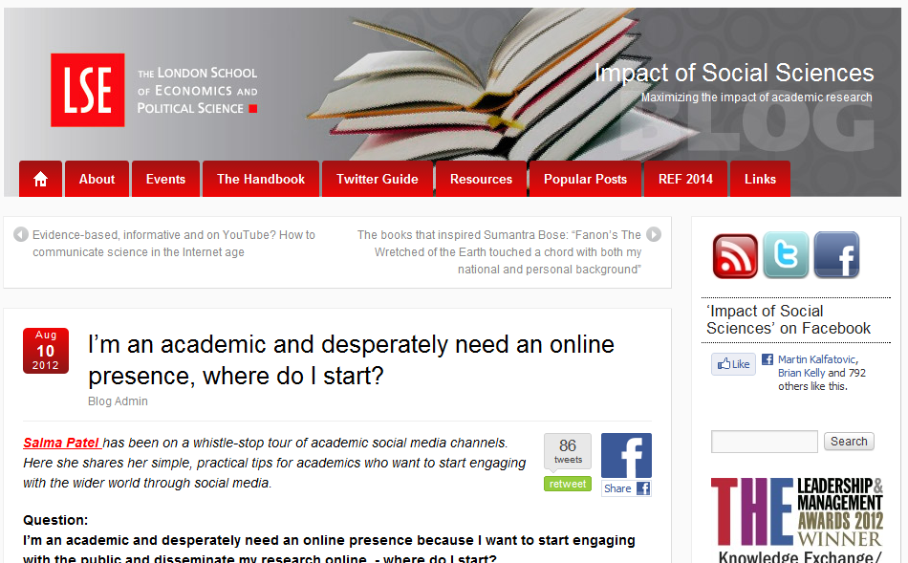
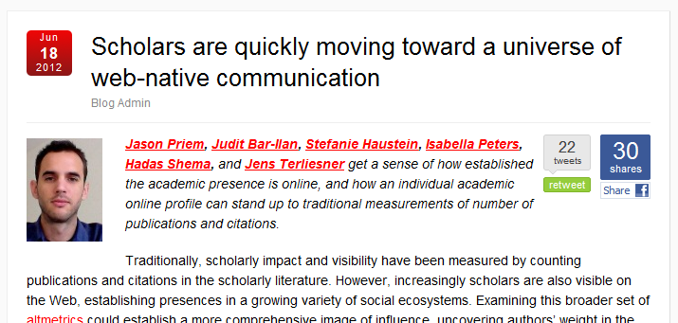

Slide 39
“
But before we can start to seriously examine scholars’ personal altmetrics, we need to get a sense of how wide and established their presence on the social Web is, and how measures of social Web impact relate to their more traditional counterparts. To answer this, we sampled the 57 presenters from the 2010 Leiden STI Conference, gathering publication and citations counts as well as data from the presenters’ Web footprints.
Looking just at authors, we found Web presence widespread and diverse: 84 per cent of scholars had homepages, 70 per cent were on LinkedIn, 23 per cent had public Google Scholar profiles, and 16 per cent were on Twitter (this last number is well higher than more conservative, earlier estimates).
We also delved deeper by looking at publications of our sampled scholars. After assembling all 1,136 articles they’d written (subject to some methodological details), we looked at how much activity these articles were attracting in various ecosystems. The coverage of the social reference manager Mendeley was the biggest story here: 82 per cent of our documents had at least one Mendeley bookmark, which compares quite favorably to 85 per cent coverage from Scopus. Interestingly, it is better coverage than Thompson ISI’s Web of Science (which uses the same data as the Impact Factor); only 74 per cent of sampled articles cited were in WoS.
Priem at al.
Scholars are quickly moving to a world of web-native communication.

Slide 40
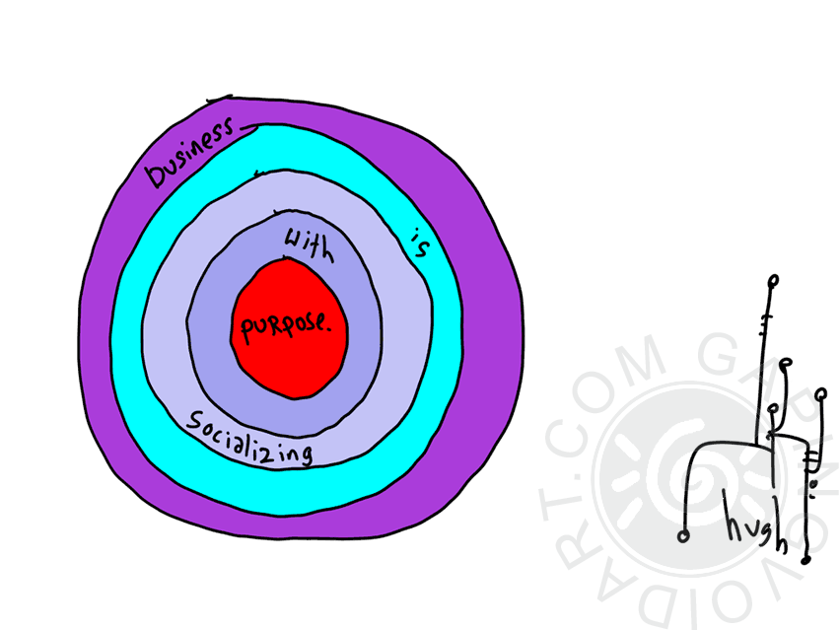

Slide 41
“
Our users are also exploring and inhabiting these spaces, building online presence and identity, and how can you serve users you do not understand? One way to understand them is by going to where they are, and they are online.
Jenica Rogers. IOLUG speaker’s notes on online identity.
Attempting Elegance. Jan 5 2010

Slide 42
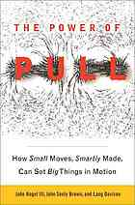
The power of pull
5

Slide 43
“
We all talk loosely about information overload and assume that this is the real problem. In fact, we live in a world of increasing knowledge scarcity. The most valuable knowledge is in very short supply and is extremely hard to access.
Information overload is a distraction. As we discussed in earlier chapters, in a world of accelerating change, the most valuable knowledge is highly distributed and may be embedded in the heads of people who are not well known and who are difficult to identify.

Slide 44
Dan Chudnov
Cody Hanson – signed vs anonymous
People are entry points too
Make personal and public recommendations of sources and articles
Expose our selection processes
Expose our expertise
People as entry points. Lorcan Dempsey’s Weblog.

Slide 45
“
… access, the ability to find people and resources when they are needed.
… the ability to attract valuable and relevant people and resources to you. Social networking, conferences, location in relevant geographic spikes (Nashville for country music) are important here, as is the ability to be open to and develop relationships through serendipitous encounter.
… the ability to achieve more by learning more effectively and translating that learning into improved performance. Interestingly, the authors discuss 'creation spaces' which support this third level. Examples include the social interaction on World of Warcraft and the SAP Developer Network which provide support for shared attention to problems.

Slide 46
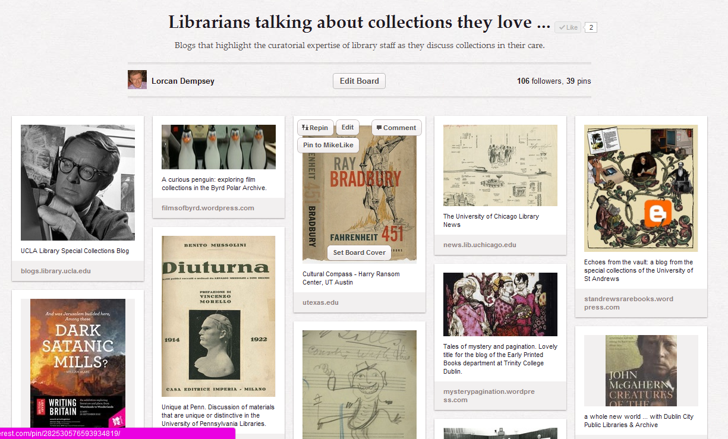

Slide 47
“
For Brett, personal branding is about finding the people he wants to know and work with, and cultivating conversations. The brand is the network. I found this a fascinating change of perspective since personal branding is normally thought of as flashy and self-focused. ….
…. Professors, vendors, colleagues, and prospective employers will google you. They’re going to find something about you. The question is: Does it represent you?
….
To me, personal branding is the notion that your career is more than your institution, especially for those of us who don’t have institutions yet. It’s up to me to provide my own professional development opportunities, name recognition, and advancement.
Andromeda Yelton. Personal branding for new librarians.
ALA.org » NMRT » News » February 2011, Volume 40 No. 3

Slide 48
Can you be easily found?
Is your expertise visible?
Is your work visible?
Can you help faculty be easily found?
Can you help faculty make their work more visible?

Slide 49
Ten simple steps to create and manage your
professional online identity:
How to use portfolios and profiles
Susanne Markgren
January 2011College & Research Libraries News vol. 72 no. 1 31-35
Link
I’m an academic and desperately need an online presence, where do I start?
Salma Patel
Impact of social sciences: maximizing the impact of academic research. Link

Slide 50
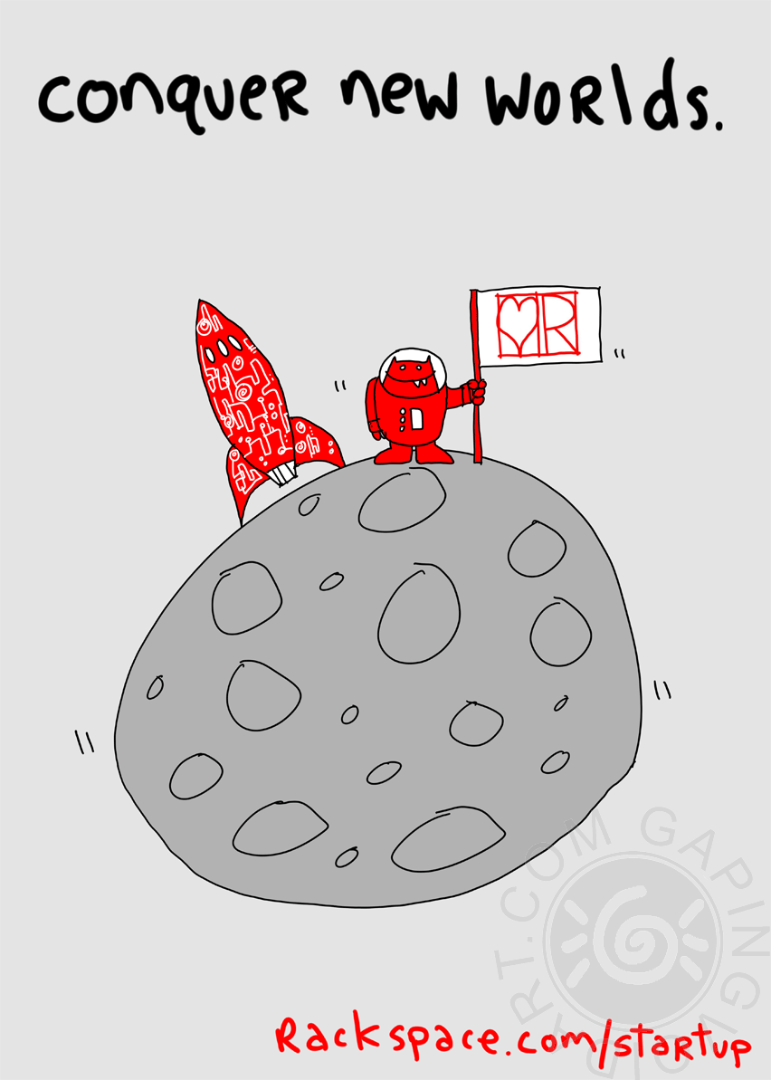
Takeaways?

