Slide 1
discovery
delivery
disclosure
Lorcan Dempsey OCLC
U Minnesota Nov 23 2009

Slide 2
overview: 3 pictures and some context
U Minnesota: some numbers
Interlude: network reconfiguration
Picture 1: an emerging systems pattern: a materials workflow perspective ..
Picture 2: a period of transition: collection directions ..
Interlude: network reconfigurations
Picture 3: extending the network picture: a disrupting ecology ..
Conclusion: some tentative directions

Slide 3
numbers
With thanks to Brian Lavoie and Constance Malpas

Slide 4
U Minnesota in WorldCat
Scale
Total number of UM holdings
in WorldCat:
4,316,022
Contribution
Number of UM-contributed
records in WorldCat:
575,542
Diversity
311 languages
(26% of holdings non-English)
233 countries of publication
(48% of holdings non-US)
Value of Contribution
Number of holdings attached
to UM-contributed records:
2,687,888
Rareness
Number of items held by:
5 or fewer institutions: 683,258
25 or fewer institutions: 1,603,701
Statistics current as of July 2009

Slide 5
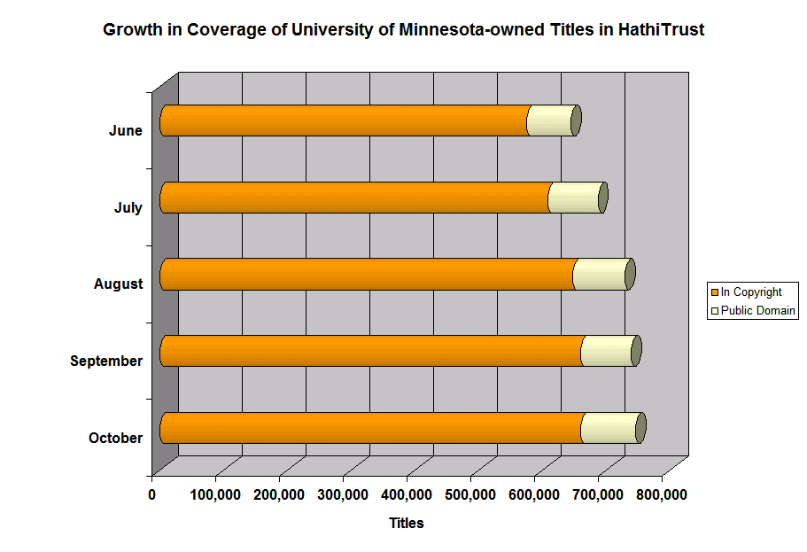
= 20% of MNU library holdings
784,796
9.3 miles of library shelving
Notes:
Coverage of MNU-owned content in the Hathi repository is growing – not because Minnesota is depositing content, but because MNU holds a significant proportion of the titles that are being digitized and contributed by other research libraries. Yet only a small part of the Hathi corpus (10-12% of titles, according to our analysis) is available as public domain content.
Can Minnesota realize the potential space savings that participation in Hathi might offer without jeopardizing its role as a leading provider of academic library content? MNU has ranked first among ARL lenders for a decade or more. How will its role as a delivery hub be affected by the increased discoverability of the Google Books corpus? What is the library’s responsibility as a provider of print ‘surrogates’ in the current scholarly environment?
This is largely a question of supply and demand. Assuming the price point for licensed access to the GBS corpus is reasonable, we can anticipate that demand for print access will decline as students and faculty at ARL libraries move their scholarly work online. One can infer that both the preservation value and scholarly demand for print versions will decline over time, reducing the need for redundant physical inventory.
This raises the question of how much redundancy in print collections exists for titles currently preserved in the Hathi repository. (i.e. how ‘safe’ is it for Minnesota to reduce its print holdings in view of Hathi coverage?)
NB: space savings calculation based on avg monograph size of .75 inches; this is the figure Hathi uses in its calculations

Slide 6
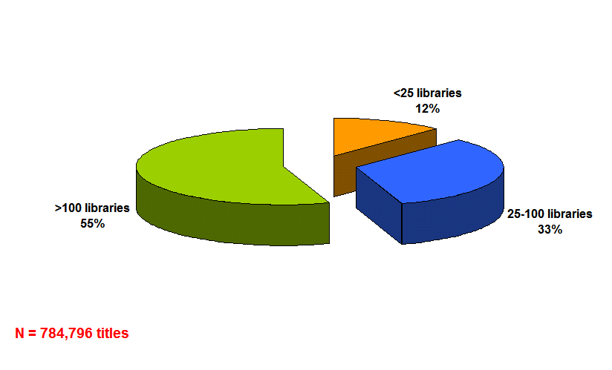
Minnesota-owned Titles in Hathi:
System-wide Print Holdings
Given ubiquitous digital access
robust digital preservation guarantees
relative abundance of alternative print supply
where should Minnesota focus library resources?
preservation priorities . . . delivery portfolio
Notes:
Minnesota is unlikely to divest holdings for which there is limited systemwide supply, since this would not only erode its role as a just-in-case provider of print editions but also compromise community preservation goals. On the other hand, the university could reasonably seek to reduce holdings for which digital access and preservation is assured, and for which systemwide supply is relatively abundant.

Slide 7
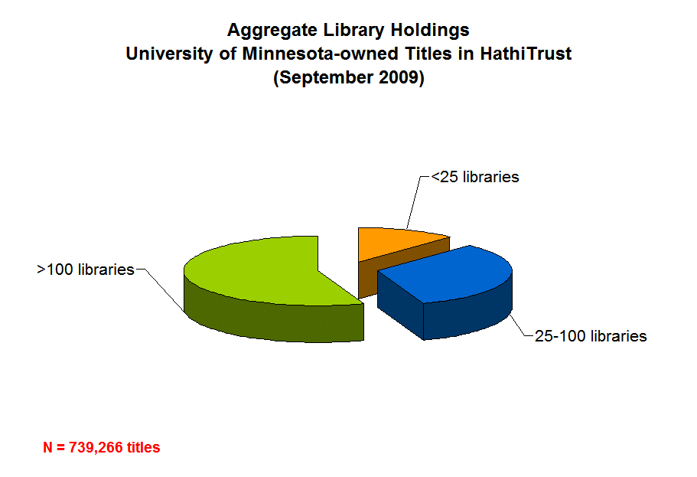
Distribution of print holdings reflects:
scale of scholarly attention (research v. teaching)
scope of intended audience
scholarly
specialist & research monographs
‘the canon’
‘the canon’
research monographs
A
T
T
E
N
T
I
O
N
broad
narrow
A U D I E N C E
core secondary works
scholarly editions
core secondary works
scholarly editions
pedagogical
Notes:
Where Minnesota choose to draw the lines will be determined in large measure by the university’s business model.

Slide 8
Choices?
. . . suggests potential redistribution of print inventory to support post-digitization access
and preservation requirements
Retain as local asset?
.. or 10 or 5 or ?
Source print delivery with network provider?
Shared research collection, regional consolidation?
Notes:
By outsourcing management of content that no longer delivers distinctive local value, Minnesota can

Slide 9
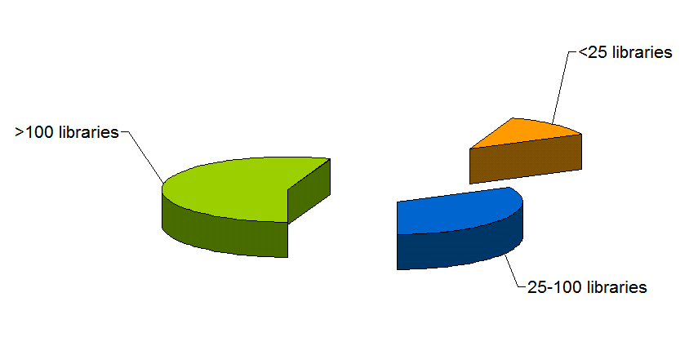
Renegotiate local,
group,
global delivery portfolios?
Notes:
[naming potential service partners is the wrong thing to do …]

Slide 10
interlude
Network reconfiguration cf bookstores, travel agents, newspapers

Slide 11
Consumer switch Then: More investment in business/education environments. Now: More investment in consumer environments.
Workflow switch Then: Expect workflows to be built around my service. Now: Build services around workflows
Attention switch Then: Resources scarce; attention abundant. Now: Attention scarce; resources abundant.

Slide 13
In an environment of scarce attention high transaction costs equals low/no availability.

Slide 14
Visitors and residents: Dave White

Slide 15
emerging pattern
An institutional view: moving beyond materials workflow silos?

Slide 16
User environment
End User Access
Bought/ Physical
Elctronic/ Licensed
Digitised/
Digital
Special colls/ Archives
Materials
workflow
Management environment
Management
Management

Slide 17
User environment
Find It
End User Access
Get It
Bought/ Physical
Elctronic/ Licensed
Digitised/
Digital
Special colls/ Archives
Library &
Network
Resource
Metadata
Content
Management environment
Manage It
Management

Slide 18
User environment
Find It
OPAC
MetaSearch
A-Z
NxtGen
Website
End User Access
Get It
Bought/ Physical
ILL/CIRC
Elctronic/ Licensed
LINK RESOLVER
Digitised/
Digital
SPECIAL
Special colls/ Archives
Library &
Network
Resource
Metadata
MARC
A&I
XXX
DC
EAD
Content
Management environment
Manage It
ILS
ERM
REPOSITORY
SPECIAL
Management

Slide 19
End-user environment integrated discovery
User environment
Find It
OPAC
MetaSearch
A-Z
NxtGen
Website
End User Access
Get It
Bought/ Physical
ILL/CIRC
Elctronic/ Licensed
LINK RESOLVER
Digitised/
Digital
SPECIAL
Special colls/ Archives
Metadata
MARC
A&I
XXX
DC
EAD
Content
Management environment
Integrated resource management
Management environment
Manage It
ILS
ERM
REPOSITORY
SPECIAL
Management

Slide 21
collection directions
Outside in and inside out

Slide 22
Collections grid
Stewardship
high
low
Low-High
Books & Journals
Newspapers
Gov Documents
CD & DVD
Maps
Scores
Low-Low
Freely-accessible web resources
Open source software
Newsgroup archives
low
Uniqueness
High-Low
Research & Learning Materials
Institutional records
ePrints/tech reports
Learning objects
Courseware
E-portfolios
Research data
Prospectus
Insitutional website
High-High
Special Collections
Rare books
Local/Historical Newspapers
Local History Materials
Archives & Manuscripts
Theses & dissertations
high

Slide 23
Collections grid
Stewardship
high
low
Licensed: concentration?
Small no. of suppliers?
‘Professional’ services
Selective archives.
low
Bought: move to licensed? Space, GBS, usage, …
Uniqueness
Institutionally important Future ‘special’
high
Special to whom?
Distinctive?

Slide 24
Outside in: consolidation of bought, licensed? Integration less difficult?
Discover, deliver
Disclose holdings Manage claims
Inside out: reputation, institutional assets, institutional record, distinctive, …
Disclose. Array alongside other insitutions? Make sense as individual destinations? …

Slide 25
network reconfig
challenge of institution scale

Slide 26
3 pressures
User-centric
Network level
Multiscalar

Slide 27
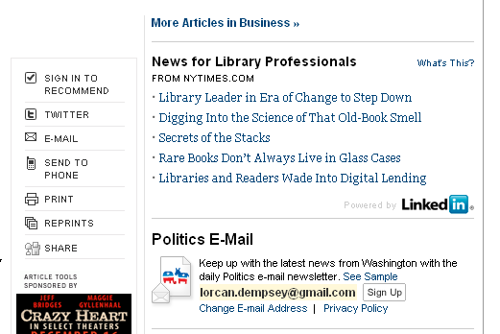
User-centric
Site-centric
Network-centric
User-centric
NYT headlines ->

Slide 28
User-centric
Socialized, realtime, and mobile …
registration
Identity services (Facebook?)
Be the trusted Identity Service for as many people as possible
give them identifiers
authenticate them
provide claims about them
who they are
what they do
what they want
Act as their Agent
(Andy Dale, OCLC)

Slide 29
Registration with FB SSO

Slide 30
Institution scale: stuck in the middle?
Social, realtime, mobile
Cloud and mobile: natural partners

Slide 31
Network level
Network is the unit of attention ..
Data aggregation
Gravitational pull
Network effects
Long tail (match supply and demand)
Niche – added value

Slide 32
Multiscalar
Personal
Departmental
Disciplinary
Library
Consortial
Systemwide
Network level
Bookmarking?
Researcher pages?
Deposit papers? Research data?
Identity and federation lacking across scales..
AgEcon search + EthicShare vs Conservancy + media archive

Slide 33
choices ….
 | Local | Collab-orative | Comm-ercial | Public | Leverage infra-structure
 | mnCat | Hathi Trust | Summon | OhioLink JISC CDL | Google Scholar
Focus on distinctive local impact? Engagement?
Externalise infrastructure? Common requirements?

Slide 34
extending the picture
But … readers do not integrate at institutional level …

Slide 35
In the flow ..
Variety of campus venues
Network level
Student portal
Course management system
Reading list
Refworks
VIVO, OSU Pro, …
…
Mendeley
Google
Amazon
Flickr
iTunes
Wikipedia
Twitter
Facebook
…

Slide 36
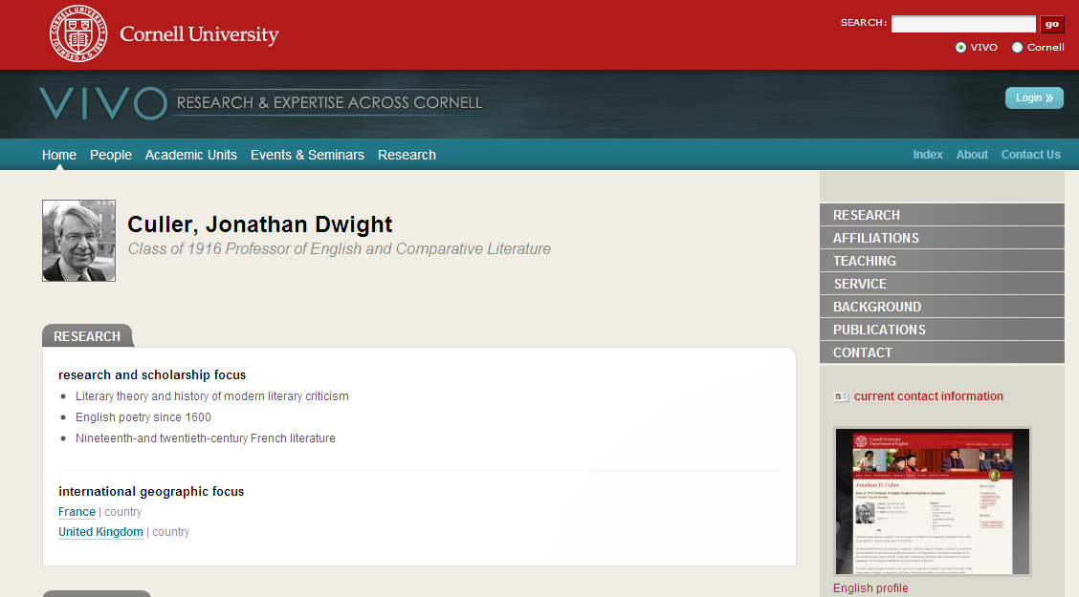
100,000 users and
8 million research papers
VIVOweb Project is a two-year $12 million project funded by the NIH.
VIVO at Cornell

Slide 37
Flow
3
Info Provider
Consumer
2
Library
1
Direct – added value
2 and 3: discovery happens elsewhere
Disclosure: holdings (non-unique) and existence.
SEO: part of the web, not just on it ..
2. Disclosure and syndication
3. Indirect – may involve identity, locate, resolution or other services at library

Slide 38
Indirect discovery

Slide 39
Indirect discovery

Slide 40
Disclosure via GB (holdings syndicated via Worldcat)

Slide 41
Syndication via iTunes

Slide 42
Syndication: bookmarking&RSS

Slide 43
Social objects
Conversation
Connections
Context
Discussion, ratings, rankings, reviews, etc
Link to others through mutual interests
Those who bought this also bought, etc

Slide 44
Flow
Info Provider
Consumer
Library
Social: incentives and scale
Federation, syndication, ..

Slide 45
Flow
Info Provider
Consumer
Library
Library
Library
Social: incentives and scale
Federation, syndication, ..
Collaborative sourcing, …

Slide 46
Research findings
First recourse
Value convenience
Variable use of social tools
Flow
Info Provider
Consumer
Library
Library
Library
Thinking about variety of disclosure paths
Sometimes confusing: high transaction costs
Referral traffic growing
Still important destination

Slide 47
tentative con-clusions

Slide 48
Current will move to emerging pattern
Books: a new balance?
Journals: move to consolidation?
Discovery layer: need one?
Institutional materials: disclose through discovery layer, but also …
Analytics: let traffic influence design of website

Slide 49
Disclose and syndicate
Institutional collections: SEO (sitemaps, etc), move to ‘flow’ services as appropriate, …
Holdings: syndicate (knowledge base, holdings, …)
Services: Libx, widgets, ..
SEO. Consistent URL patterns across services, hackable URLs, bookmarking buttons, etc
…

Slide 50
User and institutional leverage
Expertise, reputation (provide bibliographic tools, ..)
Watch Identity Management: prepare for when manage context (usage) and claims. (affinity strings)
Integration with other campus systems (course management, ..)
‘Follow’ and intervene? (Salesforce.com)

Slide 51
Organizational
Seek collaborative sourcing models
Externalize infrastructure
Focus on distinctive impact
Place local in bigger contexts
Track identity management and reputation enhancement
Recognize that things have changed …

Slide 52
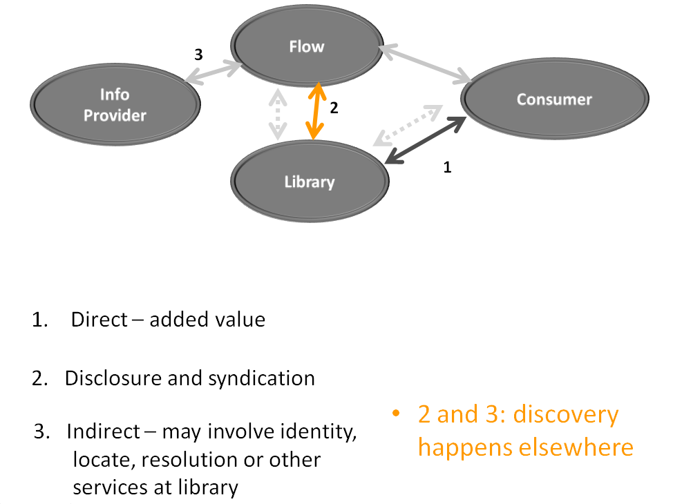
Thank you
dempseyl@oclc.org
http://www.oclc.org/research
http://orweblog.oclc.org
http://www.twitter.com/lorcanD

