Slide 1
The network repatterns the library: from infrastructure to engagement
@LorcanD
Lorcan Dempsey, OCLC
20-23 October 2013
Lianza Conference 13
#lianza13

Slide 2
Summary A shift to engagement .. the library as an actor in research and learning environments of its users. Reduce infrastructure which does not have a distinctive impact. Innovate around new forms of engagement and around institutional patterns? Carry forward what can become scalable and repeatable.

Slide 3
“… the kids will want to know” (Nanaia Mahuta) Contextualising and enriching network knowledge. Libraries: community, network, interdependence The collective resource is highly distributed.

Slide 4
New Zealand libraries provide best coverage of published record related to Maori culture

Slide 5
National Library
Academic Library
Public Library
Notes:
Centers and Comps analysis shows that collective library resource is highly distributed – clear implications for national (and international) library cooperation to support digitization and print preservation aims.
DigitalNZ project relies on content contributions from wide range of institutions, including NLNZ – as chart above suggests, this kind of cooperation is vital if (e.g.) personal histories of New Zealanders are to be made more visible and relevant on the Web. http://www.digitalnz.org/partners/current-content-contributors

Slide 6
Prelude: New Zealand in the published record

Slide 7
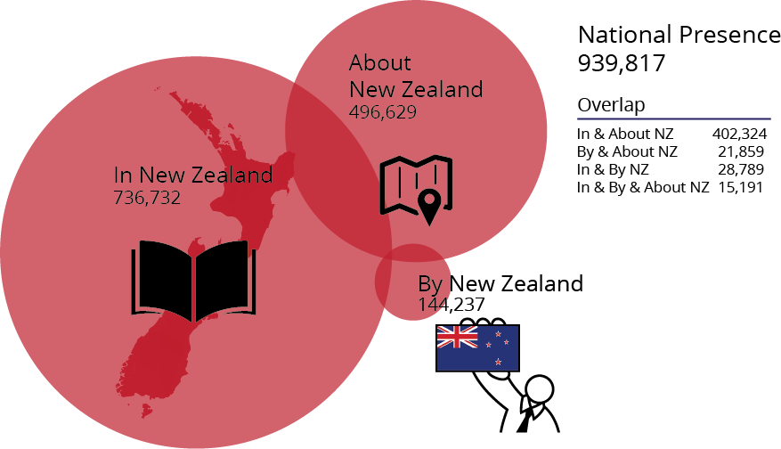
New Zealand Presence in the Published Record (Distinct publications)
Data current as of January 2013,
and reflects library collections
as they are registered in WorldCat
Graphic by JD Shipengrover

Slide 8
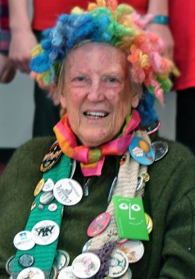
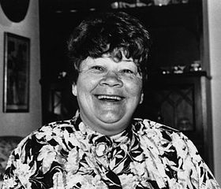
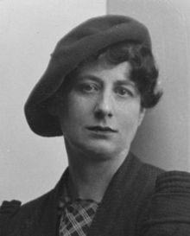
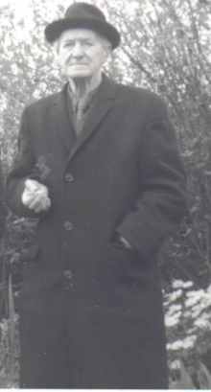
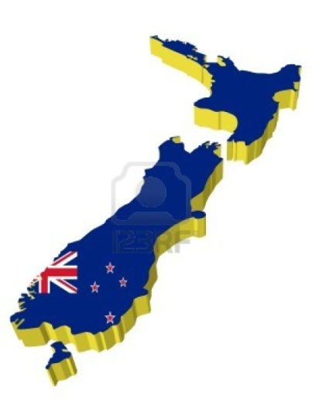
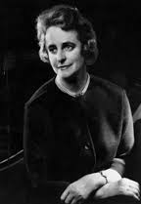
Most popular New Zealand authors
Margaret Mahy: 92,061
Joy Cowley: 69,322
Ngaio Marsh: 60,897
Eric Partridge: 45,114
Dorothy Eden: 39,912
(# of global library holdings)

Slide 9
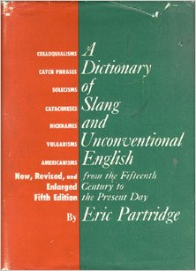
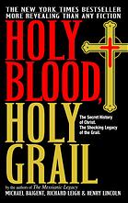
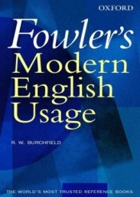
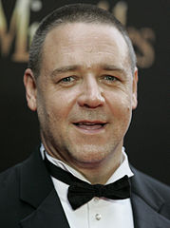
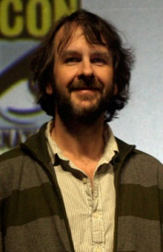
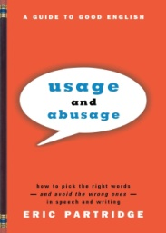
Most popular works by NZ authors
A Dictionary of Slang and Unconventional English
Eric Partridge
6,472
Holy Blood, Holy Grail
Michael Baigent, Henry Lincoln, Richard Leigh
4,470
*Excludes movies
Fowler’s Modern English Usage
R.W. Burchfield
3,470
Oxford Dictionary of English Etymology
C.T. Onions, G.W.S. Friedrichsen, R.W. Burchfield
3,414
Usage and Abusage: A Guide to Good English
Eric Partridge
3,397
(# of global library holdings)

Slide 10
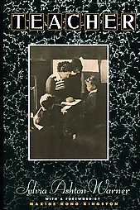
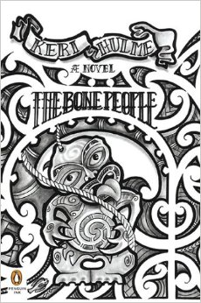
Most popular works about/set in New Zealand
Whale Rider (film): 2,857
Teacher: 2,745
Sylvia Ashton-Warner
The Bone People: 2,677
Keri Hulme
Hunter: 2,455
Joy Cowley
The Piano (film): 2,405
(# of global library holdings)

Slide 11
Top New Zealand “Concentrations” outside NZ
National Library of Australia
Library of Congress
State Library, New South Wales
British Library
State Library, Victoria
Harvard University
University of Hawaii at Manoa
University of Melbourne
New York Public Library
University of California, Los Angeles

Slide 12
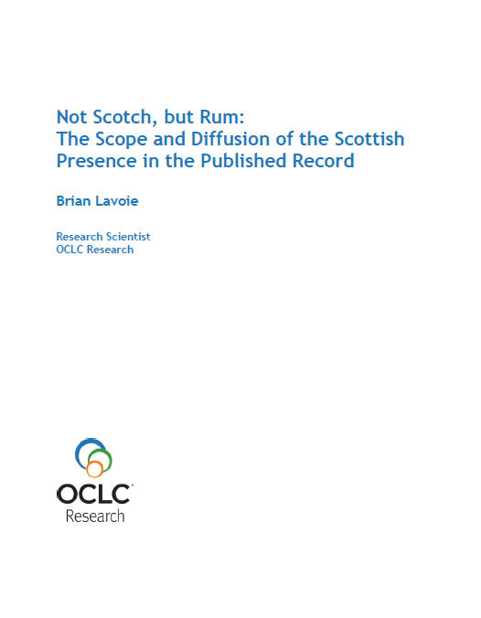
More information …
www.oclc.org/research/news/2013/09-17.html
… follow-up research note on New Zealand presence forthcoming.

Slide 13
Overview

Slide 14
A reset moment

Slide 15
Value? Are you doing the right things? ROI is secondary question …

Slide 16
Reconnect with host institution goals
Research libraries: A mission of deep exploration
Academic library: Student success, reputation
Public library: Skills, learning and civic engagement
National Libraries: Rich engagement with
national identity and memory

Slide 18
Shift to engagement
… the library as an effective actor in the research and learning environments of its users
Rightscale infrastructure
… rebalance investment in collections and systems between local, shared and third party to improve impact and efficiency. Collaboration moves from margin to core.
Innovate – scalable and repeatable
… institutions and services need to evolve in sustainable ways.

Slide 19
Shift to engagement

Slide 20
U Minnesota, ARL Institutional profile
“In alignment with the University's strategic positioning, the University Libraries have re-conceived goals, shifting from a collection-centric focus to one that is engagement-based.”
http://umcf.umn.edu/awards/2006/images/margo_library_lg.jpg

Slide 21
Examples
Visible expertise
Collections: from curation to creation
Space
Decentered web presence
Roles: means and ends

Slide 22
Visible expertise Then: Invisible and neutral. Now: If the library wishes to be seen as expert, then its expertise must be seen.

Slide 23
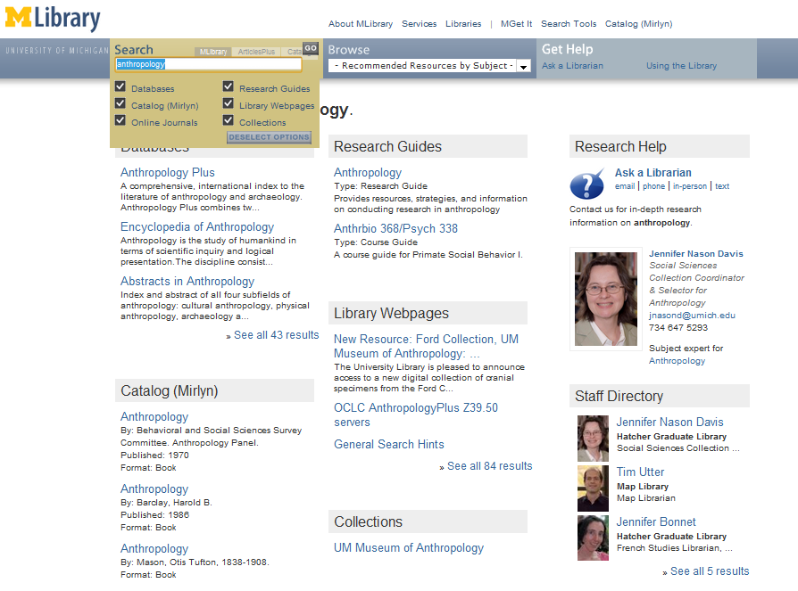
‘Indexing’ librarians at U Michigan

Slide 24
Slide from Pat Losinski, CEO Columbus Metropolitan Library

Slide 25
Pull – attract people to library resources

Slide 26
Collections: from curation to creation Then: Curation: acquire external resources Now: Curation and creation: engage with creation, use and sharing of all information resources.

Slide 27
Outside in Bought, licensed
Increased consolidation
Move from print to licensed
Manage down print – shared print
Move to user-driven models
Aim: to discover
Collections
Inside out
Institutional assets: special collections, research and learning materials, institutional records, community resources, … Reputation management Increasingly important? Aim: to *have* discovered … to disclose
Notes:
Licensed content will dominate in years to come.
Special collections will grow but only modestly (and only at some institutions); mostly growth in managing archival resources including institutional.
Much greater investment in managing research outputs.
No change in web archiving.

Slide 28
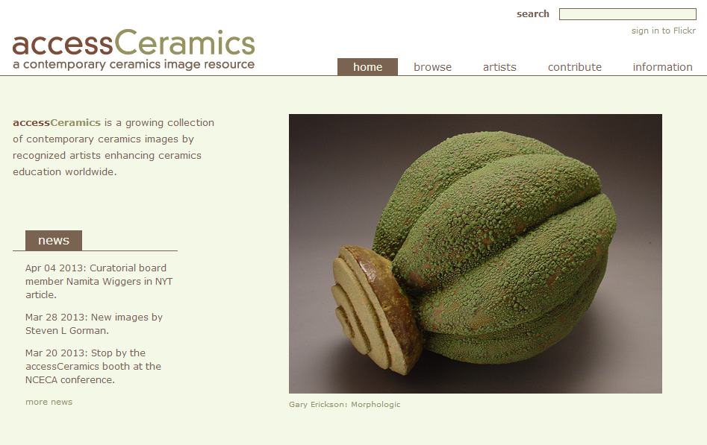
Collaboration with department around
community and learning resource
accessCeramics merges a traditional academic digital image collection's metadata capabilities with Flickr's openness and flexibility. It seeks to take advantage of Flickr's software tools and social network while also providing a web interface customized to this collection.

Slide 29
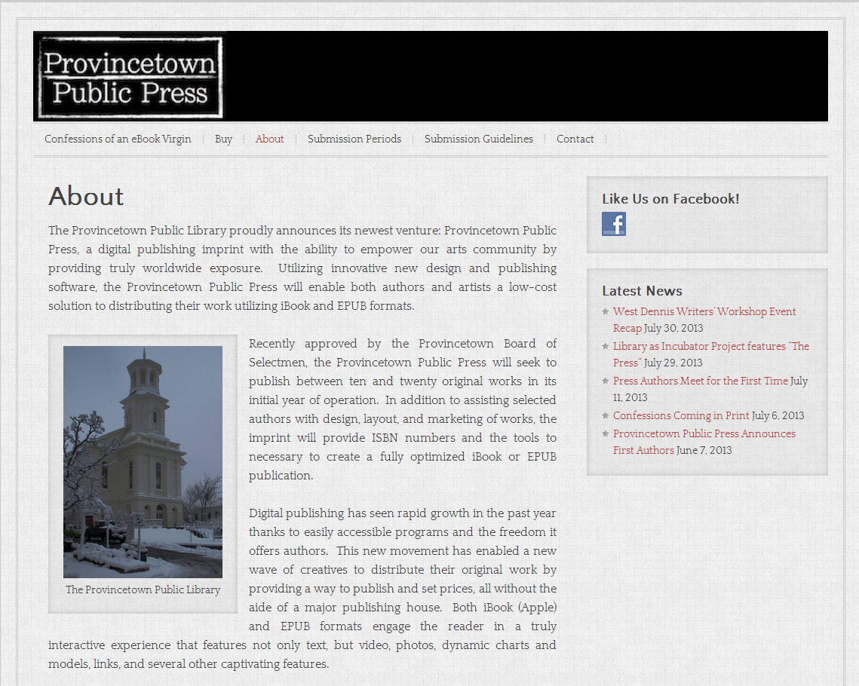

Slide 30
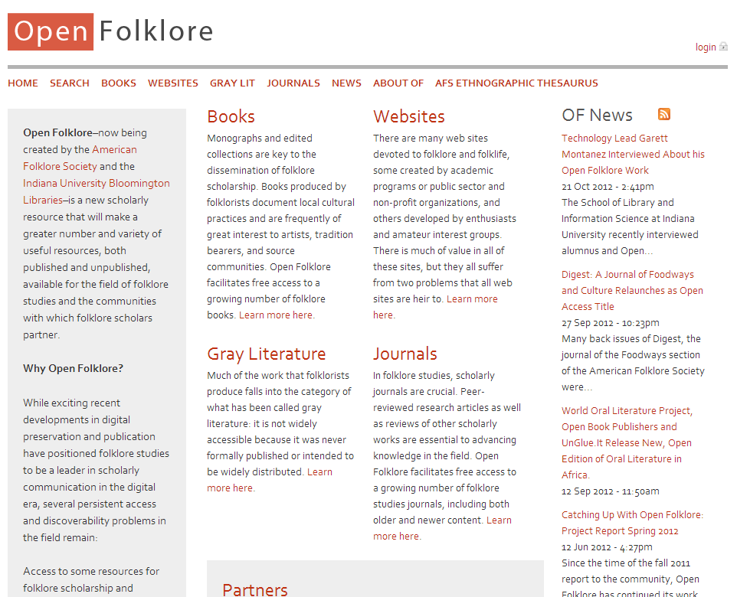
Explore new scholarly forms:
American Folklore Society
and libraries at Indiana U

Slide 31
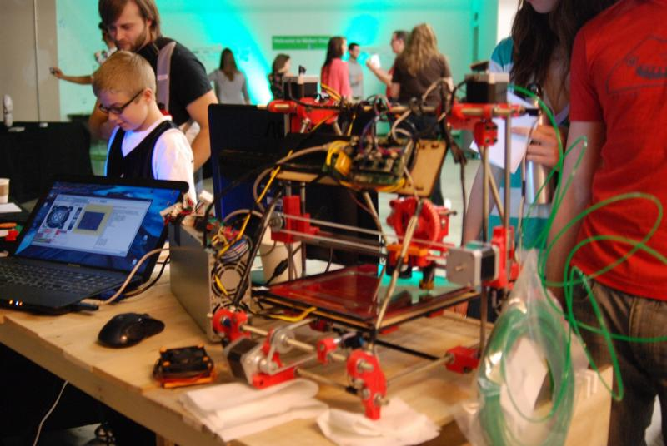
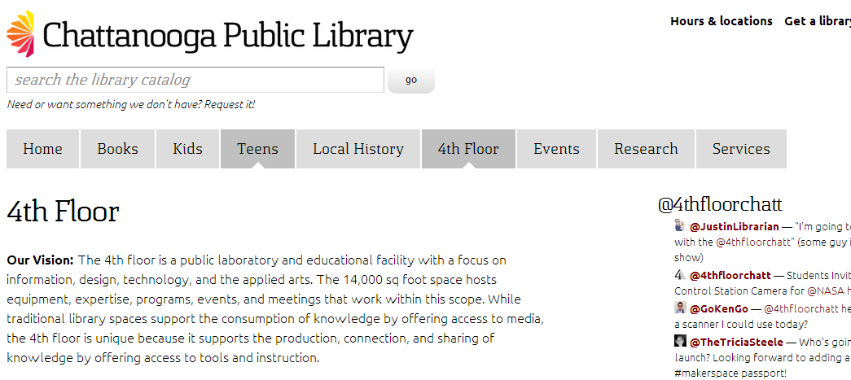

Slide 32
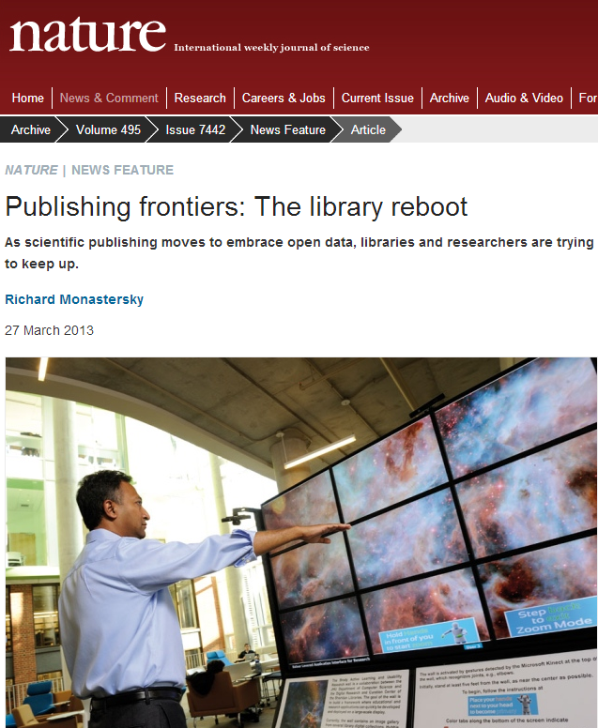
Curating data assets

Slide 33
By Ardfern (Own work) [CC-BY-SA-3.0 (http://creativecommons.org/licenses/by-sa/3.0) via Wikimedia Commons
People should think not so much of the books that have gone into the … Library but rather of the books that have come out of it. Seán O'Faoláin

Slide 34
Space Then: space is configured around collections Now: space is configured around the user

Slide 35
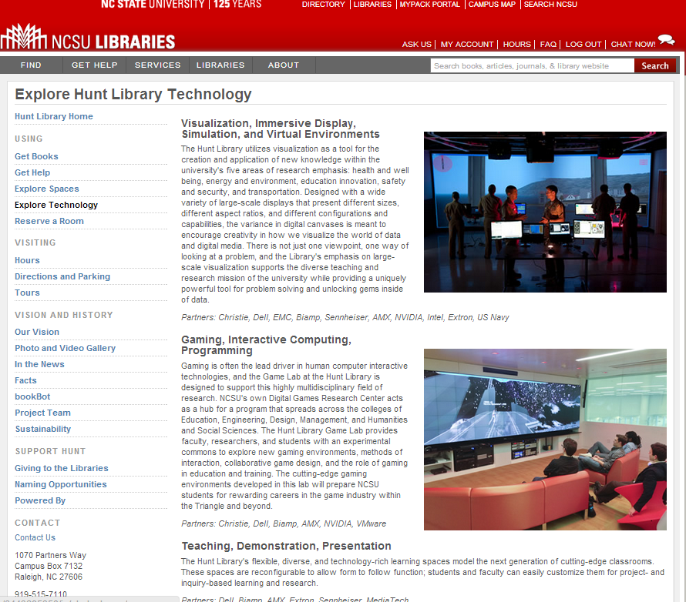
Space reconfigured
around experience,
expertise and
communication
rather than collections

Slide 36
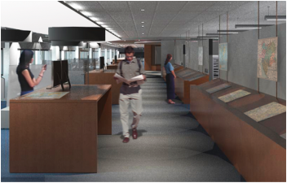
… unique combination of collections, government information expertise, and data services ….
Our new proximity, in a purposefully designed and equipped space, means that we can more effectively collaborate with each other, which in turn really enhances our ability to creatively collaborate with students, faculty, and researchers.
The new library features 60-foot long counter to enable the examination of large-format maps; a presentation space that will accommodate instruction; display cases and screens that showcase items from the print and digital collections; a large-format high-resolution scanner that produces digital copies for online work or the creation of full-size print copies; individual and group study spaces with dual-screen computers and laptop accessibility; and comfortable, moveable furniture for flexible study and collaboration.
We expect the Clark to become the campus nexus for the various data services that all disciplines increasingly require, …
Stephen S. Clark Library

Slide 37
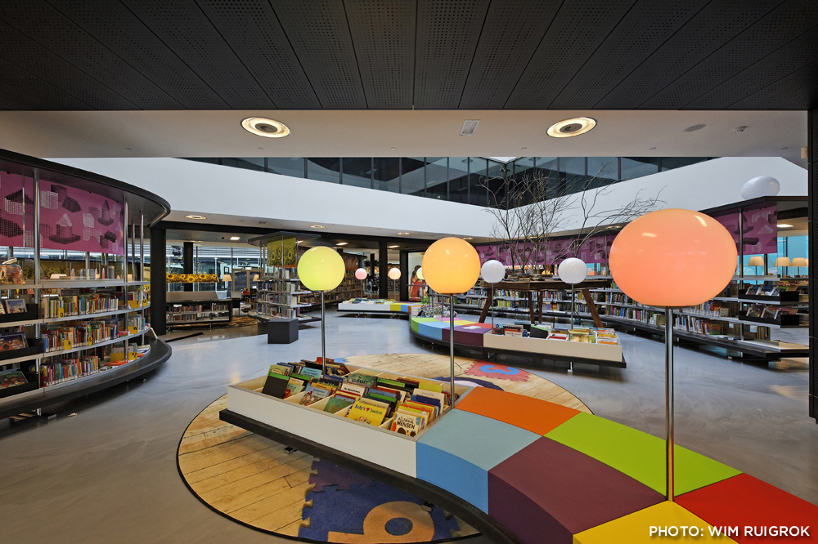
Almere Public Library, The Netherlands

Slide 38
Roles: means and ends Then: Goals are stable. Structured around means: acquisitions, reference, technical services. Well understood roles > Bureaucracy. Now: Goals changing. Structured around meeting new goals. Roles change to address shifting goals > Enterprise. Roles shifting.

Slide 39
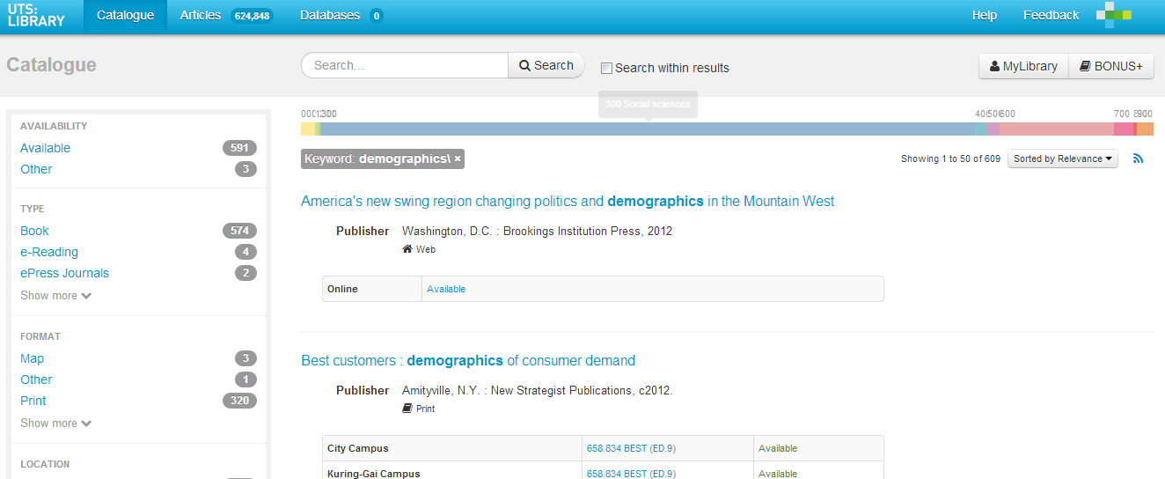

Slide 40
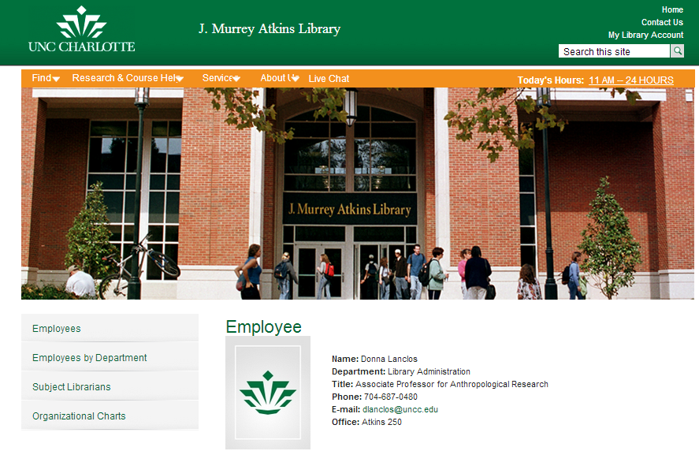

Slide 41
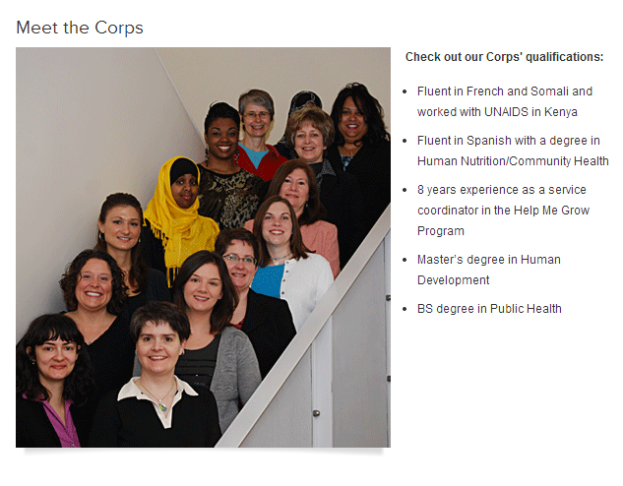
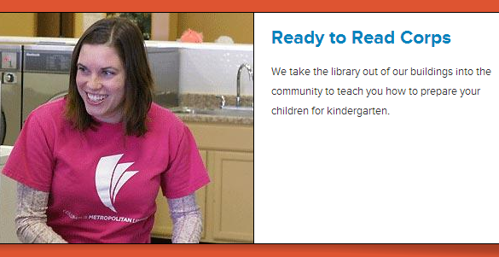

Slide 42
Transformation of the academic library
Kurt de Belder
http://www.oclc.org/content/dam/research/events/dss/ppt/dss_debelder.pptx

Slide 43
The decentered web presence Then: discovery happened at the library Now: discovery happens elsewhere. Focus on ‘discoverability’ in multiple environments.

Slide 44
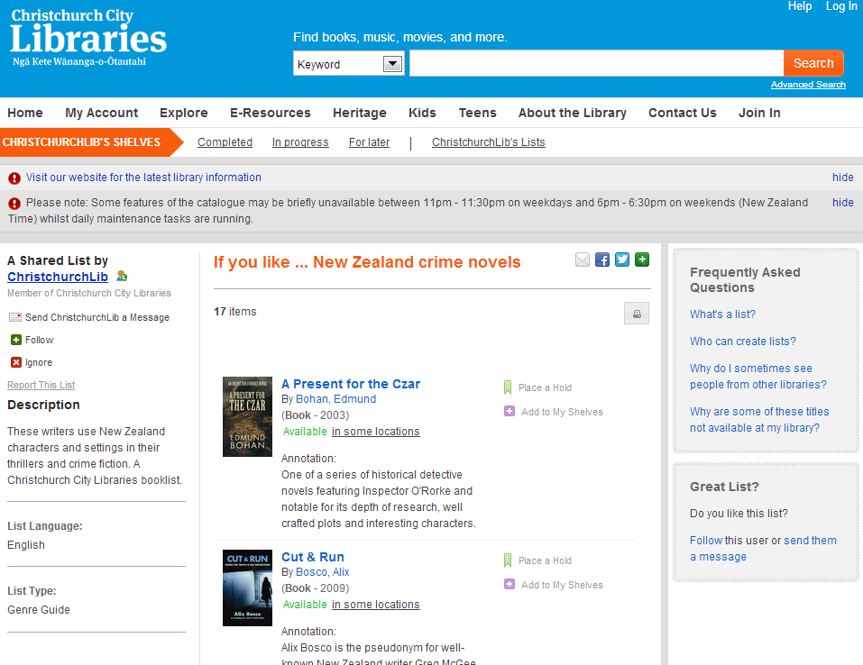

Slide 45
Not just a site but an ecosystem
Beyond the mobile web. Stephanie Rieger. http://www.slideshare.net/yiibu/beyond-themobilewebbyyiibu

Slide 46
Decoupled Communication
Flickr
Blogs
Facebook
Twitter
Google
Youtube
Discovery
Knowledgebase
Libguides
Cloud Sourced
Resolver

Slide 47
WorldCat
ArchivesGrid
Metadata
Summon
Scirus
Blogs
Suncat
Europeana
RSS
Catalogue
Ethos
Mobilepp
Proxy Toolbar
Dspace
Linked Data (Catalog)
OAI-PMH (Dspace)
Discovery
Services
Proxy Widgets
External Syndication
Library APIs
Z39.50
Data
Jorum
Digital Archive

Slide 48
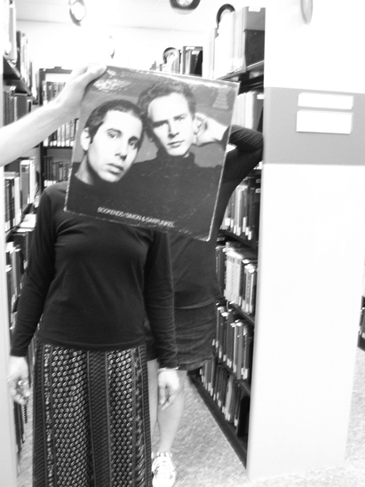
Creating conversations around collections:
Sleevefacing at Bowling Green State Univ
http://blogs.bgsu.edu/librarysleevefacing/2012/08/15/bookends/

Slide 49
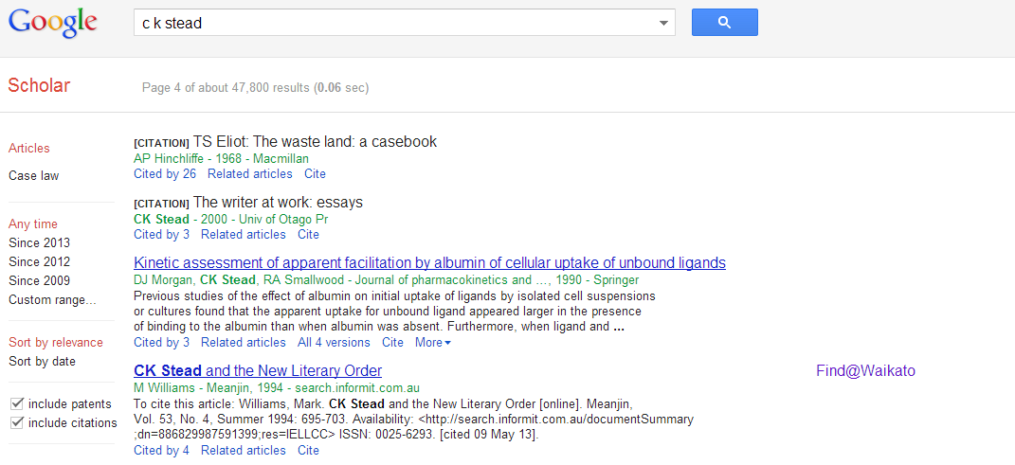

Slide 50
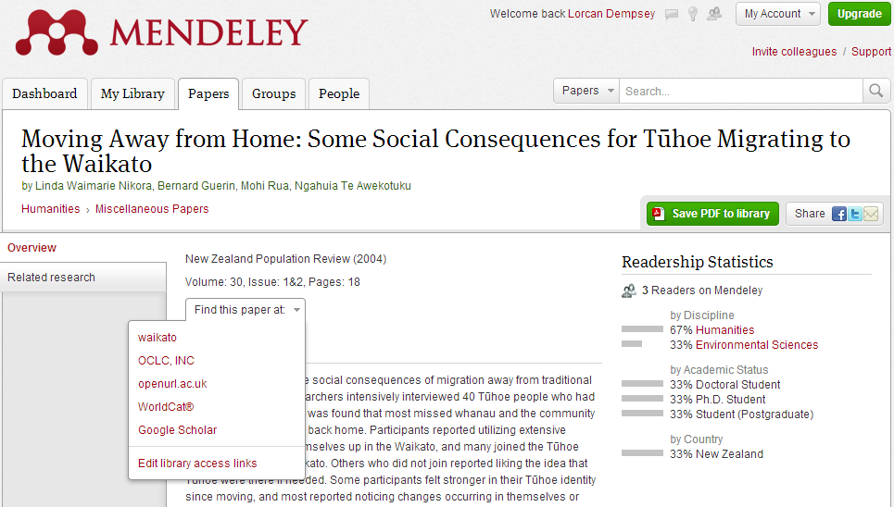
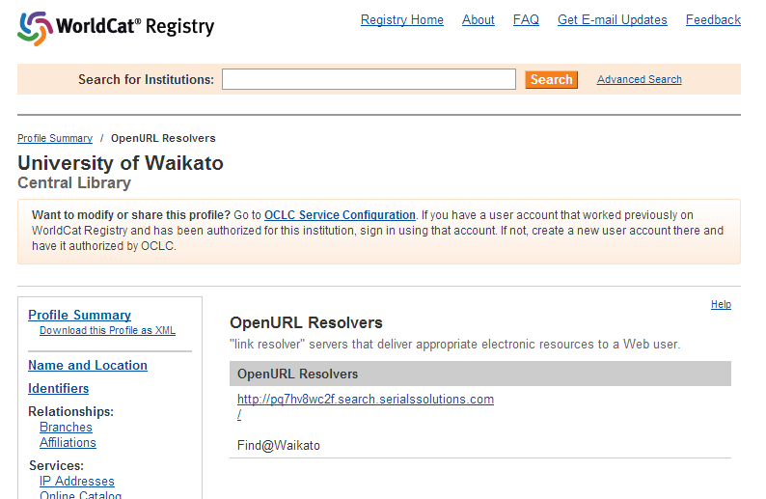

Slide 51
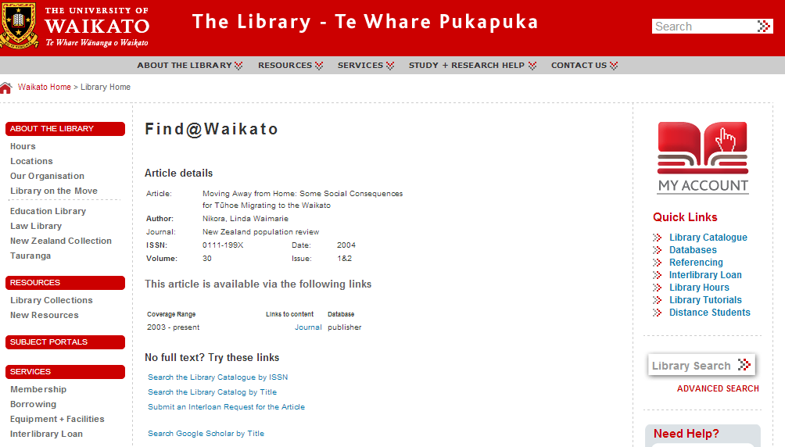

Slide 52
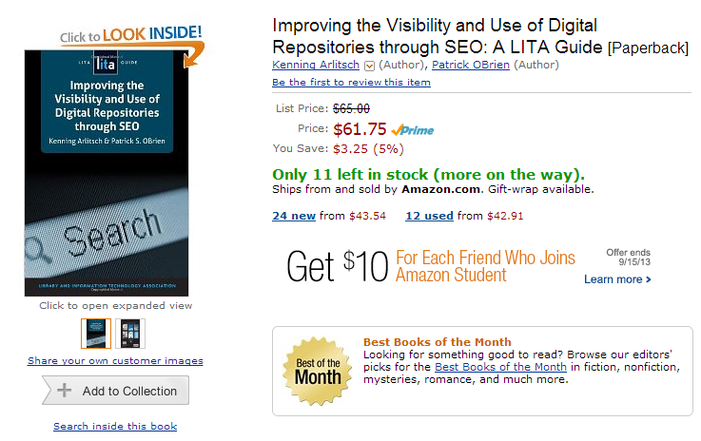

Slide 53
Rightscale infrastructure

Slide 54
“aggregate and scale towards a common infrastructure”

Slide 55
“
Colleges and universities have long competed against one another, measuring themselves in comparison to each other and holding tightly to their idiosyncrasies as defining elements of their status. But today, the distribution and reuse of information digitally via the Internet is rapidly changing the game, rewarding those who instead aggregate and scale toward a common infrastructure. It is becoming increasingly clear that neither the challenges that confront colleges and universities nor the solutions to those challenges are unique to each institution.
Chuck Henry and Brad Wheeler The game has changed
Educause Review, March 2012

Slide 56
Do locally what creates most distinctive value. Share what makes sense for efficiency and impact. Buy the rest.

Slide 57
Examples
Shared print
Managing down local print
Evolving shared approaches.
Digital infrastructure

Slide 58
Shared print Then: Value relates to depth and breadth of local collection. Now: Value relates to systemwide curation of and access to print collections.

Slide 59
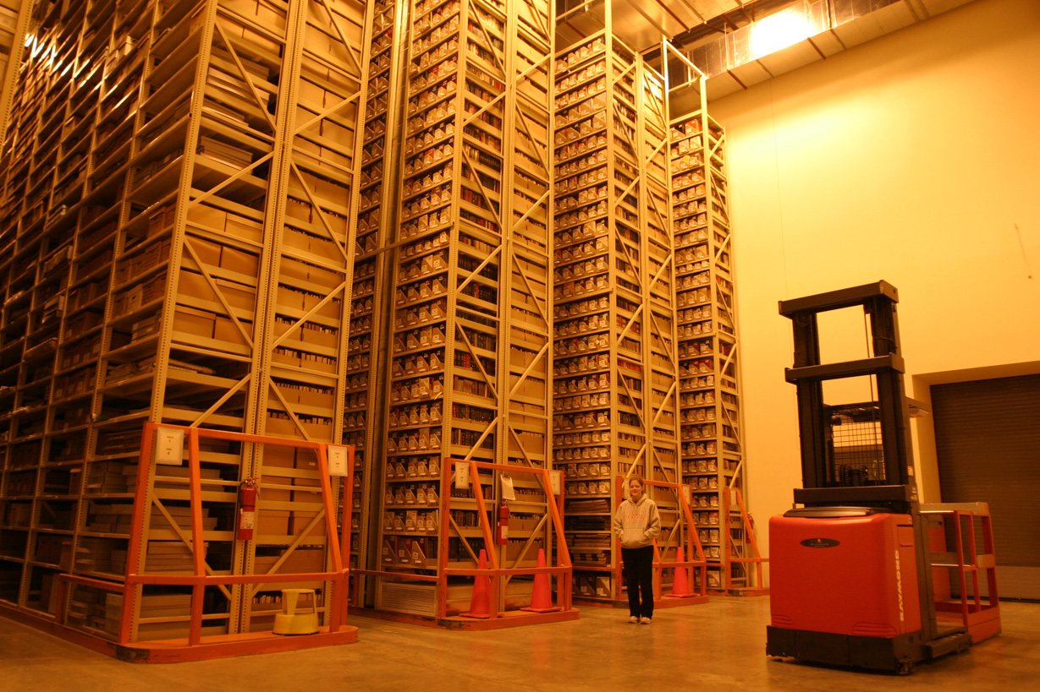
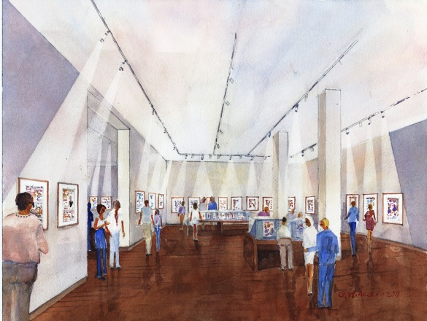
‘Cloud’ storage (Ohio State)
http://library.osu.edu/blogs/cartoons/2012/02/28/blog-launch-and-the-construction-of-our-new-home-in-sullivant-hall/

Slide 60
Directions
Institution: opportunity costs challenge
Growing misalignment between investment in print collections and practices of research and learning
Reconfigure space around engagement rather than around collections
Stewardship and efficient access still (variably) important
Systemwide: balance contributions
Manage down institutional collections
Collectively managed – regional, national based on existing/emerging infrastructure
Include different obligations:
Mid-level HEIs look for third party or collaborative solutions
Research HEIs manage stewardship responsibility within broader framework of digital and cooperative

Slide 61
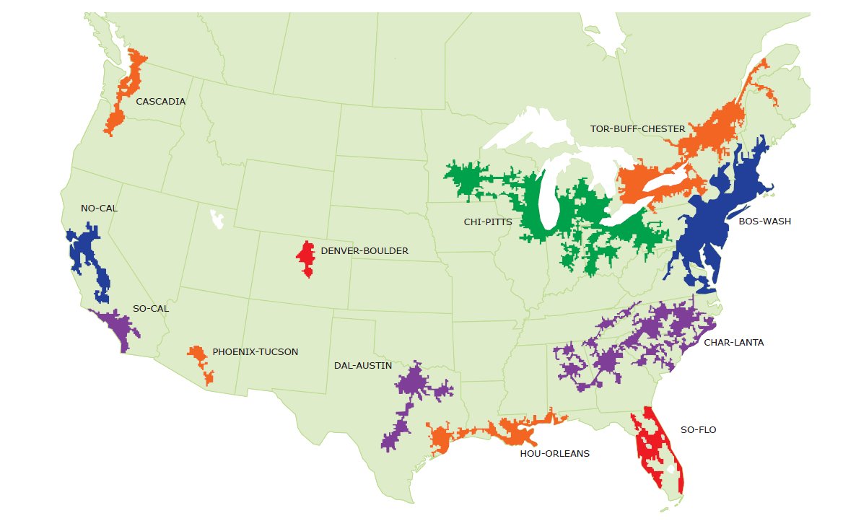
Mega-regions & Shared Print Initiatives
Orbis-Cascade
OCUL
MSCS
WEST
CIC
SCELC
WRLC
GWLA
ASERL
FLARE
We expect that in 5-7 years a large part of the North American ‘collective collection’ will have moved into shared management.
OCLC Research, 2013

Slide 62
Digital and systems infrastructure Then: Roll your own. Now: Look to scale for efficiency and impact.

Slide 63
Collaborative sourcing – interdependence is central

Slide 64
Innovation

Slide 65
Examples
Enterprise
Institutional innovation

Slide 66
A shift to engagement .. the library as an actor in research and learning environments of its users. Reduce infrastructure which does not have a distinctive impact. Innovate around new forms of engagement and around institutional patterns? Carry forward what can become scalable and repeatable.

Slide 67
A reset moment – be enterprising!
The library should not provide an argument for a particular case, but demonstrate that there is always another case to be made. The notion that the library is a place that has no agenda other than allowing people to invent their own agendas is what makes it an indispensable resource for a democracy. It is where we can learn not just to be readers, but to be the authors of our own destiny. Fintan O’Toole
Dublin City Public Libraries, Flickr: http://www.flickr.com/photos/dublincitypubliclibraries/6029467474/in/set-72157594513778442

Slide 68
Credits
Brian Lavoie and Constance Malpas for the Worldcat data analysis.
JD Shipengrover for help with decentered web pictures.
Engagement, innovation, and infrastructure framework influenced by: John Hagel and John Seely Brown. “Unbundling the corporation.” Harvard Business Review, 77, 2. January 1, 1999

Slide 69
@LorcanD
Lorcan Dempsey

