Slide 1
Reconfiguring library boundaries
The Squeezed Middle? Exploring the future of Library Systems
JISC/SCONUL Workshop
University of Warwick, Radcliffe House
19th–20th January 2012
Lorcan Dempsey, OCLC @lorcanD

Slide 2
Preamble: scale, boundaries

Slide 3
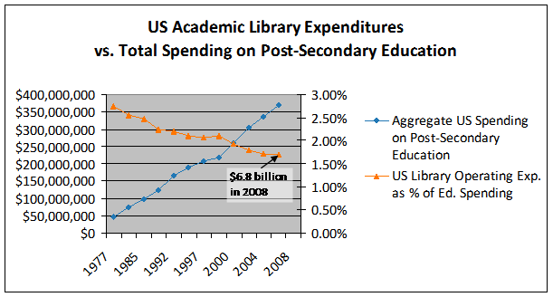
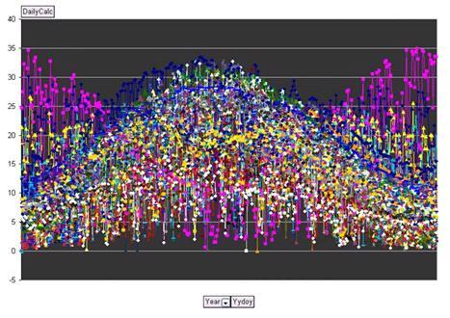
Money
Network
Microsoft research
Impact

Slide 4
Choices
Strategy
Framework

Slide 5
Scaling
Webscale
Group
Institutional
Personal

Slide 6
Space
Systems
Collections
Services & expertise
Then: vertically integrated around collection
Now: moving apart in network environment

Slide 7
Boundaries

Slide 8
Role
A university investment in shared information management.

Slide 9
Harvard Business Review (1999)

Slide 10
Core components of a firm
Attracting and building relationships with customers
“Service-oriented”, customization
Economies of scope important
Develop new products and
services and bring them to
market
Speed/flexibility important
Customer
Relationship
Management
Product Innovation
Infrastructure
Back office capacities that
support day-to-day operations
“Routinized” workflows
Economies of scale important

Slide 11
Attracting and building relationships with researchers and learners
“Service-oriented”, customization
Economies of scope important
Develop new
services and have them accepted
Speed/flexibility important
Engagement
Innovation
Infrastructure
Back office capacities that
support day-to-day operations
“Routinized” workflows
Economies of scale important

Slide 12
Specialization: what business are you really in?
Specialise where can make an impact
Externalise what is routine and can be done well collaboratively or by others
Library: what is distinctive?

Slide 13
Space
Systems
Shifting boundaries
Collections
Services & expertise
Libraries externalising infrastructure – economies of scale and network effects
Collections?
Systems?
Relationship management is central – engagement creates distinctive local value
Space The service turn
People & expertise
New systems requirements: aggregate social/analyti cs data
Patterns of externalization vary
Collaborative: sharing innovation and resources
Commercial: contracting for services
The emergence of the cloud

Slide 14
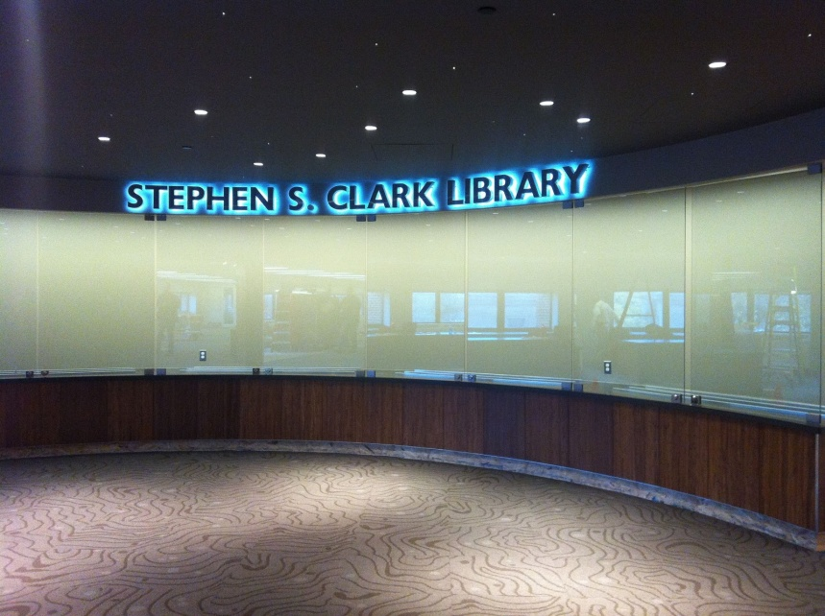
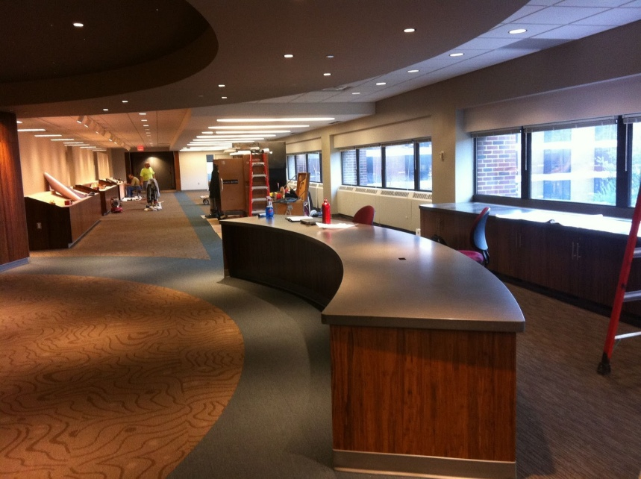
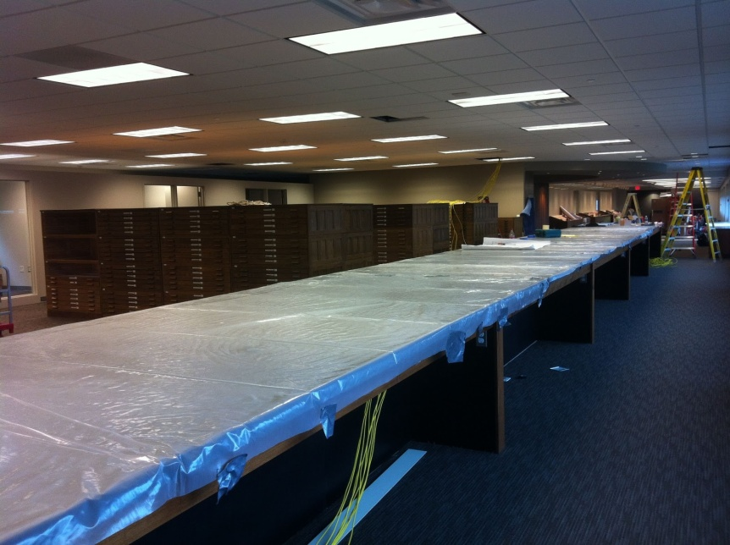
.. the new library’s unique combination of collections, government information expertise, and data services will provide scholars and researchers with unprecedented opportunities for exploration, discovery, and collaboration. “Our new proximity, in a purposefully designed and equipped space, means that we can more effectively collaborate with each other, which in turn really enhances our ability to creatively collaborate with students, faculty, and researchers.”
The new library features 60-foot long counter to enable the examination of large-format maps; a presentation space that will accommodate instruction; display cases and screens that showcase items from the print and digital collections; a large-format high-resolution scanner that produces digital copies for online work or the creation of full-size print copies; individual and group study spaces with dual-screen computers and laptop accessibility; and comfortable, moveable furniture for flexible study and collaboration.

Slide 15
Space
Systems
Collections
Services & expertise

Slide 16
Space
Being reconfigured around the user experience rather than around collections.
Moving from Infrastructure to engagement
Social
Ad hoc rendezvous
Meeting place
Showcase and sharing
Exhibitions
Specialist equipment
Specialist staff
GIS, Writing centre, digital humanities, …

Slide 17
Services
The service turn
U Minnesota, ARL Institutional profile
In alignment with the University's strategic positioning, the University Libraries have re-conceived goals, shifting from a collection-centric focus to one that is engagement-based.

Slide 18
Service
Scott Walter. “Distinctive Signifiers of Excellence”: Library Services
and the Futuref the Academic Library. Coll. & res. libr. January 2011 72:6-8
The service turn
Defining distinctive services with the clarity with which we have defined distinctive collections allows us to acknowledge that the 21st century will be marked by different, but equally valid, definitions of excellence in academic libraries, and that the manner in which individual libraries demonstrate excellence will be distinctive to the service needs, and to the opportunities to address those needs, found on each campus.

Slide 19
First year initiatives: Bowling Green State Univ Libs
The Library First-Year Initiatives (F.Y.I.) Program strives to make meaningful connections with incoming students early in their academic career.
M Publishing, U Michigan
The University of Michigan Press, the Scholarly Publishing Office, Deep Blue (the University’s institutional repository service), the Copyright Office, and the Text Creation Partnership,
Salman Rushdie Archive, Emory U
Personal digital papers of Salman Rushdie. Have become his reference collection.
Scholarly Commons, U Illinois Urbana Champaign
... to serve the emerging needs of faculty, researchers and graduate students pursuing in-depth research and scholarly inquiry. Access to expertise, hardware and software.

Slide 20
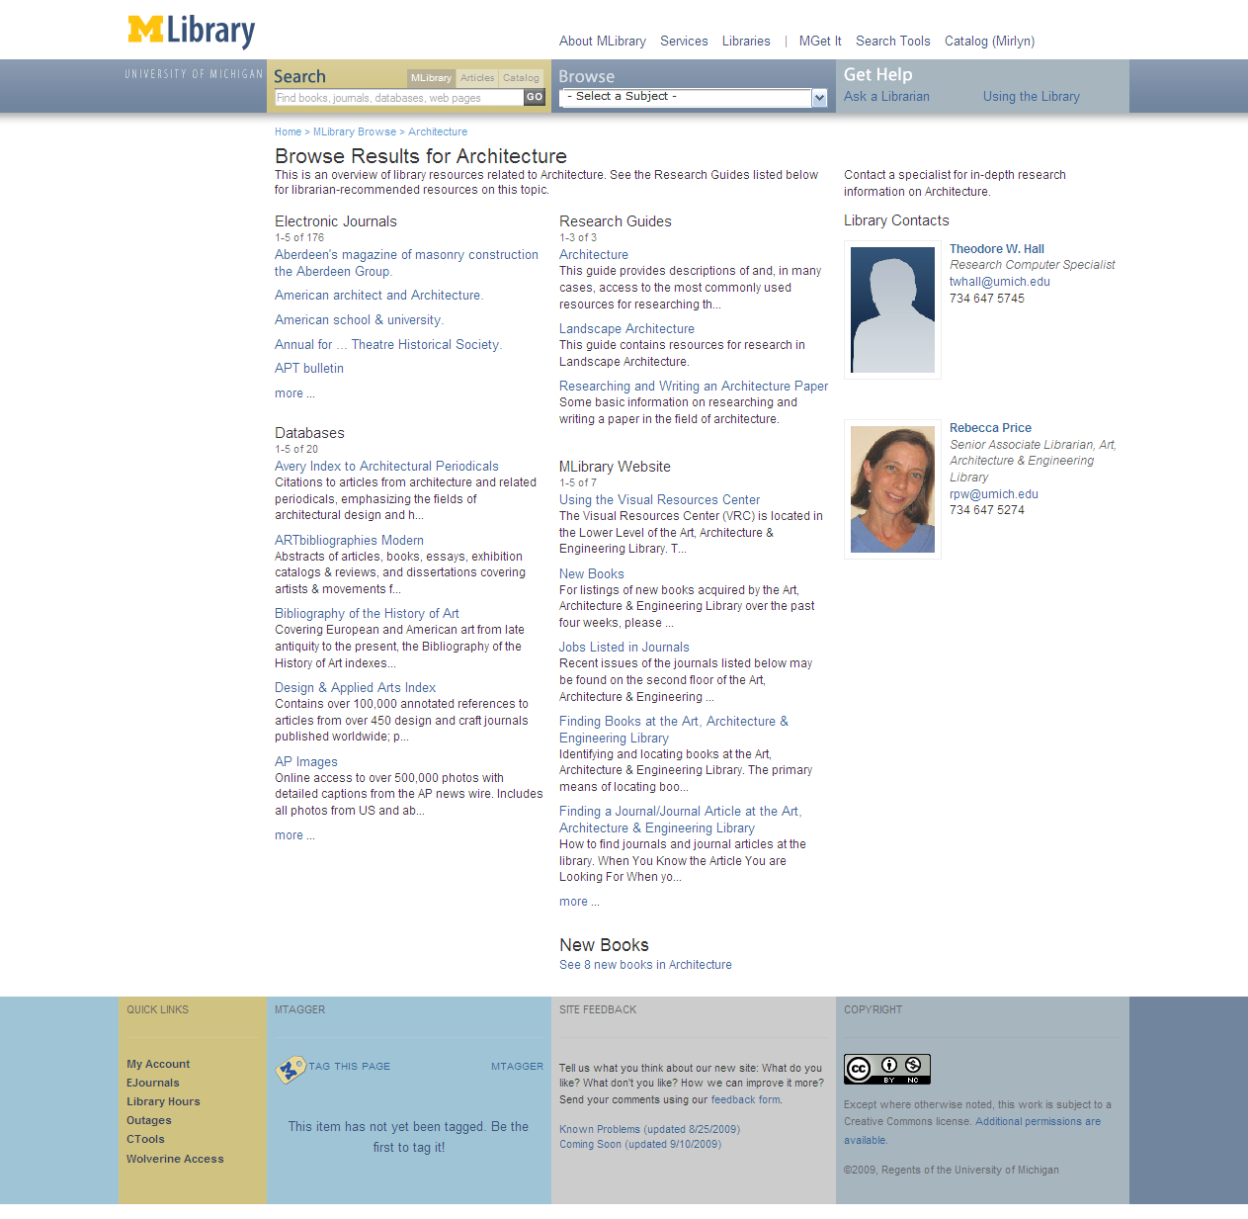
Expertise
If the library wishes to be seen as expert then its expertise must be visible
Librarans returned in search .. UMich
People are entry points
Engagement with research and learning
New skills – pedagogy, copyright, ….
Marketing/assessment/ partnership

Slide 21
Systems
Engagement, cloud and collaboration
Focus on engagement
Resource guides, integration with learning management, widgets, etc
Recommendation (aggregation)
Move to cloud for infrastructure
ILS, ERM, Discovery: move to cloud-based solutions
Deep collaboration
Shared systems infrastructure: Orbis Cascade Alliance, 2CUL

Slide 22
Collections

Slide 23
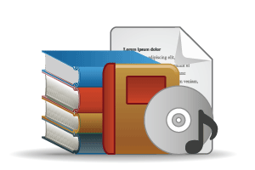
Outside in Bought, licensed
Increased consolidation
Move from print to licensed
Manage down print
Move to user-driven models
Aim: to discover
Inside out
Institutional assets: special collections,
research and learning materials, institutional records, … Reputation management Increasingly important?
Aim: to *have* discovered … to disclose
Notes:
Licensed content will dominate in years to come.
Special collections will grow but only modestly (and only at some institutions); mostly growth in managing archival resources including institutional.
Much greater investment in managing research outputs.
No change in web archiving.

Slide 24
Direction?
Print collections consolidated in national/regional initiatives?

Slide 25
Direction?
Commodity: How many data wells?
The collection?
Other players (Elsevier, Thomson Reuters?)

Slide 26
More than 75% of requests to SFX originate externally (Google Scholar, PubMed, etc.). U Minnesota, Discoverability
Direction?
Discovery moves to the network level …..

Slide 27
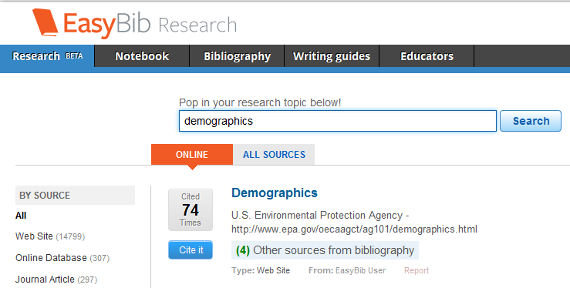
Direction?
….. And to local/institutional curation environments.

Slide 28
Disclosure to network level
Attention to institutional/personal curation environments

Slide 29
Externalization

Slide 30
 | Collab | Public | Third party
Webscale | Repec | PubMed | Worldcat.org
Group | Tripod | OhioLink COPAC
Institutional | Dspace VuFind |  | Hosted LMS
Scaling
Sourcing

Slide 31
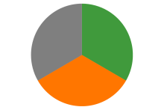
Some directions
Strengthening engagement
Systems for engagement
Relationship with campus partners
Marketing and assessment
The service turn
Externalising infrastructure
Give things up?
Deep collaboration
Cloud
Just in case to just in time
External relationships
are even more critical: Strategic choices
Sharing Innovation and expertise
New skills
Organizational innovation

Slide 32
Reconfiguring library boundaries
Thank you!
The Squeezed Middle? Exploring the future of Library Systems
JISC/SCONUL Workshop
University of Warwick, Radcliffe House
19th–20th January 2012
Lorcan Dempsey, OCLC @lorcanD

