Slide 1
Rightscaling, engagement, learning: reconfiguring the library for a network environment Lorcan Dempsey @LorcanD
The edge of the world. Theta 2013: the Higher Education Technology Agenda
Hobart, Tasmania, 7-10 April, 2013

Slide 2
Credits
John Hagel and John Seely Brown
Institutional innovation: creating smarter organizations to scale learning
http://www.scribd.com/doc/129958072/Institutional-Innovation-Creating-Smarter-Organizations-to-Scale-Learning
John Hagel and Marc Singer. (January 01, 1999). Unbundling the corporation. Harvard Business Review, 77, 2. January 1, 1999.
Constance Malpas:
Provided the U Tasmania and U Melbourne collection analyses.
Brian Lavoie, Constance Malpas and JD Shipengrover:
Print Management at “Mega-scale”:
A Regional Perspective on Print Book
Collections in North America.
https://www.oclc.org/content/dam/research/publications/library/2012/2012-05.pdf

Slide 3
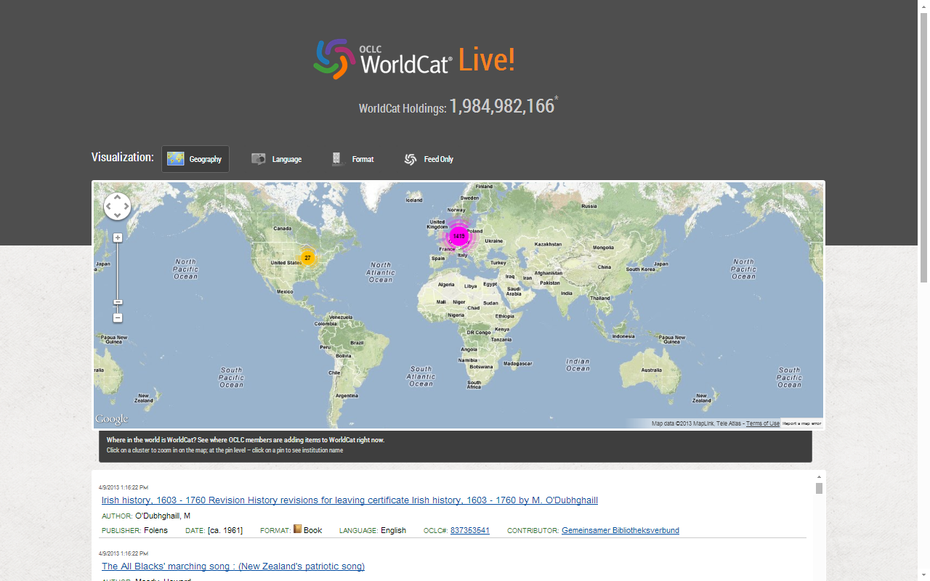

Slide 4
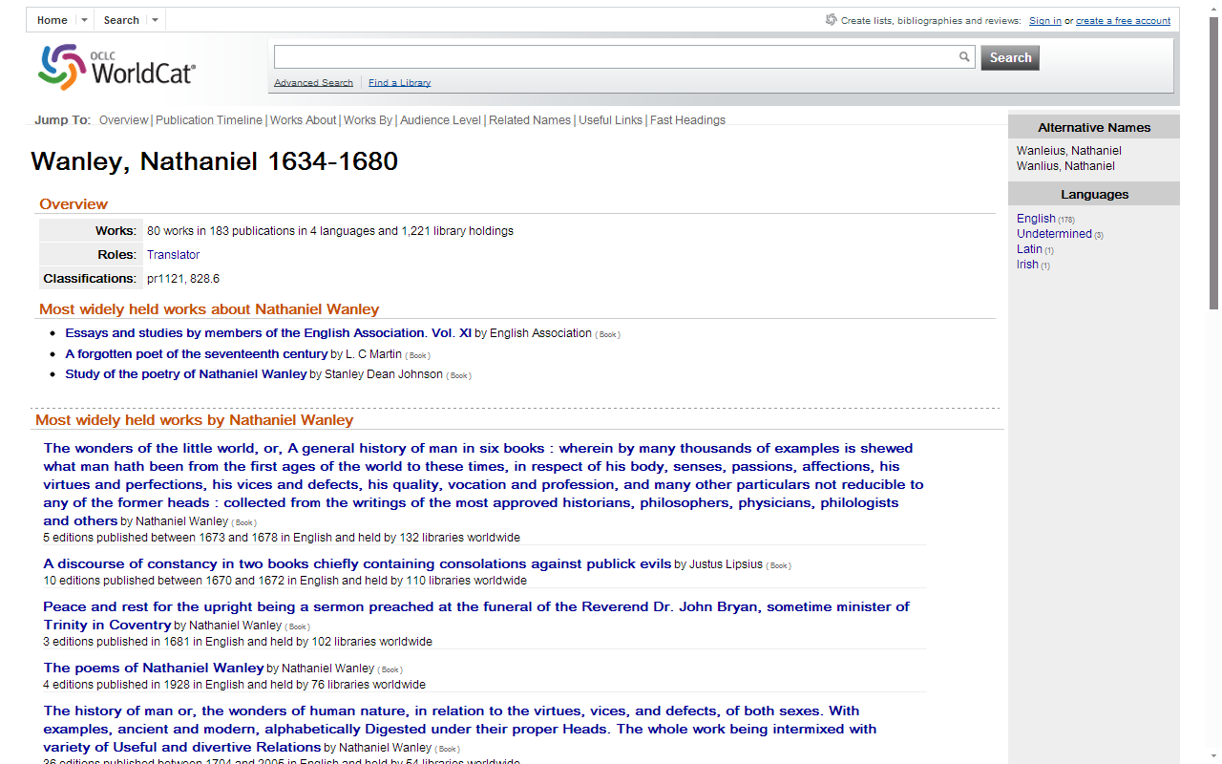

Slide 5
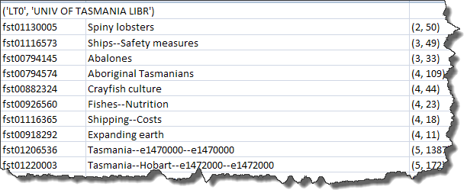
Distinctive Subjects
(rank in worldcat for no.
of holdings attached to
this subject, no. of holdings)

Slide 6
2 switches
Attention switch
Workflow switch

Slide 7
Attention switch
Then
Resources were scarce and attention was abundant.
Now
Attention is scarce and resources are abundant.
“Discovery happens elsewhere”

Slide 8
Workflow switch
Then
Researchers/learners would build their workflow around the library.
Now
The library must build its services around the user workflow.
“In the flow”

Slide 9
Harvard Business Review (1999)

Slide 10
Attracting and building relationships with researchers and learners
“Service-oriented”, customization
Economies of scope important
Develop new
services and have them accepted
Speed/flexibility important
Engagement
Innovation
Infrastructure
Back office capacities that support day-to-day operations
“Routinized” workflows
Economies of scale important
Note: Engagement substituted for Customer
relationship management

Slide 11
Reconfiguring libraries for the new environment – 3 imperatives
Rightscale infrastructure
Shift to engagement
Institutional innovation

Slide 12
Rightscale infrastructure
The example of print
The example of discovery

Slide 15
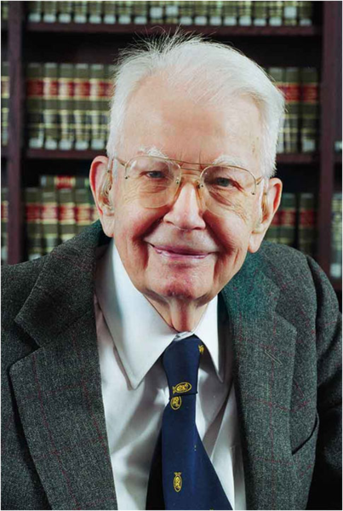
Ronald Coase Pic: Wikimedia

Slide 16
?

Slide 17
“aggregate and scale toward a common infrastructure”

Slide 20
“
Colleges and universities have long competed against one another, measuring themselves in comparison to each other and holding tightly to their idiosyncrasies as defining elements of their status. But today, the distribution and reuse of information digitally via the Internet is rapidly changing the game, rewarding those who instead aggregate and scale toward a common infrastructure. It is becoming increasingly clear that neither the challenges that confront colleges and universities nor the solutions to those challenges are unique to each institution.
Chuck Henry and Brad Wheeler The game has changed
Educause Review, March 2012

Slide 21
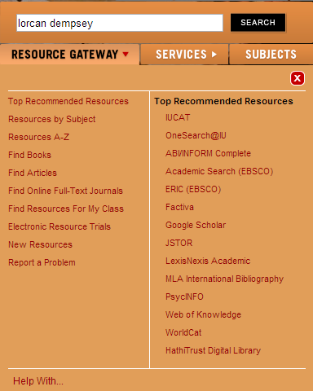
“aggregate and scale towards a common infrastructure”
Infrastructure redundantly distributed to institutions

Slide 22
Beyond the mobile web. Stephanie Rieger. http://www.slideshare.net/yiibu/beyond-themobilewebbyyiibu

Slide 23
the example of print
towards a collective collection

Slide 24
Mega-regions
Geographic area defined by high level of economic
integration, underpinned by robust supporting
infrastructure (transportation, logistics, etc.)
“Lights from space” definition (Richard Florida et al.)
In some respects, a
“natural” unit of analysis?

Slide 25
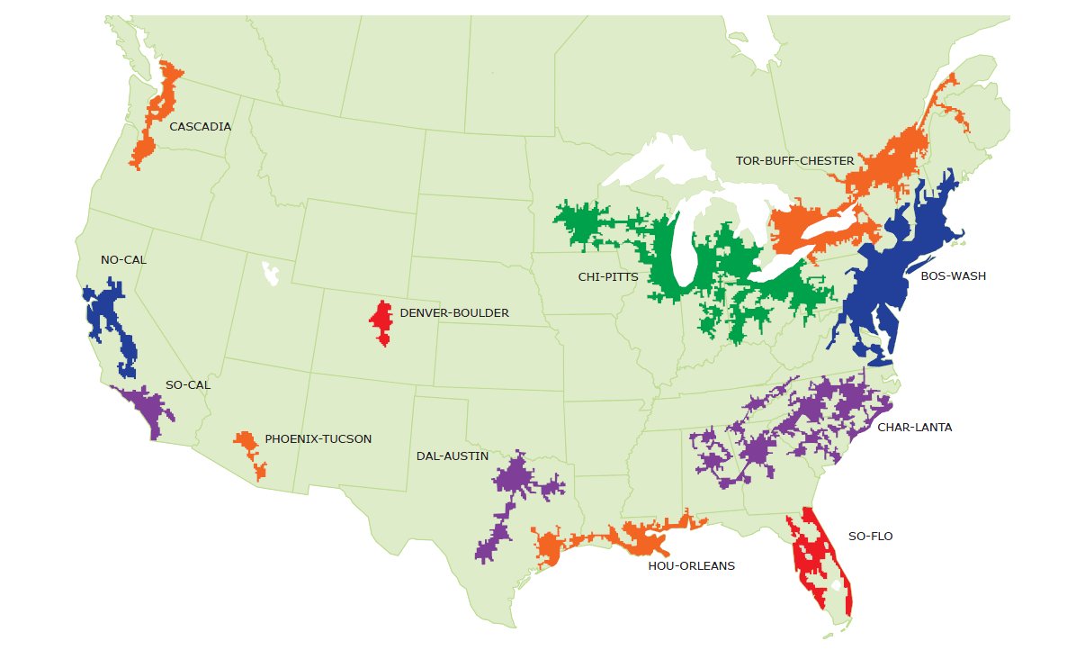
North American Mega-regions
OCLC Research, 2013

Slide 26
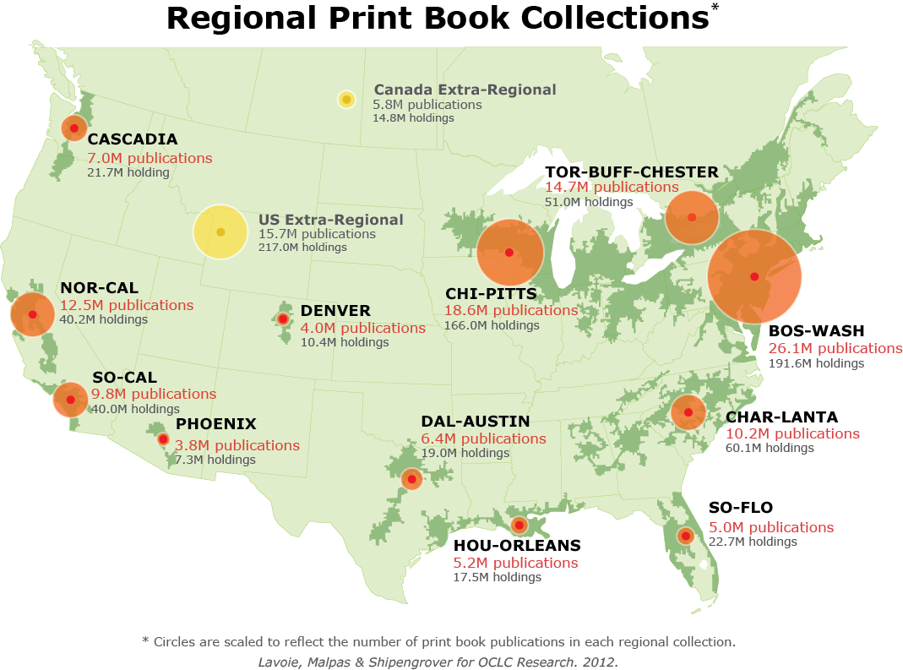
North American print book resource:
45.7 million distinct publications
889.5 million total library holdings
OCLC Research, 2013

Slide 27
Regional coverage of the North American print book resource
BOS-WASH | 57 %
CHI-PITTS | 41 %
TOR-BUFF-CHESTER | 32 %
NOR-CAL | 27 %
CHAR-LANTA | 22 %
SO-CAL | 21 %
CASCADIA | 15 %
DAL-AUSTIN | 14 %
HOU-ORLEANS | 11 %
SO-FLO | 11 %
DENVER | 9 %
PHOENIX | 8 %
OCLC Research, 2013

Slide 28
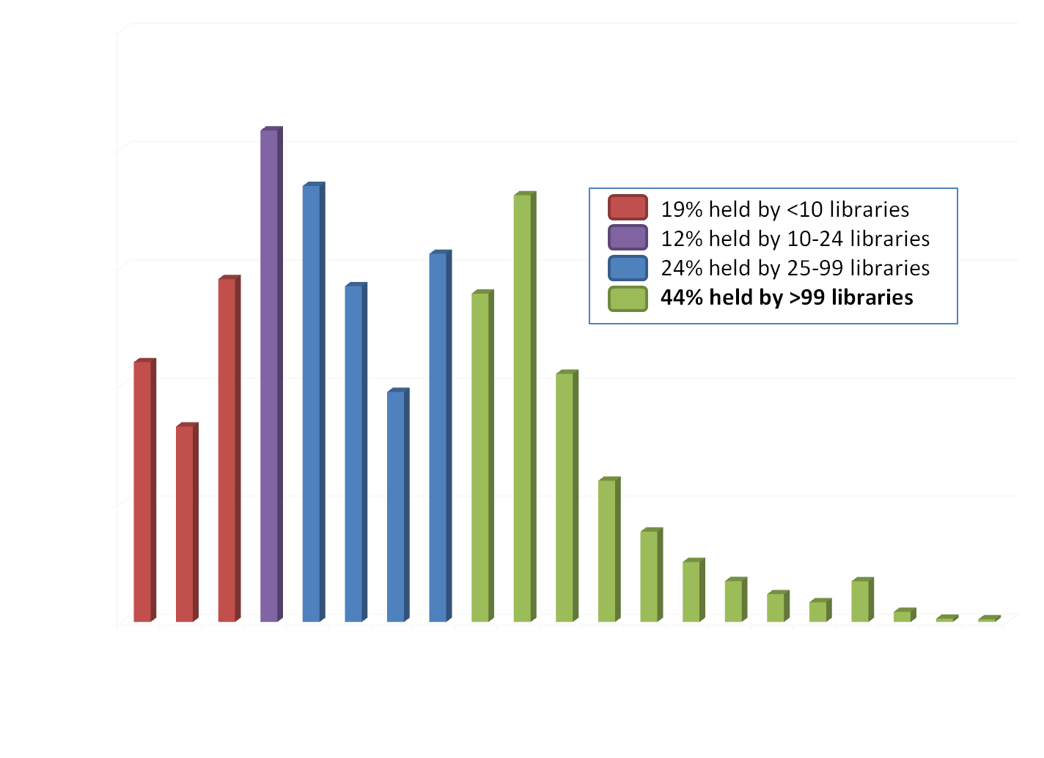
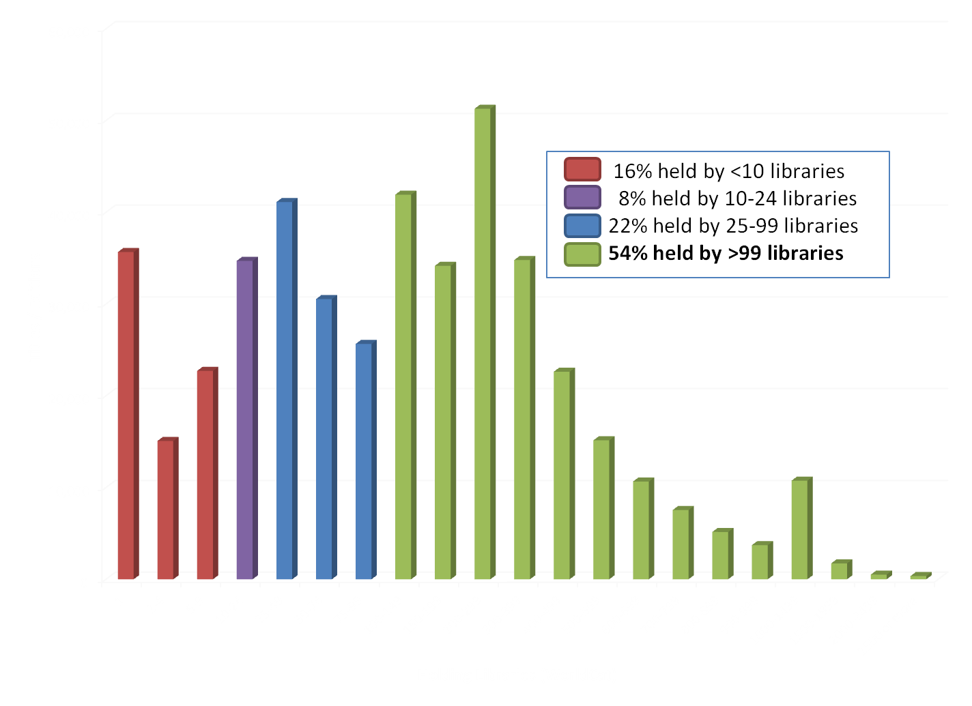
WorldCat Holdings Distribution for Titles Held by
the University of Melbourne Library (UMV) - March 2013
WorldCat Holdings Distribution for Titles Held by
the University of Tasmania Library (LT0) - March 2013

Slide 29
Institution: opportunity costs challenge
Growing misalignment between investment in print collections and practices of research and learning
Reconfigure space around engagement rather than around collections
Stewardship and efficient access still (variably) important
Systemwide: balance contributions
Manage down institutional collections
Collectively managed – regional, national based on existing/emerging infrastructure
Include different obligations:
Mid-level HEIs look for third party or collaborative solutions
Research HEIs manage stewardship responsibility within broader framework of digital and cooperative

Slide 30
Mega-regions & Shared Print Initiatives
Orbis-Cascade
OCUL
MSCS
WEST
CIC
SCELC
WRLC
GWLA
ASERL
FLARE
We expect that in 5-7 years a large part of the North American ‘collective collection’ will have moved into shared management.
OCLC Research, 2013

Slide 31
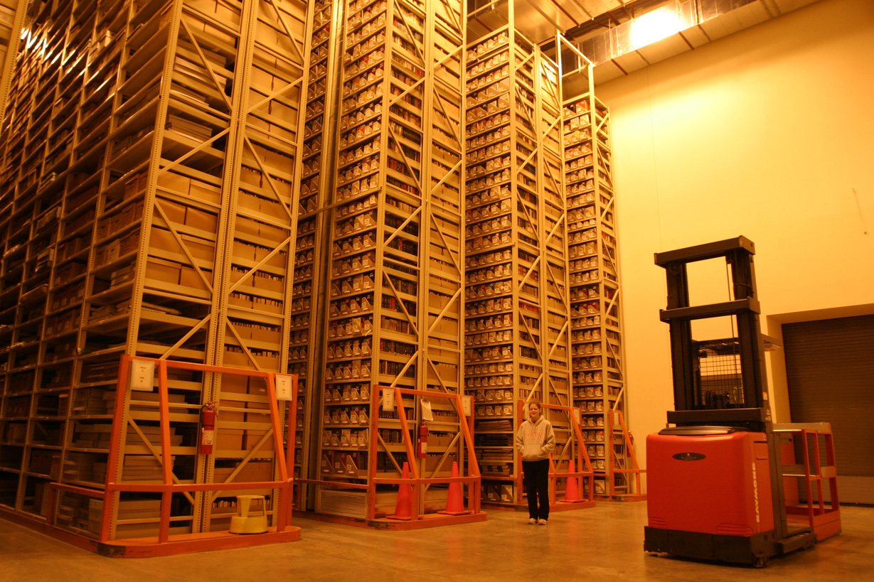
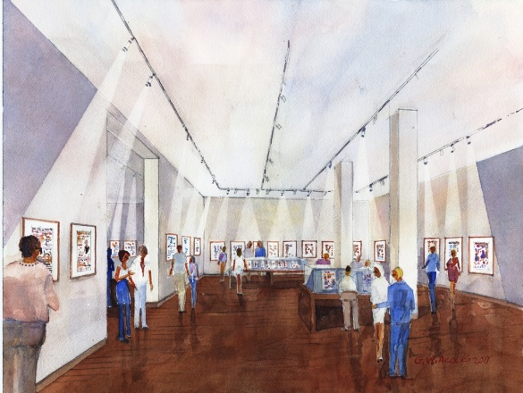
‘Cloud’ storage (Ohio State)
http://library.osu.edu/blogs/cartoons/2012/02/28/blog-launch-and-the-construction-of-our-new-home-in-sullivant-hall/

Slide 32
Overview

Slide 33
The example of discovery
a mixed environment of inside-out and outside-in approaches

Slide 34
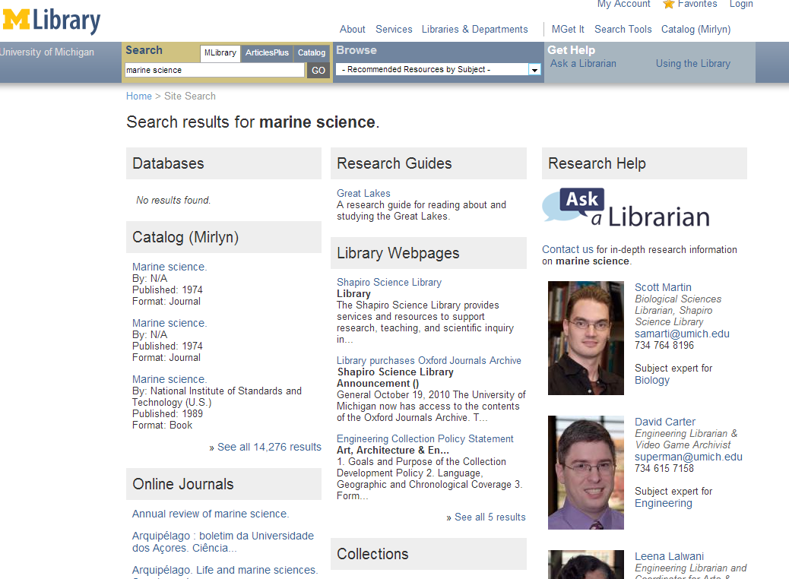
Local discovery:
towards whole library discovery

Slide 35
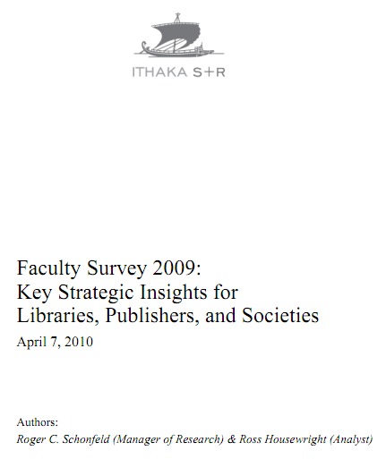
Ithaka s+r
Network-level discovery tools include disciplinary resources and powerful search tools which dramatically improve research efficiency while also increasing effectiveness. As a result, faculty discovery practices across all disciplines have continued their marked shift to the network level. This key finding has important implications for resource providers and libraries alike.
Faculty members are reducing their usage of
local library services for discovery purposes
and, as a result, put less value on the library’s
traditional intellectual value-added role as a
gateway to information.

Slide 36
Outside in Bought, licensed
Increased consolidation
Move from print to licensed
Manage down print – shared print
Move to user-driven models
Aim: to discover
Collections
Inside out
Institutional assets: special collections, research and learning materials, institutional records, … Reputation management Increasingly important? Aim: to *have* discovered … to disclose

Slide 37
A decentered network presence:
putting the library in the flow
Website
John Doe University Library
Decoupled Communication
External Syndication
Cloud Sourced

Slide 38
Decoupled Communication
Flickr
Blogs
Facebook
Archives and spec colls
Twitter
Google
Youtube
Institutional repo
Digital library
Discovery
Knowledgebase
Microsites
Libguides
Cloud Sourced
Resolver

Slide 39
WorldCat
ArchivesGrid
Metadata
Summon
Scirus
Blogs
Suncat
Europeana
RSS
Catalogue
Ethos
Mobilepp
Proxy Toolbar
Dspace
Linked Data (Catalog)
OAI-PMH (Dspace)
Discovery
Services
KB registration
Proxy Widgets
External Syndication
Library APIs
Z39.50
Data
Jorum
Digital Archive

Slide 40
Effective discoverability requires purposeful action at
different scales with multiple partners….
Outside in collections: books and journals
Discovery layer
Resolver registered in Google Scholar, Pubmed, Mendeley, ...
Union catalog links in Google Books
Toolbars, widgets, etc
Inside out collections: Growing engagement around
scholarly communication, data curation, institutional
asset management, reputation/profiles.
SEO (interoperability with search engines)
Appropriate metadata (e.g. for Google Scholar)
Syndication of metadata to other services
…

Slide 41
Other examples? Look for solutions above the level of the institution? Where there is no local advantage …
DPN ... Digital Preservation Network
Patron Driven Acquisition?
Library systems?
Knowledge base?

Slide 42
Shift to engagement
‘If libraries are to be seen as expert their expertise must be visible’
The service turn (Scott Walter)
Distinctive services to improve the student experience and enhance research
Evolving library role - enterprise

Slide 43
U Minnesota, ARL Institutional profile
“In alignment with the University's strategic positioning, the University Libraries have re-conceived goals, shifting from a collection-centric focus to one that is engagement-based.”
http://umcf.umn.edu/awards/2006/images/margo_library_lg.jpg

Slide 44
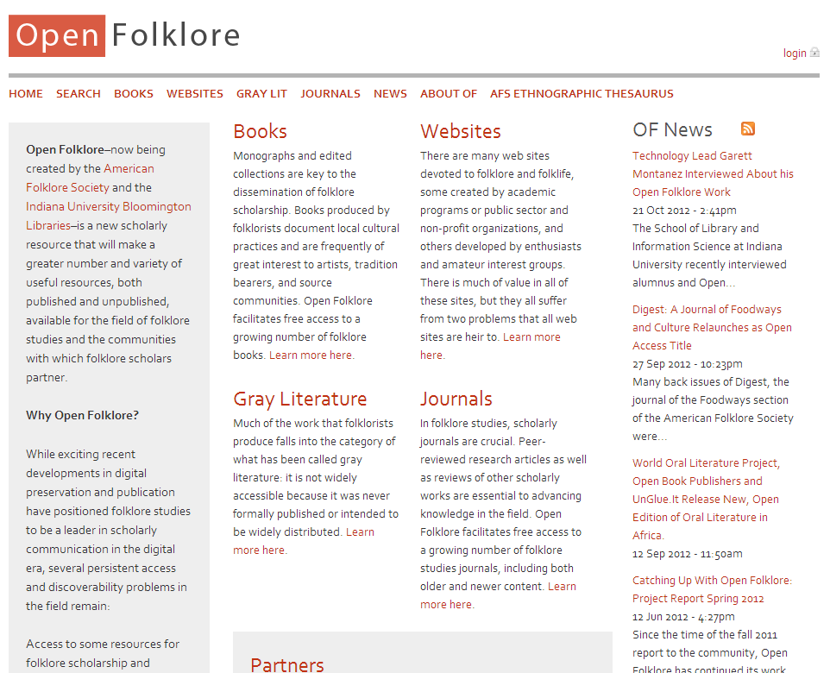
Explore new scholarly forms:
American Folklore Society
and libraries at Indiana U

Slide 45
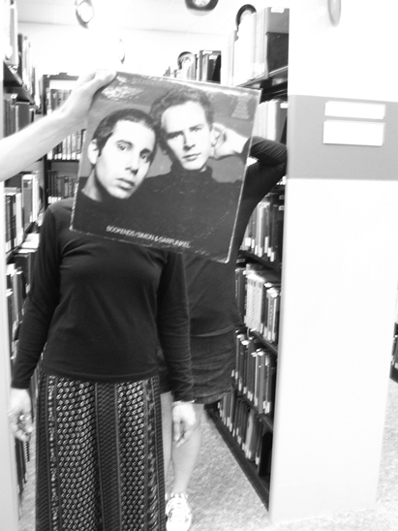
Creating conversations around collections:
Sleevefacing at Bowling Green State Univ
http://blogs.bgsu.edu/librarysleevefacing/2012/08/15/bookends/

Slide 46
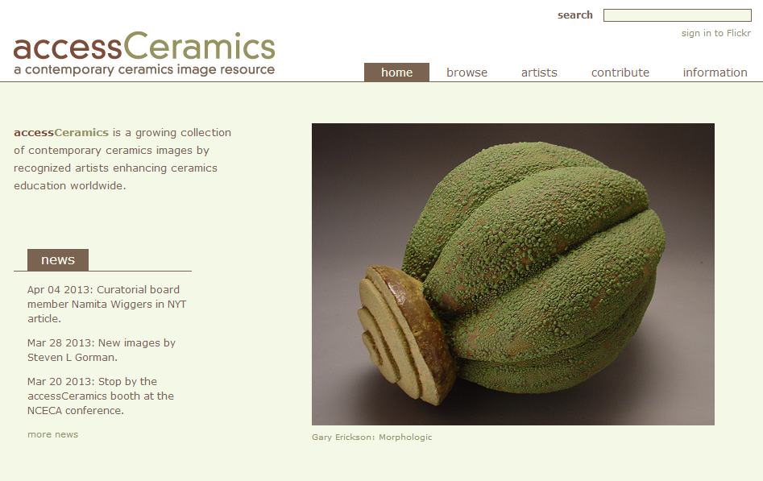
Collaboration with department around
community and learning resource
accessCeramics merges a traditional academic digital image collection's metadata capabilities with Flickr's openness and flexibility. It seeks to take advantage of Flickr's software tools and social network while also providing a web interface customized to this collection.

Slide 47
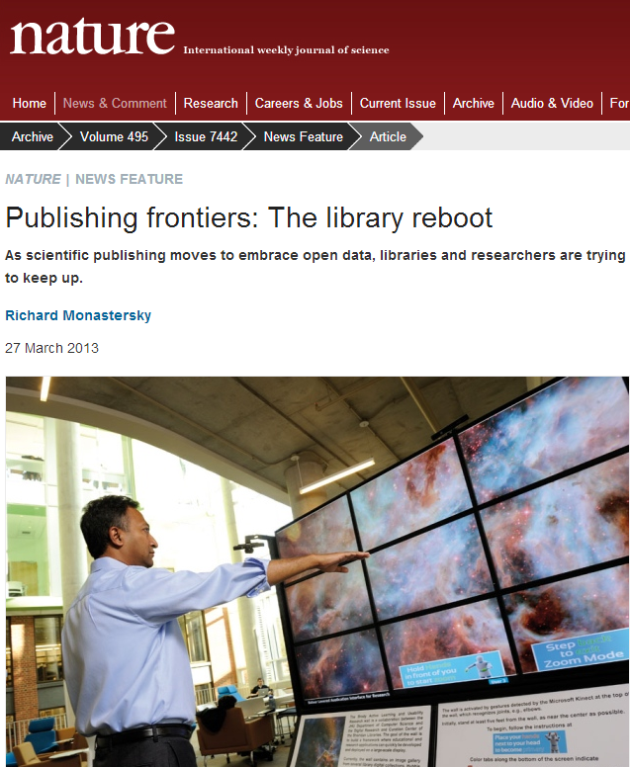
Curating data assets

Slide 48
Bibliometrics and researcher identity

Slide 49
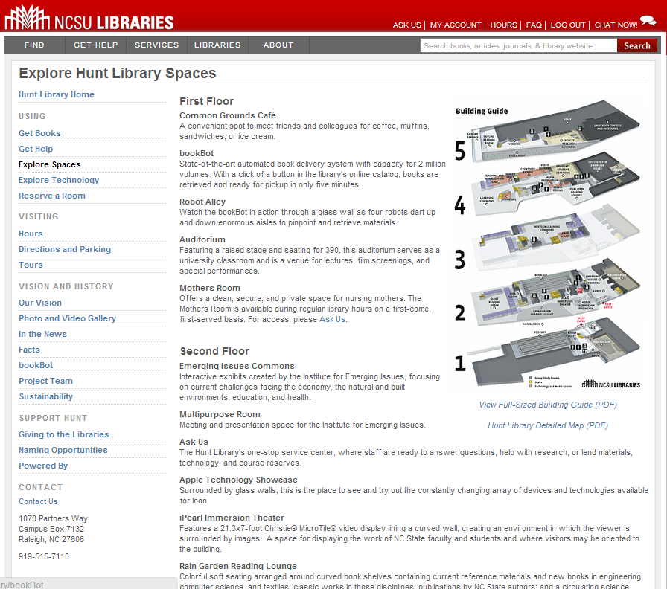
Space reconfigured
around experience,
expertise and
communication
rather than collections

Slide 50
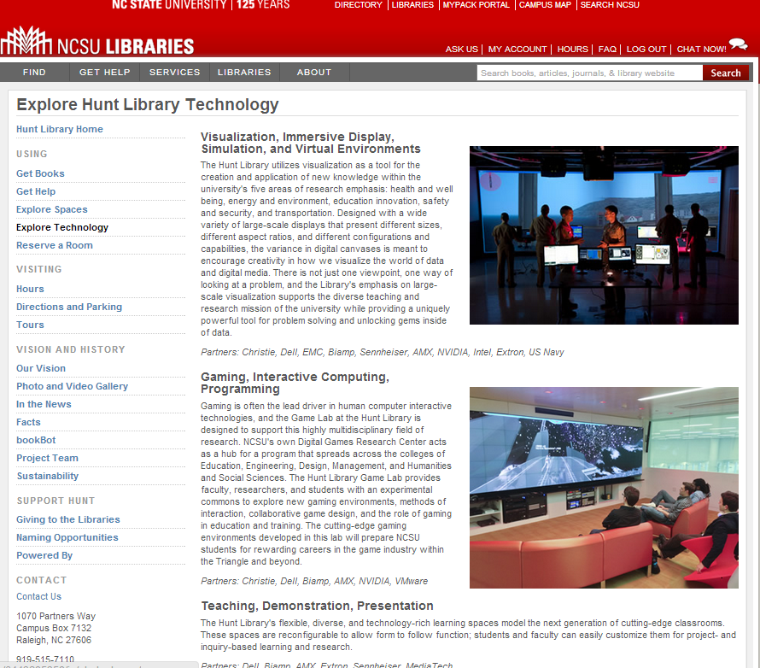

Slide 51
A shift to engagement .. the library as an actor in research and learning environments of its users.
An evolving role … an enterprising mentality …
Explore service requirements and possibilities.
Reallocate resource from infrastructure?

Slide 52
Institutional innovation ….

Slide 53
... a more fundamental level of innovation, institutional innovation – redefining the rationale for institutions and developing new relationship architectures within and across institutions to break existing performance trade-offs and expand the realm of what is possible …
John Hagel III and John Seely Brown

Slide 54
A new architecture of relationships: rightscaling

Slide 55
A new architecture of relationships: engagement
University Press
Office of Research
IT
Learning and teaching support
E-research
Writing centre
Academic departments
….

Slide 56
The journey …
Rightscale infrastructure services: find appropriate level in the network.
Shift resource to engagement: evolving information services which improve the student experience and enhance research.
Internal/external institutional innovation: building new relationships requires enterprise and promotes learning ….

Slide 57
@LorcanD
Q

