Slide 1
What business are we in?
Lorcan Dempsey
VP OCLC
@LorcanD
OCLC EMEA Regional Council Meeting
Birmingham, 28-29 February 2012

Slide 2
By Ardfern (Own work) [CC-BY-SA-3.0 (http://creativecommons.org/licenses/by-sa/3.0) via Wikimedia Commons
People should think not so much of the books that have gone into the … Library but rather of the books that have come out of it. Seán O'Faoláin

Slide 3
Preamble

Slide 4
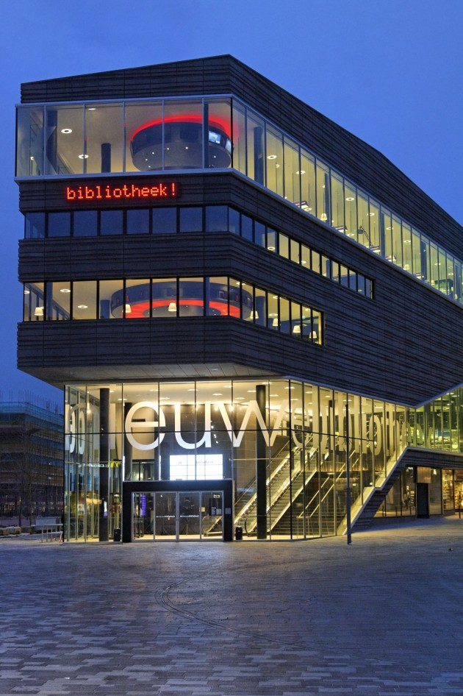
Preamble
Contemporist
http://www.contemporist.com/2010/11/18/almere-library-by-concrete-architectural-associates/
Photography by Wim Ruigrok

Slide 5
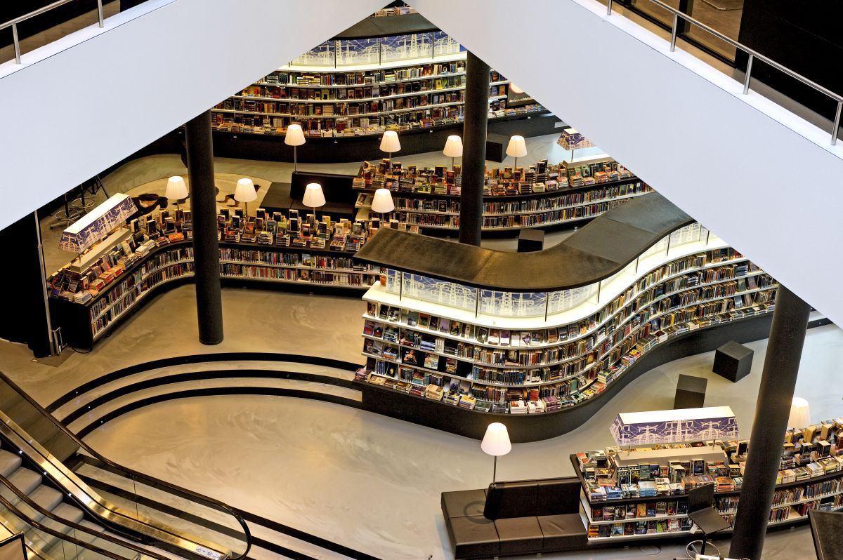

Slide 6
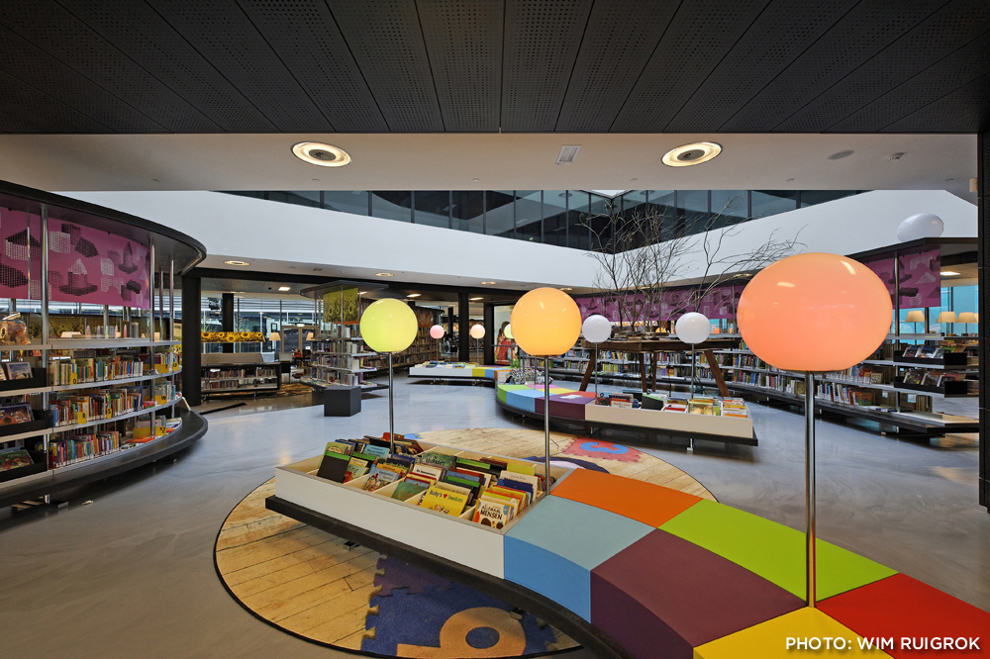

Slide 7
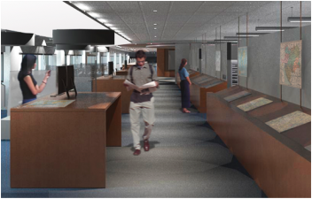
… unique combination of collections, government information expertise, and data services ….
Our new proximity, in a purposefully designed and equipped space, means that we can more effectively collaborate with each other, which in turn really enhances our ability to creatively collaborate with students, faculty, and researchers.
The new library features 60-foot long counter to enable the examination of large-format maps; a presentation space that will accommodate instruction; display cases and screens that showcase items from the print and digital collections; a large-format high-resolution scanner that produces digital copies for online work or the creation of full-size print copies; individual and group study spaces with dual-screen computers and laptop accessibility; and comfortable, moveable furniture for flexible study and collaboration.
We expect the Clark to become the campus nexus for the various data services that all disciplines increasingly require, …
Stephen S. Clark Library

Slide 8
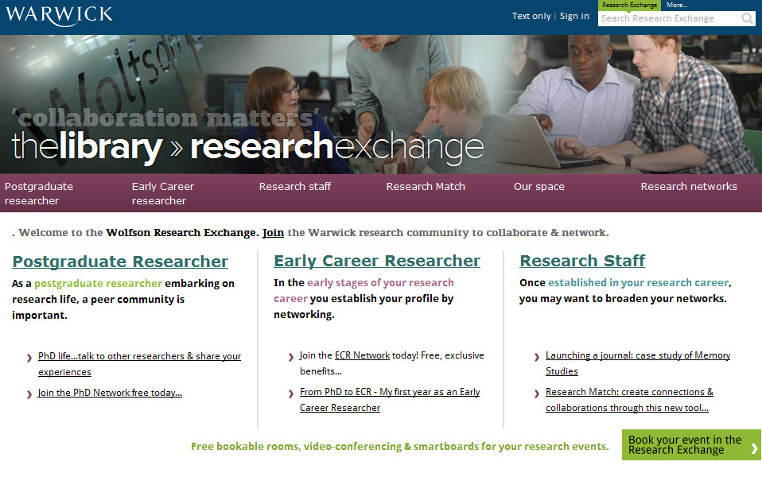

Slide 9
Engagement
Outreach: place, people and …. Network?

Slide 10
The network

Slide 11
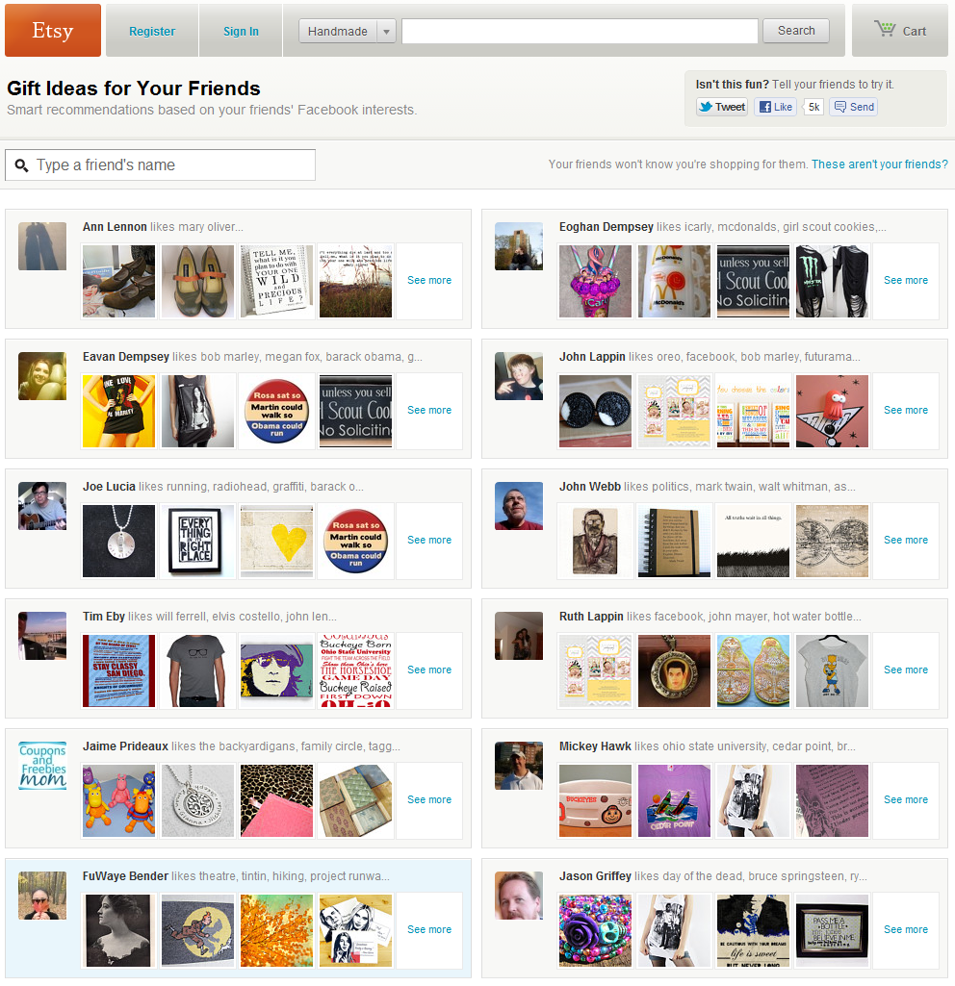

Slide 12
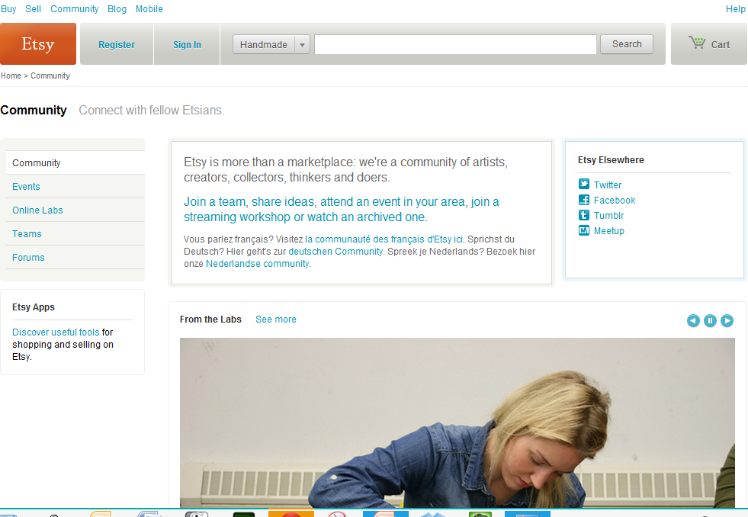

Slide 13
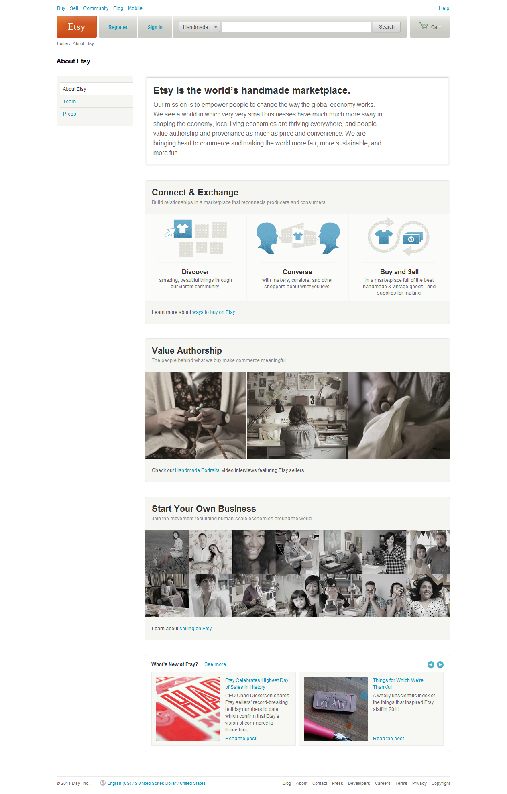
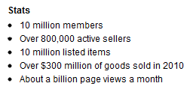
Human-scale

Slide 14
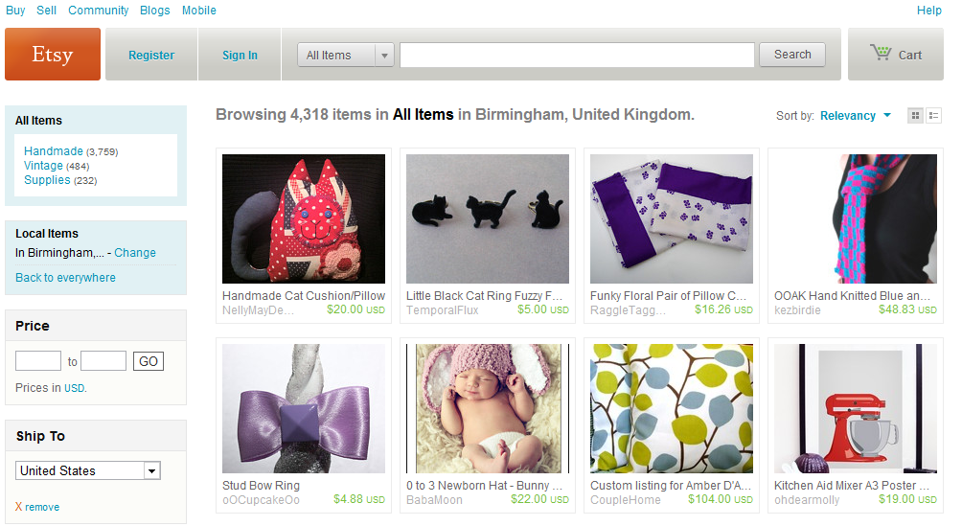

Slide 15
Network platforms
Platform – concentrates data, infrastructure, …
Community/network forms around platform
Network effects are central
Social and analytics are central
Gravitational hubs: the rich get richer
Strong seo and referencability
End user
Social
Analytics
Management

Slide 16
Not just a site but an ecosystem
Beyond the mobile web. Stephanie Rieger. http://www.slideshare.net/yiibu/beyond-themobilewebbyyiibu

Slide 17
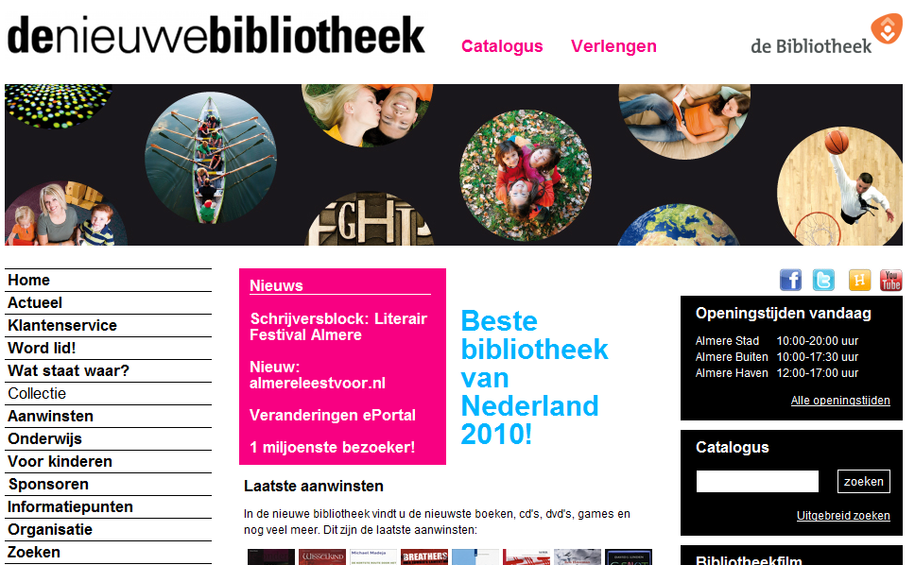

Slide 18
Beyond the mobile web. Stephanie Rieger. http://www.slideshare.net/yiibu/beyond-themobilewebbyyiibu

Slide 19
Focus

Slide 20
Harvard Business Review (1999)

Slide 21
Attracting and building relationships with researchers and learners
“Service-oriented”, customization
Economies of scope important
Develop new
services and have them accepted
Speed/flexibility important
Engagement
Innovation
Infrastructure
Back office capacities that
support day-to-day operations
“Routinized” workflows
Economies of scale important

Slide 22
Focus?
Strategy is about choices …
Where is distinctive local impact?
Enrich student experience
Improve research effectiveness and impact
Promote civic engagement
What should be done collaboratively?
What should be done by others?

Slide 23
Library directions?

Slide 24
Space
Systems
Collections
Services & expertise
Then: vertically integrated around collection
Now: moving apart in network environment

Slide 25
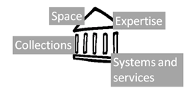
Space
Reconfigure around the user experience rather than around collections.
Infrastructure >> engagement
Social
Ad hoc rendezvous
Meeting place
Showcase and sharing
Exhibitions
Specialist equipment
Specialist staff
GIS, Writing centre, digital humanities, …
Homework help

Slide 26
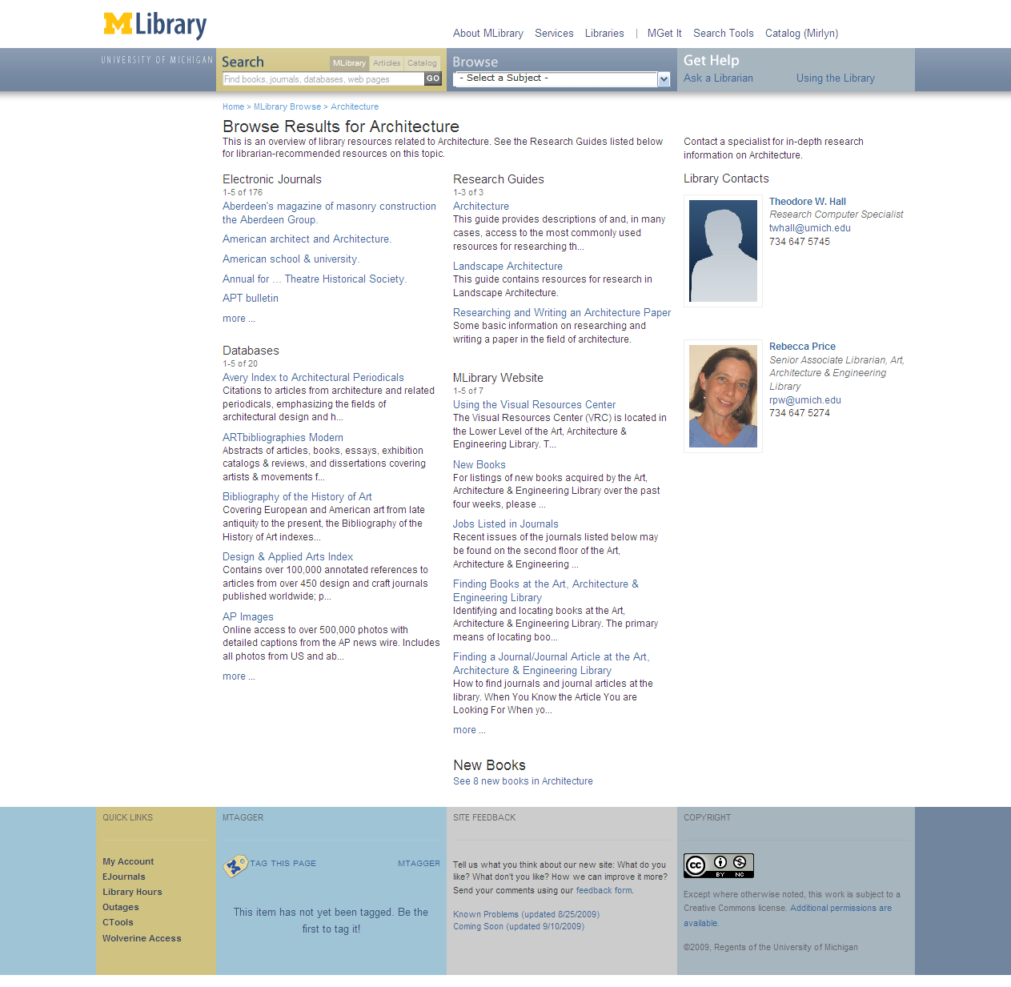
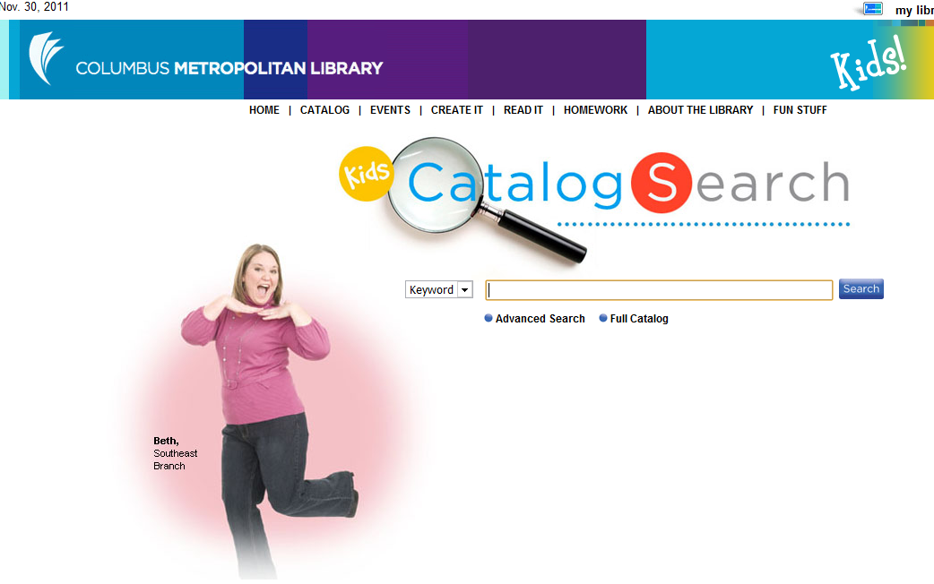
Expertise
If libraries want to be seen as expert, their expertise must be visible.
People are entry points
(DanChudnov)
Librarians returned in search .. UMich
Engagement with research and learning
Marketing/assessment/ partnership

Slide 27
Services
The service turn (Scott Walter)
U Minnesota, ARL Institutional profile
In alignment with the University's strategic positioning, the University Libraries have re-conceived goals, shifting from a collection-centric focus to one that is engagement-based.

Slide 28
Bookspace: Hennepin County Library
A community space for reading. Social engagement.
M Publishing, U Michigan
The University of Michigan Press, the Scholarly Publishing Office, Deep Blue (the University’s institutional repository service), the Copyright Office, and the Text Creation Partnership,
Salman Rushdie Archive, Emory U
Personal digital papers of Salman Rushdie. Have become his reference collection.
Stories from the web
… provides the opportunity for children and young people to have their own stories, book reviews and more displayed online in the Stories from the Web Gallery. .

Slide 29
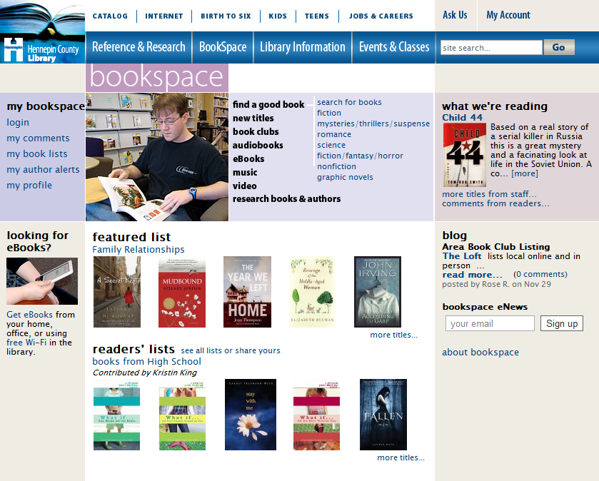

Slide 30
Systems
Engagement, cloud and collaboration
Focus on engagement
Resource guides, integration with learning management, widgets, etc
Data driven engagement (social and analytics)
Move to cloud for infrastructure
ILS, ERM, Discovery: move to cloud-based solutions
Reduce total cost of ownership and gain network benefits
Deep collaboration
Shared systems infrastructure
e.g. 2CUL

Slide 31
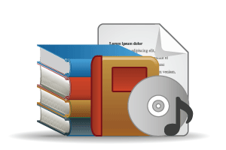
Collections
Outside in Bought, licensed
Increased consolidation
Move from print to licensed
Manage down print and develop collective ownership models
Move to user-driven models
Aim: to discover
In Many Collections
Licensed
Purchased
High Stewardship
Low Stewardship
Inside out
Institutional assets: special collections, research and learning materials, institutional records, … Reputation management Increasingly important? Aim: to *have* discovered … to disclose
In Few Collections
Notes:
Licensed content will dominate in years to come.
Special collections will grow but only modestly (and only at some institutions); mostly growth in managing archival resources including institutional.
Much greater investment in managing research outputs.
No change in web archiving.

Slide 32
Space
Systems
Libraries need to develop platform and network capacity … Data infrastructure
Knowledge base
Catalogue
Intelligence
Analytics
Social
Applications
Repository
Workflows
Expertise and innovation
Connect the human-scale to the web-scale
Collections
Services & expertise
Increase efficiency
Increase impact

Slide 33
Discovery: an example

Slide 34
Advice
Not just licensing
Connected
Disclose
Switch
Data driven engagement
Aggregate and make useful usage data
Reputation management
What is the personal/institutional profile
……..
…..

Slide 35
The library should not provide an argument for a particular case, but demonstrate that there is always another case to be made. The notion that the library is a place that has no agenda other than allowing people to invent their own agendas is what makes it an indispensable resource for a democracy. It is where we can learn not just to be readers, but to be the authors of our own destiny. Fintan O’Toole
Dublin City Public Libraries, Flickr: http://www.flickr.com/photos/dublincitypubliclibraries/6029467474/in/set-72157594513778442

