Slide 1
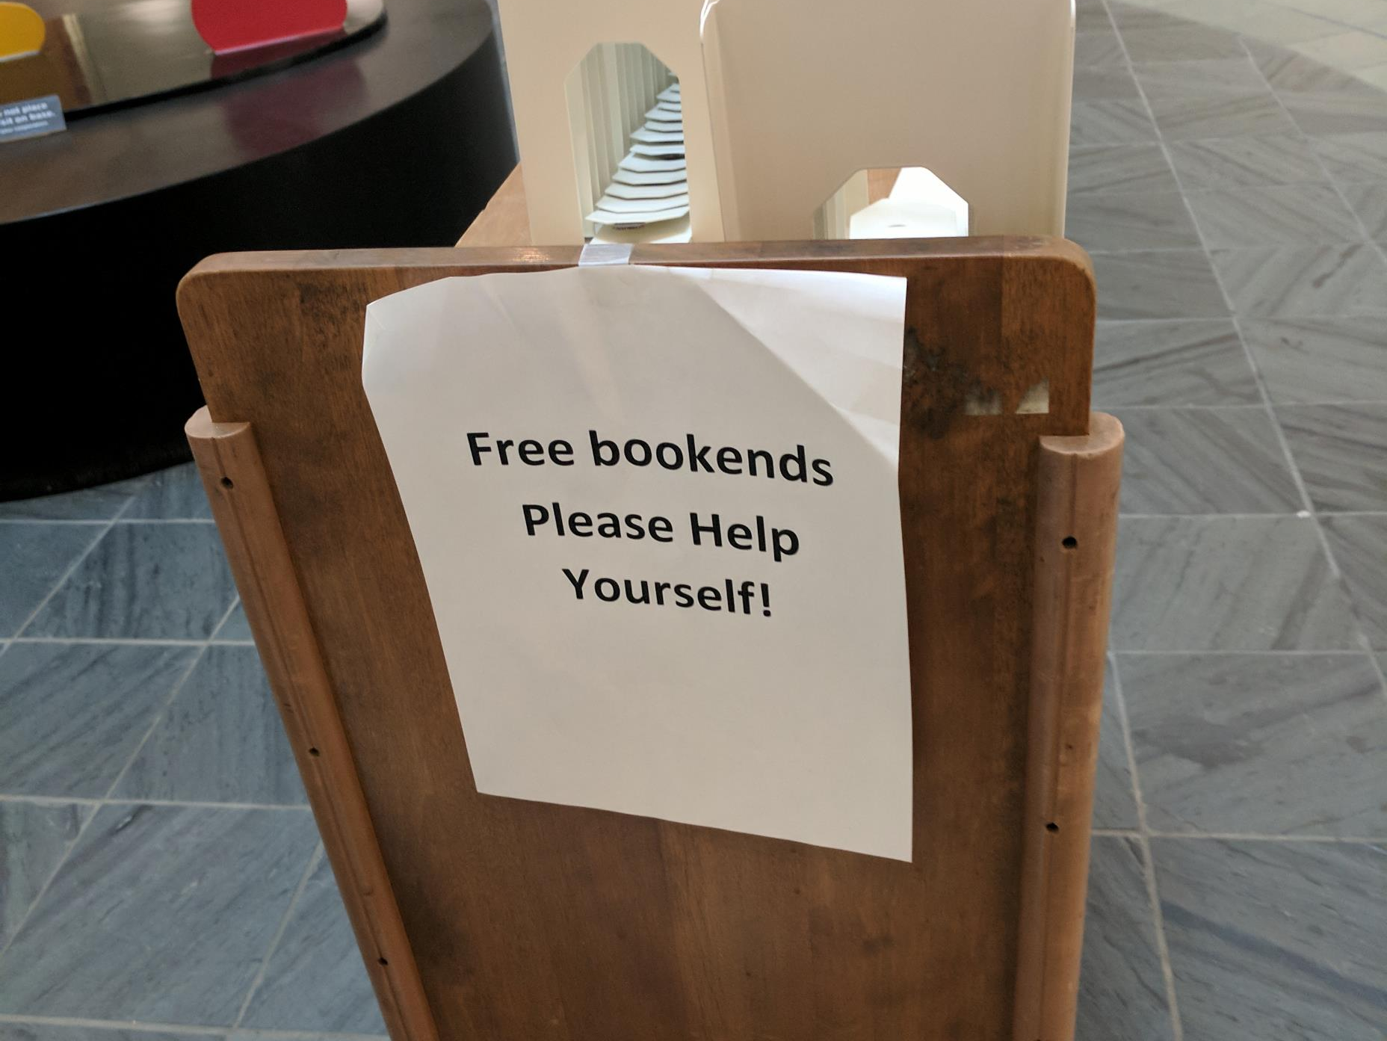
Libraries, library users, and collections
Lorcan Dempsey, OCLC @LorcanD
Jack E. & Debbie T. Thomas Endowed Lecture Series
Washington University in St Louis October 9 2017

Slide 2
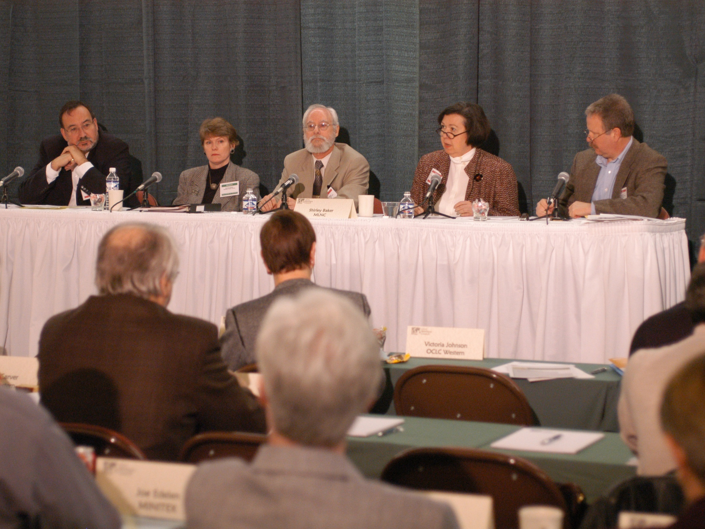
Shirley Baker, OCLC Members’ Council, 2005
Delighted to honor Shirley in this lecture series!

Slide 3
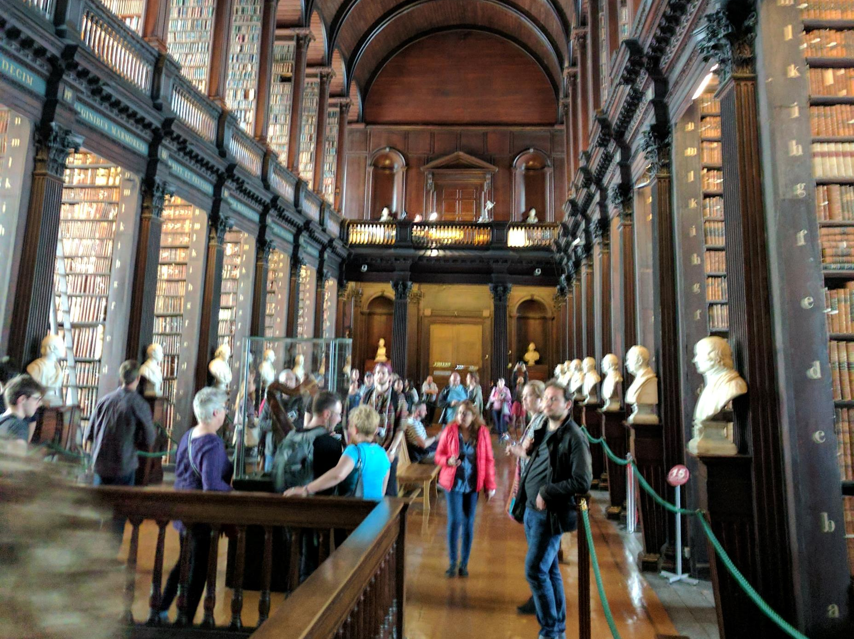
“Research libraries achieved status … by acquiring more than their peers or by building niche collections of particular depth.”

Slide 4
Research libraries achieved status in this environment by acquiring more than their peers or by building niche collections of particular depth.
…
Collections no longer lie at the center of research library operations and goals, even as academic communities focus ever more inclusively on knowledge and information.
Hazen. Lost in the cloud. 2011
Notes:
Hazen, D. (January 01, 2011). Lost in the Cloud Research Library Collections and Community in the Digital Age. Library Resources and Technical Services, 55, 4, 195-204.
https://journals.ala.org/lrts/article/view/5302

Slide 5
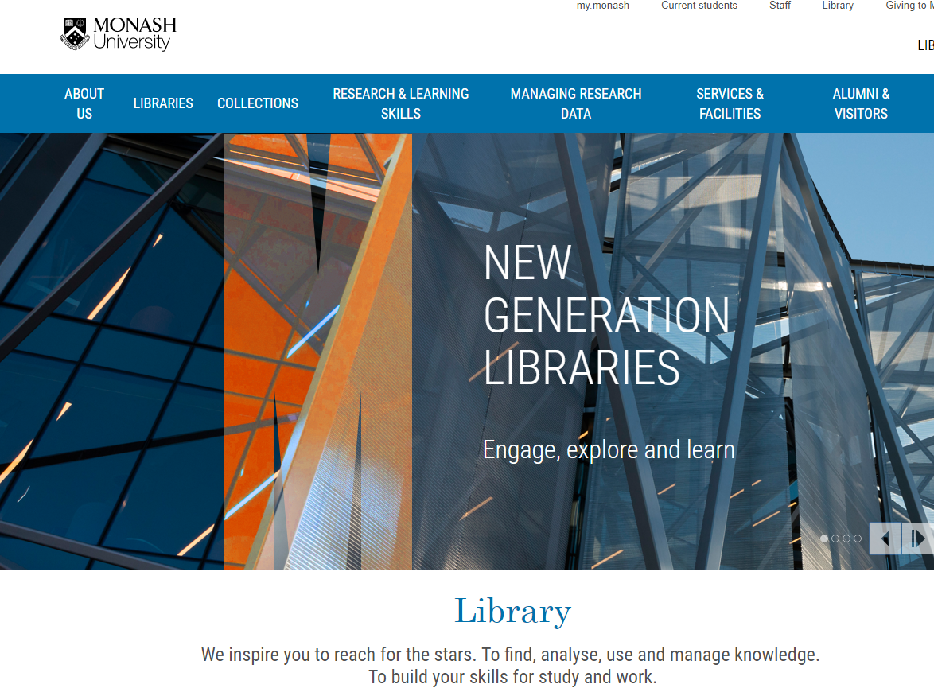
Telling the library story differently
Here … collections are a service

Slide 6
Three trends
Inside out
Facilitated
Collective

Slide 7
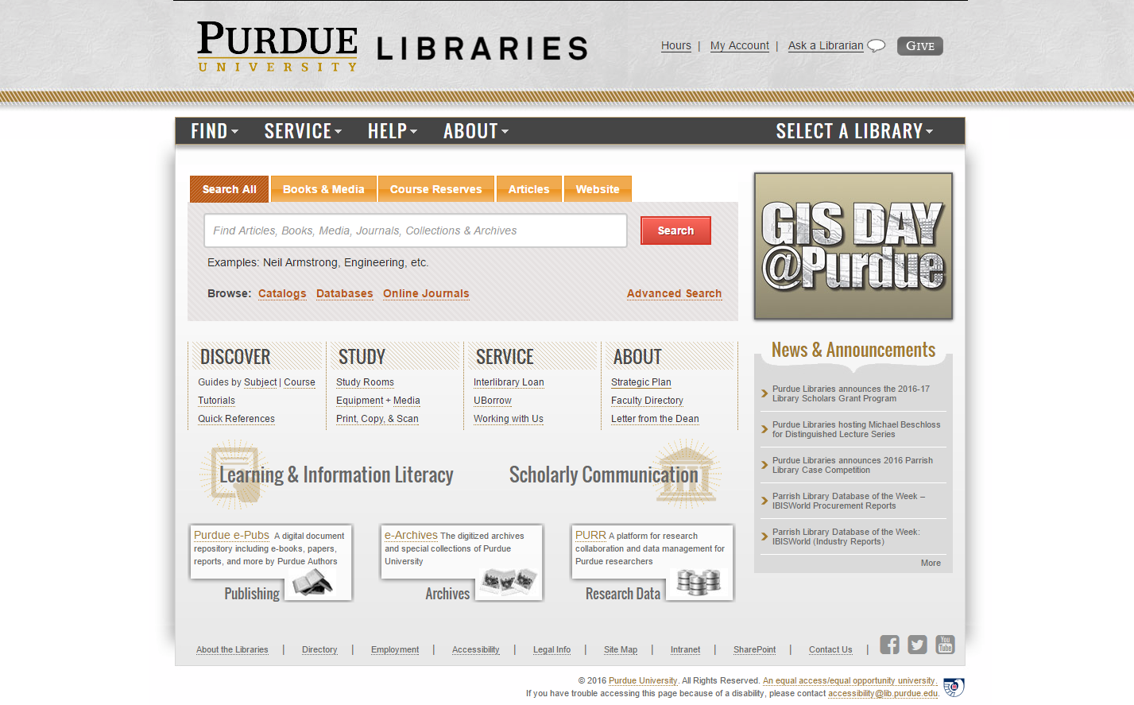
Outside in
Facil-itated
Coll-ective
Inside out
Collections: expanding view

Slide 8
Three trends
Reconfiguration of research work by network/digital environment.
Reconfiguration of the information space by network/digital environment.
Reconfiguration of library collaboration by network/digital environment.
The inside out collection
The facilitated collection
The collective collection

Slide 9
Reconfiguration of research work by network/digital environment.
Inside out collection

Slide 10
Research outputs
Expertise/Identity
R- infra-structure
Special colls

Slide 11
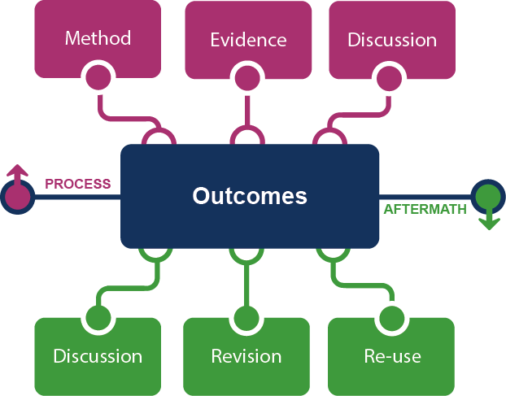
Supporting the creative process: the emerging scholarly record
Research outputs
Notes:
This is how we framed out the scholarly record in terms of nature and scope of what it might contain.
Start with published outcomes: the reporting of results, conclusions, ideas and so forth from a particular scholarly inquiry.
These outcomes are still the coin of the realm for scholarly activities, so they are privileged here at the center of the picture;
A lot of these outcomes take the form of text-based materials like books and journal articles, but often supplemented by additional materials such as video, graphics, and interactive programs.
Rest of scholarly record divided into two broad areas: process and aftermath
Process: process of scholarly inquiry; process by which outcomes are produced. Identified three categories of materials generated in this phase in which there is interest in including them as part of the scholarly record:
Method materials related to the methodology of scholarly inquiry (e.g., software, computer models, digital lab notebooks, sampling frames, experimental protocols, instrument calibrations)
Evidence raw materials/inputs to scholarly work (e.g., data sets, survey results, new or enhanced primary source documents, links to findings from other scholarly works);
Discussion refining and improving ideas, methods, conclusions (e.g., pre-prints, listserv/blog discussions, conference presentations, annotated commentary, grant proposals).
Anchoring outcomes directly to the methods employed, evidence used, and formative discussions conducted during the process of scholarly inquiry helps contextualize and deepen our understanding of these outcomes, facilitate replicability, and leverage results into new research.
Once the outcomes from a research project have been formally published or otherwise made available, scholarly activities surrounding that piece of work may still continue in the “aftermath” phase.
Activities in the aftermath phase may include Discussion (through similar channels as those in the process phase, but also post-publication formal reviews and commentary);
Revision published work can be revised in various ways (the work may be enhanced with additional findings; errors may be corrected or clarifications made, etc.)
Re-use (the work may be edited or re-packaged into new forms, such as conference presentations, summaries, blog posts, versions for the “popular media”, etc.).
Not saying that everything discussed here will end up in the scholarly record. But picture represents the maximal scope and depth of materials regarding which there is increasing interest in systematic collection and curation.
Note that some of the materials in the outlying components are becoming or might become outcomes in their own right. Data sets are a good example: in some disciplines the publication of an important data set is now considered a first-class scientific outcome.
More on the evolving scholarly record:
Lavoie, Brian, Eric Childress, Ricky Erway, Ixchel Faniel, Constance Malpas, Jennifer Schaffner, and Titia van der Werf. 2014. The Evolving Scholarly Record. Dublin, Ohio: OCLC Research.
http://www.oclc.org/content/dam/research/publications/library/2014/oclcresearch-evolving-scholarly-record-2014.pdf.

Slide 12
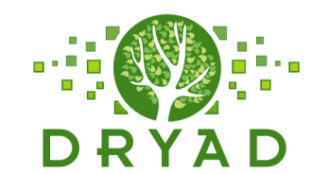
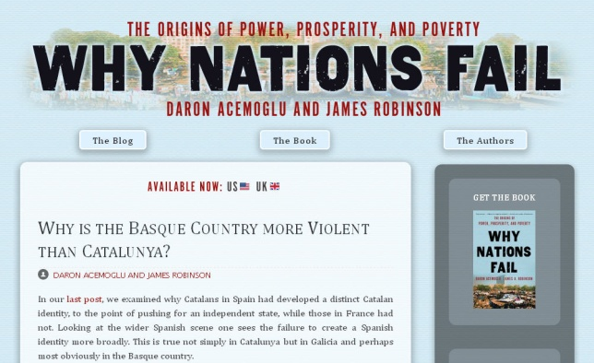
Notes:
http://global.oup.com/uk/orc/busecon/economics/carlin/

Slide 13
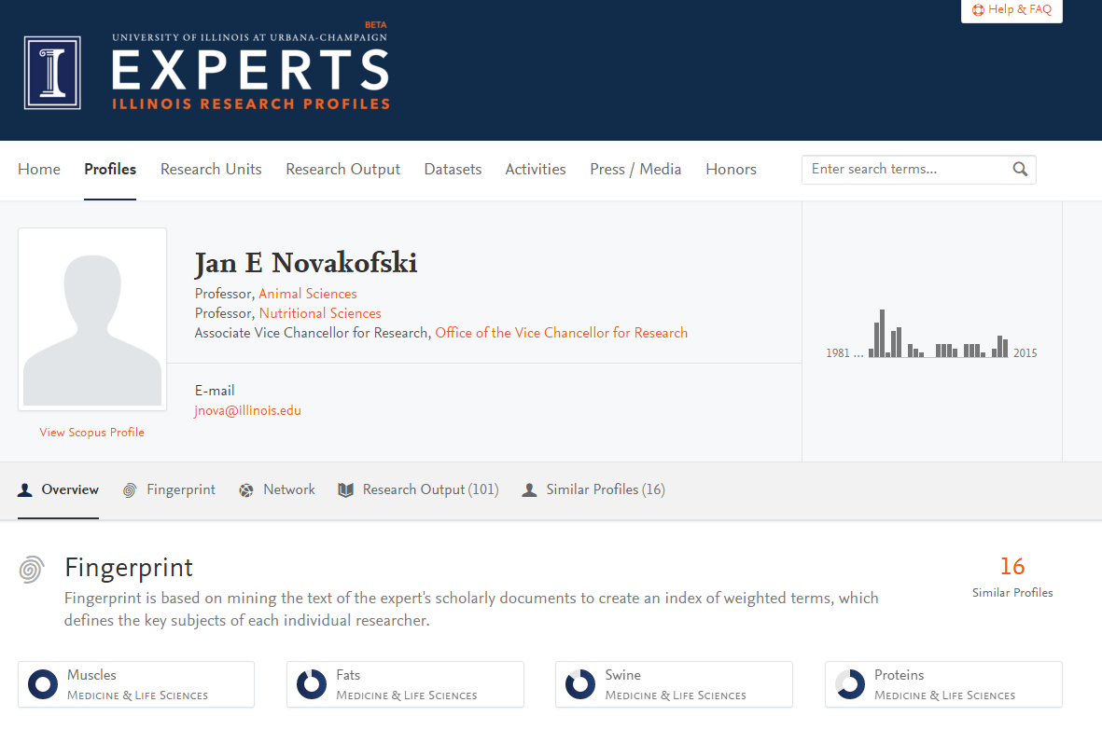
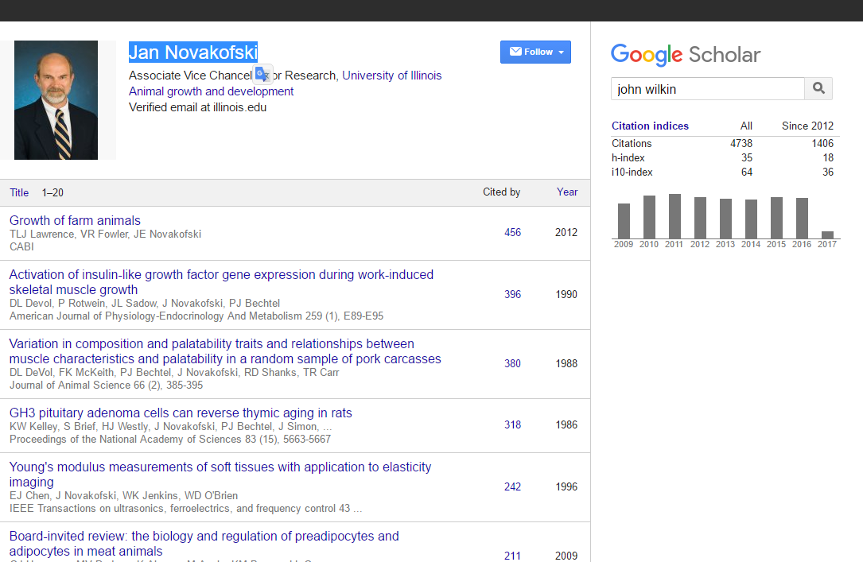
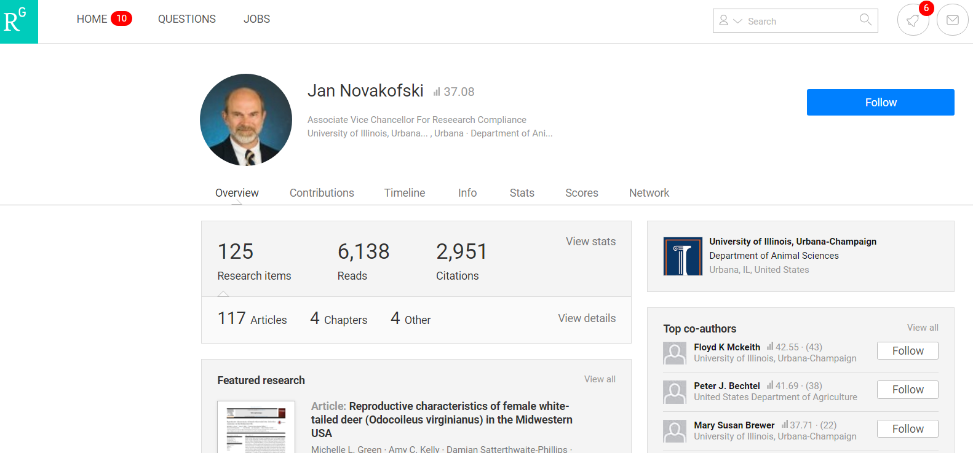
Expertise/Identity
Expertise and reputation:
Identity > workflow > content

Slide 14
Creation, management and disclosure:
Vice president for research
R- infra-structure
Medical center
Tech Transfer Office
CIO
News Bureau
Institutional Reporting
Research Data Management
Advancement & corporate relations
Provost
Data Warehouse
RIM/Profiling system
Digital scholarship
LIBRARY
Colleges & depts
Institutional Repository
User education & training
Disciplines & departments
Graduate school
Office of undergraduate research
Researcher
Research manager
Research support
Campus center for teaching & learning

Slide 15
A publisher’s new job description
Her view is that publishers are here to make the scientific research process more effective by helping them keep up to date, find colleagues, plan experiments, and then share their results. After they have published, the processes continues with gaining a reputation, obtaining funds, finding collaborators, and even finding a new job. What can we as publishers do to address some of scientists’ pain points?
Annette Thomas,
Then CEO of Macmillan
Publishers
http://www.against-the-grain.com/2012/11/a-publishers-new-job-description/
Notes:
A Publisher's New Job Description
November 8, 2012 Donald Hawkins Charleston Conference Blog
http://www.against-the-grain.com/2012/11/a-publishers-new-job-description/

Slide 16
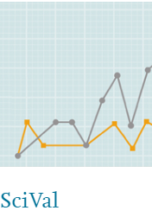
Researcher
Librarian
Research
manager

Slide 17
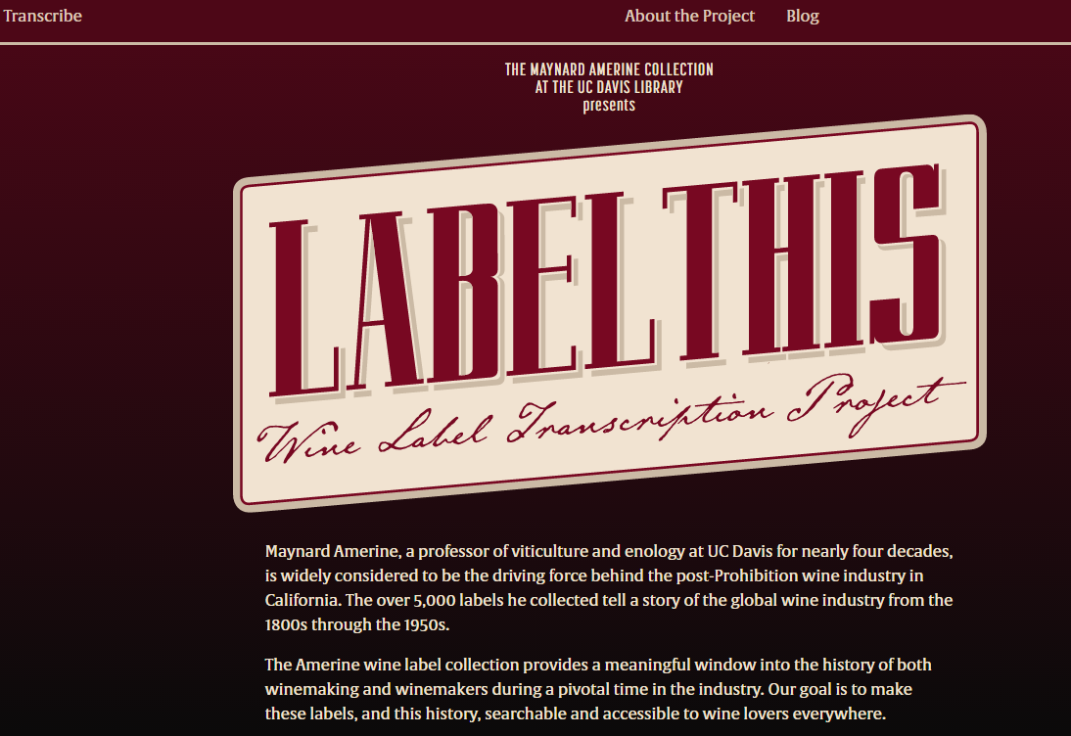
Special colls
Research, reputation, relevance

Slide 18
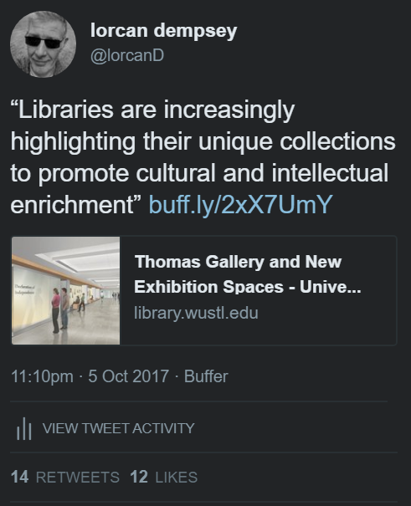

Slide 19
Support for creation, management and disclosure of evidence, memory, community
Reconfiguration of research work by network/digital environment.
Workflow is the new content
Reputation manage and disclose the intellectual outputs and expertise of the institution.
From discovery to discoverability
Collective collections: Rightscaling and collective action
The inside out collection

Slide 20
Reconfiguration of the information space by network/digital environment.
Facilitated
Collection

Slide 21
arXiv, SSRN, RePEc, PubMed Central (disciplinary repositories that have become important discovery hubs);
Google Scholar, Google Books, Amazon (ubiquitous discovery and fulfillment hubs);
Mendeley, ResearchGate (services for social discovery and scholarly reputation management);
Goodreads, LibraryThing (social description/reading sites);
Wikipedia, Yahoo Answers, Khan Academy (hubs for open research, reference, and teaching materials).
FigShare, OpenRefine (data storage and manipulation tools)
Github (software management)

Slide 22
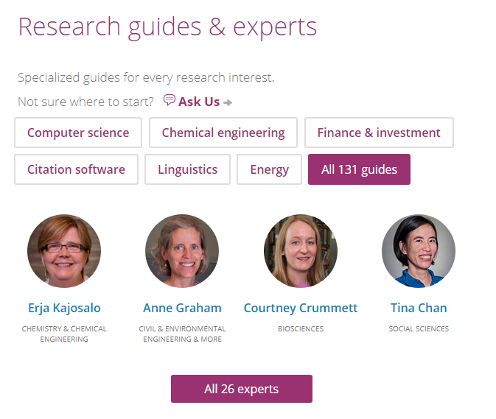

Slide 23
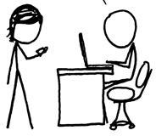
http://www.xkcd.com/917/
Value relates to locally assembled collection.
Value relates to ability to efficiently meet a variety of research and learning needs.
A print logic: the distribution of print copies to multiple local destinations
A network logic: a coordinated mix of local, external and collaborative services are assembled around user needs
A collections spectrum
The ‘owned’ collection
The ‘facilitated’ collection
Purchased and physically stored
Meet research and
learning needs in best way
Notes:
More on facilitated collections:
Dempsey, L., (2016). Library collections in the life of the user: two directions. LIBER Quarterly. 26(4). DOI: http://doi.org/10.18352/lq.10170

Slide 24
The ‘external’ collection:
Pointing researchers at Google Scholar;
Including freely available ebooks in the catalog;
Creating resource guides for web resources.
The ‘borrowed’ collection
The ‘shared print’ collection
The ‘shared digital’ collection
The evolving scholarly record
A collections spectrum
The ‘owned’ collection
The ‘licensed’ collection
The ‘demand-driven’ collection
The ‘facilitated’ collection
Note: Libraries have variable
Investments across the entire
spectrum
Purchased and physically stored
Meet research and
learning needs in best way

Slide 25
The specialized collection
Reconfiguration of the information space by network/digital environment.
The facilitated collection

Slide 26
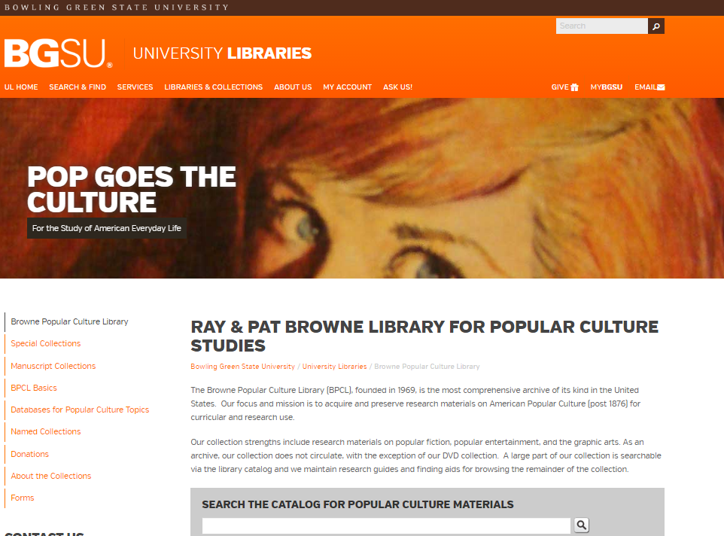
The specialized collection

Slide 27
The specialized collection
Specialization of locally acquired/held collections?
Engagement Understand and respond to needs of faculty and students.
A diffuse responsibility for stewardship of the scholarly record
Collective collections: Rightscaling and collective action
Reconfiguration of the information space by network/digital environment.
The facilitated collection

Slide 28
Collective collections:
Rightscaling and collaborative action …
Reconfiguration of library collaboration by network/digital environment.

Slide 29
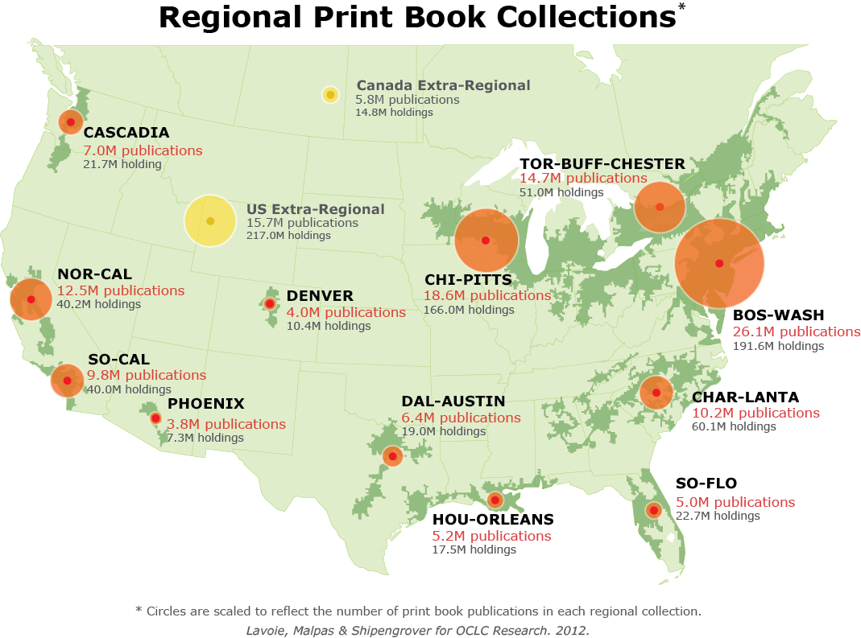
Based on January 2011 WorldCat data

Slide 30
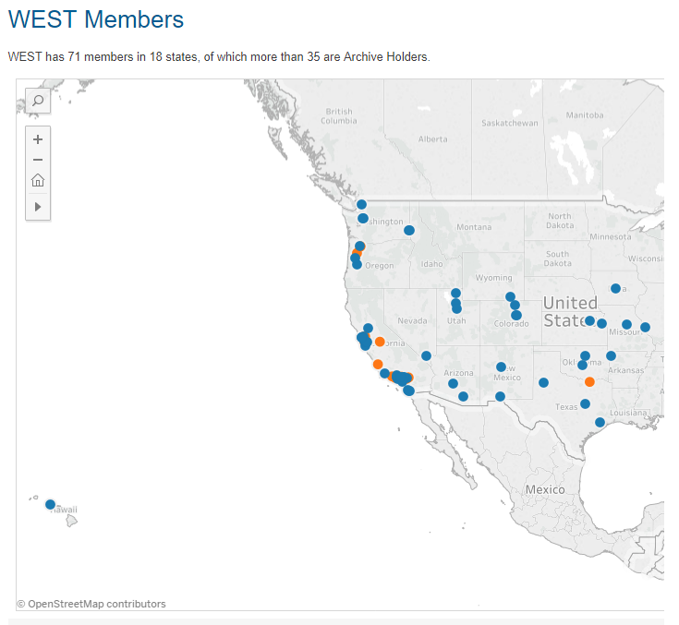

Slide 31
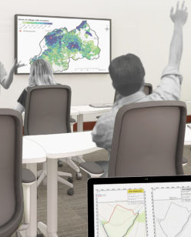
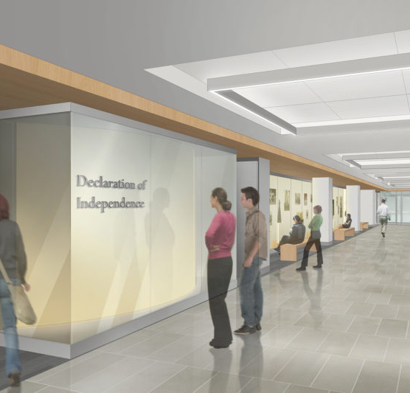
Space is being reconfigured around experiences rather than collections.

Slide 32
System-wide organization of collections—whether the “system” is a consortium, a region, a country ….
The rise of the collective collection
Discoverable
Shared
Stewarded
The collective print collection

Slide 33
Rightscaling – optimum scale?
Shared print
Research data
Shared Print Management
Notes:
For shared print management, we see a variety of group-scale efforts that leverage existing consortial partnerships, as well as built-to-purpose groups.
For research data management, there is a mix of institution-scale infrastructure and a growing range of group-scale options.
Is the scale the same for each? Can we expect a single group to support the whole range of shared stewardship objectives?

Slide 34
Collective collection
Rightscaling – optimum scale?
The ‘borrowed’ collection
The ‘shared print’ collection
The ‘shared digital’ collection
The ‘shared scholarly’ record
Notes:
Various group-scale arrangements have emerged to support collective collection management across the spectrum from owned to facilitated collections.
Significantly, there is not a single group-scale arrangement that can solve for all of these problems.
What is the optimum scale for group action? It appears to vary…

Slide 35
The specialized collection
A large part of existing print collections will move into shared stewardship in next few years?
Agreements emerging around retention and sharing.
Inside out collections aggregated in network level hubs?
Or Google?
Collective collections: Rightscaling and collective action
Reconfiguration of library collaboration by network/digital environment.
The collective collection

Slide 36
Three trends
Reconfiguration of research work by network/digital environment.
Reconfiguration of the information space by network/digital environment.
Reconfiguration of library collaboration by network/digital environment.
The inside out collection
The facilitated collection
The collective collection

Slide 37
Three trends
Create, manage and make discoverable evidence, community, memory..
Assemble a coordinated mix of local, external and collaborative services around user needs.
Increasingly organize collections at the network or systemwide level.
The inside out collection
The facilitated collection
The collective collection

Slide 38
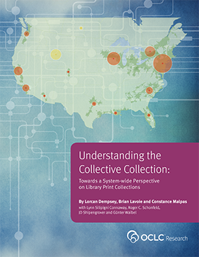
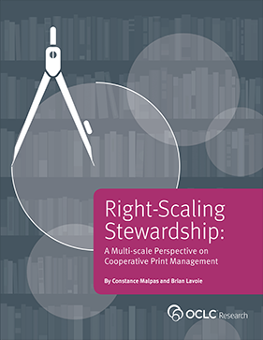
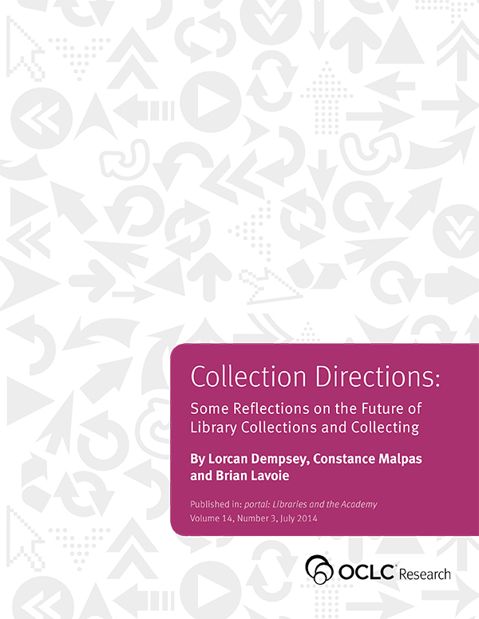
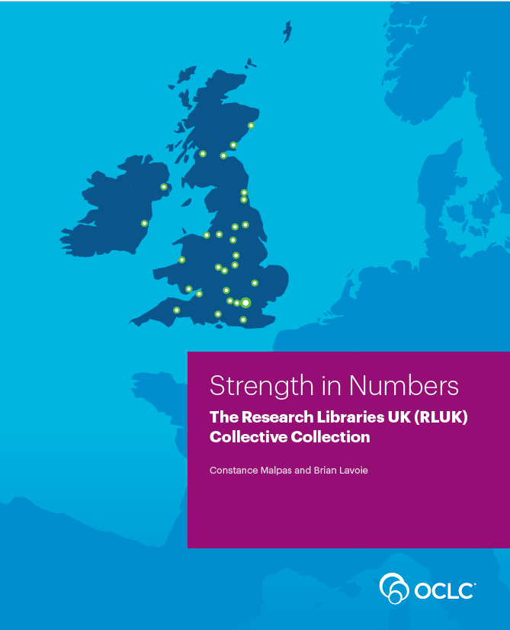
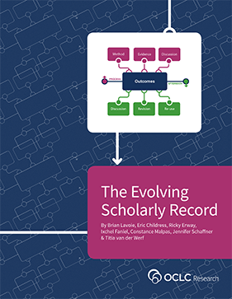
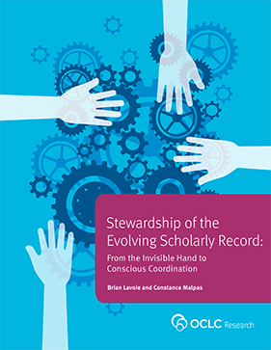
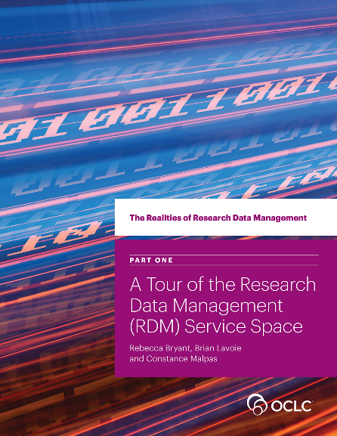
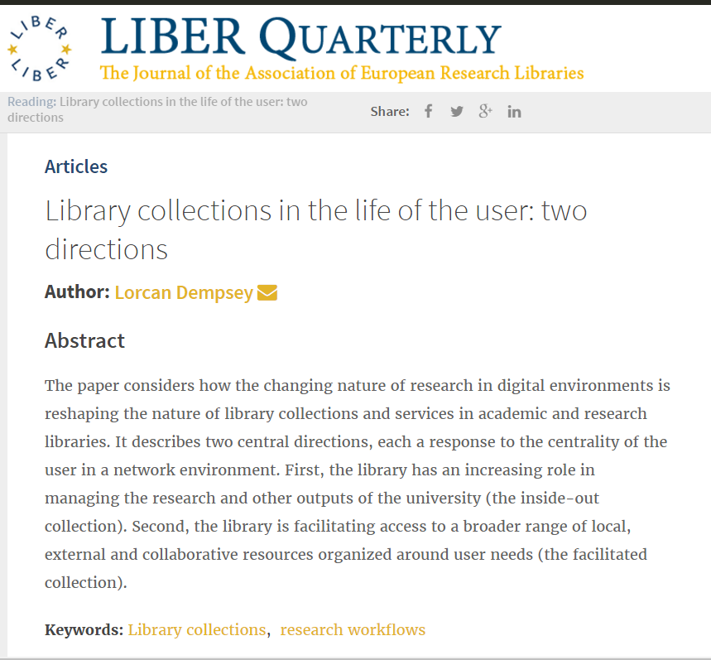
Thank you, @LorcanD

Slide 39
Citations and fuller details are included in slide notes where relevant.
Thanks to my colleagues Brian Lavoie, Constance Malpas and Rebecca
Bryant for assistance as I prepared this presentation.
The presentation follows the outline of:
Dempsey, L., (2016). Library collections in the life of the user: two directions. LIBER Quarterly. 26(4), pp.338–359. DOI:http://doi.org/10.18352/lq.10170
@LorcanD

