Slide 1
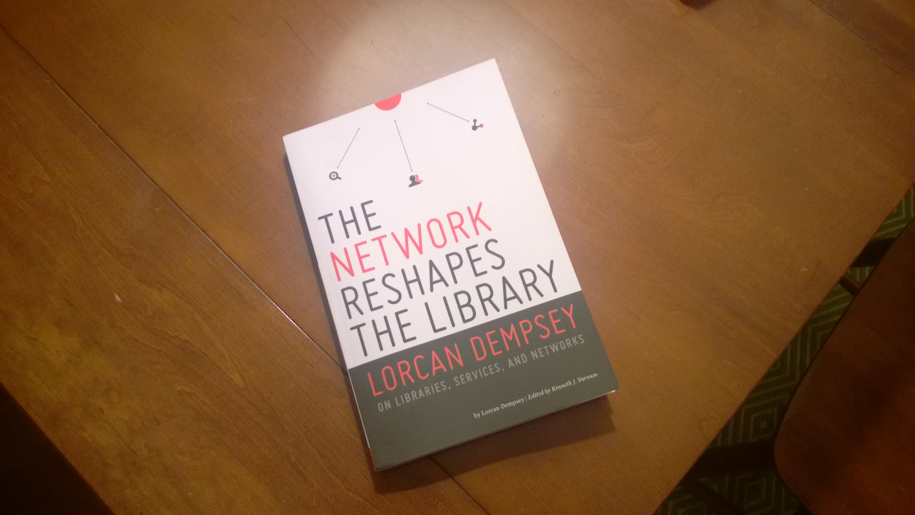

Thinking about technology: differently
@LorcanD
Lorcan Dempsey
OCLC
7 November 2014
LITA
Albuquerque

Slide 2
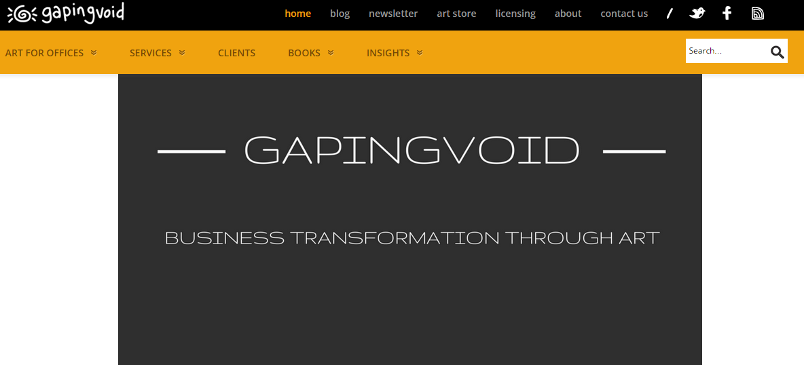
Cartoons by:

Slide 3
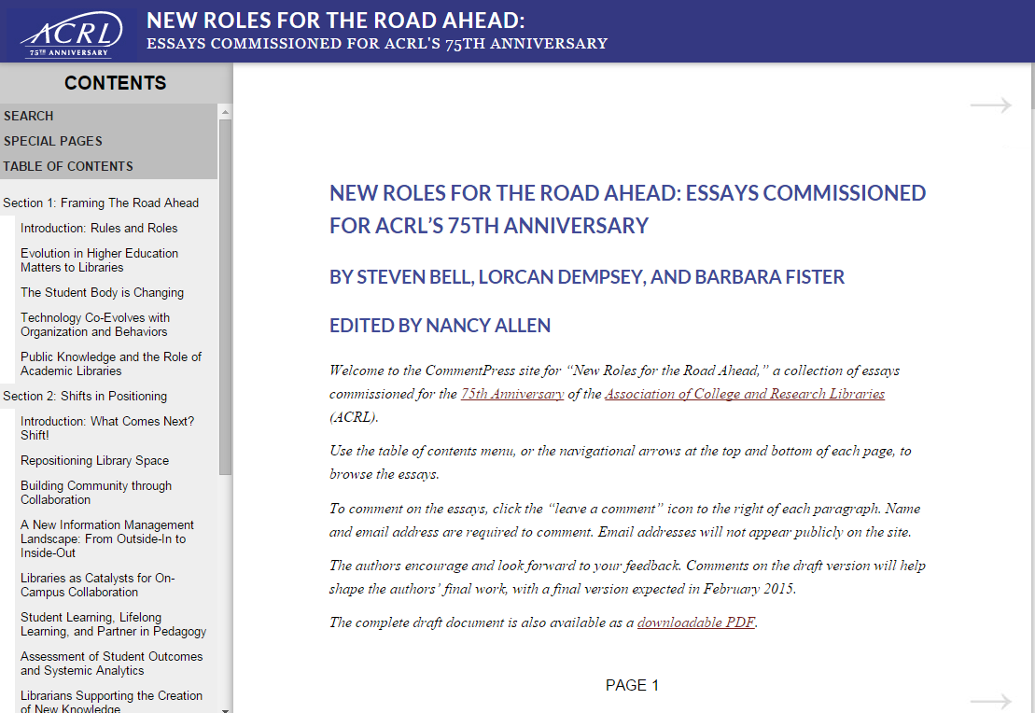

Slide 4
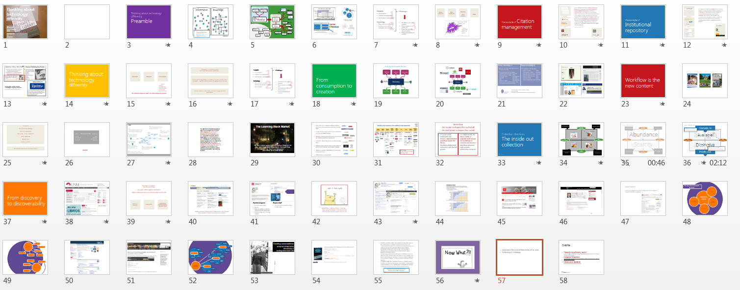
Overview

Slide 5
Preamble
A quick look at changes in processing capacity – OCLC Research

Slide 6
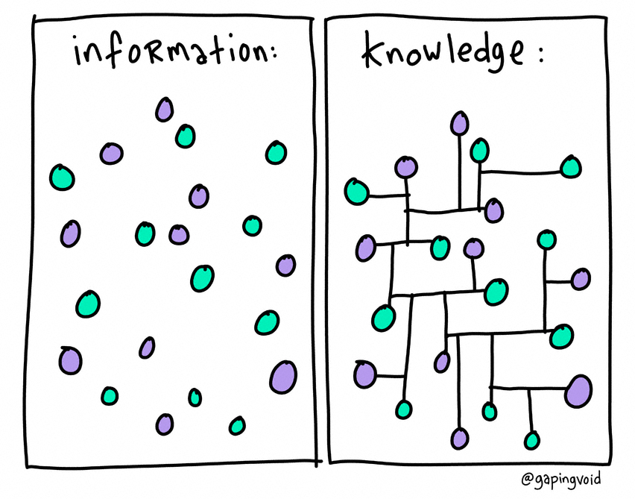
Within a discovery service …
Aspire to a singular identity for entities/things (people, works, places, organizations, …)
Gather data associated with those identities (e.g. ‘cards’)
Create relationships between identities.

Slide 7








OCLC Production Services
LCSH
Linked Data
Entities
378M
202M
VIAF
Internal OCLC Research Resources
FAST
enhanced
WorldCat
481.3M
GMGPC
939K
External OCLC Research Systems
WORKS
GSAFD
1.2M
GTT
Kindred Works
FictionFinder
6.2M
Identities
LCTGM
MeSH
Cookbook Finder
523K
DDC
107K
Classify
Notes:
2,662,433,583 controlled data points in enhanced WorldCat (including OCLC production authority control links)
DTICT 6,759,733
FAST 481,311,144
GMGPC 939,733
GSAFD 1,216,745
GTT 6,248,478
LC Form/Genre 2,388,344
LCSH 202,687,061
LCTGM 523,498
MeSH 107,027
VIAF 378,097,152

Slide 8


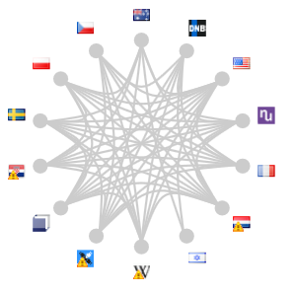

1.7B
rows
45 minutes
JSON
view
Oct. 2014
152,528,486
45 minutes to process
JSON view of VIAF
S M T W T F S
S M T W T F S
8.3 M
Clusters
(>1 authority
for same entity)
2 months to cluster VIAF
(conventional processing approach)
24 hours
(actual time to cluster VIAF
using Hadoop/HBase)
4.7M intra-VIAF links

Slide 9
Looking at technology … differently

Slide 10
1
Examples
Cell phones
Citation management
Institutional repositories
Technology
The network reshapes society and society reshapes the network
4 example Challenges
- pre strategic
organization
reshaping
2
3
From consumption to creation
Workflow is the new content
From outside-in to inside-out
From discovery to discoverability

Slide 11
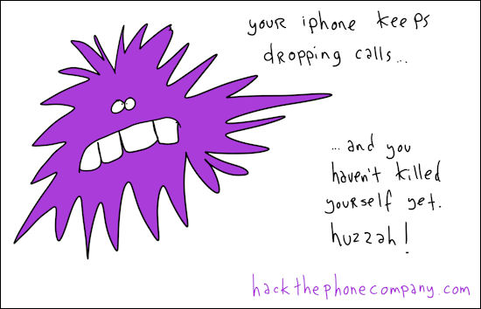
Ad hoc rendezvous
Micro-coordination
Situational
Location
Fulfilment
Relationship
Visual

Slide 12
The example of Citation management

Slide 13







So in a relatively short time, a solitary and manual function has evolved into a workflow enacted in a social and digital environment. In addition to functional value, this change has added network value, as individual users benefit from the community of use. People can make connections and find new work, and the network generates analytics which may be used for recommendations or scholarly metrics. In this way, for some people, citation management has evolved from being a single function in a broader workflow into a workflow manager, discovery engine, and social network.
Dempsey & Walter, 2014

Slide 14
The example of Institutional repository

Slide 15
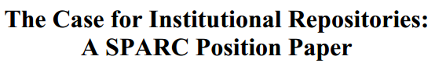






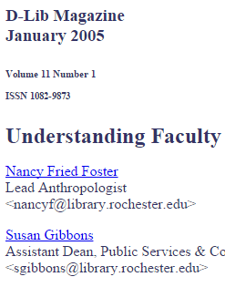



In a well-known article, Salo (2008) offers a variety of reasons as to why they have not been as heavily used as anticipated. These include a lack of attention to faculty incentives (‘prestige’) and to campus workflows. She concludes that IRs will not be successful unless developed as a part of “systematic, broad-based, well-supported data-stewardship, scholarly-communication, or digital-preservation program”.

Slide 16
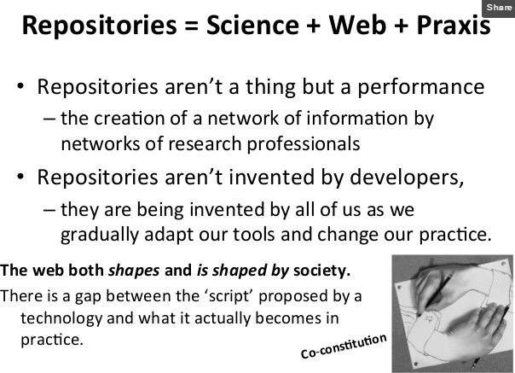
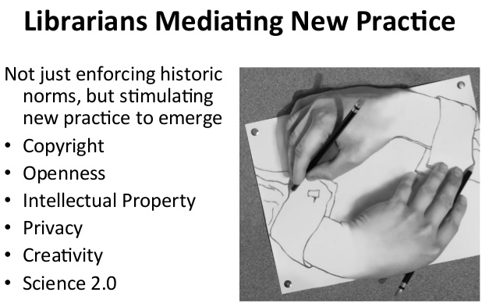
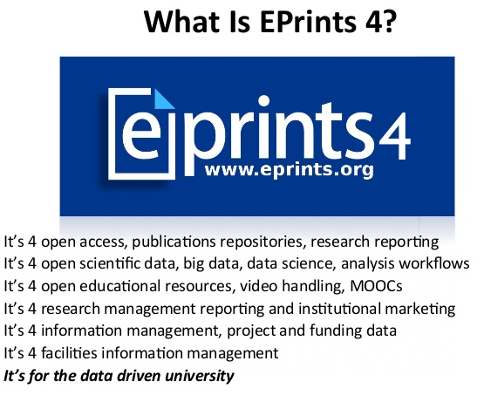
EPrints Update, Les Carr, University
of Southampton, Repository Fringe, 2014
http://www.slideshare.net/repofringe/e-prints42y

Slide 17
Thinking about technology: differently

Slide 18
Automated
Networked
Socio-technical
Ahem!
Pervasive
Sociodigitization
Informationalized
Sociomaterial
Industrial internet
The technical reshapes the social – the social reshapes the technical

Slide 19
Technology is a central part of how we
enact work, communication, organization, ….
Our view of technology belongs to an earlier era. We think of discrete systems
and impacts …. separated from the network and digital practices of our users.
Our focus will have to shift to think of how best to engage with those
environments.

Slide 20
1
Examples
Cell phones
Citation management
Institutional repositories
Technology
The network reshapes society and society reshapes the network
4 Challenges - pre strategic
organization
reshaping
2
3
From consumption to creation
Workflow is the new content
From outside-in to inside-out
From discovery to discoverability

Slide 21
From consumption to creation

Slide 22
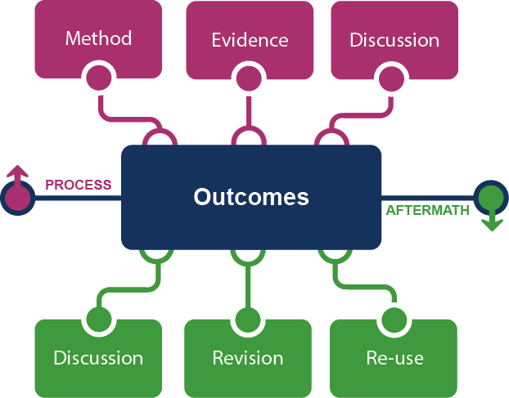
Framing the Scholarly Record …
The evolving scholarly record, Lavoie et al

Slide 23


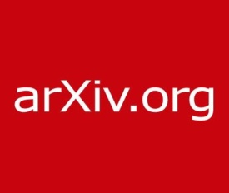

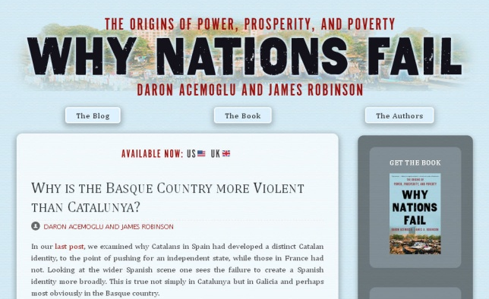



Slide 24
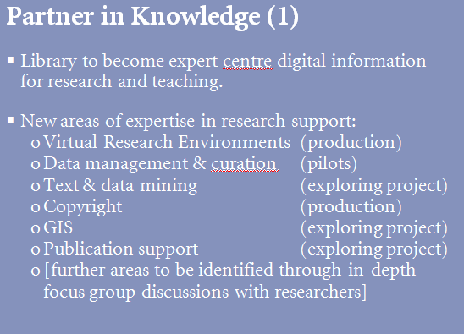
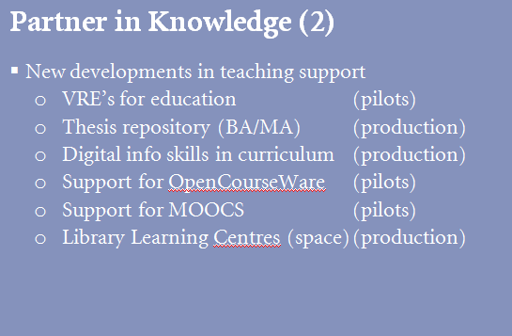

Transformation of the academic library
Kurt de Belder
http://www.oclc.org/content/dam/research/events/dss/ppt/dss_debelder.pptx

Slide 25
More opportunities for support across the whole lifecycle in a digital environment.

Slide 26
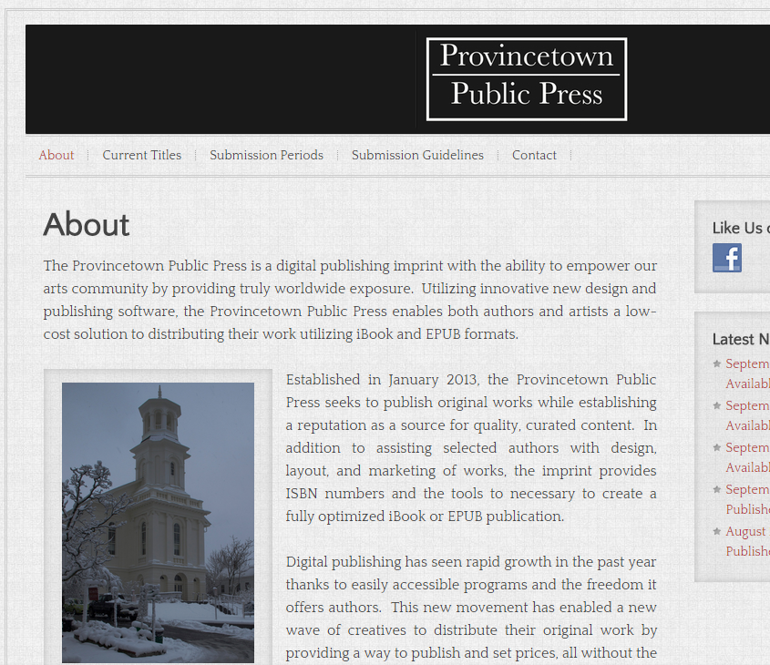
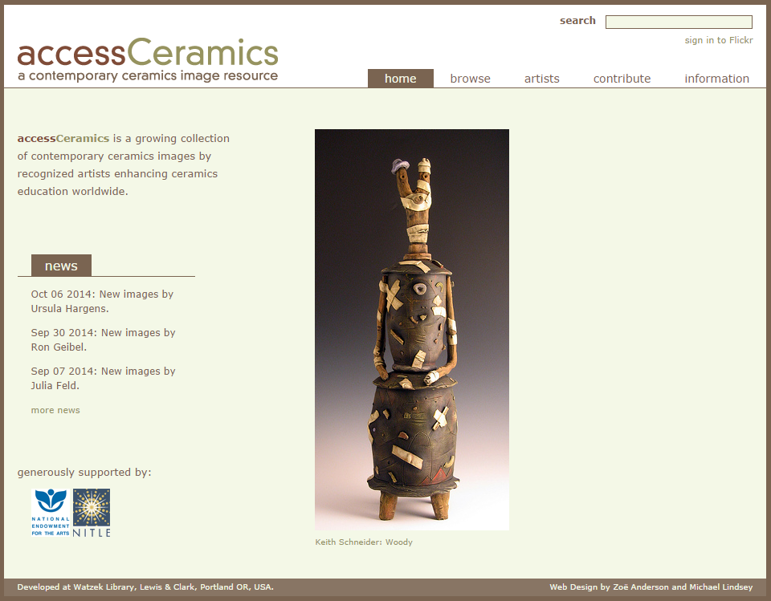
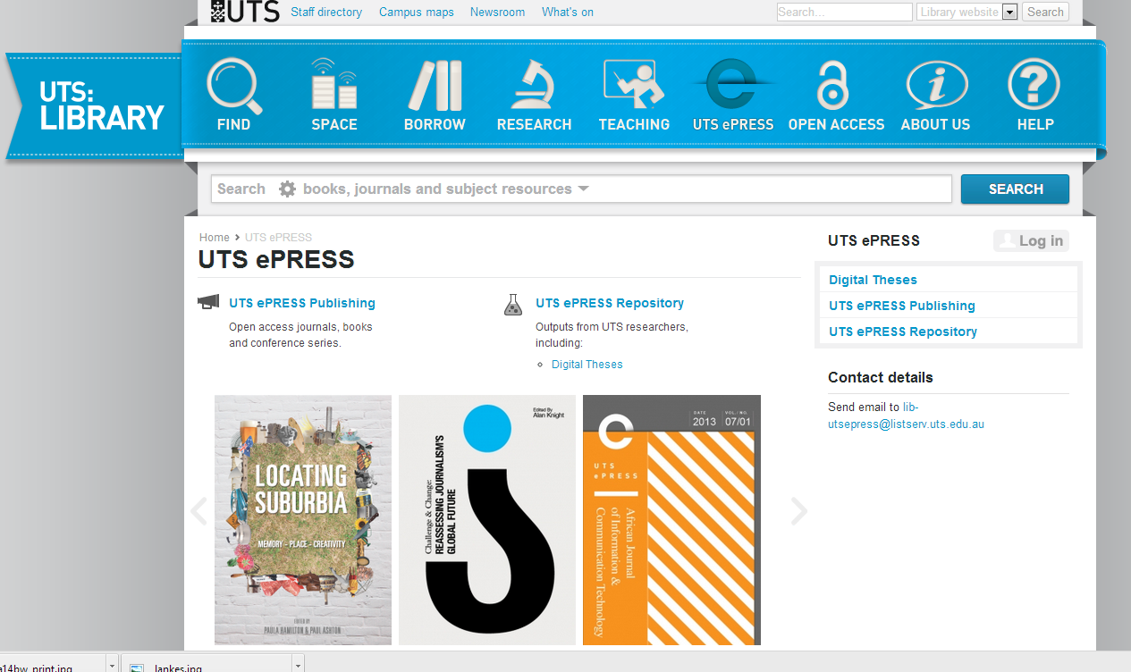
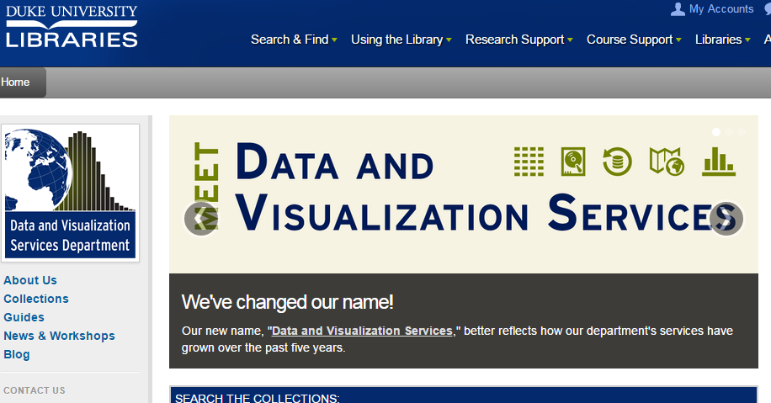

Slide 27
Workflow is the new content

Slide 28

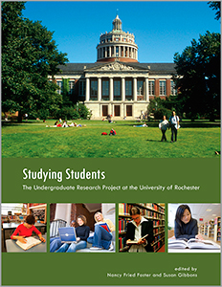
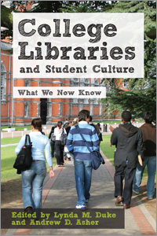

Slide 29
Convenience
The cost of context switching
The cost of fragmentation
Relationship – sharing – engagement
Solo vs collaborative
Different needs
Visitors vs residents
What people actually do, not what they say they do

Slide 30
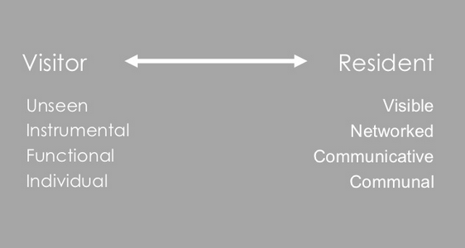
#vandr

Slide 31
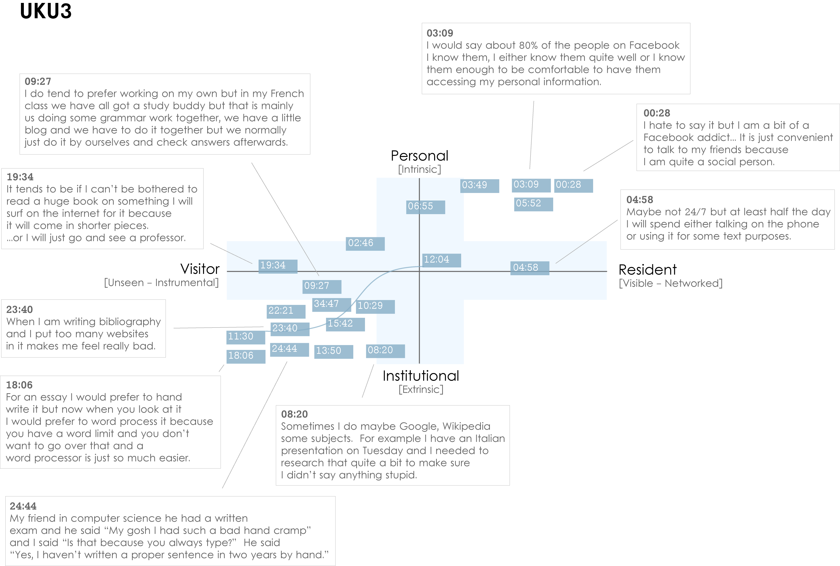
Notes:
Images created by David White, Co-manager, Technology Assisted Lifelong Learning, University of Oxford
Institutional Resident Gap
UKU3 (UK 1st year undergraduate)
This participant has a clear demarcation between Resident modes of engagement in her personal life and Visitor modes of engagement for study.
The map is a mode of engagement landscape onto which individuals can be plotted. The limits of the map have been defined by the four major framing concepts of the project: V&R – Personal and Institutional. The Personal end of the axis encompasses an individual’s private life, and the Institutional is their professional and/or academic life.
The data from the Emerging educational stage seem to suggest that individuals were engaging with systems and materials not provided by their institutions to do institutional work (e.g., consulting Wikipedia to write an essay). Such user-owned literacies, when mapped like this, take a prominent role in the academic work of many of our research subjects. Given the effect that the internet is having on collapsing the relationship between certain modes of activity and specific physical spaces, it is important not to tie notions of the intuitional and the personal to ideas of “school/university/library” and “home” as buildings.
White, D., & Connaway, L.S. Visitors & Residents: What Motivates Engagement with the Digital Information Environment. 2011-2012. Funded by JISC, OCLC, and Oxford University. http://www.oclc.org/research/activities/vandr/.

Slide 32
The data from the Emerging educational stage seem to suggest that individuals were engaging with systems and materials not provided by their institutions to do institutional work (e.g., consulting Wikipedia to write an essay). Such user-owned literacies, when mapped like this, take a prominent role in the academic work of many of our research subjects. Given the effect that the internet is having on collapsing the relationship between certain modes of activity and specific physical spaces, it is important not to tie notions of the institutional and the personal to ideas of “school/university/library” and “home” as buildings.

Slide 33

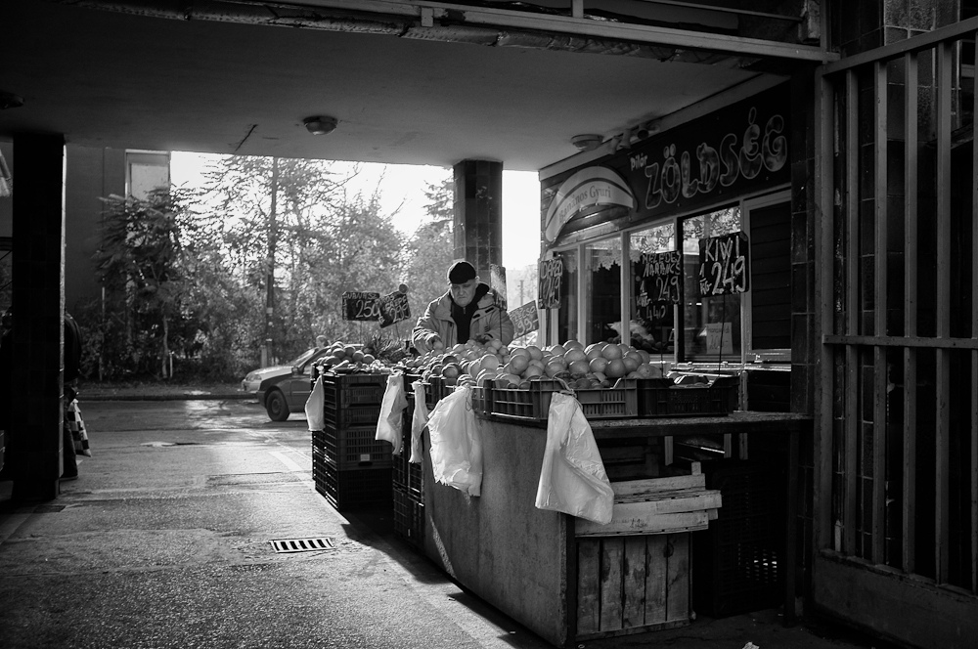
The Learning Black Market
“It’s like a taboo I guess with all teachers, they just all say – you know, when they explain the paper they always say, ‘Don’t use Wikipedia.’”
(USU7, Female, Age 19, Political Science)
Notes:
Image: http://www.deviantart.com/morelikethis/211376699
Covert online study habits
Wikipedia
Don’t cite
Widely used
Guilt
Students & teachers disagree
Quality sources
There is a “Learning Black Market”: learners use non-traditional sources but feel they cannot talk about them in an institutional context. Wikipedia usage is an example of this. (White & Connaway, 2011)
Connaway, Lynn Silipigni, Donna Lanclos, and Erin M. Hood. 2013. “I find Google a lot easier than going to the library website.” Imagine ways to innovate and inspire students to use the academic library. Proceedings of the Association of College & Research Libraries (ACRL) 2013 conference, April 10-13, 2013, Indianapolis, IN. http://www.ala.org/acrl/sites/ala.org.acrl/files/content/conferences/confsandpreconfs/2013/papers/Connaway_Google.pdf.
White, David. 2008. Not “natives’”& “immigrants” but “visitors’ & “residents.” TALL Blog: Online Education with the University of Oxford, April 23, http://tallblog.conted.ox.ac.uk/index.php/2008/07/23/not-natives-immigrants-but-visitors-residents/.
Saunders also found that faculty are “concerned with students’ reliance on Google and Wikipedia for information.” This may help to explain why many of the Emerging stage participants expressed a reluctance to acknowledge or cite Wikipedia in their work for fear of being ridiculed by faculty, or be given a lower grade. This is referred to as the Learning Black Market, which is discussed in more detail in Connaway, Lanclos, and Hood and White’s 2011 blog entry.
Saunders, Laura. 2012. Faculty perspectives on information literacy as a student learning outcome. The Journal of Academic Librarianship 38, no. 4 (2012): 231.

Slide 34












arXiv, SSRN, RePEc, PubMed Central (disciplinary repositories that have become important discovery hubs);
Google Scholar, Google Books, Amazon (ubiquitous discovery and fulfillment hubs);
Mendeley, ResearchGate (services for social discovery and scholarly reputation management);
Goodreads, LibraryThing (social description/reading sites);
Wikipedia, Yahoo Answers, Khan Academy (hubs for open research, reference, and teaching materials).
GalaxyZoo, FigShare, OpenRefine (data storage and manipulation tools)
Github (software management)

Slide 35
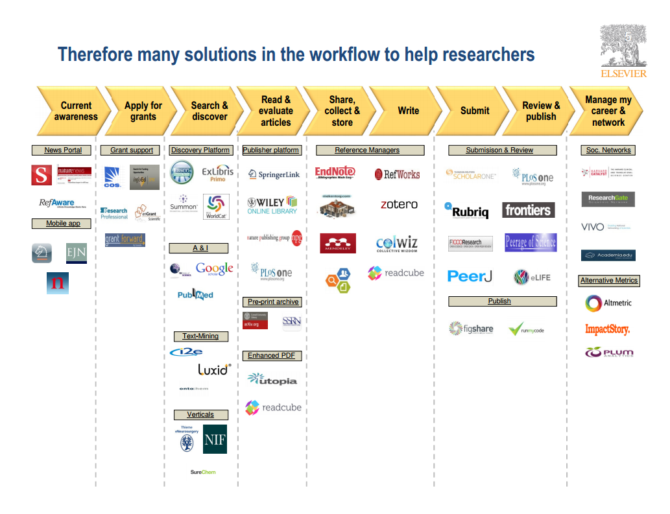
Wouter Haak
Elsevier, VP Product Strategy
LIBER, Riga, 2014

Slide 36
Workflow the social reshapes the technical the technical reshapes the social
In a print world, researchers and learners organized their workflow around the library.
The library had limited interaction with the full process.
In a digital world, the library needs to organize itself around the workflows of research and learners.
Workflows generate and consume information resources.

Slide 37
The inside out collection
Collection directions

Slide 38
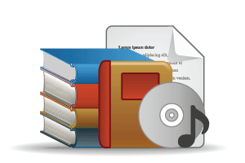

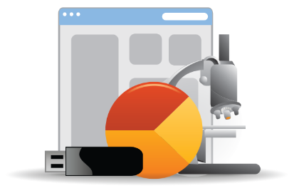
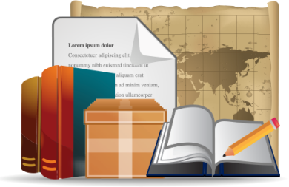
Open Web Resources
‘Published’ materials
In many collections
Licensed
Purchased
Low Stewardship
High Stewardship
Research & Learning Materials
Institutional In few collections
Special Collections
Local Digitization

Slide 39



OCLC Collections Grid
Purchased Materials
Licensed E-Resources
In many collections
Open Web Resources
Licensed
Abundance
Purchased
High Stewardship
Low Stewardship
Scarcity
Special Collections
Local Digitization
Research & Learning Materials
In few collections

Slide 40
OCLC Collections Grid
Outside, in
In many collections
Library as broker
Maximise efficiency
A
Licensed
Available
Purchased
Low Stewardship
High Stewardship
Distinctive
Library as provider
Maximise discoverability
Inside, out
In few collections
Notes:
Not just about ‘special’ collections

Slide 41
From discovery to discoverability

Slide 42
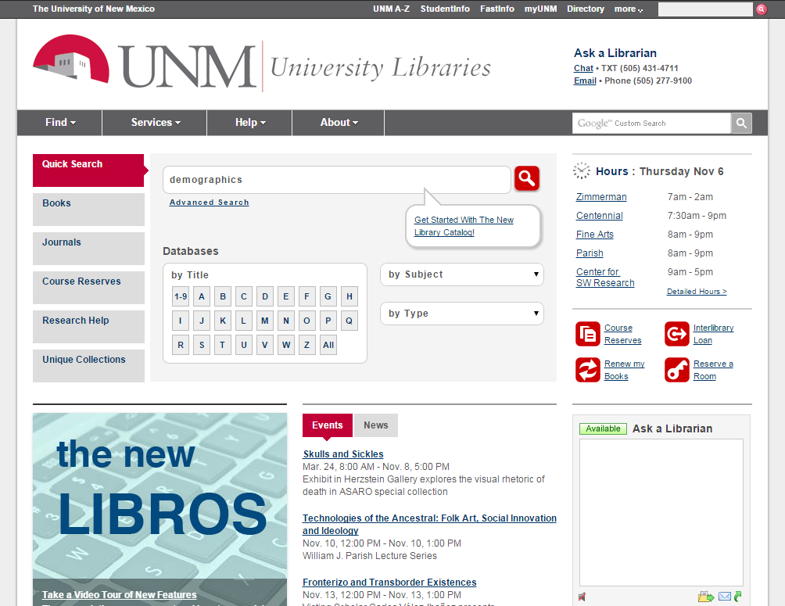

Slide 43
Discovery is not just …
the discovery layer
Discovery often happens elsewhere.
Make institutional resources discoverable (inside out).
Full library discovery
People matter
A decentered network presence – the power of pull

Slide 44
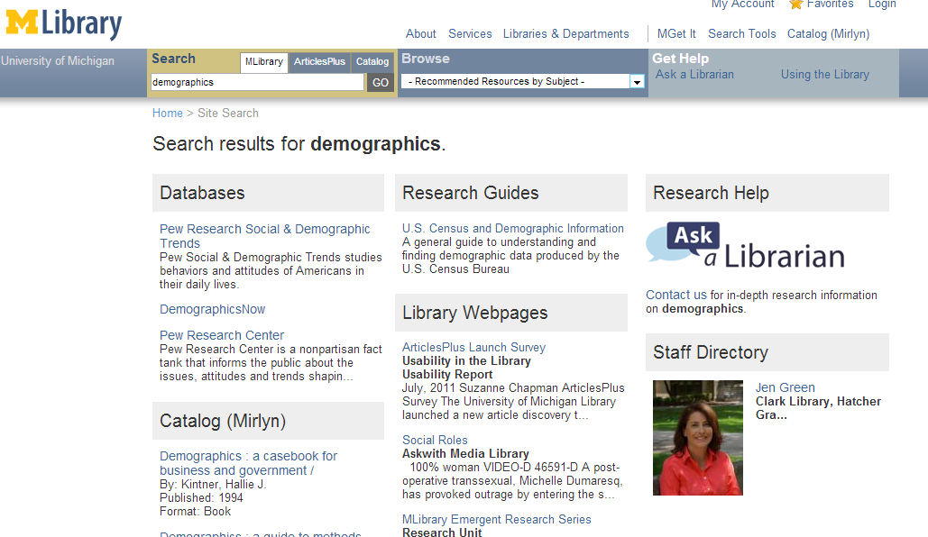
Full library discovery? Service discovery? People discovery? Event discovery?
If your expertise is not seen, you will not be seen as expert.

Slide 45
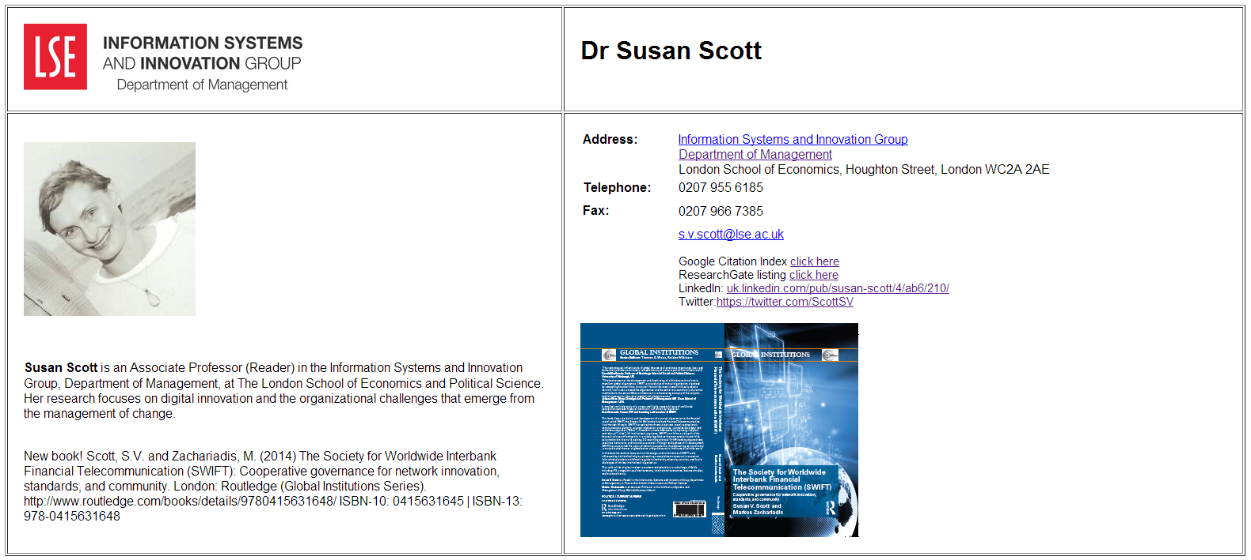
Reputation management
The power of pull
Expertise and profiling
Identity
Make the institution, expertise, research outputs, discoverable, …
New Knowledge work ( Kenning Arlitsch)
Connect to library capacities where it makes sense

Slide 46
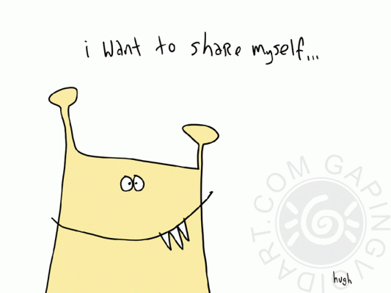
Workflow, collaboration, sharing, …
the social reshapes the technical
the technical reshapes the social

Slide 47
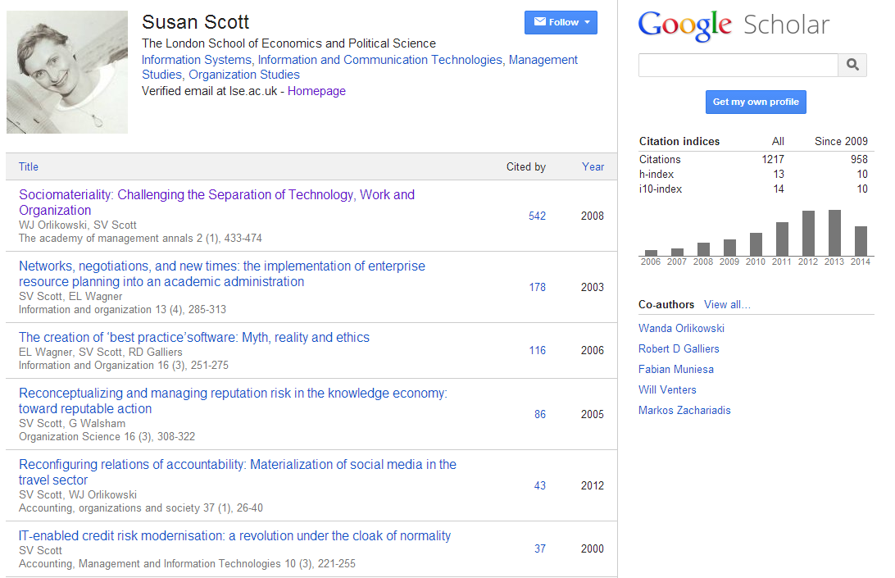
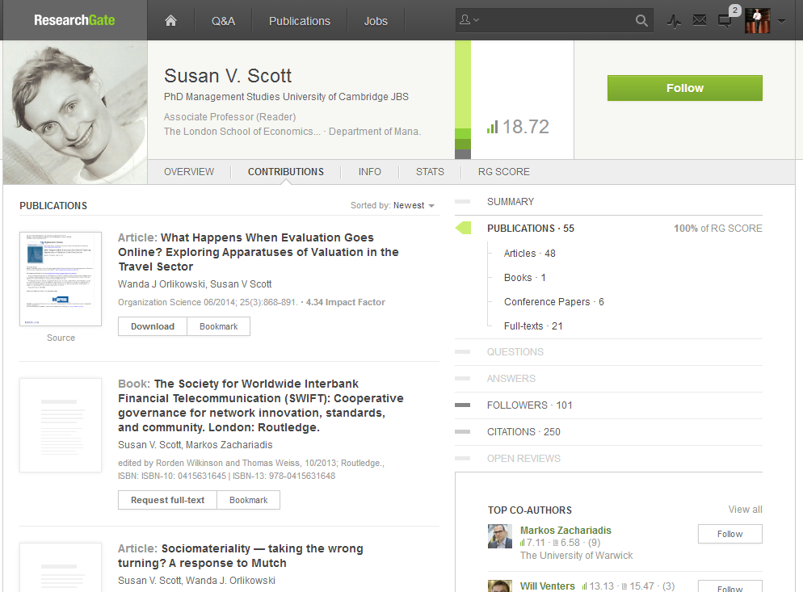

Slide 48
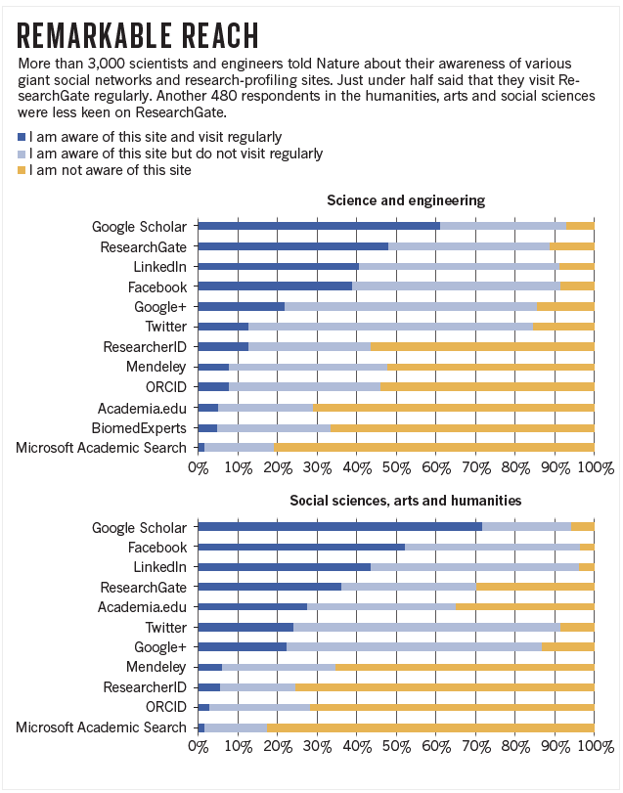

Slide 49
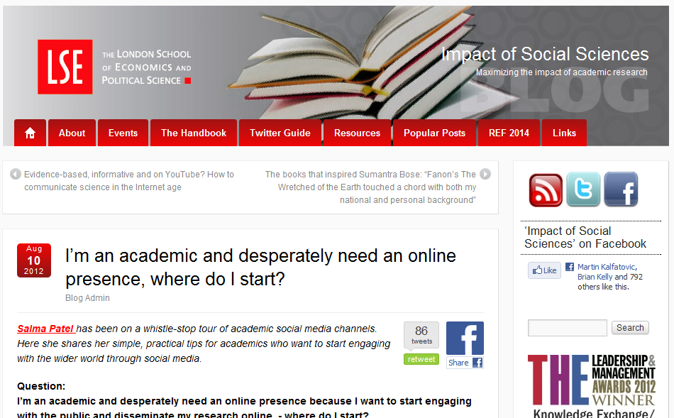

Slide 50
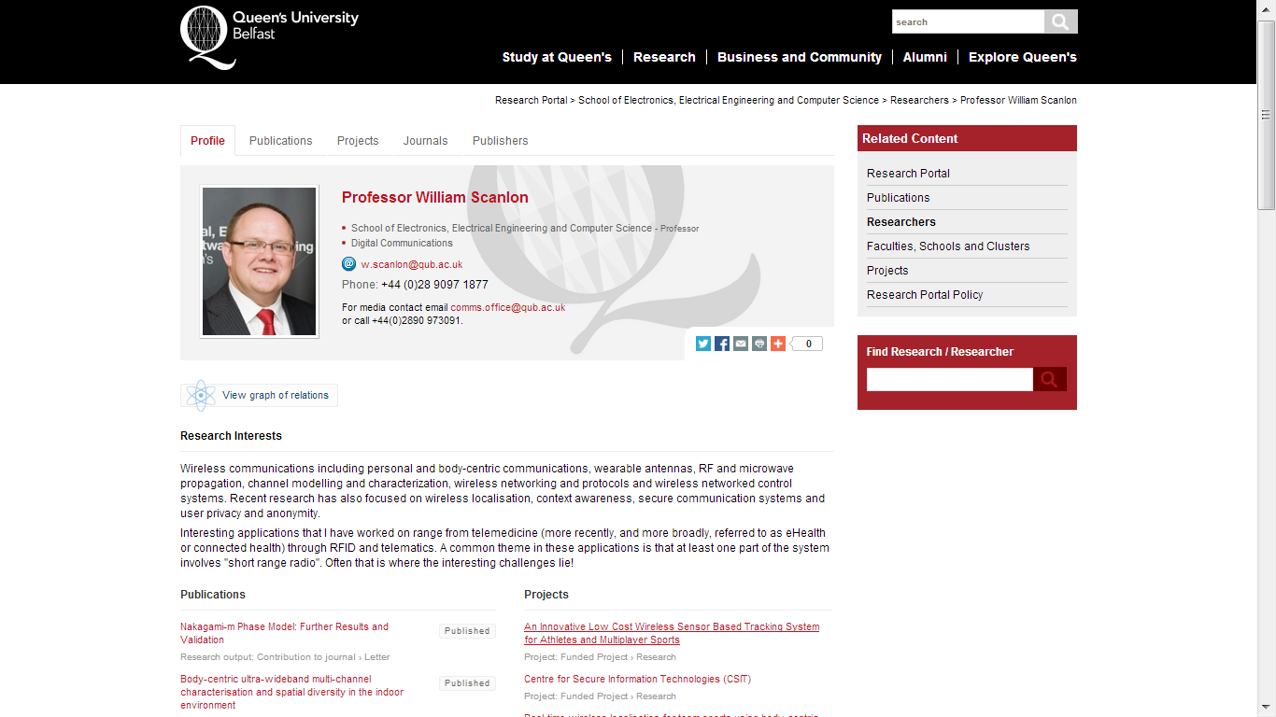

Slide 51
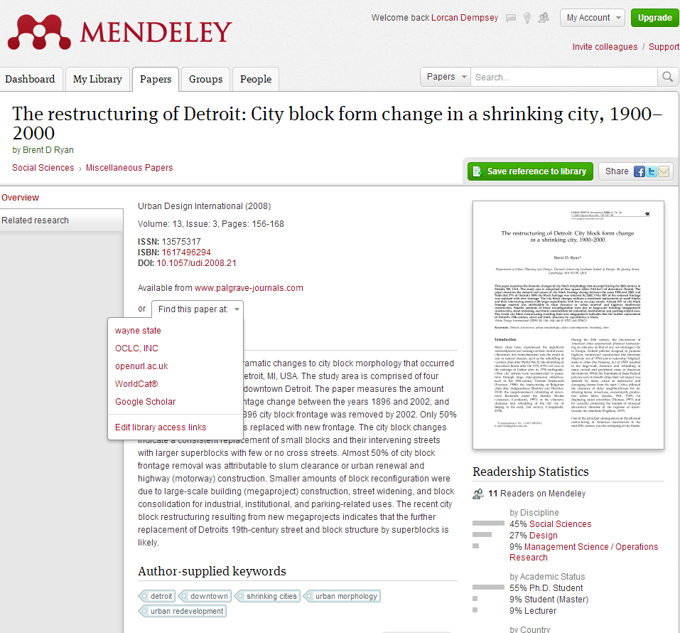
Resolver configuration.
How do you engage with researcher profiling, reputation management,
research information management, ….?

Slide 52
The decentered network presence
Website
University Library
Decoupled Communication
External Syndication
Cloud Sourced

Slide 53






Decoupled Communication
Flickr
Blogs
Facebook
Twitter
Google
Youtube
Discovery
Knowledgebase
Libguides
Cloud Sourced
Resolver

Slide 54
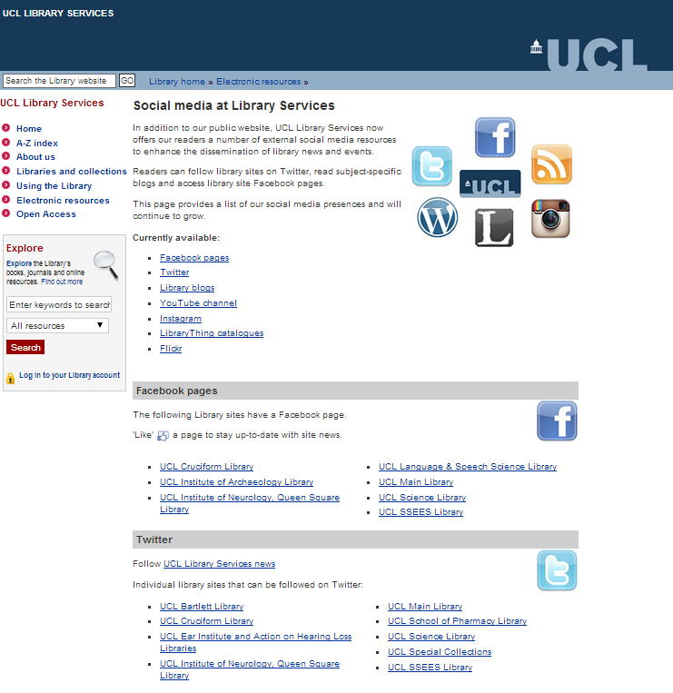

Slide 55
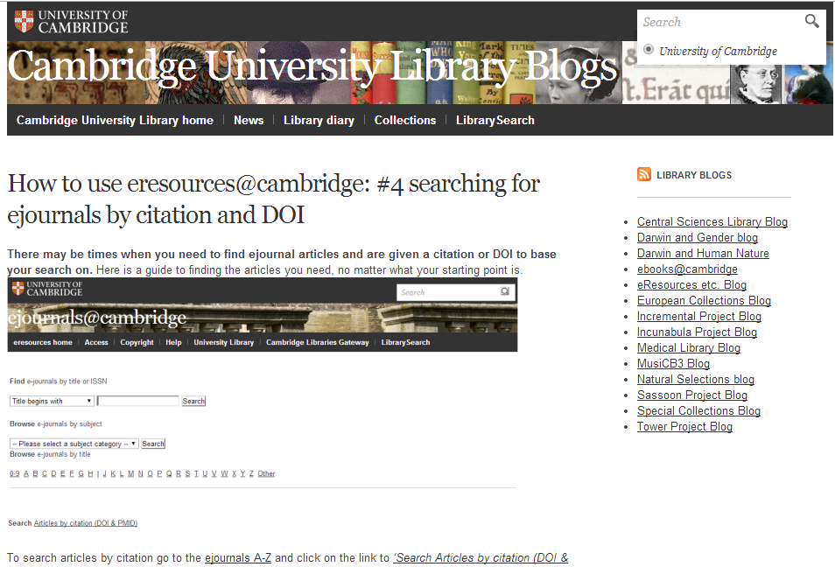

Slide 56
WorldCat
ArchivesGrid
Metadata
Summon
Scirus
Blogs
Suncat
Europeana
RSS
Catalogue
Ethos
Mobilepp
Proxy Toolbar
Dspace
Linked Data (Catalog)
OAI-PMH (Dspace)
Discovery
Services
Proxy Widgets
External Syndication
Library APIs
Z39.50
Data
Jorum
Digital Archive

Slide 57
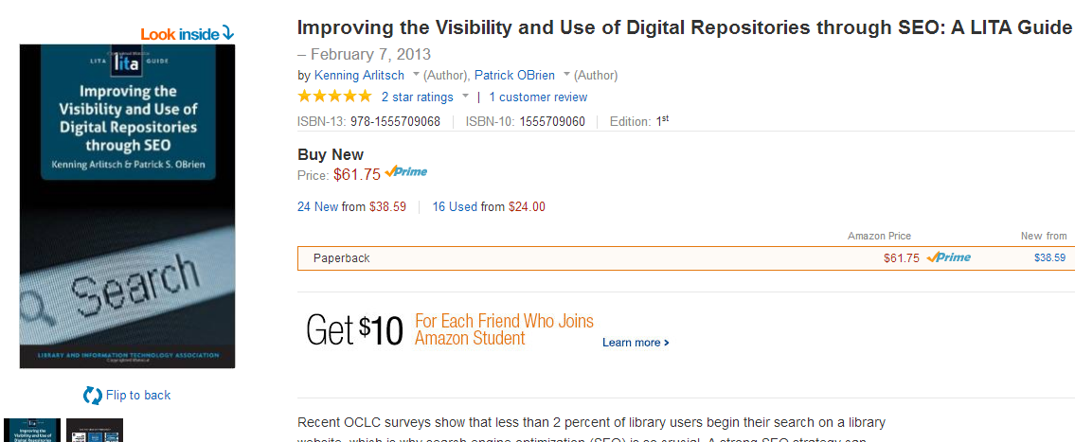

Slide 58
Are library resources visible where people are doing their work, in the search engines, in citation management tools, and so on?
Is library expertise visible when people are searching for things? Can a library user discover a personal contact easily? Are there photographs of librarians on the website? The University of Michigan has a nice feature where it returns relevant subject librarians in top level searches.
Are there blogs about special collections or distinctive services or expertise, which can be indexed and found on search engines? Are links to relevant special collections or archives created in Wikipedia. Can researchers configure a resolver in Scholar, Mendeley or other services?
As attention shifts from collections to services, are library services described in such a way that they are discoverable? On the website? In search engines? Is SEO a routine part of development? Schema?
Is metadata for resources shared with all relevant services?
Discovery is more than the discovery layer.
Discovery often happens elsewhere.
Make institutional resources discoverable (inside-out).

Slide 59


Slide 60
Research, learning and information behaviors are shaping and being reshaped by the network.
Libraries are supporting these new behaviors and working to connect their services to these new environments.
This requires us to think about technology …. Differently.

Slide 61
Credits
Arlitsch, K., Obrien, P., Clark, J. A., Young, S. W., & Rossmann, D. (2014). Demonstrating Library Value at Network Scale: Leveraging the Semantic Web With New Knowledge Work. Journal of Library Administration, 54(5), 413-425.
(Carr, 2014) EPrints Update, Les Carr, University of Southampton, Repository Fringe, 2014
http://www.slideshare.net/repofringe/e-prints42y
(de Belder, 2013) Transformation of the academic library Kurt de Belder http://www.oclc.org/content/dam/research/events/dss/ppt/dss_debelder.pptx
(Dempsey, Malpas & Lavoie) Collection Directions. portal: Libraries and the Academy, 14, 3 (July 2014), 393–423.
http://www.oclc.org/content/dam/research/publications/library/2014/oclcresearch-collection-directions-preprint-2014.pdf
(Dempsey & Walter, 2014) A Platform Publication for a Time of Accelerating Change. College & Research Libraries, 75, November 2014: 760-762.
GapingVoid. http://gapingvoid.com/
(Lavoie et al, 2014) The evolving scholarly record.
http://oclc.org/content/dam/research/publications/library/2014/oclcresearch-evolving-scholarly-record-2014.pdf
(Salo, 2008) Salo, D. (2008). Innkeeper at the roach motel. Library Trends, 57(2), 98-123.
Visitors and residents
http://oclc.org/research/activities/vandr.html
Quote from: Connaway, L. S., Lanclos, D., & White, D. (2012). Some people visit the web, some people live there: The effect of online residency on digital literacies. Presented at EDUCAUSE 2012, November 9, 2012, Denver, Colorado

