Slide 1
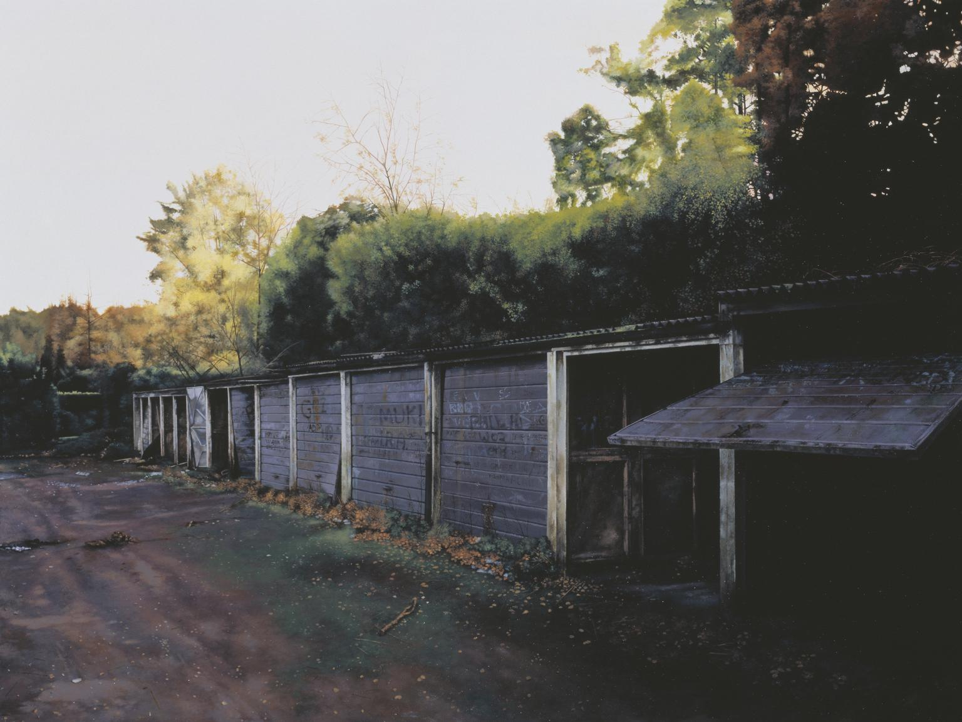
http://events.arts.ac.uk/event/2015/6/4/George-Shaw-The-Last-Days-of-Belief-/
Lorcan Dempsey, Constance Malpas & Brian Lavoie
OCLC
@LorcanD
Collections unbound:
Collection directions and the RLUK collective collection
RLUK Member’s meeting, 20 November 2015. University of Warwick.

Slide 2
Overview

Slide 3
4 contexts
3 trends
1 project

Slide 4
4 contexts

Slide 5
1
The logic of print distribution influenced library development:
Close to user – multiple library collections.
Big = good.
Just in case.

Slide 6
The bubble of growth in twentieth-century
printed collections has left … librarians
with a tricky problem.
Barbara Fister New Roles for the Road Ahead:
Essays commissioned for ACRL’s 75th Birthday

Slide 7
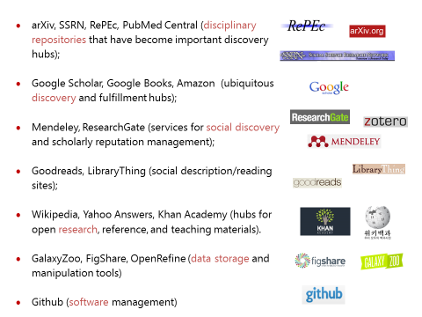
2
An abundance of resources in the network world

Slide 8
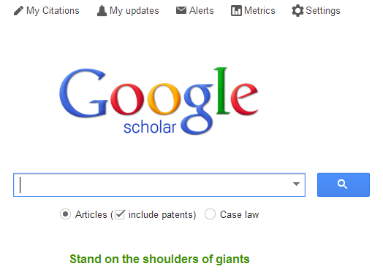
3
Discovery moved to the network level
Peeled away from local collection
“Discovery happens elsewhere”

Slide 9
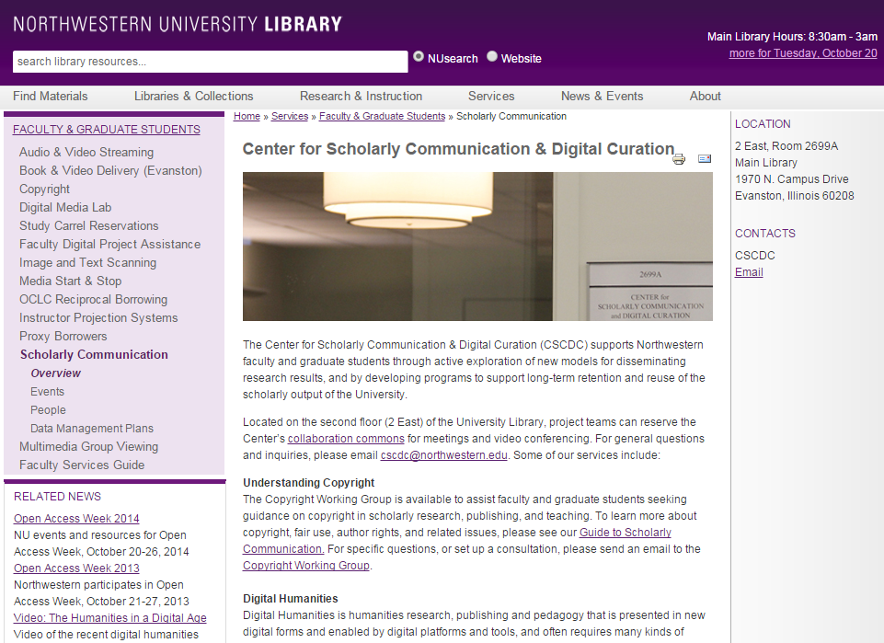
4
From consumption to creation:
Support process as well as product.
Workflow is the new content..
Support for publishing and digital scholarship.
An inside out perspective increasingly important.

Slide 10
http://www.against-the-grain.com/2012/11/a-publishers-new-job-description/
Her view is that publishers are here to make the scientific research process more effective by helping them keep up to date, find colleagues, plan experiments, and then share their results. After they have published, the processes continues with gaining a reputation, obtaining funds, finding collaborators, and even finding a new job. What can we as publishers do to address some of scientists’ pain points?
Annette Thomas,
CEO of Macmillan
Publishers (now Chief Scientific Officer Springer Nature)
A publisher’s new job description

Slide 11
3 trends

Slide 12
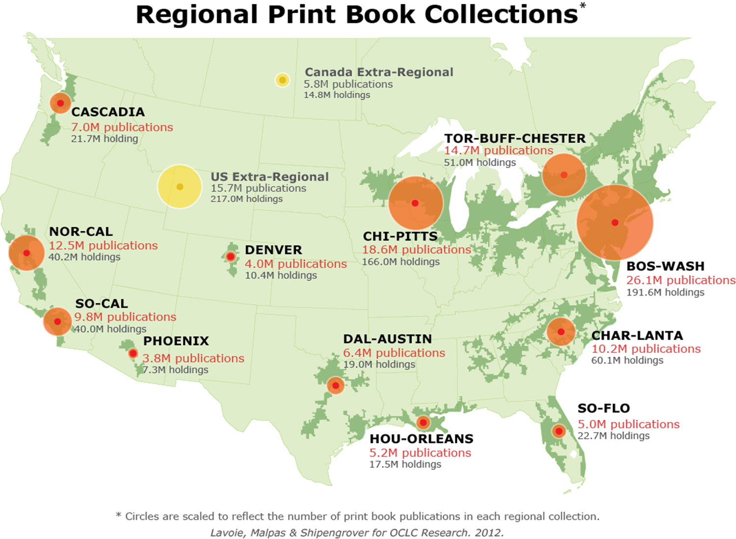
1
Strategic management of the collective print collection
Managing down print.
Emerging shared infrastructure and collective action.
Variable mission to collect/preserve.
Space reconfigured around experiences rather than collections.

Slide 13
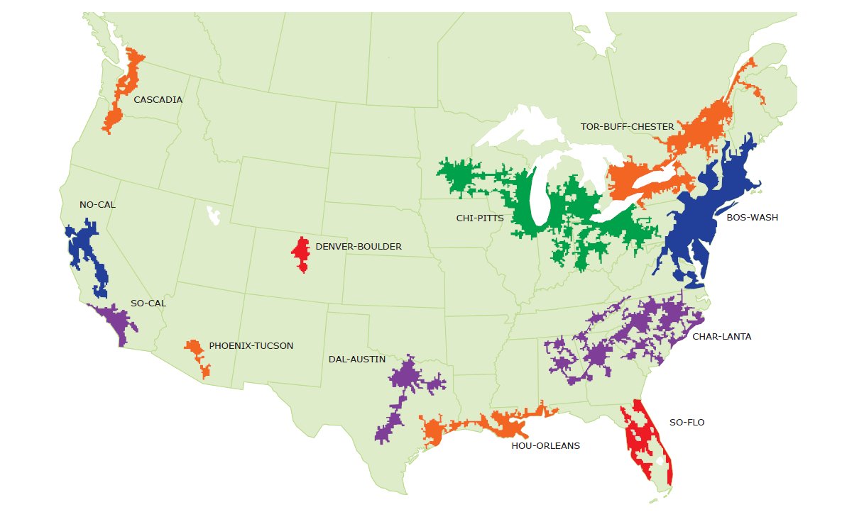
Mega-regions & Shared Print Initiatives
Orbis-Cascade
OCUL
MSCS
WEST
CIC
SCELC
WRLC
GWLA
ASERL
FLARE
We expect that in 5-7 years the larger part of the North American ‘collective collection’ will have moved into shared management.
OCLC Research, 2013

Slide 14
Strategic management of the shared print collection Then: Value relates to depth and breadth of local collection. Now: Value relates to systemwide curation of and access to print collections – ‘rightscaling’.

Slide 15
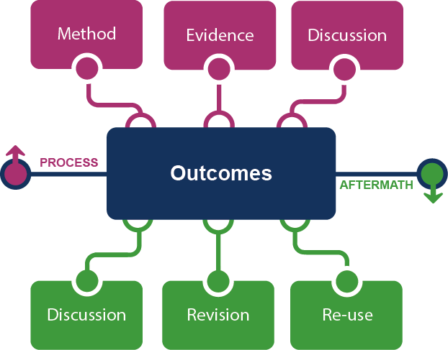
2
From curation to creation
The emerging scholarly record.
Workflow is the new content.
Process and product.

Slide 16
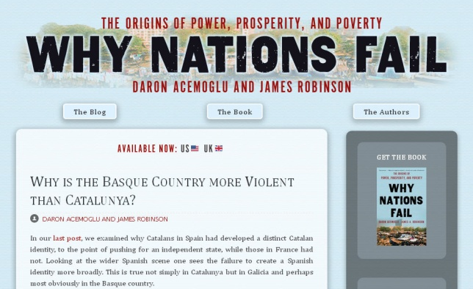

Slide 17
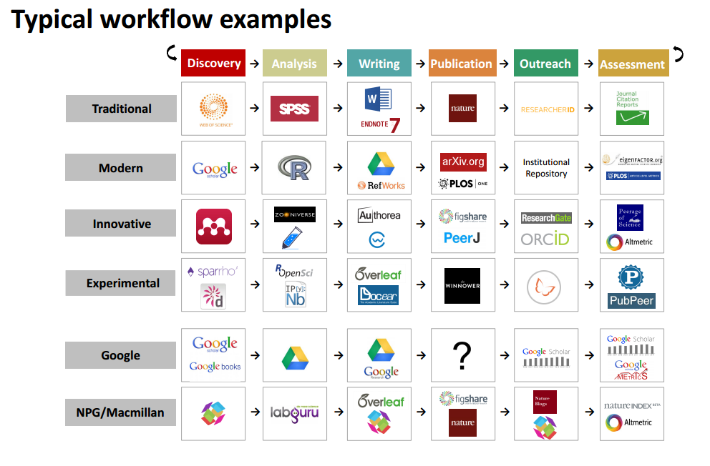

Slide 18
From curation to creation Then: Value relates to management of the ‘products’ of research. Now: Value relates to support of productivity and process of research and learning.

Slide 19
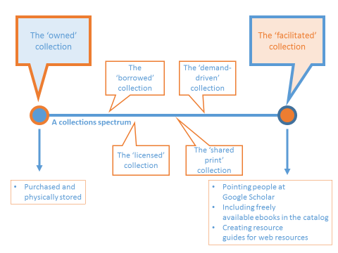
3
From owned/licensed to facilitated.
Organized around user needs
Curation is community oriented?
Inside out vs outside in.

Slide 20
Catalog
KB/Discovery
LibGuides, etc
Google, ResearchGate, etc …
Separation of discovery and collection?:
Focus shifts from owned to facilitated (available)?
More emphasis on making institutional resources discoverable?
Systemwide thinking becomes stronger?
Owned
Licensed
Available
Global
Figure: Discoverability redefines collection boundaries.
OCLC Research, 2015.

Slide 21
Towards facilitated collection Then: Value relates to locally assembled collection. Now: Value relates to ability to efficiently meet a variety of research and learning needs.

Slide 22
1 project

Slide 23
The RLUK Collective Collection
A joint initiative of RLUK and OCLC Research
Goal:
Explore characteristics of aggregate RLUK bibliographic resource in context of members’ strategic priorities
Powered by WorldCat:
Leverage distinctive data-driven, multi-scalar (local, group, global) perspective of OCLC’s international union catalogue
Building on foundations:
Complement and advance recent OCLC Research work on collective collections & shared print
Community engagement:
Refine analysis via consultation with RLUK advisory group

Slide 24
RLUK Advisory Group
Janet Aucock | University of St Andrews
Suzy Cheeke | University of Bristol
Sue Elphinstone | University of York
Gill Hamilton | National Library of Scotland
Frances Machell | University of Birmingham
Victoria Parkinson | King’s College London
Laura Shanahan | University of Edinburgh
June Tomlinson | Wellcome Library
David Prosser | RLUK

Slide 25
OCLC and shared print
Research focus – systemwide
Service focus – library and group
Highlight features of the collective collection
Establish systemwide evidence base to inform decision-making
Accelerate collaborative action
Increase confidence in community planning and directions
Visualise and model collections
Support ‘above the institution’ collection management
Make the shared print workflow less labor-intensive
Use data to support and supplement the expertise of librarians and faculty

Slide 26
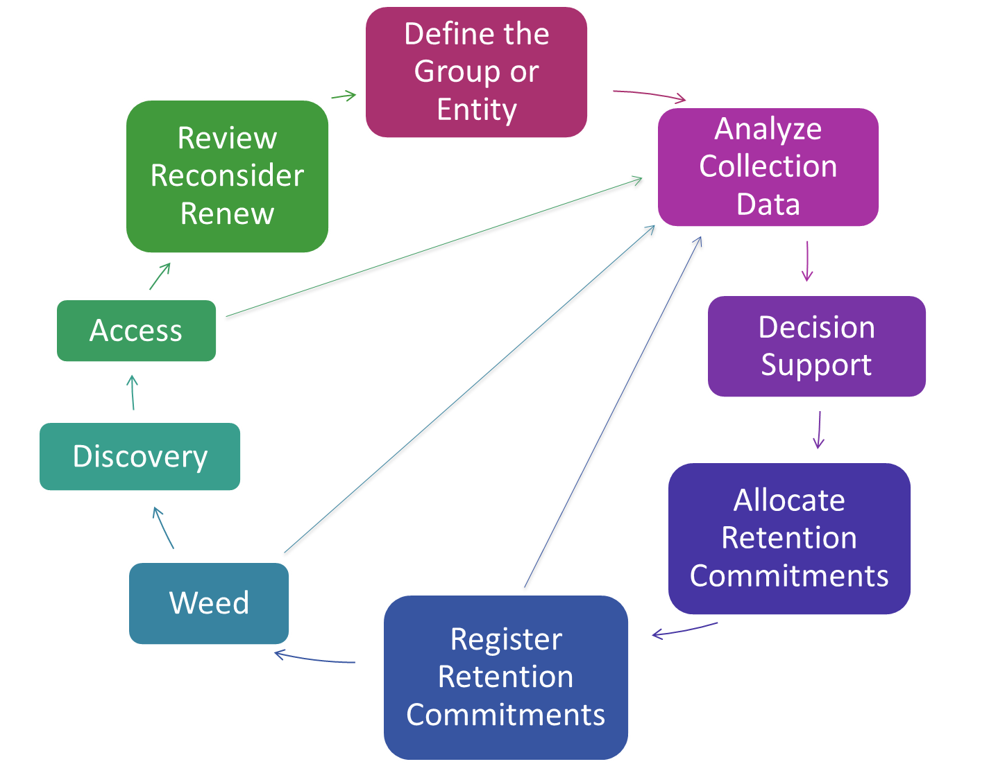
Sustainable Collection Services
GreenGlass

Slide 27
Impact
“Perhaps the most influential descriptive studies have come from OCLC Research, which has now shared reports outlining both levels of uniqueness as well as duplication among various aggregations of library collections. This growing body of computationally intensive analysis of the collective collection has also begun to clarify geographic distribution and other key characteristics of library collections relevant for decision making around coordinating activities. There is new understanding of collections at scale.”
Karla Strieb, Ohio State University
Collaboration: The Master Key to Unlocking 21st Century Library Collections

Slide 28
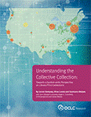
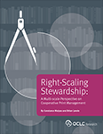
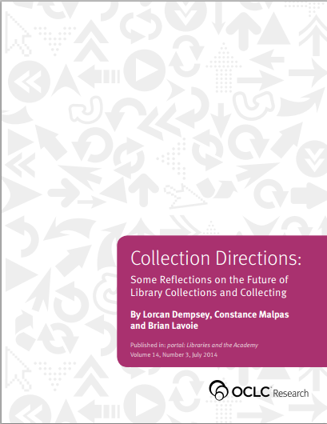
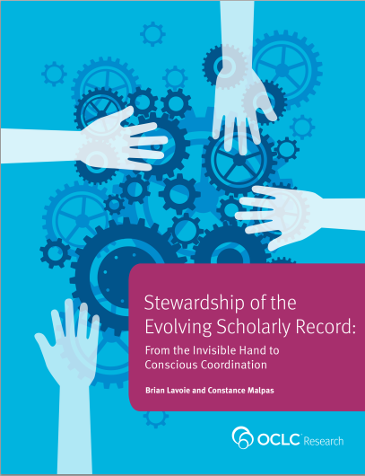
Some outputs

Slide 29
Collective Collections … in Europe
Collective print book collection
Collective collection (all materials)
Collection overlap across libraries within group
Patterns of shared collection investment
Important collection differentiators
Comparison to peer collective collections (e.g. ARL, other European research libraries)
Overlap with international digital repositories (e.g. HathiTrust)
Extend geographic focus of our collective collection work
Provide intelligence about collective holdings to support strategic planning

Slide 30
A note on data sources
Preliminary analysis based on 34 RLUK library symbols in WorldCat, representing 32 RLUK institutions
Several institutions have very low holdings in WorldCat that could be addressed through reclamation projects, e.g. Exeter, Newcastle, Nottingham, Senate House, Southampton, York.
A few RLUK institutions won’t be included: National Library of Wales, Queens University Belfast
University of Leicester, University of Reading, and Royal Holloway joined RLUK after project started and are not represented here.
Data reported here is based on preliminary analysis; figures will change as more data becomes available.

Slide 31
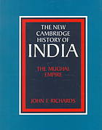
RLUK Collective Collection: anecdotally speaking
?
Most widely held (in RLUK) monographic titles:
Meadows, Donella H., Dennis L. Meadows, and Jørgen Randers. 1992. Beyond the limits: global collapse or a sustainable future. London: Earthscan Publications
Richards, John F. 1993. The Mughal Empire. Cambridge: Cambridge University Press
Miles, Matthew B., and A. M. Huberman. 1994. Qualitative data analysis: an expanded sourcebook. Thousand Oaks: Sage Publications.

Slide 32
RLUK Collective Collection: anecdotally speaking
?
Ranked order of UK ‘minority language’ titles:
Welsh 55,759 titles
Irish 18,593 titles
Scottish Gaelic 6,267 titles
Scots 2,964 titles
Cornish 338 titles
Manx 183 titles

Slide 33
RLUK Collective Collection: Top Work*
Works with the greatest number of editions in RLUK libraries
Oliver Goldsmith. The vicar of Wakefield. 1,025 editions
John Milton. Paradise lost. 951 editions
John Bunyan. The pilgrim’s progress. 917 editions
Lewis Carroll. Alice’s adventures in Wonderland. 877 editions
Dante. The divine comedy. 754 editions
James Thomson. The Seasons. 712 editions
Torquato Tasso. Jerusalem delivered. 663 editions
Terence. Comedies. 645 editions
Virgil. Works. 629 editions
Laurence Sterne. A sentimental journey. 590 editions
*excluding the Bible

Slide 34
RLUK Collective Collection: Scope
77%
works with single
edition
28M titles/manifestations*
19M
creative works
28M titles*
19M
creative works
23%
works with 2+ editions
Avg. = 1.5 manifestations/editions per work
*distinct publications; de-duplicated OCLC numbers
Data current as of September 2015

Slide 35
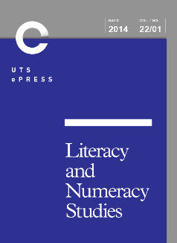
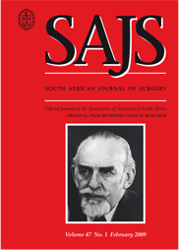
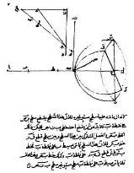
RLUK Collective Collection: Material types
5% serials
5% musical scores
3% maps, visual resources, computer files, etc.
87% books
(includes print, audio books, e-books)
Data current as of September 2015

Slide 36
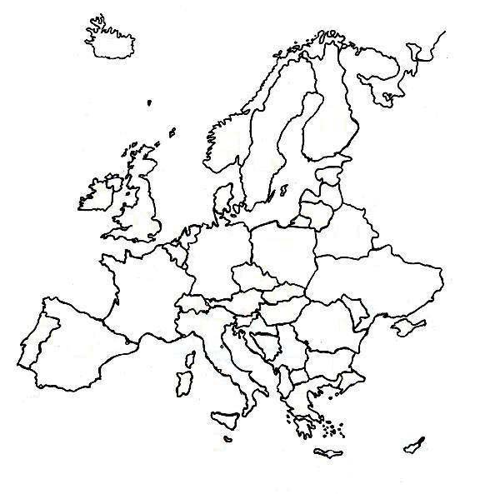
RLUK Collective Collection: Places of publication
Top 10 countries
1%
36%
.
.
13%
2%
.
6%
.
5%
.
2%
1%
.
India:
Russia:
2%
1%
Data current as of September 2015
Notes:
Would be good to compare this to ARL

Slide 37
RLUK Collective Collection: Size
57M holdings in RLUK libraries
980M holdings in WorldCat
28M titles*
Avg. = 2 RLUK holdings per title
Avg. = 35 WorldCat holdings per title
*distinct publications; de-duplicated OCLC numbers
Data current as of September 2015

Slide 38
RLUK Collective Collection: Duplication rates
N = 28M
90% scarce, distinctive at RLUK scale
WorldCat Duplication of RLUK-held Titles
N = 28M
60% scarce, distinctive at WorldCat scale
Data current as of September 2015

Slide 39
?
…which RLUK contributed record has garnered the most holdings in WorldCat
contributed by the British Library in 2010
used as source copy by >3000 libraries
Data current as of September 2015

Slide 40
Next steps
Complete preliminary analysis; consult with RLUK advisory group | November/December 2015
Update/finalise analysis when reclamation are complete | 1st Quarter 2016 (January – March)
Publish report, including analysis, inferences and observations (not prescriptive recommendations) | April/May 2016
We welcome feedback | Contact malpasc@oclc.org to be added to project listserv

Slide 41
The end

Slide 42
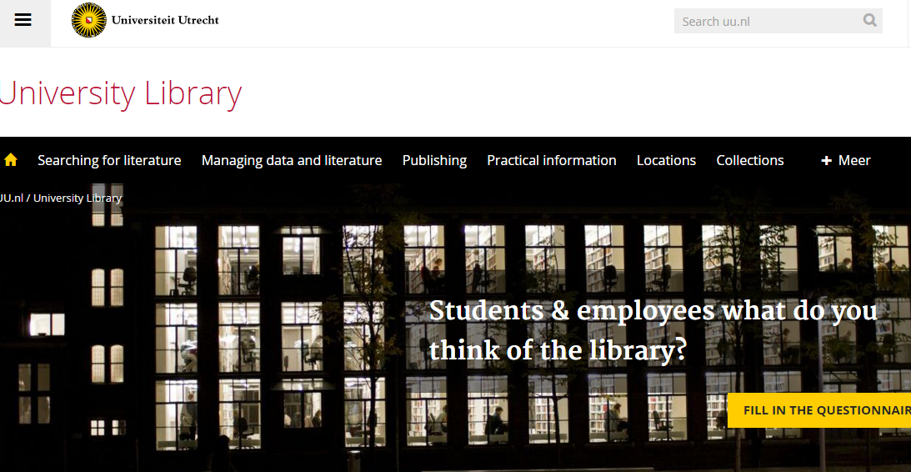
Discovery at network
level
Support for research/creation
Space
Local collections

