Slide 1
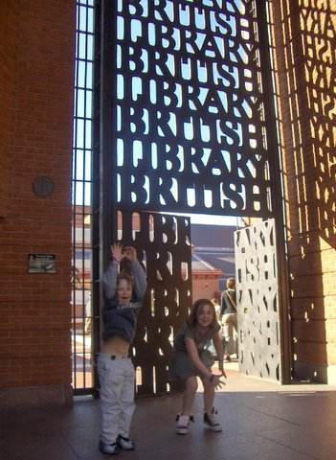
@LorcanD
Lorcan Dempsey OCLC
RLUK Conference, 2018. British Library, London
WORKSHOP – BUILDING SHARED CAPACITY: COLLABORATIVE LIBRARY DIRECTIONS IN THE UK

Slide 2
Insert succinct description of
environmental pressures here …
Downward pressure on public funding,
Changes in research and learning behaviors,
Complex information environment – public policy, evolving suppliers, expectations, …
What matters most now is our ability to manage continuing demand for the things that once wholly defined us, while moving rapidly, and at scale, into the broader range of products, services and skills demanded by our researchers and students. (U Manchester Library Strategic Plan, 2018-21)

Slide 3







Preview: Sourcing & scaling choices (Report #4)
Cooperatively/group
sourced
3rd-party
sourced
Locally sourced
Rightscaling (storing, discovery)
Sourcing
Control vs efficiency
4 different universities, 4 different approaches to sourcing Curation services.
Choices impacted by internal & external context.

Slide 4

Locally
assembled
collections.
The place to go.

Slide 5



Patterns of shared activity
National
Consortial
Third party
Hierarchy
Network
Market

Slide 6
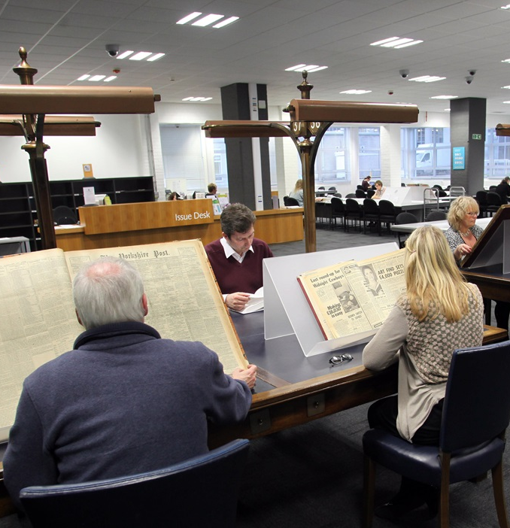


A history of UK shared library infrastructure in three pictures
https://www.bl.uk/visit/reading-rooms/boston-spa
By Chris Downer, CC BY-SA 2.0, https://commons.wikimedia.org/w/index.php?curid=13549360

Slide 7




Scaling capacity
Scaling learning
Scaling innovation
Scaling influence

Slide 8

Scaling capacity
Scaling learning
Scaling innovation
Scaling influence
Impact and efficiency
Shared infrastructure
Negotiation,
R-infrastructure,
Collective collection, …

Slide 9



Scaling influence
Scaling capacity
Scaling learning
Scaling innovation
Advocate for user and library interests in an increasingly complicated environment.
Open access,
Value and values, …

Slide 10
Actively mobilize networks of shared practice to address challenges as research and learning behaviors change in a network environment.
Evidence and arguments,
Pool uncertainty,
Diffuse and embed innovation …
“When the rate of change inside an organization becomes slower than the rate of change outside, the end is near.”
Jack Welch
Getty Images Entertainment, Mike Coppola
Scaling learning
Scaling innovation
Scaling capacity
Scaling influence
Notes:
Jack Welsh quote
Don’t fear change. embrace failure, but fail fast and fail smart. 9 out of 10 start-ups fail. Do you know the top reason cited? Lack of a market need for their product – a focus inward versus a focus on the customer.

Slide 11


Scaling capacity
Scaling learning
Scaling innovation
Scaling influence

Slide 12
People and politics
Soft powers
Role of consortia:
Vs public and market
Emergence and design

Slide 13
Building Shared Capacity: Collaborative Library Directions in the UK (Observations of an Ageing Librarian)
John MacColl, University of St Andrews RLUK Annual Conference, British Library, March 2018

Slide 14
Scale and overlap: the UK
Jisc
British Library
National Library of Scotland
National Library of Wales
Trinity College Dublin
Oxford University Library
Cambridge University Library
Regional/ Devolved nation group
RLUK
SCONUL

Slide 15
Collaboration and the UK
In the university sector we have a spectrum of funding models from near-private to near-fully public
This makes us different from the US (many leading libraries in fully private institutions) and from much of Europe (many leading libraries in fully public institutions)
It removes us from government oversight
Jisc is a good model, but its costs are not real
Regional efforts are variable and not well joined-up
A proliferation of overlapping governance arrangements (BL; Jisc; SCONUL; RLUK)
Can we leverage one governance model for the UK?
The BL is a shining example of collaborative infrastructure – created by unitary leadership

Slide 16
Prospects for new collaborations
What could we do with unitary governance?
Shared print (see the OCLC report on the UK’s ‘collective collection’)
Shared RDM; preservation services
Shared OA: services built around CORE
Imagine if the UK-based participants at this conference were designing an optimised infrastructure for the UK
Imagine each of us spending 10% of our operational budgets on this service
What would it look like?
Or are we just fine as we are?
Happier to talk about collaboration than to realise it?

Slide 17
A scenarios exercise
Pull together a group from the BL, Jisc, RLUK, SCONUL, the copyright libraries
Have them identify missing national infrastructure by addressing this question:
What do we not have, in our individual libraries, that we would like to have?
An engine that just works …
Is collaborative effort the way to get it?
If so, how do we go about it?

Slide 18
Have we lost the collaborative urge?
Mission diversification
REF-obsession
Vendor dominance
Discipline dilemma: heterogeneity
Portfolio spread, leading to single issue focusing (Open Access; UK-SCL; Research Data Management; Research Information Management)
Solutions plurality (eg Gold? Green? Or something in between? Do we know what we want?)
Lack of a body with resources for leadership (BL; Jisc)

Slide 19
Is soft power the new frontier for library collaboration?
The UK is like the international landscape in miniature: a variety of funding models, policy environments and governance arrangements
We seek the levers of power and influence: RLUK often has to concentrate on the Russell Group; cf ARL and the Ivy League or ‘Ivies Plus’
This results in occasional successes with particular campaigns
Can we develop a sustained, authoritative voice, that could command the attention of the academy at all levels?
Success would be VCs and Directors of Funding organisations coming to us to hear the research library view. Too often we have to push our way in

