Slide 1
Lorcan Dempsey Vice President, OCLC Research and Chief Strategist
January 2015
ALA Midwinter, Chicago, IL
OCLC Symposium:
Research in Context

Slide 2
Lorcan
2
Visitors and residents.
Shared print.
Evolving scholarly record.
1
Introduction
Research and advocacy at OCLC
3
Chrystie
Rooms that rock.
Outside the Box.
Supercharged Storytimes.
Notes:
Introduction – that’s the part we are in now

Slide 3
Knowledge
Plan with confidence
Evidence
Persuade with effect
Models
Make an impact

Slide 4
Visitors and residents
one

Slide 5
Our traditional model was
one in which we thought of
the user in the life of the library
… but we are now increasingly
thinking about the library
in the life of the user
Lorcan Dempsey

Slide 6
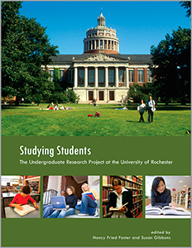
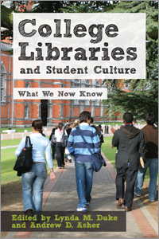

Slide 7
What people actually do, not what they say they do
The cost of context switching
Convenience
Workflow
Fragmentation is a deterrent
People like people
Relationship – sharing – engagement
Spaces and places
Different needs

Slide 8
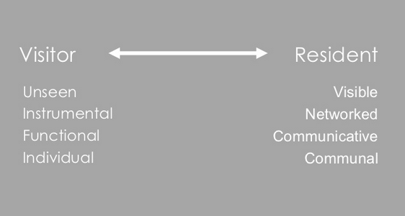
“Google doesn’t judge me” (UKF3)
#vandr

Slide 9
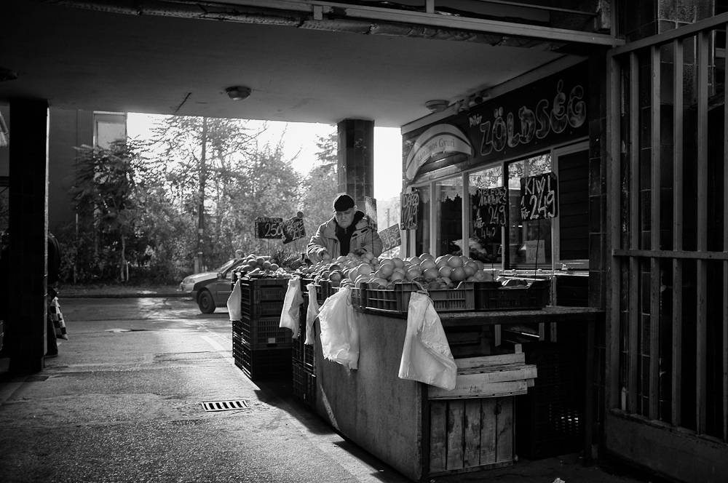
The Learning Black Market
“It’s like a taboo I guess with all teachers, they just all say – you know, when they explain the paper they always say, ‘Don’t use Wikipedia.’”
(USU7, Female, Age 19, Political Science)
Notes:
Image: http://www.deviantart.com/morelikethis/211376699
Covert online study habits
Wikipedia
Don’t cite
Widely used
Guilt
Students & teachers disagree
Quality sources
There is a “Learning Black Market”: learners use non-traditional sources but feel they cannot talk about them in an institutional context. Wikipedia usage is an example of this. (White & Connaway, 2011)
Connaway, Lynn Silipigni, Donna Lanclos, and Erin M. Hood. 2013. “I find Google a lot easier than going to the library website.” Imagine ways to innovate and inspire students to use the academic library. Proceedings of the Association of College & Research Libraries (ACRL) 2013 conference, April 10-13, 2013, Indianapolis, IN. http://www.ala.org/acrl/sites/ala.org.acrl/files/content/conferences/confsandpreconfs/2013/papers/Connaway_Google.pdf.
White, David. 2008. Not “natives’”& “immigrants” but “visitors’ & “residents.” TALL Blog: Online Education with the University of Oxford, April 23, http://tallblog.conted.ox.ac.uk/index.php/2008/07/23/not-natives-immigrants-but-visitors-residents/.
Saunders also found that faculty are “concerned with students’ reliance on Google and Wikipedia for information.” This may help to explain why many of the Emerging stage participants expressed a reluctance to acknowledge or cite Wikipedia in their work for fear of being ridiculed by faculty, or be given a lower grade. This is referred to as the Learning Black Market, which is discussed in more detail in Connaway, Lanclos, and Hood and White’s 2011 blog entry.
Saunders, Laura. 2012. Faculty perspectives on information literacy as a student learning outcome. The Journal of Academic Librarianship 38, no. 4 (2012): 231.

Slide 10
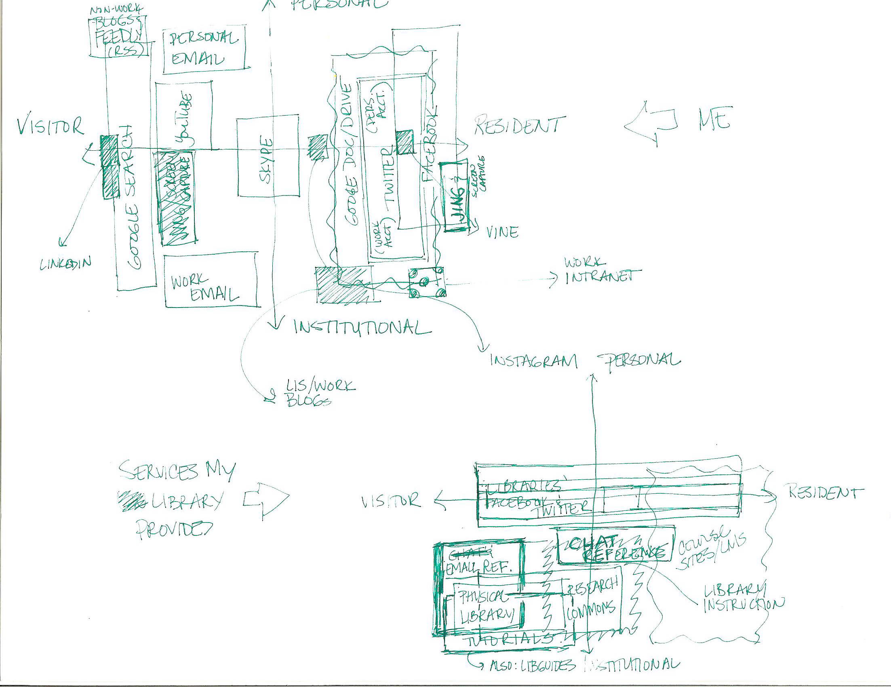

Slide 11
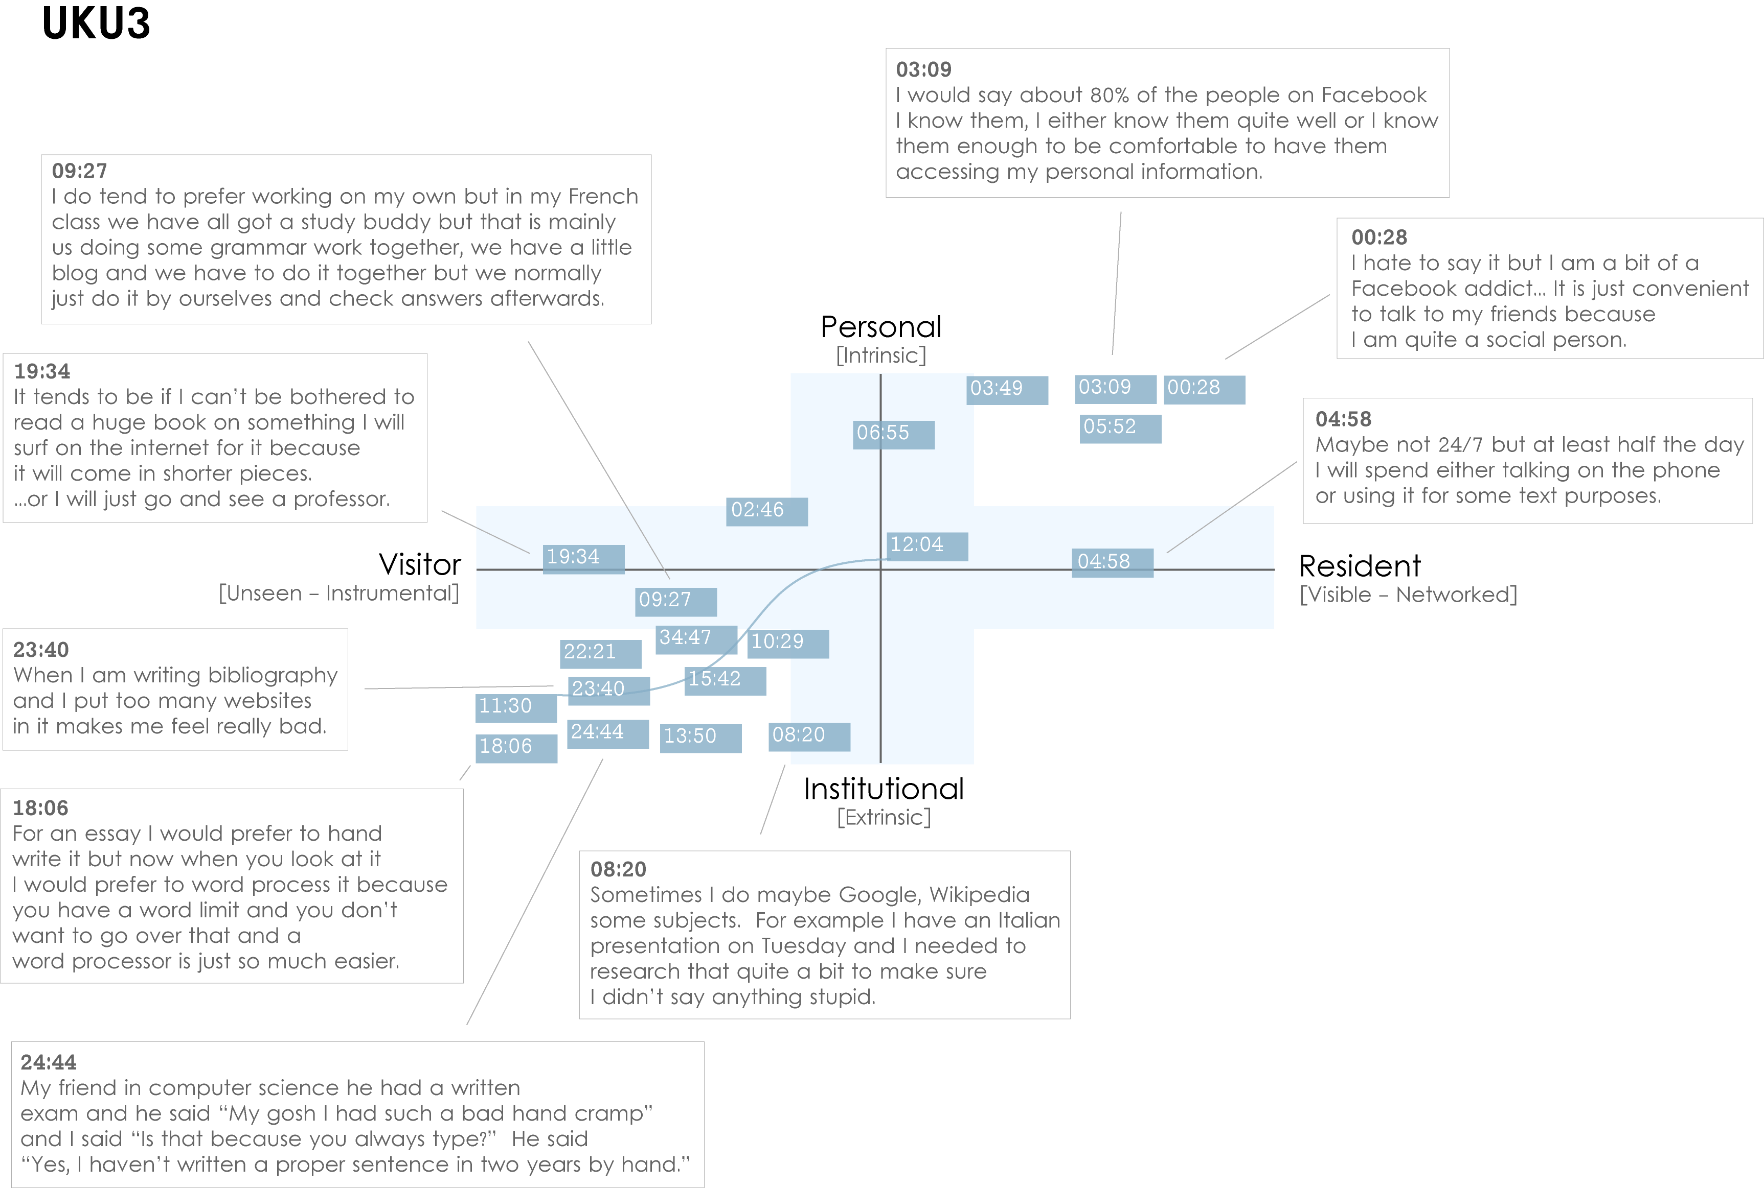
Notes:
Images created by David White, Co-manager, Technology Assisted Lifelong Learning, University of Oxford
Institutional Resident Gap
UKU3 (UK 1st year undergraduate)
This participant has a clear demarcation between Resident modes of engagement in her personal life and Visitor modes of engagement for study.
The map is a mode of engagement landscape onto which individuals can be plotted. The limits of the map have been defined by the four major framing concepts of the project: V&R – Personal and Institutional. The Personal end of the axis encompasses an individual’s private life, and the Institutional is their professional and/or academic life.
The data from the Emerging educational stage seem to suggest that individuals were engaging with systems and materials not provided by their institutions to do institutional work (e.g., consulting Wikipedia to write an essay). Such user-owned literacies, when mapped like this, take a prominent role in the academic work of many of our research subjects. Given the effect that the internet is having on collapsing the relationship between certain modes of activity and specific physical spaces, it is important not to tie notions of the intuitional and the personal to ideas of “school/university/library” and “home” as buildings.
White, D., & Connaway, L.S. Visitors & Residents: What Motivates Engagement with the Digital Information Environment. 2011-2012. Funded by JISC, OCLC, and Oxford University. http://www.oclc.org/research/activities/vandr/.

Slide 12
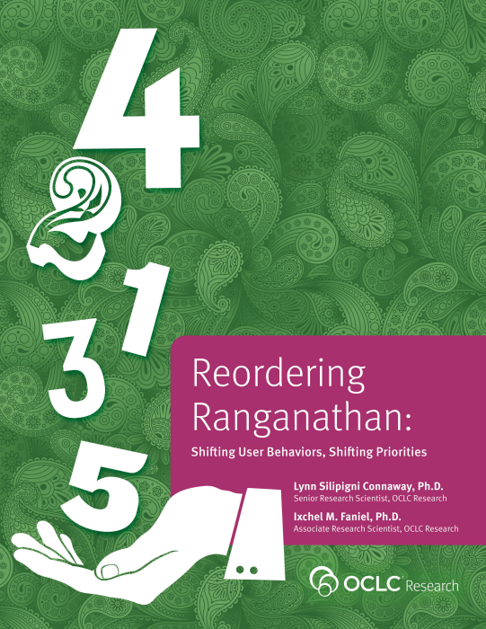
Investigate & describe user-owned digital literacies
Position the role of the library within the workflows & information-seeking patterns of students & faculty
Influence library’s design & delivery of physical spaces & digital platforms & services
The library in the life of the user …

Slide 13
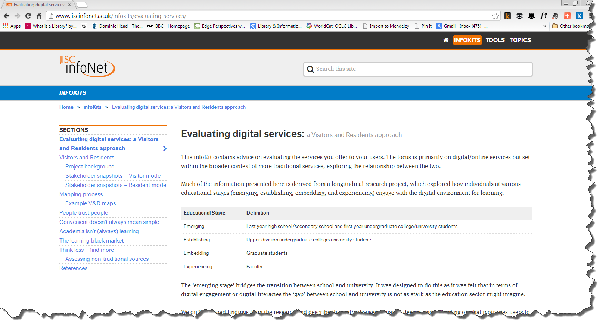

Slide 14
The evolving scholarly record
two

Slide 15
A publisher’s new job description
Her view is that publishers are here to make the scientific research process more effective by helping them keep up to date, find colleagues, plan experiments, and then share their results. After they have published, the processes continues with gaining a reputation, obtaining funds, finding collaborators, and even finding a new job. What can we as publishers do to address some of scientists’ pain points?
Annette Thomas,
CEO of Macmillan
Publishers
http://www.against-the-grain.com/2012/11/a-publishers-new-job-description/

Slide 17
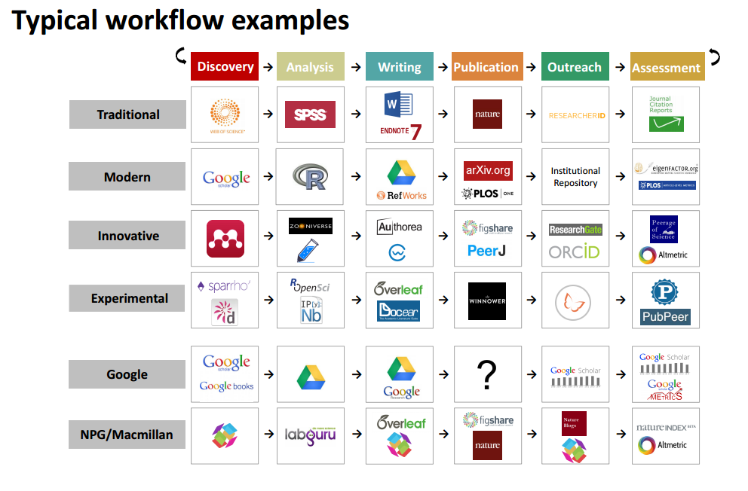

Slide 18
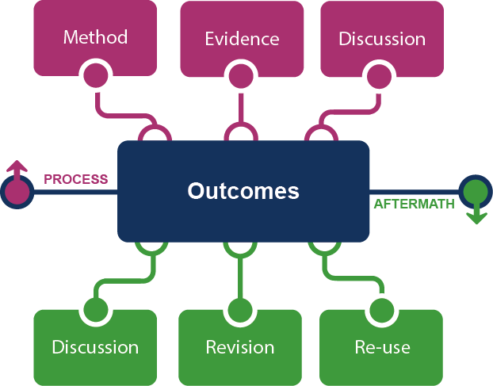
Framing the Scholarly Record …

Slide 19
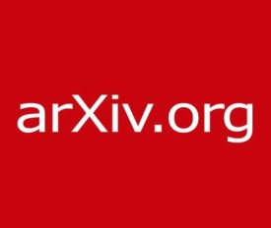
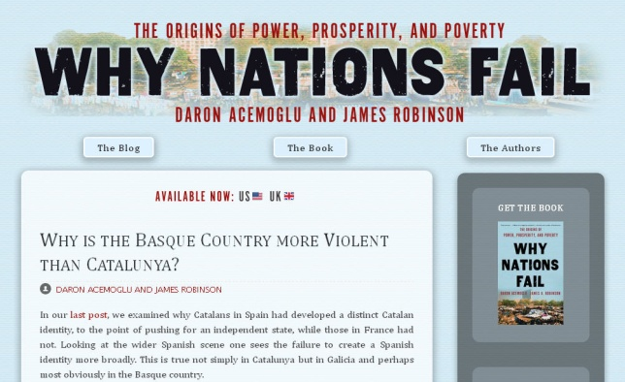
In practice …
Notes:
http://global.oup.com/uk/orc/busecon/economics/carlin/

Slide 20
Framing the stakeholder eco-system …
Fix
Collect
Create
Use

Slide 21
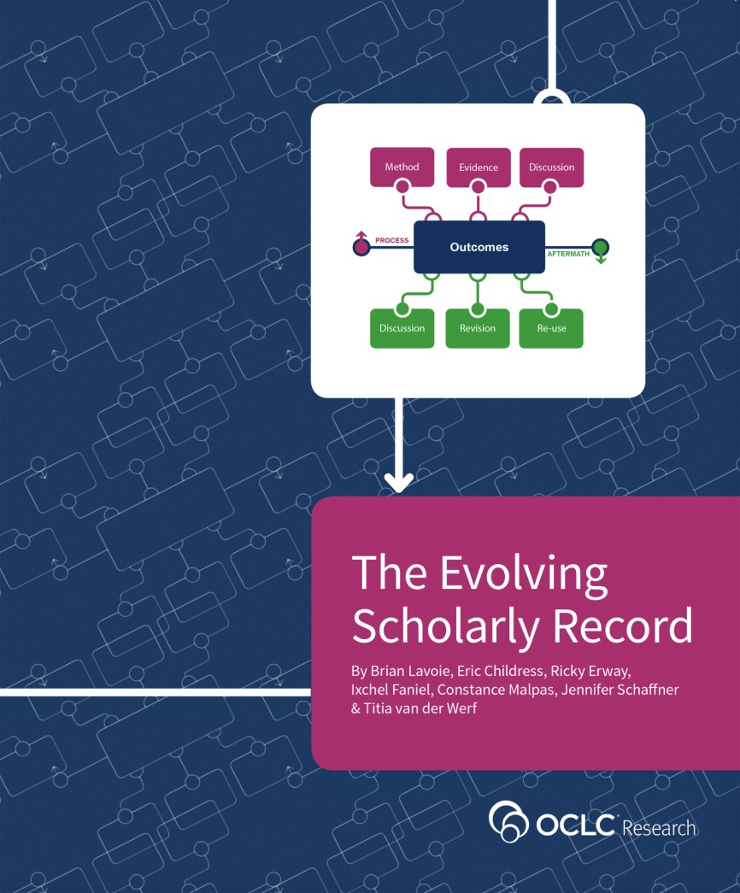
Frame the evolving scholarly record.
Share the model.
Use it to direct further work and collaboration.
Workflow is the new content …

Slide 22
Shared print
Three

Slide 23
The bubble of growth in twentieth-century printed collections has left … librarians with a tricky problem.
Barbara Fister New Roles for the Road Ahead:
Essays commissioned for ACRL’s 75th Birthday

Slide 24
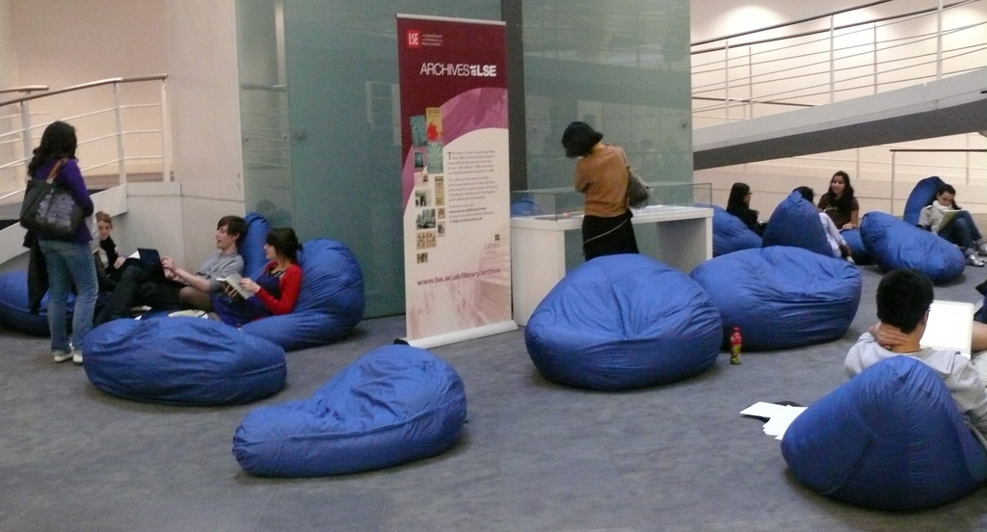
https://www.flickr.com/photos/lselearningspaces/4623536095/
Space is being reconfigured around learning and research
experiences rather than around collections.

Slide 25
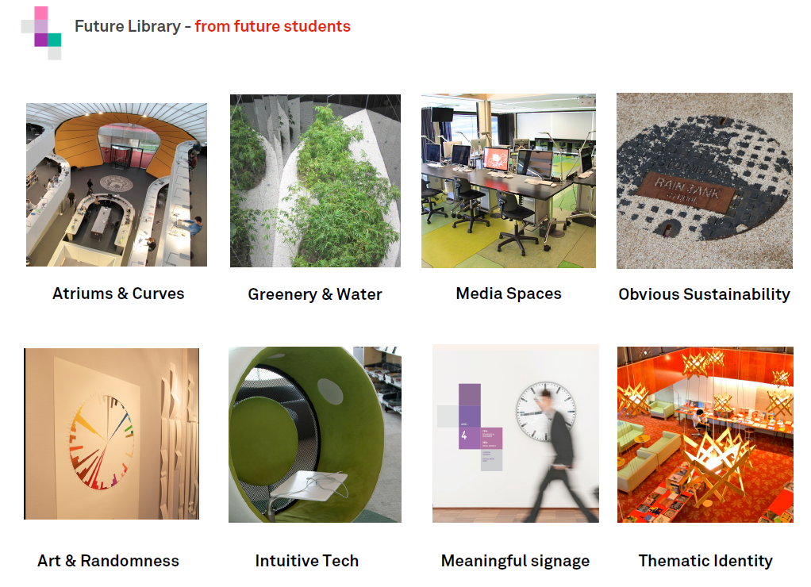
http://www.slideshare.net/malbooth/uts-future-library-more-than-spaces-technology
Mal Booth, UTS Library

Slide 26
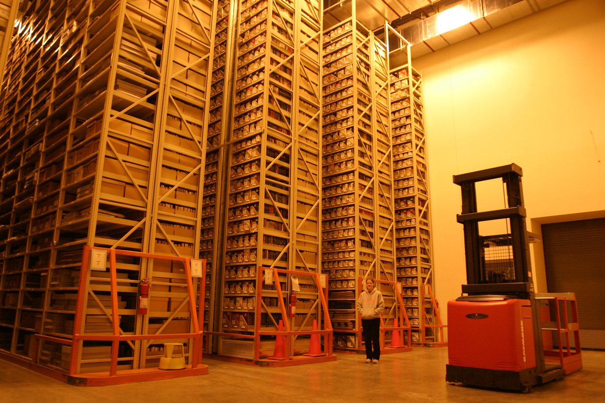
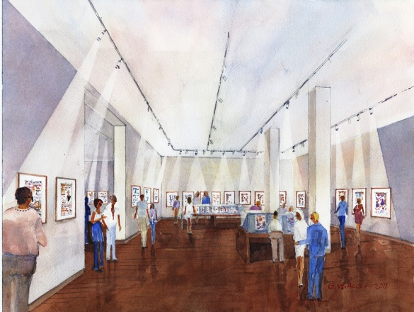
http://library.osu.edu/blogs/cartoons/2012/02/28/blog-launch-and-the-construction-of-our-new-home-in-sullivant-hall/

Slide 27
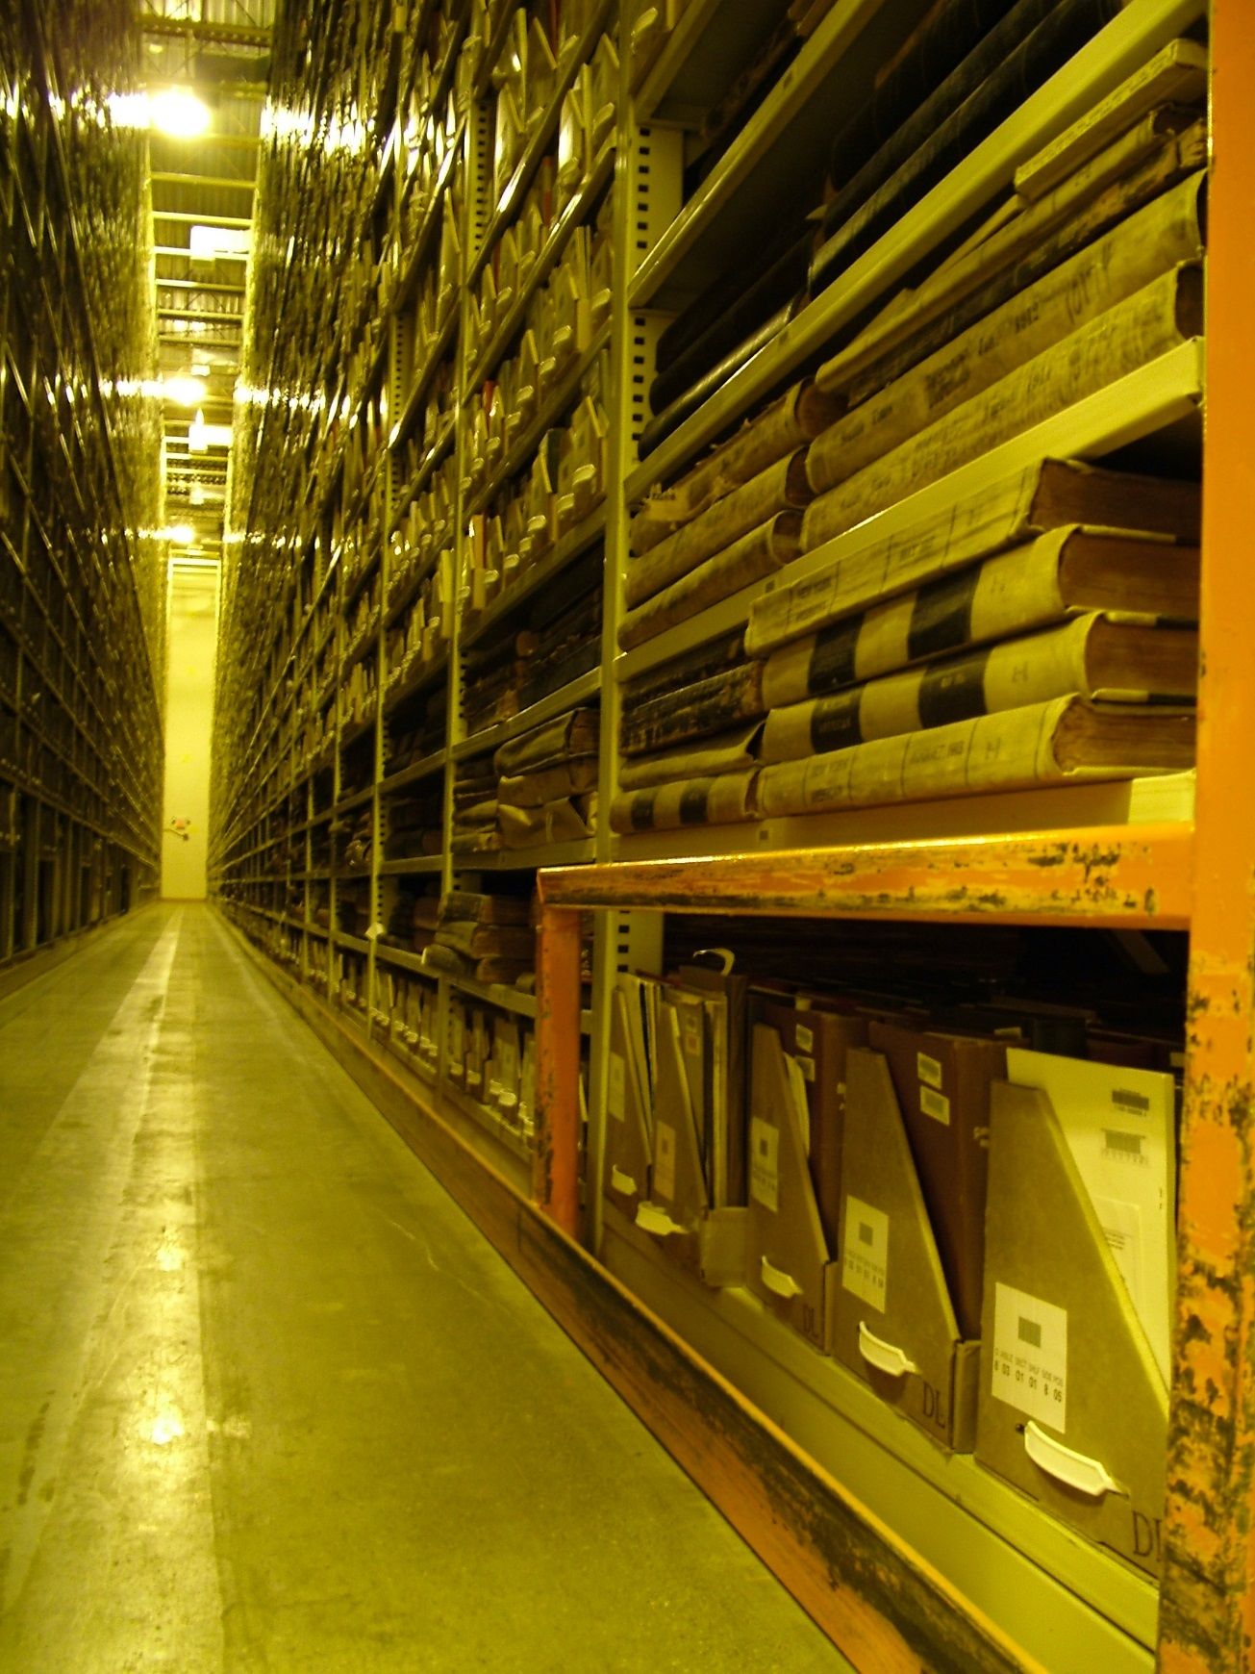
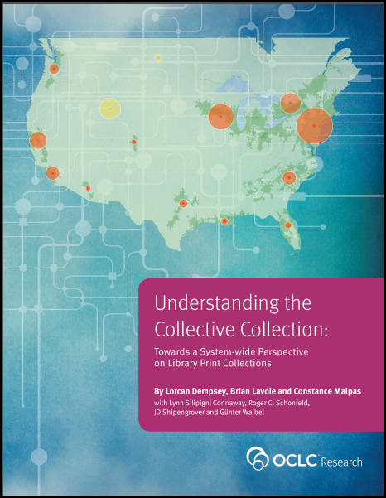
We anticipate that a large part of existing print collections, distributed across many libraries, will move into coordinated or shared management within a few years. OCLC Research has been working to develop an empirical foundation for this development based on its registry of library holdings, WorldCat.

Slide 28
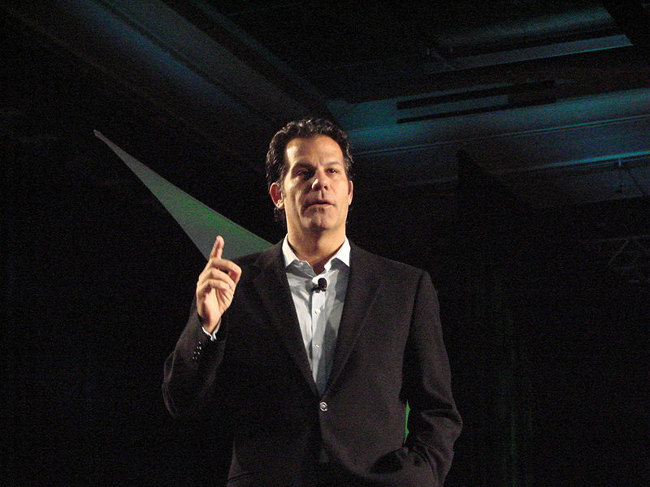
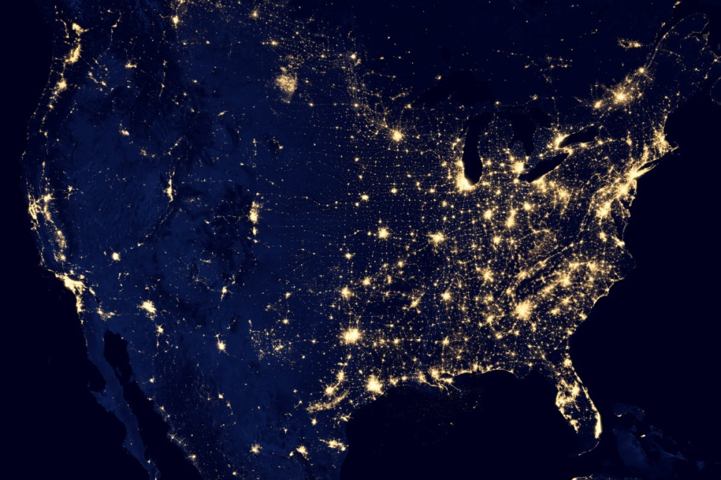
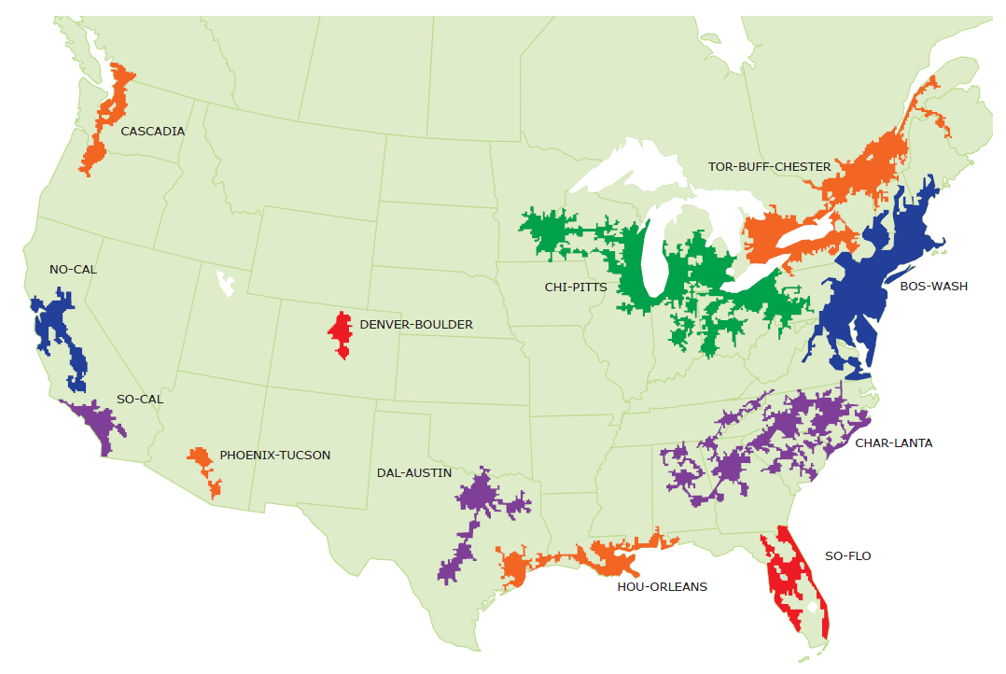
Geographic area defined by high level of economic integration, underpinned by robust supporting infrastructure (transportation, logistics, etc.)

Slide 29
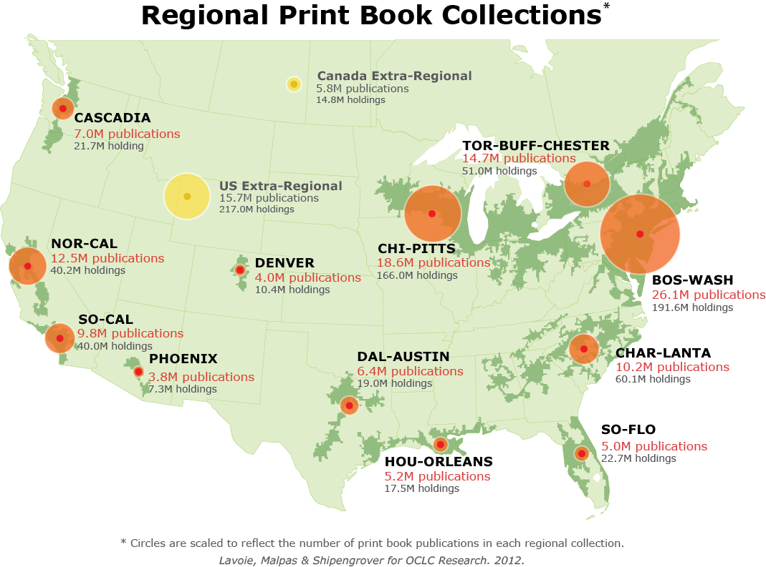
North American print book resource:
45.7 million distinct publications
889.5 million total library holdings
OCLC Research, 2013

Slide 30
Mega-regions & Shared Print Initiatives
Orbis-Cascade
OCUL
MSCS
WEST
CIC
SCELC
WRLC
GWLA
ASERL
FLARE
OCLC Research, 2013

Slide 31
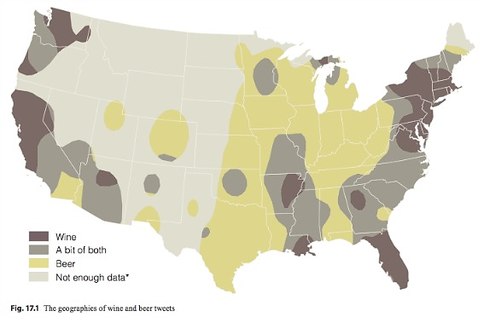
http://www.psmag.com/navigation/nature-and-technology/geography-beer-78105

Slide 32
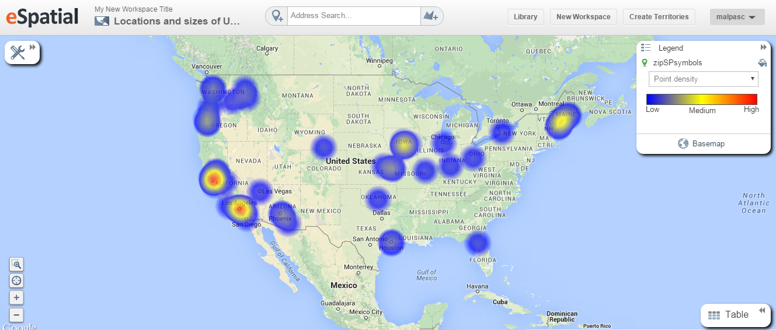
As of December 2014:
63 registered shared print repositories in WorldCat
High concentrations in NorCal, SoCal; other notable concentrations in Cascadia and ChiPitts megaregions

Slide 33
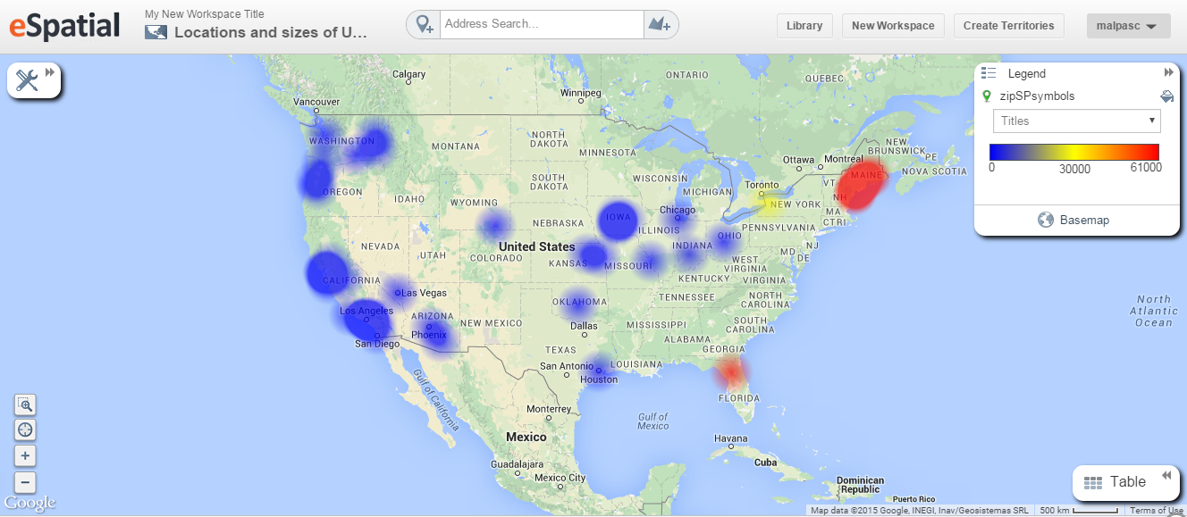
As of December 2014:
1.46 million titles held in shared print repositories
High concentrations in Maine, Florida and New York

Slide 34
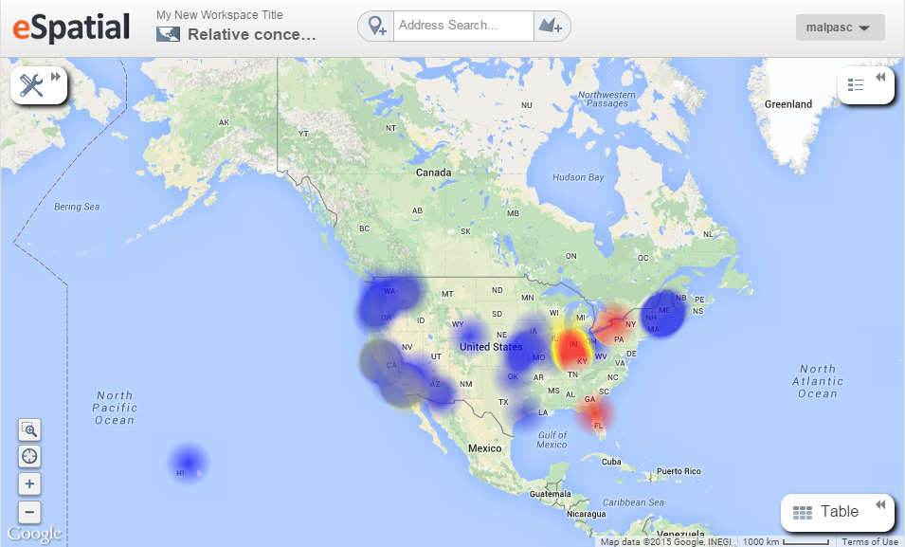
As of December 2014 :
54K serial titles held in shared print repositories
Primarily archived by CIC, CRL-JSTOR, Empire Shared Collections and FLARE programs

Slide 35
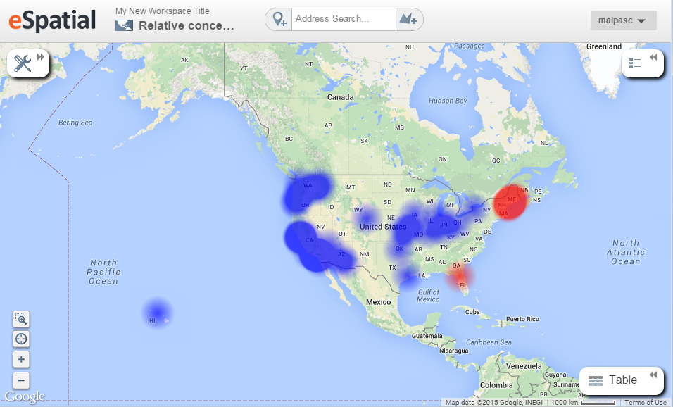
As of December 2014:
1.4 million monographic titles in shared print repositories
Primarily archived by Maine Shared Collections Strategy and FLARE programs

Slide 36
N = 1.92M shared print holdings
Based on WorldCat data as of December 2014.

Slide 37
‘Most widely preserved’ titles in collective shared print collection
Plan for shortening the time of passage between New York and London: with documents relating thereto, including the proceedings of the Railway Convention at Portland, Maine (1850) – held by 58 libraries; 8 shared print (14%); another edition with 21 holdings retained by 1 shared print repository (5%)
A.J. Coolidge. A history and description of New England, general and local (1859) – held by 76 libraries; 8 shared print (11%);
I.S. Proper. Monhegan, the cradle of New England (1930) – held by 94 libraries; 8 shared print (9%)
A.H. Chadbourne. Maine place names and the peopling of its towns (1955) – held by 116 libraries; 8 shared print (7%); 13 additional editions in shared print repositories
J.E. Mooney. Maps, globes, atlases, and geographies through the year 1800: the Eleanor Houston and Lawrence M.C. Smith Cartographic Collection at the Smith Cartographic Center, University of Southern Maine (1988) – held by 176 libraries; 8 shared print (5%)
Shared print holdings analysis provided by Constance Malpas, OCLC Research. Unpublished.

Slide 38
Challenging assumptions…
with evidence
Shared print is altering the library landscape
It affects the full spectrum of library materials – formats, languages, audiences
It concerns all segments of the library community
It is increasingly embedded in our shared bibliographic infrastructure
It will reshape the gamut of library operations – cataloging, collection management, resource sharing, public service and outreach

Slide 40
