Slide 1
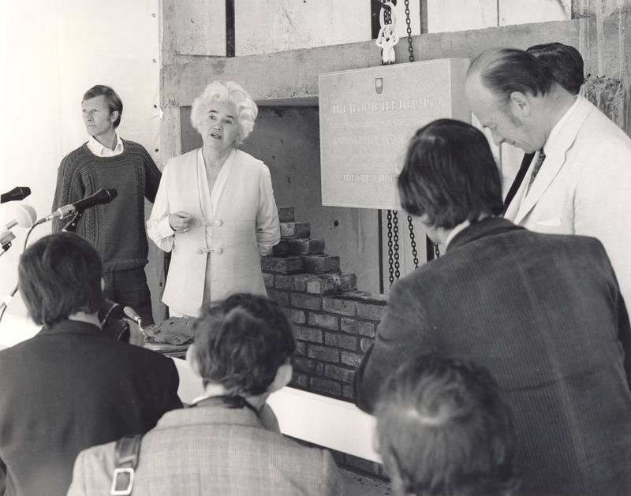
http://www.open.ac.uk/library/digital-archive/image/image:000000000094
The road ahead 4: Challenges and opportunities for academic libraries
Lorcan Dempsey, OCLC @LorcanD
The Future of Academic Libraries: A Symposium on provision for online
& distance learning students
The Open University, Milton Keynes, UK, 17 March 2016

Slide 2
http://orweblog.oclc.org/defining-the-library-reflexively/
The library should not provide an argument for a particular case, but demonstrate that there is always another case to be made. The notion that the library is a place that has no agenda other than allowing people to invent their own agendas is what makes it an indispensable resource for a democracy. It is where we can learn not just to be readers, but to be the authors of our own destiny. Fintan O’Toole
Dublin City Public Libraries, Flickr: http://www.flickr.com/photos/dublincitypubliclibraries/6029467474/in/set-72157594513778442

Slide 3
People should think not so much of the books that have gone into the National Library but rather of the books that have come out of it. Seán O’Faoláin
My professional mission as a librarian is this: Help people build their own libraries. That’s it. That’s all I care about. Dan Chudnov
A scholar is just a library’s way of making another library. Daniel Dennett
Because the purpose and result of absorbing information is always finally to produce further information, i.e., to continue the conversation, the function of the library must be understood as one that assists members of the community both in taking particular positions and in recognizing and assessing the positions taken by others. Ross Atkinson
http://orweblog.oclc.org/defining-the-library-reflexively/
Notes:
I like reflexive definitions of the library. The library is a generative component of research and learning life-cycles.

Slide 4
Not an end in itself: The library in its context

Slide 5
20 years ago I was
in the libraries business.
Today I am in the
Columbus business.
Pat Losinski, CML
http://www.theatlantic.com/national/archive/2014/10/not-your-mothers-library/381119/
Notes:
Personal communication.

Slide 6
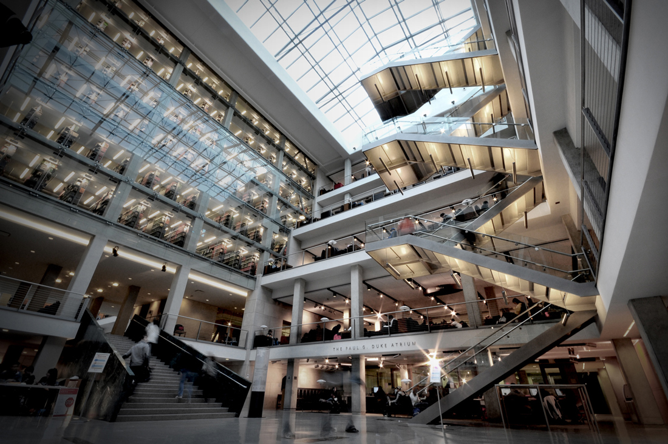
https://library.osu.edu/blogs/osulstaff/2016/02/29/from-the-director-february-29-2016-drinking-from-the-fire-hose
… to be vital to the academic enterprise, the Libraries must position itself as an active, engaged participant in solving university-level problems (Looking outside ourselves); …
Look to where teaching and research within the academic disciplines and cultural acquisition are moving, and you will see the Libraries skating to the same puck, sometimes as partner, sometimes as leader, always engaged.
Damon Jaggars, The Ohio State University
http://www.yourlightingbrand.com/portfolio-posts/ohio-state-library/

Slide 7
Challenge and opportunity

Slide 8
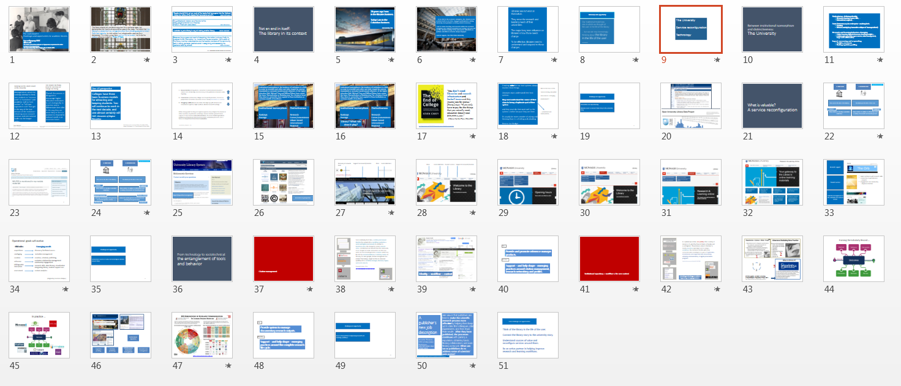
The University
Service reconfiguration
Technology

Slide 9
Between institutional isomorphism and distinctiveness: The University

Slide 10
“Rankings are the Latest Assault on the University”
“Tom Boland: We finally know for sure how our colleges are faring”
Two different perspectives appearing in the Irish media in the same week.
Managerialism, which the rankings attempt to feed, sees students as “revenue units” or “customers” and academic staff as “cost centres” or “full-time equivalent costs” that get in the way of the true mission of the institution – obtaining more research revenue and international kudos via the league tables.
Overall, this process is designed to encourage higher-education institutions to act strategically, to prioritise and to differentiate their offer. In this way they are more likely to be in a position to respond to national needs in an uncertain future.
Sean Barrett
http://www.universitytimes.ie/2016/03/rankings-are-the-latest-assault-on-the-university/
http://www.irishtimes.com/news/education/tom-boland-we-finally-know-for-sure-how-our-colleges-are-faring-1.2567762
Notes:
I was struck by these contrasting views which appeared within a few days of each other in the Irish media.

Slide 11
One US perspective
Colleges have three basic business models for attracting and keeping students. Two will continue to work in the next decade, and one almost certainly will not. Chronicle of Higher Education
Werf, Martin van der, and Grant Sabatier. The college of 2020: students. [Washington, D.C.]: Chronicle Research Services (2009).

Slide 12
Research/elite (Strong brand, connected to international network of science and scholarship; educate many of the political and business elite; flagship),
Convenience (community colleges, for-profit providers, career-focused - preparation for further education or for a career).
Struggling middle (broad education. Not kept up with distance and convenience agendas, high overhead, limited research funding).
While strong public funding, a systemwide perspective and regional agendas may mitigate this division in other countries, in particular sustaining a diverse ‘middle’, general trends support it: these include internationalization, the recent historic growth in numbers participating in third level education, economic pressures, and a focus on comparative international evaluation.
(vocabulary adapted - LD)

Slide 13
Institutional
Isomorphism
Is big ….

Slide 14
Institutional isomorphism is the tendency of institutions in a field to come to resemble each other over time, shaped by coercive (mandated) or normative (professional) influences. In the higher education field, Michael Crow and William Dabars have coined the terms ‘Harvardization or Berkeley envy’ for a historical trend they observe: universities have aspired to those institutions as common models of excellence.
Institutional isomorphism
Rankings
Prestige
Distinctiveness
Research
Career/convenience
Values based
International
Regional

Slide 15
Institutional isomorphism
Rankings
Prestige
Distinctiveness
Research
Career/convenience
Values based
International
Regional
Library? What role does it play?

Slide 16
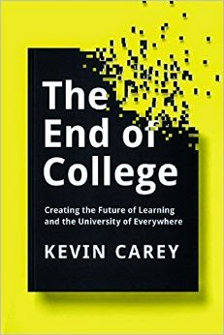
“You don’t need libraries and research infrastructure and football teams and this insane race for status,” [Carey] says. “If you only have to pay for the things that you actually need, education doesn’t cost $60,000 a year.”
J. Nocera, New York Times, 3 March 2015
http://www.nytimes.com/2015/03/10/opinion/joe-nocera-college-for-a-new-age.html
Notes:
Sees traditional academic library as part of outmoded understanding of HE infrastructure
GW campus and library viewed as a pastiche of traditional iconography of a great university (Bologna, Harvard)
Places blame (in part) on elective system promoted at Harvard which requires proliferation of infrastructure to support a ‘university of everything’

Slide 17
Creating value for our host systems always involves three things:
Librarians must understand their host systems;
they must understand the source of their claim to being a legitimate part of their system;
and they must do their work well so the system is better because they are there.
It’s usually far more a matter of asking and listening than it is of telling and pleading.
Eleanor Joe Rodger
What is the focus of the
‘demonstrating value/ROI’
discussion in a changing environment?
… understand and communicate …

Slide 18
Challenge and opportunity
Universities are repositioning.
Libraries need to connect their story to the university story.
A note on the OU
Enterprising
Non-isomorphic!

Slide 19
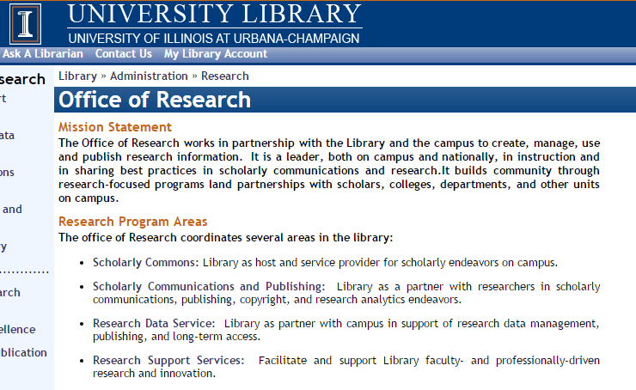
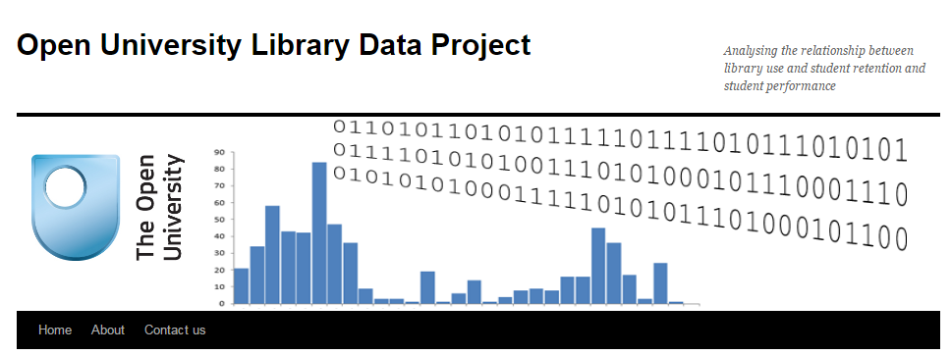

Slide 20
What is valuable? A service reconfiguration

Slide 21
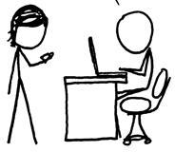
A print logic
A network logic
http://www.xkcd.com/917/
The user in the life of the library
The library in the life of the user
Owned
Facilitated
Value relates to locally assembled collection.
Value relates to ability to efficiently meet a variety of research and learning needs.

Slide 22
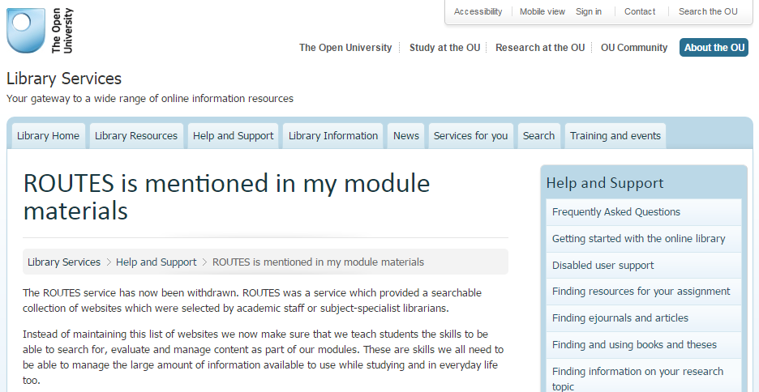

Slide 23
A print logic
A network logic
http://www.xkcd.com/917/
The user in the life of the library
The library in the life of the user
Owned
Facilitated
Value relates to locally assembled collection.
Value relates to ability to efficiently meet a variety of research and learning needs.
Product. Consume
Process. Create
Manage and interpret the products of research (books, articles, …)
Make the whole process of research and learning more productive.
Outside in
Inside out

Slide 24
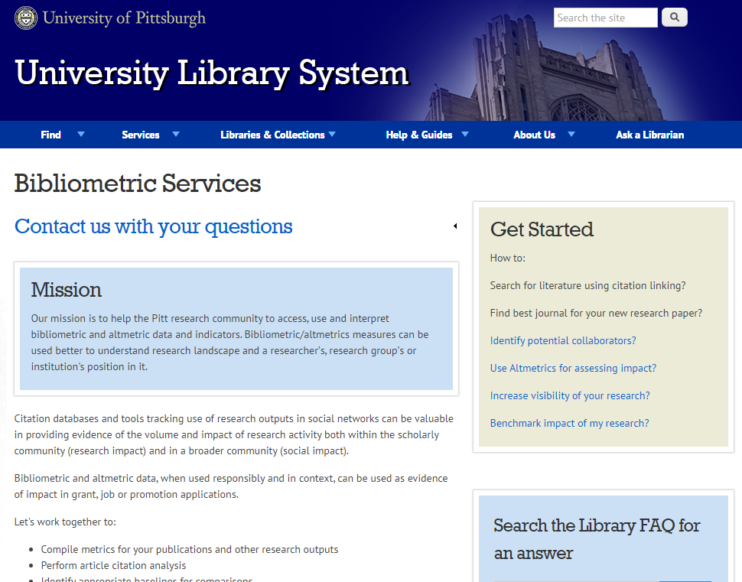
Impact/reputation management

Slide 25
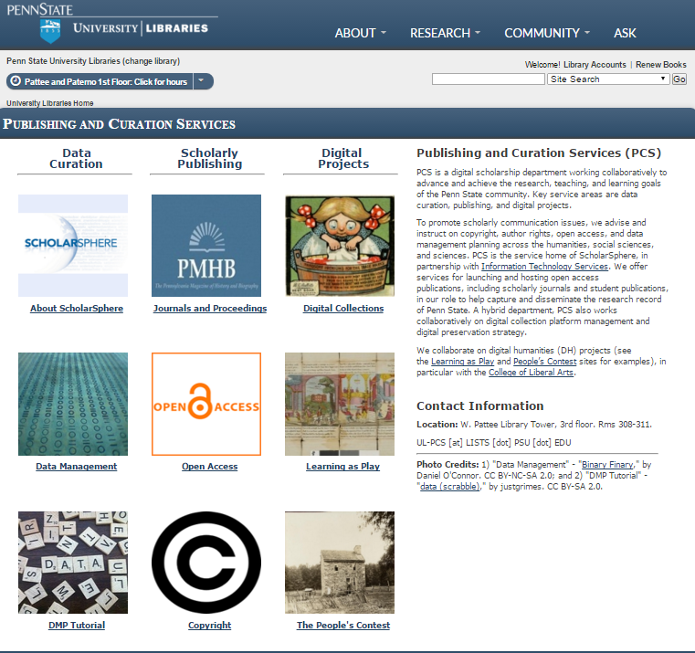
An inside out perspective

Slide 26
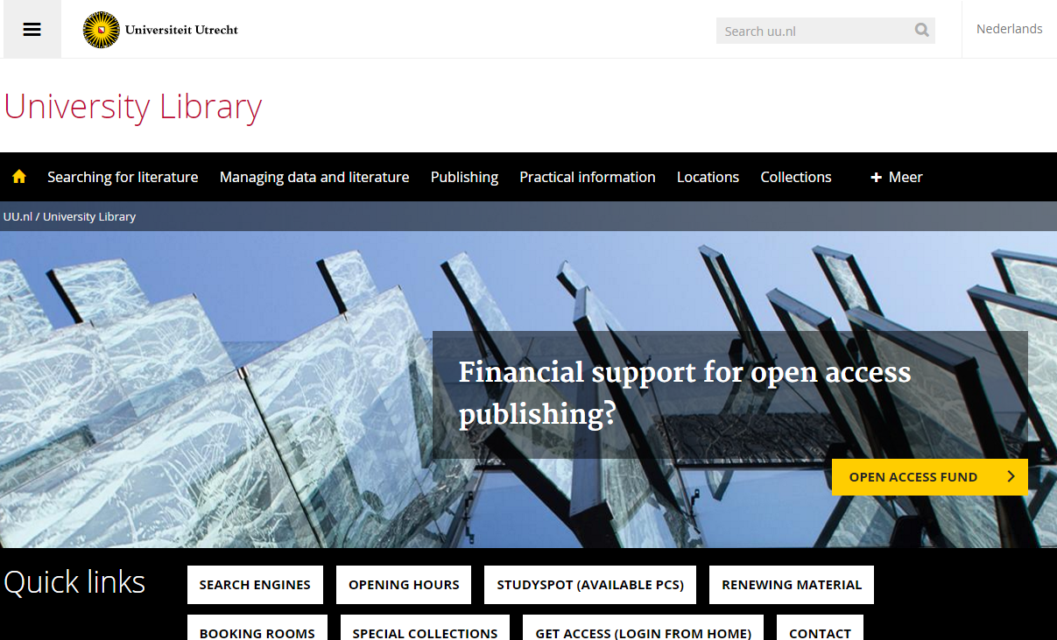
Discovery at network
level
Support for research/creation
Place
Local collections

Slide 27
Place
Local collections
Student success
Support for research/creation

Slide 28
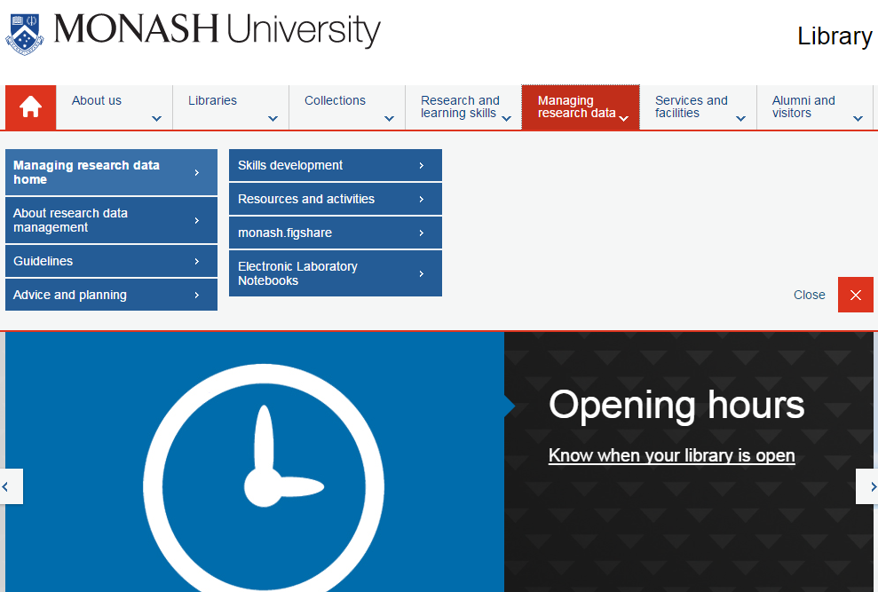

Slide 32
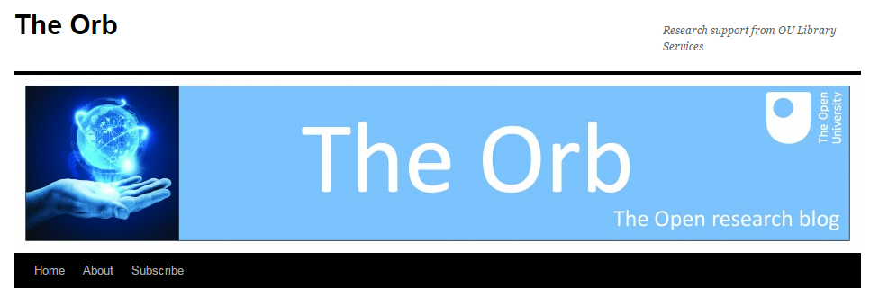
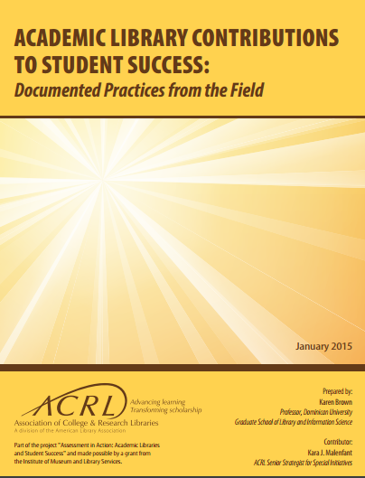
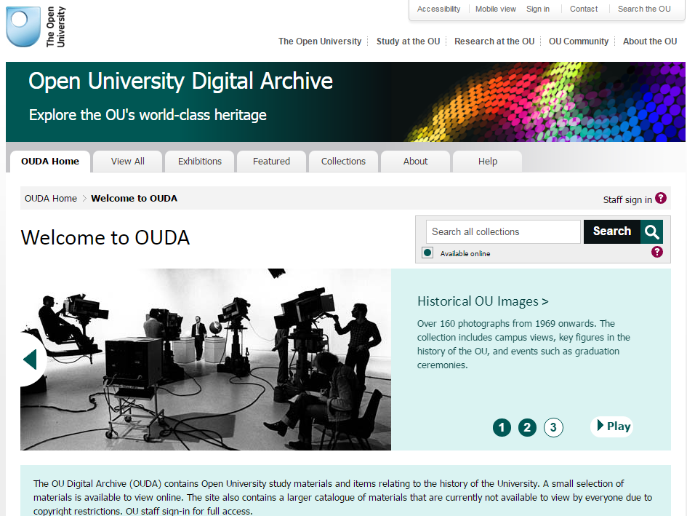
Research support
Student success
Build confidence with research skills
Connection to performance - analytics
Engagement and community – improve retention
Teaching
Selective management of the scholarly and cultural record

Slide 33
Collections | Just in case | Facilitated
Expertise | Subject, process | Partner in research and learning, creation, …
Systems | Back office | Workflow, digital scholarship, shared systems
Space | Configured around collections | Configured around user experiences

Slide 34
Challenge and opportunity
Understand sources of value and reconfigure services around them.

Slide 35
From technology to sociotechnical: the entanglement of tools and behavior

Slide 36
Citation management

Slide 37
So in a relatively short time, a solitary and manual function has evolved into a workflow enacted in a social and digital environment. In addition to functional value, this change has added network value, as individual users benefit from the community of use. People can make connections and find new work, and the network generates analytics which may be used for recommendations or scholarly metrics. In this way, for some people, citation management has evolved from being a single function in a broader workflow into a workflow manager, discovery engine, and social network.
Dempsey & Walter, 2014
http://crl.acrl.org/content/75/6/760.full.pdf+html

Slide 38
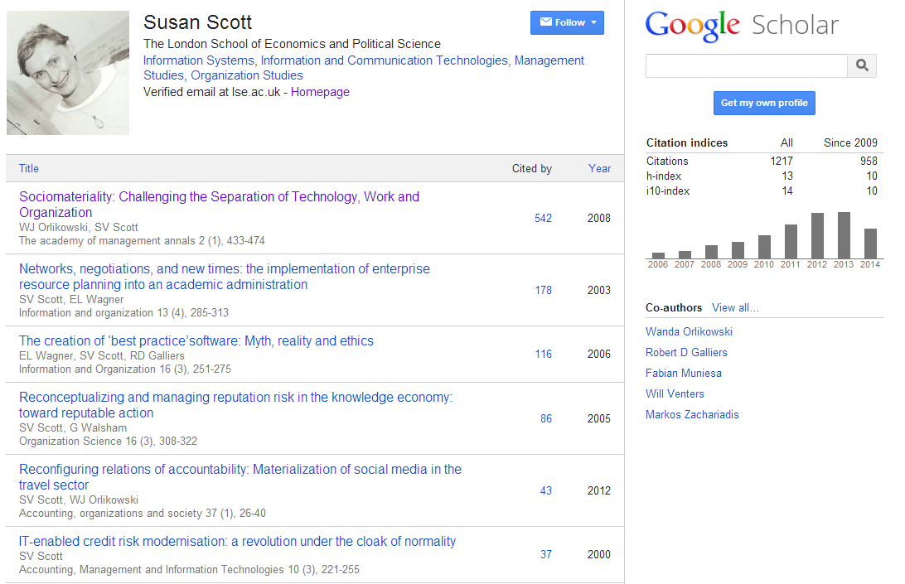
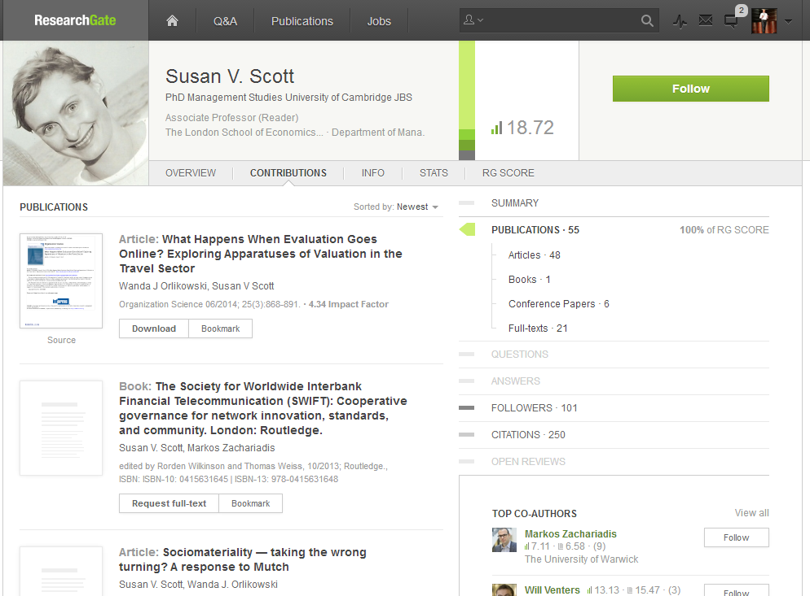
Identity > workflow > content

Slide 39
This:
Provide and promote reference manager products.
And this:
Support – and help shape - emerging practices around citation management, research networking and profiles.

Slide 40
Institutional repository > workflow is the new content

Slide 41
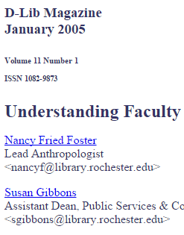
In a well-known article, Salo (2008) offers a variety of reasons as to why they have not been as heavily used as anticipated. These include a lack of attention to faculty incentives (‘prestige’) and to campus workflows. She concludes that IRs will not be successful unless developed as a part of “systematic, broad-based, well-supported data-stewardship, scholarly-communication, or digital-preservation program”.
http://minds.wisconsin.edu/handle/1793/22088
Providing technology as artifact >
Supporting emerging practices

Slide 42
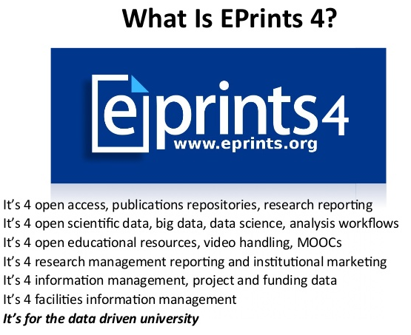
2
1
2
3
1
3
EPrints Update, Les Carr, University
of Southampton, Repository Fringe, 2014
http://www.slideshare.net/repofringe/e-prints42y

Slide 43
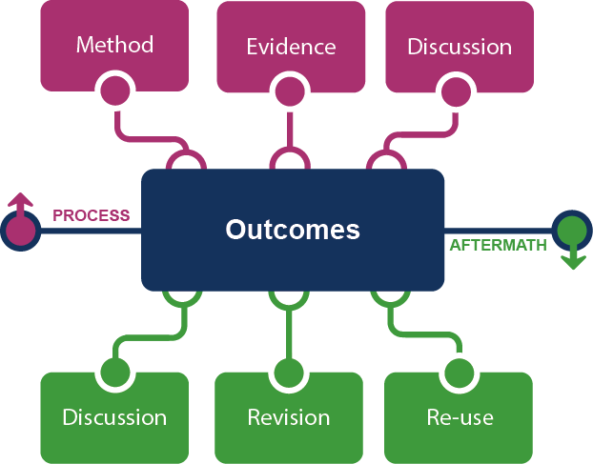
Framing the Scholarly Record …

Slide 44
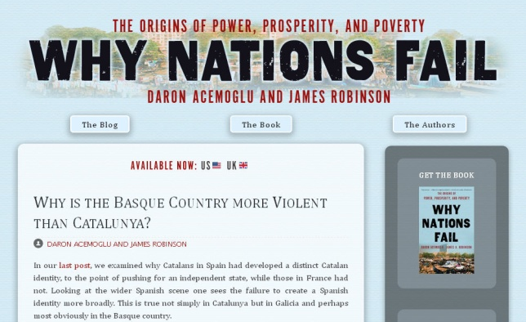
In practice …
Notes:
http://global.oup.com/uk/orc/busecon/economics/carlin/

Slide 45
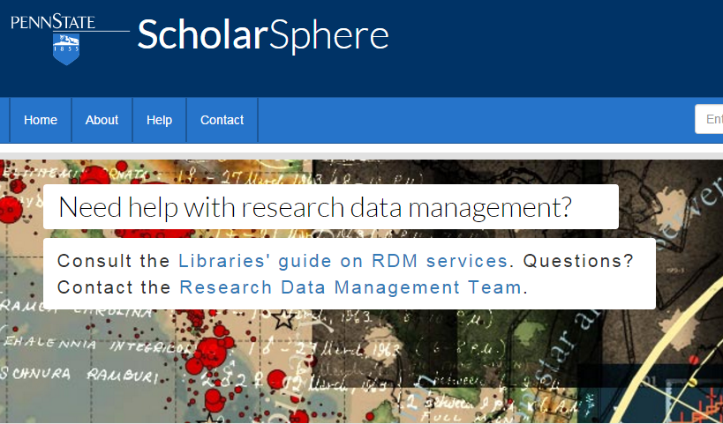
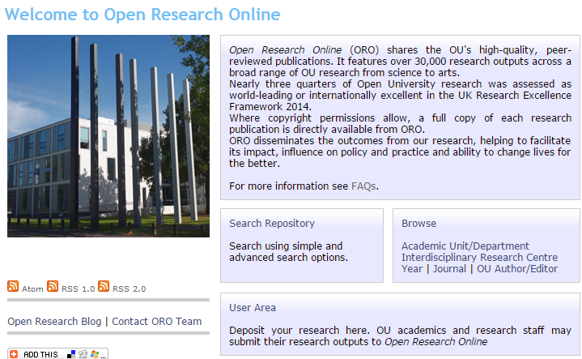
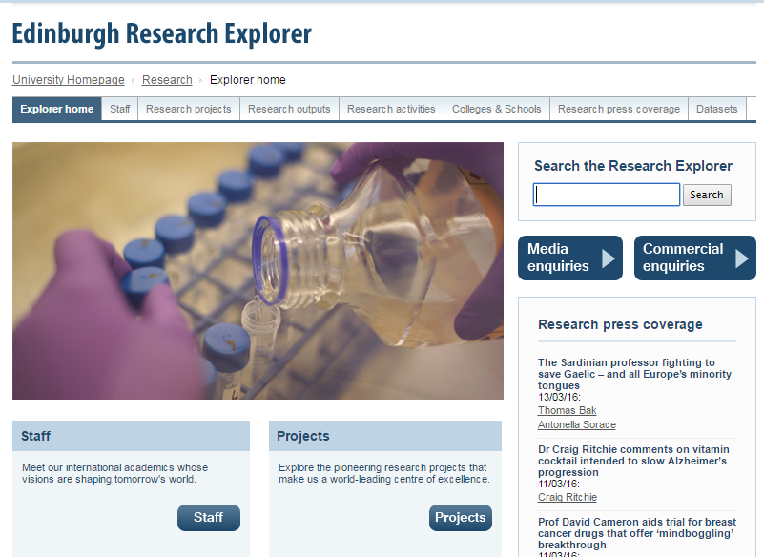
Institutional repository
Expertise profiling
Scholarly publishing
CRIS/Research information management
Research data management

Slide 46
http://innoscholcomm.silk.co/

Slide 47
This:
Provide system to manage documentary research outputs.
And this:
Support - and help shape - emerging practices around the complete research life cycle.

Slide 48
Challenge and opportunity
Be an active partner in improving research and learning workflows.

Slide 49
Her view is that publishers are here to make the scientific research process more effective by helping them keep up to date, find colleagues, plan experiments, and then share their results. After they have published, the processes continues with gaining a reputation, obtaining funds, finding collaborators, and even finding a new job. What can we as publishers do to address some of scientists’ pain points?
A publisher’s new job description
Annette Thomas,
CEO of Macmillan
Publishers (now Chief Scientific Officer Springer Nature)
http://www.against-the-grain.com/2012/11/a-publishers-new-job-description/

Slide 50
Some challenges and opportunities
Think of the library in the life of the user.
Connect the library story to the university story.
Understand sources of value and
reconfigure services around them.
Be an active partner in helping improve
research and learning workflows.

