Slide 1

Ohio Libraries Day, OCLC
11 May 2016
Working collaboratively: scaling infrastructure, services, learning and innovation
Lorcan Dempsey, OCLC
@LorcanD
http://payload140.cargocollective.com/1/10/343297/5104718/delf_567.jpg

Slide 2
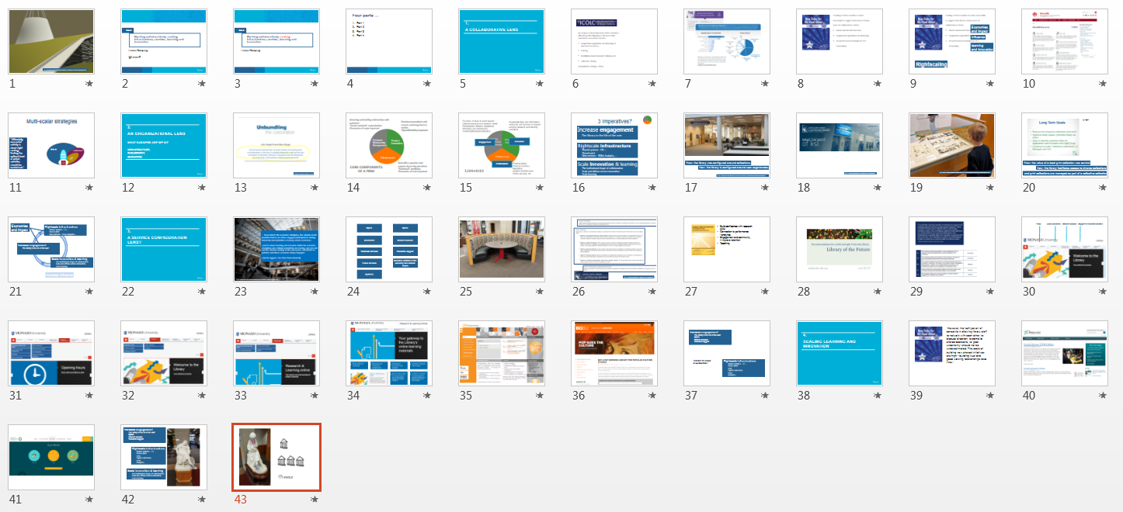

Slide 3
1.
A collaborative lens

Slide 4

An analysis of North American ICOLC members (85) shows the following as the most often mentioned consortium services:
cooperative negotiation and licensing of electronic resources,
training,
interlibrary loan/document delivery, and
collection sharing
(Unpublished. Malpas, 2014).

Slide 5
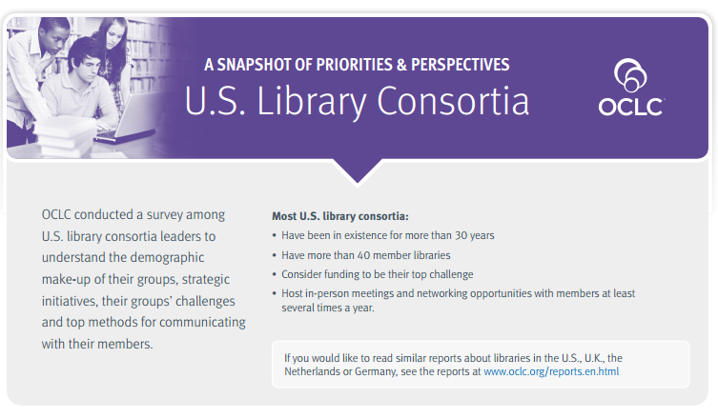
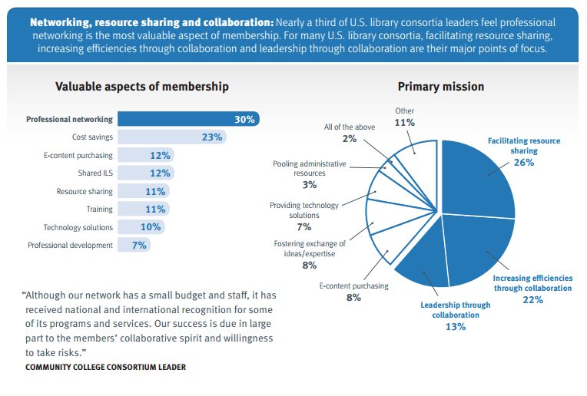

Slide 6

“Looking at these numbers it seems reasonable to suggest three broad activity areas for collaborative activity:
shared service infrastructure;
cooperative negotiation and licensing;
and professional development and networking.”

Slide 7
Looking at these numbers it seems reasonable to suggest three broad activity areas for collaborative activity:
shared service infrastructure;
cooperative negotiation and licensing;
and professional development and networking.
Economies
and impact
Influence
learning
and innovation
Rightscaling

Slide 8
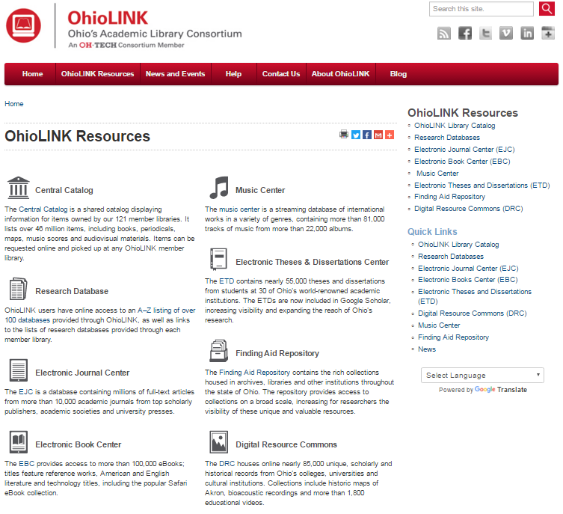

Slide 9

Multi-scalar strategies
“Ultimately, consortial activity is about right-scaling, finding the optimal level at which activities should be carried out.”
OCLC
HathiTrust
HathiTrust
Ohio
LINK
CIC

Slide 10
2.
An organizational lens
What business are we in?
Infrastructure,
engagement,
innovation

Slide 11
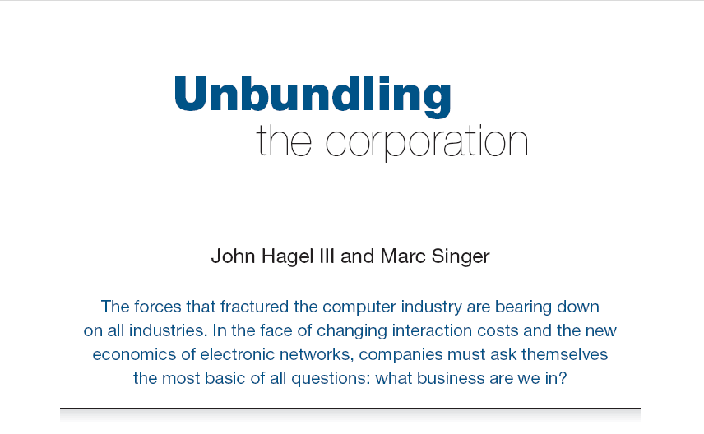
Harvard Business Review (1999)

Slide 12
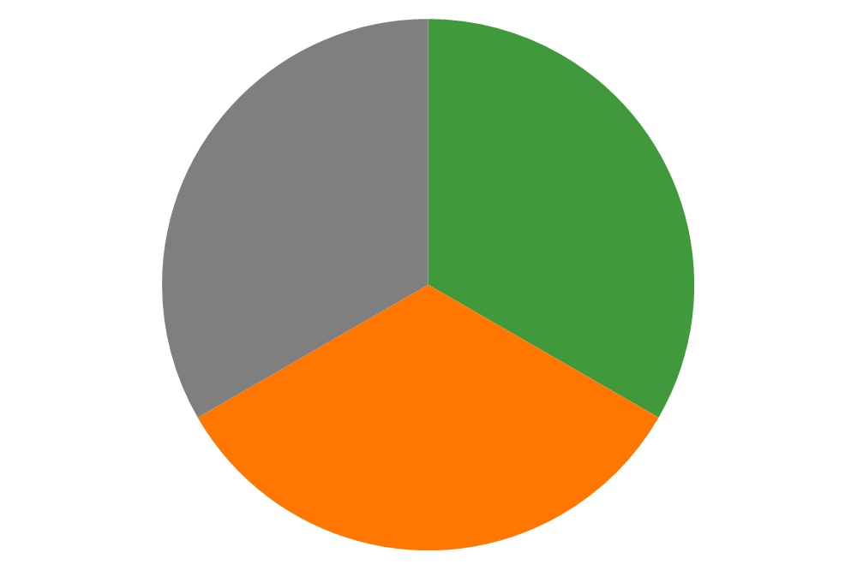
CORE COMPONENTS
OF A FIRM
Attracting and building relationships with customers
“Service-oriented”, customization
Economies of scope important
Develop new products and
services and bring them to
market
Speed/flexibility important
Customer
Relationship
Management
Product Innovation
Infrastructure
Back office capacities that
support day-to-day operations
“Routinized” workflows
Economies of scale important

Slide 13
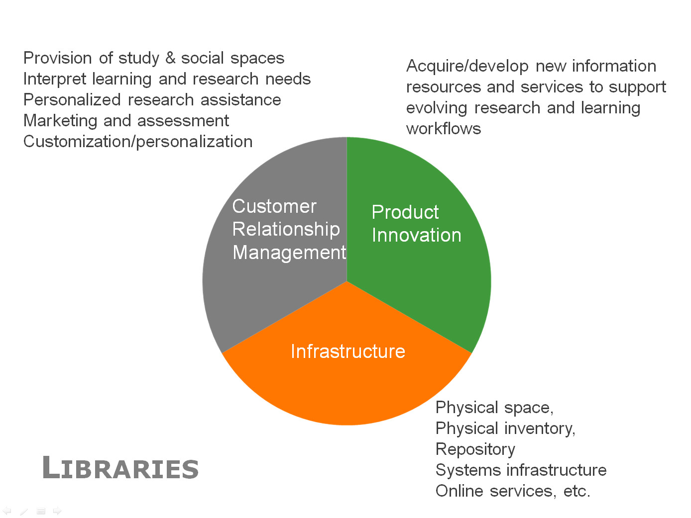
Engagement
Innovation
Infrastructure

Slide 14
3 Imperatives?
Increase engagement
  The library in the life of the user
Rightscale infrastructure
  Shared systems – HT, …
  Shared print
  New services – RDM, Analytics, …
Scale Innovation & learning
  The institutional shape of collaboration
  Scale and diffuse service innovation
  Scale learning

Slide 15
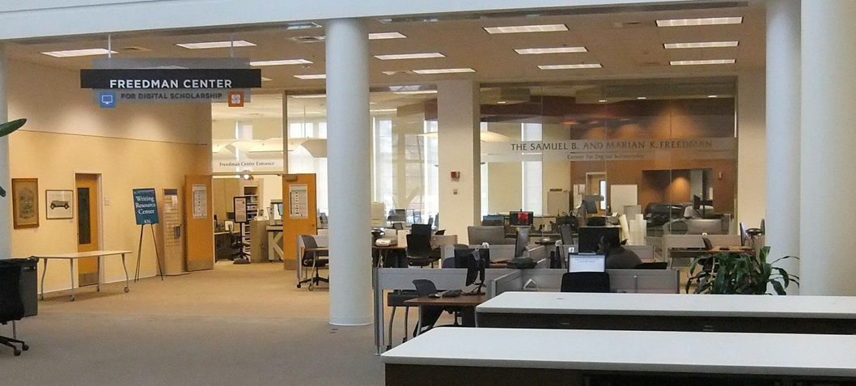
Then: the library was configured around collections.
Now: the library is configured around user experiences.
https://ocio.grc.nasa.gov/gvis/2014/01/gvis-visits-case-cleveland-museum-art/

Slide 16

http://library.case.edu/ksl/newsletter/spring2014/

Slide 17
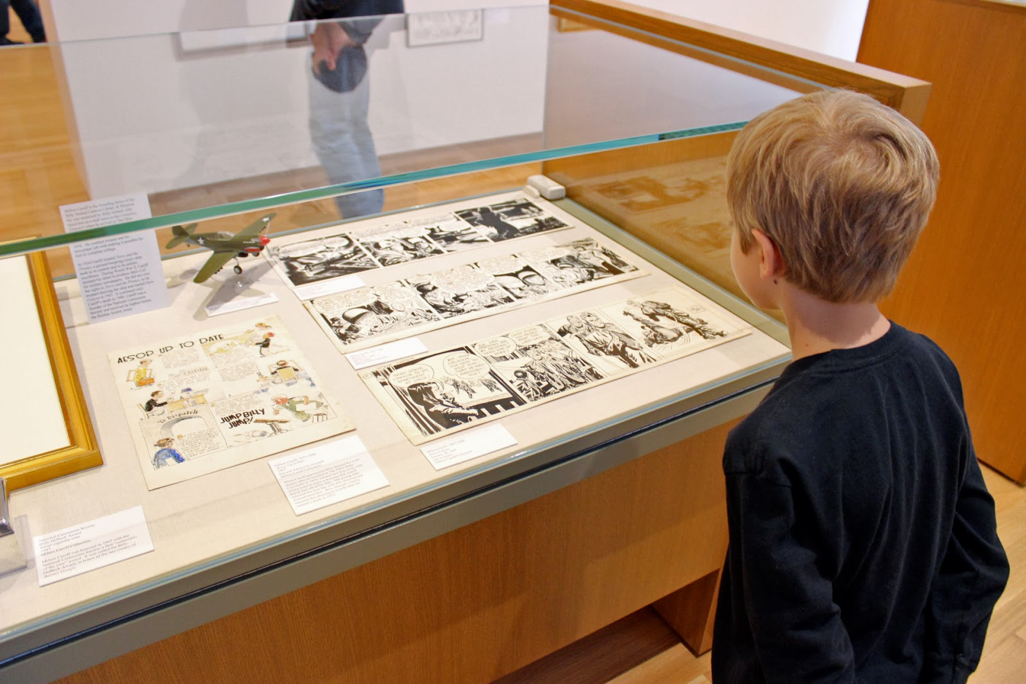
http://matttauber.blogspot.com/2013/11/billy-ireland-cartoon-library-museum.html

Slide 18
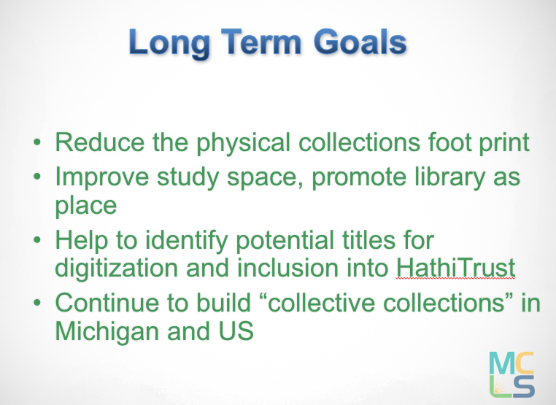
MI-SPI
Then: the value of a local print collection was central.
Now: the library facilitates access to diverse collections
and print collections are managed as part of a collective collection

Slide 19
Economies
and impact
Rightscale infrastructure
  Shared systems – HT, …
  Shared print
  New services – RDM, Analytics, …
Increase engagement
  The library in the life of the user
Scale innovation & learning
  The institutional shape of collaboration
  Scale and diffuse service innovation
  Scale learning
Increase influence

Slide 20
3.
A service configuration lens?

Slide 21
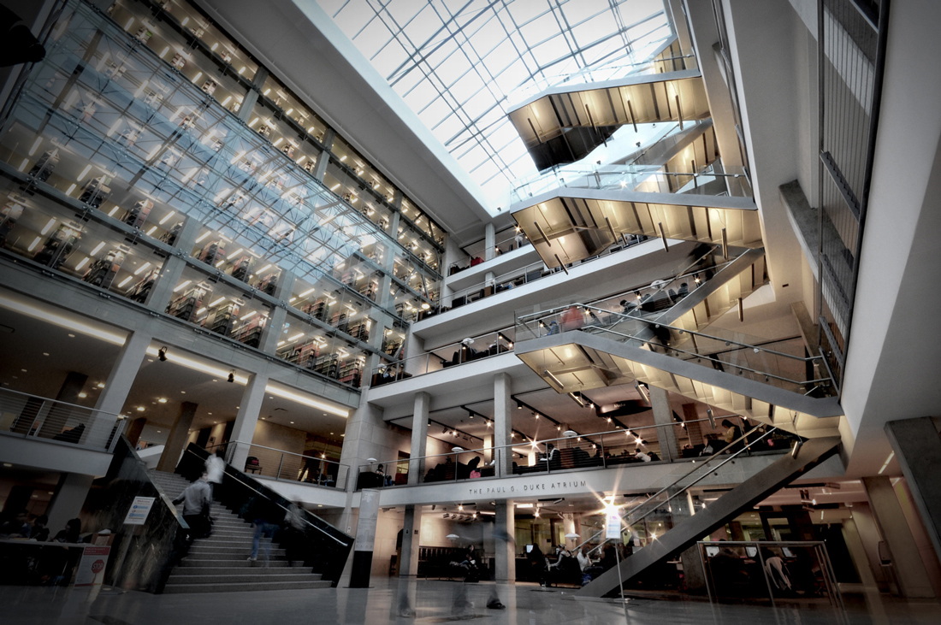
https://library.osu.edu/blogs/osulstaff/2016/02/29/from-the-director-february-29-2016-drinking-from-the-fire-hose
… to be vital to the academic enterprise, the Libraries must position itself as an active, engaged participant in solving university-level problems (Looking outside ourselves); …
Look to where teaching and research within the academic disciplines and cultural acquisition are moving, and you will see the Libraries skating to the same puck, sometimes as partner, sometimes as leader, always engaged.
Damon Jaggars, The Ohio State University
http://www.yourlightingbrand.com/portfolio-posts/ohio-state-library/

Slide 22
Then
Now?
Space
Space
Collections
Student success
Technical services
Research support
Public services
Selective curation of the scholarly and cultural record
Systems

Slide 23
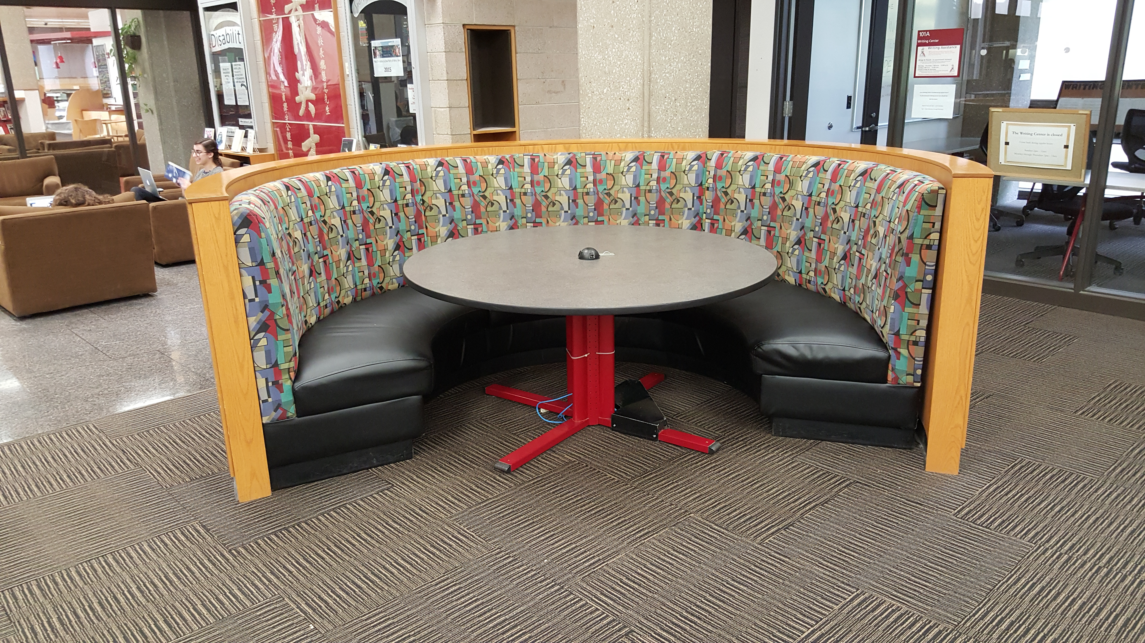

Slide 24
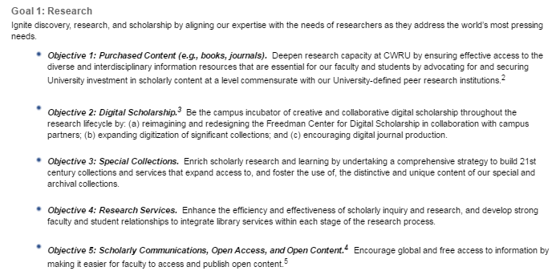

http://library.case.edu/ksl/aboutus/strategicplan/

Slide 25
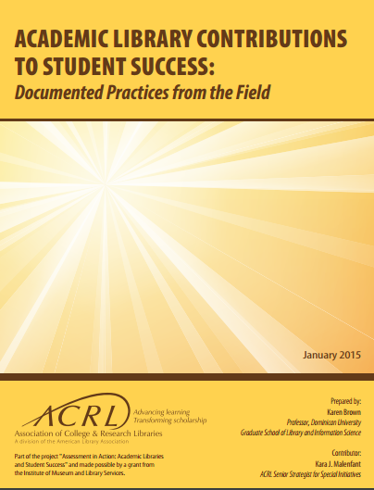
Build confidence with research skills
Connection to performance
- analytics
Engagement and community
– improve retention
Teaching

Slide 26


Slide 27
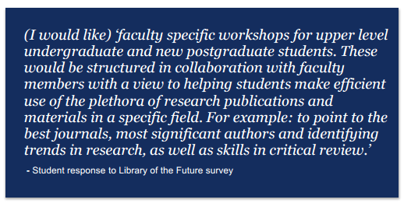
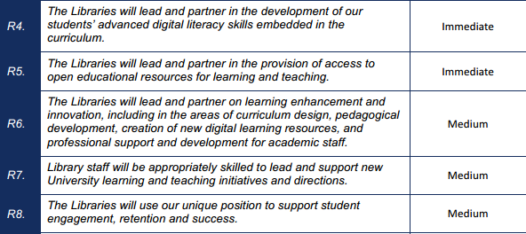

Slide 28
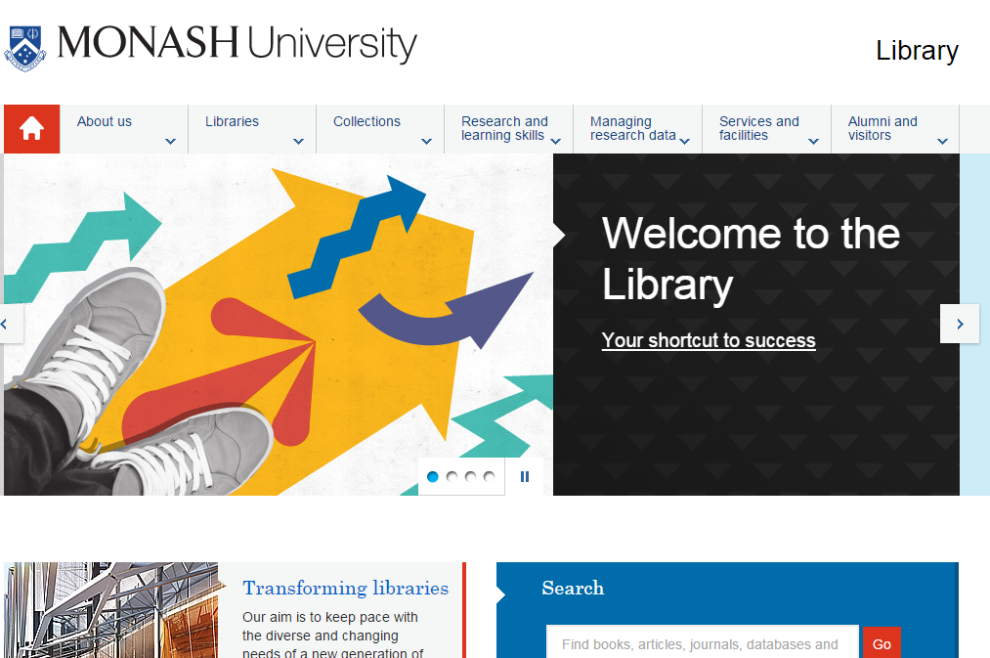
Place
Local collections
Student success
Support for research/creation

Slide 29
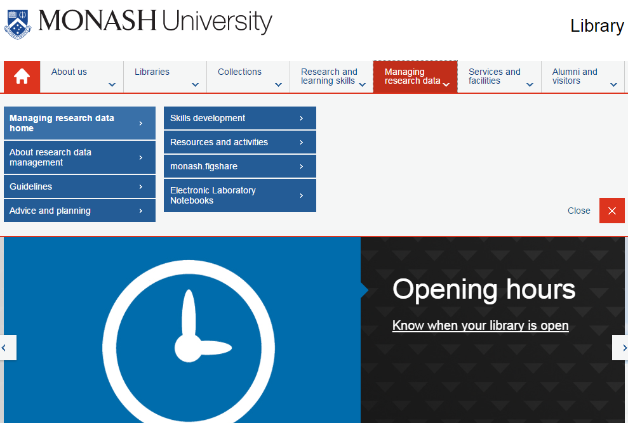

Slide 30
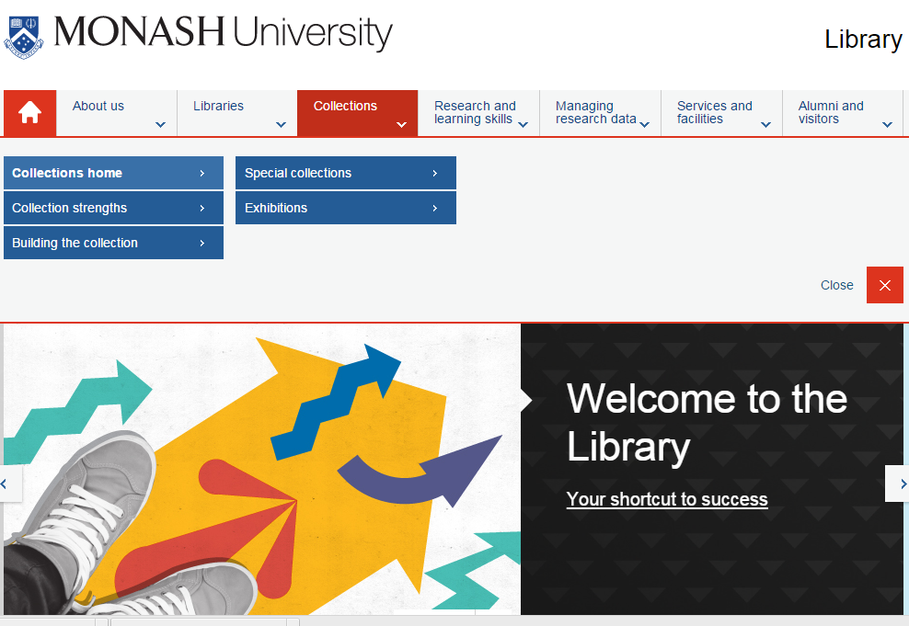

Slide 31
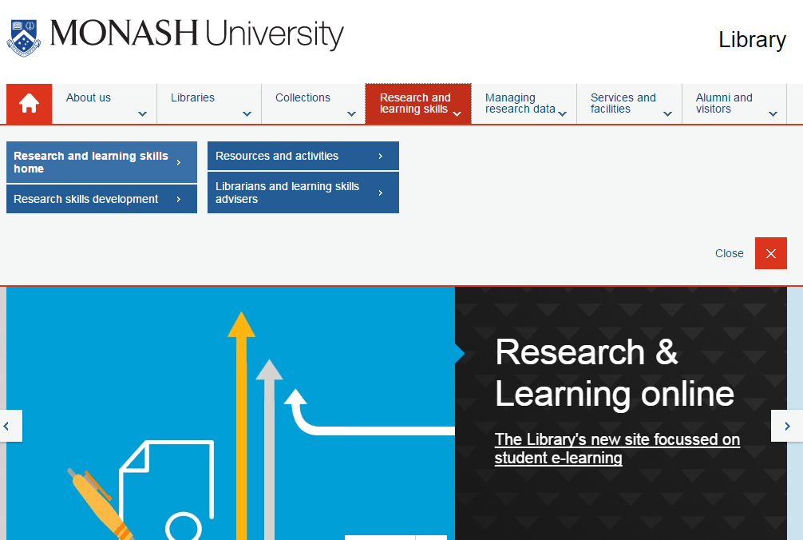

Slide 32
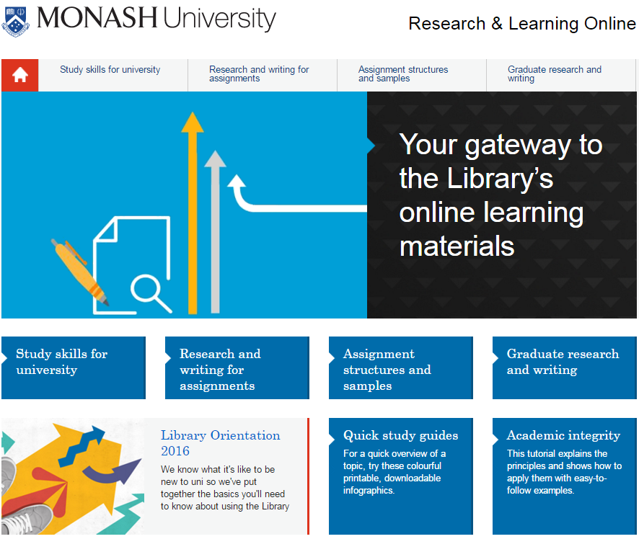

Slide 33
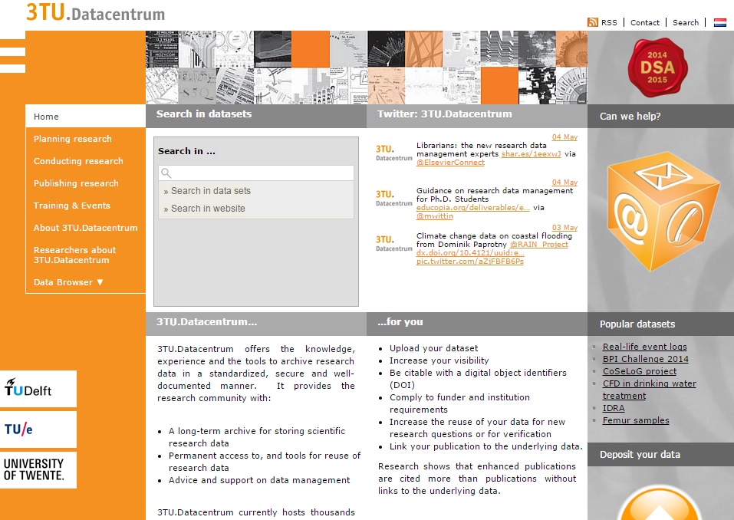

Slide 34
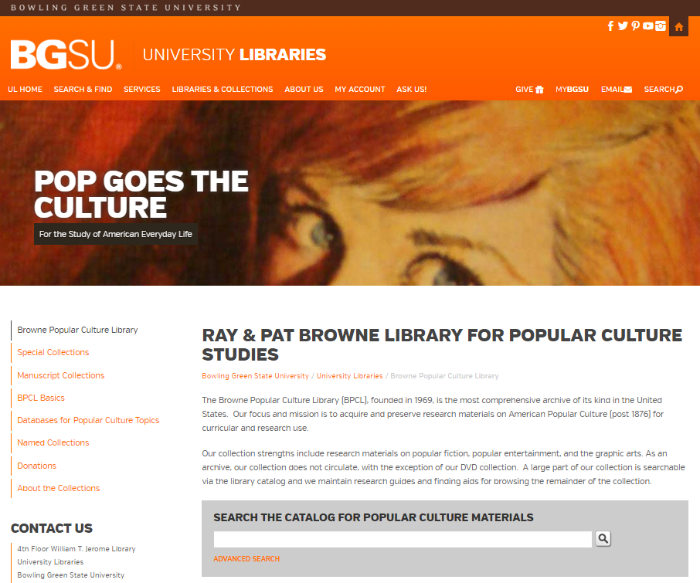

Slide 35
Increase engagement
  The library in the life of the user
  Space
  Student success
  Research support
Increase the scope
of collaboration.
Rightscale infrastructure
  Shared systems – HT, …
  Shared print
  DDA
  Digital collections
  RDM
  Analytics, …

Slide 36
4.
Scaling learning and innovation

Slide 37
“However, the 'soft power' of consortia in allowing library staff to network with each other, to discuss direction, to come to shared decisions, to 'pool uncertainty' should not be underestimated. The costs of building new shared initiatives are high - building trust and good working relationships take time.”

Slide 38
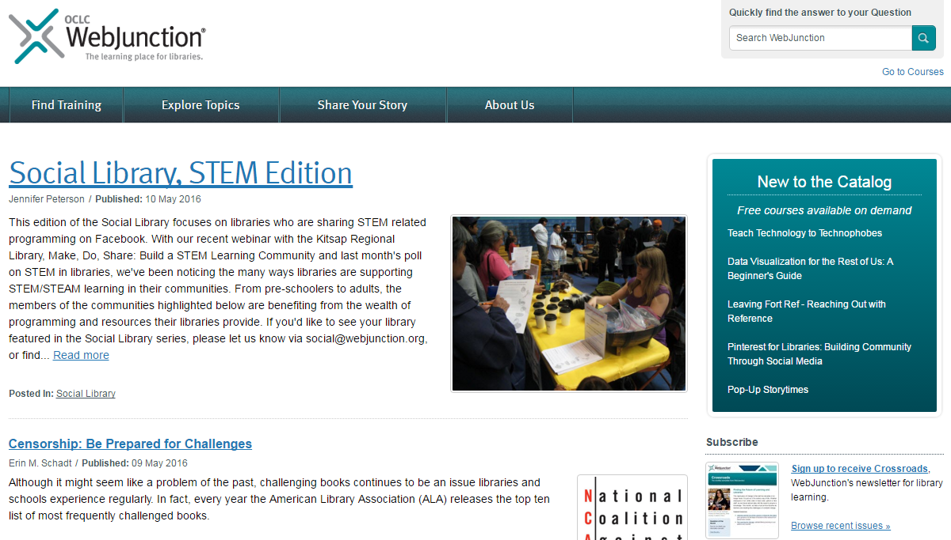

Slide 39
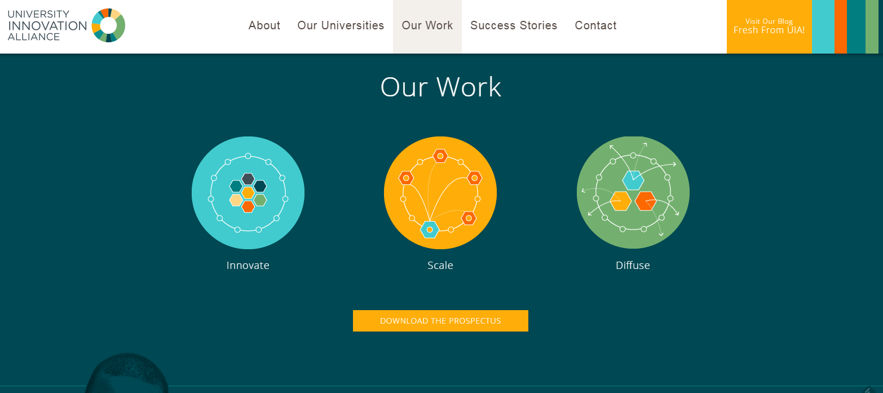

Slide 40
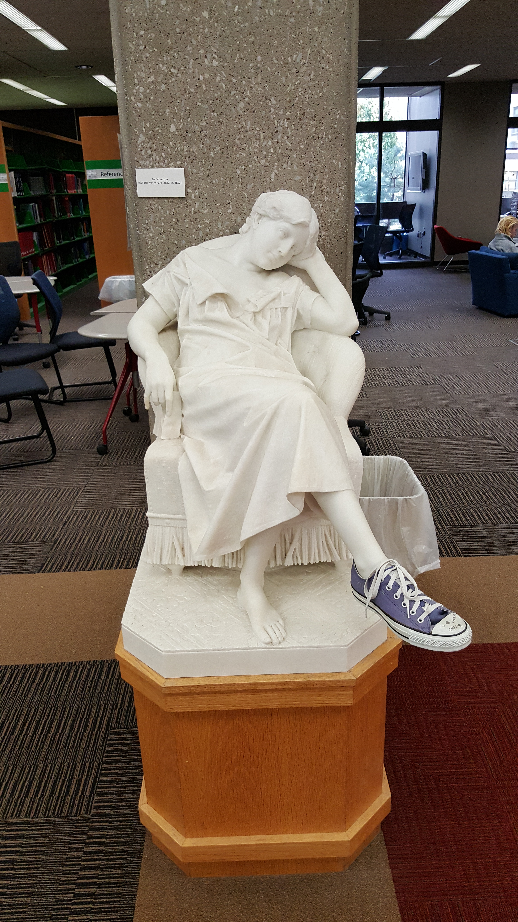
Increase engagement
  The library in the life of the user
  Space
  Student success
  Research support
Rightscale infrastructure
  Shared systems – HT, …
  Shared print
  DDA
  Digital collections
  RDM
  Analytics, …
Scale innovation & learning
  The institutional shape of collaboration
  Scale and diffuse service innovation
  Scale learning

Slide 41

