Slide 1
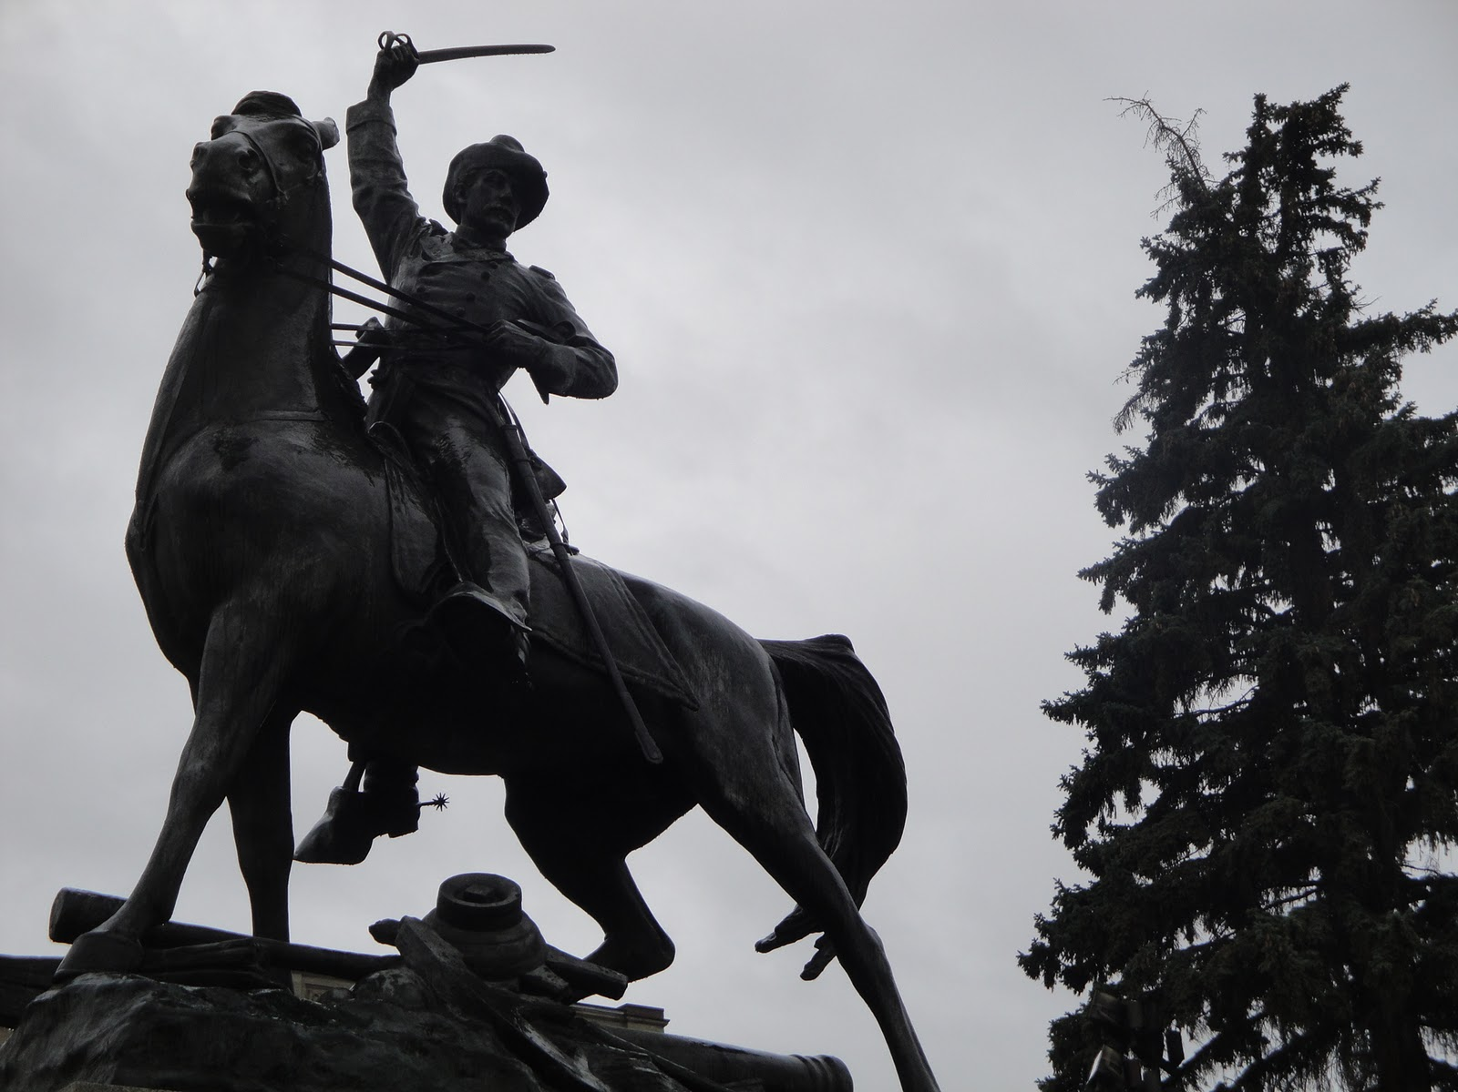
Scale, engagement, innovation: library directions
@LorcanD
Lorcan Dempsey, OCLC
February 7-8 2014
Offline Conference, Montana Library Association
Helena, Montana
http://njaegerhopcraft.blogspot.com/2011/10/dont-tell-anyone-how-great-helena-mt-is.html

Slide 2
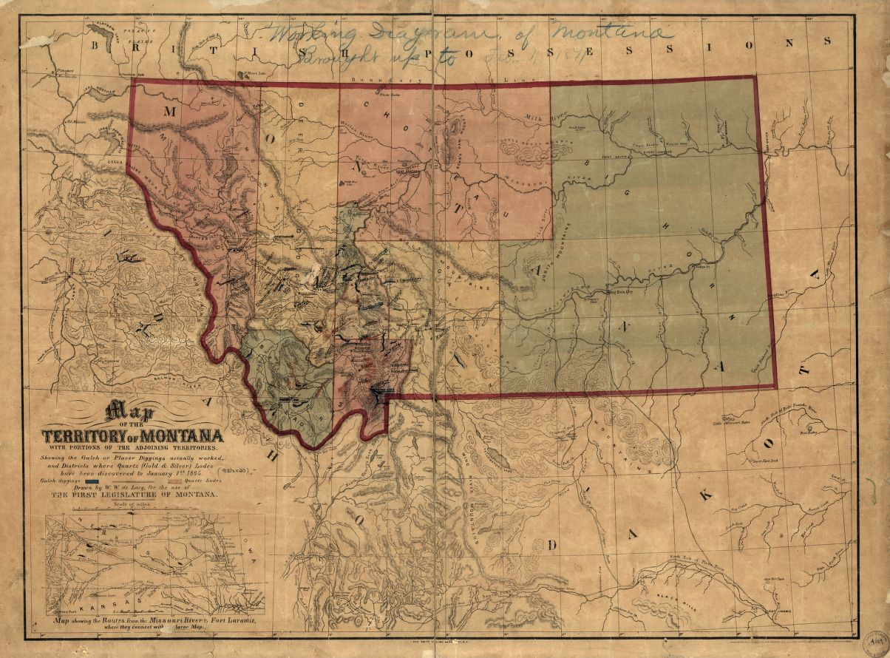
Prelude
Montana in
Library of Congress http://www.loc.gov/item/2006629627/

Slide 3
Thomas Francis Meagher (1823-1867)
25 top collections …
Montana libraries
National libraries
Vendors
Digital
By Thorpfletcher (Own work) [CC-BY-SA-3.0 (http://creativecommons.org/licenses/by-sa/3.0)], via Wikimedia Commons
Notes:
Irish rebel, stint in prison in Australia, first governor of Montana
Identity is visible/present in global library system – his strong regional ties are reflected in holdings in Montana libraries

Slide 4
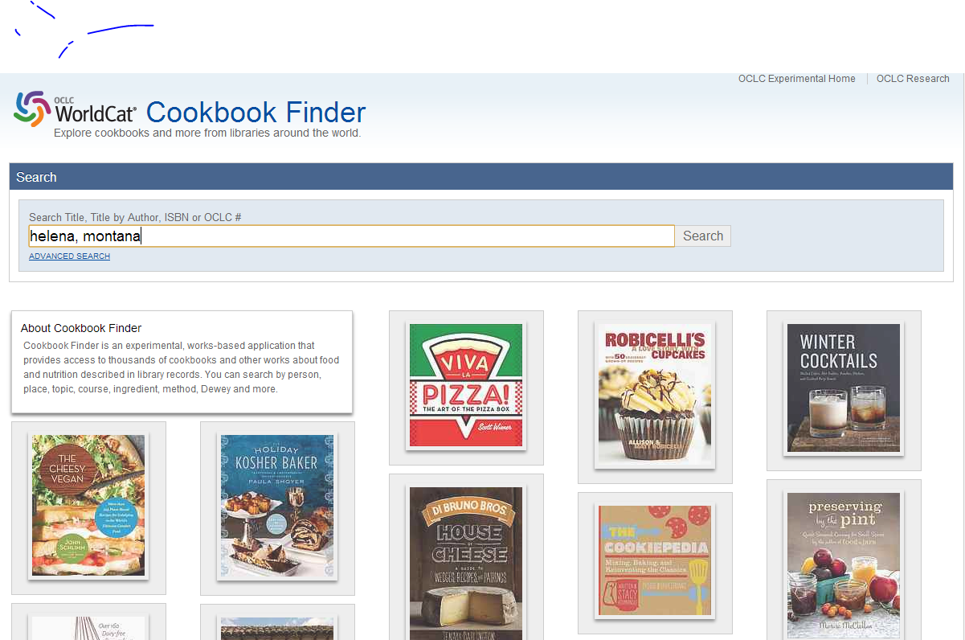

Slide 5
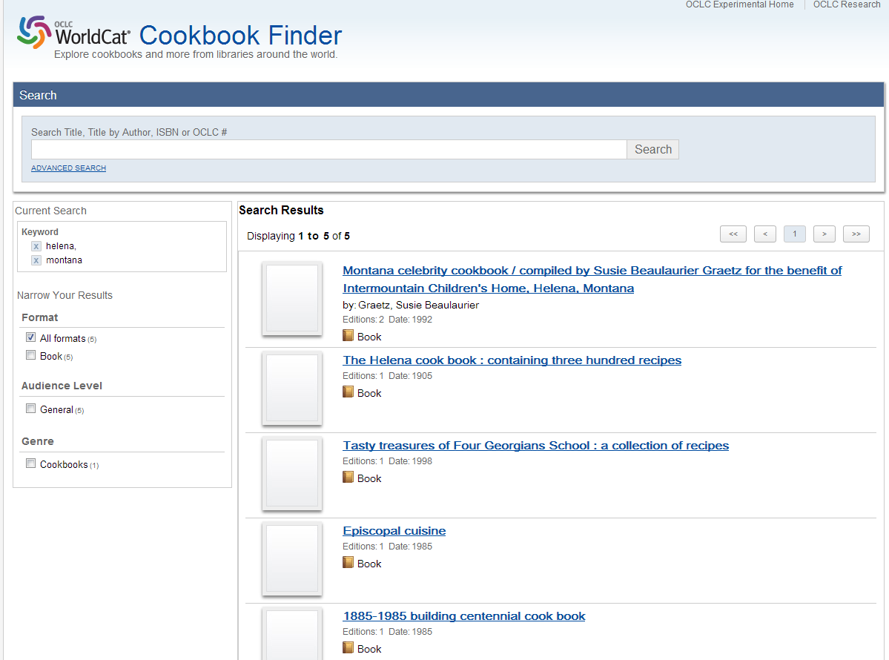

Slide 6
Montana in the cultural record
number of titles (avg. holdings)
Concepts
Form/genre
Frontier and pioneer life 1,946 (41)
Indians of North America 1,767 (23)
Ranch life 1,029 (101)
Dakota Indians 754 (49)
Cowboys 744 (52)
History 5,384 (23)
Biography 2,323 (35)
Juvenile works 629 (124)
Domestic fiction 270 (233)
People
Events
George A. Custer (1839-76) 1,529 (45)
Janet Dailey (1944-2013) 196 (160)
Ivan Doig (1939-) 155 (166)
Tracie Peterson (1959-) 140 (156)
Nicholas Evans (1950) 148 (131)
Battle of Little (1876) 3,544 (40) Bighorn
Indian Wars (1876) 515 (60)
By Thorpfletcher (Own work) [CC-BY-SA-3.0 (http://creativecommons.org/licenses/by-sa/3.0)], via Wikimedia Commons
Notes:
I.e. fictional accounts of ranch life have a dominant influence on Montana’s presence
First count is a measure of the volume of literature produced; second count is a proxy for impact or popularity (degree to which libraries have acquired the content) – so one could make the point that the literature related to frontier life in Montana is sizeable (>1900 titles) but that other topics (like Cowboys) have greater ‘presence’ in libraries.
Authors listed under People are mostly popular fiction – Dailey is a romance novelist; Peterson is a ‘Christian’ novelist, Evans (who is English) is author of The Horse Whisperer and other novels set in Montana; Doig is a native Montanan and the most ‘serious’ of the bunch with something of a literary career
Re: Idaho….Montana originally part of Idaho territory

Slide 7
Wilderness areas
Montana--Missoula
Wilderness areas--Law and legislation
Rocky Mountains Region
Ponderosa pine
Montana--Lolo National Forest
Montana--Flathead Indian Reservation
Wild and scenic rivers--Law and legislation
Mines and mineral resources--Environmental aspects
Trout fishing
Trout
Montana--Gallatin County
Biofilms
Cutthroat trout
United States--Yellowstone River Watershed
Brown trout
Fly fishing--Equipment and supplies
Aquatic invertebrates
Distinctive collection strengths
By Lumpytrout (Own work) [CC-BY-SA-3.0 (http://creativecommons.org/licenses/by-sa/3.0)], via Wikimedia Commons
Notes:
Topics for which these institutional collections are especially strong/sizeable – distinctive, complementary character? Strong environmental focus in each place

Slide 8
Overview

Slide 9
The network

Slide 10
Locally
assembled
collections.
The place to go.

Slide 11
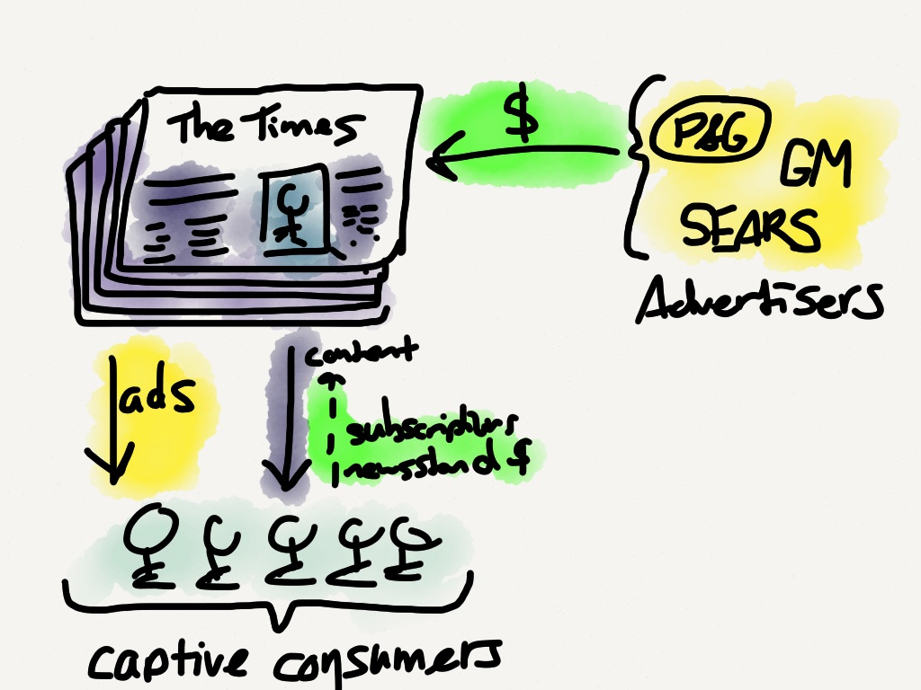
The old advertising model involved a captive audience; a middle-man needed only to deliver content
http://stratechery.com/2013/might-twitter-maximize-potential/

Slide 12
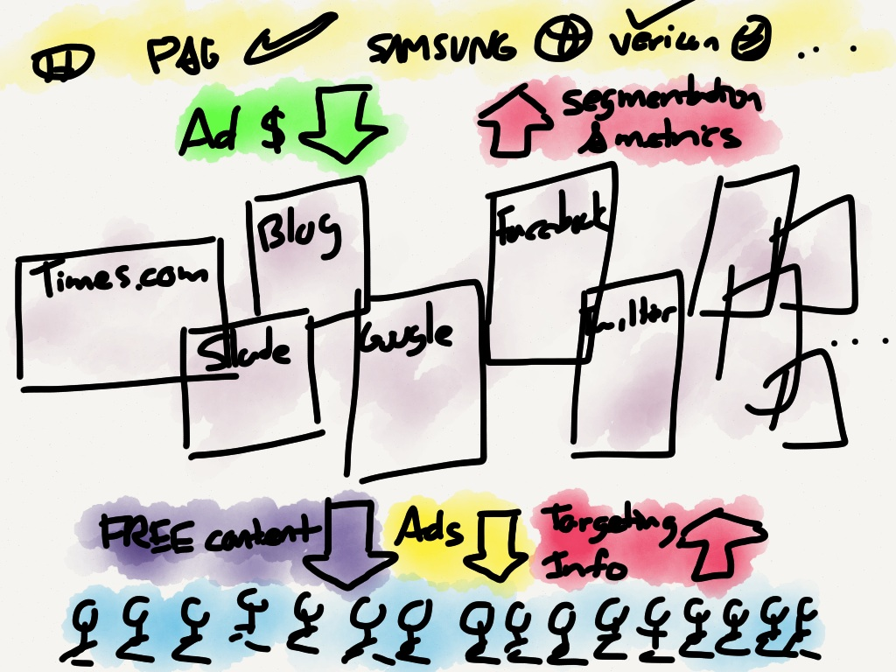
On the Internet, those in the middle have to deliver superior content and also collect superior targeting information
Experience?
http://stratechery.com/2013/might-twitter-maximize-potential/

Slide 15
Network favors scale
Platform – concentrates data, infrastructure, …
Community/network forms around platform
Network effects are central
Social and analytics are central
Gravitational hubs: the rich get richer
Strong seo and referencability
End user
Social
Analytics
Management

Slide 16
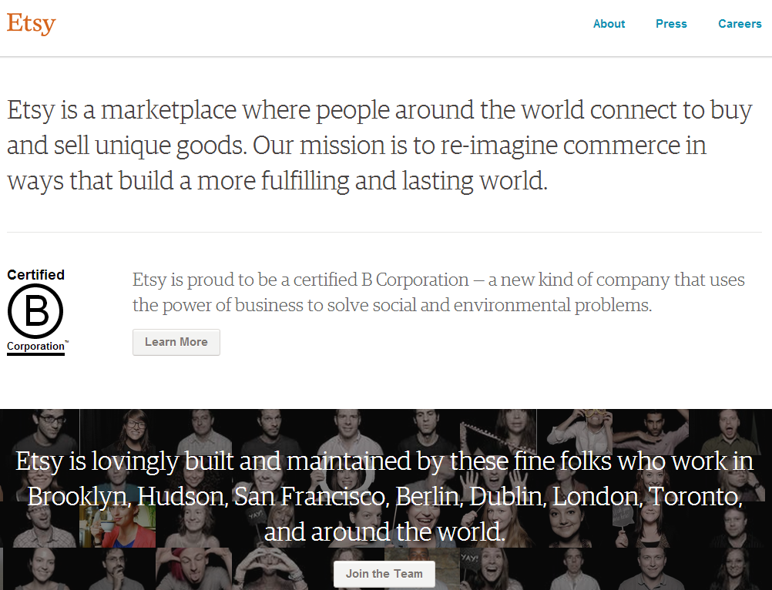

Slide 17
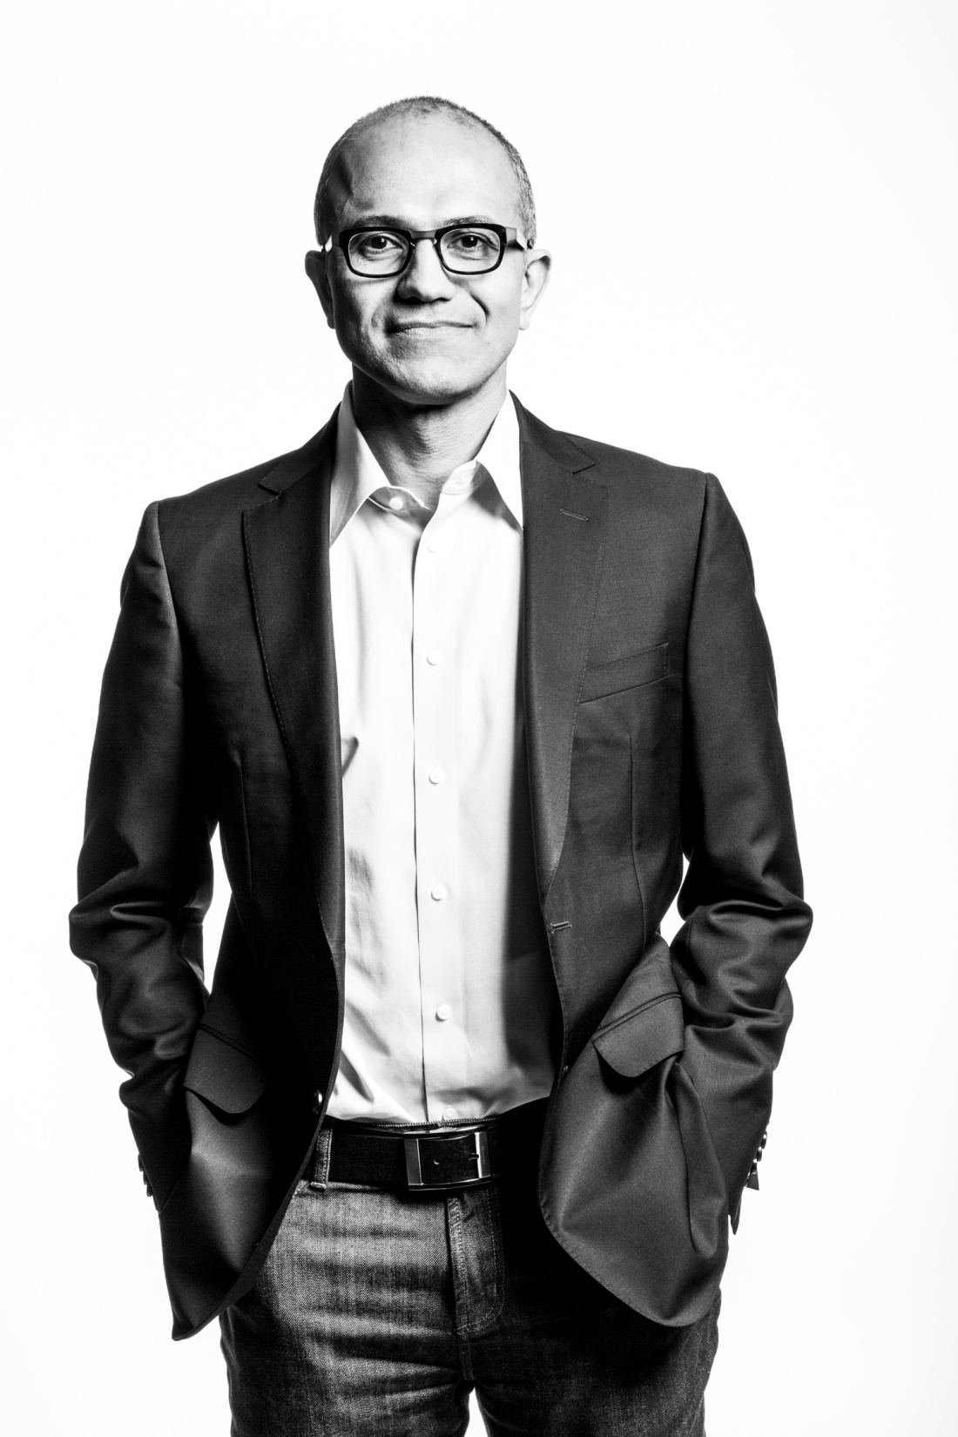
“Our job is to ensure that Microsoft thrives in a mobile and cloud-first world.”
http://www.theverge.com/2014/2/4/5377318/microsoft-ceo-satya-nadella-first-letter-to-employees

Slide 18
Harvard Business Review (1999)

Slide 19
Attracting and building relationships with researchers and learners
“Service-oriented”, customization
Economies of scope important
Develop new
services and have them accepted
Speed/flexibility important
Engagement
Innovation
Infrastructure
Back office capacities that
support day-to-day operations
“Routinized” workflows
Economies of scale important
Note: Hagel et al talk about
customer relationship management
rather than engagement

Slide 20
Locally
assembled
collections.
The place to go.

Slide 21
Rightscaling
Engagement
Innovation
Value
Unable to identify source of image

Slide 22
Focus?
Strategy is about choices …
Reconnect with parent’s goals …
Where is distinctive local impact?
Enrich student experience
Improve research effectiveness and impact
Promote civic engagement
Equip citizens with learning skills and tools
What should be done collaboratively?
What should be done by others?

Slide 24
Shift to engagement
… the library as an effective actor in the research, learning and skills environments of its users
Rightscale infrastructure
… rebalance investment in collections and systems between local, shared and third party to improve impact and efficiency. Collaboration moves from margin to core.
Innovate – scalable and repeatable
… institutions and services need to evolve in sustainable ways.

Slide 25
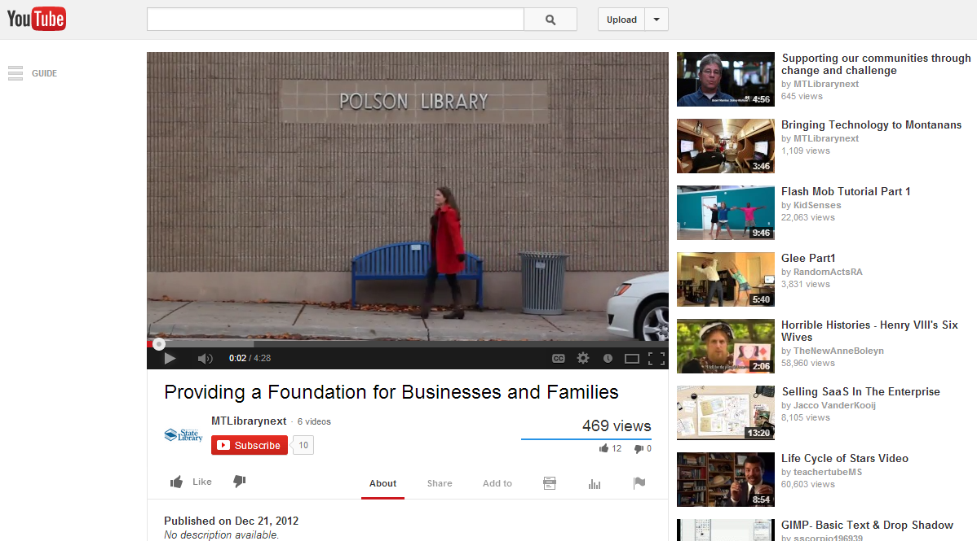

Slide 26
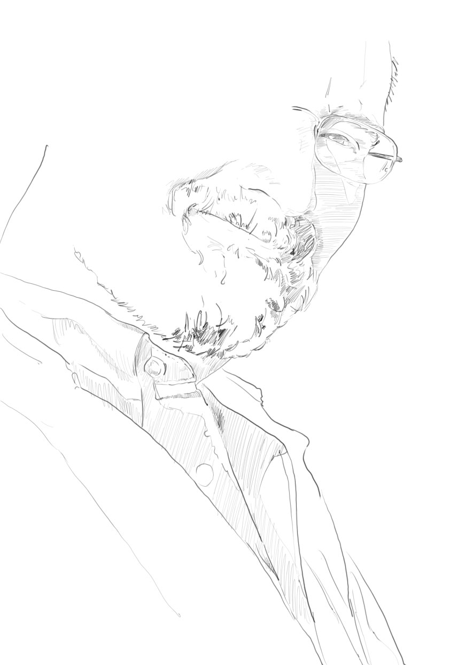
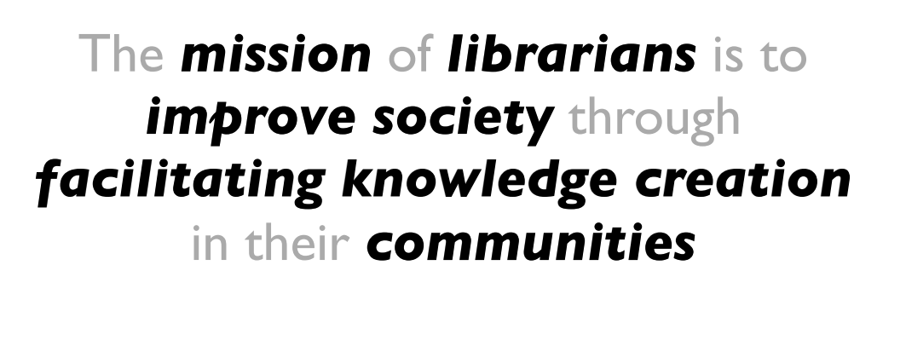
David Lankes:
http://quartz.syr.edu/blog/?page_id=27

Slide 27
Rightscaling
Engagement
Innovation
Unable to identify source of image

Slide 28
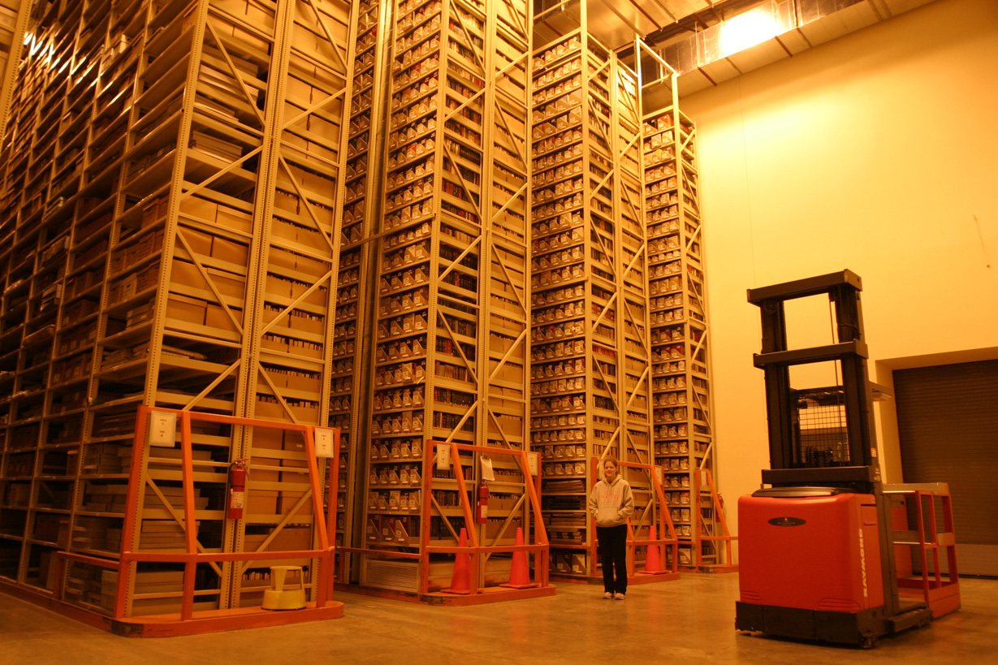
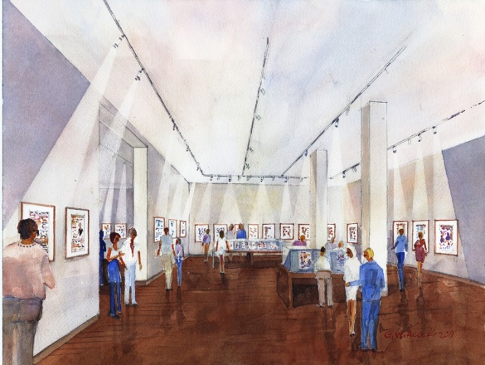
‘Cloud’ storage (Ohio State)
Rightscale infrastructure
http://library.osu.edu/blogs/cartoons/2012/02/28/blog-launch-and-the-construction-of-our-new-home-in-sullivant-hall/

Slide 29
Examples
Negotiation and licensing
Library systems infrastructure
Digital infrastructure
Processing capacity
Shared print
Managing down local print
Evolving shared approaches.

Slide 30
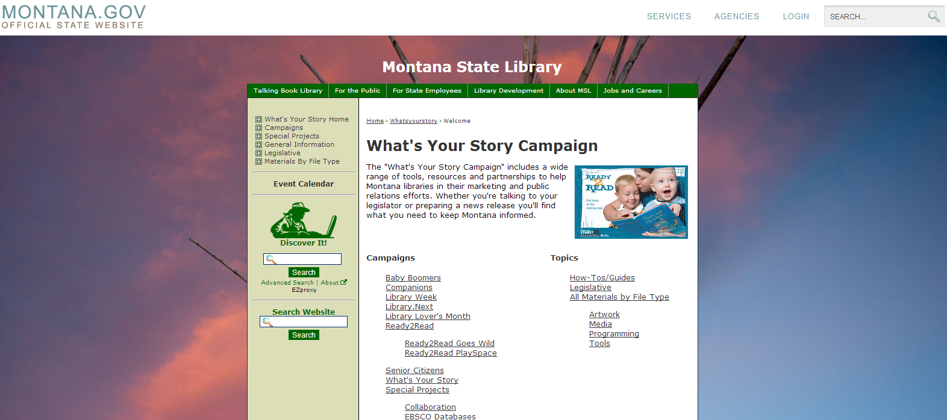

Slide 31
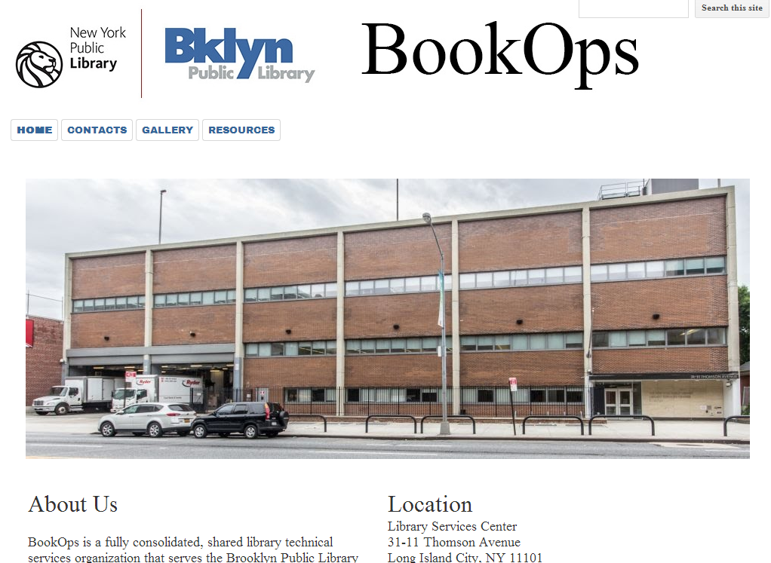

Slide 32
Do locally what creates most distinctive value. Share what makes sense for efficiency and impact. Buy the rest.

Slide 33
Shared print Then: Value relates to depth and breadth of local collection. Now: Value relates to systemwide curation of and access to print collections.

Slide 34
Digital and systems infrastructure Then: Local build or control. Now: Look to scale for efficiency and impact.

Slide 35
Collaborative sourcing –
cooperation moves from the margins

Slide 36
“aggregate and scale towards a common infrastructure”

Slide 37
“
Colleges and universities have long competed against one another, measuring themselves in comparison to each other and holding tightly to their idiosyncrasies as defining elements of their status. But today, the distribution and reuse of information digitally via the Internet is rapidly changing the game, rewarding those who instead aggregate and scale toward a common infrastructure. It is becoming increasingly clear that neither the challenges that confront colleges and universities nor the solutions to those challenges are unique to each institution.
Chuck Henry and Brad Wheeler The game has changed
Educause Review, March 2012

Slide 38
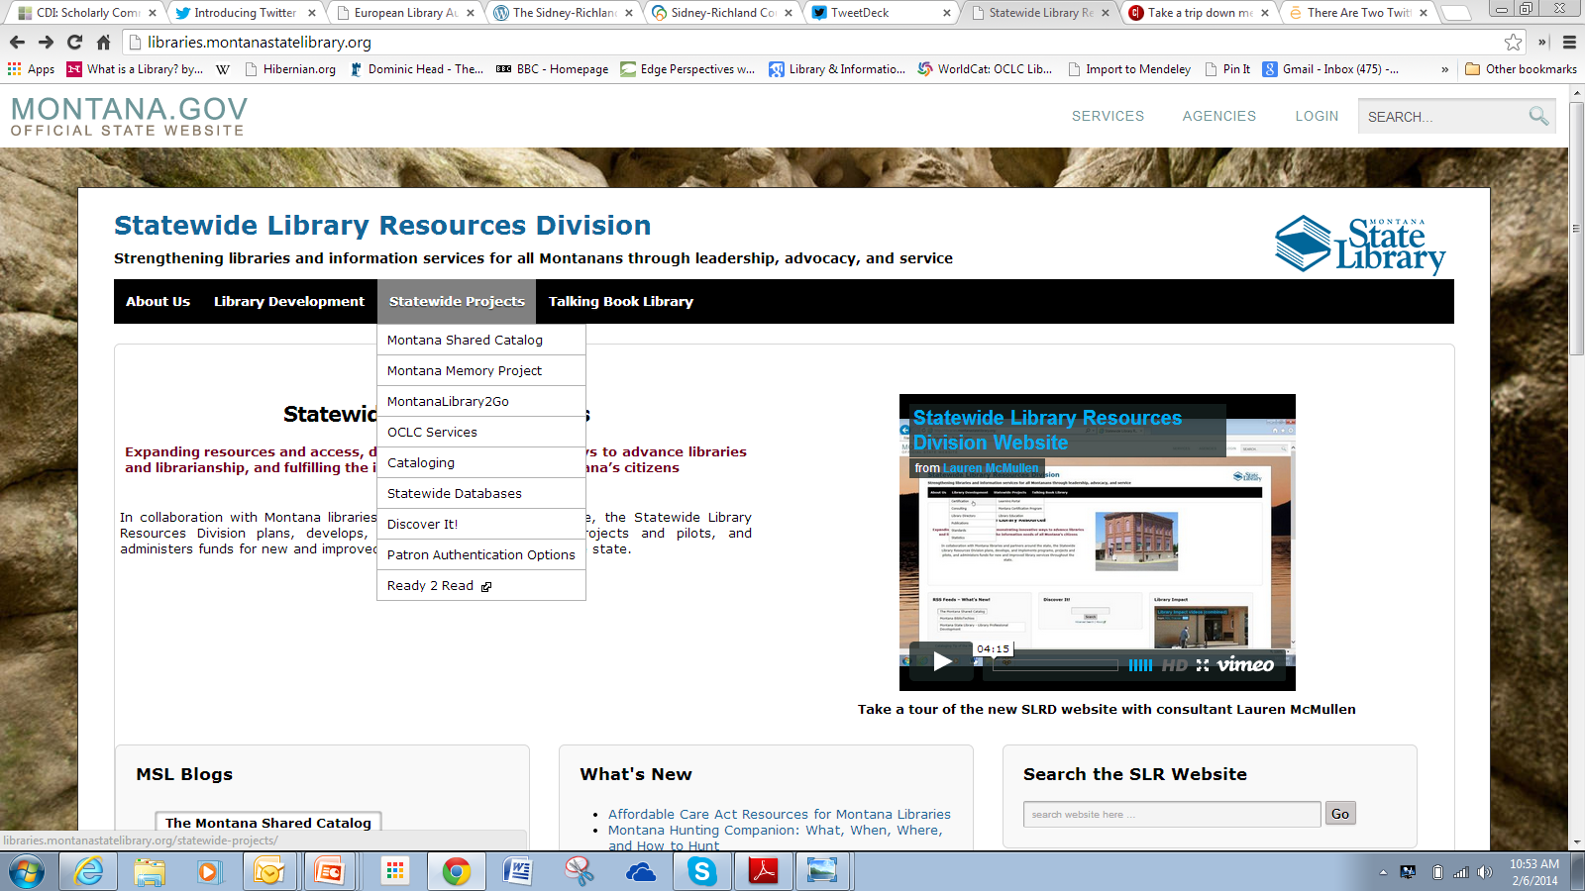
Institutional > State/Consortium > Region/national > global
Collaboratively source or buy from third party
Control vs economy
A new institutional context: agreed mutual dependence on shared/remote services

Slide 39
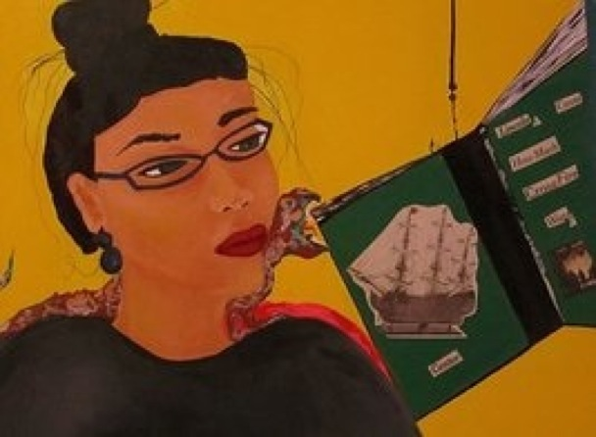
Engagement

Slide 40
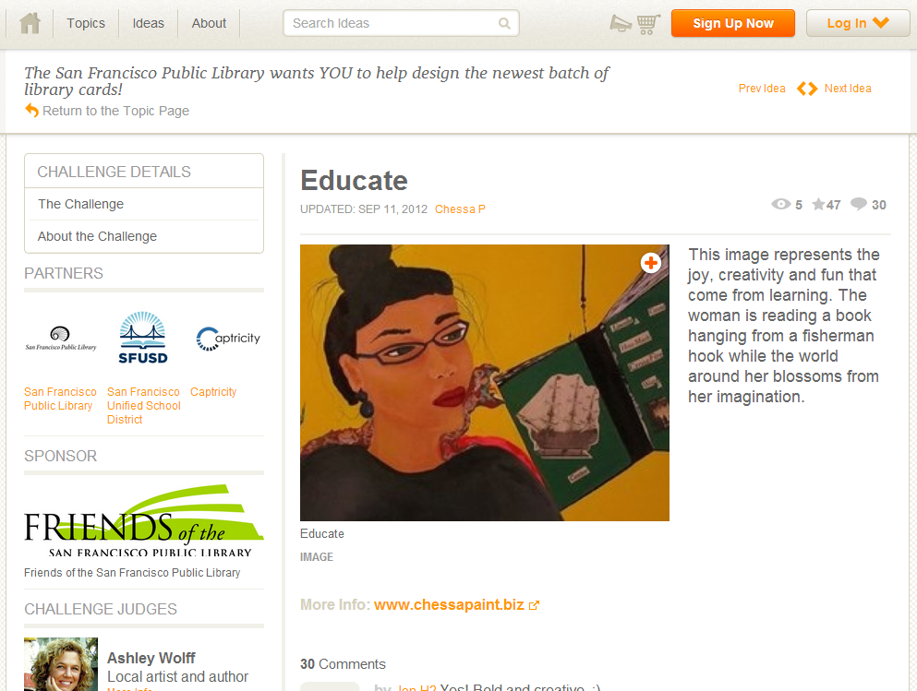

Slide 41
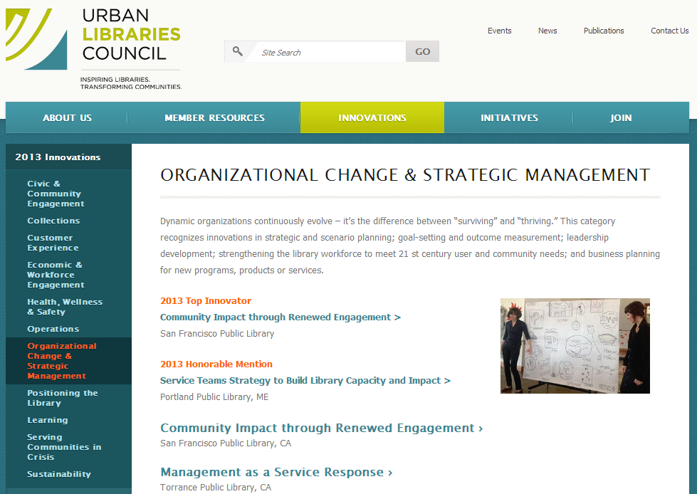

Slide 42
Examples of engagement
Visible expertise: the power of pull
Getting a life job done: community, career, learning, health
Beyond cur-sumption: directly supporting creation
Reconfigured space: configure around experiences not collections
Decentered web presence: in the flow

Slide 43
Visible expertise Then: Invisible and neutral. Now: If the library wishes to be seen as expert, then its expertise must be seen.

Slide 44
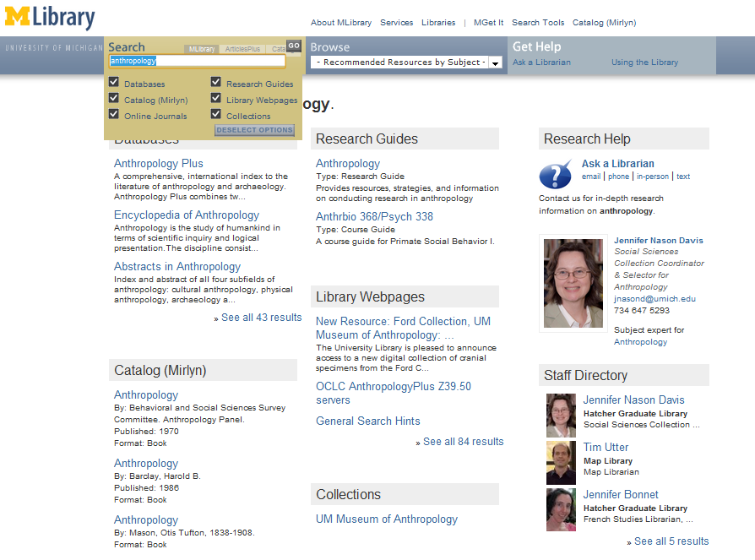
‘Indexing’ librarians at U Michigan

Slide 45
Slide from Pat Losinski, CEO Columbus Metropolitan Library

Slide 46
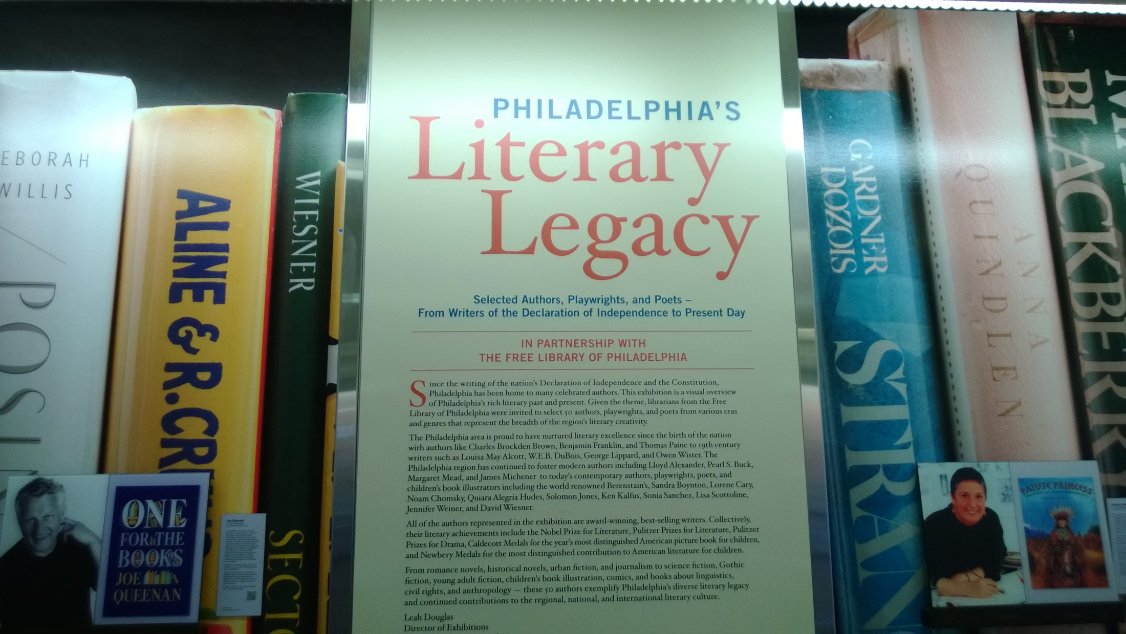
in

Slide 47
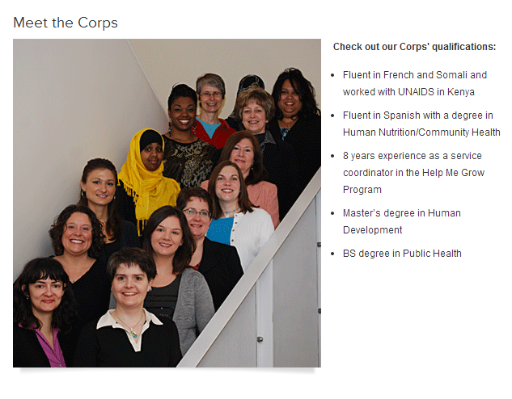
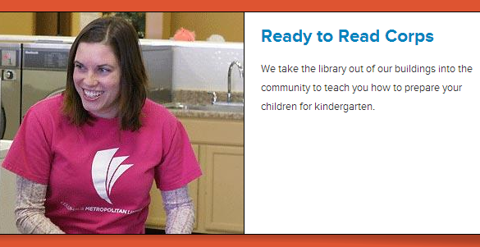

Slide 48
Transformation of the academic library
Kurt de Belder
http://www.oclc.org/content/dam/research/events/dss/ppt/dss_debelder.pptx

Slide 49
Skills to get a life job done Then: Provide access to information Now: Provide information and resources to get a life job done.

Slide 50
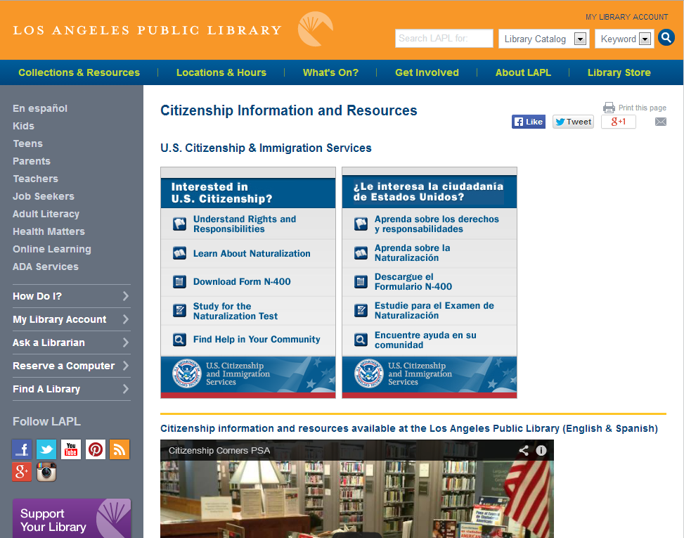

Slide 51
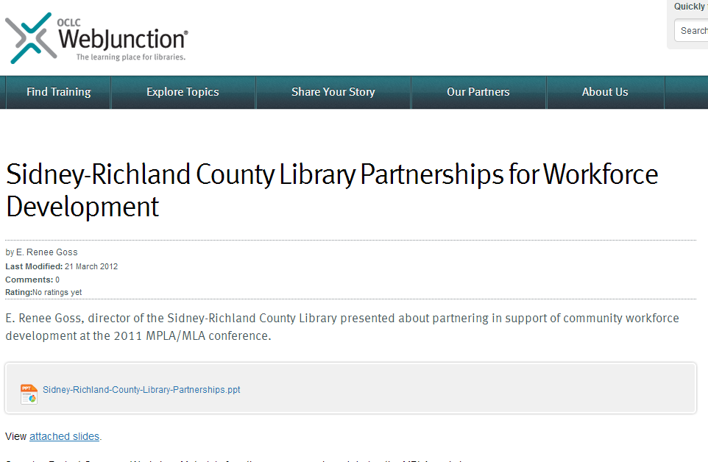
Job Services Employment Commission
Family Resource Center
Life Long Learning Action Group

Slide 52
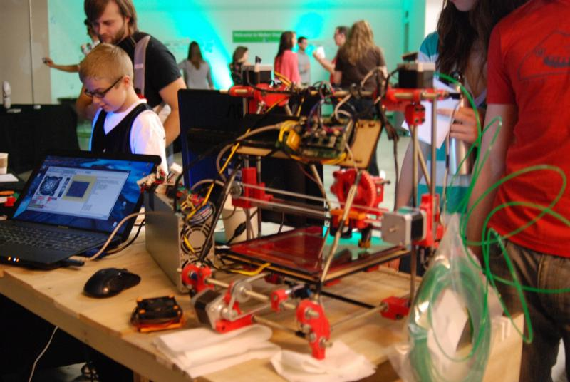
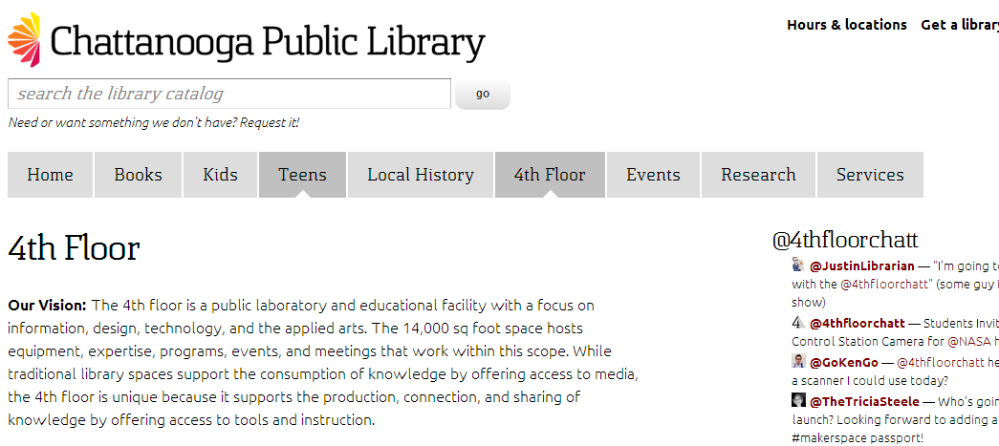

Slide 53
From curation/consumption to creation/curation/consumption Then: Acquire external resources Now: Engage with creation, use and sharing of all information resources.

Slide 54
Outside in Bought, licensed
Increased consolidation
Move from print to licensed
Manage down print – shared print
Move to user-driven models
Aim: to discover
The Inside out Library
Institutional assets: special collections, research and learning materials, institutional records, community resources, … Reputation management Increasingly important?
Publishing Aim: to *have* discovered … to disclose
Notes:
Licensed content will dominate in years to come.
Special collections will grow but only modestly (and only at some institutions); mostly growth in managing archival resources including institutional.
Much greater investment in managing research outputs.
No change in web archiving.

Slide 55
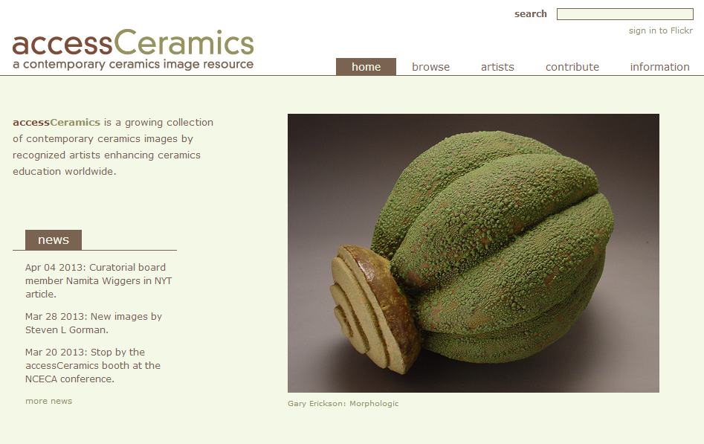
Collaboration with department around
community and learning resource
accessCeramics merges a traditional academic digital image collection's metadata capabilities with Flickr's openness and flexibility. It seeks to take advantage of Flickr's software tools and social network while also providing a web interface customized to this collection.

Slide 56
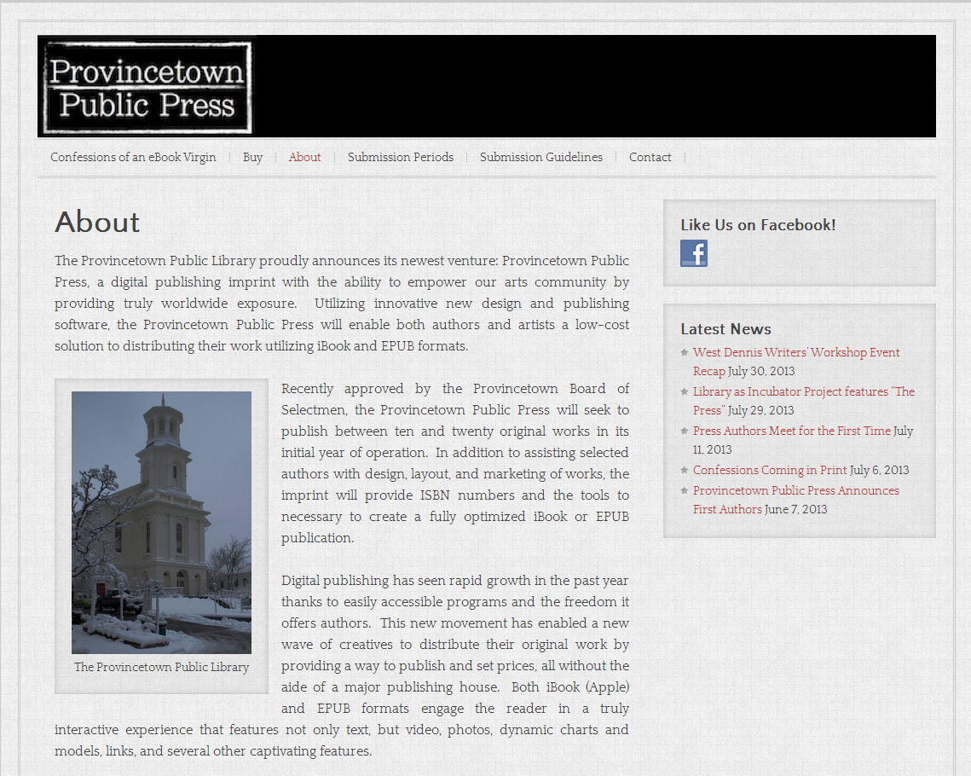

Slide 57
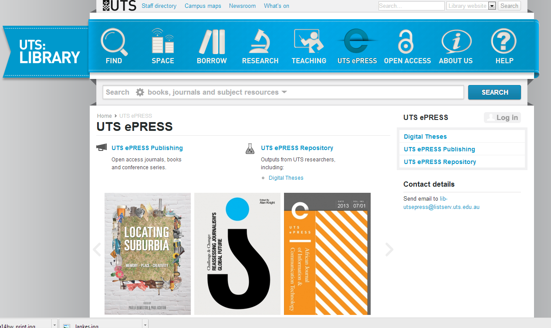

Slide 58
By Ardfern (Own work) [CC-BY-SA-3.0 (http://creativecommons.org/licenses/by-sa/3.0) via Wikimedia Commons
People should think not so much of the books that have gone into the … Library but rather of the books that have come out of it. Seán O'Faoláin

Slide 59
Space Then: space is configured around collections Now: space is configured around experiences

Slide 60
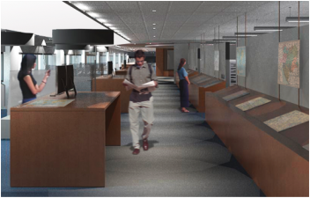
… unique combination of collections, government information expertise, and data services ….
Our new proximity, in a purposefully designed and equipped space, means that we can more effectively collaborate with each other, which in turn really enhances our ability to creatively collaborate with students, faculty, and researchers.
The new library features 60-foot long counter to enable the examination of large-format maps; a presentation space that will accommodate instruction; display cases and screens that showcase items from the print and digital collections; a large-format high-resolution scanner that produces digital copies for online work or the creation of full-size print copies; individual and group study spaces with dual-screen computers and laptop accessibility; and comfortable, moveable furniture for flexible study and collaboration.
We expect the Clark to become the campus nexus for the various data services that all disciplines increasingly require, …
Stephen S. Clark Library

Slide 61
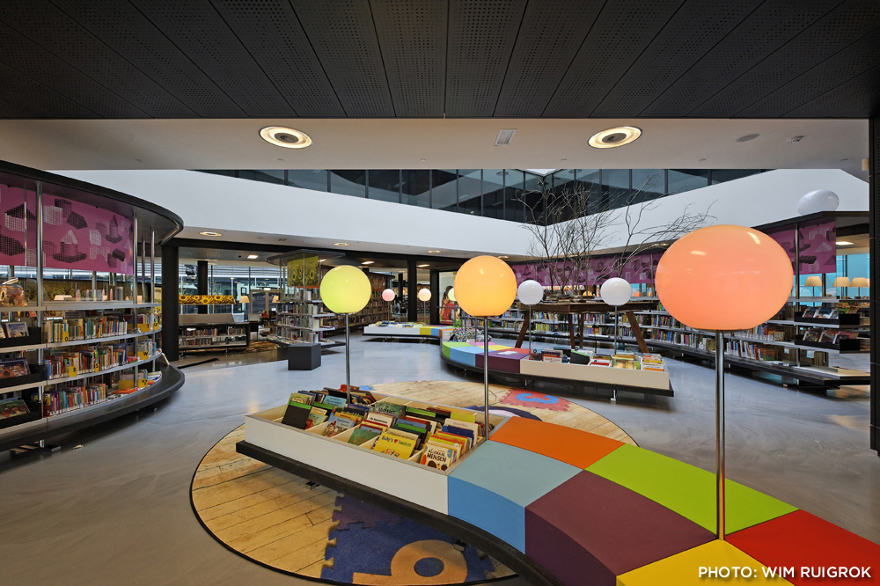
Almere Public Library, The Netherlands

Slide 62
The decentered web presence Then: discovery happened at the library Now: discovery happens elsewhere. Focus on ‘discoverability’ in multiple environments.

Slide 63
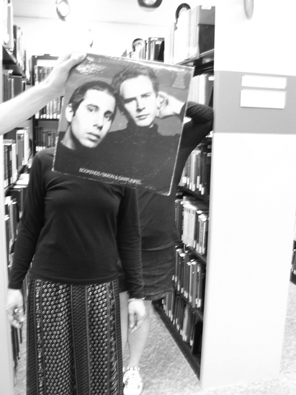
Creating conversations around collections:
Sleevefacing at Bowling Green State Univ
http://blogs.bgsu.edu/librarysleevefacing/2012/08/15/bookends/

Slide 64
Decoupled Communication
Flickr
Blogs
Facebook
Twitter
Google
Youtube
Discovery
Knowledgebase
Libguides
Cloud Sourced
Resolver

Slide 65
WorldCat
ArchivesGrid
Metadata
Summon
Scirus
Blogs
Suncat
Europeana
RSS
Catalogue
Ethos
Mobilepp
Proxy Toolbar
Dspace
Linked Data (Catalog)
OAI-PMH (Dspace)
Discovery
Services
Proxy Widgets
External Syndication
Library APIs
Z39.50
Data
Jorum
Digital Archive

Slide 66
Venues
Wikipedia
Configure resolver in Scholar, Mendeley, etc
Claim library in OCLC Spotlight
Google Books (holdings up to date)
SEO – best practice for websites and repositories

Slide 67
Engagement
Orientation to the user/parent institution
Create value in research and learning process
The ‘power of pull’
Make expertise visible

Slide 68
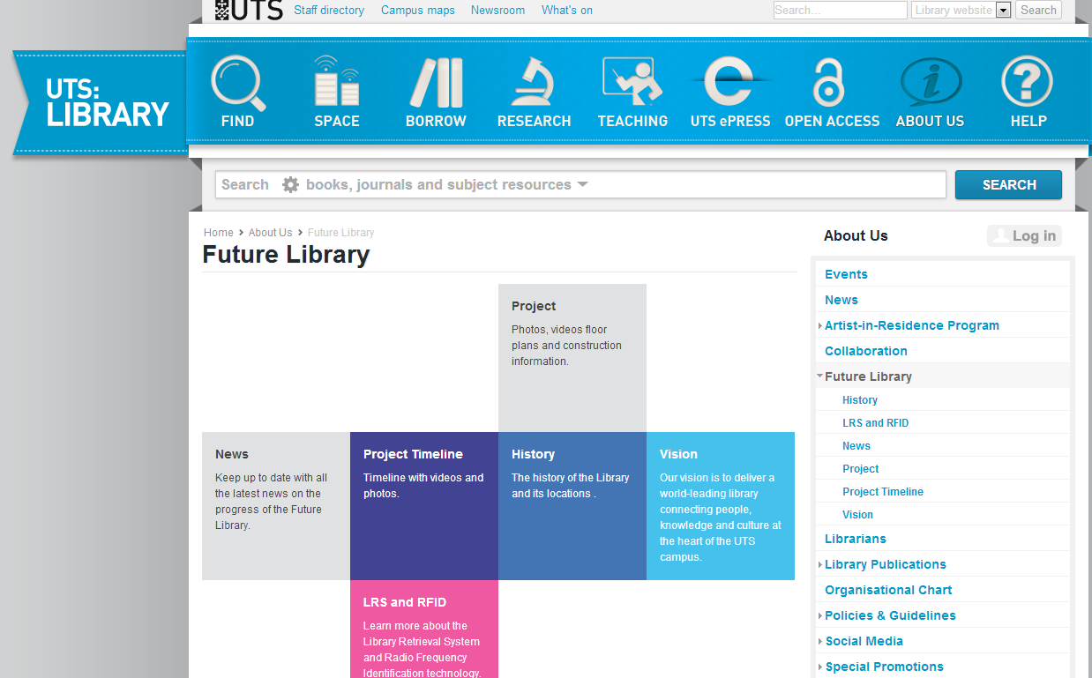
Innovation

Slide 69
Innovation
Enterprise vs bureaucracy
New forms of engagement
Institutional innovation
Skills
‘Repeatable and scalable’
What’s a startup. http://steveblank.com/2010/01/25/whats-a-startup-first-principles/

Slide 70
A shift to engagement .. the library as an actor in research and learning environments of its users. Reduce infrastructure which does not have a distinctive impact. Share to create scale. Innovate around new forms of engagement and around institutional patterns? Move resources to valuable activities – enterprise. Carry forward what can become scalable and repeatable.

Slide 71
A reset moment
The library should not provide an argument for a particular case, but demonstrate that there is always another case to be made. The notion that the library is a place that has no agenda other than allowing people to invent their own agendas is what makes it an indispensable resource for a democracy. It is where we can learn not just to be readers, but to be the authors of our own destiny. Fintan O’Toole
Dublin City Public Libraries, Flickr: http://www.flickr.com/photos/dublincitypubliclibraries/6029467474/in/set-72157594513778442

Slide 72
Credits
Constance Malpas for the Worldcat data analysis and text on slide 33.
Chrystie Hill and Jennifer Peterson for some suggestions of library examples.
J.D. Shipengrover for the decentered web presence pics.
Engagement, innovation, and infrastructure framework influenced by: John Hagel and John Seely Brown. “Unbundling the corporation.” Harvard Business Review, 77, 2. January 1, 1999

Slide 73
@LorcanD
Lorcan Dempsey

