Slide 1
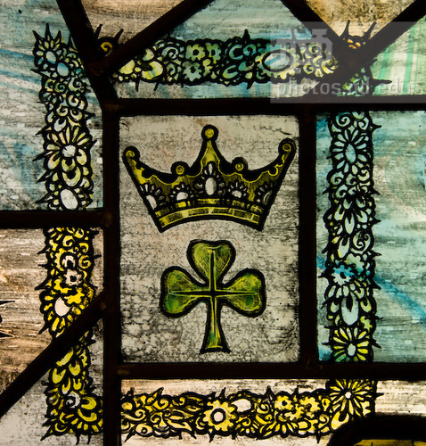
http://photos.nd.edu/image/I0000zhFgnbUJDqY
@LorcanD
Lorcan Dempsey, OCLC
Environmental trends and OCLC Research. Notre Dame University, 28 September 2015

Slide 2
Membership and Research
Member
relations
Research
Programs
Research Library Partnership
WebJunction

Slide 3
Prelude
Collection: centers and comps

Slide 4
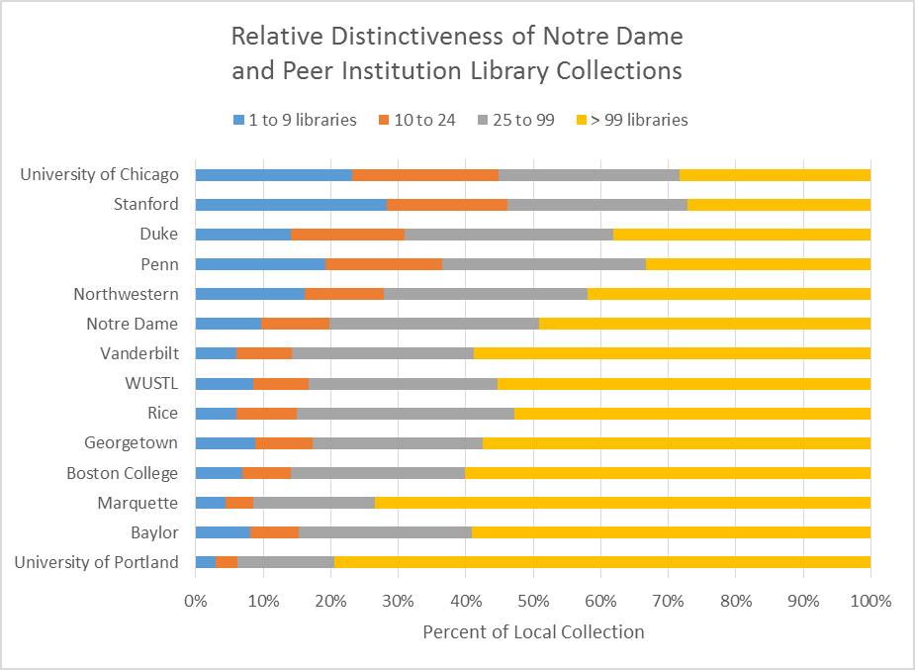
… relative scarcity of holdings not the best indicator of library’s contribution to institutional mission
Based on August 2015 WorldCat snapshot; excludes Law and Medical Library holdings.
Notes:
As a general rule, the relative proportion of ‘rare’ and distinctive library holdings is proportional to the size of the collection. Libraries with very large collections will tend to have a greater share of comparatively rare materials.

Slide 5

10 subjects for which Notre Dame holds more titles other libraries in WorldCat:
FAST Subject Heading | Titles
Thomas,--Aquinas, Saint,--1225?-1274 | 2,219
Christian ethics--Catholic authors | 1,213
Mass | 661
Lord's Supper--Catholic Church | 598
Sacraments--Catholic Church | 560
Dario, Ruben,--1867-1916 | 487
Papal documents | 414
Laity--Catholic Church | 364
Catholic Action | 354
Catholic universities and colleges | 311
Collection strengths reflect distinctive institutional identity
Title count and ranking based on March 2013 WorldCat snapshot
Notes:
NB: St Thomas Aquinas is the patron saint of Catholic colleges and universities
Ruben Dario is a celebrated Nicaraguan poet whose work is characterized by Catholic themes; Notre Dame has an extensive collection of his works in Special Collections.

Slide 6
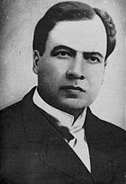
15 most comprehensive
collections related to:
https://commons.wikimedia.org/wiki/File:Rub%C3%A9n_Dar%C3%ADo.jpg
Coverage based on March 2013 WorldCat snapshot
Notes:
Title-count collection strengths often correspond to subject areas for which the library is also distinguished with respect to coverage or comprehensiveness. This figure shows that ND has the most comprehensive collection of works by Ruben Dario, representing almost a quarter of the related literature in WorldCat.

Slide 7

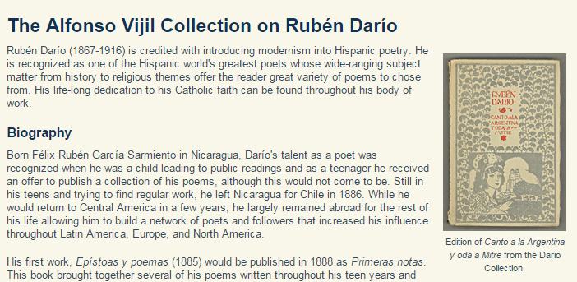
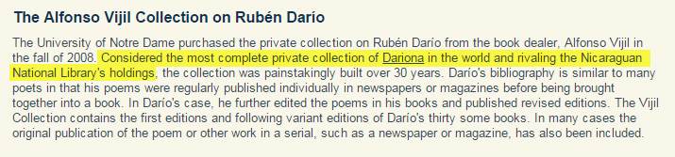
http://rarebooks.library.nd.edu/collections/latin_american/dario.shtml

Slide 8
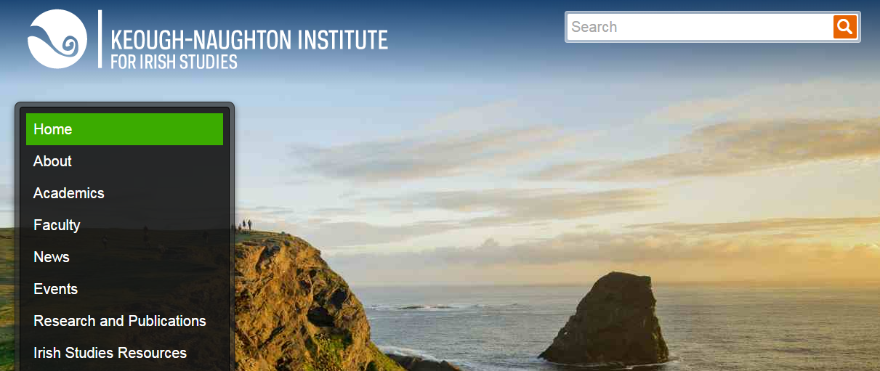
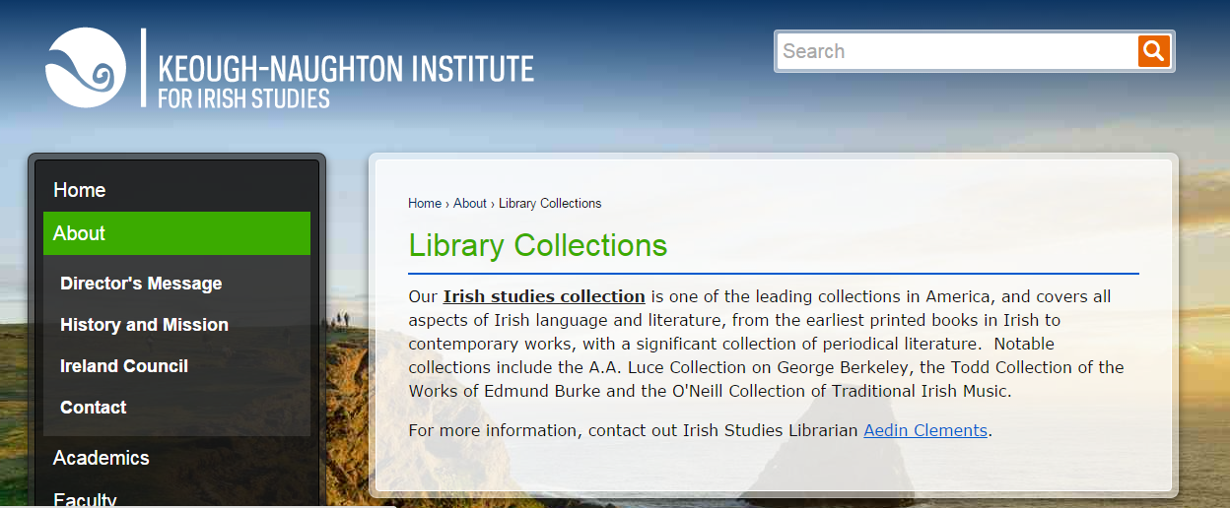
http://irishstudies.nd.edu/about/library-collections/

Slide 9
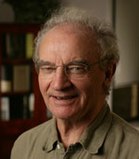
15 most comprehensive
collections related to:
http://irishstudies.nd.edu/faculty/faculty-fellows/seamus-deane/
Coverage based on March 2013 WorldCat snapshot

Slide 10
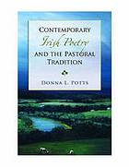


15 most comprehensive
collections related to:
Coverage based on March 2013 WorldCat snapshot
Notes:
Irish Studies are another area of emphasis in Notre Dame’s Special Collections, including large print collection of Irish poetry.

Slide 11
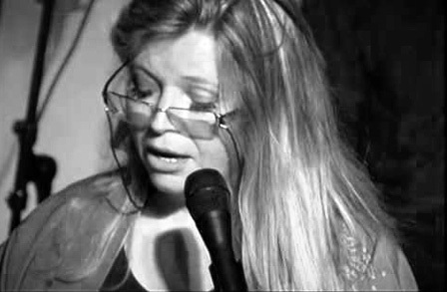
15 most comprehensive
collections related to:
http://www.poetryfoundation.org/bio/nuala-ni-dhomhnaill
Coverage based on March 2013 WorldCat snapshot

Slide 12
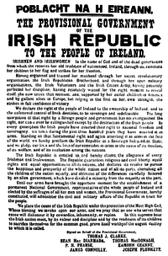
15 most comprehensive
collections related to:
https://commons.wikimedia.org/wiki/File:Easter_Proclamation_of_1916.png
Coverage based on March 2013 WorldCat snapshot
Coverage based on March 2013 WorldCat snapshot

Slide 13
Themes
OCLC Research

Slide 14
Research Collections & Support
Understanding the System-Wide Library
Data Science
User Studies
Scaling Learning

Slide 15
User studies
OCLC Research

Slide 16
Our traditional model was
one in which we thought of
the user in the life of the library
… but we are now increasingly
thinking about the library
in the life of the user

Slide 17
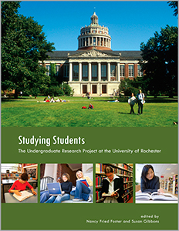
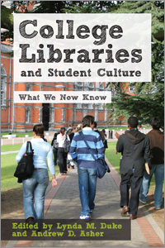


Slide 18
What people actually do, not what they say they do
The workflow context
Convenience and context switching
Fragmentation is a deterrent
The personal context
Relationship – sharing – engagement
The environmental context
Spaces and places

Slide 19
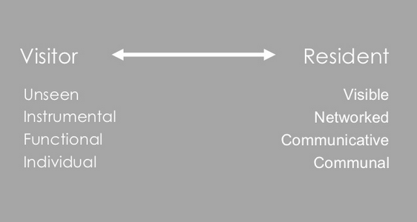
“Google doesn’t judge me” (UKF3)
#vandr

Slide 20
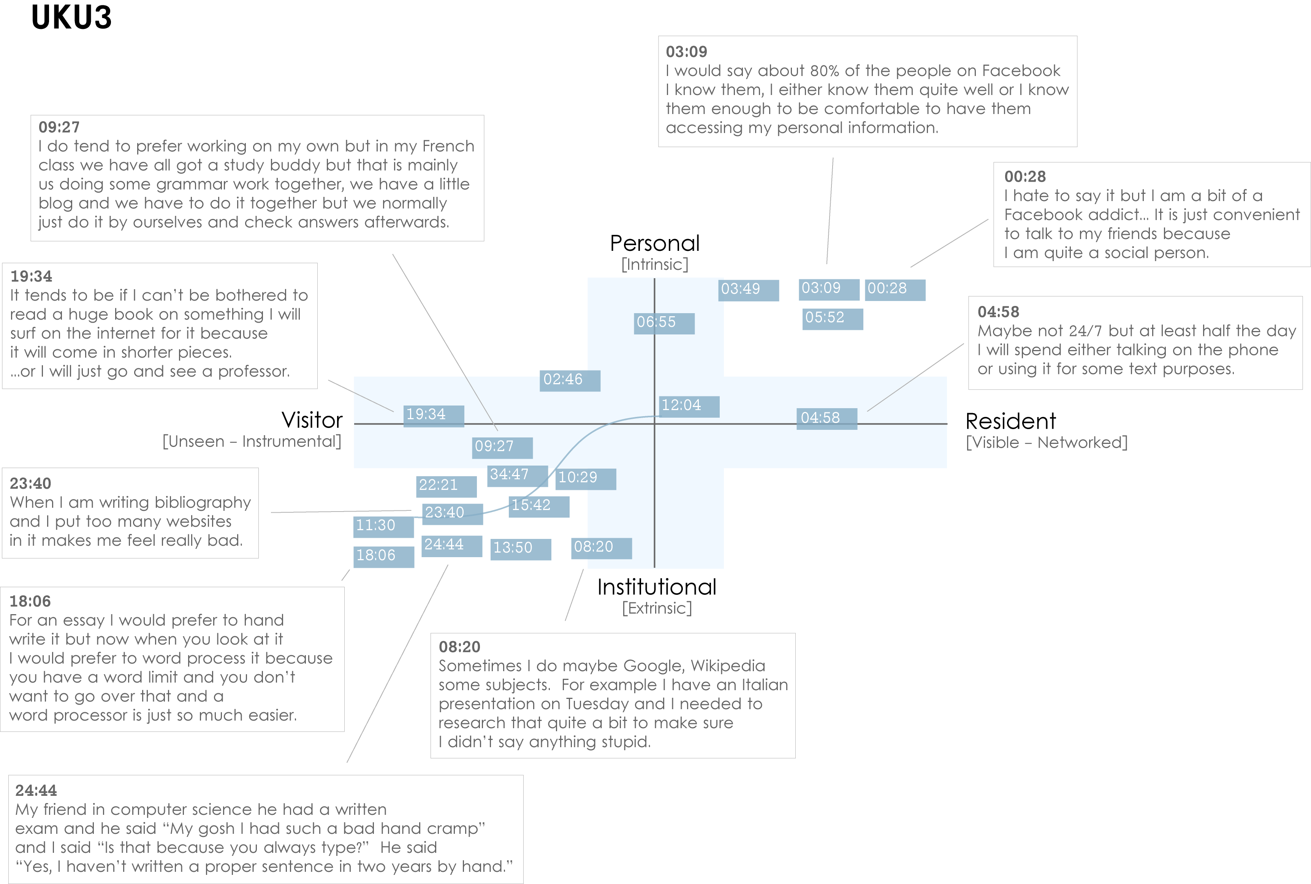
Notes:
Images created by David White, Co-manager, Technology Assisted Lifelong Learning, University of Oxford
Institutional Resident Gap
UKU3 (UK 1st year undergraduate)
This participant has a clear demarcation between Resident modes of engagement in her personal life and Visitor modes of engagement for study.
The map is a mode of engagement landscape onto which individuals can be plotted. The limits of the map have been defined by the four major framing concepts of the project: V&R – Personal and Institutional. The Personal end of the axis encompasses an individual’s private life, and the Institutional is their professional and/or academic life.
The data from the Emerging educational stage seem to suggest that individuals were engaging with systems and materials not provided by their institutions to do institutional work (e.g., consulting Wikipedia to write an essay). Such user-owned literacies, when mapped like this, take a prominent role in the academic work of many of our research subjects. Given the effect that the internet is having on collapsing the relationship between certain modes of activity and specific physical spaces, it is important not to tie notions of the intuitional and the personal to ideas of “school/university/library” and “home” as buildings.
White, D., & Connaway, L.S. Visitors & Residents: What Motivates Engagement with the Digital Information Environment. 2011-2012. Funded by JISC, OCLC, and Oxford University. http://www.oclc.org/research/activities/vandr/.

Slide 21

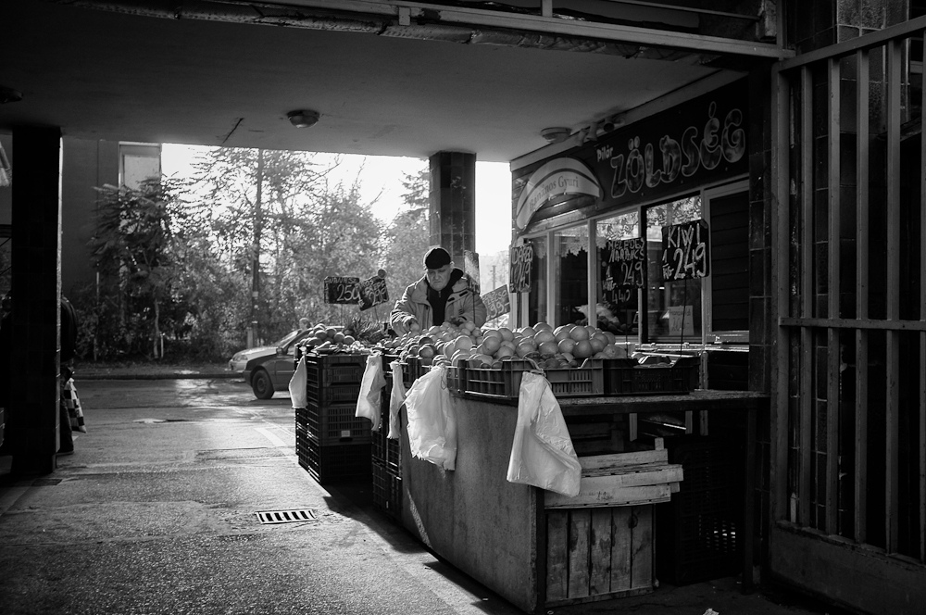
The Learning Black Market
“It’s like a taboo I guess with all teachers, they just all say – you know, when they explain the paper they always say, ‘Don’t use Wikipedia.’”
(USU7, Female, Age 19, Political Science)
Notes:
Image: http://www.deviantart.com/morelikethis/211376699
Covert online study habits
Wikipedia
Don’t cite
Widely used
Guilt
Students & teachers disagree
Quality sources
There is a “Learning Black Market”: learners use non-traditional sources but feel they cannot talk about them in an institutional context. Wikipedia usage is an example of this. (White & Connaway, 2011)
Connaway, Lynn Silipigni, Donna Lanclos, and Erin M. Hood. 2013. “I find Google a lot easier than going to the library website.” Imagine ways to innovate and inspire students to use the academic library. Proceedings of the Association of College & Research Libraries (ACRL) 2013 conference, April 10-13, 2013, Indianapolis, IN. http://www.ala.org/acrl/sites/ala.org.acrl/files/content/conferences/confsandpreconfs/2013/papers/Connaway_Google.pdf.
White, David. 2008. Not “natives’”& “immigrants” but “visitors’ & “residents.” TALL Blog: Online Education with the University of Oxford, April 23, http://tallblog.conted.ox.ac.uk/index.php/2008/07/23/not-natives-immigrants-but-visitors-residents/.
Saunders also found that faculty are “concerned with students’ reliance on Google and Wikipedia for information.” This may help to explain why many of the Emerging stage participants expressed a reluctance to acknowledge or cite Wikipedia in their work for fear of being ridiculed by faculty, or be given a lower grade. This is referred to as the Learning Black Market, which is discussed in more detail in Connaway, Lanclos, and Hood and White’s 2011 blog entry.
Saunders, Laura. 2012. Faculty perspectives on information literacy as a student learning outcome. The Journal of Academic Librarianship 38, no. 4 (2012): 231.

Slide 22
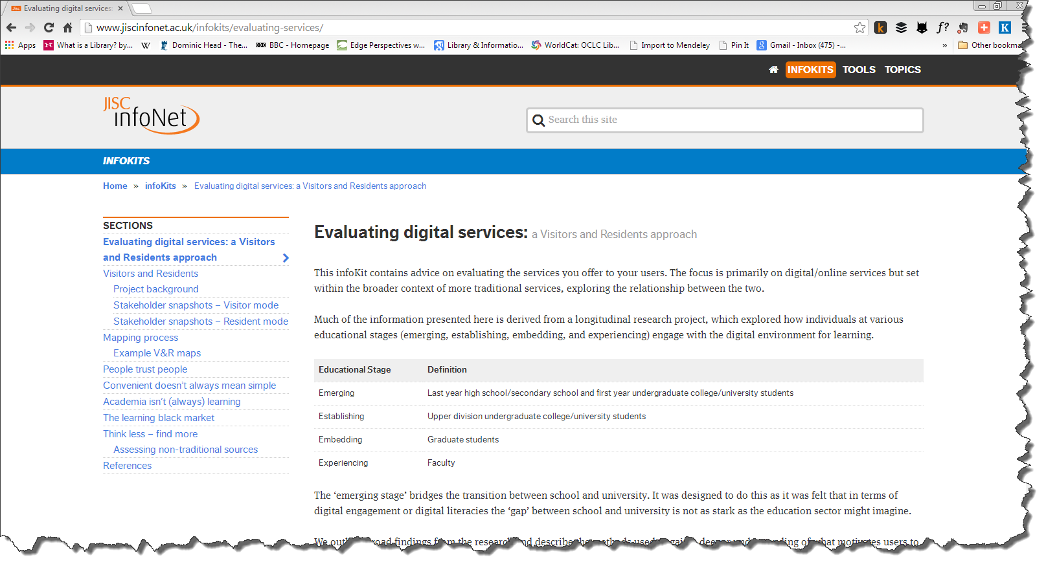
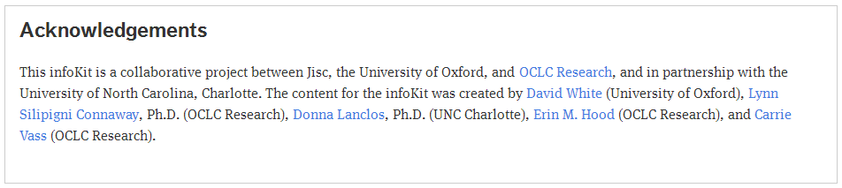

Slide 23
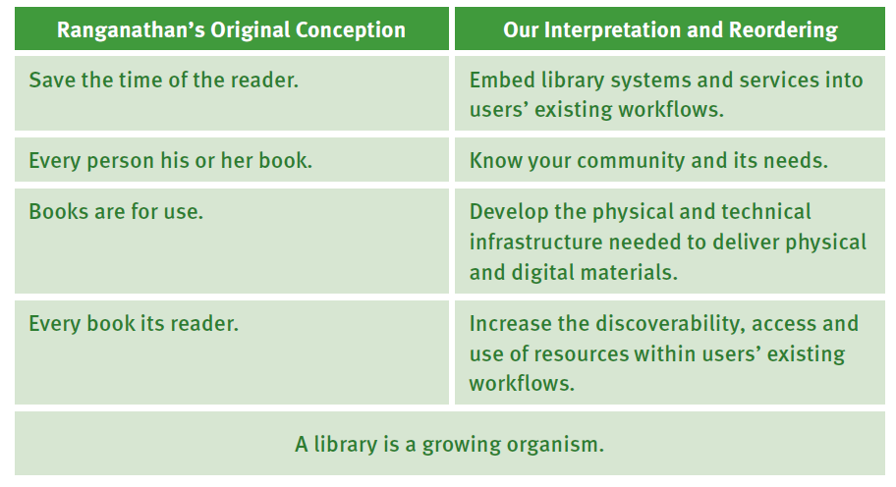

Slide 24
Research collections and support
OCLC Research

Slide 25
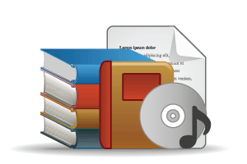

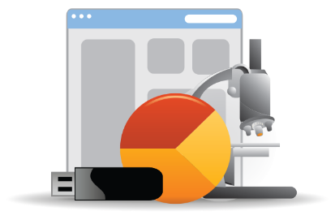
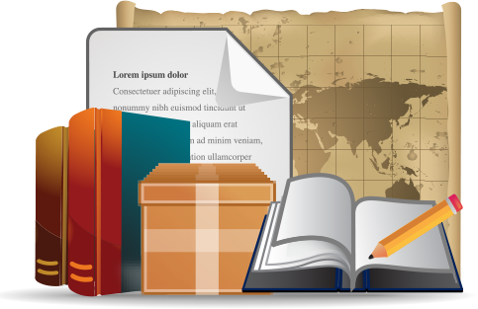
Open Web Resources
‘Published’ materials
In many collections
Licensed
Purchased
Low Stewardship
High Stewardship
Research & Learning Materials
In few collections
Special Collections
Local Digitization
Figure: OCLC Collections Grid.
OCLC Research, 2014

Slide 26
In many collections
Low Stewardship
High Stewardship
Research & Learning Materials
In few collections
Special Collections
Local Digitization
Figure: OCLC Collections Grid.
OCLC Research, 2014

Slide 27
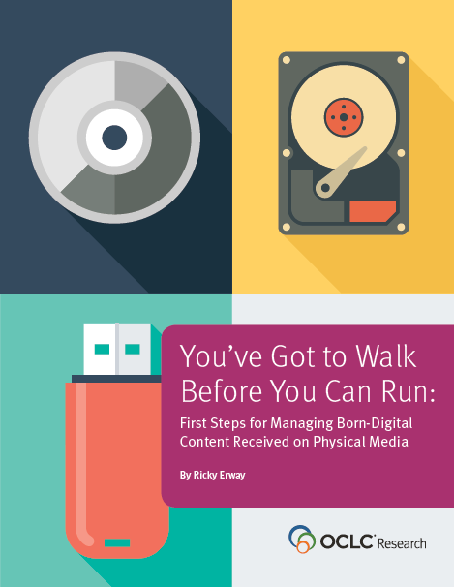
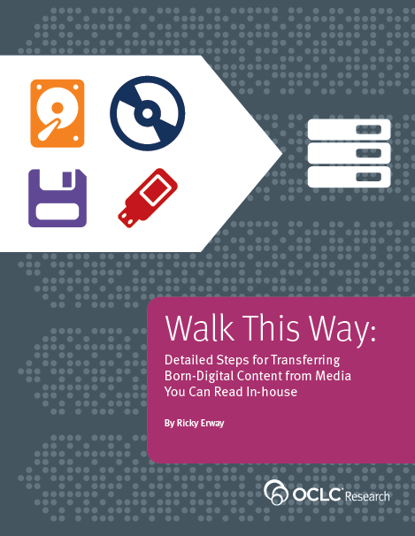

Slide 28
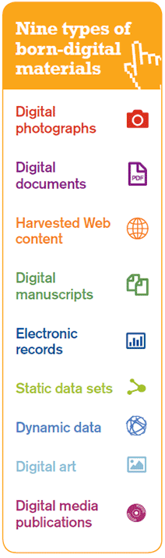
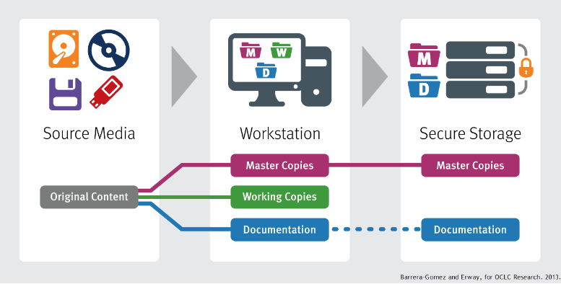

Slide 29
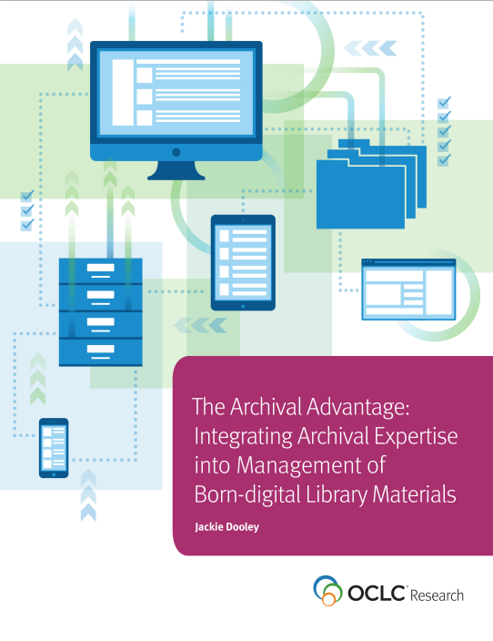
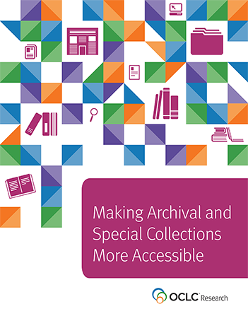

Slide 30
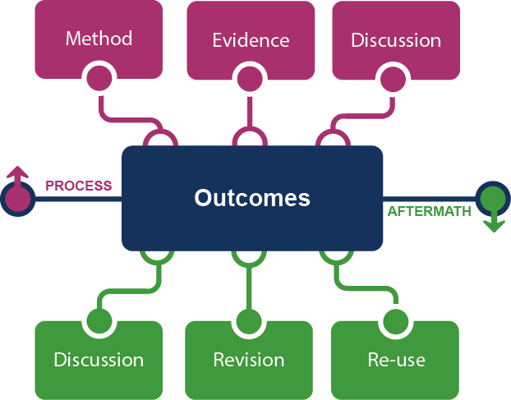
Framing the Scholarly Record …
Figure: Evolving Scholarly Record framework.

Slide 31



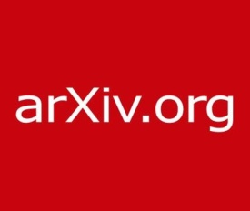

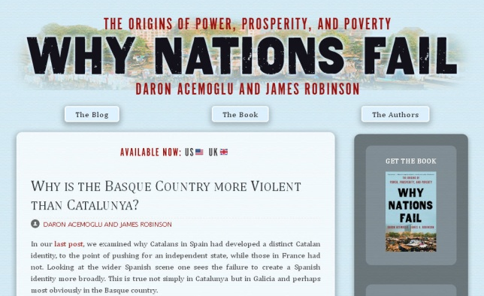


Figure: Evolving Scholarly Record framework, publishing venues.

Slide 32
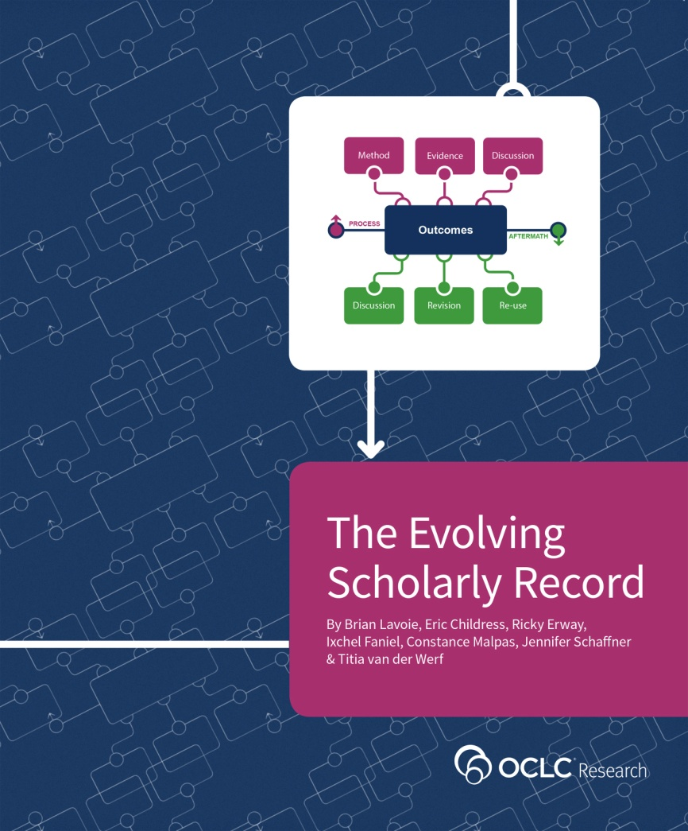
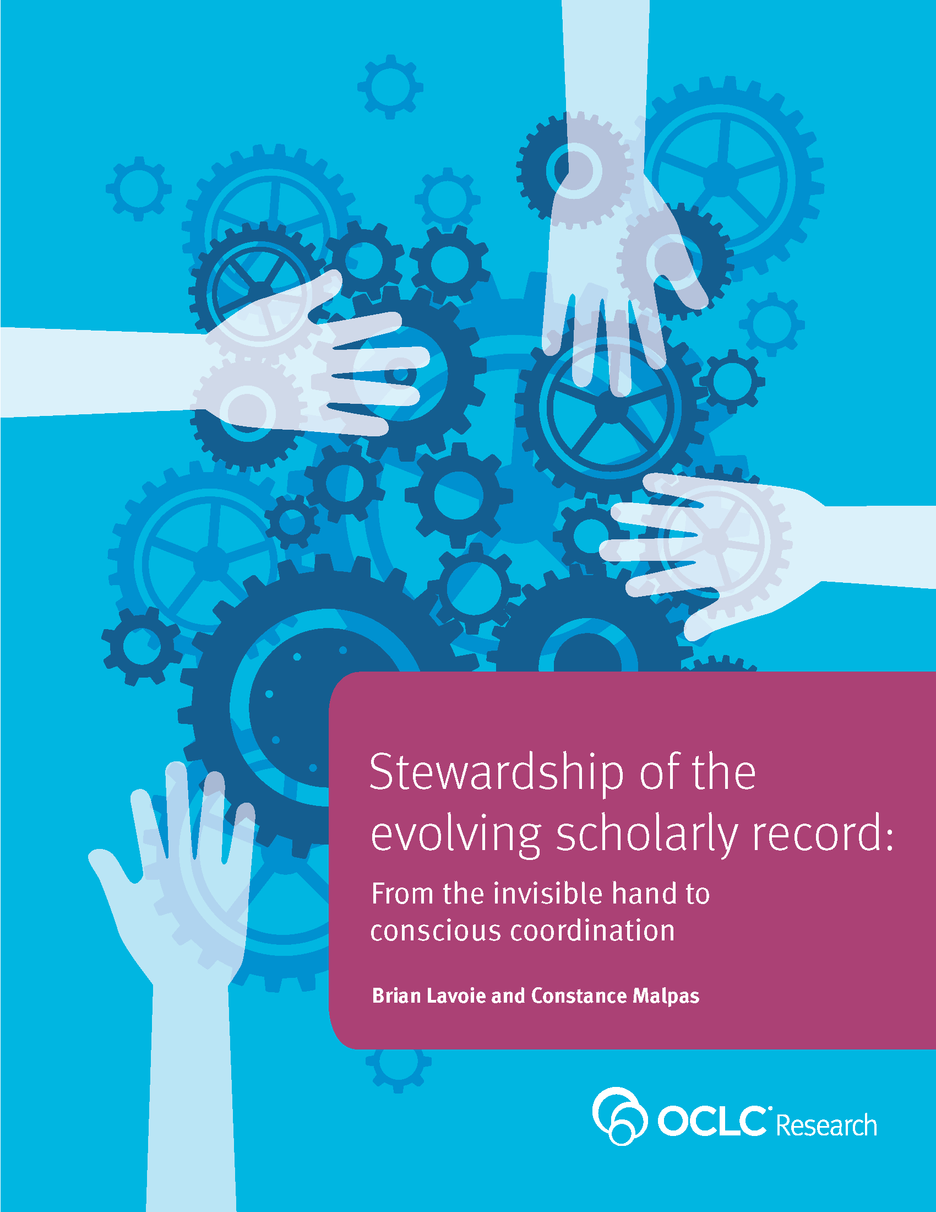

Slide 33
Data science
OCLC Research

Slide 34
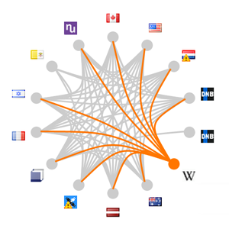
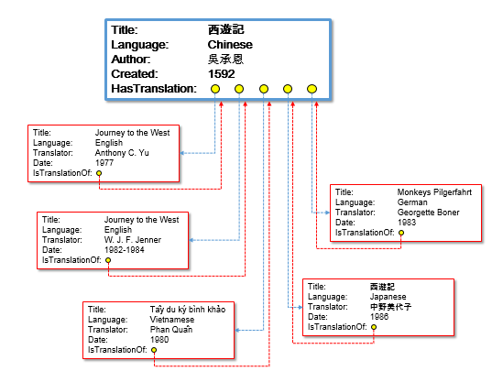
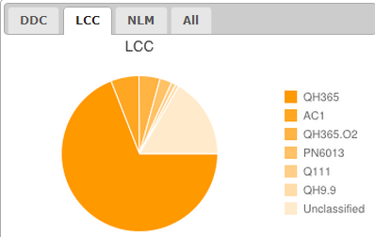
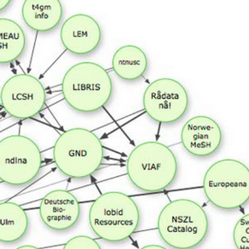
Data Science
Goal: Derive new meaning, insights and services from data-mining WorldCat and other sources for use on the Web.
Aggregate
Enhance
Mine
Expose

Slide 35
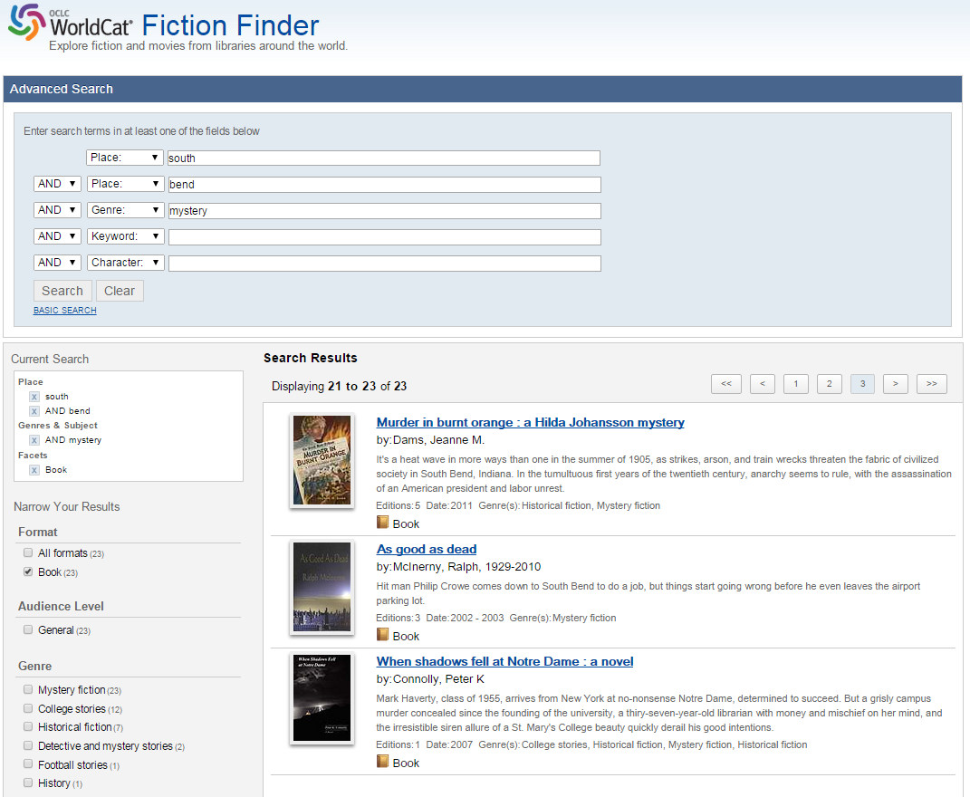

Slide 36
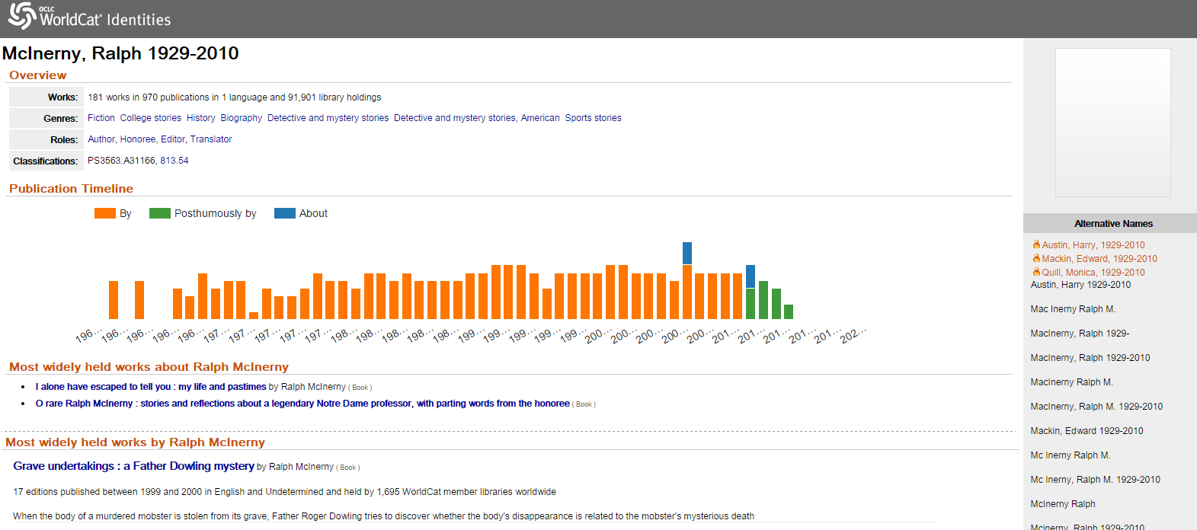
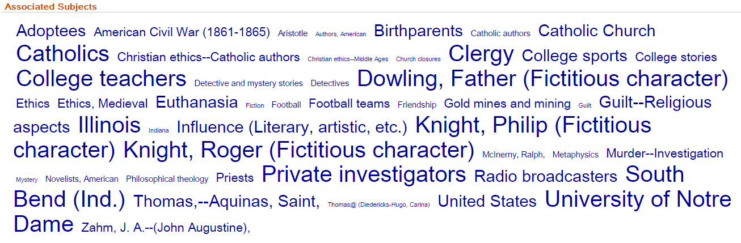

Slide 37
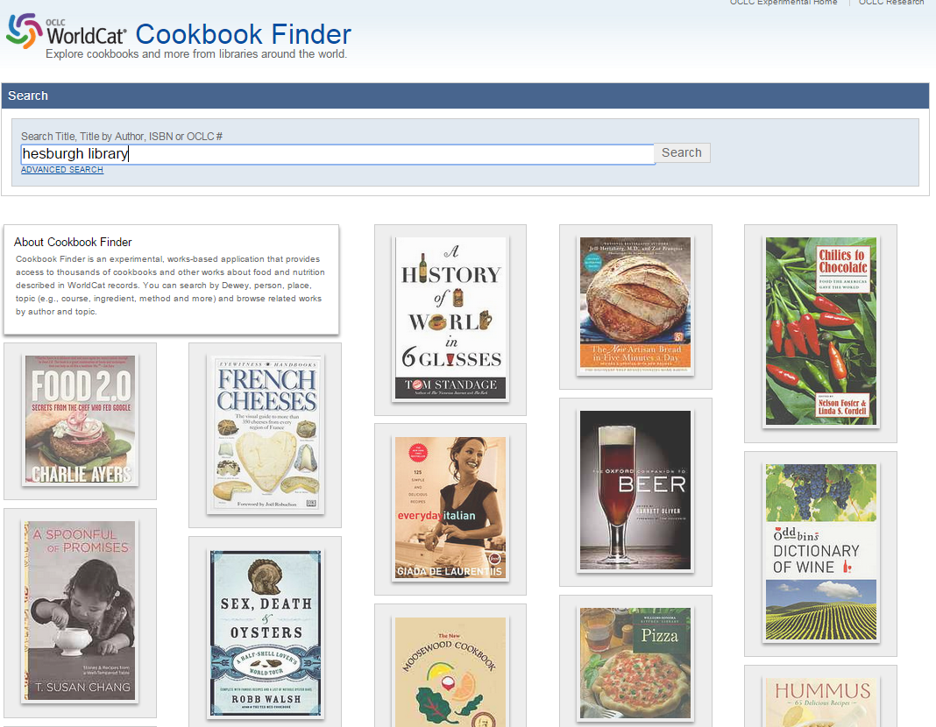

Slide 38
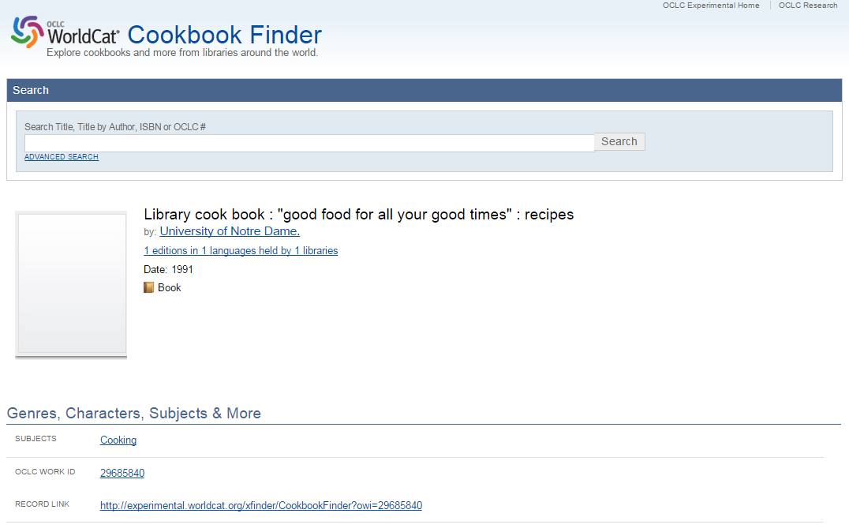

Slide 39
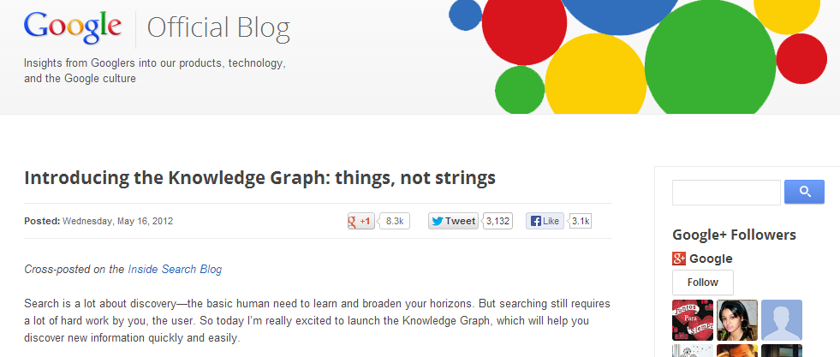
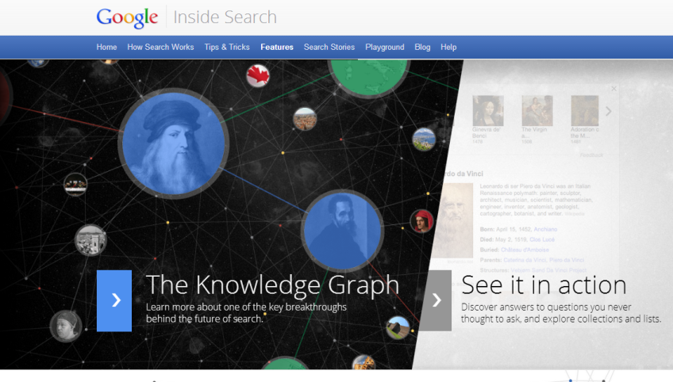
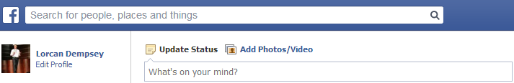
The social graph

Slide 40
Three benefits acc to Google:
Find the right thing
Get the best summary
Go deeper and broader
Within a discovery service …
Aspire to a singular identity for entities/things (people, works, places, organizations, …)
Gather data associated with those identities (e.g. ‘cards’)
Create relationships between identities.

Slide 41
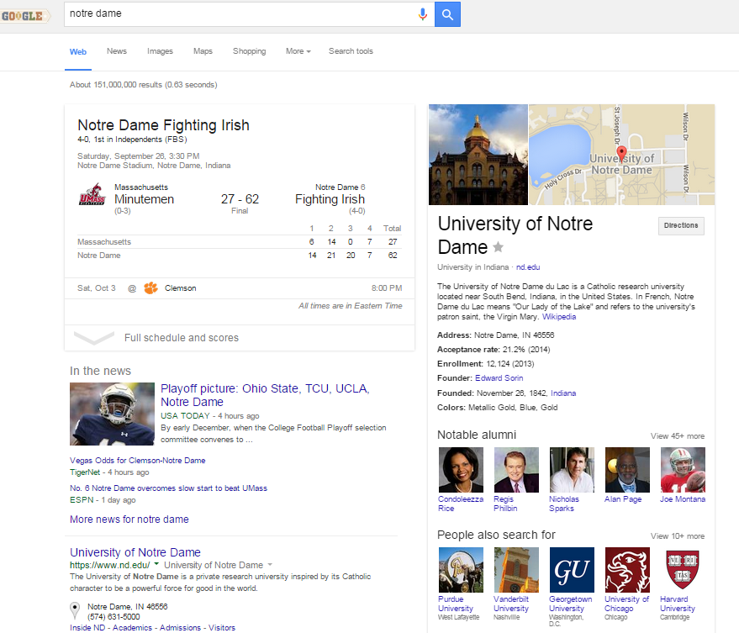

Slide 42
The incremental value of linked data: making data work harder
Web syndication
Active or actionable data
Data consumed outside the original domain or creation context
Complex data queries without pre-built indexes
Machine-understandable semantics
Cleaner, more normalized data
Notes:
The journey to good linked data is a path with many milestones. Above the line are the outcomes we’re really after. Below the line are some of the benefits that accumulate along the way. The triangle symbolizes where the most effort has been expended, and where the most results have been achieved.
To make progress, we have to start at the bottom: with clean data that faithfully describes the resources that the library community cares about.
Before we go into how to make linked data work, I’d like to spend a few minutes on what we want to do with it.

Slide 43
To make linked data work, we need…
Good data!
Structured, accurate, unambiguous,
actionable and can be linked to
other data.
Identifiers

Slide 44

Identifiers!!!
A unique, persistent and public URI associated with a digital object
resolvable globally over networks
unambiguous - use, find and identify the resource.
Examples:
http://id.loc.gov/authorities/n50038207
isni.org/isni/0000000108922788
viaf.org/viaf/42637222
https://www.wikidata.org/wiki/Q330704
http://news.nd.edu/news/40792-father-hesburgh-70th/
Notes:
Identifiers are a crucial component to make linked data work. We have at our disposal a number of identifiers – the examples here are for the Library of Congress id.loc.gov, the International Standard Name Identifier (ISNI), the Virtual Internal Authority File (VIAF) and Wikidata, the knowledge base operated by the Wikimedia Foundation providing a common source of data that feeds into such projects as different language Wikipedias. All these identifiers point to the same entity: Noam Chomsky.

Slide 45




OCLC Production Services
LCSH
Linked Data
Entities
VIAF
Internal OCLC Research Resources
Multilingual
Bib Records
enhanced
WorldCat
FAST
GMGPC
External OCLC Research Systems
WORKS
GSAFD
GTT
Kindred Works
FictionFinder
LCTGM
MeSH
ArchiveGrid
Identities
DDC
Cookbook Finder
Classify
Notes:
GMGPC, LCTGM: Thesarus for Graphic Materials
GSAFD: Genre Terms from Guidelines on Subject Access to Individual Works of Fiction, Drama, etc.
GTT: Gemeenschappelijke Trefwoorden Thesaurus, Dutch Joint Subject index

Slide 46
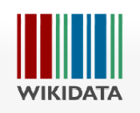


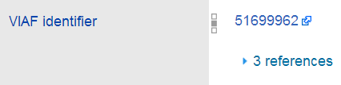


Virtual International Authority File
Aggregates data from ~36 sources
Includes personal and organizational names, works and their translations
Links in Wikidata (and thus Wikipedias)
One of most frequently accessed sources consumed by linked data services

Slide 47
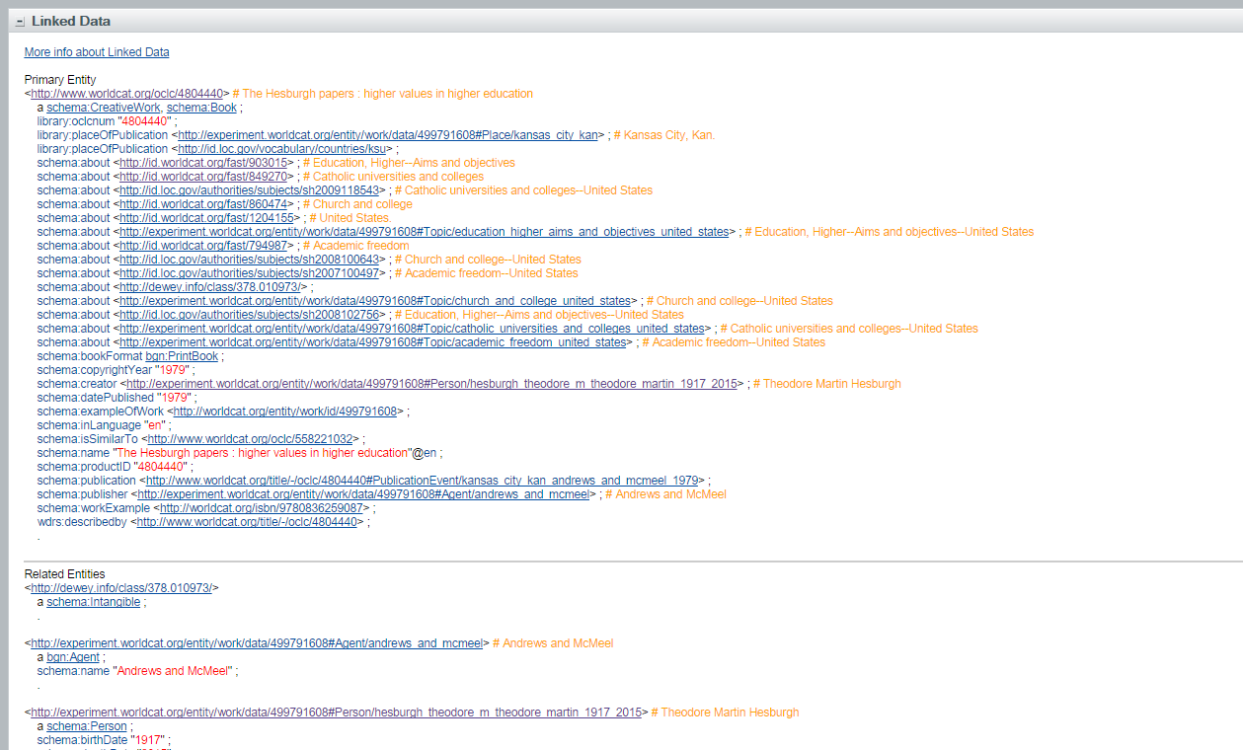
WorldCat.org

Slide 48
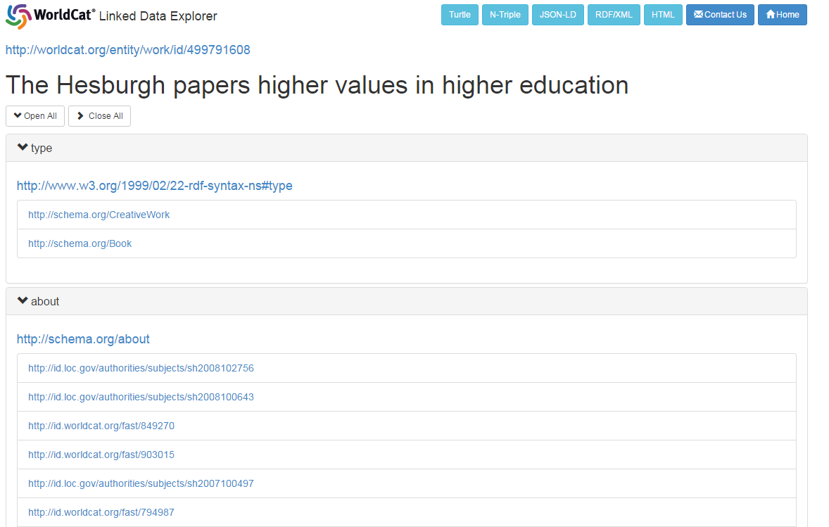
WorldCat Works

Slide 49


Slide 50




OCLC’s linked data resources
WorldCat Works: 5 billion RDF triples
FAST: 23 Million triples
WorldCat Catalog:
15 billion triples
VIAF: 2 billion triples
DDC:
300 million
triples
Notes:
As of August 2014, we can say that OCLC has published over 20 billion RDF triples extracted MARC records and library authority files.
And from OCLC Research’s survey results, conducted in September 2014 (and now being updated):
OCLC’s RDF datasets are among the oldest, largest, and most referenced LD stores in the ‘library’ sector of the linked data cloud.
There is international interest in linked data
There are many still-emerging datasets. WorldCat Works is in that group.

Slide 51


Slide 52



Slide 53
The systemwide library
OCLC Research
Notes:
Picture adapted from: https://pixabay.com/en/classroom-chairs-tables-school-824120/ (license: CC0 https://pixabay.com/en/service/terms/)

Slide 54
Understanding the System-wide Library
Local decisions taken in system-wide context
Collections, services, infrastructure
moving “above the institution”
Ecosystem of information providers
expanding and diversifying
Cooperation/coordination coalescing at multiple scales
In other words …
Libraries increasingly embedded in networks
of cooperation, coordination, sharing, and externalization

Slide 55

Explore Collective Collections
Collective development, management, and disclosure of collections across groups of libraries
Aggregate collection of distinct materials held across collections of a group of institutions
Areas of focus:
Understand characteristics of collective collections at many scales: size, distinctiveness, distribution …
Provide evidence base & intelligence to aid strategic planning, policy & service development
Detect patterns & trends in scholarly/cultural record
Powered by

Slide 56


http://library.osu.edu/blogs/cartoons/2012/02/28/blog-launch-and-the-construction-of-our-new-home-in-sullivant-hall/

Slide 57

http://www.slideshare.net/malbooth/uts-future-library-more-than-spaces-technology
Mal Booth, UTS Library

Slide 58



Perhaps the most influential descriptive studies have come from OCLC Research, which has now shared reports outlining both levels of uniqueness as well as duplication among various aggregations of library collections. This growing body of computationally intensive analysis of the collective collection has also begun to clarify geographic distribution and other key characteristics of library collections relevant for decision making around coordinating activities. There is new understanding of collections at scale. Libraries can better assess past successes in coordination and cooperation and surface the outlines of new frontiers for collaborative activities as well as clarify potential efficiencies and opportunities.
Karla Strieb Ohio State University

Slide 59

North American print book resource:
45.7 million distinct publications
889.5 million total library holdings

Slide 60


Print management at mega-scale
Characteristics and implications of a North
American network of regional shared
print book collections
Regions common scale in shared print
Regions operationalized using mega-region concept

Slide 61

Right-scaling Stewardship
Regional-scale shared print strategy:
Institutional (OSU) perspective
Consortial (CIC) perspective
Examined characteristics of:
OSU local print book collection
CIC consortial collective collection
Findings …
Coverage requires cooperation
Scale adds scope and depth
Uniqueness/scarcity is relative

Slide 62





OCLC Research
http://www.oclc.org/research.html
News & events
Reports & presentations
https://twitter.com/OCLC/lists/oclc-research
https://www.facebook.com/OCLCResearch
http://www.slideshare.net/oclcr
http://hangingtogether.org/
http://youtube.com/oclcresearch

Slide 63

https://www.facebook.com/oconnellhousedublin/photos/pb.108337209330861.-2207520000.1443306060./487041264793785/?type=3&theater
Lorcan Dempsey
VP Membership & Research & Chief Strategist

