Slide 1
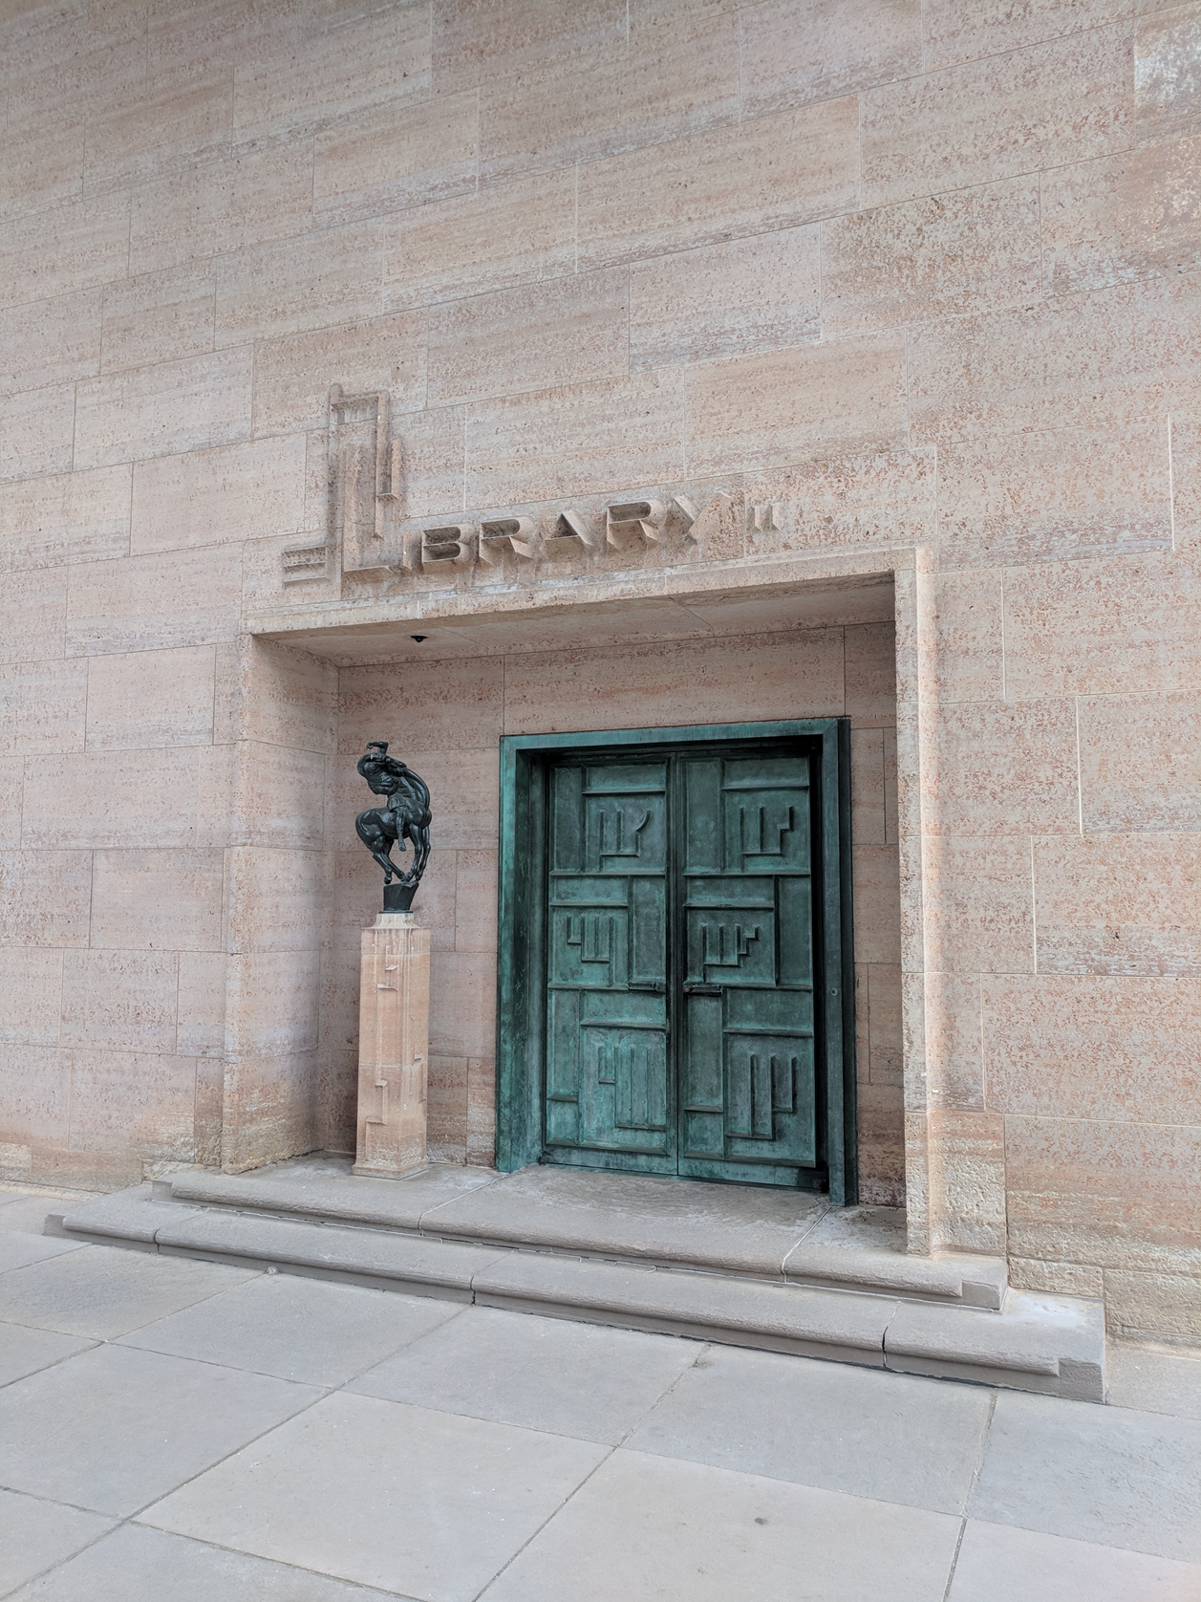
Leadership, scaling, OCLC
The 6th North America-China library conference, Dublin, Ohio, 7/30-8/2, 2018
Lorcan Dempsey
VP Membership and Research, OCLC

Slide 2




Scaling capacity
Scaling learning
Scaling innovation
Scaling influence

Slide 3


Scaling influence
Scaling capacity
Scaling learning
Scaling innovation
IARLA

Slide 4


Scaling capacity
Scaling learning
Scaling innovation
Scaling influence

Slide 5




A network of
16,000 members

Slide 6



METADATA MAN.
RESOURCE SHARING
DISCOVERABILITY
Registration
Metadata Services
Shared Print Registration
Digital Collection Gateway
Tipasa
WorldShare Interlibrary Loan
ILL Fee Management
WorldCat.org
FirstSearch

Slide 7
METADATA MAN.
RESOURCE SHARING
DISCOVERABILITY
Registration
Metadata Services
Shared Print Registration
Digital Collection Gateway
Tipasa
WorldShare Interlibrary Loan
ILL Fee Management
WorldCat.org
FirstSearch

Slide 8


METADATA MAN.
DECISION SUPPORT
RESOURCE SHARING
DISCOVERABILITY
Registration
Metadata Services
Shared Print Registration
Digital Collection Gateway
SCS
Tipasa
WorldShare Interlibrary Loan
ILL Fee Management
WorldCat.org
FirstSearch

Slide 9

METADATA MAN.
DECISION SUPPORT
RESOURCE SHARING
IDENTIFICATION
DISCOVERABILITY
Registration
Metadata Services
Shared Print Registration
Digital Collection Gateway
SCS
Tipasa
WorldShare Interlibrary Loan
ILL Fee Management
OCN
Authorities
Linked data
WorldCat.org
FirstSearch

Slide 10
Collaborate at scale
to achieve economies and impact.
Operationalize the collective collection.

Slide 11
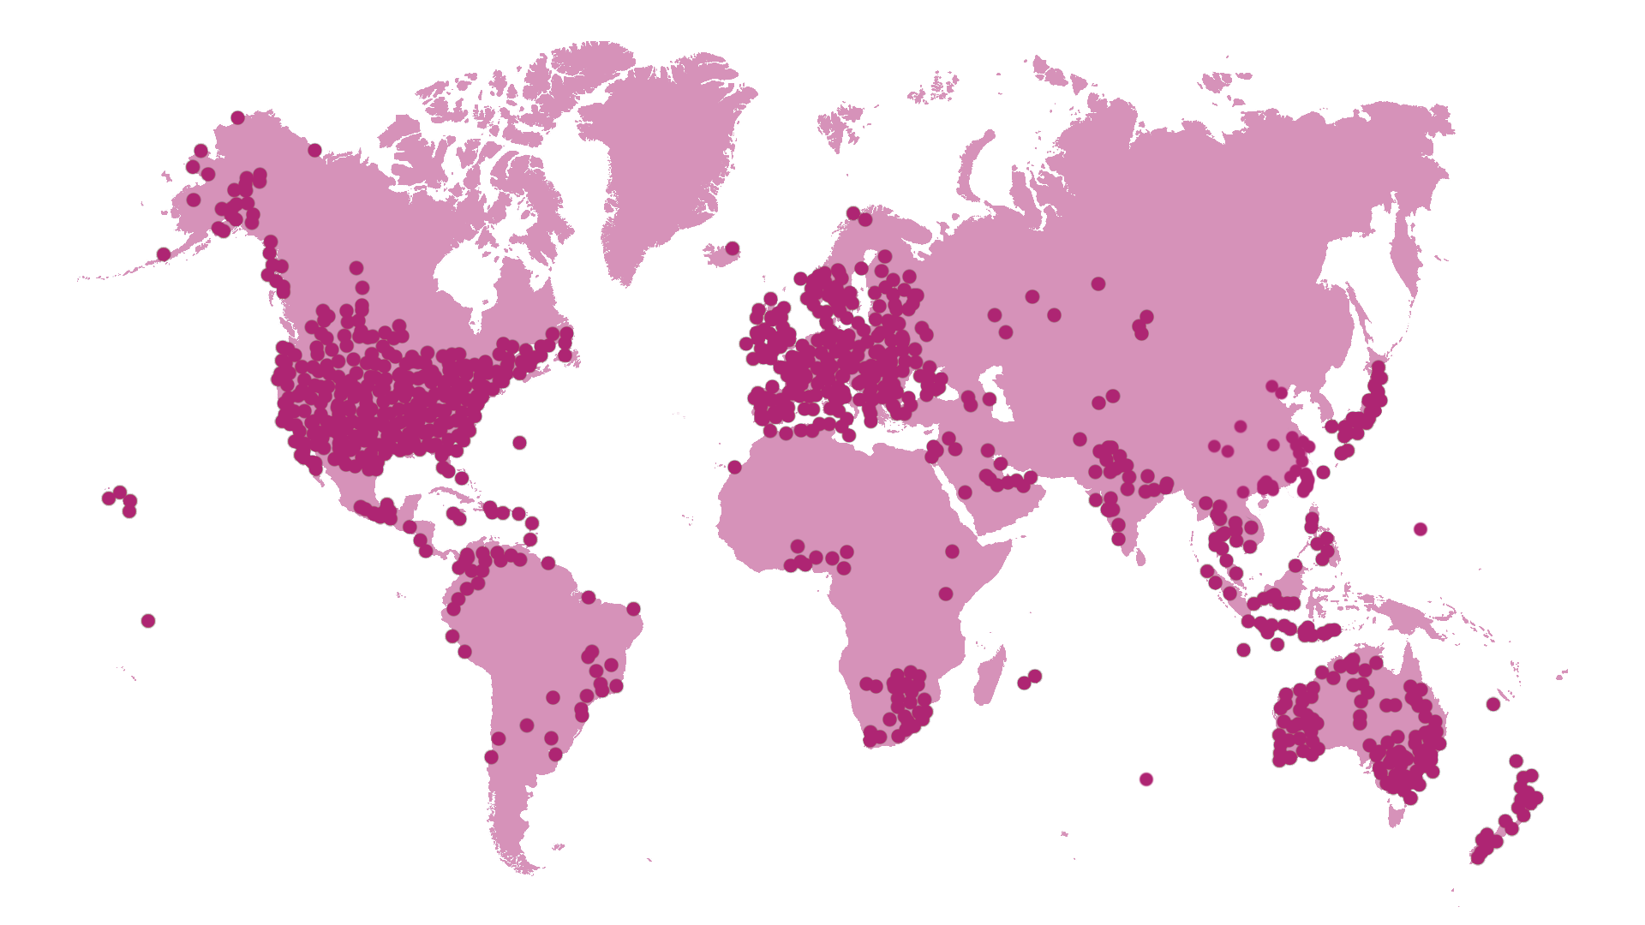
A global network of libraries:
More than 16,000 members across 123 countries
As of 31 March 2018
Notes:
OCLC libraries are part of an active and engaged global network of libraries with more than 16,000 members across 123 countries.
Global network provides unparalleled access to the world’s collected knowledge in ways that cannot be achieved independently
Ability to address shared challenges at scale
Together, we connect people to the information they need to achieve their goals
[Per Ellen McCarthy, the 12/31/2017 update is the most current info available for this slide—notes current 5/4/18]

Slide 12
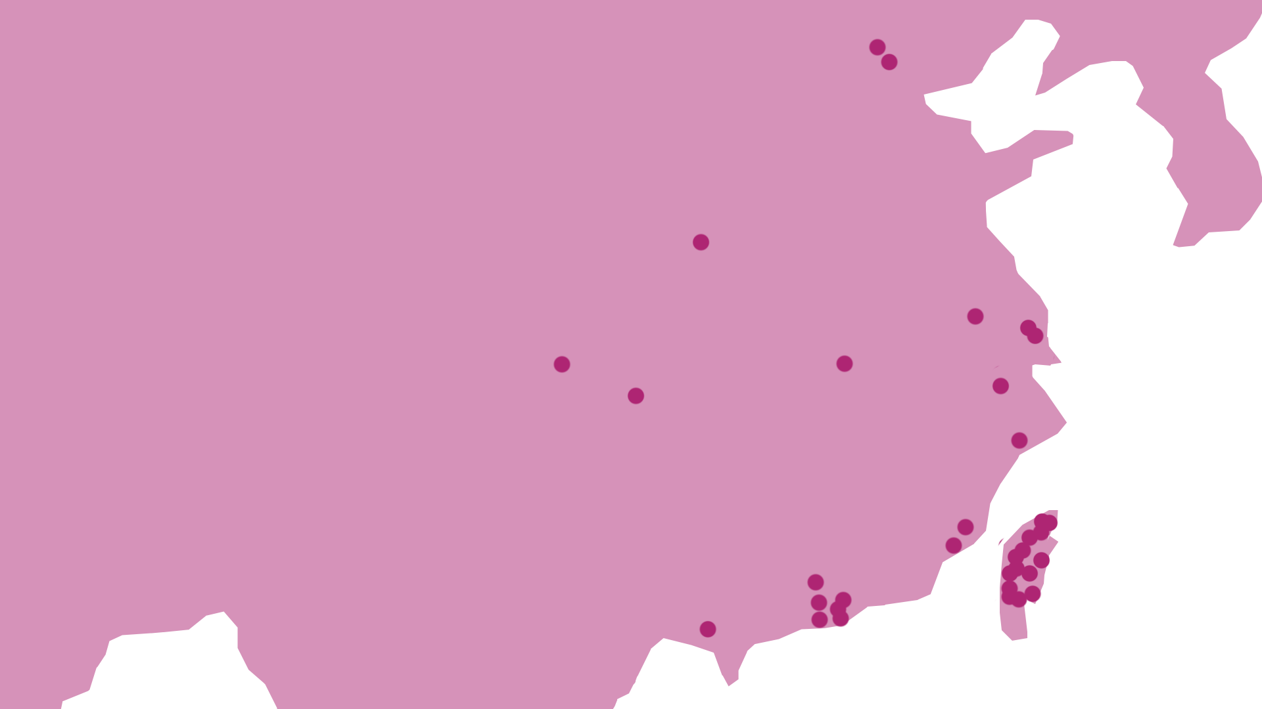
A global network of libraries:
34 OCLC members in China
As of 31 March 2018

Slide 13
73 national and regional library agreements
EMEA
53 libraries
In 48 countries
Americas
Asia Pacific
12 libraries
In 8 countries
8 libraries
In 8 countries
Notes:
Of the 73 national and regional library agreements with OCLC, 54 have records and/or holdings in WorldCat. (12 in the Americas region, 53 in EMEA and 8 in Asia Pacific)
The remaining 19 do not have data in WorldCat yet.
Also…..an interactive map of national and regional libraries is currently on our public web site at: https://www.oclc.org/en/worldcat/foundation.html
…or see below for additional details:
Inst Name Holdings
BRITISH LIBRARY 20664923
BIBLIOTHEQUE NATIONALE DE FRANCE 19455966
DIE DEUTSCHE NATIONALBIBLIOTHEK 15815137
LIBRARY OF CONGRESS 13290595
NATIONAL LIBRARY OF SWEDEN 9671721
NATIONAL LIBRARY OF AUSTRALIA 5824532
NATIONAL DIET LIBRARY 5700170
NATIONAL LIBRARY OF SCOTLAND 5491563
BIBLIOTECA NACIONAL DE ESPAÑA 4841787
NATIONAL LIBRARY OF POLAND (BibliotekaNarodowa) 4839517
NATIONAL LIBRARY OF CHINA (BNJ) 4231038
KONINKLIJKE BIBLIOTHEEK (NETHERLANDS) 4086680
NATIONAL LIBRARY OF MED 3730565
LIBRARY AND ARCHIVES CANADA, PH-RD 3446120
DET KONGELIGE BIBLIOTEK 2743135
NATIONAL LIBRARY OF ISRAEL 2645456
BIBLIO ET ARCHIVES NAT DU QUEBEC 2518549
NATIONAL LIBRARY BOARD, SINGAPORE 2106501
NATIONAL LIBRARY OF NEW ZEALAND 2074207
NATIONAL LIBRARY OF ROME 1952288
SWISS NATIONAL LIBRARY 1264638
NATIONAL LIBRARY OF SLOVENIA 1203919
NATIONAL CENTRAL LIBRARY, TAIWAN 1109475
NATIONAL AGR LIBRARY 1006691
NATIONAL LIBRARY OF THE CZECH REPUBLIC 889173
NATIONAL LIBRARY OF SOUTH AFRICA 860978
NATIONAL LIBRARY OF FINLAND 753528
NATIONAL LIBRARY OF KOREA 636481
NATIONAL LIBRARY OF MALAYSIA 570653
DANISH NATIONAL LIBRARY OF EDUCATION 469376
BIBLIOTECA NACIONAL MEXICO 428632
BIBLIOTHECA ALEXANDRINA 419250
NATIONAL LIBRARY OF EDUC 418058
LIECHTENSTEINISCHE BIBLIOTHEKEN 306539
NATIONAL LIBRARY OF WALES 258986
NATIONAL LIBRARY OF MOROCCO 209144
NATIONAL LIBRARY OF IRELAND 156453
NATIONAL & UNIV LIBRARY OF ICELAND, THE 91162
BOTSWANA NAT LIBRARY SERV 43991
NATIONAL LIBRARY OF JAMAICA 38695
NATIONAL LIBRARY OF NAMIBIA 33626
NATIONAL LIBRARY SERV, BARBADOS 27305
NATIONAL SZÉCHÉNYI LIBRARY 16355
BIBLIOTECA NACIONAL DE CHILE 13827
NATIONAL LIBRARY & INFO SYST, TRINIDAD & TOBAGO 9801
NATIONAL ARCH OF ZIMBABWE 5353
NATIONAL LIBRARY OF RUSSIA, THE 4061
SWAZILAND NAT LIBRARY SERV 2507
NATIONAL LIBRARY OF LESOTHO 1932
NATIONAL LIBRARY OF TURKEY 496
NATIONAL LIBRARY OF LITHUANIA 203
RUSSIAN STATE LIBRARY 158
NATIONAL LIBRARY OF IRAQ 114
LEBANESE NAT LIBRARY 43
BIBLIOTECA NACIONAL DE PORTUGAL 0
BIBLIOTECA NAZIONALE CENTRALE DI FIRENZE 0
FUNDAÇÃO BIBLIOTECA NACIONAL 0
GREEK NATIONAL LIBRARY 0
NASJONALBIBLIOTEKET, AVDELING OSLO 0
NATIONAL AND UNIVERSITY LIBRARY ZAGREB 0
National Library of Benin 0
National Library of Burkino Faso 0
NATIONAL LIBRARY OF ESTONIA 0
National Library of Guinea 0
National Library of Ivory Coast 0
NATIONAL LIBRARY OF LATVIA 0
National Library of Mali 0
National Library of Mauritania 0
National Library of Senegal 0
NATIONAL LIBRARY OF SERBIA 0
National Library of Togo 0
NATIONALBIBLIOTHEK ÖSTERREICH 0
RES DES BIBLIOTHEQUES LUXEMBOURGEOISES 0

Slide 14





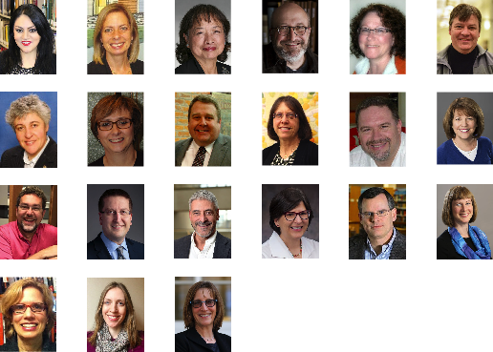













OCLC Global Council Delegates
EMEA: 10 delegates
Asia Pacific: 5 delegates
Americas: 32 delegates

Slide 15
Scaling capacity
Scaling learning
Scaling innovation
Scaling influence

Slide 16
Scaling learning
Scaling innovation
Scaling capacity
Scaling influence
A library imperative

Slide 17

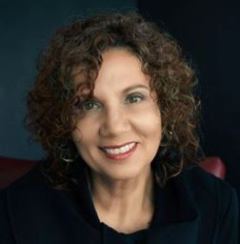



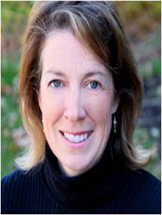
Membership and Research
Lorcan Dempsey
VP, Membership & Research Chief Strategist
Helene Blowers,
Exec. Director
Member Relations
Lynn Connaway,
Director
Library Trends & User Research
Andrew Pace,
Exec. Director
Technical Research
Sharon Streams,
Director
WebJunction
Rachel Frick,
Exec. Director
Research Library Partnership
To accelerate and scale library learning, innovation, and collaboration.​

Slide 18
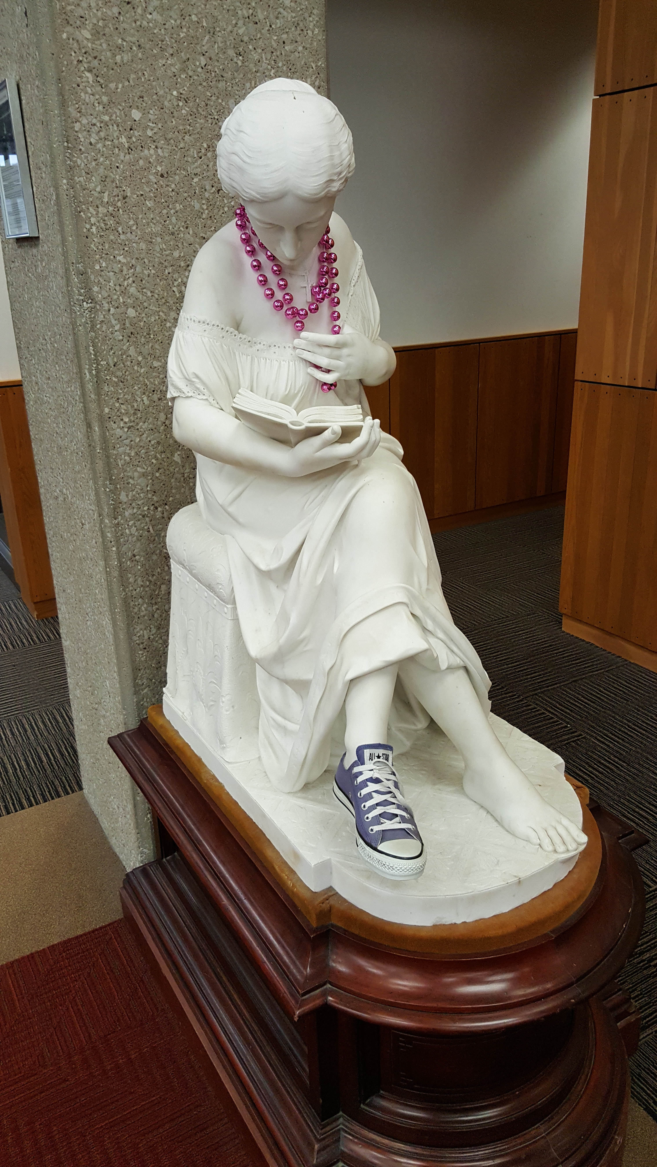
University futures/
Library futures
OCLC Research and Ithaka S+R collaboration with support from Andrew W. Mellon Foundation
Examining impact of increasing diversification of US higher education on the organization of academic libraries
Shift from collection-centric model of excellence to engagement-oriented model supporting distinctive needs of parent institution: teaching, learning, research workflows

Slide 19
Key issues
Higher education is diverging.
Library excellence should be determined in the context of strategic fit to university interests.
There are different models of library excellence

Slide 20



Most four-year institutions exhibit multiple tendencies; they have several ‘lines of business’
distinctive focus on doctoral research and scholarship
Research
distinctive focus on interdisciplinary baccalaureate education
distinctive focus on preparation for professions
Career
Liberal Education

Slide 21
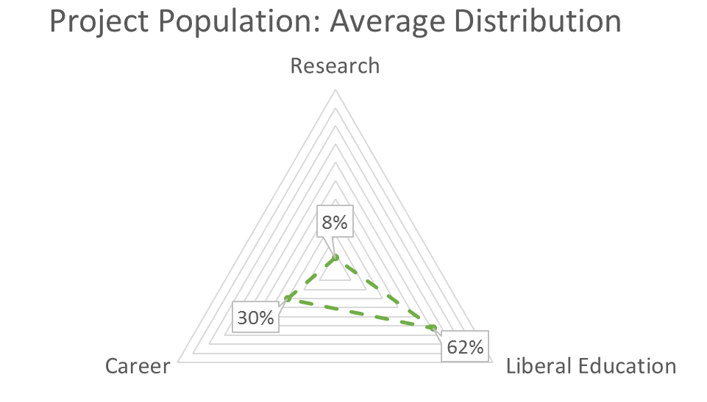
No reason to suppose that Research Library model of library service is a good fit for institutions with distinctive liberal education or career focus

Slide 22
Case Western Reserve
R: 0.53, LE:0.29, C:0.18
Antioch University - Midwest
R:0.00 , LE:0.21, C:0.79
Kenyon College
R: 0.00, LE: 1.00, C:0.00

Slide 23
Optimized for just-in-time, convenience, online
Optimized for high-touch, in-person engagement

Slide 24
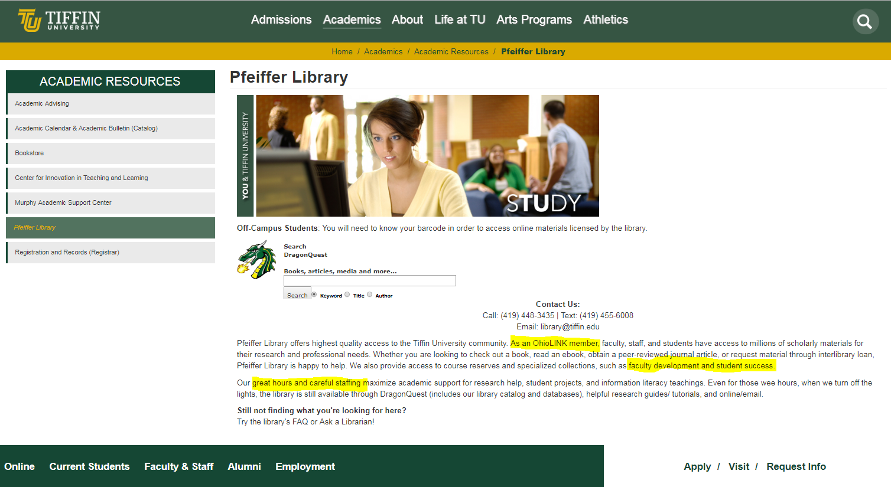
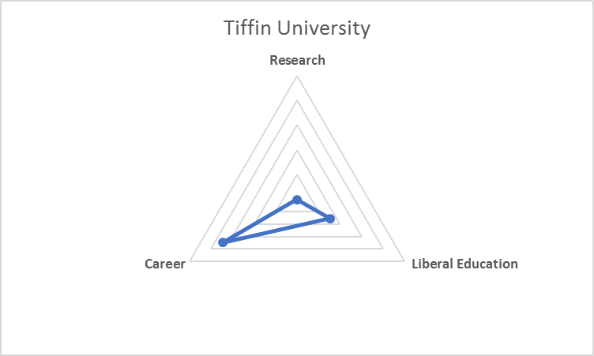
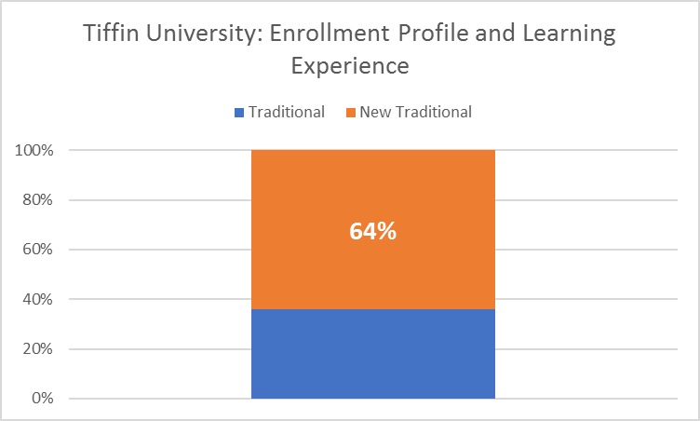
Convenience
Engagement vs. content
Partner in student and faculty success
Notes:
Running Sierra and EDS.
Collection size ~40K volumes.
Director: Catie Carlson
Enrollment: 4.4K

Slide 25
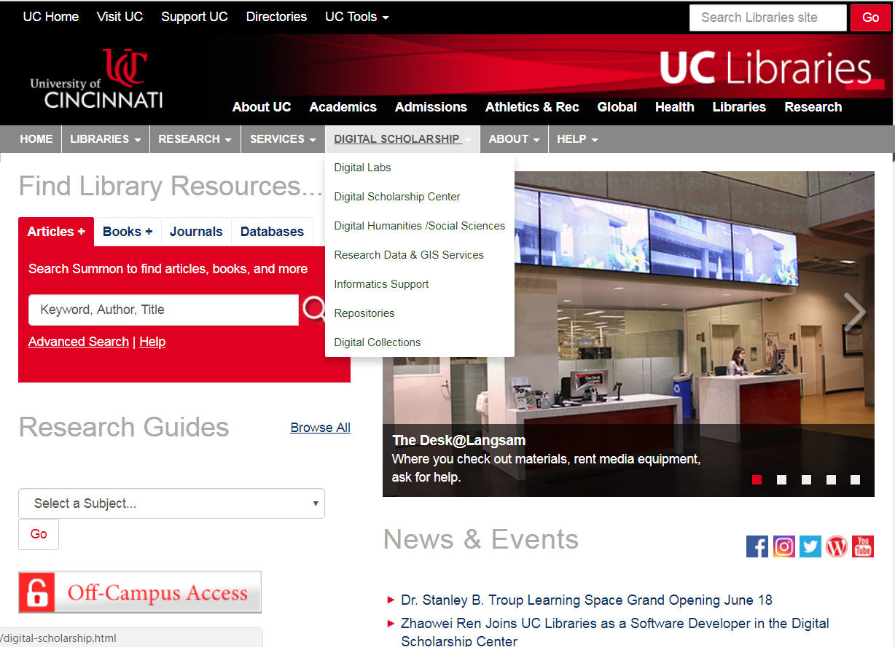
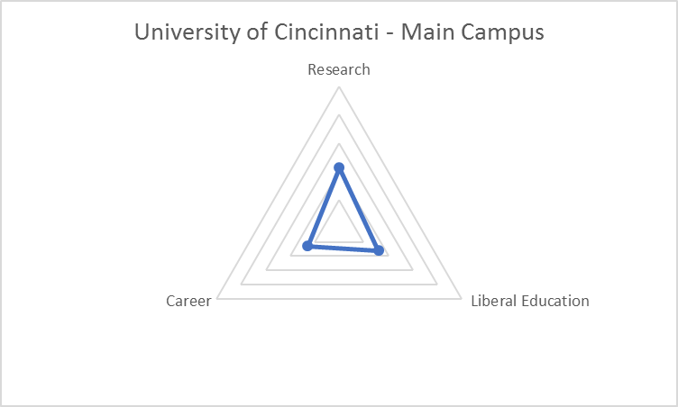
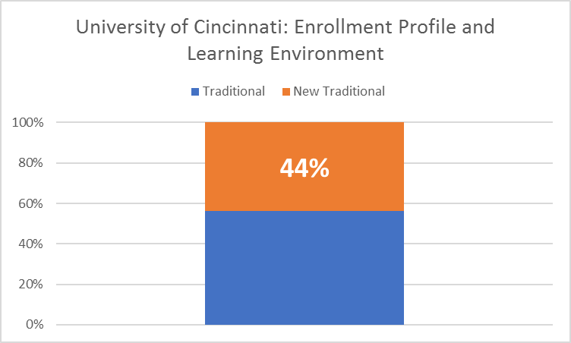
Support for digital research workflows
Reputation management (RIM)
“Inside-out” collections
Notes:
Running Millenium and Summon
Collection: 4.3M
Director: Xuemao Wang
Enrollment: 28K

Slide 26
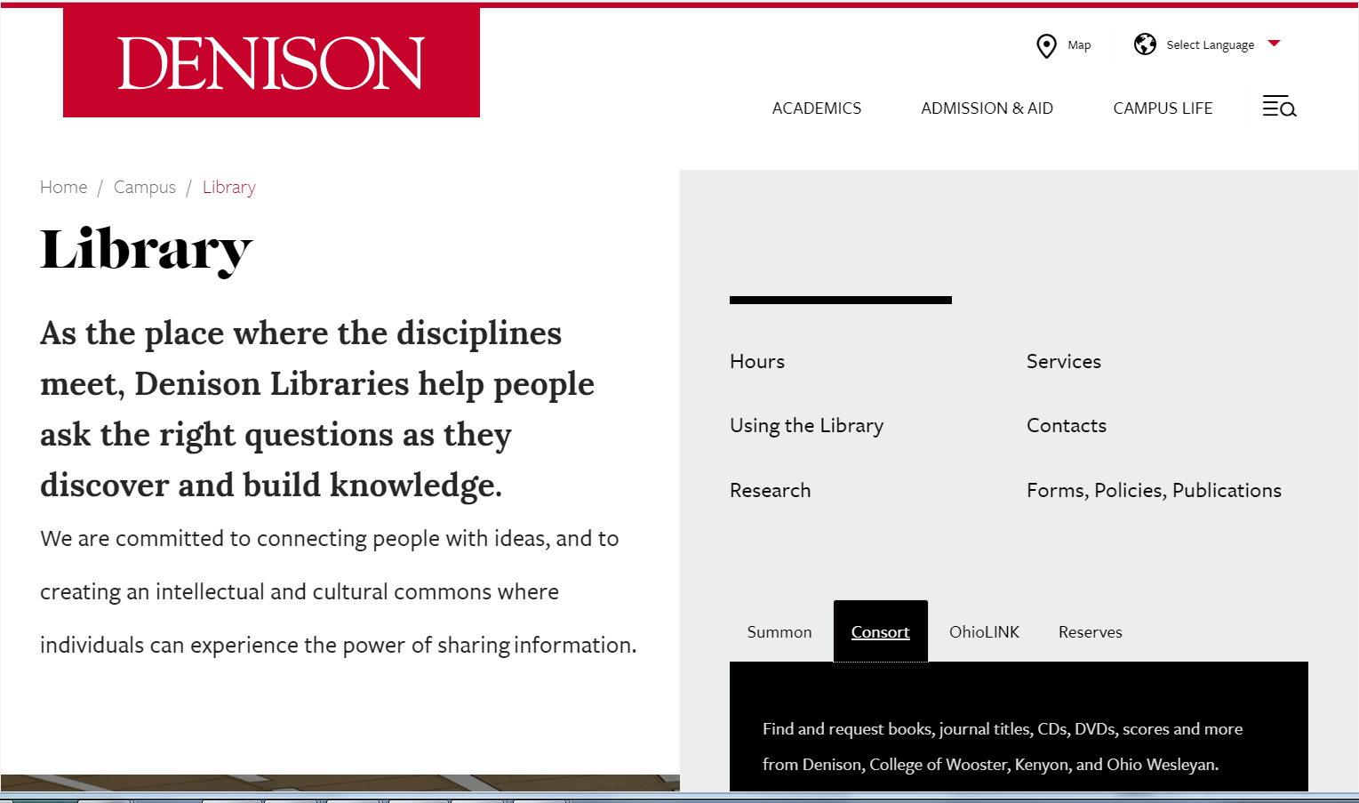
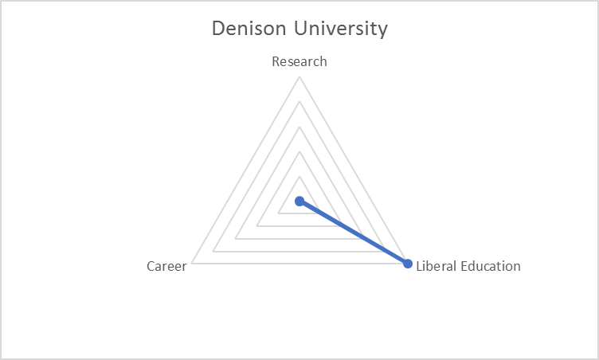
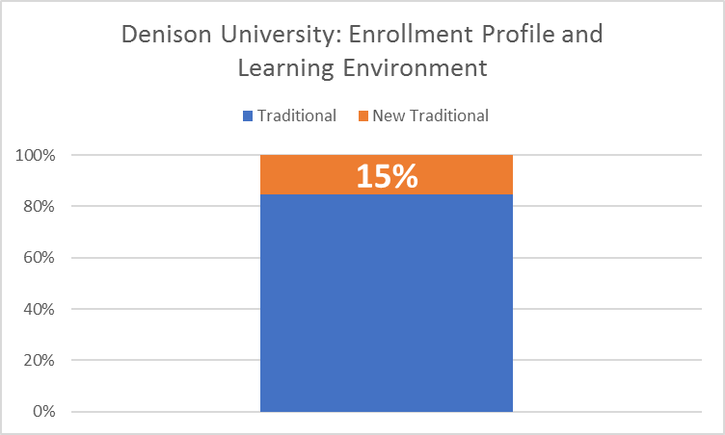
Consortial collections
Space as a service ($7.5M renovation)
Integration with exploratory, liberal education curriculum (e.g., Narrative Journalism program)
Notes:
Running Sierra and Summon
Collection: 788K
Director: BethAnn Zambella
Enrollment: 2.3K

Slide 27
Research
RDM activities
RIM/CRIS implementation
Text and data analysis services
Research impact librarian
Research data librarian
Office of sponsored research
VP for Research
Think about . . .
Library services
Library staffing
Library stakeholders
Liberal Education
Career
Instructional design services
Open Educational Resources
Fablab
Student Success Librarian
Teaching/Learning Librarian
Dean of Undergrad Education
Department chairs
E-portfolios
Training and internship resources
First Year Experience Librarian
Guided pathways support staff
Career Services
VP Enrollment

Slide 28

L. Dempsey and C. Malpas
“Academic library futures in a diversified university system”
in N. Gleason (Ed.) Higher Education in the Fourth Industrial Revolution (Palgrave, 2018)
C. Malpas, R. Schonfeld, R. Stein, L. Dempsey and D. Marcum.
University Futures, Library Futures
Final report to be published by OCLC Research, ca. August, 2018
https://www.palgrave.com/us/book/9789811301933

