Slide 1
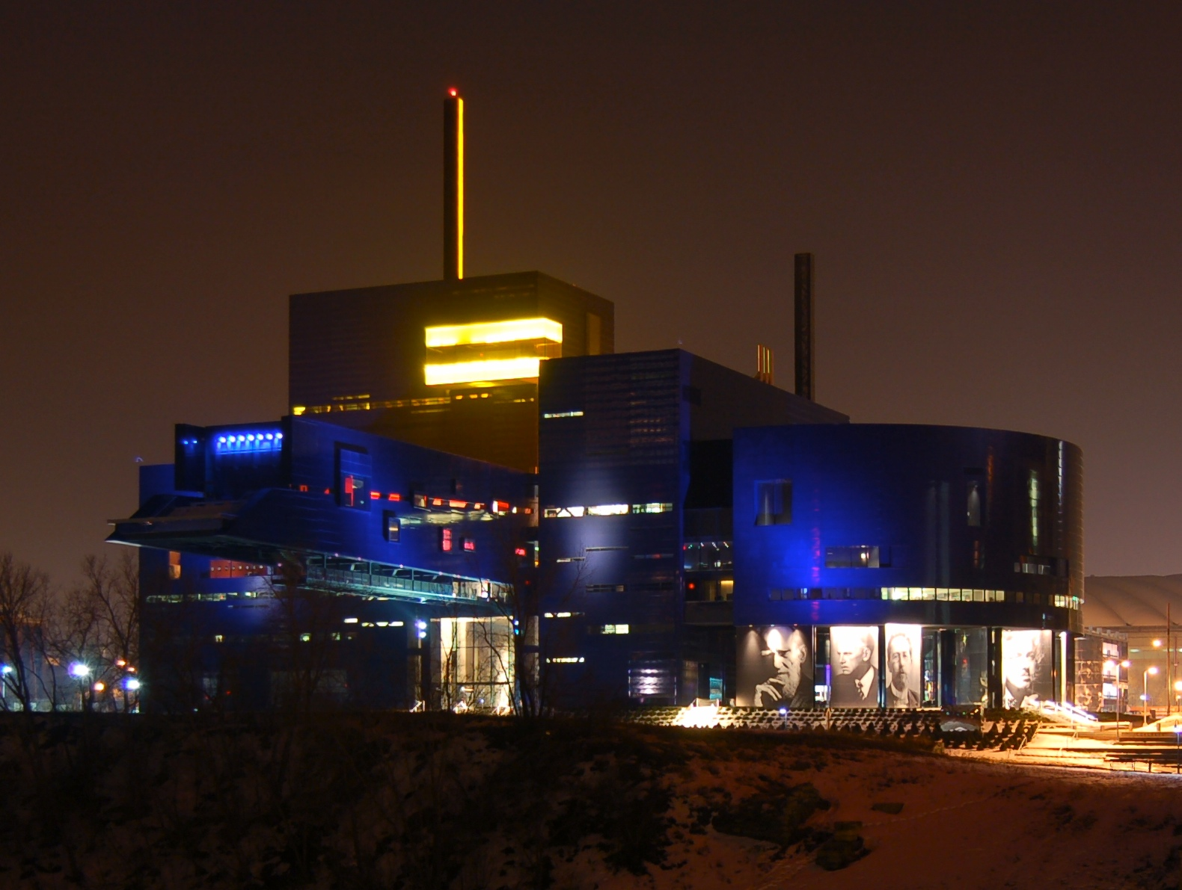
Lorcan Dempsey, OCLC with Constance Malpas and Mark Sandler @LorcanD
Collections, the network, and library collaboration
University of Minnesota Libraries 9 Oct 2018
By Steve Lyon - Flickr, CC BY-SA 2.0, https://commons.wikimedia.org/w/index.php?curid=2027401

Slide 2
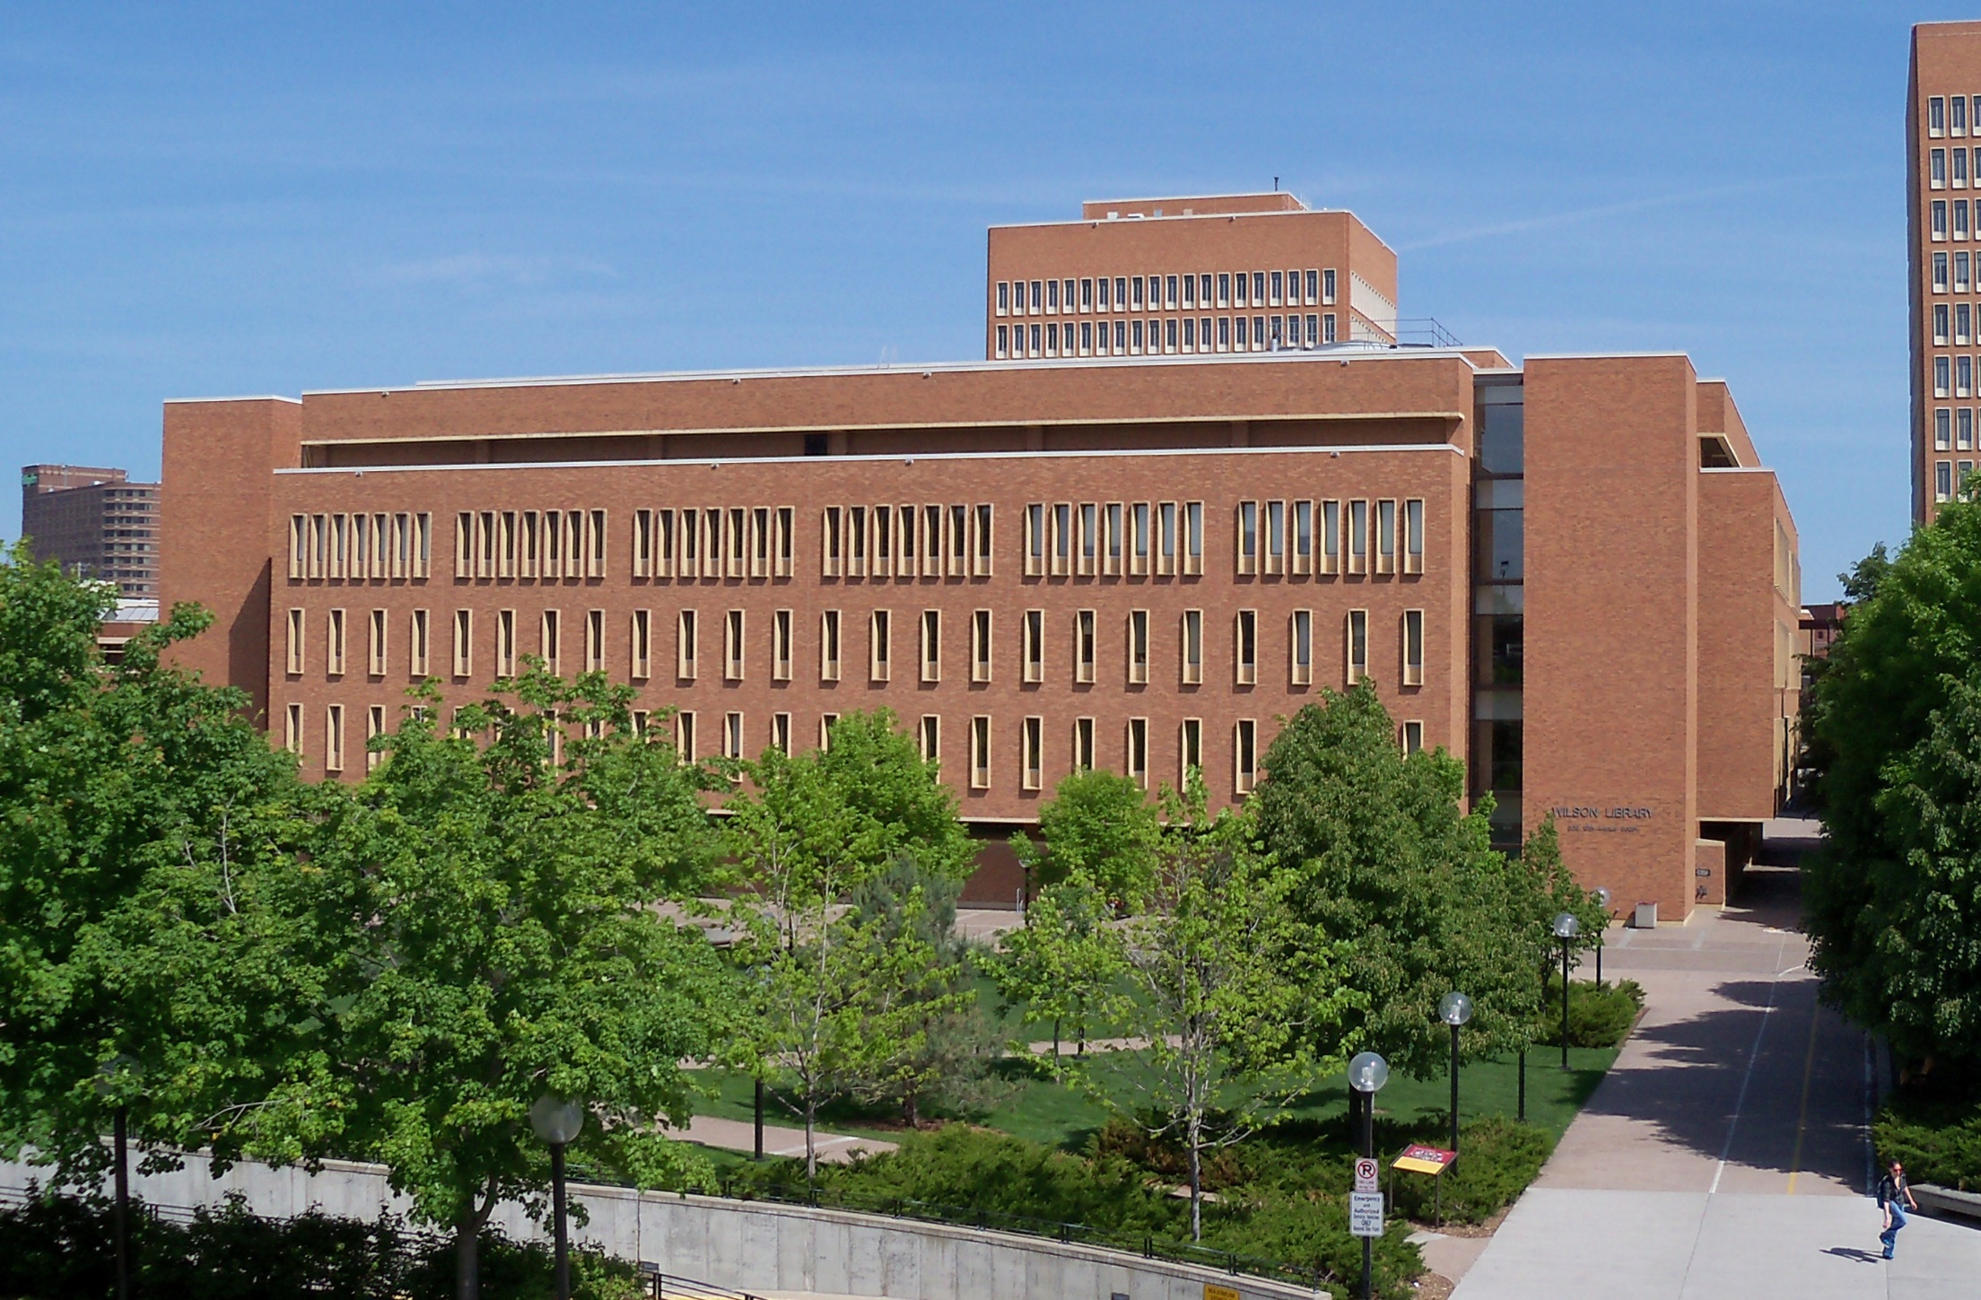
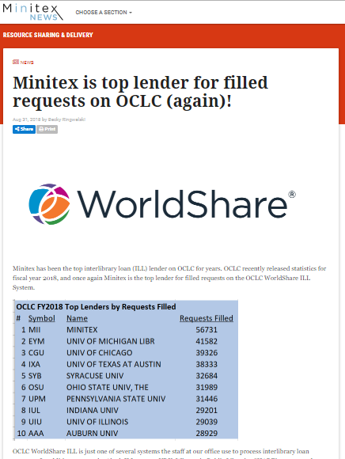
By AlexiusHoratius - Own work, CC BY-SA 3.0, https://commons.wikimedia.org/w/index.php?curid=10367777
Standing on the shoulders of …

Slide 3
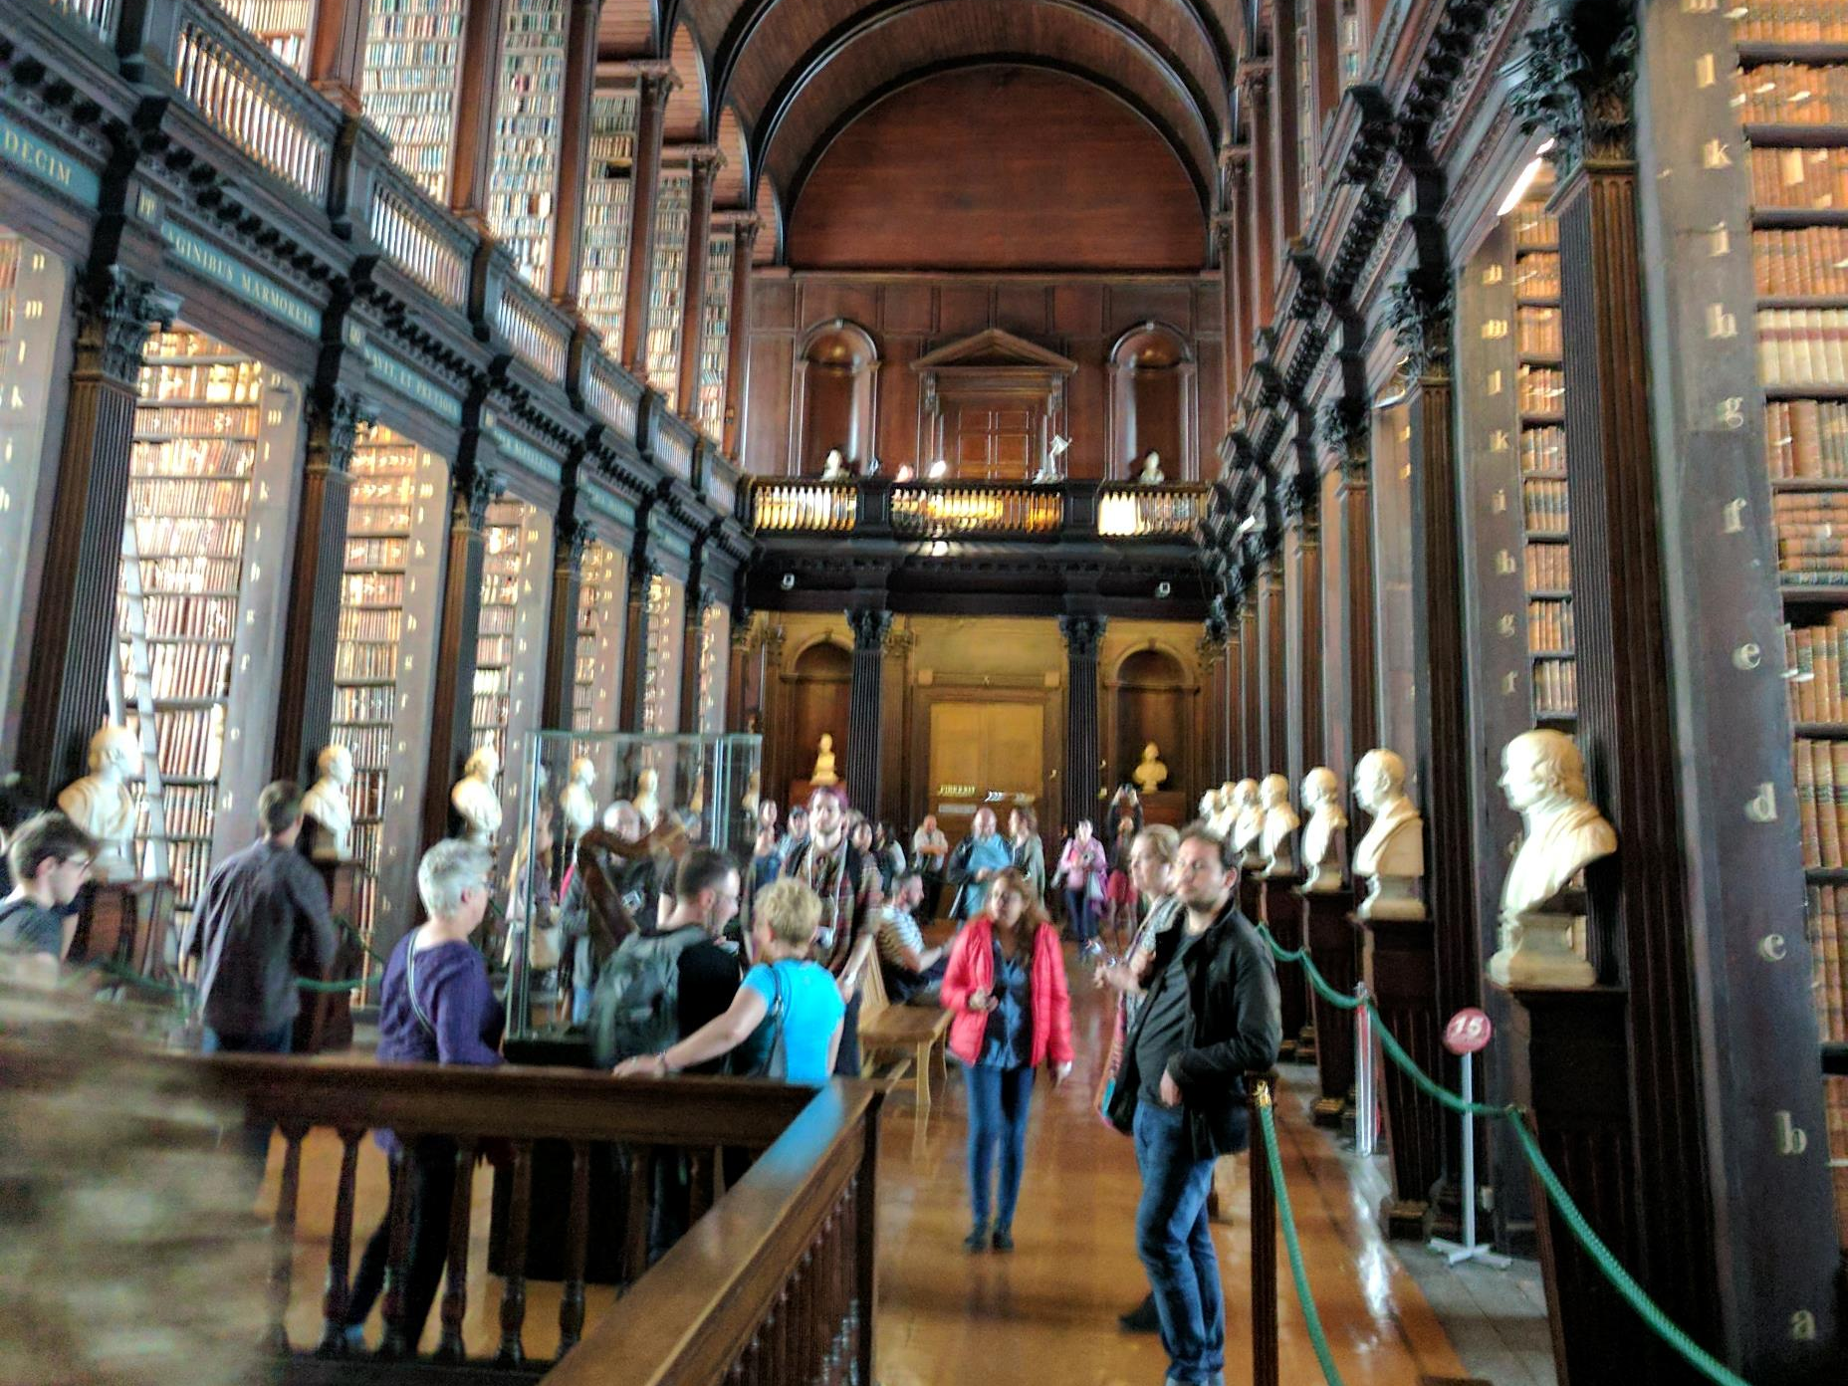
“Research libraries achieved status … by acquiring more than their peers or by building niche collections of particular depth.”

Slide 4
Research libraries achieved status in this environment by acquiring more than their peers or by building niche collections of particular depth.
Hazen.
Lost in the cloud.
2011
Collections no longer lie at the center of research library operations and goals, even as academic communities focus ever more inclusively on knowledge and information.
Notes:
Hazen, D. (January 01, 2011). Lost in the Cloud Research Library Collections and Community in the Digital Age. Library Resources and Technical Services, 55, 4, 195-204.
https://journals.ala.org/lrts/article/view/5302

Slide 5
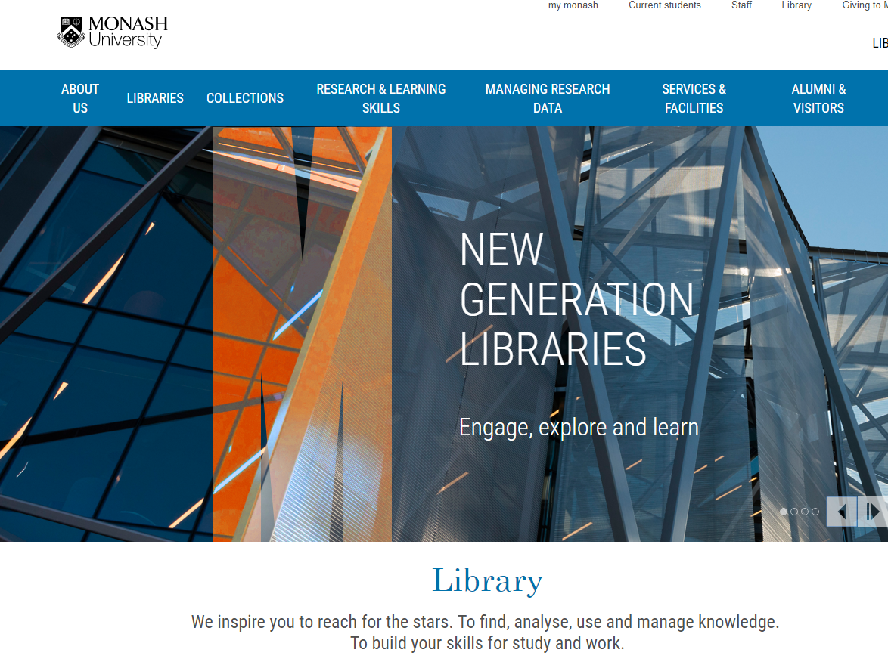
Telling the library story differently
Here … collections are a service

Slide 6
Three trends
Not the whole story ☺
Boundaries
Collective
Inside out
Facilitated

Slide 7
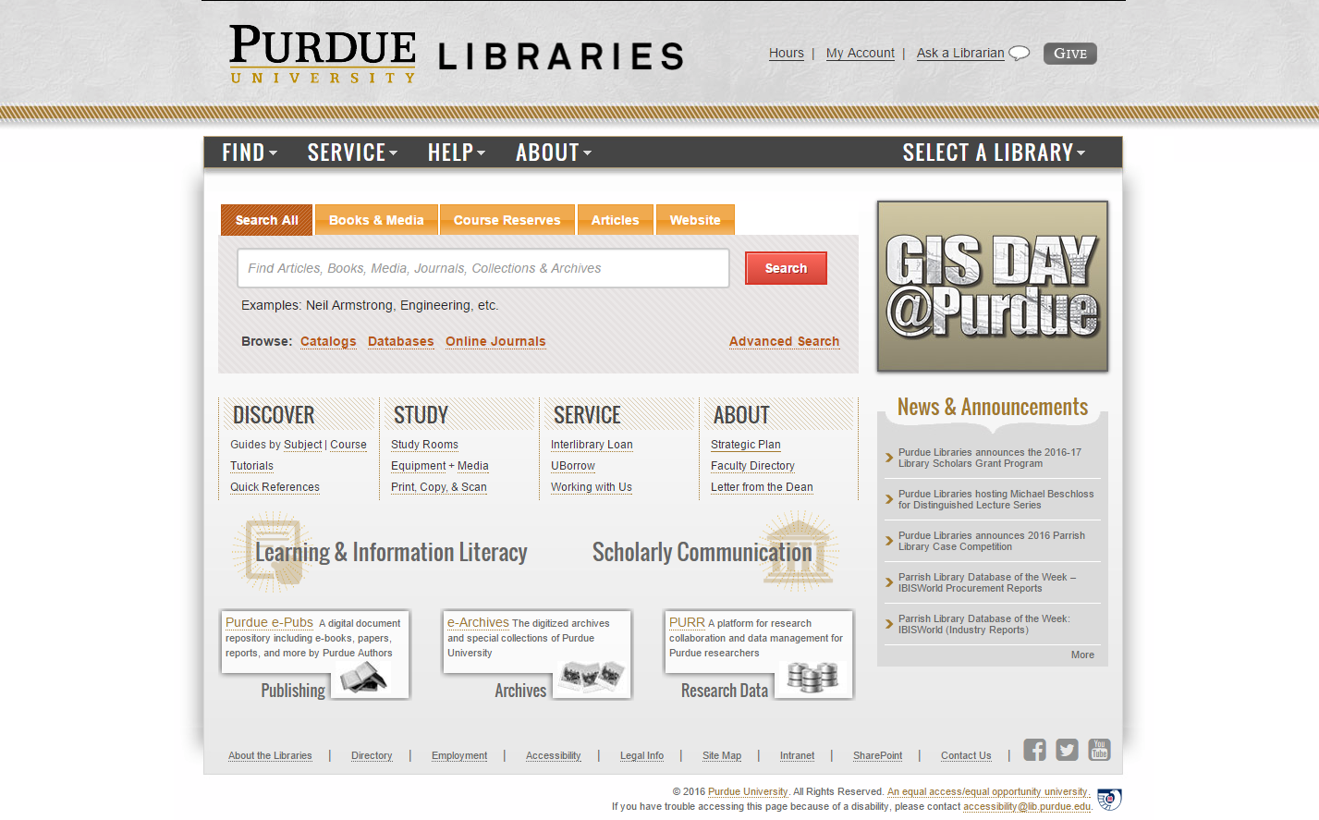
Outside in
Facil-itated
Coll-ective
Inside out
Collections: expanding view

Slide 8
Three trends
The inside out collection
The facilitated collection
Reconfiguration of research work by network/digital environment.
Reconfiguration of the information space by network/digital environment.
The collective collection
Reconfiguration of library collaboration by network/digital environment.

Slide 9
Reconfiguration of research work by network/digital environment.
Inside out collection

Slide 10
Research outputs
R- infra-structure
Expertise/Identity
Special colls

Slide 11
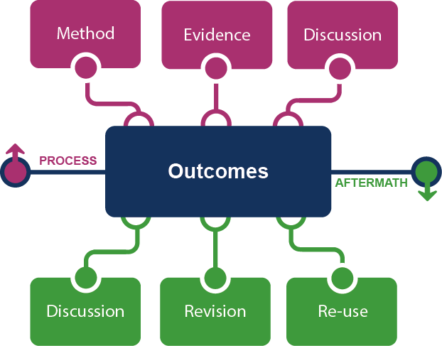
Supporting the creative process: the emerging scholarly record
Research outputs
Notes:
This is how we framed out the scholarly record in terms of nature and scope of what it might contain.
Start with published outcomes: the reporting of results, conclusions, ideas and so forth from a particular scholarly inquiry.
These outcomes are still the coin of the realm for scholarly activities, so they are privileged here at the center of the picture;
A lot of these outcomes take the form of text-based materials like books and journal articles, but often supplemented by additional materials such as video, graphics, and interactive programs.
Rest of scholarly record divided into two broad areas: process and aftermath
Process: process of scholarly inquiry; process by which outcomes are produced. Identified three categories of materials generated in this phase in which there is interest in including them as part of the scholarly record:
Method materials related to the methodology of scholarly inquiry (e.g., software, computer models, digital lab notebooks, sampling frames, experimental protocols, instrument calibrations)
Evidence raw materials/inputs to scholarly work (e.g., data sets, survey results, new or enhanced primary source documents, links to findings from other scholarly works);
Discussion refining and improving ideas, methods, conclusions (e.g., pre-prints, listserv/blog discussions, conference presentations, annotated commentary, grant proposals).
Anchoring outcomes directly to the methods employed, evidence used, and formative discussions conducted during the process of scholarly inquiry helps contextualize and deepen our understanding of these outcomes, facilitate replicability, and leverage results into new research.
Once the outcomes from a research project have been formally published or otherwise made available, scholarly activities surrounding that piece of work may still continue in the “aftermath” phase.
Activities in the aftermath phase may include Discussion (through similar channels as those in the process phase, but also post-publication formal reviews and commentary);
Revision published work can be revised in various ways (the work may be enhanced with additional findings; errors may be corrected or clarifications made, etc.)
Re-use (the work may be edited or re-packaged into new forms, such as conference presentations, summaries, blog posts, versions for the “popular media”, etc.).
Not saying that everything discussed here will end up in the scholarly record. But picture represents the maximal scope and depth of materials regarding which there is increasing interest in systematic collection and curation.
Note that some of the materials in the outlying components are becoming or might become outcomes in their own right. Data sets are a good example: in some disciplines the publication of an important data set is now considered a first-class scientific outcome.
More on the evolving scholarly record:
Lavoie, Brian, Eric Childress, Ricky Erway, Ixchel Faniel, Constance Malpas, Jennifer Schaffner, and Titia van der Werf. 2014. The Evolving Scholarly Record. Dublin, Ohio: OCLC Research.
http://www.oclc.org/content/dam/research/publications/library/2014/oclcresearch-evolving-scholarly-record-2014.pdf.

Slide 12
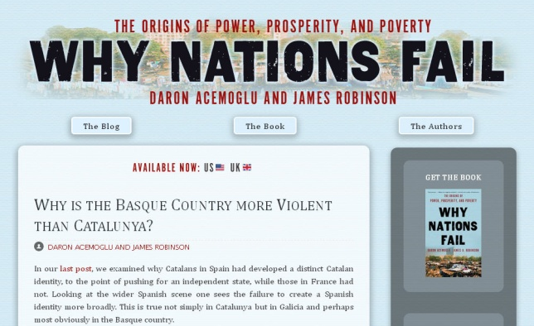
Notes:
http://global.oup.com/uk/orc/busecon/economics/carlin/

Slide 13
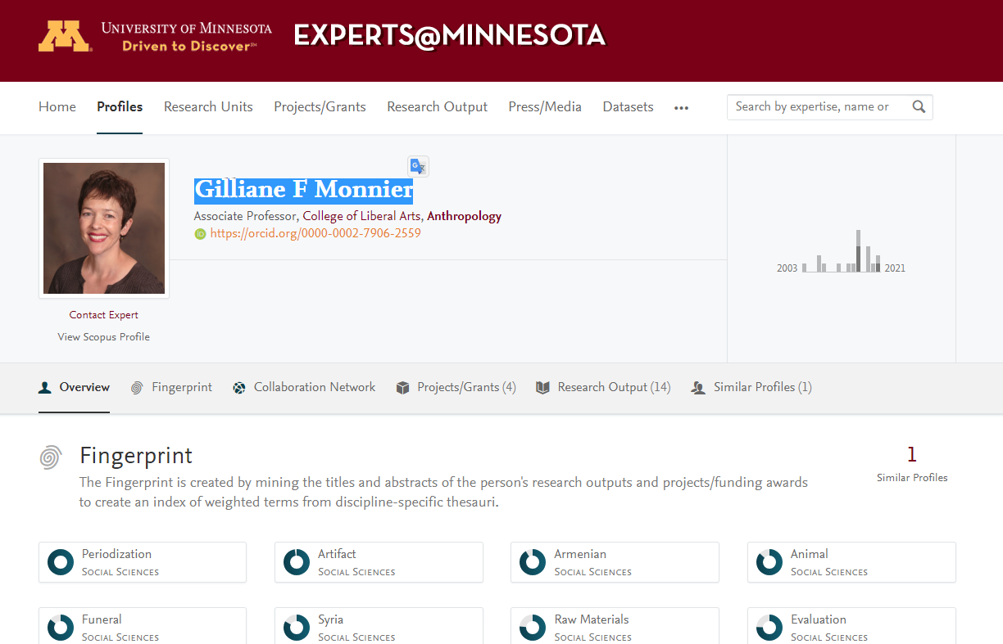
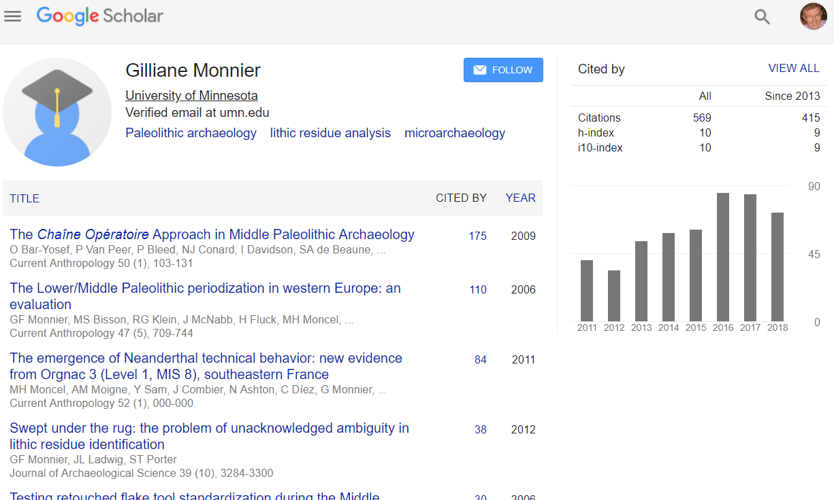
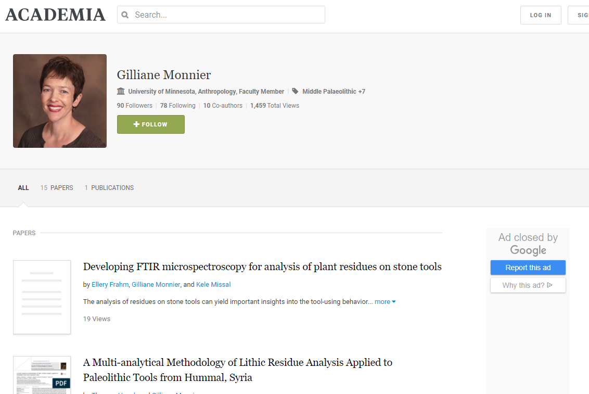
Blurring of workflow, outputs and identity

Slide 14
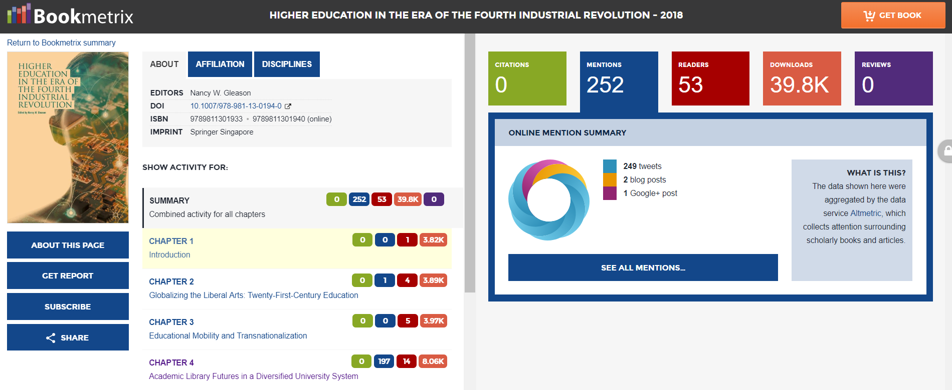

Slide 15
Creation, management and disclosure:
Vice president for research
R- infra-structure
Medical center
Tech Transfer Office
CIO
News Bureau
Institutional Reporting
Research Data Management
Advancement & corporate relations
Provost
Data Warehouse
RIM/Profiling system
Digital scholarship
LIBRARY
Colleges & depts
Institutional Repository
User education & training
Disciplines & departments
Graduate school
Office of undergraduate research
Researcher
Research manager
Research support
Campus center for teaching & learning

Slide 16
A publisher’s new job description
Her view is that publishers are here to make the scientific research process more effective by helping them keep up to date, find colleagues, plan experiments, and then share their results. After they have published, the processes continues with gaining a reputation, obtaining funds, finding collaborators, and even finding a new job. What can we as publishers do to address some of scientists’ pain points?
Annette Thomas,
Then CEO of Macmillan
Publishers
http://www.against-the-grain.com/2012/11/a-publishers-new-job-description/
Notes:
A Publisher's New Job Description
November 8, 2012 Donald Hawkins Charleston Conference Blog
http://www.against-the-grain.com/2012/11/a-publishers-new-job-description/

Slide 17
Researcher
Librarian
Research
manager

Slide 18
Support for creation, management and disclosure of evidence, memory, community
Workflow is the new content
Reputation and access manage and disclose the intellectual outputs and expertise of the institution.
From discovery to discoverability
Collective collections: aggregation?
Reconfiguration of research work by network/digital environment.
The inside out collection

Slide 19
Reconfiguration of the information space by network/digital environment.
Facilitated
Collection

Slide 20
arXiv, SSRN, RePEc, PubMed Central (disciplinary repositories that have become important discovery hubs);
Google Scholar, Google Books, Amazon (ubiquitous discovery and fulfillment hubs);
Mendeley, ResearchGate (services for social discovery and scholarly reputation management);
Goodreads, LibraryThing (social description/reading sites);
Wikipedia, Yahoo Answers, Khan Academy (hubs for open research, reference, and teaching materials).
FigShare, OpenRefine (data storage and manipulation tools)
Github (software management)

Slide 21
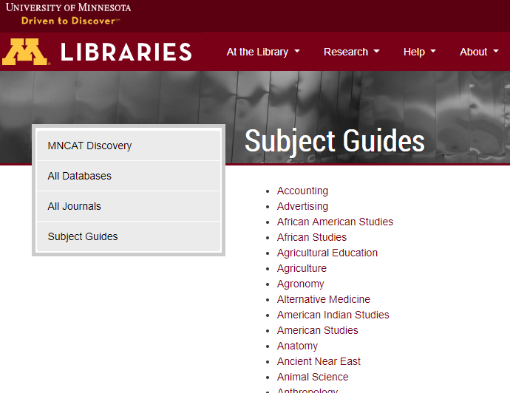
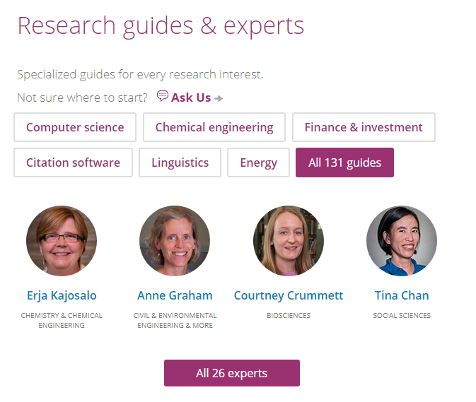
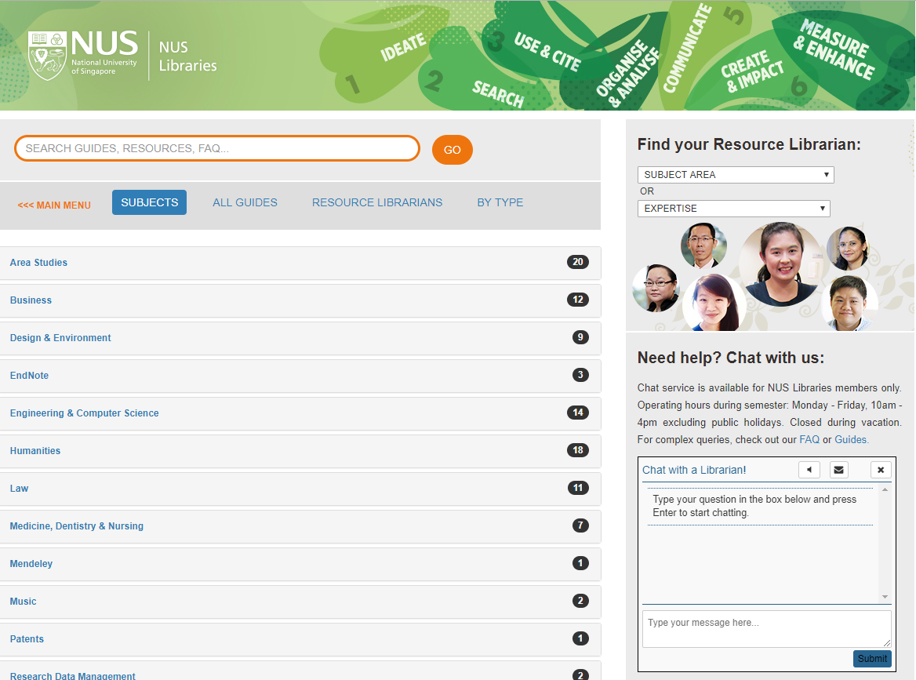
If the library is to be seen as expert then its expertise must be seen.

Slide 22
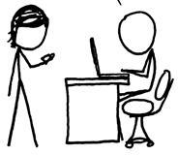
http://www.xkcd.com/917/
A print logic: the distribution of print copies to multiple local destinations
A network logic: a coordinated mix of local, external and collaborative services are assembled around user needs
Value relates to locally assembled collection.
Value relates to ability to efficiently meet a variety of research and learning needs.
A collections spectrum
The ‘owned’ collection
The ‘facilitated’ collection
Purchased and physically stored
Meet research and
learning needs in best way
Notes:
More on facilitated collections:
Dempsey, L., (2016). Library collections in the life of the user: two directions. LIBER Quarterly. 26(4). DOI: http://doi.org/10.18352/lq.10170

Slide 23
The ‘external’ collection:
Pointing researchers at Google Scholar;
Including freely available ebooks in the catalog;
Creating resource guides for web resources.
The ‘borrowed’ collection
The ‘shared print’ collection
The ‘shared digital’ collection
The evolving scholarly record
A collections spectrum
The ‘owned’ collection
The ‘licensed’ collection
The ‘demand-driven’ collection
The ‘facilitated’ collection
Note: Libraries have variable
Investments across the entire
spectrum
Purchased and physically stored
Meet research and
learning needs in best way

Slide 24
Specialization of locally acquired/held collections?
Engagement Understand and respond to needs of faculty and students.
A diffuse responsibility for stewardship of the scholarly record
The specialized collection
The facilitated collection
Reconfiguration of the information space by network/digital environment.

Slide 25
Reconfiguration of library collaboration by network/digital environment.
Collective collections:
Rightscaling and collaborative action …

Slide 26
System-wide organization of collections—whether the “system” is a consortium, a region, a country ….
The rise of the collective collection
Discoverable
Shared
Stewarded

Slide 27
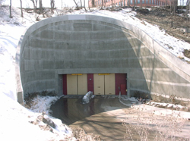
Discovery
Digital aggregation
Discovery/ Borrow
Physical retention

Slide 28
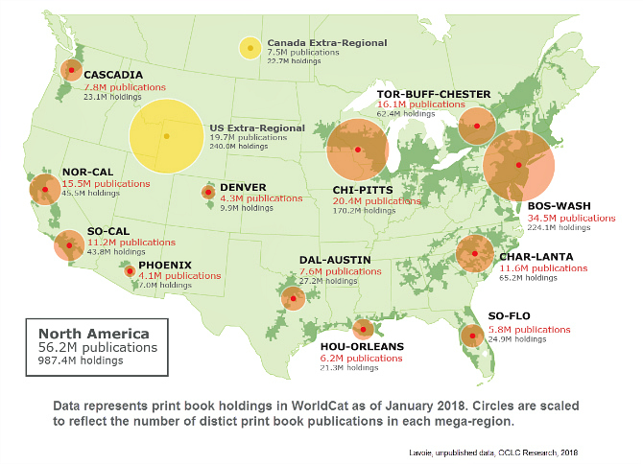
Future of collections management:
Local to shared collections.
Rightscaling stewardship.
Conscious coordination.
Reservoirs not oceans.
For the largest research libraries:
Scholarly record (reputation, mission).
Complex collections ecosystem.
Limitations of legacy infrastructure.

Slide 29
Complex ecosystem of resource sharing and stewardship partnerships
https://www.btaa.org/library/libraries
Discovery
Inventory management, ILS
Fulfillment
Analytics & decision support
Policies
Cataloguing practices
Governance and financial control – public, private
Responsibility to the scholarly record
Library leadership
Strength of existing consortium relationships

Slide 30
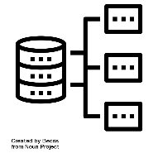
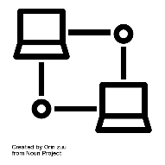
15 libraries
6 library management systems
26 resource sharing networks
6 discovery interfaces
7 shared print programs
5+ resource sharing platforms

Slide 31
STOCKS & FLOWS: BTAA
Disclosure, discovery, delivery flows traverse multiple networks
OCLC
Network
HathiTrust
Minitex
ILLinet
Indiana SRCS
MelCat
Regional
OhioLINK
SHARES
CRL
Consortium
UBorrow
EZBorrow
BorrowDirect
BTAA SPR
PALCI DPA
ReCAP
JSTOR archive
Rightscaling?

Slide 32
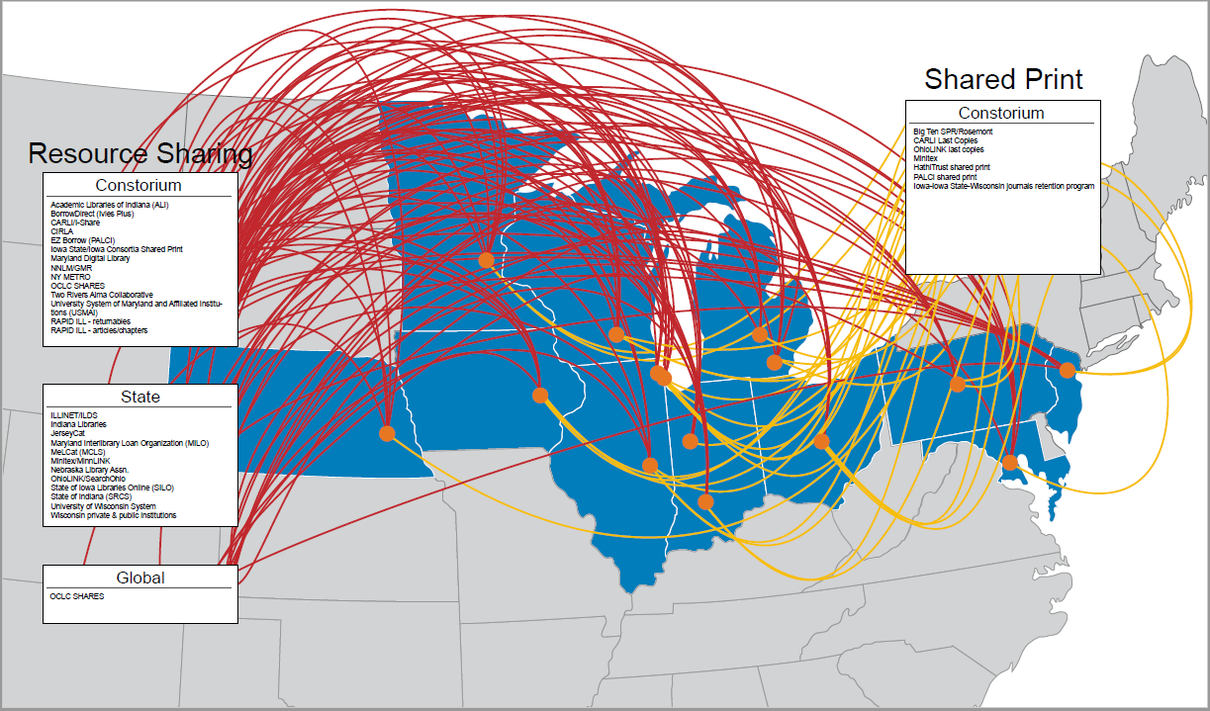
Credit: J.D. Shipengrover, OCLC

Slide 33
Stocks of multiple participating institutions
Policy layer
ILLinet
Stocks of multiple participating institutions
Policy layer
Stocks of multiple participating institutions
UBorrow
Policy layer
BorrowDirect
Participate in Uborrow and ILLinet
View of collective collection varies across BTAA
different policy regimes
different partnerships
different application choices
different data regimes
Participates in UBorrow, ILLinet, BorrowDirect

Slide 34
A spectrum of consolidation/ fragmentation
To a very great extent, existing library resource sharing networks are post-hoc agreements, stitching together collections, systems and services built for local consumption, and clumsily retrofitted to allow a degree of access to others. In other words, local priorities and practice trump the collective benefits libraries might now hope to achieve.
This is akin to deciding, after the fact, that it would be desirable to link state and municipal transit systems to support transcontinental travel. If roads, tracks, or air routes – all designed and governed to different standards – are to be connected retroactively, we can be assured that the costs of stitching together different systems will be high, and the resulting experience of travelers will be low.

Slide 35
Integrated user experience
Ease of management
Reduced coordination costs
Consortial agency
Trade offs:
Efficiency vs control?
Systemwide vs local optimization?
Reengineering vs retrofitting?
Ideal vs the art of the possible?
Local optimization
Close to the user
Control of costs
Pragmatic
Institutional agency

Slide 36
Compare and …
… contrast.

Slide 37
Coordinated systemwide planning precedes and shapes local planning and design.
Strategy/ planning
Systemwide design follows and coordinates local priorities. UX
Coordination, UX and Interop costs

Slide 38
Systemwide coordination
Policies
Interworking
Coordination, UX and Interop costs

Slide 39
Prospective
Collection development
Retrospective
Duplication costs

Slide 40
Consistent disclosure and consolidation
copies
digitised?
retention?
holdings?
usage?
Data
Silos
Coordination, UX and Interop costs

Slide 41
Small number of stores
Stocks
Widely distributed
Logistics and space costs

Slide 42
Small number of
systems.
Applications
Multiple applications.
Middleware?
Coordination, UX and Interop costs

Slide 43
Integrated user experience
Ease of management
Reduced coordination costs
Consortial agency
Trade offs:
Efficiency vs control?
Systemwide vs local optimization?
Reengineering vs retrofitting?
Ideal vs the art of the possible?
Local optimization
Close to the user
Control of costs
Pragmatic
Institutional agency

Slide 44
The specialized collection
A large part of existing print collections will move into shared stewardship in next few years?
Agreements emerging around retention and sharing.
Inside out collections aggregated in network level hubs?
Digitised corpus.
Collective collections: Rightscaling and collective action
Reconfiguration of library collaboration by network/digital environment.
The collective collection

Slide 45
Three trends
Reconfiguration of research work by network/digital environment.
Reconfiguration of the information space by network/digital environment.
Reconfiguration of library collaboration by network/digital environment.
The inside out collection
The facilitated collection
The collective collection

Slide 46
Three trends
Create, manage and make discoverable evidence, community, memory..
Assemble a coordinated mix of local, external and collaborative services around user needs.
Increasingly organize collections at the network or systemwide level.
The inside out collection
The facilitated collection
The collective collection

Slide 47
Boundaries
Collections and research workflows: “liaison”
“partner and advocate”
Collections and access:
“liaison”
“fulfilment”
Collections and collaboration:
“ILL”
“Collection development”
“partner libraries”
The inside out collection
The facilitated collection
The collective collection

Slide 48
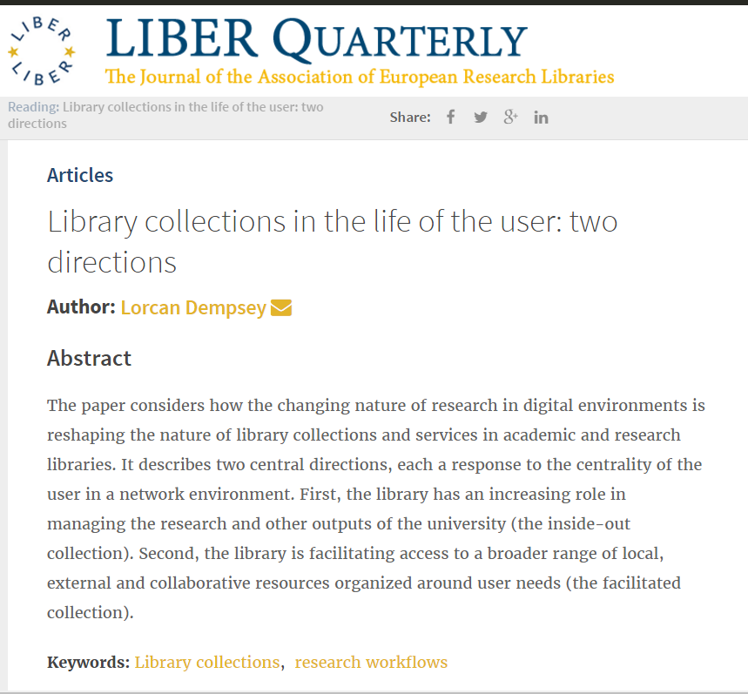
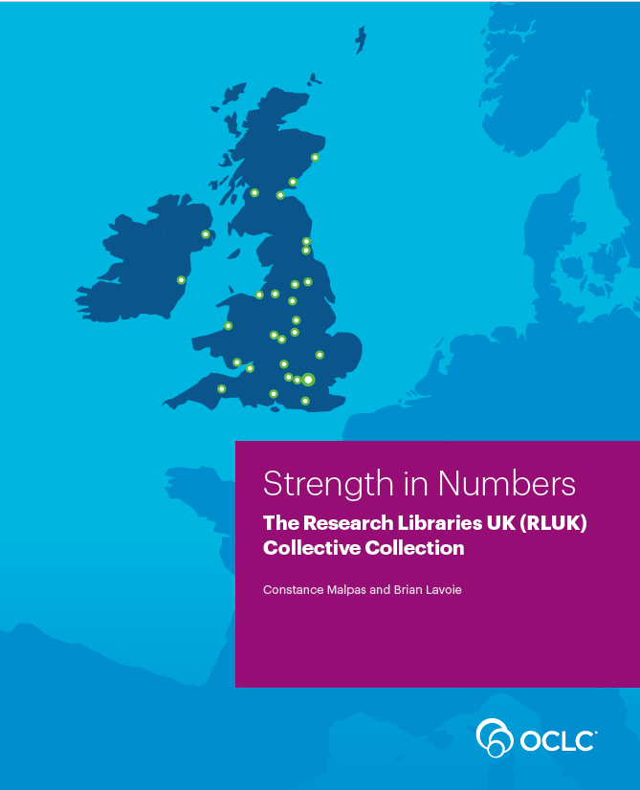
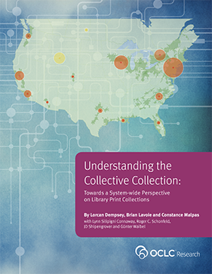
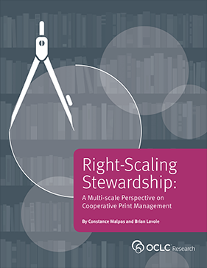
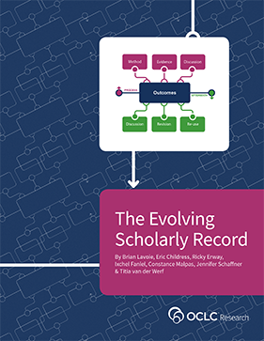
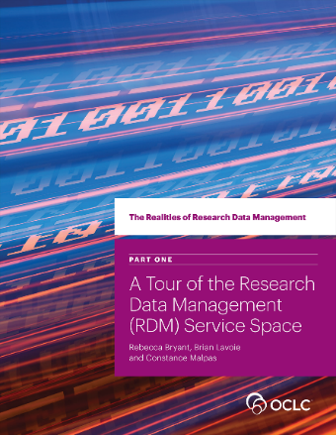
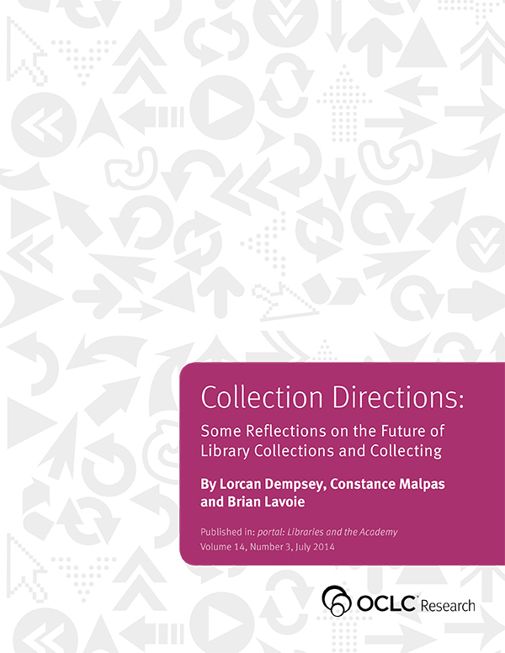
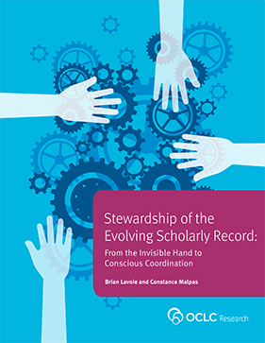
Thank you, @LorcanD

