Slide 1
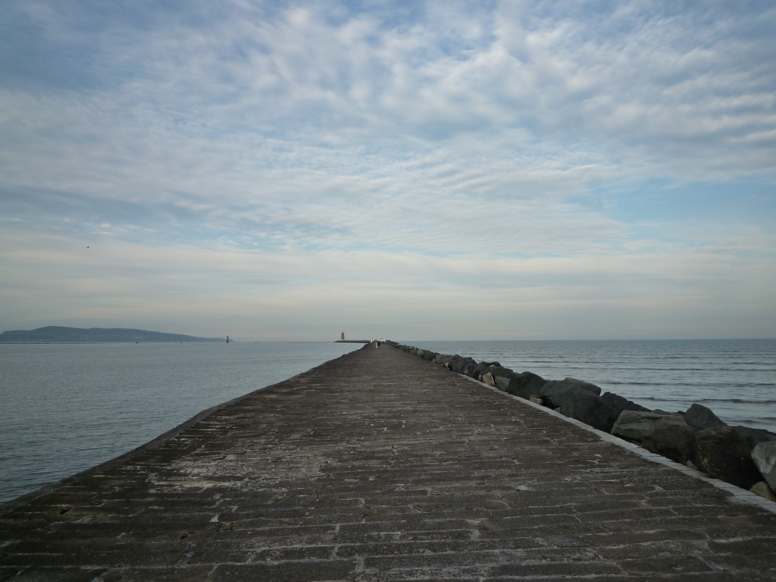
Evolving Collection Directions
Lorcan Dempsey & Constance Malpas
OCLC
@LorcanD
@ConstanceM
Chicago, 30 Jan 2015
Collection Development Strategies in an Evolving Marketplace: an ALCTS Midwinter Symposium

Slide 2
Overview
Collection directions

Slide 3
1
Collections
The evolving scholarly record
Collection attention: collections grid
Trends
Inside-out collections
Collections as a service
From curation to creation
Workflow is the new content
2
3
Towards the collective (print) collection
How we will manage print collections … differently.

Slide 4
The evolving scholarly record
Collection directions

Slide 5
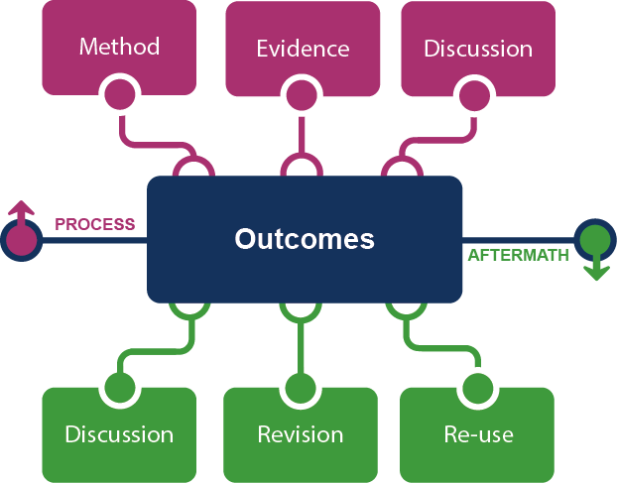
Framing the Scholarly Record …
Figure: Evolving Scholarly Record framework.
OCLC Research, 2014

Slide 6
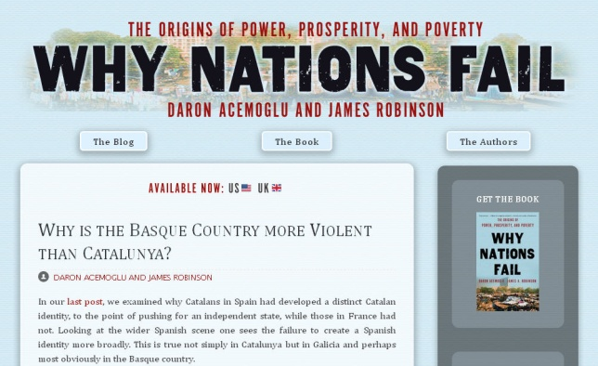
Figure: Evolving Scholarly Record framework, publishing venues.
OCLC Research, 2014

Slide 7
Grid: collection attention
Collection directions

Slide 8
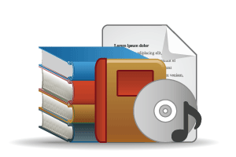
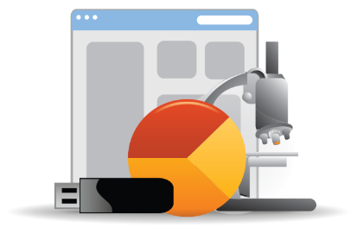
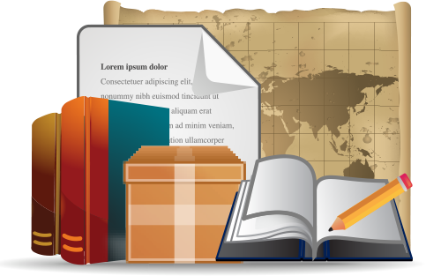
Open Web Resources
‘Published’ materials
In many collections
Licensed
Purchased
Low Stewardship
High Stewardship
Research & Learning Materials
In few collections
Special Collections
Local Digitization
Figure: OCLC Collections Grid.
OCLC Research, 2014

Slide 9
Monographs
Emergence of ‘e’ (platform)
Shift to demand driven acquisition
Digital corpora
Disciplinary differences
Growing difference between market-available and distinctive (e.g. area studies)
Managing down print - shared print
Journals
Licensed materials are now the larger part of academic library budgets
Publishers looking to research workflow (Elsevier – Mendeley, Pure)
National science/research policy and open access
A part only of the scholarly record – data, etc.

Slide 10
Research and learning material
Evolving scholarly record: research data, eprints, ..
IR – role and content?
Research information management (profiles, outputs, …)
Support for digital scholarship
Support for open access publishing
Special collections, archives, …
Release more value through digitization, exhibitions, …
Streamlining processing, production, …
Network level aggregation for scale and utility – DPLA, Europeana, Pacific Rim Digital Library,

Slide 11
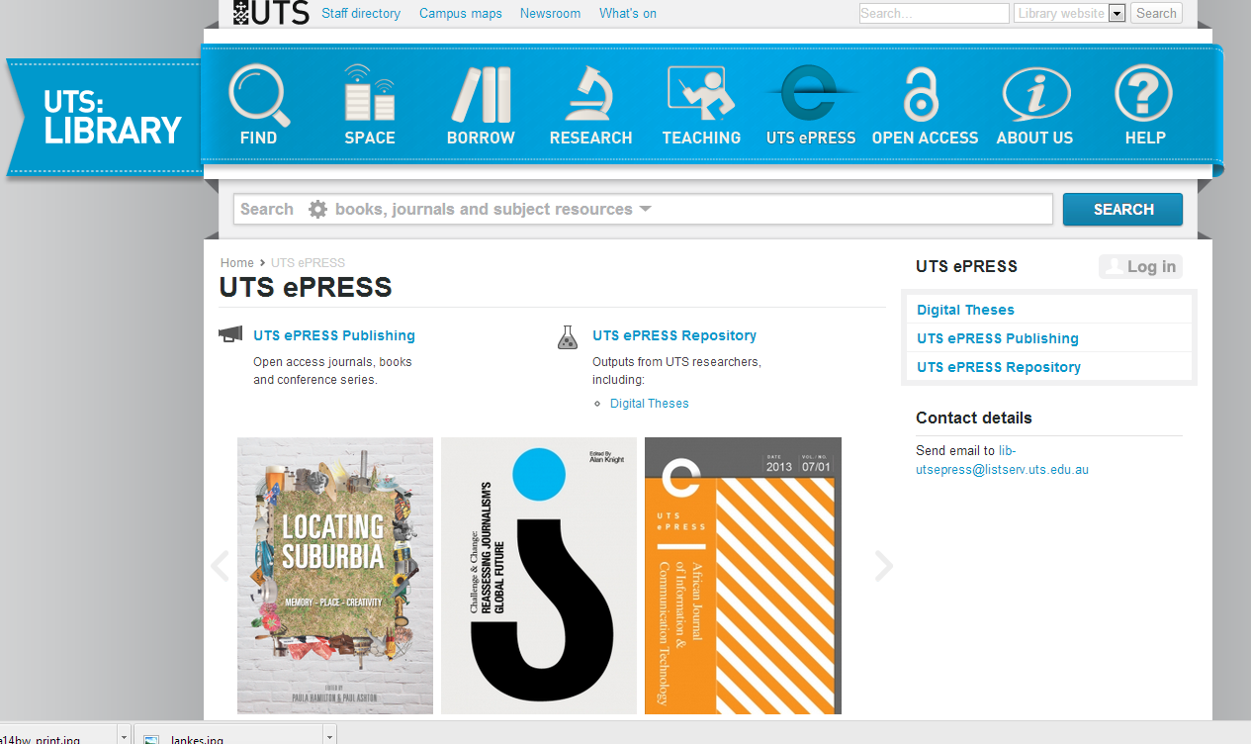
http://www.lib.uts.edu.au/uts-epress

Slide 12
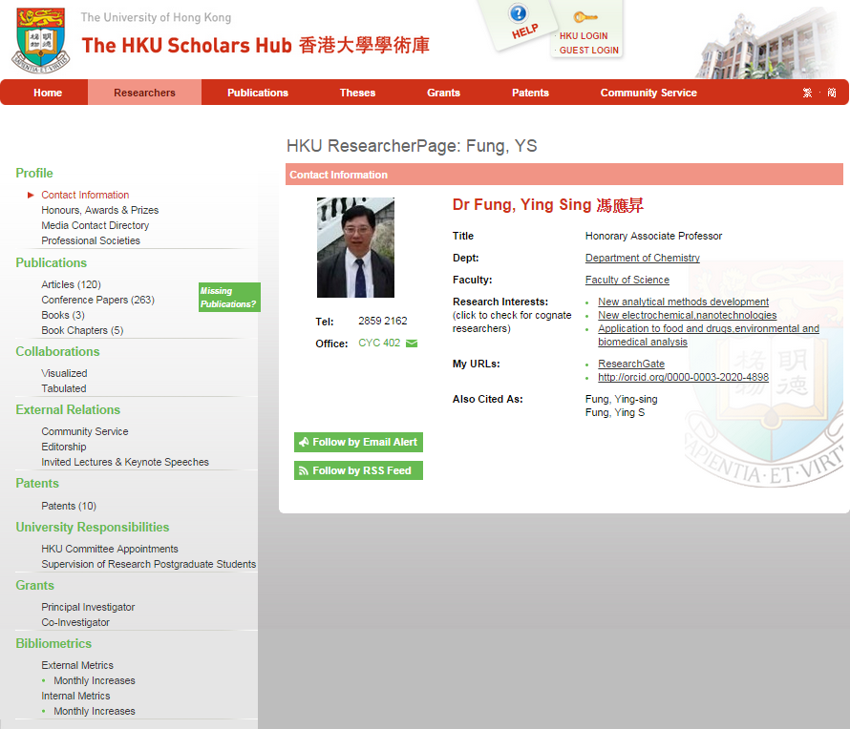
http://hub.hku.hk/cris/rp/rp00697
Compare: Kenning Arlitsch “New knowledge work”
http://www.tandfonline.com/doi/pdf/10.1080/01930826.2014.946778

Slide 13
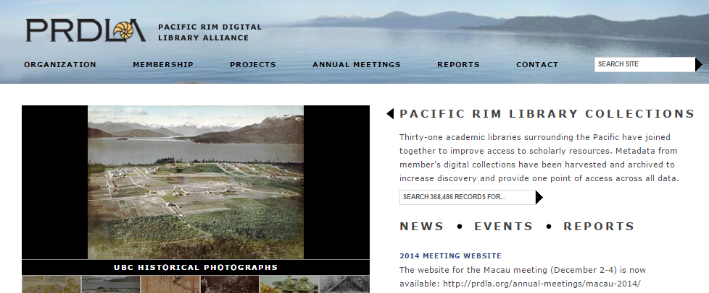
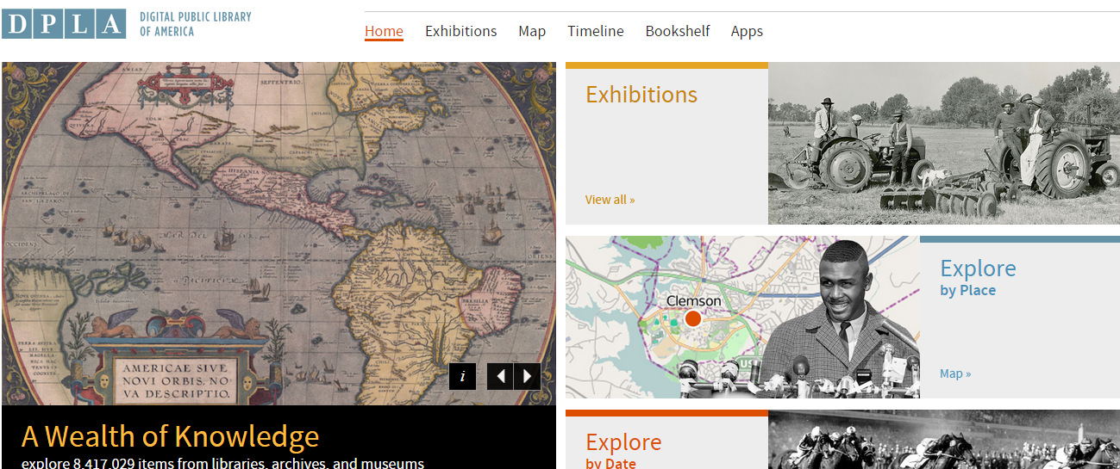

Slide 14
Institutional Needs – Academic Libraries: Current situation vs. 5 years from now
Key Trends?:
increased reliance on group provisioning of print and licensed content
more integration of freely available web-based content
special collections focus on institutional mission, reputation
growing attention to teaching/learning materials; limited library capacity
Open Web Resources
In many collections
Purchased Materials
Licensed E-Resources
Licensed
Purchased
Low
Stewardship
High Stewardship
Special Collections
Local Digitization
Research & Learning Materials
In few collections
Figure: Projected shift in institutional attention, academic libraries.
OCLC Research, 2015.

Slide 15
Institutional Needs – Research Libraries: Current situation vs. 5 years from now
Key Trends?:
strategic realignment around purchasing/licensing ‘collections as services’
redirection of investment toward research support (inc ‘reputation management’)
emphasis on effective disclosure of distinctive assets: special collections, research data, expertise
Open Web Resources
Purchased Materials
Licensed E-Resources
In many collections
Licensed
Purchased
Low
Stewardship
High Stewardship
Special Collections
Local Digitization
Research & Learning Materials
In few collections
Figure: Projected shift in institutional attention, research libraries.
OCLC Research, 2015

Slide 16
Collections as a service
Collection directions

Slide 17
Catalog
KB/Discovery
LibGuides, etc
Google, ResearchGate, etc …
Separation of discovery and collection?:
Focus shifts from owned to facilitated (available)?
Focus shifts from collection to other services (creation, …)?
Systemwide thinking becomes stronger?
Owned
Licensed
Available
Global
Figure: Discoverability redefines collection boundaries.
OCLC Research, 2015.

Slide 18
The ‘owned’ collection
The ‘facilitated’ collection
The ‘borrowed’ collection
The ‘demand-driven’ collection
A collections spectrum
The ‘licensed’ collection
The ‘shared print’ collection
Purchased and physically stored
Pointing people at Google Scholar
Including freely available e-books in the catalog
Creating resource guides for web resources
Figure: A collections spectrum.
OCLC Research, 2015.

Slide 19
Workflow is the new content
Collection directions

Slide 20
arXiv, SSRN, RePEc, PubMed Central (disciplinary repositories that have become important discovery hubs);
Google Scholar, Google Books, Amazon (ubiquitous discovery and fulfillment hubs);
Mendeley, ResearchGate (services for social discovery and scholarly reputation management);
Goodreads, LibraryThing (social description/reading sites);
Wikipedia, Yahoo Answers, Khan Academy (hubs for open research, reference, and teaching materials).
GalaxyZoo, FigShare, OpenRefine (data storage and manipulation tools)
Github (software management)

Slide 21
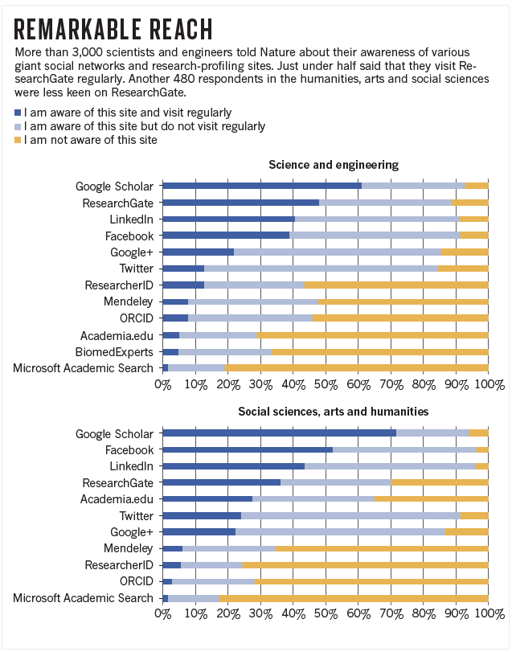
http://www.nature.com/news/online-collaboration-scientists-and-the-social-network-1.15711

Slide 22
http://innoscholcomm.silk.co/

Slide 23
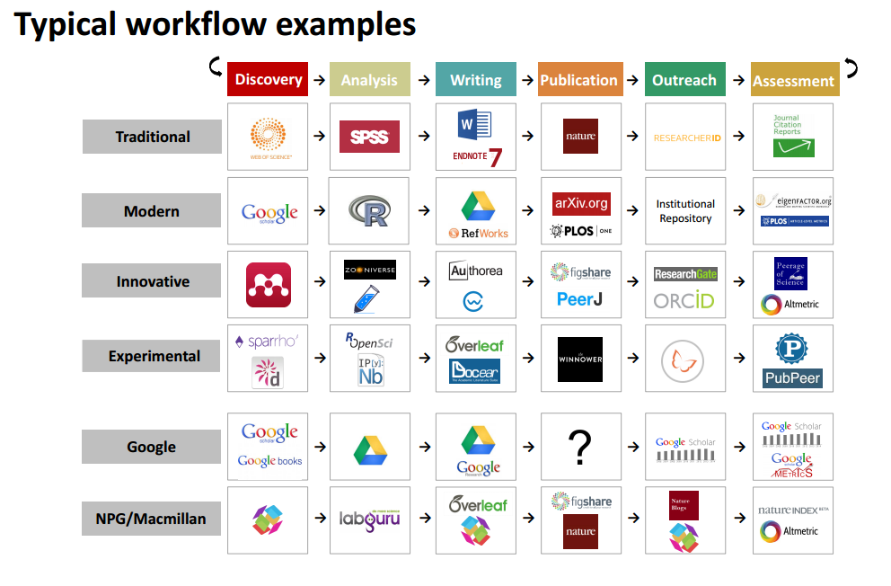
http://innoscholcomm.silk.co/

Slide 24
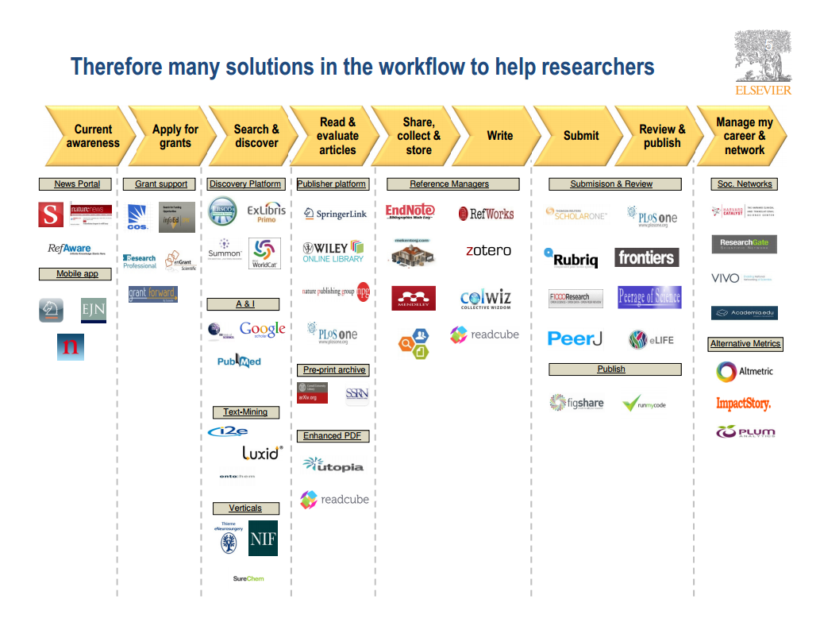
Wouter Haak
Elsevier, VP Product Strategy
LIBER, Riga, 2014

Slide 25
A publisher’s new job description
Her view is that publishers are here to make the scientific research process more effective by helping them keep up to date, find colleagues, plan experiments, and then share their results. After they have published, the processes continues with gaining a reputation, obtaining funds, finding collaborators, and even finding a new job. What can we as publishers do to address some of scientists’ pain points?
Annette Thomas,
CEO of Macmillan
Publishers
http://www.against-the-grain.com/2012/11/a-publishers-new-job-description/

Slide 27
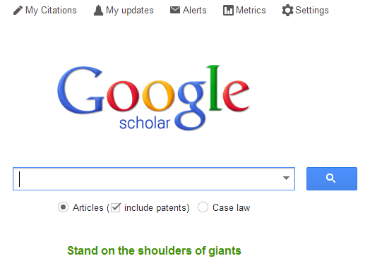

Slide 29
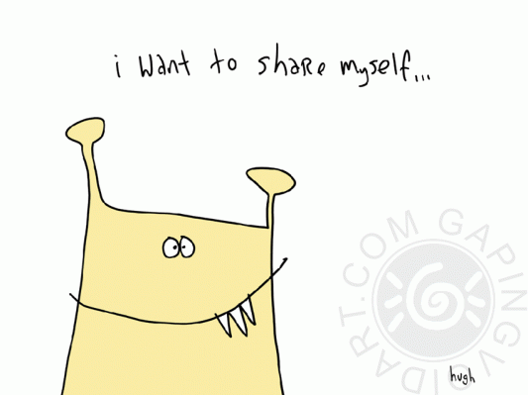

Slide 30
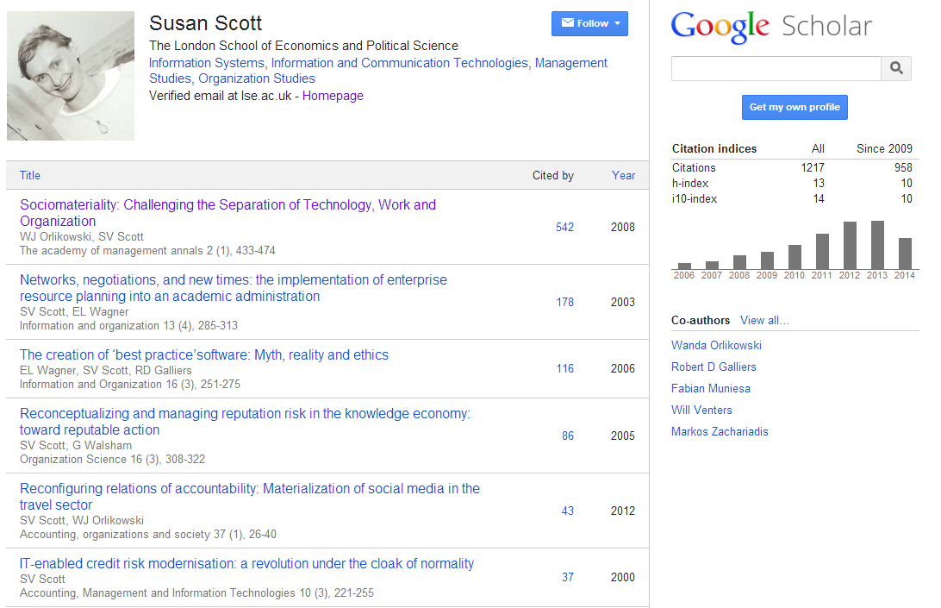
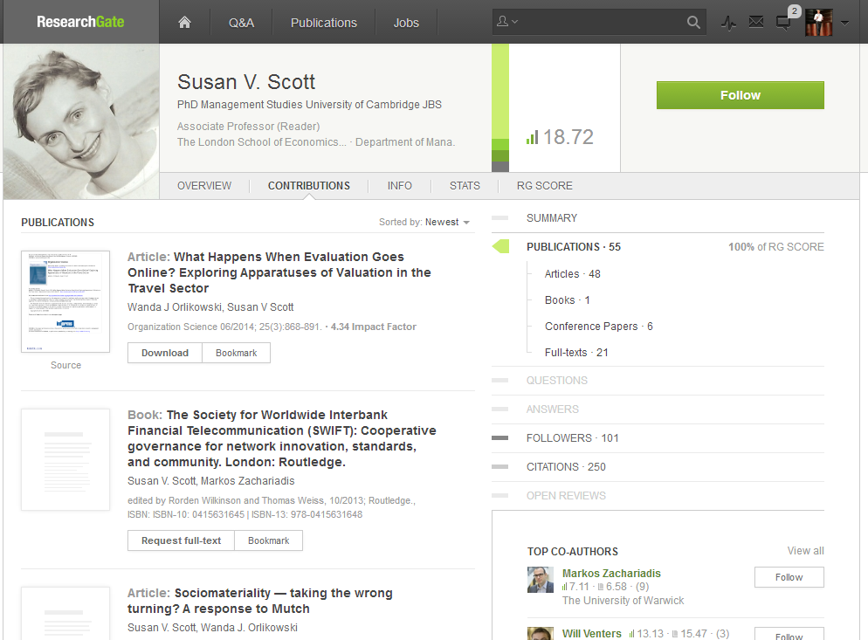

Slide 31
Workflow is the new content
In a print world, researchers and learners organized their workflow around the library.
The library had limited interaction with the full process.
In a digital world, the library needs to organize itself around the workflows of research and learners.
Workflows generate and consume information resources.

Slide 32
The inside out collection
Collection directions

Slide 33
OCLC Collections Grid
Then
Outside, in
In many collections
Library as broker
Maximise efficiency
A
Licensed
Market
Purchased
Low Stewardship
High Stewardship
Distinctive
Library as provider
Maximise discoverability
Inside, out
In few collections
Now
Figure: OCLC Collections Grid, shift in emphasis. OCLC Research, 2014.

Slide 34
From curation to creation
Collection directions

Slide 35
U Minnesota, ARL Institutional profile
“In alignment with the University's strategic positioning, the University Libraries have re-conceived goals, shifting from a collection-centric focus to one that is engagement-based.”
http://umcf.umn.edu/awards/2006/images/margo_library_lg.jpg
http://www.libqual.org/documents/admin/Profiles_apndx_C.pdf

Slide 36
Transformation of the academic library
Kurt de Belder
http://www.oclc.org/content/dam/research/events/dss/ppt/dss_debelder.pptx

Slide 37
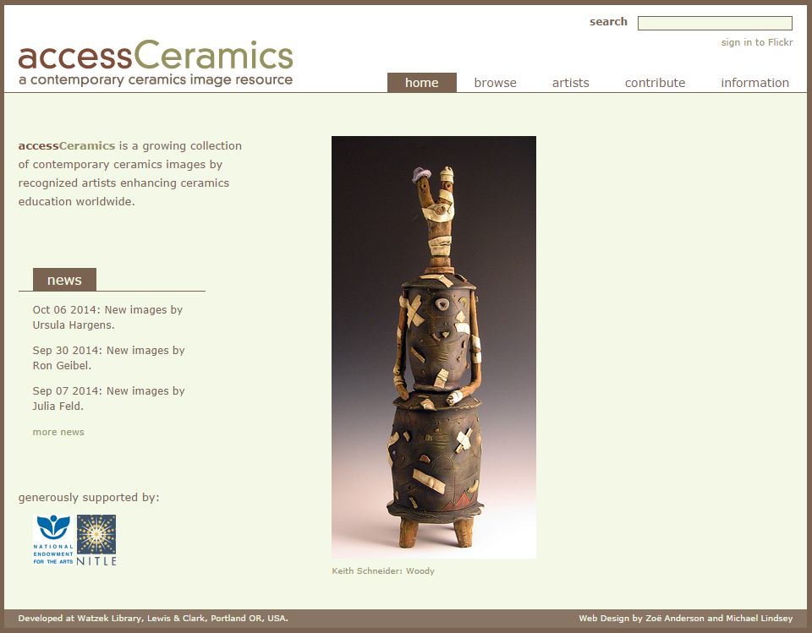
http://accessceramics.org/

Slide 38
Towards the collective (print) collection
Collection directions

Slide 39
The bubble of growth in twentieth-century printed collections has left … librarians with a tricky problem.
Barbara Fister New Roles for the Road Ahead:
Essays commissioned for ACRL’s 75th Birthday

Slide 40
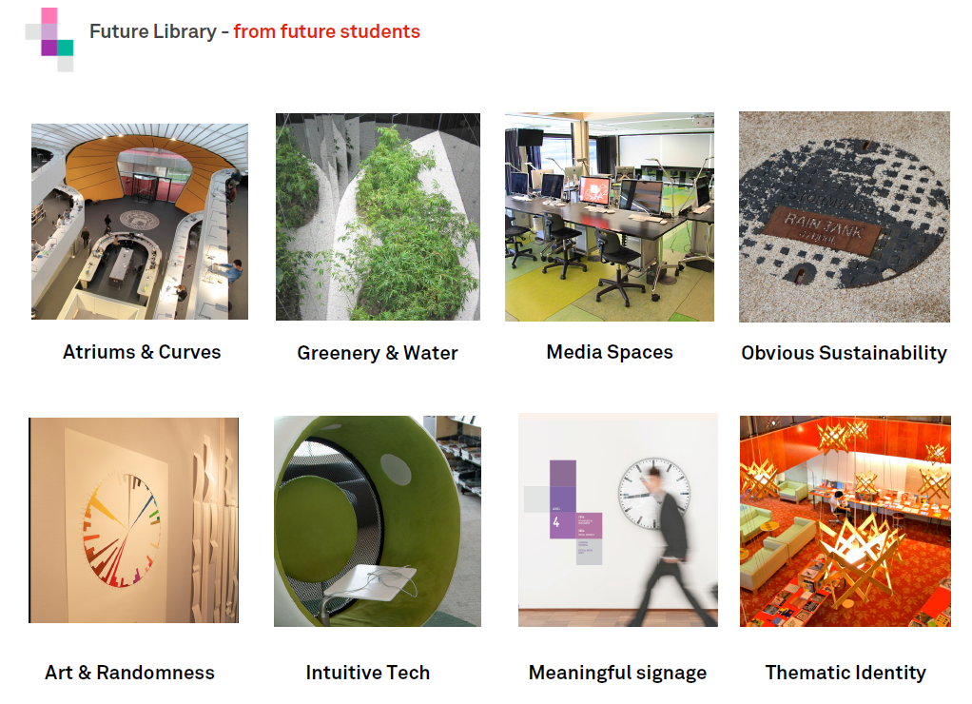
http://www.slideshare.net/malbooth/uts-future-library-more-than-spaces-technology
Mal Booth, UTS Library

Slide 41
Shared Print
‘Rightscaling’ management of print resources, part of larger shift to above-the-institution solutions
Opportunity costs of maintaining institution-scale operations are very high – acknowledging deep reluctance to managing down local inventory
Early efforts focused on journals (because risks are low; scholarly attention has moved on); new groundswell of activity around monographs
Strategic goal – increase operational efficiencies for managing print so that library resources can be redirected to distinctive collections and services

Slide 42
Shared print- collective collection Then: Value relates to depth and breadth of local collection. Now: Value relates to systemwide curation of and access to print collections – ‘rightscaling’.
Decision support through shared data.

Slide 43
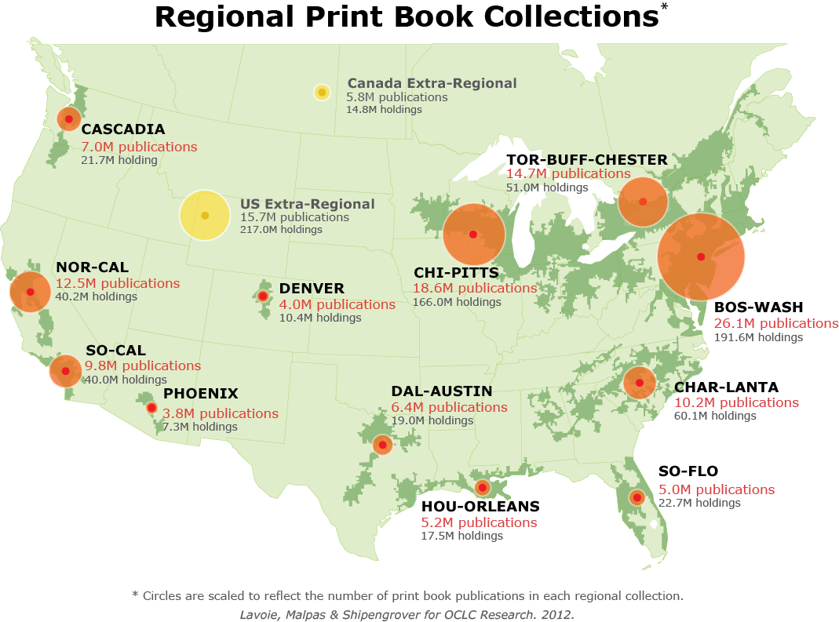
North American print book resource:
45.7 million distinct publications
889.5 million total library holdings
Figure: North American Regional Print Book Collections. OCLC Research, 2013.

Slide 44
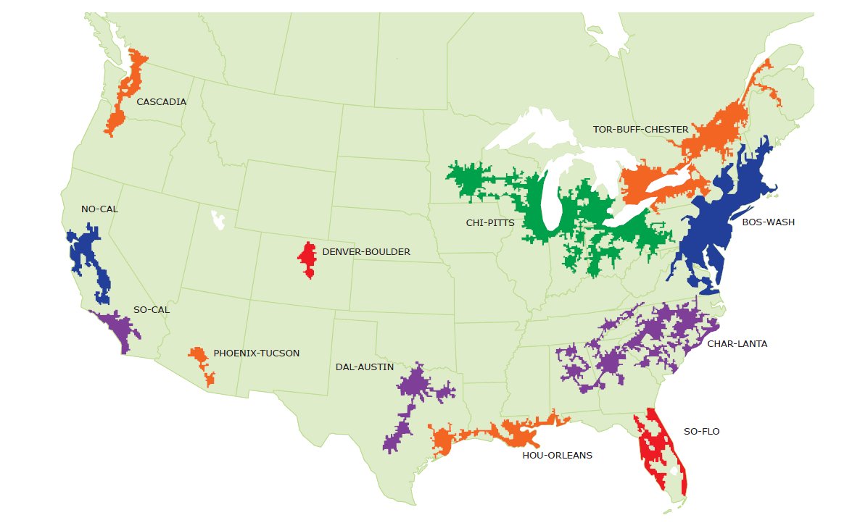
Mega-regions & Shared Print Initiatives
Orbis-Cascade
OCUL
MSCS
WEST
CIC
SCELC
WRLC
GWLA
ASERL
FLARE
We expect that in 5-7 years the larger part of the North American ‘collective collection’ will have moved into shared management.
Figure: North American Mega-regions and shared print activity. OCLC Research, 2013.
OCLC Research, 2013

Slide 45
In conclusion
Collection directions

Slide 46
Then: the user in the life of the library
Now: the library in the life of the user
The practice of research and learning is changing.
Research and learning outputs are diversifying.
Research outputs are the subject of policy attention
Publishers supporting workflow and reputation.
Move to facilitated access to require materials – collection as a service.
Move to management and disclosure of institutional materials – inside out.
The print and digital scholarly record needs conscious coordination at
the network level.

Slide 47
@LorcanD
http://www.oclc.org/research

Slide 48
Credits
This presentation reflects ongoing shared work with our colleague Brian Lavoie. Thanks to our colleague JD Shipengrover for graphics.
The Evolving Scholarly Record http://oclc.org/content/dam/research/publications/library/2014/oclcresearch-evolving-scholarly-record-2014.pdf
Understanding the Collective Collection http://oclc.org/research/publications/library/2013/2013-09r.html
Collection Directions http://www.oclc.org/content/dam/research/publications/library/2014/oclcresearch-collection-directions-preprint-2014.pdf

