Slide 1
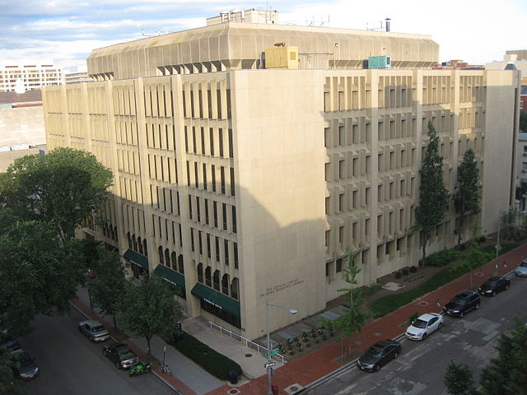
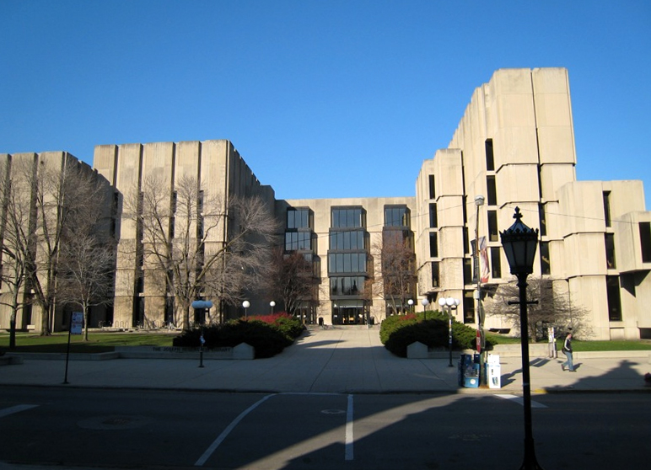
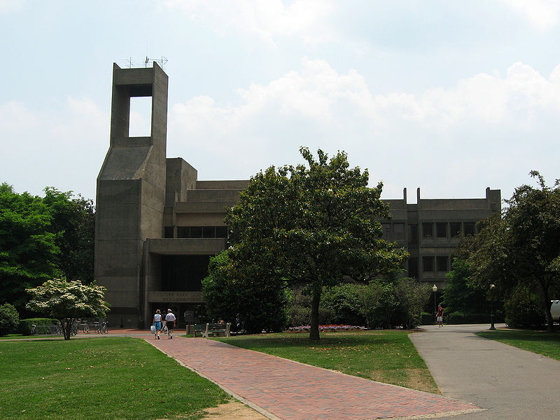
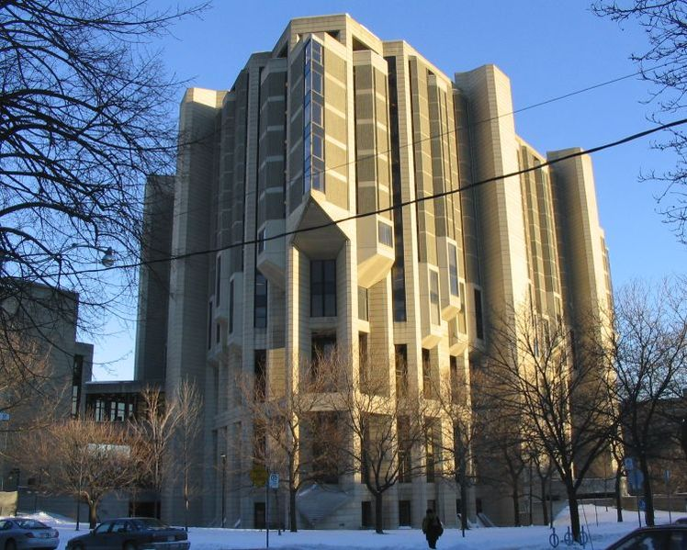
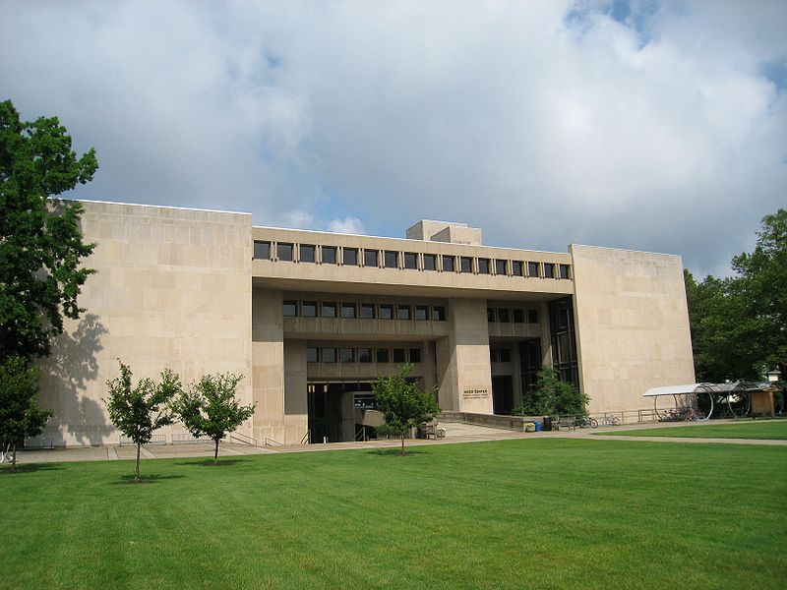
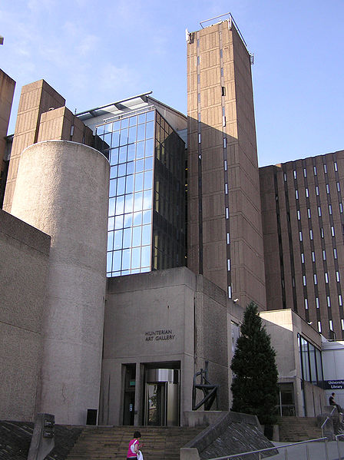
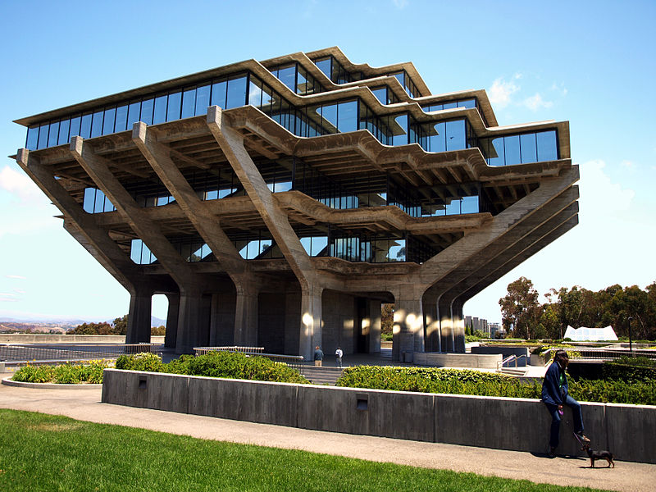
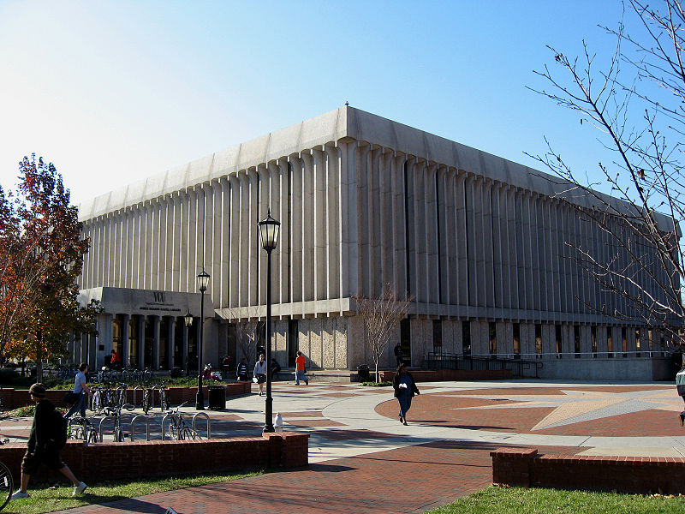
@LorcanD
The library and the network: scale, engagement, innovation
Lorcan Dempsey
OCLC
Georgetown University,
Washington DC
7 March 2014

Slide 2
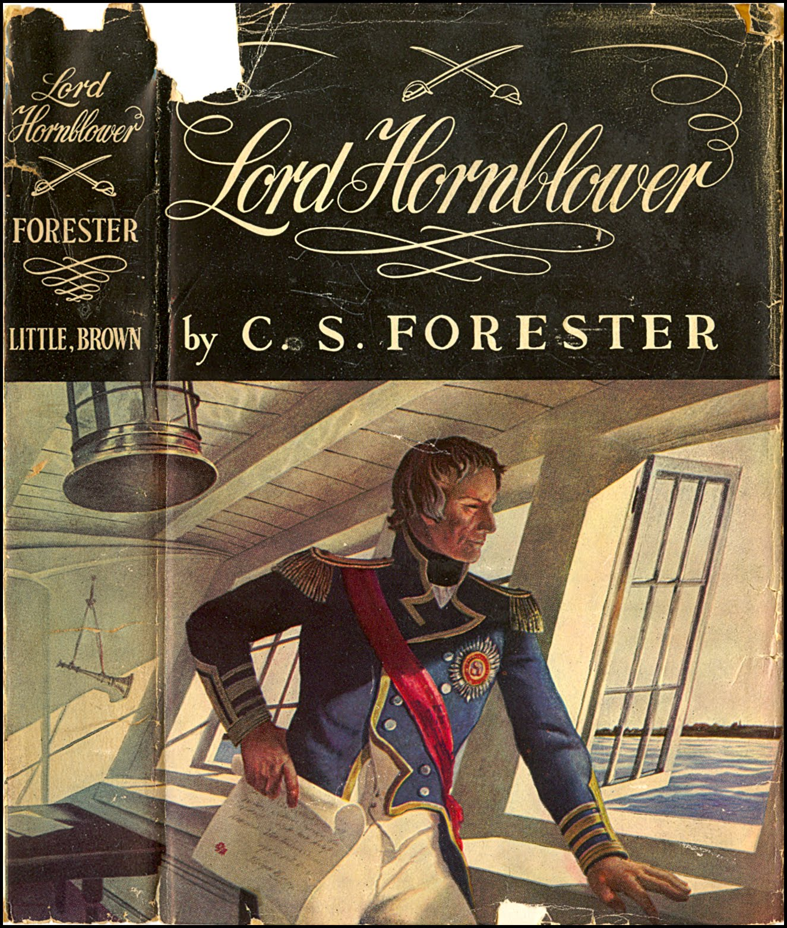
http://fantasy-ink.blogspot.com/2009/11/dustjackets-by-andrew-wyeth.html
Prelude
Georgetown in

Slide 3
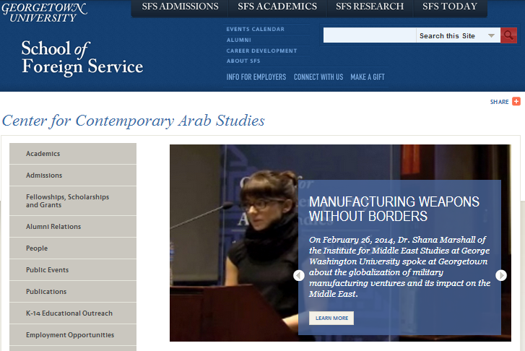
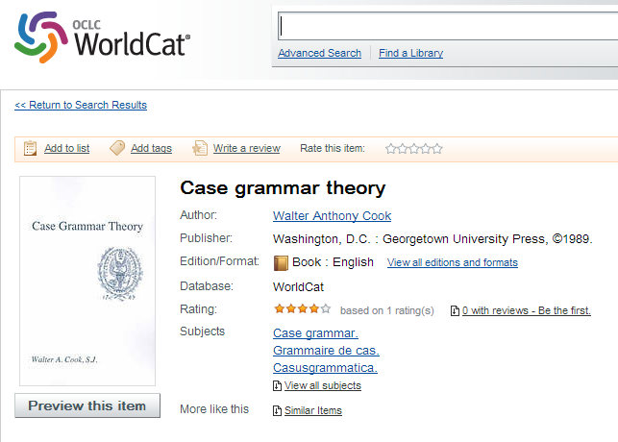
Topics where Georgetown has more titles than other libraries
Greene, Graham,--1904-1991
Hornblower, Horatio (Fictitious character)
Film serials
Arabic language--Spoken Arabic
Case grammar
Order (Grammar)
Forester, C. S.--1899-1966
Saʻdāwī, Nawāl
Relational grammar
Arab Americans--Ethnic identity

Slide 4
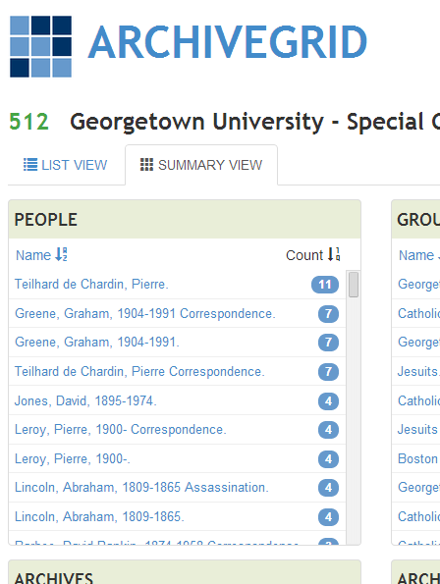
Names where Georgetown has more titles than other libraries
Greene, Graham 1904-1991
Forester, C. S. (Cecil Scott) 1899-1966
Georgetown University Institute for the Study of Diplomacy
Powell, Anthony 1905-2000
Georgetown University Center for Strategic and International Studies
Georgetown University
Munīf, ʻAbd al-Raḥmān
Communications and Society Program (Aspen Institute)
Georgetown University Center for Contemporary Arab Studies
Hughes, John 1797-1864
http://graphics8.nytimes.com/images/2004/11/04/arts/04gree.2.184.jpg

Slide 5
Introduction: The network

Slide 6
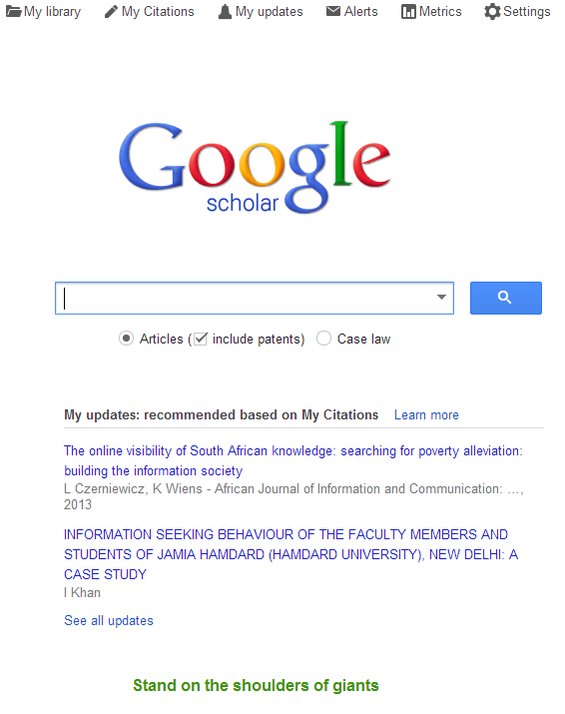

Slide 7
Network favors scale
Platform – concentrates data, infrastructure, …
Community/network forms around platform
Network effects are central
Social and analytics are central
Gravitational hubs: the rich get richer
Strong seo and referencability
End user
Social
Analytics
Management

Slide 8
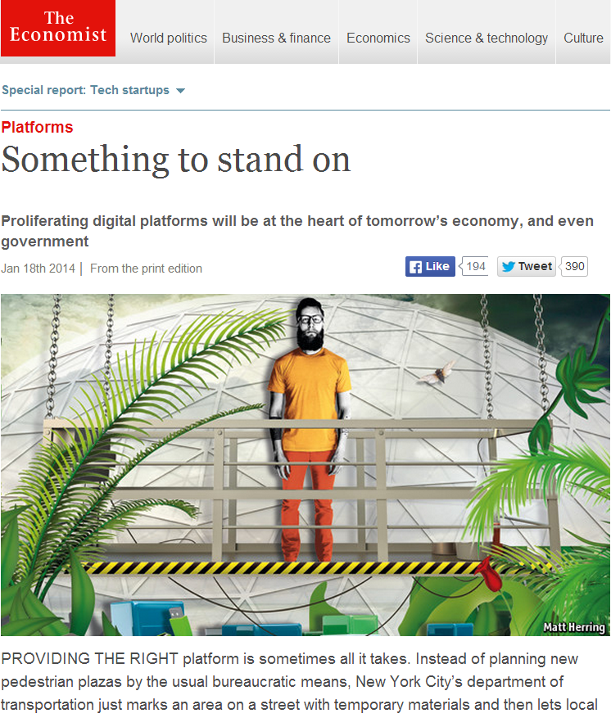

Slide 9
Infrastructure and scale in libraries: platforms

Slide 10
Print world High transaction costs
Multiple collections placed close
to the user
Redundant operations …

Slide 11
Cataloging
E-Journals
Shared Print
Discovery
…..

Slide 12
Cataloging
E-Journals
Shared Print
Discovery
…..
Worldcat
Multiple
“Webscale discovery”
?
Network world Lower transaction costs
Operations consolidate in platforms
Redundant operations …
A recent example …

Slide 13
Infrastructure is moving to cloud … Network effects in consumer services – gravitational hubs … Consolidation leads to data driven services and experiences … (analytics, recommendation, …)

Slide 14
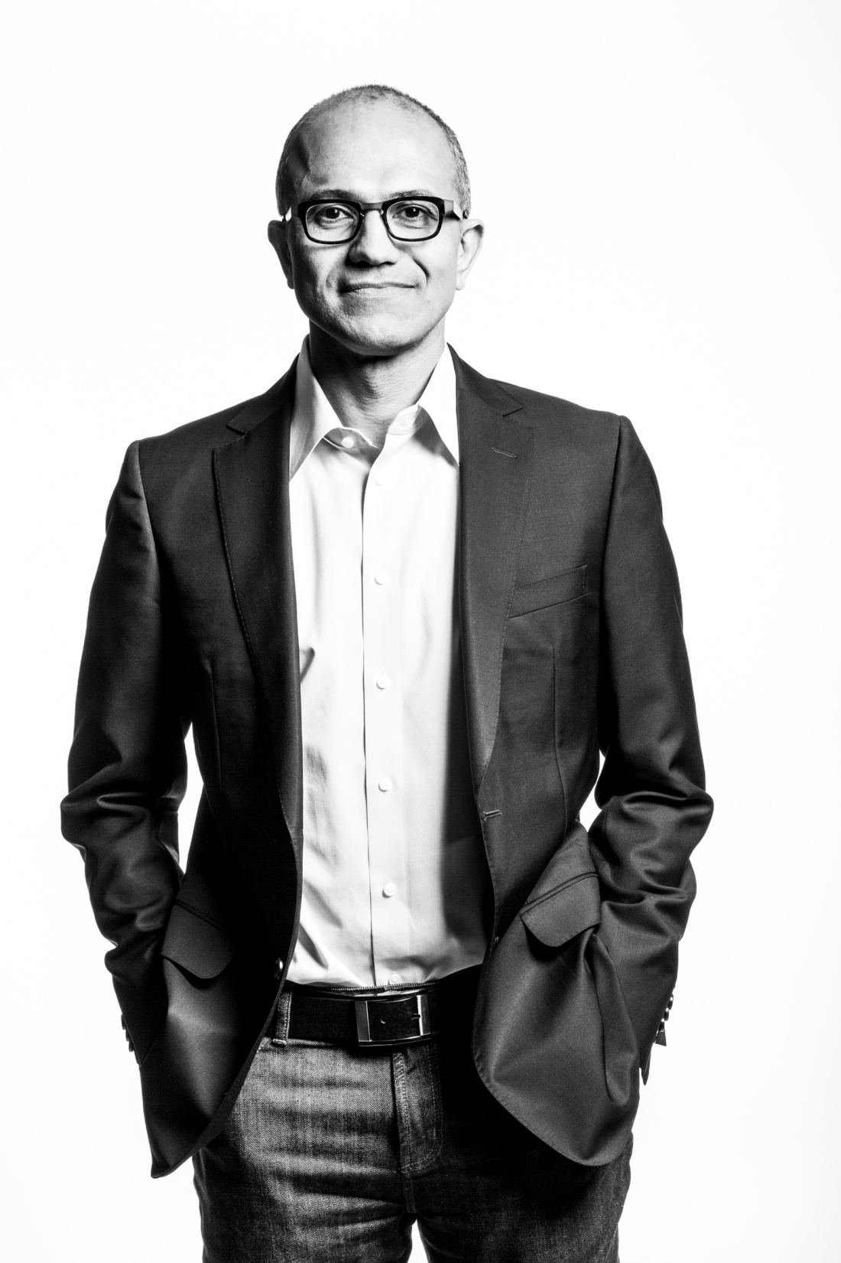
“Our job is to ensure that Microsoft thrives in a mobile and cloud-first world.”
http://www.theverge.com/2014/2/4/5377318/microsoft-ceo-satya-nadella-first-letter-to-employees

Slide 15
The squeezed middle? The network favors scale and …. …. the personal What about the institution?

Slide 18
What has changed
1
Now: resources are abundant and attention is scarce
Then: resources are scarce and attention is abundant

Slide 19
What has changed?
2
Then: High transaction costs meant putting materials/services close to the user
Now: Reduced transaction costs favor network platforms (Expedia, Amazon, Worldcat)

Slide 20
What has changed?
3
Then: The library is the user focus (institution scale)
Now: The network is the user focus

Slide 21
What has changed
4
Now: Library services are built around the user’s workflow
Then: User’s workflow built around library services

Slide 22
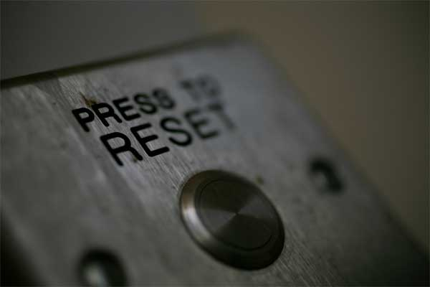
Value and focus?
Unable to identify source of image

Slide 23
Harvard Business Review (1999)

Slide 24
Attracting and building relationships with researchers and learners
“Service-oriented”, customization
Economies of scope important
Develop new
services and have them accepted
Speed/flexibility important
Engagement
Innovation
Infrastructure
Back office capacities that
support day-to-day operations
“Routinized” workflows
Economies of scale important
Note: Hagel et al talk about
customer relationship management
rather than engagement

Slide 25
Locally
assembled
collections.
The place to go.

Slide 26
Focus?
Strategy is about choices …
Reconnect with parent’s goals …
Where is distinctive local impact?
Enrich student experience
Improve research effectiveness and impact
Promote civic engagement
Equip citizens with learning skills and tools
What should be done collaboratively?
What should be done by others?

Slide 27
Shift to engagement
… the library as an effective actor in the research, learning and skills environments of its users
Rightscale infrastructure
… rebalance investment in collections and systems between local, shared and third party to improve impact and efficiency. Collaboration moves from margin to core.
Innovate – scalable and repeatable
… institutions and services need to evolve in sustainable ways.

Slide 28
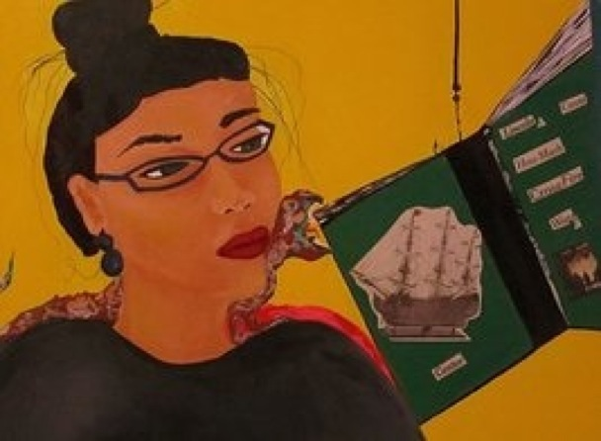
Shift to engagement

Slide 29
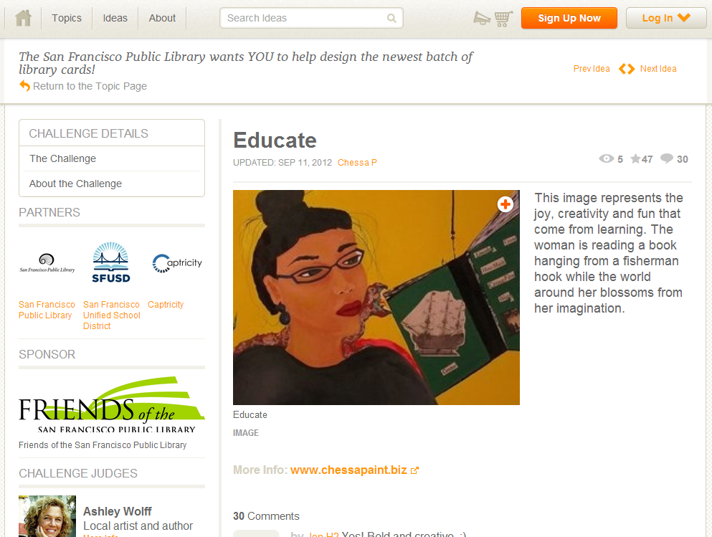

Slide 30
U Minnesota, ARL Institutional profile
“In alignment with the University's strategic positioning, the University Libraries have re-conceived goals, shifting from a collection-centric focus to one that is engagement-based.”
http://umcf.umn.edu/awards/2006/images/margo_library_lg.jpg

Slide 31
Examples of engagement
Visible expertise: the power of pull
Beyond consumption and creation: directly supporting creation
Reconfigured space: configure around experiences not collections
Decentered web presence: in the flow

Slide 32
Visible expertise Then: Invisible and neutral. Now: If the library wishes to be seen as expert, then its expertise must be seen.

Slide 33
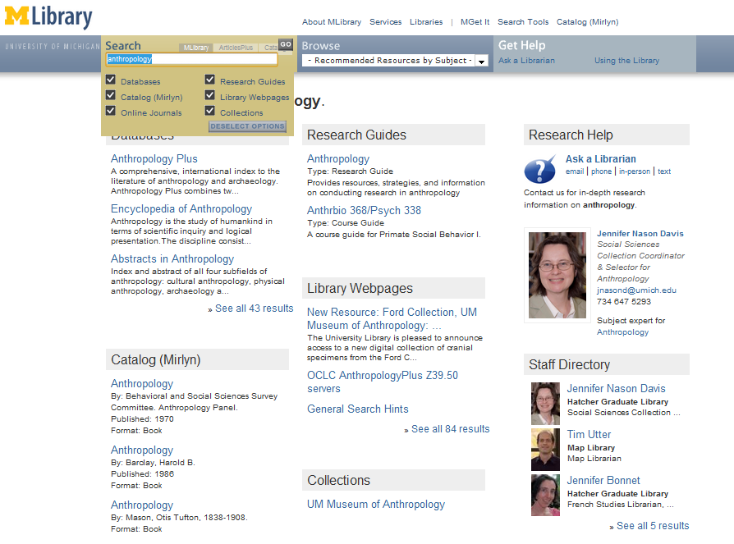
‘Indexing’ librarians at U Michigan

Slide 34
Transformation of the academic library
Kurt de Belder
http://www.oclc.org/content/dam/research/events/dss/ppt/dss_debelder.pptx

Slide 35
From curation/consumption to creation/curation/consumption Then: Acquire external resources Now: Engage with creation, use and sharing of all information resources.

Slide 36
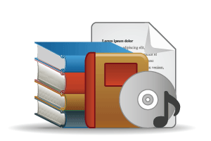
Outside in Bought, licensed
Increased consolidation
Move from print to licensed
Manage down print – shared print
Move to user-driven models
Aim: to discover
The Inside out Library
Institutional assets: special collections, research and learning materials, institutional records, community resources, … Reputation management Increasingly important?
Publishing Aim: to *have* discovered … to disclose
Notes:
Licensed content will dominate in years to come.
Special collections will grow but only modestly (and only at some institutions); mostly growth in managing archival resources including institutional.
Much greater investment in managing research outputs.
No change in web archiving.

Slide 37
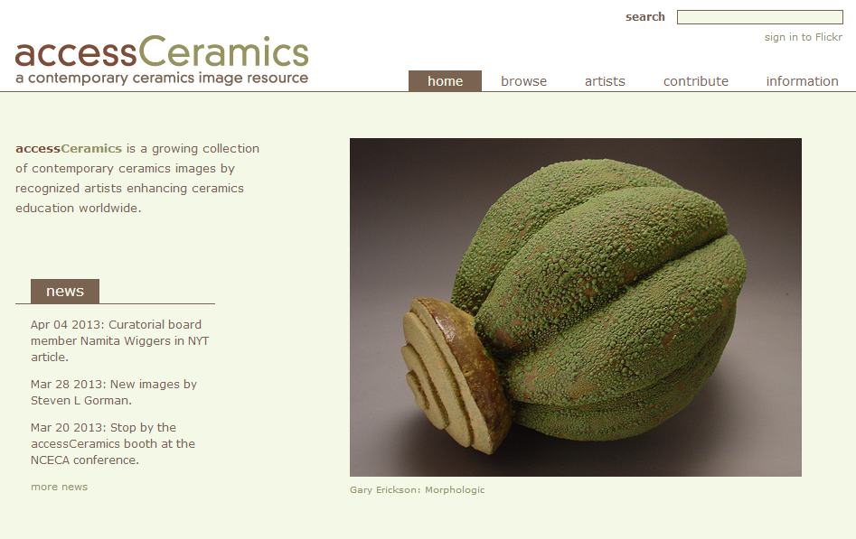
Collaboration with department around
community and learning resource
accessCeramics merges a traditional academic digital image collection's metadata capabilities with Flickr's openness and flexibility. It seeks to take advantage of Flickr's software tools and social network while also providing a web interface customized to this collection.

Slide 38
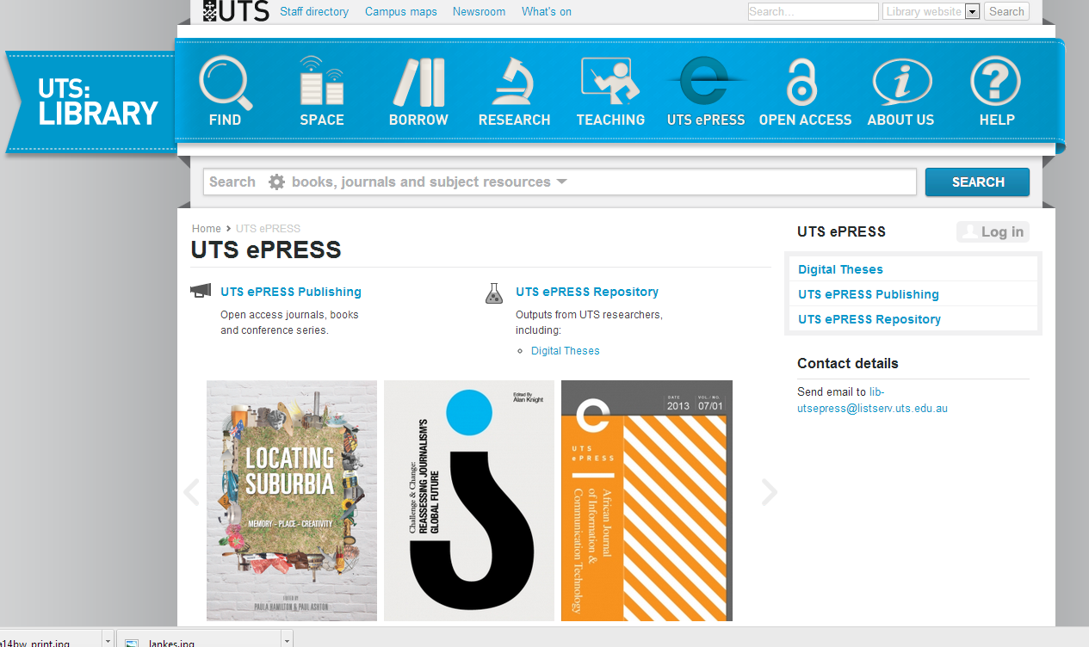

Slide 39
By Ardfern (Own work) [CC-BY-SA-3.0 (http://creativecommons.org/licenses/by-sa/3.0) via Wikimedia Commons
People should think not so much of the books that have gone into the … Library but rather of the books that have come out of it. Seán O'Faoláin

Slide 40
Space Then: space is configured around collections Now: space is configured around experiences

Slide 41
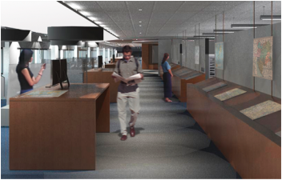
… unique combination of collections, government information expertise, and data services ….
Our new proximity, in a purposefully designed and equipped space, means that we can more effectively collaborate with each other, which in turn really enhances our ability to creatively collaborate with students, faculty, and researchers.
The new library features 60-foot long counter to enable the examination of large-format maps; a presentation space that will accommodate instruction; display cases and screens that showcase items from the print and digital collections; a large-format high-resolution scanner that produces digital copies for online work or the creation of full-size print copies; individual and group study spaces with dual-screen computers and laptop accessibility; and comfortable, moveable furniture for flexible study and collaboration.
We expect the Clark to become the campus nexus for the various data services that all disciplines increasingly require, …
Stephen S. Clark Library

Slide 42
The decentered web presence Then: discovery happened at the library Now: discovery happens elsewhere. Focus on ‘discoverability’ in multiple environments.

Slide 43
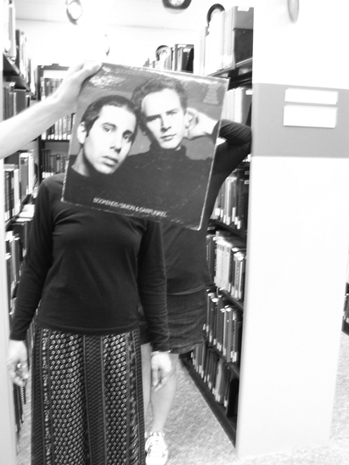
Creating conversations around collections:
Sleevefacing at Bowling Green State Univ
http://blogs.bgsu.edu/librarysleevefacing/2012/08/15/bookends/

Slide 44
Decoupled Communication
Flickr
Blogs
Facebook
Twitter
Google
Youtube
Discovery
Knowledgebase
Libguides
Cloud Sourced
Resolver

Slide 45
WorldCat
ArchivesGrid
Metadata
Summon
Scirus
Blogs
Suncat
Europeana
RSS
Catalogue
Ethos
Mobilepp
Proxy Toolbar
Dspace
Linked Data (Catalog)
OAI-PMH (Dspace)
Discovery
Services
Proxy Widgets
External Syndication
Library APIs
Z39.50
Data
Jorum
Digital Archive

Slide 46
Venues
Wikipedia
Configure resolver in Scholar, Mendeley, etc
Claim library in OCLC Spotlight
Google Books (holdings up to date)
SEO – best practice for websites and repositories

Slide 47
Engagement
Orientation to the user/parent institution
Create value in research and learning process
The ‘power of pull’
Make expertise visible

Slide 48
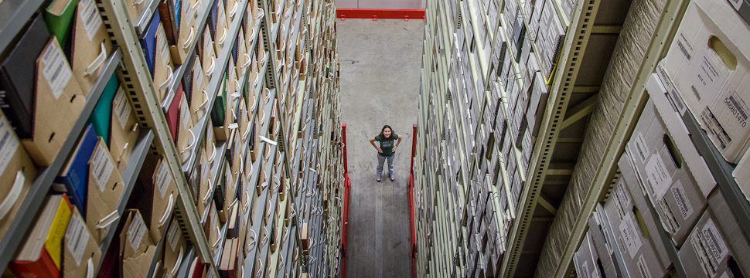
http://www.wrlc.org/sites/all/files/wrlc-storage-horizontal.jpg
‘Cloud’ storage
Rightscale infrastructure

Slide 49
Examples
Negotiation and licensing
Library systems infrastructure
Digital infrastructure
Processing capacity
Shared print
Managing down local print
Evolving shared approaches.

Slide 50
Do locally what creates most distinctive value. Share what makes sense for efficiency and impact. Buy the rest.

Slide 51
Shared print Then: Value relates to depth and breadth of local collection. Now: Value relates to systemwide curation of and access to print collections.

Slide 52
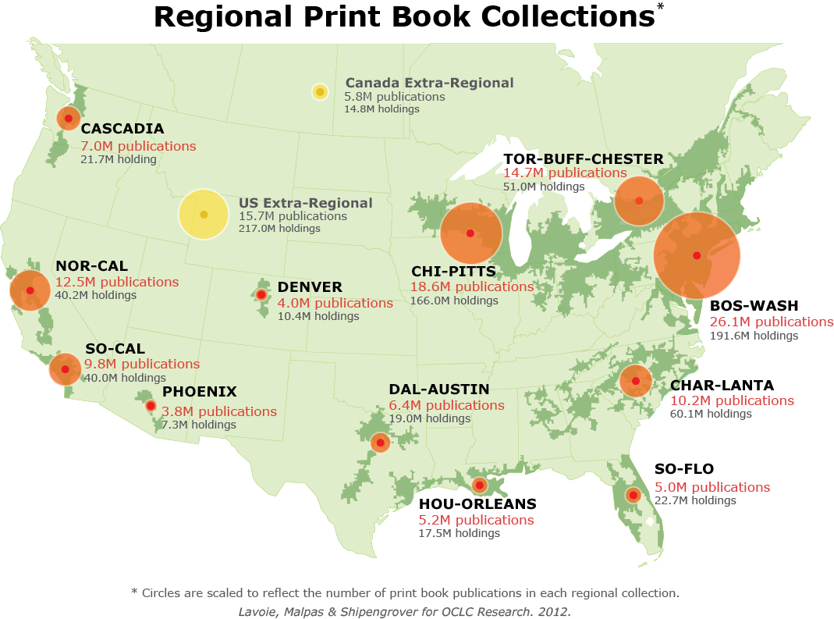
North American print book resource:
45.7 million distinct publications
889.5 million total library holdings
OCLC Research, 2013

Slide 53
Digital and systems infrastructure Then: Local build or control. Now: Look to scale for efficiency and impact.

Slide 54
Collaborative sourcing –
cooperation moves from the margins

Slide 55
“aggregate and scale towards a common infrastructure”

Slide 56
“
Colleges and universities have long competed against one another, measuring themselves in comparison to each other and holding tightly to their idiosyncrasies as defining elements of their status. But today, the distribution and reuse of information digitally via the Internet is rapidly changing the game, rewarding those who instead aggregate and scale toward a common infrastructure. It is becoming increasingly clear that neither the challenges that confront colleges and universities nor the solutions to those challenges are unique to each institution.
Chuck Henry and Brad Wheeler The game has changed
Educause Review, March 2012

Slide 57
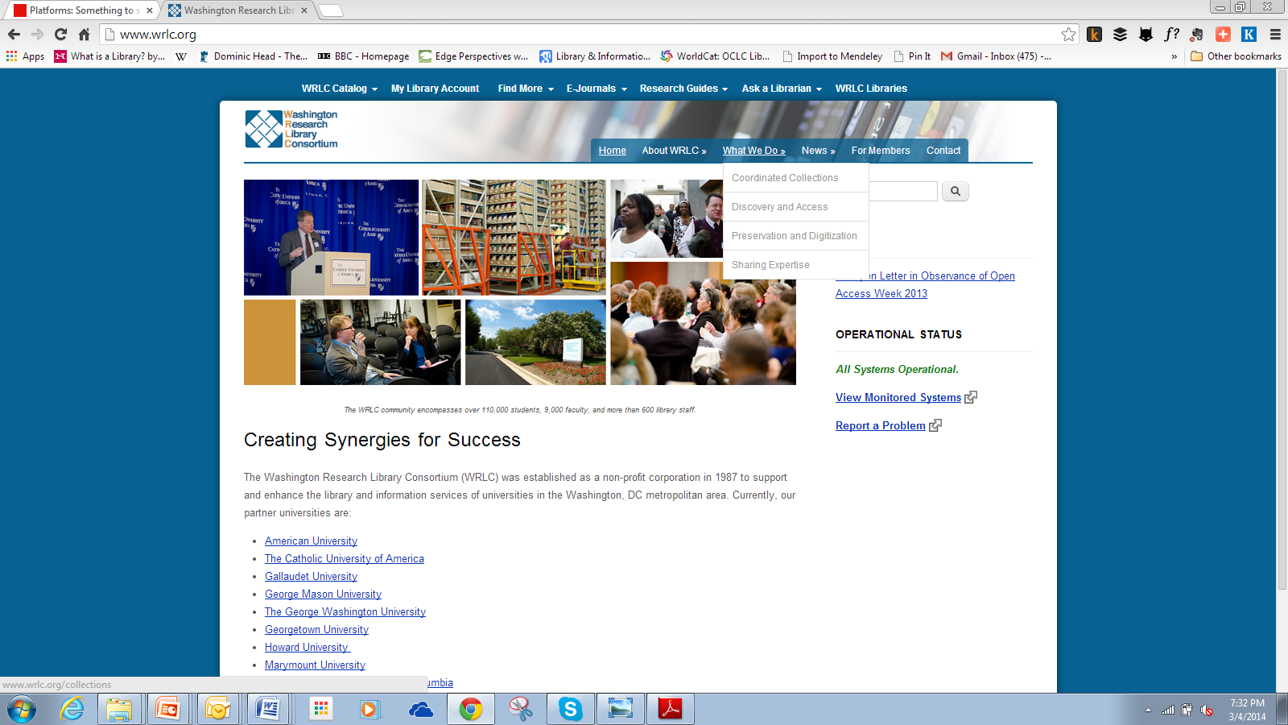
Institutional > State/Consortium > Region/national > global
Collaboratively source or buy from third party
Control vs economy
A new institutional context: agreed mutual dependence on shared/remote services

Slide 58
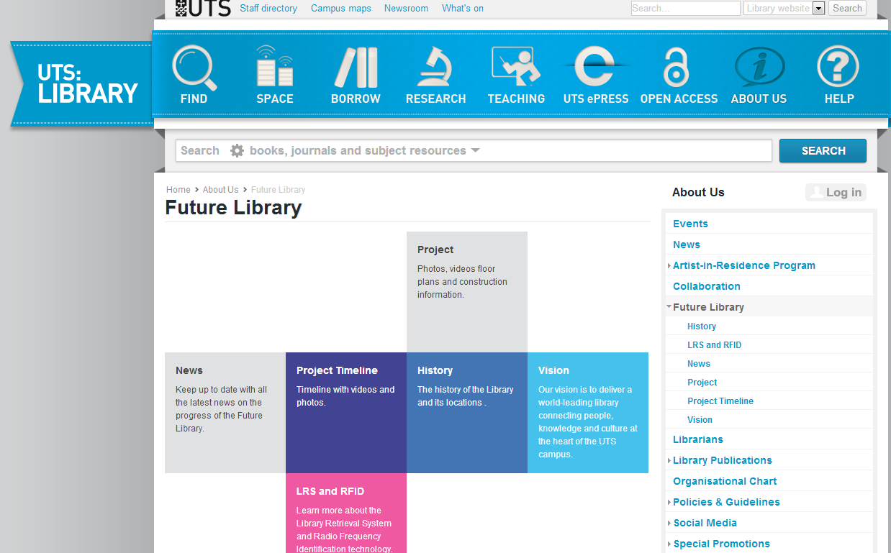
Innovation

Slide 59
Innovation
Institutional innovation
Enterprise vs bureaucracy
New forms of engagement
Skills
‘Repeatable and scalable’
What’s a startup. http://steveblank.com/2010/01/25/whats-a-startup-first-principles/

Slide 60
... a more fundamental level of innovation, institutional innovation – redefining the rationale for institutions and developing new relationship architectures within and across institutions to break existing performance trade-offs and expand the realm of what is possible …
John Hagel III and John Seely Brown

Slide 61
A new architecture of relationships: rightscaling

Slide 62
A new architecture of relationships: engagement
University Press
Office of Research
IT
Learning and teaching support
E-research
Writing centre
Academic departments
….

Slide 63
A reset moment
The library should not provide an argument for a particular case, but demonstrate that there is always another case to be made. The notion that the library is a place that has no agenda other than allowing people to invent their own agendas is what makes it an indispensable resource for a democracy. It is where we can learn not just to be readers, but to be the authors of our own destiny. Fintan O’Toole
Dublin City Public Libraries, Flickr: http://www.flickr.com/photos/dublincitypubliclibraries/6029467474/in/set-72157594513778442

Slide 64
To conclude…
Rightscale infrastructure services: find appropriate level in the network.
Shift resource to engagement: evolving information services which improve the student experience and enhance research. Creates new infrastructure and innovation challenges.
Internal/external institutional innovation: building new relationships requires enterprise and promotes learning ….

Slide 65
Credits
Thanks to Constance Malpas and Thom Hickey for the Georgetown in Worldcat data analysis.
Pictures of Brutalist libraries are from Wikimedia Commons (UC San Diego, Toronto, Virginia Commonwealth, George Washington, Georgetown, Glasgow, Oberlin).
©2014 OCLC. This work is licensed under a Creative Commons Attribution 3.0 Unported License. Suggested attribution: “This work uses content from “The Library and the Network: Scale, Engagement, Innovation” © OCLC, used under a Creative Commons Attribution license: http://creativecommons.org/licenses/by/3.0/”

