Slide 1
The inside out library redux: scale, learning, engagement Lorcan Dempsey @LorcanD
University of Melbourne, Apr 11 2013

Slide 2
By Ardfern (Own work) [CC-BY-SA-3.0 (http://creativecommons.org/licenses/by-sa/3.0) via Wikimedia Commons
People should think not so much of the books that have gone into the … Library but rather of the books that have come out of it. Seán O'Faoláin

Slide 3
prelude

Slide 8
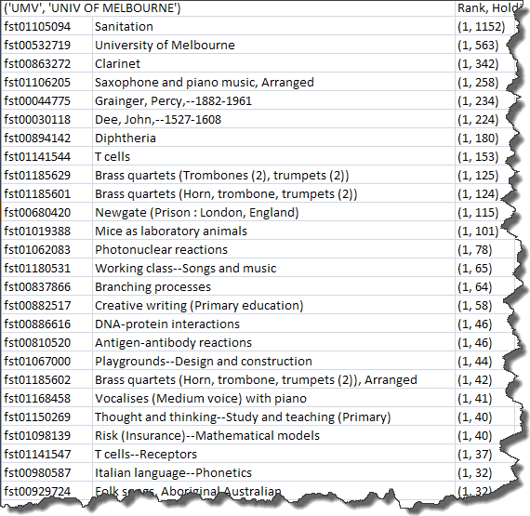
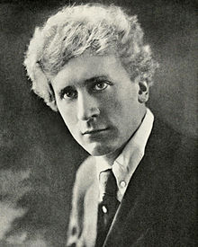
Top subjects
Medicine & Public Health
Music and Music Education

Slide 9
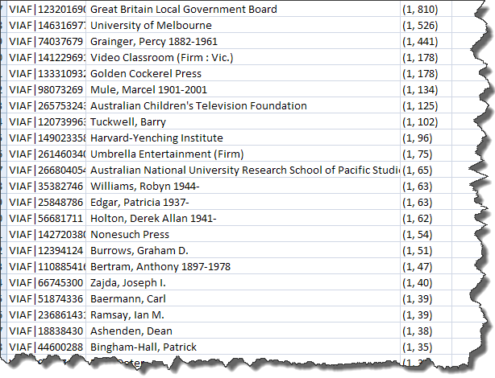
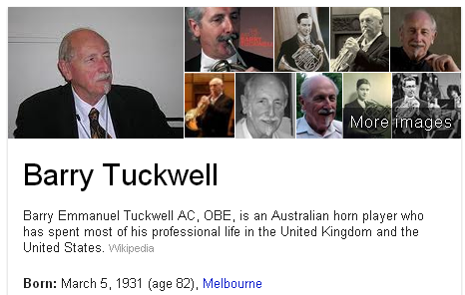
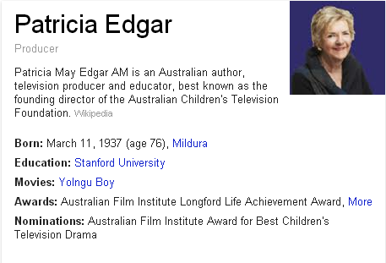
Top Identities (Persons, Organizations)
Notes:
Marcel Mule – French saxophonist

Slide 10
Network and scale

Slide 11
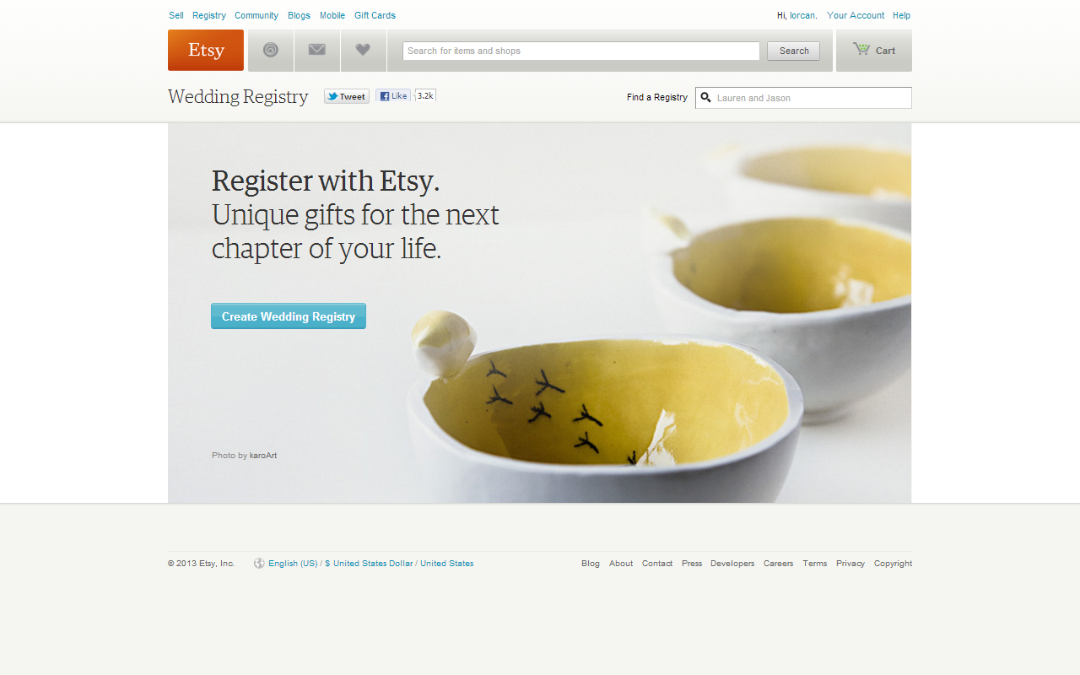

Slide 12
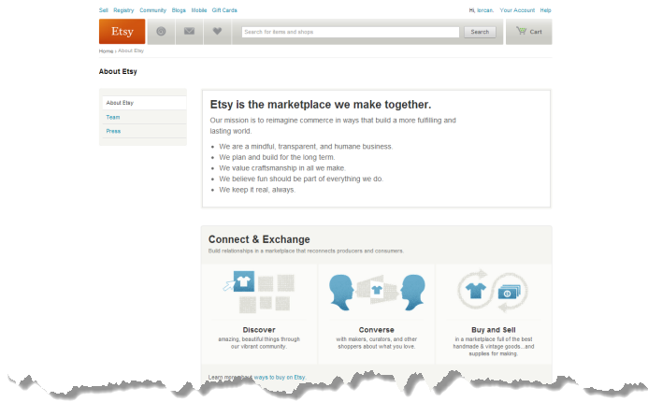
“Build relationships in a marketplace that reconnects producers and consumers.”

Slide 13
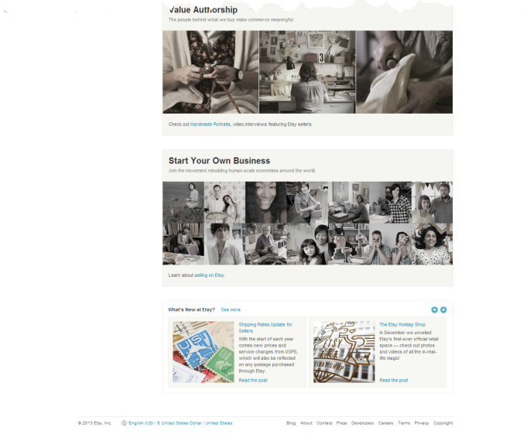
“Join the movement rebuilding human-scale economies around the world.”

Slide 14
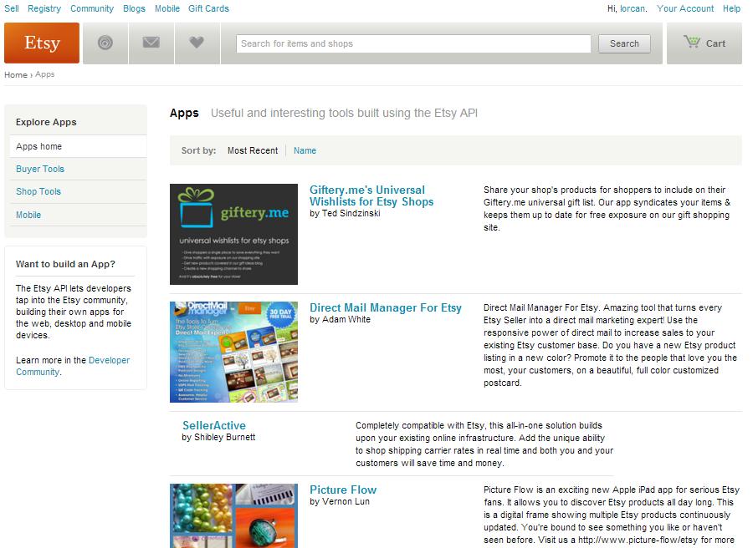

Slide 15
Not just a site but an ecosystem
Beyond the mobile web. Stephanie Rieger. http://www.slideshare.net/yiibu/beyond-themobilewebbyyiibu

Slide 16
Webscale
Webscale <> personal
The rich get richer …
Network effects
Massive aggregation
Gravitational pull
Data driven engagement
Analytics
Social
Platform
Leverage for developers …

Slide 17
Beyond the mobile web. Stephanie Rieger. http://www.slideshare.net/yiibu/beyond-themobilewebbyyiibu

Slide 18
What has changed 1
Now: resources are abundant and attention is scarce
Then: resources are scarce and attention is abundant

Slide 20
What has changed? 2
The need for local infrastructure or local assembly of materials has declined.

Slide 22
High transaction
costs led to
locally
assembled
collections.

Slide 23
What has changed? 3
The library is institution scale where many of its users operate at network scale

Slide 24
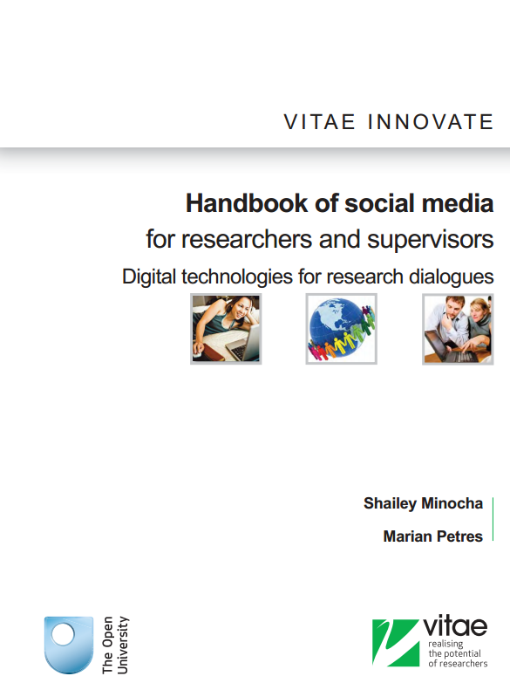
Researchers prefer to adopt open source and social media technologies that are available in the public domain rather than institutional license-based applications ….. First the social media technologies facilitate networking and community building. Second, researchers prefer to use technologies that will enable them access to resources and their own materials beyond their institution-based PhD research.
“
e.g. Mendeley, Zotero, Endnote

Slide 26
What has changed 4
Now: Library services are built around the user’s workflow
Then: User’s workflow built around library services

Slide 27
Advise on use …
Not just licensing
Connect …
Disclose
Switch
Data driven engagement
Aggregate and make useful usage data
Reputation management
What is the personal/institutional profile

Slide 28
The inside out library .. the library as an actor in research and learning environments of its users

Slide 29
Outside in
Inside out
User builds workflow around library services
Towards a centered network presence
Locally assemble externally acquired colls
Discovery happens in the library
Expertise hidden
Configure space around collections
Library services built around user workflows
Towards a decentered network presence
Engage with creation, management, use and sharing of all information resources
Discovery happens elsewhere
Expertise visible
Configure space around engagement

Slide 30
Now: towards the decentered library
2
Then: towards the centered library
Thanks to my colleague JD Shipengrover for help with the pictures in this section

Slide 31
Not just a site but an ecosystem
Beyond the mobile web. Stephanie Rieger. http://www.slideshare.net/yiibu/beyond-themobilewebbyyiibu

Slide 32
Network Presence
John Doe University Library
Website
John Doe University Library
Decoupled Communication
External Syndication
Cloud Sourced

Slide 33
Decoupled Communication
Flickr
Blogs
Facebook
Archives and spec colls
Twitter
Google
Youtube
Institutional repo
Digital library
Discovery
Knowledgebase
Microsites
Libguides
Cloud Sourced
Resolver

Slide 34
WorldCat
ArchivesGrid
Metadata
Summon
Scirus
Blogs
Suncat
Europeana
RSS
Catalogue
Ethos
Mobilepp
Proxy Toolbar
Dspace
Linked Data (Catalog)
OAI-PMH (Dspace)
Discovery
Services
Proxy Widgets
External Syndication
Library APIs
Z39.50
Data
Jorum
Digital Archive

Slide 35
Now: engage with creation, management, use and sharing of all information resources
3
Then: acquire external resources

Slide 36
COLLECTIONS GRID (Lorcan Dempsey and Eric Childress, OCLC Research)
Stewardship/scarcity
high
low
In many collections
Low-High
Books & Journals
Newspapers
Gov Documents
CD & DVD
Maps
Scores
Low-Low
Freely-accessible web resources
Open source software
Newsgroup archives
low
Uniqueness
High Stewardship
Low Stewardship
High-Low
Research & Learning Materials
Institutional records
ePrints/tech reports
Learning objects
Courseware
E-portfolios
Research data
Prospectus
Insitutional website
High-High
Special Collections
Rare books
Local/Historical Newspapers
Local History Materials
Archives & Manuscripts
Theses & dissertations
high
In few collections

Slide 37
Collections Grid
Purchased Materials
Licensed E-Resources
In many collections
Open Web Resources
Licensed
Purchased
High Stewardship
Low Stewardship
Special Collections
Local Digitization
Research & Learning Materials
In few collections

Slide 38
Outside in Bought, licensed
Increased consolidation
Move from print to licensed
Manage down print – shared print
Move to user-driven models
Aim: to discover
Collections
Inside out
Institutional assets: special collections, research and learning materials, institutional records, … Reputation management Increasingly important? Aim: to *have* discovered … to disclose
Notes:
Licensed content will dominate in years to come.
Special collections will grow but only modestly (and only at some institutions); mostly growth in managing archival resources including institutional.
Much greater investment in managing research outputs.
No change in web archiving.

Slide 39
Outside in collections – increasingly externalised to
collaborative or third party. Reduced local infrastructure.
Inside out collections. Growing engagement around
scholarly communication, data curation, institutional
asset management, reputation/profiles. Leverage internal/
external infrastructure.

Slide 40
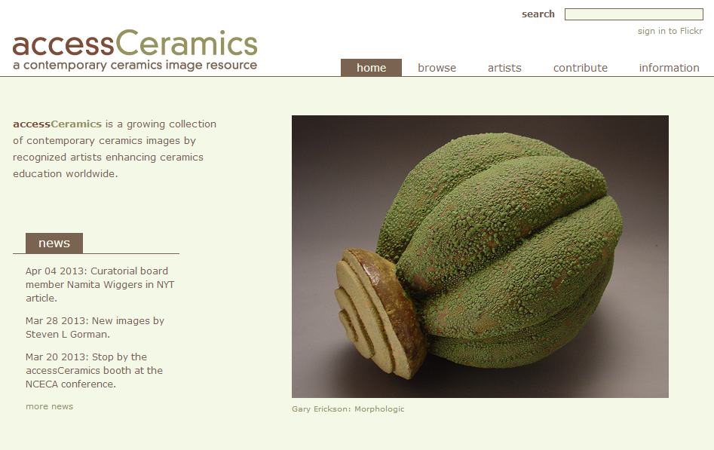
Collaboration with department around
community and learning resource
accessCeramics merges a traditional academic digital image collection's metadata capabilities with Flickr's openness and flexibility. It seeks to take advantage of Flickr's software tools and social network while also providing a web interface customized to this collection.

Slide 41
Now: discovery happens elsewhere
4
Then: discovery happens in the library

Slide 42
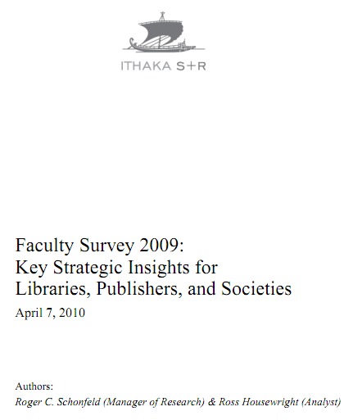
Ithaka s+r
Network-level discovery tools include disciplinary resources and powerful search tools which dramatically improve research efficiency while also increasing effectiveness. As a result, faculty discovery practices across all disciplines have continued their marked shift to the network level. This key finding has important implications for resource providers and libraries alike.
Faculty members are reducing their usage of
local library services for discovery purposes
and, as a result, put less value on the library’s
traditional intellectual value-added role as a
gateway to information.

Slide 43
Active promotion
Interpretation and promotion through social media
Syndication
Metadata
Links
Services
Search engine optimization

Slide 44
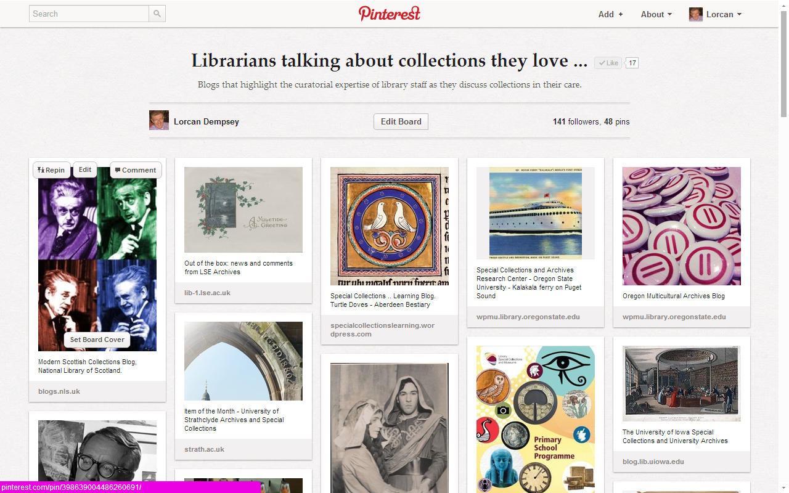

Slide 45
Getting into the flow: decoupled communication
Not just providing a way to interact with resources …
… but a way of making yourself visible and attracting resources to you.

Slide 46
Disclosure
Effective web presence
Strategic content alliance
A set of materials to advise on how to create an effective web presence.
SEO
Metadata
Structure etc ….

Slide 47
Now: visible
5
Then: hidden

Slide 48
If you want to be seen as expert …
… then your expertise has to be seen.

Slide 49
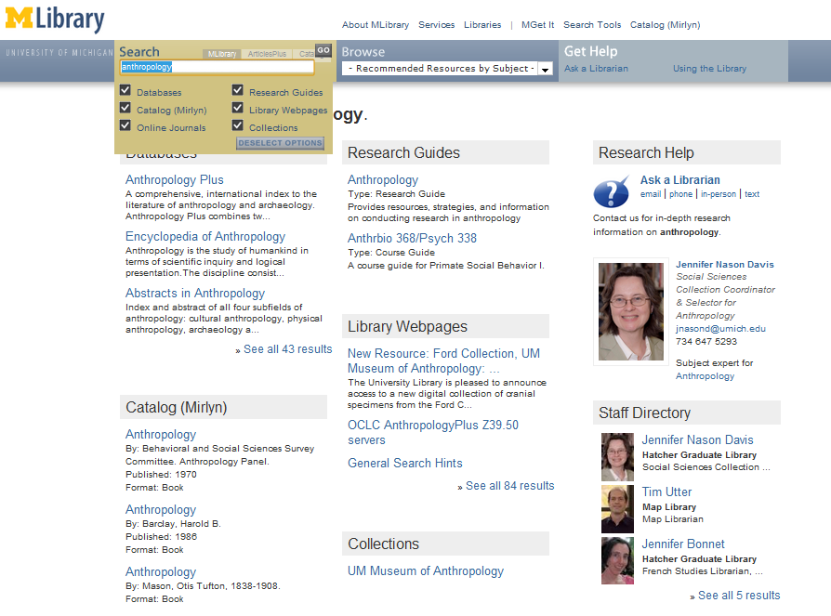
‘Indexing’ librarians at U Michigan

Slide 50
Now: space is configured around engagement with the user
6
Then: space is configured around collections

Slide 51
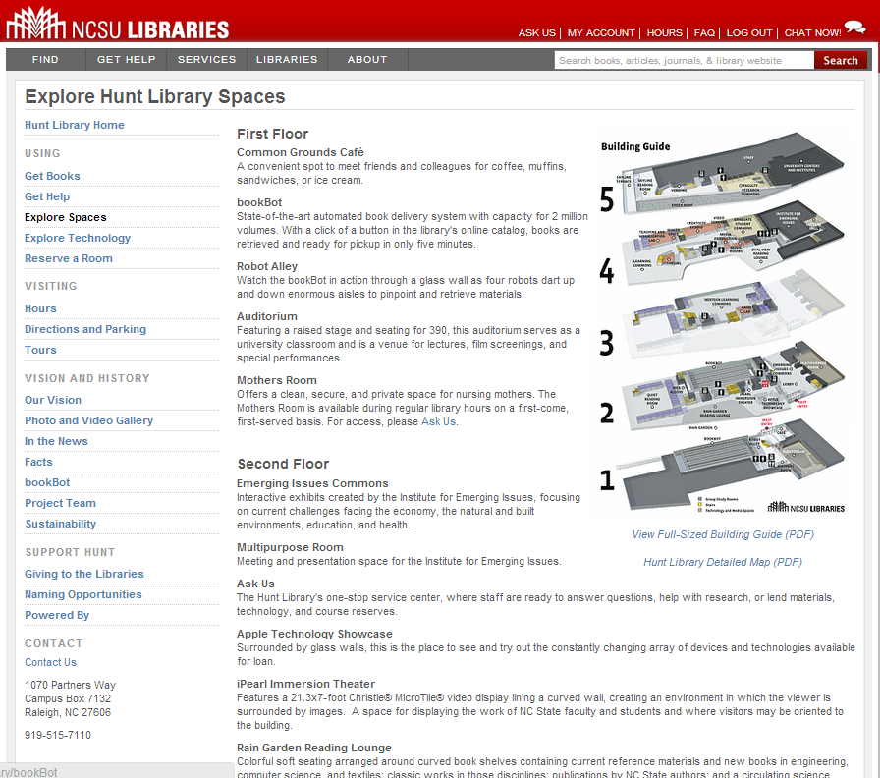
Space reconfigured
around experience,
expertise and
communication
rather than collections

Slide 52
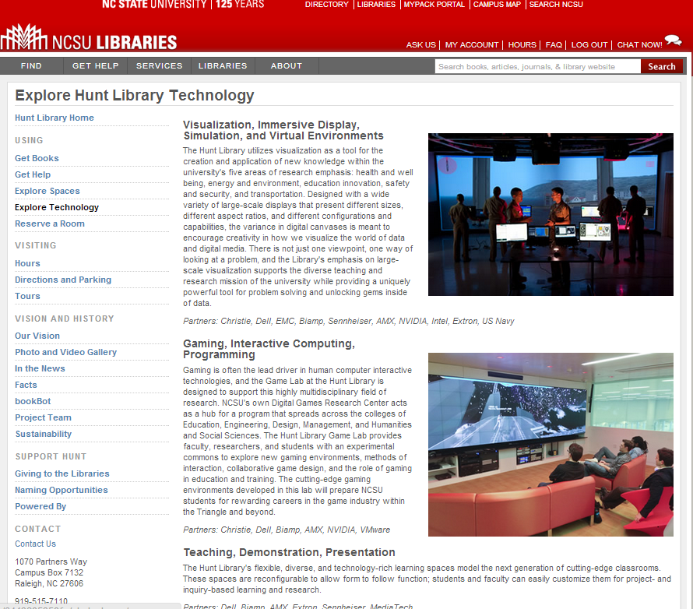

Slide 53
The library should not provide an argument for a particular case, but demonstrate that there is always another case to be made. The notion that the library is a place that has no agenda other than allowing people to invent their own agendas is what makes it an indispensable resource for a democracy. It is where we can learn not just to be readers, but to be the authors of our own destiny. Fintan O’Toole
Dublin City Public Libraries, Flickr: http://www.flickr.com/photos/dublincitypubliclibraries/6029467474/in/set-72157594513778442

Slide 54
@LorcanD
Q

