Slide 1
Inspiring and supporting research: CONUL Annual Conference 2017 Athlone, Ireland
30/31 May 2017
Lorcan Dempsey, OCLC @LorcanD
The network reshapes the research library collection
Notes:
http://undergrad.bm.ust.hk/eng/exchange/outgoing/after/manager.do?method=findDetailForStudent&esid=222&euid=61&sid=6631

Slide 2
Changing characteristics of collections
Prelude:
Collections as a service

Slide 3
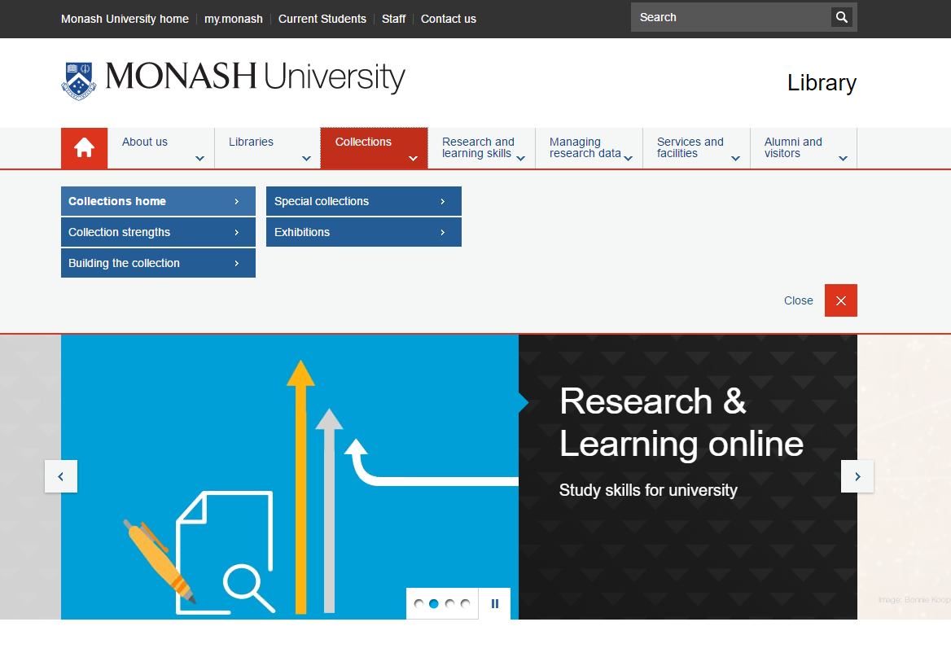
Places
Student success
Research support: creation
Collections as a service

Slide 4
Research libraries achieved status in this environment by acquiring more than their peers or by building niche collections of particular depth.
…
Collections no longer lie at the center of research library operations and goals, even as academic communities focus ever more inclusively on knowledge and information.
Hazen. Lost in the cloud. 2011
Notes:
Hazen, D. (January 01, 2011). Lost in the Cloud Research Library Collections and Community in the Digital Age. Library Resources and Technical Services, 55, 4, 195-204.
https://journals.ala.org/lrts/article/view/5302

Slide 5
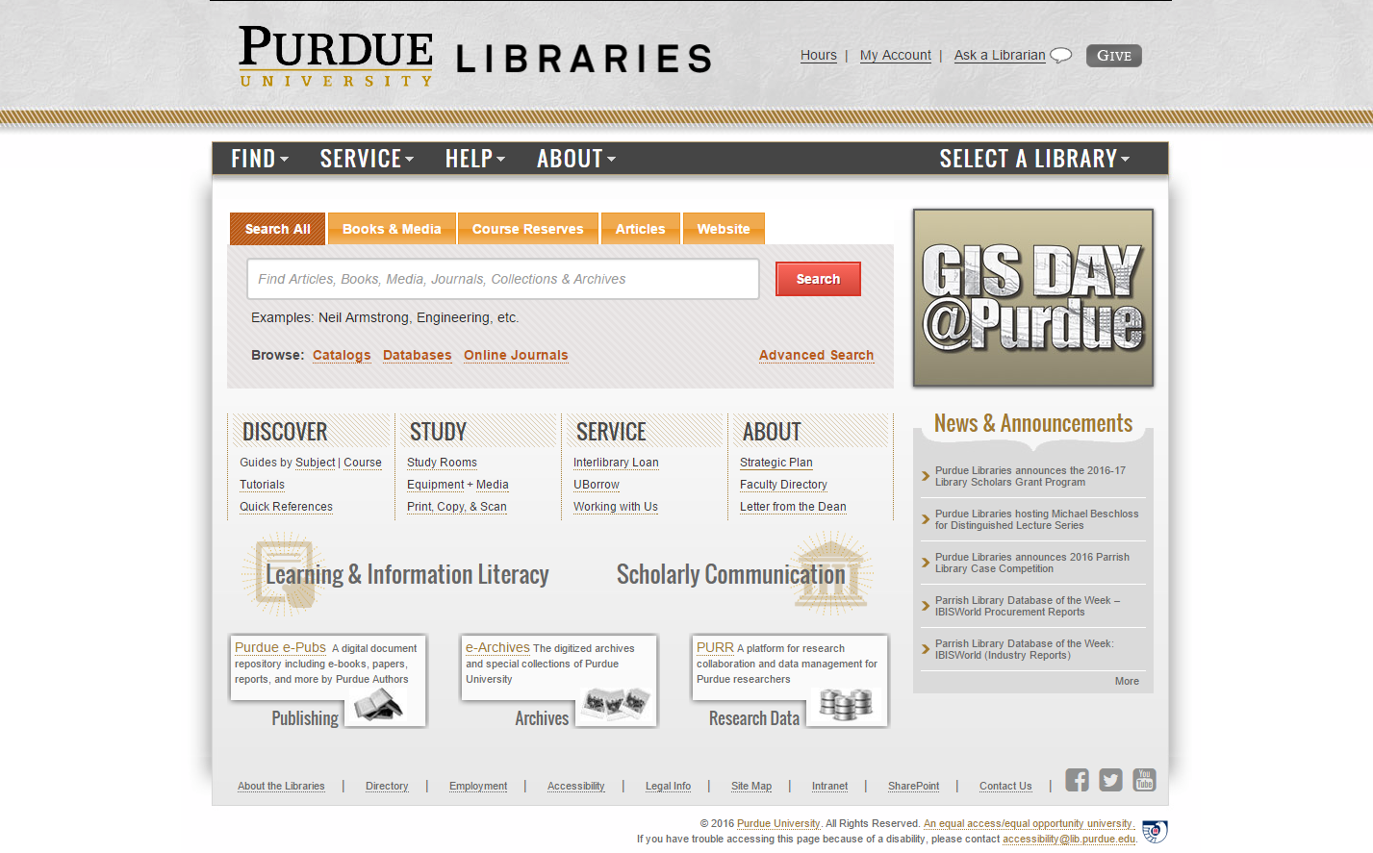
Outside in
Facili-tated
Collect-ive
Inside out
Collections: expanding view

Slide 6
Different dynamics across collecting activity
Prelude:
Collection attention: the collections grid

Slide 7
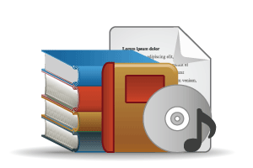
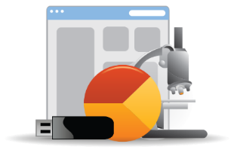
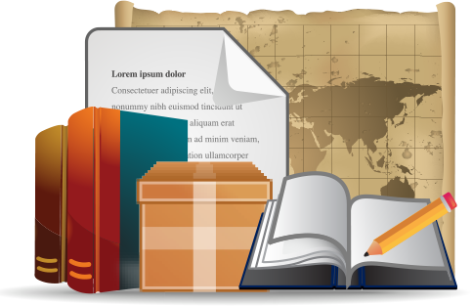
Open Web Resources
‘Published’ materials
In many collections
Outside in
(discovery, acquisition)
Licensed
Low Stewardship
Purchased
High Stewardship
Inside out
(discover-ability, stewardship)
Research & Learning Materials
In few collections
Special Collections
Local Digitization
Figure: OCLC Collections Grid.
OCLC Research, 2014

Slide 8
Monographs – managed in a different way
Managing down print - shared print
Shift to demand driven acquisition
Growing difference between market-available and specialised (e.g. area studies)
Emergence of ‘e’ (platform)
Digital corpora (Hathi Trust, Google, …)
Disciplinary differences
Journals – part of an evolving research life cycle
Publishers looking to research workflow (Elsevier – Mendeley, Pure)
Complex open access environment - National science/research policy, grant-makers, publishers
A part only of the scholarly record – data, etc.
Licensed materials are now the larger part of academic library budgets. Big deal.

Slide 9
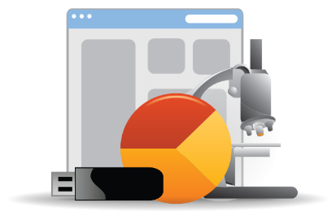
Research and learning material – new researcher, publisher and library roles
Evolving scholarly record: research data, eprints, ..
IR – role and content?
Research information management (profiles, outputs, …)
Support for digital scholarship
Support for open access publishing
Special collections, archives – mobilized for research, reputation, ….
Release more value through digitization, exhibitions, undergraduate research, …
Streamlining processing, production, …
Network level aggregation for scale and utility – DPLA, Europeana, DRI, Pacific Rim Digital Library,

Slide 10
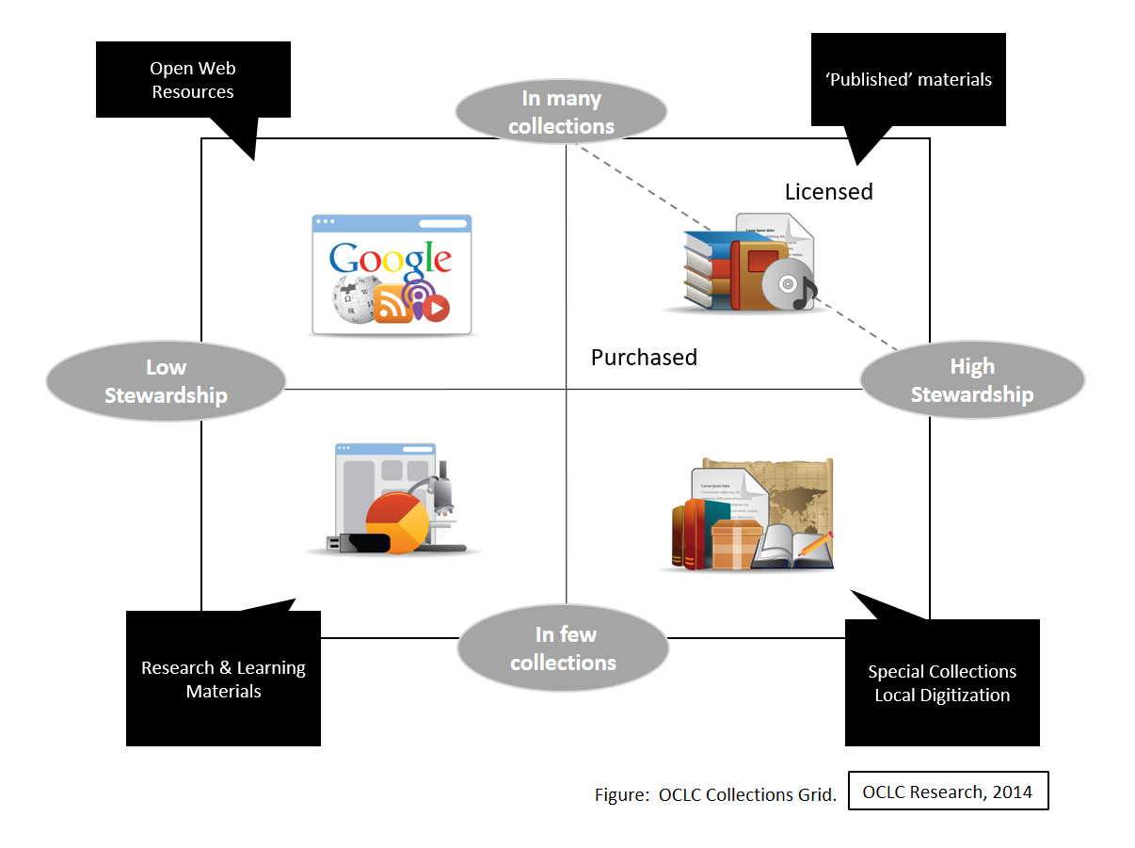
Inside out
Inside out: Create, manage and make discoverable memory, community, evidence.

Slide 11
Facilitated
A network logic: a coordinated mix of local, external and
collaborative services are assembled around user needs

Slide 12
Collective
Collective collections: The systemwide organization of collections becomes more important. It makes sense to do acquisition, discovery and/or stewardship at the network level.

Slide 13
Two trends and a direction
Reconfiguration of research work (leading to inside out collection)
Reconfiguration of information space (leading to facilitated collection)
Collective
collections

Slide 14
Two trends
Reconfiguration of research work by network/digital environment.
Reconfiguration of the information space by network/digital environment.
The inside out collection
The facilitated collection

Slide 15
Reconfiguration of research work by network/digital environment.
Inside out collection

Slide 16
Research outputs
Expertise/Identity
R- infra-structure
Special colls

Slide 17
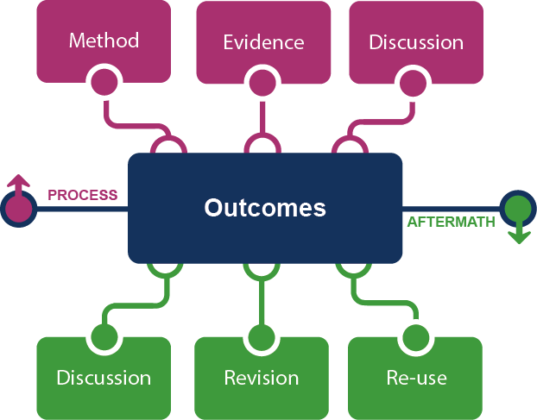
Supporting the creative process: the emerging scholarly record
Research outputs
Notes:
This is how we framed out the scholarly record in terms of nature and scope of what it might contain.
Start with published outcomes: the reporting of results, conclusions, ideas and so forth from a particular scholarly inquiry.
These outcomes are still the coin of the realm for scholarly activities, so they are privileged here at the center of the picture;
A lot of these outcomes take the form of text-based materials like books and journal articles, but often supplemented by additional materials such as video, graphics, and interactive programs.
Rest of scholarly record divided into two broad areas: process and aftermath
Process: process of scholarly inquiry; process by which outcomes are produced. Identified three categories of materials generated in this phase in which there is interest in including them as part of the scholarly record:
Method materials related to the methodology of scholarly inquiry (e.g., software, computer models, digital lab notebooks, sampling frames, experimental protocols, instrument calibrations)
Evidence raw materials/inputs to scholarly work (e.g., data sets, survey results, new or enhanced primary source documents, links to findings from other scholarly works);
Discussion refining and improving ideas, methods, conclusions (e.g., pre-prints, listserv/blog discussions, conference presentations, annotated commentary, grant proposals).
Anchoring outcomes directly to the methods employed, evidence used, and formative discussions conducted during the process of scholarly inquiry helps contextualize and deepen our understanding of these outcomes, facilitate replicability, and leverage results into new research.
Once the outcomes from a research project have been formally published or otherwise made available, scholarly activities surrounding that piece of work may still continue in the “aftermath” phase.
Activities in the aftermath phase may include Discussion (through similar channels as those in the process phase, but also post-publication formal reviews and commentary);
Revision published work can be revised in various ways (the work may be enhanced with additional findings; errors may be corrected or clarifications made, etc.)
Re-use (the work may be edited or re-packaged into new forms, such as conference presentations, summaries, blog posts, versions for the “popular media”, etc.).
Not saying that everything discussed here will end up in the scholarly record. But picture represents the maximal scope and depth of materials regarding which there is increasing interest in systematic collection and curation.
Note that some of the materials in the outlying components are becoming or might become outcomes in their own right. Data sets are a good example: in some disciplines the publication of an important data set is now considered a first-class scientific outcome.
More on the evolving scholarly record:
Lavoie, Brian, Eric Childress, Ricky Erway, Ixchel Faniel, Constance Malpas, Jennifer Schaffner, and Titia van der Werf. 2014. The Evolving Scholarly Record. Dublin, Ohio: OCLC Research.
http://www.oclc.org/content/dam/research/publications/library/2014/oclcresearch-evolving-scholarly-record-2014.pdf.

Slide 18
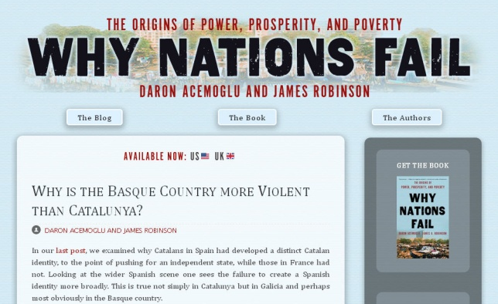
Notes:
http://global.oup.com/uk/orc/busecon/economics/carlin/

Slide 19
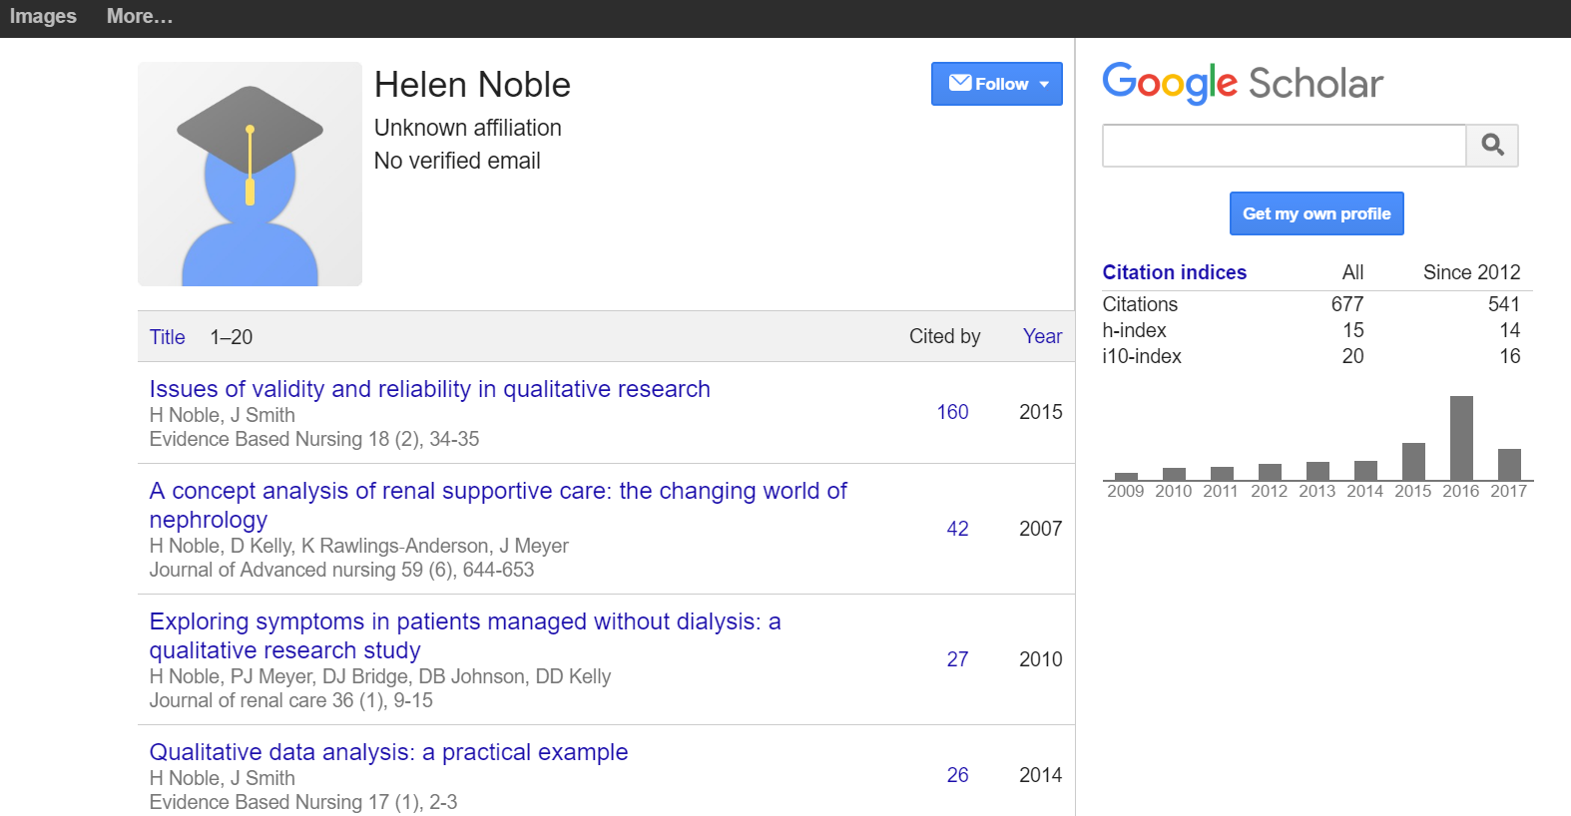
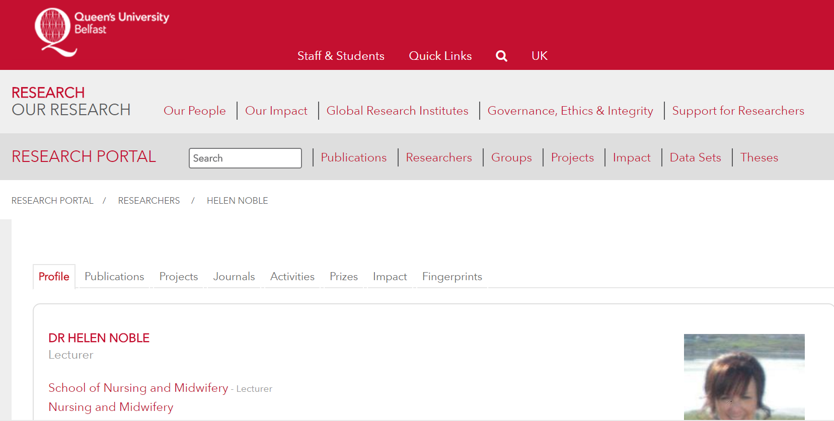
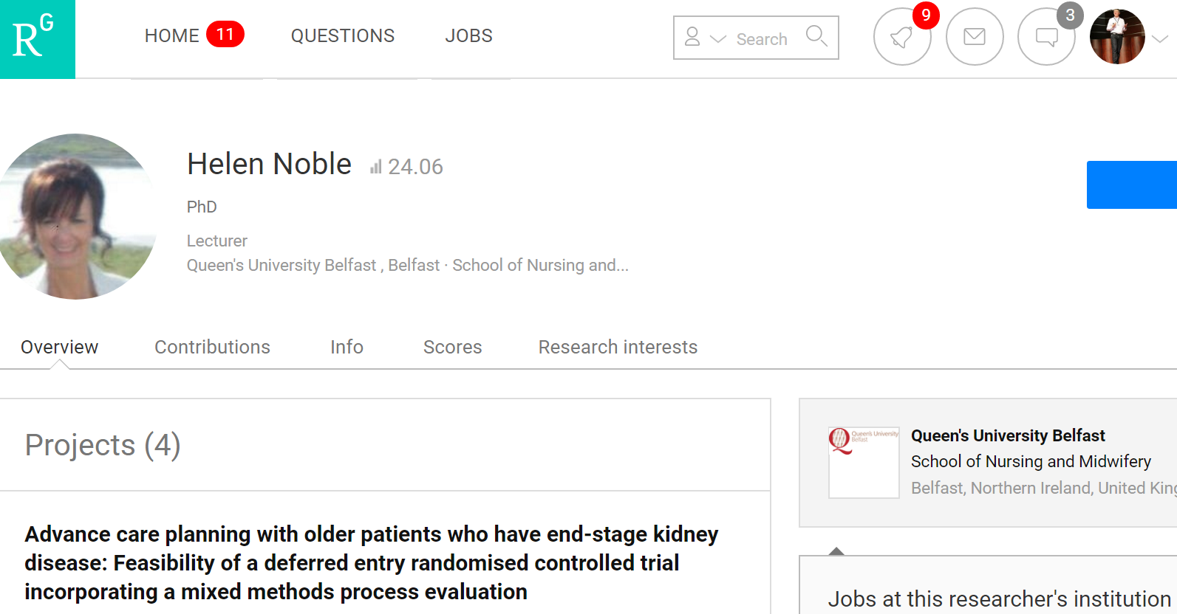
Expertise/Identity
Expertise and reputation:
Identity > workflow > content

Slide 20
Creation, management and disclosure:
Vice president for research
R- infra-structure
Medical center
Tech Transfer Office
CIO
News Bureau
Institutional Reporting
Research Data Management
Advancement & corporate relations
Provost
Data Warehouse
RIM/Profiling system
Digital scholarship
LIBRARY
Colleges & depts
Institutional Repository
User education & training
Disciplines & departments
Graduate school
Office of undergraduate research
Researcher
Research manager
Research support
Campus center for teaching & learning

Slide 21
A publisher’s new job description
Her view is that publishers are here to make the scientific research process more effective by helping them keep up to date, find colleagues, plan experiments, and then share their results. After they have published, the processes continues with gaining a reputation, obtaining funds, finding collaborators, and even finding a new job. What can we as publishers do to address some of scientists’ pain points?
Annette Thomas,
Then CEO of Macmillan
Publishers
http://www.against-the-grain.com/2012/11/a-publishers-new-job-description/
Notes:
A Publisher's New Job Description
November 8, 2012 Donald Hawkins Charleston Conference Blog
http://www.against-the-grain.com/2012/11/a-publishers-new-job-description/

Slide 22
Researcher
Librarian
Research
manager

Slide 23
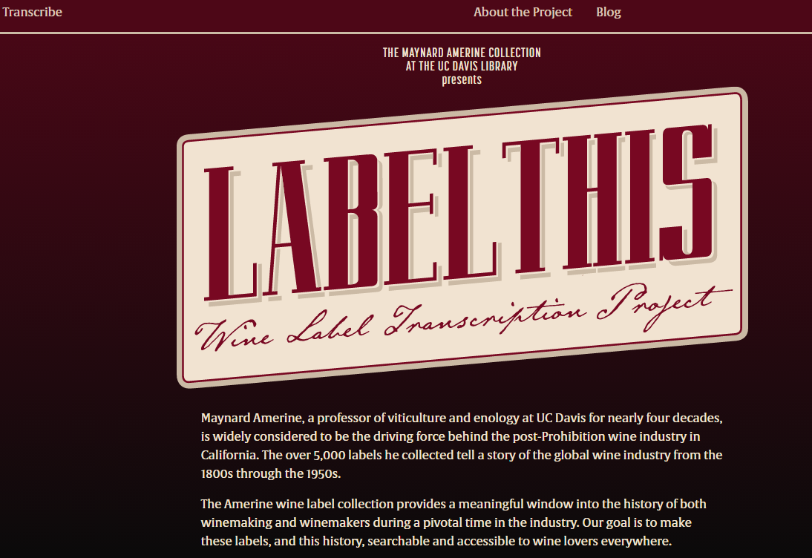
Special colls
Research, reputation, relevance

Slide 24
Special colls
Anamnesis – the case of 1916
In some respects this collection of RTÉ archive material is a microcosm of that Irish psyche. … [RTE’s] archive reflects Irish preoccupations. Its omissions point towards our blind spots. On the debit side is the fact that, as a repository of oral history the RTÉ catalogue includes barely thirty first-hand Irish witnesses of the First World War. On the merit side is the fact that it includes all of thirty first-hand witnesses of the Great War in a time of calculated and culpable amnesia.
Myles Dungan
Notes:
http://www.rte.ie/archives/exhibitions/1011-ireland-and-the-great-war/
https://en.wikipedia.org/wiki/File:War_Memorial_Gardens_Dublin.jpg

Slide 25
Support for creation, management and disclosure of memory/
evidence
Reconfiguration of research work by network/digital environment.
Workflow is the new content
Reputation manage and disclose the intellectual outputs and expertise of the institution.
From discovery to discoverability
Collective collections: Rightscaling and collective action
The inside out collection

Slide 26
Reconfiguration of the information space by network/digital environment.
Facilitated
Collection

Slide 27
arXiv, SSRN, RePEc, PubMed Central (disciplinary repositories that have become important discovery hubs);
Google Scholar, Google Books, Amazon (ubiquitous discovery and fulfillment hubs);
Mendeley, ResearchGate (services for social discovery and scholarly reputation management);
Goodreads, LibraryThing (social description/reading sites);
Wikipedia, Yahoo Answers, Khan Academy (hubs for open research, reference, and teaching materials).
FigShare, OpenRefine (data storage and manipulation tools)
Github (software management)

Slide 28
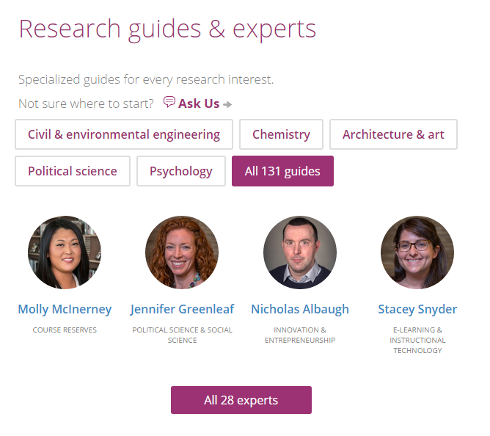

Slide 29
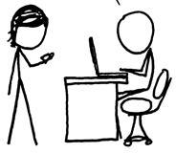
http://www.xkcd.com/917/
Value relates to locally assembled collection.
Value relates to ability to efficiently meet a variety of research and learning needs.
A print logic: the distribution of print copies to multiple local destinations
A network logic: a coordinated mix of local, external and collaborative services are assembled around user needs
A collections spectrum
The ‘owned’ collection
The ‘facilitated’ collection
Purchased and physically stored
Meet research and
learning needs in best way
Notes:
More on facilitated collections:
Dempsey, L., (2016). Library collections in the life of the user: two directions. LIBER Quarterly. 26(4). DOI: http://doi.org/10.18352/lq.10170

Slide 30
The ‘external’ collection:
Pointing researchers at Google Scholar;
Including freely available ebooks in the catalog;
Creating resource guides for web resources.
The ‘borrowed’ collection
The ‘shared print’ collection
The ‘shared digital’ collection
The evolving scholarly record
A collections spectrum
The ‘owned’ collection
The ‘licensed’ collection
The ‘demand-driven’ collection
The ‘facilitated’ collection
Note: Libraries have variable
Investments across the entire
spectrum
Purchased and physically stored
Meet research and
learning needs in best way

Slide 31
The specialized collection
Reconfiguration of the information space by network/digital environment.
The facilitated collection

Slide 32
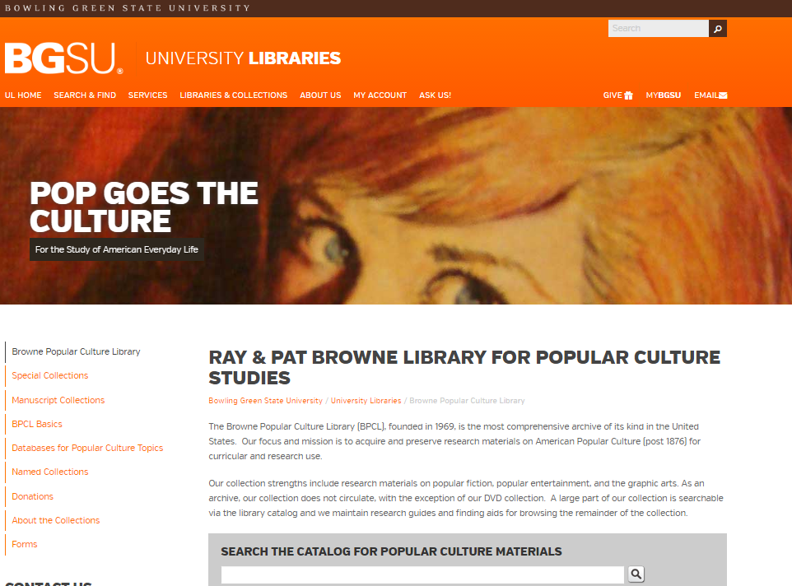
The specialized collection

Slide 33
The specialized collection
Specialization of locally acquired/held collections?
Engagement Understand and respond to needs of faculty and students.
A diffuse responsibility for stewardship of the scholarly record
Collective collections: Rightscaling and collective action
Reconfiguration of the information space by network/digital environment.
The facilitated collection

Slide 34
Support for creation, management and disclosure of memory/
evidence
The specialized collection
Reconfiguration of research work by network/digital environment.
Reconfiguration of the information space by network/digital environment.
The inside out collection
The facilitated collection

Slide 35
Collective collections:
Rightscaling and collaborative action …
The best example of an activity that can be done most appropriately in a networked context is curation. Here I would argue that a library’s collection is not owned solely by the library, but by the society or culture that has collected it and put it in the library in the first place. We own the collection as a culture, and we must attend to it as a culture.
John Wilkin
Notes:
Meanings of the library today.
John Price Wilkin.
https://www.ideals.illinois.edu/handle/2142/79053

Slide 36
System-wide organization of collections—whether the “system” is a consortium, a region, a country ….
The rise of the collective collection
Discovery/discoverability
Sharing/acquisition
Stewardship

Slide 37
Operationalising the Collective collection?
Rightscaling – optimum scale?
The ‘borrowed’ collection
The ‘shared print’ collection
The ‘shared digital’ collection
The ‘shared scholarly’ record
Notes:
Various group-scale arrangements have emerged to support collective collection management across the spectrum from owned to facilitated collections.
Significantly, there is not a single group-scale arrangement that can solve for all of these problems.
What is the optimum scale for group action? It appears to vary…

Slide 38
Rightscaling – optimum scale?
Shared print
Research data
Shared Print Management
Notes:
For shared print management, we see a variety of group-scale efforts that leverage existing consortial partnerships, as well as built-to-purpose groups.
For research data management, there is a mix of institution-scale infrastructure and a growing range of group-scale options.
Is the scale the same for each? Can we expect a single group to support the whole range of shared stewardship objectives?

Slide 39
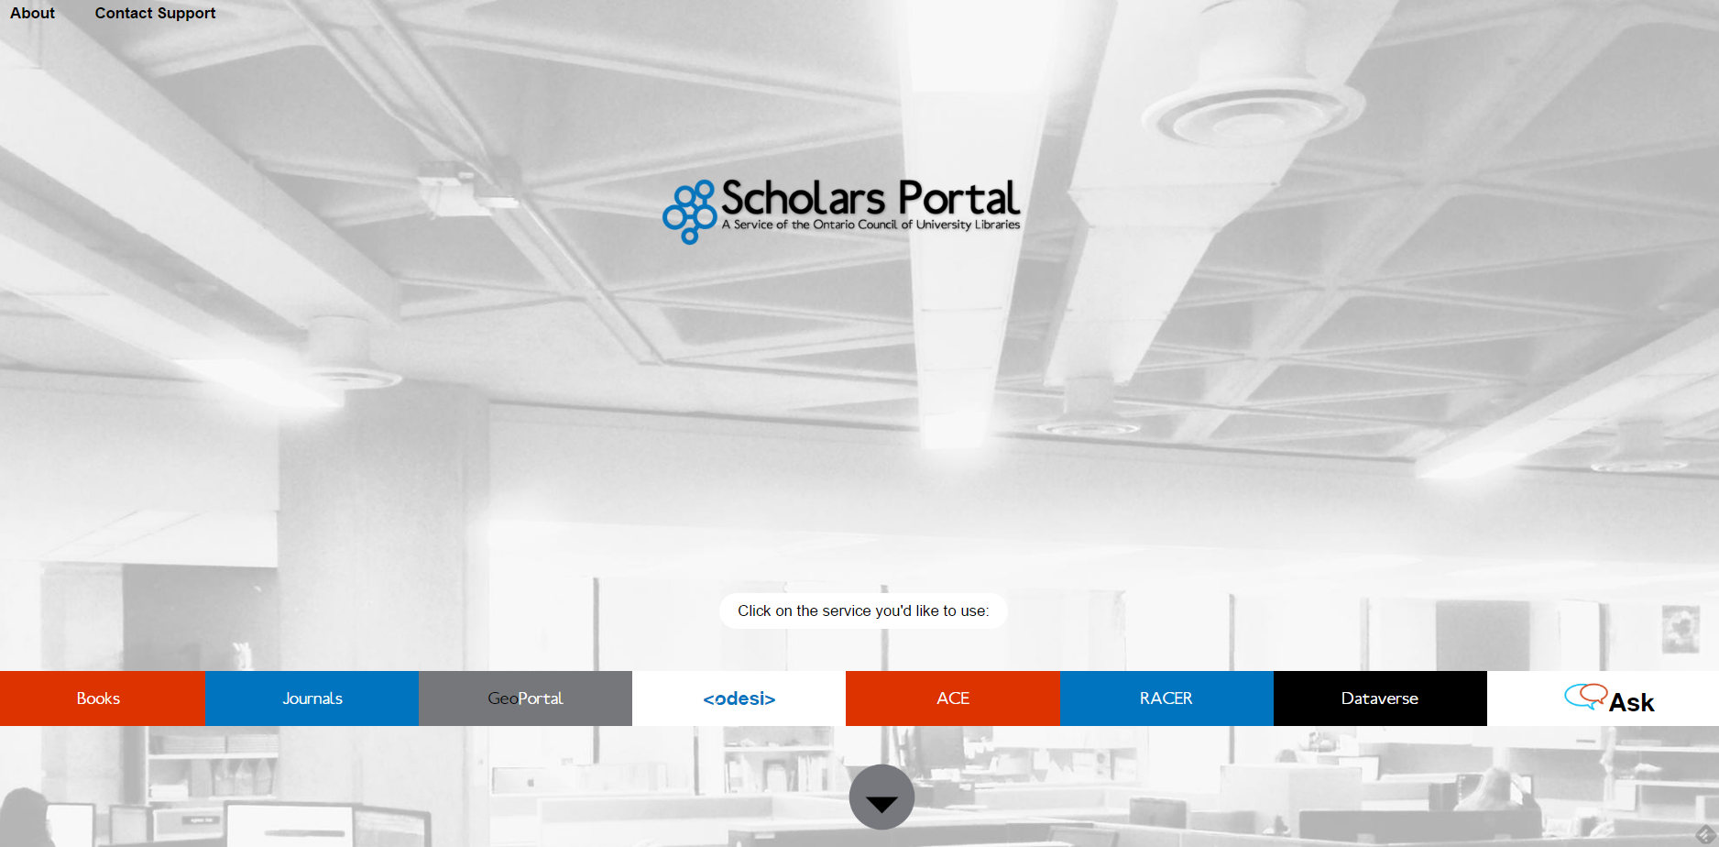
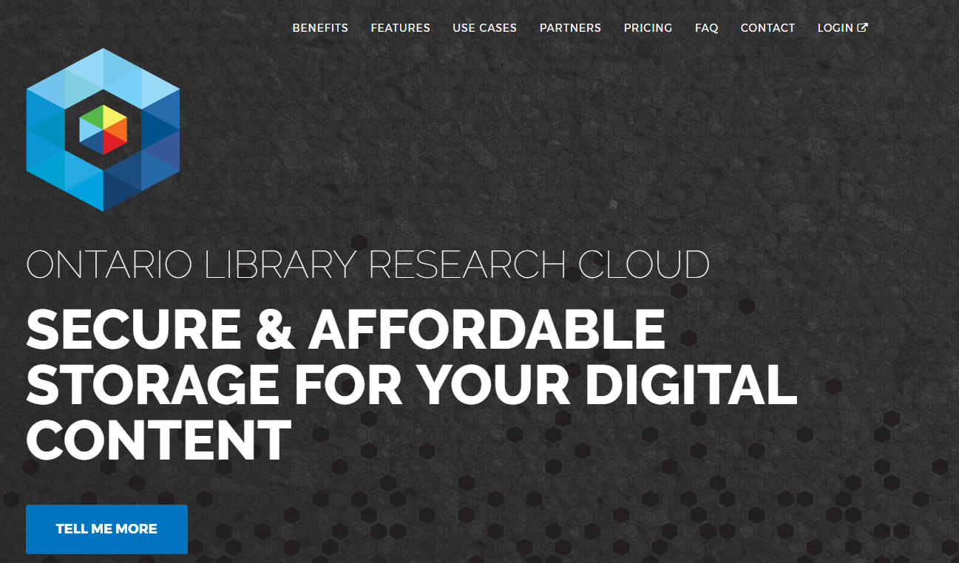
Soft power of groups …
Venue for: * Scaling learning and innovation * Scaling services * Scaling collections
Notes:
OCUL offers a wide range of group-scale operations – a locus for discussions about shared print (U of T Downsview project), local loading of licensed e collections, D2D [RACER, I think it is called], RDM…
Will it end up providing group-scale solutions for everything Ontario libraries need? Probably not. Intrinsic limits on ‘scalar advantage’ of a consortium.

Slide 40
Outside-in
Shared print collections
Consortial borrowing
Web archiving
Union catalogue?
Group D2D, stewardship, acquisition
Inside-out
Research data
Scholarly Materials
Digital Collections
Network discovery?
Group stewardship?

Slide 41
Inside out: Create, manage and make discoverable memory, community, evidence.
Facilitated: collecting according to a network logic: a coordinated mix of local, external and collaborative services are assembled around user needs
Collective collections: The systemwide organization of collections becomes more important. It makes sense to do acquisition, discovery and/or stewardship at the network level.

Slide 42
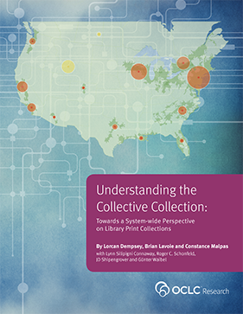
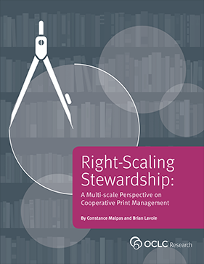
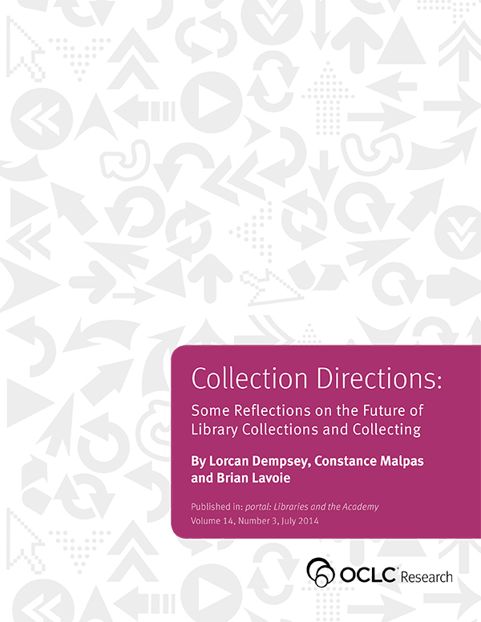
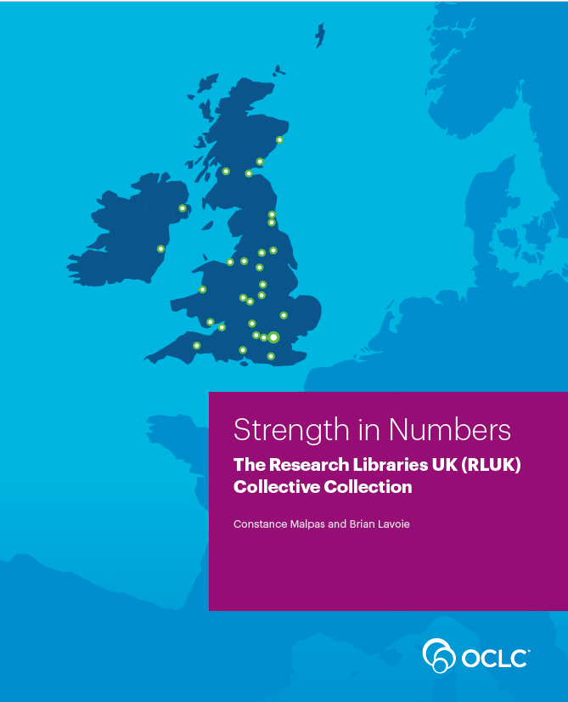
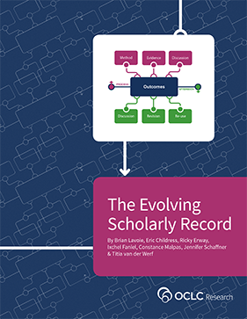
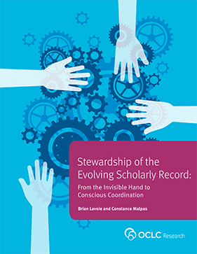
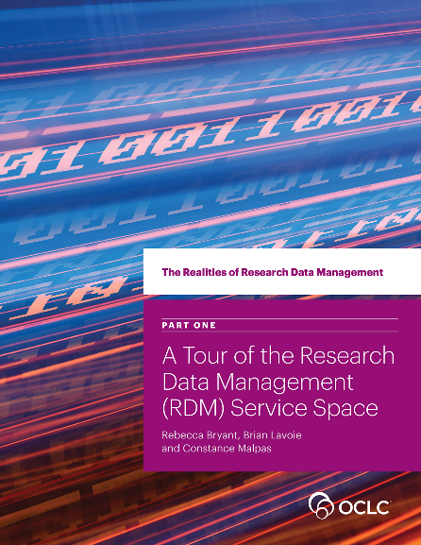
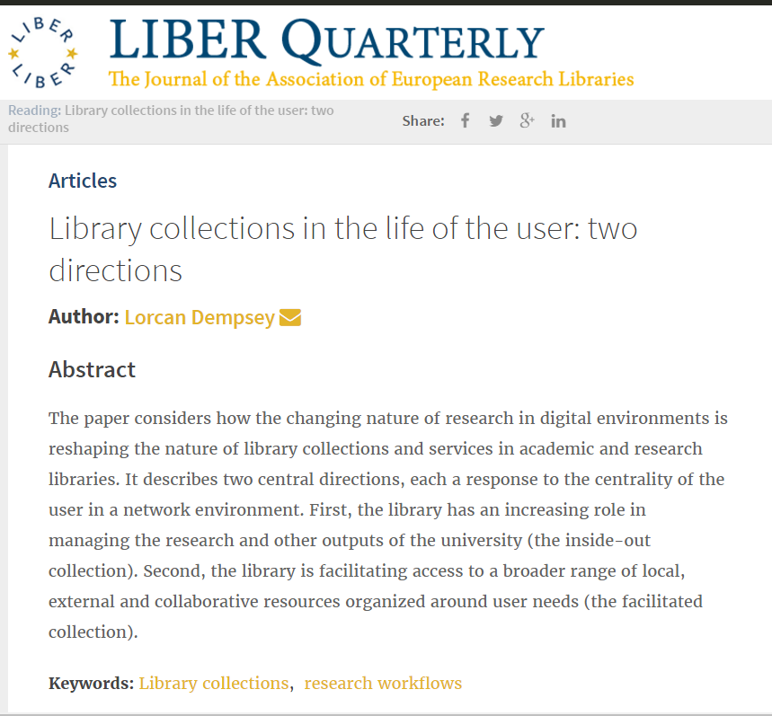
Thank you, @LorcanD

Slide 43
Citations and fuller details are included in slide notes where relevant.
Thanks to my colleagues Brian Lavoie, Constance Malpas and Rebecca
Bryant for assistance as I prepared this presentation.
The presentation follows the outline of:
Dempsey, L., (2016). Library collections in the life of the user: two directions. LIBER Quarterly. 26(4), pp.338–359. DOI:http://doi.org/10.18352/lq.10170
@LorcanD

