Slide 1
Collection directions: inside-out, facilitated and collective
Lorcan Dempsey, OCLC @LorcanD
A presentation to staff at Princeton University Library 24 March 17
Notes:
All rights reserved by WhiPix
https://www.flickr.com/photos/whipix1/14452334538/in/album-72157625449666256/

Slide 2
Research libraries achieved status in this environment by acquiring more than their peers or by building niche collections of particular depth.
… a collections logic of enforced parsimony and conscious selectivity can feel anachronistic and even perverse.
Collections no longer lie at the center of research library operations and goals, even as academic communities focus ever more inclusively on knowledge and information.
Hazen. Lost in the cloud. 2011
Notes:
Hazen, D. (January 01, 2011). Lost in the Cloud Research Library Collections and Community in the Digital Age. Library Resources and Technical Services, 55, 4, 195-204.
https://journals.ala.org/lrts/article/view/5302

Slide 3
A couple of preliminary observations

Slide 4
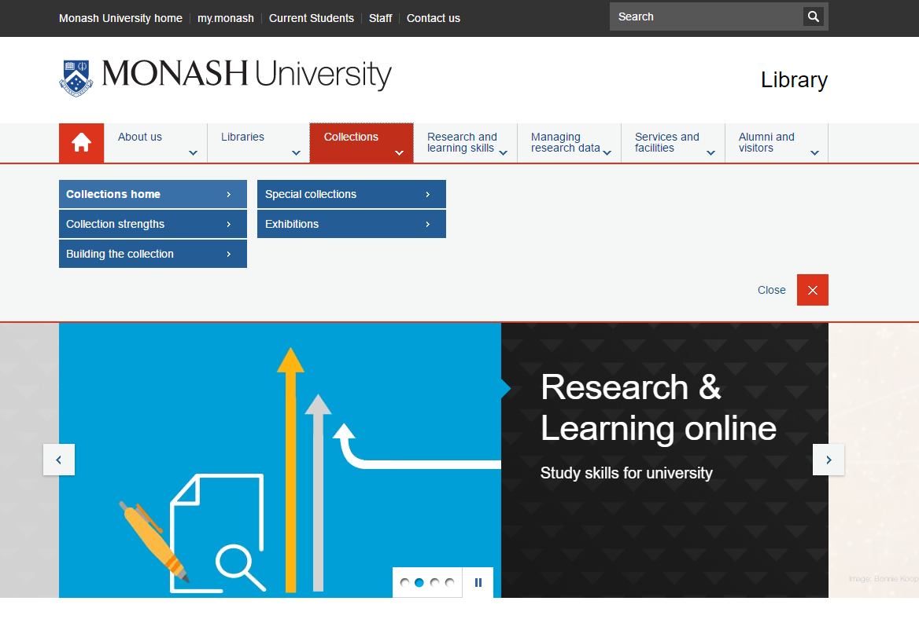
Places
Student success
Research support: creation
Collections as service

Slide 5
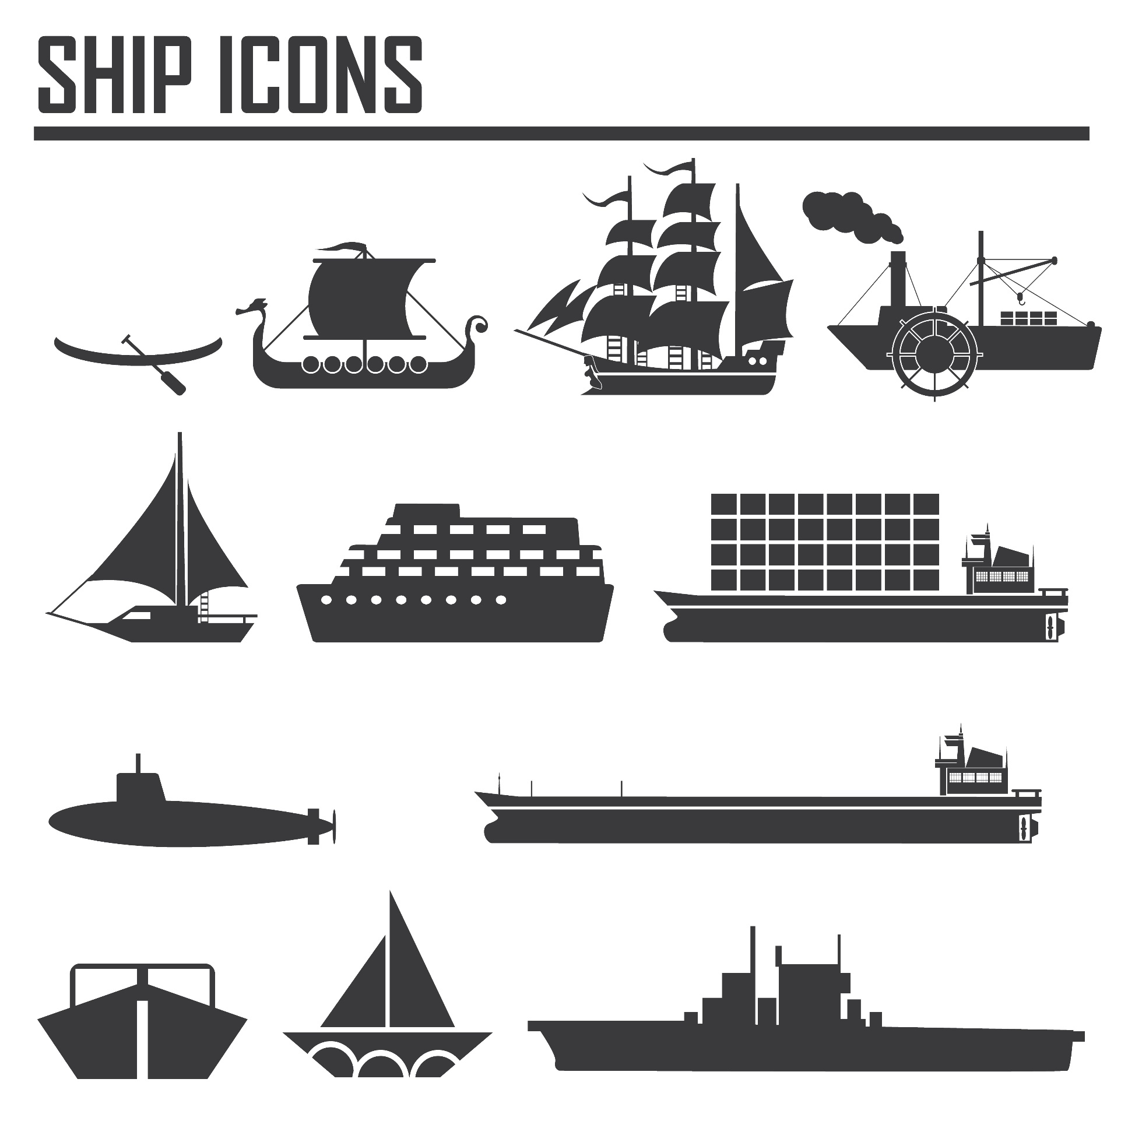
Greater stratification: libraries focused on institutional mission: responsibility to the scholarly record variably realised

Slide 6
Background

Slide 7
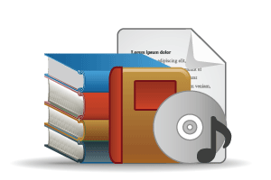
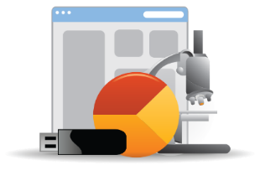
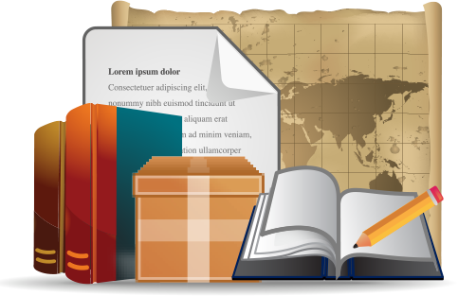
Open Web Resources
‘Published’ materials
In many collections
Licensed
Low Stewardship
Purchased
High Stewardship
Research & Learning Materials
In few collections
Special Collections
Local Digitization
Figure: OCLC Collections Grid.
OCLC Research, 2014

Slide 8
Monographs
Growing difference between market-available and specialised (e.g. area studies)
Managing down print - shared print
Shift to demand driven acquisition
Emergence of ‘e’ (platform)
Digital corpora (Hathi Trust, Google, …)
Disciplinary differences
Journals
Publishers looking to research workflow (Elsevier – Mendeley, Pure)
Complex open access environment - National science/research policy, grant-makers, publishers
A part only of the scholarly record – data, etc.
Licensed materials are now the larger part of academic library budgets. Big deal.

Slide 9
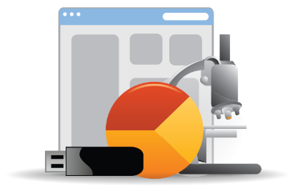
Research and learning material
Evolving scholarly record: research data, eprints, ..
IR – role and content?
Research information management (profiles, outputs, …)
Support for digital scholarship
Support for open access publishing
Special collections, archives, …
Release more value through digitization, exhibitions, undergraduate research, …
Streamlining processing, production, …
Network level aggregation for scale and utility – DPLA, Europeana, Pacific Rim Digital Library,

Slide 10
Web archive
Books
Aggregations
Major student
reference resource
Subject
Databases
Subject
repositories
Digital
heritage
Archives
Research networks/citation management/profiling
Data
The network dynamically influences…
…. an evolving information space
…. changing research behaviors.

Slide 11
A
Borrow
Direct
Prelude

Slide 12
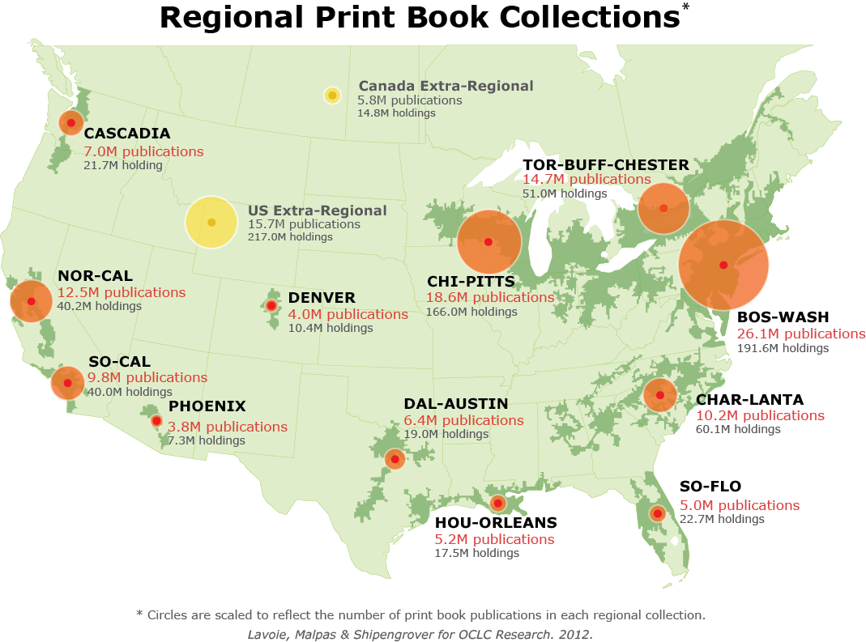
BOS-WASH &
BorrowDirect
B-W
26.1m
B-D
16.1m
Chicago, Cornell,
Duke, Stanford:
1.4m print book
publications NOT in BOS-WASH
Notes:
Opening view: mega-regional print collections
First click: Borrow Direct partners are mostly in BOS-WASH mega-region
Second click: Chicago, Cornell, Duke, and Stanford are each located in another mega-region.
Third click: BD overlap with BOS-WASH collection; non-BOS-WASH contribution highlighted.
More on mega-regional print book collections:
Lavoie, Brian, Constance Malpas and JD Shipengrover. 2012. Print Management at "Mega-scale": A Regional Perspective on Print Book Collections in North America. Dublin, Ohio: OCLC Research. http://www.oclc.org/research/publications/library/2012/2012-05.pdf.

Slide 13
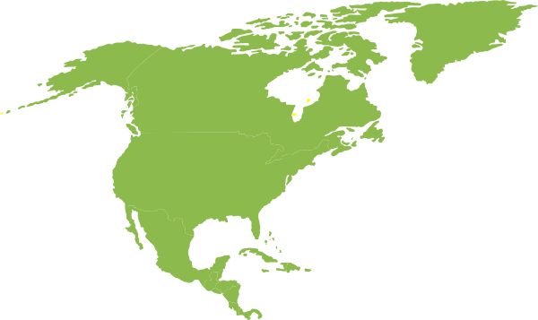
BorrowDirect compared to megaregions
Bos-Wash
57%
North
America:
45.7m
Chi-Pitts
41%
Borrow Direct
35%
BorrowDirect coverage
VS
HOUORLEANS
DAUSTIN
DENVER
CASCADIA
SOFLO
SOCAL
NOCAL
CHARLANTA
BOSWASH
TORBUFF
CHIPITTS
Notes:
North American print book collection: 45.7m distinct publications
57 percent of the print book publications held in North America are available within BOS-WASH (the largest mega-regional collection)
41 percent of the print book publications held in North America are available in CHI-PITTS (the second largest mega-regional collection)
35 percent of the print book publications held in North America are available within the BorrowDirect partnership (which would represent the third largest mega-regional collection)
The BorrowDirect print book collection duplicates at least half of every mega-regional collection in North America.

Slide 14
OK Let’s begin

Slide 15
Overview
Support for creation, management and disclosure
The specialized collection
Reconfiguration of research work by network/digital environment.
Reconfiguration of the information space by network/digital environment.
The inside out collection
The facilitated collection

Slide 16
Reconfiguration of research work by network/digital environment.
Research work

Slide 17
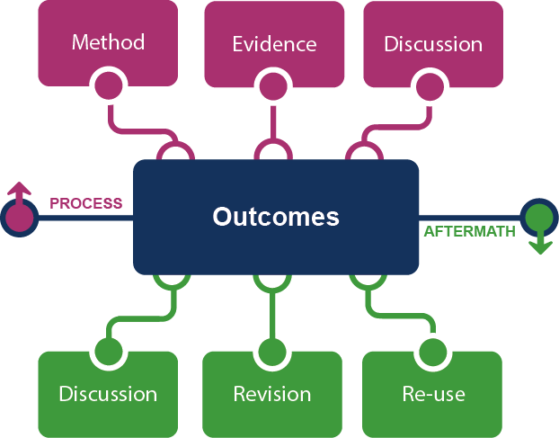
Supporting the creative process: the emerging scholarly record
Notes:
This is how we framed out the scholarly record in terms of nature and scope of what it might contain.
Start with published outcomes: the reporting of results, conclusions, ideas and so forth from a particular scholarly inquiry.
These outcomes are still the coin of the realm for scholarly activities, so they are privileged here at the center of the picture;
A lot of these outcomes take the form of text-based materials like books and journal articles, but often supplemented by additional materials such as video, graphics, and interactive programs.
Rest of scholarly record divided into two broad areas: process and aftermath
Process: process of scholarly inquiry; process by which outcomes are produced. Identified three categories of materials generated in this phase in which there is interest in including them as part of the scholarly record:
Method materials related to the methodology of scholarly inquiry (e.g., software, computer models, digital lab notebooks, sampling frames, experimental protocols, instrument calibrations)
Evidence raw materials/inputs to scholarly work (e.g., data sets, survey results, new or enhanced primary source documents, links to findings from other scholarly works);
Discussion refining and improving ideas, methods, conclusions (e.g., pre-prints, listserv/blog discussions, conference presentations, annotated commentary, grant proposals).
Anchoring outcomes directly to the methods employed, evidence used, and formative discussions conducted during the process of scholarly inquiry helps contextualize and deepen our understanding of these outcomes, facilitate replicability, and leverage results into new research.
Once the outcomes from a research project have been formally published or otherwise made available, scholarly activities surrounding that piece of work may still continue in the “aftermath” phase.
Activities in the aftermath phase may include Discussion (through similar channels as those in the process phase, but also post-publication formal reviews and commentary);
Revision published work can be revised in various ways (the work may be enhanced with additional findings; errors may be corrected or clarifications made, etc.)
Re-use (the work may be edited or re-packaged into new forms, such as conference presentations, summaries, blog posts, versions for the “popular media”, etc.).
Not saying that everything discussed here will end up in the scholarly record. But picture represents the maximal scope and depth of materials regarding which there is increasing interest in systematic collection and curation.
Note that some of the materials in the outlying components are becoming or might become outcomes in their own right. Data sets are a good example: in some disciplines the publication of an important data set is now considered a first-class scientific outcome.
More on the evolving scholarly record:
Lavoie, Brian, Eric Childress, Ricky Erway, Ixchel Faniel, Constance Malpas, Jennifer Schaffner, and Titia van der Werf. 2014. The Evolving Scholarly Record. Dublin, Ohio: OCLC Research.
http://www.oclc.org/content/dam/research/publications/library/2014/oclcresearch-evolving-scholarly-record-2014.pdf.

Slide 18
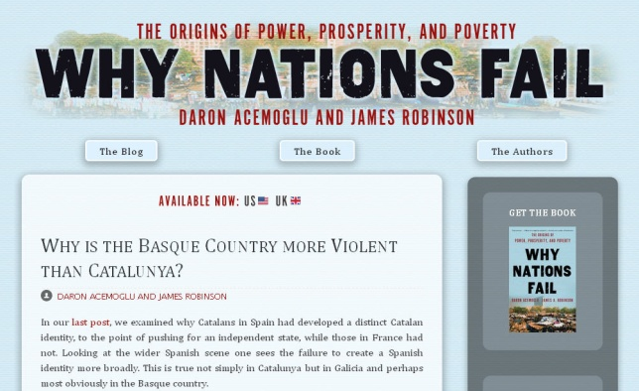
Notes:
http://global.oup.com/uk/orc/busecon/economics/carlin/

Slide 19
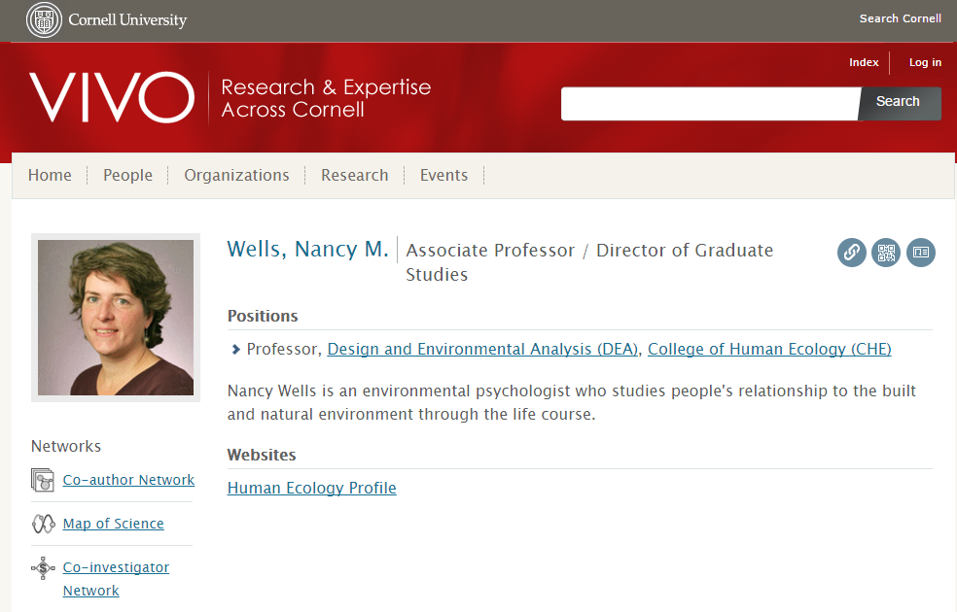
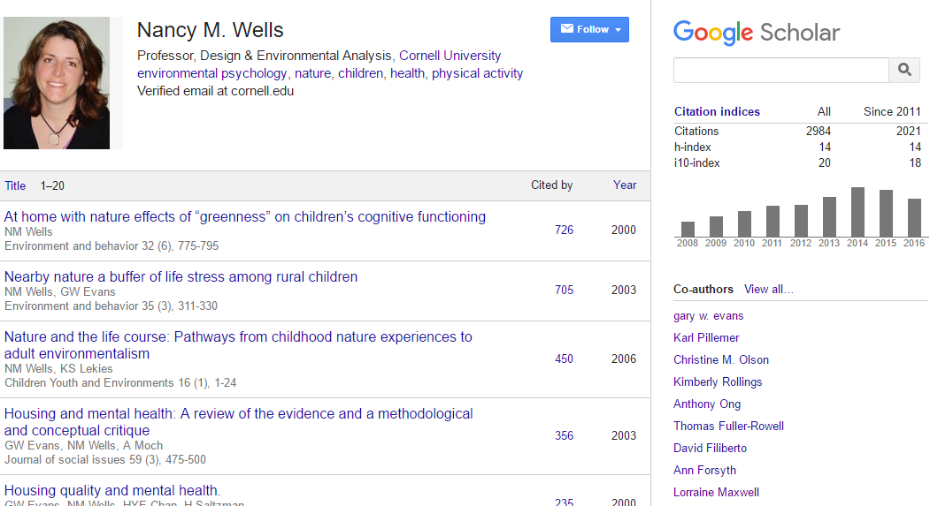
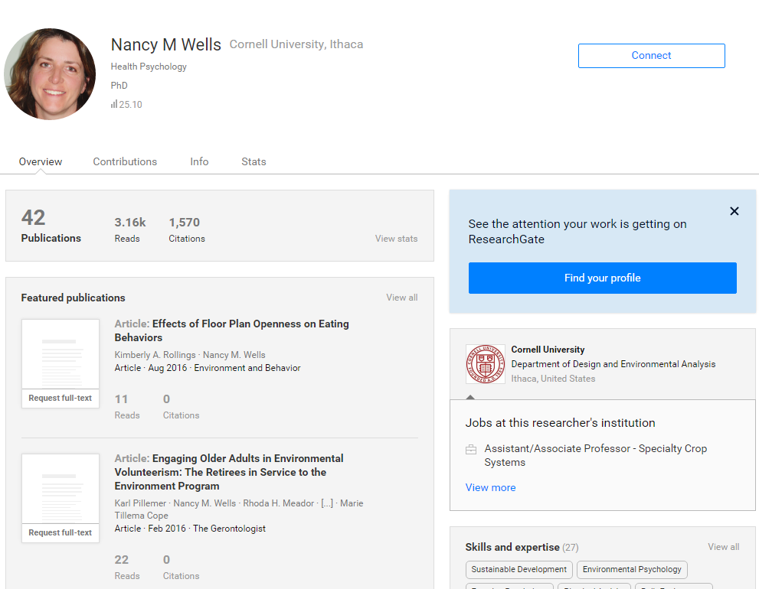
Expertise and reputation:
Identity > workflow > content

Slide 20
Creation, management and disclosure:
R-infrastructure
Vice president for research
Medical center
Tech Transfer Office
CIO
News Bureau
Institutional Reporting
Research Data Management
Advancement & corporate relations
Provost
Data Warehouse
RIM/Profiling system
Digital scholarship
LIBRARY
Colleges & depts
Institutional Repository
User education & training
Disciplines & departments
Graduate school
Office of undergraduate research
Researcher
Research manager
Library - Research support
Campus center for teaching & learning

Slide 21
A publisher’s new job description
Her view is that publishers are here to make the scientific research process more effective by helping them keep up to date, find colleagues, plan experiments, and then share their results. After they have published, the processes continues with gaining a reputation, obtaining funds, finding collaborators, and even finding a new job. What can we as publishers do to address some of scientists’ pain points?
Annette Thomas,
Then CEO of Macmillan
Publishers
http://www.against-the-grain.com/2012/11/a-publishers-new-job-description/
Notes:
A Publisher's New Job Description
November 8, 2012 Donald Hawkins Charleston Conference Blog
http://www.against-the-grain.com/2012/11/a-publishers-new-job-description/

Slide 22
Researcher
Librarian
Research
manager

Slide 23
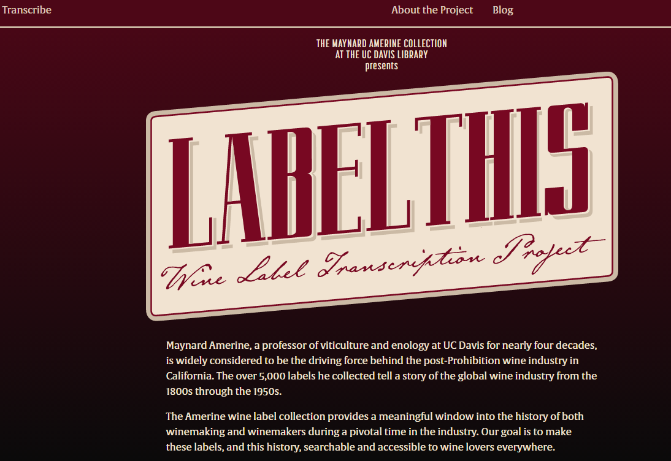
Research, reputation, relevance

Slide 24
Support for creation, management and disclosure
Reconfiguration of research work by network/digital environment.
Workflow is the new content
Reputation manage and disclose the intellectual outputs and expertise of the institution.
From discovery to discoverability
Rightscaling and collective action
Institutional
Collective collection
Third party
Collaboration at scale
The inside out collection

Slide 25
Reconfiguration of the information space by network/digital environment.
Inform-ation space

Slide 26
arXiv, SSRN, RePEc, PubMed Central (disciplinary repositories that have become important discovery hubs);
Google Scholar, Google Books, Amazon (ubiquitous discovery and fulfillment hubs);
Mendeley, ResearchGate (services for social discovery and scholarly reputation management);
Goodreads, LibraryThing (social description/reading sites);
Wikipedia, Yahoo Answers, Khan Academy (hubs for open research, reference, and teaching materials).
FigShare, OpenRefine (data storage and manipulation tools)
Github (software management)

Slide 27
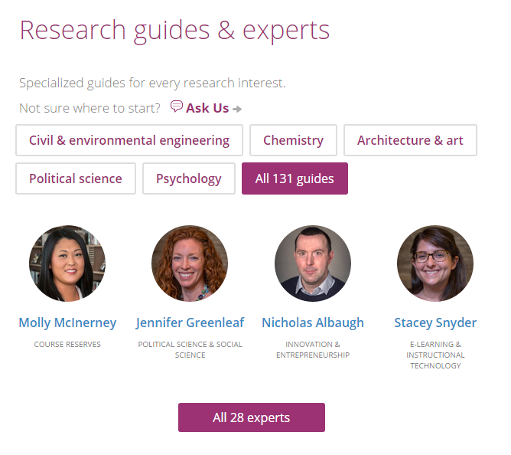

Slide 28
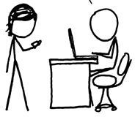
http://www.xkcd.com/917/
Value relates to locally assembled collection.
Value relates to ability to efficiently meet a variety of research and learning needs.
A print logic: the distribution of print copies to multiple local destinations
A network logic: a coordinated mix of local, external and collaborative services are assembled around user needs
A collections spectrum
The ‘owned’ collection
The ‘facilitated’ collection
Purchased and physically stored
Meet research and
learning needs in best way
Notes:
More on facilitated collections:
Dempsey, L., (2016). Library collections in the life of the user: two directions. LIBER Quarterly. 26(4). DOI: http://doi.org/10.18352/lq.10170

Slide 29
The ‘external’ collection:
Pointing researchers at Google Scholar;
Including freely available ebooks in the catalog;
Creating resource guides for web resources.
The ‘borrowed’ collection
The ‘shared print’ collection
The ‘shared digital’ collection
The evolving scholarly record
A collections spectrum
The ‘owned’ collection
The ‘licensed’ collection
The ‘demand-driven’ collection
The ‘facilitated’ collection
Note: Libraries have variable
Investments across the entire
spectrum
Purchased and physically stored
Meet research and
learning needs in best way

Slide 30
The specialized collection
Reconfiguration of the information space by network/digital environment.
The facilitated collection

Slide 31
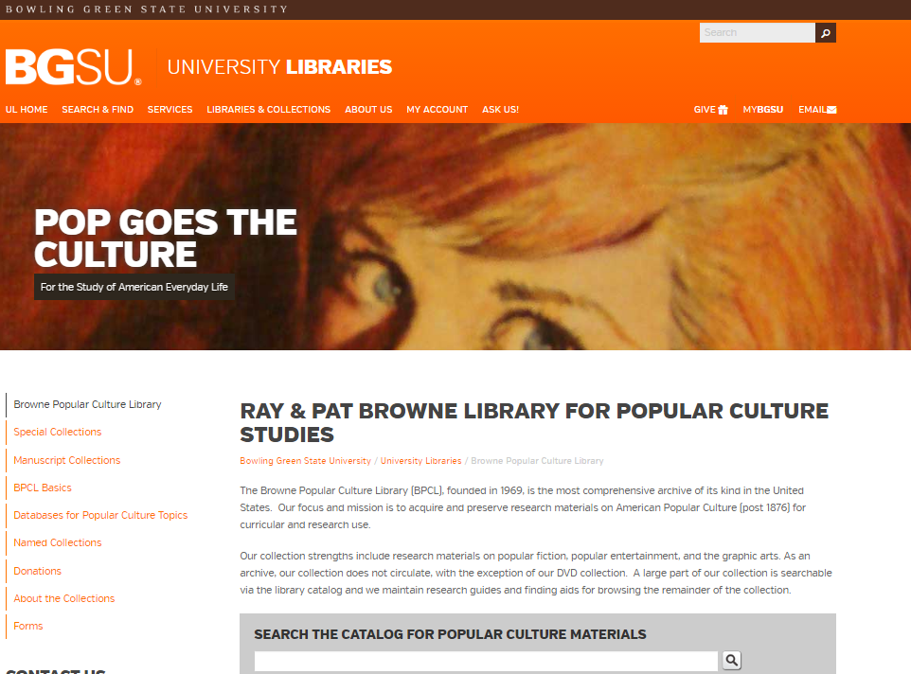
The specialized collection

Slide 32
The specialized collection
Specialization of locally acquired/held collections?
Engagement Understand and respond to needs of faculty and students.
A diffuse responsibility for stewardship of the scholarly record
Rightscaling and collective action
Institutional
Collective collection
Third party
Collaboration at scale
Reconfiguration of the information space by network/digital environment.
The facilitated collection

Slide 33
Support for creation, management and disclosure
The specialized collection
Reconfiguration of research work by network/digital environment.
Reconfiguration of the information space by network/digital environment.
The inside out collection
The facilitated collection

Slide 34
An engagement model in which library liaisons and functional specialists collaborate to understand and address the wide range of processes in instruction and scholarship is replacing the traditional tripartite model of collections, reference, and instruction.
Jaguszewski, J. M., & Williams, K. (2013)
Library structures
University structures
New campus configurations are emerging.
Research managers (Research office), CIO, University Press, Departments, …
Collaborative structures
Sourcing and scaling.
Rightscaling: finding the right level at which to do things.
Sourcing: finding the right partners.

Slide 35
But …

Slide 36
“…the US infrastructure for research and collaboration continues to be primarily at the institutional level. Is this a “structural problem,” as was argued in that ARL board discussion? It certainly is “structural” in the sense that the landscape looks a certain way. This is a choice, however, and it’s worth pondering the question of why we have not organized ourselves for scale, impact and efficiency.
Radical Scatter. JISC/CNI 2016.
Notes:
Jisc and CNI conference 2016
International advances in digital scholarship
Oxford, July 2016
Powerpoint from presentation available at:
http://www.slideshare.net/JISC/closing-plenary-john-wilkin-and-david-Maguire
Quote from unpublished paper provided by the author.
Pic: http://www.library.illinois.edu/administration/librarian/aboutme.html

Slide 37
Collective collection
Rightscaling – optimum scale?
The ‘borrowed’ collection
The ‘shared print’ collection
The ‘shared digital’ collection
The evolving scholarly record

Slide 38
Rightscaling – optimum scale?
Shared print
Research data
Shared Print Management

Slide 39
Collection integrity
Research libraries have built their collections through
expensive, carefully planned efforts that have extended
over decades and in some cases centuries. Their holdings
are deliberate creations of mutually reinforcing materials
not just haphazard accumulations of books and journals.
Hazen. Selecting for storage. LRTS 44(4)
From collection integrity to collective collection integrity?
Conscious coordination required to overcome radical scatter
Notes:
Hazen, D. (January 01, 2000). ARTICLES - Selecting for Storage - Local Problems, Local Responses, and an Emerging Common Challenge. Library Resources & Technical Services, 44, 4, 176.
https://journals.ala.org/lrts/article/view/5508

Slide 40
Shared collections
Borrow
Web archiving
Research data
Archives and special collections

Slide 41
Workflow is the new content: process and product
The specialized collection
Reconfiguration of research work by network/ digital environment.
Reconfiguration of the information space by network/ digital environment.
The inside out collection
The facilitated collection
@LorcanD
Thank You

Slide 42
Citations and fuller details are included in slide notes where relevant.
Thanks to my colleagues Brian Lavoie, Constance Malpas, JD
Shipengrover, Merrilee Proffitt and Rebecca Bryant for assistance
as I prepared this presentation.
The presentation follows the outline of:
Dempsey, L., (2016). Library collections in the life of the
user: two directions. LIBER Quarterly. 26(4).
DOI: http://doi.org/10.18352/lq.10170
@LorcanD

