Slide 1
Some Collection Directions: Inside Out, Facilitated, Collective
Lorcan Dempsey, OCLC @LorcanD
Ohio Valley Technical Services Group Xavier University May 21 2017

Slide 2
Collections as a service

Slide 3
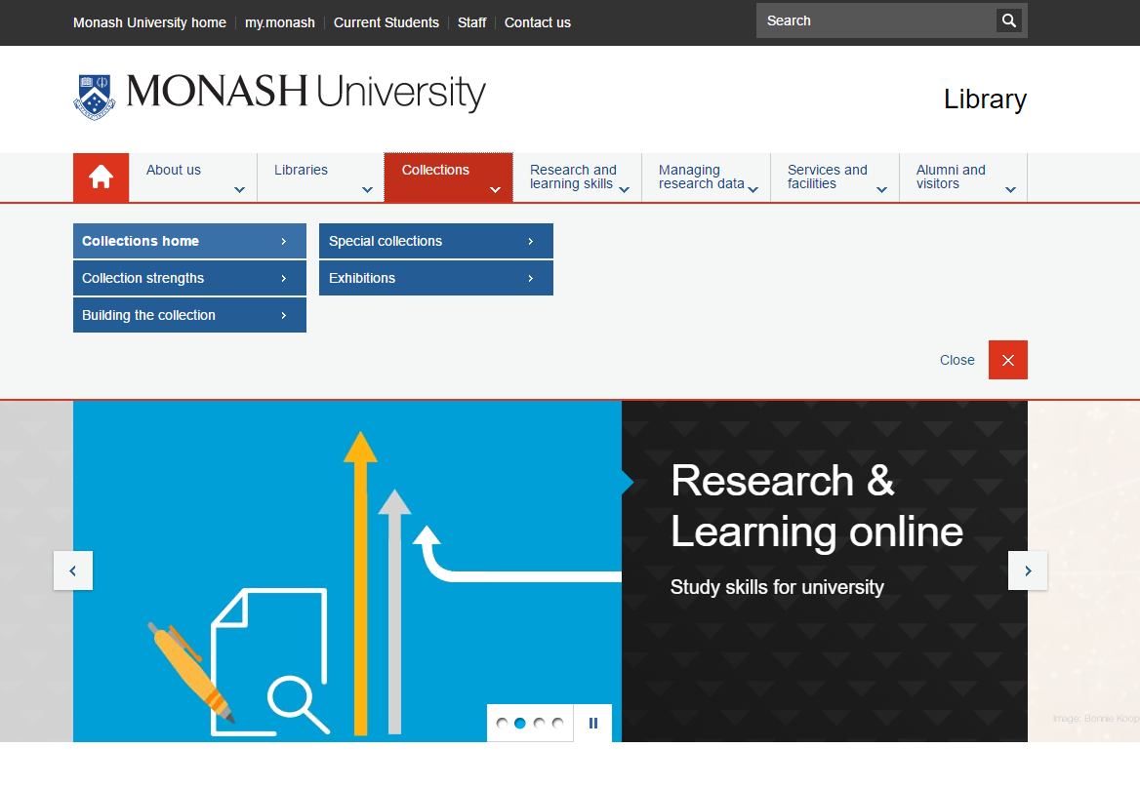
Places
Student success
Research support: creation
Collections as a service

Slide 4
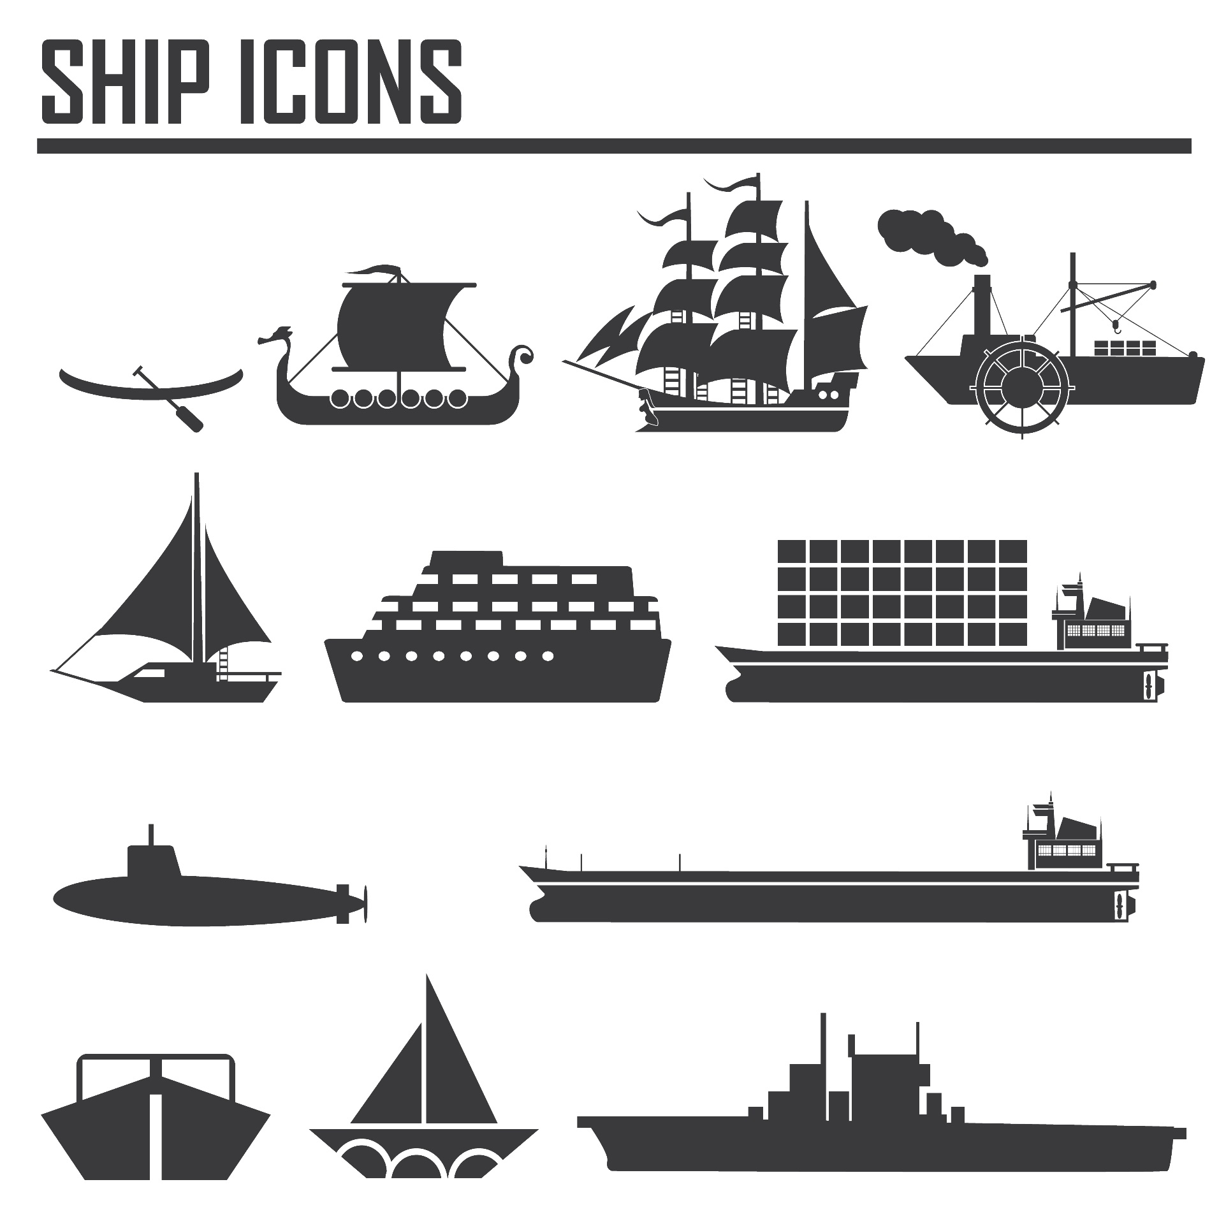
Greater stratification: libraries focused on institutional mission: responsibility to the scholarly and cultural record variably realised

Slide 5
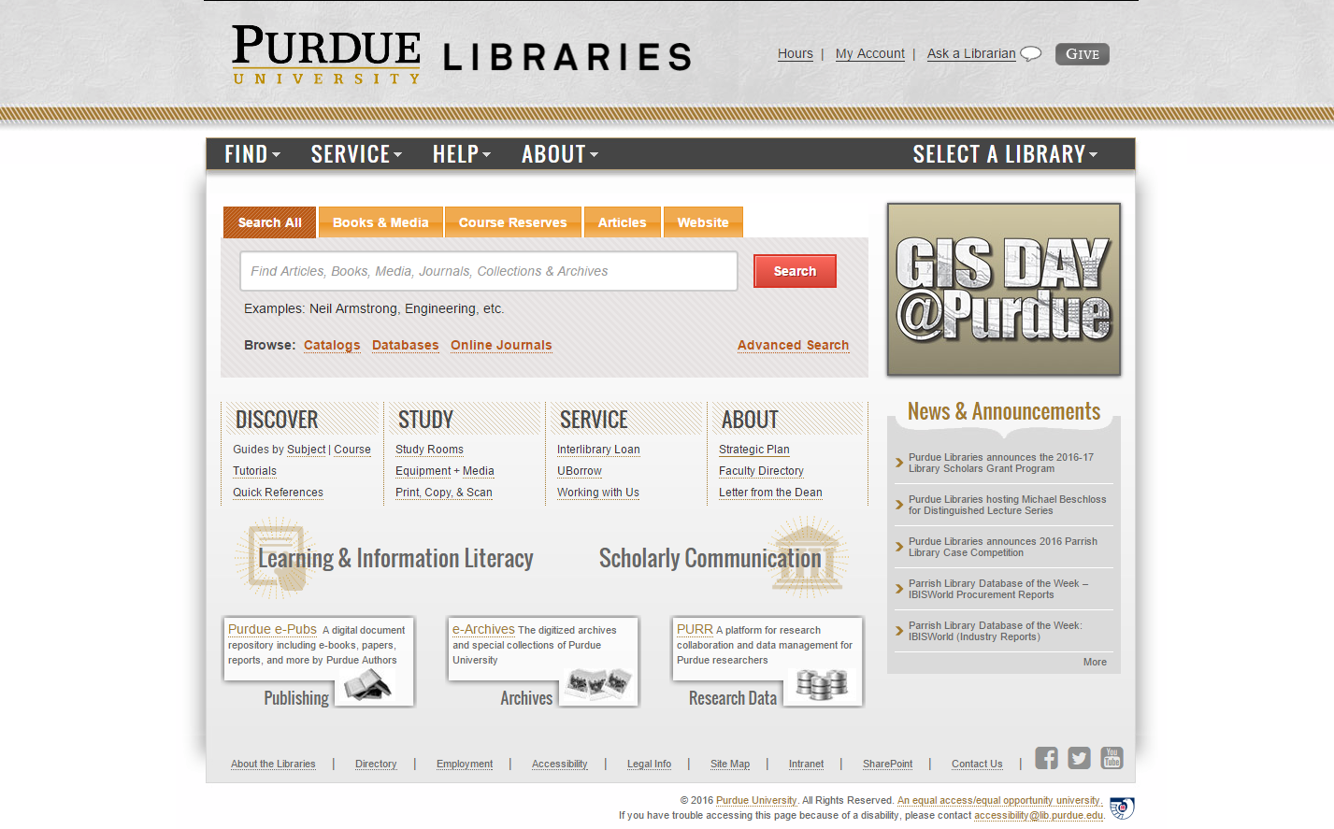
Outside in
Facili-tated
Collect-ive
Inside out
Collections: expanding view

Slide 6
Different dynamics across collecting activity
Collection attention: the collections grid

Slide 7
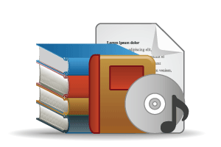
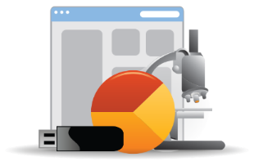
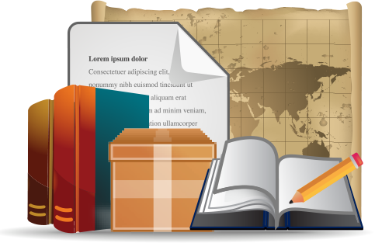
Open Web Resources
‘Published’ materials
In many collections
Licensed
Low Stewardship
Purchased
High Stewardship
Research & Learning Materials
In few collections
Special Collections
Local Digitization
Figure: OCLC Collections Grid.
OCLC Research, 2014

Slide 8
Monographs
Growing difference between market-available and specialised (e.g. area studies)
Managing down print - shared print
Shift to demand driven acquisition
Emergence of ‘e’ (platform)
Digital corpora (Hathi Trust, Google, …)
Disciplinary differences
Journals
Publishers looking to research workflow (Elsevier – Mendeley, Pure)
Complex open access environment - National science/research policy, grant-makers, publishers
A part only of the scholarly record – data, etc.
Licensed materials are now the larger part of academic library budgets. Big deal.

Slide 9
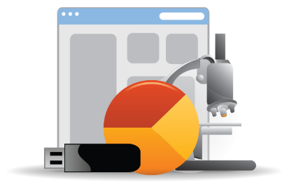
Research and learning material
Evolving scholarly record: research data, eprints, ..
IR – role and content?
Research information management (profiles, outputs, …)
Support for digital scholarship
Support for open access publishing
Special collections, archives, …
Release more value through digitization, exhibitions, undergraduate research, …
Streamlining processing, production, …
Network level aggregation for scale and utility – DPLA, Europeana, Pacific Rim Digital Library,

Slide 10
Three directions
Inside out
Facilitated
Collective

Slide 11
The network has reconfigured the information space.
Facilitated collection
We are now reconfiguring collections around the user.

Slide 12
Goodreads, LibraryThing (social description/reading sites);
Wikipedia, Yahoo Answers, Khan Academy (hubs for open research, reference, and teaching materials).
Google Scholar, Google Books, Amazon (ubiquitous discovery and fulfillment hubs);
Mendeley, ResearchGate (services for social discovery and scholarly reputation management);
FigShare, OpenRefine (data storage and manipulation tools)
arXiv, SSRN, RePEc, PubMed Central (disciplinary repositories that have become important discovery hubs);
Github (software management)

Slide 13
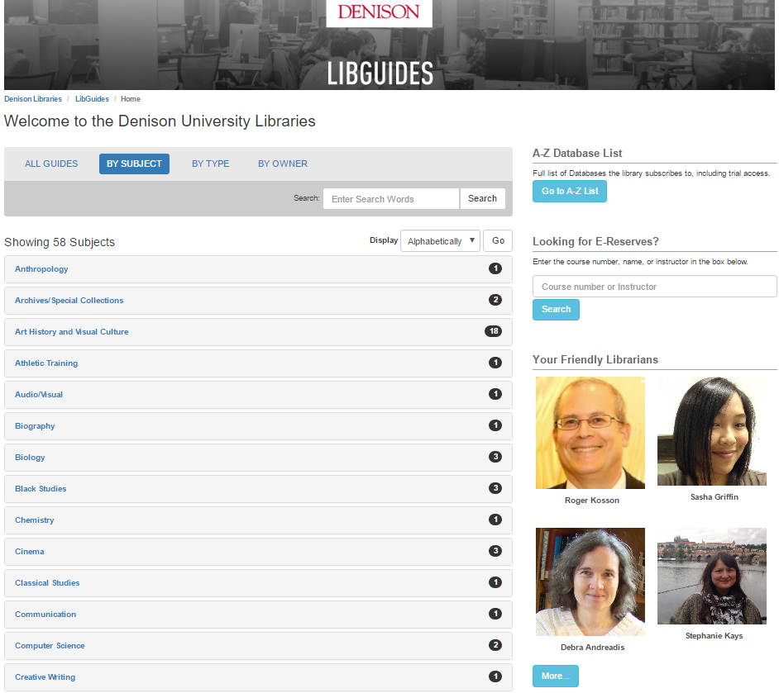

Slide 14
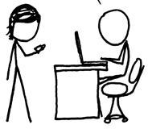
http://www.xkcd.com/917/
Value relates to locally assembled collection.
Value relates to ability to efficiently meet a variety of research and learning needs.
A print logic: the distribution of print copies to multiple local destinations
A network logic: a coordinated mix of local, external and collaborative services are assembled around user needs
A collections spectrum
The ‘owned’ collection
The ‘facilitated’ collection
Purchased and physically stored
Meet research and
learning needs in best way
Notes:
More on facilitated collections:
Dempsey, L., (2016). Library collections in the life of the user: two directions. LIBER Quarterly. 26(4). DOI: http://doi.org/10.18352/lq.10170

Slide 15
The ‘external’ collection:
Pointing researchers at Google Scholar;
Including freely available ebooks in the catalog;
Creating resource guides for web resources.
The ‘borrowed’ collection
The ‘shared print’ collection
The ‘shared digital’ collection
The evolving scholarly record
A collections spectrum
The ‘owned’ collection
The ‘licensed’ collection
The ‘demand-driven’ collection
The ‘facilitated’ collection
Note: Libraries have variable
Investments across the entire
spectrum
Purchased and physically stored
Meet research and
learning needs in best way

Slide 16
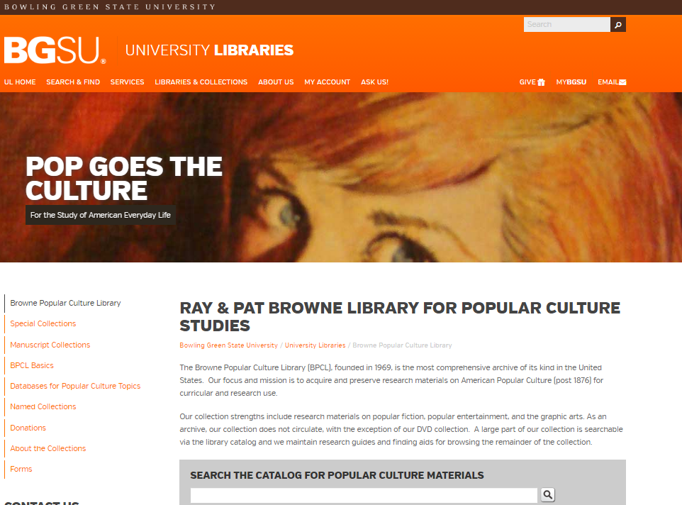
The specialized collection

Slide 17
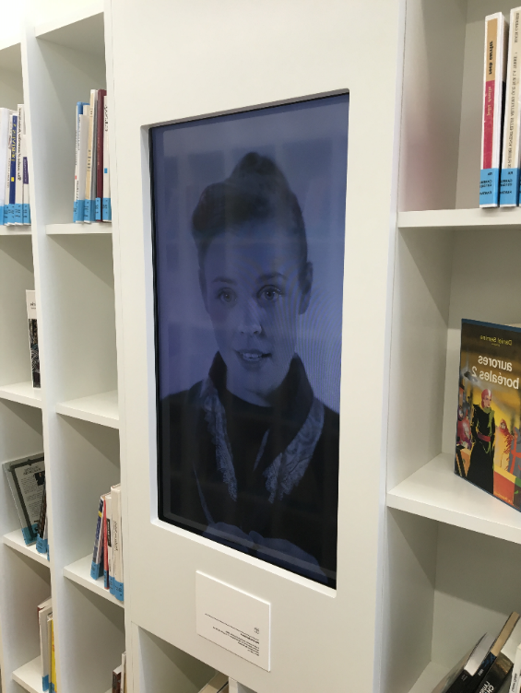
Retain our values: supporting local cultures in a global knowledge commons
Maison de la littérature,
la Bibliothèque de Québec
Slide via Martha Whitehead
Queen’s University, Canada
Notes:
A character from a Gabrielle Roy novel (Rue Deschambault) speaks on video among the stacks.

Slide 18
Specialised local collection
Deep engagement with user community
Make expertise visible
Interest in collective collections
The facilitated collection

Slide 19
Reconfiguration of research/cultural work by network/digital environment.
A shift from support for consumption to support for creation.
The inside out collection

Slide 20
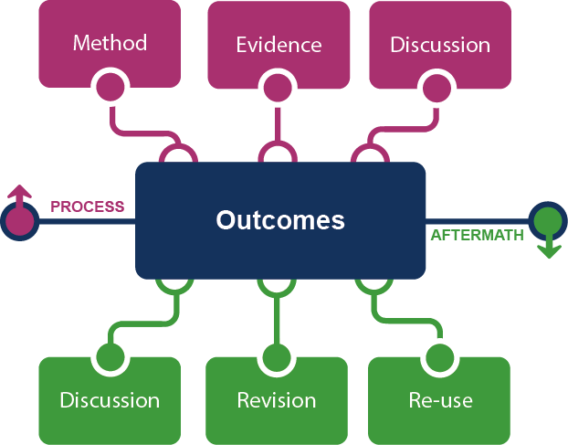
Supporting the creative process: the emerging scholarly record
Notes:
This is how we framed out the scholarly record in terms of nature and scope of what it might contain.
Start with published outcomes: the reporting of results, conclusions, ideas and so forth from a particular scholarly inquiry.
These outcomes are still the coin of the realm for scholarly activities, so they are privileged here at the center of the picture;
A lot of these outcomes take the form of text-based materials like books and journal articles, but often supplemented by additional materials such as video, graphics, and interactive programs.
Rest of scholarly record divided into two broad areas: process and aftermath
Process: process of scholarly inquiry; process by which outcomes are produced. Identified three categories of materials generated in this phase in which there is interest in including them as part of the scholarly record:
Method materials related to the methodology of scholarly inquiry (e.g., software, computer models, digital lab notebooks, sampling frames, experimental protocols, instrument calibrations)
Evidence raw materials/inputs to scholarly work (e.g., data sets, survey results, new or enhanced primary source documents, links to findings from other scholarly works);
Discussion refining and improving ideas, methods, conclusions (e.g., pre-prints, listserv/blog discussions, conference presentations, annotated commentary, grant proposals).
Anchoring outcomes directly to the methods employed, evidence used, and formative discussions conducted during the process of scholarly inquiry helps contextualize and deepen our understanding of these outcomes, facilitate replicability, and leverage results into new research.
Once the outcomes from a research project have been formally published or otherwise made available, scholarly activities surrounding that piece of work may still continue in the “aftermath” phase.
Activities in the aftermath phase may include Discussion (through similar channels as those in the process phase, but also post-publication formal reviews and commentary);
Revision published work can be revised in various ways (the work may be enhanced with additional findings; errors may be corrected or clarifications made, etc.)
Re-use (the work may be edited or re-packaged into new forms, such as conference presentations, summaries, blog posts, versions for the “popular media”, etc.).
Not saying that everything discussed here will end up in the scholarly record. But picture represents the maximal scope and depth of materials regarding which there is increasing interest in systematic collection and curation.
Note that some of the materials in the outlying components are becoming or might become outcomes in their own right. Data sets are a good example: in some disciplines the publication of an important data set is now considered a first-class scientific outcome.
More on the evolving scholarly record:
Lavoie, Brian, Eric Childress, Ricky Erway, Ixchel Faniel, Constance Malpas, Jennifer Schaffner, and Titia van der Werf. 2014. The Evolving Scholarly Record. Dublin, Ohio: OCLC Research.
http://www.oclc.org/content/dam/research/publications/library/2014/oclcresearch-evolving-scholarly-record-2014.pdf.

Slide 21
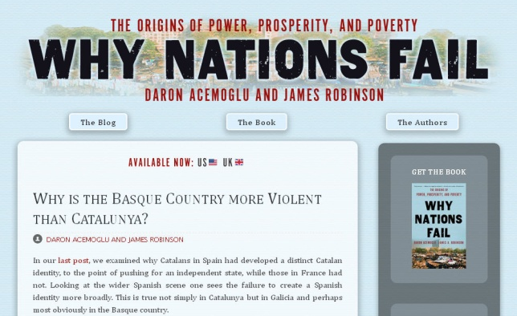
Notes:
http://global.oup.com/uk/orc/busecon/economics/carlin/

Slide 22
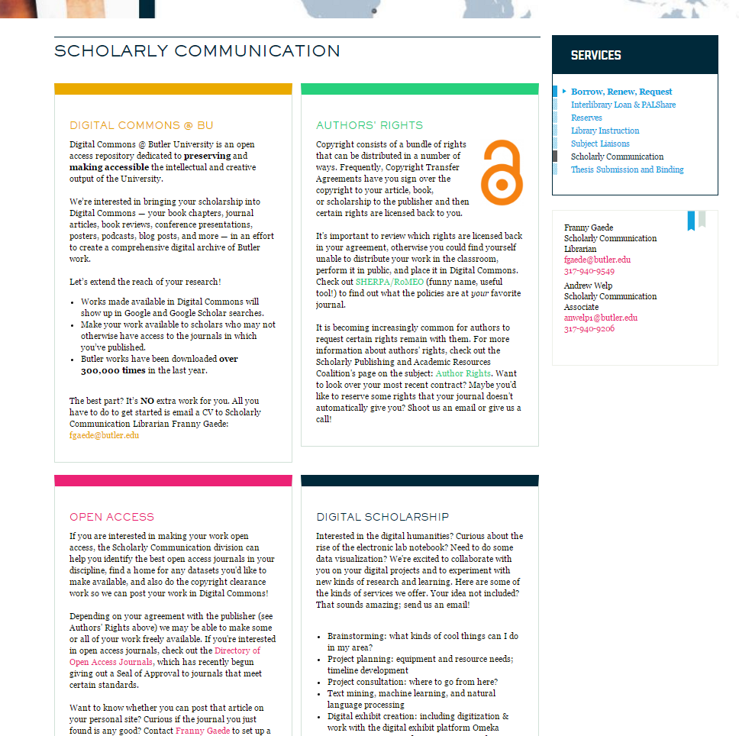

Slide 23
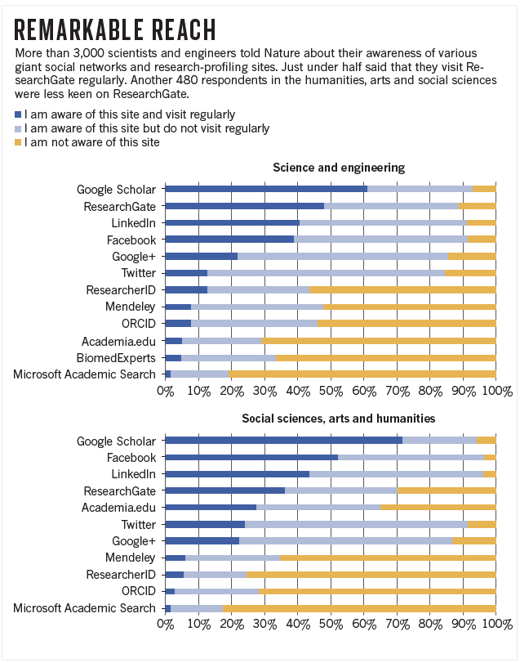
Faculty/researcher engagement in academic social network
Digital
Residents
Digital
Visitors
http://www.nature.com/news/online-collaboration-scientists-and-the-social-network-1.15711

Slide 24
Workflow is the new content (supply chain)
In a print world, researchers and learners organized their workflow around the library.
The library had limited interaction with the full process.
In a digital world, the library needs to organize itself around the workflows of research and learners.
Workflows generate and consume information resources.

Slide 25
Creation, management and disclosure:
Vice president for research
R- infra-structure
Medical center
Tech Transfer Office
CIO
News Bureau
Institutional Reporting
Research Data Management
Advancement & corporate relations
Provost
Data Warehouse
RIM/Profiling system
Digital scholarship
LIBRARY
Colleges & depts
Institutional Repository
User education & training
Disciplines & departments
Graduate school
Office of undergraduate research
Campus center for teaching & learning

Slide 26
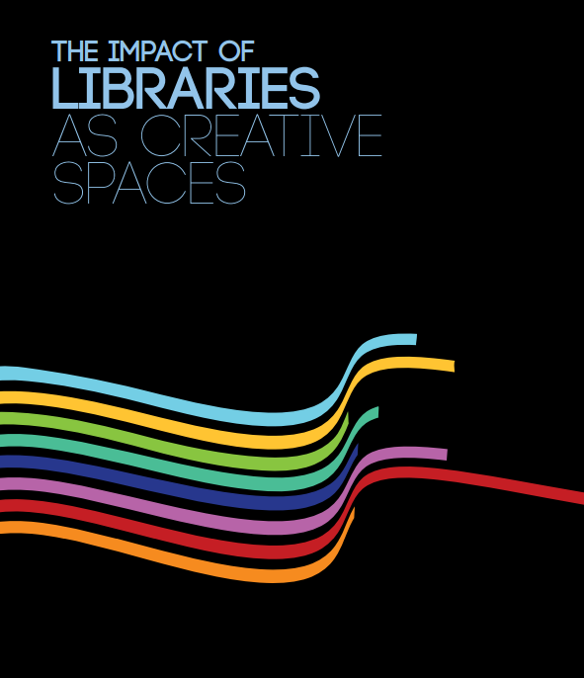
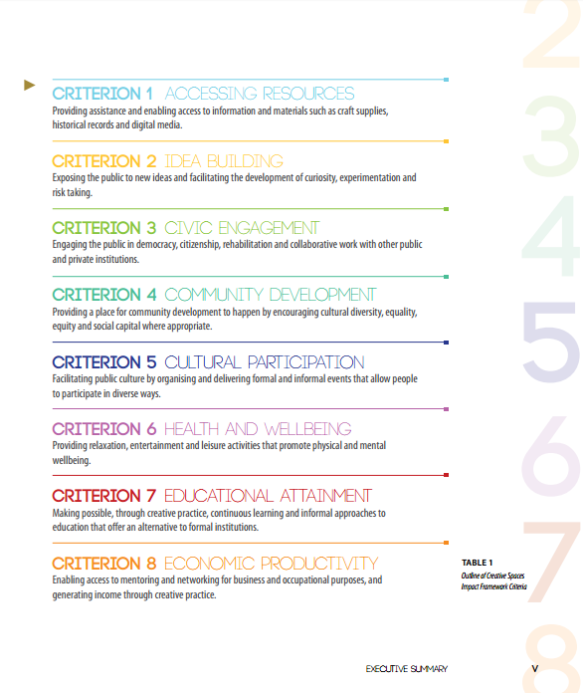

Slide 27
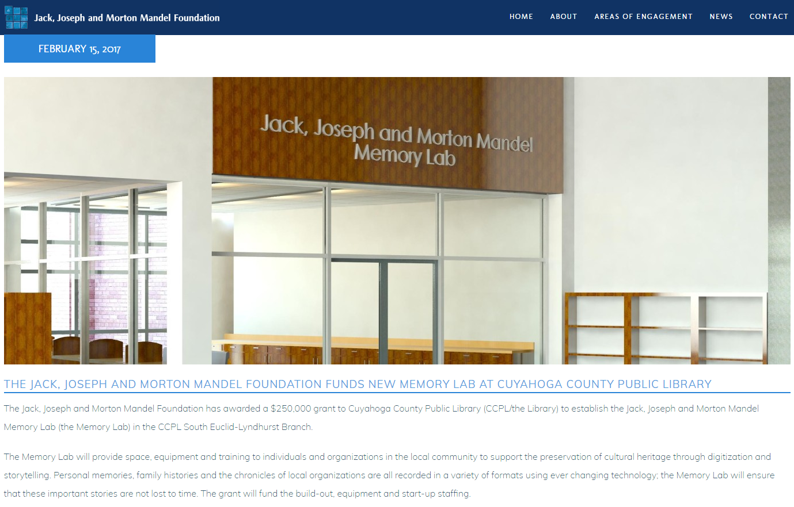

Slide 28
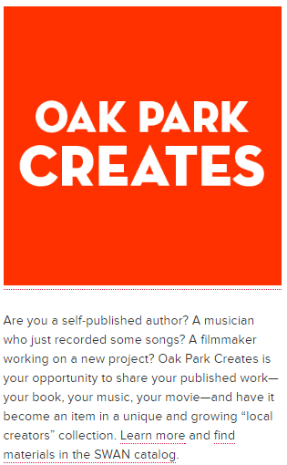
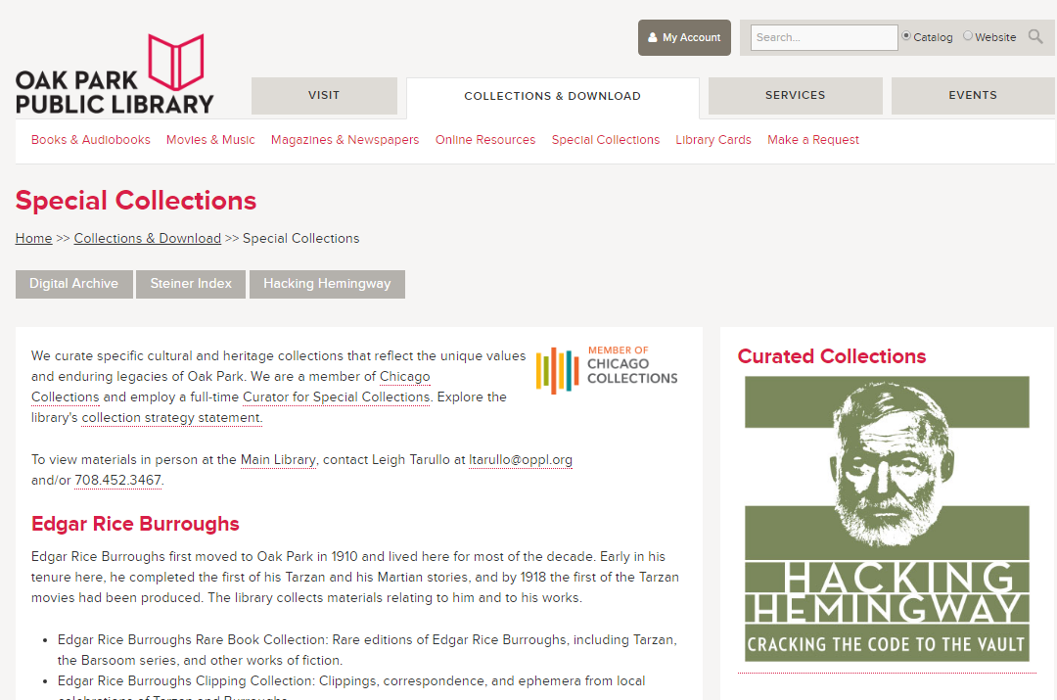
“We create specific cultural and heritage collections that reflect the unique values and enduring legacies of Oak Park.”

Slide 29
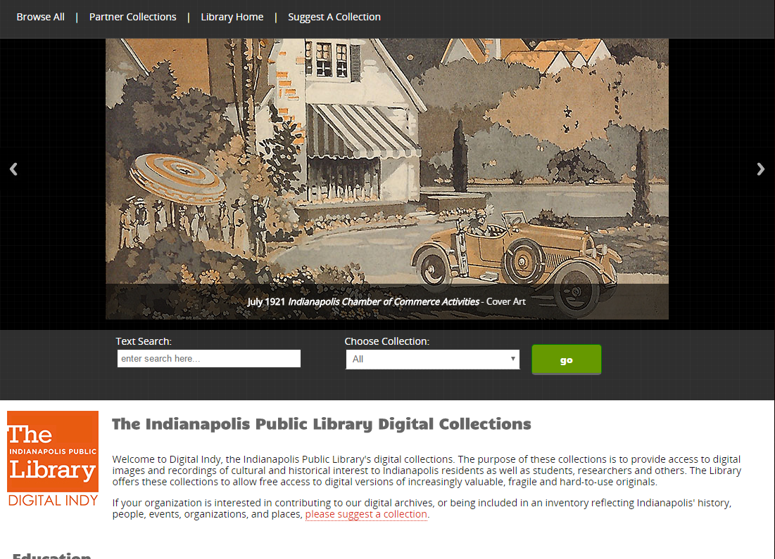

Slide 30
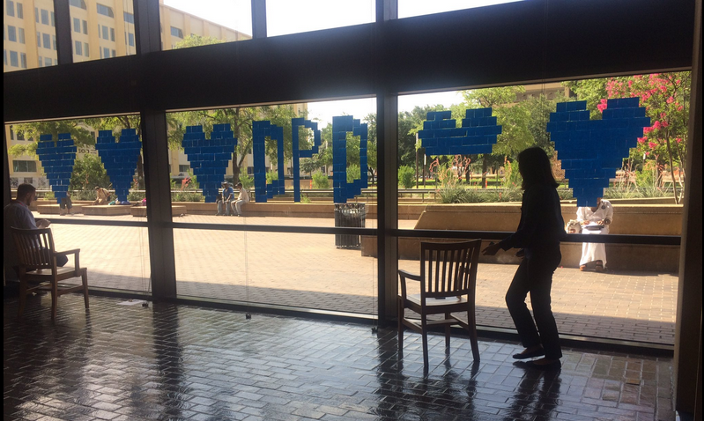
Libaries and anamnesis
Notes:
Note: this slide has one animation inserting the Instagram image from DPL
In the wake of community tragedies, PLs have taken on the roles as safe spaces and community healer/rebuilders. Obviously, this is not part of any library’s specific strategy to serve their communities in new and different ways, but when tragedies such as the Dallas Police shootings, the Pulse nightclub shootings in Orlando, the Ferguson riots, Sandy Hook school shootings in Newton, CT strike communities, Public Libraries are often the first to respond providing safe spaces for dialogue, discourse, grief and community expression. And in some cases they also become the archivists of such expression.
Image: Dallas Public Library PostIt Note memorial. The Library, in partnership with the Dallas Police Dept, is currently working to preserve and curate all the memorabilia and community sentiments that were left at the fallen police officer memorial. Insert shows just a small sampling of items that they collected and will be preserving as part of the collection.
Photo: Jo Giudice, Dallas Public Library https://pbs.twimg.com/media/Cm2epeeUkAAplOt.jpg:thumb
Article: https://dpdbeat.com/2016/07/15/dallas-police-department-and-dallas-public-library-personnel-partner-to-preserve-fallen-officer-memorial/

Slide 31
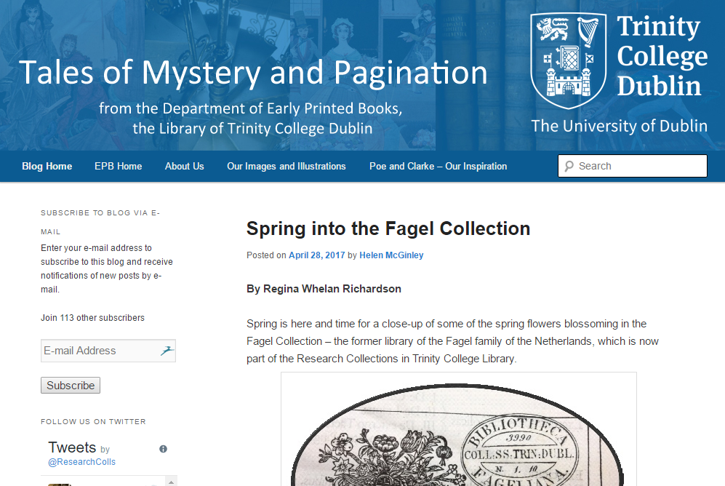
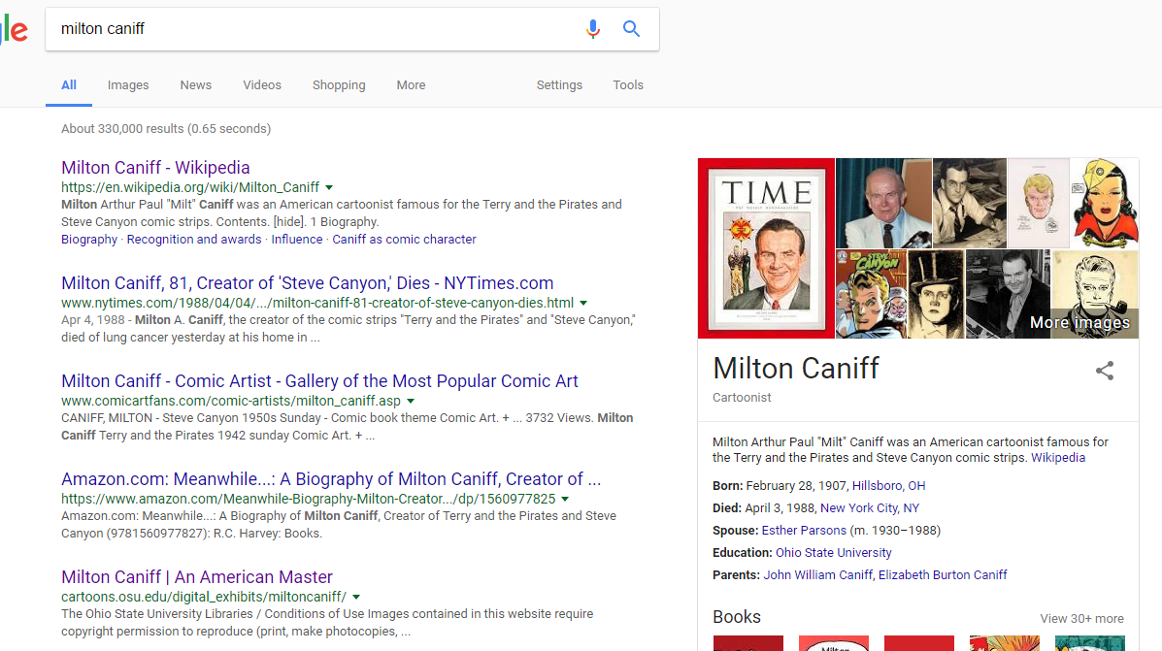
Active promotion
Interpretation and promotion through social media
Syndication
Metadata
Links
Services
Wikipedia
Search engine optimization

Slide 32
Support for creation, management and disclosure
Memory
Community
Evidence
Interest in aggregation (DPLA, WorldCat, Share)
From discovery to discoverability
The inside out collection

Slide 33
Managing down print.
Configuring space around user experiences rather than collections.
Aggregating ‘inside out’ materials
The rise of the collective collection

Slide 34
System-wide organization of collections—whether the “system” is a consortium, a region or a country.
The rise of the collective collection
Discovery
Sharing
Owned
The collective print collection
The collective digital collection
The collective scholarly collection

Slide 35
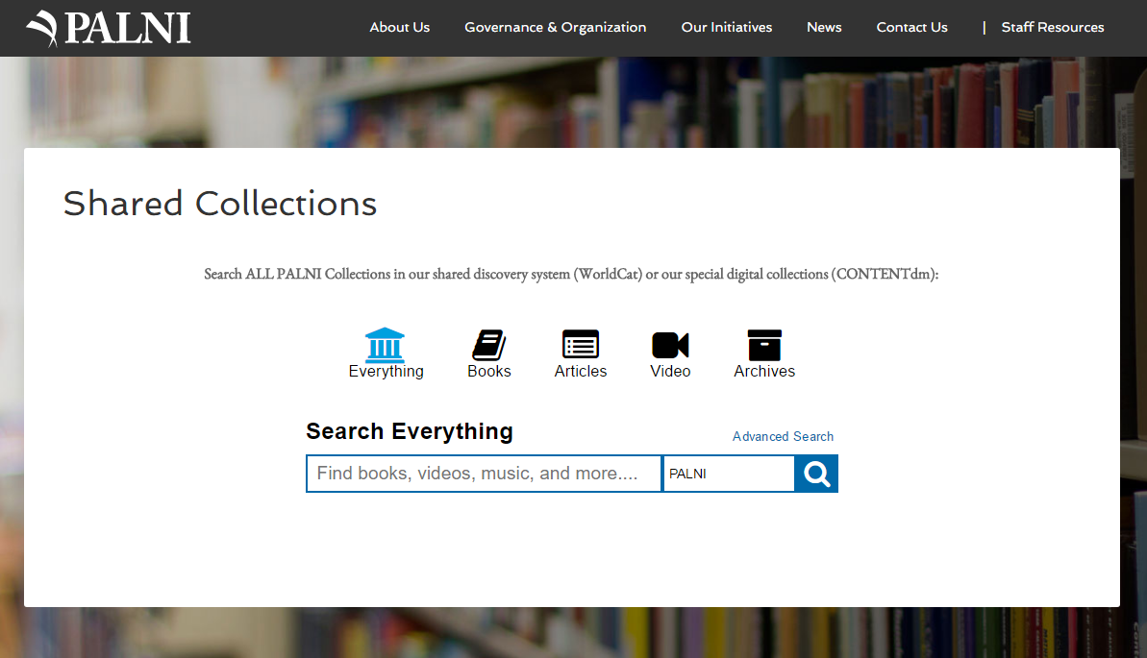

Slide 36
So …

Slide 37
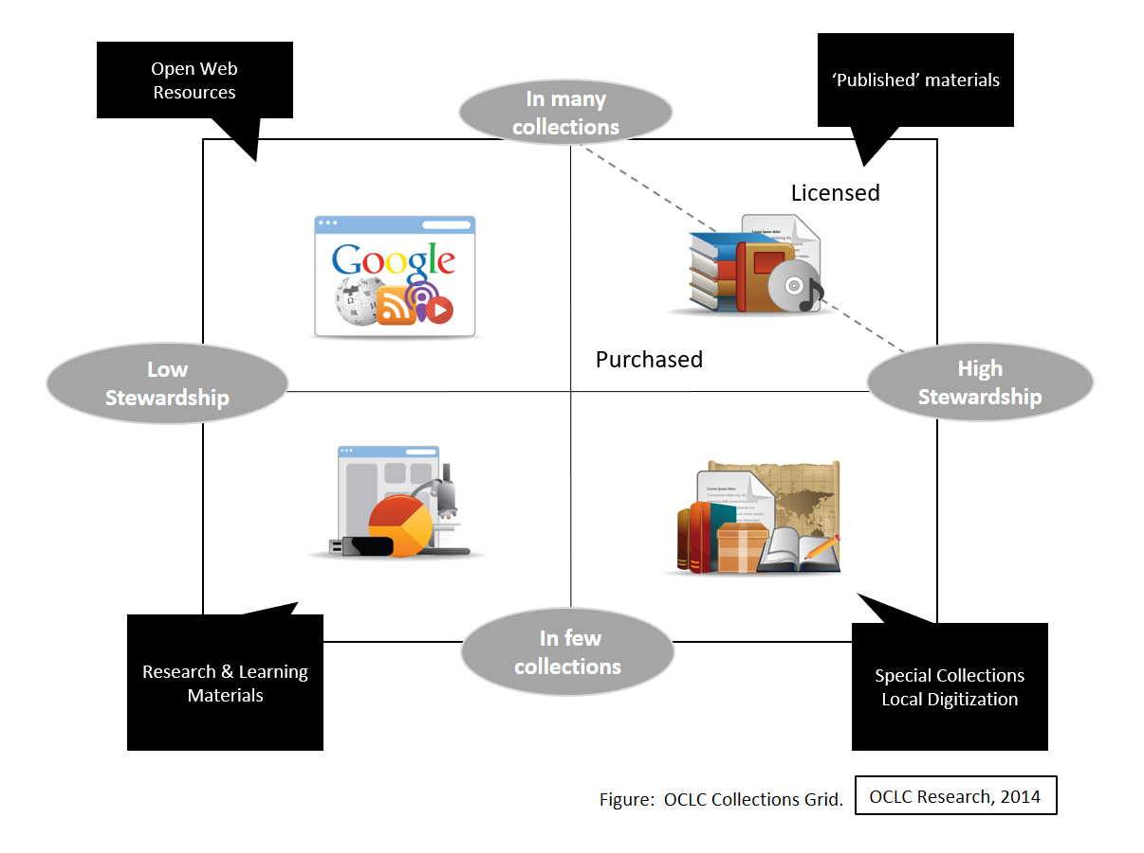
Facilitated
A network logic: a coordinated mix of local, external and collaborative services are assembled around user needs

Slide 38
Inside out
Inside out: Create, manage and make discoverable memory, community, evidence.

Slide 39
Collective
Collective collections: The systemwide organization of collections becomes more important.

Slide 40
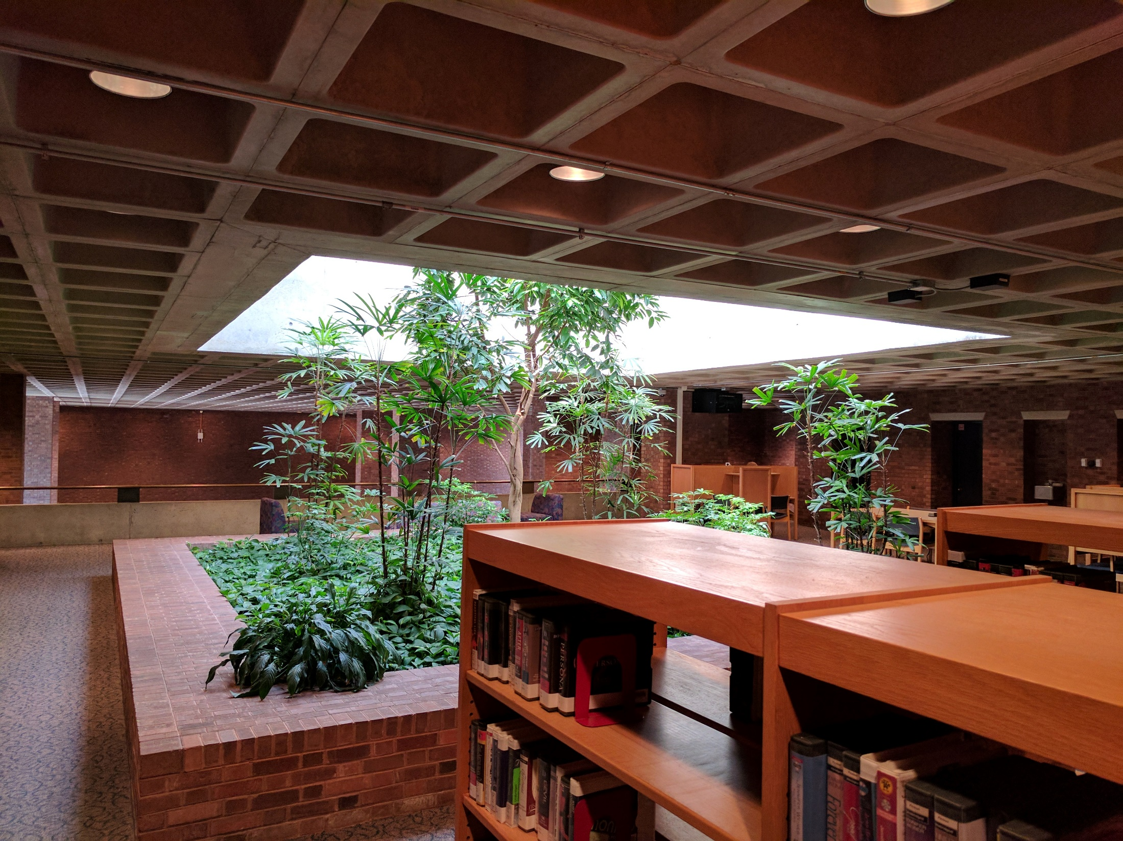
Thank you
Lorcan Dempsey
@LorcanD
OCLC

Slide 41
