Slide 1
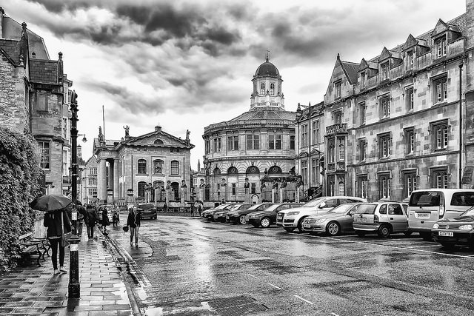
https://www.flickr.com/photos/ahnagi/17198299788
Looking at Libraries,
collections, & technology
Lorcan Dempsey,
OCLC Research
@LorcanD
Bodleian Libraries, University of Oxford, 16 June 2016
With contributions from Constance Malpas and Brian Lavoie
Notes:
The past has a monumental presence at Oxford

Slide 2
RLUK and Oxford
4
1
Collection environment
Technology reshapes practice; practice reshapes technology
The facilitated collection
2
5
Web sightings
Collections and service reconfiguration
Conclusion
3
6

Slide 3
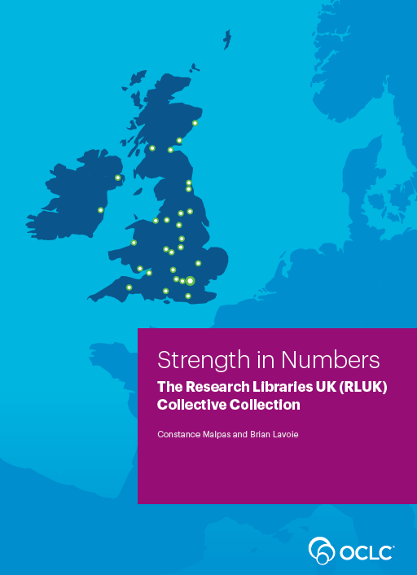

RLUK and Oxford
collections
Notes:
With RLUK, OCLC undertook a joint research project to examine the collective library holdings of RLUK libraries in WorldCat. The results of this project were published in a recent report exploring patterns within the aggregate holdings of RLUK libraries and comparing them to patterns we have examined in past research.
We were pleased to have Michael Williams (Head of Storage & Logistics at The Bodleian Libraries) as a member of the project advisory group.

Slide 4
“ … Some print book publications that appear scarce at group-scale—i.e., within the RLUK membership—may in fact exhibit much higher availability when evaluated at global scale …”
“… The age of the RLUK collective print book collection skews young, with … almost a third of the collection published since 1990. A significant portion of the collection (11%) originates from the pre-1850 period …”
Notes:
A few of a key findings from this research, which are consistent with patterns we have seen in other aggregate academic collections:
Scarcity is relative – while superficially unsurprising, this finding has important consequences for thinking about the scale at which cooperative preservation is optimally organized. In smaller groups, especially among research institutions, a long tail distribution (few copies of many titles) will mean that the opportunities to redistribute or balance stewardship obligations will be quite small.
A significant share of research library collections represents relatively recent publications, which will tend to be more widely duplicated within and outside the group. Fine-tuning cooperative management schemes around different segments of the collection can maximize potential space recovery while also shoring up preservation of historical collections. (It is worth noting that the RLUK collection appears “younger” in WorldCat than it actually is, since some RLUK libraries do not contribute bibliographic records or holdings for special collections.)

Slide 5
“… Comparison of the 20.9 million publications in the RLUK print book resource to the ARL collection yields an overlap of 8.8 million publications, amounting to 42% of the RLUK collection and 25% of the ARL collection …”
“… 13% of the print book publications in the RLUK collective collection is duplicated in HathiTrust …More than three-quarters of the RLUK print book titles duplicated in HathiTrust are in copyright or subject to other rights restriction …”
Notes:
Comparing the RLUK collection to the aggregate collection of the US Association of Research Libraries (ARL), we find an overlap of nearly 9 million titles, representing 42% of the RLUK collective print book collection. This is important, as it suggests that ARL and RLUK have a shared stake in the preservation of their respective collective collections.
Comparing the RLUK collective collection to a large repository of digitized library content (HathiTrust), we find an overlap of 13%. This figure is only slightly less than what we find for ARL libraries (15% duplication of titles in collective collection), which again suggests that the nature of collections in UK and US university research libraries has important similarities. It is important to recognize that while the title-level duplication rate between the RLUK collective collection and HathiTrust may seem quite small, the duplication rate for individual institutions is substantially higher (above 30% for some libraries). Further, as HathiTrust is now building a shared print collection, these figures give some idea of the potential value to UK libraries of a large-scale US print archive.

Slide 6
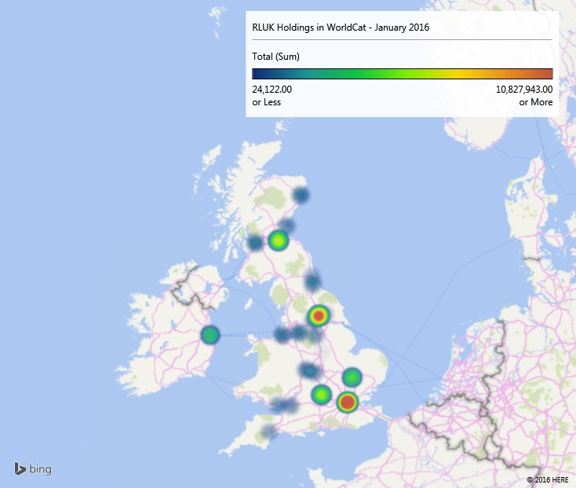
Visible concentration of library resource at Oxford
Notes:
This heatmap shows the geographic distribution of the RLUK collective collection and its concentration in a relatively small number locales.
Long history of collecting puts Oxford near the top of RLUK – only the British Library and National Library of Scotland have larger collections.
This distribution has important implications for the organization of shared print management and cooperative stewardship.

Slide 7
Bodleian Libraries in WorldCat
Collection profile in WorldCat is complicated:
Bodleian Libraries holdings are not differentiated by location or unit
Some special collections (archives, manuscripts, printed ephemera with non-MARC finding aids) are not represented
CJK and other vernacular script materials in local Allegro system are not yet included
Legal Deposit status means collection is broader than is typical for UK HEI; a benchmarking challenge
Notes:
Multiple Bodleian Library collections are represented by a single institutional symbol in WorldCat (EQO), so our ability to differentiate between resources managed in one unit or another within the Libraries is quite limited.
Materials in the “pre-1920” catalogue are not well represented due to complications with loading sparse, non-MARC data. Happily, progress is being made in this area and efforts are underway to bring more of the resources managed in databases outside the main LMS (e.g. the Allegro catalogue) into WorldCat.
A further complication is that Oxford’s legal deposit status means that the breadth of the collection is quite different from that of other university research libraries in the UK, simply for statutory reasons. This makes benchmarking something of a challenge.
Even so, it is possible to draw out some interesting perspectives on Bodleian collections…

Slide 8
Bodleian Libraries – Distinctive Strengths
Classics, civilizations of the Ancient World, Roman Britain
Greek inscriptions
Roman fortification
Anglo-Saxons
J.G. Milne (1867-1951)
R.M. Dawkins, R. M. (1871-1955)
John Boardman (1927-)
Cartography
Emanuel Bowen (1694?–1767)
Thomas Kitchin (1718–1784)
Carington Bowles (1724 1793)
John Cary (1754-1835)
Subjects and authors with deep ties to Oxford – scholars and keepers of collections
Engravers and printers who shaped Western understanding of world geography
A few among the many areas for which Bodleian Library holdings are second to none in global library system
Notes:
Listed here are a few of the individual subject headings and personal names for which the Bodleian Libraries holds more titles than any other library in WorldCat. The subject headings represent FAST headings (Faceted Application of Subject Terminology) derived from pre-coordinated LCSH headings. The personal names are VIAF (Virtual International Authority File) headings. To support a variety of research activities, OCLC programmatically enhances bibliographic records in WorldCat with FAST and VIAF identifiers. These identifiers support experimental analyses of subject and author strengths in WorldCat as a whole, as well as in individual libraries.
Here, we list some illustrative examples of subjects and names where Oxford’s holdings are particularly rich (larger, on a title-count basis, than any other library in WorldCat). When taken individually, these strengths might appear surprising or even baffling – yet, as can be seen, patterns emerge that align with the institutional history of the university and its libraries.
These examples were selected from among many others, because they do seem to reflect “authentic” Oxford strengths. In other instances, “strengths” or evidence of collection excellence that are revealed by this sort of analysis can be quite misleading. For instance, if an institution has applied a single subject heading to a very large volume of material (associating a donor name with a donated collection, for example), that name will appear especially prominent in the collection when compared to other institutions. In other words, as these analyses are based on cataloguing metadata, they sometimes reveal more about local cataloguing practices than institutional research or collecting interests.

Slide 9
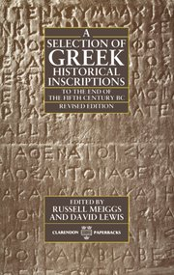
Top 15 most comprehensive collections:
Notes:
Having applied VIAF and FAST identifiers to as much of WorldCat as is possible, we can compare the breadth of institutional holdings as they compare to WorldCat as a whole. This provides an approximate view of institutional coverage, compared to the published record. In these analyses, we use FRBR worksets to consolidate individual titles. Thus for the FAST heading “Greek Inscriptions” we find a total of 4,311 work clusters in WorldCat.
For purposes of computing coverage, we compare institutional holdings to this baseline of ‘related works’ in WorldCat. As seen here, Oxford is shown to have the most comprehensive collection related to Greek Inscriptions. In practical terms, this means that Oxford holds at least one edition of about 1500 works related to Greek Inscriptions, representing about 34% of the related literature in WorldCat. (The actual title count at Oxford will be higher than this figure, as some works will be held in multiple editions.)
It is important to remember that these figures rely on cataloging decisions of individual libraries – another institution may have much broader holdings related to Greek Inscriptions, but if the descriptive catalogue doesn’t provide us with a hook enabling us to assign the FAST identifier, the strength of that collection in this subject area will be obscured. It is equally important to recognize that libraries do not need to be contributing bibliographic metadata with FAST headings to be represented in the analysis – they simply need to have contributed records, or set holdings on records, that contain LCSH or a name authority source that is represented in VIAF.

Slide 10
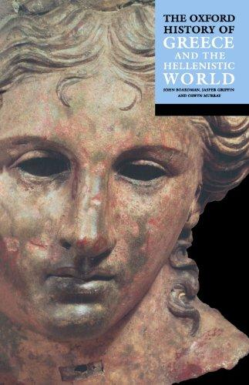
Top 15 most comprehensive collections:
Notes:
John Boardman (an Emeritus Professor of the University) is a prominent historian of Greek art who served for many years as a Keeper at the Ashmolean Museum. It is not particularly surprising to see that Oxford holds the most comprehensive collection related to Boardman, given his long association with the university.
We include this example not only as an illustration of Oxford’s distinctive strength, but also to show that the relatively flat distribution of his works at other major research institutions indicates that Boardman’s scholarship has apparently achieved the status of “core” literature – many research institutions hold approximately the same portion of (~17%) of the literature associated with Boardman. In some instances, a flat distribution of this kind is a good indicator that the literature is included in a widely-held microform series or e-resource collection.
A further observation to be made is that even the “most comprehensive” collection will very often fall short of covering 50% of the related literature – a useful reminder that even the world’s greatest university libraries cannot individually provide complete coverage of scientific and research literature, even in subject areas that are recognized to be part of the university brand.

Slide 11
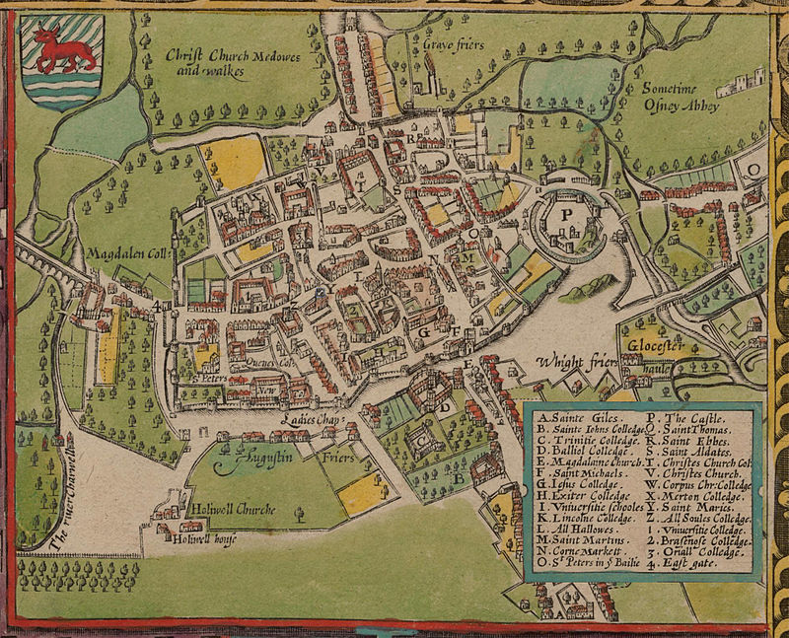
Name | Titles | Aggregate Library Holdings
Bayley, John, 1925-2015. | 33 | 3741
Wood, Anthony à, 1632-1695. | 198 | 3514
Hollinghurst, Alan. | 28 | 2658
Blake, Nicholas, 1904-1972. | 61 | 2515
Cobban, Alan B. | 10 | 2110
Newton, Richard, 1676-1753. | 50 | 1695
Carpenter, Humphrey. | 8 | 1689
Deslandes, Paul R., 1965- | 3 | 1612
Sanderson, Robert, 1587-1663. | 81 | 1511
Evans, G. R. (Gillian Rosemary) | 5 | 1491
Macgowan, John, 1726-1780. | 64 | 1480
Aydelotte, Frank, 1880-1956. | 23 | 1353
Batson, Judy G., 1943- | 2 | 1341
DePol, John, 1913-2004. | 8 | 1295
Morris, Willie. | 7 | 1294
Hawkins, William, 1722-1801 | 43 | 1243
Popplewell, Oliver. | 3 | 1235
Warton, Thomas, 1728-1790. | 50 | 1235
Fell, John, 1625-1686. | 45 | 1222
Names most frequently associated with Oxford University in global bibliographic record
John Speed's map of Oxford, 1605.
Bodleian Libraries.
Notes:
Map held in Bodleian Libraries. Sourced from Wikimedia as public domain image.
https://commons.wikimedia.org/wiki/File:John_Speed%27s_map_of_Oxford,_1605..jpg
These are the VIAF identities that occur most frequently with Oxford University (FAST subject) in WorldCat as of February 2016. They are presented here in rank order, based on aggregate library holdings of titles for which the given author and Oxford co-occur in bibliographic records.
They represent a combination of figures associated with the university as scholars and educators, alumni, and historians of the institution.
John Bayley, a long-time professor of English at Oxford an well-known literary critic, tops the list – he has published quite a lot and his works have found their way into thousands of libraries. The figures on this list relate only to those titles that have been catalogued as having some association with Oxford University.
At the bottom of this list, we see John Fell, Bishop of Oxford and a long-time administrator of the University. Fell had a prominent role at Oxford University Press and it is through this association that his works appear on this list – these are not necessarily representative of Fell’s own writings, but of the secondary literature on the history of the University and its press.
As can be readily seen, some of the names on this list are associated with Oxford by a very small number of titles. Judy Batson, for example, has produced two books related to the University – one is an annotated bibliography of Oxford in fiction, the other is a history of women’s education at Oxford. In combination, these titles have had a substantial impact, in terms of global library holdings.
Most of the names on this list will be widely known with a more or less obvious connection to Oxford:
Hollinghurst and Blake (pen name of Cecil Day-Lewis) are alumni who have written fiction in which Oxford has a role.
Cobban, Deslandes, Batson and Evans are authors of histories of Oxford.
Carpenter is a biographer of the Inklings as a group and as individual authors.
Popplewell famous for being among the oldest of mature students at Oxford (among other things) – wrote a popular memoir of his time there.
Three of names (Aydelotte, DePol and Morris) are Americans; Aydelotte and Morris were Rhodes scholars who maintained a connection with Oxford (or the concept of it) in their later careers. DePol was the illustrator of a book by Morris on his “Two Oxfords” (Oxford, UK and Oxford, Mississippi). Aydelotte was president of Swarthmore College. Morris is a prominent American author, editor and educator.

Slide 12
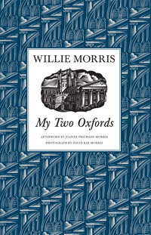
http://www.upress.state.ms.us/images/book-covers/9781604735703.jpg
Notes:
Included on the list of names most closely associated with Oxford University in global library collections is Willie Morris (1934-1999). Morris’ connection to the university is not very strong, historically speaking – he spent a few years at Oxford on a Rhodes scholarship. He is mostly known for his novels about the American South.
Morris was a writer-in-residence at the University of Mississippi, located in Oxford, Mississippi. The work shown here is a brief essay in which he compares and contrasts his experiences in the two Oxfords. It is a minor work, but it has been widely collected.
This example is especially noteworthy because the essay was originally published as part of an edited volume of writings. Under usual circumstances, the essay would not have been individually catalogued by libraries and would not have risen to the top in our data. However, because the University of Mississippi republished the essay to celebrate Morris’ contributions to “Ole Miss” (as the university is known), it has been acquired and catalogued by many libraries as a monographic work. Thus, Morris’ place on the list of ‘names most frequently associated with Oxford in library collections’ is largely an artifact of library cataloguing practices.

Slide 13
Technology reshapes practice; practice reshapes technology
Citation management
Institutional repository
2
Libraries, collections, technology

Slide 14
Citation management

Slide 15







So in a relatively short time, a solitary and manual function has evolved into a workflow enacted in a social and digital environment. In addition to functional value, this change has added network value, as individual users benefit from the community of use. People can make connections and find new work, and the network generates analytics which may be used for recommendations or scholarly metrics. In this way, for some people, citation management has evolved from being a single function in a broader workflow into a workflow manager, discovery engine, and social network.
Dempsey & Walter, 2014
http://crl.acrl.org/content/75/6/760.full.pdf+html

Slide 16
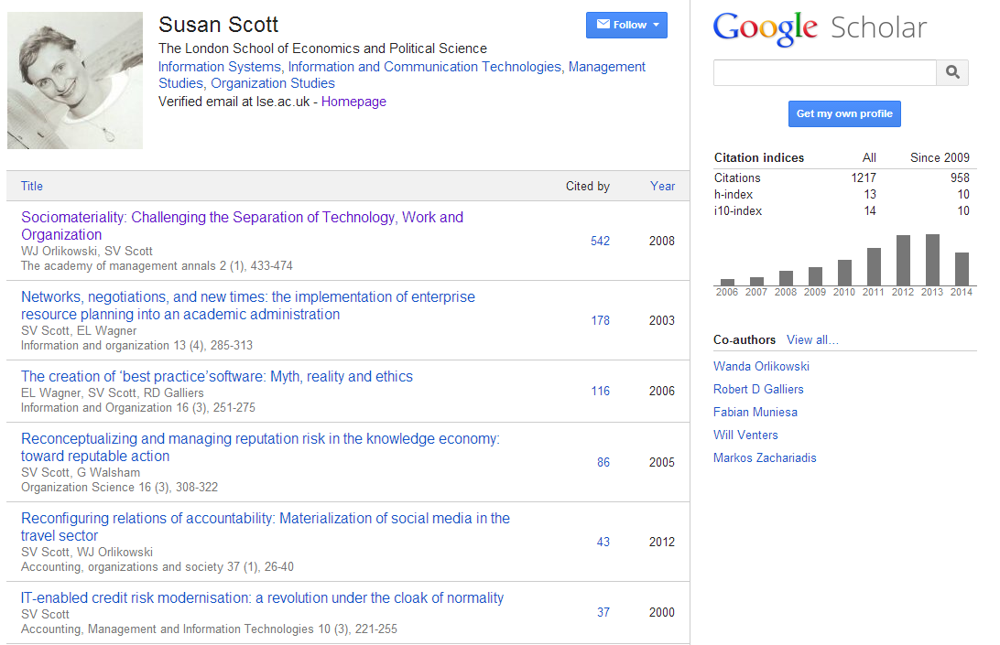
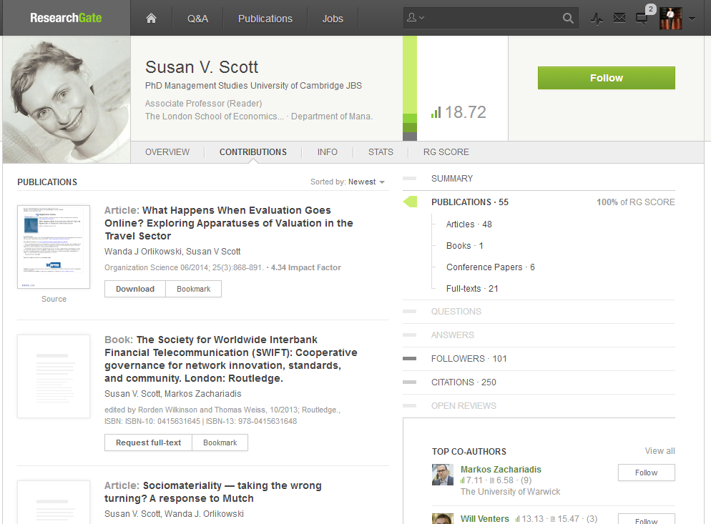
Identity > workflow > content

Slide 17
This:
Provide and promote reference manager
products.
And this:
Support – and help shape - emerging
practices around citation management,
research networking and profiles.

Slide 18
Institutional repository > workflow is the new content

Slide 19
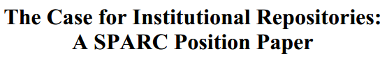






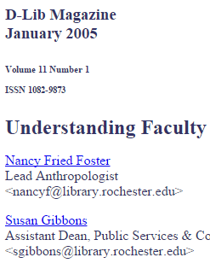


In a well-known article, Salo (2008) offers a variety of reasons as to why they have not been as heavily used as anticipated. These include a lack of attention to faculty incentives (‘prestige’) and to campus workflows. She concludes that IRs will not be successful unless developed as a part of “systematic, broad-based, well-supported data-stewardship, scholarly-communication, or digital-preservation program”.
http://minds.wisconsin.edu/handle/1793/22088
Providing technology as artifact >
Supporting emerging practices

Slide 20
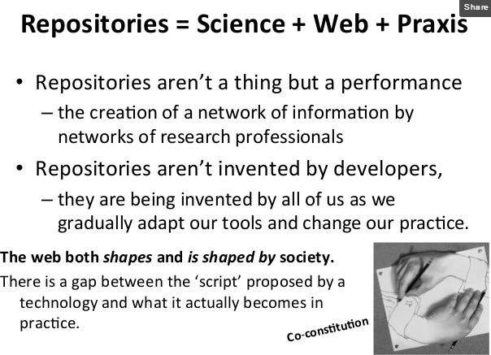
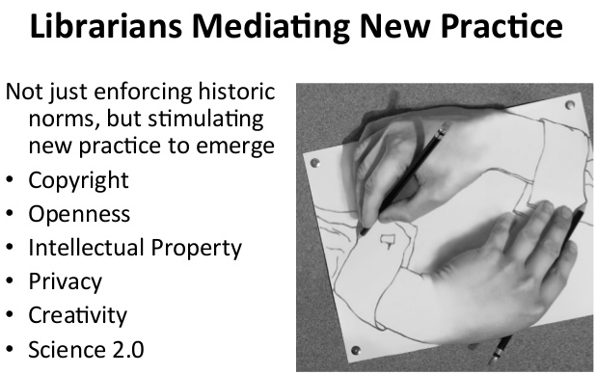
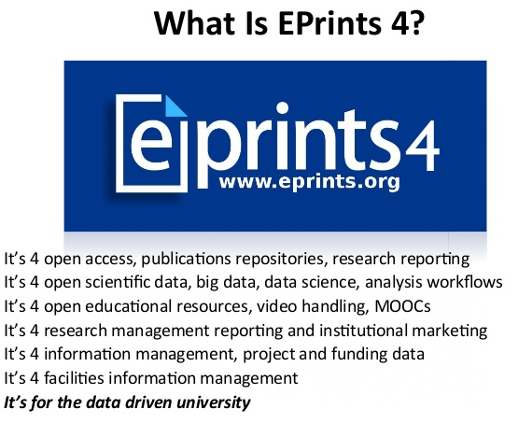
2
1
2
3
1
3
EPrints Update, Les Carr, University
of Southampton, Repository Fringe, 2014
http://www.slideshare.net/repofringe/e-prints42y

Slide 21
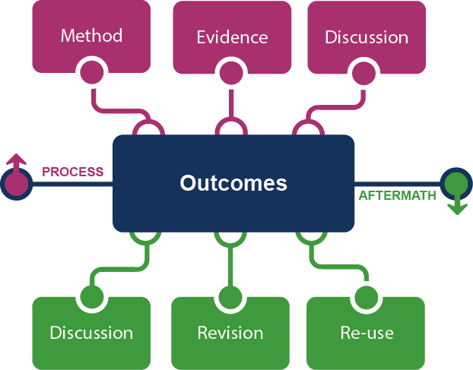
Framing the Scholarly Record …
Notes:
This is how we framed out the scholarly record in terms of nature and scope of what it might contain.
Start with published outcomes: the reporting of results, conclusions, ideas and so forth from a particular scholarly inquiry.
These outcomes are still the coin of the realm for scholarly activities, so they are privileged here at the center of the picture;
A lot of these outcomes take the form of text-based materials like books and journal articles, but often supplemented by additional materials such as video, graphics, and interactive programs.
Rest of scholarly record divided into two broad areas: process and aftermath
Process: process of scholarly inquiry; process by which outcomes are produced. Identified three categories of materials generated in this phase in which there is interest in including them as part of the scholarly record:
Method materials related to the methodology of scholarly inquiry (e.g., software, computer models, digital lab notebooks, sampling frames, experimental protocols, instrument calibrations)
Evidence raw materials/inputs to scholarly work (e.g., data sets, survey results, new or enhanced primary source documents, links to findings from other scholarly works);
Discussion refining and improving ideas, methods, conclusions (e.g., pre-prints, listserv/blog discussions, conference presentations, annotated commentary, grant proposals).
Anchoring outcomes directly to the methods employed, evidence used, and formative discussions conducted during the process of scholarly inquiry helps contextualize and deepen our understanding of these outcomes, facilitate replicability, and leverage results into new research.
Once the outcomes from a research project have been formally published or otherwise made available, scholarly activities surrounding that piece of work may still continue in the “aftermath” phase.
Activities in the aftermath phase may include Discussion (through similar channels as those in the process phase, but also post-publication formal reviews and commentary);
Revision published work can be revised in various ways (the work may be enhanced with additional findings; errors may be corrected or clarifications made, etc.)
Re-use (the work may be edited or re-packaged into new forms, such as conference presentations, summaries, blog posts, versions for the “popular media”, etc.).
Not saying that everything discussed here will end up in the scholarly record. But picture represents the maximal scope and depth of materials regarding which there is increasing interest in systematic collection and curation.
Note that some of the materials in the outlying components are becoming or might become outcomes in their own right. Data sets are a good example: in some disciplines the publication of an important data set is now considered a first-class scientific outcome.

Slide 22





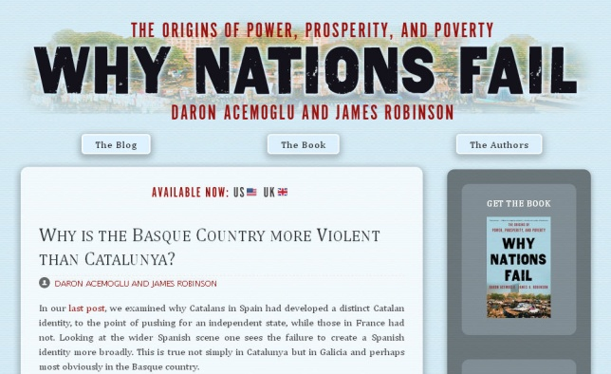



In practice …
Notes:
http://global.oup.com/uk/orc/busecon/economics/carlin/

Slide 23
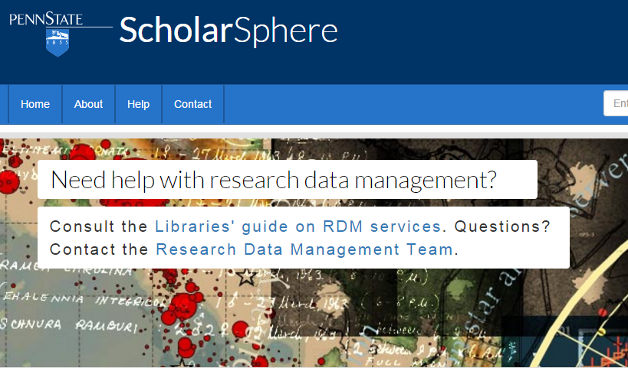
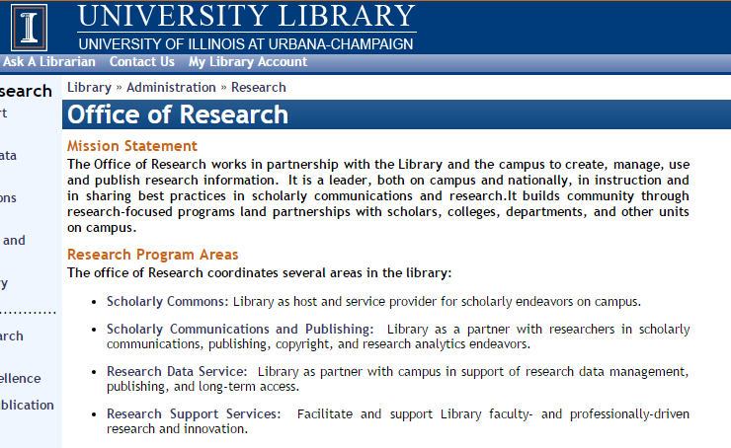
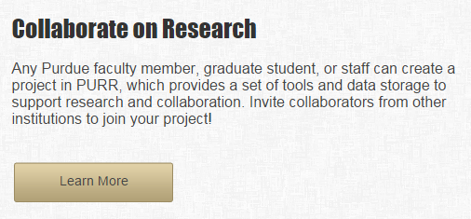
Institutional repository
Expertise profiling
Scholarly publishing
CRIS/Research information management
Research data management

Slide 24
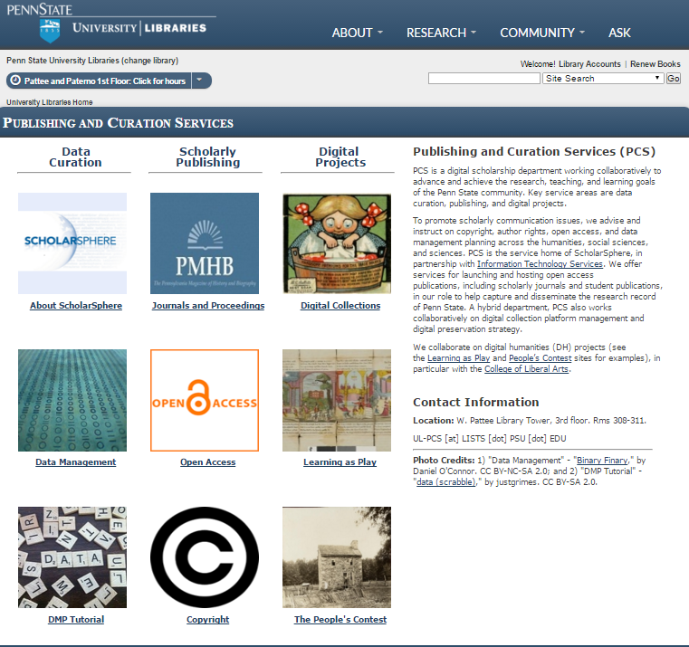

Slide 25
This:
Provide system to manage documentary research outputs.
And this:
Support - and help shape - emerging
practices around the complete research
life cycle.

Slide 26
Her view is that publishers are here to make the scientific research process more effective by helping them keep up to date, find colleagues, plan experiments, and then share their results. After they have published, the processes continues with gaining a reputation, obtaining funds, finding collaborators, and even finding a new job. What can we as publishers do to address some of scientists’ pain points?
A publisher’s new job description
Annette Thomas,
CEO of Macmillan
Publishers
(now Chief Scientific Officer
Springer Nature)
http://www.against-the-grain.com/2012/11/a-publishers-new-job-description/

Slide 27
Web sightings:
Collections in a new service configuration
3
Library, collections, technology

Slide 28
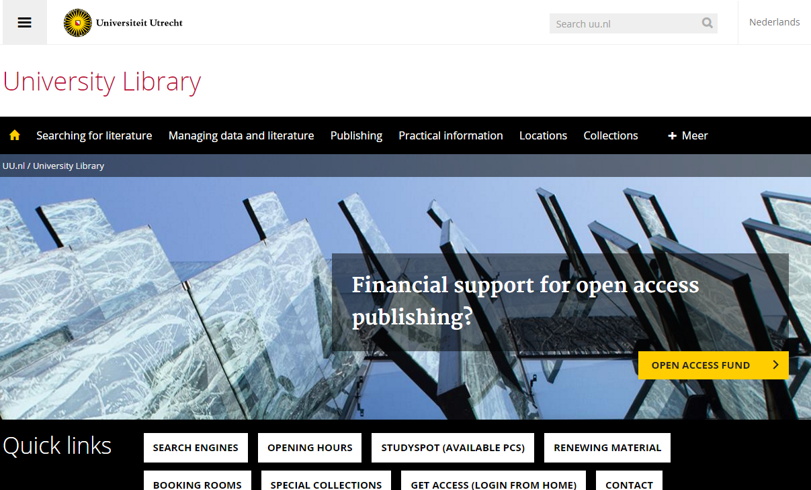
Discovery at network
level
Support for research/creation
Place
Local collections

Slide 29
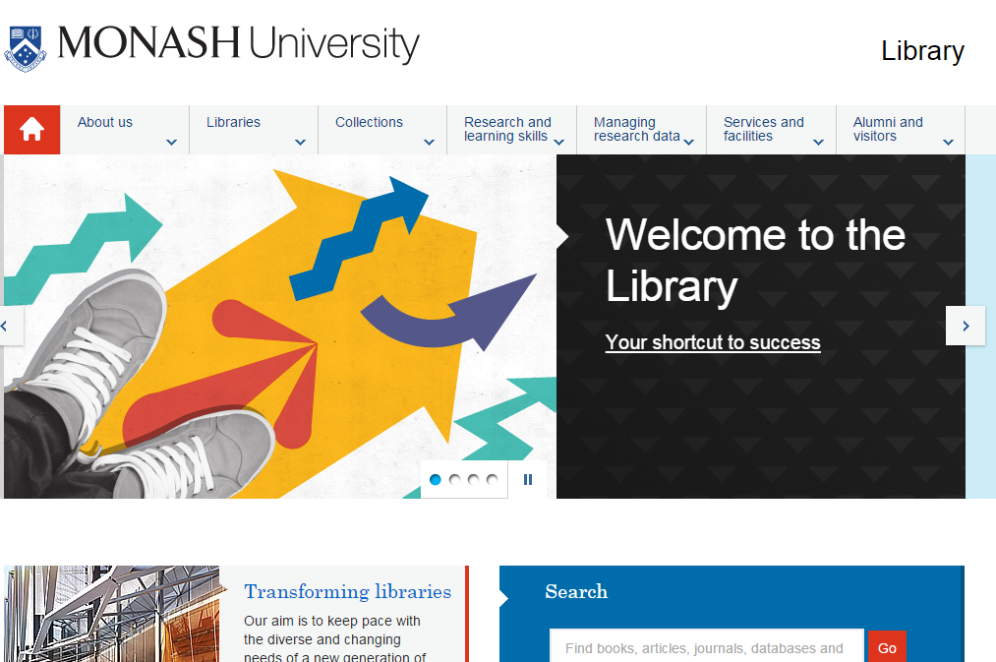
Place
Local collections
Student success
Support for research/creation

Slide 30
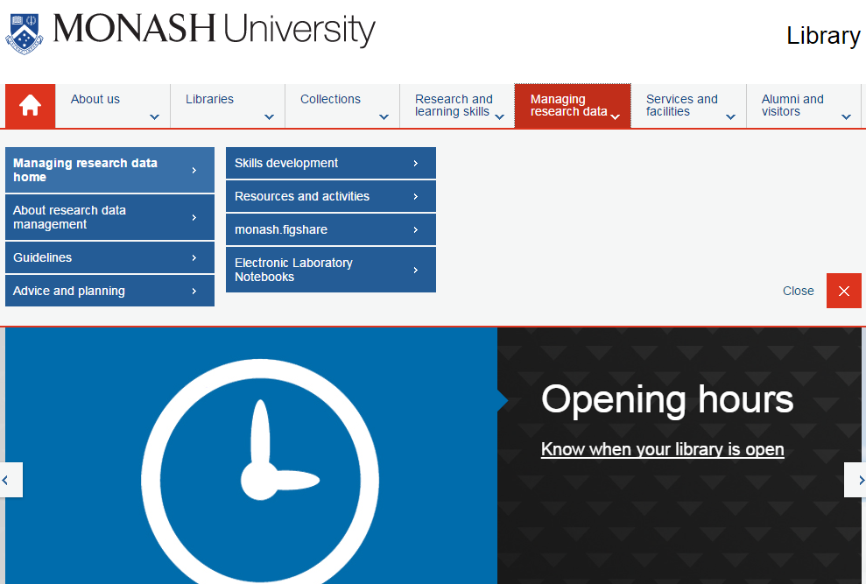

Slide 31
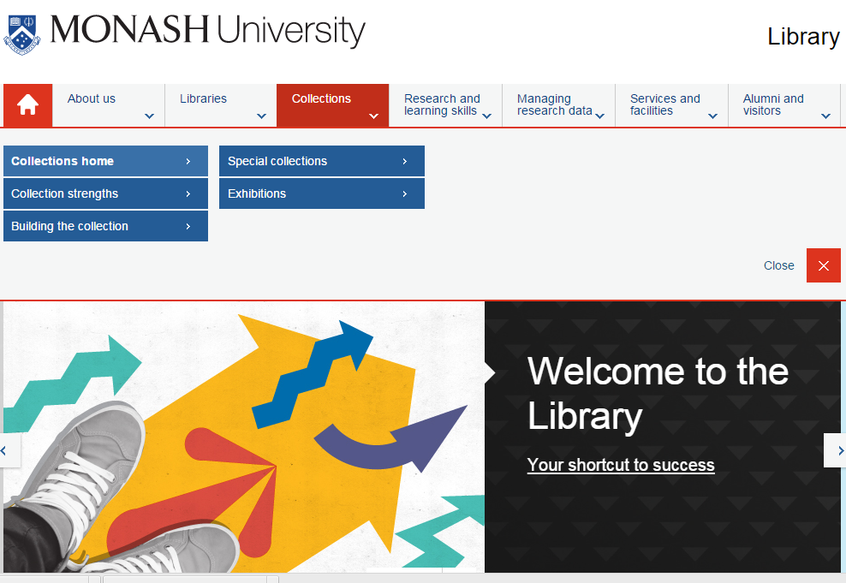

Slide 32
Collection environment
4
Libraries, collections, technology

Slide 33

1
The logic of print distribution influenced library development:
  Close to user – multiple library collections.
  Big = good.
  Just in case.

Slide 34
The bubble of growth in twentieth-century
printed collections has left … librarians
with a tricky problem.
Barbara Fister
New Roles for the Road Ahead:
Essays commissioned for ACRL’s 75th Birthday

Slide 35
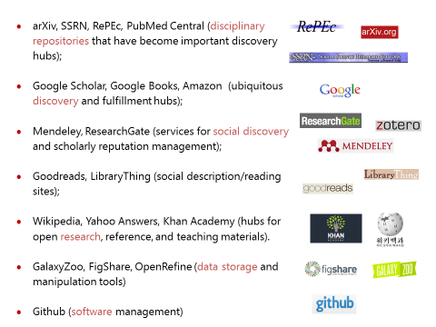
2
An abundance of resources in the network world

Slide 36
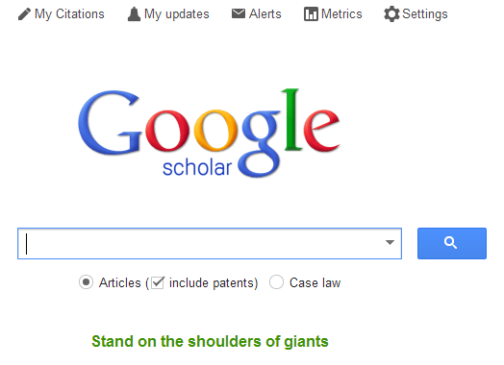



Discovery moved to the network level
  Peeled away from local collection
  “Discovery happens elsewhere”
  Discoverability very important (WorldCat syndication)
3

Slide 37

4
From consumption to creation:
  Support process as well as product, making as well as taking
  Workflow is the new content..
  Support for publishing and digital scholarship.
  An inside out perspective increasingly important.

Slide 38

A print logic
A network logic
http://www.xkcd.com/917/
The user in the life of the library
The library in the life of the user
Owned
Facilitated
Value relates to locally assembled collection.
Value relates to ability to efficiently meet a variety of research and learning needs.
Product
Process
Manage the products of research (books, articles, …)
Make the whole life cycle of process of research and learning more productive.
Outside in
Inside out

Slide 39
Towards the facilitated collection
5
Libraries, collections, technology

Slide 40
A print logic: the distribution of
print copies to multiple local
destinations
A network logic: a coordinated mix of local, external and collaborative services are assembled around user needs
A collections spectrum
The ‘owned’ collection
The ‘facilitated’ collection
Purchased and
physically stored
Meet research and
learning needs in best way

Slide 41
The ‘external’ collection:
Pointing researchers at Google Scholar;
Including freely available ebooks in the catalog;
Creating resource guides for web resources.
The ‘borrowed’ collection
The ‘shared print’ collection
The ‘shared digital’ collection
The evolving scholarly record
A collections spectrum
The ‘owned’ collection
The ‘licensed’ collection
The ‘demand-driven’ collection
The ‘facilitated’ collection
Purchased and
physically stored
Meet research and
learning needs in best way

Slide 42








Collaboration requires ‘conscious coordination’
Rightscaling – optimum scale?
The ‘borrowed’ collection
The ‘shared print’ collection
The ‘shared digital’ collection
The evolving scholarly record

Slide 43
Conclusion
6
Libraries, collections, technology

Slide 44
“Rather than constructing archipelagoes of isolated collections, increasingly libraries are seeking to create ecosystems of shared collections.”
Karla Strieb “Collaboration: The Master Key to Unlocking Twenty-First-Century Library Collections” in Shared Collections: Collaborative Stewardship (ALCTS, 2016)
Notes:
Network logic demands a new kind of collections assessment. Evaluating ecosystems becomes at least as important as analyzing local holdings.

Slide 45
The practices of research and learning are changing.
Research and learning outputs are diversifying.
Some emerging themes:
Creation and Curation
Libraries are supporting the process as well as the products of research.
Inside out
Management and disclosure of institutional materials.
Facilitated collection
Coordinated mix of local, external and collaborative services are assembled around user needs
Conscious coordination
The print and digital scholarly record needs conscious coordination at the network level.

Slide 46
@LorcanD
@ConstanceM
http://www.oclc.org/research

Slide 47
Credits
This presentation reflects ongoing shared work with our colleague Brian Lavoie. Thanks to our colleague JD Shipengrover for graphics.
The Evolving Scholarly Record
http://oclc.org/content/dam/research/publications/library/2014/oclcresearch-evolving-scholarly-record-2014.pdf
Understanding the Collective Collection
http://oclc.org/research/publications/library/2013/2013-09r.html
Collection Directions
http://www.oclc.org/content/dam/research/publications/library/2014/oclcresearch-collection-directions-preprint-2014.pdf
Stewardship of the Evolving Scholarly Record
http://www.oclc.org/research/publications/2015/oclcresearch-esr-stewardship-2015.html

