Slide 1


Towards collaboration at scale:
Libraries, the social and the technical
OCLC Asia Pacific Regional Council meeting,
RMIT University, Melbourne.
3-4 December 2015.
Lorcan Dempsey
@LorcanD
http://www.mfacade.com/wp-content/uploads/2013/08/DSC02547-Edited-Edited.jpg

Slide 2
The social and the technical

Slide 3


Cloud
Mobile
Social
Sensors/
collectors
Big data
Analytics
Processing/
storage capacity
Google!!
Interaction costs
Graph 1
Rapid growth in some things
Graph 2
Rapid decline in some other things

Slide 4
Uber
FaceBook (safe)
Square
Nest
Amazon: logistics and e-commerce
Walmart:
supply chain
Google:
machine learning
Target:
predictive analytics
Cataloguing and resource sharing
Electronic journals
Emerging network platforms – shared library systems, shared print, preservation, data, …

Slide 5
Technology as artifact
Technology as practice
Reshapes organizations, workflow and behavior
The technical reshapes the social –
the social reshapes the technical
I borrow artifact/practice terms from Wanda Orlikowski, 2000. Using Technology and Constituting Structures: A Practice Lens for Studying Technology in Organizations

Slide 6
Technology in practice: an example
Cell phone and mobility

Slide 7
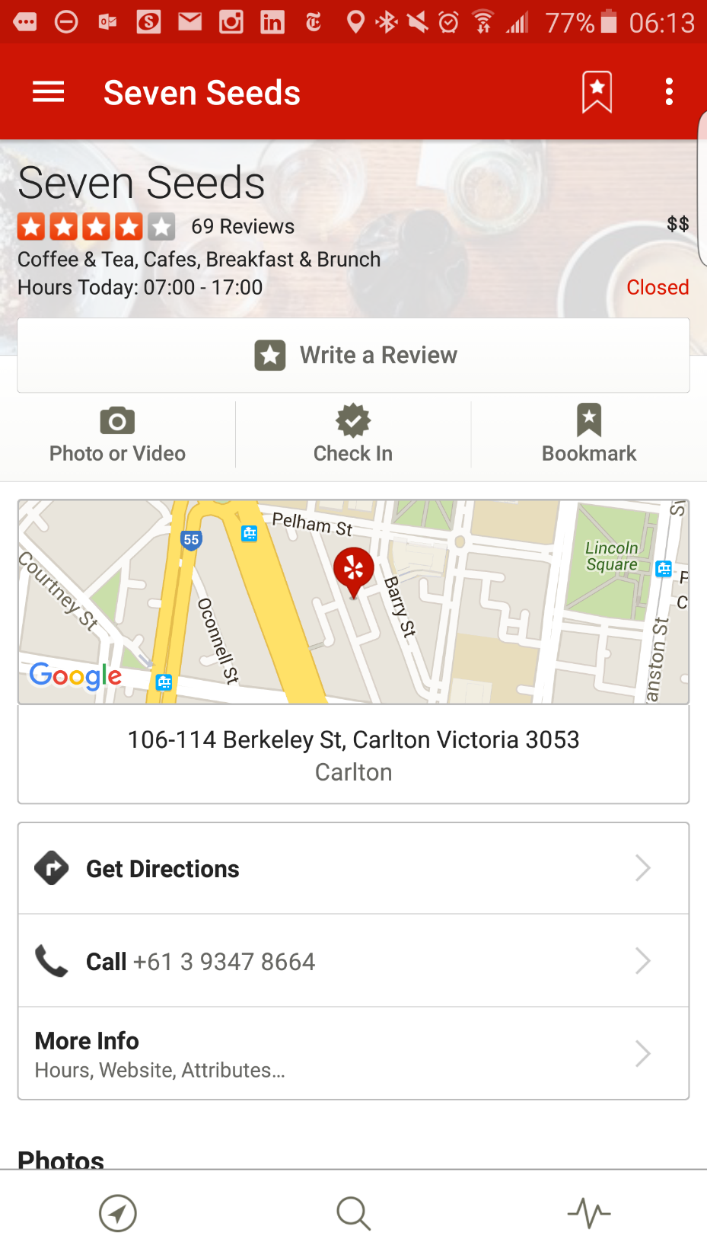
Cell phone
Ad hoc rendezvous
Micro-coordination
Location
Tying place and network.
Maps
Visual
Tying place, network and image

Slide 8
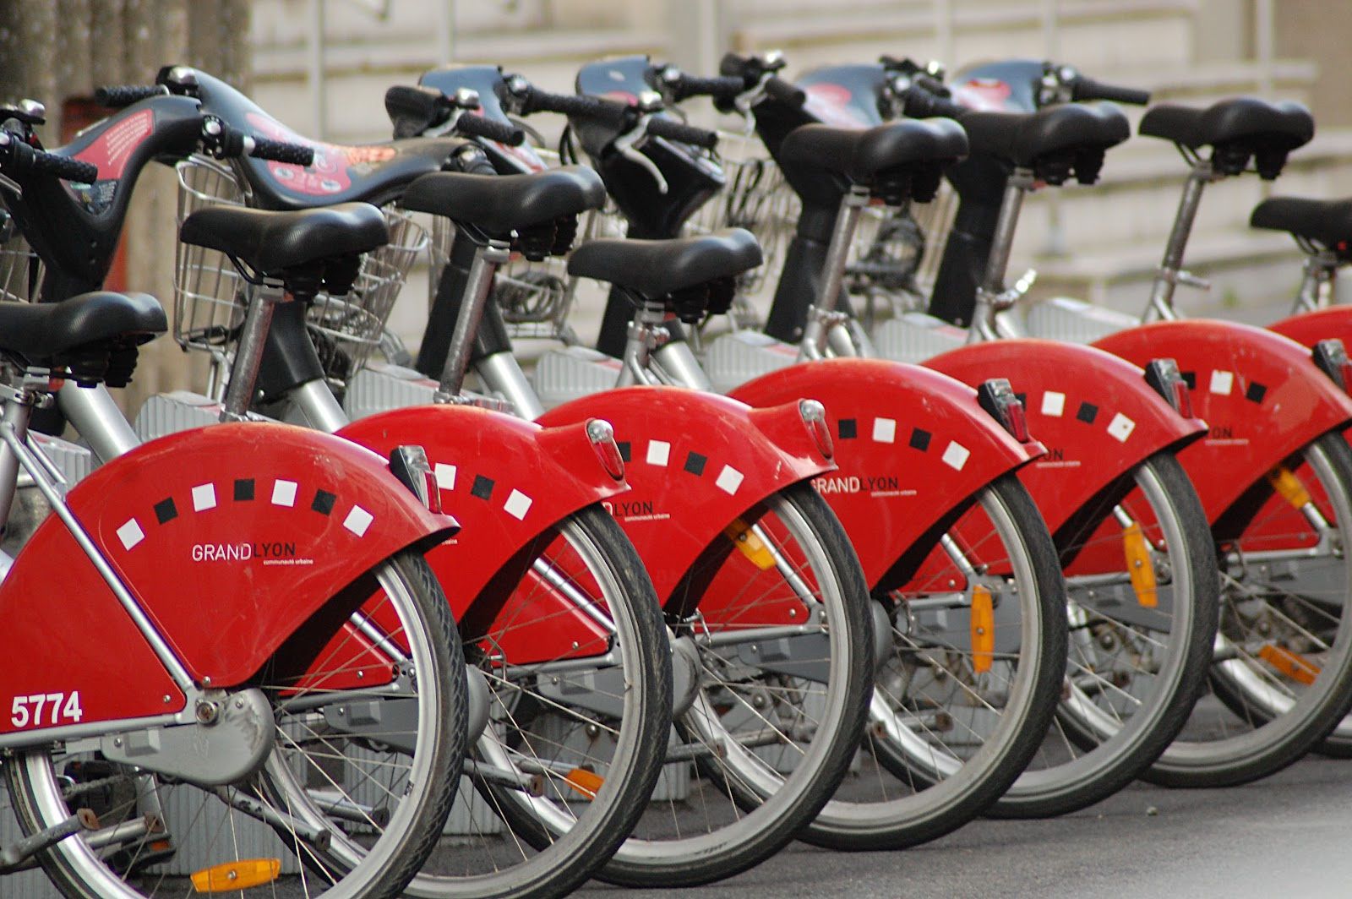
End of the car age: how cities are outgrowing the automobile
http://www.theguardian.com/cities/2015/apr/28/end-of-the-car-age-how-cities-outgrew-the-automobile
“Digital information is the fuel of mobility,” he says. “Some transport sociologists say that information about mobility is 50% of mobility. The car will become an accessory to the smartphone.”
http://peterblade.blogspot.com/2012/05/inauguration-du-showroom-peter-blade.html

Slide 9
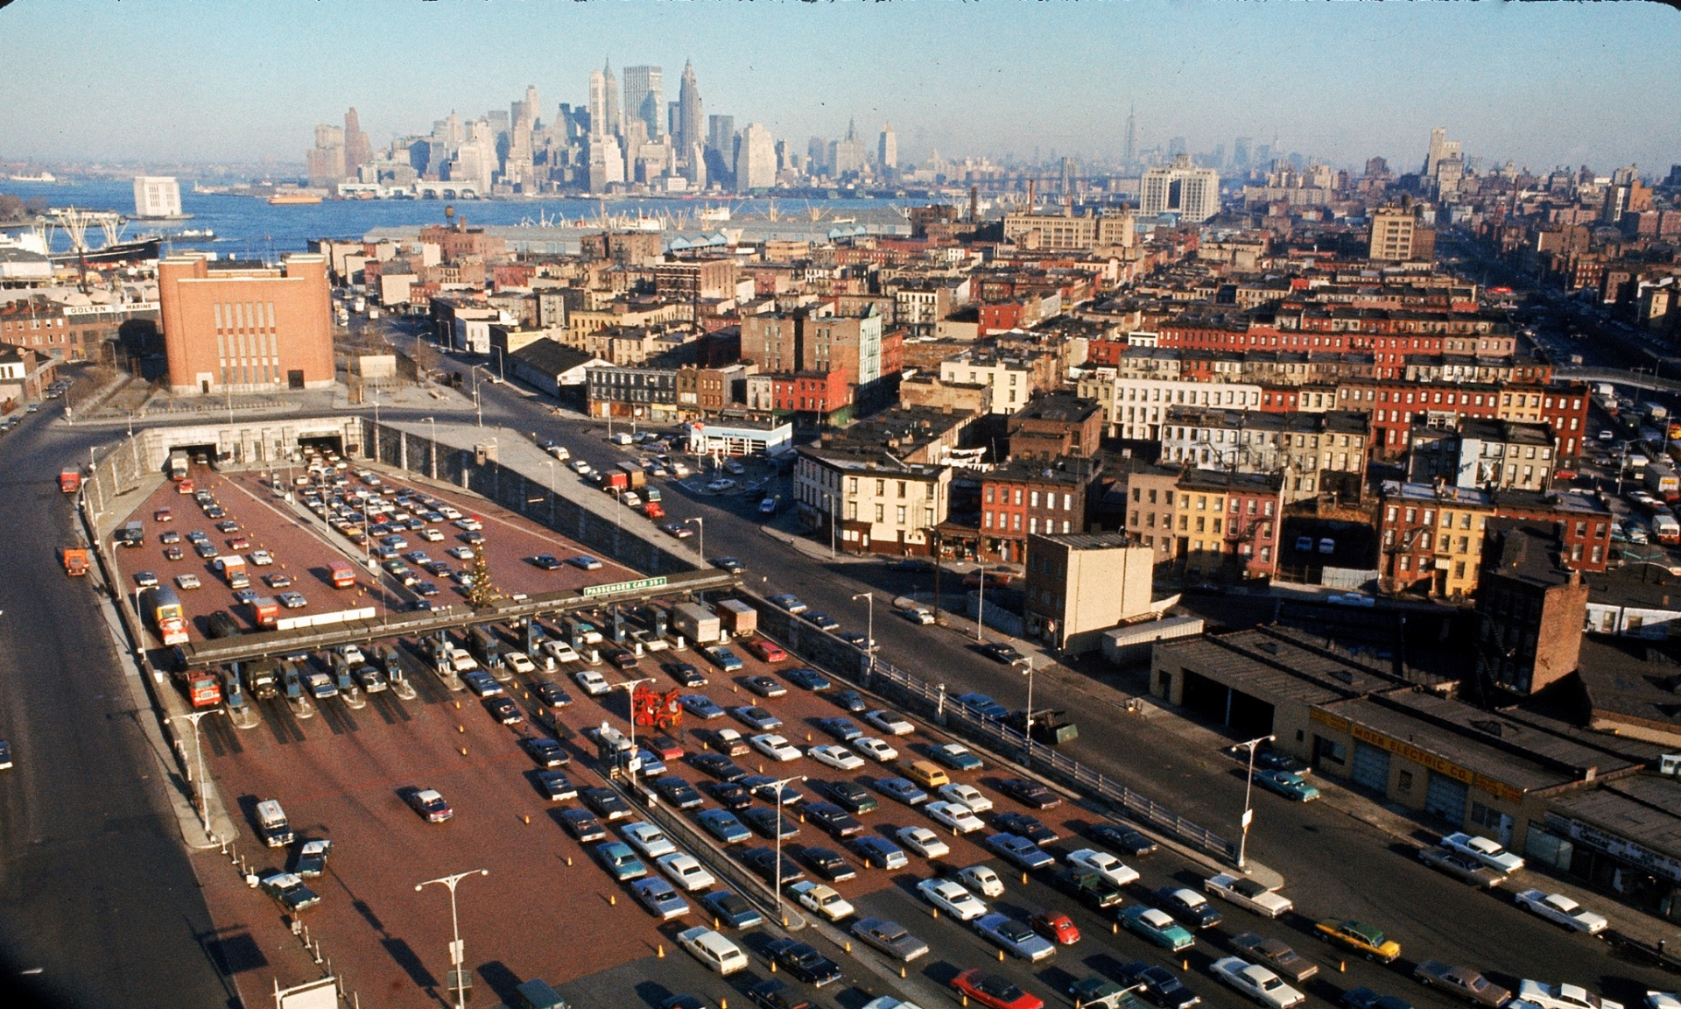
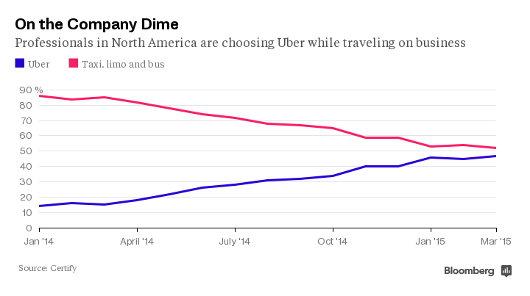
http://www.bloomberg.com/news/articles/2015-04-07/uber-is-winning-over-americans-expense-accounts
Mobility as a service
http://www.theguardian.com/cities/2015/apr/28/end-of-the-car-age-how-cities-outgrew-the-automobile

Slide 10
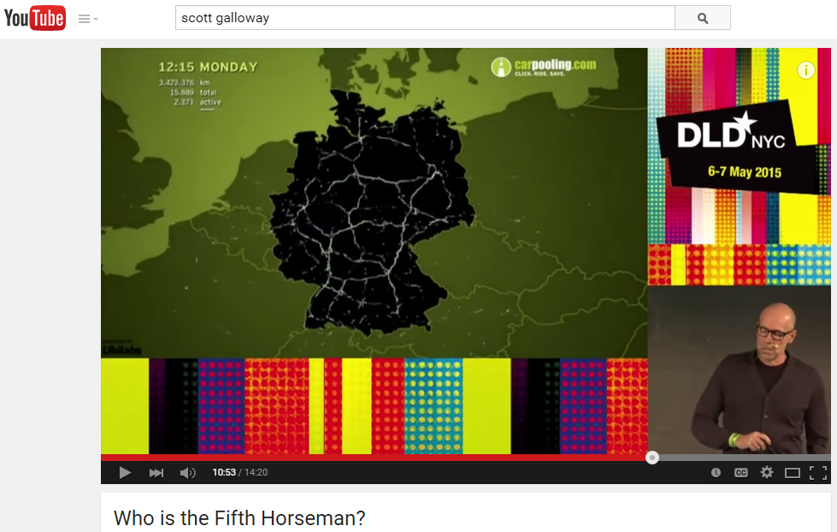
“Uber – has effectively become the vascular system for business …
or think of it this way: it is the broadband pipe for atoms.”
“Uber looks like a taxi business but really it's all about routing - it's trying to unbundle both car ownership and public transport and shift roads from circuit-switching to packet-switching.” B Evans.
http://us6.campaign-archive2.com/?u=b98e2de85f03865f1d38de74f&id=ac5933501b
“More and more, Uber is positioning itself as a logistics company. The goal is to deliver people and things within cities as quickly as possible — relying heavily on Google’s Maps in the process..”
NYT May 7 2015

Slide 11
Uber drivers— and other “on-demand” workers— have become increasingly vocal as the question the rights of these enterprises to operate outside of minimum wage laws, anti-discrimination statutes, workers’ compensation laws, and union-organizing rights. …
In a Wall Street Journal article about on-demand employment, One worker tells the WSJ, ‘We are not robots; we are not a remote control; we are individuals…”
Shoshana Zuboff on the sharing economy.
http://www.faz.net/aktuell/feuilleton/debatten/the-digital-debate/shoshana-zuboff-on-the-sharing-economy-13500770-p4.html

Slide 12
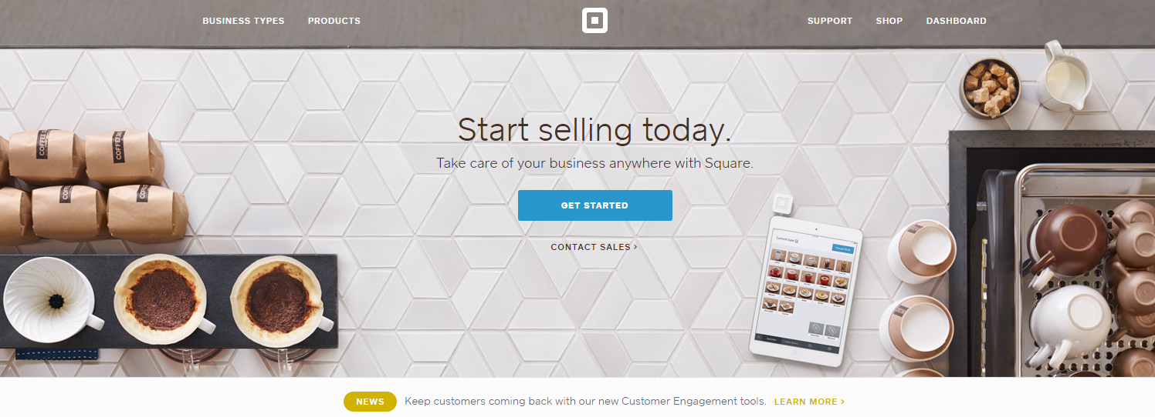
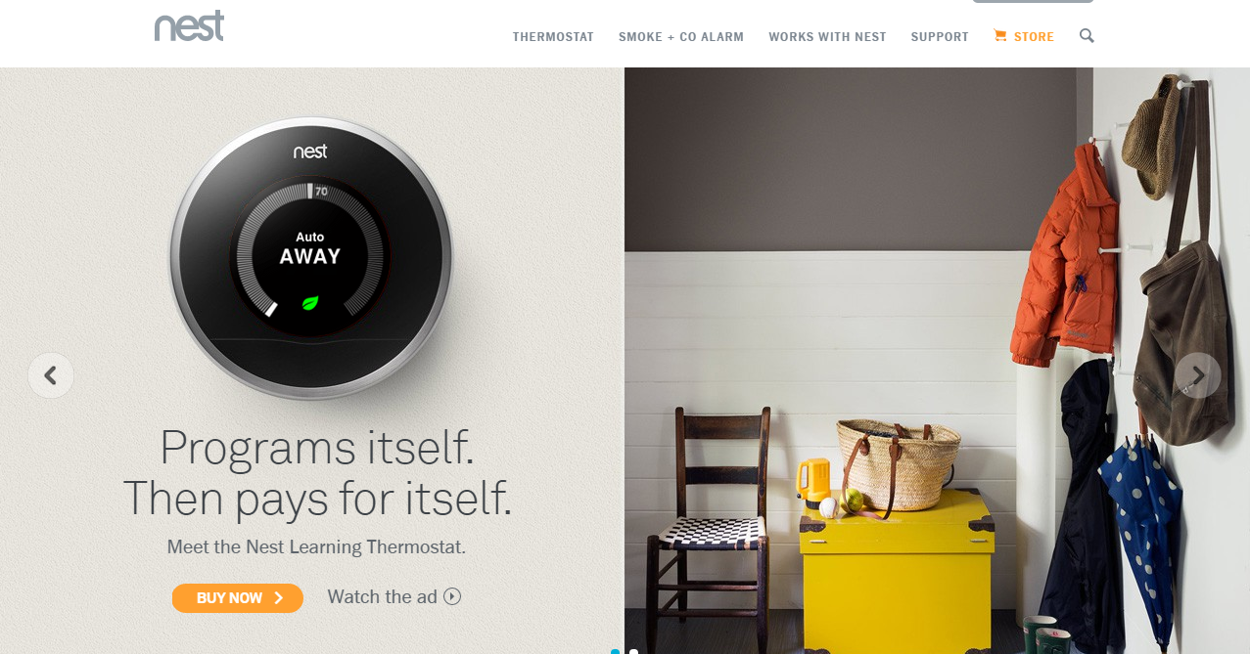
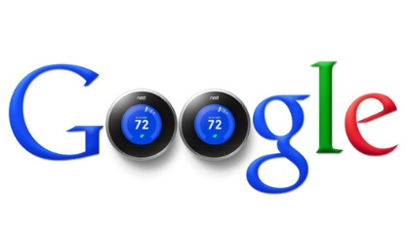
http://www.log.com.tr/google-akilli-ev-urunleri-firmasi-nesti-satin-aldi/

Slide 13
This:
A communication device.
And this:
Connecting identity, place and workflows
to reshape industries and behaviors.

Slide 14
3 library examples
Citation management
Institutional repository > workflow is the new content
The collections shift

Slide 15
Technology as practice
Reshaping behaviors/workflows
Citation management

Slide 16







So in a relatively short time, a solitary and manual function has evolved into a workflow enacted in a social and digital environment. In addition to functional value, this change has added network value, as individual users benefit from the community of use. People can make connections and find new work, and the network generates analytics which may be used for recommendations or scholarly metrics. In this way, for some people, citation management has evolved from being a single function in a broader workflow into a workflow manager, discovery engine, and social network.
Dempsey & Walter, 2014
http://crl.acrl.org/content/75/6/760.full.pdf+html

Slide 17
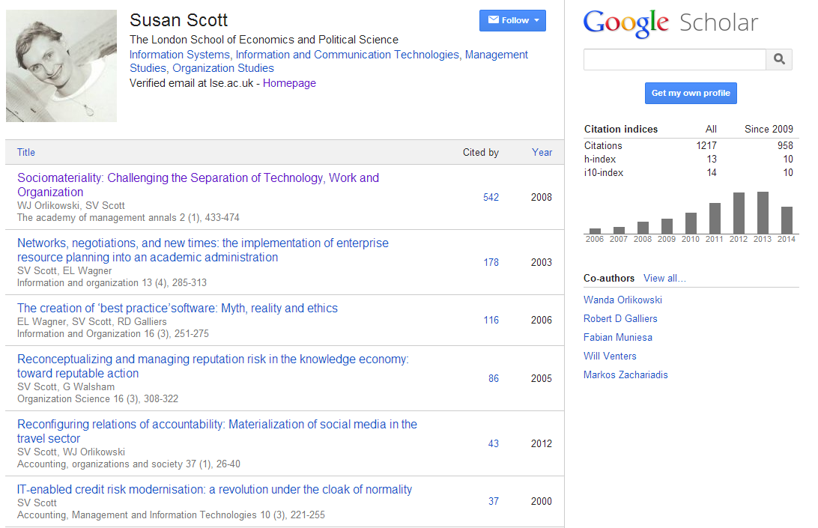
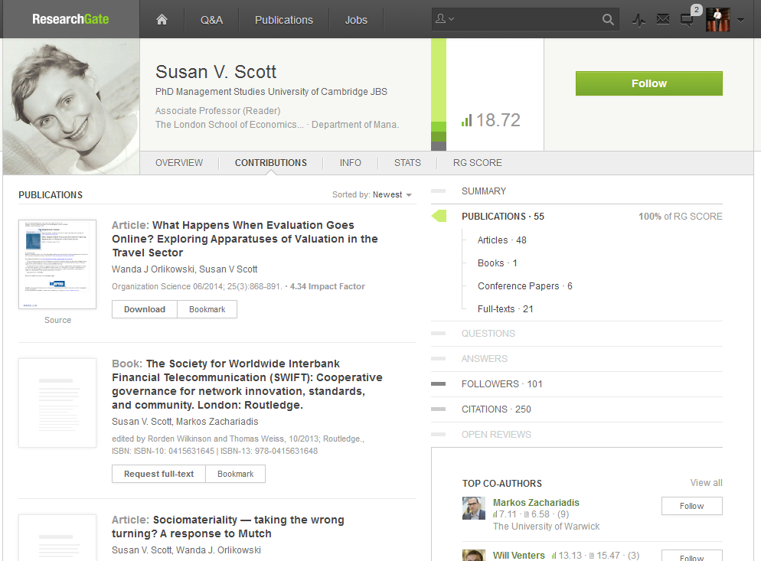
Identity > workflow > content

Slide 18
This:
Provide and promote reference manager
products.
And this:
Support – and help shape - emerging
practices around citation management,
research networking and profiles.

Slide 19
Technology as practice
Reshaping behaviors/workflows
Institutional repository > workflow is the new content

Slide 20
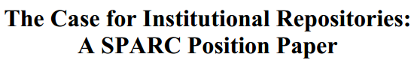






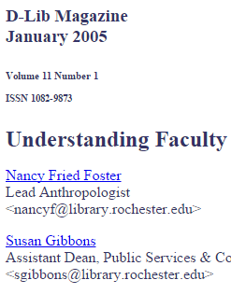


In a well-known article, Salo (2008) offers a variety of reasons as to why they have not been as heavily used as anticipated. These include a lack of attention to faculty incentives (‘prestige’) and to campus workflows. She concludes that IRs will not be successful unless developed as a part of “systematic, broad-based, well-supported data-stewardship, scholarly-communication, or digital-preservation program”.
http://minds.wisconsin.edu/handle/1793/22088
Providing technology as artifact >
Supporting emerging practices

Slide 21
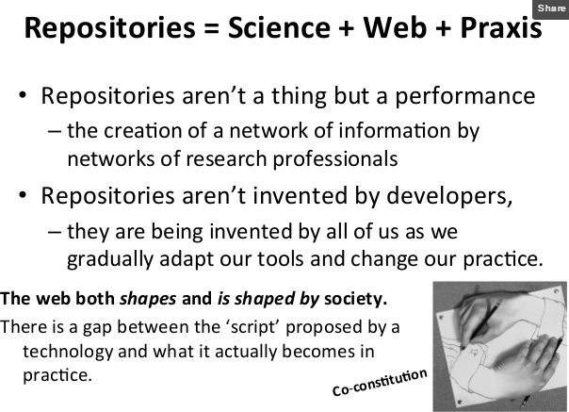
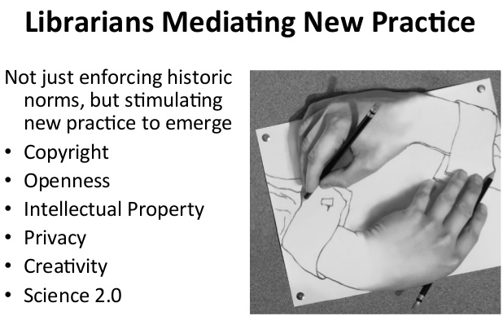
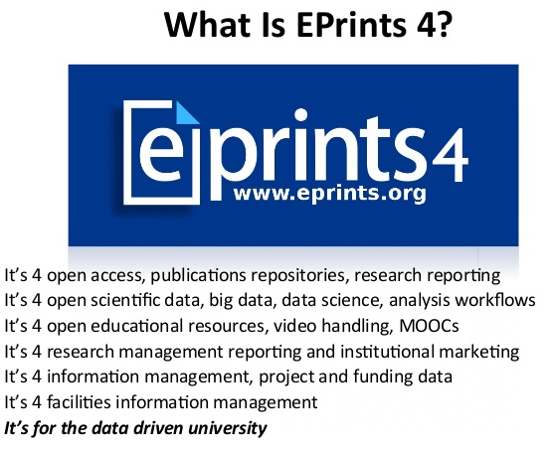
2
1
2
3
1
3
EPrints Update, Les Carr, University
of Southampton, Repository Fringe, 2014
http://www.slideshare.net/repofringe/e-prints42y

Slide 22
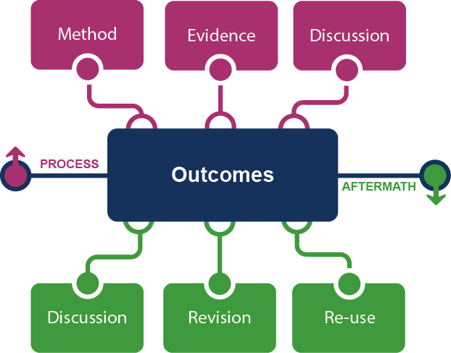
Framing the Scholarly Record …

Slide 23

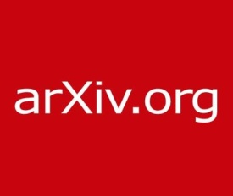



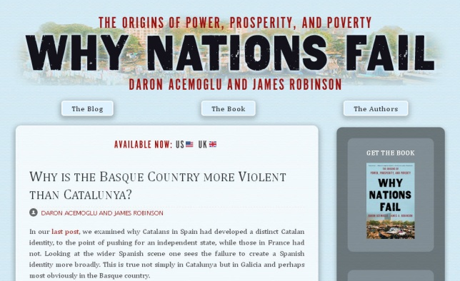



In practice …
Notes:
http://global.oup.com/uk/orc/busecon/economics/carlin/

Slide 24
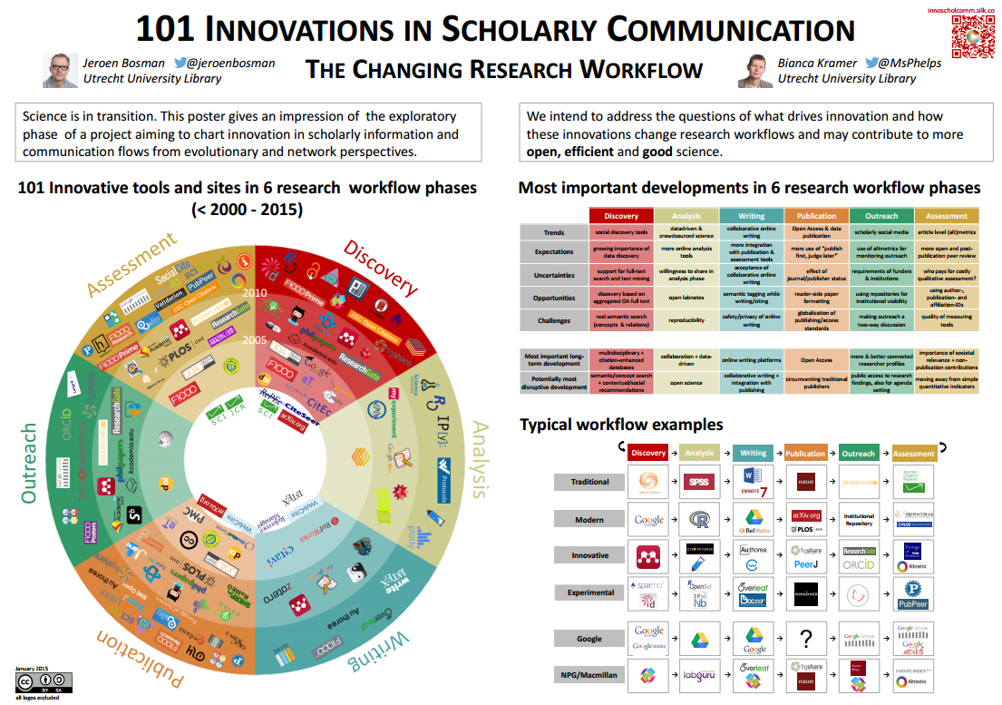

Slide 25
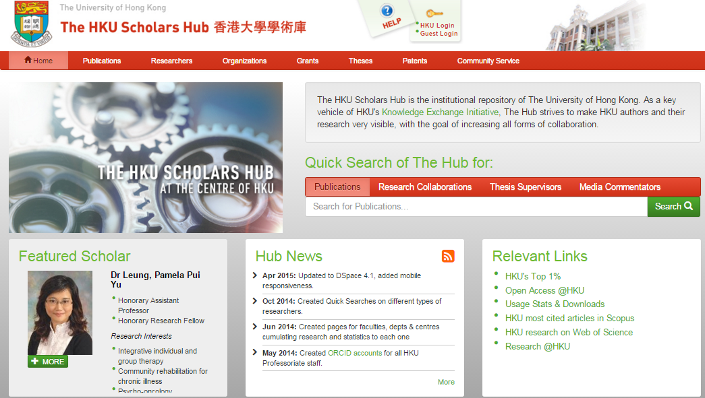


Slide 26
Her view is that publishers are here to make the scientific research process more effective by helping them keep up to date, find colleagues, plan experiments, and then share their results. After they have published, the processes continues with gaining a reputation, obtaining funds, finding collaborators, and even finding a new job. What can we as publishers do to address some of scientists’ pain points?
A publisher’s new job description
Annette Thomas,
(then) CEO of Macmillan
Publishers
http://www.against-the-grain.com/2012/11/a-publishers-new-job-description/

Slide 27
This:
Provide system to manage documentary research outputs.
And this:
Support - and help shape - emerging
practices around the complete research
life cycle.

Slide 28
Technology as practice
Reshaping behaviors/workflows
The collections shift – 4 contexts and towards the facilitated collection

Slide 29

1
The logic of print distribution influenced library development:
  Close to user – multiple library collections.
  Big = good.
  Just in case.

Slide 30
The bubble of growth in twentieth-century
printed collections has left … librarians
with a tricky problem.
Barbara Fister
New Roles for the Road Ahead:
Essays commissioned for ACRL’s 75th Birthday

Slide 31
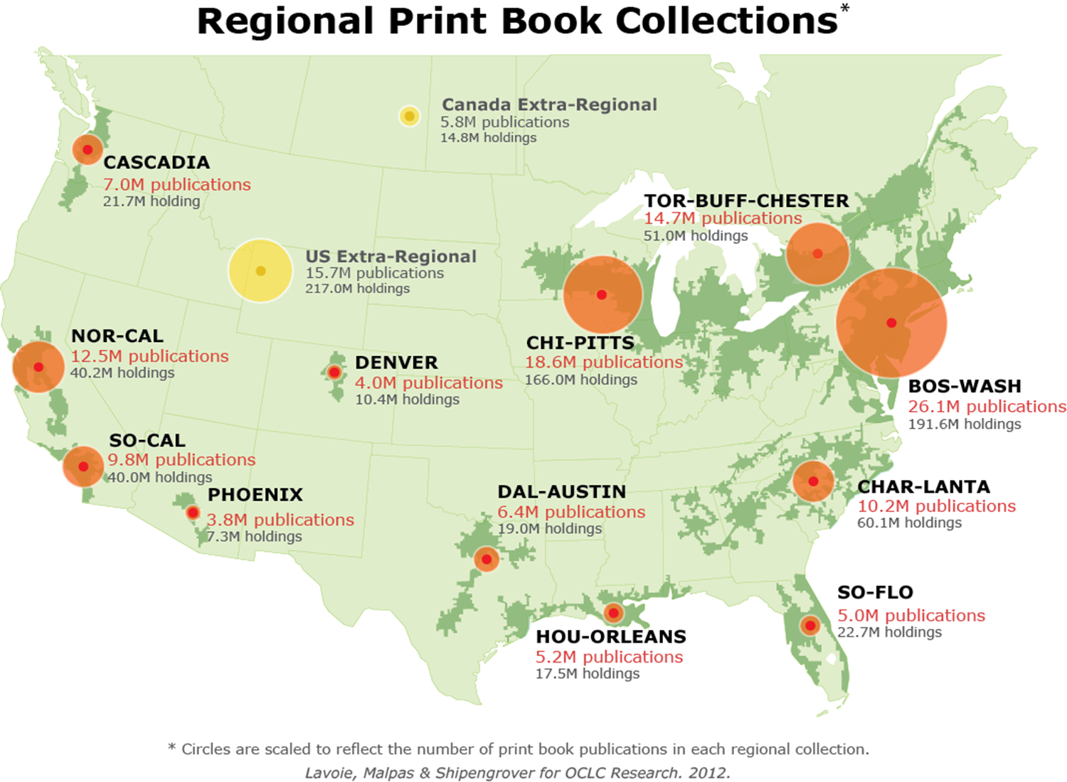

Strategic management of the collective print collection
  Managing down print.
  Emerging shared infrastructure and collective action.
  Space reconfigured around experiences rather than collections.

Slide 32
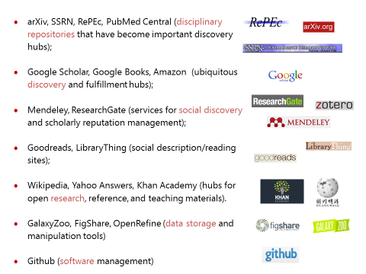
2
An abundance of resources in the network world

Slide 33
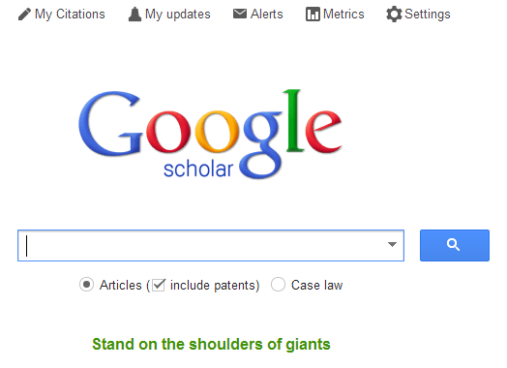



Discovery moved to the network level
  Peeled away from local collection
  “Discovery happens elsewhere”
  Discoverability very important (WorldCat syndication)
3

Slide 34

4
From consumption to creation:
  Support process as well as product, making as well as taking
  Workflow is the new content..
  Support for publishing and digital scholarship.
  An inside out perspective increasingly important.

Slide 35
Collections shift …
From owned/licensed to facilitated.
  Organized around user needs
  Curation is community oriented?

Slide 36
The ‘external’ collection:
Pointing researchers at Google Scholar;
Including freely available ebooks in the catalog;
Creating resource guides for web resources.
The ‘borrowed’ collection
The ‘shared print’ collection
The ‘shared digital’ collection
The evolving scholarly record
A collections spectrum
The ‘licensed’ collection
The ‘demand-driven’ collection
The ‘facilitated’ collection
The ‘owned’ collection
Purchased and
physically stored
Meet research and
learning needs in best way

Slide 37




Collaboration – requires ‘conscious coordination’
The ‘borrowed’ collection
The ‘shared print’ collection
The ‘shared digital’ collection
The evolving scholarly record
A collections spectrum
The ‘owned’ collection
The ‘facilitated’ collection
Purchased and
physically stored
Meet research and
learning needs in best way

Slide 38
This:
Print logic: distributed library model.
And this:
Network logic: coordination of external and
collaborative services around user needs.

Slide 39
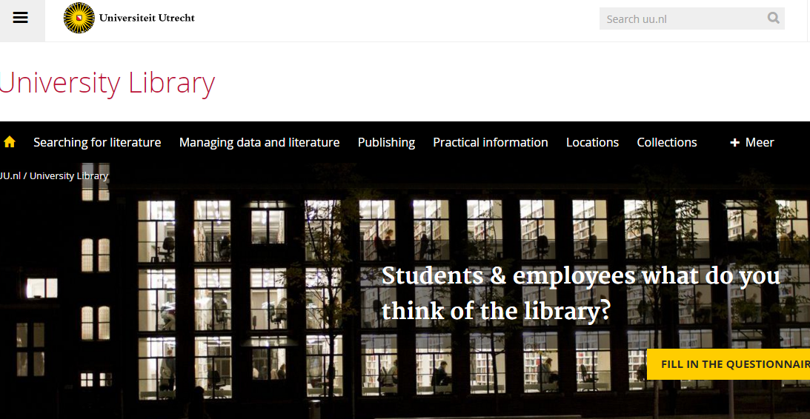
Discovery at network
level
Support for research/creation
Place
Local collections

Slide 40
The new context of collaboration
The institution
The user
Systemwide

Slide 41
1. Institutional Convergence, boundaries, cooperation
IT and Library
‘Digital’
Older model of integration: Integration around artifact: IT and Library organization. Common in the UK and some other sectors in 90s.
A new model of integration: Integrate around practices?
Shared support for data management, research and learning workflows, ..
Research
and learning
workflow,
Data
Learning management,
Library, research support office, Press, ….
Network,
Compute,
Storage,
Security
Notes:
In the UK in the 80s and 90s it was common for Libraries and IT to merge. At one stage over 50% of universities had this model. It was also adopted elsewhere. This belongs to an earlier stage, when it was thought possible to isolate technology-as-artifact – all the ‘digital’ stuff was being put together.
As the digital has become more pervasive I had thought we would see a differently structured integration emerge, where the ‘infrastructure’ was managed by one group (network, compute, storage, security, …), and research and learning workflows were managed in a more integrated way in some new organizational contexts. For example, think about learning management, research support, data curation, university press, and so on.
In practice we have not see this happened widely. It will be interesting to see how services do emerge to meet the needs of research and learning behaviors increasingly enacted in data-rich, network environments.

Slide 42
2. Deeper engagement with research and learning behaviors of library users – a partner in knowledge creation.
Our traditional model was one in which we thought of the user in the life of the library
… but we are now increasingly thinking about the library in the life of the user as they enact new research and learning practices.

Slide 43








3. Conscious coordination – collaboration at scale
- rightscaling?
The ‘borrowed’ collection
The ‘shared print’ collection
The ‘shared digital’ collection
The evolving scholarly record

Slide 44
So …

Slide 45
This:
Manage systems and services to support
research and learning.
And this:
Support – and help shape - knowledge
creation and sharing practices
in data-rich network environments.

Slide 46

Collaboration at scale
A shared data network that connects people to knowledge through the world’s libraries and their collections.
A platform for library services that enables libraries to share data, work and resources to save money and deliver value to their users.

