Slide 1
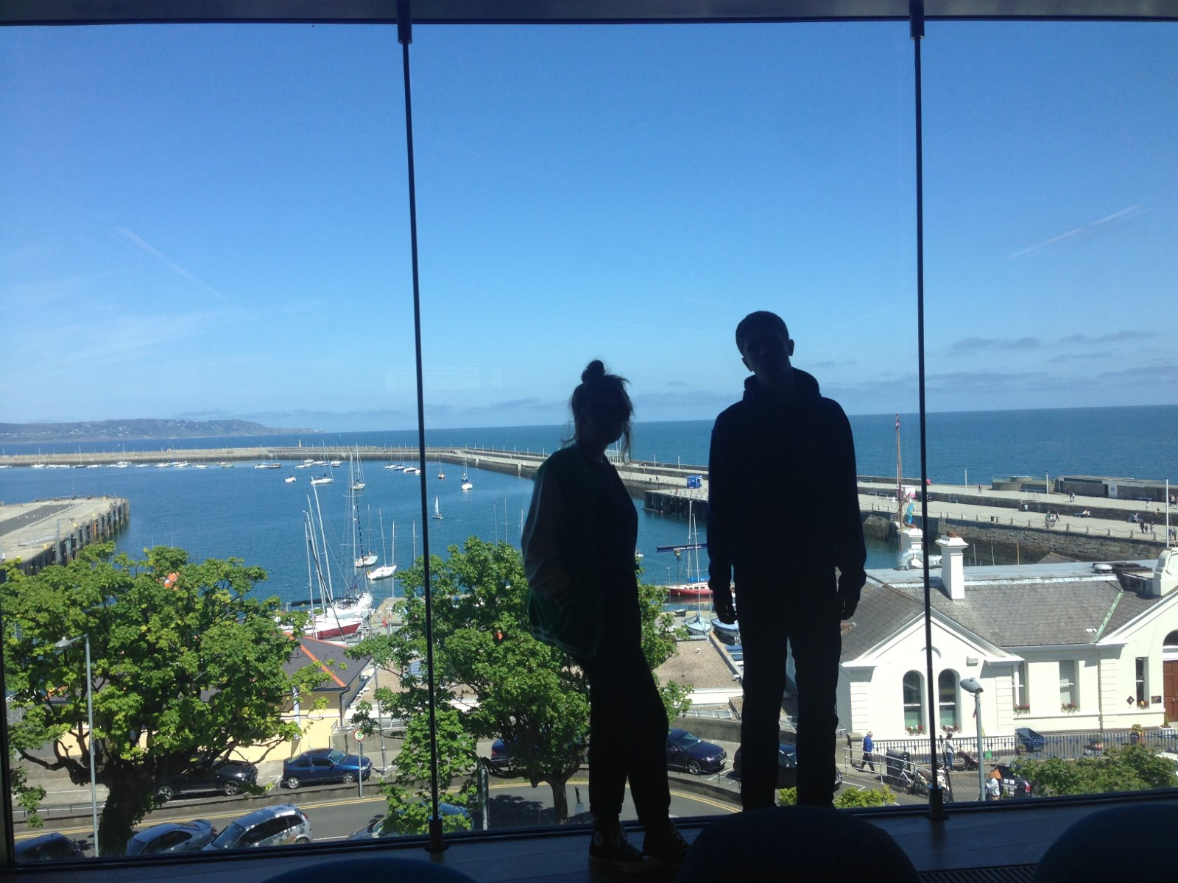
@LorcanD
Lorcan Dempsey, OCLC
Irish Studies: making library data work harder
American Conference for Irish Studies. University of Notre Dame, 1 April 2016

Slide 2
Making data work harder
Distant reading – a short interlude
Mapping the collective Irish Studies collection

Slide 3
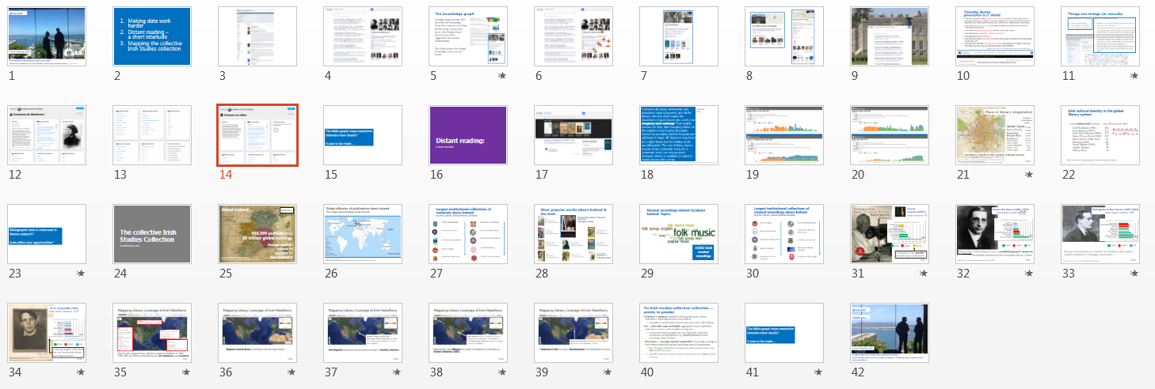
Overview …

Slide 4
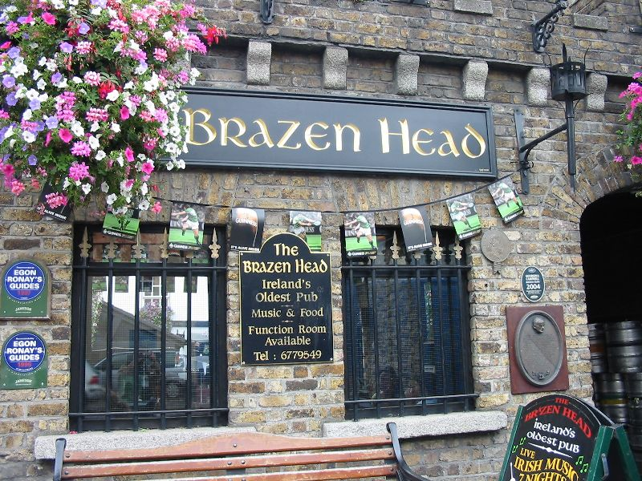
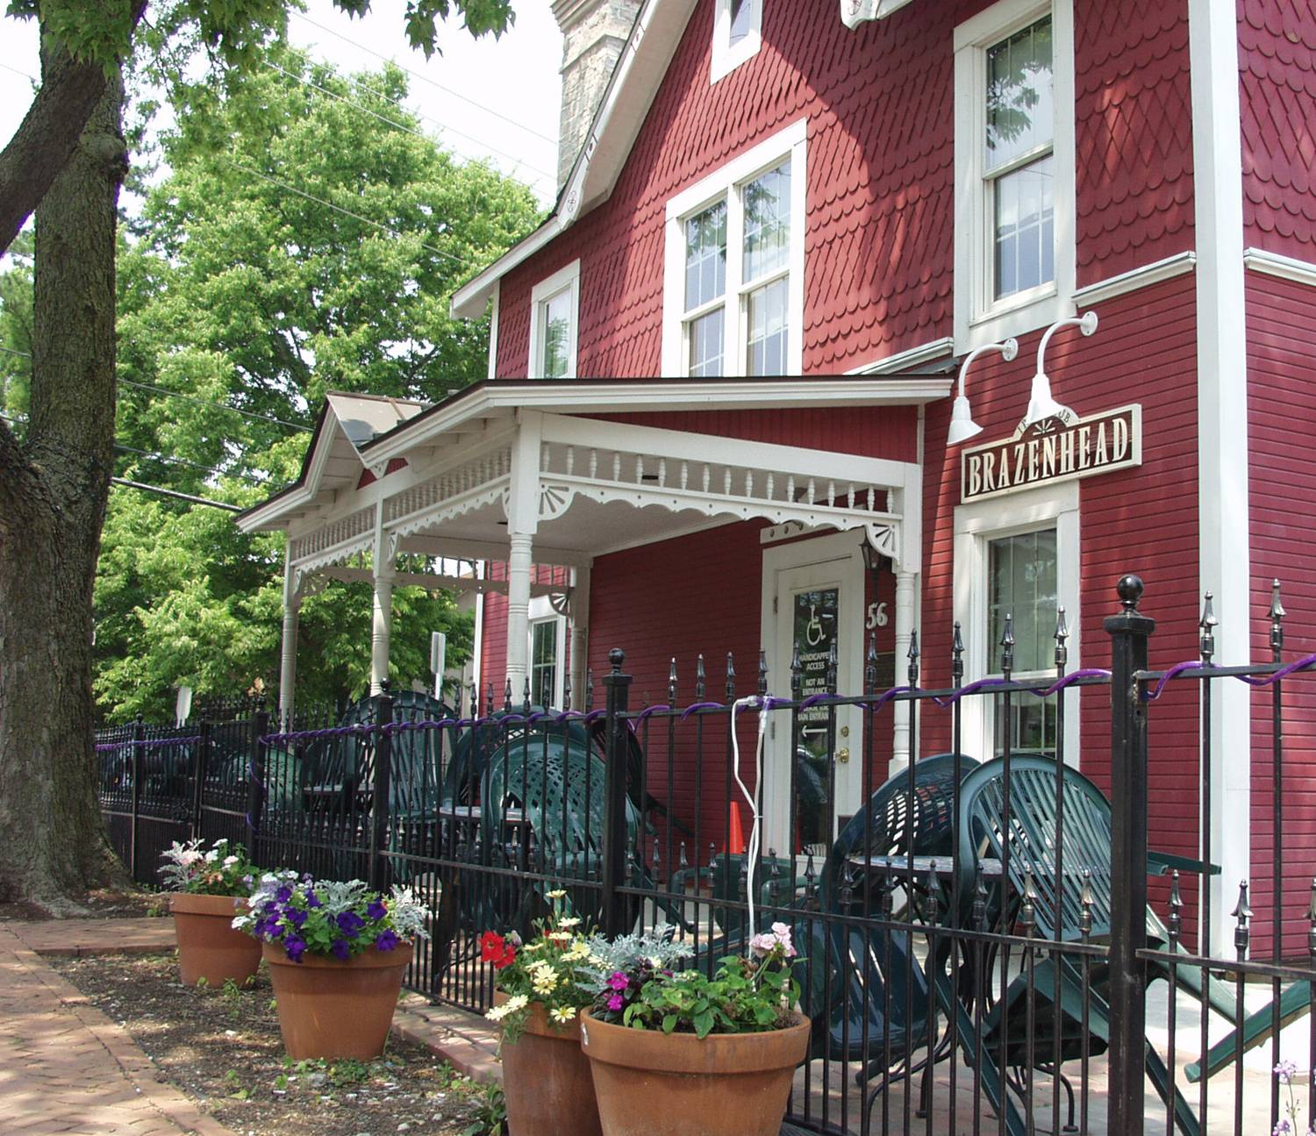
Dublin Public Libraries
Notes:
Top – James Joyce Library, University College Dublin. I noted that I graduated with a degree in English Language and Literature from UCD.
Bottom – the Brazen Head (left) is the oldest pub in Dublin Ireland. This has inspired the Brazen Head (right) in Dublin, Ohio, where OCLC HQ is.

Slide 5
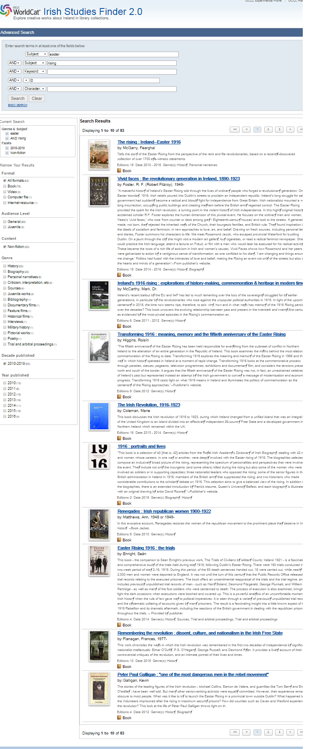
Notes:
Finders are experimental work-based systems developed by OCLC Research. This shows works ranked by library holdings.

Slide 6
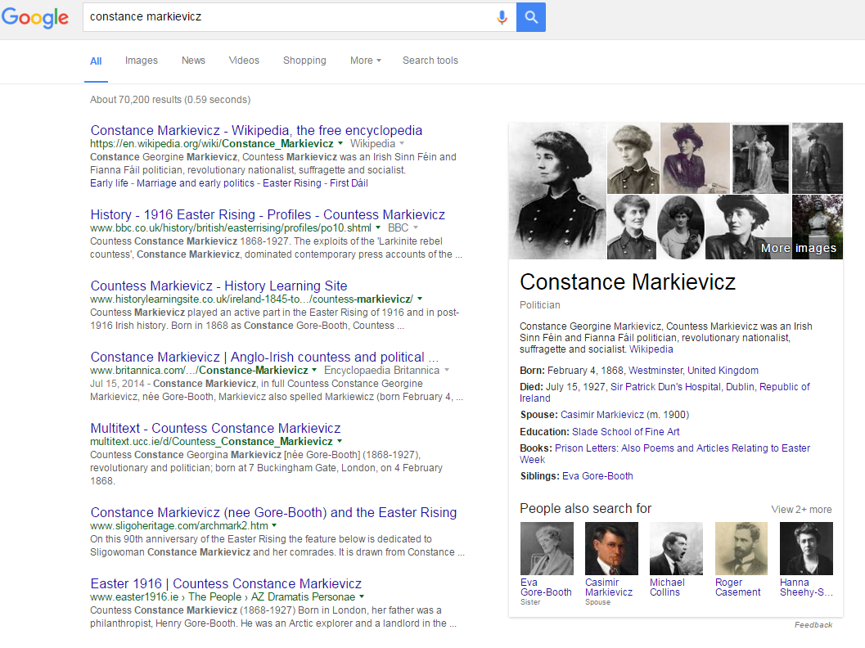

Slide 7
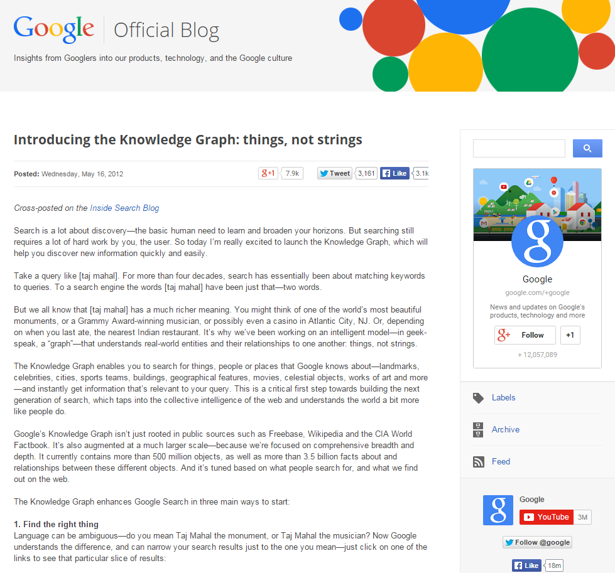
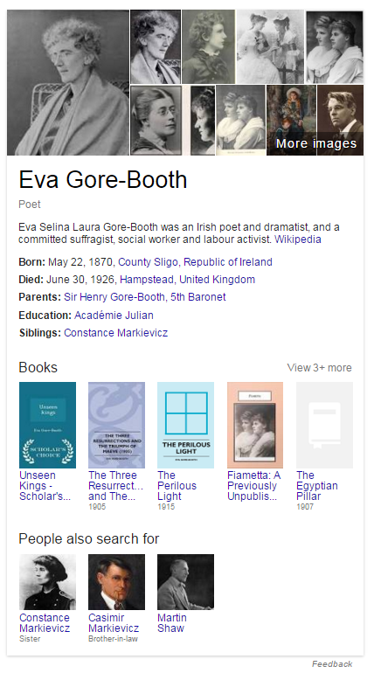
The knowledge graph
A Google blog post from 2012 describes the Knowledge Graph that supports searching for the things, people and places that Google knows about and provides suggestions for relevant related things.
The Graph powers the Google Knowledge Card in search results
Notes:
The Knowledge Graph that Google began promoting in 2012 is often noted as a model of the power of linked data.
Recently, as Knowledge Panels have appeared with more frequency in search engine results, they have been pointed to as exemplars of that power, with libraries, archives and museums aspiring to be reflected in those highlighted views, and with some library systems emulating that type of focus on working in the data.

Slide 8
Things …

Slide 9
Notes:
Google ‘knows about’ Eva Gore-Booth.

Slide 10
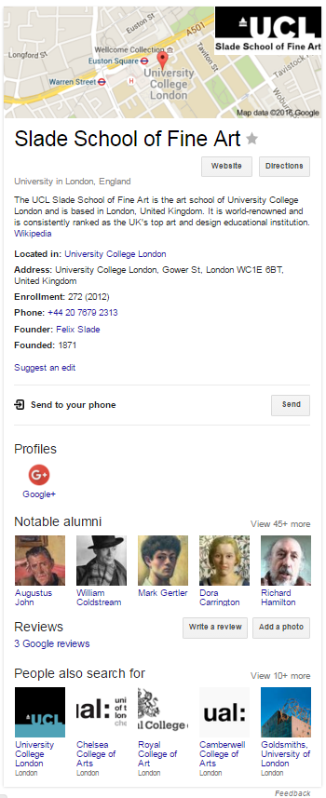
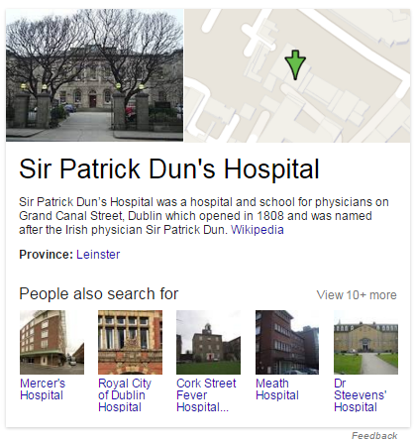
Notes:
Google ‘knows about’ Sr Patrick Dun’s Hospital and the Slade School of Fine Art.

Slide 11
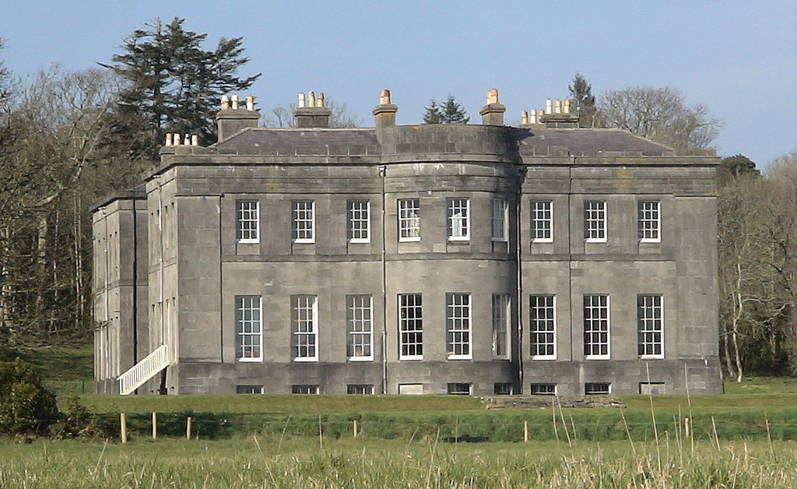
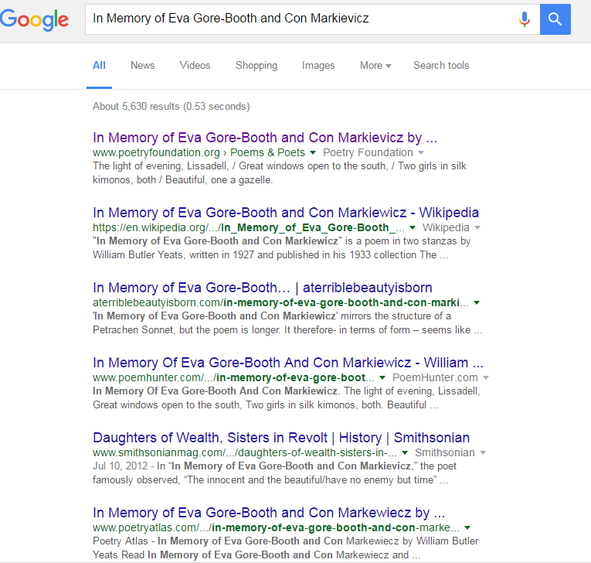
https://www.wikiwand.com/en/Lissadell_House
String …
Notes:
However, Google does not ‘know about’ this famous poem about the sisters – it can find it but it does not present details about it, related things, etc.

Slide 12
Timothy Burke presentation to LC WGFBC
tools that recognize existing clusters of knowledge; if you find a book using lcsh, you probably already know it existed. tool that recognizes the conversation the book was in. those that were written after the book came out and have continued the conversation.
tools that know lines of descent; chronology of publications; later readers determine connection between texts
tools that find unknown connections (full text search; topic maps?)
tools that produce serendipity -- hidden connections.
tools that inform me of authority
tools that know about real world usage (those who bought x bought y; how many people checked this out?)
tools that know about the sociology of knowledge; the pedigrees of authors: who were they trained by, how long ago; how trustworthy is this institution?
[Report: Karen Coyle, http://www.kcoyle.net/bib_futures.html#burke]
Notes:
Interesting list from Timothy Burke, Professor of History at Swarthmore, about tools he would like to see when doing research.

Slide 13
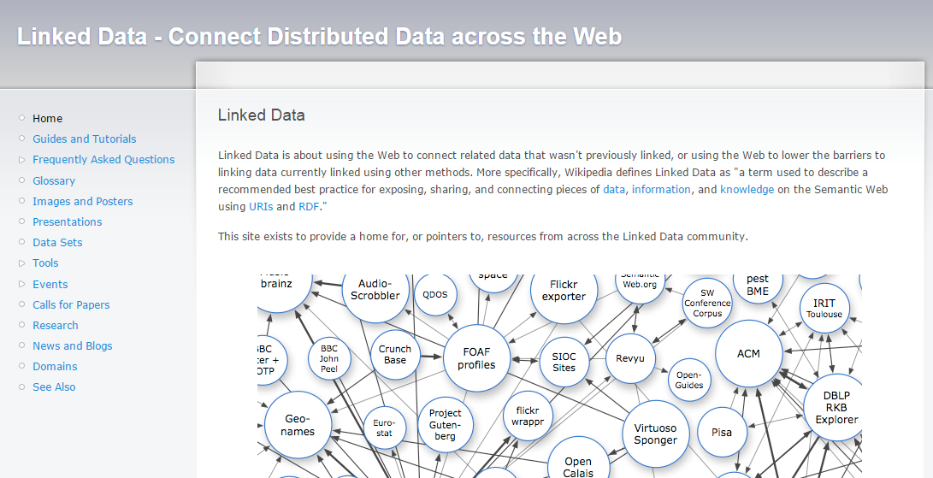
Things not strings (or records)
Three benefits acc to Google:
Find the right thing
Get the best summary
Go deeper and broader
Linked data (Tim Berners-Lee):
All kinds of conceptual things, they have names now that start with HTTP.
If I take one of these HTTP names and I look it up [..] I will get back some data in a standard format which is kind of useful data that somebody might like to know about that thing, about that event.
When I get back that information it's not just got somebody's height and weight and when they were born, it's got relationships. And when it has relationships, whenever it expresses a relationship then the other thing that it's related to is given one of those names that starts with HTTP.
Notes:
Google’s knowledge graph benefits compared to Tim Berners-Lee’s characteristics of linked data.

Slide 14
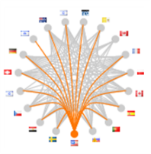
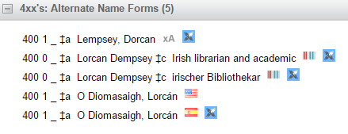
367 Million bibliographic records
2.3 Billion holdings set
214.9 Million worksets
Workset with largest number of manifestations (7.9K):
Don Quixote / Miguel de Cervantes
VIAF (Virtual International Authority File)
(derived from 44 data sources, chiefly national authority files)
31 Million clusters
Faceted Application of Subject Terminology
8 Facets
1.7 Million Authority records
Important note:
Our analysis is based on the data in WorldCat and related resources listed here.
Links from FAST, VIAF and WorldCat
Notes:
Data sources we work with in OCLC Research.
WorldCat is the best proxy we have for the print scholarly record.

Slide 15
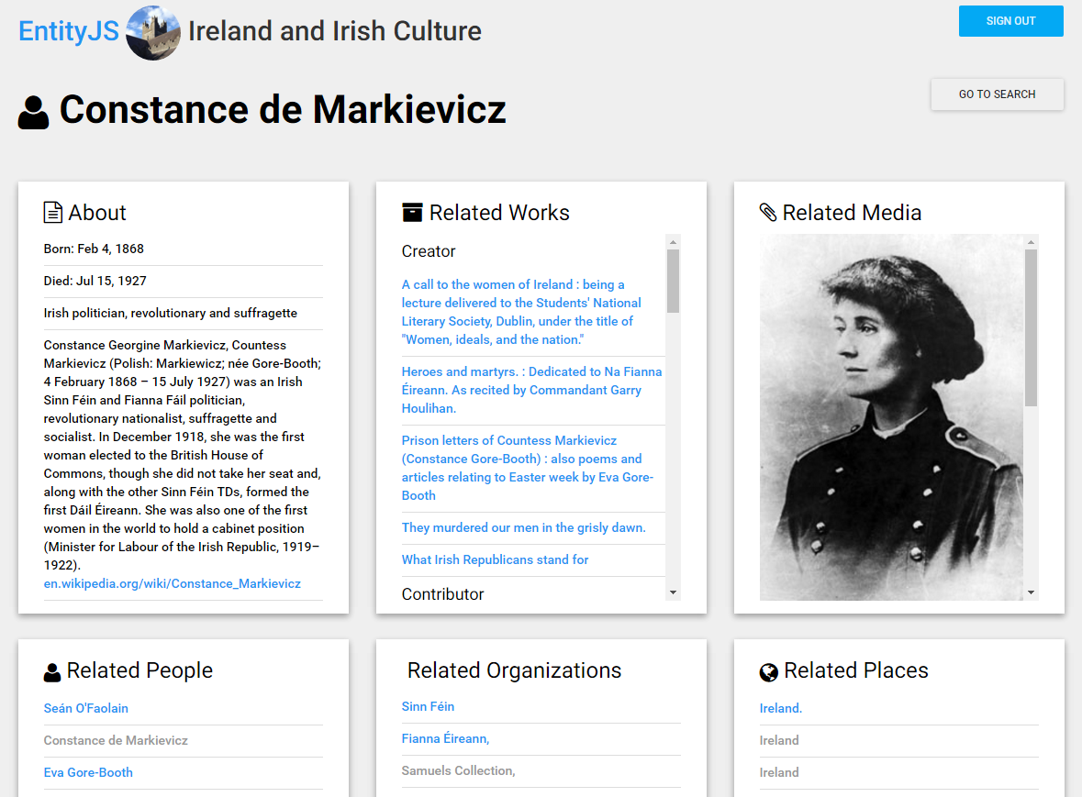
Notes:
EntityJS is an OCLC Research prototype for searching across, exploring, and interacting with Linked Data. Using OCLC’s linked data as a starting point, EntityJS provides a way to expand search results to discover not only bibliographic items but also entities associated with bibliographic items such as People, Places, Events, Subjects and Organizations. The application pulls data from a variety of sources such as WorldCat.org, OCLC Works, VIAF, FAST, DBpedia, Wikidata.org and GeoNames. These diverse but connected resources support an entity-oriented discovery experience, a departure from the record-oriented view common in most library systems.
EntityJS is helping us better understand what kinds of data processes and system architectures will work well for RDF Triples ... the basic subject-predicate-object relationships of Linked Data. It provides OCLC researchers with a human-friendly interface for testing discovery and navigation of Linked Data resources, and is part of a testbed for experimenting with user-contributed Linked Data.

Slide 16
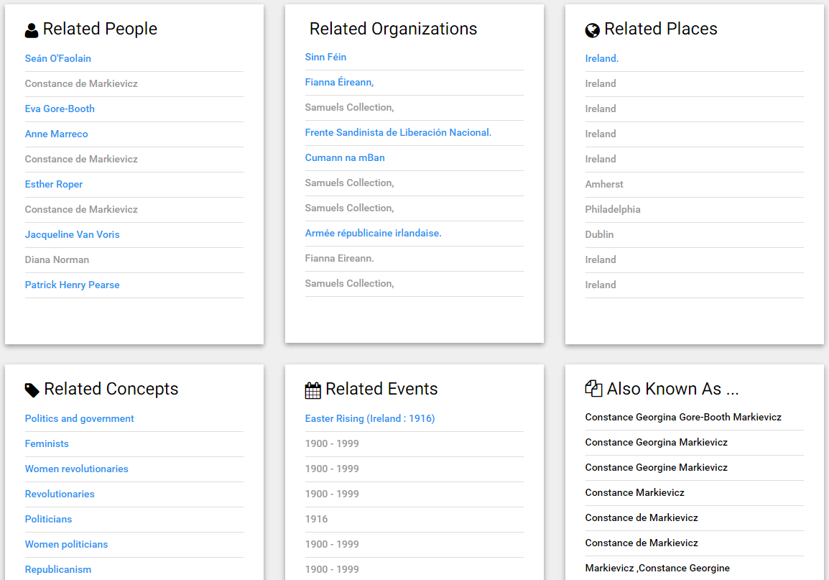

Slide 17
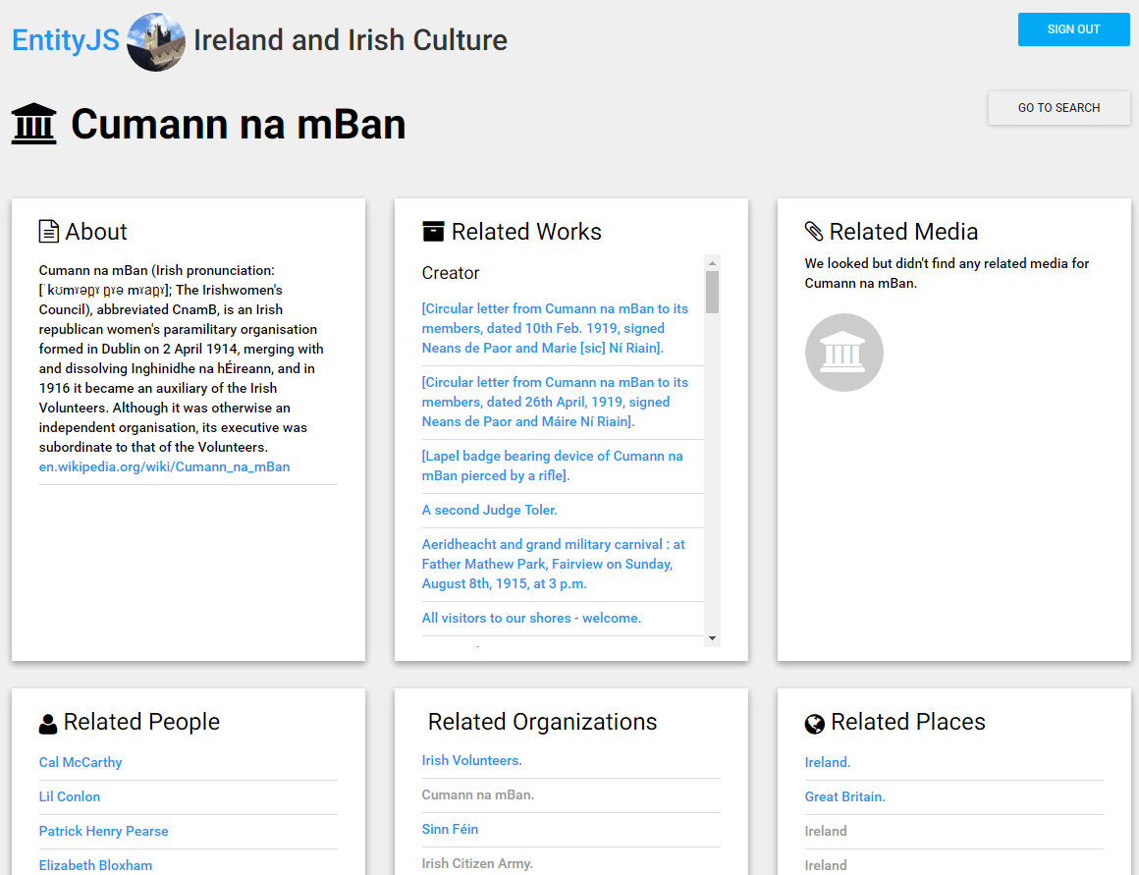

Slide 18
The biblio-graph maps researcher
interests more clearly?
A case to be made …

Slide 19
Distant reading:
A short interlude

Slide 20
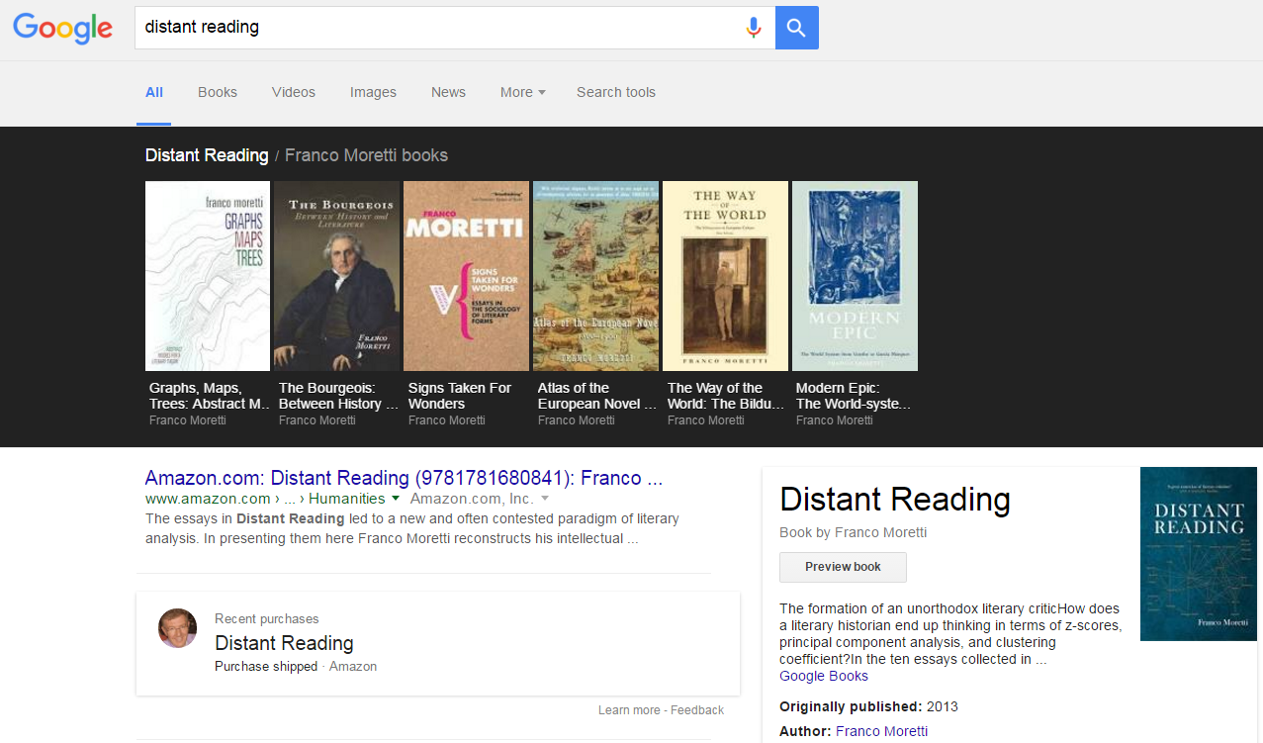
Notes:
Distant reading – reading at a scale above the individual text. Library-scale. Corpus-scale. ….

Slide 21
It includes all casual, sentimental, and prejudiced value-judgments, and all the literary chit-chat which makes the reputations of poets boom and crash in an imaginary stock exchange. That wealthy investor Mr. Eliot, after dumping Milton on the market, is now buying him again; Donne has probably reached his peak and will begin to taper off; Tennyson may be in for a slight flutter but the Shelley stocks are still bearish. This sort of thing cannot be part of any systematic study, for a systematic study can only progress: whatever dithers or vacillates or reacts is merely leisure-class gossip.
Northrop Frye
http://northropfrye-theanatomyofcriticism.blogspot.com/

Slide 22
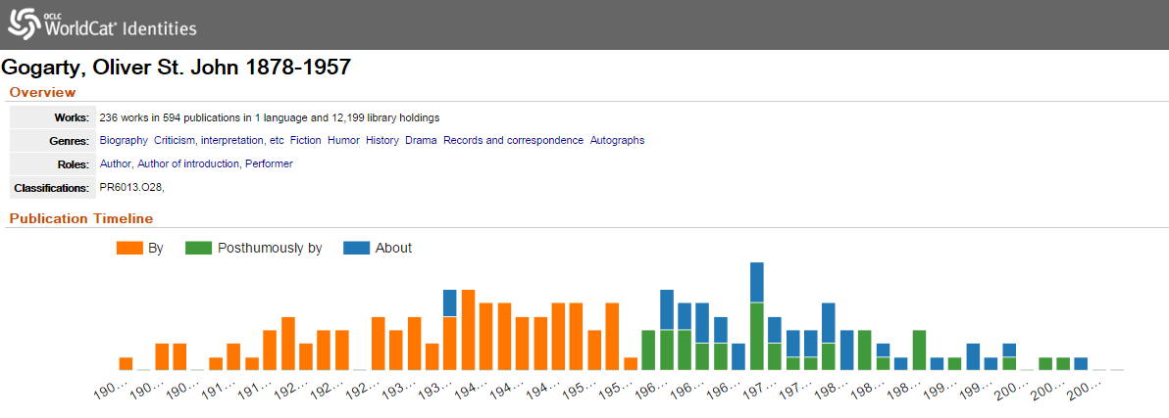
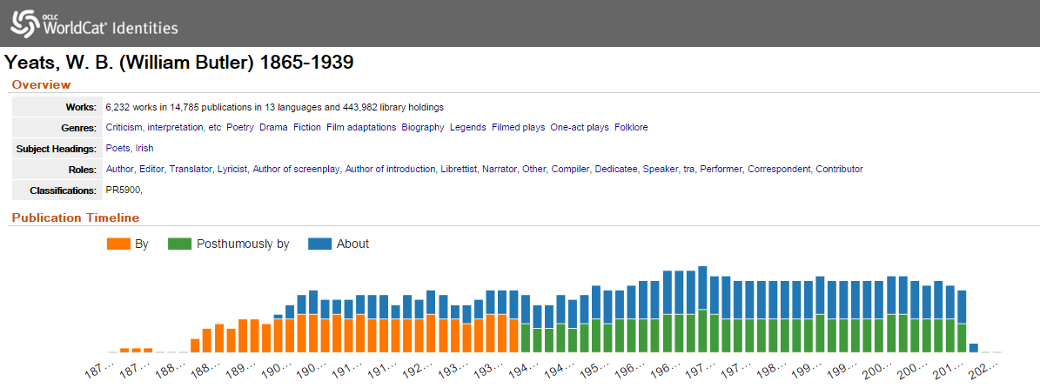
Notes:
WorldCat identities provides a glancable profile of an author’s publications.
Interesting to see what this says about the author’s reception/reputation/etc.

Slide 23
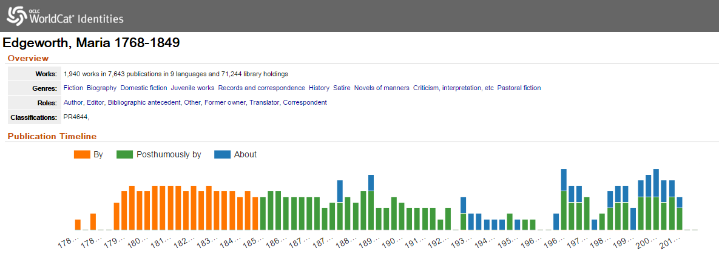
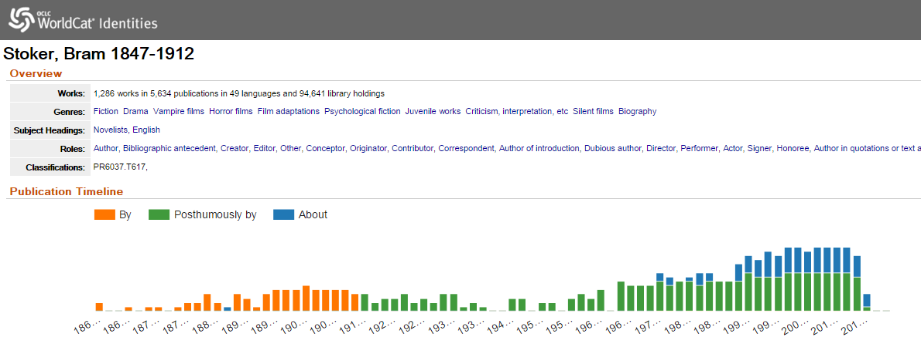

Slide 24
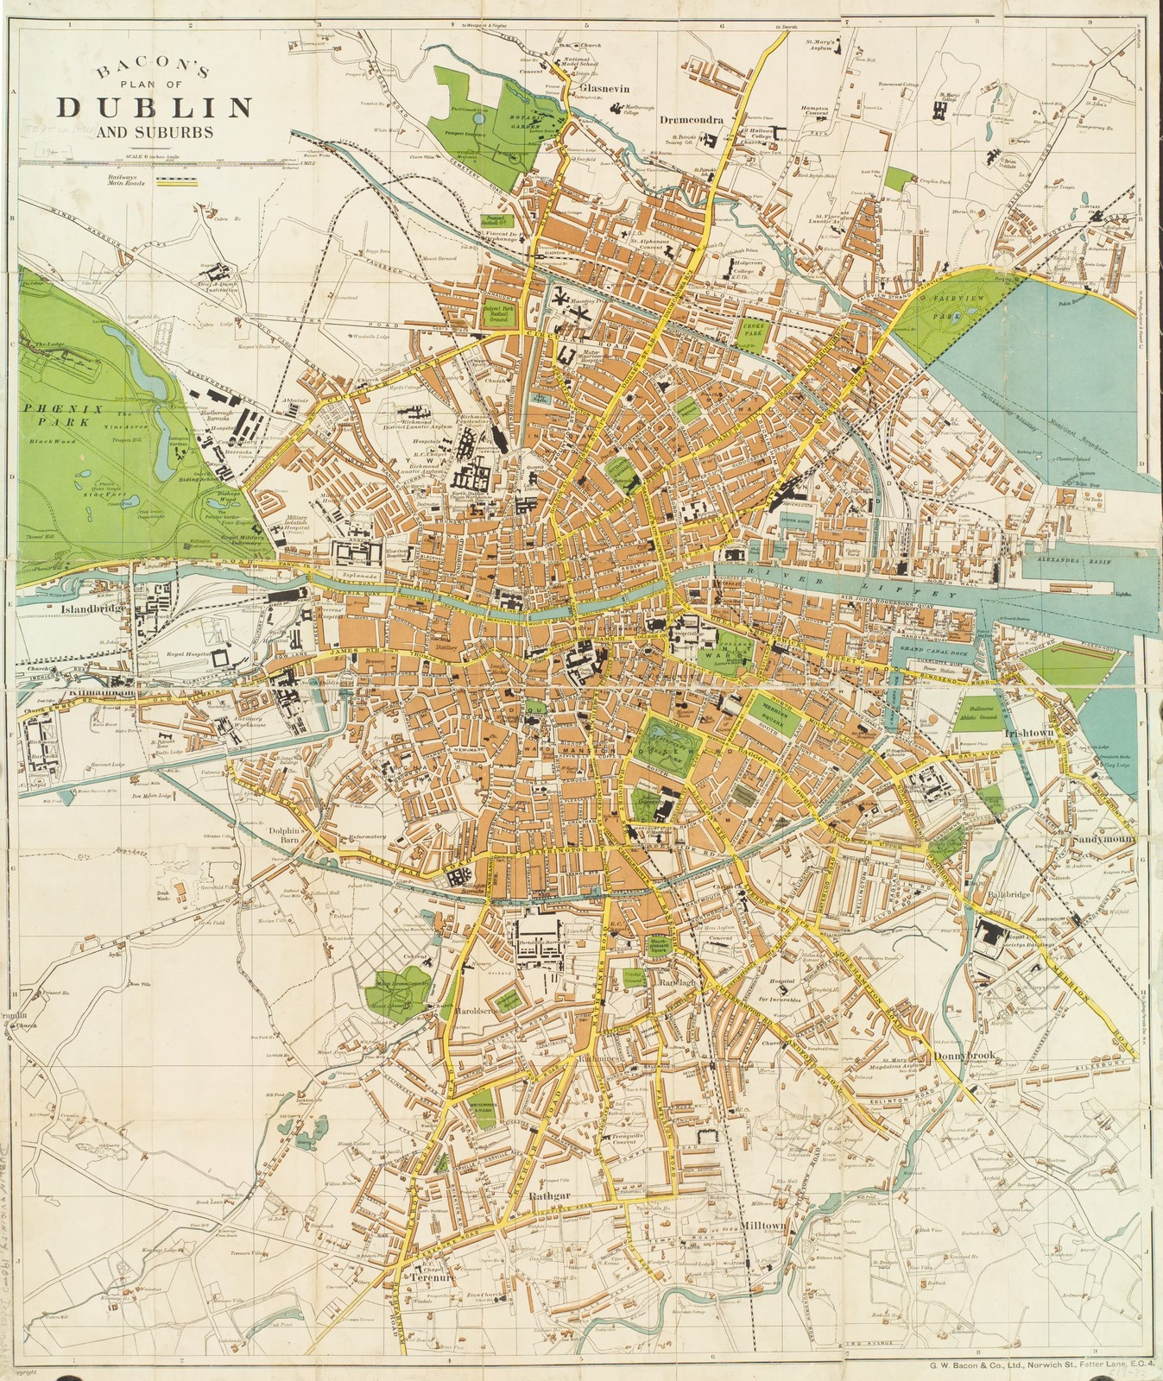
Place in literary imagination
Weight in global library system
James Joyce | 65,401
Maeve Binchy | 37,804
Roddy Doyle | 14,591
Benjamin Black | 14,483
Tana French | 12,219
Marian Keyes | 10,005
Anne Enright | 8,771
Edward Rutherfurd | 6,453
Charles Lucas | 5,933
Declan Hughes | 4,400
inscribing Dublin in the global cultural record
Source: Lionel Pincus and Princess Firyal Map Division, The New York Public Library. (19--?). Large scale plan of Dublin. Retrieved from http://digitalcollections.nypl.org/items/9dfbe99e-f18e-55ae-e040-e00a18063f22
Notes:
By aggregating library holdings data, we can see the impact of individual authors in shaping our cultural understanding of ‘place’.
Rather than simply counting the publications associated with Dublin and these authors, we computed the aggregate library holdings for their works. This provides a measure of the ‘weight’ of these works and authors in the published record: thousands of libraries around the world have acquired this content.
Data based on co-occurrence of author name (VIAF ID) and Dublin geographic heading (FAST ID) in February 2016 WorldCat snapshot.

Slide 25
Irish cultural identity in the global library system
… most widely held authors | avg. libraries per title*
Kate Thompson (1956- ) | 181
Frank Delaney (1942-) | 111
Karen Marie Moning (1964-) | 111
Robert Fitzroy Foster (1949-) | 107
Maeve Binchy (1940-2012) | 97
Peter Tremayne (1943-) | 88
William Trevor (1928-) | 85
Morgan Llywelyn (1937-) | 85
Edna O’Brien (1930-) | 84
fix popular understanding of Ireland?
*titles associated with geographic subject heading “Ireland”
Notes:
We can analyze aggregated library data to identify “important” authors based on their publication record and their relative success in gaining library shelf-share. Here, we have divided the total library holdings for each author by the number of titles (related to Ireland) that they have published. An author with just two best-selling publications will do better in a ranked list like this than a scholar who has published a dozen titles that are not widely collected. So the list is not a measure of the intrinsic merits of individual authors or titles, but a view of how successful they have been in penetrating the global library market.
In general, lists like this will favor authors whose works are widely collected by public libraries.
This is an important dimension of cultural production and the dissemination of national identity. For many readers in the US, Ireland is genuinely a fiction.

Slide 26
Bibliographic data is underused in
literary research?
Scale offers new opportunities?

Slide 27
The collective Irish Studies Collection
A preliminary view

Slide 28
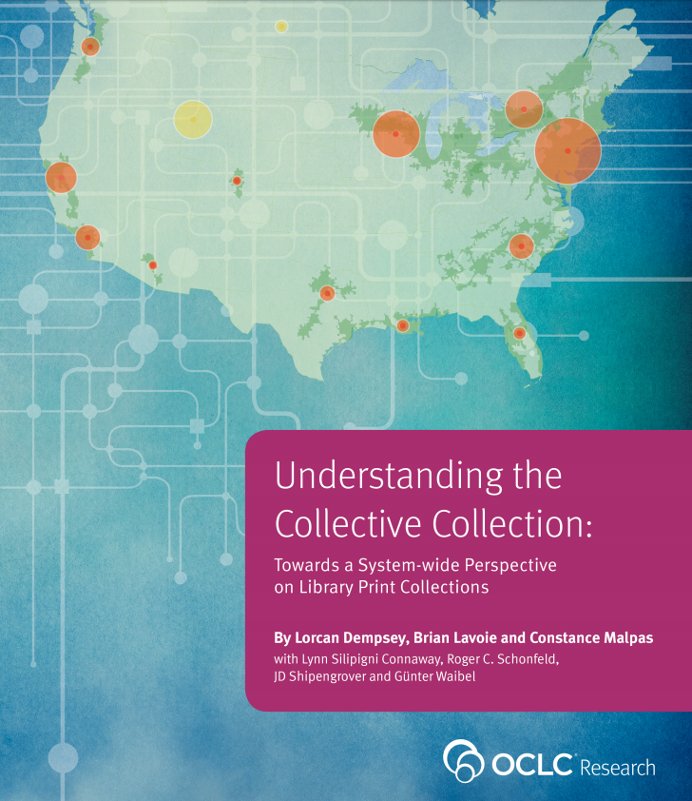

Slide 29
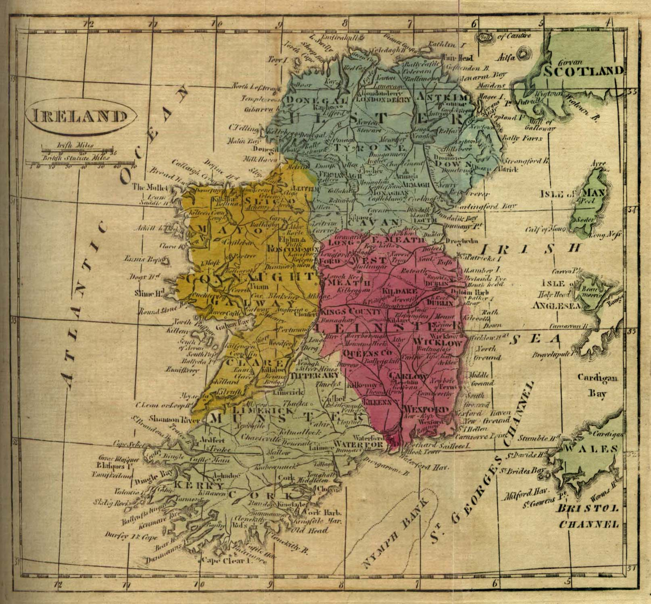
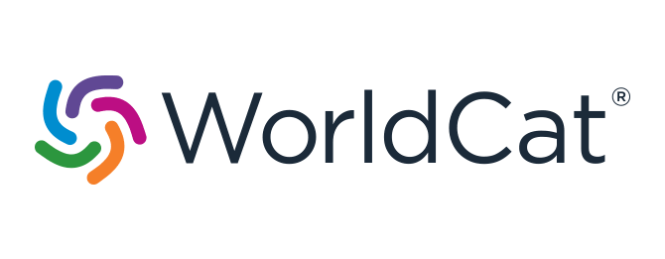
About Ireland …
418,000 publications
10 million global holdings
Average holdings
Ireland: 24
Scotland: 15
New Zealand: 8
Image: University of Texas Libraries
https://www.lib.utexas.edu/maps/historical/ireland_1808.jpg
Notes:
To identify materials about Ireland, the WorldCat database was scanned to identify all records that contained at least one FAST subject heading that included a string constituting a direct reference to Ireland: i.e., “Ireland” or “Irish”. Headings referencing “Northern Ireland” were filtered out. All FAST subject facets were analyzed: topical, geographic, chronological, personal names, corporate names, events, form, and genre. These headings constituted a core set of Ireland-related subject headings. Any WorldCat record containing one of these subject headings, or a Geographic Area Code of “e-ie” (Ireland), was retained. The next step was to extract all of the FAST headings in WorldCat that co-occurred with the core Ireland-related headings. These were ranked by frequency of occurrence (i.e., number of records in which each heading co-occurred with a core Ireland-related heading). All of the headings that co-occurred ten or more times with one of the core Ireland-related headings were reviewed to assess whether they were also Ireland-related. Given the list of subject headings that survived the review, a second scan of WorldCat was performed to identify all records that contained any of these headings, regardless of whether or not they co-occurred with one of the core Ireland-related headings. The resulting record set was then merged with the first record set produced by the core Ireland-related headings alone, for a total of 417,988 records.
The publications represented by these records account for more than 10 million holdings in library collections worldwide.
Similar analyses done for Scotland and New Zealand indicate that, on average, Ireland-related materials are more widely held than Scottish- or New Zealand-related materials.

Slide 30
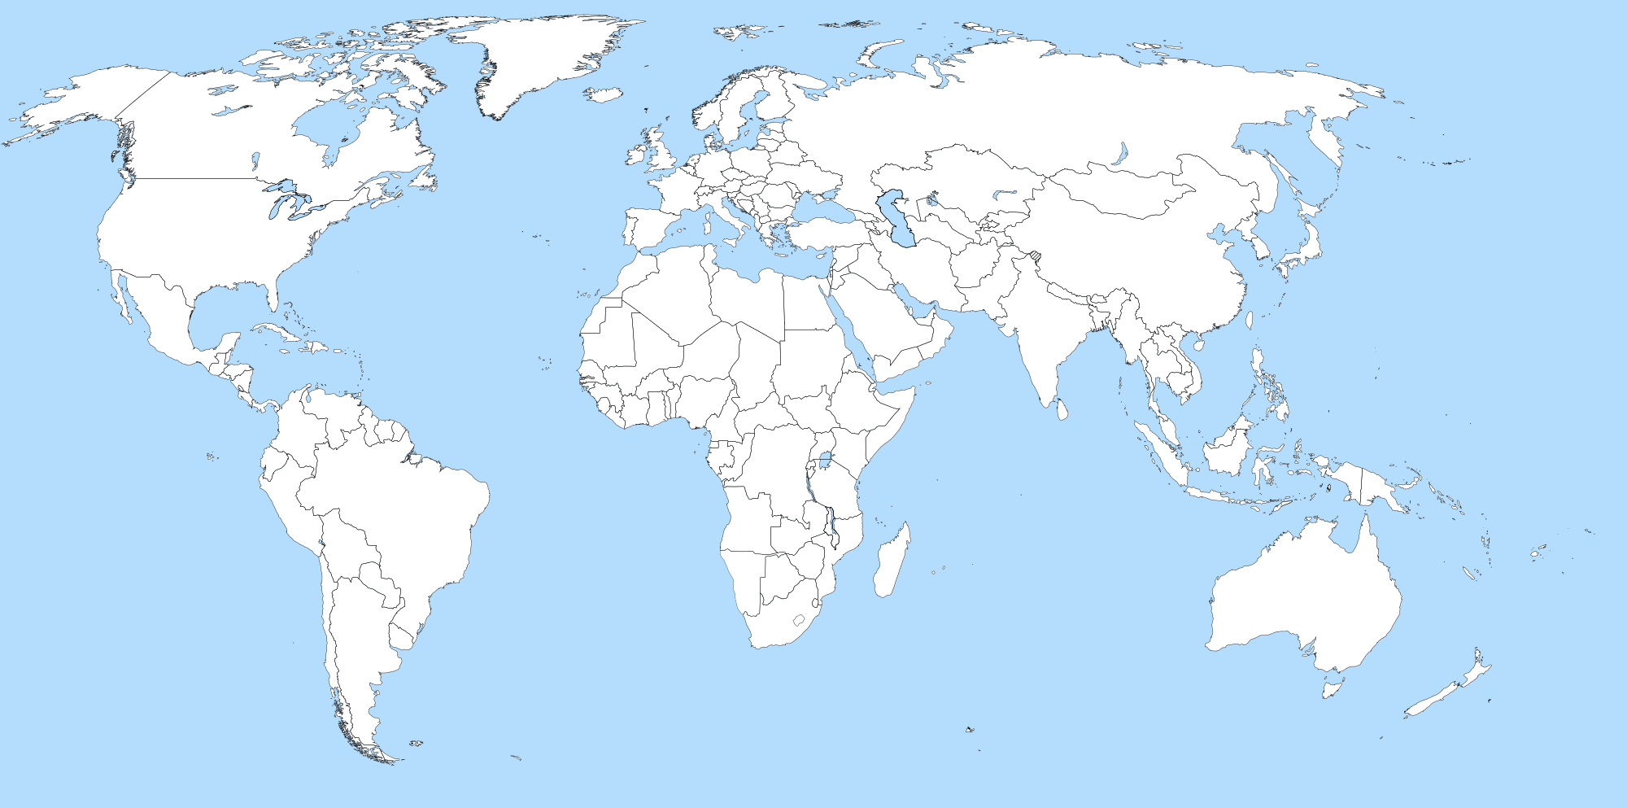
Global diffusion of publications about Ireland
Top 10 largest national holdings outside of Ireland
2 UK
7 Netherlands
3 Canada
10 France
5 Germany
1 US
8 China
9 Japan
Irish Diaspora: 2013
UK
USA
Australia
Canada
Spain
Germany
South Africa
France
New Zealand
Source: Irish Times
4 Australia
6 New Zealand
Image: Wikimedia Commons
https://commons.wikimedia.org/wiki/File:A_large_blank_world_map_with_oceans_marked_in_blue.svg
Notes:
This map shows the largest national concentrations of Ireland-related publications outside of Ireland, as represented by their presence in domestic library collections. The ranking is based on each country’s total holdings of the 417,988 publications identified as being about Ireland. The ranking of the ten largest concentrations correlates with a recent ranking of the most common destinations of the Irish diaspora.

Slide 31
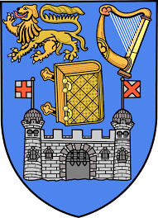
Largest institutional collections of materials about Ireland (by OCLC symbol, national libraries excluded)
Trinity College Dublin
University of Cambridge
University of Oxford
New York Public Library
University of Notre Dame
University College Dublin
Cornell University
Boston College
University College Cork
Harvard University (HCL)
Notes:
The largest institutional collections of Irish-related publications (national libraries excluded). The ranking is based on each institution’s total holdings of the 417,988 publications identified as being about Ireland.

Slide 32
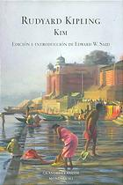
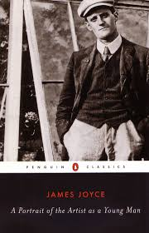
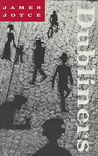
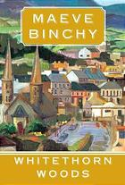
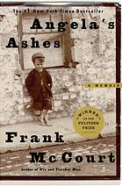
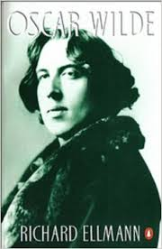
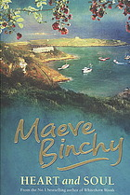
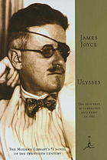
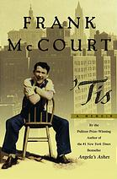
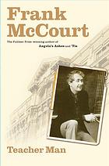
Most popular works about Ireland & the Irish
A Portrait of the Artist as a Young Man
James Joyce
13,652 global holdings
Kim
Rudyard Kipling
8,932 global holdings
Dubliners
James Joyce
8,457 global holdings
Whitethorn Woods
Maeve Binchy
5,415 global holdings
Angela’s Ashes
Frank McCourt
8,167 global holdings
Oscar Wilde
Richard Ellmann
6,004 global holdings
Heart and Soul
Maeve Binchy
5,125 global holdings
Ulysses
James Joyce
8,078 global holdings
‘Tis
Frank McCourt
5,761 global holdings
Teacher Man
Frank McCourt
4,989 global holdings
Notes:
Most popular works about Ireland and the Irish, ranked by total global library holdings. Each work consists of all related publications that have been explicitly cataloged as being “about Ireland”.

Slide 33
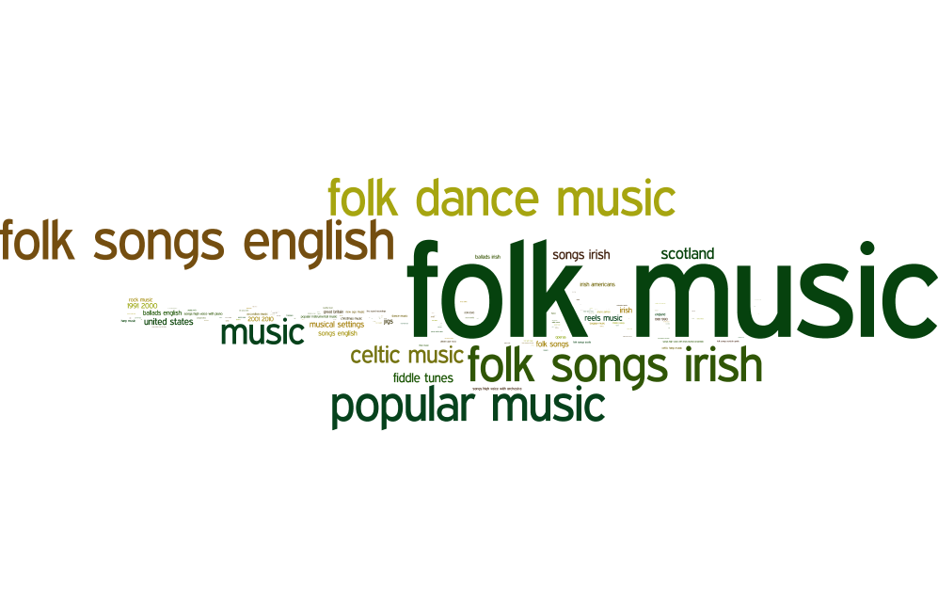
Musical recordings related to/about Ireland: Topics
14,922 total musical recordings
Notes:
Word cloud built from the most frequently-occurring subject headings associated with musical recordings about Ireland.

Slide 34
Largest institutional collections of musical recordings about Ireland (by OCLC symbol, national libraries excluded)
Boston College
New York Public Library
New York University
University of Missouri,
Kansas City
University of Notre Dame
University of Limerick
Brown University
Minuteman Library Network
Bowling Green State University
University of Mississippi
Notes:
The largest institutional collections of Irish-related musical recordings (national libraries excluded). The ranking is based on each institution’s total holdings of the 14,922 musical recordings identified as being about Ireland.

Slide 35
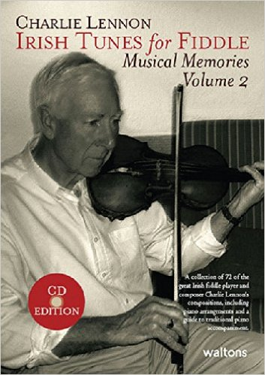
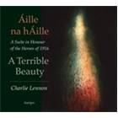
Charlie
Lennon (1938-)
Works in WorldCat: 41
Ireland
England
Vendors
A measure of the market for Irish music in libraries
Notes:
Library data in WorldCat is mostly about decisions that have already been made – acquisitions that were made in the past. But in some cases, the concentration of holdings associated with vendors to the library community tells us something about the continued market interests in a topic.
To measure comprehensiveness, we first extract all the library holdings associated with a given author or subject identifier. We then calculate the total number of works associated with the heading, and compute the percentage of works held by individual libraries. Libraries are then ranked according to the breadth of their holdings (their “coverage”) related to the topic or author of interest.
More information on the methods behind this work is available here: http://outgoing.typepad.com/outgoing/2013/05/centers-and-coverage.html

Slide 36
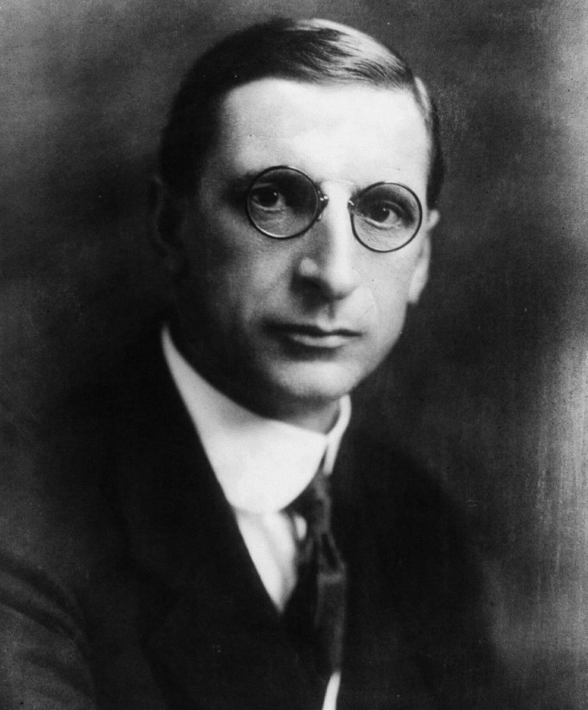
Éamon De Valera (1882-1975)
Related Works in WorldCat: 193
Ireland
England
USA
Many major cultural figures have a small
bibliographic footprint
distributed unevenly across the global library system
Source: https://commons.wikimedia.org/w/index.php?curid=11192051
Notes:
It is important to recognize that our measure of coverage relies on the availability of a FAST or VIAF heading in the bibliographic record. For example, if a library holds works by or about De Valera that have been cataloged in such a way that his name cannot be “controlled” to a VIAF identifier, those holdings will be excluded from the ranked list.
Most libraries do not catalog their collections using FAST and VIAF identifiers; OCLC relies on machine processing routines to map local descriptors (names, subjects) to identifiers. Our “coverage” analysis is only possible because of the efforts that are made to organize and enrich the aggregated data.

Slide 37
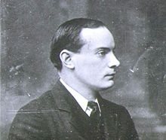
Pádraig Anraí Mac Piarais (1879-1916)
Related Works in WorldCat: 249
Ireland
England
USA
Strong concentrations of material at institutions with related research interests or heritage connections . . .
Source: https://commons.wikimedia.org/wiki/File:Patrick_Pearse.jpg
Notes:
Pearse studied for a time at University College Dublin and this may account in part for the library’s relatively high coverage. The strength of coverage at Trinity College Dublin and the National Library likely reflect manuscript and archival holdings in addition to published works.
It is important to recognize that institutions that appear to have similar coverage may have very different collections related to Pearse. For example, Boston College may cover a different ~25% of the literature than is available at TCD. In general, however, when we see a ‘plateau’ in coverage across multiple institutions it is an indicator that multiple libraries have acquired the same ‘core’ literature – a microform set, for example, or a series of Collected Works.
We make no attempt in this analysis to compare the covered content (titles) across different institutions. Thus the ‘quality’ of coverage may be very different from the numerical advantage of holding a greater share of the literature. One can easily imagine that libraries with relatively low coverage might have exceptionally well curated collections, with a small number of works but a large degree of coherence.

Slide 38
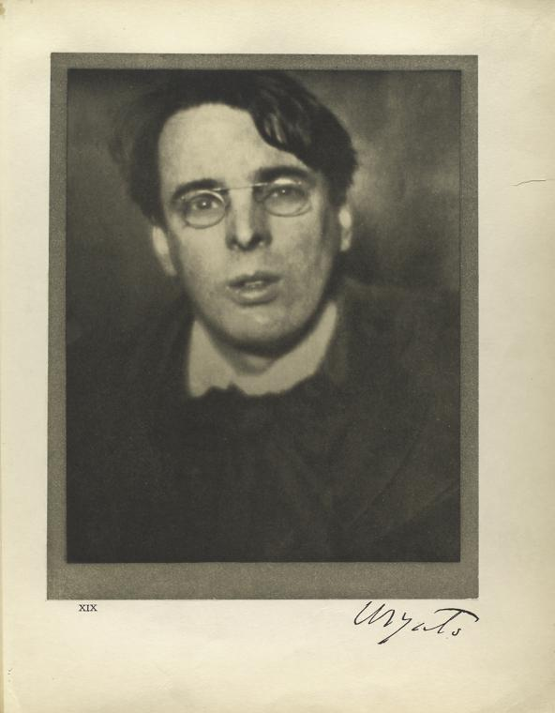
W. B. Yeats (1865-1939)
Related Works in WorldCat: 3,137
Ireland
England
USA
… but strongest collections are not necessarily where one might predict.
Source: Rare Book Division, The New York Public Library. (1913). W. B. Yeats, Dublin, January 24th, 1908. Retrieved from http://digitalcollections.nypl.org/items/510d47db-c494-a3d9-e040-e00a18064a99
Notes:
The bulk of UNC Yeats collection was acquired as a commemorative gift to the library to mark 5 millionth volume. The library’s very strong coverage was achieved in a fell swoop, and not as a deliberate curatorial effort over many years.
An inescapable artefact of this approach to computing coverage is the fact that libraries that have catalogued resources as part of a Yeats-related collection (items with Yeats provenance but which are not by or about the poet, for example) will rise to the top.

Slide 39
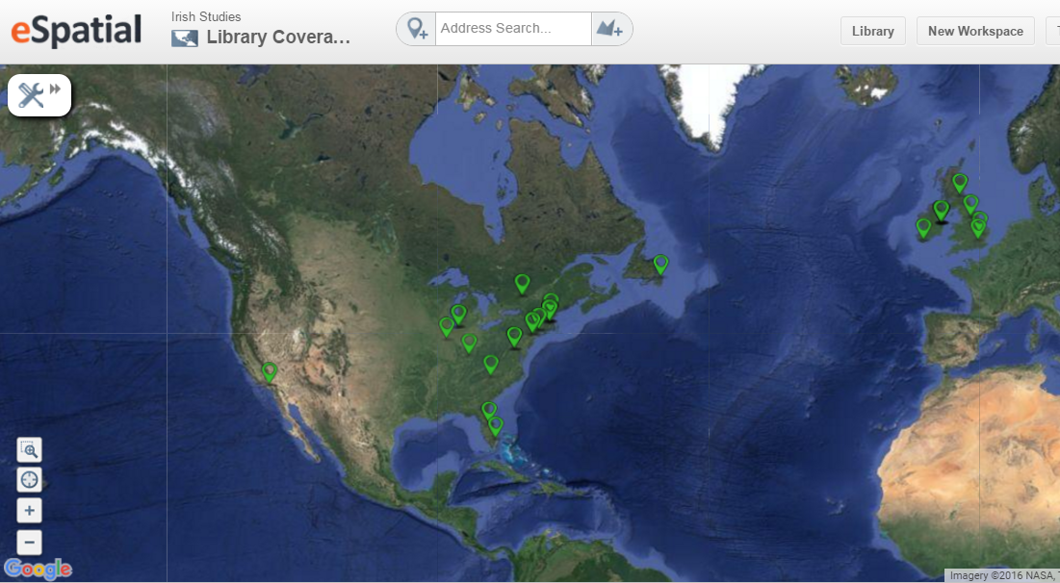
Mapping Library Coverage of Irish Rebellions
Canada:
Carleton U, Memorial U, U Ottawa
US:
Boston College
Claremont Colleges
Florida Atlantic U
Harvard
Library of Congress
NYPL
U Central Florida
U Illinois
U Kentucky
U New Hampshire
U Notre Dame
Yale
Ireland:
National Library of Ireland
Trinity College Dublin
U College Dublin
U College Cork
UK:
British Library
Cambridge U
Edinburgh U
King’s College London
National Library of Scotland
Top ten most comprehensive collections related to rebellions of 1641, 1798, 1803 and 1916 are distributed across 15 institutions and 4 countries
Notes:
Geographic locations of the top ten collections related to four different Irish rebellions.
To produce this map, we extracted ‘coverage’ data for four different Irish rebellions using FAST event identifiers. We then compiled the top ten most comprehensive collections for each of the rebellions and plotted their locations based on the libraries physical address. Some locations will have coverage for only one of the rebellions; others will have coverage for multiple rebellions.

Slide 40
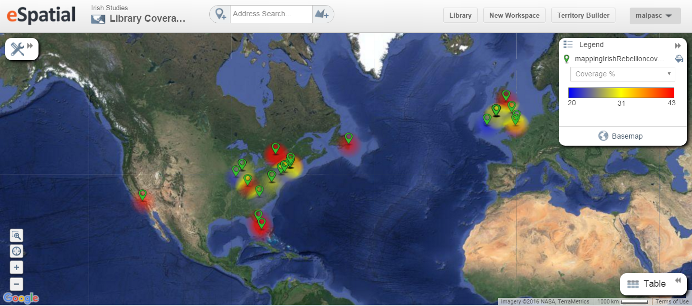
Mapping Library Coverage of Irish Rebellions
Regional concentrations of excellence become more evident
Notes:
Beyond institutional strengths, one can see regional concentrations of excellence – here the color spectrum of the heat map indicates the average regional ‘coverage’ of the literature. The red zones have a high degree of coverage (at one or more institutions) for literature related to Irish rebellions.
This map relies on the same underlying data as the previous ‘location’ map, but it aggregates the coverage into regional averages. The red areas will have on average 40% or more of the related literature; blue areas will have only about 20%. Because the map aggregates data for four different subject areas, the averages are computed across all of the rebellions. So a region that has superior coverage of Emmet’s rebellion but relatively limited coverage of the Easter Rising, will tend to have a yellow profile.

Slide 41
Mapping Library Coverage of Irish Rebellions
Boston College, Harvard, the University of New Hampshire and Yale have substantial coverage for several Irish rebellions
New England repositories provide broad coverage of multiple rebellions
Notes:
In New England, there are several repositories that hold substantial collections related to multiple rebellions – from a practical point of view, this could be useful information for planning a research trip.

Slide 42
Mapping Library Coverage of Irish Rebellions
Notre Dame has good coverage for Easter Rising, Emmet’s Rebellion and Rebellion of 1798; University of Illinois has good coverage of Emmet’s Rebellion
Repositories in the Midwest are centers of excellence for literature on Emmet’s Rebellion (1803).
Notes:
In the Midwest, there is a smaller concentration of institutions with broad coverage of the literature, but there is a shared pattern of collecting around the rebellion of 1803. This pattern is revealed by the data – whether or not there is any deliberate coordination of collecting activity at Notre Dame and the University of Illinois, we can see a convergence of library investment reflected in holdings.

Slide 43
Mapping Library Coverage of Irish Rebellions
Memorial University holds 46% of the published literature on the Rebellion of 1641
If Rebellion of 1641 is a focus, Newfoundland is the destination of choice.
Notes:
Some regions have broad coverage of literature on multiple rebellions, in multiple libraries. Others have a single institution with exceptionally good coverage of a single rebellion – this is true for Memorial University, which has the best coverage of the Rebellion of 1641.

Slide 44
An Irish studies collective collection … points to ponder
Rareness is common: relatively small overlap across library collections; collecting decisions not uniform.
Only 10% of works about Ireland have more than 100 holdings
So … scale adds scope and depth: aggregation across individual collections creates a rich and diverse long tail.
Unexpected local strengths vis-à-vis collective collection uncovered and highlighted: e.g., Bowling Green/musical recordings about Ireland
This means … coverage requires cooperation: increasing coverage of Irish studies materials requires increasing scale of cooperation.
Top 10 largest collections of materials about Ireland cover only 45% of total resource
Top 500 collections about Ireland required to cover 80% of total resource

Slide 45
The best example of an activity that can be done most appropriately in a networked context is curation
John P Wilkin …
https://www.ideals.illinois.edu/handle/2142/79053

Slide 46
The biblio-graph maps researcher
interests more clearly?
A case to be made …
Colleagues interested in
providing feedback –
get in touch with me
Bibliographic data is underused in
literary research?
Scale offers new opportunities?
Prepared to made data available data under research license.
The best example of an activity that can be done most appropriately in a networked context is curation
John P Wilkin …
Open to ‘large scale’ collaborative research suggestions from ACIS, ….

Slide 47
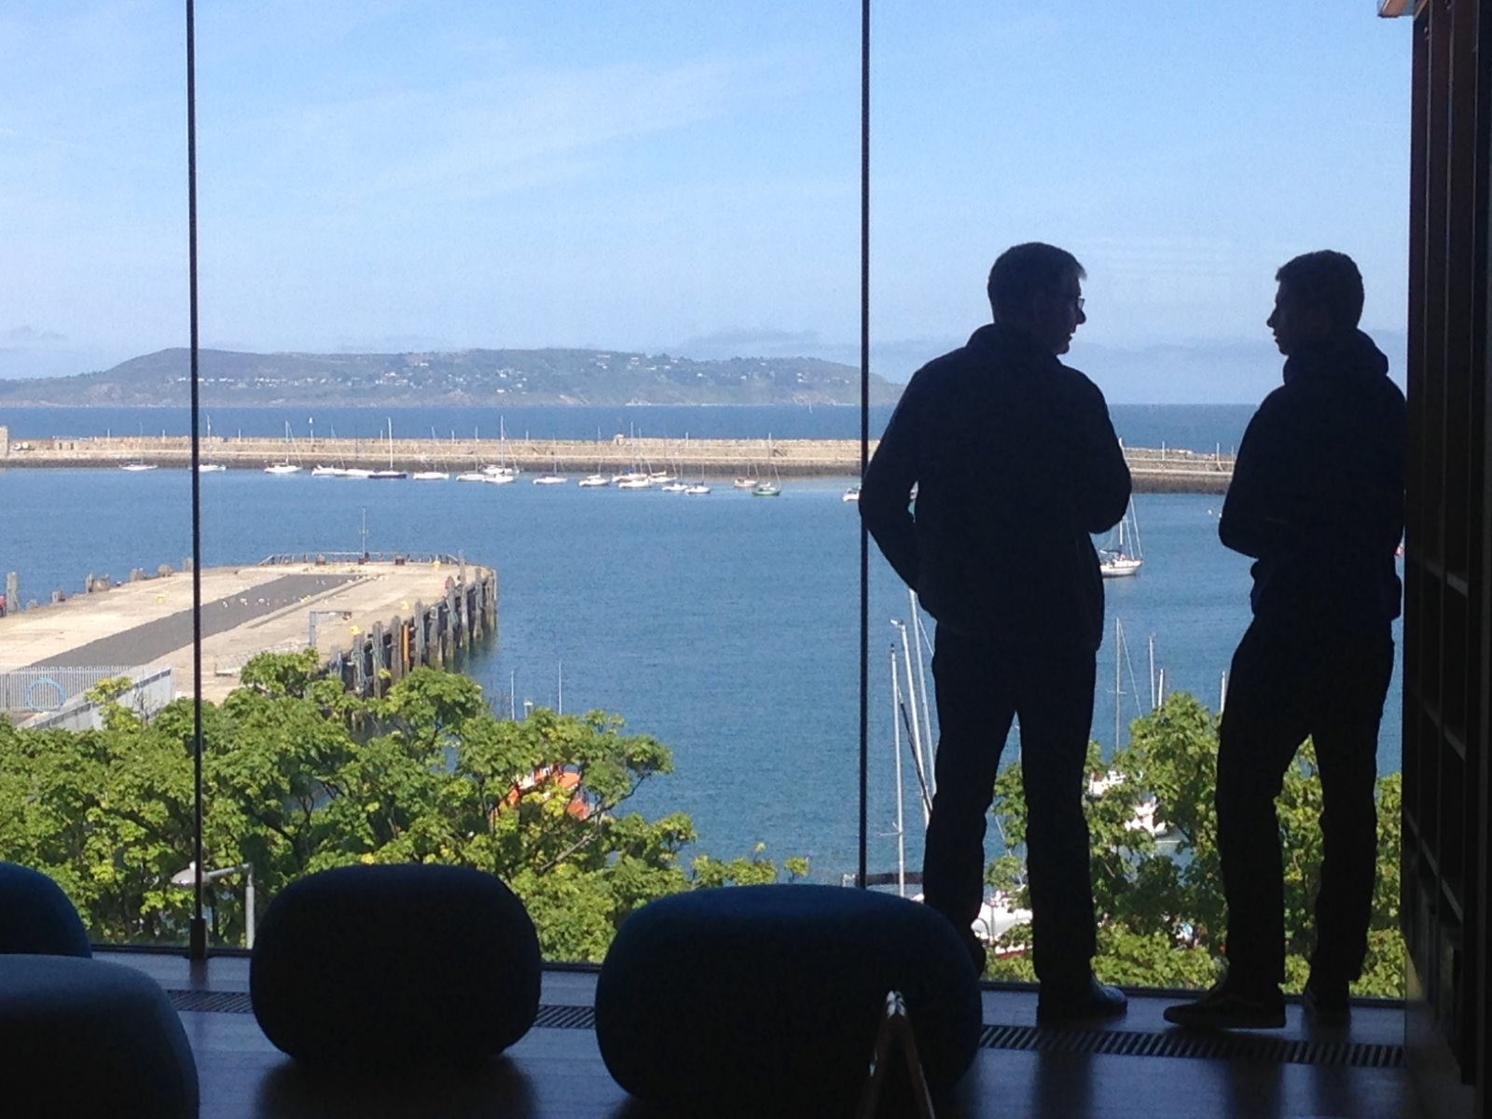
@LorcanD
Thank you …
Lorcan Dempsey, OCLC
Created with a lot of help from my friends at OCLC:
Thom Hickey, Brian Lavoie, Constance Malpas, Jeff Mixter, Diane Vizine-Goetz, Bruce Washburn.

