Slide 1
SHARE:
Discovery:Focus on papers
@LorcanD
Lorcan Dempsey, OCLC
11 October 2013
ARL Fall Forum: Mobilizing the research enterprise
#ARLforum13

Slide 2
Aggregation is a pain

Slide 3
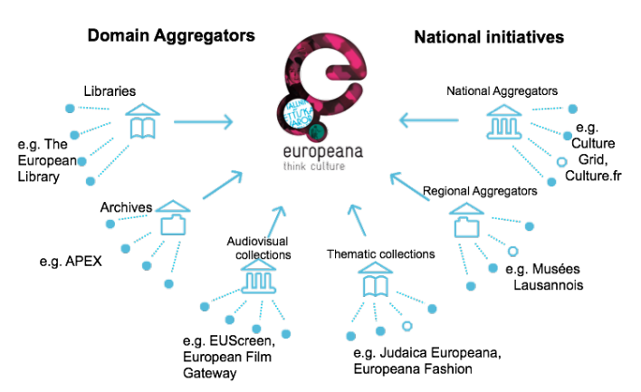
Shenghui Wang (OCLC), Antoine Isaac (Europeana), Valentine Charles (Europeana), Rob Koopman (OCLC), Anthi Agoropoulou (Europeana), and Titia van der Werf (OCLC)
Hunting for Semantic Clusters: Hierarchical Structuring of Cultural Heritage Objects within Large Aggregations
17th International conference on Theory and Practice of Digital Libraries (TPDL), 22-26 September 2013, Valletta (Malta)

Slide 4
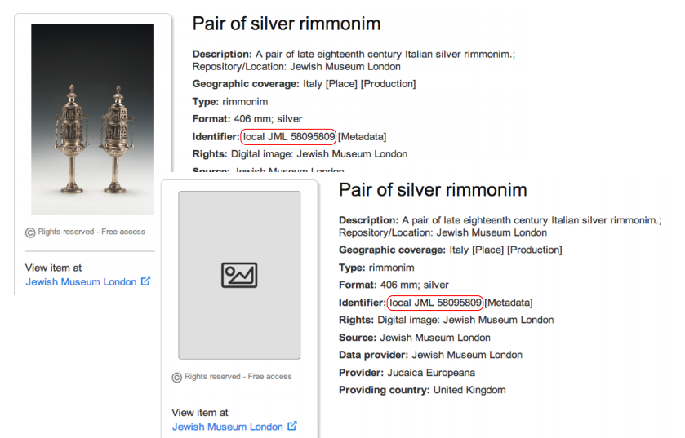
Duplicates

Slide 5
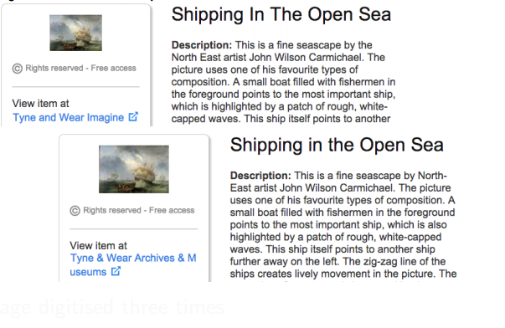
Duplicates? Same object: different providers

Slide 6
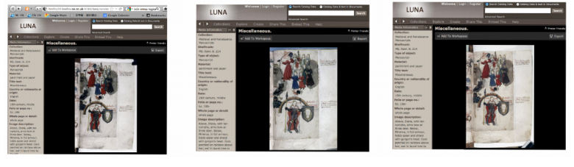
Duplicates? Same page: different digital copies

Slide 7
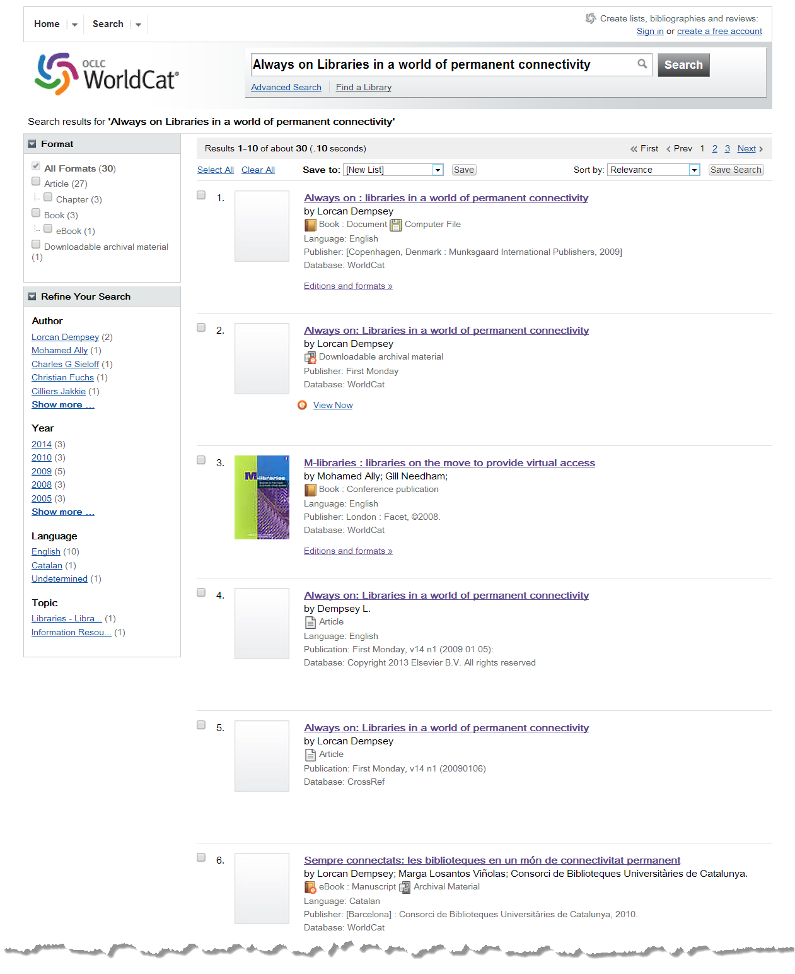
Cataloging error
Harvested – points to repository splash page
Analytic – essay in book
Loaded from Elsevier
Loaded from Crossref
Three ‘expressions’.
Cataloging now fixed ☺
Catalan translation

Slide 8
Cross repository record matching issues – confused identities
Different data models
  Mapping is lossy.
  Relationship issues, e.g.
    Preprint
    Published article
    Publisher splash page
    Repository splash page
    …
Replication of content across repositories
Different content and ‘fullness’ standards
Granularity issues
  What is being described?
‘Business’ issues
  Publisher wants separate display?

Slide 9
From strings to things … an emerging pattern?
Search engines
Linked data

Slide 10
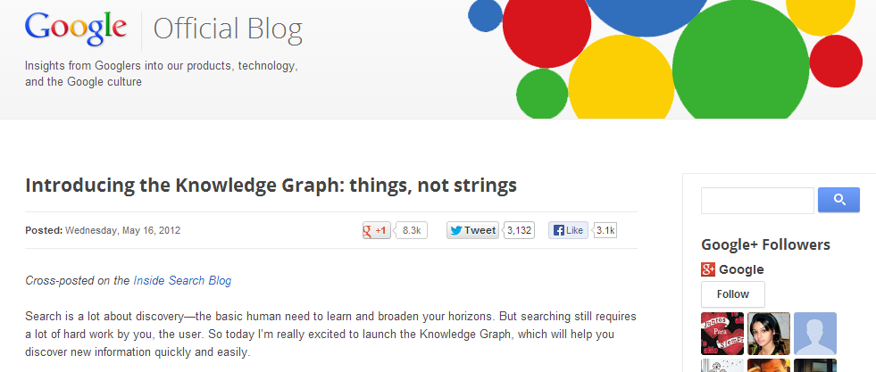
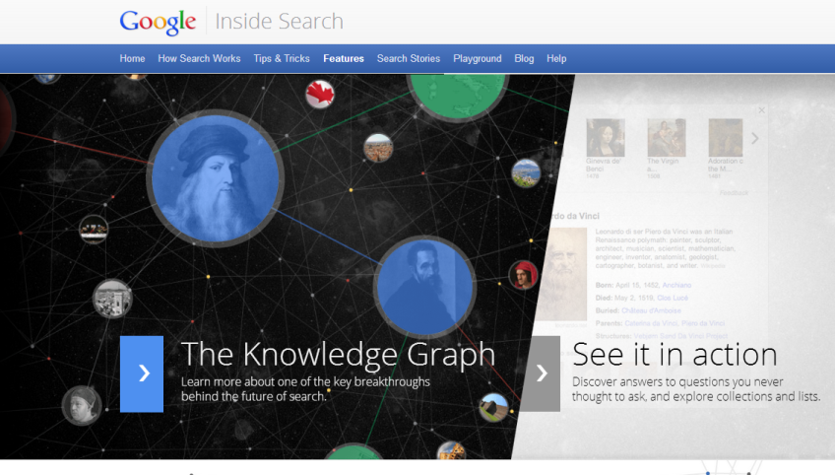
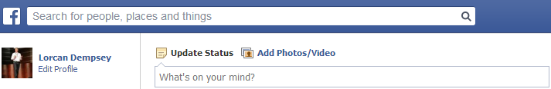
The social graph

Slide 11
Three benefits acc to Google:
Find the right thing
Get the best summary
Go deeper and broader
Within a discovery service …
Aspire to a singular identity for entities/things (people, works, places, organizations, …)
Gather data associated with those identities (e.g. ‘cards’)
Create relationships between identities.

Slide 12
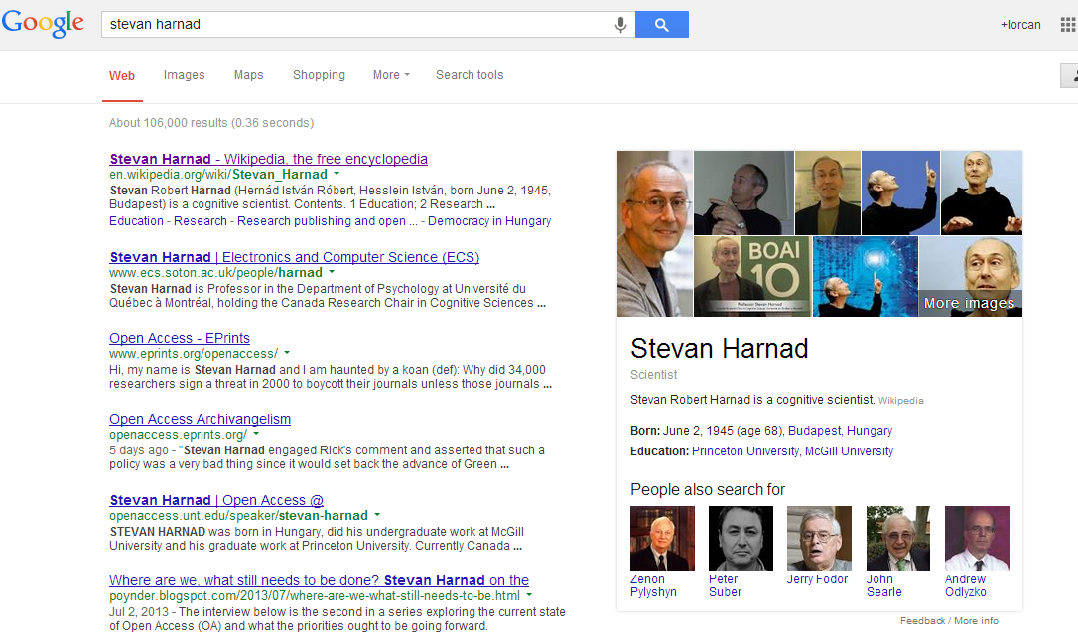

Slide 13
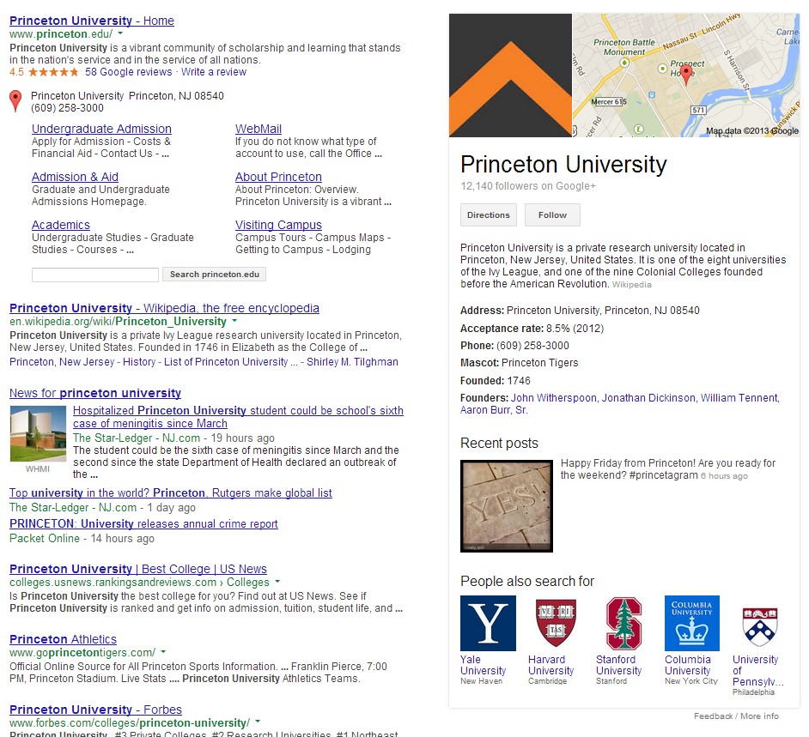

Slide 14
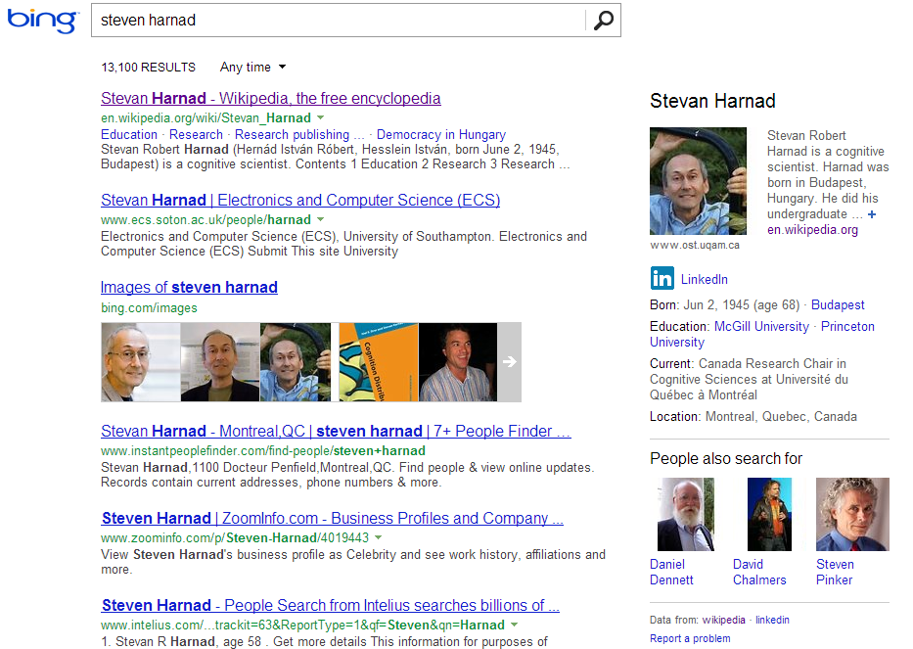

Slide 15
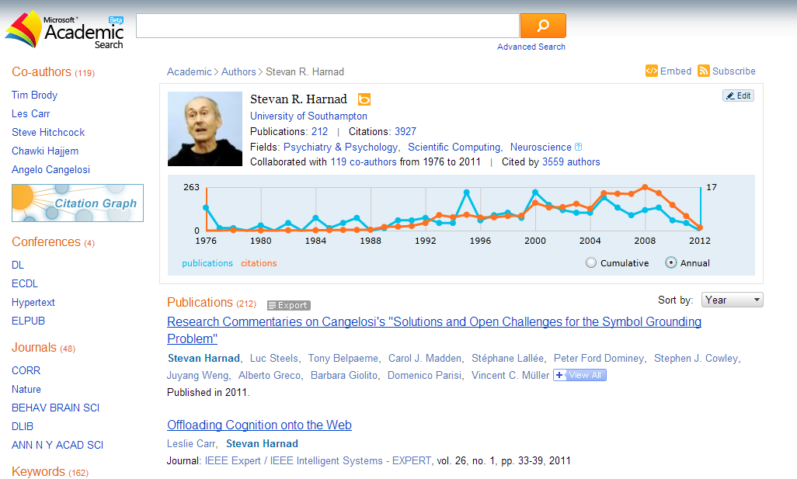

Slide 16
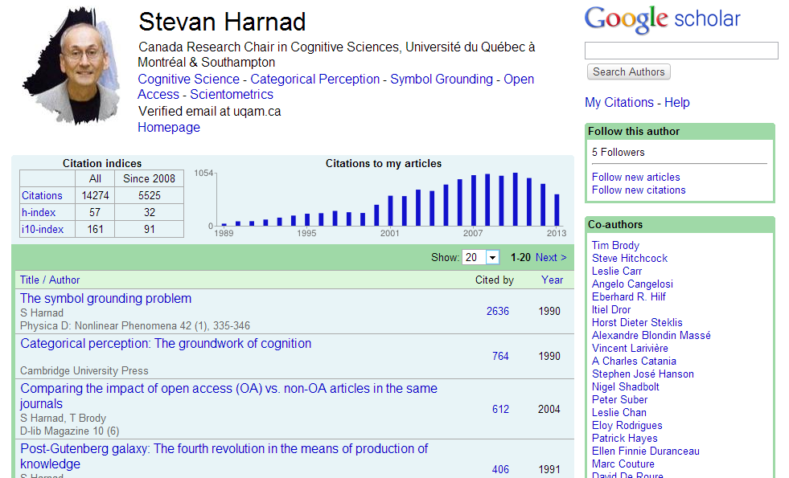

Slide 17
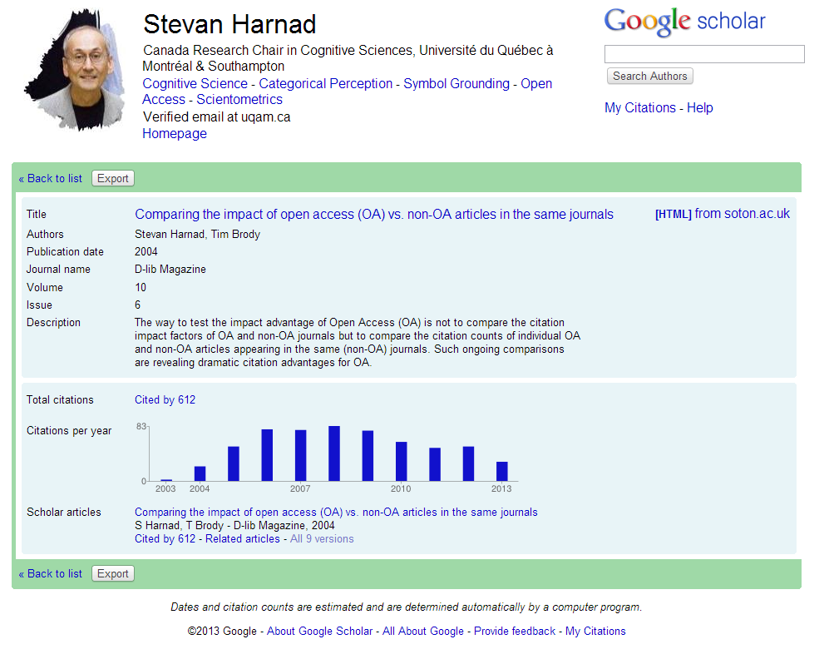

Slide 18
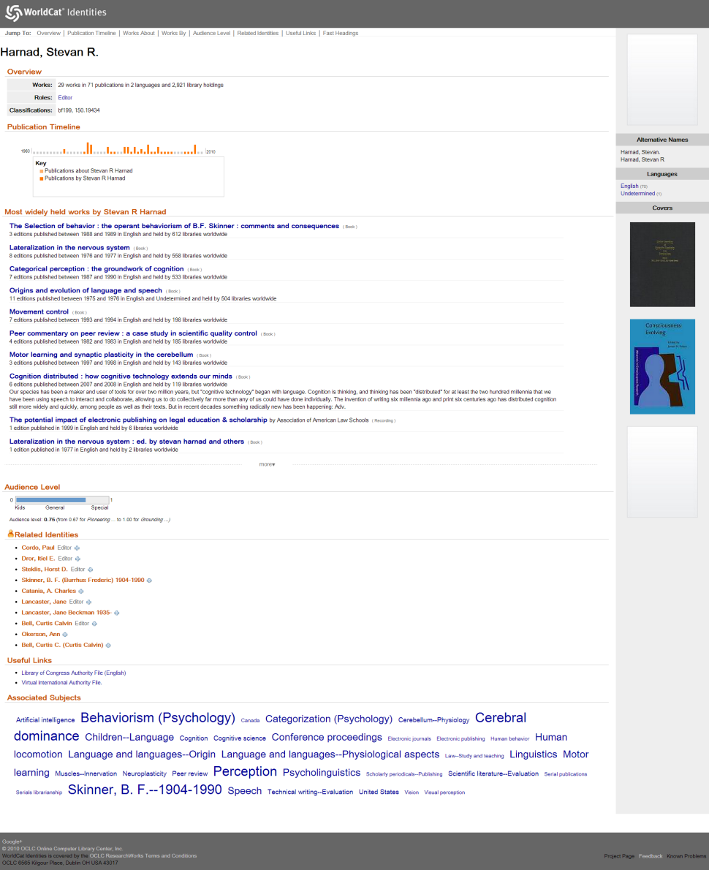
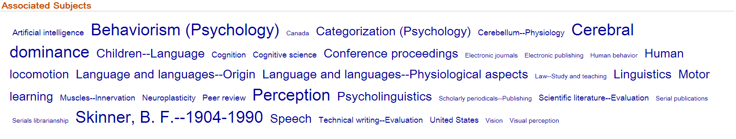

Slide 19
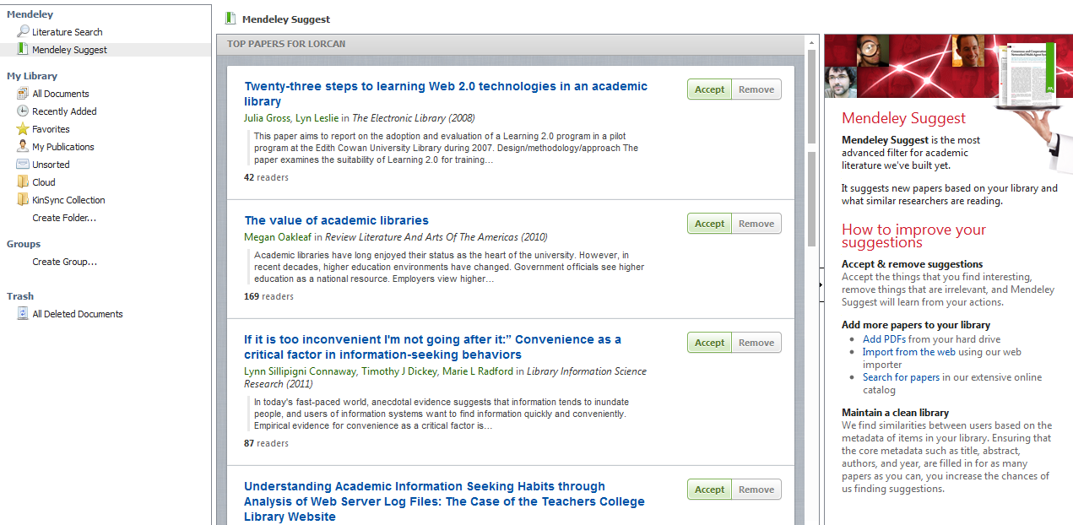

Slide 20
Make data work harder so that the user doesn’t
Create singular identity (‘entification’)
Gather information about entities (e.g. cards)
Create relationships between entities (navigation – citation, co-creation, derivative, affiliation, recommendations, …)
Strongly leverage four types of metadata about things ..
  ‘Professional’
  Crowdsourced (claiming profiles, …)
  Programmatically promoted (entity extraction, categorization, clusters, ….)
  Usage (relationships based on usage)
Now: shredding records
Future: manage entities in linked data world
Plural - Work with what you have.
Wikipedia – an addressible knowledgebase
Wikidata/Freebase – source of structured data

Slide 21
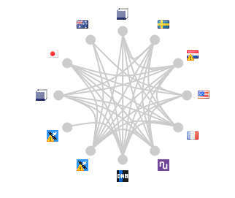





German Wikipedia
National Libraries
Submit VIAF IDs /
Show centralized data
VIAF
Matching Algorithm
Wikidata Wikibase
VIAF matches Articles /
Wikipedia shows matched IDs
Read data
3rd Party Users
Submit VIAF IDs /
Show centralized data
English Wikipedia
A small example of links/entities
Other Wikipedias

Slide 22
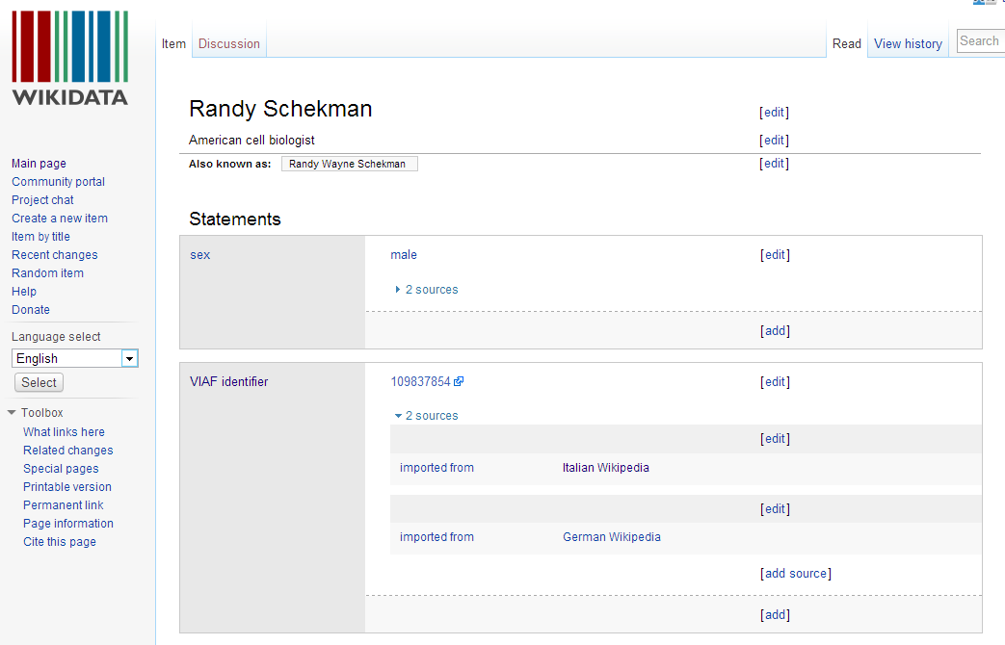

Slide 23
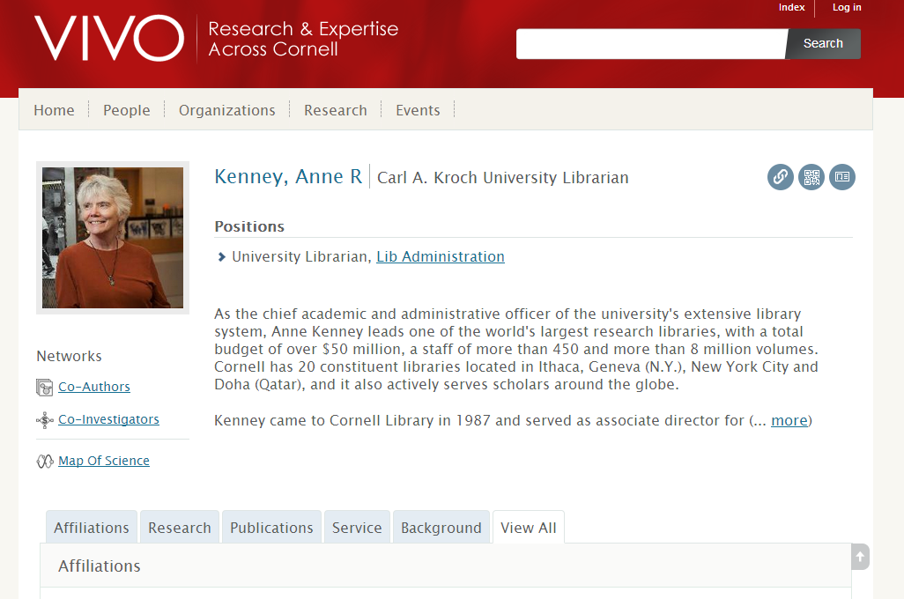
The scholarly graph?
Architecture components
  Author IDs
  Paper/work IDs
  Institutions?
Signals of interest
  Research analytics
  Research workflow
Questions
  What is the role of libraries/SHARE/….?
  Vivo?
  Who will manage entity backbones in linked data world?

Slide 24
Questions and issues …

Slide 25
Repository scope
Campus bibliography
*-prints
Digital materials
Tactical ‘structure up’/SEO
More links to entities in records - Identifiers
  Orcid, ISNI, VIAF, …
  DOI, Pubmed ID, …
Schema.org markup
Site maps; ResourceSync
What do hubs want to see? (e.g. Scholar)

Slide 26
Purposeful syndication
Share data with network/disciplinary hubs
A discovery service?
A discovery destination?
  The bar is getting higher …
A source of data for others?

Slide 27
Sourcing and scaling …
    Workflow, Repository, Disclosure, Discovery, …
  Scaling
    Rightscaling
    Different things done at different scales
    Institution, Consortium, ARL, world?
  Sourcing
    Collaboratively sourced?
    Third party?
    Existing agency?
    Multiple approaches?

Slide 28
Discovery and SHARE
What is Share’s role in creating and/or maintaining the scholarly graph?

Slide 29
Credits

Slide 30
Ack kind advice from …
Max Klein, Merrilee Proffitt, Karen Smith Yoshimura, Thom Hickey (Wikidata/Wikipedia/Viaf)
Shenghui Wang, Rob Koopman, Titia van der Werf (clustering and Europeana data)
Jeff Young, Eric Childress

Slide 31
@LorcanD

