Slide 1
4 things about discovery
Lorcan Dempsey
OCLC
@LorcanD
Big Heads – Heads of Technical Services of Large Research Libraries
ALA 2013
Chicago 28 June 2013

Slide 2
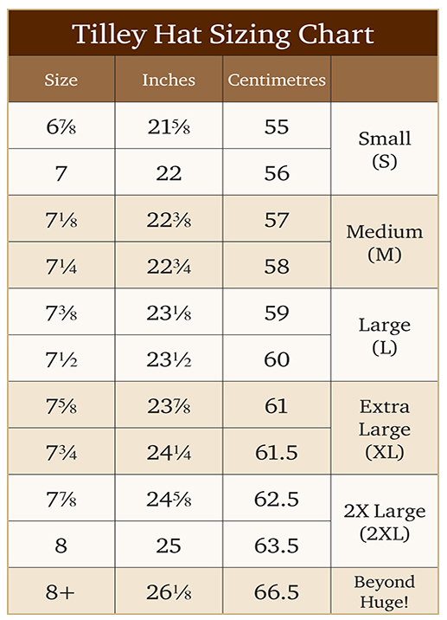
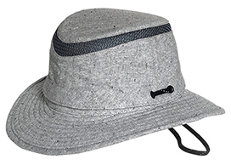
My size

Slide 3
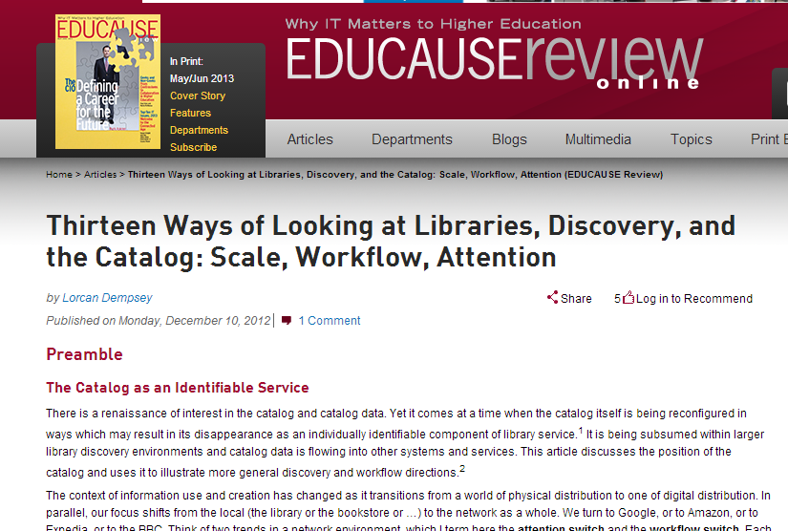
http://www.educause.edu/ero/article/thirteen-ways-looking-libraries-discovery-and-catalog-scale-workflow-attention

Slide 4
Discovery happens elsewhere
1

Slide 5
Ithaka s+r
Network-level discovery tools include disciplinary resources and powerful search tools which dramatically improve research efficiency while also increasing effectiveness. As a result, faculty discovery practices across all disciplines have continued their marked shift to the network level. This key finding has important implications for resource providers and libraries alike.
Faculty members are reducing their usage of local library services for discovery purposes and, as a result, put less value on the library’s traditional intellectual value-added role as a gateway to information.

Slide 7
Active promotion
Interpretation and promotion through social media
Syndication
Metadata
Links
Services
Search engine optimization

Slide 8
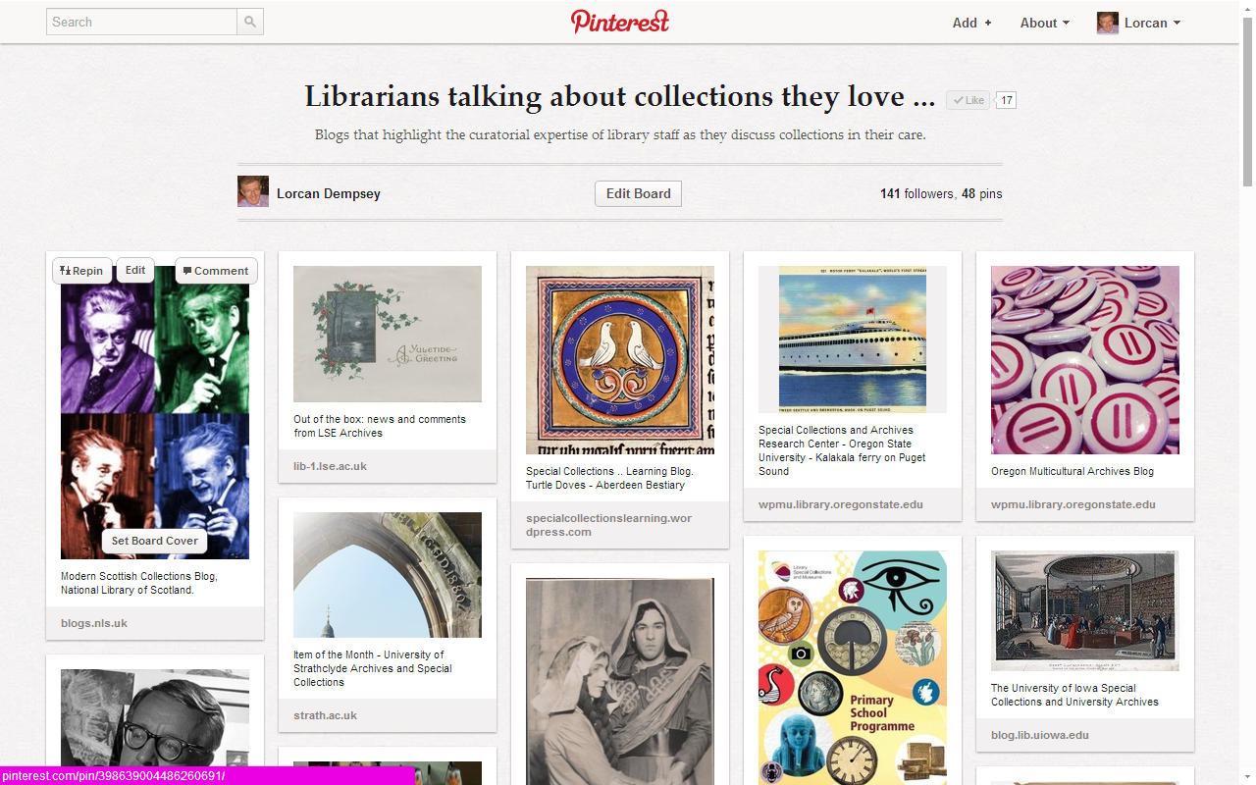

Slide 9
Outside-in vs inside-out
2

Slide 10
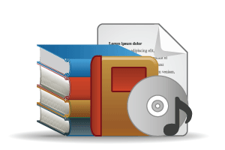
COLLECTIONS GRID (Lorcan Dempsey and Eric Childress, OCLC Research)
Stewardship/scarcity
high
low
In many collections
Low-High
Books & Journals
Newspapers
Gov Documents
CD & DVD
Maps
Scores
Low-Low
Freely-accessible web resources
Open source software
Newsgroup archives
low
Uniqueness
High Stewardship
Low Stewardship
High-Low
Research & Learning Materials
Institutional records
ePrints/tech reports
Learning objects
Courseware
E-portfolios
Research data
Prospectus
Insitutional website
High-High
Special Collections
Rare books
Local/Historical Newspapers
Local History Materials
Archives & Manuscripts
Theses & dissertations
high
In few collections

Slide 11
Collections Grid
Purchased Materials
Licensed E-Resources
In many collections
Open Web Resources
Licensed
Purchased
High Stewardship
Low Stewardship
Special Collections
Local Digitization
Research & Learning Materials
In few collections

Slide 12
Outside in Bought, licensed
Increased consolidation
Move from print to licensed
Manage down print – shared print
Move to user-driven models
Comng together of licensed and print metadata workflows
Aim: to discover
Collections
Inside out
Institutional assets: special collections, research and learning materials, institutional records, … Reputation management Increasingly important? Aim: to *have* discovered … to disclose
Notes:
Licensed content will dominate in years to come.
Special collections will grow but only modestly (and only at some institutions); mostly growth in managing archival resources including institutional.
Much greater investment in managing research outputs.
No change in web archiving.

Slide 13
Outside in collections – increased streamlining, commoditization.
Inside out collections. Growing engagement around
scholarly communication, data curation, institutional
asset management, reputation/profiles. Leverage internal/
external infrastructure.

Slide 14
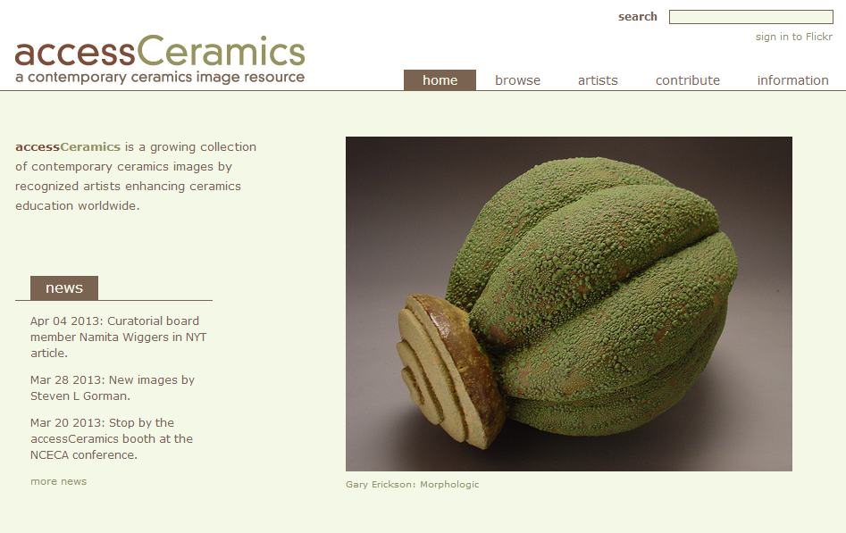
Collaboration with department around
community and learning resource
accessCeramics merges a traditional academic digital image collection's metadata capabilities with Flickr's openness and flexibility. It seeks to take advantage of Flickr's software tools and social network while also providing a web interface customized to this collection.

Slide 15
From collection to whole library
3

Slide 16
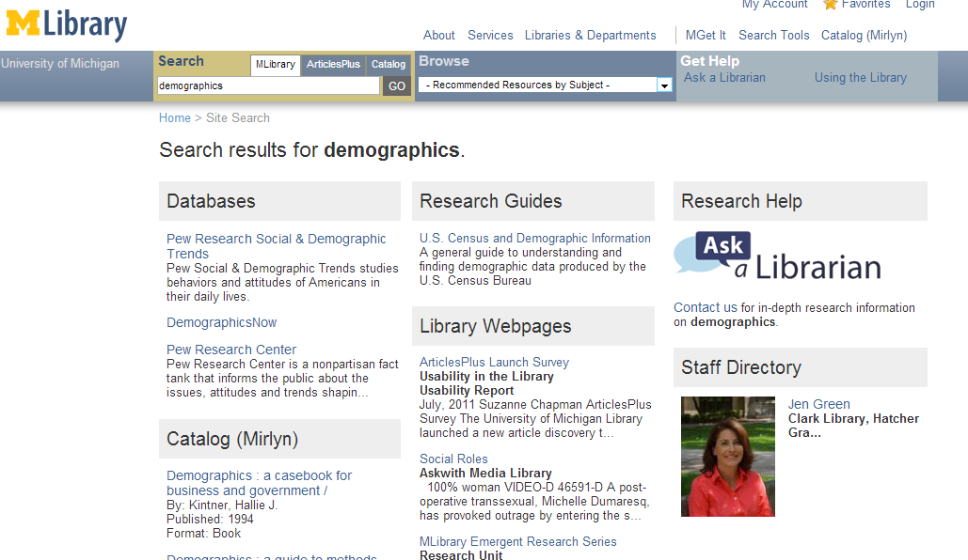

Slide 17
Remodelling
4

Slide 18
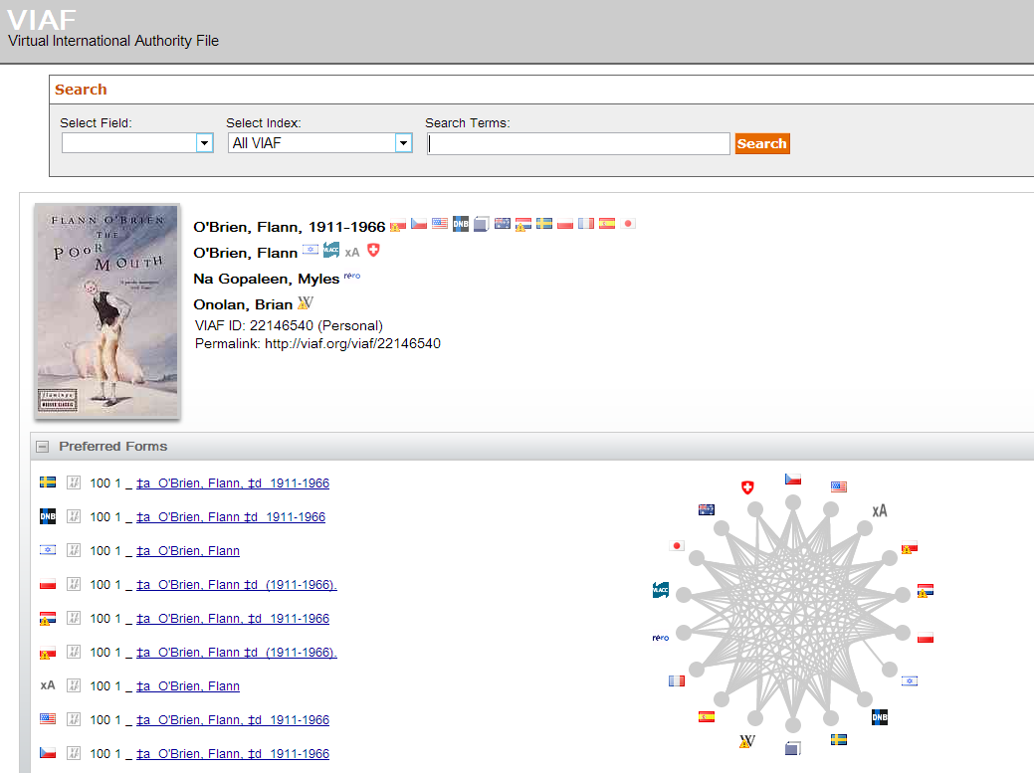

Slide 19
Schema.org
Bibframe
Linked data
Use the idiom of the web.
Authority files represent the entities – people, works, places, etc - we want to
make linked data backbones.

Slide 20
End …

Slide 21
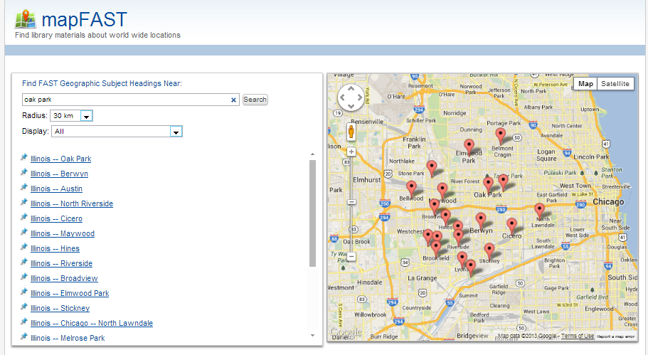

Slide 22
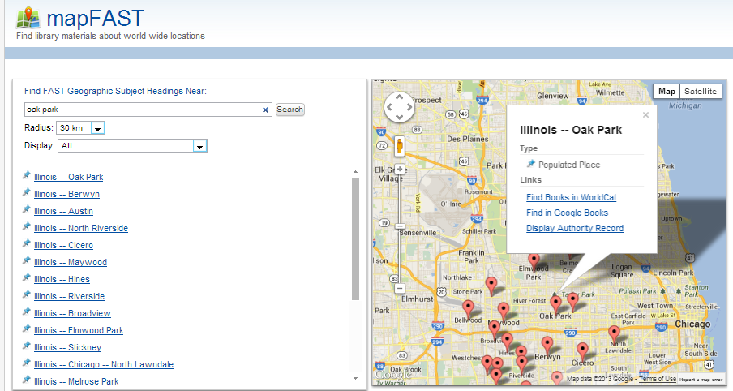

Slide 23
@LorcanD

