Slide 1
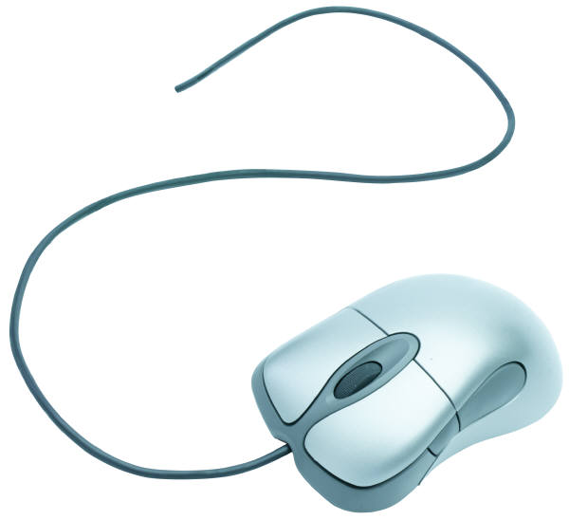
“I Don’t Have to Know,
I Go to One Spot:”
Convenience as a Critical Factor in Recent User Studies of Information Behavior
LRS-V
October 8,2010
Lynn Silipigni Connaway
Senior Research Scientist
Timothy J. Dickey
Post-Doctoral Researcher

Slide 2

Introduction
JISC-funded meta-analysis
The Digital Information Seeker:
Report of Findings from Selected OCLC, RIN, and JISC User Behaviour Projects
Notes:
Joint Information Systems Committee. “JISC inspires UK colleges and universities in the innovative use of digital technologies, helping to maintain the UK’s position as a global leader in education.” … “JISC manages and funds 215 Projects within 34 Programmes. Outputs and lessons are made available to the HE and FE community.” … “JISC also supports 49 Services that provide expertise, advice, guidance and resources to address the needs of all users in HE and FE.”
Today, we will be sharing an outcome of a Joint Information Systems Committee-commissioned synthesis of twelve multi-year, publically funded, and recent user studies, with the goal being to tease out common themes in the state of the art in user studies research.
One constant and major theme in different information-seeking behaviors is convenience. We all have anecdotal evidence from our practitioner colleagues that users want things that are convenient; today we will discuss broad-based empirical support for the notion. We will first give an overview of the general findings from this synthesis regarding convenience, then will focus on the findings from two multi-year IMLS-funded projects: Sense-making the information confluence: The whys and hows of college and university user satisficing of information needs (Sense-Making: Dervin, & Reinhard, 2006; Connaway, Prabha, & Dickey, 2006; Prabha, Connaway, & Dickey, 2006); and Seeking synchronicity: Evaluating virtual reference services from user, non-user, and librarian perspectives (Seeking Synchronicity: Radford & Connaway, 2008).

Slide 3
Theoretical Framework for Convenience
Rational Choice Theory
  Green, S.L. (2002). Rational choice theory.
“Satisficing” behavior
  Prabha, et al. (2007). What is enough? Satisficing information needs. JDoc 63(1).
Notes:
We view convenience as a situational criterion in people’s choices and actions during the information-seeking process. The concept can include their choice of an information source, their satisfaction with its ease of access and use, and their time horizon in information seeking. The framework for this understanding is founded in a web of related theoretical approaches.
Rational choice theory - even the most complex social behavior may be viewed in terms of discrete and elementary individual actions. Individuals act in their own self-interest in these actions, and that the choice among actions is rationally directed towards their own values.
Specifically, “satisficing” –rational choices during information seeking lead to satisficing behavior: “a judgment that the information is good enough to satisfy a need even though the full cost-benefit analysis was not performed” (ibid, p. 76).

Slide 4
Theoretical Framework for Convenience
Gratification Theory
  Chatman, E. (1991). Life in a small world: Application of gratification theory to information-seeking behavior. JASIS&T 42(6).
Everyday-life Information Seeking
  Savolainen, R. (2008). Everyday information practices.
Notes:
Gratification theory - Chatman (1991) introduced time horizons by applying gratification theory to information-seeking behavior of poorer demographics. Specifically, she used the “prevailing finding … that poor people seek immediate gratification … and they engage in activities that result in instantaneous pay-offs” (p. 442). The theory finds that, at least for poorer subjects, information sources must be easily accessible, and respond an immediate concern in a timely fashion.
Everyday-life information seeking (ELIS) - also emphasizes the importance of time as a contextual factor. If “time is a scarce resource for information seekers … the time available for information seeking usually permits people to access and use only a limited set of information sources” (Savolainen, 2006, p. 116).

Slide 5

Convenience in the User Studies Data
Perceptions of Libraries and Information Resources (OCLC, 2005)
  Search engines a “lifestyle fit” for speed & convenience
  Key criterion in resource choice is speed
College Students’ Perceptions of Libraries and Information Resources (OCLC, 2006)
  Use the library less since they began using the Internet
Notes:
Convenience permeates the data from the twelve studies reviewed and synthesized in The Digital Information Seeker. Here are some brief examples. The first are from the broad-based surveys conducted by OCLC.
5

Slide 6

Convenience in the User Studies Data
Researchers and Discovery Services (RIN, 2006)
  Researchers value the convenience of desktop access
Researchers’ Use of Academic Libraries (RIN, 2007)
  Convenience a major factor in behaviors
  Users expect not to spend much time in locating an item
Notes:
The Research Information Network in the UK conducted these studies of professional, postdoctoral researchers in the first case, and in the second, nearly 3000 researchers and librarians.
6

Slide 7

Convenience in the User Studies Data
Information Behavior of the Researcher of the Future (CIBER, 2008)
  Users demand 24/7 access, instant gratification
JISC National E-books Observatory Project (JISC, 2009)
  Article downloads have nearly doubled
  Convenience a major factor in usage
Notes:
The CIBER study brings evidence to bear on the “digital natives“ narrative, and the JISC produced a large transaction log analysis of e-resource usage.
7

Slide 8



Sense-making the Information Confluence: The Whys and Hows of College and University User Satisficing of Information Needs

Slide 9

Sense-making the Information Confluence
Phrases used
  convenience
  convenient
  easy to access
  quick
  fast
  saved time
  time-saver
Notes:
This study is a three-year mixed-methods study, sponsored jointly by the IMLS, OCLC, and the Ohio State University. Its data include three hundred and seven randomly sampled subjects responding to an online survey and telephone interview follow-up, seventy-eight subjects completing sense-making focus group interviews, and a subset of fifteen focus group participants randomly selected for individual semi-structured interviews.
For this presentation, all of the study data were re-coded for the incidence of language arising from our theoretical understanding of convenience.
9

Slide 10

Sense-making the Information Confluence
Undergraduates
  Google & Amazon
  Library systems
Graduate students
  Google
  Library collections, ILL
  E-books
Faculty
  Personal home or office library
  Google
  Colleague
Notes:
Regardless of academic rank, convenience emerged as a major contributing factor in individual choices as to the selection of which information strategies or resources to use. In the focus group interviews, for instance, this applied both in situations of a quick, everyday-life information search (when the subjects tended to choose Google or a home office library for reasons of convenience), and in more thorough research situations, when libraries or colleagues might emerge.
10

Slide 11
Sense-making the Information Confluence:
Academic and personal situations
Survey Question | # of convenience phrases
Situation in university life where you used electronic resources | 88
Situation specifically involving research | 83
Situation in life outside university where you used electronic resources | 64
Troublesome situation in university life | 39
Troublesome situation in life outside university | 11
TOTAL: | 285
Notes:
In the online surveys, on the other hand, questions about research-related situations (the first two questions above) elicited MORE convenience-related language even than in the ELIS situations (the final pair).
11

Slide 12
Sense-making the Information Confluence:
Sources used
Information sources used (from a list provided in the survey) | Convenience phrases | Convenience phrases where source helped | Convenience phrases where source did not help
Internet search engine | 56 | 52 | 4
Electronic databases | 48 | 44 | 1
College or university libraries | 17 | 12 | 5
Library catalogs | 8 | 6 | 2
Own observations | 6 | 5 | 1
Journal articles | 6 | 4 | 2
Students, classmates | 5 | 5 | 0
Public libraries | 5 | 2 | 3
Newspapers | 5 | 2 | 3
Notes:
When the telephone follow-up to the survey questions delved into the specific sources that respondents used in each situation, convenience most often appeared as a factor when they were using Internet search engines, electronic databases, or the college/university libraries.
And far more often, their mentioning a source’s convenience were in cases where they answered that the particular source helped their information search. At the same time, some of the times they claimed that the source hindered their information search, lack of convenience or time-saving was apparently part of the problem they experienced.
12

Slide 13

Magic Wand: Ideal Information System
Undergraduates
  Keyword searching in all books
  Universal library catalog
  Roving library staff
  Federated searching in databases
  Better hyperlinks
Graduate students
  Better book/journal delivery systems
Faculty
  Selective Dissemination of Information
  VRS
Notes:
Finally, the participants were asked to imagine an ideal information system, created via a “magic wand.”
Several comments from each population speak to the convenience that they hoped to achieve. Ideas from undergraduates include the ability to use keyword searching in all books (a prophecy of Google Book Search?), a universal library catalog for all libraries, reference staff that conveniently rove about the library (“…where they have people who walk around and are there available to help you not always just confined behind a desk where you have to go up and they’re like, well if you take a left after that bookcase then a right.” FG-2), federated search in databases (speaking to both time saving and ease of use), and better hyperlinks. Graduate students desired better book and journal delivery systems, presumably for the convenience of receiving materials in their office (“But other times, it says you have to actually go get the article, and I do a lot of research under a lot of supervisors and stuff. So it’s such a drag.” FG-6). Faculty mention selective alerts for new information in their field, termed Selective Dissemination of Information (SDI) in information science; although the respondents did not use the technical term, they described the service (“…a constant perusing of what’s available and if something is new that gets a hit, it's automatically directed to us whether we ask for it or not.” FG-1), as well as virtual reference services available from their computer (“Something that I really liked about our website, was the ask a librarian icon.” FG-9).
This brings us to the second study.
13

Slide 14
Seeking Synchronicity:
Evaluating Virtual Reference Services from User, Non-user, and Librarian Perspectives

Slide 15
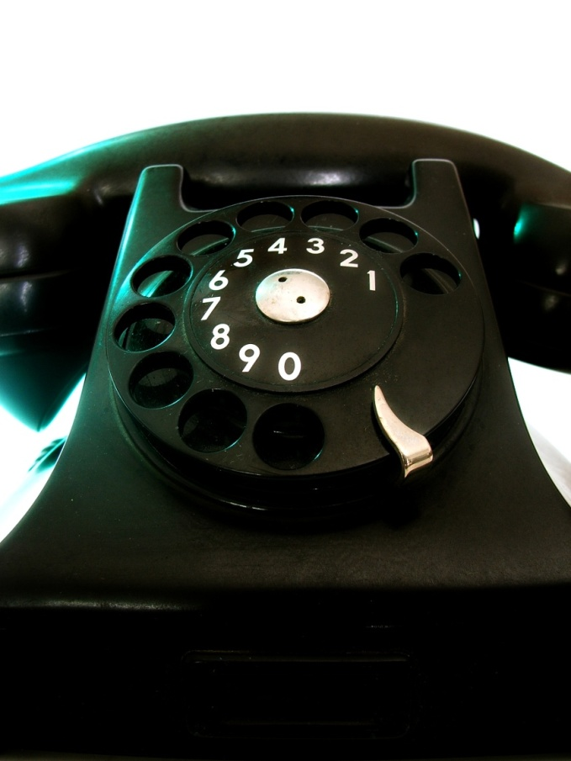
Seeking Synchronicity: VRS Users
Very Important or Important
Convenience
  97% (n=133) of all respondents
  98% (n=58) of frequent VRS users
Immediate answers
  89% (n=122) of all respondents
  92% (n=54) of frequent VRS users
Notes:
The Seeking Synchronicity project studied the needs, behaviors, and impressions of users, non-users, and librarian providers of virtual reference services (VRS) (Radford & Connaway, 2008). The respondents for this study included both academics and the general public. Both user and non-user data will be included in this discussion. Phase I of the project incorporated eight exploratory focus group interviews; Phase II examined a random sample of actual VRS transcripts. In the third phase, members of each population (see Table 1 below) responded to online surveys, which included both quantitative (comparisons and Likert scale questions) and qualitative (open-ended discussions about positive and negative experiences with reference services) data; in Phase IV, telephone interviews were conducted with VRS users and non-users and results were transcribed and analyzed for themes emerging from the data. For the present study, a wide variety of quantitative and qualitative questions which evinced data on convenience, ease of access and use, and time as a context in individual decisions were considered.
For example, out of the VRS users’ online survey respondents (N=137) – as well as the responses of the “frequent“ VRS users (N=59) – convenience and immediate answers were the two most important features about the service.
15

Slide 16
Convenience as factor in information seeking: VRS Users
Notes:
Convenience factors scored uniformly high among both users (N=137, see Table 7, below) and non-users (N=184, see Table 10 below). In many cases, the “frequent” users of VRS (N=59), defined for this purpose as respondents who reported using virtual reference 4-6 times or more, rated convenience even higher than less frequent users in their choice to use the service.
Users (and especially frequent users) rated the chat medium as the “most efficient” of all reference modes
Users (and especially frequent users) rated the chat medium as the “most efficient” of all reference modes, and rated the “convenience of my access” to VRS as excellent or very good.
16

Slide 17
Factors important when choosing VRS:
VRS Users
Notes:
When asked to rate different factors which affect their decision to use VRS, 95% of users (100% of frequent users) cited convenience directly
When asked to rate different factors which affect their decision to use VRS, 95% of users (100% of frequent users) cited convenience directly; needs for information late at night or on the weekend, at times when the subject could not get to a library, or when there was a “desperate need for quick answers” also rated highly in their choice. (N=57 for this question only)
When asked to rate different factors which affect their decision to use VRS, 95% of users (100% of frequent users) cited convenience directly; needs for information late at night or on the weekend, at times when the subject could not get to a library, or when there was a “desperate need for quick answers” also rated highly in their choice.
When asked to rate different factors which affect their decision to use VRS, 95% of users (100% of frequent users) cited convenience directly; needs for information late at night or on the weekend, at times when the subject could not get to a library, or when there was a “desperate need for quick answers” also rated highly in their choice.
17

Slide 18
Factors important when choosing VRS:
VRS Users
Notes:
The youngest cohort of respondents was more likely to express a “desperate need for quick answers” than the oldest group, and also more likely to request faster software.

Slide 19
Reasons for chat as first choice for information:
VRS Users
Notes:
The same two aspects of their experience with VRS also emerged in their responses to a question probing for the kind of situation when chat is their first choice of mode for obtaining reference services (question 3); in this case specific aspects of convenience include after-hours need, online workflow, and being at a home or office.

Slide 20

Comparing specific aspects of FtF:
VRS Non-Users
Convenience of my access to FtF reference help is
  45%, (n=83) Excellent or very good
Don’t choose chat reference because it may be unavailable when needed
  60%, (n=110)
  Strongly agree or agree
* VRS non-users (N=184)
Notes:
Likewise among the non-users of VRS (these individuals did use libraries, they just did not use VRS) surveyed, convenience emerged as a factor in choices in their library information seeking. When responding to a question about the convenience of their access to face-to-face reference services (FtF), almost half rated it excellent or very good (a much less enthusiastic endorsement than the 95% of VRS users who rated the convenience of VRS excellent or very good).
For those who prefer reference services by telephone or email, both physical and temporal convenience played a negative role in their choice not to use a library, and the fear that “Chat reference might not be offered at times I need the service” was a significant deterrent expressed as a reason these non-users had not tried VRS

Slide 21
Comparing specific features of other formats:
VRS Non-Users
Notes:
Please note that:
The library is convenient: N=137 preferring library, but 138 answered the question, (116/138, 84%)
The telephone is convenient: N=9 preferring telephone, but 26 answered the question, (19/26, 73%)
Electronic formats are convenient: N=38 preferring electronic, but 55 answered the question, (50/55, 91%)
However, when asked about the convenience of their preferred mode of obtaining reference assistance, a large majority cited the convenience of whichever specific mode was their preference

Slide 22
Convenience as factor in choosing information sources:
VRS Non-Users
Notes:
Responses by VRS non-users to four questions in their telephone interviews also provided data related to convenience as a major factor in their individual choices while seeking information. When asked in the most general sense to “Think about a time you needed to know something,” a large majority responded that they would find the information themselves, potentially a very convenient and easy choice. Almost all of the remaining interviewees (with some overlap to the “find it myself” answer) responded with some form of electronic resource; this is not explicitly a convenience choice, but implicitly.

Slide 23
Alternatives to the library and why:
VRS Non-Users
Notes:
Note: Question 3 N=104 for some questions
Similarly, when asked to consider times when they chose an alternative to the library, the largest number of respondents mentioned the Internet as a resource, with numerous references to specific online (and implicitly more convenient) resources.

Slide 24
Possible reasons for trying chat:
VRS Non-Users
Notes:
When asked to hypothesize about what might convince them to try asking a librarian for help using a chat reference service, the single greatest factor was some form of convenience (“It would be convenient, because if I was sitting at a computer and I could ask a question and they would answer immediately… that would be good.. Convenience is why I do something as opposed to something else.” N-131). This included a large number of respondents who could foresee an immediate need for answers, those who would value using VRS from home in a variety of circumstances, and those who would use the service at a time that was after library hours.

Slide 25

Implications for Practice
Make library experience more like the Web
  Google, Amazon.com, iTunes
Provide more authoritative, reliable digital sources
  e-journals, data sets, VREs, open source materials, multimedia objects, blogs
Advertise library brand better
Develop economic model for resources
Notes:
In order to entice people to use libraries and to change their perceptions of libraries, the library experience needs to become more like that available on the web (e.g., Google, Amazon.com, iTunes, etc.) and to be embedded in individual workflows. The web environment is familiar to users; therefore, they are comfortable and confident choosing to search for information there. Librarians need to adapt or seek to purchase services and systems that are designed to replicate the web environment so that they are perceived as convenient and easy to use.
Access to sources, not the discovery of sources, is the concern of information-seekers. People lack the patience to wade through content silos and indexing and abstracting databases. They expect seamless access to resources such as full text e-journals, online foreign-language materials, e-books, a variety of electronic publishers’ platforms, and virtual reference desk services (Connaway, & Dickey, 2010, p. 46-47). To meet these expectations, it is recommended that librarians should provide more authoritative, reliable digital sources through the library systems and services, from e-journals to curated data sets, as well as emerging services such as virtual research environments (VREs), open source materials, non-text-based and multimedia objects, and blogs.
Librarians also must advertise the library brand and its resources better to academics, researchers, students, and the general public. Demonstrating the library’s value can be accomplished by identifying and promoting collections and services. One size does not fit all for library services, which need to be offered in multiple delivery modes to meet the different information needs of users in different situations. This versatility and flexibility is difficult in the current economic environment, but warrants further investigation.
The development of an economic model for the allocation of resources for the different delivery modes for library services would benefit all types of libraries. This would not only enable optimal scheduling of human resources for services but also the allocation of funds for both electronic and print resources based on user preferences.

Slide 26
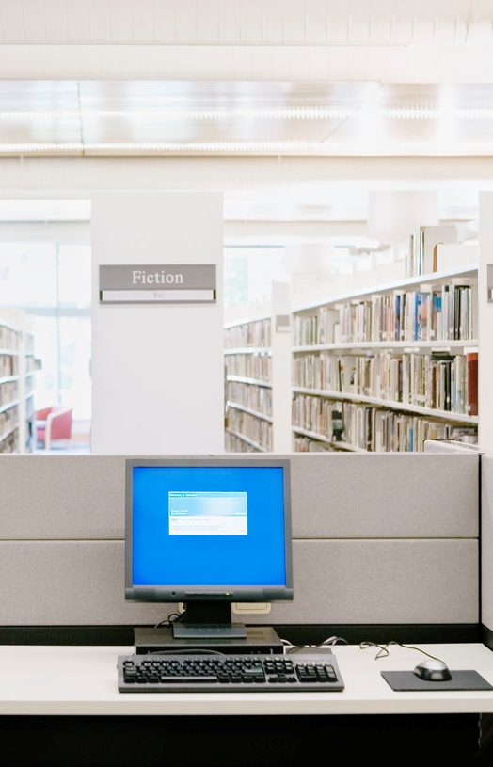
Implications for Research
Investigate how and why people get information in different contexts and situations
Theoretical research combining individual and social factors that influence information-seeking behaviors
Notes:
There is a need for further study of user behaviors to address how library users find information in different contexts and situations. Vakkari (1997) calls for “studies which will concentrate more on contextual factors, and then combine the results with those of studies using more individual factors” (p.463). An approach like this would provide theoretical research that combines both the individual and social factors that influence information-seeking behaviors (Connaway & Dickey, 2010).
As seen above, in some situations information seekers will readily sacrifice content for convenience. Convenience is thus one of the primary criteria used for making choices during the information-seeking process. Convenience includes the choice of the information source (is it readily available online or in print), the satisfaction with the source (does it contain the needed information and is it easy to use), and the time it will take to access and use the information source (how long will it take to access). In the current environment, most people do not have time to spend searching for information or for learning how to use a new information source or access method. In order to be one of the first choices for information, library systems and interfaces need to look familiar to people by resembling popular web interfaces and library services need to be easily accessible and to require little or no training to use. Convenience is a critical factor for users across all demographic categories, and is liable to remain so going forward.

Slide 27
Connaway, LS & Dickey, TJ. (2010). The Digital Information Seeker: Report of Findings from Selected OCLC, RIN, and JISC User Behaviour Projects. London: HECFCE.
Perceptions of libraries and information resources (OCLC, December 2005).
College students’ perceptions of libraries and information resources (OCLC, April 2006).
Sense-making the information confluence: The whys and hows of college and university user satisficing of information needs (IMLS/Ohio State University/OCLC, July 2006).
Researchers and discovery services: Behaviour, perceptions and needs (RIN, November 2006).
Researchers’ use of academic libraries and their services (RIN/CURL, April 2007).
Information behaviour of the researcher of the future (CIBER/UCL, commissioned by BL and JISC, January 2008).
http://www.jisc.ac.uk/media/documents/publications/reports/2010/digitalinformationseekerreport.pdf

Slide 28
Connaway, LS & Dickey, TJ. (2010). The Digital Information Seeker: Report of Findings from Selected OCLC, RIN, and JISC User Behaviour Projects. London: HECFCE
Seeking synchronicity: Evaluating virtual reference services from user, non-user and librarian perspectives (OCLC/ IMLS/ Rutgers, June 2008).
Online catalogs: What users and librarians want (OCLC. March 2009).
E-journals: Their use, value and impact (RIN, April 2009).
JISC national e-books observatory project: Key findings and recommendations (JISC/UCL, November 2009).
Students’ use of research content in teaching and learning (JISC, November 2009).
User behaviour in resource discovery (JISC, November 2009).
http://www.jisc.ac.uk/media/documents/publications/reports/2010/digitalinformationseekerreport.pdf

Slide 29

Questions

