Slide 1
Developing Engagement with Institutional Services to Meet the Needs of Digital Visitors and Residents
ALA, Chicago, June 27-July 2, 2013
Lynn Silipigni Connaway, Ph. D.
Senior Research Scientist OCLC
connawal@oclc.org & @LynnConnaway
Donna Lanclos, Ph. D.
Associate Professor for Anthropological Research
University of North Carolina, Charlotte
dlanclos@uncc.edu & @DonnaLanclos
David White
Co-manager, Technology Assisted Lifelong Learning
University of Oxford
david.white@conted.ox.ac.uk & @daveowhite
Erin M. Hood, M.L.I.S.
Research Support Specialist
OCLC
hoode@oclc.org & @ErinMHood1
This work is licensed under a Creative Commons Attribution 3.0 Unported License. http://creativecommons.org/licenses/by/3.0/
Notes:
Lynn

Slide 2
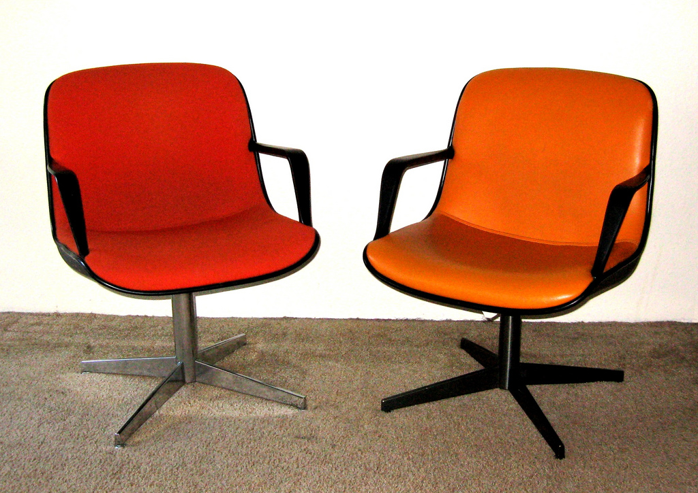
Overview
Notes:
Image: http://www.flickr.com/photos/toddmecklem/2730613340/
Lynn

Slide 3
Visitors and Residents: What motivates engagement with the digital information environment?
Partners
JISC (UK funding body)
OCLC
Lynn Silipigni Connaway, Ph.D.
Erin M. Hood, M.L.I.S.
Oxford University
David White
Alison Le Cornu, Ph.D.
University of North Carolina, Charlotte
Donna Lanclos, Ph.D.
Notes:
Image from: http://www.flickr.com/photos/myxi/712710373/
Lynn
The Digital Visitors and Residents (V&R) project is a US/UK collaborative project, funded by JISC, OCLC Online Computer Library Center, Inc., Oxford University, and the University of North Carolina, Charlotte.
“This paper reports the initial findings of a three-year longitudinal study to identify how late-stage secondary school and first-year undergraduate students in the US and UK, referred to here as members of the “Emerging” educational stage, engage with technology and information sources. The assumptions embedded in traditional academic library services and systems and the existing disconnect between the everyday information-seeking behaviors of members of the Emerging stage (last year high school/secondary school or first year college/university) are examined. Initial results highlight the importance of convenience as a crucial factor in information-seeking behavior. There also are indications that as users progress through the educational stages, the digital and information literacies they employ do not necessarily become more sophisticated.” (Connaway, Lanclos, and Hood, 2013)
Connaway, Lynn Silipigni, Donna Lanclos, and Erin M. Hood. “‘I find Google a lot easier than going to the library website.’ Imagine Ways to Innovate and Inspire Students to Use the Academic Library.” Proceedings of the Association of College & Research Libraries (ACRL) 2013 conference, April 10-13, 2013, Indianapolis, IN, 2013, http://www.ala.org/acrl/sites/ala.org.acrl/files/content/conferences/confsandpreconfs/2013/papers/Connaway_Google.pdf.

Slide 4
Project Phases
Phase 1
Interviewed 31 (16 US/15 UK) Emerging educational stage individuals
Last year of secondary/high school & first year of university
Majority of students aged 18 & 19 with a few outliers
Phase 2
Interviewed
10 (5 US/5 UK) Establishing second/third year undergraduate),
10 (5 US/5 UK) Embedding (postgraduates, PhD students), &
10 (5 US/5 UK) Experienced (Scholars) stages
Some Phase 1 participants agreed to submit monthly diaries
Notes:
Image: Microsoft Office
Lynn
The findings will be used to create a matrix of implementation options allowing those designing and delivering digital platforms and services to make informed decisions relative to engagement and motivation for individuals at each of the educational stages.
Work as an interdisciplinary team, bringing to bear our relative expertises in Educational Technology, Library Information and Science/Research Methodology (User behaviour), and Anthropology (Ethnography)
Phase 1
Individual Interviews
Emerging (secondary school/1st year undergraduates: 31 (16 US, 15 UK)
Establishing (2nd-3rd year undergraduates): 10 (5 US, 5 UK)
Embedding (postgraduates, PhD students): 10 (5 US, 5 UK)
Experiencing (scholars): 10 (5 US, 5 UK)
Phases 1 & 2: Participant Demographics
61 participants: 15 secondary students/46 university students & faculty
34 females/27 males
38 Caucasian/5 African-American/2 Multi-racial/1 Asian/2 Hispanic/13 Unidentified

Slide 5
Project Phases, cont.
Phase 3
Interviewed second group of 6 students in the Emerging stage
Phase 4
In-depth survey
50 participants from each educational stage in both US & UK
Code, analyze, & compare data
4
Notes:
Image: Microsoft Office
Lynn
Phase 3
Interviewed a second group of 6 students in the Emerging stage
This will help to determine if methods of engagement are changing over time
Phase 4
Test interview and diary results with in-depth survey of 50 participants from each educational stage
Code data to refine emerging findings and explore possible trends

Slide 6
Resident Mode
Visible and persistent online presence
Collaborative activity online
Contribute online
Internet is a place
Notes:
Image: Microsoft Office
Dave
Residents: significant online presence and usage; high level of collaborative activity online; contributions to the online environment in the form of uploading materials, photos, videos;

Slide 7
Visitor Mode
Functional use of technology
Formal need
Invisible online presence
Internet is a toolbox
Notes:
Image: Microsoft Office
Dave
Visitors: functional use of technology, often linked to formal need (such as use of software for specific coursework, or organising meetings through email contact); less visible/more passive online presence, more likely to favour face- to- face interactions (even as they use the internet to organize/schedule those interactions);

Slide 8
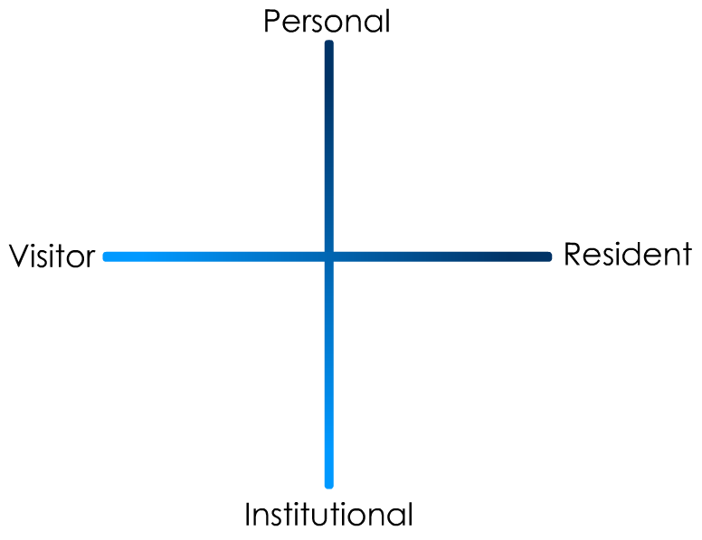
(Connaway and White for OCLC Research, 2012.)
Notes:
Dave
“In simple terms the Visitors see the web as a series of tools. They decide what they want to achieve, chose an appropriate online tool to do the job, then log-off. They leave no social trace of themselves online. The Residents live a proportion of their lives online. They see the web as a place where they can express themselves and spend time with people. Residents will have a profile on a social networking platform and aspects of their persona, or digital identity, maintaining presence even when they are not online. The premise of V&R is presented as a continuum whereby individuals’ modes of engagement will be more Visitor or Resident depending on their personal motivations and the context and situation at the time.” (Connaway, Lanclos, and Hood, 2013)
Connaway, Lynn Silipigni, Donna Lanclos, and Erin M. Hood. “‘I find Google a lot easier than going to the library website.’ Imagine Ways to Innovate and Inspire Students to Use the Academic Library.” Proceedings of the Association of College & Research Libraries (ACRL) 2013 conference, April 10-13, 2013, Indianapolis, IN, 2013, http://www.ala.org/acrl/sites/ala.org.acrl/files/content/conferences/confsandpreconfs/2013/papers/Connaway_Google.pdf.
First Monday Paper: http://is.gd/vandrpaper
Video: http://is.gd/vandrvideo

Slide 9
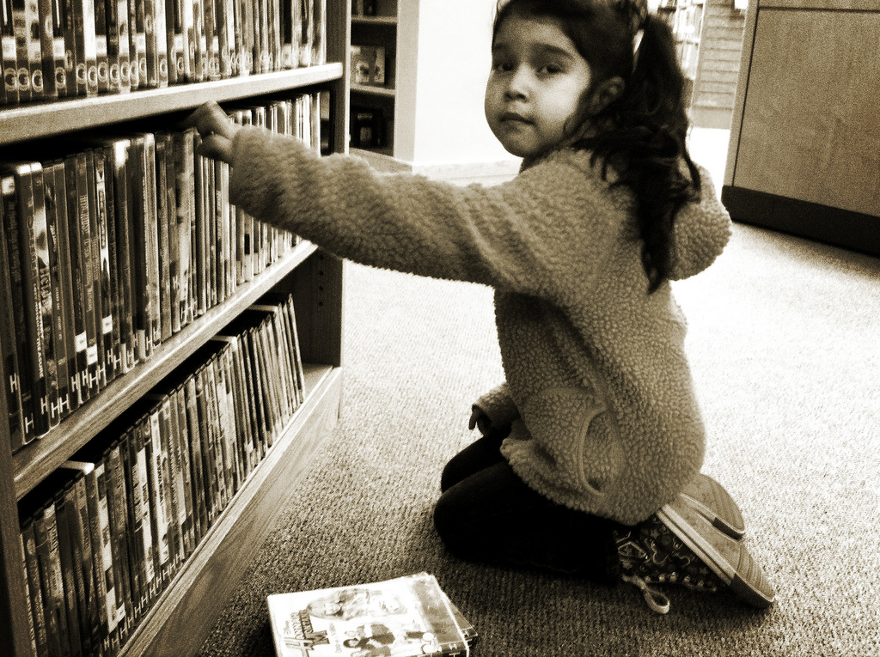
Mapping of Personal Behavior
Notes:
Image: http://www.flickr.com/photos/jasonlparks/5242709536/
Dave

Slide 10
(Connaway and White for OCLC Research, 2012.)
Notes:
Dave
“In simple terms the Visitors see the web as a series of tools. They decide what they want to achieve, chose an appropriate online tool to do the job, then log-off. They leave no social trace of themselves online. The Residents live a proportion of their lives online. They see the web as a place where they can express themselves and spend time with people. Residents will have a profile on a social networking platform and aspects of their persona, or digital identity, maintaining presence even when they are not online. The premise of V&R is presented as a continuum whereby individuals’ modes of engagement will be more Visitor or Resident depending on their personal motivations and the context and situation at the time.” (Connaway, Lanclos, and Hood, 2013)
Connaway, Lynn Silipigni, Donna Lanclos, and Erin M. Hood. “‘I find Google a lot easier than going to the library website.’ Imagine Ways to Innovate and Inspire Students to Use the Academic Library.” Proceedings of the Association of College & Research Libraries (ACRL) 2013 conference, April 10-13, 2013, Indianapolis, IN, 2013, http://www.ala.org/acrl/sites/ala.org.acrl/files/content/conferences/confsandpreconfs/2013/papers/Connaway_Google.pdf.
First Monday Paper: http://is.gd/vandrpaper
Video: http://is.gd/vandrvideo

Slide 11
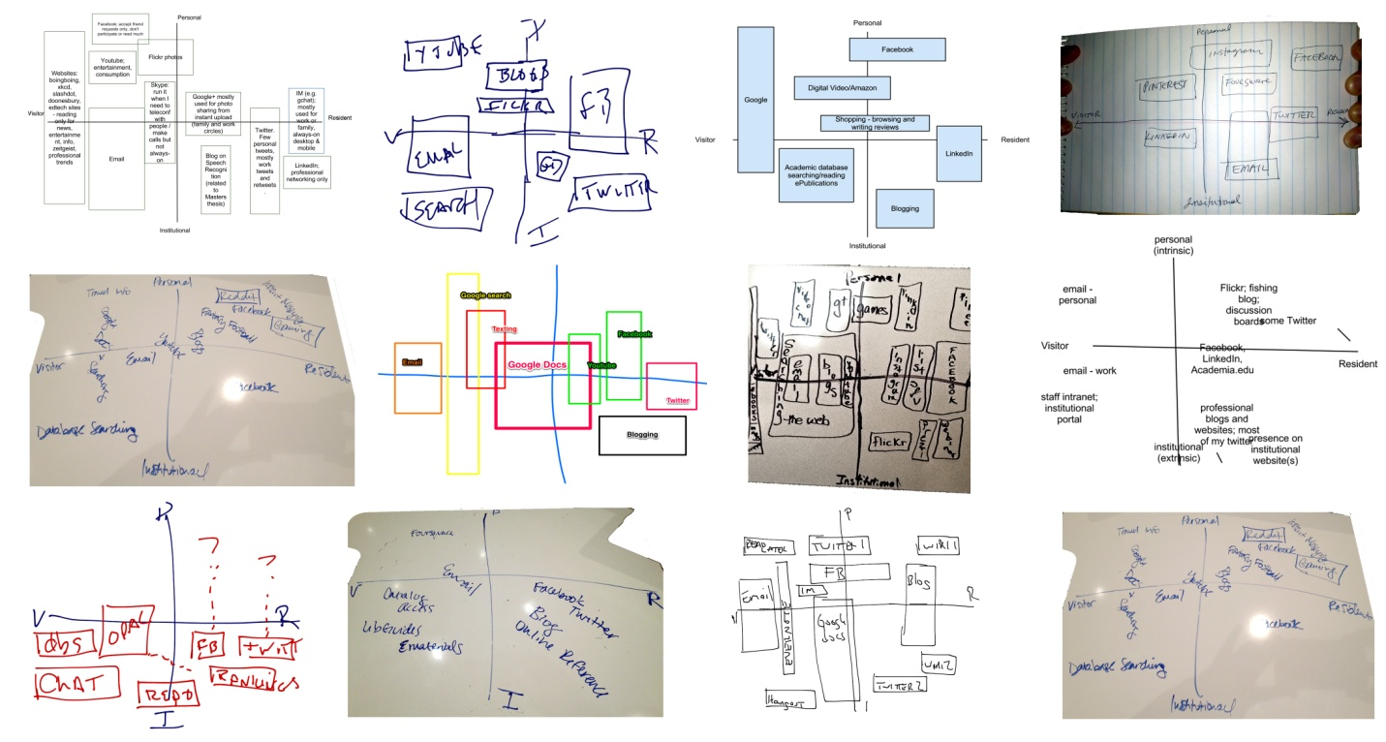
How to Share
Google Doc
Donna.lanclos@gmail.com
Email
connawal@oclc.org
Take a photo and email
Donna.lanclos@gmail.com
connawal@oclc.org
Twitter
#VandR #Me
Whatever else you can think of!
(Courtesy of David White)
Notes:
Donna

Slide 12
Discussion of Personal Mapping
Notes:
Image: http://www.flickr.com/photos/ejpphoto/6307523224/
Donna

Slide 13
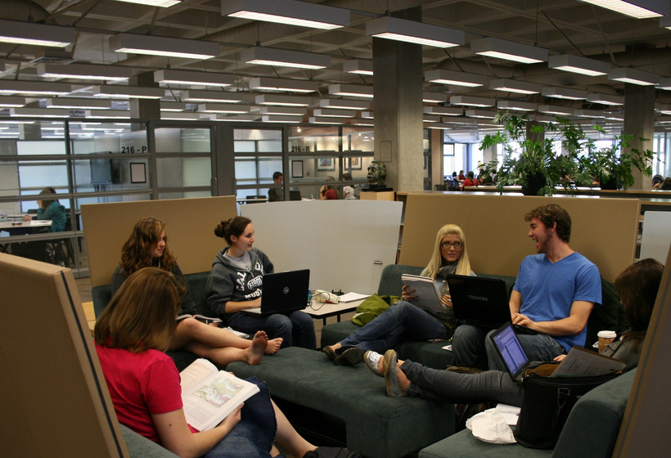
Mapping of Perceptions of Constituent Behavior
Notes:
Image: http://www.flickr.com/photos/kennedylibrary/4312501994/
Dave

Slide 14
(Connaway and White for OCLC Research, 2012.)
Notes:
Dave
“In simple terms the Visitors see the web as a series of tools. They decide what they want to achieve, chose an appropriate online tool to do the job, then log-off. They leave no social trace of themselves online. The Residents live a proportion of their lives online. They see the web as a place where they can express themselves and spend time with people. Residents will have a profile on a social networking platform and aspects of their persona, or digital identity, maintaining presence even when they are not online. The premise of V&R is presented as a continuum whereby individuals’ modes of engagement will be more Visitor or Resident depending on their personal motivations and the context and situation at the time.” (Connaway, Lanclos, and Hood, 2013)
Connaway, Lynn Silipigni, Donna Lanclos, and Erin M. Hood. “‘I find Google a lot easier than going to the library website.’ Imagine Ways to Innovate and Inspire Students to Use the Academic Library.” Proceedings of the Association of College & Research Libraries (ACRL) 2013 conference, April 10-13, 2013, Indianapolis, IN, 2013, http://www.ala.org/acrl/sites/ala.org.acrl/files/content/conferences/confsandpreconfs/2013/papers/Connaway_Google.pdf.
First Monday Paper: http://is.gd/vandrpaper
Video: http://is.gd/vandrvideo

Slide 15
How to Share
Google Doc
Donna.lanclos@gmail.com
Email
connawal@oclc.org
Take a photo and email
Donna.lanclos@gmail.com
connawal@oclc.org
Twitter
#VandR #Them
Whatever else you can think of!
Notes:
Donna

Slide 16
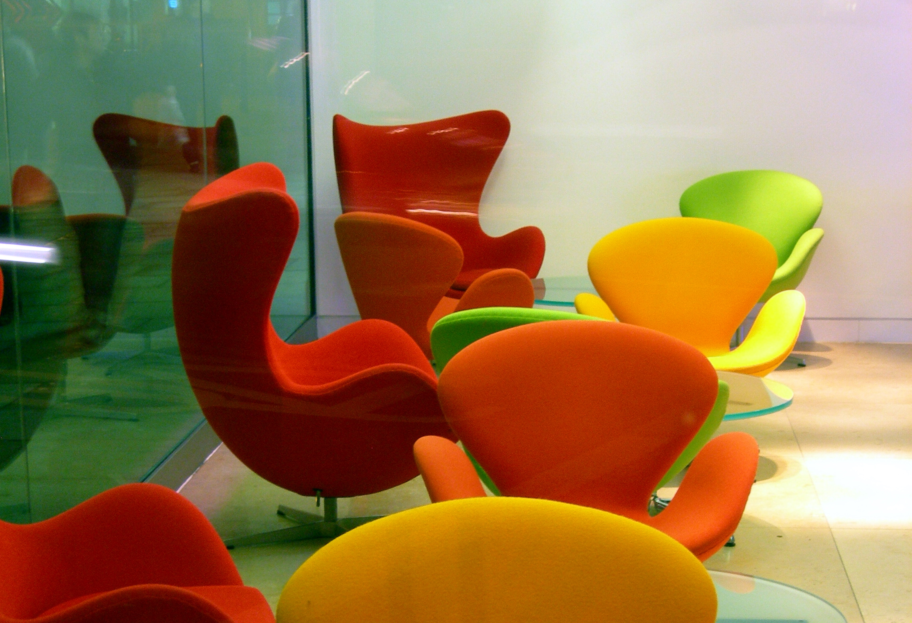
Discussion of Constituent Mapping
Notes:
Image: http://www.flickr.com/photos/criminalintent/89026773/
Lynn, Donna, Dave, and Erin

Slide 17
Major Findings of Visitors & Residents Project
Notes:
Image: Microsoft Office
Lynn

Slide 18
Digital Sources and Educational Stages
Experiencing: Scholars
Embedding:
PhD Students
Establishing: Upper Undergrads
Emerging:
High School & 1st Year Undergrads
(Connaway, Lanclos, and Hood, 2013)
Notes:
Erin
Digital Sources and Educational Stages (Books and Databases)
E-books: Emerging 29%, Establishing 40%, Embedding 50%, Experiencing 40%
Online Textbooks: Emerging 10%, Establishing 0%, Embedding 10%, Experiencing 0%
Databases: Emerging 19%, Establishing 30%, Embedding 80%, Experiencing 80%
“Interest in e-books varied among the participants of the four educational stages. They only were mentioned by 29% (n=9) of those in the early years of their academic careers (Emerging participants), 40% (n=4) of Establishing participants, increasing to 50% (n=5) of Embedding participants, then decreasing again to 40% (n=4) of Experiencing participants. However, it was the online textbooks that were spoken of the least, mentioned by only 3 (9.7%) of Emerging interviewees, none of the Establishing interviewees, only 1 (10%) of the Embedding participants, and none of the Experiencing interviewees.” (Connaway, Lanclos, and Hood, 2013)
“University databases were mentioned most often by the Embedding (80%) and Experiencing (80%) participants. The large number of Embedding and Experiencing mentions of university databases could be attributed to the fact that those in the advanced educational stages actually realize they are accessing databases provided by the university and not because they actually use university databases more than those in the early stages of their academic careers. The lower number of mentions among the Emerging and Establishing stage participants is not necessarily a measure of how often undergraduates use university databases—the rate might actually be high, but they may not know that they are accessing university databases; therefore, not mentioning them in the interviews.” (Connaway, Lanclos, and Hood, 2013)
Connaway, Lynn Silipigni, Donna Lanclos, and Erin M. Hood. “‘I find Google a lot easier than going to the library website.’ Imagine Ways to Innovate and Inspire Students to Use the Academic Library.” Proceedings of the Association of College & Research Libraries (ACRL) 2013 conference, April 10-13, 2013, Indianapolis, IN, 2013, http://www.ala.org/acrl/sites/ala.org.acrl/files/content/conferences/confsandpreconfs/2013/papers/Connaway_Google.pdf.

Slide 19
Contexts for Digital Sources
Experiencing: Scholars
Embedding:
PhD Students
Establishing: Upper Undergrads
Emerging:
High School & 1st Year Undergrads
(Connaway, Lanclos, and Hood, 2013)
Notes:
Erin
When we analyze the interview data to reveal what, if any, intersection there might be with the consulting of any types of digital resources and academic libraries, we find that the interviewees mention digital in conjunction with academic, library, and database contexts the most. (See Figure 5 for contexts for digital sources by educational stage). The changes across educational stages are instructive. Emerging interviewees have the lowest rates of mentioning academic digital or digital library spaces or contexts. They are the only group, naturally, that contains mentions of the digital in school (K-12) environments. If we combine the mentions of digital AND school and the digital AND academic percentages for the Emerging participants, their percentages of mentioning digital along with academic contexts (including K-12) is almost as high as that of Experiencing (faculty), but not as high as Embedding (graduate students). (Connaway, Lanclos, and Hood, 2013)
Connaway, Lynn Silipigni, Donna Lanclos, and Erin M. Hood. “‘I find Google a lot easier than going to the library website.’ Imagine Ways to Innovate and Inspire Students to Use the Academic Library.” Proceedings of the Association of College & Research Libraries (ACRL) 2013 conference, April 10-13, 2013, Indianapolis, IN, 2013, http://www.ala.org/acrl/sites/ala.org.acrl/files/content/conferences/confsandpreconfs/2013/papers/Connaway_Google.pdf.

Slide 20
Digital Sources and Educational Stages
Experiencing: Scholars
Embedding:
PhD Students
Establishing: Upper Undergrads
Emerging:
High School & 1st Year Undergrads
(Connaway, Lanclos, and Hood, 2013)
Notes:
Erin
Digital Sources and Educational Stages (Retail and University Sites)
Wikipedia: Emerging 77%, Establishing 90%, Embedding 70%, Experiencing 50%
Syllabus-and Discipline-based Sites: Emerging 48%, Establishing 40%, Embedding 20%, Experiencing 40%
University Websites: Emerging 32%, Establishing 40%, Embedding 50%, Experiencing 30%
“Other notables were university websites, mentioned by 40% (n=4) of Establishing participants and 50% (n=5) of Embedding participants. Retail websites were discussed by 40% of the Establishing participants and 50% (n=5) of the Embedding and Experiencing participants. Syllabus- and discipline-based sites were spoken of by 48% (n=15) of Emerging interviewees, 40% (n=4) of Establishing and Experiencing interviewees, but only by 20% (n=2) of Embedding participants.” (Connaway, Lanclos, and Hood, 2013)
“When Wikipedia was mentioned many of the Emerging stage participants believe that teachers, professors, and tutors do not accept Wikipedia as a legitimate source.” (Connaway, Lanclos, and Hood, 2013)
Connaway, Lynn Silipigni, Donna Lanclos, and Erin M. Hood. “‘I find Google a lot easier than going to the library website.’ Imagine Ways to Innovate and Inspire Students to Use the Academic Library.” Proceedings of the Association of College & Research Libraries (ACRL) 2013 conference, April 10-13, 2013, Indianapolis, IN, 2013, http://www.ala.org/acrl/sites/ala.org.acrl/files/content/conferences/confsandpreconfs/2013/papers/Connaway_Google.pdf.

Slide 21
Evaluating Information/Resources Part 1
Experiencing: Scholars
Embedding:
PhD Students
Establishing: Upper Undergrads
Emerging:
High School & 1st Year Undergrads
(Connaway, Lanclos, and Hood, 2013)
Notes:
Erin
Connaway, Lynn Silipigni, Donna Lanclos, and Erin M. Hood. “‘I find Google a lot easier than going to the library website.’ Imagine Ways to Innovate and Inspire Students to Use the Academic Library.” Proceedings of the Association of College & Research Libraries (ACRL) 2013 conference, April 10-13, 2013, Indianapolis, IN, 2013, http://www.ala.org/acrl/sites/ala.org.acrl/files/content/conferences/confsandpreconfs/2013/papers/Connaway_Google.pdf.

Slide 22
Evaluating Information/Resources Part 2
Experiencing: Scholars
Embedding:
PhD Students
Establishing: Upper Undergrads
Emerging:
High School & 1st Year Undergrads
(Connaway, Lanclos, and Hood, 2013)
Notes:
Erin
Relevance and reliability are highly important to the Emerging stage participants, which could be attributed to their lack of subject expertise. As individuals progress through their educational stages, they become more familiar with the subject-specific sources, such as journals, publishers, databases, and including human sources, such as authors. The Emerging stage participants are concerned about selecting reliable sources and often will mention searching for web sites ending in .edu, .ac, .gov, etc. to indicate reliability compared to .com or other commercial sites. (Connaway, Lanclos, and Hood, 2013)
Connaway, Lynn Silipigni, Donna Lanclos, and Erin M. Hood. “‘I find Google a lot easier than going to the library website.’ Imagine Ways to Innovate and Inspire Students to Use the Academic Library.” Proceedings of the Association of College & Research Libraries (ACRL) 2013 conference, April 10-13, 2013, Indianapolis, IN, 2013, http://www.ala.org/acrl/sites/ala.org.acrl/files/content/conferences/confsandpreconfs/2013/papers/Connaway_Google.pdf.

Slide 23
Motivation
Experiencing: Scholars
Embedding:
PhD Students
Establishing: Upper Undergrads
Emerging:
High School & 1st Year Undergrads
(Connaway, Lanclos, and Hood, 2013)
Notes:
Donna
The need for collaboration is reported by 80% of the Emerging stage participants, but decreases to 40% for Establishing, and Embedding, and then increases to 70% for the Experiencing. This may reflect not only the need for collaboration in their work among high school seniors and college freshmen, but also the emphasis on individual/isolating work for upper division undergraduate students as well as graduate students. The high level of faculty collaboration is an interesting contrast to the sort of training the graduate students apparently are receiving in their respective fields. See Figure 11.
Connaway, Lynn Silipigni, Donna Lanclos, and Erin M. Hood. “‘I find Google a lot easier than going to the library website.’ Imagine Ways to Innovate and Inspire Students to Use the Academic Library.” Proceedings of the Association of College & Research Libraries (ACRL) 2013 conference, April 10-13, 2013, Indianapolis, IN, 2013, http://www.ala.org/acrl/sites/ala.org.acrl/files/content/conferences/confsandpreconfs/2013/papers/Connaway_Google.pdf.

Slide 24
Contact and Educational Stages
(Connaway, Lanclos, and Hood, 2013)
Notes:
Donna
Contact and Educational Stages
Face-to-Face: Emerging 55%, Establishing 60%, Embedding 40%, Experiencing 70%
Phone Call: Emerging 84%, Establishing 90%, Embedding 70%, Experiencing 70%
IM, Chat: Emerging 52%, Establishing 30%, Embedding 40%, Experiencing 10%
Email: Emerging 52%, Establishing 100%, Embedding 100%, Experiencing 100%
“The importance of FtF communication among faculty is high, in comparison to other stages, for whom phone and other remote forms of communication are much more prevalent. Some of the phone mentions by the Emerging stage participants may be linked to students communicating with family and friends who are located in distant geographical locations. IM and chat are mentioned more than 50% of the time with the Emerging stage participants, and decreases with each stage, with a slight rebound among Embedding before plummeting among the Experiencing stage. Email is mentioned 52% by Emerging students who are about to enter or are entering institutions of higher education (applying for and attending university) and are required to use email for official communication. Once the individuals are acclimated to the university culture (Establishing, Embedding, and Experiencing educational stages), the mentions of email are at 100%.” (Connaway, Lanclos, and Hood, 2013)
Connaway, Lynn Silipigni, Donna Lanclos, and Erin M. Hood. “‘I find Google a lot easier than going to the library website.’ Imagine Ways to Innovate and Inspire Students to Use the Academic Library.” Proceedings of the Association of College & Research Libraries (ACRL) 2013 conference, April 10-13, 2013, Indianapolis, IN, 2013, http://www.ala.org/acrl/sites/ala.org.acrl/files/content/conferences/confsandpreconfs/2013/papers/Connaway_Google.pdf.

Slide 25
“It’s like a taboo I guess with all teachers, they just all say – you know, when they explain the paper they always say, ‘Don’t use Wikipedia.’” (USU7, 0:33:05, Female, Age 19, Political Science)
“I just type it into Google and see what comes up.” (UKS2)
Learning Black Market
Notes:
Image: http://wp.me/pLtlj-fH Lynn
Covert online study habits
Wikipedia
Don’t cite
Widely used
Guilt
Students & teachers disagree
Quality sources
There is a “Learning Black Market”: learners use non-traditional sources but feel they cannot talk about them in an institutional context. Wikipedia usage is an example of this. (White and Connaway, 2011-2012)
“…students admit to using Wikipedia and citing the references included in the Wikipedia articles but not formally acknowledging the use of Wikipedia.” (Connaway, Lanclos, and Hood, 2013)
White, David S., and Lynn Silipigni Connaway. Visitors & Residents: What Motivates Engagement with the Digital Information Environment. 2011-2012. Funded by JISC, OCLC, and Oxford University. http://www.oclc.org/research/activities/vandr/.
White, David S., and Alison Le Cornu, A. “Visitors and Residents: A New Typology for Online Engagement.” First Monday 16, no. 9 (2011). http://firstmonday.org/htbin/cgiwrap/bin/ojs/index.php/fm/article/viewArticle/3171/3049.
“I mean if teachers don’t like using Wikipedia they don’t want you to use Wikipedia. A lot of students will still use Wikipedia and then cite another source. As long as it has the same information and it is not word for word or anything they’ll use Wikipedia because it is the easiest thing to go look up on Wikipedia. It will give you a full in-depth detailed thing about the information. Teachers don’t just like it because it’s not the most reliable source since anyone can post something on there even though the site is monitored, it’s because it’s too easy.” (USU3, 0:30:59, Male, Age 19, Mechanical Engineering, Digital Visitors and Residents)
Students’ Perceptions of Teachers’ opinions of Wikipedia:
“Avoid it.” (UKS8, 0:28:28, Female, Age 16, High School Student, Digital Visitors and Residents)
“They say it’s because anyone can make up – I mean, anyone can add information on there but I mean when I’ve actually looked into information it seemed the same as any information I find anywhere else. I mean, it’s not like if you look up fourth of July, it’s not like it gives you like some weird explanation of aliens or something.” (USU7, 0:33:14, Female, Age 19, Political Science, Digital Visitors and Residents)
Students’ on Wikipedia:
“I use it, kind of like, I won't cite it on my papers but I, kind of, use it as a like, as a start off line. I go there and look up the general information, kind of, read through it so I get a general idea what it is. Then I start going through my research.” (USU7, 0:33:49, Female, Age 19, Political Science, Digital Visitors and Residents)
“Everyone knows that you try not to use Wikipedia as a source because it is a cardinal sin.” (UKU3, 0:31:03, Female, Age 19, Languages, Digital Visitors and Residents)

Slide 26
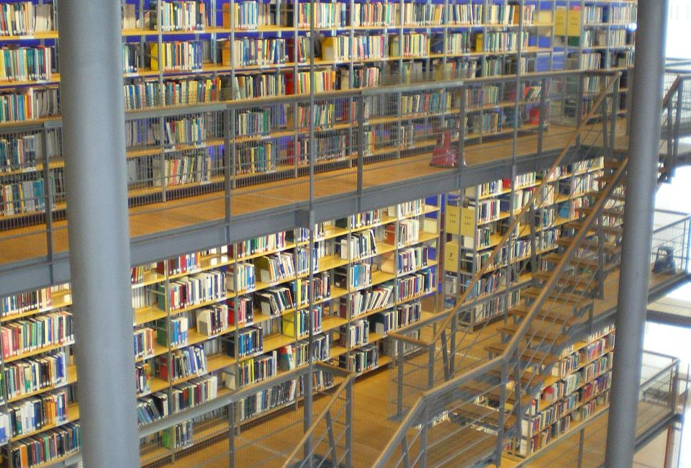
The word “librarian” was mentioned once in original interviews by Emerging Stage participants as a source of information
One participant referred to “a lady in the library who helps you find things”
(USU5, 0:37:17, Male, Age 19, Systems Engineering)
Notes:
Image: http://www.flickr.com/photos/jenwaller/2844687403/
Lynn
“– there’s a lady in the library who helps you find things.” Digital Visitors and Residents (USU5, 0:37:17, Male, Age 19, Systems Engineering, Digital Visitors and Residents)

Slide 27
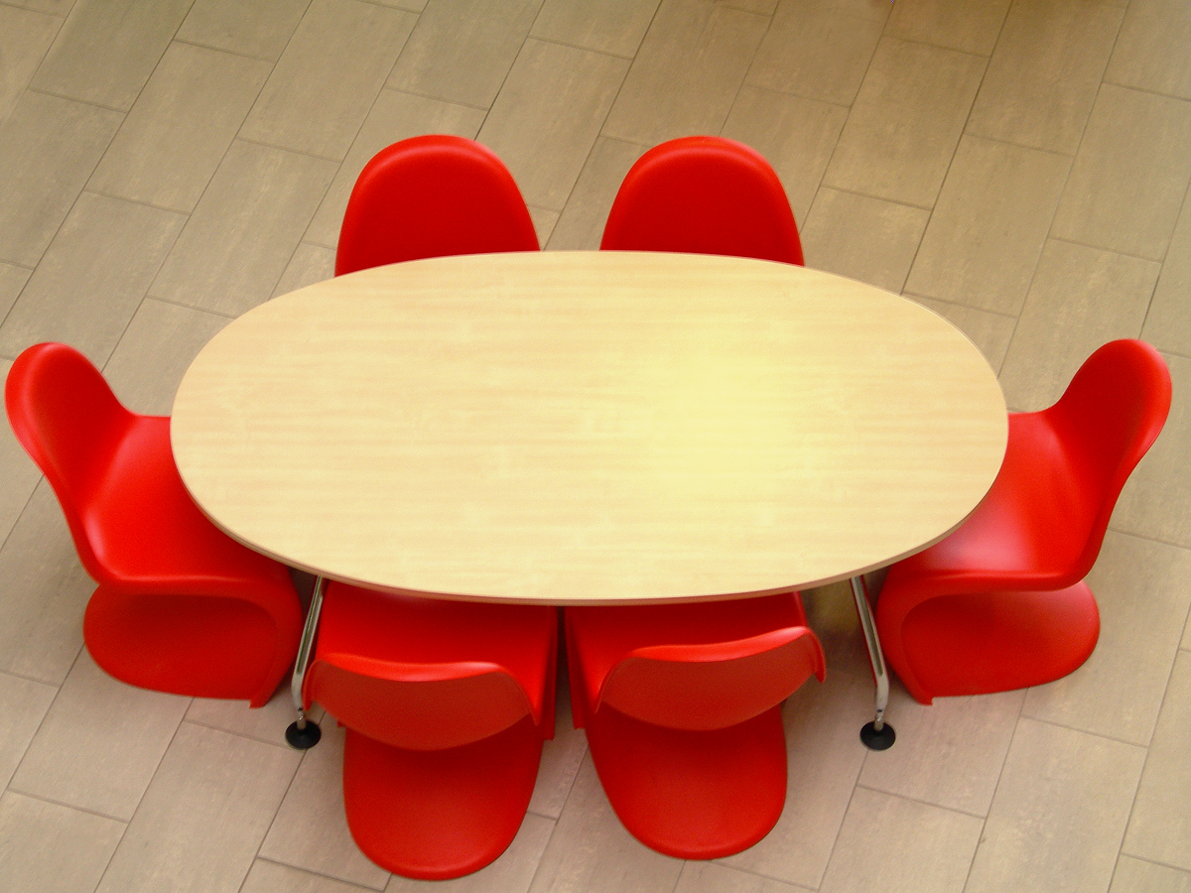
Engaging Constituents
Notes:
Image: http://www.flickr.com/photos/mnadi/32325828/
Lynn, Donna, Dave, and Erin
Who has engaged in some type of assessment?
What did you do?
What did you learn?
What, if any, changes came about from what you learned?
What would have helped you during this process?
If you have not engaged in some type of assessment at your institution, why do you think this is the case?
What would help you engage in some type of assessment?

Slide 28
Questions & Discussion
Lynn Silipigni Connaway connawal@oclc.org
@LynnConnaway
Donna Lanclos
dlanclos@uncc.edu
@DonnaLanclos
David White
david.white@conted.ox.ac.uk
@daveowhite
Erin Hood
hoode@oclc.org
@ErinMHood1
Notes:
28
28
28
Image: http://www.flickr.com/photos/joelmarkwitt/2797956179/
Lynn

Slide 29
Selected Bibliography
Connaway, Lynn Silipigni, Donna Lanclos, and Erin M. Hood. “‘I find Google a lot easier than going to the library website.’ Imagine Ways to Innovate and Inspire Students to Use the Academic Library.” Proceedings of the Association of College & Research Libraries (ACRL) 2013 conference, April 10-13, 2013, Indianapolis, IN, 2013, http://www.ala.org/acrl/sites/ala.org.acrl/files/content/conferences/confsandpreconfs/2013/papers/Connaway_Google.pdf.
Connaway, Lynn Silipigni, Donna Lanclos, David White, Alison Le Cornu, and Erin M. Hood. “User-centered Decision Making: A New Model for Developing Academic Library Services and Systems.” IFLA Journal 39, no. 1 (2013): 30-36. http://www.ifla.org/files/assets/hq/publications/ifla-journal/ifla-journal-39-1_2013.pdf.
Connaway, Lynn Silipigni, David White, Donna Lanclos, and Alison Le Cornu. “Visitors and Residents: What Motivates Engagement with the Digital Information Environment?” Information Research 18, no. 1 (2013), http://informationr.net/ir/18-1/infres181.html.
White, David. “Visitors and Residents Mapping Process: The Video.” TALL Blog: Online Education with the University of Oxford, June 5, 2013, http://tallblog.conted.ox.ac.uk/index.php/2013/06/05/vandrmapping/.
White, David S., and Lynn Silipigni Connaway. Visitors & Residents: What Motivates Engagement with the Digital Information Environment. 2011-2012. Funded by JISC, OCLC, and Oxford University. http://www.oclc.org/research/activities/vandr/.
White, David S., and Alison Le Cornu, A. “Visitors and Residents: A New Typology for Online Engagement.” First Monday 16, no. 9 (2011). http://firstmonday.org/htbin/cgiwrap/bin/ojs/index.php/fm/article/viewArticle/3171/3049.

