Slide 1
ASIS&T Regional Meeting, March 3, 2017
Visitors and Residents
Interactive Mapping Exercise Workshop
Lynn Silipigni Connaway, PhD
Senior Research Scientist and Director of User Research
William Harvey, PhD
Consulting Software Engineer

Slide 2
V&R Framework
#vandr
Visitors and Residents resources http://goo.gl/vxUMRD
(White and Le Cornu 2011)
Notes:
This is a continuum and individuals may display visitor or resident characteristics in different contexts and situations.

Slide 3
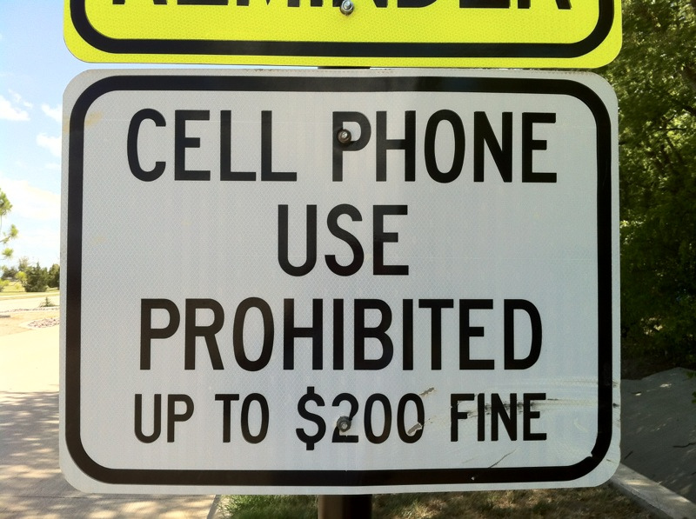
Visitor Mode
Functional use of technology
Formal need
Invisible online presence
Internet is a toolbox
(White and Connaway 2011-2014)
Notes:
Image: http://www.flickr.com/photos/31442459@N00/7648151218 by Wesley Fryer / CC BY 2.0
Visitors: functional use of technology, often linked to formal need (such as use of software for specific coursework, or organizing meetings through email contact); less visible/more passive online presence, more likely to favor face- to- face interactions (even as they use the internet to organize/schedule those interactions)

Slide 4
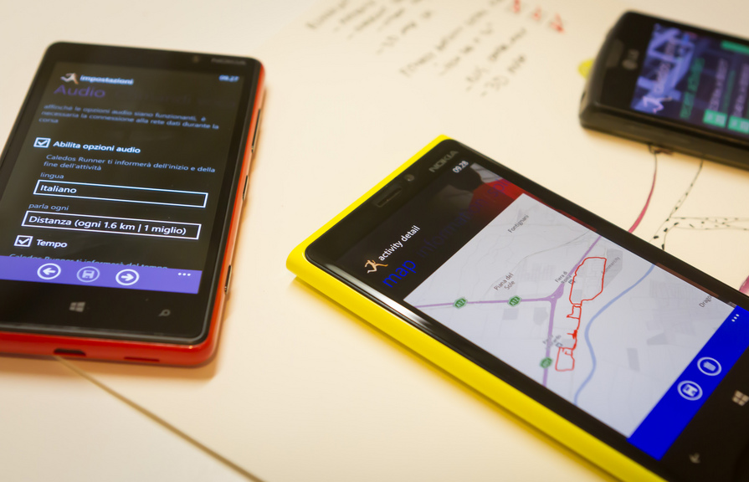
Resident Mode
Visible and persistent online presence
Collaborative activity online
Contribute online
Internet is a place
(White and Connaway 2011-2014)
Notes:
http://www.flickr.com/photos/15216811@N06/8521338394 by N i c o l a / CC BY 2.0
Residents: significant online presence and usage; high level of collaborative activity online; contributions to the online environment in the form of uploading materials, photos, videos.

Slide 5
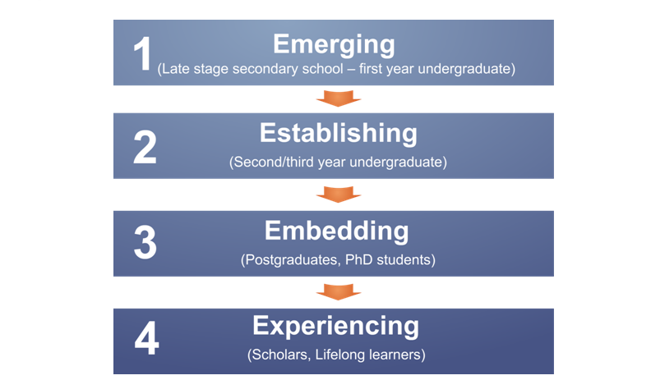
Educational Stages
(Connaway, White, and Lanclos 2011)
Notes:
1. Emerging (Late stage secondary school/First year undergraduate);
2. Establishing (Second/third or third/fourth year undergraduate);
3. Embedding (Postgraduates, PhD students);
4. Experienced (Faculty, Researchers, Scholars Lifelong Learners).

Slide 6
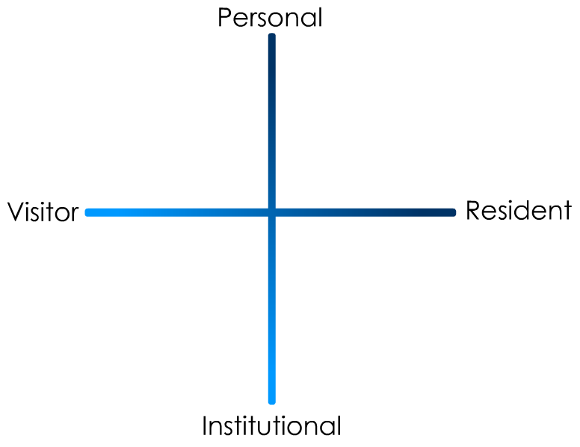
(Connaway and White for OCLC Research 2012)
Notes:
“In simple terms the Visitors see the web as a series of tools. They decide what they want to achieve, chose an appropriate online tool to do the job, then log-off. They leave no social trace of themselves online. The Residents live a proportion of their lives online. They see the web as a place where they can express themselves and spend time with people. Residents will have a profile on a social networking platform and aspects of their persona, or digital identity, maintaining presence even when they are not online. The premise of V&R is presented as a continuum whereby individuals’ modes of engagement will be more Visitor or Resident depending on their personal motivations and the context and situation at the time.” (Connaway, Lanclos, and Hood 2013)
First Monday Paper: http://is.gd/vandrpaper
Video: http://is.gd/vandrvideo

Slide 7
1st year undergraduate

Slide 8
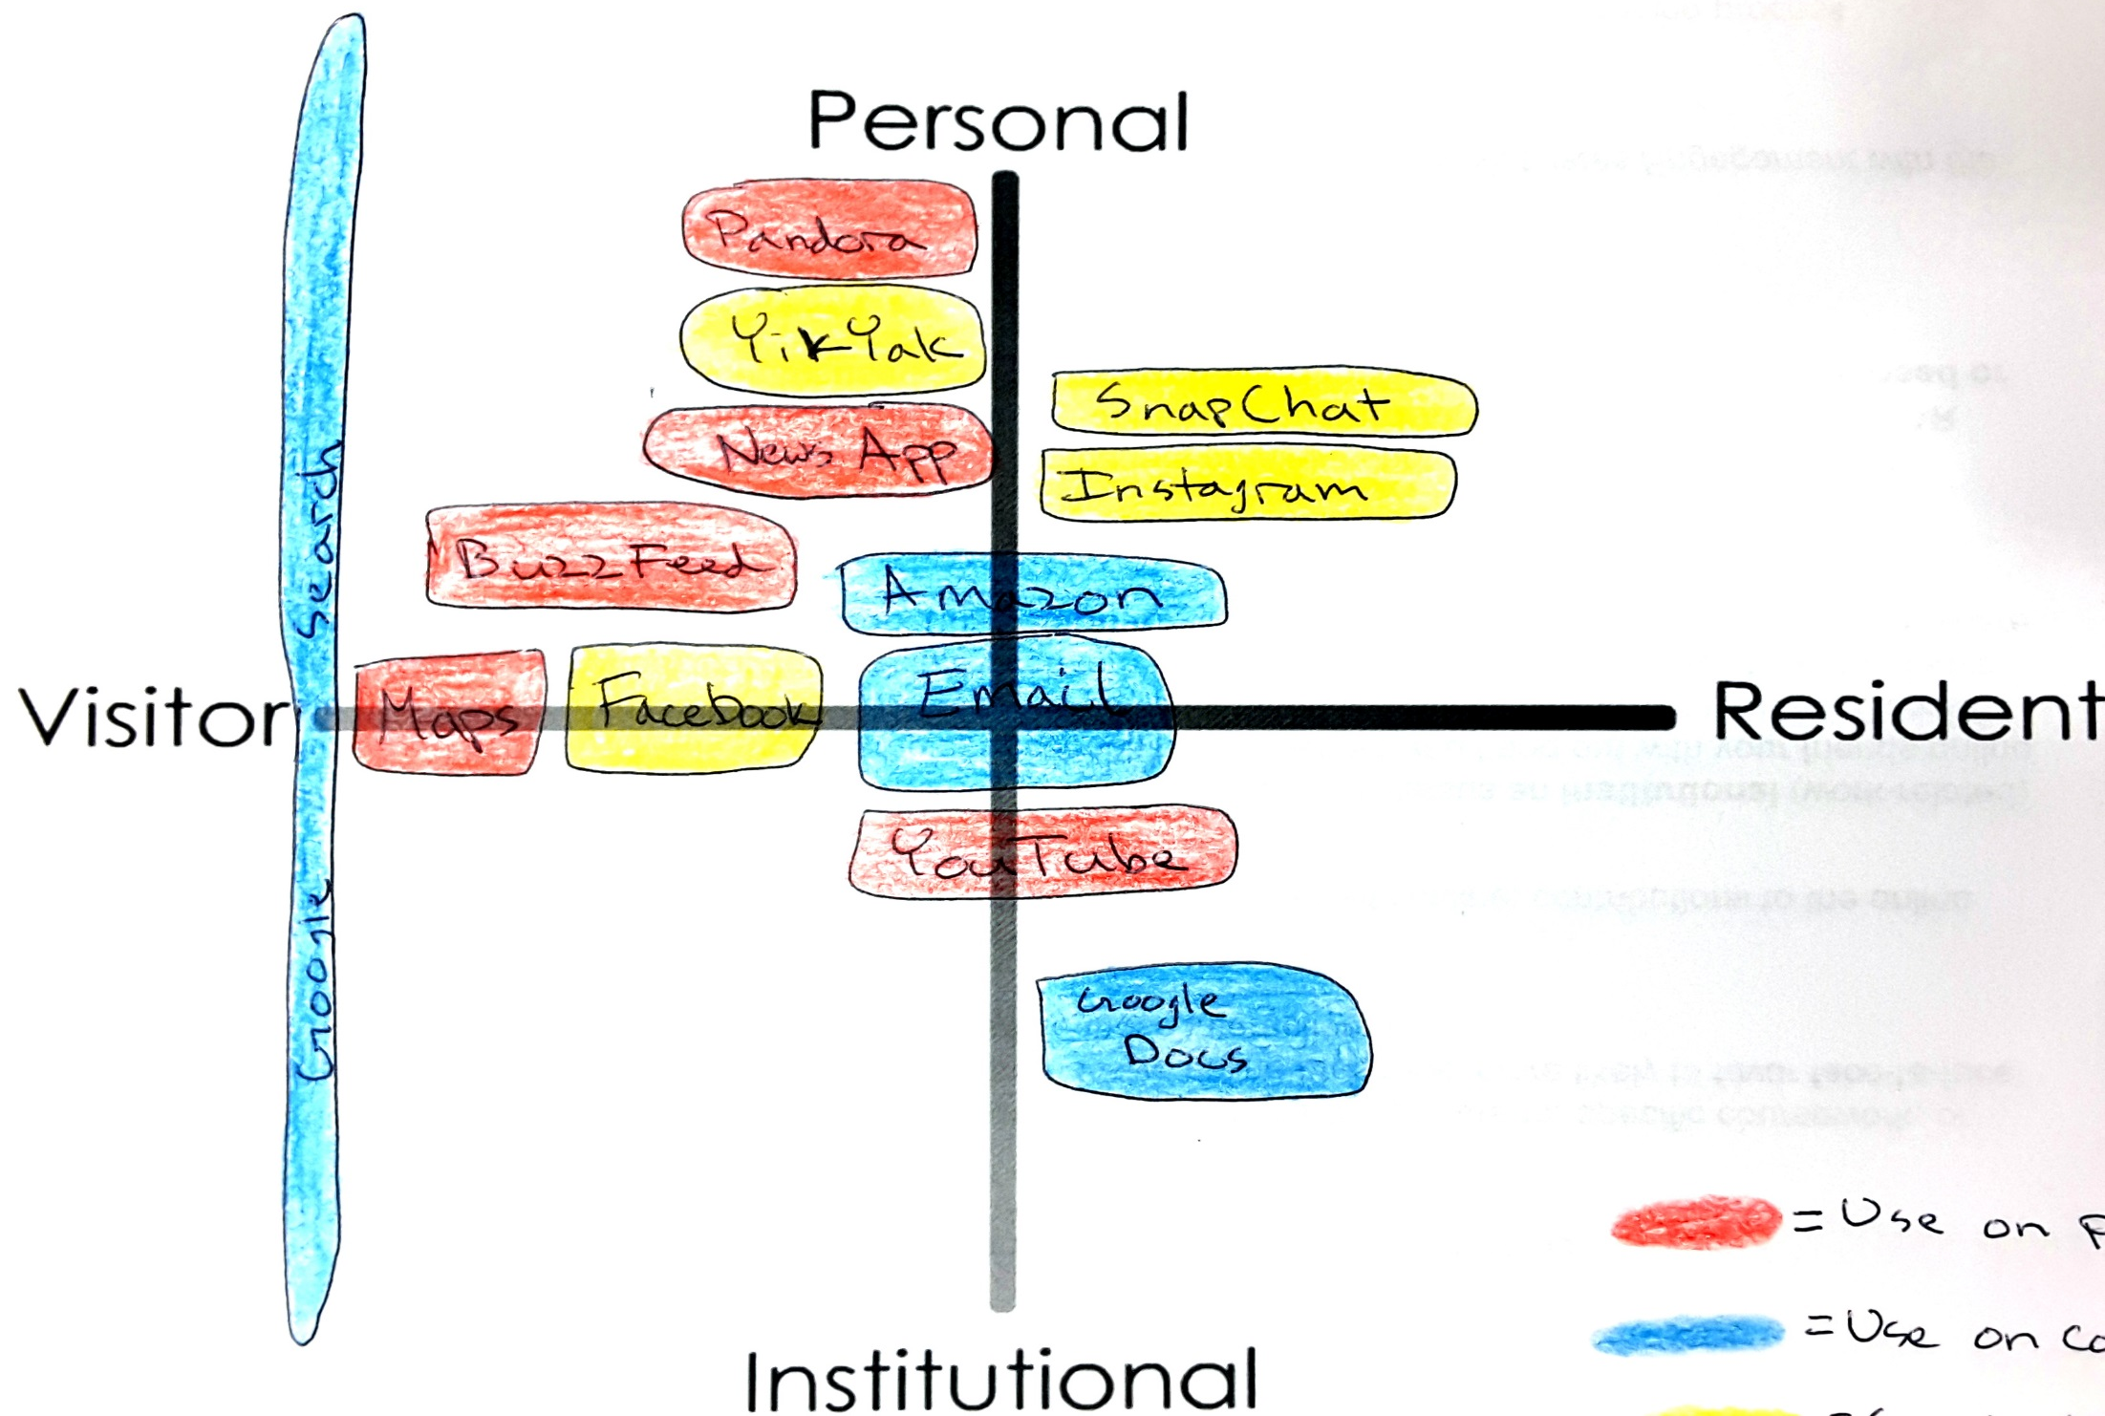
Notes:
UCLA, 1st year undergrad

Slide 9
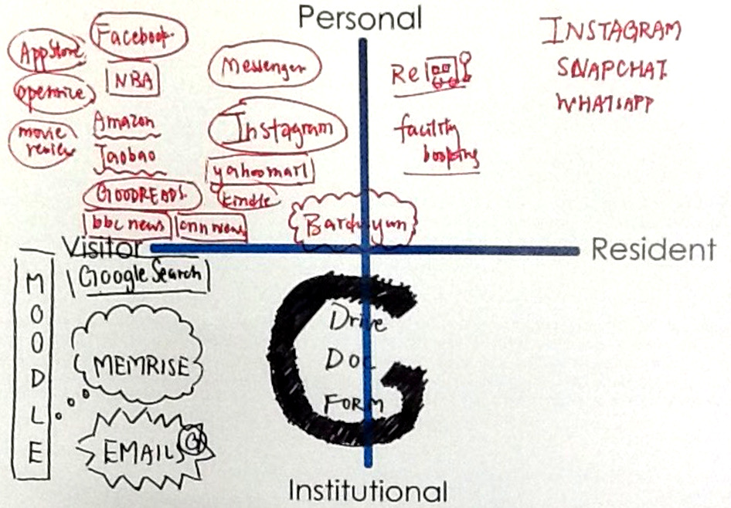
Notes:
HKU, 1st year undergrad
Go to openrice for food,
Go for specific sites to search for info, not really via google
Good recommendations for personal reading – goodreads
General adding people I know in Instagram
Another account is for really close friends, sharing something with close people
Rebus (most us don’t know the apps) – app for booking buses
Facilities booking – booking facilities
Baidu cloud – Chinese google
Mostly use apps via iphone.
Academic: course materials go to Moodle
Anything I don’t know, I go to google
Only use public library website (HKPL) for renewing books for personal reasons
I don’t go to library websites that much
Wikipedia –access via google search , I do use it (much), for academic work, I use it to check for particular terms and definitions

Slide 10
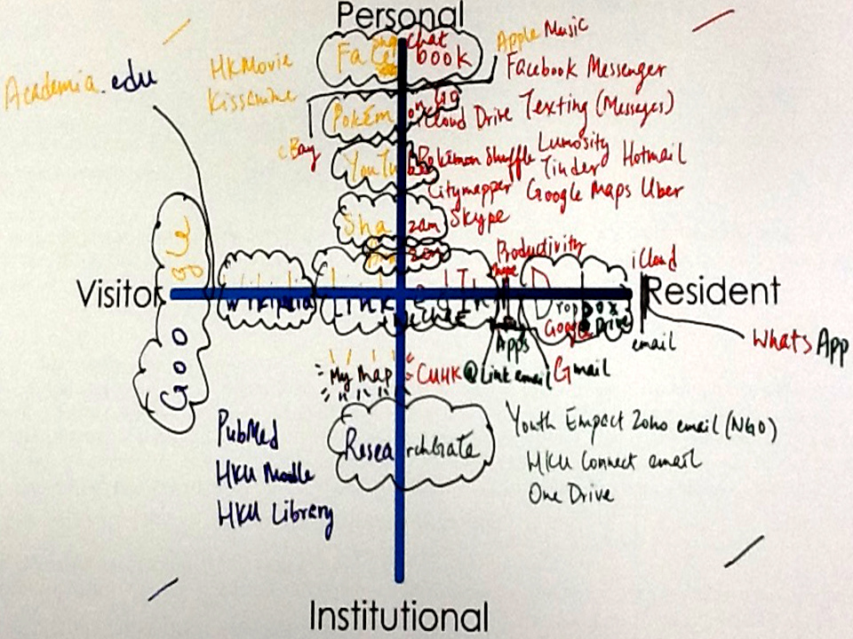
Notes:
HKU, 1st year undergrad
Use library
As an undergradate, I tried to public and share my paper
Colour for each quardrant
Shazam – music based apps, detect the music in the background and will give you information about the song
I really like music
Productivity apps: google doc, word …
Chopd app for booking tables for dinner
A lot of e-mails: resident – e-mail for NGO, not really for personal
I go to library web page, get text books, past papers for medical
Wikipedia to find out about when shows will be broadcast
Watch shows, whats next?
What did you learn/surprises: Internet addiction, laptop is my wife, mobile is my girlfriend who I cheat on my wife with, use apps on iwatch
Check next show in HK, catch the new show, book seat directly
How I classify myself as visitors and resident, alumni in cuhk store personal capacity … more than visitors and residents..
access someone list as contact, more like visitor; add someone to the contact more like resident
Use for so many reasons
Colour – Red, Green, Yellow, and Black, one for each project. Not enough space or colors. Would be better to do on the computer.

Slide 11
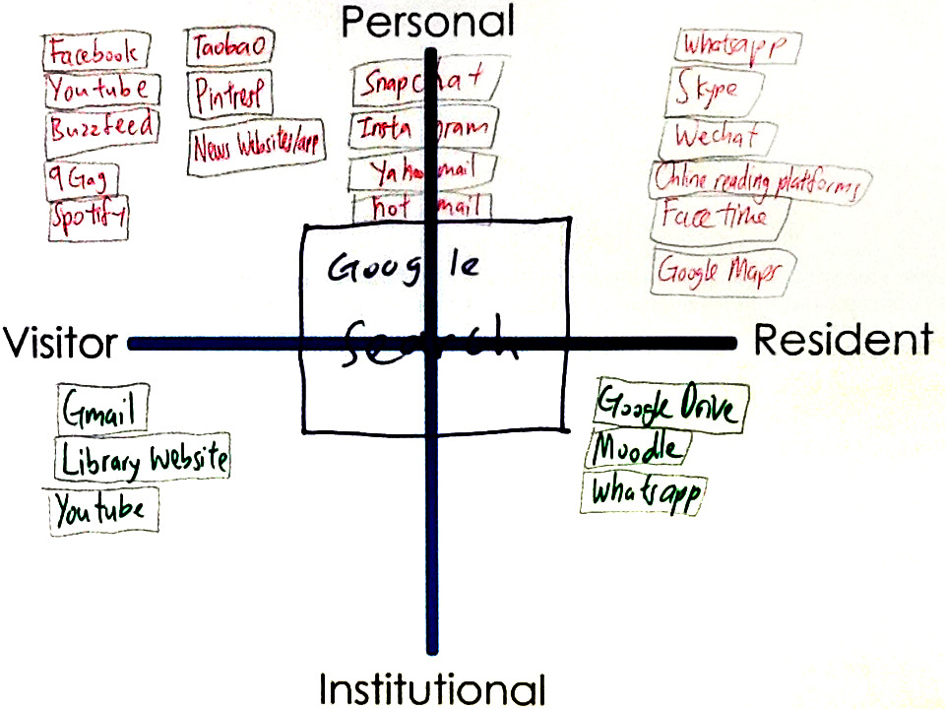
Notes:
HKU, 1st year undergrad
Realized I am not that hard working
In desperation when I have to directly go to library website
Google search: usually don’t login, just search, more on visitor side
Snapchat …Hotmail : Not too often do sharing
A way to release my burden
FB try not to post/share, look at what my friends share

Slide 12
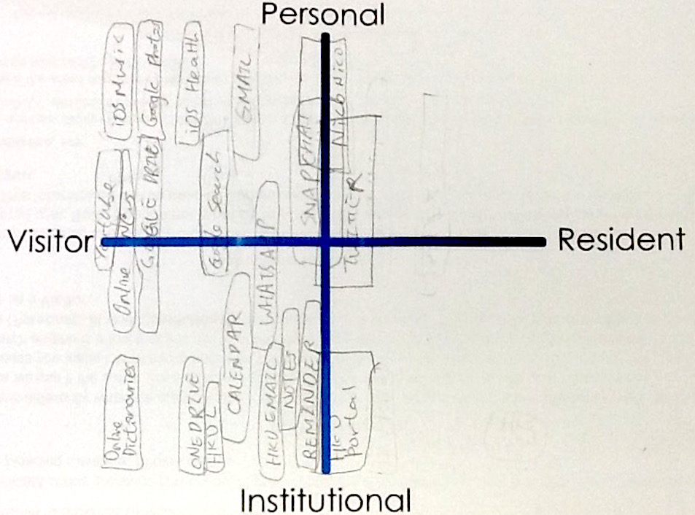
Notes:
HKU, 1st year undergrad
Choose to not have much in resident side
I DO go to HKU library website
Portal – includes Moodle, sometimes post
Twitter – most Japanese news in Twitter, so I browse Japanese news
iOS Health – recalling exercises
Personal Gmail – for receiving some email from commercial parties, eating / drinking

Slide 13
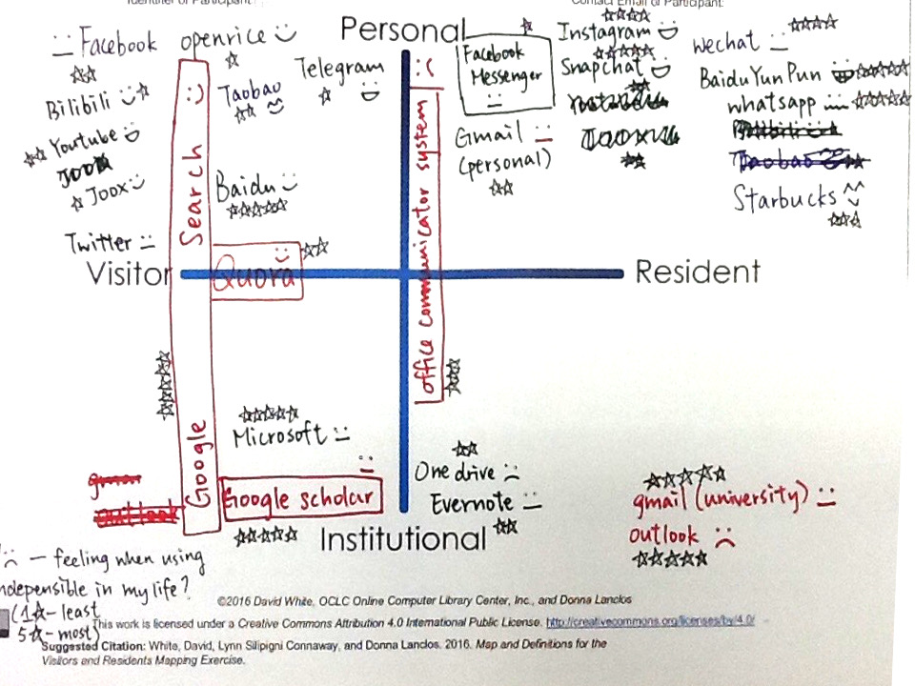
Notes:
HKU, 1st year undergrad
Stars: cannot live without them
Gmail for University
Starbucks ^^(enjoy),
Office communication (apps for communication like whatsapp)
FB – try to read news from friends, don’t post
Surpise: write a lot in leisure, not academic
Moodle (institution - resident)
Quara – online platform to ask questions, people will tell you the answer. Just read, do not post

Slide 14
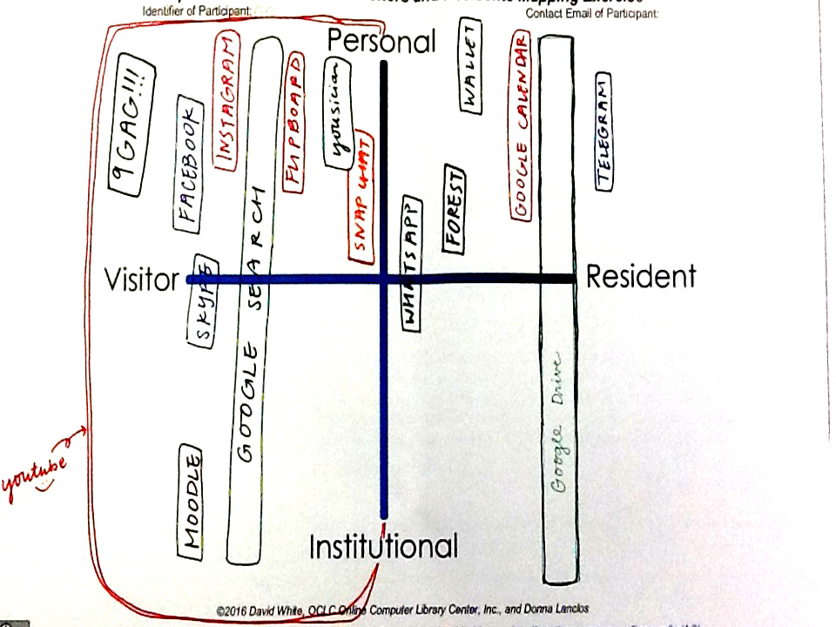
Notes:
HKU, 1st year undergrad
I wasn’t aware that I check e-mail every few minutes
Youtube…had to think about it but uses it all the time
Addicted – google system, basically everything here is google. Sign in , have history,
Whatsapp – google knows that it is whatsapp, android
Forest, a app that you stop in using another apps, want to more concentrate
Wallet – online finances
Fupboard – apps for news
Yousisian – learn guitar
Academic – use google searches, use Moodle,
The things that you use the most you don’t realize. They are inherent in my life

Slide 15
Upper level undergraduate

Slide 16
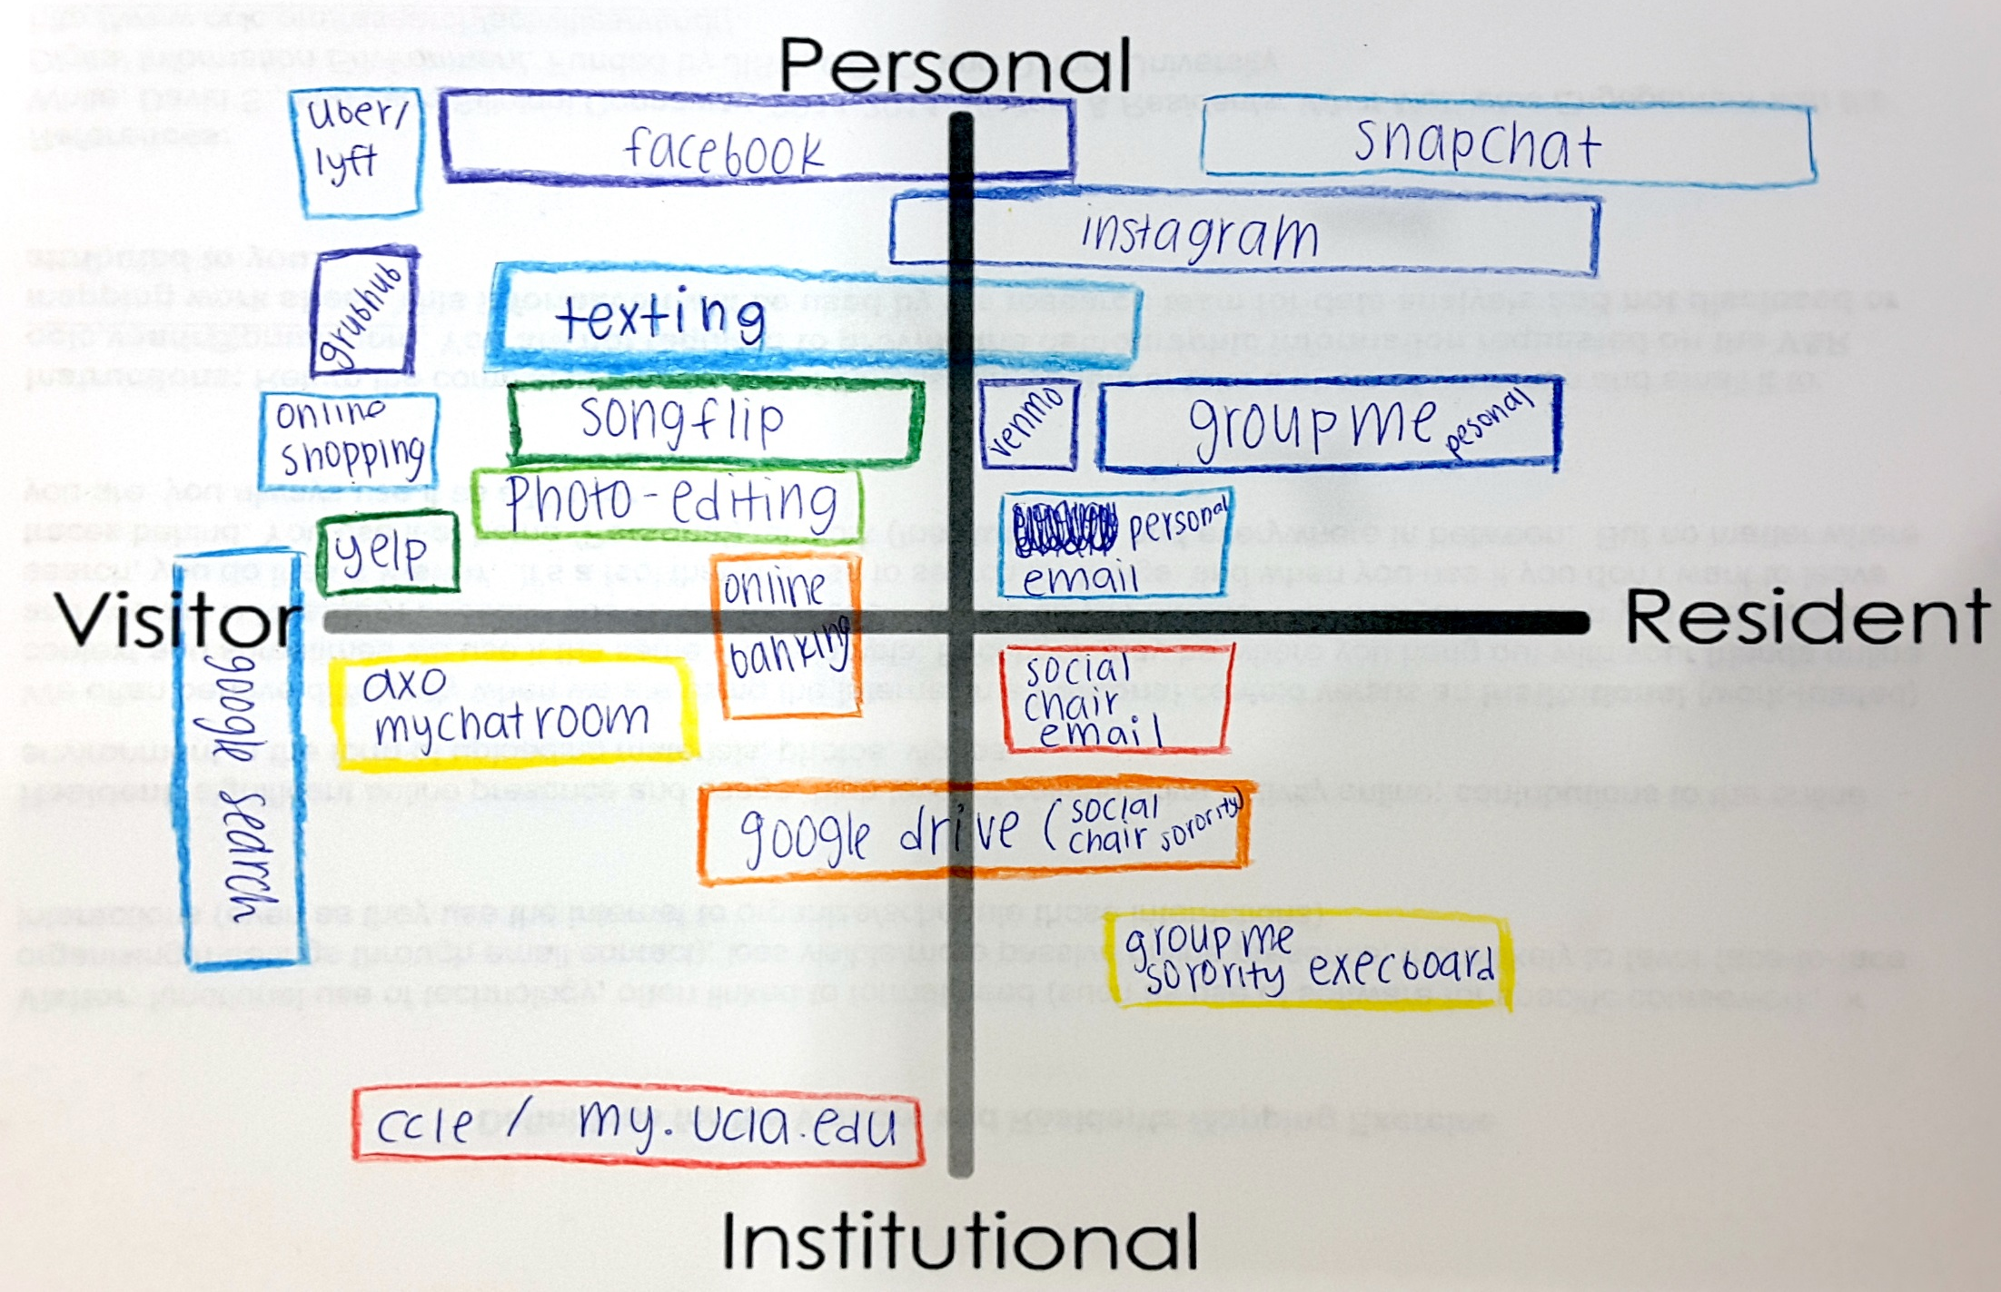
Notes:
UCLA, 2nd year undergrad

Slide 17
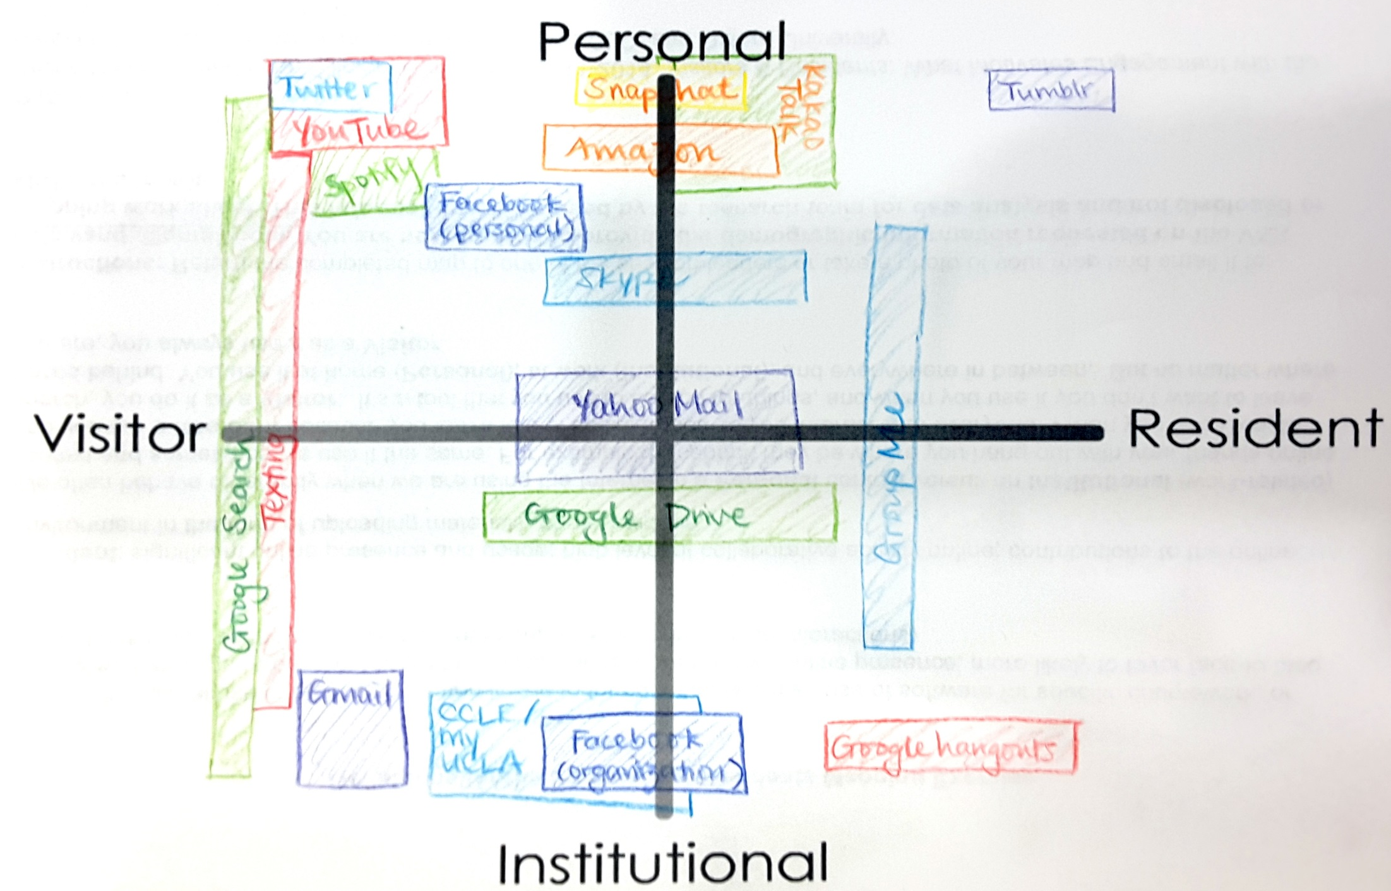
Notes:
UCLA, 3rd year undergrad

Slide 18
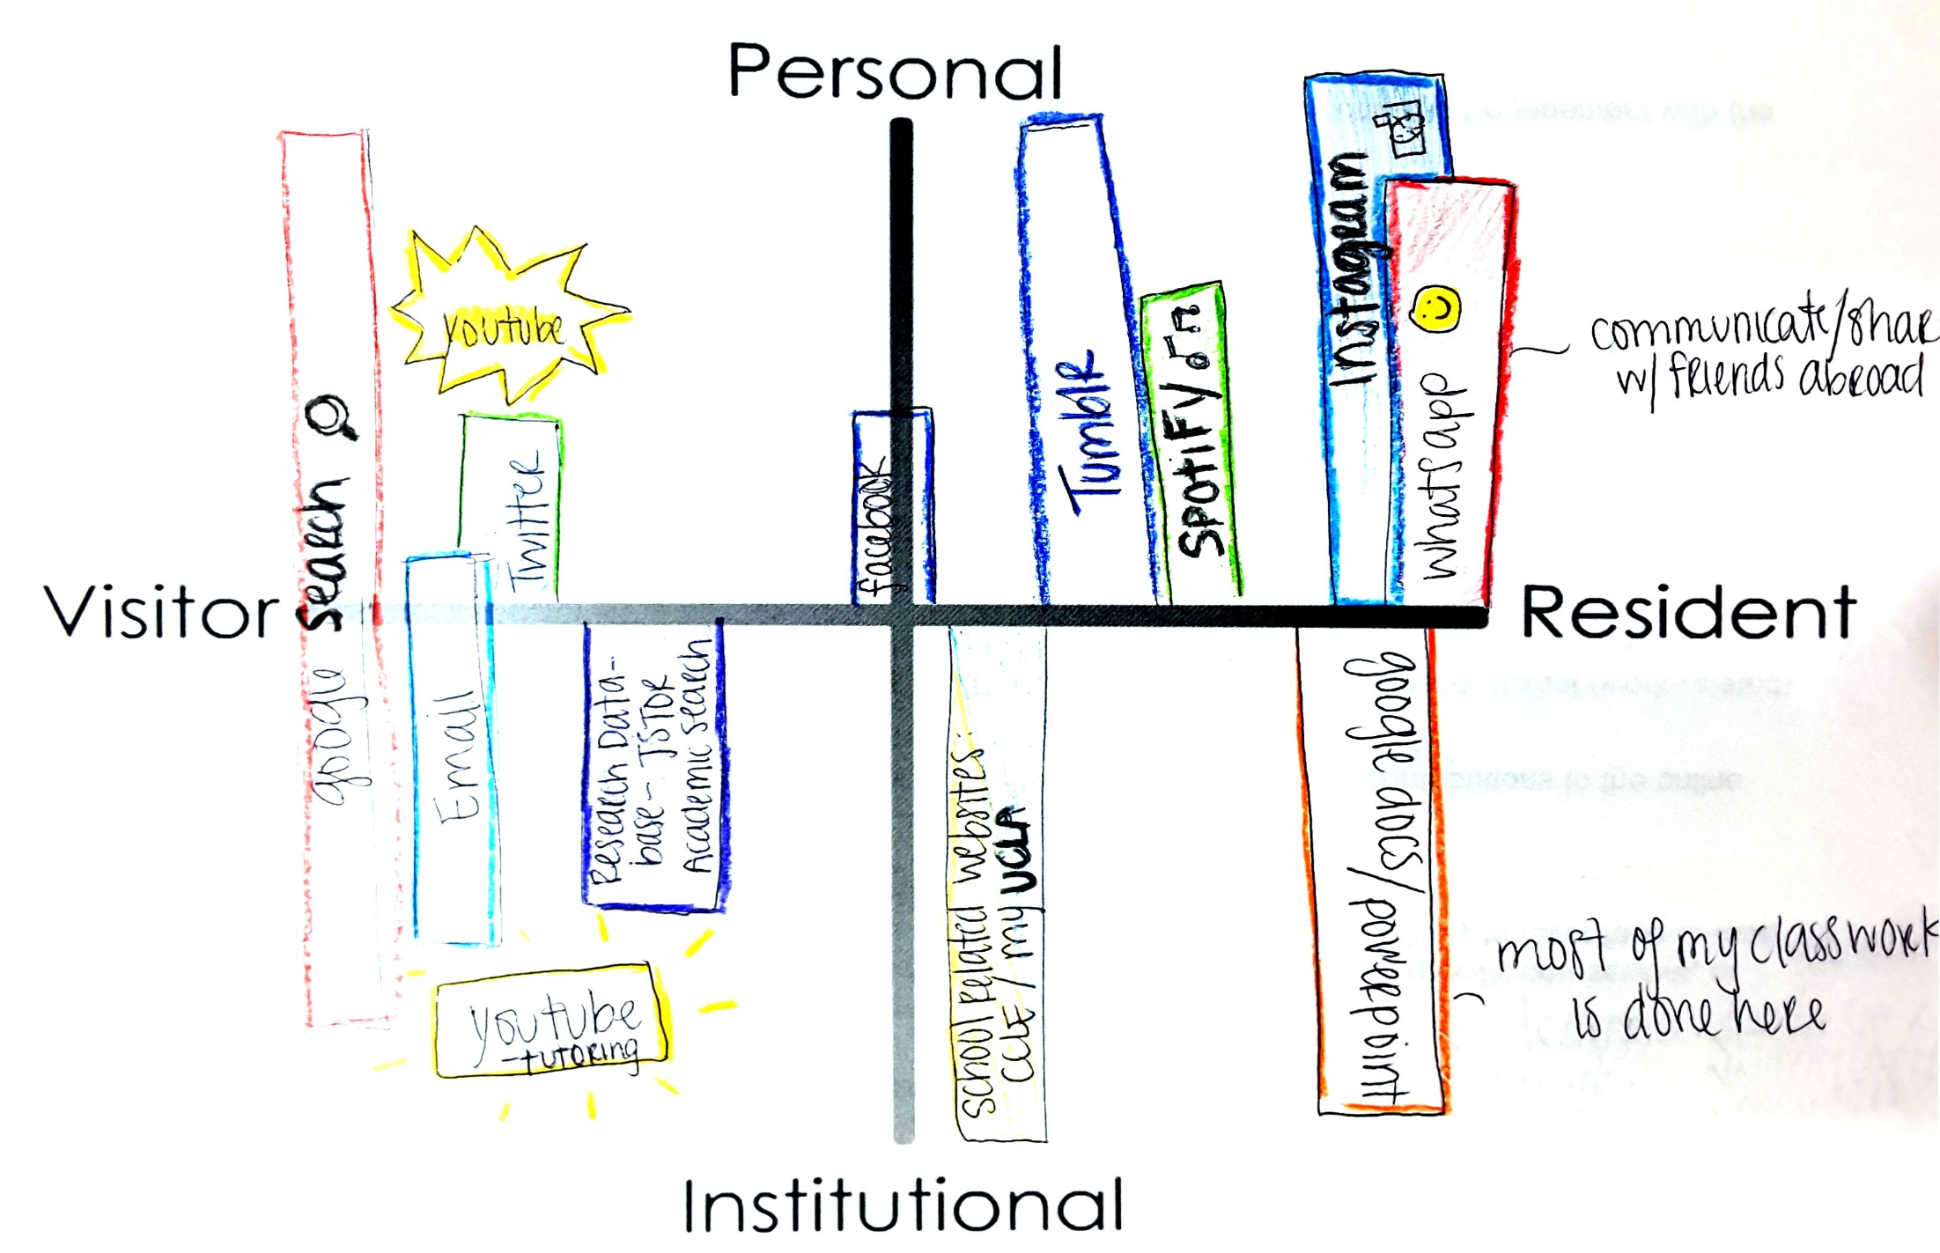
Notes:
UCLA, 3rd year undergrad
Academic Search
JSTOR mentioned the most with undergraduate students
EBSCO Host was mentioned by one undergraduate student who used this at another university

Slide 19
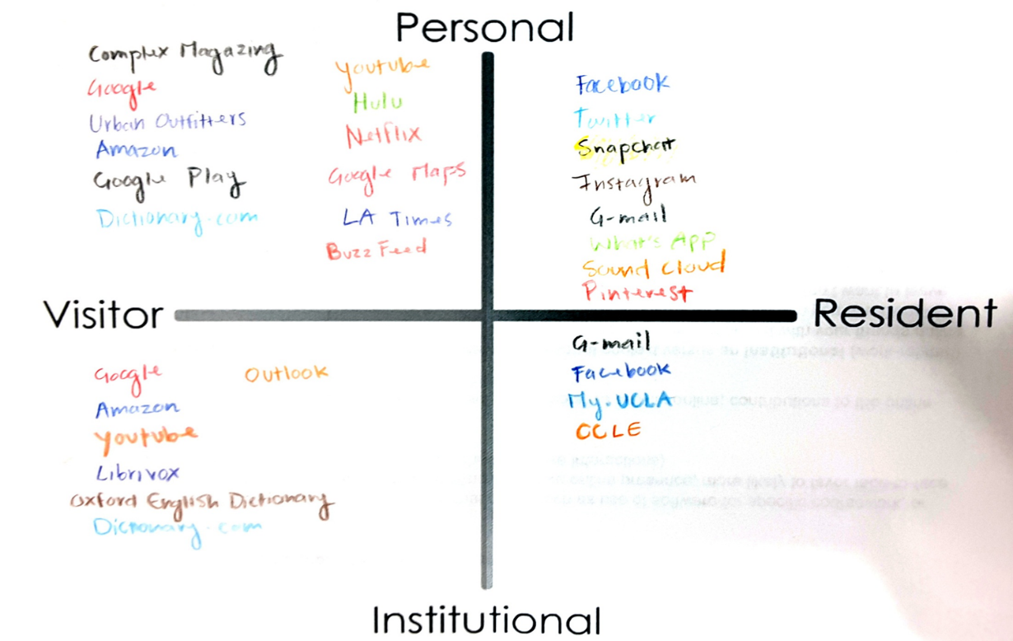
Notes:
UCLA, 4th Year Undergrad
When asked about the use of library materials/web site, stated that she is an English major and uses books so goes to Amazon or Librivox
Latina student, speaks Spanish with family

Slide 20
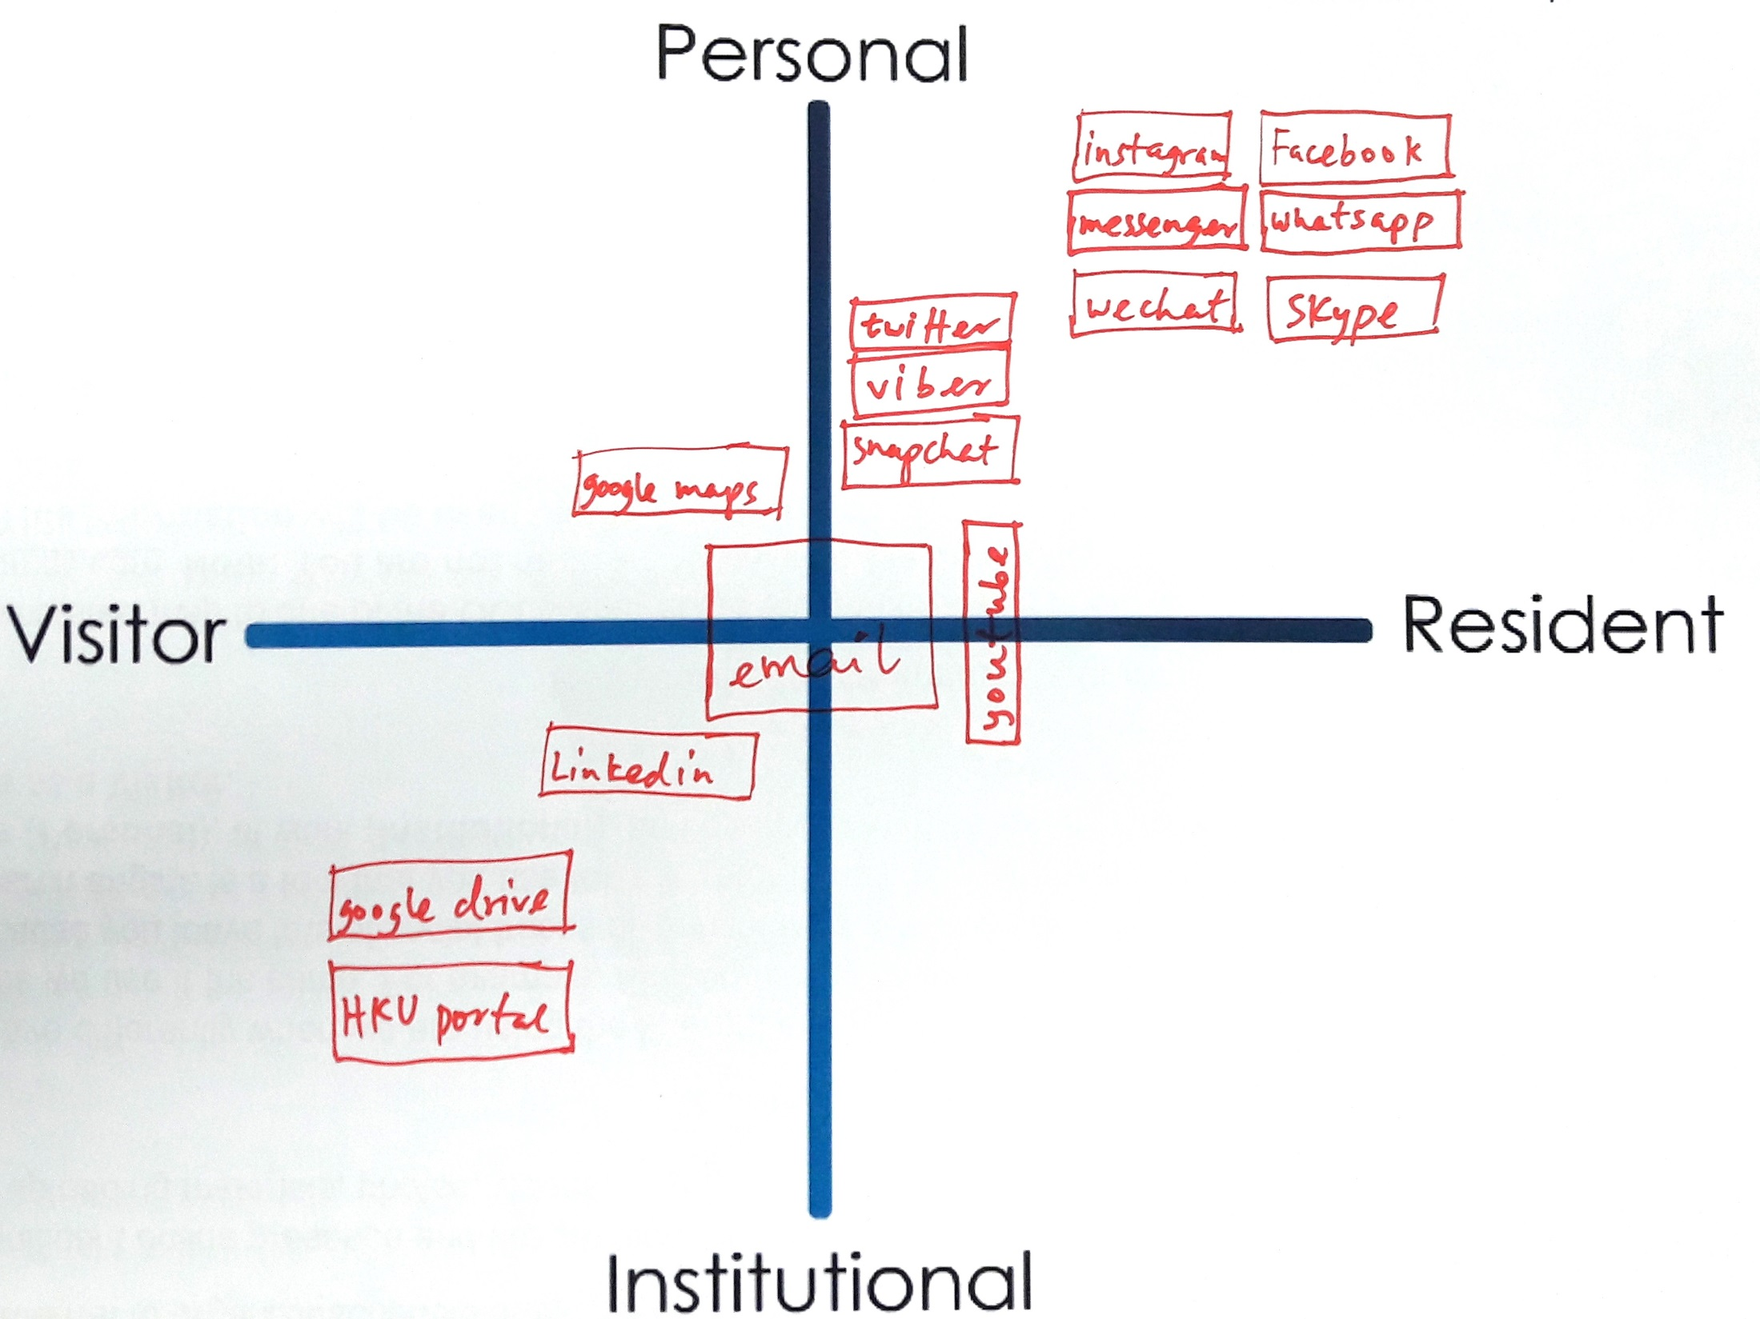
Notes:
HKU, upper undergrad
Library- Borrow book for personal
Google drive – only for group project (visitor)
Social media apps make us anti – social

Slide 21
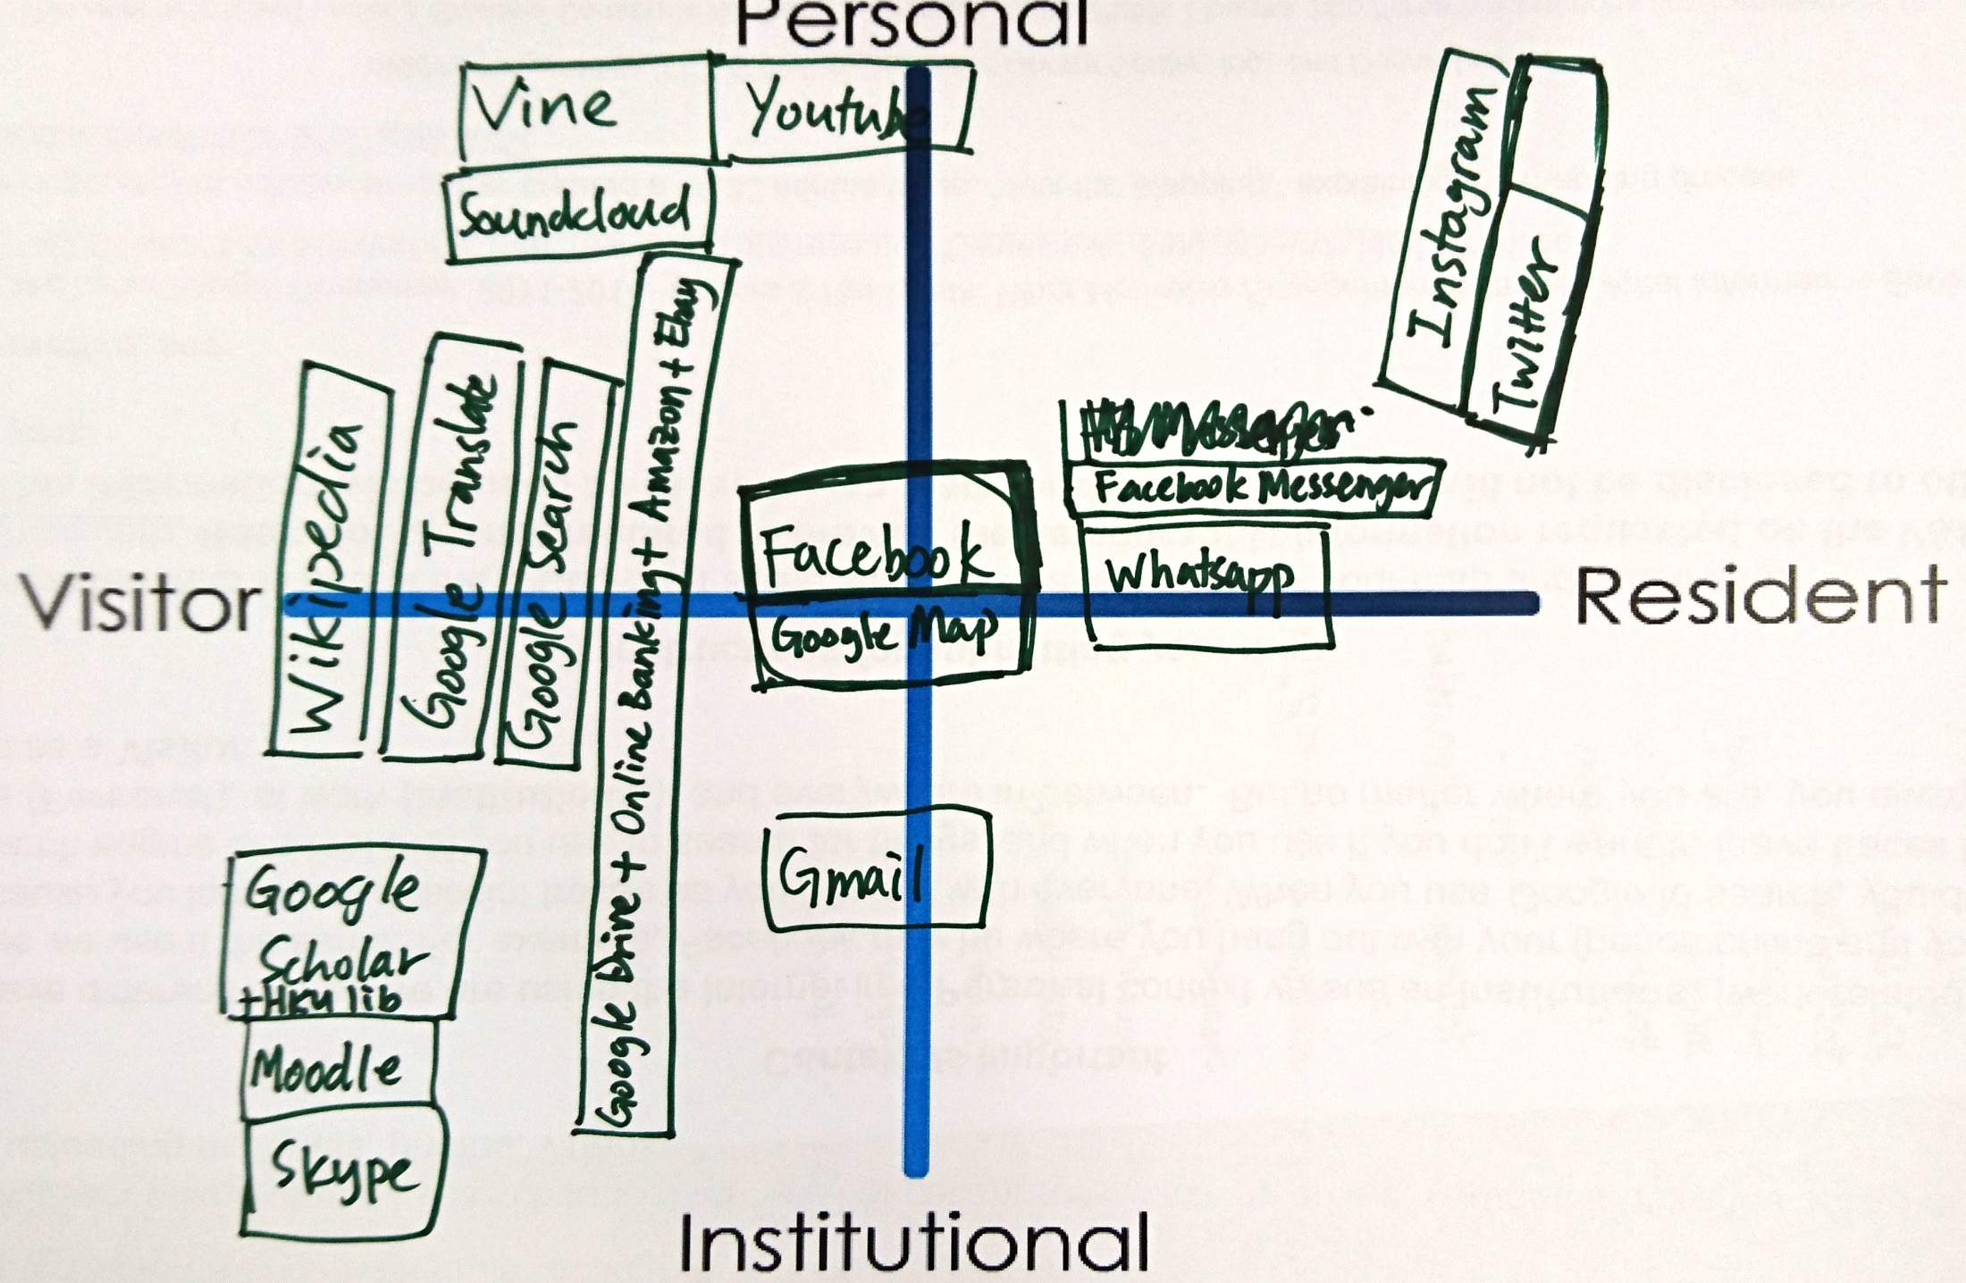
Notes:
HK, upper undergrad
Wikipedia – just find sources but not cite. For both academic and personal
ebay- buy textbook, pokemon
Wikipedia is a good tool to start research

Slide 22
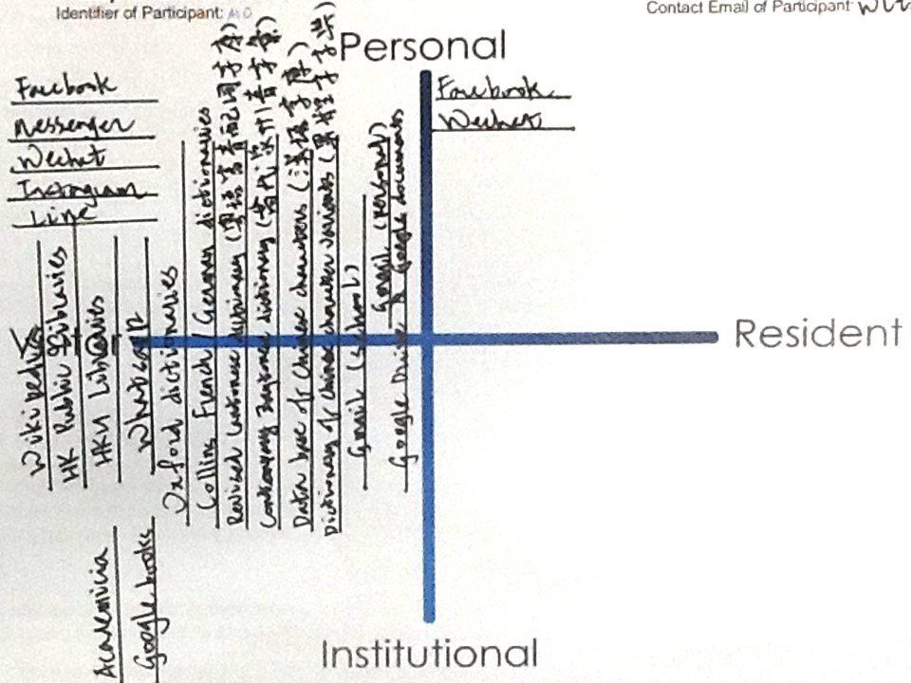
Notes:
HKU, upper undergrad
Write long text about specific topic
Google books and academia – sign for source paper
Online forum – people don’t respond in Hong Kong, cultural different from US

Slide 23
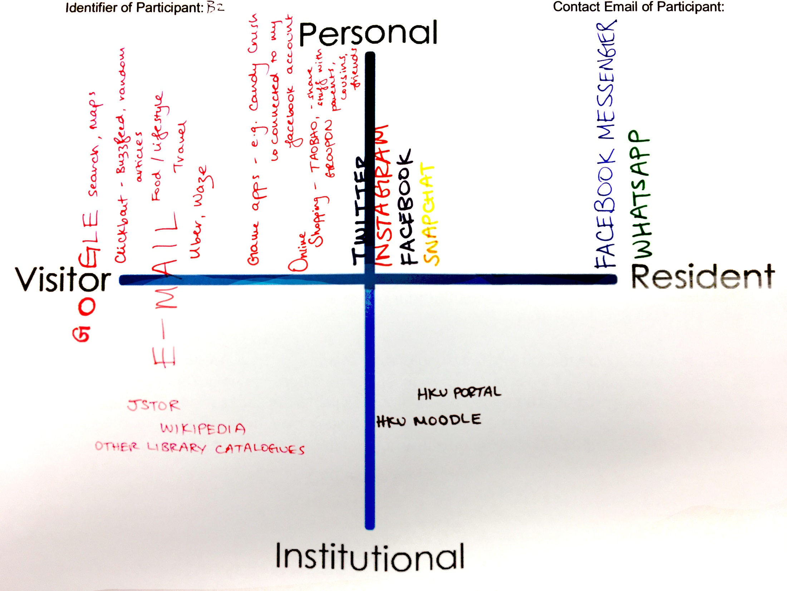
Notes:
HKU, upper undergrad
Facebook Message – contact friend from other countries
Moodle – will post
- use blog feature
Wikipedia – find first information and citiation
- directly go to Wikipedia
Jstor –always use jstor
Uber- sometime use it in HK but mostly in foreign country
- share with friend
Game apps – compete to other fds
Online shopping apps - share with parents

Slide 24
Graduate students

Slide 25
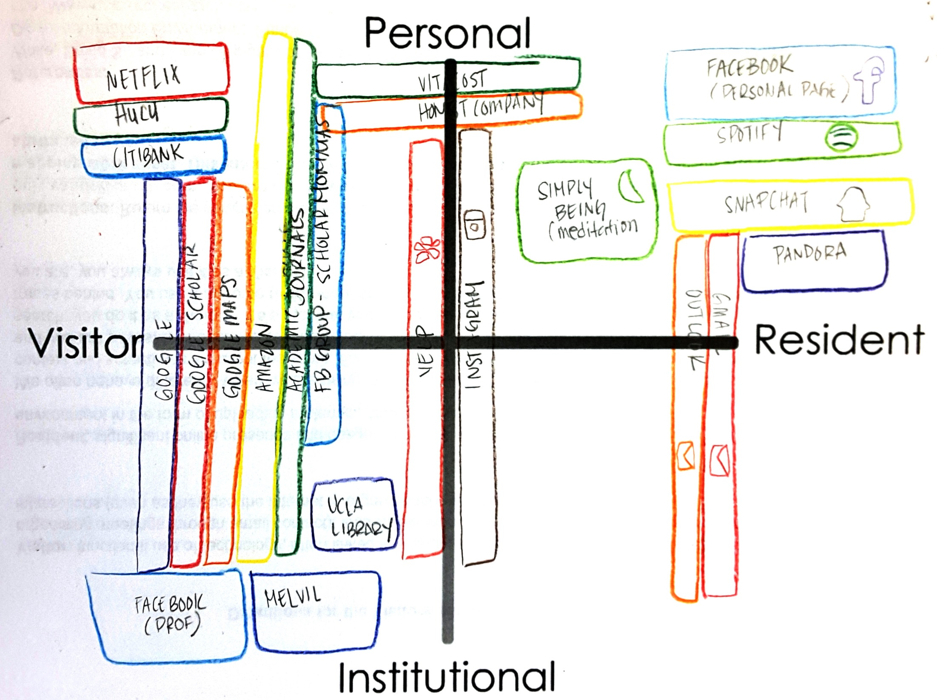
Notes:
UCLA, graduate student
UCLA Library
Melvil

Slide 26
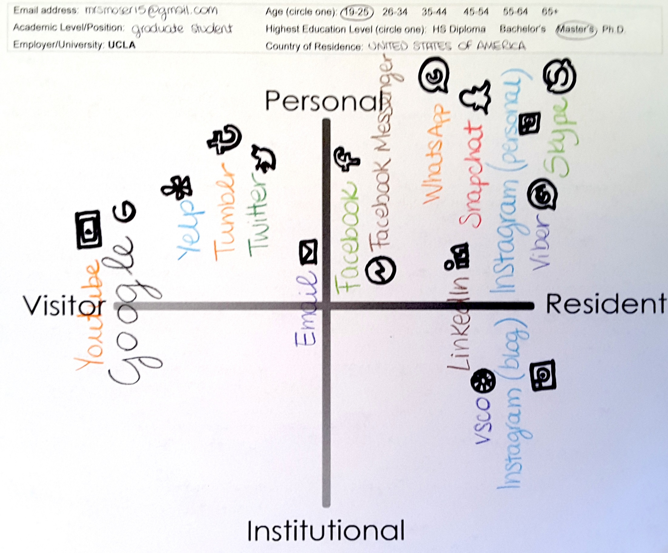
Notes:
UCLA, graduate student
Doctoral student: Very surprised that she remembered all of the icons for apps, etc. She thought this may be telling her that she is spending too much time on social media
Did not include library website or sources
Access through Google Search

Slide 27
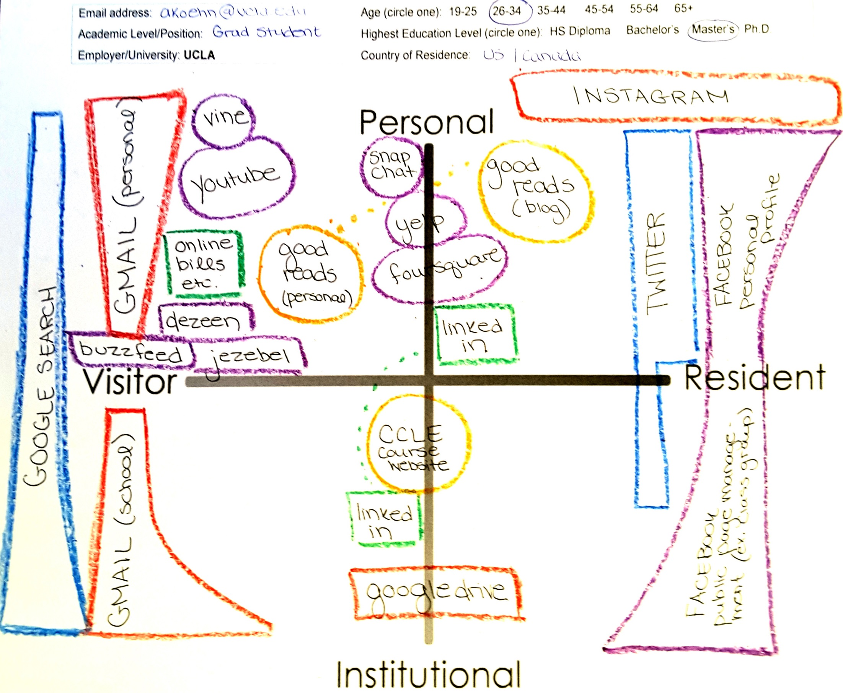
Notes:
UCLA, graduate student
Discoverability of library website features
Not optimized for smartphone interaction
Take photo of screen with information, then look for item
Email information to self
Did not know this option was available

Slide 28
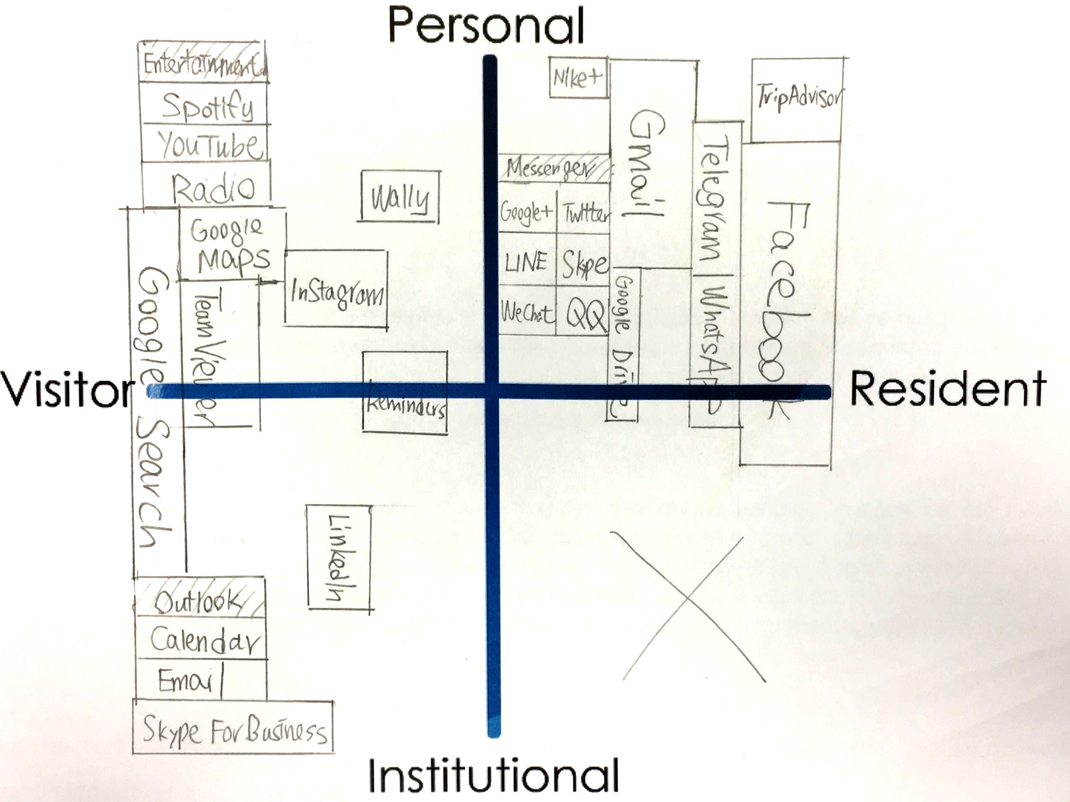
Notes:
HKU, graduate student
School side, person-to-person contact, therefore not Resident
Use Facebook a lot
Use Gmail for personal emails
Use a lot of messenger, to stick with a lot of different people, even has QQ
Twitter & Google Plus, not many people there right now
Google search, for both school work & personally, therefore in between personal & institutional
“Team”, Remote control computer
“Reminder”, built-in reminder in iPhone
“Wally”, expense management apps
“TripAdvisor”, travel a lot & therefore write reviews regularly
“Google Trip”, started writing reviews
Institutional – Google Scholar & Moodle

Slide 29
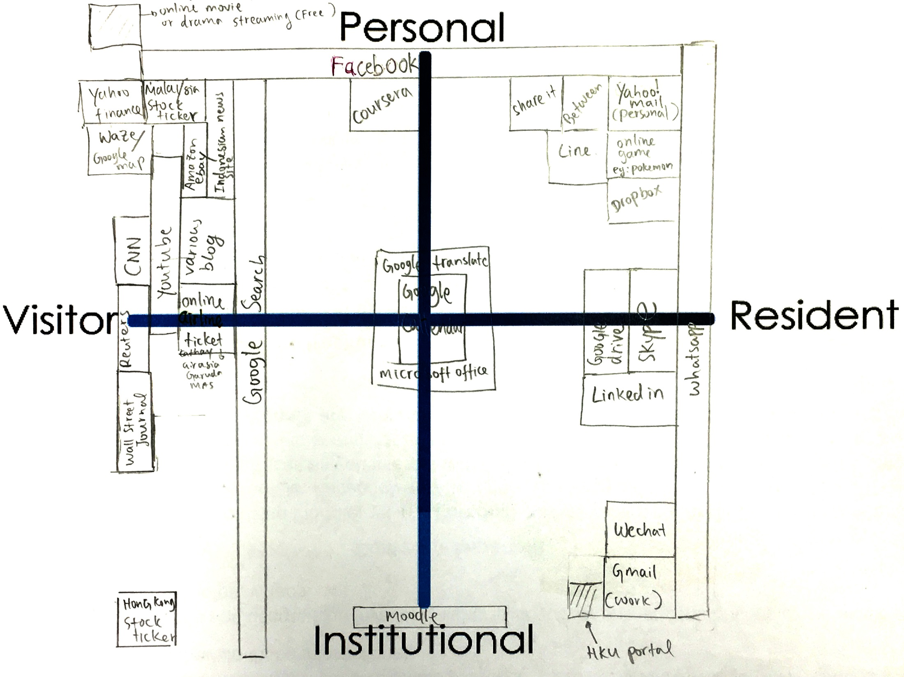
Notes:
HKU, graduate student
Technically, using a lot of Google products
Personal email & work email separated, therefore gmail for work, yahoo for personal
Sometimes use only less than 1 min to check
Catch up a lot of news (in the Finance work world)
Google map in Hong Kong sometimes not pointing you the right way
Movie streaming (top left)
HKU portal, linked everything you have to email & manage your information
Moodle, others use to make timetables, and this participant has course schedule change every 2 months, so not for scheduling, but only to download notes (available while some courses do not put anything on moodle at all)
“Coursera”, use sometimes

Slide 30
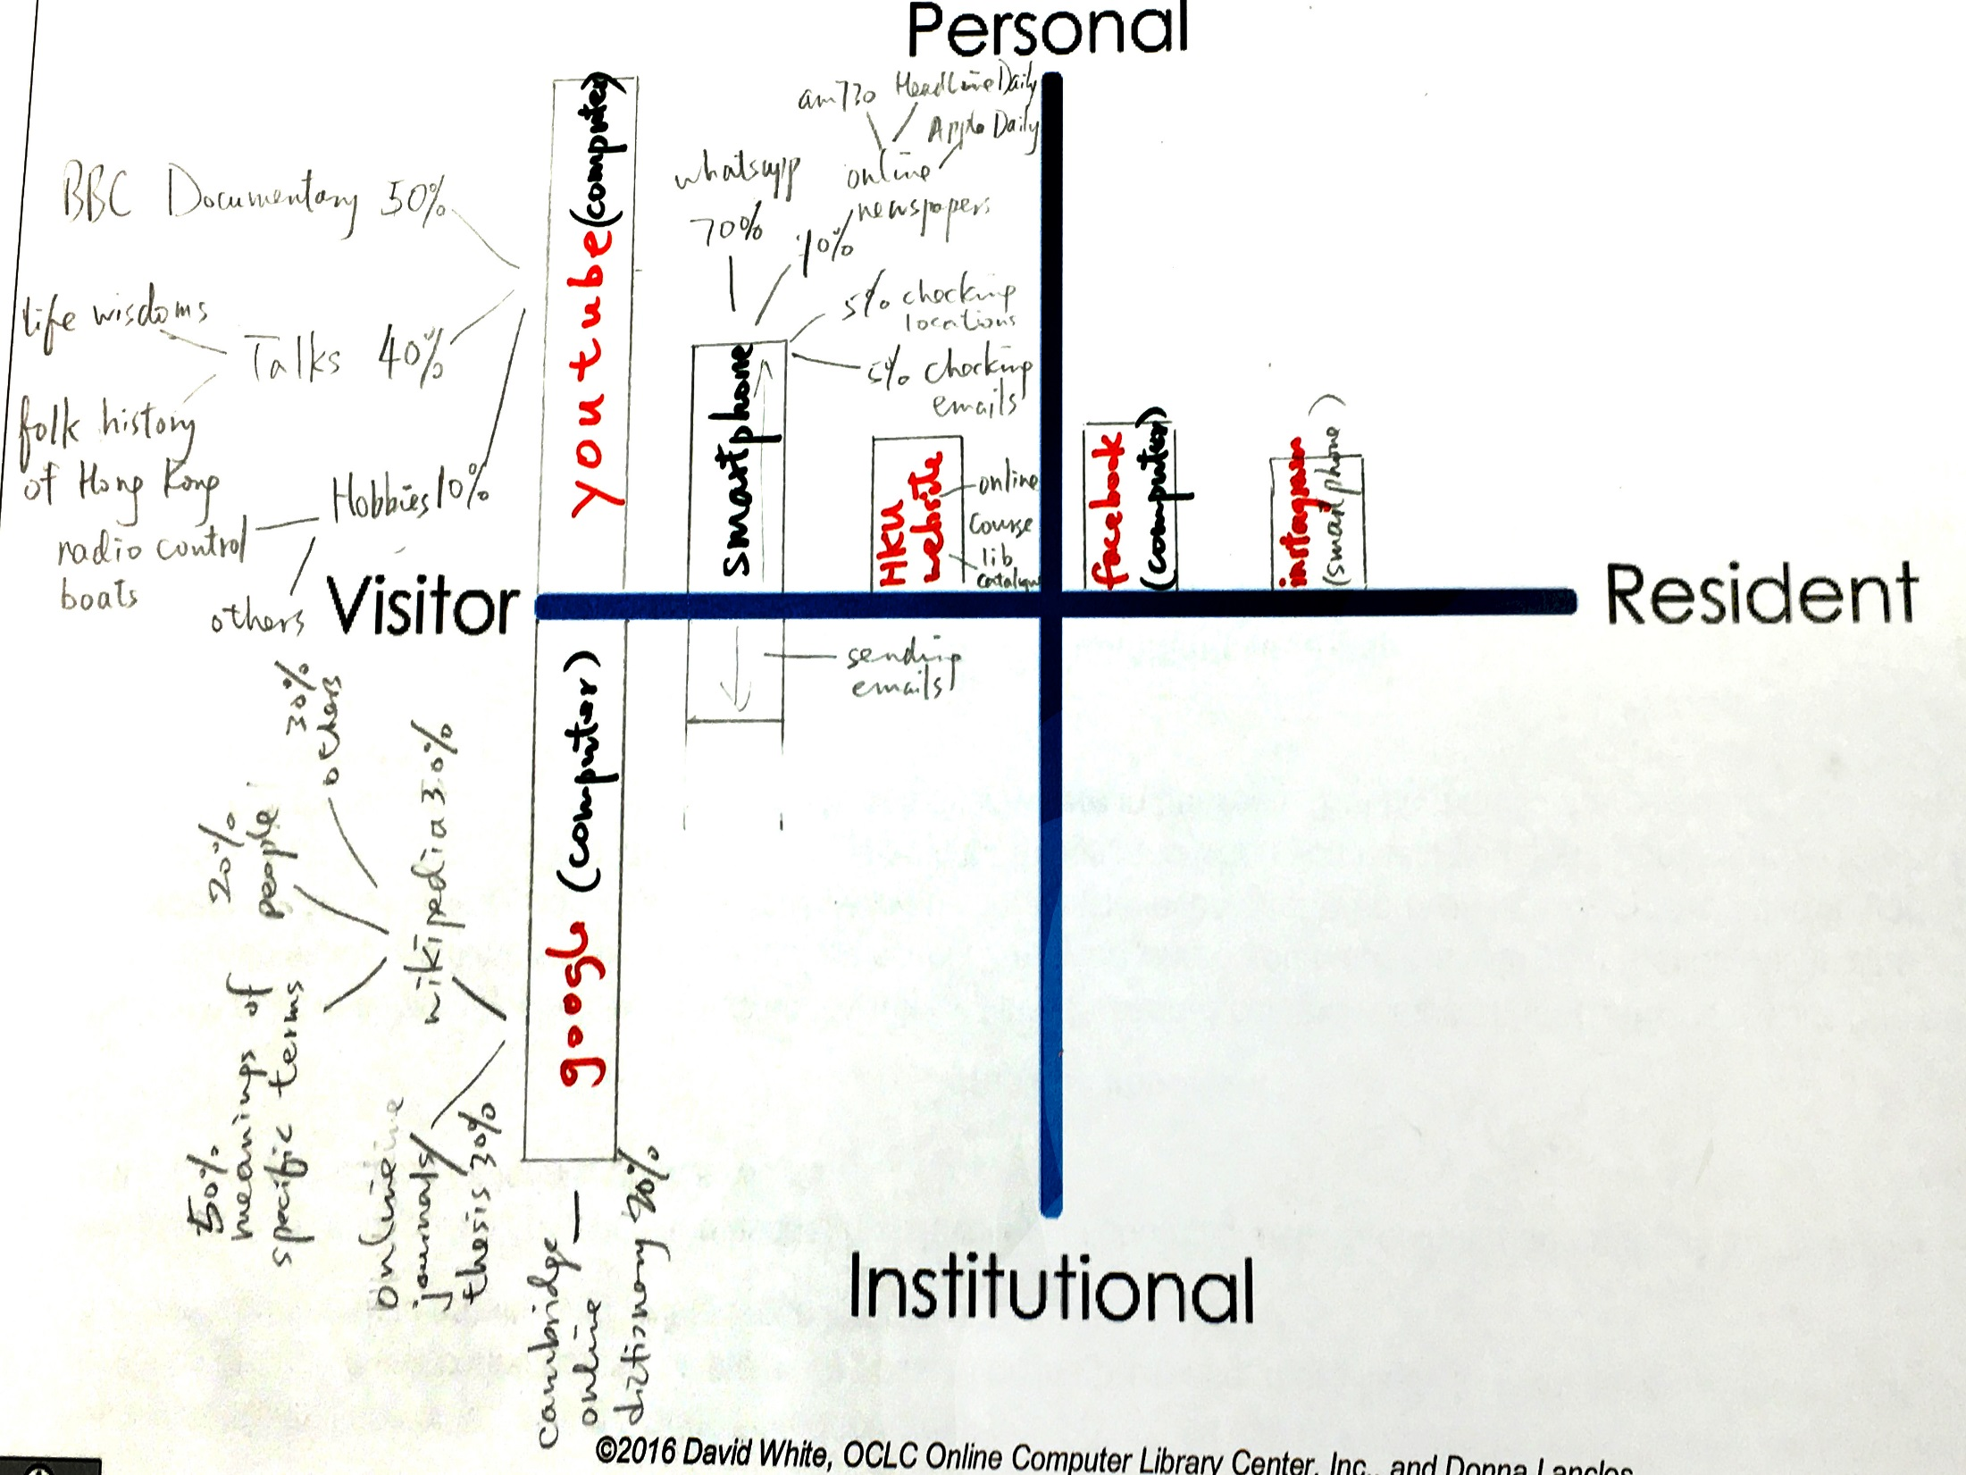
Notes:
HKU, graduate student
Use a lot of YouTube for learning, via computer instead of mobile phone
Use IT / technology for information & communications, mainly for learning as well
(left bottom) time spent on each of the categories
“Wikipedia”, online dictionary, to check terms
Library catalog is easy to use

Slide 31
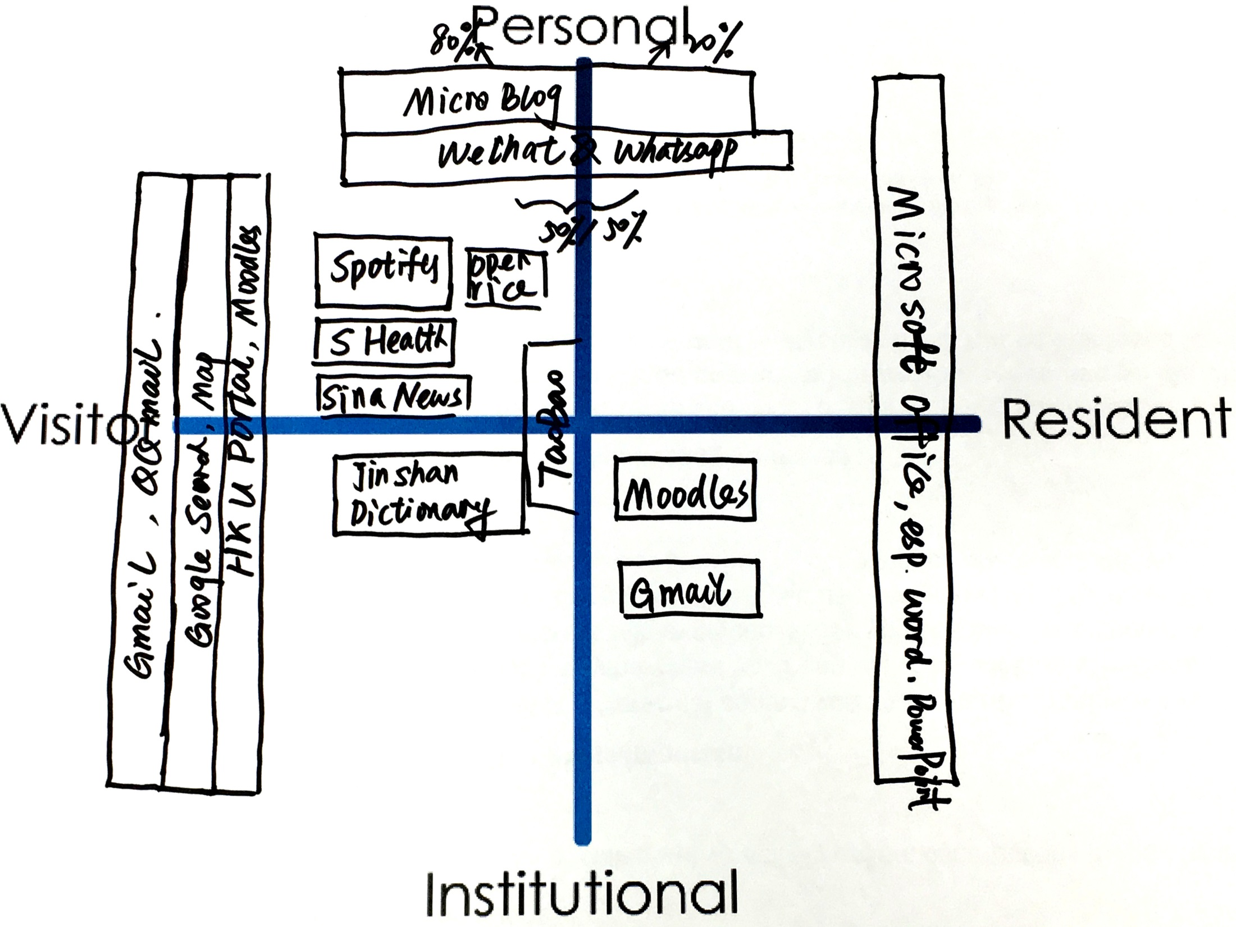
Notes:
HKU, graduate student
“Microblog”, Weibo, post very little (20% post, 80% read)
Use “wechat” much more in Mainland China, but “whatsapp” more in Hong Kong
“S Health”, apps to track physical activity, e.g. how many steps you want each day
HKU Portal, Moodle, for personal info search

Slide 32
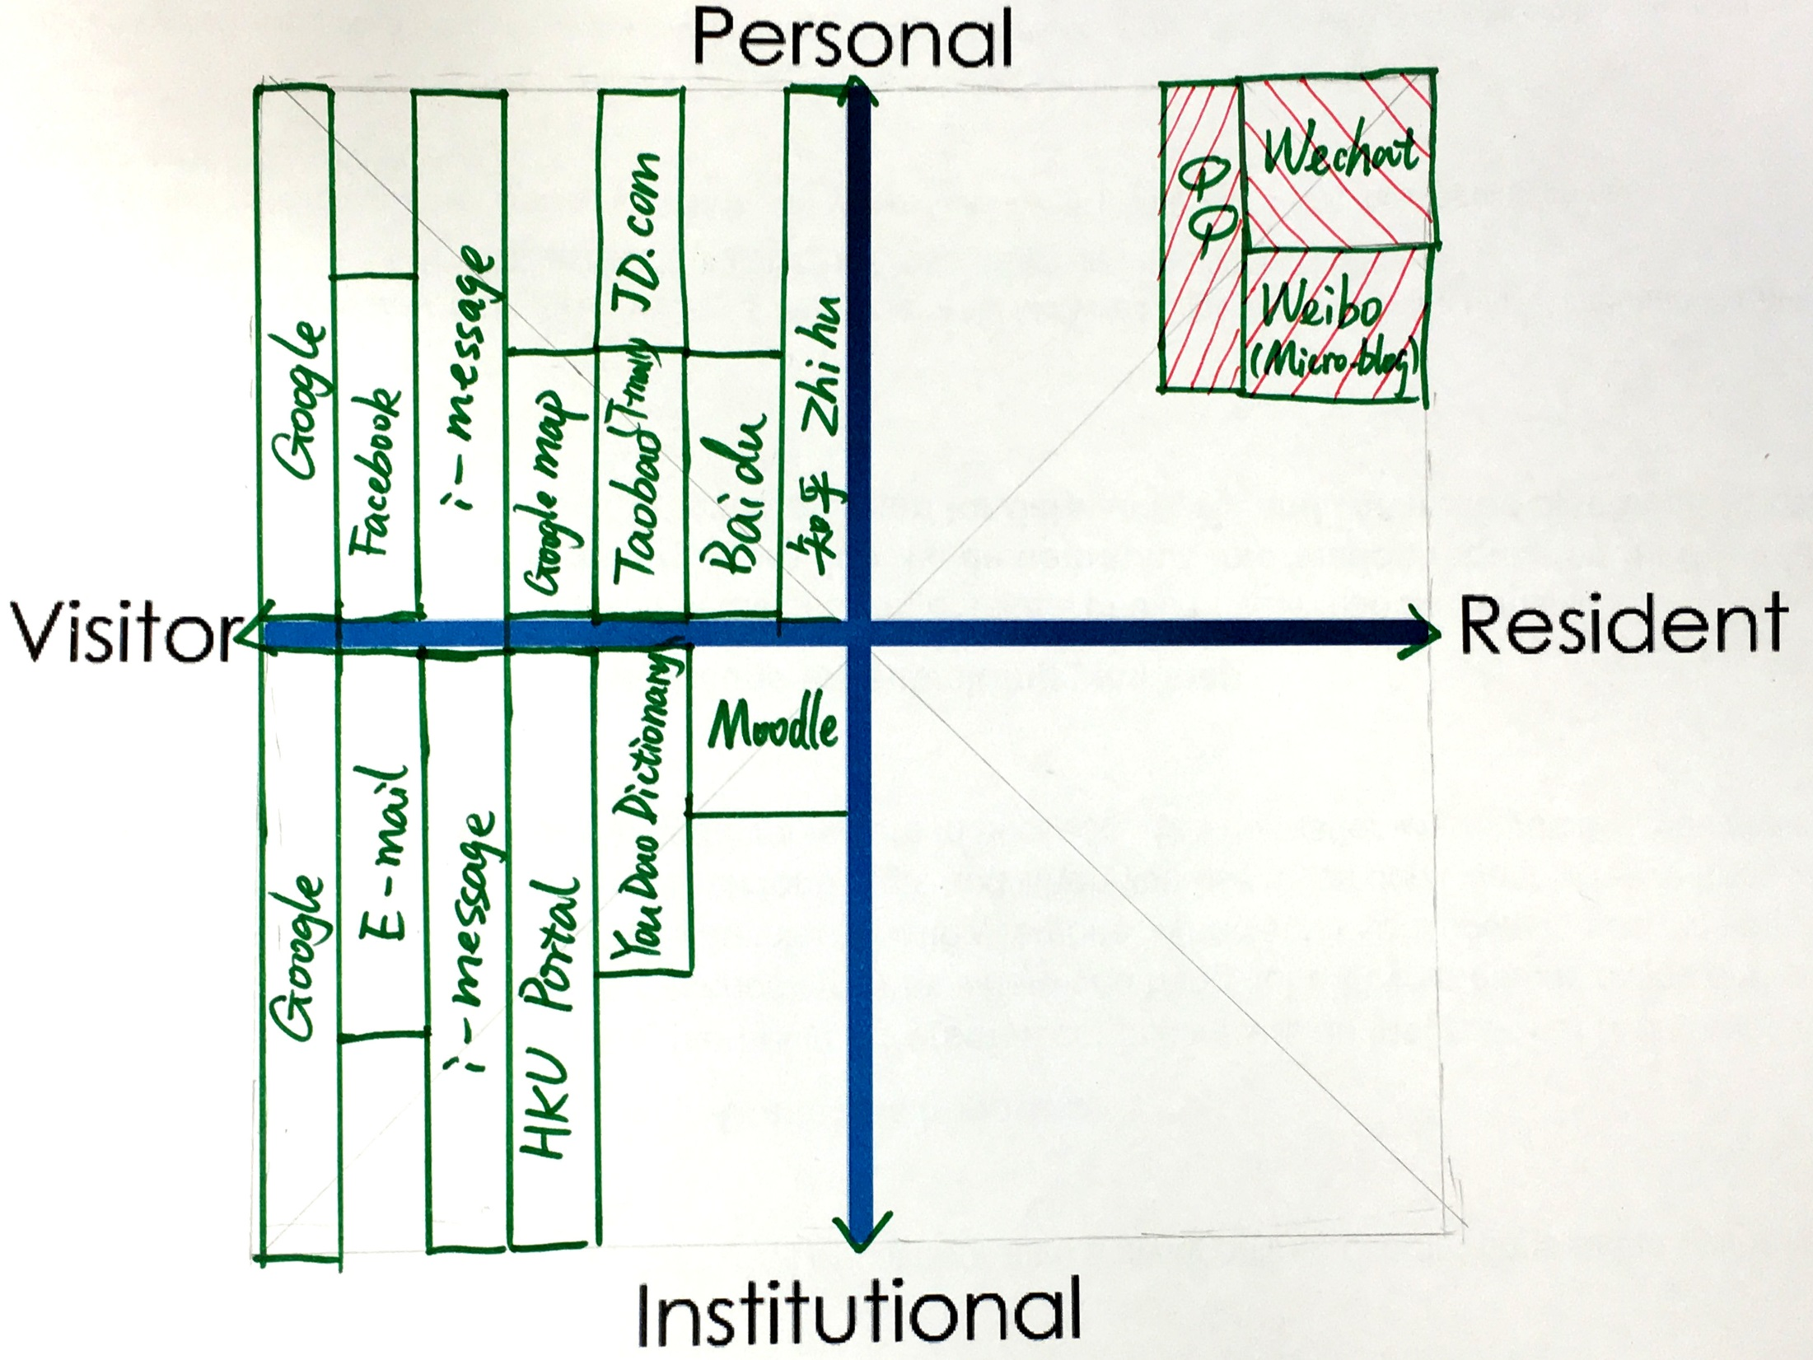
Notes:
HKU, graduate student
A lot of visitor type, except for those social network apps
“QQ”, “Wechat”, “Weibo”, more for personal connection with classmates
“Zhi hu”, a platform you post questions on specific subjects/ fields, though there are sometimes silly questions (social Q&A site), viewers can LIKE and answer questions
“Baidu”
“i-message”, contact colleagues and families who do not use WeChat or Whatsapp

Slide 33
faculty

Slide 34
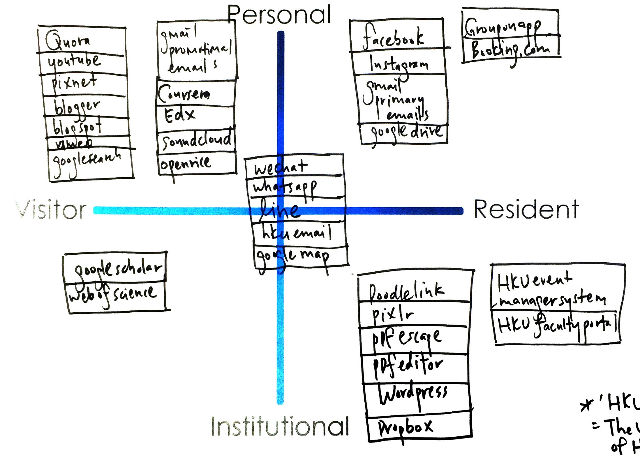
Notes:
HKU, faculty researcher and/or scholar
Research assistant
Least Digital footprint as possible, substantial, good thing to live (the left side of the map)
Middle – use a lot in work, create contacts
Use HKU specific apps for work, wordpress, create webpage
Learn about yourself: need to learn more & contribute more in digital footprint (at work and in personal)

Slide 35
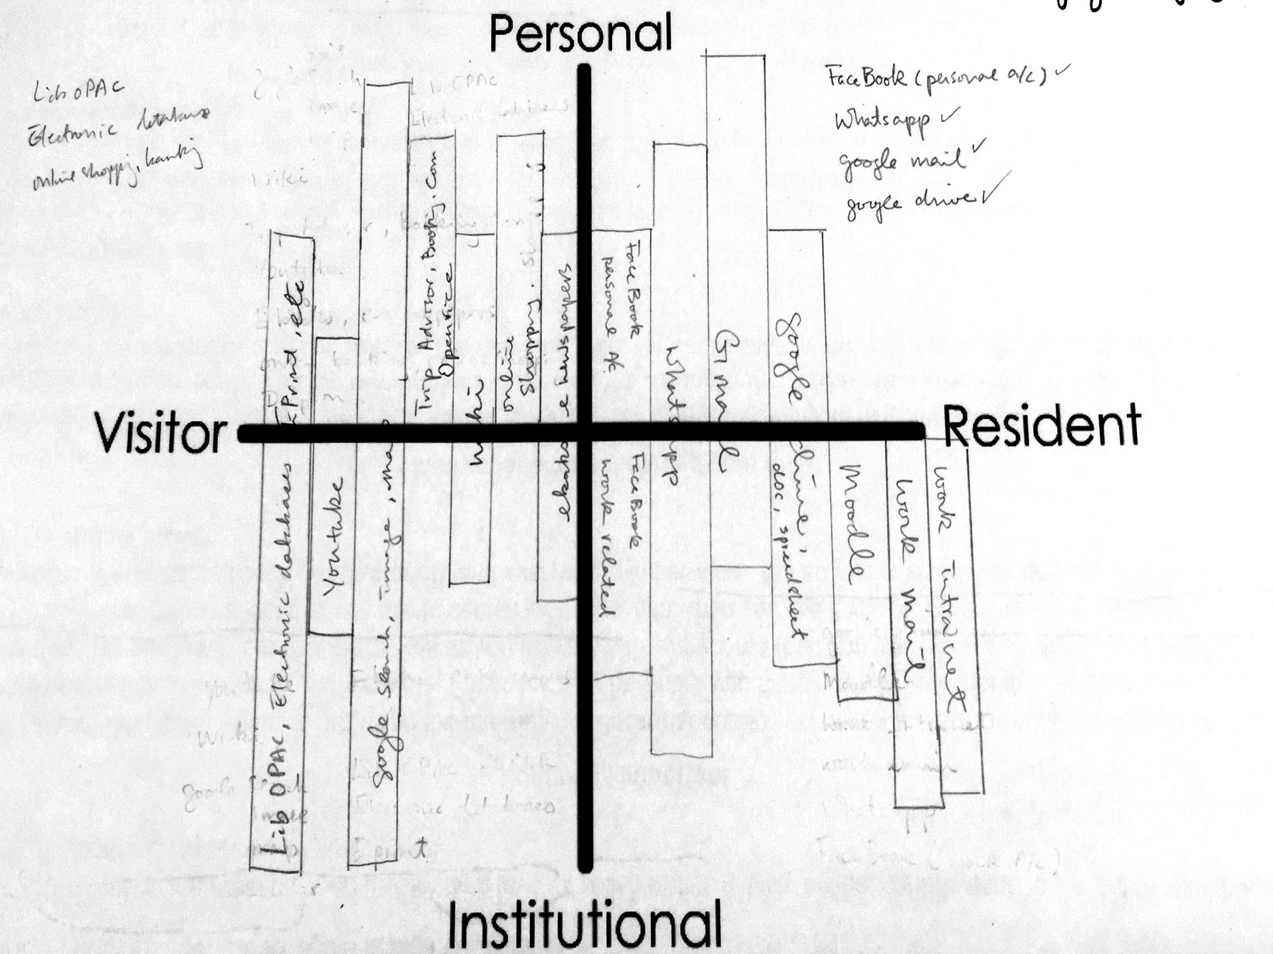
Notes:
HKU, lecturer
Bar chats to indicate time that I spend on each thing
Gmail most of time is personal, may be 10% for work too
Whatspps 10% to close colleagues, most of the time is personal
Fb – share what happen in the field, share job adv.
Wiki chat with students sometimes but will look for more trustful site
Youtube – lesson planning, students can know things before the lecture class
What did you learn?
First time to sit down and think about it.
Simple, I see technology as a tool, as long as it works fine. Don’t want technology to influence me.

Slide 36
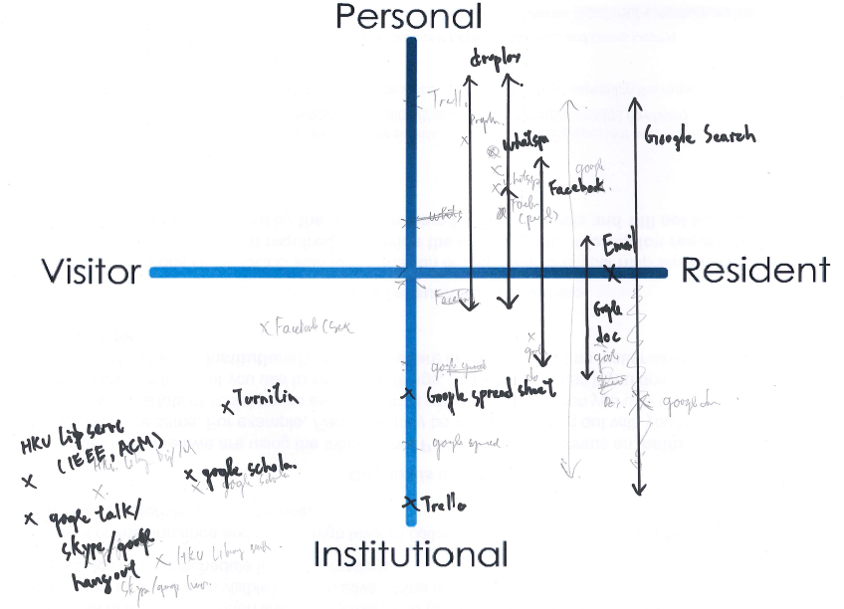
Notes:
HKU, Faculty Researcher and/or Scholar
HKU Teaching and Learning (digital native) – IMPROVE e-learning, bag data.
Surprise yourself? Do similar study before, always check own data
Use sign – promote google search to promote learning
Calculator, web search, use most of things with Google
Trolle is in the Middle – working on lots of projects at the same time, sorting info, google spreadsheet, - online, can be edit, comment, good for collaboration, promote this in teaching & learning
Virtual learning environment – skip, do not use Moodle this year, but the team is helping campus to improve Moodle

Slide 37
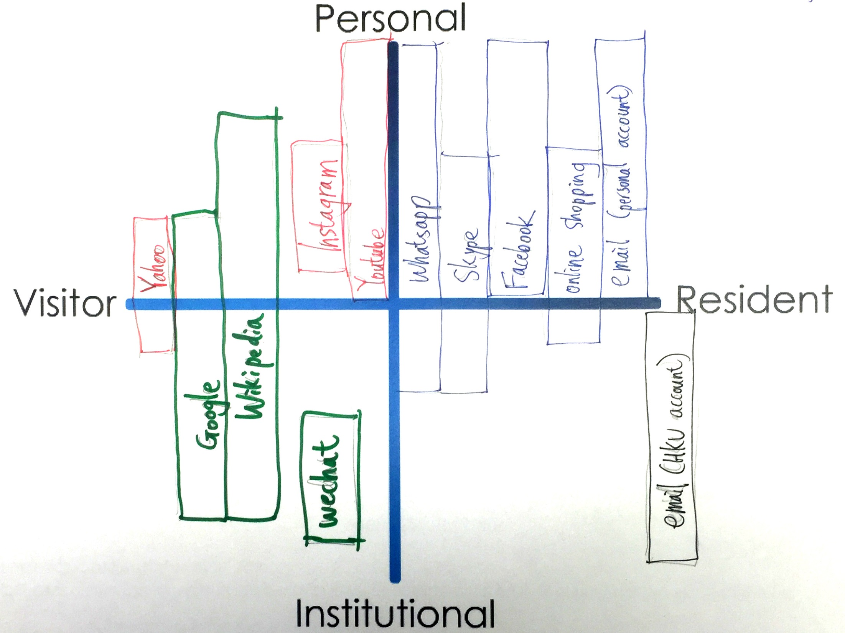
Notes:
HKU, clinical assistant professor
I use Wikipedia for some publications, fast info, will go for references,
Wechat – communication with Shenzhen staff (for work)
FB for personal – seldom add colleagues to FB
E-mail: try to separate HKU and personal e-mail
Shopping, seldom do reviews, do pay & shop so put in resident
Learn about yourself: Separate work & non-work things

Slide 38
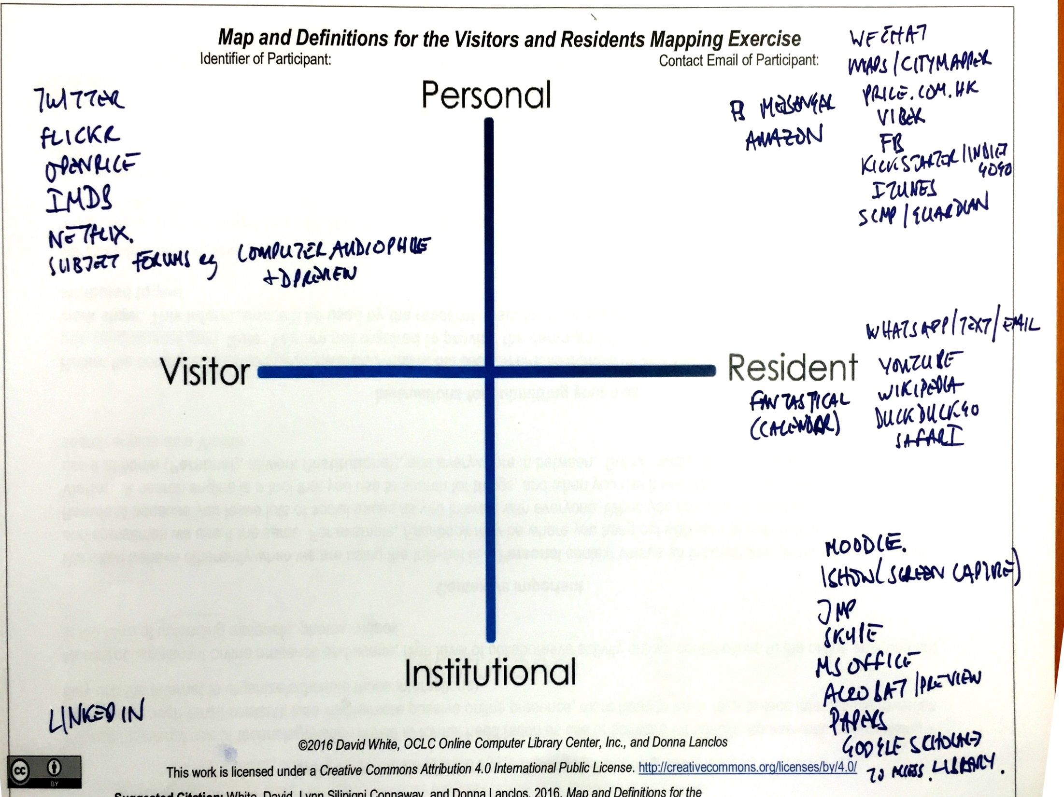
Notes:
HKU, faculty researcher and/or scholar
Work: paper PDF, Goggle Scholar is the primary link to go to Library
The library web page is awful. It is not good. You have to go through all kinds of authentications and there are large lists of data bases and journals.
The only thing I think of a a visitor thing for work is Linkedin, not FB (I removed people from FB. I don’t want to share with some. I learned this from my kids.)
Don’t have HKU e-mail on my phone so if I’m not at HKU, I have to use personal e-mail to connect with me.
Dropbox for work sharing, google drive – non-work sharing
2 Dropbox accounts – links to different e-mail accounts to get more storage space (2FB accounts)
Institutional: students & other work will use different tools
Moodle is substantial for students, e-mail no longer works for students
Whatsapp works for student as it gets instant reply
University sends all messages via e-mail but students may not always read them.
E-mail not for communication for students.
It can be HK content, mobile is common, all generation has smart phones. This may not happen in other places (in other place old people may not have mobile, not less to say whatspps, but seems that everyone in HK has mobile and knows how to use it.)

Slide 39
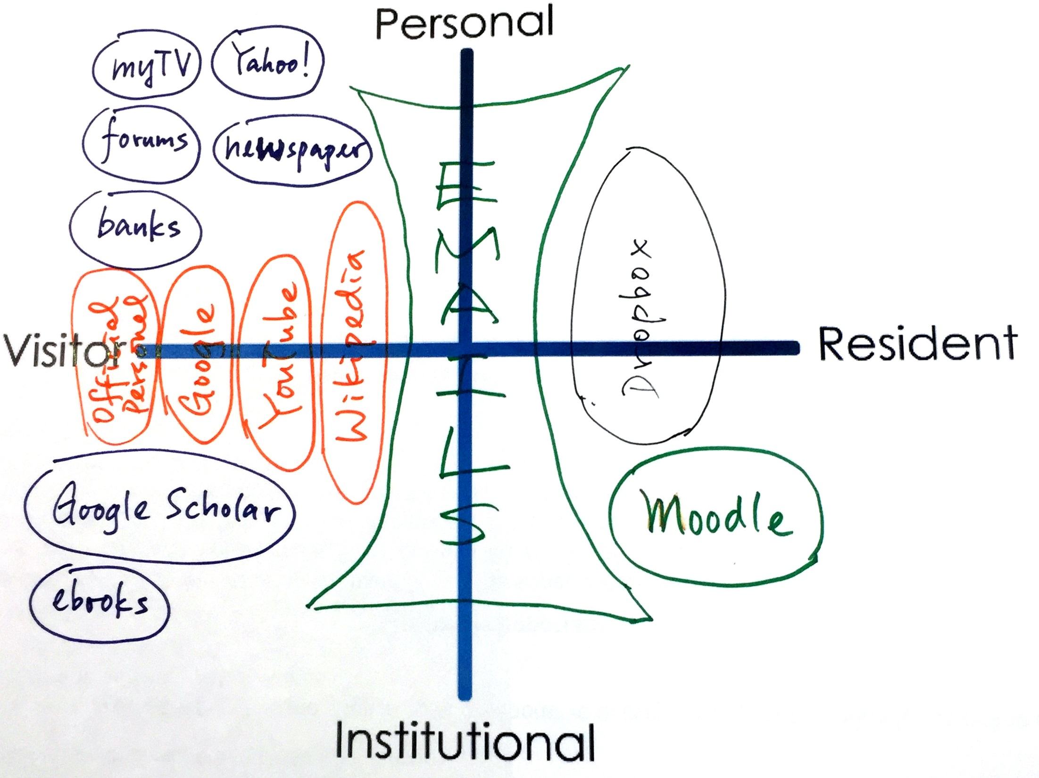
Notes:
HKU, teaching staff
Consumer rather than resident
Do some things on Moodle, like set discussion,
Don’t do much actively online
Via google find the resources , not much from library webpage
It’s my intent not to be actively online
Use Wikipedia for some information and share with students because it is well organized

Slide 40
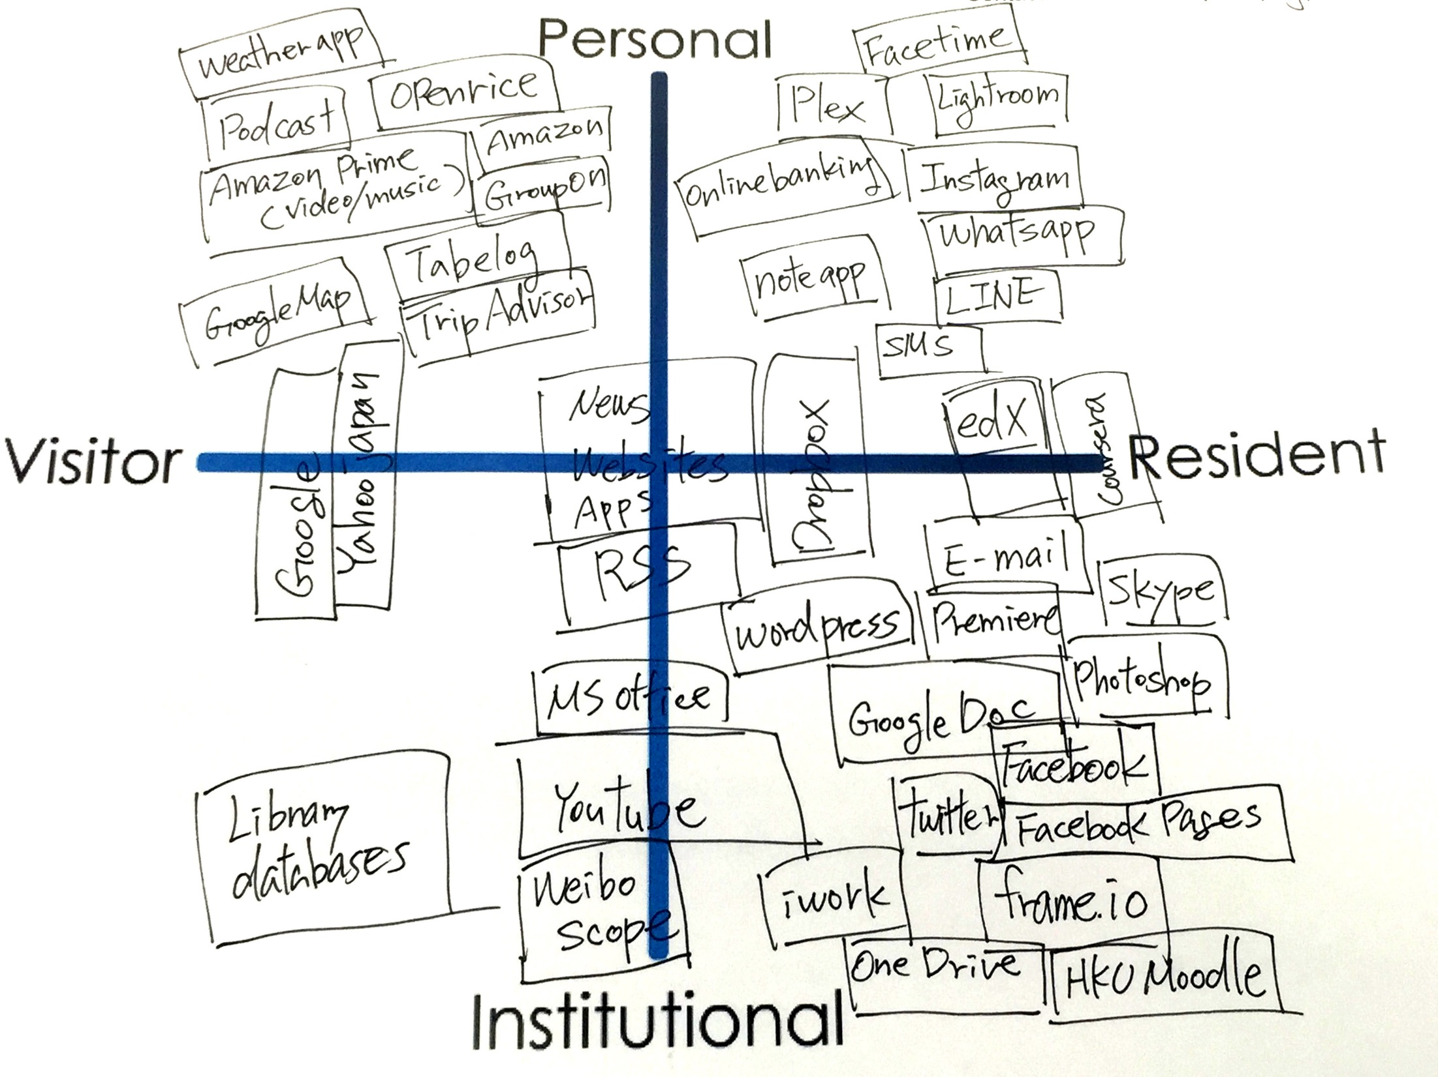
Notes:
HKU, faculty research and/or scholar
Frameio can communicate with people not in the same places/environment
FB mostly for work, don’t have separate accounts as only for work.
News is a big part of my life.
Post news on FB and share it with students and friends. Post a lot of FB pages
Go to library website directly, not via google
John: library web site is not confusing but some journals that library may not subscribe to are in Google Scholar and we can see more. Google Scholar has far more citations than the library.
Use a lot of tools, Twitter & FB - most people use for private communication. I use them for work/professional communication.
Personally I use Line and share photos via cloud. FB is purely for work
My wife share everything on FB, like kids’ photos

Slide 41
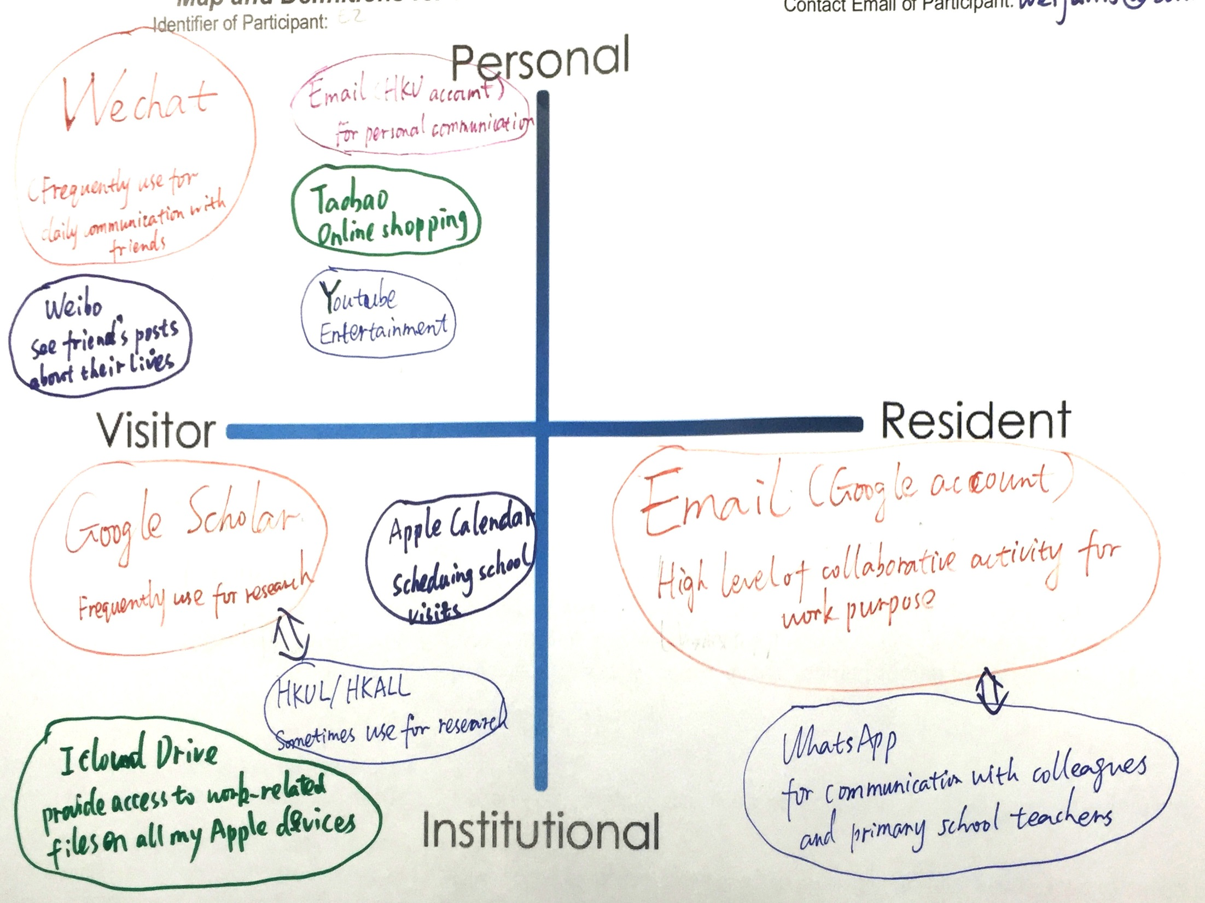
Notes:
HKU, faculty researcher and/or scholar
Personal: shopping online using Taobao
HKU email account only for work
Use Apple calendar to make schedule more organized, use to organize school visitors for teaching program
Residents: e-mail (work account) – high-level for collaboration, whatsapp only for work purposes
Surprise: I don’t have anything from my personal life in the resident quadrant
I am too shy to post anything to arouse people’s attention,
I learned more about myself
Have FB account but never use it

Slide 42
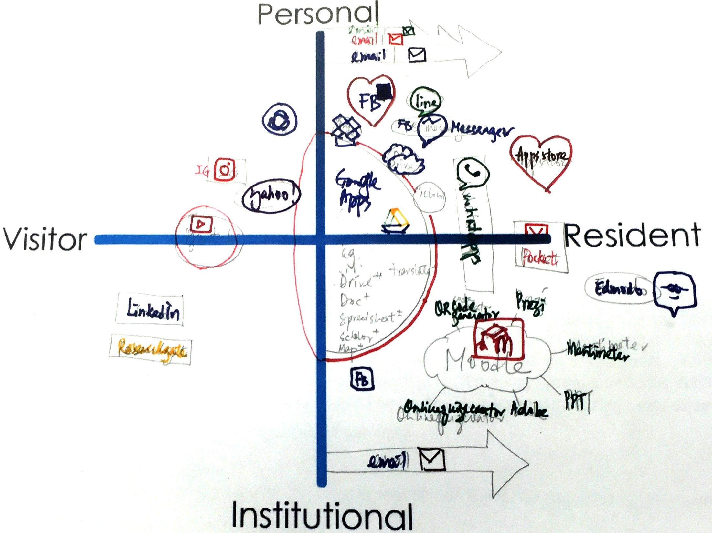
Notes:
HKU, teaching staff
Spend most of the time in teaching – use Moodle, online apps that use in teaching
Moodle not a very good platform, as students may not like it, may not engaged
Google Drive for teaching & learning activities
The heart shape means I like it
Play store look for apps that are suitable for work, not personal
Work at home with all necessary files available, so Google Drive is important
Separate personal one from professional/work in Dropbox.
Google map, translation … google stuff for work
I am quite open, visible.
Before google I used yahoo, now Google is more popular
Arrow work e-mail and personal e-mail indicates they are increasing
What did you lear: Catch up with technology, it is not easy, first time may not know how to work on it, but I keep trying and somehow much better than my colleagues

Slide 43
librarians

Slide 44
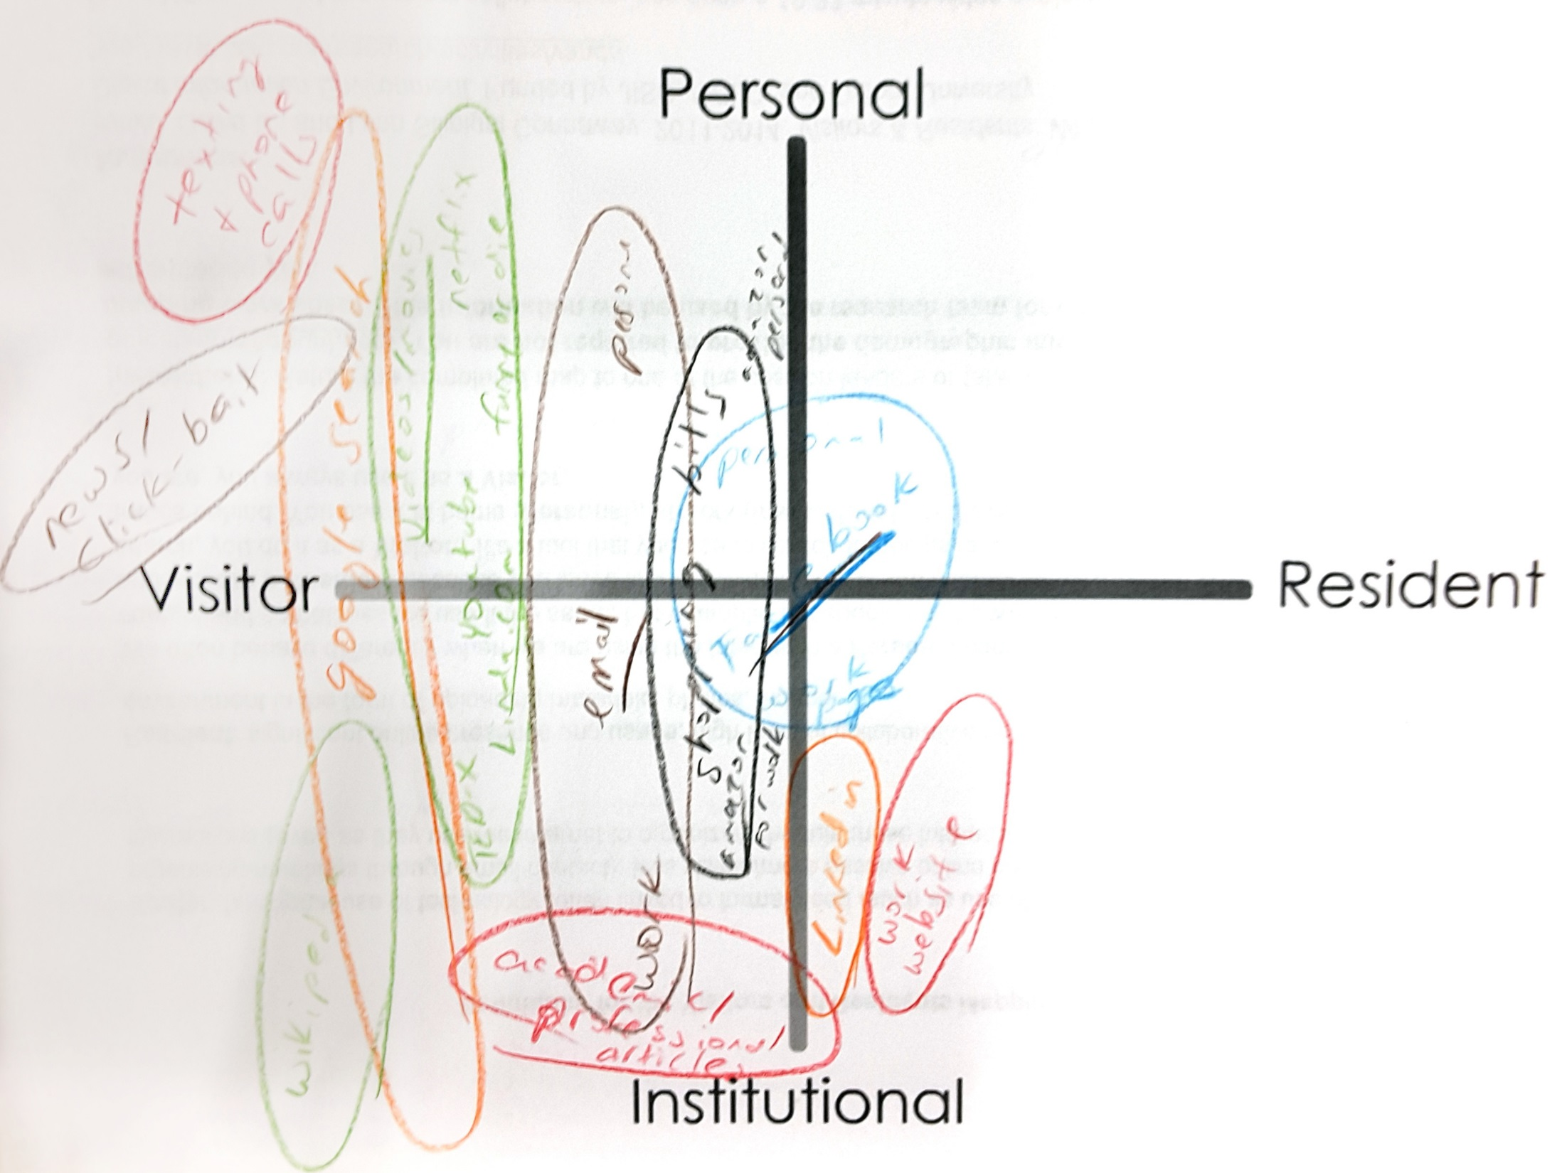
Notes:
UCLA, librarian

Slide 45
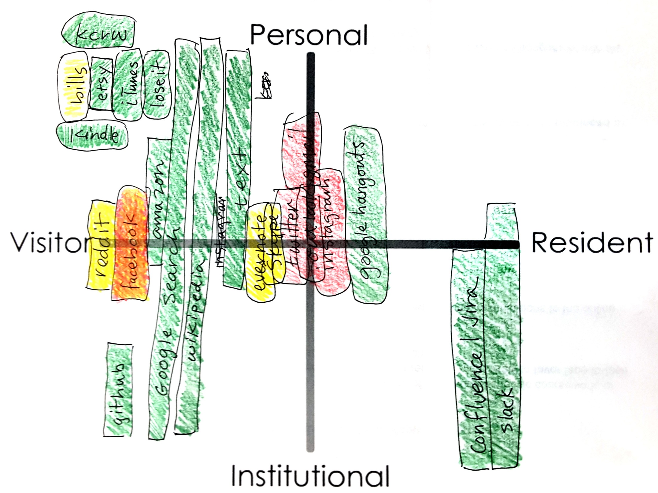
Notes:
UCLA, librarian
Color-coded – green was good/liked
Yellow – ok
Red – did not like

Slide 46
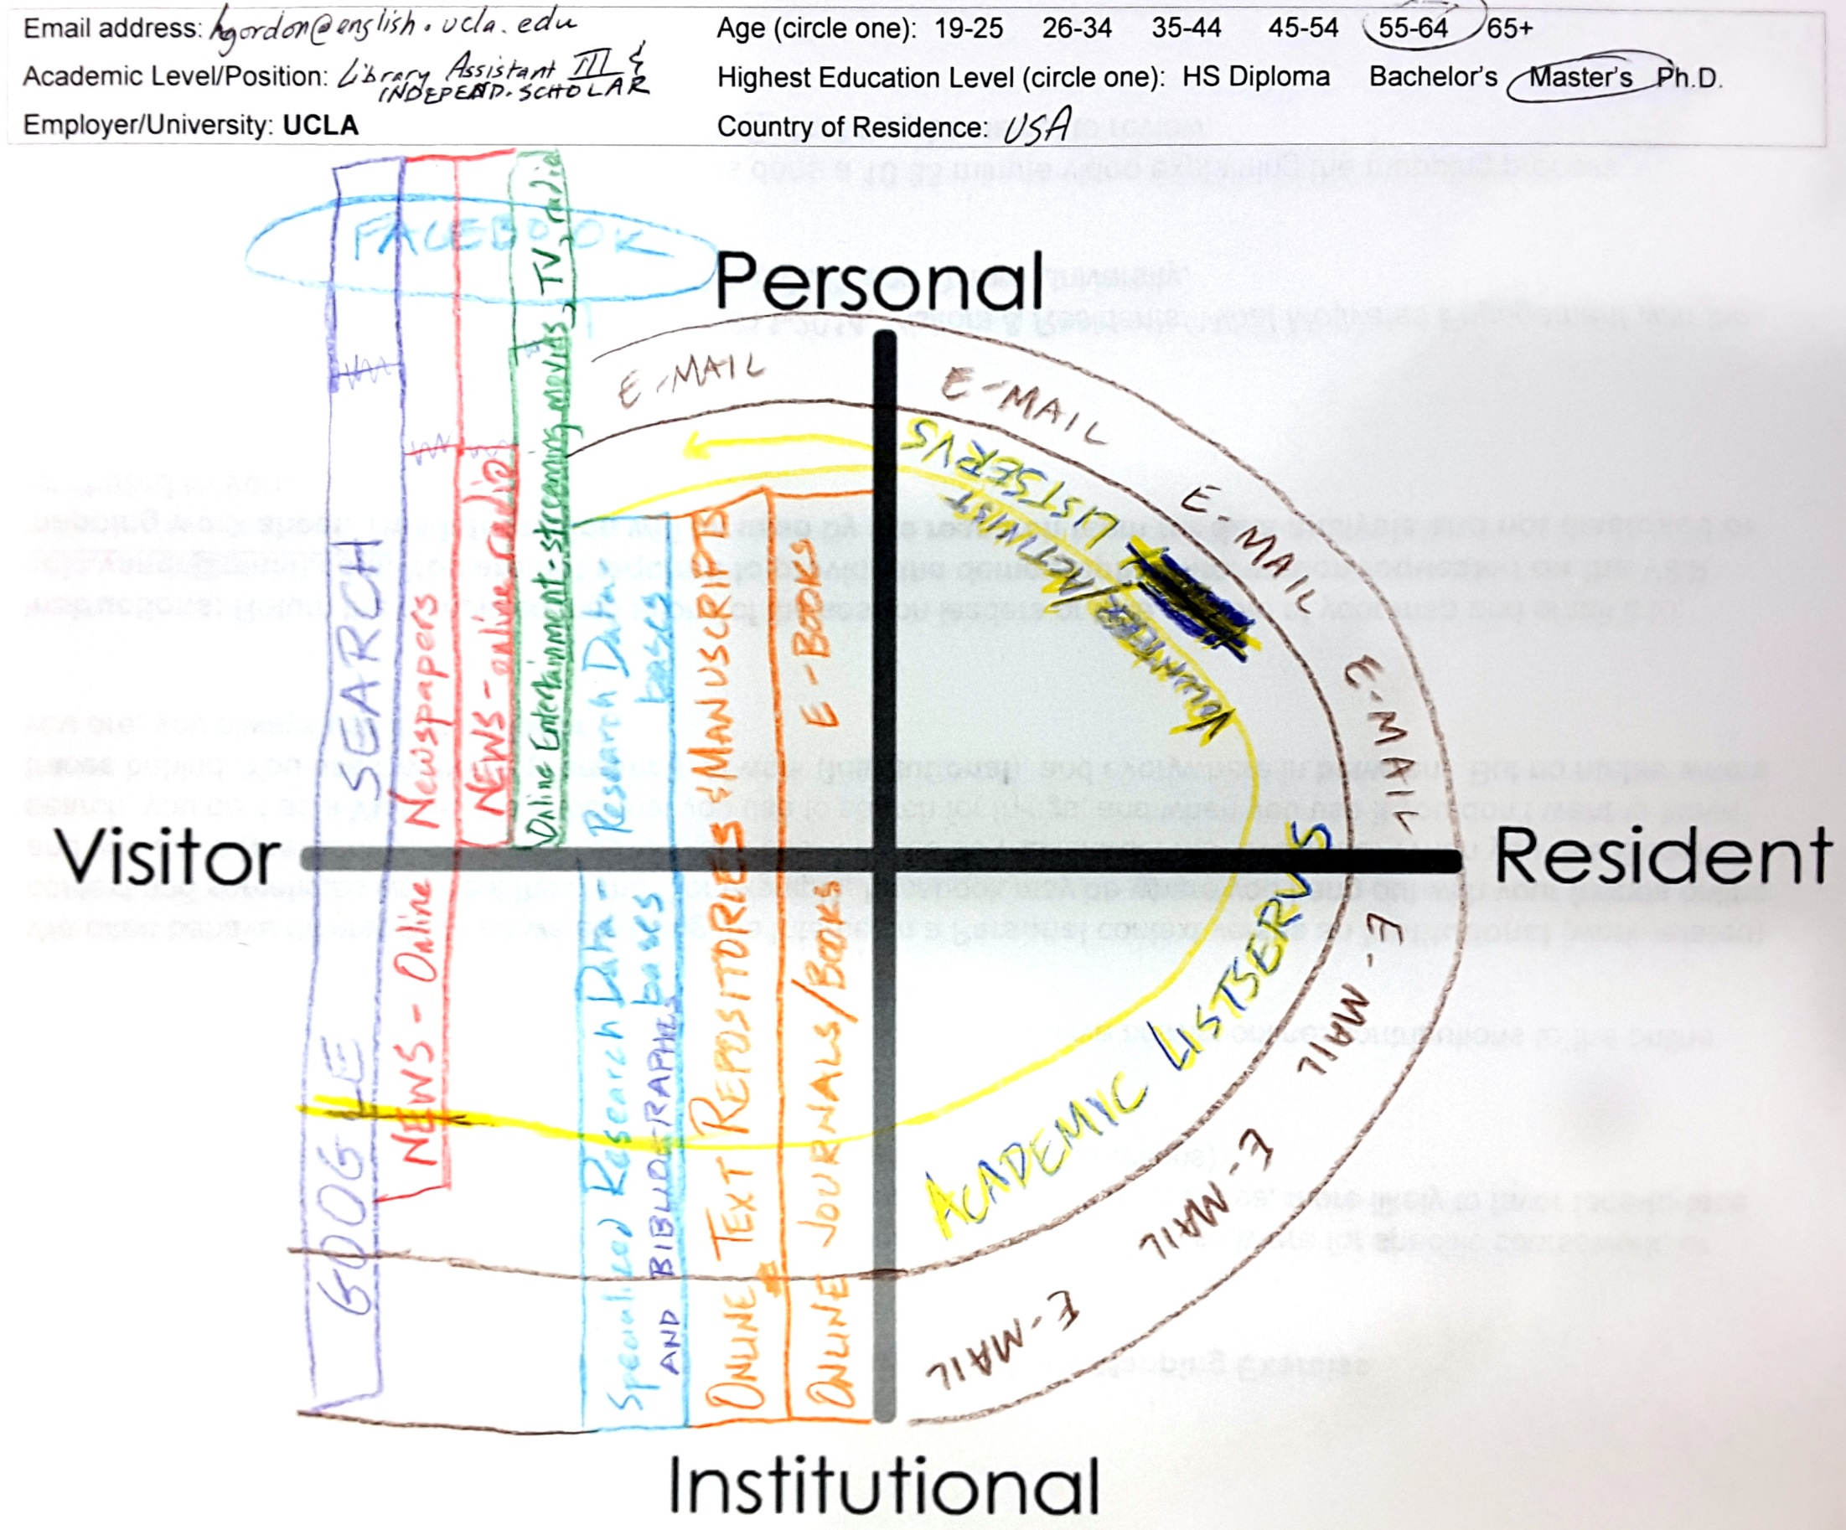
Notes:
UCLA, library assistant & independent scholar
Circular drawing to indicate personal and professional/academic merging

Slide 47
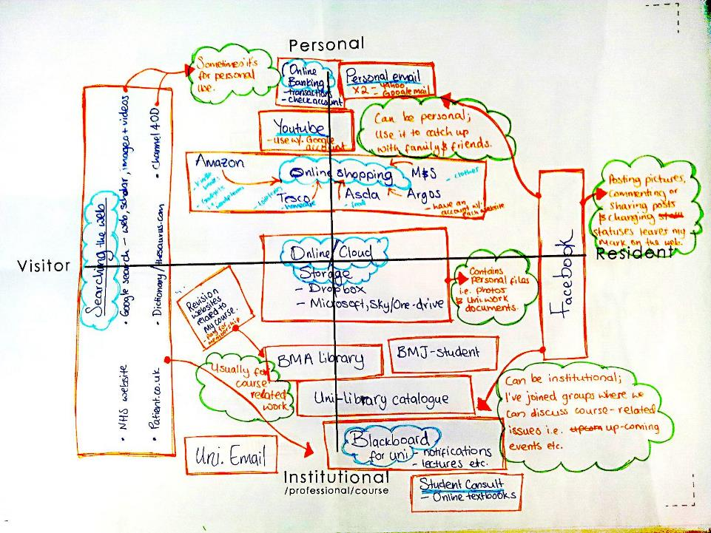
Notes:
Ideal - Annotations

Slide 48
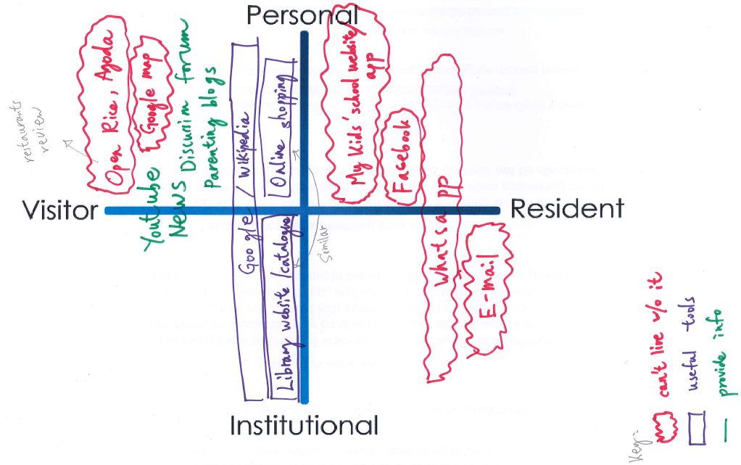
Notes:
HKU Librarian.
Email is the most important
Not much personal correspondence through email because my friends would use whatsapp for personal life
Open rice is important too: reviews are good because they have pictures to look at and detailed description
Google map: “I am easily get lost so I need this”
“my kids”: kids apps know the time and situation of kids, kids may not like it
FB: read post from friends
Useful tools: wiki; library website; online shopping website; Classify herself as visitor

Slide 49
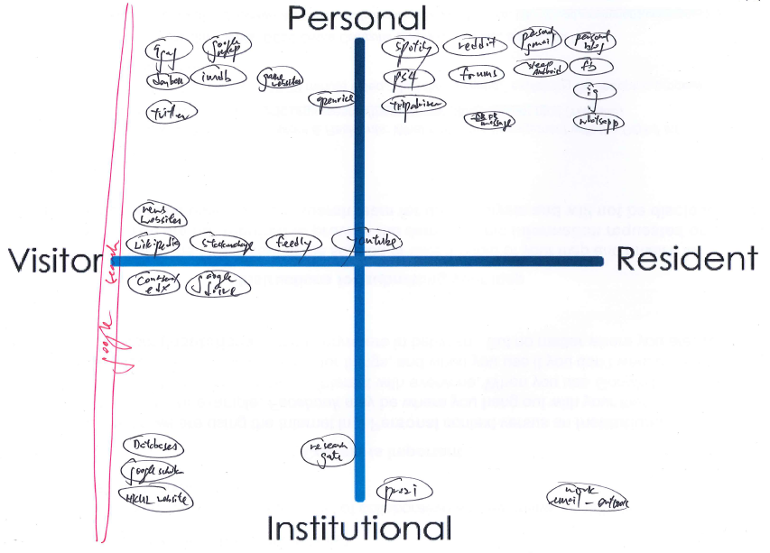
Notes:
HKU Librarian.
Trip Advisor: post occasionally
Openrice: read
Game website
Dunaib: similar to movie web site imbd
9gag: surfs only (includes memes)
News/wikis /stock Exchange: read
Youtube: subscribe: instructional video/ data services etc.
Coursera and EdEx: recreational/profession purpose
Research Gate: institution part in between institution and personal
Institutional: mostly visitor
Google drive: do not often upload things
Wikipedia: both personal and institutional
Forums/blog:sometimes posts
Spotify, playstation 4: uses everyday
I can live without tech in institutional
Can live without digital / online for weeks
I can read books and news instead
I can disconnect from work e.g. email

Slide 50
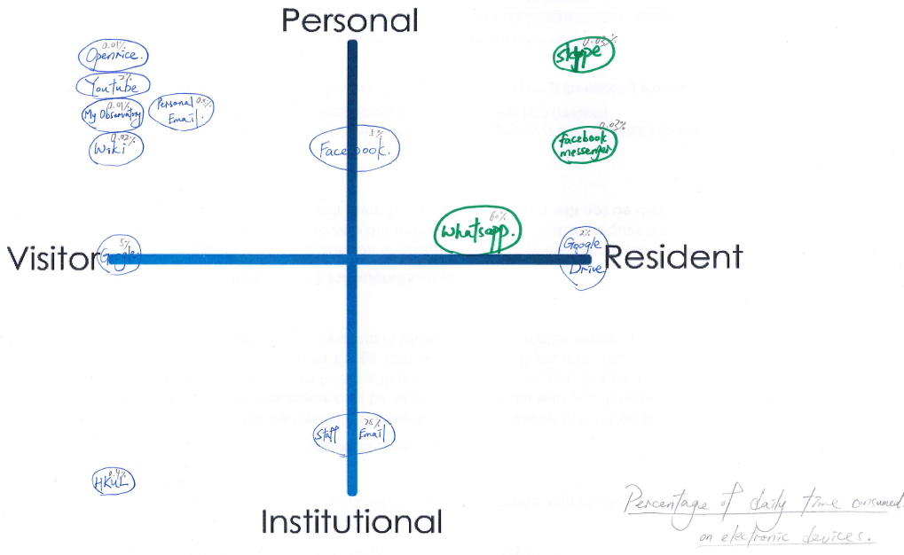
Notes:
HKU Librarian.
Not diverse in using technology/social media
Count number on percentage on daily time consumed on the apps
Approx: 10% per day using these e-devises
5-6 hours for whatsapp
Then email: work
Interesting in applying calculations in pattern of using such apps -> good for time management (esp. email and whatsapp)
Behavior is changing compared to undergraduate status: before=never use before, seldom use email communication with students/friends; now I need to work so I need to use more email
Wikipedia
HK observatory app to check weather

Slide 51
Making a map

Slide 52
Let’s Make a Map
Okay, here we go!

Slide 53

Let’s Make a Map
Okay, here we go!
Our friend Clippy will guide us along the way.

Slide 54
It looks like you’re trying to create a Visitors and Residents map. Would you like help?

Slide 55
Step 1: Draw horizontal and vertical axes.

Slide 56


Slide 57



Slide 61
Visitor
Resident

Slide 62
Personal
Visitor
Resident
Institutional

Slide 63
Personal
Now think really hard about your engagement with the Web. Making a list can be helpful.
Visitor
Resident
Institutional

Slide 64
My Engagement with the Web
Google search
Github
Journal articles
Computer science blogs
Email
Personal website
Google Groups
Gitter.im
Hacker News
YouTube
Shopping/Purchasing/Bills

Slide 65
Personal
Try to think about how you use each service. Plot your modes of engagement using one or more boxes or regions.
Visitor
Resident
Institutional

Slide 66
Personal
Google Search
Visitor
Resident
Institutional

Slide 67
Personal
Google Search
Email
Visitor
Resident
Institutional

Slide 68
Personal
Google Search
Email
Journal Articles
Visitor
Resident
Institutional

Slide 69
Personal
Google Search
It looks like you have two different modes of engagement here.
Email
Journal Articles
Github (Personal)
Visitor
Resident
Github (Work-related)
Institutional

Slide 70
Personal
Google Search
Comp. Sci. Blogs
Email
Journal Articles
Github (Personal)
Visitor
Resident
Github (Work-related)
Institutional

Slide 71
Personal
Google Search
Comp. Sci. Blogs
Email
Journal Articles
Github (Personal)
Visitor
Resident
Github (Work-related)
Gitter.im
Institutional

Slide 72
Personal
Google Search
Comp. Sci. Blogs
Email
Journal Articles
Github (Personal)
Visitor
Resident
Github (Work-related)
Google Groups
Gitter.im
Institutional

Slide 73
Personal
Google Search
Hacker News
Comp. Sci. Blogs
Email
Journal Articles
Github (Personal)
Visitor
Resident
Github (Work-related)
Google Groups
Gitter.im
Institutional

Slide 74
Personal
Google Search
Hacker News
Personal Website
Comp. Sci. Blogs
Email
Journal Articles
Github (Personal)
Visitor
Resident
Github (Work-related)
Google Groups
Linkedin
Gitter.im
Institutional

Slide 75
Personal
Google Search
YouTube
Hacker News
Personal Website
Comp. Sci. Blogs
Email
Journal Articles
Github (Personal)
Visitor
Resident
Github (Work-related)
Google Groups
Linkedin
Gitter.im
Institutional

Slide 76
Personal
Google Search
Shopping/Bills
YouTube
Hacker News
Personal Website
Comp. Sci. Blogs
Email
Journal Articles
Github (Personal)
Visitor
Resident
Github (Work-related)
Google Groups
Linkedin
Gitter.im
Institutional

Slide 77

Personal
Google Search
Shopping/Bills
YouTube
Yaaay! You did it!
Hacker News
Personal Website
Comp. Sci. Blogs
Email
Journal Articles
Github (Personal)
Visitor
Resident
Github (Work-related)
Google Groups
Linkedin
Gitter.im
Institutional

Slide 78
Take a photo of map
Email to: oclc.vandr@gmail.com

Slide 79
Why?
We can learn about how we engage
personally,
professionally,
individually, &
collectively
We can better understand our identity & dynamics

Slide 80

Why?
Identify users’ expectations of services & systems
Position the role of the library within the individuals’ workflows & information-seeking patterns
Influence library’s design & delivery of physical spaces & digital platforms & services
Investigate & describe user-owned digital literacies
Notes:
Image: https://www.flickr.com/photos/alanandanders/2218071833/ by Alan Lam / CC BY-ND 2.0
People trust people “I get on Twitter a whole bunch. It’s Twitter or Facebook are what I usually use the most to talk to my friends.” (USS1, Emerging, Female, Age 17, High School Student) The point is that individuals seek what they need within the relationships that surround them. As they move through the educational stages, their networks are increasingly populated with people who have relevant subject expertise, so that by the time individuals are faculty members, when they say they called a “friend” about an article, it is nearly certain that the friend is also an expert in the field. Relationships continue to be a major component in how individuals get their information and whom they choose for collaboration and one of the reasons for engaging with technology (Connaway and Radford 2011 ). (InfoKit, People Trust People)
Technology “But I could probably not live without the computer and, you know, the internet. Because, work, and the emails.” (USU2, Emerging, Female, Age 19, Engineering) The high frequency of mentions of texting, telephone calls, and private messaging by the Emerging and Establishing educational stage interviewees correlates with the technology that these participants said they could not live without - the smart phone/cell phone or laptop. These not only are used for communicating and contacting individuals but also for searching the internet, and organizing their time and activities with the calendar. (InfoKit, People Trust People)
Convenient doesn’t always mean simple “It’s convenience. It’s the immediacy of it.” (UKF3, Experiencing, Male, Age 52, Artist & Technical Support) Data from the V&R project reveal that individuals in all educational stages cite the relevance of convenience/ease of use to their decision-making, trumping all other reasons for selecting and using a source (White and Connaway 2011-2014 ; Connaway, White, and Lanclos 2011). (InfoKit, Convenient Doesn’t Always Mean Simple)
Human Sources “I use Facebook for organizing my life basically, with friends and stuff. ...I also use that in education to talk to my friends about an equation, the things I don't understand and it works quite well.” (2UKS2, Emerging, Male, Age 18, Secondary School Student) It was important to Emerging students that the digital sources they found were authoritative, specifically that they were identified by trustworthy human sources: people who, in their personal experience, had proven that they were knowledgeable, either generally, or specifically about the topic at hand (Connaway, White, Lanclos, and Le Cornu 2012 ).

Slide 81
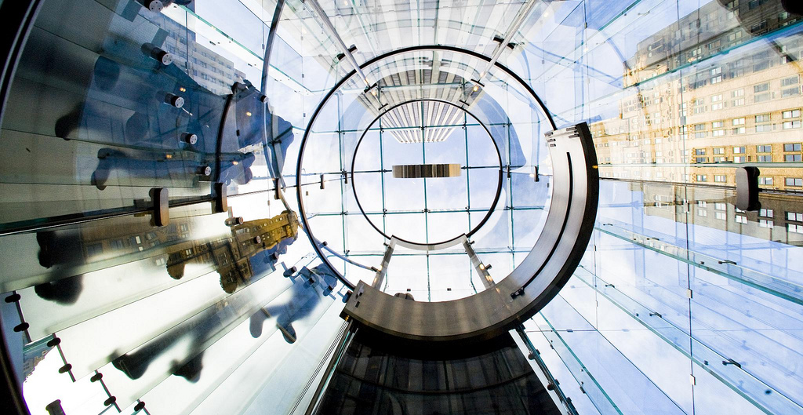
So What?
Identify how target audiences
Engage with technology
Discover & access information
Modify & develop services & systems
Notes:
Image: https://www.flickr.com/photos/thomashawk/2318784624/ by Thomas Hawk / CC BY-NC 2.0

Slide 82
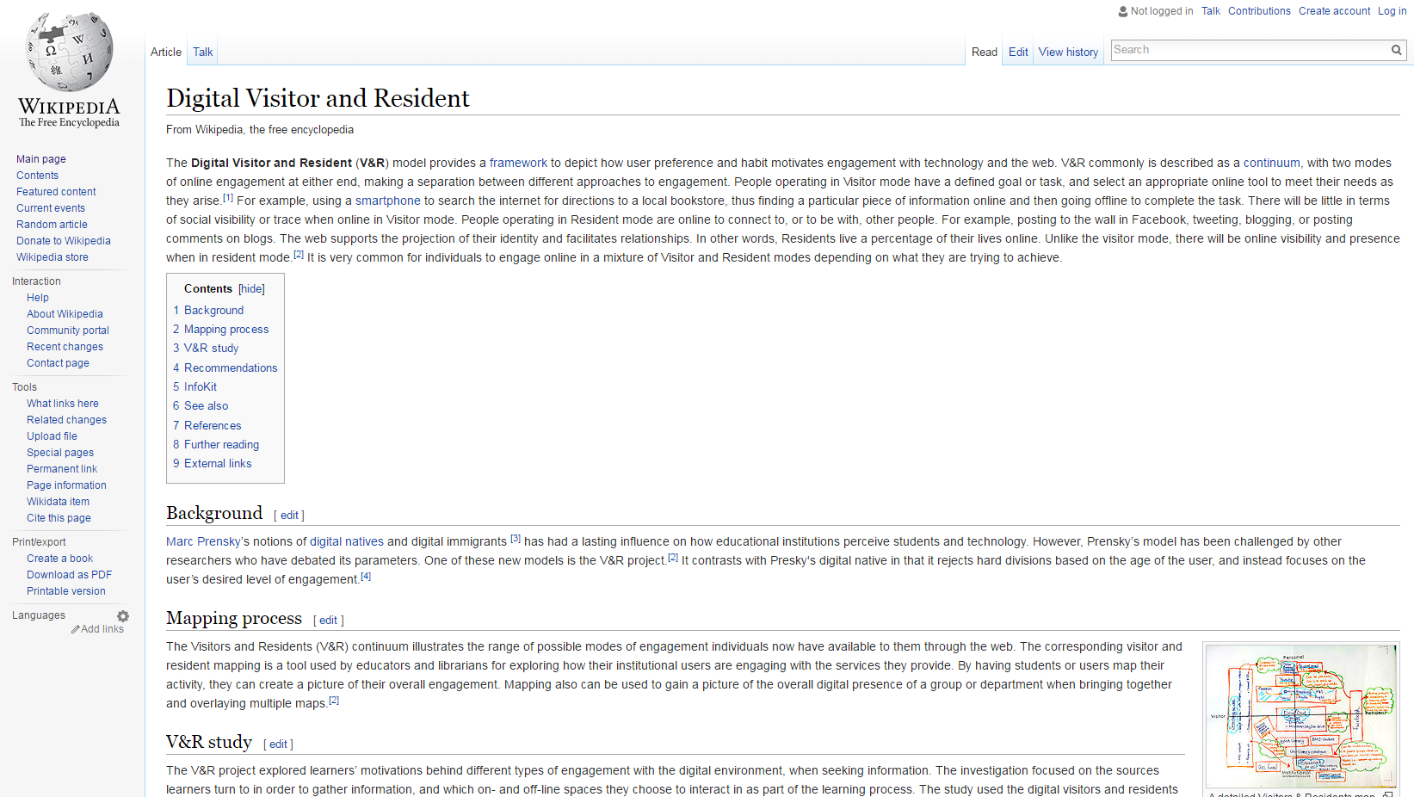
Notes:
Image: Wikipedia contributors. "Digital Visitor and Resident." Wikipedia, The Free Encyclopedia. https://en.wikipedia.org/wiki/Digital_Visitor_and_Resident.

Slide 83
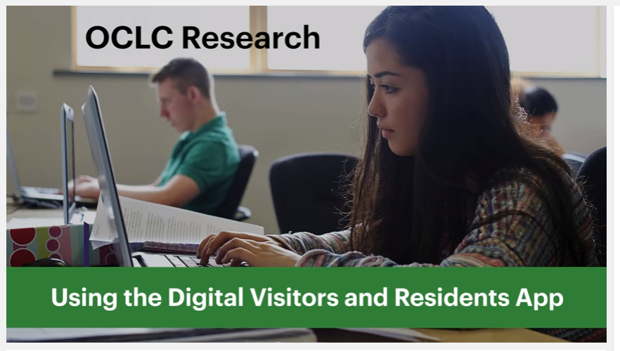
Play
Notes:
OCLC Research. 2016. Using the Digital Visitors and Residents App. YouTube video. May 5. https://www.youtube.com/watch?v=6ai0ZO3lDR4.

Slide 84
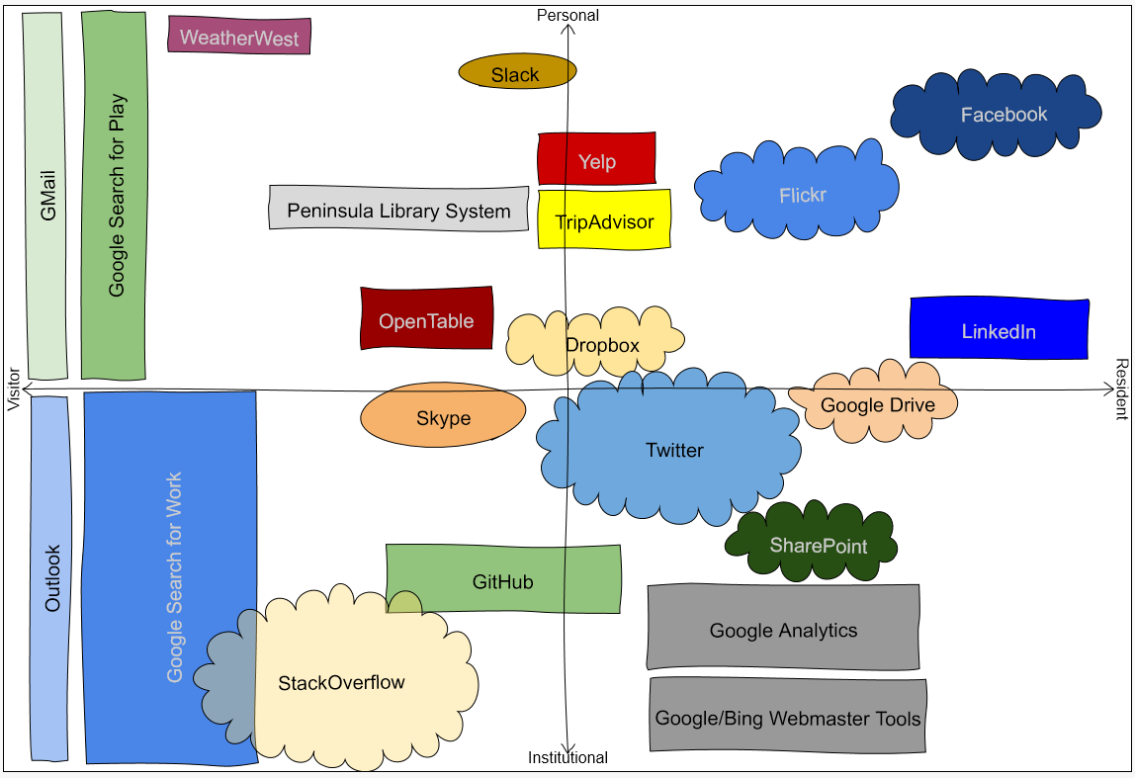

http://oc.lc/vrmap
Notes:
1. To use the app, go to “http://oc.lc/vrmap”.
If you like it, share it!

Slide 85
References
Connaway, Lynn S., David White, and Donna Lanclos. 2011. “Visitors and Residents: What motivates engagement with the digital information environment?” Proceedings of the 74th ASIS&T Annual Meeting 48: 1-7.
Connaway, Lynn Silipigni, Donna Lanclos, and Erin M. Hood. 2013. “‘I find Google a lot easier than going to the library website.’ Imagine Ways to Innovate and Inspire Students to Use the Academic Library.” Proceedings of the Association of College & Research Libraries (ACRL) 2013 conference, April 10-13, 2013, Indianapolis, IN. http://www.ala.org/acrl/sites/ala.org.acrl/files/content/conferences/confsandpreconfs/2013/papers/Connaway_Google.pdf.
White, David S., and Lynn Silipigni Connaway. 2011-2014. Visitors & Residents: What Motivates Engagement with the Digital Information Environment. Funded by JISC, OCLC, and Oxford University. http://www.oclc.org/research/activities/vandr/.

Slide 86
Image Attributions
Slide 3: Image: http://www.flickr.com/photos/31442459@N00/7648151218 by Wesley Fryer / CC BY 2.0
Slide 4: Image: http://www.flickr.com/photos/15216811@N06/8521338394 by N i c o l a / CC BY 2.0
Slide 80: Image: https://www.flickr.com/photos/alanandanders/2218071833/ by Alan Lam / CC BY-ND 2.0
Slide 81: Image: https://www.flickr.com/photos/thomashawk/2318784624/ by Thomas Hawk / CC BY-NC 2.0
Slide 82: Image: Wikipedia contributors. "Digital Visitor and Resident." Wikipedia, The Free Encyclopedia. https://en.wikipedia.org/wiki/Digital_Visitor_and_Resident.
Slide 88: Image: https://www.flickr.com/photos/scatteredashes/5844154762/ by Scipio / CC BY-NC 2.0

Slide 87
Thank You!
Lynn Silipigni Connaway, PhD
connawal@oclc.org
@LynnConnaway
William Harvey, PhD
harveyw@oclc.org

Slide 88

Questions & Discussions
Notes:
Image: https://www.flickr.com/photos/scatteredashes/5844154762/ by Scipio / CC BY-NC 2.0

