Slide 1
“But Wikipedia is always right, so I always use that.” Implications for Library Services Modeled on the Digital Visitors and Residents Continuum
Lynn Silipigni Connaway, Ph.D.
Senior Research Scientist
OCLC
Chair of Excellence
Departmento de Biblioteconomía y Documentación Universidad Carlos III de Madrid
@LynnConnaway
connawal@oclc.org
16 May 2014
Chair of Excellence, UC3M, Madrid, Spain
Notes:
Buenas Tardes!
Estoy muy contenta de estar aqui.
Y, ahora, en ingles.
“But Wikipedia is always right, so I always use that.” (Digital Visitors and Residents, USS6, Female, Age 17, High School Student)
White, D., & Connaway, L. S. (2011-2014). Visitors and Residents: What motivates engagement with the digital information environment. Funded by JISC, OCLC, and Oxford University. Retrieved from http://www.oclc.org/research/activities/vandr/

Slide 2

Visitors and Residents:
What motivates engagement with the digital information environment?
Partners
  JISC (UK funding body)
  OCLC
    Lynn Silipigni Connaway, Ph.D.
    Erin M. Hood, M.L.I.S.
    Carrie Vass, M.S.
  Oxford University
    David White
  University of North Carolina, Charlotte
    Donna Lanclos, Ph.D.
Notes:
Image: http://www.flickr.com/photos/myxi/712710373/
The Digital Visitors and Residents (V&R) project is a US/UK collaborative project, funded by JISC, OCLC Online Computer Library Center, Inc., Oxford University, and the University of North Carolina, Charlotte.
“This paper reports the initial findings of a three-year longitudinal study to identify how late-stage secondary school and first-year undergraduate students in the US and UK, referred to here as members of the “Emerging” educational stage, engage with technology and information sources. The assumptions embedded in traditional academic library services and systems and the existing disconnect between the everyday information-seeking behaviors of members of the Emerging stage (last year high school/secondary school or first year college/university) are examined. Initial results highlight the importance of convenience as a crucial factor in information-seeking behavior. There also are indications that as users progress through the educational stages, the digital and information literacies they employ do not necessarily become more sophisticated.” (Connaway, Lanclos, & Hood, 2013)
Connaway, L. S, Lanclos, D., & Hood, E. M. (2013). “I find Google a lot easier than going to the library website.” Imagine ways to innovate and inspire students to use the academic library. Proceedings of the Association of College & Research Libraries (ACRL) 2013 conference, April 10-13, 2013, Indianapolis, IN, 2013. Retrieved from http://www.ala.org/acrl/sites/ala.org.acrl/files/content/conferences/confsandpreconfs/2013/papers/Connaway_Google.pdf

Slide 3
Video: http://is.gd/vanrvideo
First Monday Paper: http://is.gd/vandrpaper
(White & Connaway, 2011)
Notes:
Discuss Prensky and how this is an attempt, started by Dave White, to move away from Native/Immigrant metaphor:
“‘The digital natives/digital immigrants distinction is dead or at least dying’. So proclaims Doug Holton in his blogpost. He continues: ‘Unfortunately, the idea is still uncritically accepted even in some journal articles, and perhaps used as an excuse or crutch too often for poor or ineffective teaching practices’. Holton is not alone in his criticism. McKenzie (2007) writes strongly against Prensky’s (2001a, b) typology identifying a number of ‘thinly supported claims’, while Kennedy, et al. (2010) demonstrate through an empirical research project that Prensky’s age–related hypothesis is very much less clear–cut than the Natives and Immigrants dichotomy implies. Our intention is to propose an alternative, which we have termed ‘Visitors and Residents’.”
Prensky, M. (2001a). Digital natives, digital immigrants. On the Horizon, 9(5). Retrieved from http://www.marcprensky.com/writing/Prensky%20-%20Digital%20Natives,%20Digital%20Immigrants%20-%20Part1.pdf
Prensky, M. (2001b). Do they really think differently? On the Horizon, 9(5). Retrieved from http://www.marcprensky.com/writing/Prensky%20-%20Digital%20Natives,%20Digital%20Immigrants%20-%20Part2.pdf
White, D. S., & Le Cornu, A. (2011). Visitors and Residents: A new typology for online engagement. First Monday, 16(9). Retrieved from http://firstmonday.org/htbin/cgiwrap/bin/ojs/index.php/fm/article/viewArticle/3171/3049

Slide 4
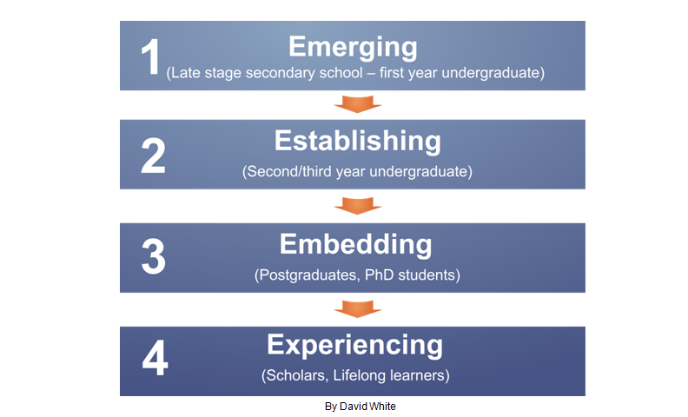
Visitors & Residents
(White & Connaway, 2011-2014)
Notes:
“Using the V&R framework ensures that analysis is firmly focused on motivations to engage rather than on age or technological “skill.” It facilitates the identification of modes of engagement which potentially cut across traditional academic levels and boundaries. The project is tracking US and UK participants’ shifts in their motivations and forms of engagement with technology and information as they transition between four educational stages:
1. Emerging (Late stage secondary school/First year undergraduate);
2. Establishing (Second/third or third/fourth year undergraduate);
3. Embedding (Postgraduates, PhD students);
4. Experienced (Scholars).
In Phase 1 of the V&R research, semi-structured interviews with participants from the four project-defined educational stages were conducted in the US and UK. In Phase 2 of the project, a sub-set of the interviewees were selected to participate in the monthly information diaries.” (Connaway, Lanclos, & Hood, 2013)
Connaway, L. S, Lanclos, D., & Hood, E. M. (2013). “I find Google a lot easier than going to the library website.” Imagine ways to innovate and inspire students to use the academic library. Proceedings of the Association of College & Research Libraries (ACRL) 2013 conference, April 10-13, 2013, Indianapolis, IN, 2013. Retrieved from http://www.ala.org/acrl/sites/ala.org.acrl/files/content/conferences/confsandpreconfs/2013/papers/Connaway_Google.pdf
White, D., & Connaway, L. S. (2011-2014). Visitors and Residents: What motivates engagement with the digital information environment. Funded by JISC, OCLC, and Oxford University. Retrieved from http://www.oclc.org/research/activities/vandr/

Slide 5

Resident Mode
Visible and persistent online presence
Collaborative activity online
Contribute online
Internet is a place
Notes:
Image: Microsoft Office
Residents: significant online presence and usage; high level of collaborative activity online; contributions to the online environment in the form of uploading materials, photos, videos;

Slide 6

Visitor Mode
Functional use of technology
Formal need
Invisible online presence
Internet is a toolbox
Notes:
Image: http://www.flickr.com/photos/51035610542@N01/6868746106/
Visitors: functional use of technology, often linked to formal need (such as use of software for specific coursework, or organising meetings through email contact); less visible/more passive online presence, more likely to favour face- to- face interactions (even as they use the internet to organize/schedule those interactions);

Slide 7
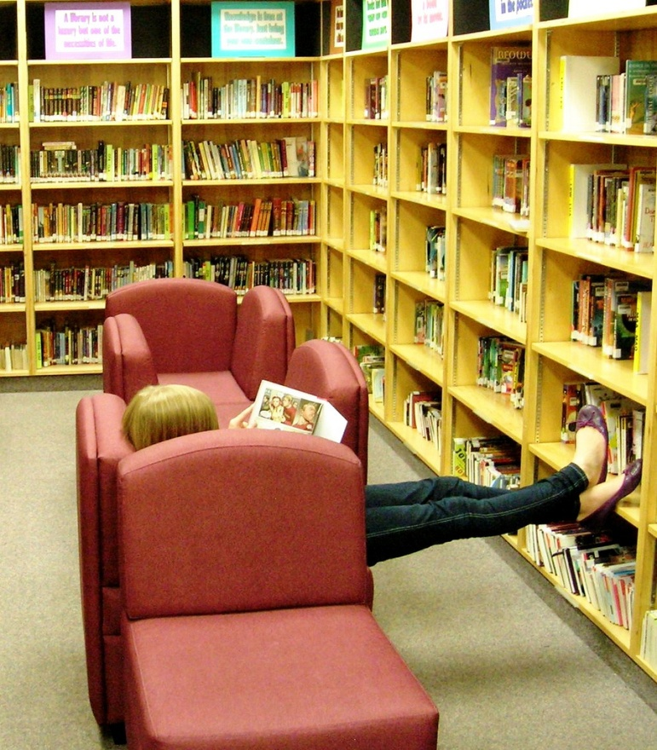
Project Phases
Phase 1
  Interviewed 31 (16 US/15 UK) Emerging educational stage individuals
Phase 2
    Interviewed
      10 (5 US/5 UK) Establishing
      10 (5 US/5 UK) Embedding
      10 (5 US/5 UK) Experienced
      Some Phase 1 participants agreed to submit monthly diaries
Notes:
Image: http://www.flickr.com/photos/vblibrary/4993069751/
The findings will be used to create a matrix of implementation options allowing those designing and delivering digital platforms and services to make informed decisions relative to engagement and motivation for individuals at each of the educational stages.
Work as an interdisciplinary team, bringing to bear our relative expertises in Educational Technology, Library Information and Science/Research Methodology (User behaviour), and Anthropology (Ethnography)
Individual Interviews
Emerging (secondary school/1st year undergraduates: 31 (16 US, 15 UK)
Establishing (2nd-3rd year undergraduates): 10 (5 US, 5 UK)
Embedding (postgraduates, PhD students): 10 (5 US, 5 UK)
Experiencing (scholars): 10 (5 US, 5 UK)

Slide 8

Project Phases, cont.
Phase 3
  Interviewed second group of 12 students in the Emerging stage
Phase 4
  In-depth survey
    50 participants from each educational stage in both US & UK
  Code, analyze, & compare data
4
Notes:
Image: http://www.flickr.com/photos/sveinhal/2488694307/
Phase 3
Interviewed a second group of 12 students in the Emerging stage
This will help to determine if methods of engagement are changing over time
Phase 4
Test interview and diary results with in-depth survey of 50 participants from each educational stage
Code data to refine emerging findings and explore possible trends

Slide 9
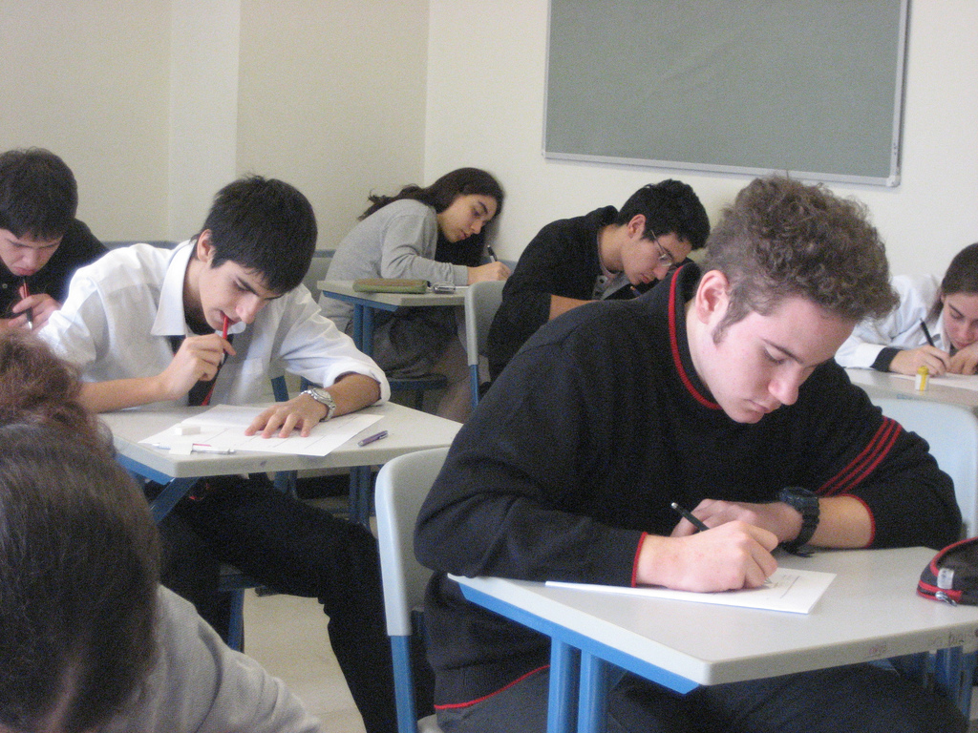
Participants
Phases 1-3
Total of 73 participants (36 UK, 37 US)
  43 Emerging (21 UK, 22 US)
  10 Establishing (5 UK, 5 US)
  10 Embedding (5 UK, 5 US)
  10 Experiencing (5 UK, 5 US)
  Gender
  Female 39
  Male 34
Notes:
Image: http://www.flickr.com/photos/cristic/359572656/
Total of 73 participants
43 participants started (initial interview) at the Emerging stage
10 started (initial interview) at the Establishing stage
10 started (initial interview) at the Embedding stage
10 started (initial interview) at the Experiencing stage

Slide 10
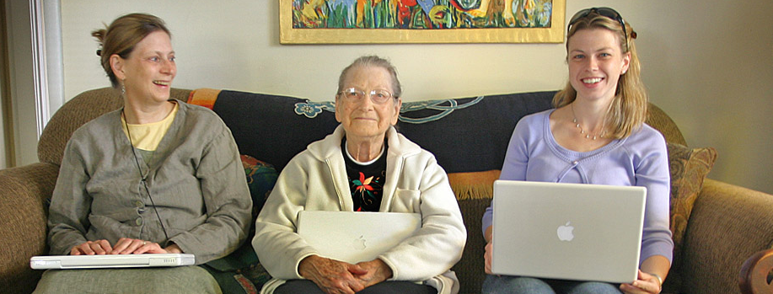
Participants
Age
  12-18 years old 26
  19-25 years old 25
  26-34 years old 6
  35-44 years old 5
  45-54 years old 8
  55-64 years old 3
Ethnicity
  African American 5
  Caucasian 41
  Multi-racial 2
  Asian 1
  Hispanic 3
  Undeclared 21
Notes:
Image: http://www.flickr.com/photos/lyza/276990225/

Slide 11
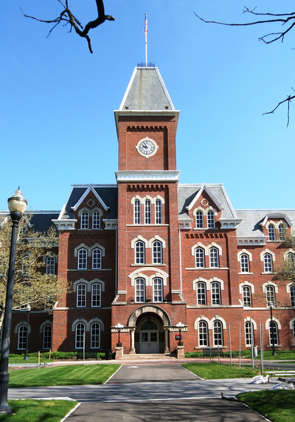
Participants
Discipline Type
  High School 21
  Sciences 22
  Arts/Humanities 12
  Social Sciences 16
  Undeclared 2
Notes:
Image: http://www.flickr.com/photos/75905404@N00/3483019354/

Slide 12
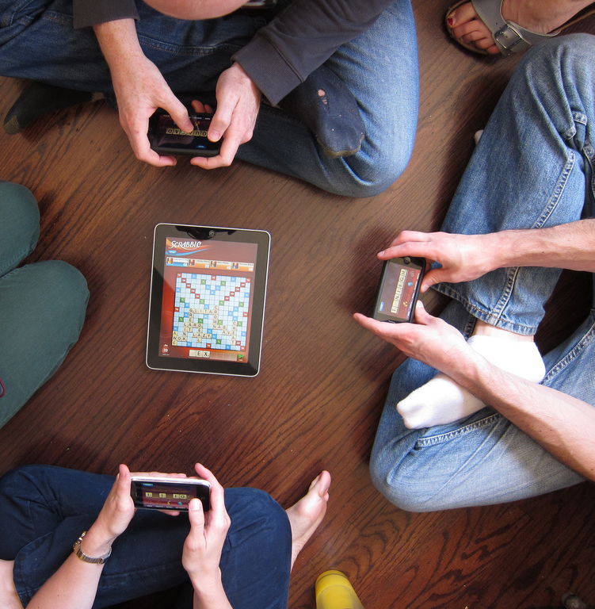
Participant Interview Questions
1. Describe the things you enjoy doing with technology and the web each week.
2. Think of the ways you have used technology and the web for your studies. Describe a typical week.
3. Think about the next stage of your education. Tell me what you think this will be like.
Notes:
Image: http://www.flickr.com/photos/superamit/4569922802/
For faculty, these are being slightly edited to ask about their preconceptions of academic life before the stage they currently occupy, as well as what they think the future might hold.

Slide 13
Participant Interview Questions
4. Think of a time when you had a situation where you needed answers or solutions and you did a quick search and made do with it. You knew there were other sources but you decided not to use them. Please include sources such as friends, family, teachers, coaches, etc.
5. Have there been times when you were told to use a library or virtual learning environment (or learning platform), and used other source(s) instead?
6. If you had a magic wand, what would your ideal way of getting information be? How would you go about using the systems and services? When? Where? How?
(Dervin, Connaway, & Prabha, 2003-2006)
(Radford & Connaway, 2005-2007)
Notes:
These questions come from previous research
Dervin, B., Connaway, L. S., & Prabha, C. (2003-2006). Sense-making the information confluence: The whys and hows of college and university user satisficing of information needs. Funded by the Institute of Museum and Library Services (IMLS). Retrieved from http://imlsosuoclcproject.jcomm.ohio-state.edu/
Radford, M. L., & Connaway, L. S. (2005-2007). Seeking Synchronicity: Evaluating virtual reference services from user, non-user, and librarian perspectives. Funded by the Institute for Museums and Library Services (IMLS). Retrieved from http://www.oclc.org/research/activities/synchronicity/default.htm

Slide 14

Diarists
Phases 1-4
20 participants (8 UK, 12 US)
  15 Emerging (7 UK, 8 US)
  3 Establishing (1 UK, 2 US)
  1 Embedding (1 US)
  1 Experiencing (1 US)
Notes:
Image: http://www.flickr.com/photos/olivander/58499153/

Slide 15

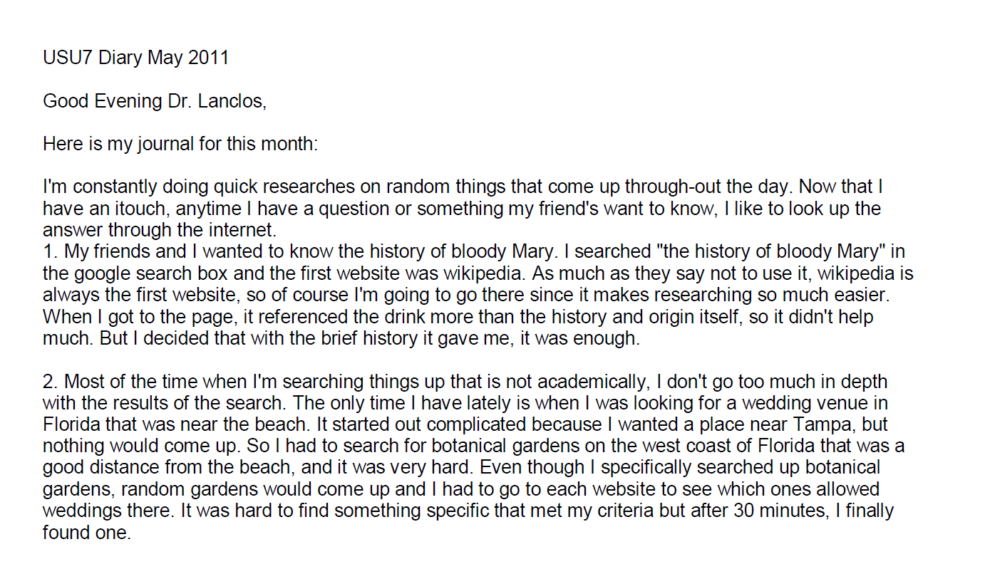
Example:
Digital Visitors & Residents Diaries
(White & Connaway, 2011-2014)
Notes:
Image: http://www.flickr.com/photos/8525214@N06/4222170639
Screenshot: USU7 Emg Dry1 Ph1 (Digital Visitors and Residents, USU7, Female, Age 19, Political Science)
“March was a little more serious. We’re nearing election time and all that jazz, and this is the first election I’ll be able to vote in, so I’ve been doing a bit of reading on a few of the candidates (not much, mind you). As a side note, I’m kind of debating whether or not I should actually vote in this election since I have such little knowledge on the candidates.” (Digital Visitors and Residents, USU12, Male, Age 19) USU12 Est Dry2 Ph2
“Um they do have a search box but I didn’t—I didn’t use that. Um I pretty much just, I pretty much just clicked links.” (Digital Visitors and Residents, USU12, Male, Age 19, 30:37) USU12 Est Follup Int1 Ph3
White, D., & Connaway, L. S. (2011-2014). Visitors and Residents: What motivates engagement with the digital information environment. Funded by JISC, OCLC, and Oxford University. Retrieved from http://www.oclc.org/research/activities/vandr/

Slide 16

Codebook
I. Place
A. Internet
1. Search engine
a. Google
b. Yahoo
2. Social Media
a. FaceBook
b. Twitter
c. You Tube
d. Flickr/image sharing
e. Blogging
B. Library
1. Academic
2. Public
3. School (K-12)
C. Home
D. School, classroom, computer lab
E. Other
(White & Connaway, 2011-2014)
Notes:
Image: http://www.flickr.com/photos/themadguru/3546619930/
How we used the codebook:
First: the 3 researchers and research assistant coded the same two transcripts, one US and one UK (both secondary school).
We met and re-met and coded and re-coded until there was agreement.
THEN we went our separate ways to code. BUT we still communicate with each other in our coding processes, because of the remote nature of our collaboration.
Coding is done on paper, for the most part, and then the codes are entered into word, or scanned and sent to research assistants, who enter the coding into NVivo9. When the research assistants are entering the coding, they notice discrepancies, document them, and generate a discussion about what was intended, and what should the final coding be.
This continuous communication provides more consistency in coding across the researchers.
When Inter-coder Reliability was calculated between all five coders it was found to be an average of 0.6380 for Kappa and an Agreement Percentage of 98%.
White, D., & Connaway, L. S. (2011-2014). Visitors and Residents: What motivates engagement with the digital information environment. Funded by JISC, OCLC, and Oxford University. Retrieved from http://www.oclc.org/research/activities/vandr/

Slide 17
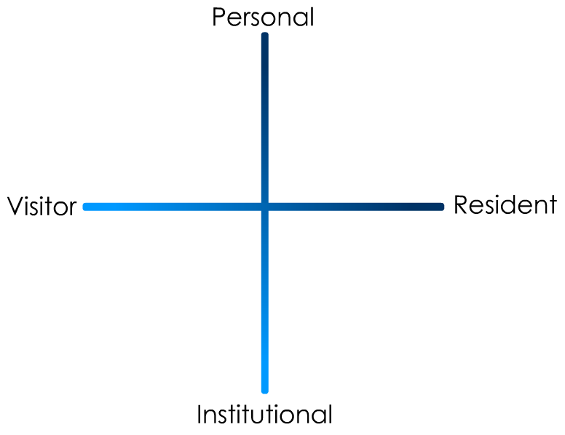
(Connaway & White for OCLC Research, 2012)
Notes:
“In simple terms the Visitors see the web as a series of tools. They decide what they want to achieve, chose an appropriate online tool to do the job, then log-off. They leave no social trace of themselves online. The Residents live a proportion of their lives online. They see the web as a place where they can express themselves and spend time with people. Residents will have a profile on a social networking platform and aspects of their persona, or digital identity, maintaining presence even when they are not online. The premise of V&R is presented as a continuum whereby individuals’ modes of engagement will be more Visitor or Resident depending on their personal motivations and the context and situation at the time.” (Connaway, Lanclos, & Hood, 2013)
Connaway, L. S, Lanclos, D., & Hood, E. M. (2013). “I find Google a lot easier than going to the library website.” Imagine ways to innovate and inspire students to use the academic library. Proceedings of the Association of College & Research Libraries (ACRL) 2013 conference, April 10-13, 2013, Indianapolis, IN, 2013. Retrieved from http://www.ala.org/acrl/sites/ala.org.acrl/files/content/conferences/confsandpreconfs/2013/papers/Connaway_Google.pdf
First Monday Paper: http://is.gd/vandrpaper
Video: http://is.gd/vandrvideo

Slide 18
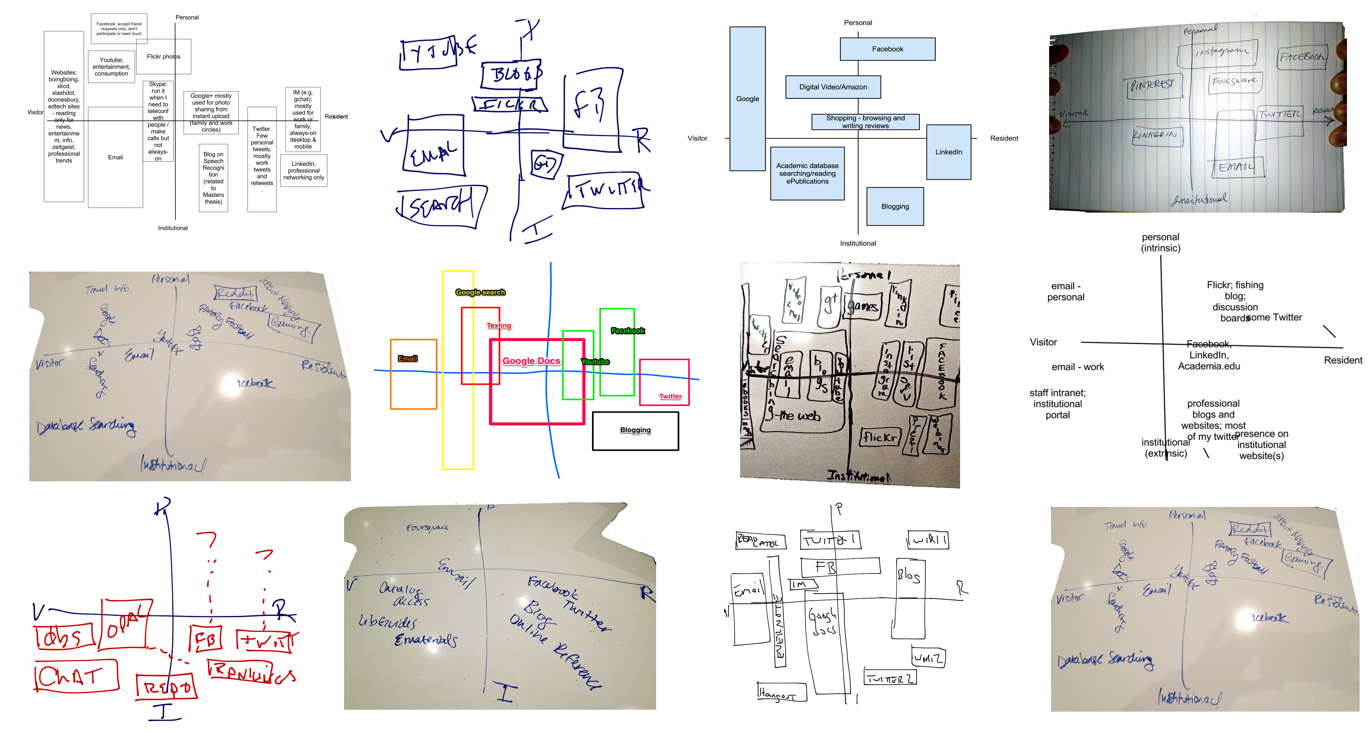
Notes:
Mappings from EDUCAUSE 2012

Slide 19
Notes:
Mappings from EDUCAUSE 2012

Slide 20
Digital Sources and Educational Stages
Notes:
Digital Sources and Educational Stages: Interviews
Wikipedia: Emerging 81%, Establishing 90%, Embedding 70%, Experiencing 50%
Major Media Sites: Emerging 28%, Establishing 60%, Embedding 70%, Experiencing 40%
iPlayer/TV Programs: Emerging 33%, Establishing 30%, Embedding 20%, Experiencing 10%

Slide 21
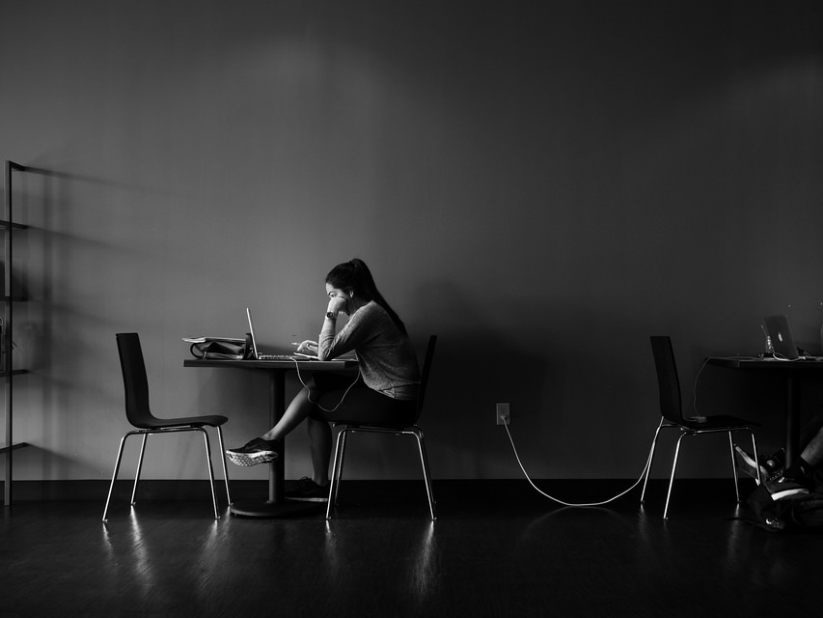
“I think, it's [Wikipedia’s] quite good for broadening knowledge if you don't know much about a subject, gives you ideas.”
(Digital Visitors and Residents, 2UKU1, Female, Age 19, Geography)
Notes:
Image: http://www.flickr.com/photos/3ammo/12490957864/
Wikipedia
Emerging: Second Round Emerging participants are completely divided by their Country. The six UK participants coded for Wikipedia indicated that they use Wikipedia and find it trustworthy for at least a starting point or quick answers. On the other hand, the five US participants coded all indicated that they don’t use it or that they don’t trust it and have had their instructors tell them to not trust it. With the First Round Participants, there was more variance distributed between the countries. However, the majority still trusted Wikipedia, at least for a starting point and quick facts, and used it even if they were told not to by their instructors. However, like with the Second Round, most negative distrust and warnings against using Wikipedia by the instructors was found in the US participants. This division by country seems to only last during this Educational stage, not found during the later educational stages.
Establishing: All of the nine Establishing participants coded for Wikipedia indicated that they used it, with most indicating that they use it as a good starting point and that it’s reliable enough for basic information and usage. A few indicated that they found it a less biased source and just as reliable as textbooks because it is authored by so many people.
Embedding: Of the Embedding participants, the majority indicated that Wikipedia is good for a starting point and for getting basic facts. Only one indicated that they didn’t like Wikipedia.
Experiencing: The Experiencing participants found Wikipedia useful for quick searches and double checking their own knowledge, but do view it with some skepticism and do not see it as authoritative.

Slide 22


The Learning Black Market
“It’s like a taboo I guess with all teachers, they just all say – you know, when they explain the paper they always say, ‘Don’t use Wikipedia.’”
(Digital Visitors and Residents, USU7, Female, Age 19, Political Science)
Notes:
Image: http://www.deviantart.com/morelikethis/211376699
Covert online study habits
Wikipedia
Don’t cite
Widely used
Guilt
Students & teachers disagree
Quality sources
There is a “Learning Black Market”: learners use non-traditional sources but feel they cannot talk about them in an institutional context. Wikipedia usage is an example of this. (White & Connaway, 2011)
Connaway, Lynn Silipigni, Donna Lanclos, and Erin M. Hood. 2013. “I find Google a lot easier than going to the library website.” Imagine ways to innovate and inspire students to use the academic library. Proceedings of the Association of College & Research Libraries (ACRL) 2013 conference, April 10-13, 2013, Indianapolis, IN. http://www.ala.org/acrl/sites/ala.org.acrl/files/content/conferences/confsandpreconfs/2013/papers/Connaway_Google.pdf.
White, D. (2008). Not “natives’”& “immigrants” but “visitors’ & “residents.” TALL Blog: Online Education with the University of Oxford, April 23. Retrieved from http://tallblog.conted.ox.ac.uk/index.php/2008/07/23/not-natives-immigrants-but-visitors-residents/
Saunders also found that faculty are “concerned with students’ reliance on Google and Wikipedia for information.” This may help to explain why many of the Emerging stage participants expressed a reluctance to acknowledge or cite Wikipedia in their work for fear of being ridiculed by faculty, or be given a lower grade. This is referred to as the Learning Black Market, which is discussed in more detail in Connaway, Lanclos, and Hood and White’s 2011 blog entry.
Saunders, L. (2012). Faculty perspectives on information literacy as a student learning outcome. The Journal of Academic Librarianship ,38(4), 231.

Slide 23
Additional Wikipedia quotes
Notes:
Wikipedia quotes:
“Wikipedia I would only use for getting a general overview of particular topics. So, the other week on a talking tour of Oxford and they had mentioned the British Civil War and how it had played out in Merton College. I wanted a quick overview; I did not care about going in-depth or learning the detailed history, so I would go to Wikipedia for that. We yesterday used Wikipedia to figure out whether the person in the front of the boat in rowing is called a cox or a coxswain. It turns out coxswain is the correct term, but that’s an example where on surface level information we would only – we would look to Wikipedia for that because it’s quick.” (Digital Visitors and Residents, UKG2, Female, Age 22, Learning and Technology) Embedding
“I sometimes use it if there’s a saint or the name of somebody, I’ll look it up. I myself have not found any errors of fact in stuff that I’m aware of, but I wouldn’t know. I certainly wouldn’t quote it in an academic context really, because I’m not sure of its academic credentials or its origins really.” (Digital Visitors and Residents, UKG3, Male, Age 51, Practical Theology) Embedding
“I personally think Wikipedia is fantastic…Umm, teachers don't like us using it because they're always saying, "Well, anyone can edit it, anyone can do that", but no one does. The thing, thing is, what's on Wikipedia is actually written by science professionals, people who've got degrees in the subject, things like that. And there will be references on there, so if you're not sure on something, you can check it… I feel that Wikipedia is a fantastic resource, and I use it all the time.” (Digital Visitors and Residents, 2UKS1, Male Age, 17, Secondary Student) Emerging

Slide 24
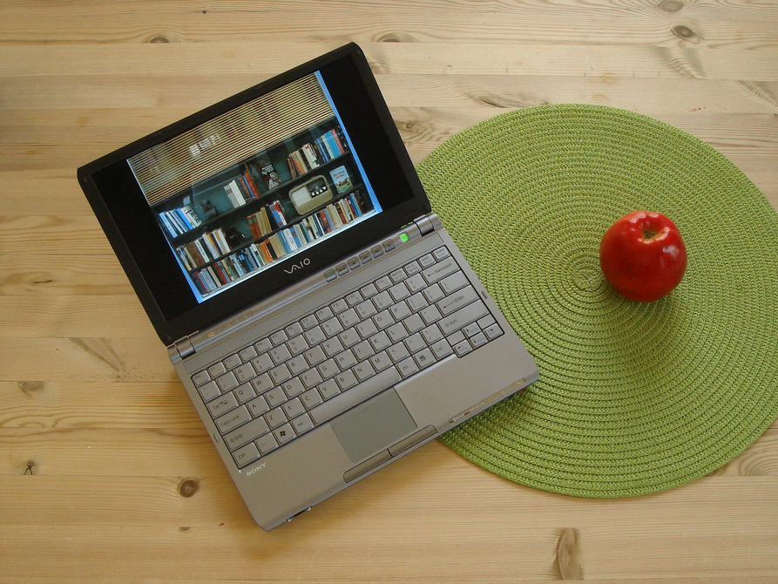
“So BBC iPlayer and 4 id and stuff like that. You know, to catch up on programmes, and obviously we are using YouTube…”
(Digital Visitors and Residents, UKS4, Female, Age 17, Secondary Student)
Notes:
Image: http://www.flickr.com/photos/larskflem/132754339/
iPlayer, TV Programmes
Emerging: 9 Second Round Emerging participants were coded, though two of those only mentioned YouTube, however the other seven said that they watch television programs (and sports) through the internet to get caught up on what they’ve missed or because they don’t have cable. Five First Round Emerging participants were coded, four indicating iPlayer specifically. It is possible that coding during the second round was loosened up, giving high results. Additionally, as programs continue to be more available online, it is more cost efficient and time efficient to watch them online rather than through costly cable television.
Establishing: Three Establishing participants were coded, one indicating the iPlayer as well as other means. Two others spoke in general terms of watching television online.
Embedding: Two US participants, using Netflix and Hulu.
Experiencing: One Experiencing participant coded as watching by Netflix.
“And sometimes what I’ll do is I’ll watch Netflix, because we don’t have television so we’ve streamed everything to our computer, so we just watch movies.” (Digital Visitors and Residents, USG5, Female, Age 30, Latin American Studies) Embedding
“But, yes, if someone said “Oh I found this,” like someone suggested I watch a TV programme the other week, in my RS lesson actually, they’d seen on TV and they’d said “Oh it raised loads of questions about this subject we were doing.” And they said “Oh iPlayer it.” So I went home and watched it because it sounded interesting and sounded like it was useful, so.” (Digital Visitors and Residents, UKS2, Female, Age 17, Secondary Student) Emerging
“Like ABC, Fox. I like to actually, I follow up on a few shows actually, like ‘House’ and ‘Castle’.” (Digital Visitors and Residents, USU2, Female, Age 19, Electrical Engineering) Emerging

Slide 25
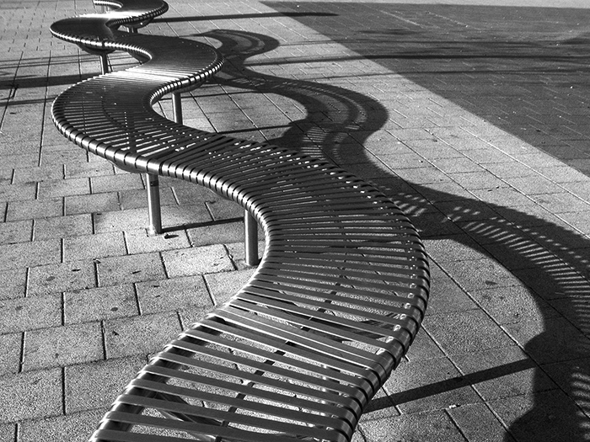
Determining Credibility and Authority
“Like, if two of them say the same thing then that must be right.”
(Digital Visitors and Residents, USS4, Male, Age 17, High School Student)
Notes:
Image: http://www.flickr.com/photos/nikonvscanon/1750671901/
“Like, if two of them say the same thing then that must be right.” (Digital Visitors and Residents, USS4, Emerging, Male, Age 17, High School Student)

Slide 26
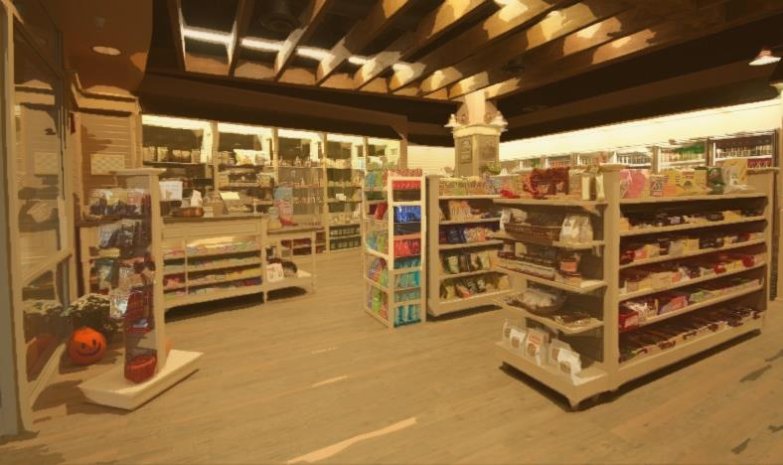
Convenience
Convenience trumps all other reasons for selecting and using a source
(Connaway, Lanclos, & Hood 2013)
Notes:
Image : http://wellnesslawyer.com/2012/11/14/wellness-by-convenience/
Convenience:
-Finding information online is not directly equated with the quality of that information.
-Time is related to convenience which is a recurring theme in information-seeking behavior research.
Connaway, L. S., Dickey, T. J., & Radford, M. L. (2011). “If it is too inconvenient I’m not going after it:” Convenience as a critical factor in information-seeking behaviors. Library & Information Science Research, 33(3), 179-190.
Connaway, L. S., White, D., Lanclos, D., & Le Cornu, A. (2013). Visitors and residents: What motivates engagement with the digital information environment? Information Research, 18(1). Retrieved from http://informationr.net/ir/18-1/infres181.html
Connaway, L. S, Lanclos, D., & Hood, E. M. (2013b). “I find Google a lot easier than going to the library website.” Imagine ways to innovate and inspire students to use the academic library. Proceedings of the Association of College & Research Libraries (ACRL) 2013 conference, April 10-13, 2013, Indianapolis, IN, 2013. Retrieved from http://www.ala.org/acrl/sites/ala.org.acrl/files/content/conferences/confsandpreconfs/2013/papers/Connaway_Google.pdf
-Convenience can be either physical or virtual, based on the context and situation at the time of need.
-“Convenience is a situational criterion in people’s choices and actions during all stages of the information-seeking process.”
-The concept of convenience can include their choice of an information source (including physical and electronic formats), their satisfaction with the source and its ease of use, and their time horizon in information seeking.
Case, D. O. (2012). Looking for information: A survey of research on information seeking, needs, and behavior. Bingley: Emerald.
“…convenience/ease of use were frequently mentioned by participants in all educational stages, authority/legitimacy is consistently discussed by last year high school/secondary school and first-year college/university student (Emerging stage) participants, decreasing for the third- and fourth-year college and university student (Establishing stage) participants, then increasing with the graduate/postgraduate and doctoral student (Embedding stage) and faculty, scholars, and life-long learner (Experiencing stage) participants” (Connaway, Lanclos, Hood 2013a, 12).
Connaway, L. S, Lanclos, D. M., & Hood, E. M. (2013a). “I always stick with the first thing that comes up on Google…” Where people go for information, what they use, and why. EDUCAUSE Review Online (December 6). Retrieved from http://www.educause.edu/ero/article/i-always-stick-first-thing-comes-google-where-people-go-information-what-they-use-and-why

Slide 27
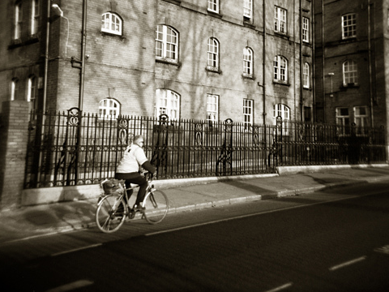
“It’s [Google’s] convenience. It’s the immediacy of it.”
(Digital Visitors and Residents, UKF3, Male, Age 52, Artist & Technical Support)
Notes:
Image: http://www.flickr.com/photos/dubpics/8685963533/
“It’s convenience. It’s the immediacy of it.” (Digital Visitors and Residents, UKF3, Male, Age 52, Artist & Technical Support) (referring to Google)

Slide 28
Contact and Educational Stages
(Connaway, Lanclos, and Hood, 2013)
Notes:
As shown, Email was mentioned at a much higher rate than other means of contact.
Contact and Educational Stages: Interviews
Email: Emerging 60%, Establishing 100%, Embedding 100%, Experiencing 100%
Texting: Emerging 84%, Establishing 80%, Embedding 70%, Experiencing 50%
Phone Calls: Emerging 77%, Establishing 90%, Embedding 70%, Experiencing 70%
Face-to-Face: Emerging 60%, Establishing 60%, Embedding 40%, Experiencing 70%

Slide 29

“But I could probably not live without the computer and, you know, the internet. Because, work, and the emails.”
(Digital Visitors and Residents, USU2, Female, Age 19, Engineering)
Notes:
Image: http://www.flickr.com/photos/mangpages/3233581857/
“But I could probably not live without the computer and, you know, the internet. Because, work, and the emails.” (Digital Visitors and Residents, USU2, Emerging, Female, Age 19, Engineering)

Slide 30
Human Sources and Educational Stages
Notes:
Human Sources and Educational Stages: Interviews
Mother: Emerging 58%, Establishing 50%, Embedding 40%, Experiencing 10%
Father: Emerging 49%, Establishing 50%, Embedding 40%, Experiencing 10%
Extended Family: Emerging 53%, Establishing 50%, Embedding 30%, Experiencing 20%
Friends, Colleagues: Emerging 77%, Establishing 70%, Embedding 40%, Experiencing 40%

Slide 31
Human Sources and Educational Stages
Notes:
Human Sources and Educational Stages: Interviews
Librarians: Emerging 12%, Establishing 0%, Embedding 10%, Experiencing 20%
Peers: Emerging 51%, Establishing 60%, Embedding 40%, Experiencing 50%
Teachers, Professors: Emerging 86%, Establishing 90%, Embedding 60%, Experiencing 20%
Experts, Professionals: Emerging 30%, Establishing 20%, Embedding 30%, Experiencing 20%

Slide 32
Place (Type of Library) and Educational Stage
Notes:
(Place referring to what type of library is mentioned when they speak of libraries in any context (going to study, going to get sources, going to for classes, etc. ). These mentions were coded as their academic/university library, their local public library, or their high school library. If they do not specify what type of library it is, then it was coded as just library).
Place AND Educational Stage: Interviews
Academic: Emerging 60%, Establishing 60%, Embedding 90%, Experiencing 50%
Public: Emerging 12%, Establishing 10%, Embedding 0%, Experiencing 0%
School (K-12): Emerging 14%, Establishing 10%, Embedding 0%, Experiencing 0%
Library (General): Emerging 28%, Establishing 40%, Embedding 60%, Experiencing 40%

Slide 33
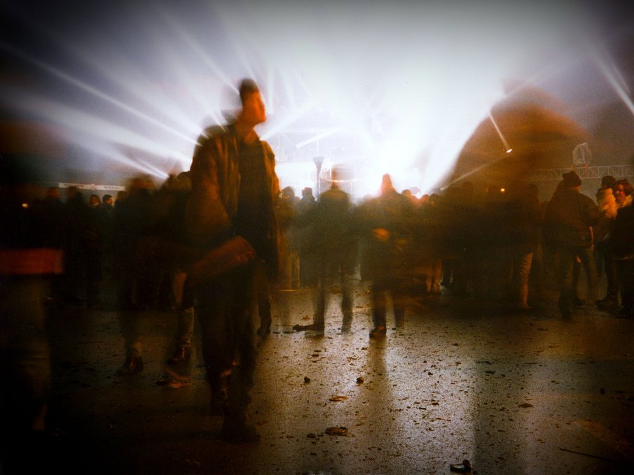
“…library catalogues that’s supposed to be a really good way for looking for books but usually they are so bad that you are sort of stuck between the two worlds...”
(Digital Visitors and Residents, UKG5, Female, Age 25, Early Modern History)
Notes:
Image: http://www.flickr.com/photos/werkunz/3524659054/
“Because I mean the thing that annoys me most is when these things are online, unlike library catalogues that’s supposed to be a really good way for looking for books but usually they are so bad that you are sort of stuck between the two worlds of you can’t go and ask someone for anything. You’re supposed to use the internet but they’re not very well developed.” (Digital Visitors and Residents, UKG5, 0:34:36, Female, Age 25, Early Modern History)
“I know they’ve changed the website. I think they changed that, actually, pretty recently. But now it just seems like you have more access just kind of with your library account just online you have more access. You don’t have to come here. You don’t have to call. It just seems like it’s easier to find something in researching” (Digital Visitors & Residents, USG3, 0:15:54, Female, Age 23, History)

Slide 34
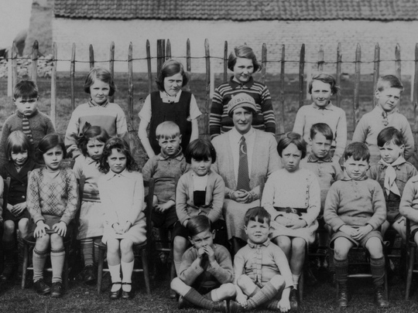
“And so like my parents will always go, ‘Well look it up in a book, go to the library.’ And I’ll go, ‘Well there’s the internet just there.’”
(Digital Visitors and Residents, UKU5, Emerging, Female, Age 19, Chemistry)
Notes:
Image: http://www.flickr.com/photos/22326055@N06/6732616879/

Slide 35
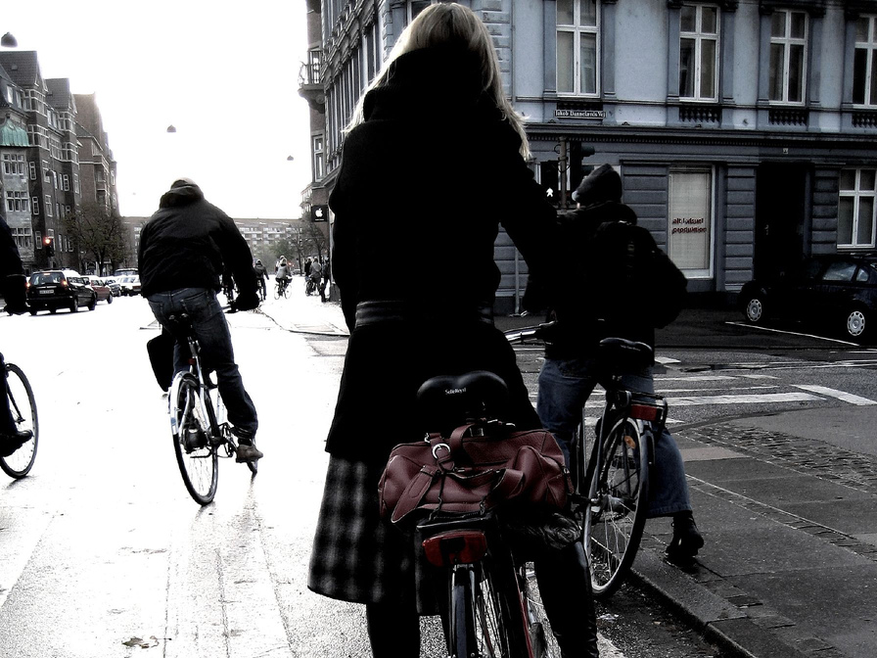
“This year I don’t think I have ever picked up a book out of the library to do any research, all I have used is my computer.”
(Digital Visitors and Residents, USU1, Female, Age 19, Undeclared)
Notes:
Image: http://www.flickr.com/photos/16nine/297307637/
“This year I don’t think I have ever picked up a book out of the library to do any research, all I have used is my computer.” (Digital Visitors and Residents, USU1, 0:15:16, Female, Age 19, Undeclared)

Slide 36

“And since a lot of my academic work is done at night, later hours, it’s much more convenient to do so within the home rather than to go to a library and seek out a computer there.”
(Digital Visitors and Residents, UKG2,Female, Age 22, Learning and Technology)
Notes:
Image: http://www.flickr.com/photos/33284937@N04/5041476803/
Library
Overall results indicate that the library is not negatively viewed and is seen as a resource, though the trend is leaning towards it being viewed as much as for a quiet study space as for any physical resources.
Emerging: About two-thirds of the coded Emerging participants indicated that they used the library/were willing to use the library not only to find books but frequented the library as a place to study quietly and work on their papers. One third indicated that they preferred to simply use the internet and that it was inconvenient to go to the library to get materials.
Establishing: Two of the Establishing participants coded indicated that they use the library to meet for study groups and the other two spoke of using the library for materials/having their own personal library of materials.
Embedding: From the Embedding participants we see that while there is not an aversion to the library and they speak well of the library website and catalogue and use they use the facilities, it is often merely the inconvenience of travel that keeps them from the physical library.
Experiencing: Three indicating a strong use of the library.
“I do tend to do that because as I said I am a bit old fashioned. I don’t really like everything being online because reading a book online just feels wrong to me, a book is a book, it has pages, it has words that I can touch on the page. So reading something on a computer screen is really not appealing to me, even if it is a slower process, trudge through a book, find pages like that I find it just more satisfying. Normally when I am writing huge assignments I will go to the library…” (Digital Visitors and Residents, UKU3, Female, Age 19, French and Italian) Emerging
“They do often advise that we go to the library and look for books but I would normally go to the internet and go to the library as my last sort of option really. (Laughter) It just takes me – I don’t really know how to use the library, I’ve got to be honest, but I know how to use the internet. Yes, I would normally use the internet or sort of word of mouth if someone else knows how to do it – that kind of thing – first.” (Digital Visitors and Residents, UKU5, Female, Age 19, Chemistry) Emerging

Slide 37
Place and Educational Stages
Notes:
Place AND Educational Stages: Interviews
Facebook: Emerging 95%, Establishing 100%, Embedding 100%, Experiencing 90%
Twitter: Emerging 21%, Establishing 50%, Embedding 50%, Experiencing 70%
YouTube: Emerging 33%, Establishing 50%, Embedding 30%, Experiencing 40%

Slide 38

“I get on Twitter a whole bunch. It’s Twitter or Facebook are what I usually use the most to talk to my friends.”
(Digital Visitors and Residents, USS1, Female, Age 17, High School Student)
Notes:
Image: http://www.flickr.com/photos/auro/230377281/
“I get on Twitter a whole bunch. It’s Twitter or Facebook are what I usually use the most to talk to my friends.” (Digital Visitors and Residents, USS1, Emerging, Female, Age 17, High School Student)

Slide 39
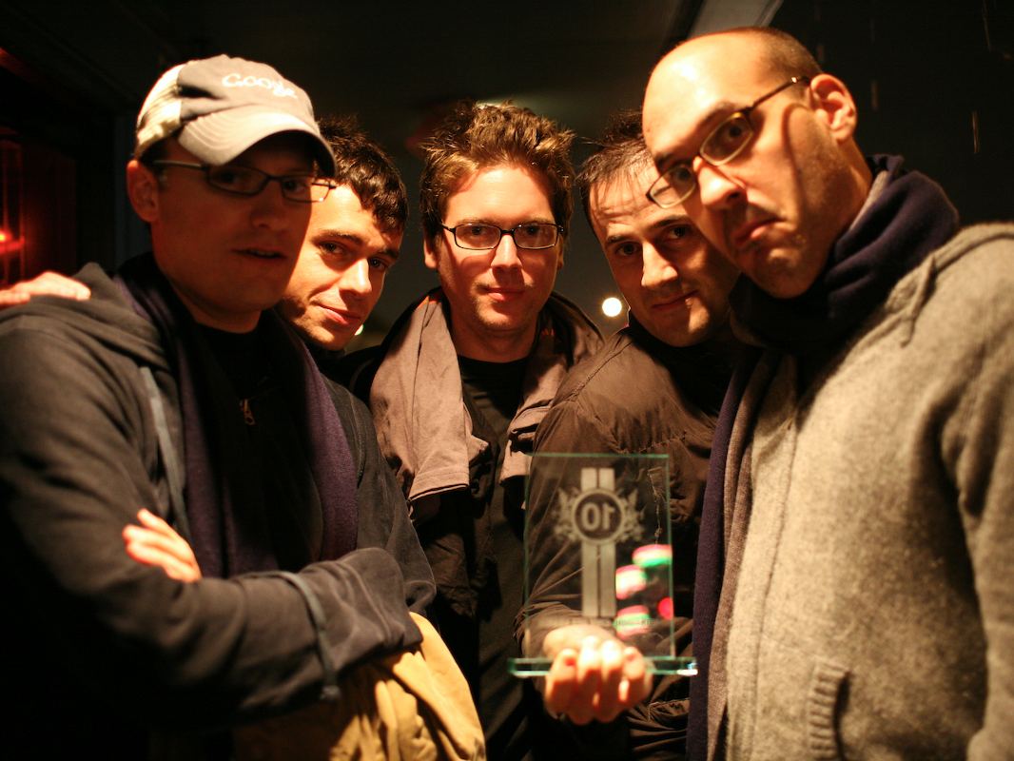
“I don’t use Twitter, partially because a lot of my friends – there’s a certain negative connotation with Twitter that it’s online presence taken too far, taken to the extreme among people my age I suppose…And so it’s a weird connotation, so I’d never use it for that reason.”
(Digital Visitors and Residents, UKG2, Female, Age 22, Learning and Technology)
Notes:
Image: http://www.flickr.com/photos/laughingsquid/418633438/
Twitter
Emerging: Of the eight second round participants, two said they don’t use Twitter (one stating that Twitter is “stupid”), and the other six said they use Twitter. They had various reasons for using it, some to communicate with friends and family members, others to follow celebs. Only one First Round Emerging participant was coded for Twitter. They said they use it for communicating with friends.
Establishing: Of the five Establishing participants coded for Twitter, four said they don’t use it, and one said they do. Of the four who don’t use it, three indicated their negative opinions of it, one calling it a “bit bizarre.”
Embedding: Of the five participants coded, 4 said they use Twitter, one said they don’t because of the “negative connotation with Twitter.”
Experiencing: Of the seven Experiencing participants who were coded for Twitter, four said they don’t use Twitter, and three said they do.
“Well so Facebook is basically a combination of family, old high school friends and friends that I interact with now. But the primary ones that I interact with on Facebook and Twitter are pretty much the same thing, however if we’re getting specific, I use Twitter to interact with mainly friends that I have at my church.” (Digital Visitors and Residents, USG2, Male, Age 25, Biology) Embedding
“I’m on Twitter but like I don’t really post anything. I just like scroll through news and see people complaining about life.” (Digital Visitors and Residents, 2USU1, Male, Age 18, Electrical Engineering and Math) Emerging
“No, no. I think Twitter’s a bit bizarre because it seems to be people just declaring what they think rather than socializing really with other people. I mean you can choose to comment upon what other people are saying but in general it’s sort of like a declaration of your status and I don’t really see why it’s- well I see why it’s so popular but it’s not for me I don’t think.” (Digital Visitors and Residents, UKU12, Female, Age 21, Physics) Establishing
“It’s something I find… yes, I’m not… although I’m very open with everyone, I don’t see the point of telling people that I’m going to the loo or I’m going somewhere, I don’t know, I just find very weird. So I don’t know, I find weird.” (Digital Visitors and Residents, UKF5, Female, Age 41, Urban Design) Experiencing

Slide 40
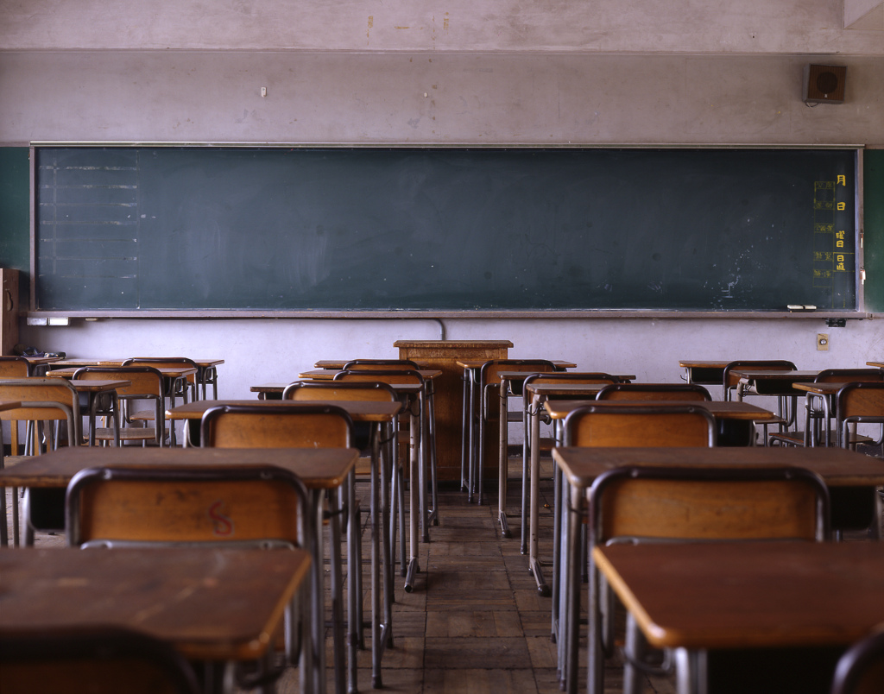
“…[on YouTube] you can see people writing out the solutions themselves or doing the working out so you follow it step by step and you can see exactly where you go wrong.”
(Digital Visitors and Residents, UKU12, Female, Age 21, Physics)
Notes:
Image: http://www.flickr.com/photos/ogwrnsk/5020082786/
YouTube
Emerging: The Emerging participants had a great variety of usage for YouTube, using it for tutorial videos to help them with their classes and for their hobbies/interests. Additionally, they mentioned using it for entertainment like watching programs, funny videos, and “discussions.” I see no explanation for any discrepancy in the numbers between the First Round and the Second Round Emerging. Seems consistent.
Establishing: Of the five Establishing participants, three spoke of using YouTube for school related activities, two watching math tutorials and one had to make a video and upload it. Another participant makes guitar instructional videos and uploads them and the fifth makes music videos.
Embedding: One participant spoke of using it listen to music in advance before trying to play it on the viola. The second learned how to tie a tie and the third to listen to music in general.
Experiencing: Among the Experiencing participants, there was the same variety as with all educational stages. One watches funny videos, one uploads their lectures for students, and another uploads videos they make.
“Wedding, don’t know how to tie a tie….I need to learn how to tie a tie really quick. YouTube, how to tie a tie. First tip, 14 million views, seven minutes long, read it, tie a tie, done.” (Digital Visitors and Residents, USG2, Male, Age 25, Biology) Embedding
“Um YouTube sometimes—‘cause I’m taking an online class. So I have to—some of the stuff isn’t covered in the book so I have to learn it on my own, from YouTube. So for example, I’m taking an [Indiscernible] class and we’re learning Excel. And some of the stuff from the book isn’t clear, so I would go on and look it up.” (Digital Visitors and Residents, 2USU2, Female, Age 18, Pre-Business) Emerging
“Yes. I’m also – I’ve got my own YouTube channel and occasionally I upload like guitar tutorials.” (Digital Visitors and Residents, UKU10, Male, Age 20, Law) Establishing

Slide 41
Motivation and Educational Stages
Notes:
Motivation AND Educational Stage: Interviews
Lazy: Emerging 23%, Establishing 20%, Embedding 50%, Experiencing 10%
Organization: Emerging 44%, Establishing 80%, Embedding 80%, Experiencing 60%
Intrinsic: Emerging 44%, Establishing 50%, Embedding 40%, Experiencing 40%

Slide 42
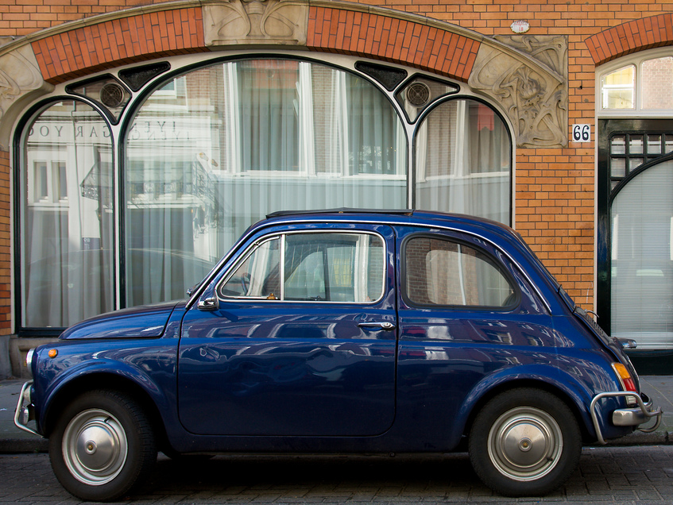
“Last semester I was writing a paper on Brazil and there was a book in the library that I just did not want to leave my house to go to. It is a 50 minute drive, I didn’t want to do that, but I was writing my paper and so I used Google books instead and really they only had a section of the book available but that was the section I used. So, you know, doing that instead of coming here physically and going to get the whole book. And it saved time, it saved gas, I got what I needed and it wasn’t a big deal.”
(Digital Visitors and Residents, USG4, Female, Age 23, Latin/American Studies)
Notes:
Image: http://www.flickr.com/photos/haagsuitburo/2315233844/
Lazy (No Motivation)
Laziness levels appear to not be a true indicator of actual laziness, but perception. Not surprisingly Emerging participants indicated higher levels of laziness as they are unmotivated by their work at this stage. Considering how many required core classes are required along with high school classes, they have lower levels of interest in their classes at this point. Establishing and Embedding participants spoke of laziness as being that they don’t want to travel all the way back to campus to the library, especially late at night, and not going above and beyond in their work. These students are necessarily lazy, though they speak of themselves that way, rather most of us would speak of these participants as busy and trying to manage their time.
Emerging: Participants do not want to take the time to do the actual task. Want to find shortcuts/quickest way to complete the task or how to avoid doing it at all. Often do not want to leave their computer. Recognize laziness in themselves/find themselves to not be motivated. I don’t see a response difference between First Round and Second Round.
Establishing: Only two participants, one speaking of professors, not themselves. The other speaks of not going above and beyond, just doing the minimum.
Embedding participants: Do not live on campus and do not want to travel just to go to the library.
Experiencing: One participant, teacher discussing student’s laziness versus their own. They would not be as lazy, but understand that the students are overwhelmed.
“I mean may be sometimes when I have to do research like I guess with the assignment last night once I’d found that website I didn’t continue to see what else I could find. So it’s kind of I guess a lazy approach to it – not going above and beyond, once I get there I just kind of stop.” (Digital Visitors and Residents, USU9, Female, Age 21, Sociology/Gerontology) Establishing
“I live about two miles away form her on bike, which is not that far, but when you’re writing a paper and don’t feel like getting out of your pajamas… Frequently when I’m working from home, it does feel a bit onerous to come all the way, which is about two miles away on bike, to use the library when I’m immediately probably going to go home afterwards. I find working from home very comfortable. I’d like – it feels also very private, it’s easy for me to concentrate without other people within the library space. So all of those reasons influenced my decision to take the easier route rather than physically having to move to get information.” (Digital Visitors and Residents, UKG2, Female, Age 22, Learning and Technology) Embedding

Slide 43
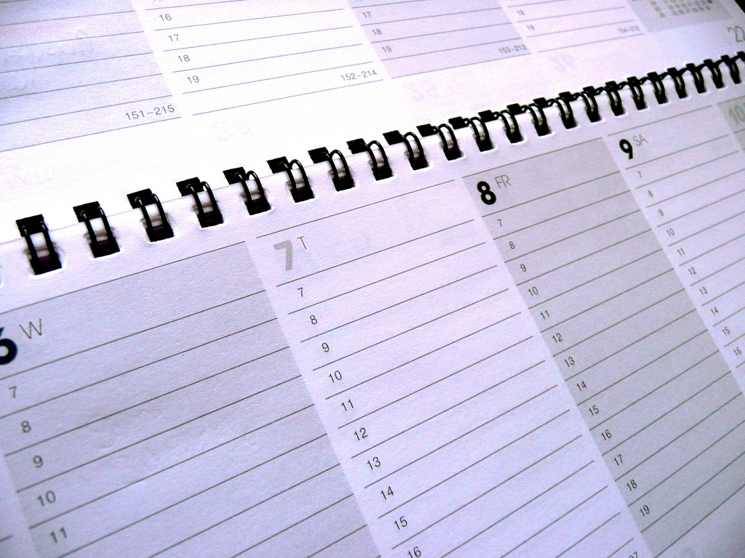
“Ironically, I have a paper calendar. I do this because I find it very useful to actually have to write rather than type out the things that I have to do. I don’t have an online calendar in any form because I find that if I write something physically down on a piece of paper, I’m more likely to remember it.”
(Digital Visitors and Residents, UKG2, Female, Age 22, Learning and Technology)
Notes:
Image: http://www.flickr.com/photos/42931449@N07/6812481635/"
Organization
Overall, organization methods for keeping track of one’s schedule does not appear to be dictated by educational stage but personal preference, or rather, what that person has discovered has worked for them. Written diaries are just as commonly used as electronic calendars on their cellphones (Google calendar being often mentioned). Additionally, many mentioned keeping track by more than one method. (For organizing emails, participants said they have multiple email accounts to separate school from work from family/friends).
Emerging 1st Round: Three said they use calendars on their phones/iPods. Two said they used written diaries. One just checks emails and powerpoints to keep track of assignments, etc. One spoke of emails from people as letting them know what needed to be done, where to be. Post it notes were also mentioned by two.
Emerging 2nd Round: Two second round participants (high school students) said that they keep organized by social media/Facebook, one also keeping track with an electronic calendar on their phone and iPad. Three more also said they keep organized by their phones using electronic calendars and one takes notes directly into Springpad onto his phone in class. Three more kept written diaries/calendars. One just keeps it in their head.
Establishing: Participants use multiple methods of keeping track of their schedule, using written calendars and their phones/electronic calendars and even social media.
Embedding: 5 of the 8 participants coded here keep choose physical calendars or post-its to keep track of their calendars and deadlines, two of them specifically explaining that the physical act of writing helps them remember. Only one participant mentioned keeping a electronic calendar. Others mentioned electronic methods they plan on trying for organizing their data and articles but have not fully invested in.
Experiencing: One participant mentions using a written diary to keep track of their schedule, two state that they use Google calendars, one said they don’t use a calendar and that they just use their emails.

Slide 44
Additional Organization quotes
Notes:
Organization Quotes
“I have to keep a diary, because I've got so many things... Things going on. I've got deadlines and things to make. So I have to write it down, otherwise, I'll just, it would... Well, I used to, all I'm trying to do is remember these dates in my head, and then they would pass, and I would forget things, so I've... This year I thought I'd just got to get it sorted, so I just started writing everything down in a diary.” (Digital Visitors and Residents, 2UKU2, Male, Age 18, History) Referring to a written diary/planner.
“I have a little pink book. I like writing lists, I like writing things down. So I have a little book which I use as my homework diary as I like to call it. That is how I keep track of my assignments. Where I need to go I have a little timetable that I carry round with me and the same copy in my room so when I wake up in the morning I can plan my day and my copy that is always carried with me, whenever I am confused where I have to go just pop it out of my bag, have a quick look and off I go.” (Digital Visitors and Residents, UKU3, Female, Age 19, French and Italian) Emerging
“I use a lot of paper which- to do my work I always write work on paper and stuff so I’m used to writing things down whenever people tell me a date or something. I don’t do it that systematically but I recently bought a table calendar that has pictures of trains on it or something. So I’ve started to write things down on a calendar to try and keep them all in the same place. Often I write them on my phone as well because I’ve always got my phone with me whereas a small calendar I might or might not have depending on where I’m going.” (Digital Visitors and Residents, UKU12, Female, Age 21, Physics) Establishing
“Yes I use Outlook that’s what we have at the university so I use that for work purposes. For personal purposes I have both a Gmail and a Hotmail account. Hotmail I find I use- it’s simple to have any business related things that I’m doing. So if I have to sign up for a website in order to say get an airline ticket and I don’t use it for personal reasons simply because there’s too much spam on Hotmail. So for all of my personal contacts; friends, family I use Gmail. And that way I can keep separate the work related or the spam related things or companies I’ve signed up for newsletters and just have my Gmail for just pure communication with family and friends.” (Digital Visitors and Residents, UKF2, Female, Age 51, Marketing) Experiencing

Slide 45

“I use Facebook for organizing my life basically, with friends and stuff. ...I also use that in education to talk to my friends about an equation, the things I don't understand and it works quite well.”
(Digital Visitors and Residents, 2UKS2, Male, Age 18, Secondary School Student)
Notes:
Image: http://www.flickr.com/photos/sackton/6799330916/
“I use Facebook for organizing my life basically, with friends and stuff. ...I also use that in education to talk to my friends about an equation, the things I don't understand and it works quite well.”
(Digital Visitors and Residents, 2UKS2, Emerging, Male, Age 18, Secondary School Student)

Slide 46
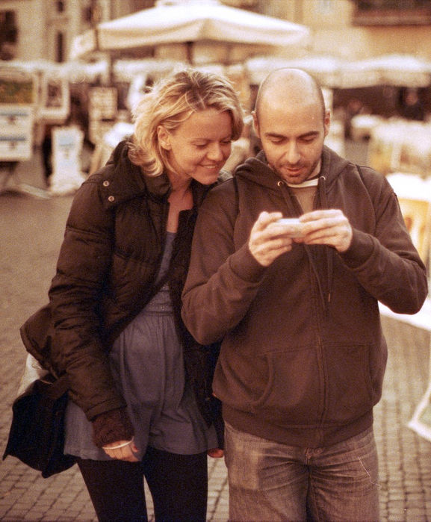
What Can We Change?
Improved OPACs
  Community as content
Full text, online accessible
Seamless discovery to delivery
  Access more important than discovery
  Mobile access
Presence in social networks
  Facebook
  Twitter
Notes:
Image: http://www.flickr.com/photos/disaster_area/7005162079/
Three issues with catalog being in multiple places (Facebook, widgets, apps, etc.)
1. Divorce between discovery and delivery
2. Reconfiguration of functions in app/mobile environments
3. Attention is shifting to the full collection and the discovery layers that make them available
Dempsey, L. (2012). Thirteen ways of looking at libraries, discovery, and the catalog: Scale, workflow, attention. Educause Review Online. Retrieved from http://www.educause.edu/ero/article/thirteen-ways-looking-libraries-discovery-and-catalog-scale-workflow-attention
Overall, 63% of respondents say they would be likely to use library if there was a cell phone app that would allow them to access and use library services from their phone; some 35% say they would be “very likely” to use such an app, including 45% of smartphone owners and 41% of tablet owners. (Zickuhr, Rainie, & Purcell, 2013, p.62).
Zickuhr, K., Rainie, L., & Purcell, K. (2013). Library services in the digital age. Washington, DC: Pew Research Center’s Internet & American Life Project.
“Not to mention reading online pdf books. Its really cool that now a days you dont have to go to the library to find a book but its right there on your labtop.“ (Digital Visitors & Residents, USU2, Emerging Diary 11, Phase 2, Female, Age 19, Electrical Engineering)
“I know they’ve changed the website. I think they changed that, actually, pretty recently. But now it just seems like you have more access just kind of with your library account just online you have more access. You don’t have to come here. You don’t have to call. It just seems like it’s easier to find something in researching” (Digital Visitors & Residents, USG3, 0:15:54, Female, Age 23, History).
VRS meets users where they are
Text, e-mail, chat
Facebook
Face-to-face – still preference
Librarians’ expertise can deliver quality sources to users through VRS that they cannot find with a Google search
Link users to special collections
Facebook (“On Facebook, Librarian Brings 2 Students From the Early 1900s to Life,” January 6, 2012, Nick DeSantis, Chronicle of Higher Education. http://chronicle.com/blogs/wiredcampus/on-facebook-librarian-brings-two-students-from-the-early-1900s-to-life/34845
Joe McDonald, sophomore at University of Nevada, Reno in 1913, and girlfriend and future wife, Leola Lewis
University of Washington includes its special collections in the references in Wikipedia
De Santis, N. (2012, January 6). On Facebook, librarian brings 2 students from the early 1900s to life. Chronicle of Higher Education. Retrieved from http://chronicle.com/blogs/wiredcampus/on-facebook-librarian-brings-two-students-from-the-early-1900s-to-life/34845

Slide 47

Community is Content
Social networks formed around social objects
  Music, photos, videos, links
  Reviewing
  Tagging
  Commenting
  Rating
Refines interaction with resources
(Dempsey, 2012)
Notes:
Image: http://www.flickr.com/photos/24992516@N07/4347962723/
Dempsey, L. (2012). Thirteen ways of looking at libraries, discovery, and the catalog: Scale, workflow, attention. Educause Review Online. Retrieved from http://www.educause.edu/ero/article/thirteen-ways-looking-libraries-discovery-and-catalog-scale-workflow-attention
The interaction of community and resources — in terms of discussion, recommendation, reviews, ratings and so on — is evident in some form in most of the major network services we use (Amazon, iTunes, Netflix, Flickr). Indeed, this is now so much a part of our experience that sites without this experience can seem bleached somehow, like black and white television in a color world.
What about the catalog in this context? Some catalogs have experimented with collecting tags and reviews but it does not seem that the catalog has the centrality, scale, or personal connection to crystallize social activity on its own. There is some activity at the aggregate level (e.g., Worldcat, BiblioCommons) and there is some syndication of social data from commercial social collecting/reading sites (e.g., LibraryThing). Similarly, catalogs have not generally mobilized usage data to rank, relate or recommend, and again this seems like something that might best be done at the aggregate level, and syndicated locally (as with the Bx service from Ex Libris, for example).
There are some places where catalog data gets used — reading lists and resource guides, for example — which seem to be especially appropriate for such attention. The choices involved in this additional layer of curation could be aggregated to provide useful intelligence. What items occur frequently on reading lists, for example? Would it be useful to provide an environment where students rate, review or comment on assigned readings? Is there enough commonality across institutions to make it useful to aggregate this data?
Our web experiences are now actively shaped by ranking, relating and recommending approaches based on social and usage data. For library services this is a major organizational challenge, as supra-institutional approaches may be required to generate appropriate scale (Dempsey, 2012).

Slide 48
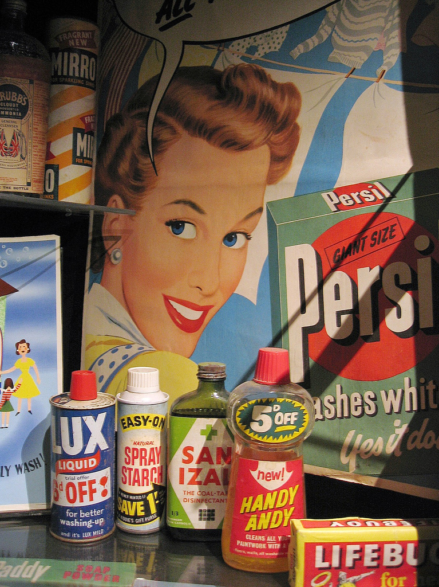
What Can We Do?
Advertise resources, brand, & value
Provide search help at time of need
    Chat & IM
    Mobile technology
Design all of our systems with users in mind
  Familiar formats
Model services on popular services
Notes:
Image: http://www.flickr.com/photos/maddi/173718675/
Zickuhr, K., Rainie, L., & Purcell, K. (2013). Library services in the digital age. Washington, DC: Pew Research Center’s Internet & American Life Project.
Advertise resources, brand, value
One aspect mentioned very often, both in focus groups and in qualitative work from previous research, is that people wish they were more aware of the full range of services offered by their libraries. One focus group member loved her local library and rated it highly in all areas—except communication; “there’s so much good stuff going on but no one tells anybody.” Another said, “they do so many fabulous things, [but] they have horrible marketing” (Zickuhr, Rainie, & Purcell, p. 38)
However, focus group members say that having resources and events listed on their library’s website wasn’t enough—as several participants pointed out, they probably weren’t going to go to the website to look for events (or even to sign up for email newsletters) unless they already knew that the library had those events (Zickuhr, Rainie, & Purcell, p. 38)
Help at time of need
When asked, “What do you value in VRS?”, one participant said “Instantaneous help. Sometimes if you're looking for something and you can't find it, it takes forever. Since you have someone there that can respond to you live, you have the comfort that someone is there” (Cyber Synergy ,VS47, Male, Age 26-34, Sales Account Manager)
Another was able to receive searching help in a database, “I would say it was my freshman year and I was doing an English paper for my expository writing class and I was looking for something in JSTOR and I used the "Ask a Librarian" to do more advanced searches in JSTOR as to what keywords to put in, and it really helped me. One, her quickness and response, and two, the simplicity of her instructions as to the key title words to put in really helped me and made it successful” (Cyber Synergy ,VS17, Female, Age 19-25, Social Work)
St. Louis University library provided pop-up help when OPAC displayed 0 retrievals. Within the first hour, 20 individuals used the pop-up, chat help.
Users in Mind
One size fits no one – design services for those who use them – Boutique libraries (Priestner, A., & Tilley, E. (2012). Personalising library services in higher education: The boutique approach. Farnham, Surrey, England : Ashgate).
Embedded librarians
Familiar formats
Something clean, simple, streamlined and user friendly, but also credible sources (Cyber Synergy ,VS 23, Female, Age 26-34, Stay-at-Home-Mom).
“In college, and especially grad school, I’m not afraid to go to the library anymore because we have a very good [assist 0:45:56] and we have a very good website.” (Digital Visitors and Residents, USG2, 0:45:28, Male, Age 25,)
Radford, M. L., Connaway, L. S., & Shah, C. (2011-2013). Cyber Synergy: Seeking Sustainability through Collaboration between Virtual Reference and Social Q&A Sites. Funded by the Institute of Museum and Library Services (IMLS), Rutgers University, and OCLC. Retrieved from http://www.oclc.org/research/activities/synergy/default.htm
White, D., & Connaway, L. S. (2011-2014). Visitors and Residents: What motivates engagement with the digital information environment. Funded by JISC, OCLC, and Oxford University. Retrieved from http://www.oclc.org/research/activities/vandr/

Slide 49
infoKit
What is it?
Contains advice on evaluating digital/online services within the broader context of traditional services.
Why did we create it?
To understand the contexts surrounding individual engagement with digital resources, spaces and tools.
Who will use it?
Librarians and information technology staff
(White, Connaway, Lanclos, Hood, & Vass, 2014)
Notes:
Image: Microsoft Clip Art
The infoKit contains advice on evaluating the services offered. The focus primarily is on digital/online services but set within the broader context of more traditional services, exploring the relationship between the two. Much of the information presented is derived from a longitudinal research project, the Digital Visitors & Residents project, which explored how individuals at various educational stages (emerging, establishing, embedding, and experiencing) engage with the digital environment for learning.
Paying attention to which services people adopt can lead to more effective engagement between individuals and institutions, and the resources/services therein. It’s not just about identifying how individuals engage with technology and how they acquire their information but also why they make the choices that they do. We need to understand the larger, more complex contexts that surround individual engagement with digital resources, spaces, and tools before we can think constructively about how to (if, indeed in some cases, we should) provide institutionally-based digital resources and services. This is also important when considering how institutional systems interface, or overlap, with the environment and culture of the wider web.
The infoKit is designed to help practitioners generate their own qualitative inquiries, to inform their own policy needs and to frame the organisation (corporate, department, faculty) and its services within the institutional agendas surrounding student experience and engagement.
White, D., Connaway, L. S., Lanclos, D., Hood, E. M., & Vass, C. (2014). Evaluating digital services: A Visitors and Residents approach. Retrieved from http://www.jiscinfonet.ac.uk/infokits/evaluating-services/

Slide 50
Lynn Silipigni Connaway, Ph.D.
connawal@oclc.org
Notes:
50

Slide 51

Discussion & Questions
Notes:
Image: Microsoft Clip Art

Slide 52
References
Case, D. O. (2012). Looking for information: A survey of research on information seeking, needs, and behavior. Bingley: Emerald.
Connaway, L. S., Dickey, T. J., & Radford, M. L. (2011). “If it is too inconvenient I’m not going after it:” Convenience as a critical factor in information-seeking behaviors. Library & Information Science Research, 33(3), 179-190.
Connaway, L. S, Lanclos, D. M., & Hood, E. M. (2013a). “I always stick with the first thing that comes up on Google…” Where people go for information, what they use, and why. EDUCAUSE Review Online (December 6). Retrieved from http://www.educause.edu/ero/article/i-always-stick-first-thing-comes-google-where-people-go-information-what-they-use-and-why
Connaway, L. S, Lanclos, D., & Hood, E. M. (2013b). “I find Google a lot easier than going to the library website.” Imagine ways to innovate and inspire students to use the academic library. Proceedings of the Association of College & Research Libraries (ACRL) 2013 conference, April 10-13, 2013, Indianapolis, IN, 2013. Retrieved from http://www.ala.org/acrl/sites/ala.org.acrl/files/content/conferences/confsandpreconfs/2013/papers/Connaway_Google.pdf
Connaway, L. S., White, D., Lanclos, D., & Le Cornu, A. (2013). Visitors and Residents: What motivates engagement with the digital information environment? Information Research, 18(1). Retrieved from http://informationr.net/ir/18-1/infres181.html
Dempsey, L. (2012). Thirteen ways of looking at libraries, discovery, and the catalog: Scale, workflow, attention. Educause Review Online. Retrieved from http://www.educause.edu/ero/article/thirteen-ways-looking-libraries-discovery-and-catalog-scale-workflow-attention
Dervin, B., Connaway, L. S., & Prabha, C. (2003-2006). Sense-making the information confluence: The whys and hows of college and university user satisficing of information needs. Funded by the Institute of Museum and Library Services (IMLS). Retrieved from http://imlsosuoclcproject.jcomm.ohio-state.edu/
De Santis, N. (2012, January 6). On Facebook, librarian brings 2 students from the early 1900s to life. Chronicle of Higher Education. Retrieved from http://chronicle.com/blogs/wiredcampus/on-facebook-librarian-brings-two-students-from-the-early-1900s-to-life/34845

Slide 53
References
Prensky, M. (2001a). Digital natives, digital immigrants. On the Horizon, 9(5). Retrieved from http://www.marcprensky.com/writing/Prensky%20-%20Digital%20Natives,%20Digital%20Immigrants%20-%20Part1.pdf
Prensky, M. (2001b). Do they really think differently? On the Horizon, 9(5). Retrieved from http://www.marcprensky.com/writing/Prensky%20-%20Digital%20Natives,%20Digital%20Immigrants%20-%20Part2.pdf
Radford, M. L., & Connaway, L. S. (2005-2007). Seeking Synchronicity: Evaluating virtual reference services from user, non-user, and librarian perspectives. Funded by the Institute for Museums and Library Services (IMLS). Retrieved from http://www.oclc.org/research/activities/synchronicity/default.htm
Radford, M. L., Connaway, L. S., & Shah, C. (2011-2013). Cyber Synergy: Seeking Sustainability through Collaboration between Virtual Reference and Social Q&A Sites. Funded by the Institute of Museum and Library Services (IMLS), Rutgers University, and OCLC. Retrieved from http://www.oclc.org/research/activities/synergy/default.htm
Saunders, L. (2012). Faculty perspectives on information literacy as a student learning outcome. The Journal of Academic Librarianship ,38(4), 231.
White, D. (2008). Not “natives’”& “immigrants” but “visitors’ & “residents.” TALL Blog: Online Education with the University of Oxford, April 23. Retrieved from http://tallblog.conted.ox.ac.uk/index.php/2008/07/23/not-natives-immigrants-but-visitors-residents/
White, D., & Connaway, L. S. (2011-2014). Visitors and Residents: What motivates engagement with the digital information environment. Funded by JISC, OCLC, and Oxford University. Retrieved from http://www.oclc.org/research/activities/vandr/
White, D., Connaway, L. S., Lanclos, D., Hood, E. M., & Vass, C. (2014). Evaluating digital services: A Visitors and Residents approach. Retrieved from http://www.jiscinfonet.ac.uk/infokits/evaluating-services/
White, D. S., & Le Cornu, A. (2011). Visitors and Residents: A new typology for online engagement. First Monday, 16(9). Retrieved from http://firstmonday.org/htbin/cgiwrap/bin/ojs/index.php/fm/article/viewArticle/3171/3049
Zickuhr, K., Rainie, L., & Purcell, K. (2013). Library services in the digital age. Washington, DC: Pew Research Center’s Internet & American Life Project.

