Slide 1
University of Hong Kong, Faculty of Education | 7 April 2017
Demonstrating the Value of Academic Libraries in Times of Uncertainty:
A Research Agenda for Student Learning and Success
Lynn Silipigni Connaway, PhD
Senior Research Scientist & Director of User Research, OCLC
connawal@oclc.org
@Lynn Connaway

Slide 2
2017 Higher Ed Trends
The Chronicle of Higher Education (US)
Information Literacy
Safety Net
Sanctuary Campus
Cultural Divide
Defending Diversity
Harassment Vigilance
Times Higher Education (UK)​
Improving Digital Literacy​
Culture Wars​
Brexit​
Free Speech​​
​
Notes:
The Chronicle of Higher Education. 2017. The Trends Report, March 3, Special Report, http://www.chronicle.com/specialreport/The-2017-Trends-Report/95.
--Najmabadi, Shannon. 2017. “Information Literacy: It’s Become a Priority in an Era of Fake News.” The Chronicle of Higher Education, February 26, http://www.chronicle.com/article/Information-Literacy/239264?cid=cp95.
Teaching students to separate fact from fiction has become a priority after an election in which false "news" played a large role.
--Brown, Sarah. 2017. “Activist Athletes.” The Chronicle of Higher Education, February 26, http://www.chronicle.com/article/Activist-Athletes/239300?cid=cp95.
Players test their power with protests on and off the field.
--Field, Kelly. 2017. “Safety Net.” The Chronicle of Higher Education, February 26, http://www.chronicle.com/article/Safety-Net/239295?cid=cp95.
Colleges struggle to help their hungry and homeless students.
--Basken, Paul. 2017. “Cybersecurity, Rising.” The Chronicle of Higher Education, February 26, http://www.chronicle.com/article/Cybersecurity-Rising/239270?cid=cp95.
Working to meet a national shortage of computer-safety personnel, colleges find customers and complications.
--Kelderman, Eric. 2017. “Sanctuary Campus.” The Chronicle of Higher Education, February 26, http://www.chronicle.com/article/Sanctuary-Campus/239289?cid=cp95.
Some colleges consider "sanctuary" status for undocumented students. But what effect would that have?
--Mangan, Katherine. 2017. “Cultural Divide.” The Chronicle of Higher Education, February 26, http://www.chronicle.com/article/Cultural-Divide/239276?cid=cp95.
Some professors see the election as a sign that they should reach out to people who hold different views. Others are doubling down. “On campuses across the country where people are protesting what they see as threats to the environment, women’s rights, diversity initiatives, and even truth itself, many say higher education should be doubling down on its ideals, not bending over backwards to try to reach across what they see as a moral divide.”
--Hoover, Eric. 2017. “Defending Diversity.” The Chronicle of Higher Education, February 26, http://www.chronicle.com/article/Defending-Diversity/239275?cid=cp95.
Without gauges of effectiveness, diversity policies can be legally risky. “Many institutions are using big data to refine their recruitment, admissions, and retention strategies in ways that might enhance diversity. ”
--Biemiller, Lawrence. 2017. “Reckoning with History.” The Chronicle of Higher Education, February 26, http://www.chronicle.com/article/Reckoning-With-History/239291?cid=cp95.
American colleges are in a unique position, both practically and morally, to do justice to their own history of slavery.
--Brown, Sarah. 2017. “Title IX Due Process.” The Chronicle of Higher Education, February 26, http://www.chronicle.com/article/Title-IX-Due-Process/239282?cid=cp95.
In what many see as a much-needed shift, colleges are paying more attention to the rights of the accused in sexual-assault cases.
--Wilson, Robin. 2017. “Harassment Vigilance.” The Chronicle of Higher Education, February 26, http://www.chronicle.com/article/Harassment-Vigilance/239278?cid=cp95.
Scholarly societies and academic departments are becoming more vigilant about monitoring and preventing sexual harassment in their profession.
://www.flickr

Slide 3
Notes
Notes:
Elmes, John. 2017. " Six Significant Challenges for Technology in Higher Education in 2017." Times Higher Education, February 16, https://www.timeshighereducation.com/features/six-significant-challenges-technology-higher-education-2017.
Lists six challenges from the The NMC Horizon Report: 2017 Higher Education Edition.
--"Improving Digital Literacy...Being digitally literate is more than obtaining “isolated technological skills”, the Horizon report notes. It is about: “generating a deeper understanding of the digital environment, enabling intuitive adaptation to new contexts and co-creation of content with others”."
--"Integrating formal and informal learning...experts believe that blending formal and informal methods of learning can “create an environment that fosters experimentation, curiosity, and creativity”, the 2017 report reiterates."
--"Achievement gap...“The achievement gap…reflects a disparity in the enrollment and academic performance between student groups, defined by socioeconomic status, race, ethnicity, or gender,” the Horizon report says. While developments in technology have made it easier for students from these groups to engage with learning resources, “significant issues of access and equity persist”."
--"Advancing digital equity...Digital equity – ensuring equal access to technology – is a “rampant social justice issue”, affecting developed and developing countries alike, but is also a major concern for higher education, according to the report."
--"Managing knowledge obsolescence...Although technological developments can potentially improve the “quality of learning and operations” at universities, they are replaced incredibly swiftly by newer versions, making it difficult to keep up."
--"Rethinking the roles of educators...The report notes that role of faculty is shifting considerably. They are “increasingly expected to employ a variety of technology-based tools and engage in online discussions and collaborative authoring” while also tasked with “leveraging active learning methodologies like project and problem-based learning”. With learning shifting towards being more in the control of the students, educators are now acting as “guides and facilitators”."
Morgan, John. 2017. "Campus Culture Wars Over‘Anti-right Bias’ Threaten to Spread." Times Higher Education, March 2, 2017, https://www.timeshighereducation.com/news/campus-culture-wars-over-anti-right-bias-threaten-to-spread.
"Politicians’ claims that universities are systematically prejudiced against researchers and students with conservative views raise the prospect that Western institutions could become key battlegrounds in a new age of “culture wars”."
Baker, Simon. 2017. "Fact Check: are England’s Universities ‘ Swimming in Cash’?" Times Higher Education, March 2, https://www.timeshighereducation.com/news/fact-check-are-englands-universities-swimming-cash.
Elmes, John, and John Morgan.2017. "Don't Be 'Angst-Ridden' Over Brexit-Divide:V-C." Times Higher Education, February 24, https://www.timeshighereducation.com/news/dont-be-angst-ridden-over-brexit-divide-communities-v-c.
Baker, Simon. 2017. "Risks of Post-Brexit 'Brain Drain' Highlighted." Times Higher Education, February 23, https://www.timeshighereducation.com/news/dont-be-angst-ridden-over-brexit-divide-communities-v-c.
Elmes, John. 2017. "Nine Out of 10 Universities 'Restrict Free Speech.'" Times Higher Education, February 11, https://www.timeshighereducation.com/news/spiked-nine-out-10-uk-universities-restrict-free-speech.

Slide 4
How far have we come and what do we do next?
An agenda for action-based research on student learning and success

Slide 5
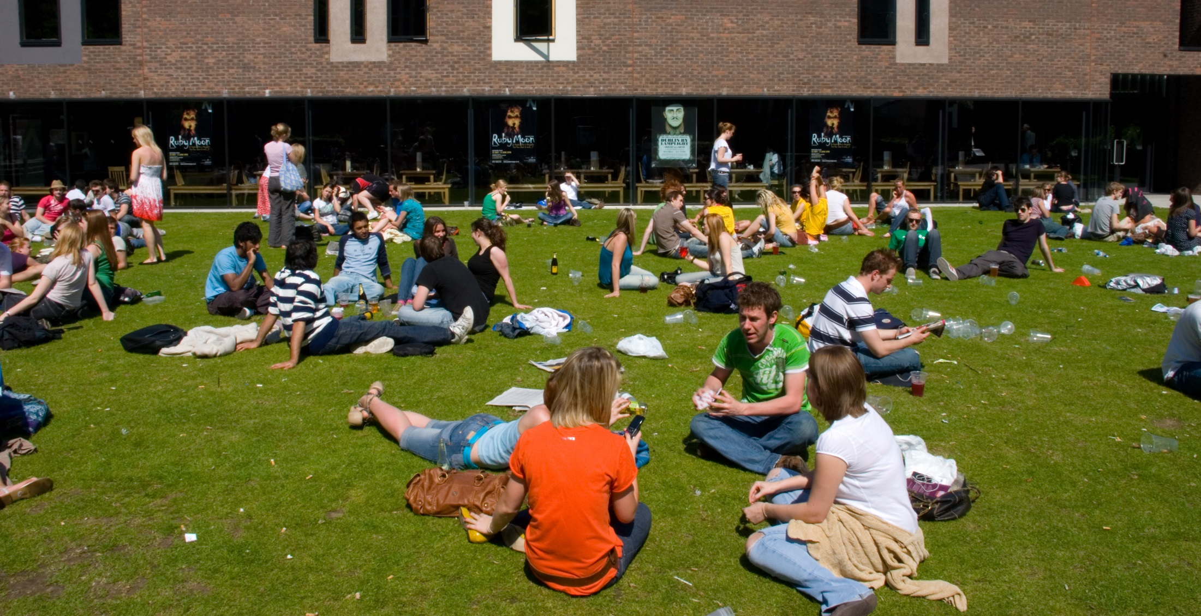
Research Agenda
Action-oriented Research Agenda on Library Contributions to Student Learning & Success
Update progress since 2010 VAL Report
Identify research needs in higher ed. sector
Focus on institutional priorities for student learning & success (i.e., retention, persistence, degree completion)
Notes:
Slide 5: Image: https://www.flickr.com/photos/conchur/525596627/ by Conor Lawless / CC BY 2.0
Agenda builds on Values of Academic Libraries Report commissioned by ACRL and published in 2010
Report argued that libraries need to demonstrate value by measuring contribution to institutionally defined outcomes
Our research agenda is an update and extension to VAL report focusing on student learning and success
Defining and measuring learning and success can be difficult, as reflected in higher education and library and information science literature.
Some would define student success as including satisfaction, persistence, and high levels of learning and personal development (Kuh, Kinzie, Schuh, and Whitt)
One of our advisory group members explained that for those in student affairs, student learning is associated with attaining learning goals and objectives, while student success is associated with programs that support those goals.
However, the definition that the team defined the terms based on their measurability.
Success in college: An outcome focused on the more objective indicators of learning, or “quantifiable student attainment indicators, such as enrollment in postsecondary education, grades, persistence to the sophomore year, length of time to degree, and graduation.” These tend to be linked to a specific assignment/semester, such as grades/GPA. It could also be related to whether the student re-enrolled or graduated. . Kuh, Kinzie, Buckley, Bridges, and Hayek, "What Matters to Student Success,” 5; Venezia, Callan, Finney, Kirst, and Usdan, "The Governance Divide.”
Learning in college: An outcome focused on the less objective concepts of learning, such as critical thinking. These encompass the outcomes not covered by the Success in college theme, which are “quantifiable student attainment indicators, such as enrollment in postsecondary education, grades, persistence to the sophomore year, length of time to degree, and graduation.” Usually not tied to a specific graded assignment or graduation. . Kuh, Kinzie, Buckley, Bridges, and Hayek, "What Matters to Student Success,” 5; Venezia, Callan, Finney, Kirst, and Usdan, "The Governance Divide.”
Our research agenda:
First part: Analyze the current state of the research of how the library impacts student learning and success
Next part: Suggest directions for future research
Team will develop a data visualization piece that will allow librarians, researchers, and students to search for documents and studies based on certain criteria, such as themes addressed and methodological aspects that were informed by content analysis of the selected literature
The visualization piece currently is being developed and will undergo usability testing in March

Slide 6
Data Collection
Individual Interviews with Provosts
Selected Literature
Focus Group Interview & Feedback from Advisory Group
Three data sources
Iterative process
Advisory group
Literature review
Provost interviews
Notes:
This slide depicts three data sources:
Selected literature on student learning and success identified in the RFP and documents found in LIS and higher education databases
Focus group with Advisory Group Members
Consist of library administrators from a variety of community colleges, 4 year colleges and universities around the country
Members provide us feedback throughout the process and put us in touch with provosts or similarly high level academic administrators in their institutions
Individual, semi-structured interviews with provosts from each Advisory Group member’s institution
Process of data collection is iterative, with findings from each source informing the other
E.g., focus group and provost interview protocol was based on the themes that we identified in the initial database searches

Slide 7
Literature Selection:
Indexed by LIS &/or higher ed databases
2010-2016
Themes in 2010 VAL Report
Published in US
Notes:
Image: https://www.flickr.com/photos/beta500/97819986/ by Cody Geary / CC BY-NC-ND 2.0
Selection criteria are: 1) indexed by LIS and/or higher education databases or identified by the project team or ACRL (e.g., ACRL Assessment in Action (AiA) studies, Ithaka S+R surveys, see Relevant ACRL Documents section), 2) published between 2010-2016, 3) contained themes identified in the 2010 VAL Report, and 4) published in the US, except for studies outside the US deemed relevant by the project team
Association of College and Research Libraries. 2010. Value of Academic Libraries: A Comprehensive Research Review and Report. Researched by Megan Oakleaf. Chicago: Association of College and Research Libraries. http://www.ala.org/acrl/sites/ala.org.acrl/files/content/issues/value/val_report.pdf.

Slide 8
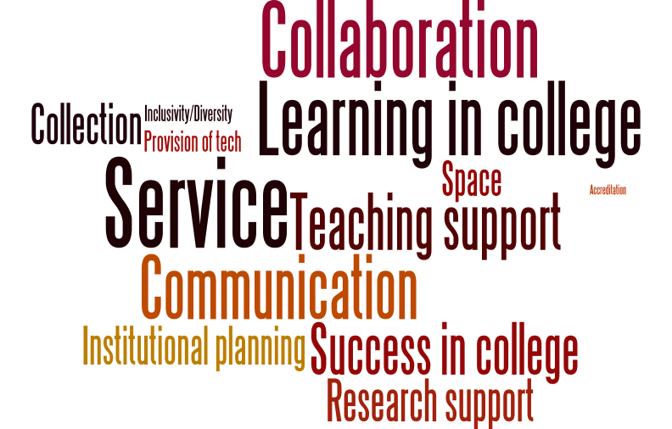
Notes:
Here’s a word cloud of the themes by frequency of documents they were present in. The larger the word, the more documents that included the theme.
To reiterate:
The selection criteria for LIS and higher education documents reviewed are: 1) indexed by LIS and/or higher education databases or identified by the project team or ACRL (e.g., ACRL Assessment in Action (AiA) studies, Ithaka S+R surveys, see Relevant ACRL Documents section), 2) published between 2010-2016, 3) contained themes identified in the 2010 VAL Report, and 4) published in the US, except for studies outside the US deemed relevant by the project team
Selected higher education databases were:
Academic Search Premier
Education Resources Information Center (ERIC)
ProQuest Education Journals, and Teacher Reference Center
Selected LIS databases were:
Library and Information Science Abstracts (LISA)
Library Literature & Information Science Full Text (H.W. Wilson)
Library, Information Science & Technology Abstracts (LISTA)

Slide 9
Notes:
The team compared the differences in proportion of themes discussed in documents from the higher education literature versus the LIS literature.
Search terms used for the database searches included the word “Library” and its derivatives.
For this reason, this comparison is only able to inform of differences in the proportion of themes between what is being said about student learning outcomes as related to libraries within the higher education literature versus the LIS literature, not student learning outcomes in general.
We are going to conduct a search more broadly to identify trends in higher education related to outcomes that advance the mission and goals of the university, including student outcomes
Results of this literature review will be contained in the final version of the report
Documents labeled as higher education literature were those retrieved from higher education databases that were not indexed by LIS databases and reports from Ithaka S+R. Therefore a total of 354 documents of the total 535 documents (66%) were reviewed when making this comparison given that the team retrieved documents for review that were not indexed by databases (e.g., AiA studies). There were:
n=18 documents designated as higher education literature (about 5% of the total documents)
n=52 documents (15%) designated as both higher education and LIS literature since they were indexed by both databases
n=284 documents (80%) were from LIS literature.
This figure illustrates the percent difference between thematic code by whether a document is from the higher education literature, LIS literature, or higher education and LIS literature.
Which themes vary most by the proportion of documents to which they are applied?
LIS literature and higher ed. and LIS literature combined discuss service more than higher education literature
LIS literature discusses service and success in college more than in higher education and LIS literature

Slide 10
Focus group interviews
N =14 (of 14)
90 minutes
Transcribed
NVivo for analysis
Thematic coding scheme
One team member coded, another checked
Notes:
Image: https://www.flickr.com/photos/ryan_fung/2203561517/ by Ryan Fung / CC BY-SA 2.0
Next, we will examine which findings from the content analysis resonate with practicing librarians in higher education
Based on focus group interviews with 11 advisory group members; the other three were unable to meet and were sent focus group questions that they completed. The responses to these questions were included in analysis
Coded transcripts in Nvivo using thematic coding scheme, allowing for inductive categories to be pulled from the data
Another team member checked the codes

Slide 11
Notes:
Focus group interview participants most often discussed:
Communication (20%, n=54)
Collaboration (17%, n=46)
Service (16%, n=44)
They less frequently mentioned the themes of:
Accreditation (n=0, 0%)

Slide 12
“….it needs to be sort of multi-level communication from the provost to those relationships you have with other units like the centers for teaching and learning to the academic units to the individual relationships that, that librarians and staff have with faculty and students.”
(Advisory Group Member LM03, Research University, Secular, Public)
Notes:
Image: https://www.flickr.com/photos/aditchandra/356955388/ by adit Chandra / CC BY-NC 2.0
“There's one other thing I was uh, when I was sitting here thinking about every, a lot of what's come out is that we're not islands, not that we ever were, but I think part of our success in reaching to students and faculty is the way we collaborate with others….one thing I will say is I think it needs to be sort of multi-level communication from the provost to those relationships you have with other units like the centers for teaching and learning to the academic units to the individual relationships that, that librarians and staff have with faculty and students. You know, all of those levels reinforce each other, and any alone doesn't quite work as well.” (Advisory Group Member LM03, Research University, Secular, Public)
Making connections is not as simple as having a conversation with one specific group or implementing the same strategies to make connections across various ones.
Outreach beyond the library necessary for its success relates to recognizing and adapting to the unique “eco-system” of relationships within the specific institution (Advisory Group Member LM14, Research University, Secular, Public).
Establishing multi-level communication requires collaboration. Librarians must have the ability to recognize how the multiple stakeholders within their specific university ecosystem interrelate and leverage their relationships to attain “shared goals,” rather than just library-oriented ones (Advisory Group Member LM07, Research University, Secular, Public).

Slide 13
“…the whole kind of conversation around fake news is this really important example of how important it is in our daily life and civic health in order to bring critical skills to bear on understanding information and being able to critically evaluate the source of that.”
(Advisory Member LM03, Research University, Secular, Private)
Notes:
Image: https://www.flickr.com/photos/mxmstryo/3507201141/ by mxmstryo / CC BY 2.0
“If I’m understanding you correctly, the whole kind of conversation around fake news is this really important example of how important it is in our daily life and civic health in order to bring critical skills to bear on understanding information and being able to critically evaluate the source of that.” (Advisory Member LM03, Research University, Secular, Private)

Slide 14
Provost individual interviews
N = 14 provosts (of 14)
45 minute average
Transcribed (9 of 14)
Detailed interview notes (5 of 14)
NVivo for analysis
Thematic coding scheme
One team member coded, another checked
Notes:
Image: https://www.flickr.com/photos/smiling_da_vinci/14785644/ by Eelco / CC BY-NC 2.0
Three team members interviewed the provosts on the phone and recorded the interviews. Nine of the fourteen interviews were transcribed. The other five were deemed to have low sound quality, so team members took in-depth notes and recorded juicy quotes.

Slide 15
Notes:
Themes discussed most by provosts were:
Communication (17%, n=199)
Institutional planning (14%, n=159)
Themes not discussed frequently by provosts were:
Accreditation (2%, n=18)
Top themes for focus group interview with librarians were communication, collaboration, and institutional planning
The theme among the librarians was accreditation, and this was the least mentioned theme among the provosts

Slide 16
“People [are] talking about the problems of educating people to be citizens more, with this election being indicative of that.”
(Provost Interviewee PP02, Research University, Non-Secular, Private)
Notes:
Image: https://www.flickr.com/photos/criminalintent/5403052781/ by Lars Plougmann / CC BY-SA 2.0
“People [are] talking about the problems of educating people to be citizens more, with this election being indicative of that. This is a hard thing to confront right now because we are going to have an administration that doesn't think that's important at all.” (Provost Interviewee PP02, Research University, Non-Secular, Private)

Slide 17
“Thinking of how these new learning environments work, and how the library would enhance students' and faculty's ability to access and process knowledge, data information, in those particular kinds of environments. That's what libraries need to do to be successful.”
(Provost Interviewee PP02, Research University, Non-Secular, Private)
Notes:
Image: http://bit.ly/2l8fAwO (https://www.flickr.com/photos/napafloma-pictures/16081970310/) by Patrick BAUDUIN / CC BY-NC-ND
“There's not one specific thing a library can do, because the environments are so different. Thinking of how these new learning environments work, and how the library would enhance students' and faculty's ability to access and process knowledge, data information, in those particular kinds of environments. That's what libraries need to do to be successful.” (Provost Interviewee PP02, Research University, Non-Secular, Private)
The way that libraries can impact learning is contextually-bound because of their dependency on the mission and goals unique to their institution. The importance of context in shaping how librarians communicate value is exemplified by the following provost account.

Slide 18
“I think each of us would have some example of our shared strategic initiatives around enhancing students' success. And promoting innovation and teaching and learning. What's underlying all of this is that all of us see our work as directly tied to the mission of the university.…Academic libraries are those directly connected to the mission of their unique institution.”
(Advisory Group Member LM13, Research University, Non-Secular, Private)
Notes:
Image: https://www.flickr.com/photos/ydhsu/7284859854/ by Daniel / CC BY-NC 2.0
“I think each of us would have some example of our shared strategic initiatives around enhancing students' success. And promoting innovation and teaching and learning. What's underlying all of this is that all of us see our work as directly tied to the mission of the university. And it is what makes academic libraries unique in some ways, but also so successful. Academic libraries are those directly connected to the mission of their unique institution.” (Advisory Group Member LM13, Research University, Non-Secular, Private)
On first pass, it may be surprising that the focus group interview participants did not discuss student learning (4%, n=12) and success (2%, n=6), compared to how often these themes are mentioned in the literature (learning, 58%, n=308; success, 41%, n=218). However, as explained by the quote on this slide [read quote].
As perceived by this participant, the library’s role in enhancing student learning and success is perceived by librarians to be inherent to the mission of the academic library. This participant felt that solely being concerned with fulfilling library-oriented goals would detract from the effect they would be able to have at the university level. This observation may be explained by the fact that the participants are administrators in their academic libraries, therefore their focus is to be strategic and targeted on high-level library goals. It also likely accounts for why themes that implied making connections and establishing relationships outside of the library--collaboration and communication--were among those most frequently discussed (communication, 20%, n=54; collaboration, 17%, n=46).

Slide 19
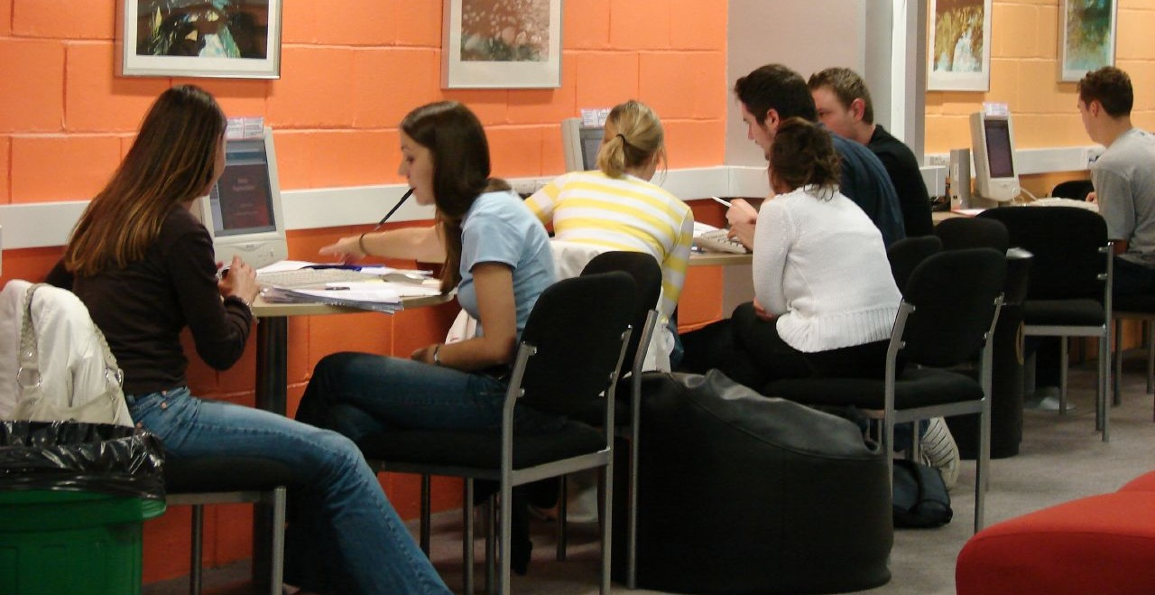
“My biggest concern is that the students aren't coming together…there's a hunger within our undergraduate student population to actually socialize. The library has always been that crossroads for campuses. It could serve in this capacity, pulling students together.”
(Provost Interviewee PP04, Research University, Secular, Public)
Notes:
Image: https://www.flickr.com/photos/jiscinfonet/291372743/ by Jisc infoNet / CC BY-NC-ND 2.0
“My biggest concern is that the students aren't coming together. The library can be that place, that nexus where students can come to study together. Yes, everything's posted online and they know they can do this alone, but there's a hunger within our undergraduate student population to actually socialize. The library has always been that crossroads for campuses. It could serve in this capacity, pulling students together.” (Provost Interviewee PP04, Research University, Secular, Public)

Slide 20
“Only sharing space, such as with a writing or computer lab is low level. There needs to be cooperative programming and interaction.”
(Advisory Group Member LM06, Research University, Secular, Public)
Notes:
Image: https://www.flickr.com/photos/ubclibrary/2702161578/ by UBC Library Communications / CC BY-NC-ND 2.0
“Only sharing space, such as with a writing or computer lab is low level. There needs to be cooperative programming and interaction.” (Advisory Group Member LM06, Research University, Secular, Public)

Slide 21
“The way many of our faculty and students research now, it’s less about going to a physical space but accessing information in their offices.…I think that that is one of the challenges of changing the paradigm.”
(Provost Interviewee PP13, Research University, Non-Secular, Private)
Notes:
Image: http://bit.ly/2m3H2uS (https://www.flickr.com/photos/rolexpv/9752688231/) by Raul Pacheco-Vega / CC BY-NC-ND 2.0
“For so long [librarians] have had a role of support rather than integration into work. Much more of a partnership rather than support as needed, so it’s proactive in its orientation rather than reactive. The way many of our faculty and students research now, it’s less about going to a physical space but accessing information in their offices. Trying to imagine a new way where it’s not just a service model, but it’s actually an integration and partnership model, I think that that is one of the challenges of changing the paradigm.” (Provost Interviewee PP13, Research University, Non-Secular, Private)
Provosts suggest the importance of collaborating with faculty and students, such as introducing a liaison program. As conveyed by one provost, it is very important for libraries to “establish themselves as a critical link or a critical piece” early on by having “intentional interventions” (e.g., in orientations, by going to classes or convincing instructors to bring classes to the libraries, online or on campus) (Provost Interviewee PP05). The goal of the library should be to go beyond its role as “a service body” and instead be integrated into the lives of its potential users (Provost Interviewee PP13).

Slide 22
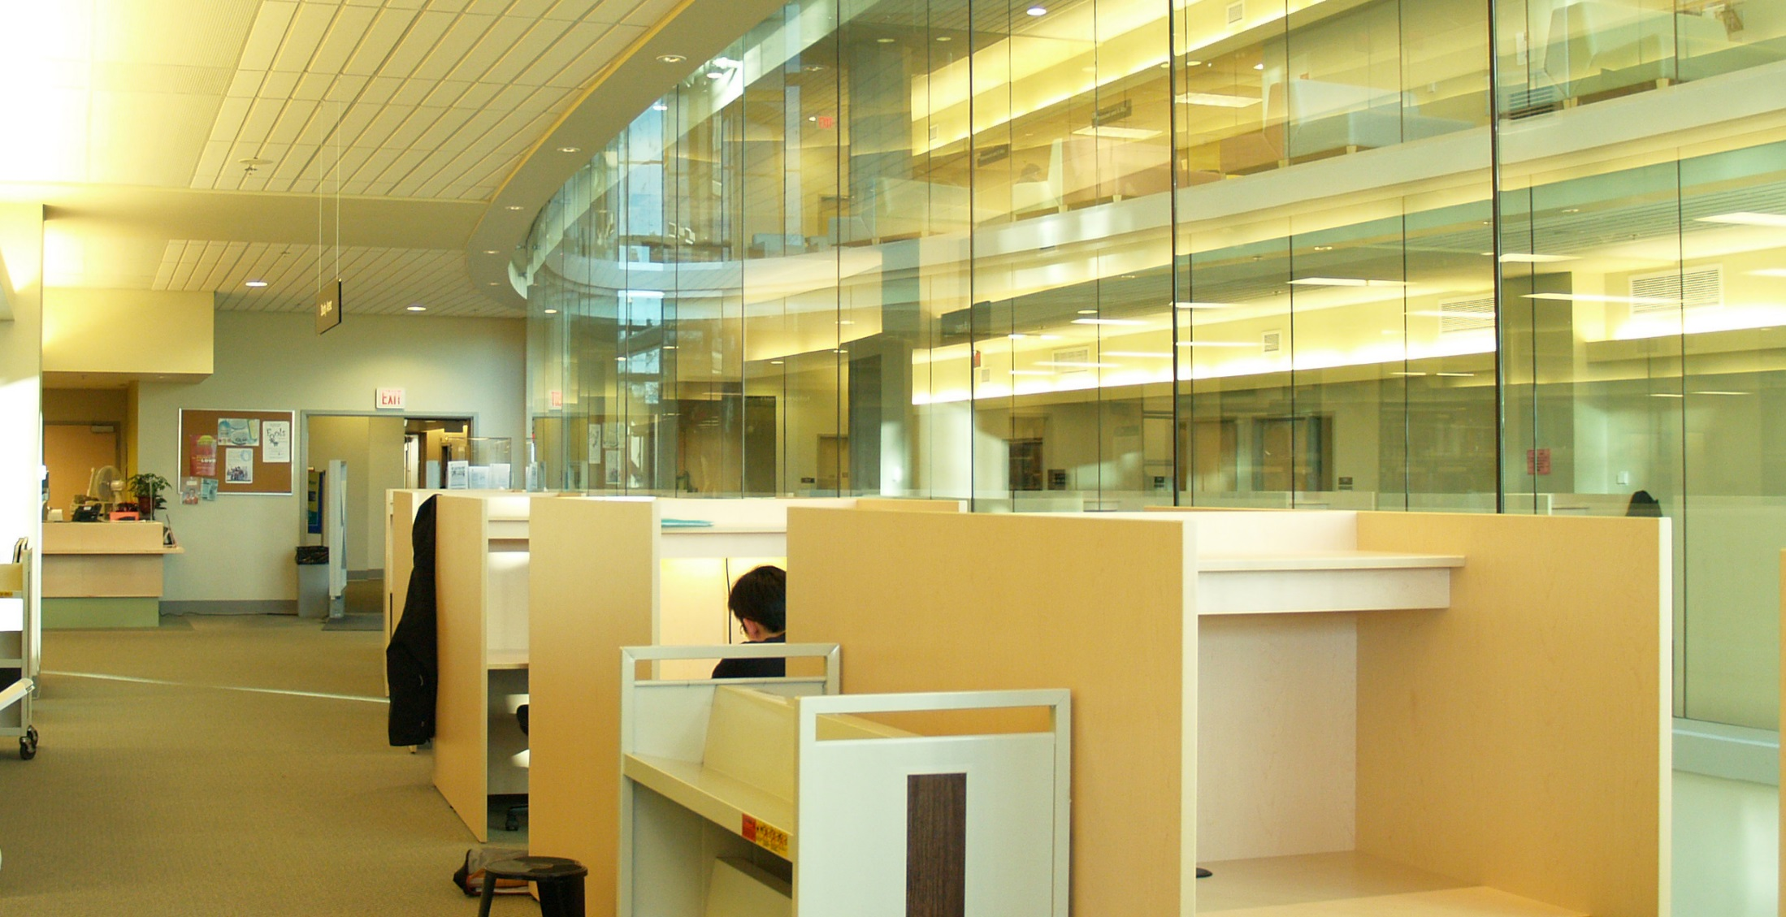
“…we have to be willing to do types of data collection that libraries have shied away from in the past.…I think that we have to be able to be willing to have conversations on campus about tracking user behavior in ways that libraries just haven't done.” (Advisory Group Member LM14, Research University, Secular, Public)
Notes:
Image: https://www.flickr.com/photos/ubclibrary/405901913/ by UBC Library Communication / CC BY-NC-ND 2.0
“To truly be able to look at, and be able to tell those stories, and to come up with those snippets of information that will resonate with other leaders, we have to be willing to do types of data collection that libraries have shied away from in the past. That involves tracking user behavior in a way that we've seen in a couple of the different studies that have looked at retention. There are ways of extrapolating and growing that out a little bit more so that we are dealing with large datasets, and we could...We could still keep it anonymous when we look at it in aggregate, right? I think that we have to be able to be willing to have conversations on campus about tracking user behavior in ways that libraries just haven't done.” (Advisory Group Member LM14, Research University, Secular, Public)
Privacy only was mentioned once, but is an important area of exploration. This topic is particularly fraught in the areas of assessment and academic libraries since there is a lack of established best practices and standards addressing the methods and contexts that may threaten the privacy of students. For this reason, privacy, when broadly defined, can be viewed by librarians in some instances as less of an ethics issue and more of an impediment, as articulated by the following participant [read quote].

Slide 23
Notes:
This slide depicts key differences in themes discussed by advisory focus group members versus provosts
Not a surprise that accreditation is not discussed by either. As Krisellen (Advisory Group Member LM07, Research University, Secular, Public) says “accreditation is just a task to be done.”
Key differences are:
Provosts discussed learning in college more than advisory group members
Provosts discussed space more than advisory group members
Advisory group members focused more on service than provosts
Advisory group members focused more on collaboration than provosts

Slide 24
Recommendation
Identify & articulate both learning & success outcomes
Engage students in redesigning library space to demonstrate library’s impact for learning outcome
Library resource or service usage & its relationship to student retention exemplifies the effect of library’s service, collection, &/or space for success outcome
Notes:
Image: https://www.flickr.com/photos/kimmanleyort/2130314519/ by Kim Manley Ort / CC BY-NC-ND 2.0
Based on these initial findings, we’ve come up with the following recommendations.

Slide 25
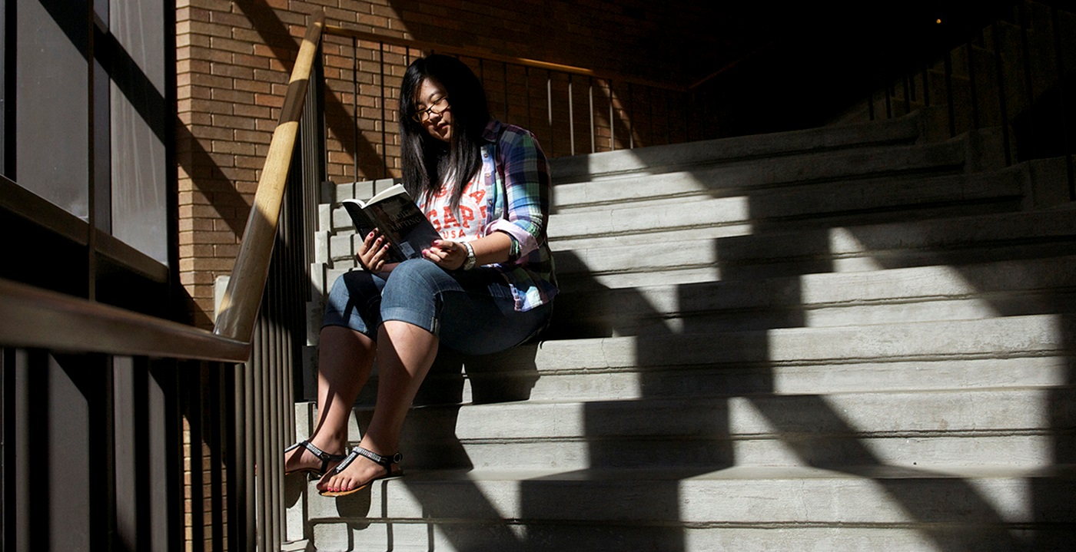
Recommendation
Focus less on service & more on sharing space & collaborative programming with groups both on & off campus
Notes:
Image: https://www.flickr.com/photos/illinoisspringfield/15681361005/ by Illinois Springfield / CC BY-NC-ND 2.0

Slide 26
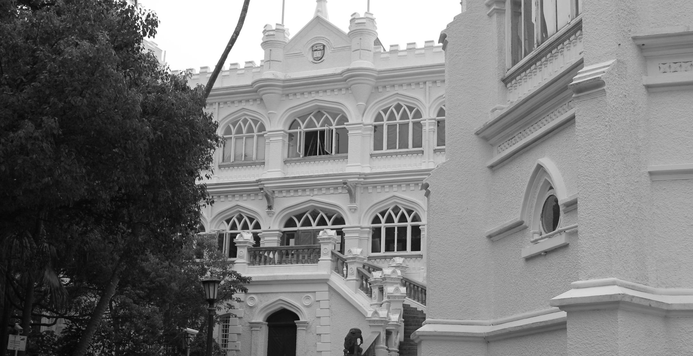
Recommendation
Bolster collaboration with other campus units or external partners, including consortia, on assessment-based efforts
Notes:
Image: https://www.flickr.com/photos/18378305@N00/8482645256/ by Can Pac Swire / CC BY-NC 2.0

Slide 27
Recommendation
Communicate how library services, collections, and spaces address the larger mission of the institution by becoming better at marketing & customer service
Notes:
Image: https://www.flickr.com/photos/edublogger/5119742141/ by Ewan McIntosh / CC BY-NC 2.0
Strategically align the student success goals and metrics with the Chancellors’/Presidents’ institutional priorities on student success.

Slide 28
Recommendation
Study the assessment & student-centered outcomes of diverse populations across various institutions using multiple methods
Notes:
Image: https://www.flickr.com/photos/kimberlykv/4495272217/ by Kimberly Vardeman / CC BY 2.0

Slide 29
Recommendation
Develop relationships within different academic service areas, such as teaching & learning, at various levels throughout institution
Notes:
Refers back to/is part of sharing space and developing collaborative programming

Slide 30
Recommendation
Continue to develop & foster relationships and engagement with academic administrators & other service providers, such as student services, offices of sponsored programs, teaching & learning, etc.
Notes:
Image: https://www.flickr.com/photos/goodimages/1448139556/ by Gianni / CC BY-NC-ND 2.0

Slide 31
Recommendation
Represent data in different contexts & visualizations to make case with diverse groups of academic administrators
Notes:
Image: https://www.flickr.com/photos/skinnylawyer/6337956175/ by InSapphoWeTrust / CC BY-SA 2.0

Slide 32
Priority Area
Communication
Communicate with those outside of library & at different levels within the institution
Can provide offer a bird’s eye view of what library should be doing
Can be advocates for & supporters of library
Notes:
Image: https://www.flickr.com/photos/wsl-libdev/20313732103/ by Washington State Library / CC BY-NC 2.0
The Priority Areas for future research are based on the findings of the selected literature review, the library administrator focus group interview, and the provost semi-structured individual interviews. These Priority Areas intentionally are broad to foster discussion and input from academic librarians and to include more specific research questions within each Priority Area.
The most important factor for identifying the Priority Areas was to discover which themes occurred most frequently in each data source. This was in response to the RFP, which specifically stated that the project would “Begin with a high level look at the trends in higher education that concern academic librarians in the broader context of academia and identify current academic library responses to the trends.” Individual library responses, such as information literacy instruction and data analytics were not included in the codebook. Therefore, it should be noted that while library response (collection, service, space) was coded as a theme, these codes were not included within the count of the top five themes since each Priority Area addresses a theme across all three responses.
Per the RFP, which asked for between 5-10 priority areas, six were addressed, which will now be overviewed. We will also briefly discuss an exemplar study for each area, and identify best practices related to the area.
The importance of communication was identified in the RFP and in the project plan, and was one of the main reasons for the creation of the Advisory Group. It provided the opportunity for library administrators to connect with provosts at their institutions and provide data on how librarians can communicate the value the library brings to the academic community. As a theme, its definition was: “Librarians communicate impact or other aspects of value with stakeholders.” However, only three studies published since 2000 have looked at how administrators perceive the library and its collections, spaces, and services. An earlier study from 2007 found that according to multiple administrators at six American universities, the library’s symbolic role as the heart of the university was outweighed by its practical role, through which it needed to “connect what it does to the values and mission of the university.” A later study of nine Canadian provosts found that the participants most valued information access provided by the library and envisioned the library evolving into more of a learning space. The study the team identified as exemplar is Fister's (2010) survey of 134 administrators, which covered the highest number of themes (n=11) and received the highest score of all the studies (17 points).
Fister, Barbara. “Critical Assets: Academic Libraries, A View from the Administration Building.” Library Journal 135, no. 8 (2010): 24–27.

Slide 33
Priority Area
2. Collaboration
Understand different types & levels of collaboration & consider reviewing literature from related fields to see what is said about libraries & common ground
Work with academic administrators, academic services, faculty, students, alumni, & other members of regional & local communities.
Notes:
Collaboration is an important theme because of the academic library’s primary mission as a research and teaching support unit. The AiA projects also explicitly required librarians to collaborate with at least two other people outside the libraries. As a theme, its definition was: “Librarians work with other institutional departments to influence student outcomes or with other institutions.” The 2015 study by Hess, Greer, Lombardo, and Lim at Oakland University Libraries is exemplary because it documents the libraries’ efforts to collaborate with other departments in support of student success and persistence. Their documented and suggested collaborations cover a wide range of services and collections. Another notable collaboration was between Wolfe, who is an Assistant Professor in the Behavioral and Social Sciences at Hostos Community College (CUNY), who published the results of a study that incorporated information literacy into a class assignment in a higher education journal, and was one of the highest scoring research documents from the higher education databases.
Hess, Amanda Nichols. 2015. “Equipping Academic Librarians to Integrate the Framework into Instructional Practices: A Theoretical Application.” Journal of Academic Librarianship 41, no. 6: 771–76. doi:10.1016/j.acalib.2015.08.017.
Wolfe, Kate S. 2015. “Emerging Information Literacy and Research-Method Competencies in Urban Community College Psychology Students.” The Community College Enterprise 21, no. 2: 93–99.

Slide 34
Priority Area
3. Mission Strategy & Alignment
Go outside of library to collect data & seek possible collaborators for common issues
Inform students, faculty, & administrators of how the academic library contributes to the institutional mission and goals.
Achieving this connection & communicating it to academic community are critical for integrating the library into the life of the university
Notes:
Image: https://www.flickr.com/photos/parksdh/11340519505/ by Daniel Parks / CC BY-NC 2.0
The definition for this theme was: “Institutionally-identified student outcomes (can be co-coded with learning and success).” It appeared in the top five themes in the Advisory Group’s focus group interview and the provosts’ semi-structured individual interviews, but it was the seventh most common theme in the literature. Moreover, there was a statistically significant difference in the number it was reported in theoretical documents compared to research documents, which means that it likely is being discussed more than being empirically tested. Lombard’s 2012 study at Gannon University had a short write up, but was exemplar in several ways, which led to its relatively high score. First, it looked at the library’s influence on recruitment, which has been studied in higher education research documents addressing student outcomes, but rarely appears in library research documents. The data collection method also was interesting because the survey was posted on various non-library online spaces, meaning that it may have tapped into those who do not use the library. It also collected and analyzed qualitative data from interviews with fourteen admissions professionals from various institutions and, based on survey and interview findings, makes suggestions for ways librarians can collaborate with admissions departments.
Lombard, Emmett. 2012. “The Role of the Academic Library in College Choice.” Journal of Academic Librarianship 38, no. 4: 237-241.

Slide 35
Priority Area
4. Teaching & Learning
Engage with faculty & students for librarian inclusion in developing academic & everyday life support services for students
Develop educated & informed citizens
Notes:
Image: https://www.flickr.com/photos/cogdog/2555280926/ by Alan Levine / CC0 1.0 Universal (CC0 1.0)
This area also builds on the first two Priority Areas, communication and collaboration.
The definition for this theme was: “Outcome was focused on the less objective concepts of learning, such as critical thinking. Usually not tied to a specific graded assignment or graduation.” In contrast with student success, the code was used for identifying the less tangible or indirect effect of the library on students. Brown-Sica's 2013 study of space redesign at Auraria Library offers one way for various groups to provide multiple types of input and otherwise engage with the library. The Auraria Library serves the University of Colorado Denver, the Metropolitan State College of Denver, and the Community College of Denver. Students were involved in all stages of the study, from formulating the questions to ask, analyzing the data, and offering suggestions based on the results. This study was a high scoring example of learning in college because although not tied to an objective outcome, such as student retention or GPA, this study gave students a voice in the project and facilitated unexpected collaborations with faculty. It also touched on library space, which was a library response that was mentioned by the provosts that was not mentioned as often by librarians.
Brown-Sica, Margaret. 2013. “Using Academic Courses to Generate Data for Use in Evidence Based Library Planning.” Journal of Academic Librarianship 39, no. 3: 275–87. doi:10.1016/j.acalib.2013.01.001.

Slide 36
Priority Area
5. Student Success
Identify quantifiable student attainment indicators
Enrollment in postsecondary education
Grades
Persistence to the sophomore year
Length of time to degree & graduation
Work with academic services & faculty
Develop data collection & reporting methods that retain student privacy & confidentiality

Slide 37
How do academic library resource or services impact success outcomes for students?
How do library collections impact student retention for undergraduate students?
How do library spaces support student enrollment?
How does library instruction affect post-graduate metrics such as job placement?
Research Questions
Notes:
Image: http://bit.ly/2msQ06a (https://www.flickr.com/photos/governordayton/5572098001/) by Governor Mark Dayton / CC BY 2.0
For each priority area, we are creating research questions to address each priority area. These questions are informed by our data. I will show some examples of research questions for the Student Success theme. Each high-level question is more general, while the sub-questions beneath them offer suggestions for how librarians can tailor these questions to their institutions and needs.
Italicized items signify a key high-level themes indexed by the visualization tool, while underlined words are detected by a keyword search using the tool.

Slide 38
How do academic library resources or services impact success outcomes for different students?
What difference in information literacy tests do graduate & undergraduate students exhibit?
How do military students benefit from library instruction?
Research Questions
Notes:
Image link: http://bit.ly/2mdCT8p
For each priority area, we are creating research questions to address each priority area. These questions are informed by our data. I will show some examples of research questions for the Student Success theme. Each high-level question is more general, while the sub-questions beneath them offer suggestions for how librarians can tailor these questions to their institutions and needs.
Italicized items signify a key high-level themes indexed by the visualization tool, while underlined words are detected by a keyword search using the tool.

Slide 39
What outcome data do other departments/units in different institution types collect?
What student persistence data do tutoring centers in 4-year colleges collect?
What student success & library instruction data do community college libraries collect?
Research Questions
Notes:
For each priority area, we are creating research questions to address each priority area. These questions are informed by our data. I will show some examples of research questions for the Student Success theme. Each high-level question is more general, while the sub-questions beneath them offer suggestions for how librarians can tailor these questions to their institutions and needs.
Italicized items signify a key high-level themes indexed by the visualization tool, while underlined words are detected by a keyword search using the tool.

Slide 40
Research Questions
How have librarians ethically collected student outcome & library resource or service data? (Question cross listed with learning analytics)
How have other librarians collected student GPA & library usage data?
Notes:
Image: https://www.flickr.com/photos/queenslanduniversityoftechnology/11831068653/ by Queensland University of Technology (QUT) / CC BY-NC 2.0
For each priority area, we are creating research questions to address each priority area. These questions are informed by our data. I will show some examples of research questions for the Student Success theme. Each high-level question is more general, while the sub-questions beneath them offer suggestions for how librarians can tailor these questions to their institutions and needs.
Italicized items signify a key high-level themes indexed by the visualization tool, while underlined words are detected by a keyword search using the tool.

Slide 41
Priority Area
6. Learning analytics
Measure, collect, analyze & report “data about learners and their contexts, for purposes of understanding and optimizing learning and the environments in which it occurs.”
Include library data with institutionally collected data to predict student success
(Jantti and Heath 2016)
Notes:
Image: https://www.flickr.com/photos/13523064@N03/7807957322/ by llee_wu / CC BY-ND 2.0
Although learning analytics did not have its own thematic code, it was identified as being an important area in documents such as ACRL’s top trends in academic libraries and ACRL initiatives, such as the e-Learning Webcast Series on Learning Analytics. Jantti and Heath’s 2016 study describes the use of learning analytics at the University of Wollongong in Australia. In addition to collecting library related data in a repository called the Library Cube, this library collects and analyzes more sources of institutional data than any other. These data sets come from course management software called Moodle, student administration, tutorials, and student support service usage data.
Jantti, Margie, and Jennifer Heath. 2016. “What Role for Libraries in Learning Analytics?” Performance Measurement and Metrics 17, no. 2: 203-210.

Slide 42
VISUALIZATION DASHBOARD

Slide 43
Interactive Visualization Dashboard
Find literature relevant to your research interests
Create charts and graphs
Notes:
Image: https://www.flickr.com/photos/markleepower/7962282652/ by Mark Power / CC BY-NC-ND 2.0
We have developed an interactive visualization dashboard to help librarians filter the existing literature for studies most relevant to their research interests. A second visualization tool will help librarians communicate their value to their constituencies and may allow entry of local data to produce a graphic that could be shared with stakeholders.
The dashboard has two primary components: A literature search tool, and charts and graphs tool.

Slide 44
Charts and graphs tool
Notes:
The “Charts and Graphs” tool allows us to visualize data. Currently it allows exploration of the document database for this project, but has been designed to support arbitrary tabular data (upcoming feature).

Slide 45
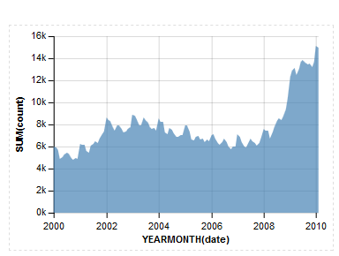
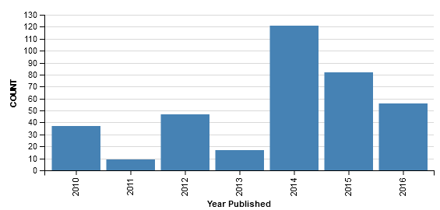
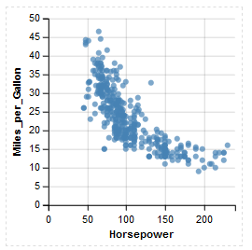
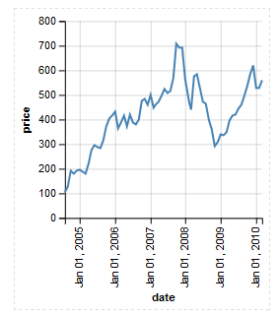
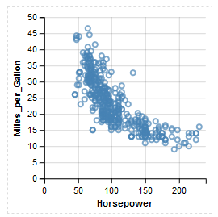
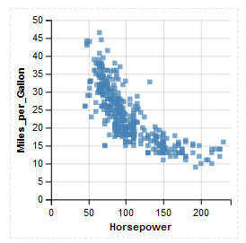
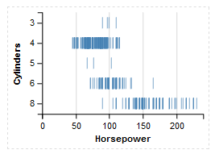
Notes:
…Area, Bar, Point, Line, Circle, Square, and Tick.

Slide 46
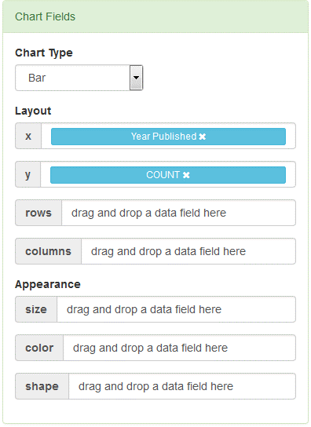
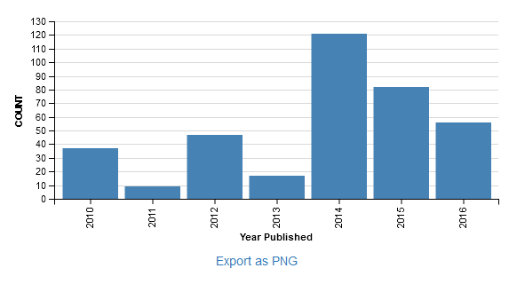
Notes:
When you have built your chart, you can use “Export as PNG” to save it as a graphic…

Slide 47
Notes:
…or you can choose the “Save My Work” button to save your chart so you can edit it later.

Slide 48
Available for Use & Comment
Public Release May 23, 2017
Accessible from:
http://www.oclc.org/research/themes/user-studies/acrl-agenda.html
Notes:
When the dashboard is publicly released, you will be able to access it via this URL.

Slide 49
Next Steps
May 2017
Release full report & research agenda
June 2017
ACRL Open Online Forum
ALA 2017 Annual Conference presentation
Notes:
Image: https://www.flickr.com/photos/courtneymcgough/9211901056/ by Courtney McGough / CC BY-NC-ND 2.0

Slide 50
I thank the following people for their contributions to this project:
Vanessa Kitzie, Rutgers University
Stephanie Mikitish, Rutgers University
William Harvey, OCLC
Erin M. Hood, OCLC
Brittany Brannon, OCLC
Marie L. Radford, Rutgers University
ACRL Board
ACRL VAL Committee
Advisory Group Members
Notes:
Image: https://www.flickr.com/photos/epicfireworks/8058678846/ by Epic Fireworks / CC BY 2.0

Slide 51
References
Association of College and Research Libraries. 2010. Value of Academic Libraries: A Comprehensive Research Review and Report. Researched by Megan Oakleaf. Chicago: Association of College and Research Libraries. http://www.ala.org/acrl/sites/ala.org.acrl/files/content/issues/value/val_report.pdf.
Baker, Simon. 2017. "Fact Check: are England’s Universities ‘Swimming in Cash’?" Times Higher Education, March 2, https://www.timeshighereducation.com/news/fact-check-are-englands-universities-swimming-cash.
Baker, Simon. 2017. "Risks of Post-Brexit 'Brain Drain' Highlighted." Times Higher Education, February 23, https://www.timeshighereducation.com/news/dont-be-angst-ridden-over-brexit-divide-communities-v-c.
Basken, Paul. 2017. “Cybersecurity, Rising.” The Chronicle of Higher Education, February 26, http://www.chronicle.com/article/Cybersecurity-Rising/239270?cid=cp95.
Biemiller, Lawrence. 2017. “Reckoning with History.” The Chronicle of Higher Education, February 26, http://www.chronicle.com/article/Reckoning-With-History/239291?cid=cp95.
Brown, Sarah. 2017. “Activist Athletes.” The Chronicle of Higher Education, February 26, http://www.chronicle.com/article/Activist-Athletes/239300?cid=cp95.

Slide 52
References
Brown, Sarah. 2017. “Title IX Due Process.” The Chronicle of Higher Education, February 26, http://www.chronicle.com/article/Title-IX-Due-Process/239282?cid=cp95.
Brown-Sica, Margaret. 2013. “Using Academic Courses to Generate Data for Use in Evidence Based Library Planning.” Journal of Academic Librarianship 39, no. 3: 275–87. doi:10.1016/j.acalib.2013.01.001.
The Chronicle of Higher Education. 2017. The Trends Report, March 3, Special Report, http://www.chronicle.com/specialreport/The-2017-Trends-Report/95.
Elmes, John. 2017. "Nine Out of 10 Universities 'Restrict Free Speech.'" Times Higher Education, February 11, https://www.timeshighereducation.com/news/spiked-nine-out-10-uk-universities-restrict-free-speech.
Elmes, John. 2017. " Six Significant Challenges for Technology in Higher Education in 2017." Times Higher Education, February 16, https://www.timeshighereducation.com/features/six-significant-challenges-technology-higher-education-2017.
Elmes, John, and John Morgan.2017. "Don't Be 'Angst-Ridden' Over Brexit-Divide:V-C." Times Higher Education, February 24, https://www.timeshighereducation.com/news/dont-be-angst-ridden-over-brexit-divide-communities-v-c.

Slide 53
References
Field, Kelly. 2017. “Safety Net.” The Chronicle of Higher Education, February 26, http://www.chronicle.com/article/Safety-Net/239295?cid=cp95.
Fister, Barbara. “Critical Assets: Academic Libraries, A View from the Administration Building.” Library Journal 135, no. 8 (2010): 24–27.
Hess, Amanda Nichols. 2015. “Equipping Academic Librarians to Integrate the Framework into Instructional Practices: A Theoretical Application.” Journal of Academic Librarianship 41, no. 6: 771–76. doi:10.1016/j.acalib.2015.08.017.
Hoover, Eric. 2017. “Defending Diversity.” The Chronicle of Higher Education, February 26, http://www.chronicle.com/article/Defending-Diversity/239275?cid=cp95.
Jantti, Margie, and Jennifer Heath. 2016. “What Role for Libraries in Learning Analytics?” Performance Measurement and Metrics 17, no. 2: 203-210.
Kelderman, Eric. 2017. “Sanctuary Campus.” The Chronicle of Higher Education, February 26, http://www.chronicle.com/article/Sanctuary-Campus/239289?cid=cp95.

Slide 54
References
Lombard, Emmett. 2012. “The Role of the Academic Library in College Choice.” Journal of Academic Librarianship 38, no. 4: 237-241.
Mangan, Katherine. 2017. “Cultural Divide.” The Chronicle of Higher Education, February 26, http://www.chronicle.com/article/Cultural-Divide/239276?cid=cp95.
Morgan, John. 2017. "Campus Culture Wars Over‘Anti-right Bias’ Threaten to Spread." Times Higher Education, March 2, 2017, https://www.timeshighereducation.com/news/campus-culture-wars-over-anti-right-bias-threaten-to-spread.
Najmabadi, Shannon. 2017. “Information Literacy: It’s Become a Priority in an Era of Fake News.” The Chronicle of Higher Education, February 26, http://www.chronicle.com/article/Information-Literacy/239264?cid=cp95.
Wilson, Robin. 2017. “Harassment Vigilance.” The Chronicle of Higher Education, February 26, http://www.chronicle.com/article/Harassment-Vigilance/239278?cid=cp95.
Wolfe, Kate S. 2015. “Emerging Information Literacy and Research-Method Competencies in Urban Community College Psychology Students.” The Community College Enterprise 21, no. 2: 93–99.

Slide 55
Image Attributions
Slide 5: Image: https://www.flickr.com/photos/conchur/525596627/ by Conor Lawless / CC BY 2.0
Slide 7: Image: https://www.flickr.com/photos/beta500/97819986/ by Cody Geary / CC BY-NC-ND 2.0
Slide 10: Image: https://www.flickr.com/photos/ryan_fung/2203561517/ by Ryan Fung / CC BY-SA 2.0
Slide 12: Image: https://www.flickr.com/photos/aditchandra/356955388/ by adit Chandra / CC BY-NC 2.0
Slide 13: Image: https://www.flickr.com/photos/mxmstryo/3507201141/ by mxmstryo / CC BY 2.0
Slide 14: Image: https://www.flickr.com/photos/smiling_da_vinci/14785644/ by Eelco / CC BY-NC 2.0
Slide 16: Image: https://www.flickr.com/photos/criminalintent/5403052781/ by Lars Plougmann / CC BY-SA 2.0
Slide 17: Image: http://bit.ly/2l8fAwO (https://www.flickr.com/photos/napafloma-pictures/16081970310/) by Patrick BAUDUIN / CC BY-NC-ND 2.0
Slide 18: Image: https://www.flickr.com/photos/ydhsu/7284859854/ by Daniel / CC BY-NC 2.0
Slide 19: Image: https://www.flickr.com/photos/jiscinfonet/291372743/ by Jisc infoNet / CC BY-NC-ND 2.0
Slide 20: Image: https://www.flickr.com/photos/ubclibrary/2702161578/ by UBC Library Communications / CC BY-NC-ND 2.0

Slide 56
Image Attributions
Slide 21: Image: http://bit.ly/2m3H2uS (https://www.flickr.com/photos/rolexpv/9752688231/) by Raul Pacheco-Vega / CC BY-NC-ND 2.0
Slide 22: Image: https://www.flickr.com/photos/ubclibrary/405901913/ by UBC Library Communication / CC BY-NC-ND 2.0
Slide 24: Image: https://www.flickr.com/photos/kimmanleyort/2130314519/ by Kim Manley Ort / CC BY-NC-ND 2.0
Slide 25: Image: https://www.flickr.com/photos/illinoisspringfield/15681361005/ by Illinois Springfield / CC BY-NC-ND 2.0
Slide 26: Image: https://www.flickr.com/photos/18378305@N00/8482645256/ by Can Pac Swire / CC BY-NC 2.0
Slide 27: Image: https://www.flickr.com/photos/edublogger/5119742141/ by Ewan McIntosh / CC BY-NC 2.0
Slide 28: Image: https://www.flickr.com/photos/kimberlykv/4495272217/ by Kimberly Vardeman / CC BY 2.0
Slide 30: Image: https://www.flickr.com/photos/goodimages/1448139556/ by Gianni / CC BY-NC-ND 2.0
Slide 31: Image: https://www.flickr.com/photos/skinnylawyer/6337956175/ by InSapphoWeTrust / CC BY-SA 2.0
Slide 32: Image: https://www.flickr.com/photos/wsl-libdev/20313732103/ by Washington State Library / CC BY-NC 2.0

Slide 57
Image Attributions
Slide 34: Image: https://www.flickr.com/photos/parksdh/11340519505/ by Daniel Parks / CC BY-NC 2.0
Slide 35: Image: https://www.flickr.com/photos/cogdog/2555280926/ by Alan Levine / CC0 1.0 Universal (CC0 1.0)
Slide 37: Image: http://bit.ly/2msQ06a (https://www.flickr.com/photos/governordayton/5572098001/) by Governor Mark Dayton / CC BY 2.0
Slide 40: Image: https://www.flickr.com/photos/queenslanduniversityoftechnology/11831068653/ by Queensland University of Technology (QUT) / CC BY-NC 2.0
Slide 41: Image: https://www.flickr.com/photos/13523064@N03/7807957322/ by llee_wu / CC BY-ND 2.0
Slide 43: Image: https://www.flickr.com/photos/markleepower/7962282652/ by Mark Power / CC BY-NC-ND 2.0
Slide 49: Image: https://www.flickr.com/photos/courtneymcgough/9211901056/ by Courtney McGough / CC BY-NC-ND 2.0
Slide 50: Image: https://www.flickr.com/photos/epicfireworks/8058678846/ by Epic Fireworks / CC BY 2.0
Slide 55: Image: https://www.flickr.com/photos/noarau/5540659743/ by Thomas Rusling / CC BY-NC-ND 2.0

Slide 58
Discussion & Questions
Notes:
Image: https://www.flickr.com/photos/noarau/5540659743/ by Thomas Rusling / CC BY-NC-ND 2.0

