Slide 1
Update on Value of Academic Libraries Initiative
Alan Carbery
Lynn Siligpigni Connaway
Sara Goek

Slide 2

http://www.ala.org/acrl/membership/volunteer/volunteer

Slide 3


Slide 4

The Value of Academic Libraries by Megan Oakleaf
published in 2010
PDF: acrl.org/value

Slide 5
Connect, collaborate, and communicate:
a report from the Value of Academic Libraries Summits
ACRL 2012 white-paper

Slide 6
IMLS-funded 14-month professional development program that ran for 3 cycles, with over 200 library teams.
http://www.ala.org/acrl/AiA

Slide 7

Call for Proposals for a new action-oriented research agenda on library contributions to student learning & success

Slide 8
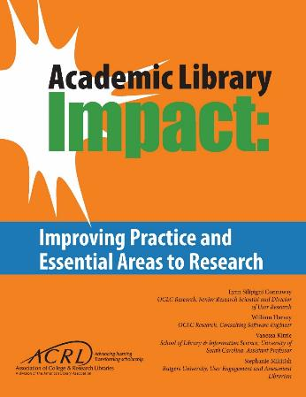
Free pdf online acrl.org/value
– or –
Purchase print from ALA Store www.alastore.ala.org

Slide 9
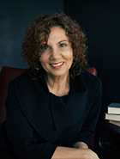

Lynn Silipigni Connaway
OCLC Research Senior Research Scientist and Director of User Research

Slide 10
Data Collection
Three data sources
Iterative process
  Advisory group
  Literature review
  Provost interviews
Individual Interviews with Provosts
Selected Literature
Focus Group Interview & Feedback from Advisory Group
Notes:
This slide depicts three data sources:
Selected literature on student learning and success identified in the RFP and documents found in LIS and higher education databases
Focus group with Advisory Group Members
Consist of library administrators from a variety of community colleges, 4 year colleges and universities around the country
Members provide us feedback throughout the process and put us in touch with provosts or similarly high level academic administrators in their institutions
Individual, semi-structured interviews with provosts from each Advisory Group member’s institution
Process of data collection is iterative, with findings from each source informing the other
E.g., focus group and provost interview protocol was based on the themes that we identified in the initial database searches

Slide 11
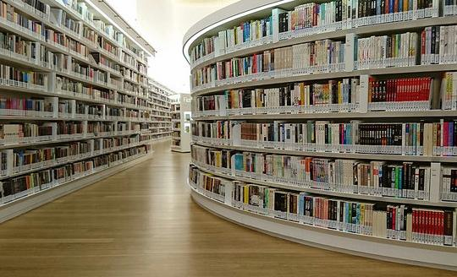
Literature Selection
Indexed by LIS &/or higher ed databases
2010-2016
Themes in 2010 VAL Report
Published in US
Notes:
Image: “library@orchard DSC_3630” (https://www.flickr.com/photos/benhosg/32627578042), by Benjamin Ho, used under CC BY-NC-ND 2.0
Selection criteria are: 1) indexed by LIS and/or higher education databases or identified by the project team or ACRL (e.g., ACRL Assessment in Action (AiA) studies, Ithaka S+R surveys, see Relevant ACRL Documents section), 2) published between 2010-2016, 3) contained themes identified in the 2010 VAL Report, and 4) published in the US, except for studies outside the US deemed relevant by the project team
Association of College and Research Libraries. (2010). Value of Academic Libraries: A Comprehensive Research Review and Report, researched by Megan Oakleaf. Chicago, IL: Association of College and Research Libraries. Retrieved from: http://www.ala.org/acrl/sites/ala.org.acrl/files/content/issues/value/val_report.pdf

Slide 12
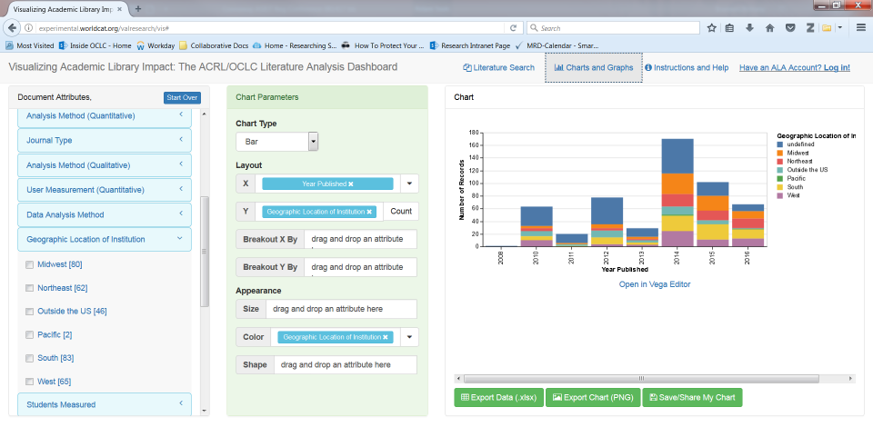
Visualization Dashboard
Notes:
Visualization tool containing all of the literature analyzed

Slide 13
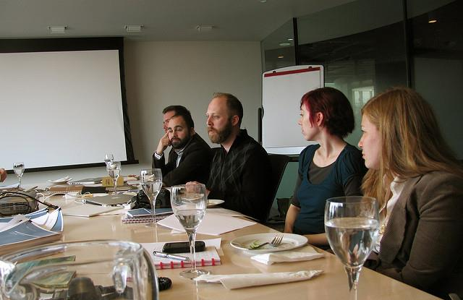
Focus group interviews
N=14 (of 14)
90 minutes
Transcribed
NVivo for analysis
Thematic coding scheme
  One team member coded, another checked
Notes:
Image: “Meeting” (https://www.flickr.com/photos/zeldman/4409704728/), by Jeffrey Zeldman, used under CC BY-NC-ND 2.0
Next, we will examine which findings from the content analysis resonate with practicing librarians in higher education
Based on focus group interviews with 11 advisory group members; the other three were unable to meet and were sent focus group questions that they completed. The responses to these questions were included in analysis
Coded transcripts in Nvivo using thematic coding scheme, allowing for inductive categories to be pulled from the data
Another team member checked the codes

Slide 14
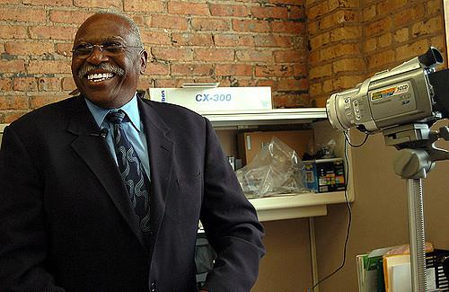
Provost individual interviews
N = 14 provosts (of 14)
45 minute average
Transcribed (9 of 14)
Detailed interview notes
(5 of 14)
NVivo for analysis
Thematic coding scheme
  One team member coded, another checked
Notes:
Image: “interview” (https://www.flickr.com/photos/vickiwolkinsphotography/270985453/), by Vicki Wolkins, used under CC BY-NC-ND 2.0
Three team members interviewed the provosts on the phone and recorded the interviews. Nine of the fourteen interviews were transcribed. The other five were deemed to have low sound quality, so team members took in-depth notes and recorded juicy quotes.

Slide 15
Notes:
Themes most discussed in the selected documents are:
Service (n=377, 70%)
Collaboration (n=321, 60%)
Learning in college (n=308, 58%)
Focus group interview participants most often discussed:
Communication (20%, n=54)
Collaboration (17%, n=46)
Service (16%, n=44)
Themes discussed most by provosts were:
Communication (17%, n=199)
Institutional planning (14%, n=159)
Learning in college (11%, n=129)

Slide 16
Notes:
This slide depicts key differences in themes discussed by advisory focus group members versus provosts
Not a surprise that accreditation is not discussed by either. As Krisellen (Advisory Group Member LM07, Research University, Secular, Public) says “accreditation is just a task to be done.”
Key differences are:
Provosts discussed learning in college more than advisory group members
Provosts discussed space more than advisory group members
Advisory group members focused more on service than provosts
Advisory group members focused more on collaboration than provosts

Slide 17

Language Differences
Librarians use “service”
Provosts use more specific terms
  Teaching & learning
  Customer service
  Space
Notes:
Image: “Green Apple” (https://www.flickr.com/photos/prince_tigereye/5290630847/), by Raj, used under CC BY 2.0
Mikitish, Stephanie, Vanessa Kitzie, and Lynn Silipigni Connaway. (forthcoming). “Assessing for Alignment: How to Win Collaborators and Influence Stakeholders.” In Shaping the Campus Conversation on Student Learning and Experience: Activating the Results of Assessment in Action, edited by Kara Malenfant, Karen Brown, Deb Gilchrist, Lisa Hinchliffe, Chase Ollis, and Allison Payne.

Slide 18
PRIORITY AREAS

Slide 19

Priority Areas
Communication
Collaboration
Mission strategy & alignment
Teaching & learning
Student success
Learning analytics
Notes:
Image: “asterdetail” (https://www.flickr.com/photos/vizpix/8063474709), by naturalflow, used under CC BY-SA 2.0
Analysis of all three data sources informed the identification of six priority areas for future research.
Communication: Communicate with those outside of library & at different levels within the institution
Collaboration: Understand different types & levels of collaboration & consider reviewing literature from related fields to see what is said about libraries & common ground
Mission strategy & alignment: Go outside of library to collect data & seek possible collaborators for common issues; Inform students, faculty, & administrators of how the academic library contributes to the institutional mission and goals.
Teaching & learning: Engage with faculty & students for librarian inclusion in developing academic & everyday life support services for students; Develop educated & informed citizens
Student success: Identify quantifiable student attainment indicators; Work with academic services and faculty
Learning analytics: Measure, collect, analyze & report “data about learners and their contexts, for purposes of understanding and optimizing learning and the environments in which it occurs.” ; Include library data with institutionally collected data to predict student success
Brown-Sica, Margaret. “Using Academic Courses to Generate Data for Use in Evidence Based Library Planning.” Journal of Academic Librarianship 39, no. 3 (2013): 275–87. doi:10.1016/j.acalib.2013.01.001.
Fister, Barbara. “Critical Assets: Academic Libraries, A View from the Administration Building.” Library Journal 135, no. 8 (2010): 24–27.
Hess, Amanda Nichols. “Equipping Academic Librarians to Integrate the Framework into Instructional Practices: A Theoretical Application.” Journal of Academic Librarianship 41, no. 6 (2015): 771–76. doi:10.1016/j.acalib.2015.08.017.
Jantti, M. and Heath, J. (2016). What role for libraries in learning analytics? Performance Measurement and Metrics 17(2), 203-210.
Lombard, E. (2012). The role of the academic library in college choice. Journal of Academic Librarianship 38(4), 237–41.

Slide 20
Communication
Communicate with those outside of library & at different levels within the institution
  Can provide a bird’s eye view of what library should be doing
  Can be advocates for & supporters of library
Notes:
The Priority Areas for future research are based on the findings of the selected literature review, the library administrator focus group interview, and the provost semi-structured individual interviews. These Priority Areas intentionally are broad to foster discussion and input from academic librarians and to include more specific research questions within each Priority Area.
The most important factor for identifying the Priority Areas was to discover which themes occurred most frequently in each data source. This was in response to the RFP, which specifically stated that the project would “Begin with a high level look at the trends in higher education that concern academic librarians in the broader context of academia and identify current academic library responses to the trends.” Individual library responses, such as information literacy instruction and data analytics were not included in the codebook. Therefore, it should be noted that while library response (collection, service, space) was coded as a theme, these codes were not included within the count of the top five themes since each Priority Area addresses a theme across all three responses.
Per the RFP, which asked for between 5-10 priority areas, six were addressed, which will now be overviewed. We will also briefly discuss an exemplar study for each area, and identify best practices related to the area.
The importance of communication was identified in the RFP and in the project plan, and was one of the main reasons for the creation of the Advisory Group. It provided the opportunity for library administrators to connect with provosts at their institutions and provide data on how librarians can communicate the value the library brings to the academic community. As a theme, its definition was: “Librarians communicate impact or other aspects of value with stakeholders.” However, only three studies published since 2000 have looked at how administrators perceive the library and its collections, spaces, and services. An earlier study from 2007 found that according to multiple administrators at six American universities, the library’s symbolic role as the heart of the university was outweighed by its practical role, through which it needed to “connect what it does to the values and mission of the university.” A later study of nine Canadian provosts found that the participants most valued information access provided by the library and envisioned the library evolving into more of a learning space. The study the team identified as exemplar is Fister's (2010) survey of 134 administrators, which covered the highest number of themes (n=11) and received the highest score of all the studies (17 points).
Fister, Barbara. “Critical Assets: Academic Libraries, A View from the Administration Building.” Library Journal 135, no. 8 (2010): 24–27.

Slide 21

Sample Research Questions
How can library administrators and staff communicate their contributions to student outcomes more effectively with institutional stakeholders (e.g., administrators)?
To what extent do institutional stakeholders recognize library administrators’ and staff ’s contributions to teaching and learning? What factors affect levels of recognition?
Notes:
Image: “Free to use texture/background” (https://www.flickr.com/photos/28481088@N00/12793759334/) by tanakawho, used under CC BY 2.0
Association of College and Research Libraries. Academic Library Impact: Improving Practice and Essential Areas to Research. Prepared by Lynn Silipigni Connaway, William Harvey, Vanessa Kitzie, and Stephanie Mikitish of OCLC Research. Chicago: Association of College and Research Libraries, 2017.

Slide 22

Exemplary Study
Fister, Barbara. “Critical Assets: Academic Libraries, A View from the Administration Building.” Library Journal 135, no. 8 (2010): 24–27.
Notes:
Image: “Free to use texture/background” (https://www.flickr.com/photos/28481088@N00/12793759334/) by tanakawho, used under CC BY 2.0
“The third study we identified as exemplary is Fister’s survey of 134 administrators, which covered the highest number of themes (n=11) and received the highest score of all the studies using the scoring system explained in Appendix K: Detailed Scoring Scheme for Exemplary Research Designs and Practices (17 points).”
Association of College and Research Libraries. Academic Library Impact: Improving Practice and Essential Areas to Research. Prepared by Lynn Silipigni Connaway, William Harvey, Vanessa Kitzie, and Stephanie Mikitish of OCLC Research. Chicago: Association of College and Research Libraries, 2017.

Slide 23
Collaboration
Understand different types & levels of collaboration & consider reviewing literature from related fields to see what is said about libraries & common ground
  Work with academic administrators, academic services, faculty, students, alumni, & other members of regional & local communities.
Notes:
Collaboration is an important theme because of the academic library’s primary mission as a research and teaching support unit. The AiA projects also explicitly required librarians to collaborate with at least two other people outside the libraries. As a theme, its definition was: “Librarians work with other institutional departments to influence student outcomes or with other institutions.” The 2015 study by Hess, Greer, Lombardo, and Lim at Oakland University Libraries is exemplary because it documents the libraries’ efforts to collaborate with other departments in support of student success and persistence. Their documented and suggested collaborations cover a wide range of services and collections. Another notable collaboration was between Wolfe, who is an Assistant Professor in the Behavioral and Social Sciences at Hostos Community College (CUNY), who published the results of a study that incorporated information literacy into a class assignment in a higher education journal, and was one of the highest scoring research documents from the higher education databases.
Hess, Amanda Nichols. “Equipping Academic Librarians to Integrate the Framework into Instructional Practices: A Theoretical Application.” Journal of Academic Librarianship 41, no. 6 (2015): 771–76. doi:10.1016/j.acalib.2015.08.017.
Wolfe, Kate S. “Emerging Information Literacy and Research-Method Competencies in Urban Community College Psychology Students.” The Community College Enterprise 21, no. 2 (2015): 93–99.

Slide 24

Sample Research Questions
How can library administrators and staff collaborate with staff and faculty members from other academic institutions to increase student learning and success?
How can library administrators and staff collaborate with staff and faculty from other academic departments within the same academic institution to increase student learning and success?
Notes:
Image: “pretty fence background” (https://www.flickr.com/photos/kafka4prez/73294130/), by kafka4prez, used under CC BY-SA 2.0
Association of College and Research Libraries. Academic Library Impact: Improving Practice and Essential Areas to Research. Prepared by Lynn Silipigni Connaway, William Harvey, Vanessa Kitzie, and Stephanie Mikitish of OCLC Research. Chicago: Association of College and Research Libraries, 2017.

Slide 25

Exemplary Study
Hess, Amanda, Katie Greer, Shawn V. Lombardo, and Adriene Lim. “Books, Bytes, and Buildings: The Academic 98 Academic Library Impact Library’s Unique Role in Improving Student Success.” Journal of Library Administration 55, no. 8 (2015): 622–38. doi:10.1080/01930826.2015.1085241.
Notes:
Image: “pretty fence background” (https://www.flickr.com/photos/kafka4prez/73294130/), by kafka4prez, used under CC BY-SA 2.0
“The 2015 study by Hess, Greer, Lombardo, and Lim at Oakland University Libraries is exemplary because it documents the libraries’ efforts to collaborate with other departments in support of student success and persistence. The documented and suggested collaborations cover a broad range of services and collections.”
Association of College and Research Libraries. Academic Library Impact: Improving Practice and Essential Areas to Research. Prepared by Lynn Silipigni Connaway, William Harvey, Vanessa Kitzie, and Stephanie Mikitish of OCLC Research. Chicago: Association of College and Research Libraries, 2017.

Slide 26
Mission Strategy & Alignment
Go outside of library to collect data & seek possible collaborators for common issues
Inform students, faculty, & administrators of how the academic library contributes to the institutional mission & goals.
  Achieving this connection & communicating it to academic community are critical for integrating the library into the life of the university
Notes:
The definition for this theme was: “Institutionally-identified student outcomes (can be co-coded with learning and success).” It appeared in the top five themes in the Advisory Group’s focus group interview and the provosts’ semi-structured individual interviews, but it was the seventh most common theme in the literature. Moreover, there was a statistically significant difference in the number it was reported in theoretical documents compared to research documents, which means that it likely is being discussed more than being empirically tested. Lombard’s 2012 study at Gannon University had a short write up, but was exemplar in several ways, which led to its relatively high score. First, it looked at the library’s influence on recruitment, which has been studied in higher education research documents addressing student outcomes, but rarely appears in library research documents. The data collection method also was interesting because the survey was posted on various non-library online spaces, meaning that it may have tapped into those who do not use the library. It also collected and analyzed qualitative data from interviews with fourteen admissions professionals from various institutions and, based on survey and interview findings, makes suggestions for ways librarians can collaborate with admissions departments.
Lombard, E. (2012). The role of the academic library in college choice. Journal of Academic Librarianship 38(4), 237–41.

Slide 27

Sample Research Questions
In what ways has the support by library administrators and staff of the institution’s mission and specific goals affected student learning and success outcomes?
How do libraries fit into the broader array of institutional resources and programs (e.g., writing centers, tutoring)?
Notes:
Image: “* Harry Potter Background *” (https://www.flickr.com/photos/pareeerica/6489877101/in/photostream/), by Parée, used under CC BY-NC 2.0
Association of College and Research Libraries. Academic Library Impact: Improving Practice and Essential Areas to Research. Prepared by Lynn Silipigni Connaway, William Harvey, Vanessa Kitzie, and Stephanie Mikitish of OCLC Research. Chicago: Association of College and Research Libraries, 2017.

Slide 28

Exemplary Study
Lombard, Emmett. “The Role of the Academic Library in College Choice.” Journal of Academic Librarianship 38, no. 4 (2012): 237–41. doi:10.1016/j.acalib.2012.04.001.
Notes:
Image: “* Harry Potter Background *” (https://www.flickr.com/photos/pareeerica/6489877101/in/photostream/), by Parée, used under CC BY-NC 2.0
“Lombard’s 2012 study at Gannon University had a short write-up but was an exemplar in several ways. First, it looked at the library’s influence on recruitment, which has been studied in higher education research documents addressing student outcomes, but rarely appears in library research documents. The data collection method, which relied on an online survey of students, also was interesting because the survey was posted on various non-library online spaces, meaning that it may have reached those who do not use the library. It also collected and analyzed qualitative data from interviews with fourteen admissions professionals from various institutions and, based on survey and interview findings, makes suggestions for ways library administrators and staff can collaborate with admissions departments.”
Association of College and Research Libraries. Academic Library Impact: Improving Practice and Essential Areas to Research. Prepared by Lynn Silipigni Connaway, William Harvey, Vanessa Kitzie, and Stephanie Mikitish of OCLC Research. Chicago: Association of College and Research Libraries, 2017.

Slide 29
Teaching & Learning
  Engage with faculty & students for librarian inclusion in developing academic & everyday life support services for students
  Develop educated & informed citizens
Notes:
Image: https://www.flickr.com/photos/cogdog/2555280926/ (Library Studio Space. This rooms in the basement of Norris Library are available for students to use to create or practice with media.)
This area also builds on the first two Priority Areas, communication and collaboration.
The definition for this theme was: “Outcome was focused on the less objective concepts of learning, such as critical thinking. Usually not tied to a specific graded assignment or graduation.” In contrast with student success, the code was used for identifying the less tangible or indirect effect of the library on students. Brown-Sica's 2013 study of space redesign at Auraria Library offers one way for various groups to provide multiple types of input and otherwise engage with the library. The Auraria Library serves the University of Colorado Denver, the Metropolitan State College of Denver, and the Community College of Denver. Students were involved in all stages of the study, from formulating the questions to ask, analyzing the data, and offering suggestions based on the results. This study was a high scoring example of learning in college because although not tied to an objective outcome, such as student retention or GPA, this study gave students a voice in the project and facilitated unexpected collaborations with faculty. It also touched on library space, which was a library response that was mentioned by the provosts that was not mentioned as often by librarians.
Brown-Sica, Margaret. “Using Academic Courses to Generate Data for Use in Evidence Based Library Planning.” Journal of Academic Librarianship 39, no. 3 (2013): 275–87. doi:10.1016/j.acalib.2013.01.001.

Slide 30

Sample Research Questions
What is the role of library administrators and staff in evaluating teaching and student learning outcomes?
What are the most common difficulties faced by library administrators and staff in measuring teaching and learning outcomes?
Notes:
Image: “yellow_background” (https://www.flickr.com/photos/green_means_go/8412427888/), by pattee green, used under CC BY 2.0
Association of College and Research Libraries. Academic Library Impact: Improving Practice and Essential Areas to Research. Prepared by Lynn Silipigni Connaway, William Harvey, Vanessa Kitzie, and Stephanie Mikitish of OCLC Research. Chicago: Association of College and Research Libraries, 2017.

Slide 31

Exemplary Study
Brown-Sica, Margaret. “Using Academic Courses to Generate Data for Use in Evidence Based Library Planning.” Journal of Academic Librarianship 39, no. 3 (2013): 275–87. doi:10.1016/j.acalib.2013.01.001.
Notes:
Image: “yellow_background” (https://www.flickr.com/photos/green_means_go/8412427888/), by pattee green, used under CC BY 2.0
“Brown-Sica’s 2013 study of space redesign at Auraria Library offers one way for various groups to provide multiple types of input and otherwise engage with the library. The Auraria Library serves the University of Colorado Denver, the Metropolitan State College of Denver, and the Community College of Denver. Students were involved in all stages of the study, from formulating the questions to ask, to analyzing the data and offering suggestions based on the results. This study was a high-scoring example (using the scoring system explained in Appendix K: Detailed Scoring Scheme for Exemplary Research Designs and Practices) of learning in college because, although not tied to an objective outcome such as student retention or GPA, this study gave students a voice in the project and facilitated unexpected collaborations with faculty. It also touched on library space, which was a library resource that provosts mentioned more frequently than library administrators.”
Association of College and Research Libraries. Academic Library Impact: Improving Practice and Essential Areas to Research. Prepared by Lynn Silipigni Connaway, William Harvey, Vanessa Kitzie, and Stephanie Mikitish of OCLC Research. Chicago: Association of College and Research Libraries, 2017.

Slide 32
Student Success
Identify quantifiable student attainment indicators
  Enrollment in postsecondary education
  Grades
  Persistence to the sophomore year
  Length of time to degree & graduation
Work with academic services & faculty
  Develop data collection & reporting methods that retain student privacy & confidentiality

Slide 33

Sample Research Questions
How do library resources and programs (e.g., courses, events, etc.) impact indicators of student success?
Does access to library collections impact student retention? If so, how?
Notes:
Image: “Free to use texture/background” (https://www.flickr.com/photos/28481088@N00/6348626817/), by tanakawho, used under CC BY-NC 2.0
Association of College and Research Libraries. Academic Library Impact: Improving Practice and Essential Areas to Research. Prepared by Lynn Silipigni Connaway, William Harvey, Vanessa Kitzie, and Stephanie Mikitish of OCLC Research. Chicago: Association of College and Research Libraries, 2017.

Slide 34

Exemplary Study
Soria, Krista M., Jan Fransen, and Shane Nackerud. “Library Use and Undergraduate Student Outcomes: New Evidence for Students’ Retention and Academic Success.” portal: Libraries and the Academy 13, no. 2 (2013): 147–64. doi:10.1353/pla.2013.0010.
Notes:
Image: “Free to use texture/background” (https://www.flickr.com/photos/28481088@N00/6348626817/), by tanakawho, used under CC BY-NC 2.0
“Soria, Fransen, and Nackerud’s 2013 study found empirical evidence that first-time, first-year undergraduate students who used the library were more likely to re-enroll for the second semester and to have higher GPAs than those who did not use the library at the thirteen library access points covered in the data collected. While this study has one of the strongest findings empirically, it was not given as many points using the scoring system explained in Appendix K: Detailed Scoring Scheme for Exemplary Research Designs and Practices as other exemplary studies. This lack of points awarded illustrates the difficulty of setting evaluative criteria. As a result, the team solicited additional exemplary studies from advisory group members and other relevant stakeholders. While these individuals did not offer many exemplary studies, they did provide several examples of effective practices, which are noted throughout this report.”
Association of College and Research Libraries. Academic Library Impact: Improving Practice and Essential Areas to Research. Prepared by Lynn Silipigni Connaway, William Harvey, Vanessa Kitzie, and Stephanie Mikitish of OCLC Research. Chicago: Association of College and Research Libraries, 2017.

Slide 35
Priority Area 6
Learning analytics
Measure, collect, analyze & report “data about learners and their contexts, for purposes of understanding and optimizing learning and the environments in which it occurs.”
Include library data with institutionally collected data to predict student success
(Jantti & Heath, 2016)
Notes:
Image: https://www.flickr.com/photos/13523064@N03/7807957322/
Although learning analytics did not have its own thematic code, it was identified as being an important area in documents such as ACRL’s top trends in academic libraries and ACRL initiatives, such as the e-Learning Webcast Series on Learning Analytics. Jantti and Heath’s 2016 study describes the use of learning analytics at the University of Wollongong in Australia. In addition to collecting library related data in a repository called the Library Cube, this library collects and analyzes more sources of institutional data than any other. These data sets come from course management software called Moodle, student administration, tutorials, and student support service usage data.
Jantti, M. and Heath, J. (2016). What role for libraries in learning analytics? Performance Measurement and Metrics 17(2), 203-210.

Slide 36

Sample Research Questions
How can library administrators and staff connect their data with student outcomes? To do this effectively, will library administrators and staff need to begin collecting different or additional data?
How are other stakeholders in higher education using analytics to affect the areas of teaching and learning and student success, and how can library administrators and staff contribute to these efforts?
Notes:
Image: “Grass background” (https://www.flickr.com/photos/mourner/4668704320/), by Vladimir Agafonkin, used under CC BY-NC 2.0
Association of College and Research Libraries. Academic Library Impact: Improving Practice and Essential Areas to Research. Prepared by Lynn Silipigni Connaway, William Harvey, Vanessa Kitzie, and Stephanie Mikitish of OCLC Research. Chicago: Association of College and Research Libraries, 2017.

Slide 37

Exemplary Study
Jantti, Margie, and Jennifer Heath, “What Role for Libraries in Learning Analytics?” Performance Measurement and Metrics 17, no. 2 (2016): 203–10, doi:10.1108/PMM-04-2016-0020.
Notes:
Image: “Grass background” (https://www.flickr.com/photos/mourner/4668704320/), by Vladimir Agafonkin, used under CC BY-NC 2.0
“Jantti and Heath’s 2016 study describes the use of learning analytics at the University of Wollongong in Australia. In addition to collecting library-related data in a repository called the Library Cube, this library collects and analyzes more sources of institutional data than any other. These data sets come from course management software called Moodle, student administration, tutorials, and data measuring student support service use.”
Association of College and Research Libraries. Academic Library Impact: Improving Practice and Essential Areas to Research. Prepared by Lynn Silipigni Connaway, William Harvey, Vanessa Kitzie, and Stephanie Mikitish of OCLC Research. Chicago: Association of College and Research Libraries, 2017.

Slide 38
What research project do you have in mind?

Slide 39

I thank the following people for their contributions to this project:
Vanessa Kitzie, Rutgers University
Stephanie Mikitish, Rutgers University
William Harvey, OCLC
Erin M. Hood, OCLC
Brittany Brannon, OCLC
Marie L. Radford, Rutgers University
ACRL Board
ACRL VAL Committee
Advisory Group Members
Notes:
Image: “Fireworks” (https://www.flickr.com/photos/chaos08/4765138953/), by Merritt Boyd, used under CC BY-SA 2.0

Slide 40
References
Association of College and Research Libraries. Academic Library Impact: Improving Practice and Essential Areas to Research. Prepared by Lynn Silipigni Connaway, William Harvey, Vanessa Kitzie, and Stephanie Mikitish of OCLC Research. Chicago: Association of College and Research Libraries, 2017. http://www.ala.org/acrl/sites/
ala.org.acrl/files/content/publications/whitepapers/academiclib.pdf.
Brown-Sica, Margaret. “Using Academic Courses to Generate Data for Use in Evidence Based Library Planning.” Journal of Academic Librarianship 39, no. 3 (2013): 275–87. doi:10.1016/j.acalib.2013.01.001.
Fister, Barbara. “Critical Assets: Academic Libraries, A View from the Administration Building.” Library Journal 135, no. 8 (2010): 24–27.
Hess, Amanda Nichols. “Equipping Academic Librarians to Integrate the Framework into Instructional Practices: A Theoretical Application.” Journal of Academic Librarianship 41, no. 6 (2015): 771–76. doi:10.1016/j.acalib.2015.08.017.

Slide 41
References
Jantti, M. and Heath, J. (2016). What role for libraries in learning analytics? Performance Measurement and Metrics 17(2), 203-210.
Lombard, E. (2012). The role of the academic library in college choice. Journal of Academic Librarianship 38(4), 237–41.
Mikitish, Stephanie, Vanessa Kitzie, and Lynn Silipigni Connaway. (forthcoming). “Assessing for Alignment: How to Win Collaborators and Influence Stakeholders.” In Shaping the Campus Conversation on Student Learning and Experience: Activating the Results of Assessment in Action, edited by Kara Malenfant, Karen Brown, Deb Gilchrist, Lisa Hinchliffe, Chase Ollis, and Allison Payne.
Wolfe, Kate S. “Emerging Information Literacy and Research-Method Competencies in Urban Community College Psychology Students.” The Community College Enterprise 21, no. 2 (2015): 93–99.

Slide 42
Image Attributions
Slide 3: “library@orchard DSC_3630” (https://www.flickr.com/photos/benhosg/32627578042), by Benjamin Ho, used under CC BY-NC-ND 2.0
Slide 5: “Meeting” (https://www.flickr.com/photos/zeldman/4409704728/), by Jeffrey Zeldman, used under CC BY-NC-ND 2.0
Slide 6: “interview” (https://www.flickr.com/photos/vickiwolkinsphotography/270985453/), by Vicki Wolkins, used under CC BY-NC-ND 2.0
Slide 9: “Green Apple” (https://www.flickr.com/photos/prince_tigereye/5290630847/), by Raj, used under CC BY 2.0
Slide 11: “asterdetail” (https://www.flickr.com/photos/vizpix/8063474709), by naturalflow, used under CC BY-SA 2.0
Slide 13 & 14: “Free to use texture/background” (https://www.flickr.com/photos/28481088@N00/12793759334/) by tanakawho, used under CC BY 2.0
Slide 16 & 17: “pretty fence background” (https://www.flickr.com/photos/kafka4prez/73294130/), by kafka4prez, used under CC BY-SA 2.0
Slide 19 & 20: “* Harry Potter Background *” (https://www.flickr.com/photos/pareeerica/6489877101/in/photostream/), by Parée, used under CC BY-NC 2.0
Slide 22 & 23: “yellow_background” (https://www.flickr.com/photos/green_means_go/8412427888/), by pattee green, used under CC BY 2.0
Slide 25 & 26: “Free to use texture/background” (https://www.flickr.com/photos/28481088@N00/6348626817/), by tanakawho, used under CC BY-NC 2.0
Slide 28 & 29: “Grass background” (https://www.flickr.com/photos/mourner/4668704320/), by Vladimir Agafonkin, used under CC BY-NC 2.0
Slide 31: “Fireworks” (https://www.flickr.com/photos/chaos08/4765138953/),
by Merritt Boyd, used under CC BY-SA 2.0

Slide 43
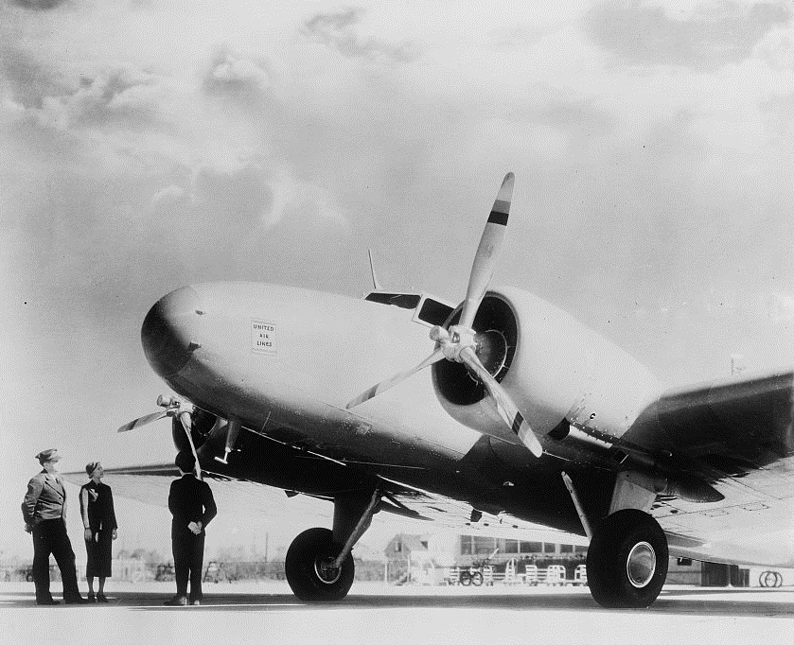
VAL Travel Scholarships
Applications were due Dec. 15th for travel by Aug. 2018
Future rounds TBA
Call for Proposals: http://www.ala.org/acrl/awards/researchawards/valtravel
Notes:
SARA
Purpose: to support librarians and information professionals to travel to non-library conferences to present on work demonstrating the impact of academic libraries in the broader landscape of higher education. Based on recommendation in ALI report that academic librarians effectively communicate their contributions both up to institutional stakeholders and out to other departments.
Funding: up to $2000 each to cover conference registration, transportation, lodging, meals.
Application details are available on the ACRL website. Future rounds are expected to be announced by this summer.
My email address is also on the website if you read through the CFP and FAQs and still have questions.
Photo: “Aviation, commercial.” Harris & Ewing, photographer [Between 1905 and 1945] Photograph. Retrieved from the Library of Congress, https://www.loc.gov/item/hec2009001267/.

Slide 44
Travel Scholarship Recipients
Sara Arnold-Garza (Towson University): “Research as Inquiry, or, How to Win Librarian Friends and Influence Students” at the American Political Science Association Teaching & Learning Conference.
Elisandro Cabada (University of Minnesota): “A Survey of Information Professionals on the Preparedness of STEM Graduates Entering the Workforce” at the American Association for the Advancement of Science.
Britt Foster and Dave Tyckoson (California State University, Fresno): “Taking a Deeper Dive: Using Capstone Papers for Richer Information Literacy Assessment” at the Western Association of Schools and Colleges Senior College and University Commission Academic Resource Conference.
Kathleen Kasten (Stony Brook University): “The Intellectual Landscape in the Library: Speaker Events as a Tool for Academic Engagement” at the Northeast Modern Language Association Conference.
Sarivette Ortiz-Sanchez (Ana G. Mendez University): “The Role of Academic Libraries in Support of Cultural Diversity and Inclusion in Education” at the International Congress of the Latin American Studies Association.
Michelle Reed (University of Texas at Arlington): “Beyond Open Connections: Leveraging Information Literacy to Increase Impact of Open Education” at the Open Education Global Conference.
Notes:
Announced Jan. 30, 2018
Diversity in subject matter of the presentation, types of conferences (incl. by location and audience), and types of institutions the recipients work in.
Selection committee were most excited about proposals that clearly connected to the VAL goals and objectives Future applicants encouraged to read those carefully (within ACRL strategic plan) and articulate how their work contributes to the initiative.
Value of Academic Libraries
Goal: Academic libraries demonstrate alignment with and impact on institutional outcomes.
Objectives:
Cultivate research opportunities that communicate the impact of academic and research libraries in the higher education environment.
Promote the impact and value of academic and research libraries to the higher education community.
Expand professional development opportunities for assessment and advocacy of the contributions towards impact of academic libraries.
Support libraries in articulating their role in advancing issues of equity, access, diversity, and inclusion in higher education.

Slide 45
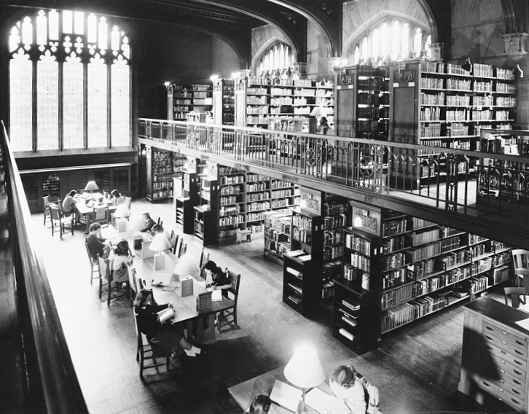
Academic Library Impact
Research Grants
Call for Proposals: http://www.ala.org/acrl/awards/researchawards/impactgrants
Applications due April 1, 2018
Notes:
SARA
Purpose: Grants are for research that will demonstrate library contributions to student learning and success, and advance research on priority areas identified in ALI report.
Photo: “Portrait of America. No. 106. Vassar - A famous American college for women. 7 - The Easy-To-Use Library. Students at Vassar College are strongly in favor of the open-shelf arrangement of their library's contents, for the system makes the entire collection freely available, and they have direct and comfortable access to books and periodicals. They may study at a quiet alcove table, or in stalls or studies adjoining the stacks, in the midst of the materials required. If they need assistance, they may consult trained librarians. Part of the education of every Vassar student is a knowledge of how to use the library.” United States, ca. 1944. Photograph. Retrieved from the Library of Congress, https://www.loc.gov/item/fsa2014000038/PP/.

Slide 46
Research Grants
Key facts:
  Applications due April 1, 2018
  Up to $3,000 each
  Eligibility: must be ACRL member and employed in an academic or research library
  Proposed research should be feasible to complete within approx. 12 months
  Dissemination is a requirement for recipients
Notes:
Up to $3,000 each. We have $20,000 total to award this fiscal year.
Timeline
Due date: April 1, 2018
Funds to be disbursed summer 2018
Research to be carried out over a c.12 month period
Details Full details in CFP on website

Slide 47
Research Grant Applications
Application components
  Cover sheet (form online)
  CV/résumé
  Abstract
  Budget (worksheet online)
  Project proposal
http://www.ala.org/acrl/awards/researchawards/impactgrants
Notes:
Discuss this if there’s time. Otherwise cut and suggest anyone with questions read the CFP and email me.
The proposal should include:
1) Statement of the research objectives and question(s): These should align with at least one of the six priority areas identified in the Academic Library Impact report. Critical perspectives will also be considered.
2) Methodology and analysis strategy for answering the question(s): Identify the methods that will be used, why they are appropriate for addressing the research question(s), and how the results will be assessed.
3) Planned research activities: Detailed description of how the research project will be organized and implemented, including a timeline of activities. These activities should relate to the stated budget.
a. If the proposed research constitutes a piece of a larger project, please address how the work funded by this grant fits in and what results will be achieved within the time allotted.
b. For collaborative projects, state how each team member will contribute. Team members may come from different institutions.
4) Expected outcomes and plans for dissemination: Describe plans for sharing the results of the project (a requirement). We strongly encourage that the chosen avenue of dissemination be open access and that it reach a wide audience of stakeholders within higher education.
a. Possibilities include: a conference presentation, a peer-reviewed article, a book or book chapter, a webinar, or a digital project.
b. The ACRL VAL committee will be assembling a special issue of College & Research Libraries and facilitating special sessions at the ACRL 2019 conference for grant recipients. They will invite all interested recipients to submit to those two venues. ACRL also has other avenues for publication that we would be happy to discuss.
c. In any publication or presentation of results, the grantee should acknowledge that support for the project came from ACRL.
5) Benefit of this research: Articulate the significance of this research project in advancing the role of academic libraries within your institution and the wider higher education landscape.

Slide 48
QUESTIONS? COMMENTS? OBSERVATIONS?

